Slide 1
Forced Flow : Facts and Friction (and Fracture)
Shobo Bhattacharya
March 03, 2017
Looking back
Condensed Matter and Fundamentalism
2. Looking around : Friction problems in Condensed Matter; Examples
4. Looking ahead: Friction & Self Organization

Slide 2
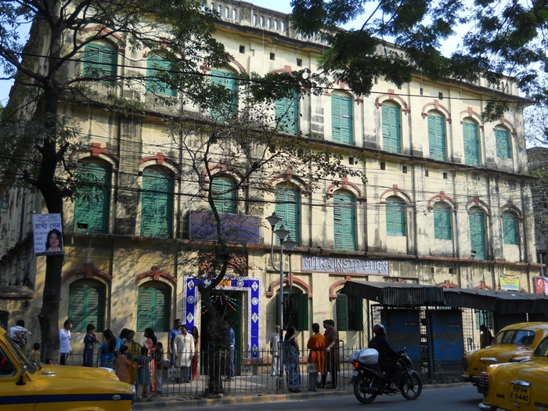
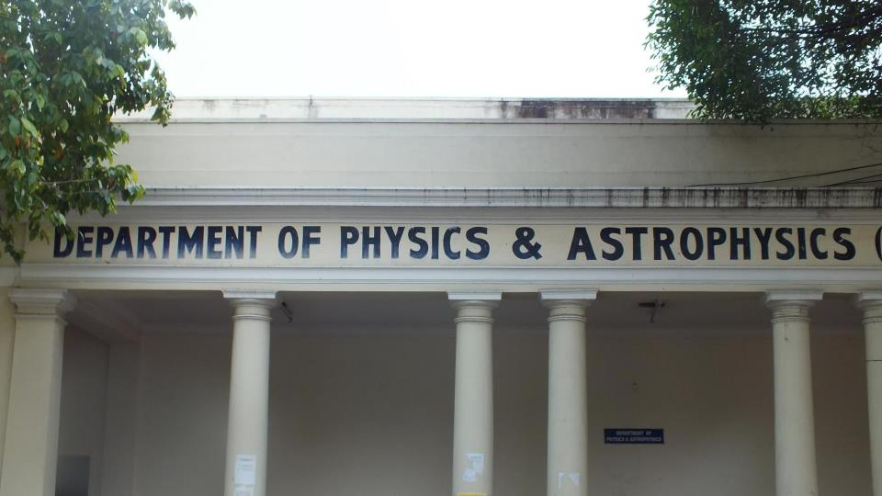
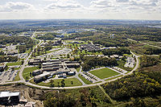
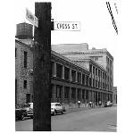
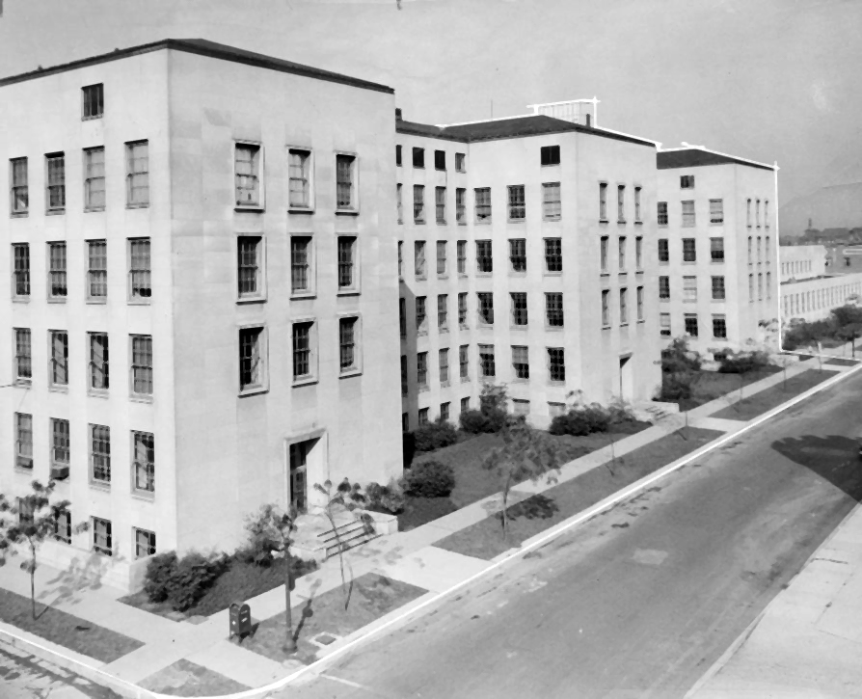
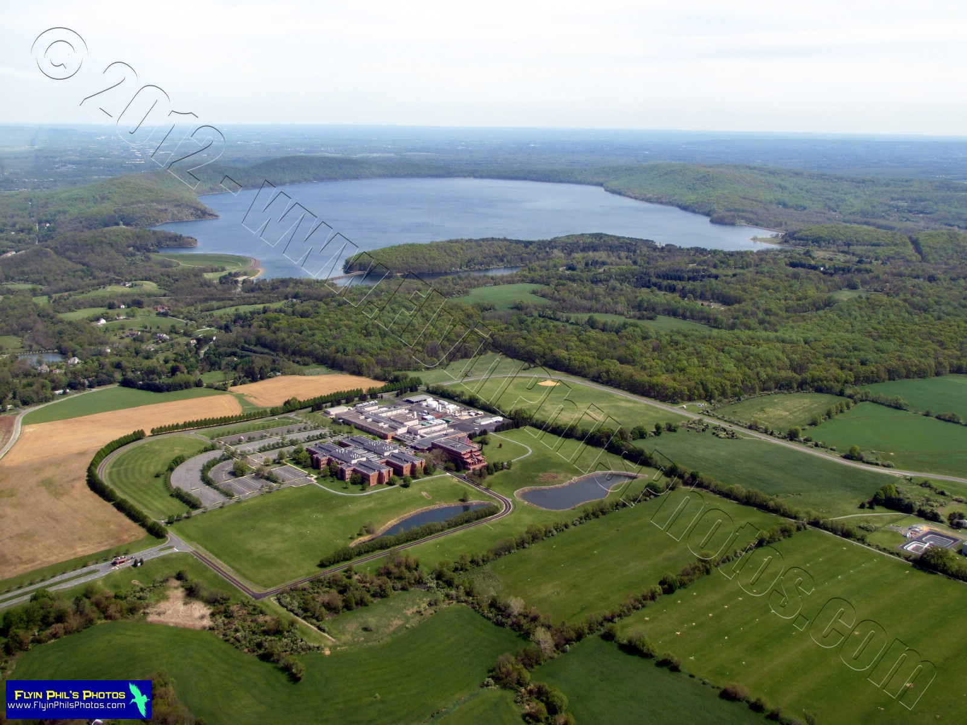
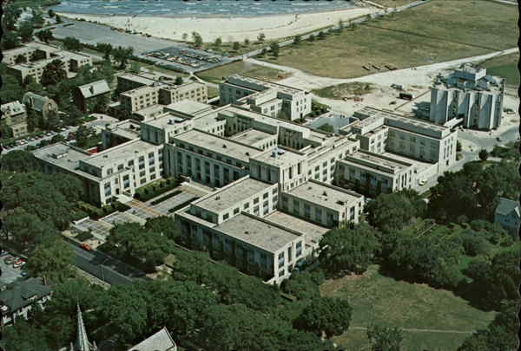
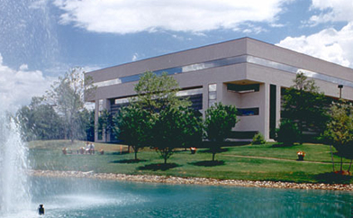
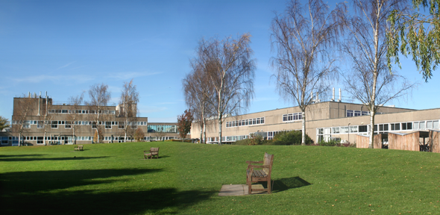
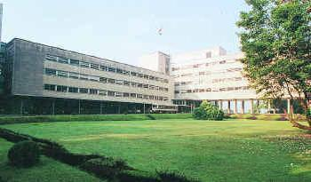
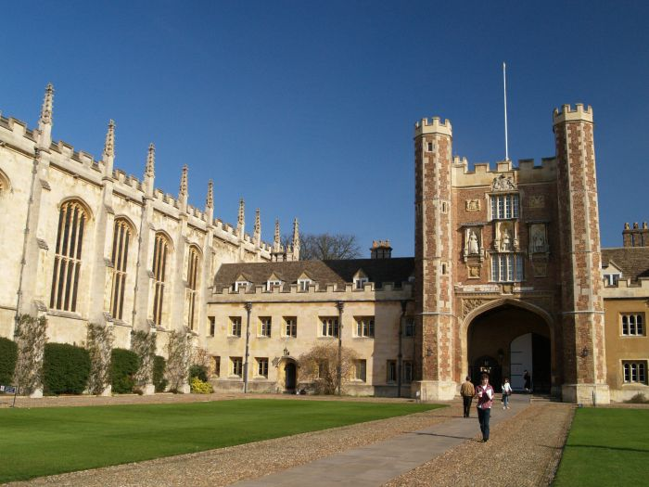
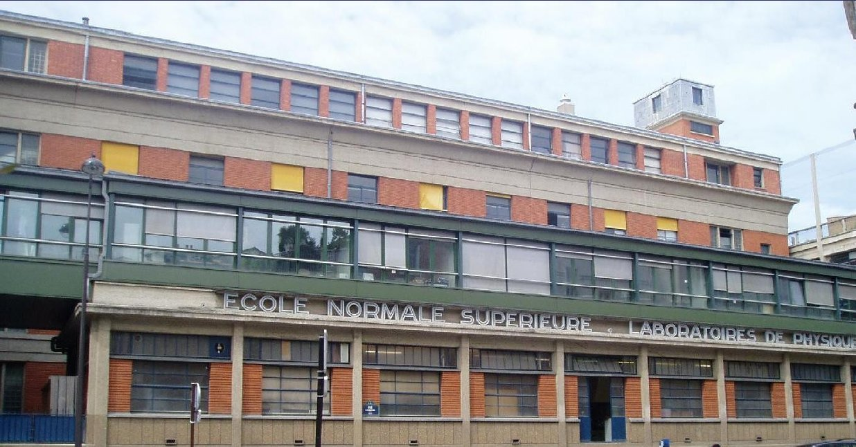
3-4
2
1
8
Places I have been (1959 – 2016)
1
8
4
3
11-12
1
13-14
< 1

Slide 3
Motion of a particle (could be me in different length and time scales) from one trap to another on a rough surface (quenched randomness?)
Tweezer Trap relocated at t=0
Motion of a 1μm Brownian silica colloid on a microscope cover slip in water under a distant tweezer potential
Initial location of tweezer trap

Slide 4
Things I have worked on over 42 years :
Broken Symmetry Liquids : liquid crystals
Dipolar and Quadrupoler Glasses. Liquid-Glass transition
Incommensurate Charge Density Wave Transport in quasi-1d systems
Micelles and microemulsions, “stirred percolation”
Two-fluid interface dynamics
High temperature superconductors (“pseudo-gap” transition)
Polymer films for capacitors
Novel Lubricants
Conventional superconductors, vortex phase dynamics
Dynamical Phase transitions in many-body driven systems, coherent and incoherent collective transport
Ferroelectric non-volatile memory
(Since moving to TIFR BB30)
Multiferroics
Colloids, Colloidal thin films
Granular matter
Triboelectricity
Two fluid interface dynamics : imaging
Flow of slurry
Self-organization by friction - some really weird things!!
was there ever a method in this madness?

Slide 5
Forced Flow : Facts and Friction (and Fracture)
Looking back
Condensed Matter and Fundamentalism
2. Looking around : Friction problems in Condensed Matter; Examples
4. Looking ahead: Friction & Self Organization

Slide 6
All things are made up of atoms: The Atomic Hypothesis
Atoms are fundamental or are they ?
How large is an atom or a molecule ? How do you know?
Benjamin Franklin
________________________________________________
“What is W?” “W is nothing by itself, it is the result of a good brother u and a bad brother v who annihilated each other”
“What is an X then?” ” X is nothing by itself. It is made out of two Y’s? “What is a Y then?” “Well, Y is again nothing, it is made out of three Z’s.”
“Oh, well. If you have all the Z’s in the world, can you make me a Zebra?” “ Don’t be silly, a Zebra is not fundamental.”

Slide 7
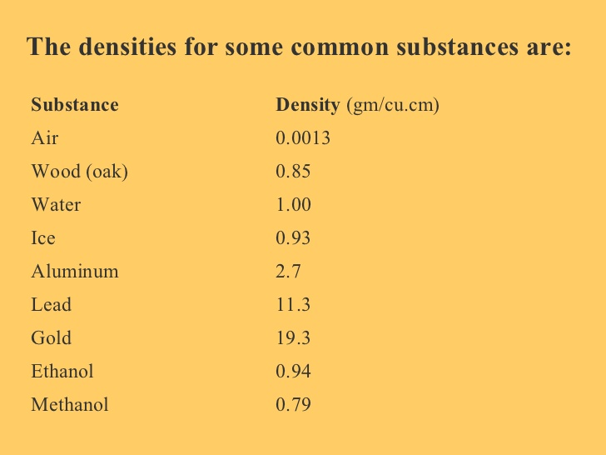
M_{proton} = 1.67 x 10 ⁻²⁷ kg
Bohr Radius a₀ = 5 x 10 ⁻¹¹ m
Density in (Nucleon per unit Bohr Volume) is
M/(2a₀)³ = 1670 Kg/m³ 0r 1.67gm/c.c
Density of materials is usually better understood as nucleons per (Bohr Radius)³
(but remember atomic radii)

Slide 8
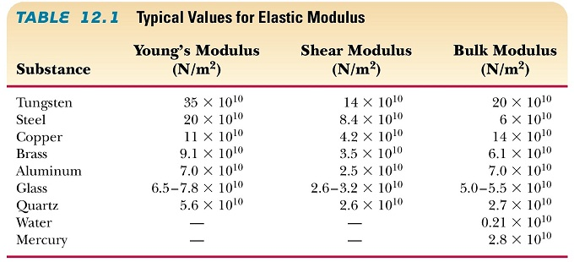
How rigid is a solid ?
Dimensionally, G~ force/unit area, i.e, energy/volume
Energy is bond energy ~ 1 eV, volume is (2a₀)³ or (A^{o) 3}
G ~ 1.6 X 10⁻¹⁹ J/ (2x5x10⁻¹¹)³ m³ ~ 16x 10¹⁰ N/m²
In a colloidal crystal, a ~ 1micron : G ~ 1 Pa (12 orders of magnitude smaller : This is a soft solid – a different paradigm !

Slide 9
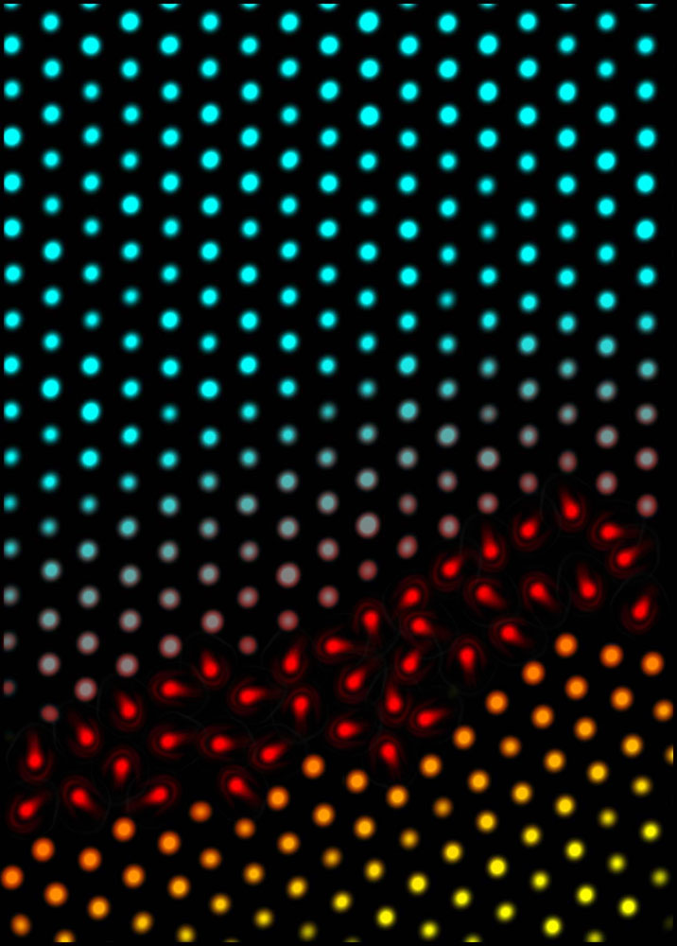
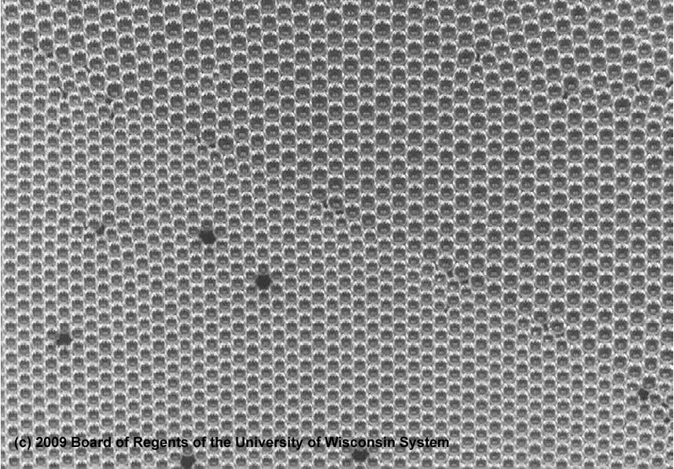
Two images of interfaces from the Internet
A Bubble-Raft from Univ. Wisconsin
See also, Bragg and Nye
Premelting of colloidal crystals
Arjun Yodh. U. Penn

Slide 10
Some more numbers
Time for shear wave to travel one lattice constant
τ_{s} = R/c_{s} = (10) ^{-12—13} seconds
Diffusion time to travel one lattice constant (Stokes-Einstein).
τ_{d} ~ 6πηR³/k_{B}T ~ (10) ⁻¹¹ seconds
For time scales shorter than τ_{d}, no discrimination between propagating (ω = ck) modes and diffusive modes (ω = iDk²) for microscopic dynamics.
Viscoelasticity (Maxwell) : Effective rigidity at short times for a liquid is : G** η/τ ~ 10 -100 GPa
All macroscopic parameters are derivable from atomic parameters & k_{B}
For R = 1μm, τ_{d} ~ 1-10 seconds.
For larger objects, the crossover occurs at longer times, lower frequencies.
Quantum time ~ h/E ~ ¹⁰ sec, faster than classical activation time at very low T only

Slide 11
There is nothing very new between an atom and an Avogadro’s number of atoms/molecules. Dirac said, “all else is chemistry”. Rutherford said “all of science is either physics or stamp collecting”. Pauli named solid state the “squalid state”.
This fundamentalist position arises from an adherence to “ideal” circumstances. Departure from ideality gives rise not to complications alone but also richness, like the Zebra which is more interesting than many Z’s together. Reality is not always ideal! “Spherical Horse” approximation is usually not useful, beyond a point.
A bulk crystal is very large, N >> (N) ^{1/2} . The number of atoms on the surface ~ L² while the ones in the interior ~ L³. So the surface-to-volume ratio goes as 1/L. Smaller N is different. When the two kinds of atoms are equal, one gets “nano”.
The word in spatially 3-d. Reducing d is different. Interfaces between two types of constituents are different.
Having dirt is interesting. Introduces flexibility in a variety of confounding ways.
We understand thermodynamic equilibrium. But most of nature is not in equilibrium. Driven systems are often non-linear and produces self-organization differently than in equilibrium: new route to self-assembly. Athermal systems are different too. None of this is stamp-collecting.

Slide 12
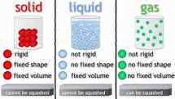
Phases of matter:
Macroscopic phases of matter such as solid, liquid and gas differ in the arrangement of the constituent atoms in the different phases. Most of their macro-scale, everyday-scale behavior can be traced to their atomic characteristic arrangements.
Microscopic – to- Macroscopic using laws of physics
Crystal <u (0) u*(R)> ~ finite at large R
Liquid <u (0) u*(R)> ~ exp (-R/ξ)
Is the correlation length ~ a
Making ξ intermediate
between a and infinity
Makes interesting variation
from ideality.
Or making components non-spherical to start with
Pictures from the Internet

Slide 13
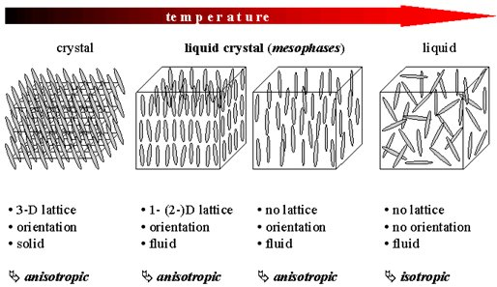
Liquid Crystals of Rod-like molecules (not spheres)

Slide 14
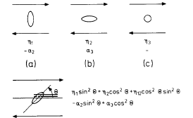
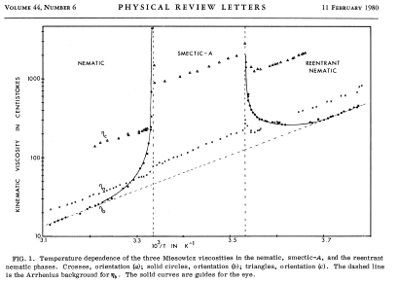

Slide 15
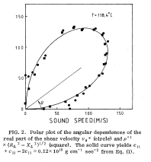
Conservation Laws and Hydrodynamic modes
Liquids ∂/∂t =∇. J
∂J_{i} /∂t =∇_{j}. Σ_{ij}
∂q/∂t =∇. E
A pair of sound modes ω² = (ck)²
Two viscous shear modes ω = iDk²
One thermal diffusion mode ω = iDk²
Each broken symmetry adds
∂/∂t =∇. Π
3 such in a solid
3 pairs of propagating longitudinal and shear
One thermal diffusion mode
What is the other?
But smectic-A is not a real 1D-solid : Landau-Peierls Fluctuations
Mazenko, Ramaswamy and Toner : Theory
SB and Ketterson : Experiment
“Second Sound” (deGennes)

Slide 16
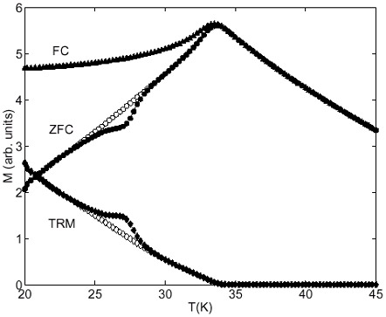
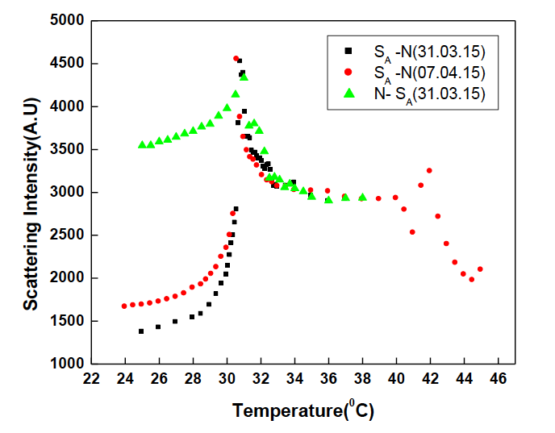
Spin glass shows history effects, but thermodynamic anomalies are difficult to find.
Nematic-SmectiC-A shows unchanged and large Sp. Heat anomaly. Small number of domains in light scattering
Multi-domain
smectic

Slide 17
A generic version of friction in overdamped disordered
many-body system
Larkin
Larkin-Ovchinnikov
Fukuyama-Lee
Lee-Rice
Imry-Ma
Dynamics
D.S. Fisher, S. Coppersmith, P.Littlewood, A. Middleton
Onuttam Narayan,…….
Given it many good years!!!!

Slide 18
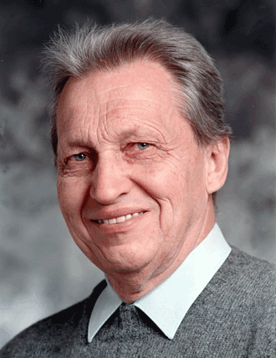
Elastic media in a random quenched potential
E = K( grad.φ)² + V_{R}(φ)
In a volume L: E~ K/L² + V(L)^{d/2}
Minimizing: L₀ ~ (K/ V_{R} )^{(2/4-d)} -- Correlation length
Order is destroyed in all space dimensions d<4
In dynamics : Threshold force ~ (L₀)⁻²
Softer things have shorter correlation length and are stuck more.

Slide 19
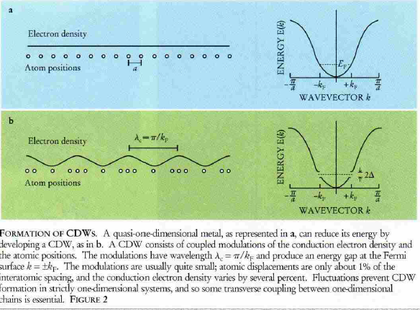

Slide 20
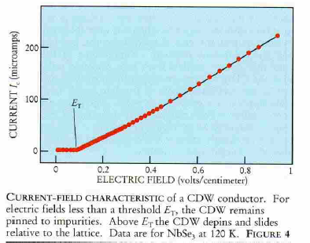
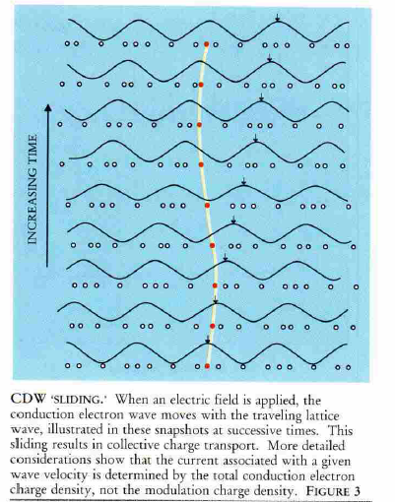
washboard frequency ω_{int} ~ J_{CDW}
Current controlled oscillator

Slide 21
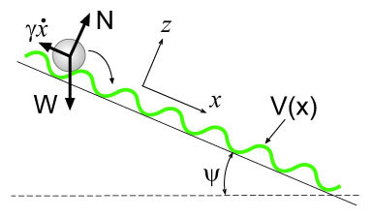
Overdamped particle in a washboard potential
(d²X/dt²) + (1/ τ) (dX/dt) + (ω₀²/2k_{F)} sin 2k_{F}X) =eE/m*
<X> = eτ/m* (E² – E_{T}²)^{1/2} ; E_{T} = (m*ω₀²/2πne)
<j> = (ne²τ/m* ) (E² – E_{T}²)^{1/2} ; Drude for E >> E_{T}
But in general : J ~ (E-E_{T}) ^{β} – D.S. Fisher, Dynamical Critical phenomena
For d< 4 , Defects will occur at threshold (Coppersmith)
Overcome by external modulation enforcing coherence

Slide 22
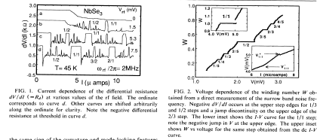
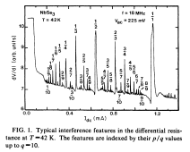
Indexed by p/q; like a Miller Index in ω –space instead of q-space. Mode-locked states,
not resonance.

Slide 23
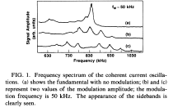
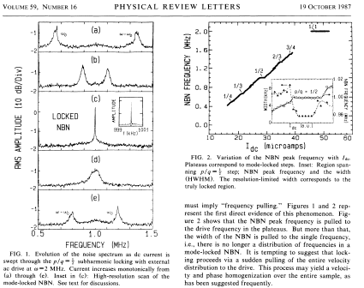
Mode-locking directly in frequency space. Enhancement of coherence by 5 orders of magnitude
Each mode-locked step is a pinned state with a fixed velocity. Exit from it can be first or second order transition

Slide 24
A brief foray into cuprate superconductivity
BSC theory was established by comparison with ultrasonic attenuation below the transition where the attenuation went as
exp (-Δ/kT) where D is the energy gap. Elemental Tantalum and Lead produced the most extraordinary agreement with BCS theory.
The cuprate showed a gap far above the transition. Much derision followed the observation. Now we know that to be the “Pseudo-gap”. But no one, especially friends, refers to it ………

Slide 25
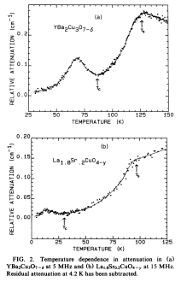
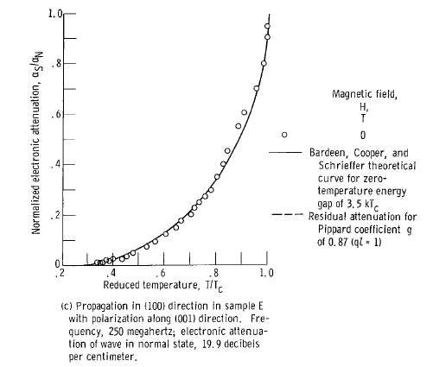
Tantalum

Slide 26
Work in BB30

Slide 27
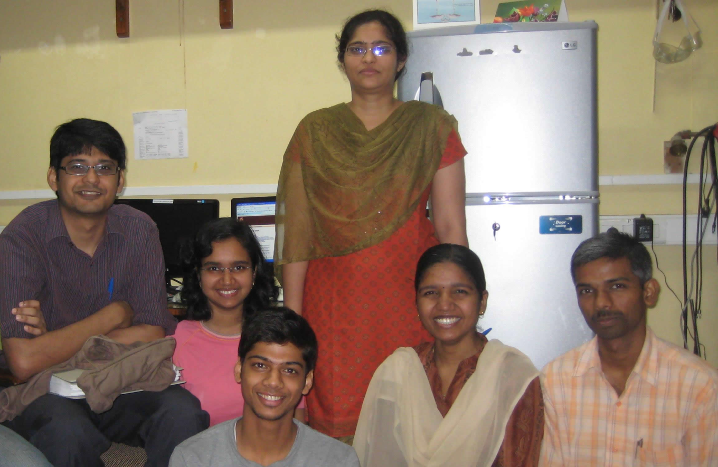
Peeling of thin films

Slide 28
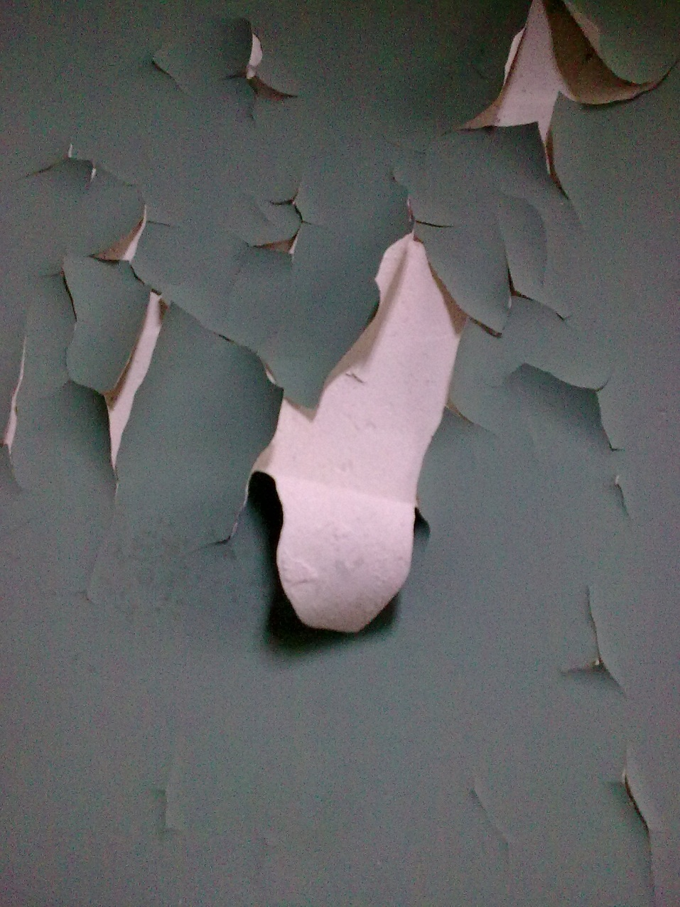
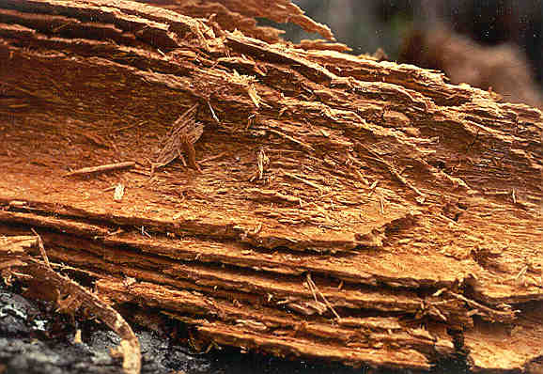
It is a complex problem !!!!!!!!!!

Slide 29
Spans a large range of length scales
$$ξ\sim a$$
$$ξ≫a$$
Delamination
Desorption
Peeling of paints
gas desorption from Palladium
Atul Varshney, P. Sharma, A. Sane, S. Ghosh,* and S. Bhattacharya (PRL 2010)

Slide 30
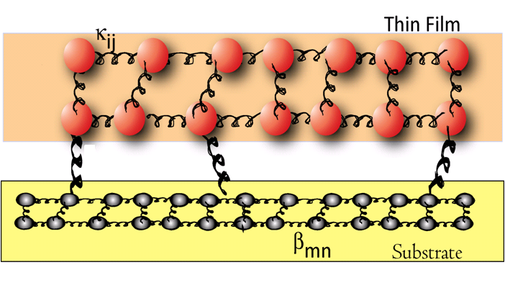
An observable parameter : Length scale (ξ) over which the system fails
For a critical stress value
If f_{p} is large ξ is small
If G is large ξ is large

Slide 31
An observable parameter : Length scale (ξ) over which the system fails
For a critical stress value
If f_{p} is large ξ is small
If G is large ξ is large

Slide 32
Experiments
The external mechanical stress to the films was applied in the form of a dc electric field between two ITO electrodes separated by an oil-filled insulating space of thickness ~100 µm. For all experiments reported here, the field was ramped in steps of 0.01 V/μm with a waiting period of 2 sec between steps.

Slide 33
Experiments
The external mechanical stress to the films was applied in the form of a dc electric field between two ITO electrodes separated by an oil-filled insulating space of thickness ~100 µm. For all experiments reported here, the field was ramped in steps of 0.01 V/μm with a waiting period of 2 sec between steps.

Slide 34
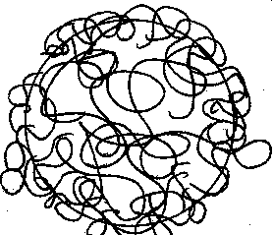
Changing Rigidity
Soft Polystyrene particle network
Rigid Silica particle network
The covalent-type interaction between sililca particles (Si-O-Si) is stronger than the van der Waal type interaction between polystyrene particles

Slide 35
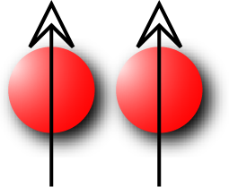
Origin of Stress in the system
Torque T = P X E

Slide 36
vapor-like for polystyrene films
eV/µm

Slide 37
silica films

Slide 38
How to change G
Polystyrene
(Low G)
Silica
(High G)

Slide 39
Creating percolating networks of silica particles
Volume fraction of silica particles
Low G
High G
Tuning inter-particle interactions between silica spheres

Slide 40
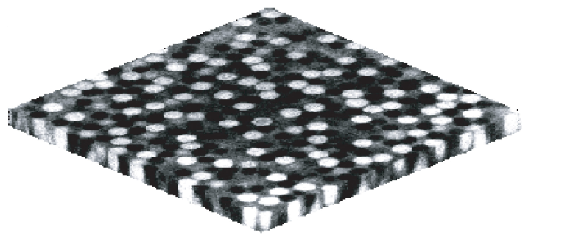
$$0.3<φ_{s}<0.8$$

Slide 41
Variation of the fraction of delaminated area (A_{d}) as a function of electric field

Slide 42
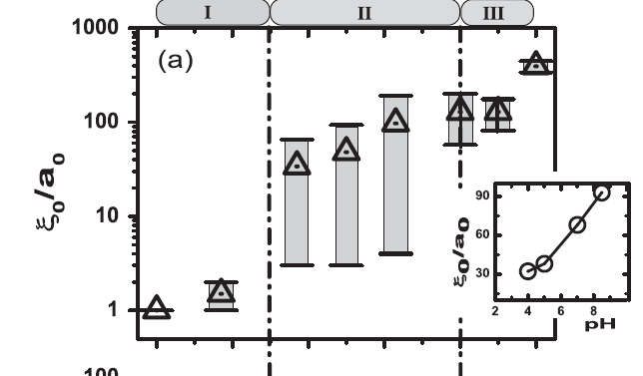
Variation of correlation as a function of silica volume fraction.

Slide 43
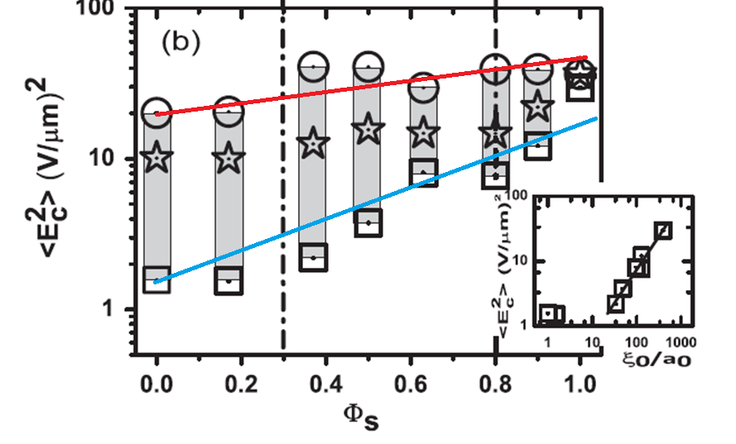
Stress values for which 30% of the film gets delaminated
Stress values for which 1 % of the film gets delaminated

Slide 44
Similar phenomena in Nature occur for many systems over many scales and many time scales.
Dynamics of disordered manybody system is one such class of phenomena.
Spent many years on it. Was it worthwhile ?

Slide 45
Thank you for everything!

