Slide 1
Building the Layer 4 of Belle II SVD
Kamesh and Team
DHEP Annual Meeting
May 8-9, 2018

Slide 2
Milestones of L4 ladder production
Production complete:
10 ladders for installation and
2 as spare
IPMU visit:
2nd module with
two origamis
1st and 2nd
class C review
Class A review
2018
March
2011
2013
2016
2014
2012
2015
2017
April
Ladder mount
completed
Design, production and fine-tuning of assembly
jigs at TIFR since 2012
3rd class C, class B-,
and class B review;
Start of Class A production
HEPHY visit:
1st module with
single origami

Slide 3
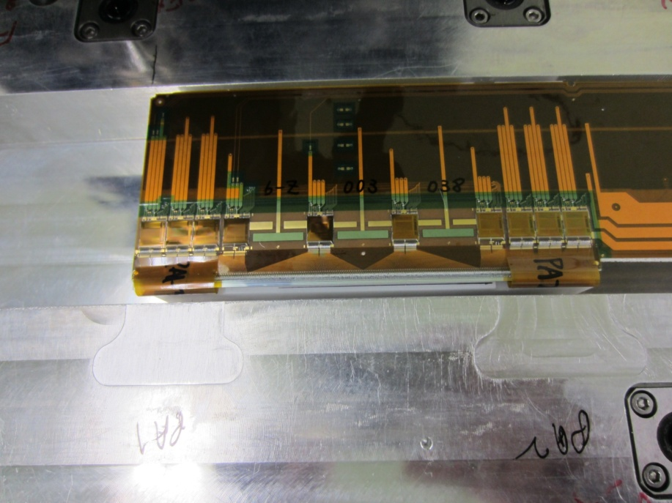
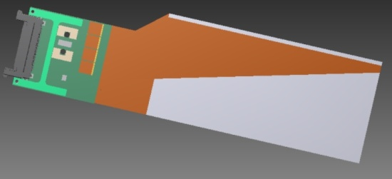
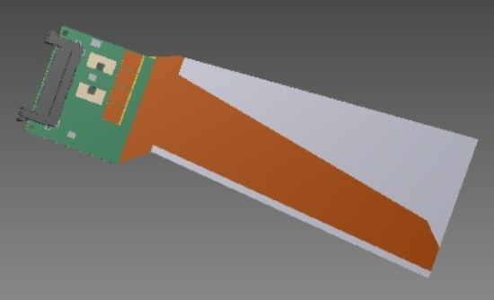
3D model and main parts of an L4 ladder
Backward sensor
(Rectangular DSSD)
Forward sensor
(Trapezoidal DSSD)
Slant angle of 11.9°
Central origami sensor
(Rectangular DSSD)

Slide 4
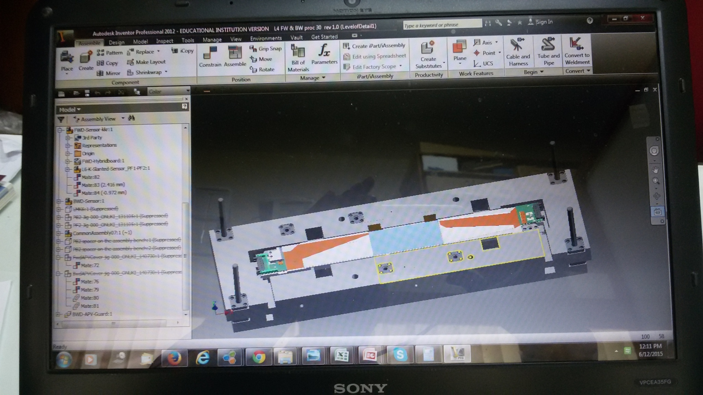
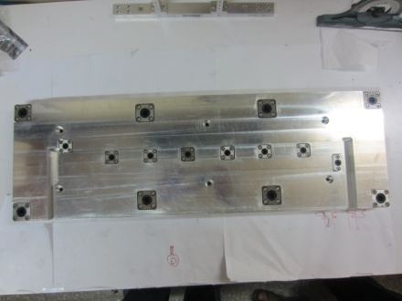
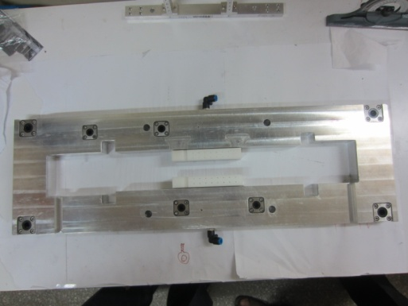
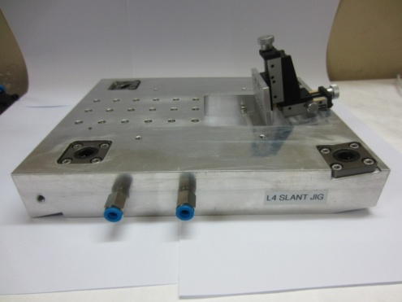
Design and production of assembly jigs
Number of jigs designed: ~50
Assembly
bench
Slant jig
(11.9°)
Design software: Autodesk Inventor
Professional 2012
Assembly base
Tolerances Achieved:
Length of rods tolerance : +/- 40 µm
Diameter of rods : +/-20 µm
Flatness of small jigs : less than 70 µm
Flatness of large jigs: less than 150 µm
Purpose of jigs:
Precise placing of the components
(sensor always on polyacetal part)
Starting from step# 1 they are used
for each and every operation (never
touch the components with hand)
Picking up and placing components
Alignment of the components
Holding the hybrid boards
Transfer of components with the
help of vacuum
Design, production and fine-tuning of the jigs and their CMM were all performed in-house

Slide 5
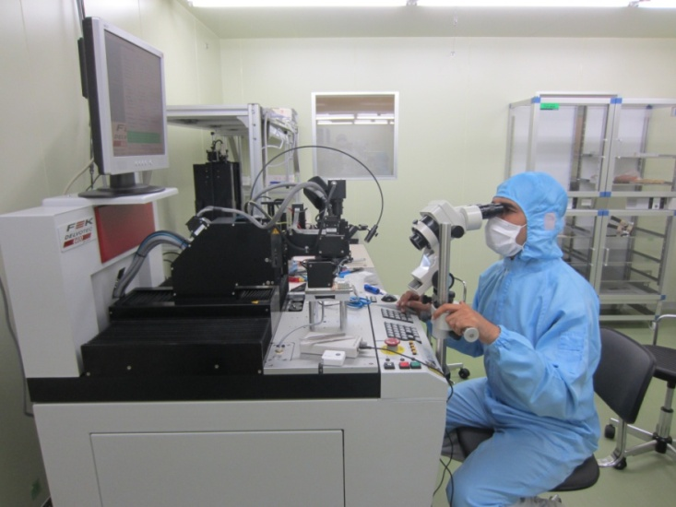
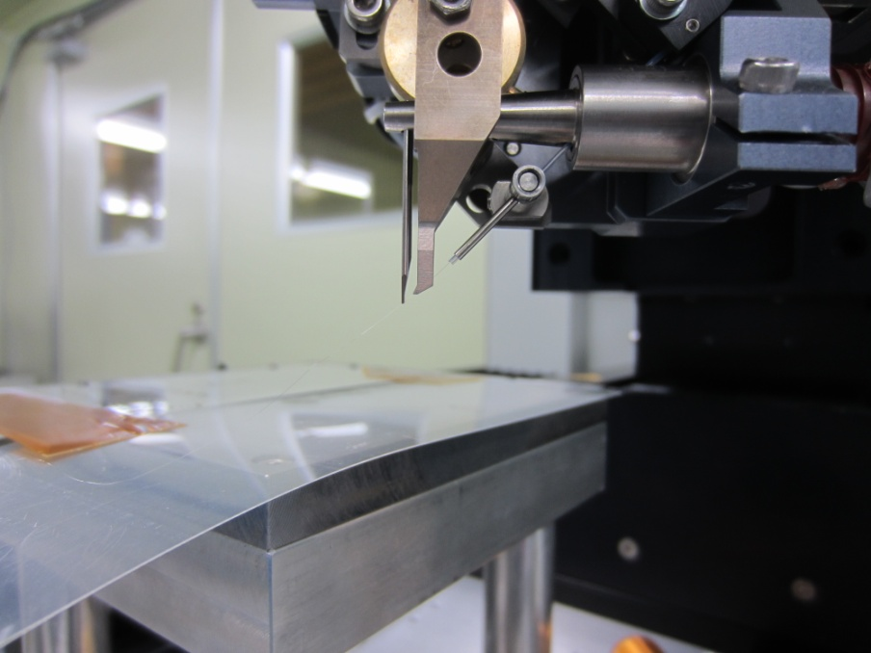
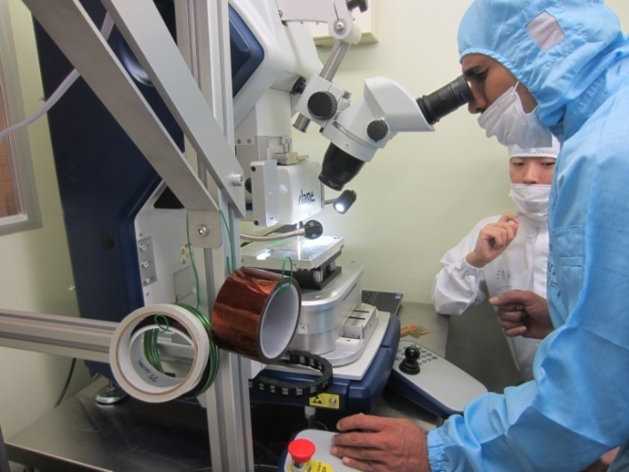
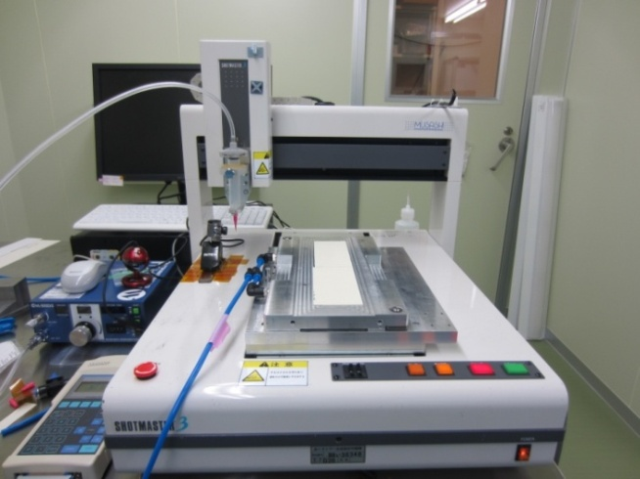
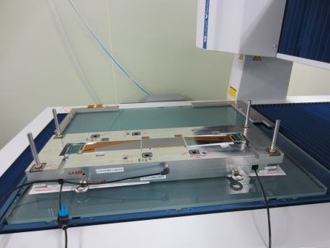
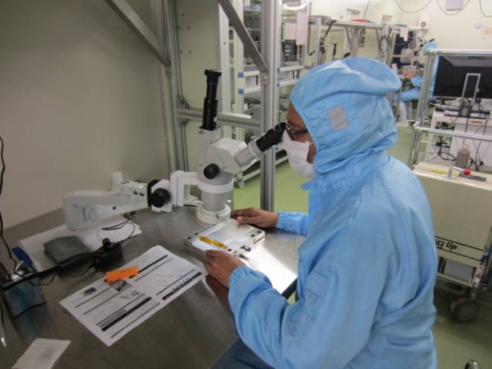
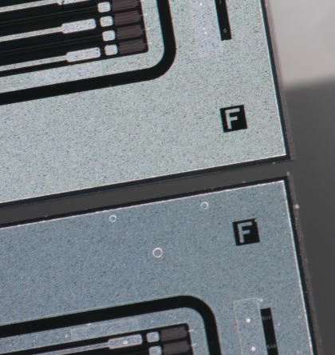
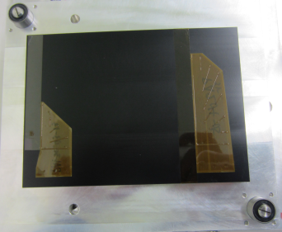
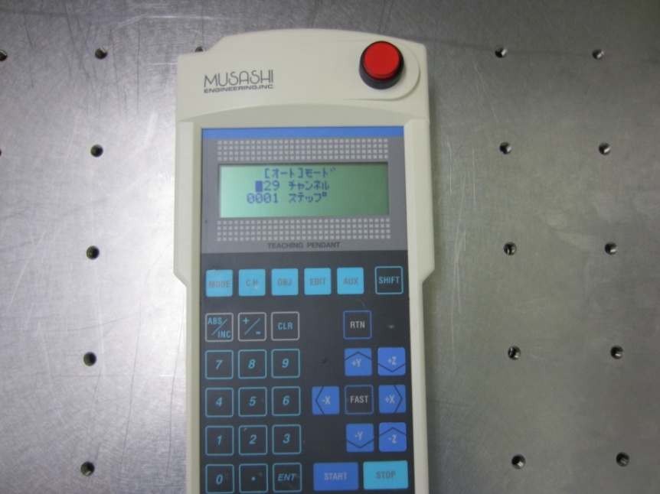
Instruments for ladder assembly at IPMU
Wire: Al+Si (1%) 25 µm diameter
Wire bonder (TIFR)
Pull tester
Gluing
robot
Microscope (TIFR)
CMM
Glue pattern
Teaching pendant

Slide 6
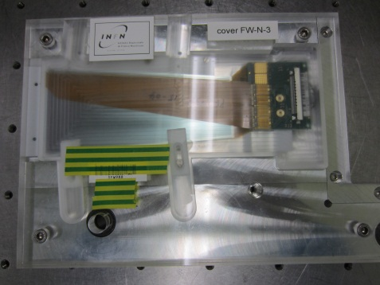
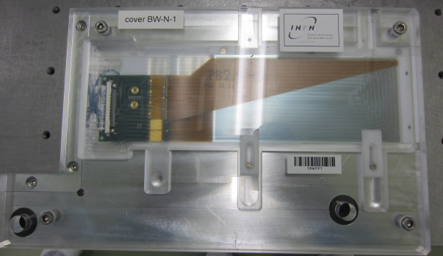
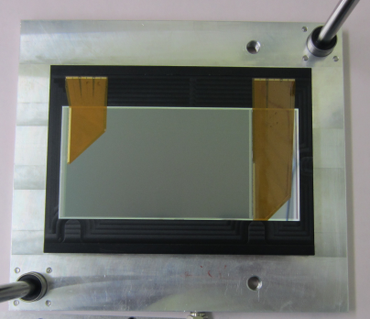
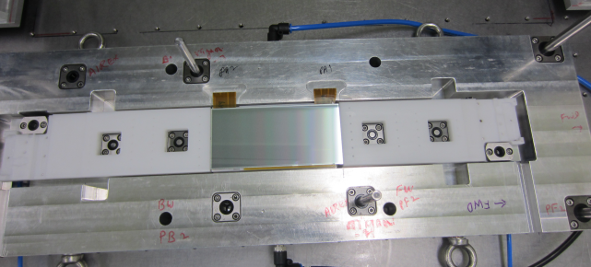
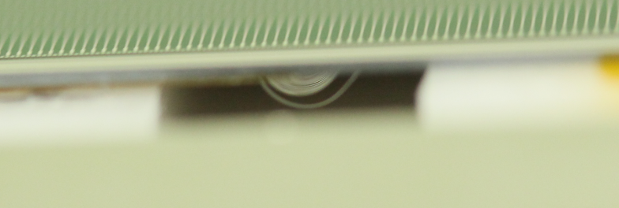
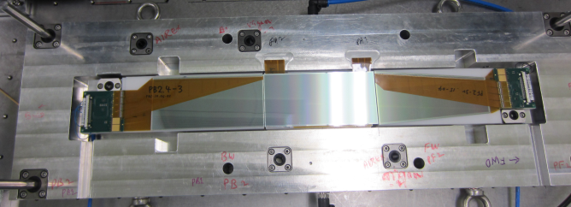
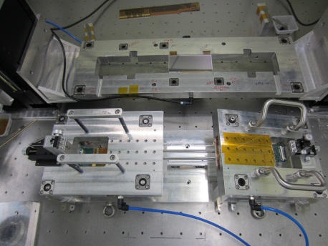
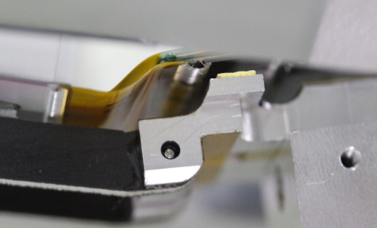
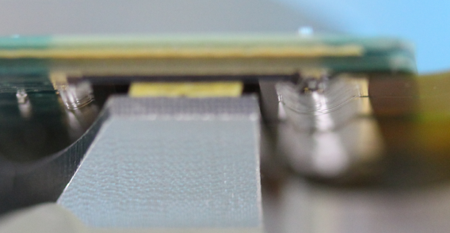
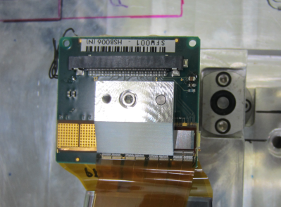
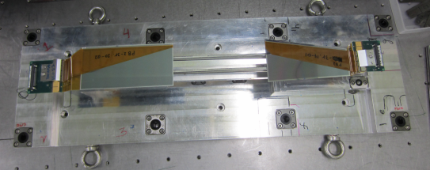
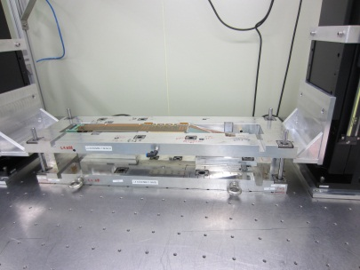
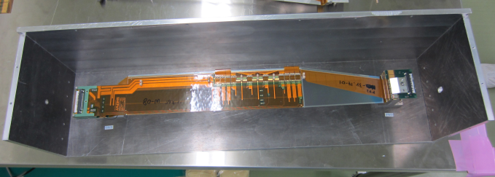
Key steps in ladder assembly
Well defined protocols
for assembly
Checklist for each key
step in database
Electrical verification
Photos @ each operation
Half ladder
Ladder in the container
APV guard fixing
Final stage

Slide 7
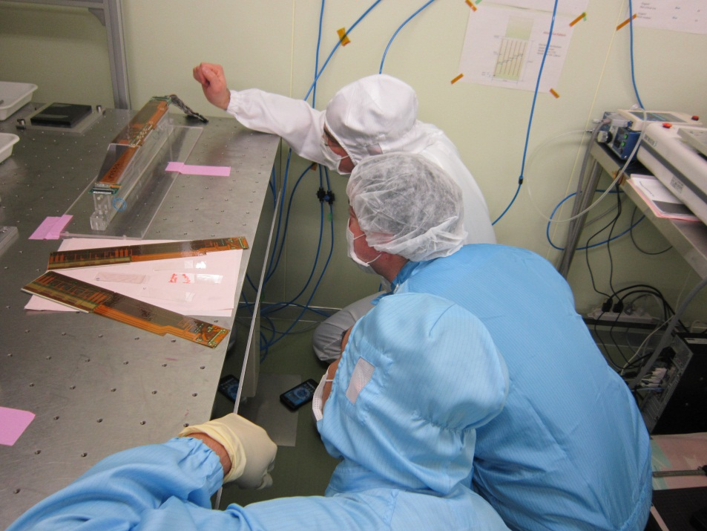
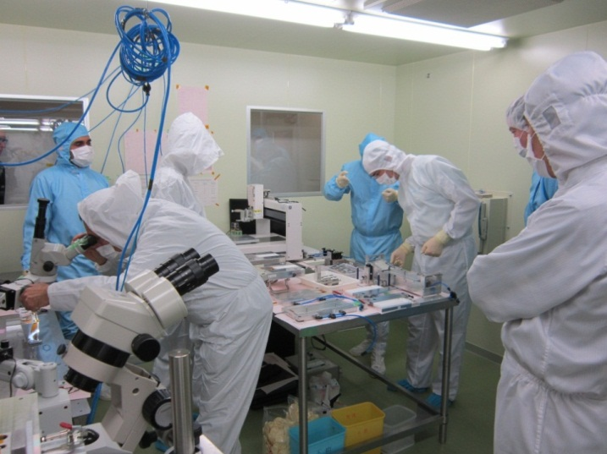
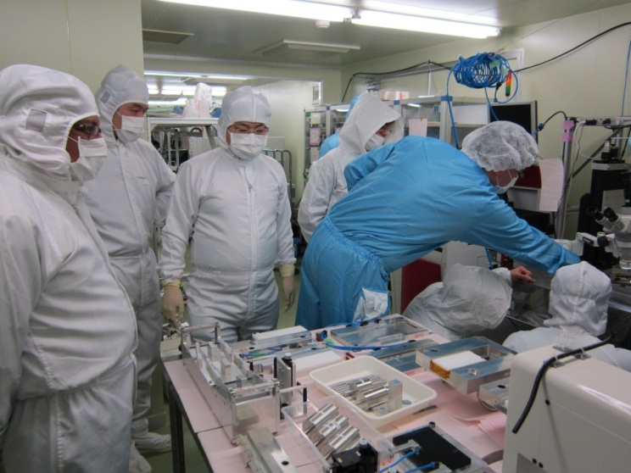
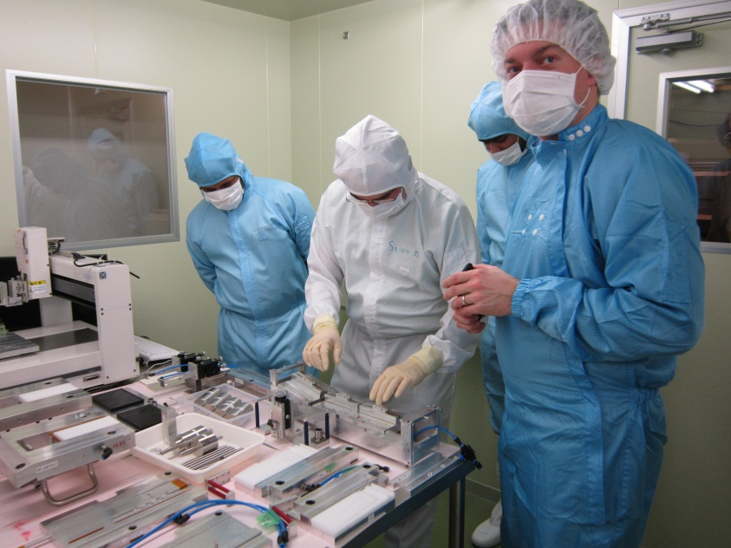
Class C review
Me
Sanjay
Babu
Sukant
All jigs and assembled ladder were critically
monitored and verified by the experts from
Austria, Italy, Australia and Japan

Slide 8
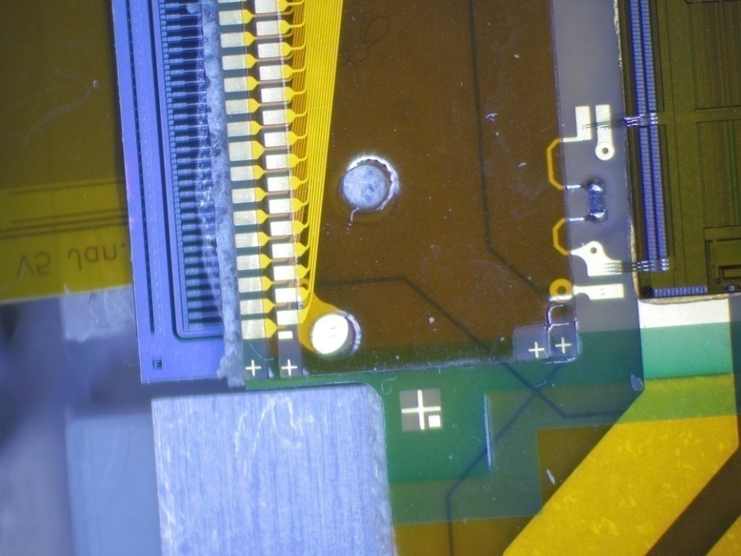
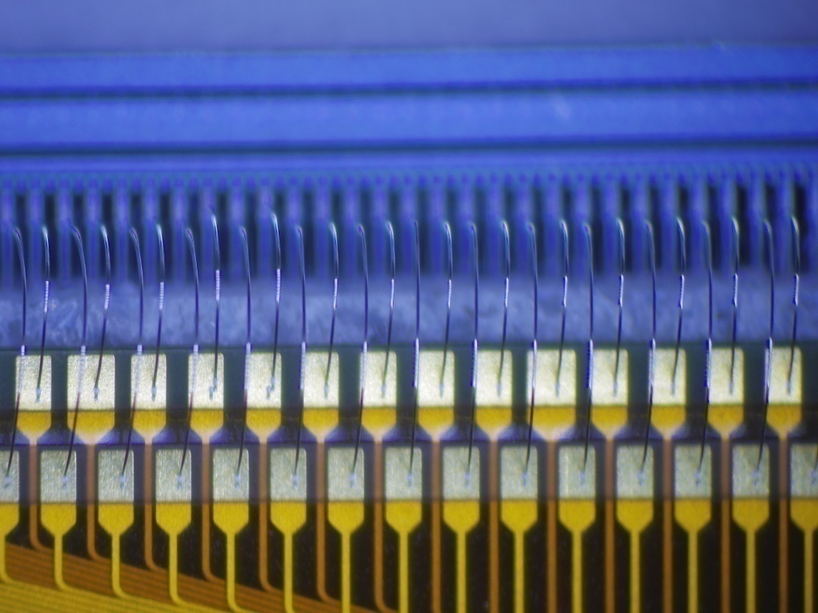
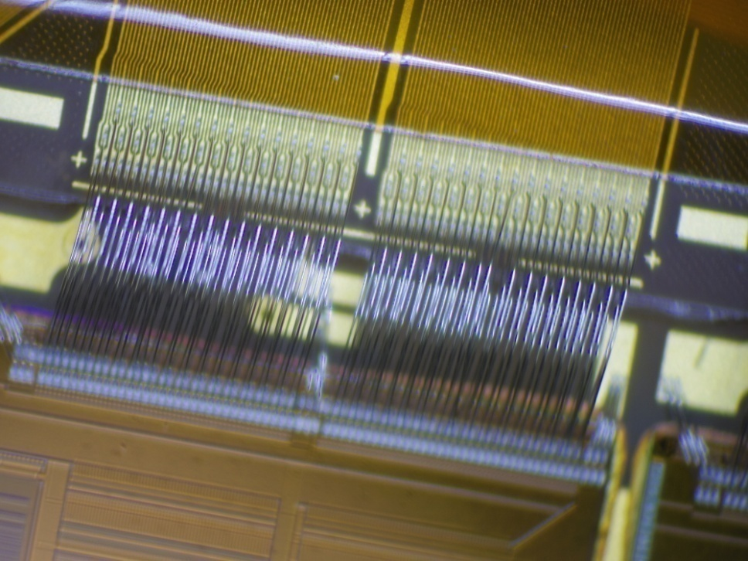
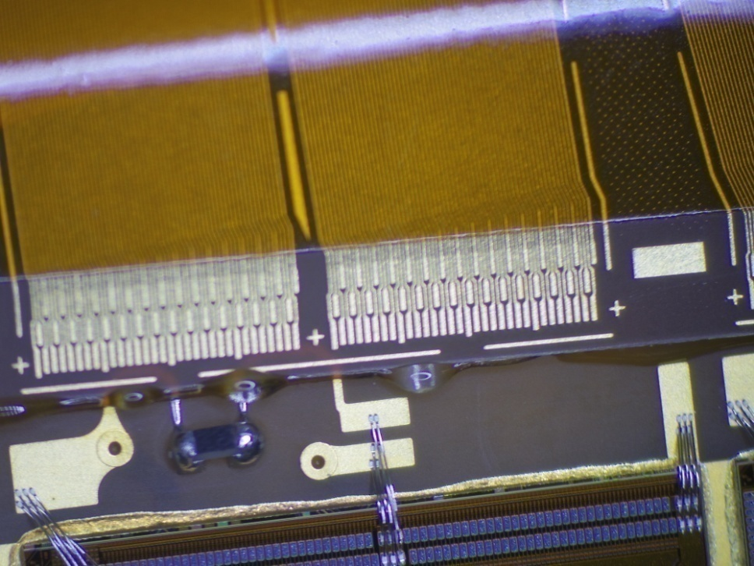
Gluing and wire-bonding
Gluing
Wire-bonding
- Bond pull strength ~10 gf
(destructive test on samples)
- Total wirebonds per ladder
~ 8000
Pitch adapter to sensor
Pitch adapter to APV
chips (three rows)
Key challenges:
Proper selection of pads while programing the bonder
Removal of tiny wire-bond pieces from the pads (left
over due to unbonding during auto-operation)
Rebonding due to the limited bondable space on pad,
particularly for APV chip bond pads
Adjustment of shorted wire-bonds (pitch: 88 µm)
Continuous monitoring with microscope
- Monitor glue spread at each step
- Else, we risk WB performance

Slide 9
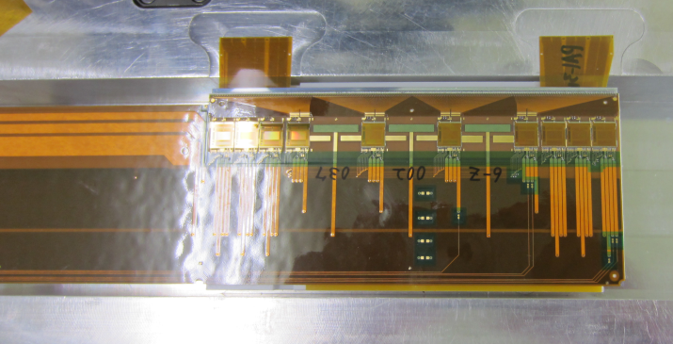
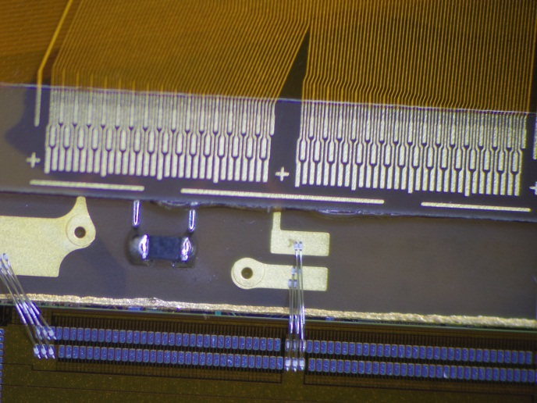
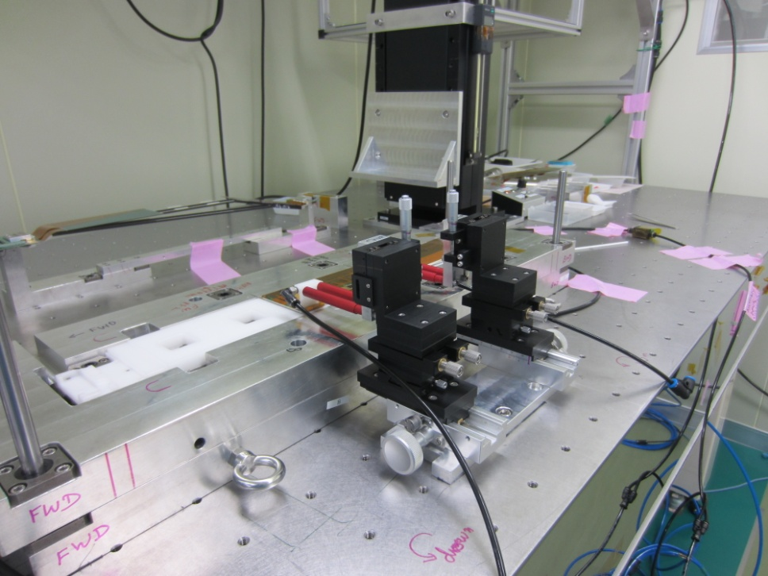
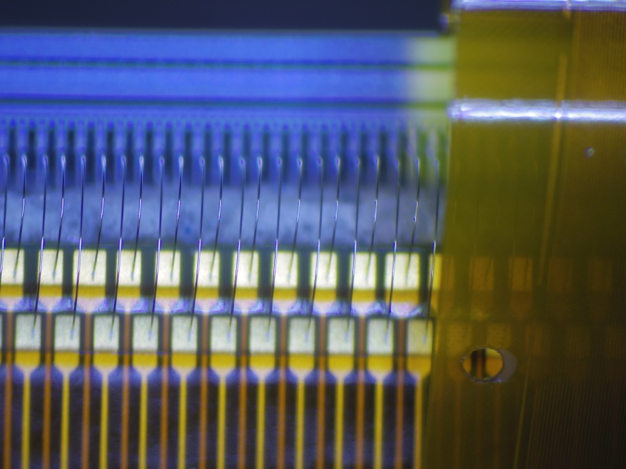
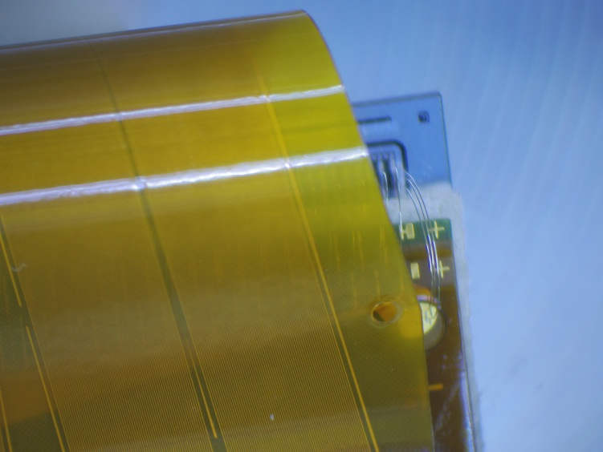
PA wrapping setup
Origami module
fig 1
fig 3
fig 2
Key challenges:
Perform the operation very slowly under microscope
Not too much pressing from the top, but ensure to have
proper gluing between the parts, else bonding issues fig 1
Take care of bias bonds on the N side of sensor fig 2
Take care of delicate bonds as shown in fig 3

Slide 10
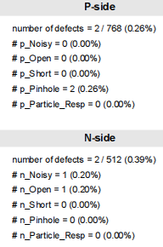
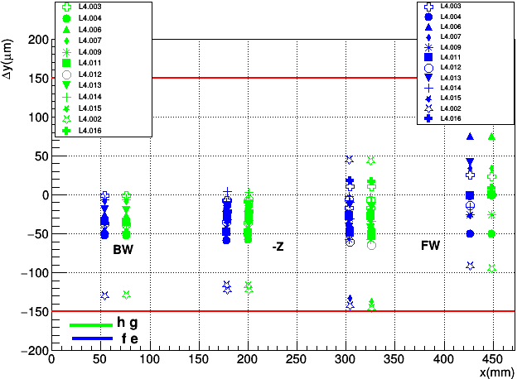
CMM and EQA results of assembled ladders
Mechanical Quality:
Electrical Quality Assurance:
Deviations from the design value along three axes are within the specification: ±150 µm in x, y and ±250 µm along the z-axis
On average, 1-2 electrical defects introduced during assembly

Slide 11
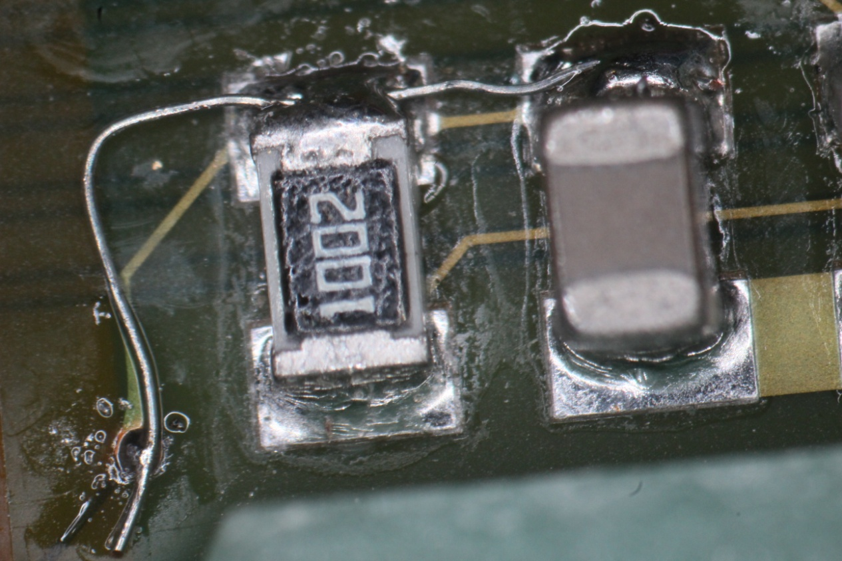
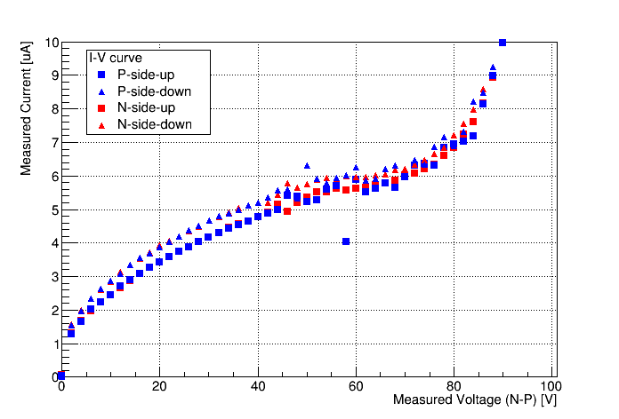
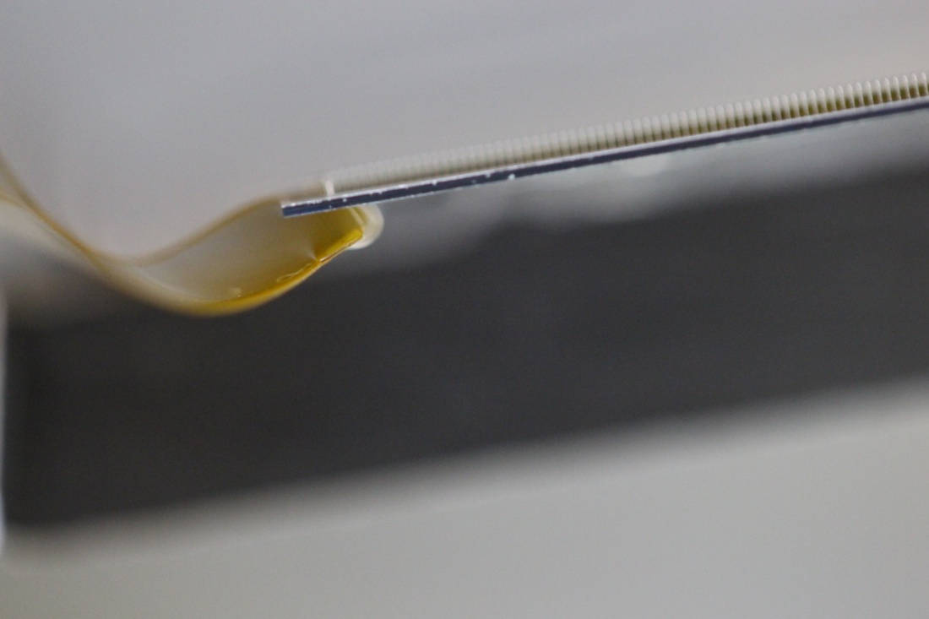
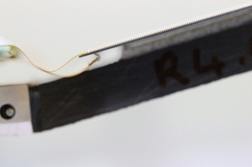
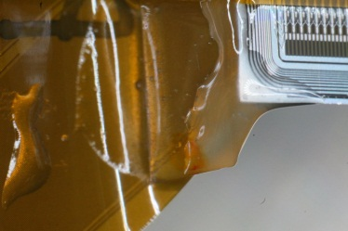
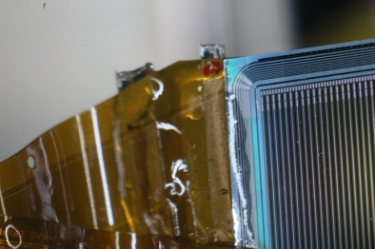
Challenges faced during production
1st challenge: In the 1st ladder, found open in the origami PCB due
to which the sensor was drawing no current fixed the open
2nd challenge: Sensor breakdown early due to a suspicious pinhole
removed the wire-bond of the bonded pinhole strip
3rd challenge: PA partially peeled off from the FW sensor
(this time only happened to L4)
4th Challenge: PA fully peeled off from the FW sensor both
for L4 and L6 on the half as well as full ladders
Initial solution: Type 2 glue reinforcement (left)
Challenge contd.: Peel-off reappeared in L4 ladder
Final solution: Type 3 glue reinforcement (right)
Reason: L4 has more constraint between the FW sensor
and PA compared to L5 and L6
5th challenge: One of the assembled origamis has more
noise channels so we needed to keep it aside

Slide 12
Additional jigs to mitigate challenges
Designed and produced an Origami pickup jig to pickup the OS4 from the assembly bench to
make a way for aligning FW and BW sensors on the assembly bench and gluing onto the ribs
Holding the OS4 jig with holders as shown in the figure
Flip Jig

Slide 13
Summary
Visual inspection and photos at IPMU
Transport ladders to KEK
Incoming inspection and EQA at KEK
Keratharm attachment
Visual Inspection (photos)
Ladder mount one per day due to complex and laborious inspection procedures
3pm tea time
discussion at
IPMU
L4 and L6 teams at IPMU
Mockup Assembly @ KEK
Production completed - April 18, 2018

Slide 14
Thank You

Slide 15
Backup slides

Slide 16
SFW study before gluing

Slide 17
Effect on sensor while adjusting the Hybrid board in x direction

Slide 18
Effect on sensor while adjusting the Hybrid board in x direction

Slide 19
Effect on sensor while adjusting the Hybrid board in x direction

Slide 20
Solution for Peel-off issue from next Ladder
Type 2 glue
reinforcement

Slide 21
Peel-off reappeared on L4.010
Type 3 Glue reinforcement
After Type 3 Glue reinforcement – No more Peel-offs

