Slide 1
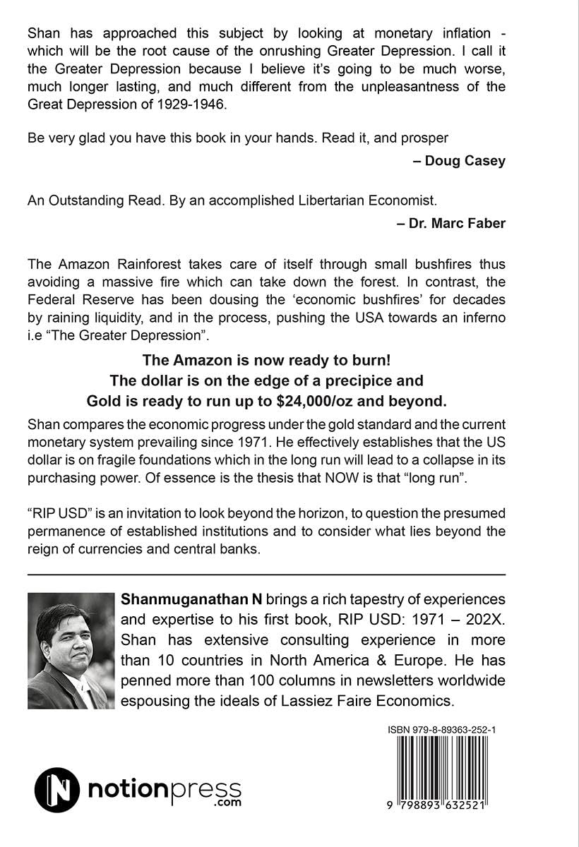
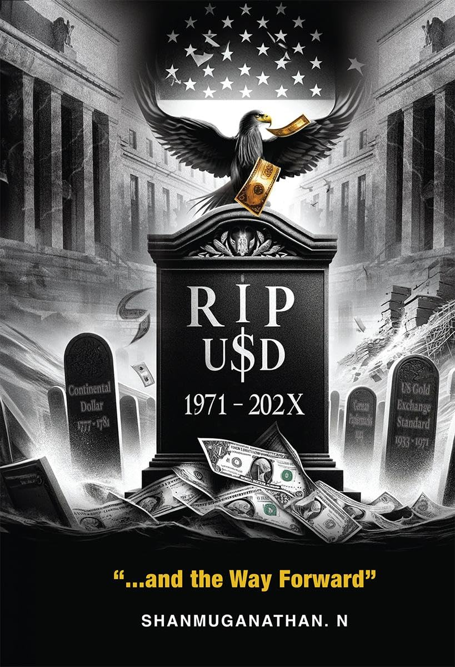
Sep 20, 2024
TIFR, Mumbai

Slide 2
FAR LEFT
Economic Schools of Thoughts
FAR RIGHT
Outcomes Slavery & Poverty
Outcomes Liberty & Prosperity
Marxism
Keynesian Economics
Monetarists or The Chicago School
Austrian School of Economics
The Equivalent Political Philosophies – Not a 1:1 Correlation though!!!
Communists
Liberals
Conservatives
Libertarians

Slide 3
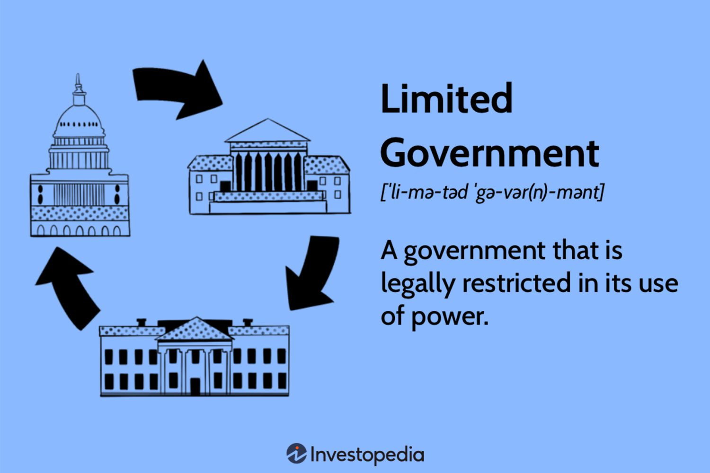
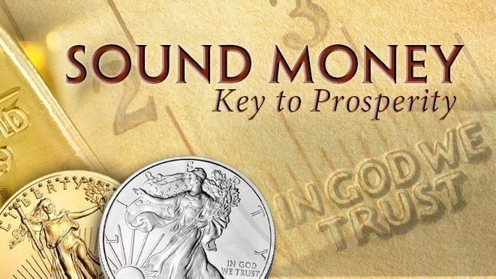
The Defining Features of the “Austrian School / Capitalism / Lassiez Faire Economics”
Political Structure where laws limit the powers of the government to avoid abuse.
Govt role restricted to two activities:
Protection of private property from internal and external aggressors/
Enforcement of legal contracts.
Supply of money is decided by Markets and is Commodity-backed.
US Constitution – Article I, Section 10, Clause 1
No State shall make any Thing but gold and silver Coin a Tender in Payment of Debts.

Slide 4
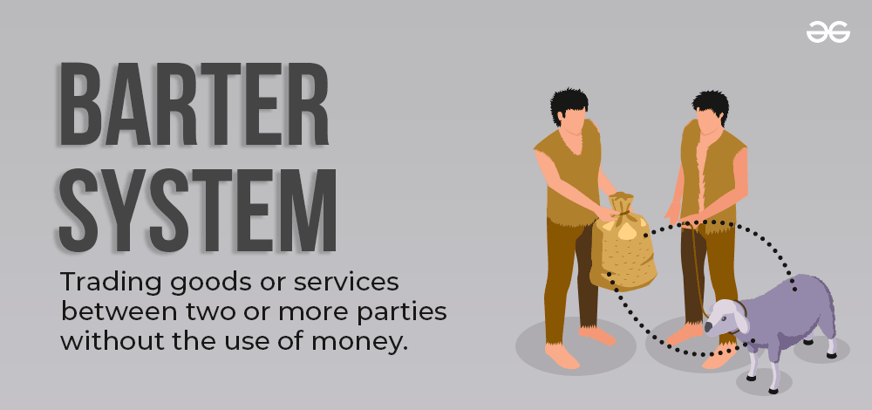
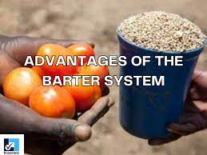
From Barter System to Monetary Transactions
DISADVANTAGES OF THE BARTER SYSTEM
Lack of double-coincidence of wants
Large number of intermediate transactions
Indivisibility of some goods
Difficulty as a store of value
Problem of future payments

Slide 5
The D3C2 Properties of “Money”
 | Desirable | Durable | Divisible | Convenient | Consistent
Gold / Silver | ✔ | ✔ | ✔ | ✔ | ✔
Steel | ✔ | X | ✔ | X | ✔
Diamond | ✔ | ✔ | X | ✔ | X
Real Estate | ✔ | ✔ | X | X | X
Salt | ✔ | X | ✔ | X | ✔
Cigarette / Tobacco | ✔ | X | ✔ | X | ✔
Cryptocurrency / Bitcoin | X | ? | ✔ | ✔ | ✔
Fiat Currency (e.g. USD) | X | ✔ | ✔ | ✔ | ✔

Slide 6
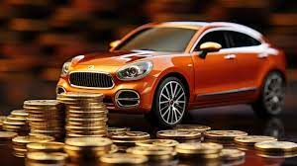
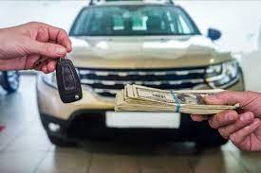
Till What Point in History did Gold Function as “Money”?
Aug 14, 1971 – Buying a Car for $3500
Aug 16, 1971 – Buying a Car for $3500
Buying a car for $3500 meant paying with 100 ounces of gold coins (at the then-convertibility rate of $35/oz).
Buying a car for $3500 meant paying with a few pieces of paper (dollar bills) that cost almost nothing to print !!!
Aug 15th 1971 – A “Temporary” Closure of the Gold Window by US President Richard Nixon.

Slide 7
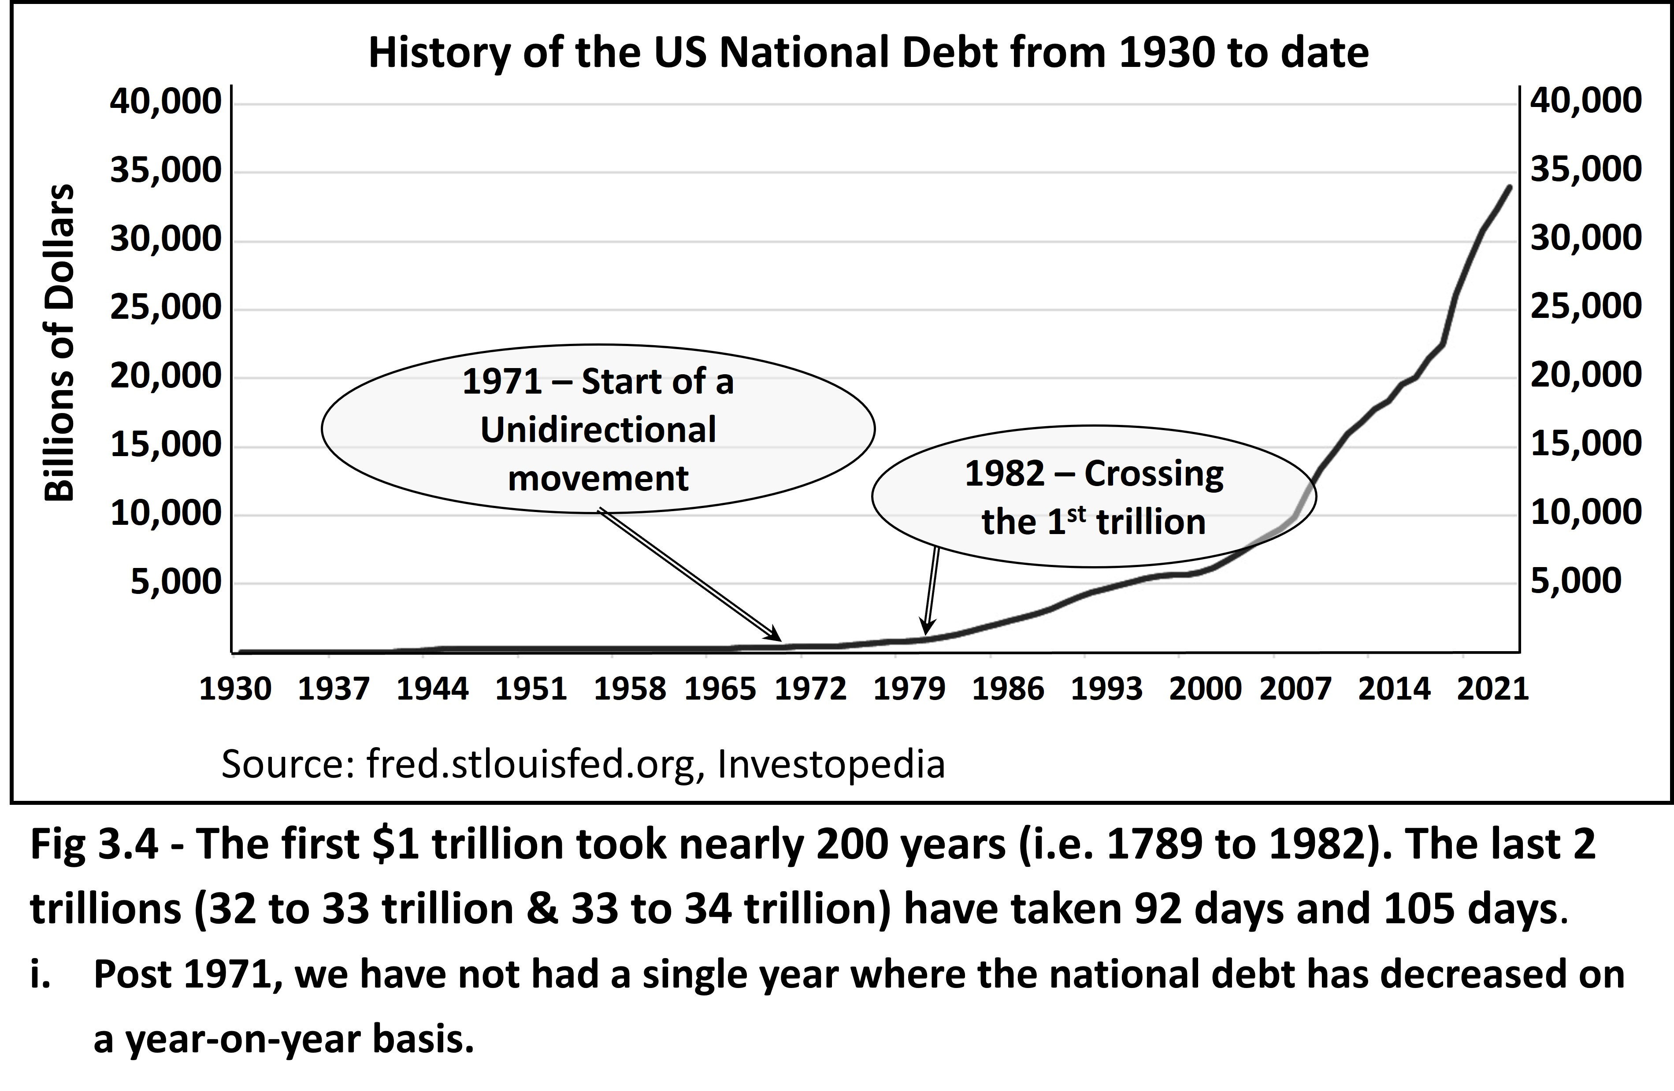
Paper Money DoB Aug 15, 1971 - Consequences.
"It costs only a few cents for the Bureau of Engraving and Printing to produce a $100 bill, but other countries had to pony up $100 of actual goods in order to obtain one.“
Barry Eichengreen
Author of “Exorbitant Privilege: The Rise and Fall of the Dollar and the Future of the International Monetary System”

Slide 8
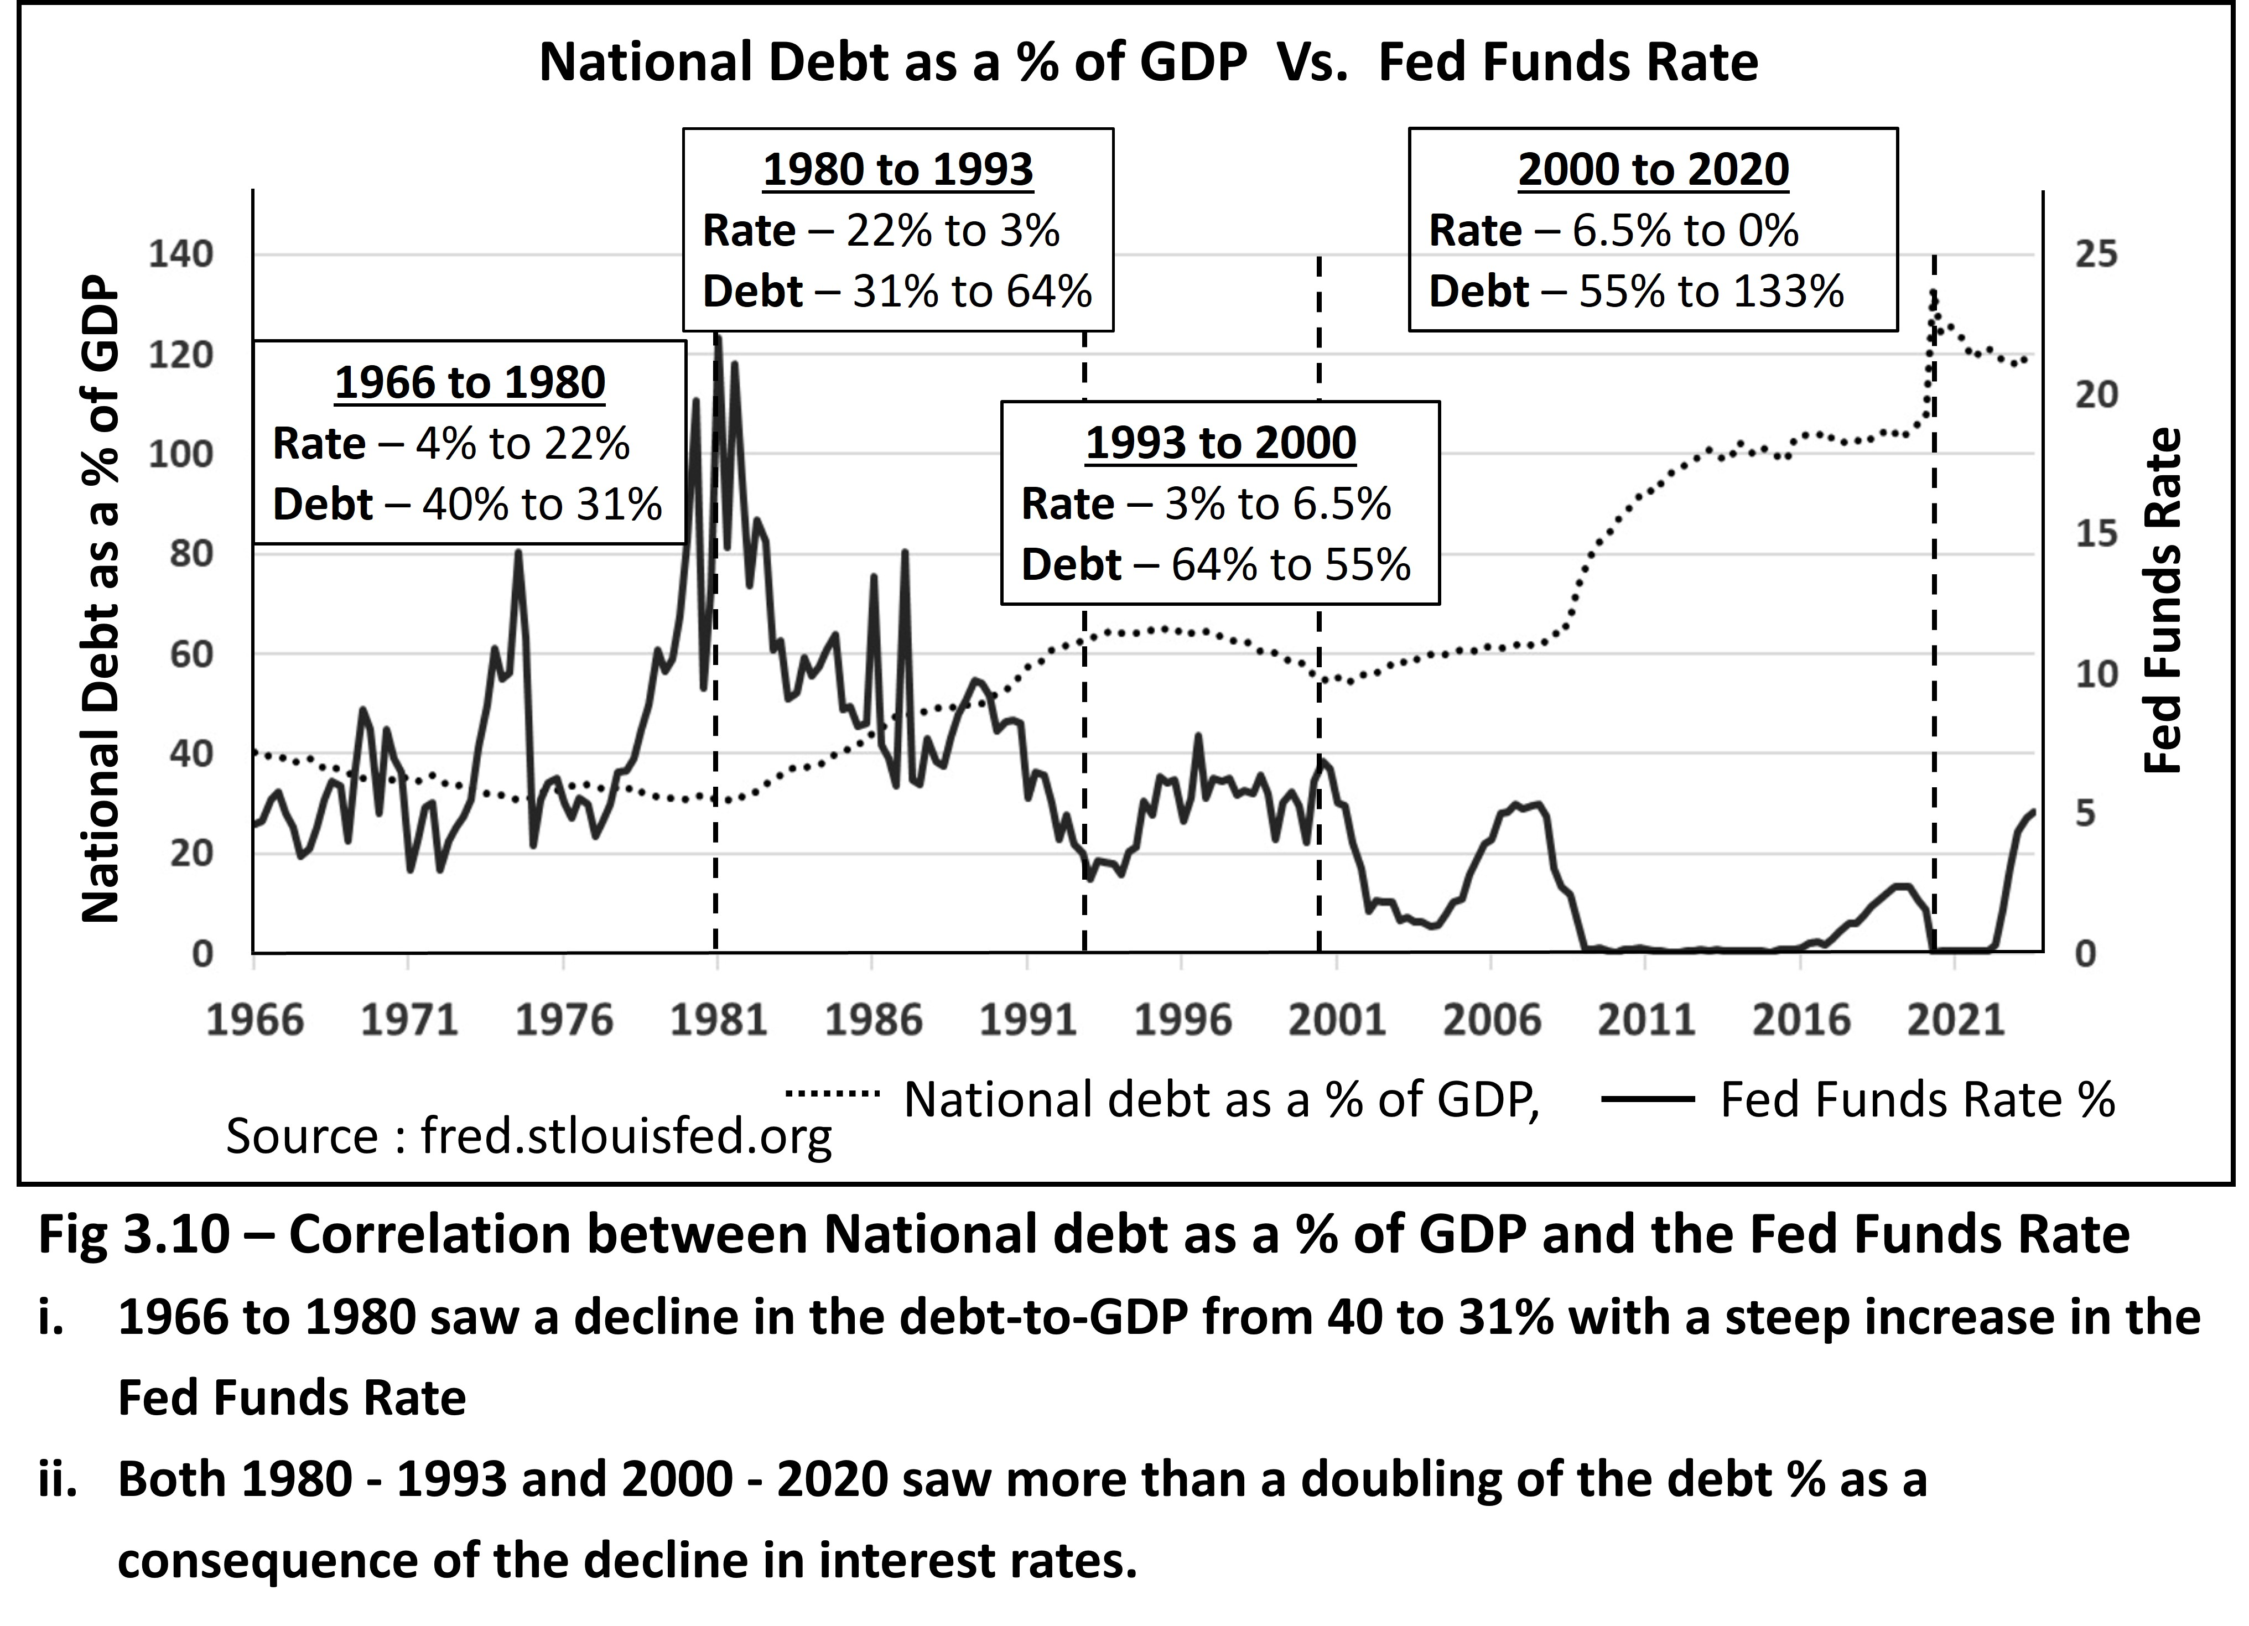
Skyrocketing Debt as a % of GDP
Debt-to-GDP on an unsustainable path
A very mild recession could put this ratio at 150%+
A GFC 2008 like scenario would put this at 200%+
How far are we from another 2008-style crisis?

Slide 9
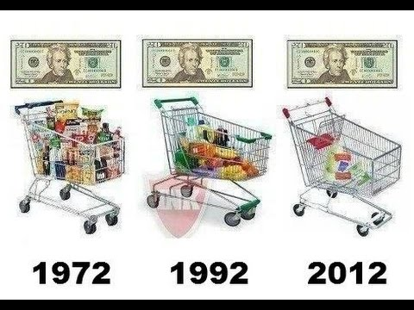
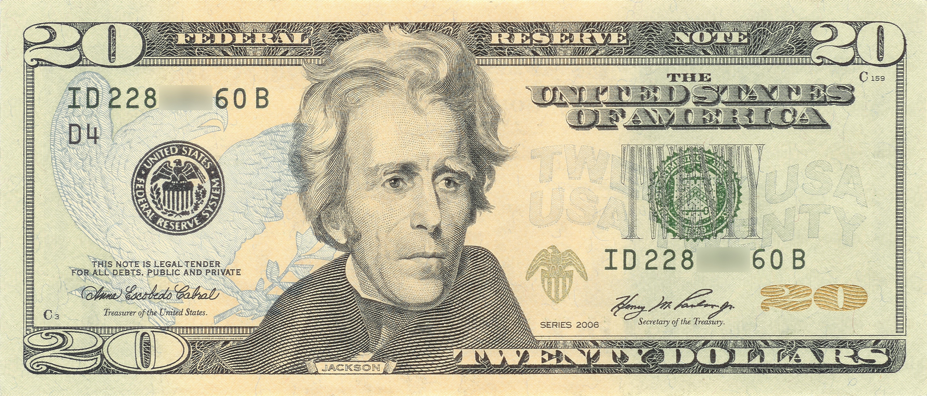
What is Inflation?
How has the definition of Inflation morphed over time?
Websters Dictionary – 1864 Ernest Hemingway, 1920’s | Undue expansion or increase, from over-issue; - said of currency. The first panacea of a mismanaged nation is inflation of the currency; the second is war. Both bring a temporary prosperity; both bring a permanent ruin.
1930’s to 1950’s | An increase in the supply of money and credit relative to the goods and services produced within an economy resulting in higher prices
1960’s | A general increase in price levels of goods and services within an economy.
An increase in the general price levels of a basket of goods and services.
A Not-So-Innocuous Semantic Innovation!!!

Slide 10
So what is Inflation?
As you cannot name the policy i.e. increasing the quantity of the circulating medium, it goes on luxuriantly. – Von Mises
Monetary Inflation – An increase in the Supply of Money and Credit.
Price Inflation – A general increase in the prices of a basket of goods and services in the Economy. Monetary Inflation is the Cause; Price Inflation is the Effect
The Classical Gold Standard (CGS) 1800 to 1913
The Price Index fell from 50 to under 30. A decline of 40% with vastly improved quality of products.
All major innovations (except the Internet) happened under the CGS resulting in an unrecognizable change in living standards during the period i.e. from horse-driven carriages to trains to cars to airplanes – the entire change happened in one human life span between 1850 and 1913.

Slide 11
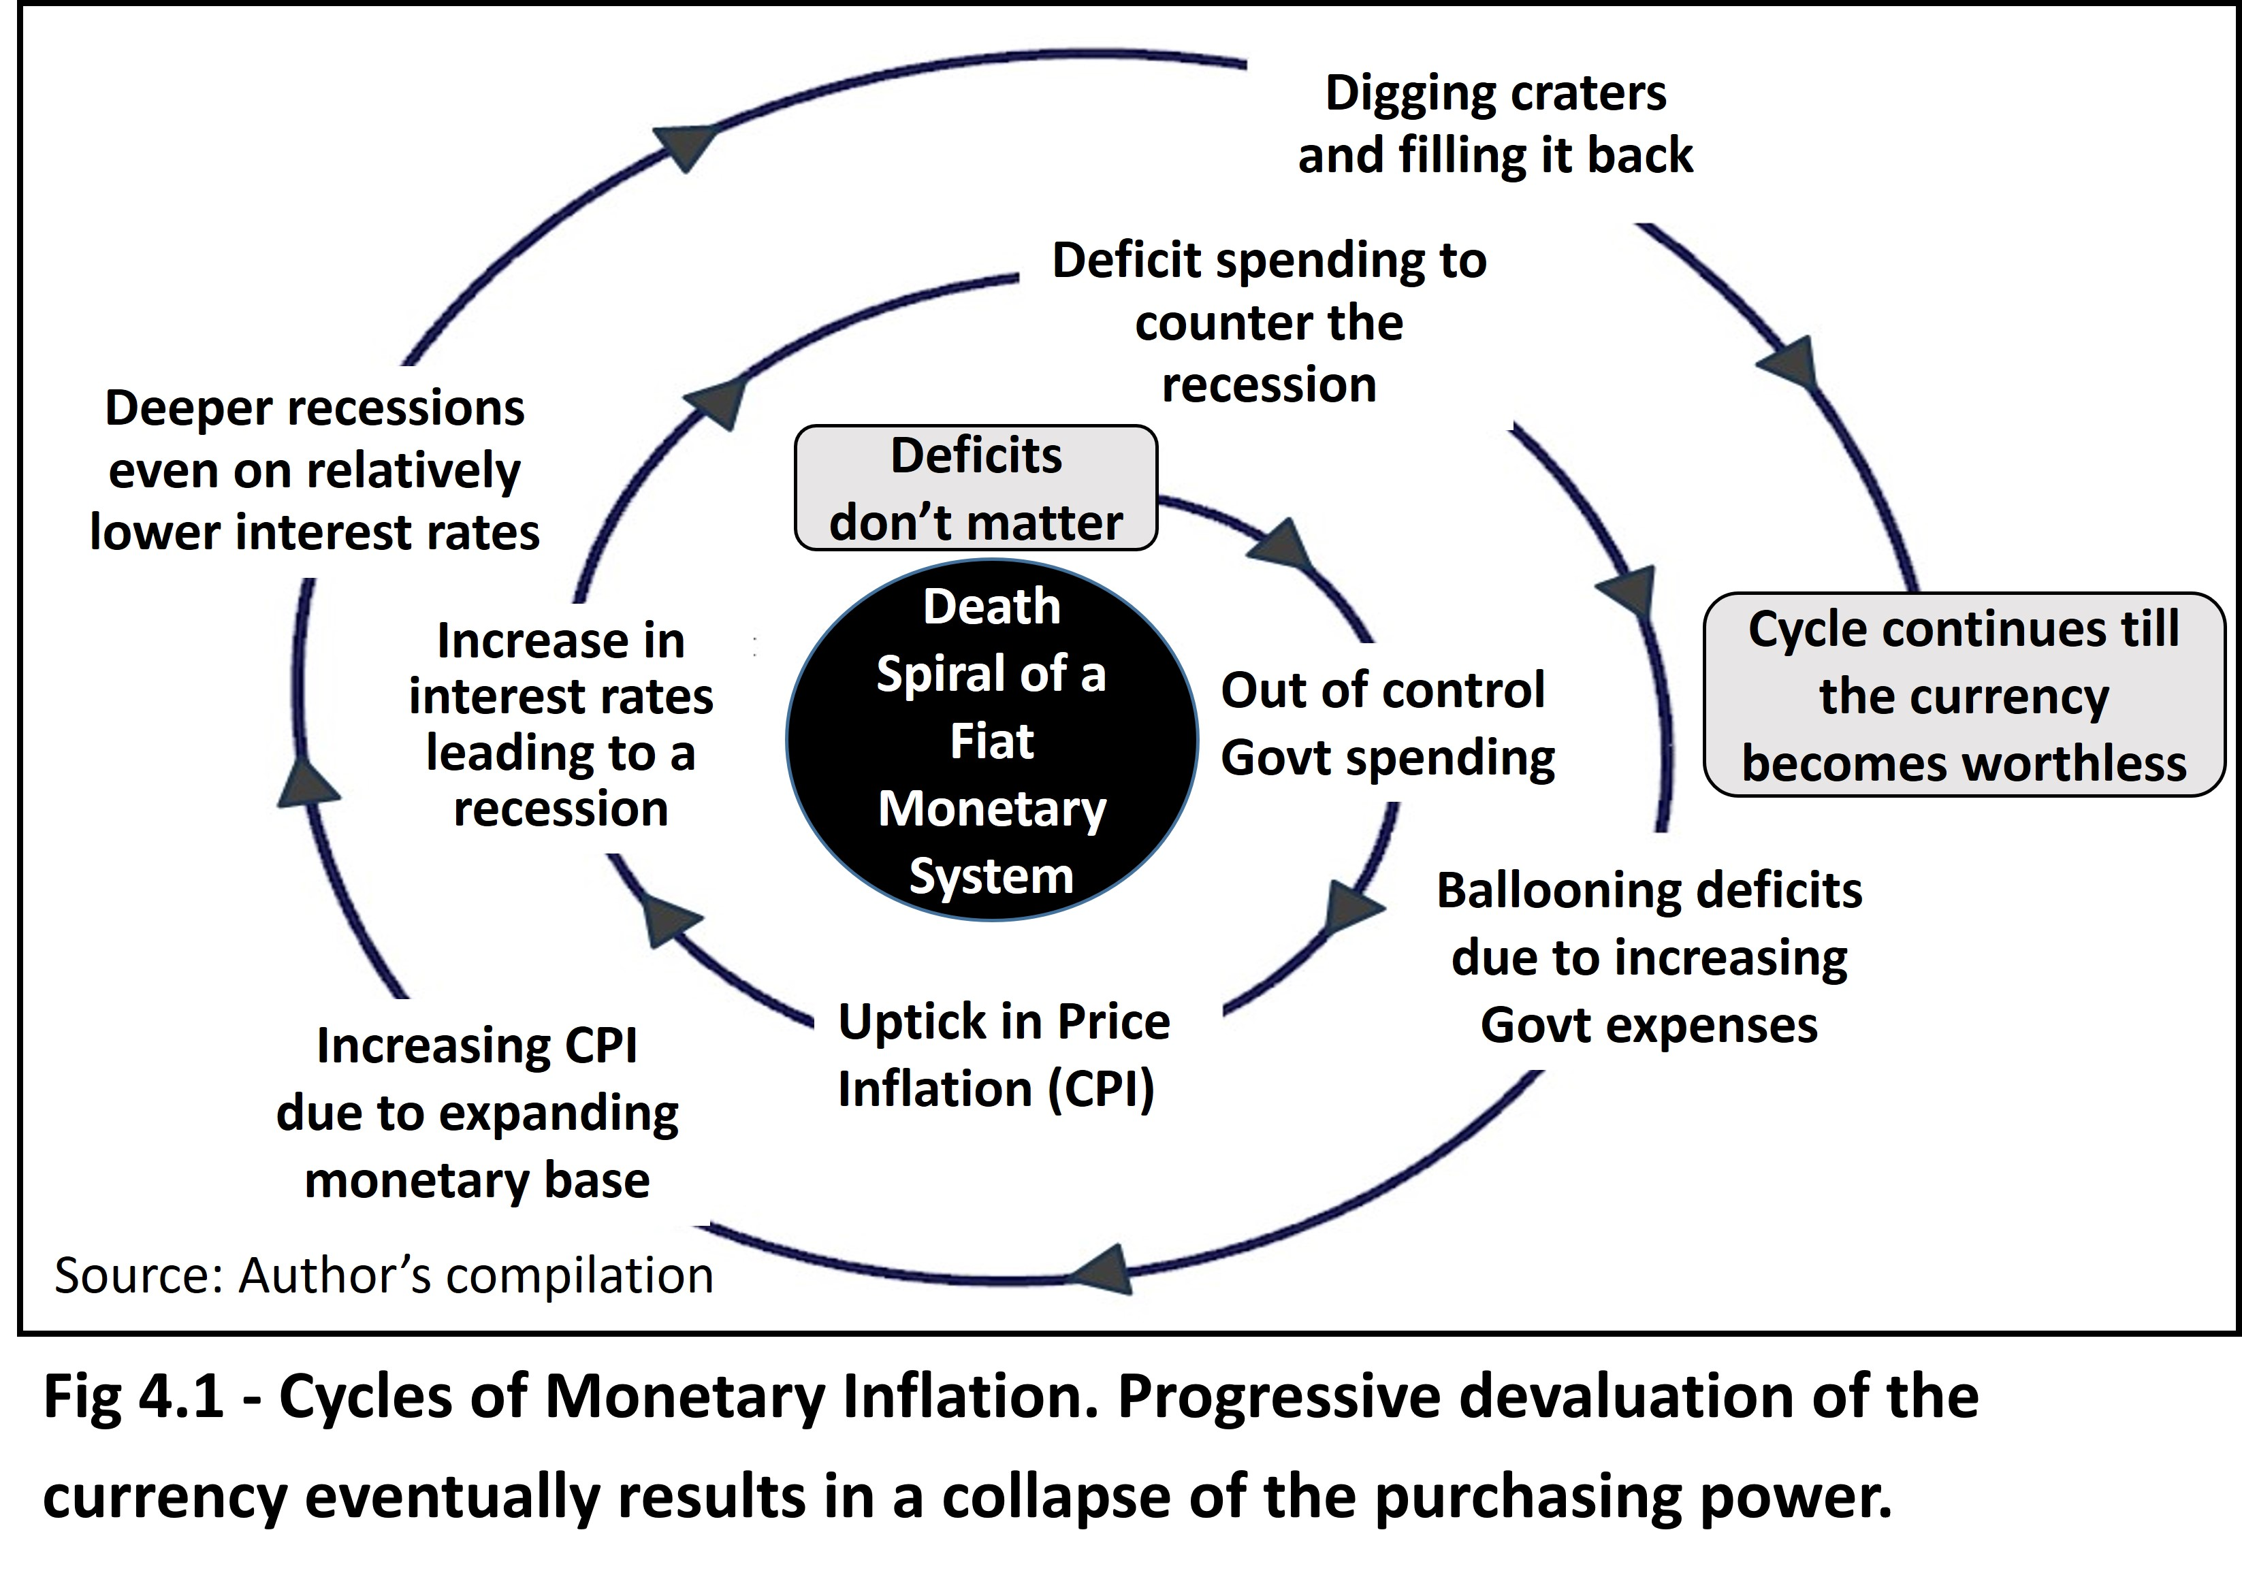
Cycles of Monetary Inflation

Slide 12
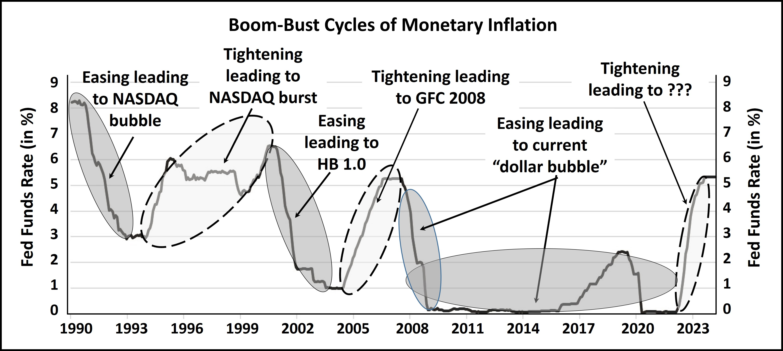
Boom-Bust Cycles
If a few years of low-single digit interest rates lead to a GFC 2008, what would a combination of (near 15 years of ZIRP + 10X growth in the US Fed balance sheet + quadrupling of National debt) lead us to?

Slide 13
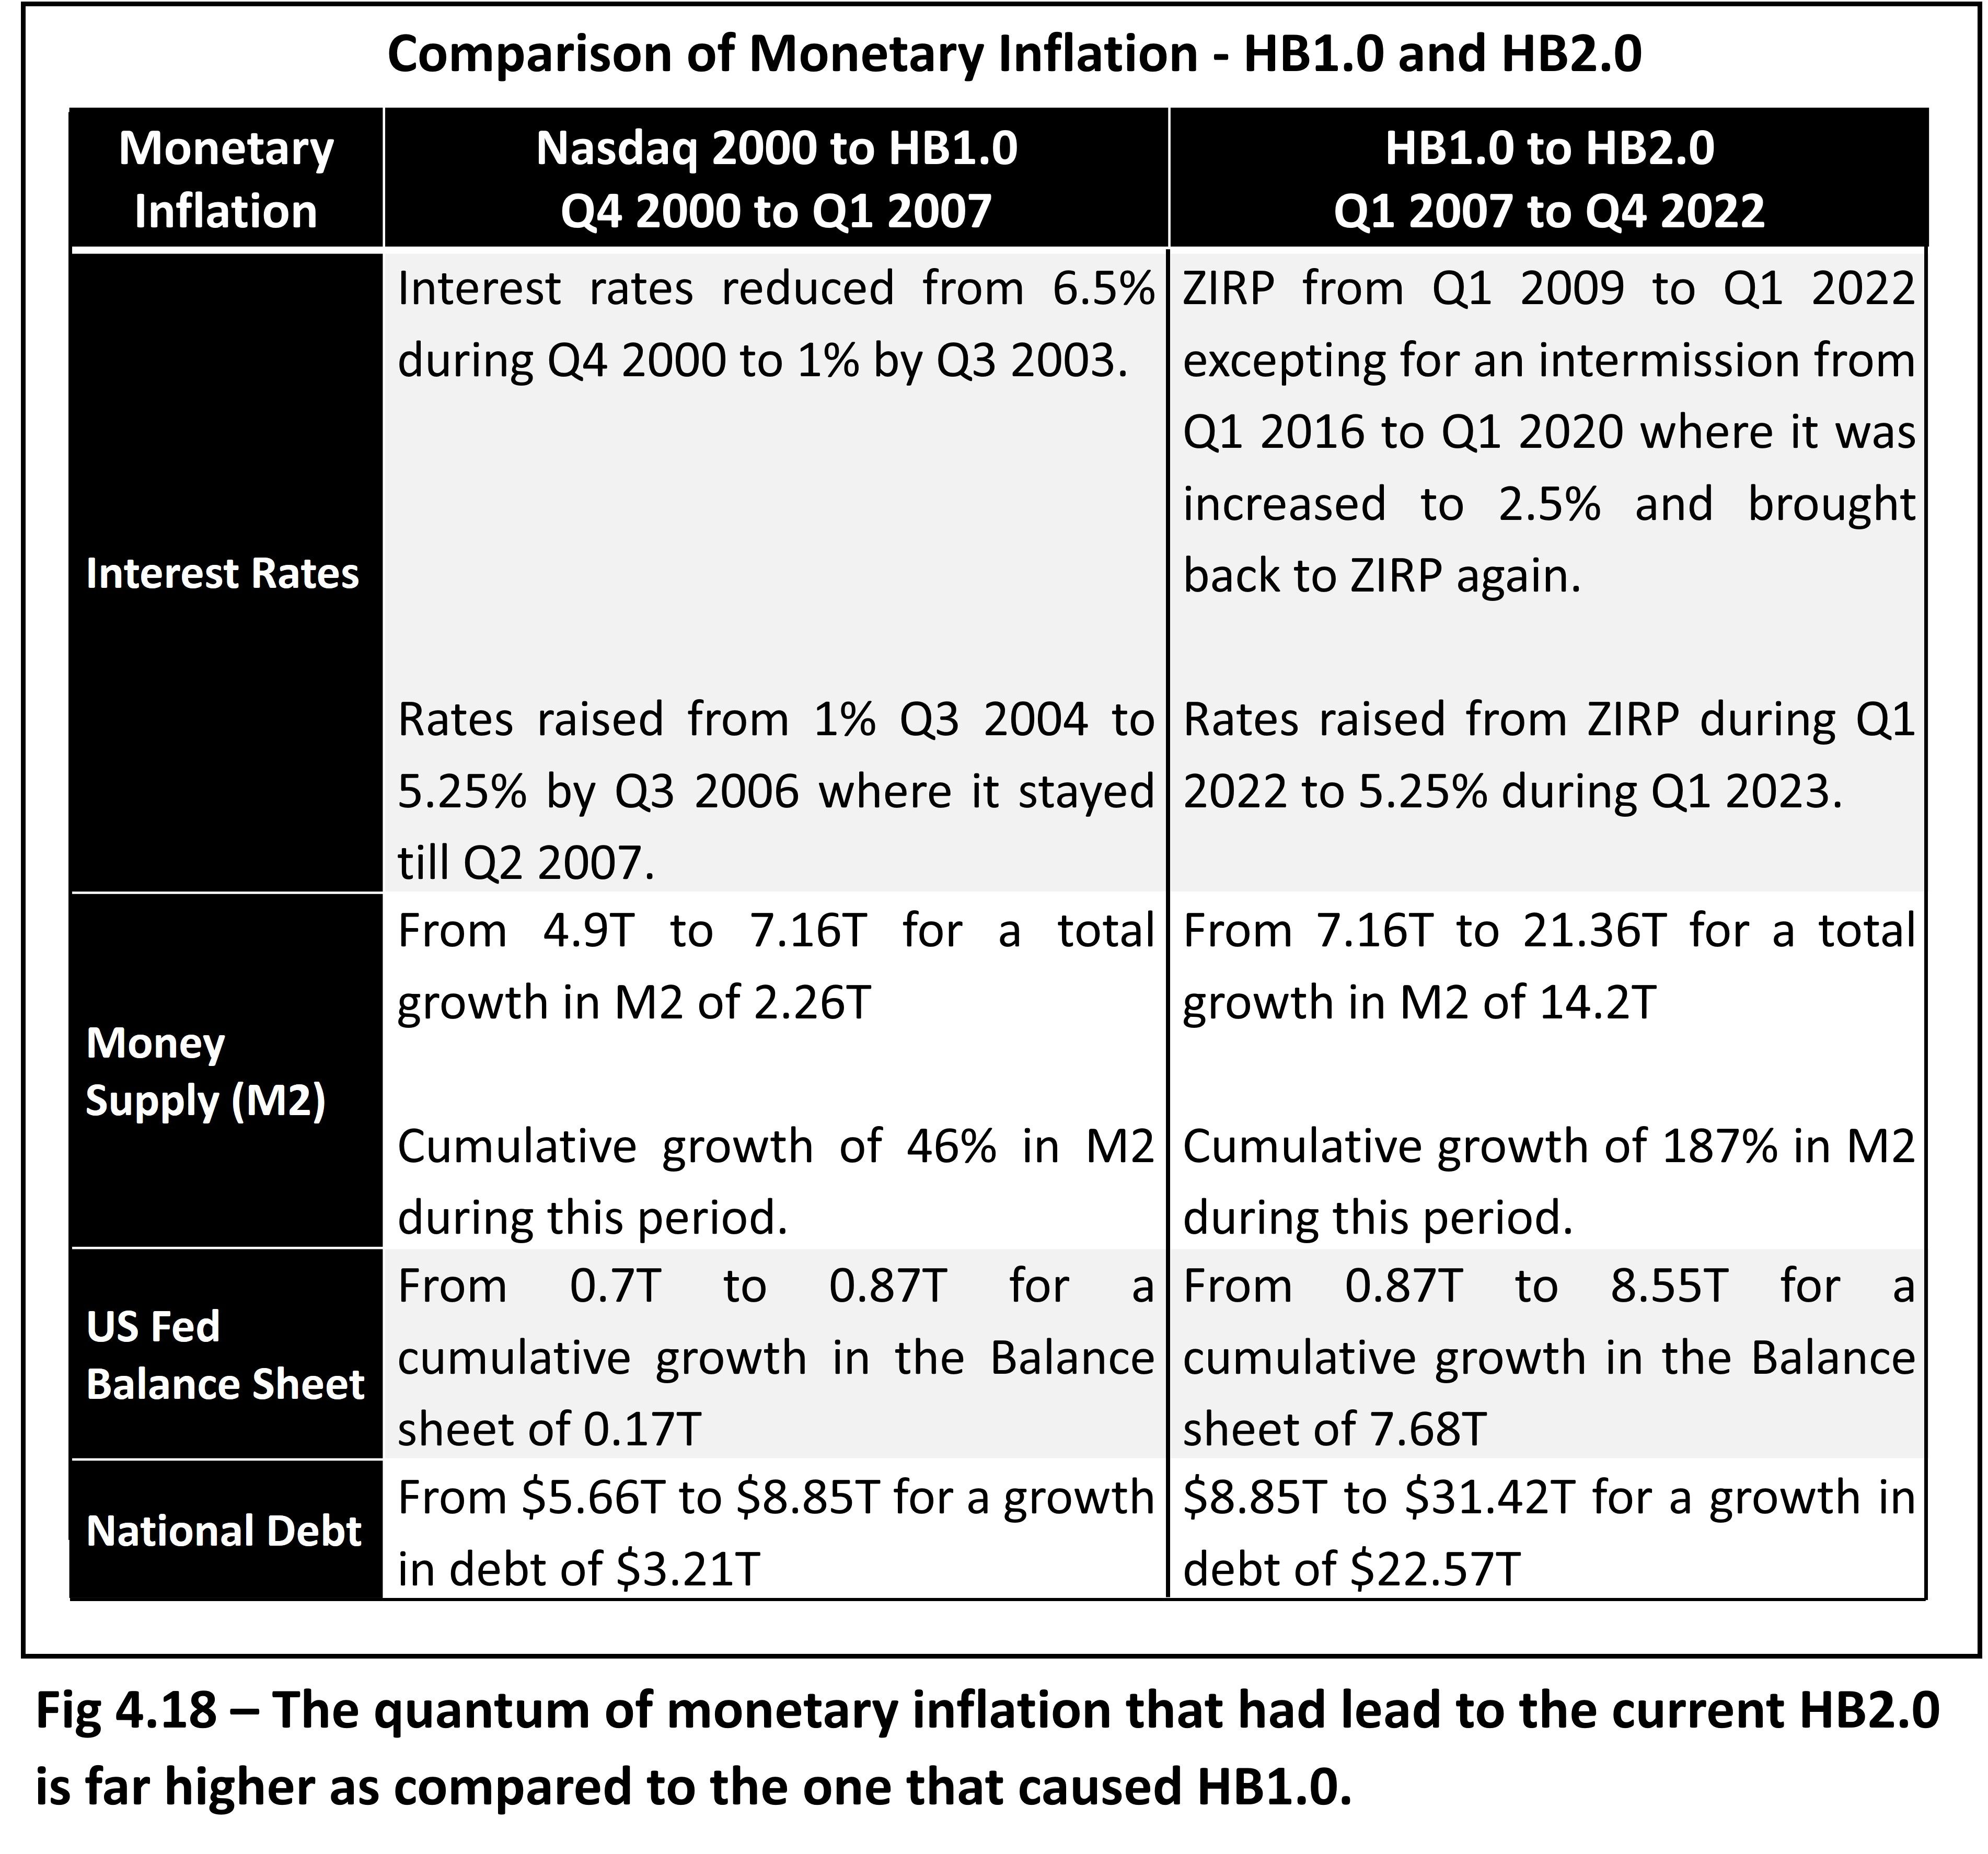
The Unprecedented Monetary Inflation leading up to 2024

Slide 14
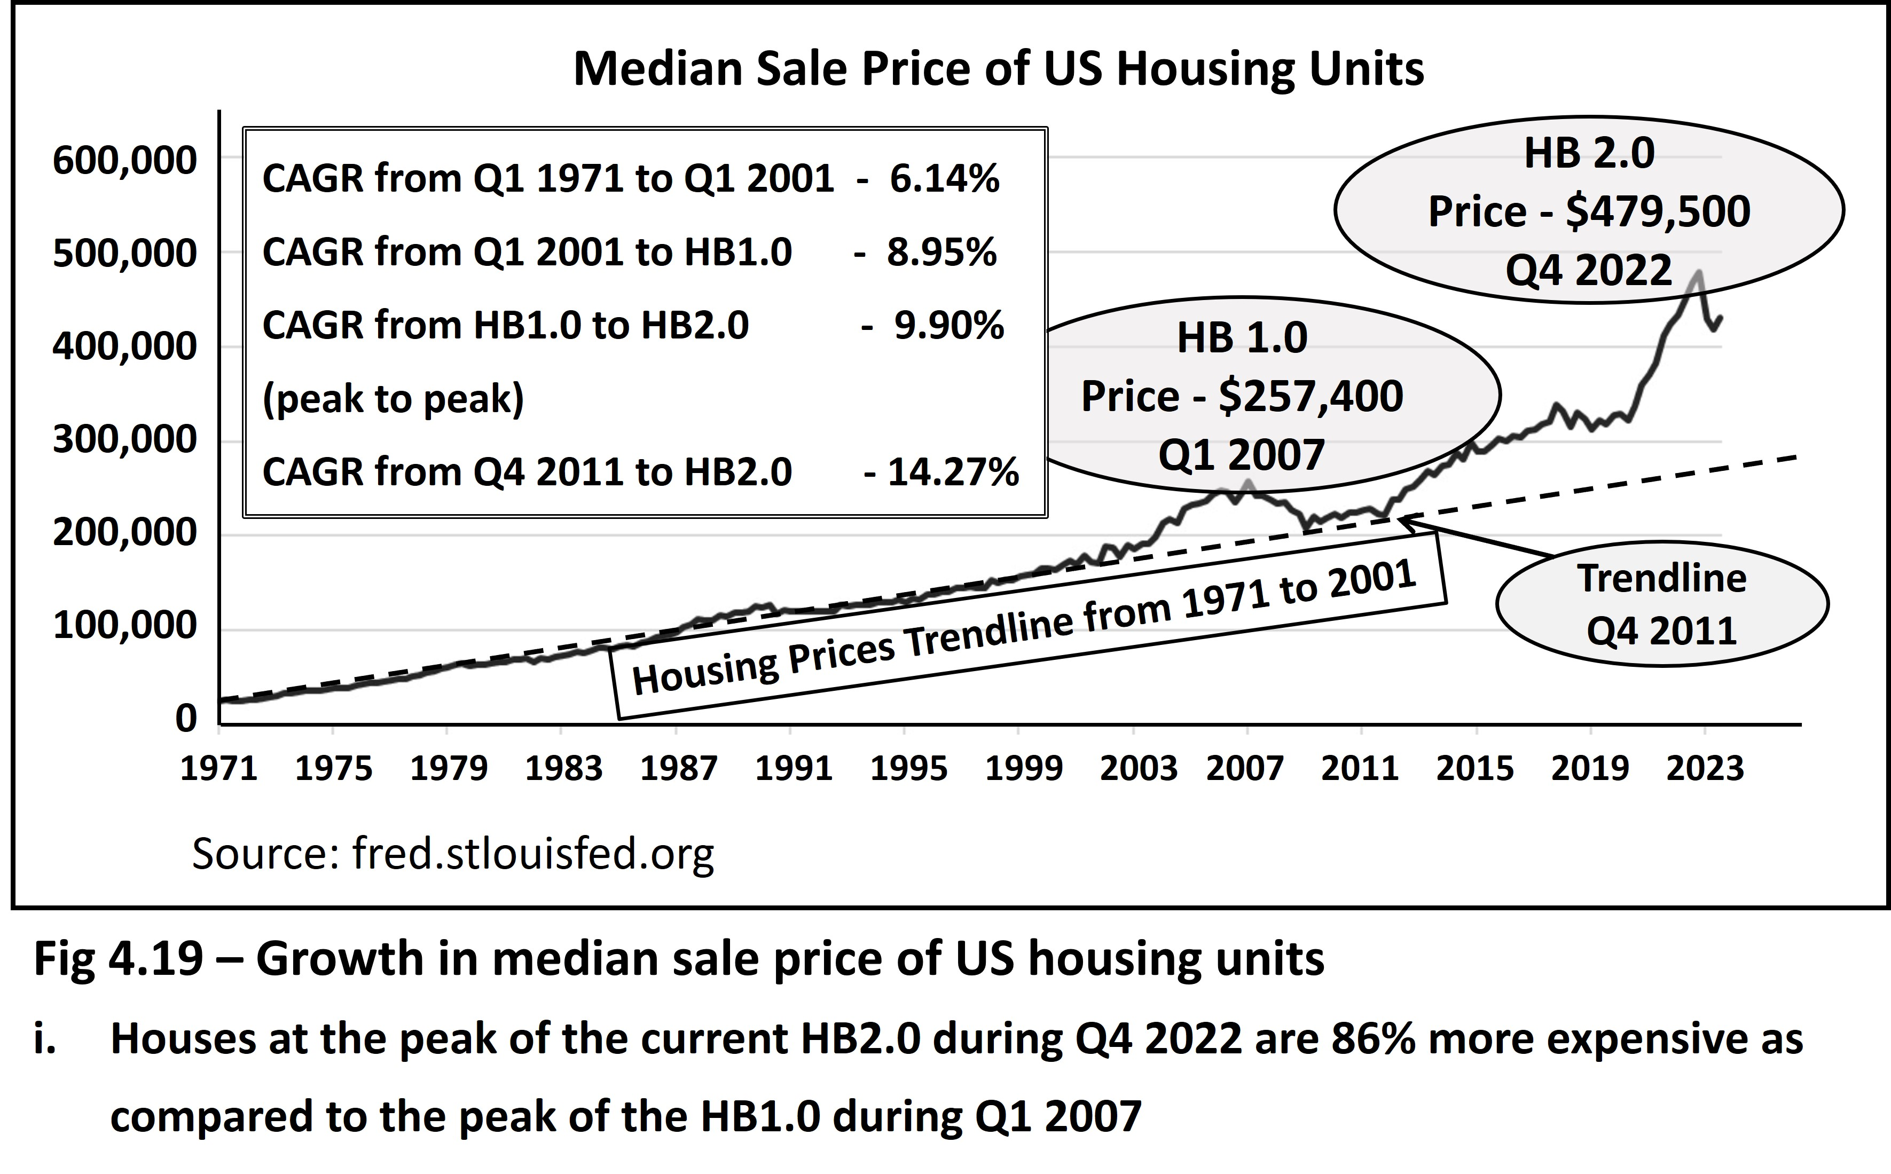
Housing Bubble 2.0

Slide 15
The Funny Money Flows

Slide 16
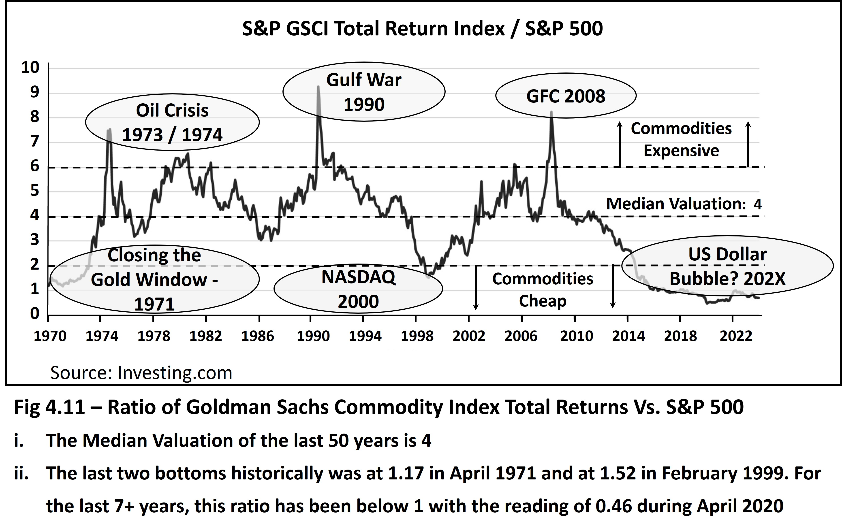
Relative Valuations – Stocks Vs Commodities
Commodity prices (and consumer price inflation and hence interest rates) are set to soar in the years ahead. Any monetary loosening – QE’s, rate cuts etc. would be the equivalent of throwing gasoline on a Commodity Inferno!!!

Slide 17
US Federal Government Finances
FY2024 Projected Revenues : $4.9 trillion
FY2024 Projected Expenses : $6.9 trillion
FY2024 Budgeted Deficit : $1.9+ trillion
Increase in National Debt in FY2024 : $3.0+ trillion
Interest Expense during FY2024 : About $1 trillion
Interest Rate on National Debt : Around 3%
National Debt : $35+ trillion
Unaccounted Liabilities : $200+ trillion
The Interest rate on National Debt is increasing (it is at 3.2% during June 2024) due to the new debt issuances as well as refinancing of existing debt that is maturing. The rate is expected to be 4%+ in FY 2025 even assuming a 100 bps reduction in the Fed funds rate.
The finances of the US Federal Government resembles that of a Ponzi Scheme!!! Even at a “near 0%” rate, the Govt has to borrow to service the interest cost on the current borrowings.

Slide 18
The Next Few Years
A Housing Bubble / Tech Bubble / Bond Bubble burst : Probably H2 of CY 2024
The US Economy is going to stumble from one crisis to another for the next decade. The period will unquestionably witness geopolitical tensions and military confrontations that would add to the Economic woes.
QE’s that dwarf TARP, QE 1, 2 .. National Debt could well exceed $50 trillion within 18-24 months of the bubble burst
Consumer Price Inflation in double-digits If measured accurately, first digit will not be “1”

Slide 19
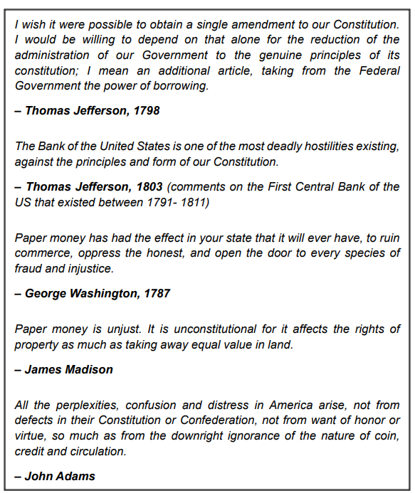
The Road Ahead
The situation is beyond hopeless for the US Economy and the US Dollar; An empire is on the verge of decimation of a magnitude that the world has not witnessed since the days of the collapse of the Roman Empire.
Where do we look for answers on “WHAT TO DO”?
What did the founding fathers advice?

Slide 20
Thank You!!!

