Slide 1
Simulation of successive Cascades in Fe-Ni-Cr Model Alloy using Molecular Dynamics for studying Defect Microstructure during ion irradiation
Soumita Chakraborty, Argha Dutta, Santu Dey, N. Gayathri, Paramita Mukherjee
Variable Energy Cyclotron Centre, India

Slide 2
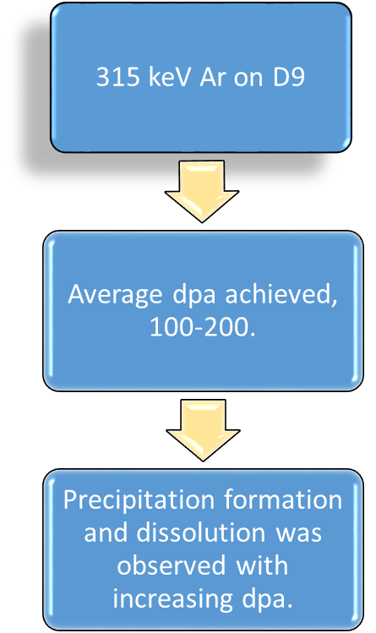
Motivation & Aim
Experiments performed :
To understand the differences in the microstructure created by the different ions.
Effect of different ions by using the average PKA energy for cascade (dpa) initiation in the model alloy cell.
Successive cascade simulations performed to find the variation as a function of dose.
35 MeV He on D9
145 MeV Ne on 316L
Average dpa achieved 0.00087-0.034
Average dpa achieved 0.063
Microstructural changes were mainly observed using X-ray line profile analysis and no precipitation was observed
N. Gayathri, K. Das, P. Mukherjee, R. Menon, P.Y. Nabhiraj, Phys. Chem. 165 (2019) 108379
P. Mukherjee, A. Sarkar, M. Bhattacharya, N. Gayathri, P. Barat, J. Nucl. Mater. 395 (2009) 37–44.
S. Dey, N. Gayathri, P. Mukherjee,, Radiat. Eff. Defects Solids. 173 (2018) 300–317

Slide 3
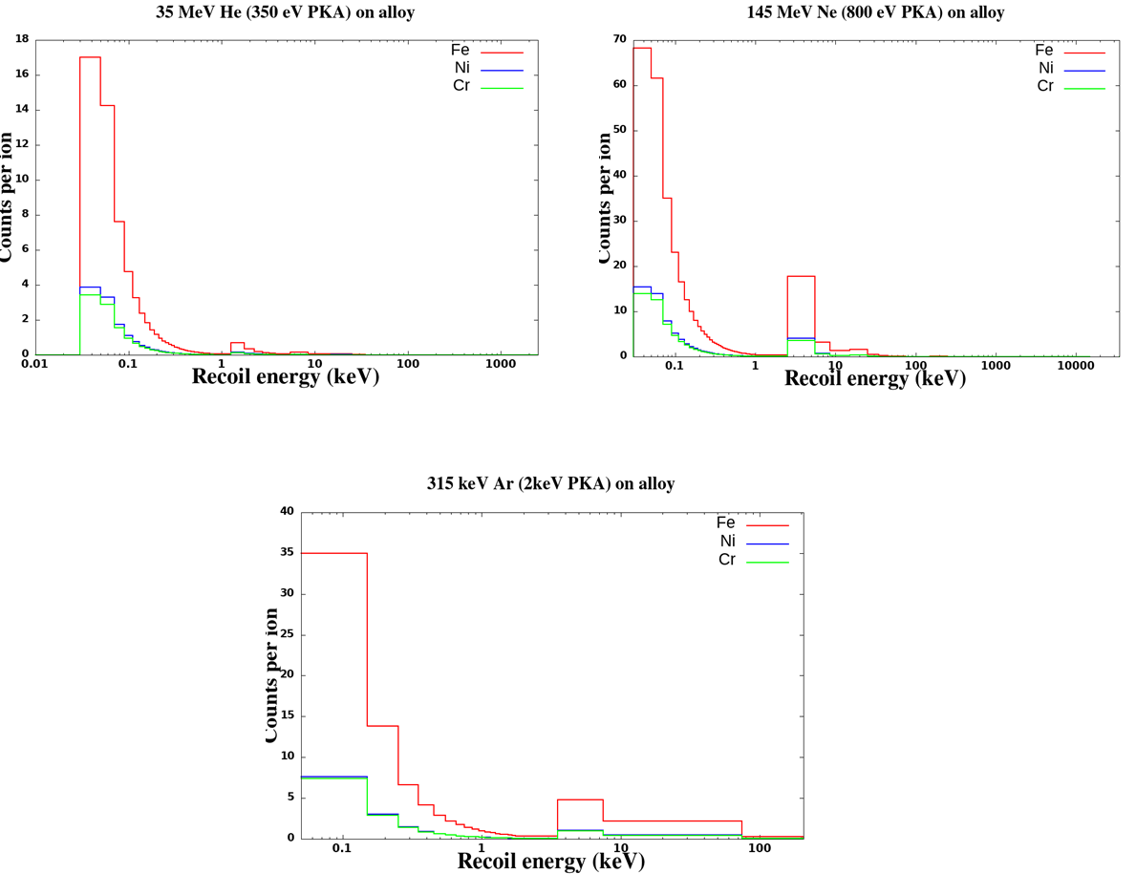
PKA energy calculation
Cumulative Fraction of Fe PKA’s for the three incident ions.
PKA spectra of the (a) 35 MeV He; (b) 145 MeV Ne and (c) 315 keV Ar calculated using SRIM 2013 output file.
PKA energy chosen
Ion beam specification | PKA energy
35 MeV He | 350 eV
145 MeV Ne | 800 eV
315 keV Ar | 2 keV

Slide 4
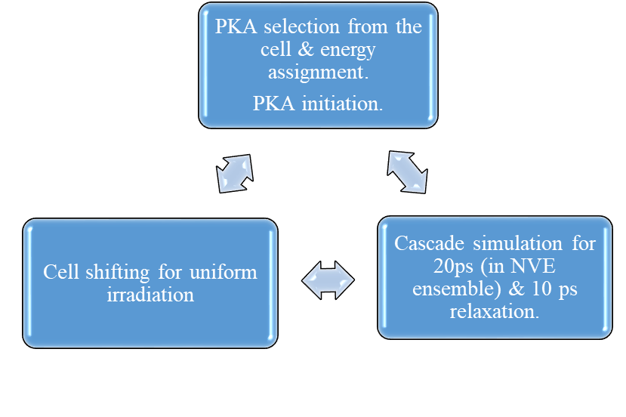
Simulation details
Atomic ratio of the simulation cell , Fe:Ni:Cr = 70:15:15.
Lattice parameter = 3.5945 Å
Simulation cell dimension, 20x 20x 20 unit cell
FCC cell with periodic boundary condition in all three directions
Total number of atoms in the cell = 32000
Equilibrated for 100 ps at 300K and 0 pressure in NPT ensemble
Cell size optimization by calculation of % of atom taking part in single PKA.
Percentage of atom taking part in single PKA event
Ion beam specification | PKA energy | Percentage of atoms taken part in single PKA damage cascade
35 MeV He | 350 eV | 1.33 %
145 MeV Ne | 800 eV | 2.7 %
315 keV Ar | 2 keV | 7.8 %
5000 iterations

Slide 5
Simulation observations & results
Cluster size (interstitial)
Maximum NRT dpa achieved for 5000 cascades
Ion beam specification | NRT equivalent dpa
35 MeV He | 0.46
145 MeV Ne | 1.02
315 keV Ar | 2.487
Interstitial cluster counts in terms of the successive cascades. The black line is the indicative of the overall changes of the cluster counts
Parameters studied in this simulation
3-10 size clusters are the most frequent one which is taken for further calculations.
Cluster size
Cluster composition
Stacking fault probability
Dislocations – type; density etc.

Slide 6
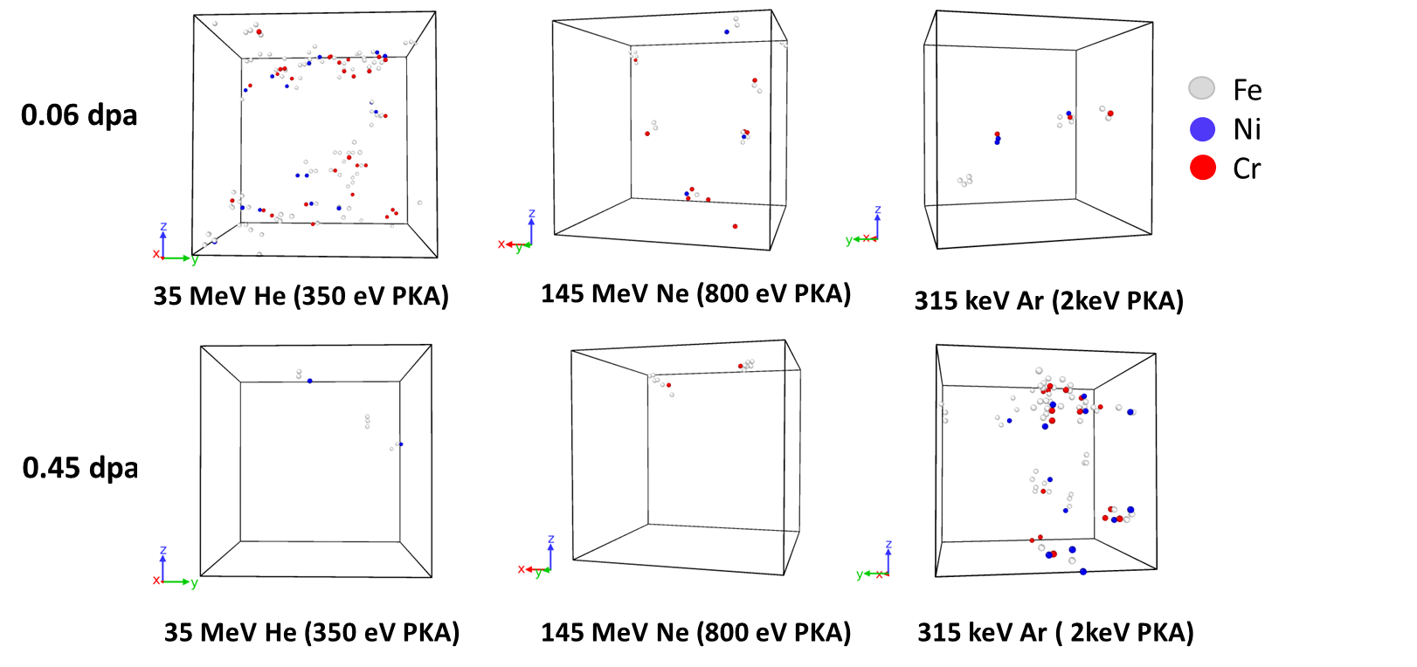
Cluster composition
Representative simulation cells showing clusters (size 3-10) with their individual composition at 0.06 and 0.45 dpa for three different PKA energies
Ni and Cr percentages in the interstitial clusters as a function of successive cascade for the 3 different PKA energies
In the 2 keV PKA simulation, there is clear oscillatory behaviour in the Cr content in these clusters.

Slide 7
Conclusions
Earlier experimental results on ion irradiation of SS316L/D9 have been verified
Using molecular dynamics simulation with appropriate PKA energies in model alloy Fe-15Ni-15Cr.
The distinct results obtained in the three cases could be understood as effect of different PKA energies in the three cases.
At low PKA energies (<1 keV) the irradiated microstructure is found to be dominated by the formation of dislocations (loops) and stacking faults (tetrahedra).
Corroborates with 145 MeV Ne and 35 MeV He ion irradiation
For high PKA energy (2 keV), irradiation induced microchemical changes seem to be more dominant. This is visible through the oscillatory behaviour in the Cr percentage in the interstitial cluster formed during the successive irradiation.
Corroborates with 315 keV Ar ion irradiation.

Slide 8
Thank You

