Slide 1
Novel Coronavirus: CoVID-19
Dr. Sandhya Raghavan,
Medical Section, TIFR,
14/02/2020.

Slide 2
Coronavirus

Slide 3
Epidemics caused by Coronaviruses
SARS- Severe acute respiratory syndrome (SARS CoV)- 2002 in Guangdong, China. According to WHO statistics 8098 cases were reported with 774 deaths. [Nov 2002 to July 2003]. Transmitted from Cats to humans.
MERS- Middle east respiratory syndrome (MERS CoV)- 2012 in Saudi Arabia. WHO statistics 2494 cases with 858 deaths. [April 2012 to Nov 2019]. Transmitted from Camels to humans.
Third recent coronavirus attack (COVID-19)- Dec 2019 in Wuhan, China. Transmission has been linked to the large seafood & animal market. As of WHO situation report (13/02/2020)-total number of confirmed cases in China is 46,997 with 1368 deaths. Cases reported from outside China [about 24 countries] is 447 with 1 death reported.

Slide 4
Epidemiology of the novel coronavirus
Not enough is known yet to draw definitive conclusions about the clinical nature of the illness, mode of transmission, incubation period & period of communicability.
Spread is thought to be through droplets containing viruses generated while coughing & sneezing.
Close contact with infected person/surfaces.

Slide 5
Incubation period
Period between infection & appearance of symptoms. According to WHO, this period is about 14 days for COVID-19. Hence follow up for 14 days is recommended for contacts of confirmed cases.
According to reports it may be possible that people infected with this novel virus are infectious during incubation period also. But data also shows that symptomatic patients are causing majority of spread.

Slide 6
Signs & Symptoms
The symptoms are very similar to those with any other viral infection. So it is difficult to identify the disease based on symptoms alone. Lab tests are required for confirmation.
Common Severe:
Fever Pneumonia
Running nose Kidney failure
Cough Severe Acute Respiratory distress
Shortness of breath Death
Breathing difficulties
* Elderly, Immunocompromised people, people with diabetes, heart disease, Asthma or other lung diseases are more likely to get severe infections.

Slide 7
Investigations & Treatment
In highly suspicious cases, samples are collected & sent for virus isolation which takes about 2-3 days time. Real time PCR test. Few detect only novel virus while some detect SARS also which is genetically similar. Several assays to detect the novel coronavirus are under development.
There is no specific treatment available.
Vaccines also not available at present.
Symptomatic treatment
Prevention of complications & vital organ failure.
Antibiotics do not act against viruses.

Slide 8
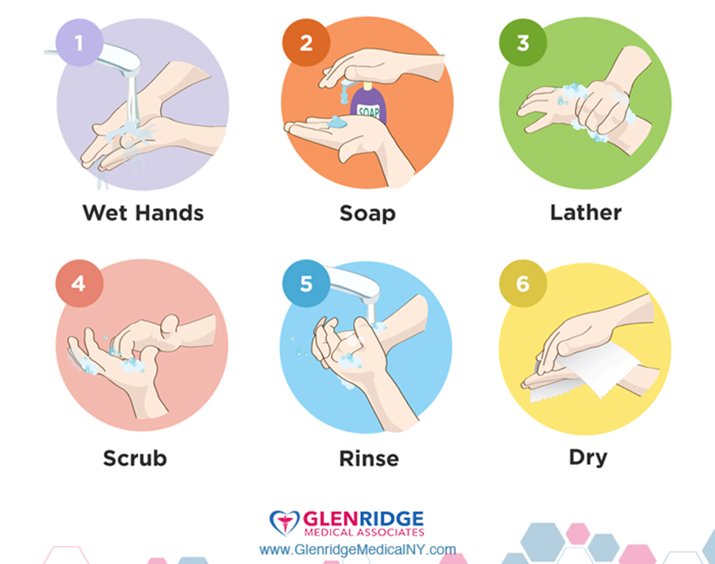
Prevention
Preventive measures are targeted to curtail the spread of infection thereby reducing the global burden of the disease.
These are general measures effective against many diseases. So do not stop these practices once the coronavirus threat is over.
Hand washing – one of the most important aspects of hygiene.
Use Soap & water or Alcohol based hand sanitizer.
HAND WASHING
TECHNIQUE

Slide 9
Few things about hand wash
Sanitizer should contain 60-95% alcohol. Lower alcohol concentration does not kill the germs completely.
Washing hands with soap & water is better than the sanitizer use:
Sanitizer does not kill all types of organisms.
Not suitable for visibly dirty & greasy hands.
Not effective against certain pesticides & heavy metals.
Should be used as directed-not using enough volume or wiping it off before drying may not be effective.
Swallowing may cause alcohol poisoning-more incidences in children [pleasant smell, attractive & bright packing], so be careful.

Slide 11
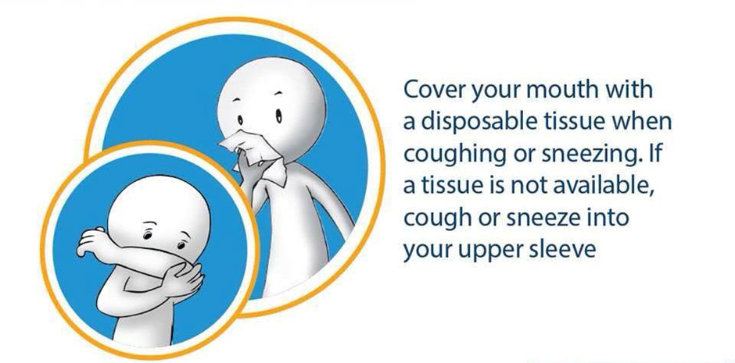
Prevention
Discard the tissue into a closed bin & wash hands immediately.
Avoid contact with people having symptoms of respiratory illness.

Slide 12
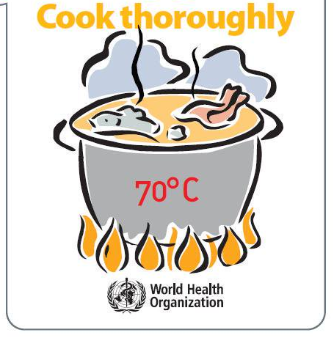
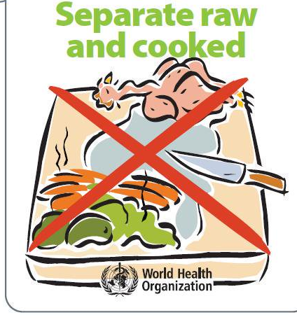
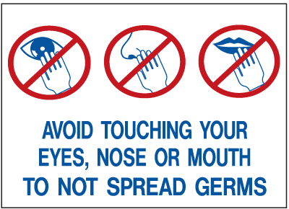
Prevention
If you are having respiratory symptoms, consult the healthcare personnel. Share your recent travel history. Stay at home till recovery. Avoid going to public places. You can use mask to prevent spread to others.
Food safety precautions: Eat thoroughly cooked animal food. Do not mix raw & cooked food.
Avoid travel to the affected area unless absolutely essential.
Avoid touching mouth/nose/eyes with unclean hands.
Clean & disinfect frequently touched objects & surfaces.

Slide 13
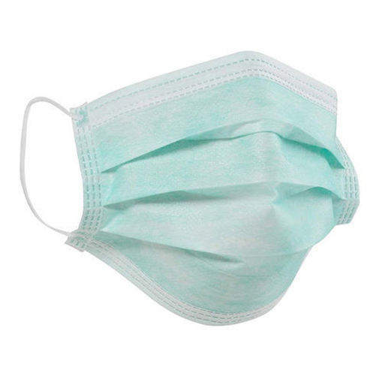
Mask use
WHO advises rational use of masks to avoid
unnecessary wastage & misuse.
Masks are effective only in combination
with proper hand & respiratory hygiene.
If you are using a mask, you must know
how to use it & how to dispose it.
Use the mask
If you have respiratory symptoms.
If you are caring for someone who is suspected 2019-nCoV infection.
If you are a health worker working in the affected area or taking care of suspected infectious patients.

Slide 14
Mask
How to use the mask-
Before putting the mask clean your hands with soap & water or alcohol based sanitizer.
Cover nose & mouth with the mask in such a way that there are no gaps between your face & mask.
Do not touch the front of the mask. If you do, wash your hands as advised.
Replace the mask with new one, once it is damp & do not re-use the single use mask.
Remove the mask from behind, discard it immediately in a closed bin. Wash hands with soap & water or alcohol based sanitizer.

Slide 15
Dos
In case of respiratory symptoms, consult your healthcare provider without delay.
Give history of any recent travel.
Follow hand & respiratory hygiene practices as well as other precautionary measures.
Don’ts
Do not get panicked or do not create panic.
Do not travel to affected area.
Do not self medicate with antibiotics.
Following ARE NOT recommended
Vitamin C
Drinking herbal teas.
Wearing multi-layered masks.
Regular nose rinsing.
Use of mouthwash.
Garlic or Sesame oil use.

Slide 16
Thank you

