Slide 1
Concept inventories in physics: Multiple choice or free text?
Sally Jordan¹, Holly Hedgeland², Jonathan Nylk¹, Mark Parker¹ and Ashutosh Kumar Pathak¹
¹School of Physical Sciences, The Open University, Milton Keynes, UK
²Clare Hall, University of Cambridge, UK

Slide 2
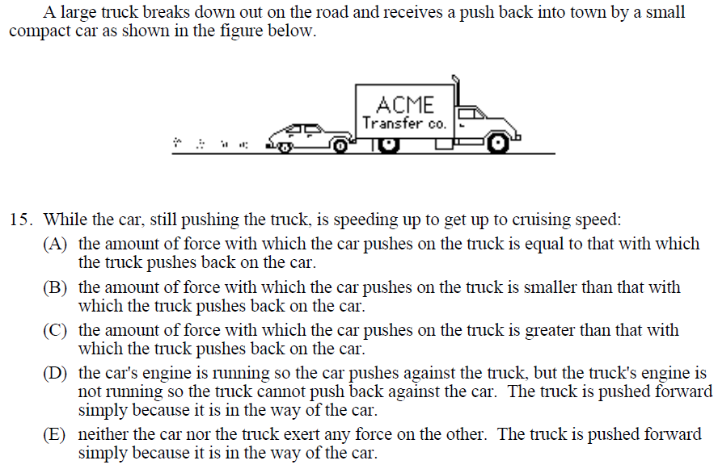
What is a concept inventory?
A concept inventory is an instrument designed to assess students’ conceptual understanding, usually with the aim of measuring the learning gain that has occurred across a class as a result of a particular piece of teaching¹.
Most concept inventories consist of a series of multiple-choice questions, each with one correct answer and a number of incorrect answers, known as distractors, based on common student misconceptions.
Concept inventories do not usually give feedback to students, rather just informing professors of their class’s conceptual understanding.
The Force Concept Inventory (FCI)² was one of the earliest concept inventories and remains widely used.
Figure: Here and throughout the presentation, most figures show questions from the Force Concept Inventory (source: https://www.talkphysics.org/wp-content/uploads/2015/07/fci-rv95_1.pdf)

Slide 3
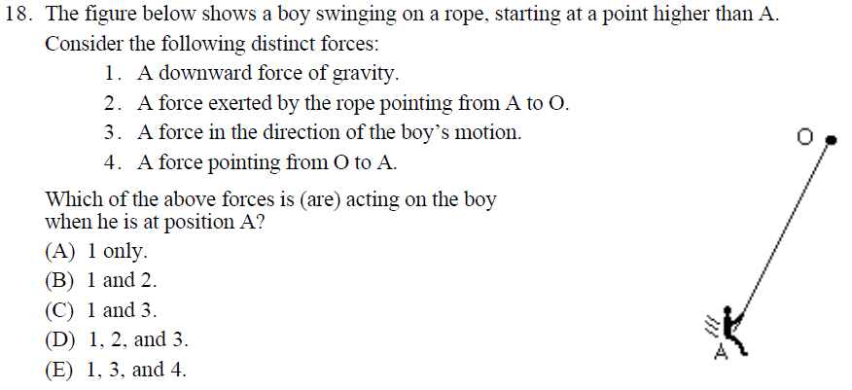
Concerns about the use of multiple-choice questions
Students can guess the answer.
Students can work backwards from the distractors to work out which is correct.
The distractors suggest options a student may not have thought of.
The answer a student might want to give may not be one of those provided.^{3,4}
So, do multiple-choice
concept inventories tell
us the truth about our
students’ conceptual
understanding?⁵

Slide 4
The gender gap
Women perform less well than men on the FCI (with a particularly large gap on some questions) even when women’s outcomes on their physics qualification as a whole are better than men’s.^{6,7}
Might this be because, in general, men are more likely than women to prefer multiple-choice questions over ones in which they give free text answers, and are found to do better on them?⁸

Slide 5
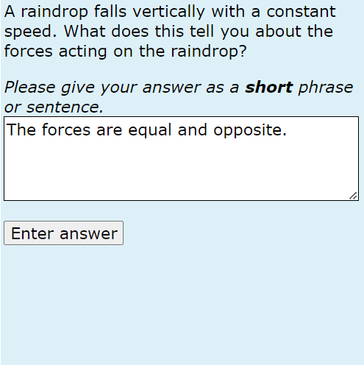
There is an alternative: automatically marked short-answer free-response questions
We developed a question type called OpenMark PMatch that can automatically mark and give feedback on free-text responses of up to about 20 words in length. The Moodle Pattern-match question type uses the same approach.
PMatch and Pattern-match can cope with:
Alternative answers
Incorrect spelling
Negation
Particular word order
Based on a training set of 100-300 marked responses for each question, a marking accuracy greater than that of human markers was obtained^{9,10}
Figure: A PMatch question (Copyright: The Open University)

Slide 6
A free-text Force Concept Inventory
Mark Parker’s PhD project investigated the viability of creating a version of the FCI comprising a combination of multiple-choice and free-response questions.
FCI Question 4 (shown in Figure A) became the question shown in Figure B.
Marking accuracy and user perception was found to be acceptable^{11,12}.
Figure A: Force Concept Inventory Question 4 (source: https://www.talkphysics.org/wp-content/uploads/2015/07/fci-rv95_1.pdf)
Figure B: A free-response version of the question shown in Figure A

Slide 7
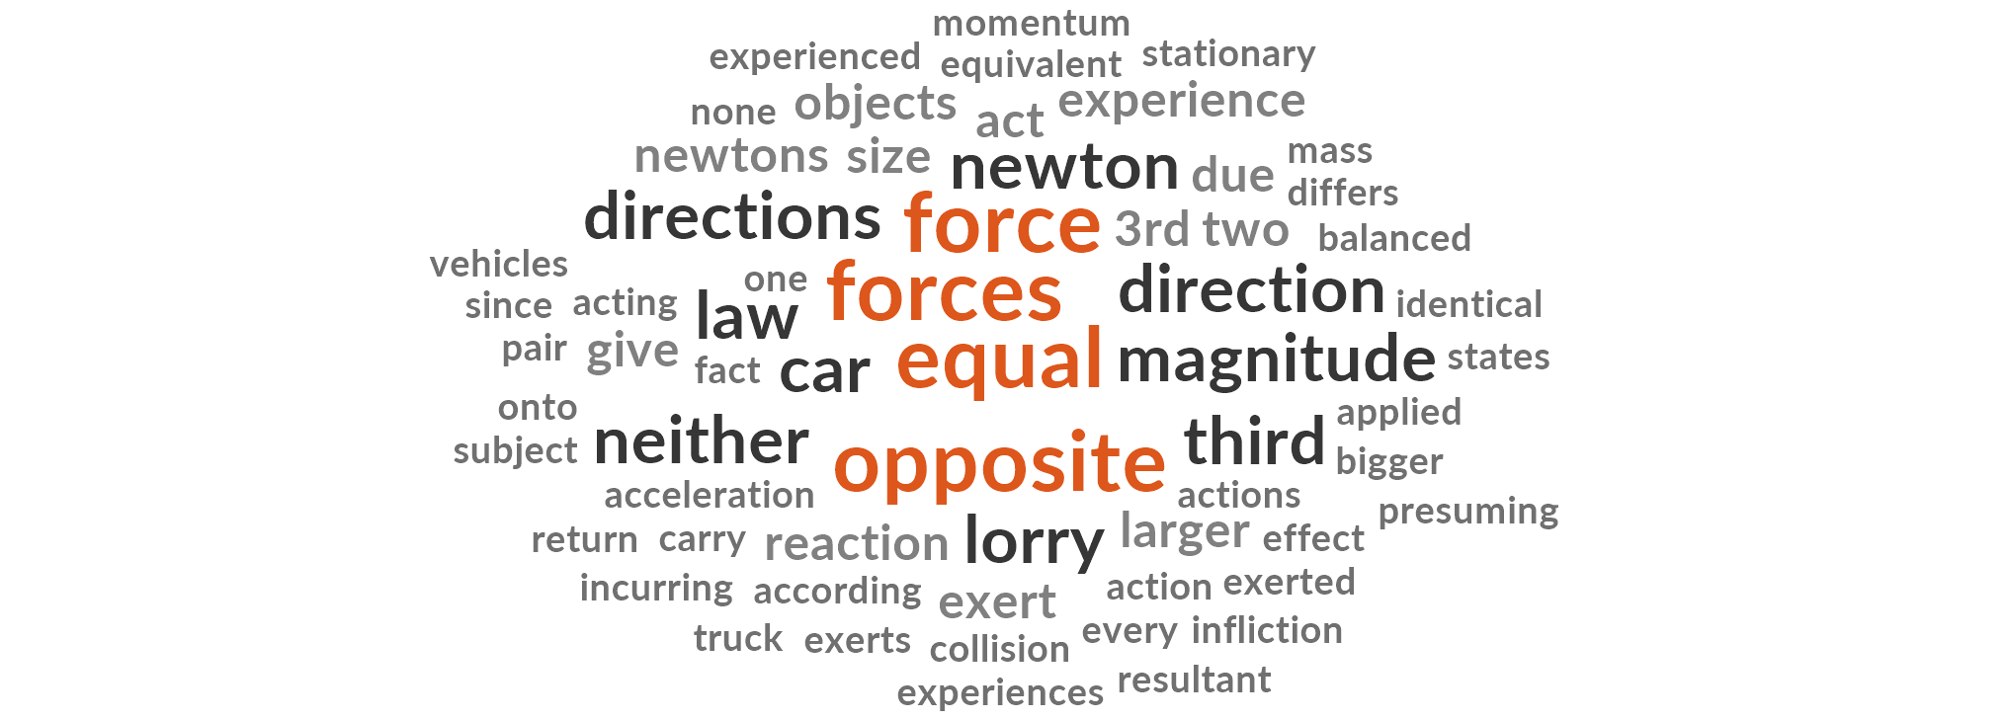
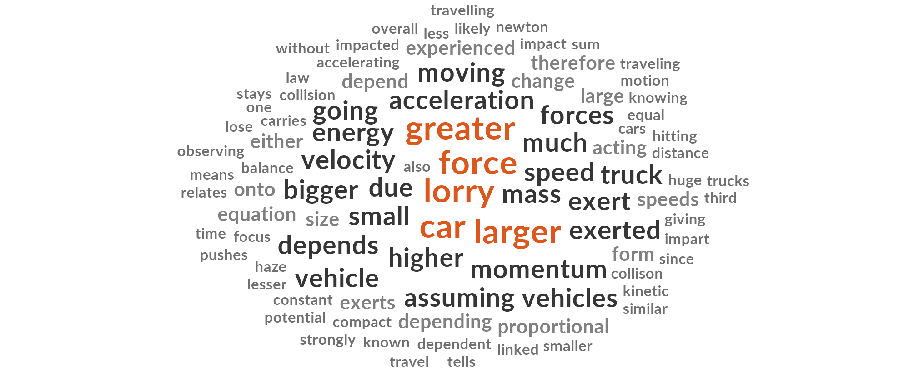
Free-response FCI sub-questions to further evaluate conceptual understanding
In a second PhD project, Ashutosh Kumar Pathak is further analysing the student responses gathered in Mark’s project.
Ashutosh is also developing free-response sub-questions to evaluate the reasons students choose the options that they do in the original multiple choice version of the FCI.
Finally, Ashutosh will investigate gendered differences in responses.
If you would like to join in our evaluation, please contact sally.jordan@open.ac.uk .
Figure C: Word cloud for correct responses to the question shown in Figure B (FCI Q4)
Figure D: Word cloud for incorrect responses to the question shown in Figure B (FCI Q4)

Slide 8
References
D. Sands et al., Using concept inventories to measure understanding, Higher Education Pedagogies, 3, 60 (2018)
D. Hestenes, M. Wells and G. Swackhamer, Force concept inventory, The Physics Teacher, 30 (1992)
S. Jordan, E-assessment : past, present and future, New Directions, 9, 87 (2013)
C. Sangwin (2013) Computer-Aided Assessment of Mathematics. Oxford: Oxford University Press.
N. Rebello and D. Zollman, The effect of distractors on student performance on the Force Concept Inventory, American Journal of Physics, 72, 116 (2004)
S. Bates et al., Gender differences in conceptual understanding of Newtonian mechanics, European Journal of Physics, 34, 421 (2013)
A. Traxler et al., Gender fairness within the Force Concept Inventory, Physical Review Physics Education Research, 14, (2018)
J. Delaney J and P.J. Devereux (2021) Gender and Educational Achievement: Stylized Facts and Causal Evidence. Available at: https://papers.ssrn.com/abstract=3783979
S. Jordan and T. Mitchell, eAssessment for learning?: The potential of short-answer free-text questions with tailored feedback, British Journal of Educational Technology, 40, 371 (2009)
P. Butcher and S. Jordan, A comparison of human and computer marking of short free-text student responses, Computers and Education, 55, 489 (2010)
M. Parker et al., Student Reaction to a Modified Force Concept Inventory: The Impact of Free-Response Questions and Feedback. European Journal of Science and Mathematics Education, 10, 310 (2022)
M. Parker et al., Establishing a physics concept inventory using computer marked free-response questions, European Journal of Science and Mathematics Education, 11, 360 (2023)

Slide 9
Thank you!
Thank you to everyone for listening.
We are particularly grateful for the assistance of Dr Ross Galloway (University of Edinburgh), Dr David Sands (formerly of the University of Hull), Dr Tom Mitchell (Intelligent Assessment Technologies Ltd.), Dr Phil Butcher (formerly of the Open University) as well as Dr Christine Leach, Dr Tim Hunt and Professor Nick Braithwaite of the Open University, and all the students who have assisted in this work.
We gratefully acknowledge assistance from colleagues at Isaac Physics and the University of Cambridge, in particular during Mark Parker’s PhD project.
We also gratefully acknowledge the financial contributions from the Open University which have enabled us to provide two funded PhD studentships for work in this area.

