Slide 1
RPC Production status for Engineering Module & Detector stack at IICHEP, Madurai
Shri. S.D.Kalmani
TIFR

Slide 2
Part A
Manufacturing Process at Saint Gobain at Sriperumbudur,Chennai
RPC- “Glass Gap” – 400 number
HV groove etching process
Screen Printing : Surface resistance about 1 to 5 Mega Ohm
Surface resistance measurements (plots)
Gap Making : Semi automated process
Leak Test
QC certification and packing/transporting :IICHEP Madurai
Storage at IICHEP

Slide 3
Part B
Detector stack at IICHEP, Madurai
Number of RPC of (1900 X 1800 )mm :12
Leak Test
Surface resistance measurements (plots)
RPC Assembly
Installation.
Up gradation of electronic
Results

Slide 4
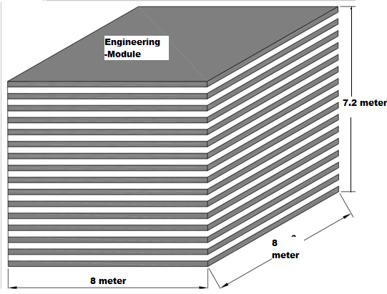
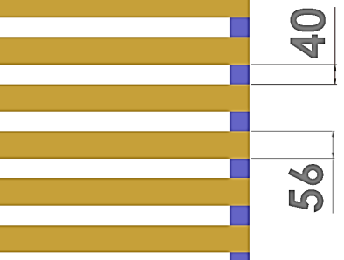
Engineering Module :
Detector size: 8 meters X 8 meters X 70 layers [RPC’s = 4 X 4 X 70L= 1120 and if 20 layers then 320 RPC’s]

Slide 5
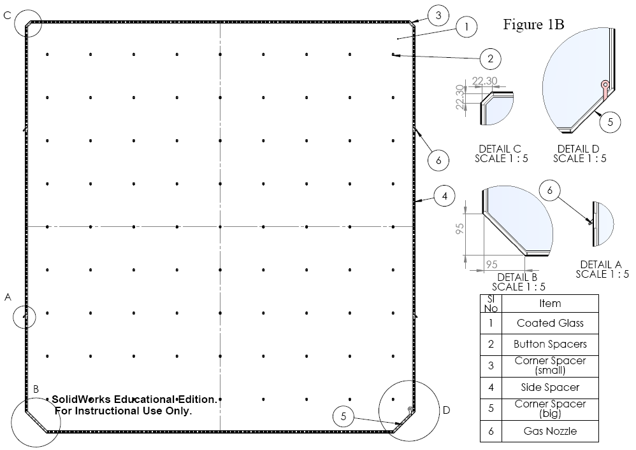
Schematic: Glass Gap
The “coated glass gap” with a gap of 2mm created in between two 3mm thick float glass with four gas nozzles, and these glasses are coated with conductive paint on the outer surface, while the surfaces inside the gap are cleaned and not coated. The 2mm gap is maintained by button spacers placed at distances of 200mm both along X and Y directions and by side spacers of thickness of 2mm, on the four edges. So a gap of 2mm is created inside the chamber and the buttons and side spacer are glued with 3M glue.

Slide 6
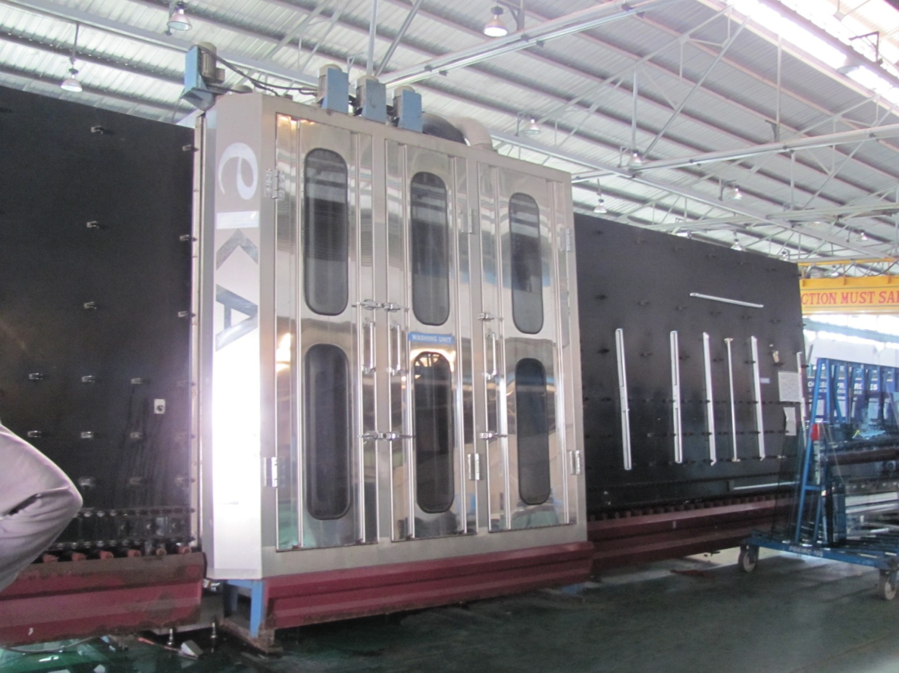
Glass Cleaning and Drying Machine

Slide 7
HV groove: Etching Process
HV groove for High voltage lug fixation is done by chemical etching process.
60% diluted Hydrofluoric acid has been used.
First HV groove Die will be fixed by checking TOP and Bottom glass selection using wax.
Near by surface covered with plastic paper to avoid damage due to HF acid.
Waited for 85 min.
Thrice replacing HF during this process.

Slide 8
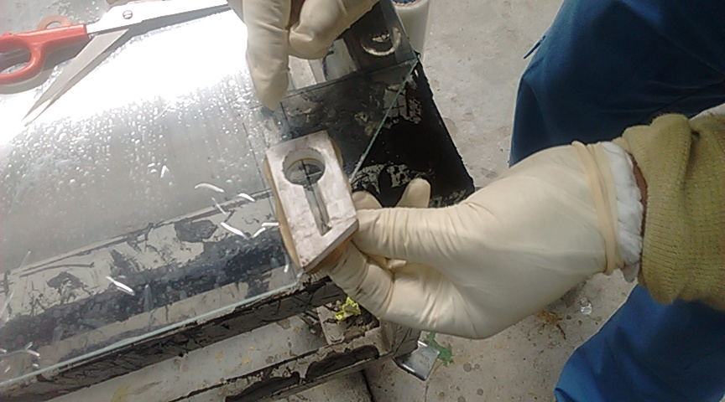
Etching process for HV Groove
DIE
Wax

Slide 9
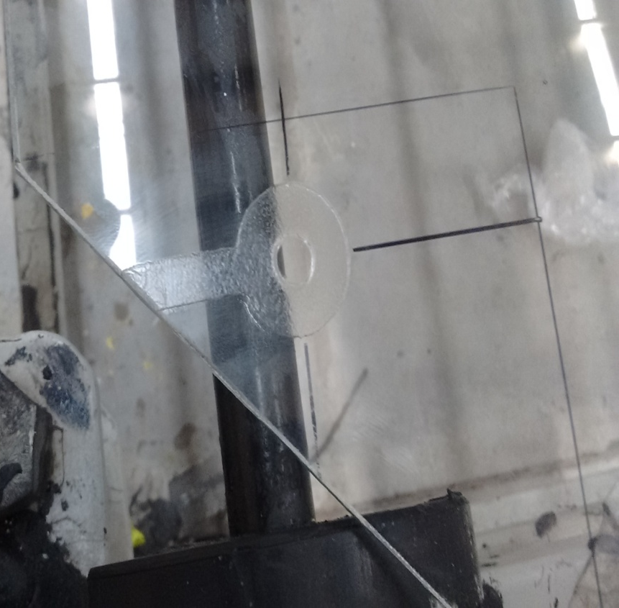
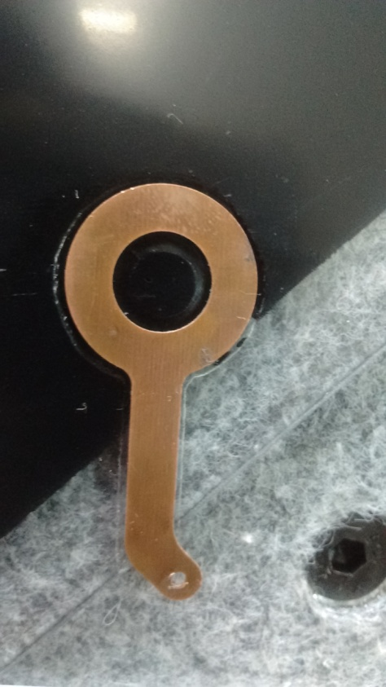
Etched HV groove
HV Lug on the Painted glass
0.4mm Depth

Slide 10
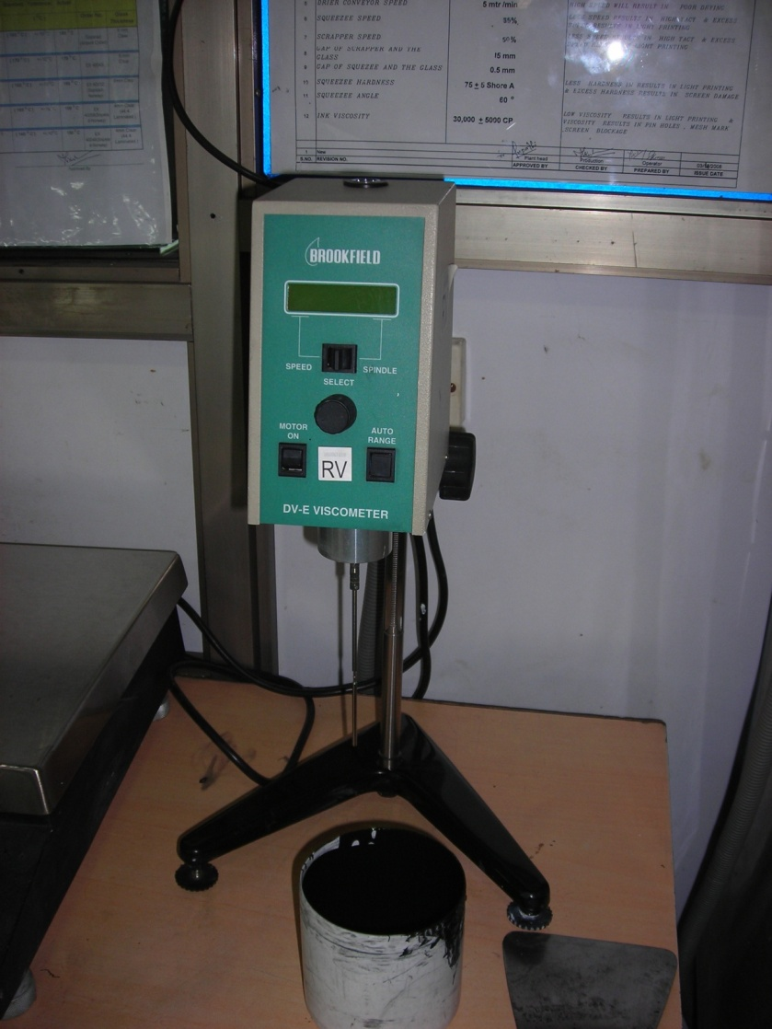
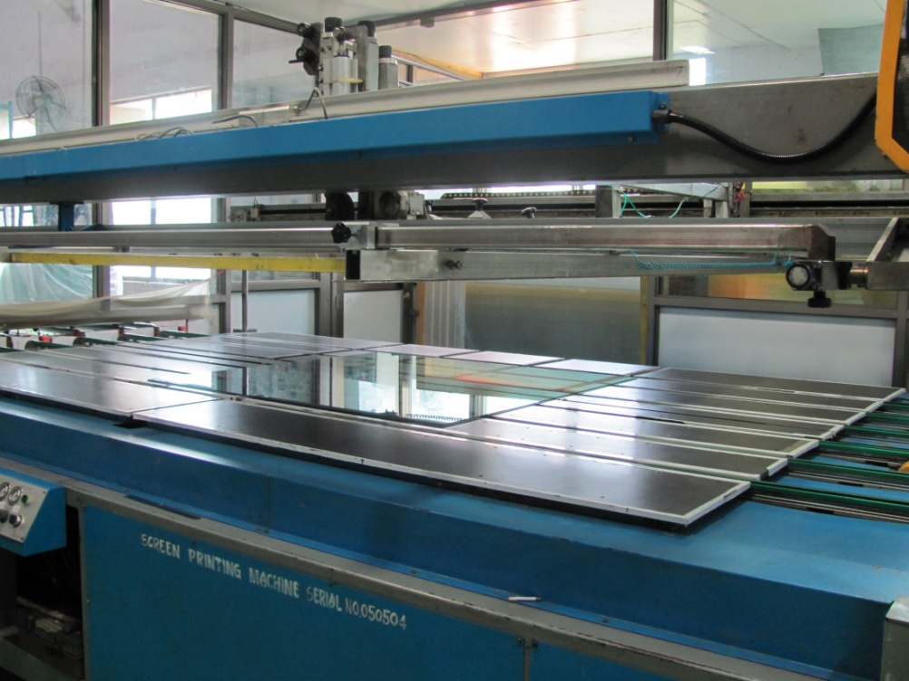
Screen Printing
Stirrer cum Viscosity meter

Slide 11
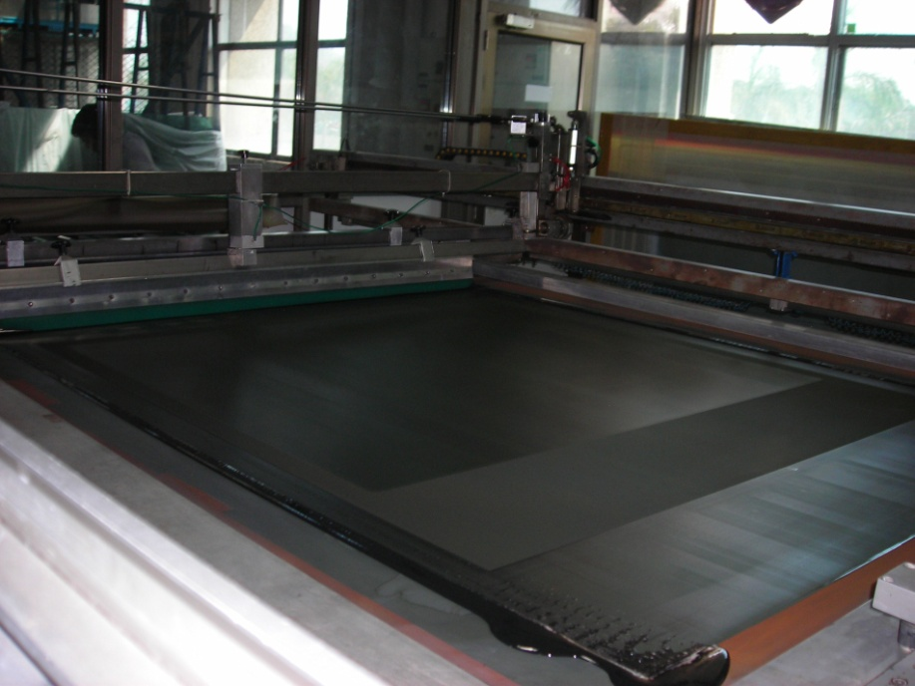
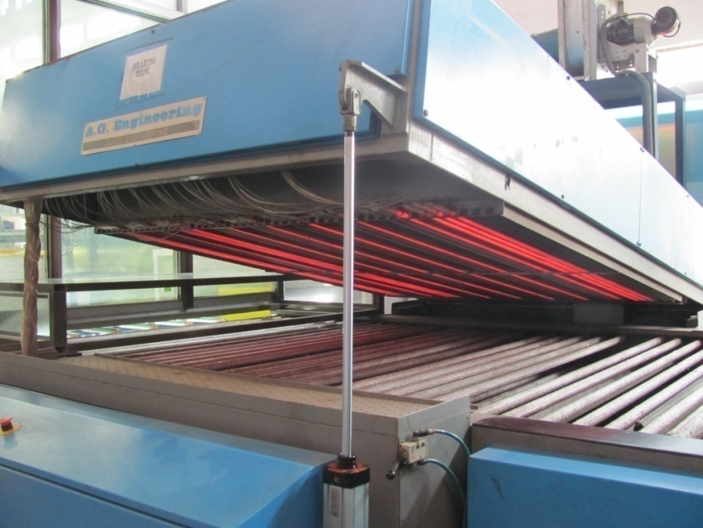
SCREEN PRINTING AND CURING
1. Screen printing has been done using Korean ink DC20 and DC1000 in proportion of 1:5.5.
2. IR drying temperature 110 degrees.
3. Surface resistance in range of 1M to 5 M ohm with 25 cm x 25 cm jig and with grid of 5 x 5 is acceptance criteria.

Slide 12
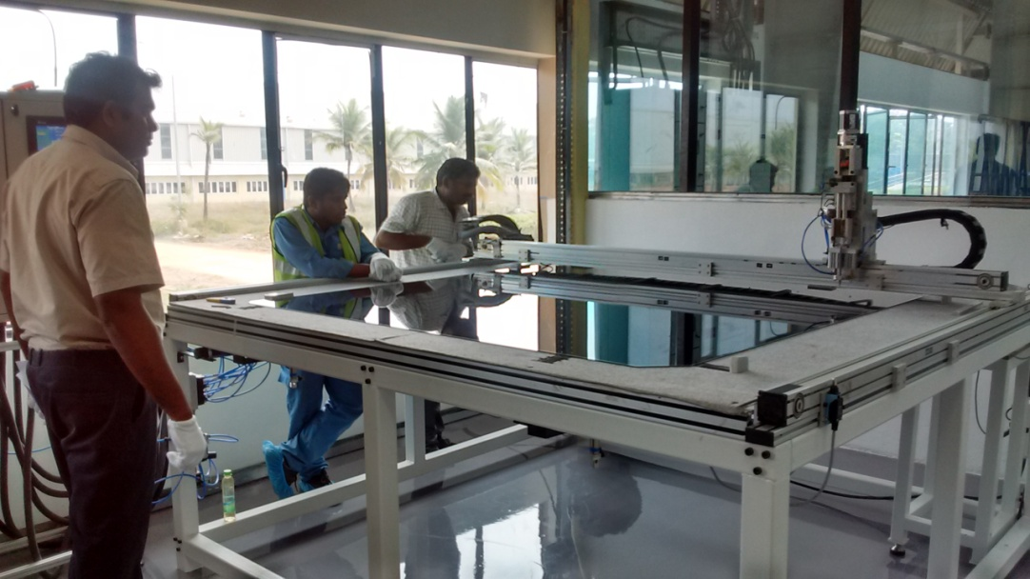
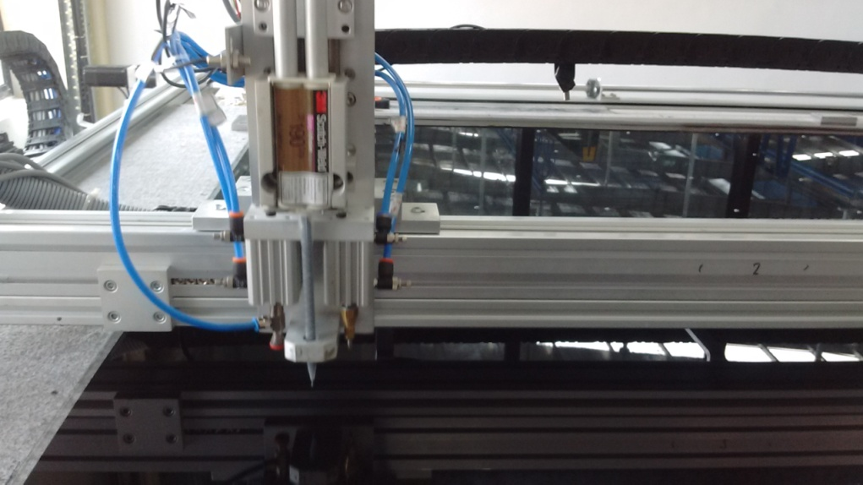
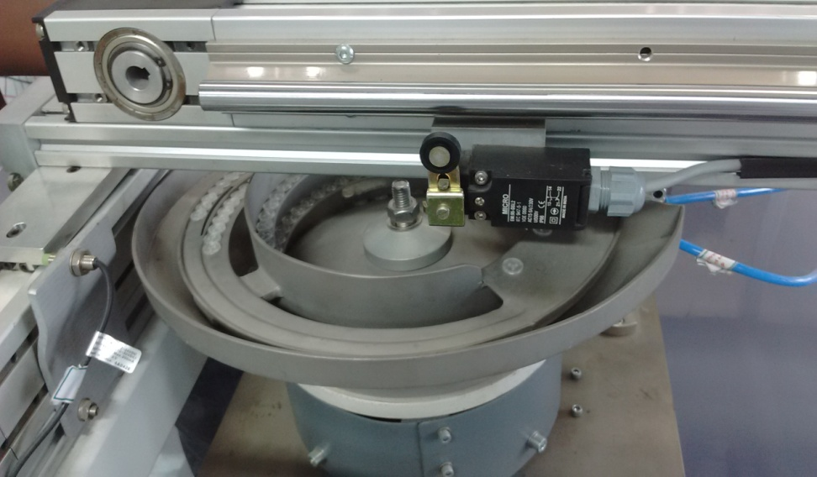
Semi Automated RPC-Glass Gap Assembly machine
Glue dispensing, button placing and side spacer glueing
Button Pickup
Glue Disp.
Button Pusher
Button Selector Pot

Slide 13
Leak Test: Developed by Suryanarayan
Sensor Board: Pressure and Temperature
Raspberry Pi board
Poster

Slide 14
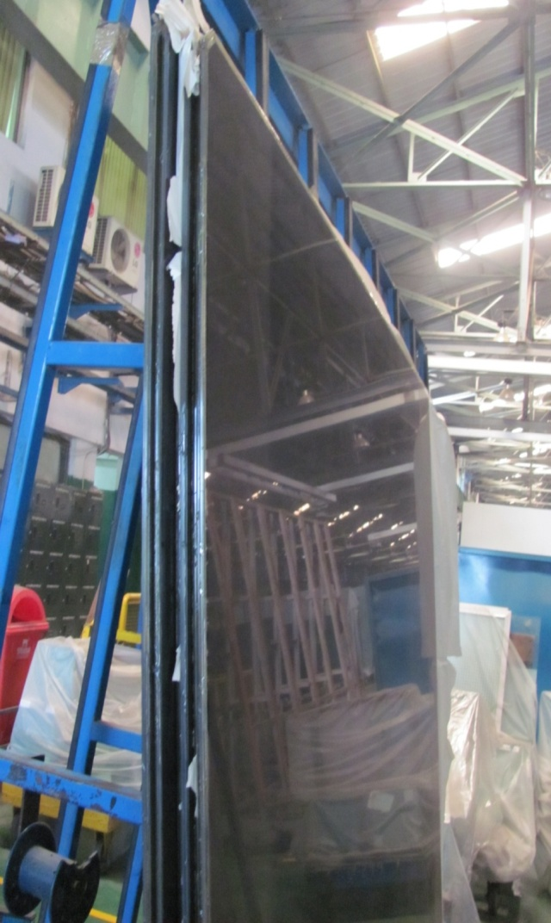
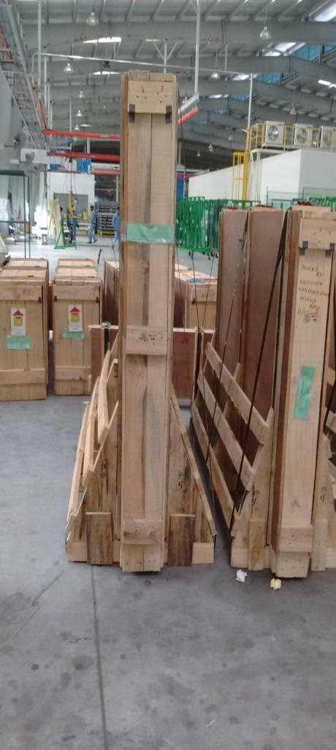
READY GLASS Gap
QC qualified Gap

Slide 15
Preparation for Storage of Glass Gaps :IICHEP Madurai

Slide 16
Detector stack at IICHEP, Madurai
Sample 14 gas gaps made at SG factory, Chennai for Testing and Qualifying at IICHEP Madurai.
Team of staff visited in batches for Installation and testing for about 3months .
M.Sc students actively participated

Slide 17
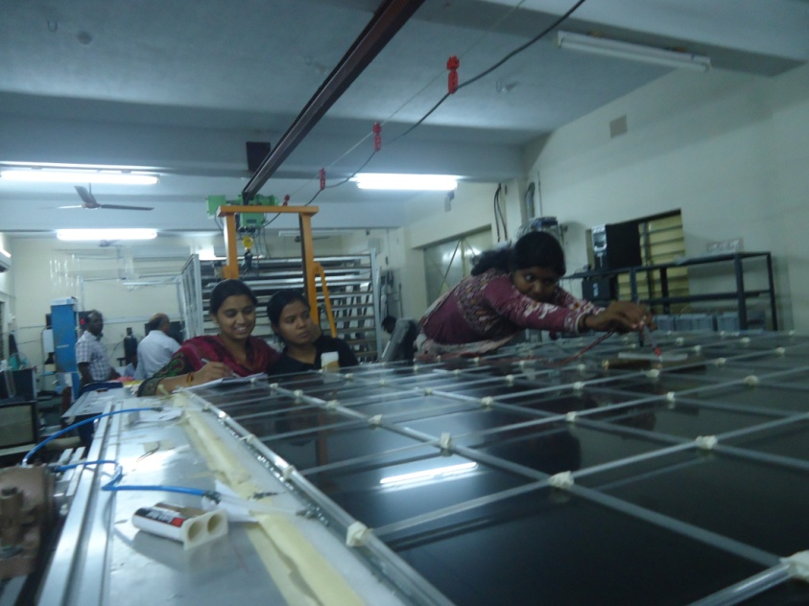
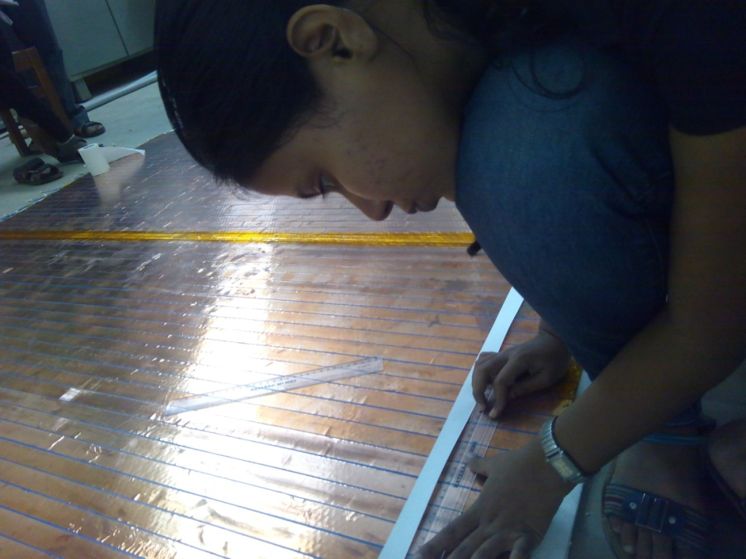
Resistance and Pickup strip measurements

Slide 18
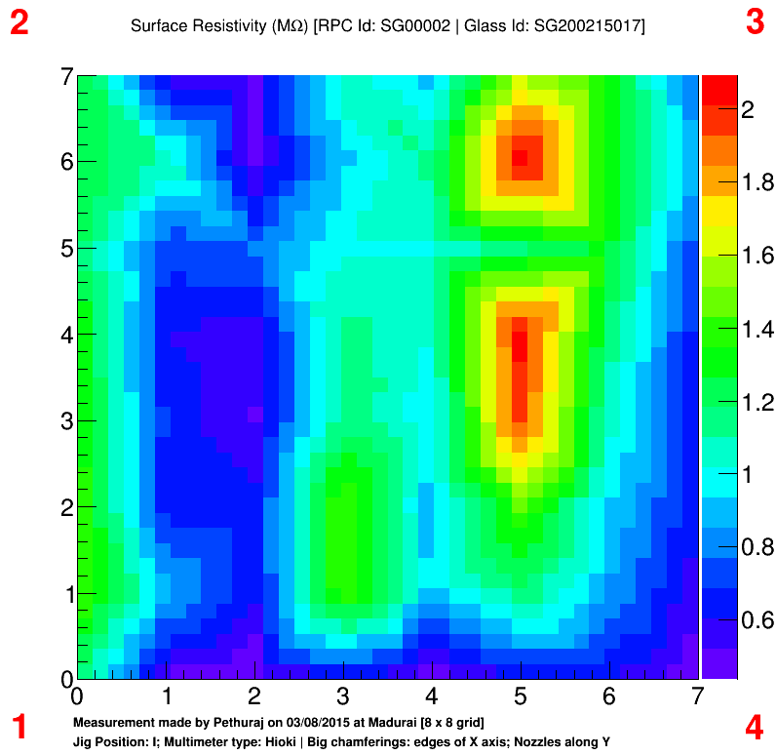

Slide 19
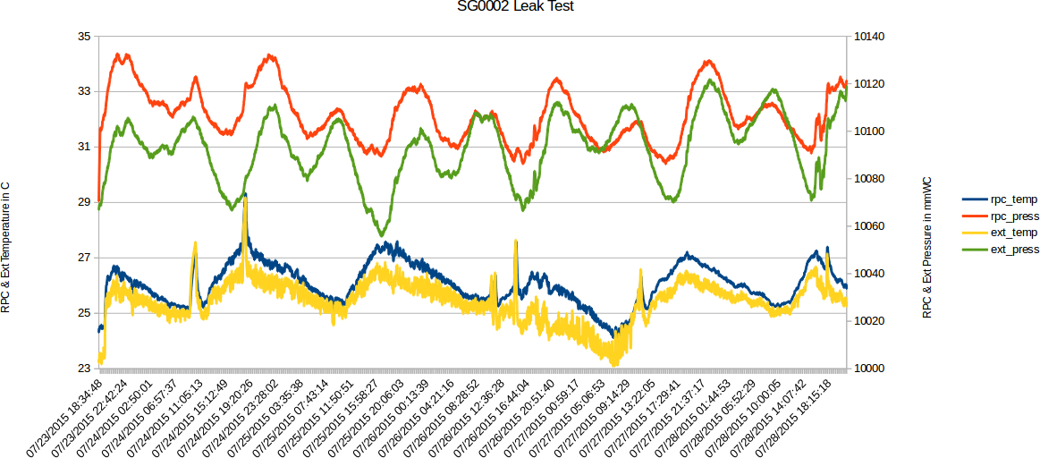
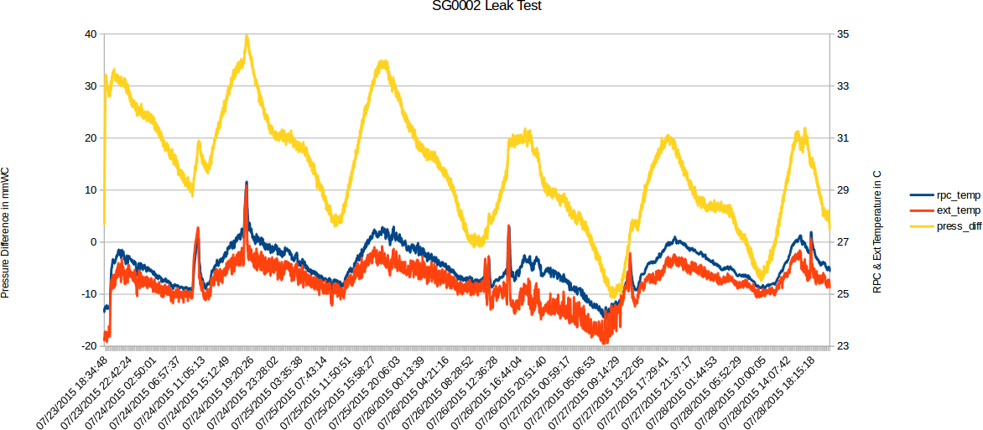

Slide 20
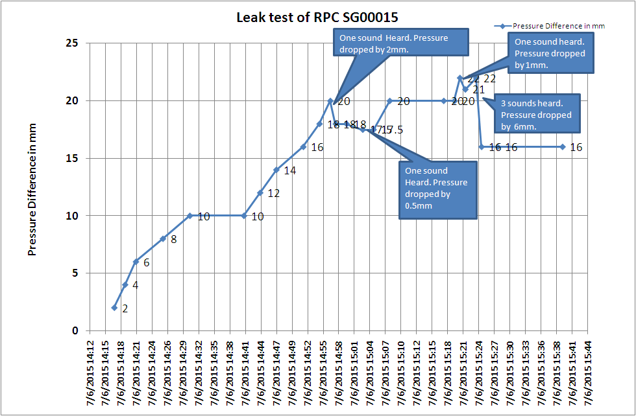

Slide 21
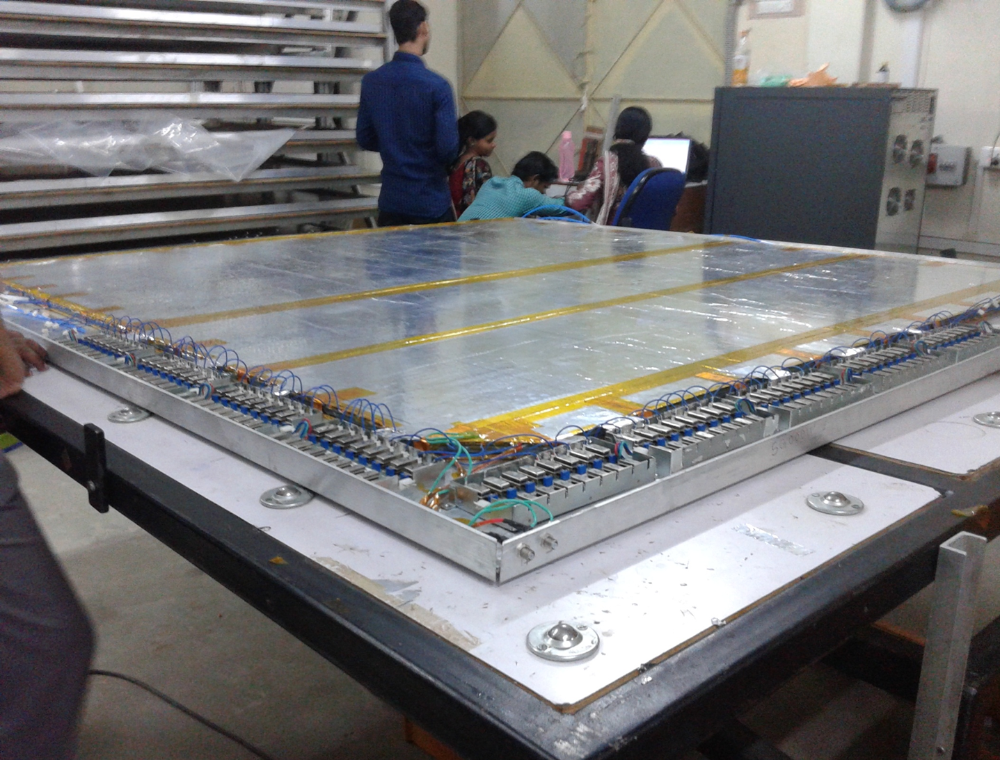
Final RPC Detector

Slide 22
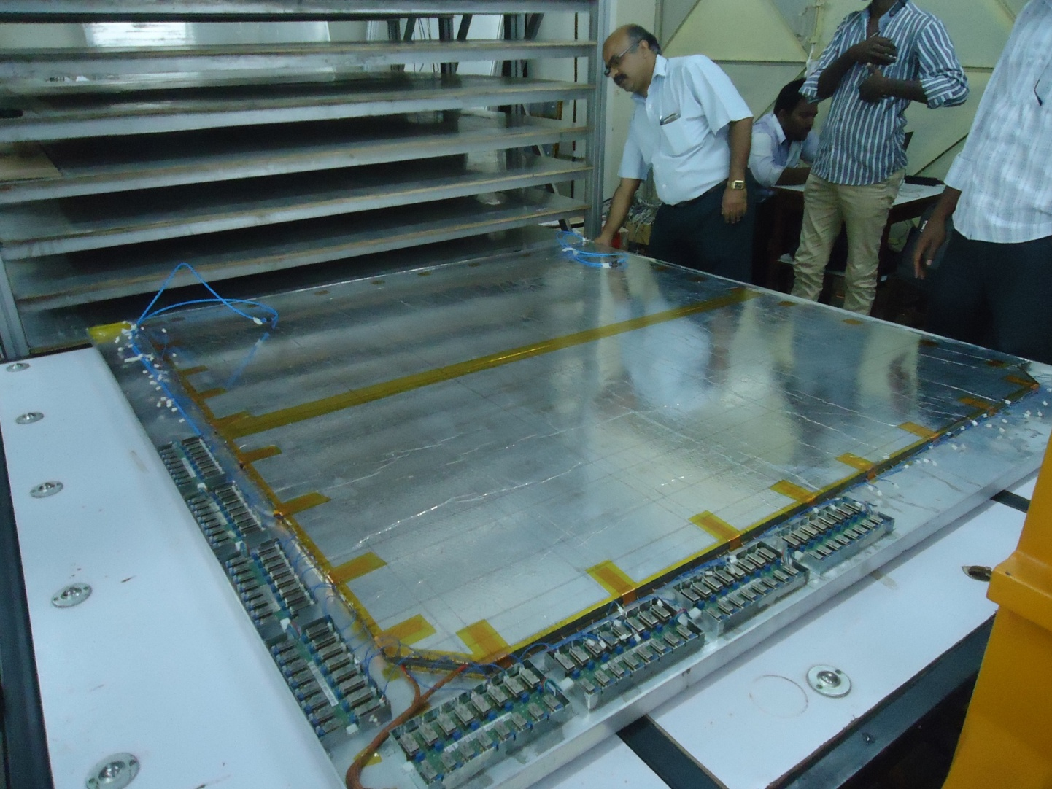
Installation RPC

Slide 23
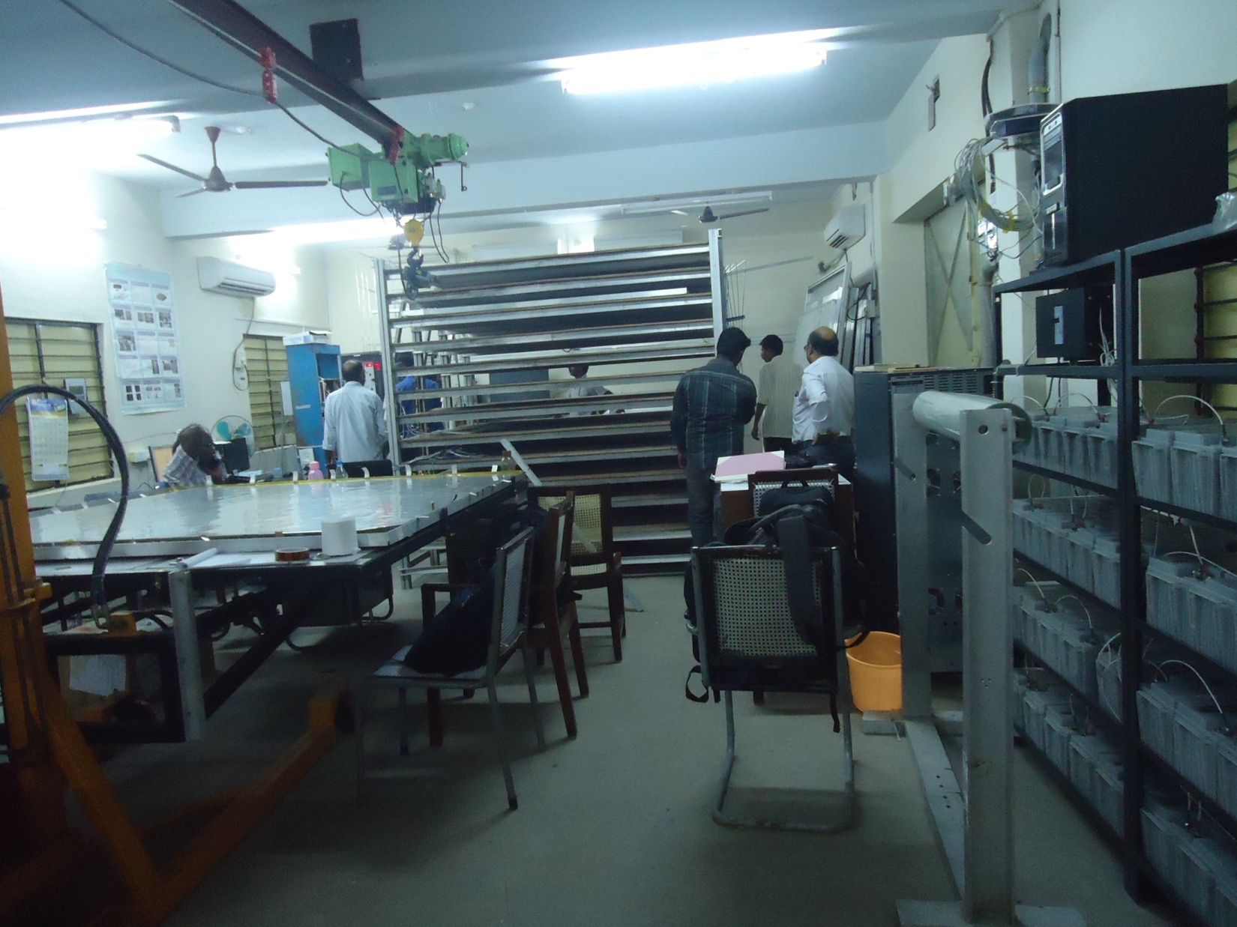

Slide 24
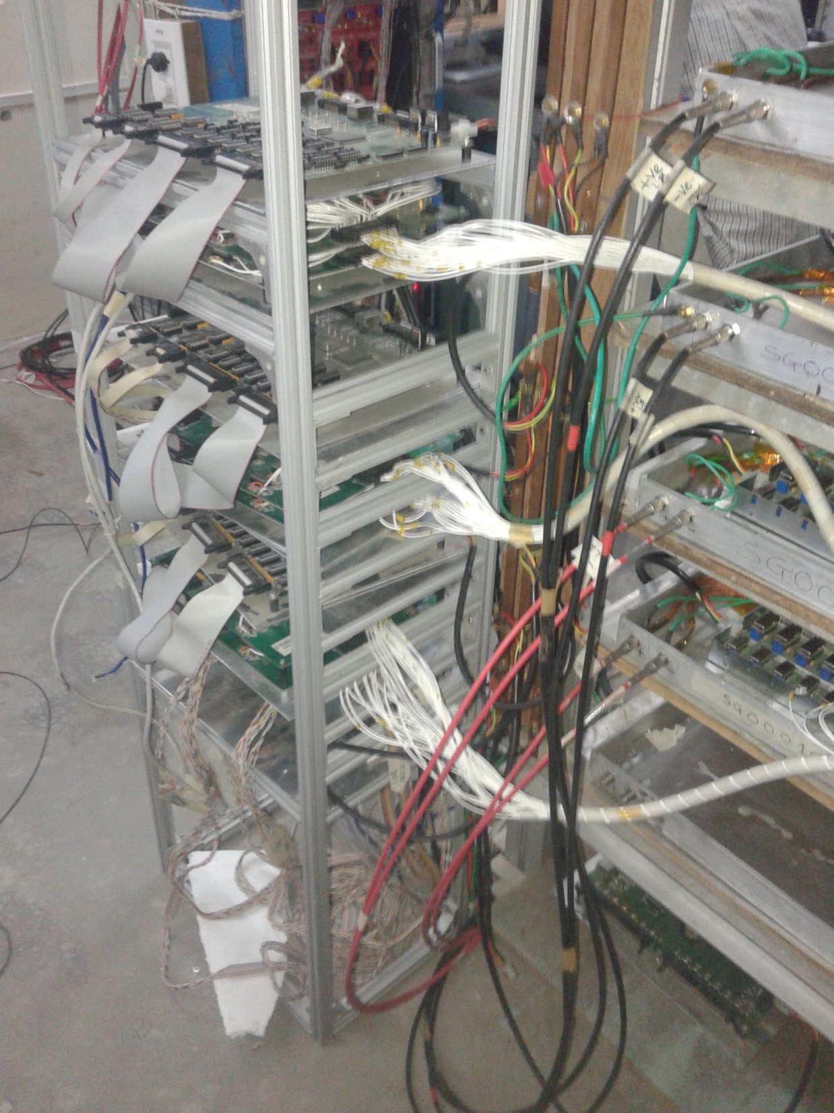

Slide 25
Summary
Getting Industries into the R & D and then into production is almost done.
Presently 30 Glass gaps per month are being fabricated
Two INO member are station at Saint Gobain for day to day supervision and measurement work.
Noise free 12 layers of RPC detector in operation at IICHEP, Madurai
Up gradation of the existing electronics with newly tested RPC-DAQ will be implemented soon-
Next talk by Dr. B. Satyanarayana.

Slide 26
Hope for early clearance from Tamilnadu Government to built the INO detector
Thank You

Slide 27
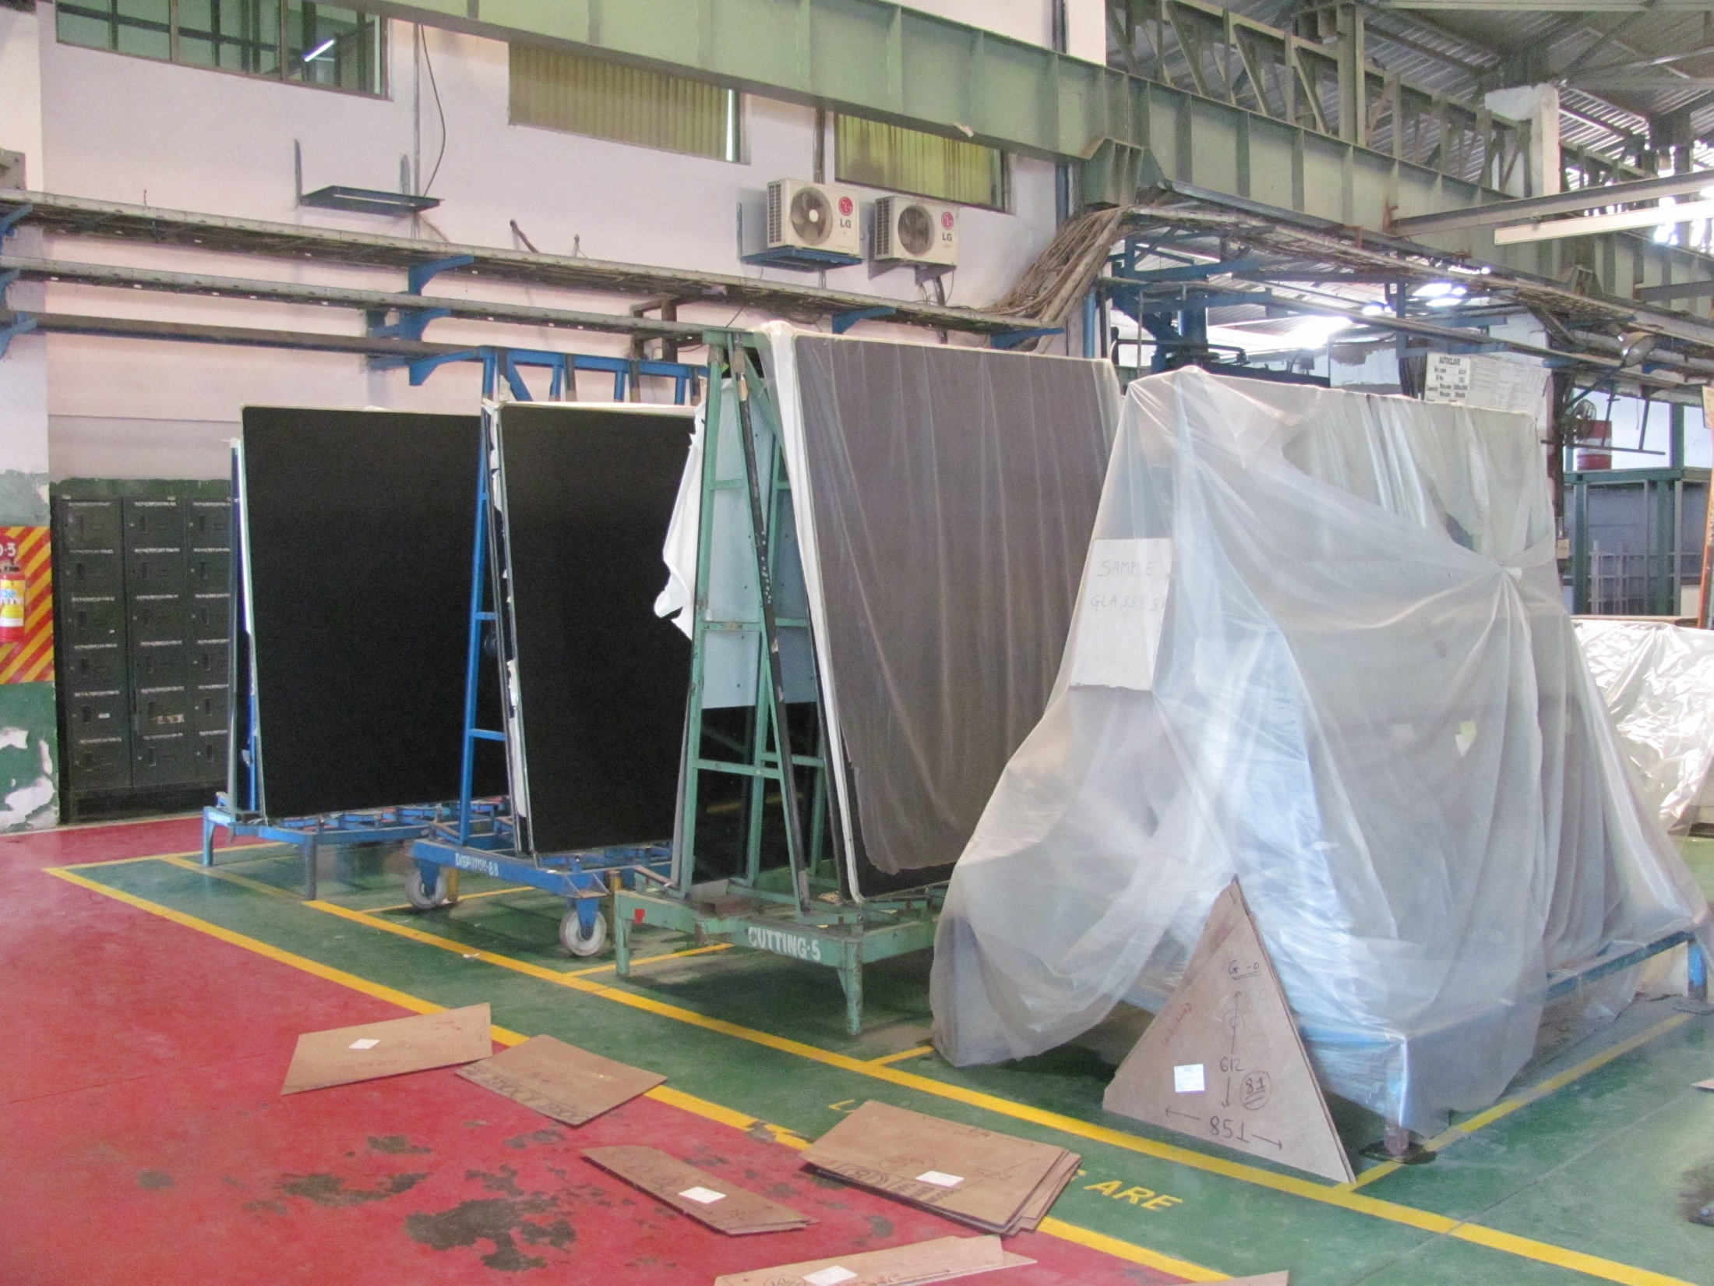

Slide 28
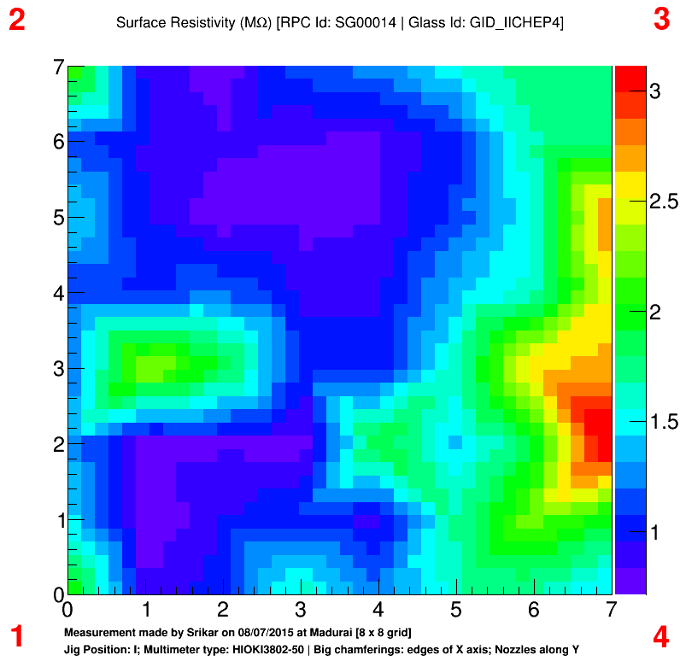

Slide 29
