Slide 1
Social Cognition in Infancy
Sweta Anantharaman
University of Auckland
ASET Colloquium
22 July 2016
Notes:
Good afternoon everyone. My name is Sweta Anantharaman and I would like to start by thanking Dr Satyanarayana for inviting me to present at this symposium.
I'm really excited to be here and talking to you about research in socio-cognitive development – I’ll be introducing you to a couple of techniques in developmental psych and corresponding studies that you use these techniques to understand how much babies understand of their social worlds
Let me tell you a bit about my background and how I got to around to studying cognitive development. I trained as a clinical psychologist at U of Mumbai and worked in a comprehensive epilepsy surgery programme at KEM Hospital for a few years before going to the UK for further training in atypical development. Whilst there, I got an opportunity to volunteer at the Babylab at university. I really enjoyed my time working with energetic lil ones and I discovered my fascination for I love experimental methodologies - the challenge of designing a new methodology or tweaking an existing one to examine social and cognitive phenomena. Another thing that happened were Conversations and thoughts that had been brewing for a long time while studying atypicality for so many years - it's pretty darn remarkable that most of us are able to get on with our lives without much fuss and 'normally'. Get out of bed and get to work handle colleagues, friends, relationships in our lives and getting through the day without killing anyone

Slide 2
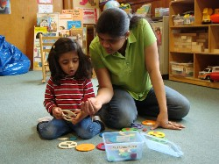
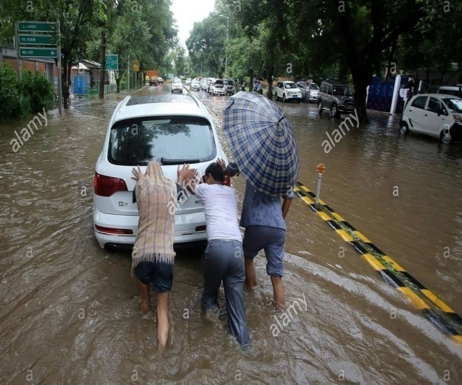
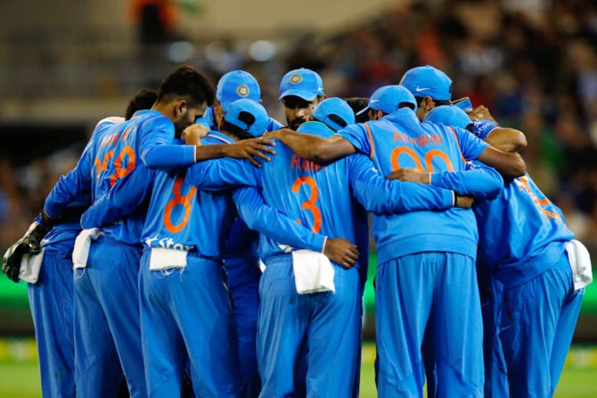
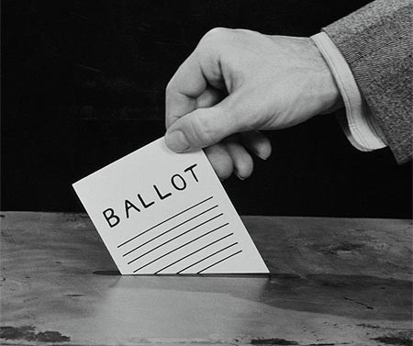
Notes:
*
This made me think hard about what makes us normal, and the fact that I had been focusing on atypicality for so long made me overlook how typical systems emerge in the first place. So I started by asking some of my friends about what they thought was normal and typical, and doing a simple google scholar search on 'normal and typical', and some recurring themes that kept popping up - routine, day-to-day, conventional, shared ideas, behaviours, being social.
And when I reflected about what these entail, is that we have to depend on others and cooperate, a lot! (family, friends, colleagues, strangers even) to achieve some degree of normal in our lives.

Slide 3
How would you study these questions?
What information do people use to identify the goal of a person’s actions?
What do people understand about cooperative vs non-cooperative actions?
Do people prefer to work with others or act alone?
Are individuals’ guided by the wisdom of the group?
Notes:
I was convinced that it'd be worthwhile to pursue the idea of how we learn to navigate through our worlds.

Slide 4
Prosocial Kids
https://www.youtube.com/watch?v=Z-eU5xZW7cU
Warneken and Tomasello, 2006
Notes:
SO here, I',m going to play a few videos at just how social they are. (Warneken videos). Prosocial behaviours - so in these clips. we get a sense of how willing these 2 year old kids are at being prosocial. What is being prosocial? Prosociality encompasses a variety of things - helpful, altruistic (helping someone for no personal gain, cooperative, sharing things, everything you'd want from a model citizen). But, are we born with an immediate understanding of these things - we don't even know whether babies understand our actions and to what purpose they serve. So before children get around to doing these cool things we just saw, we first have to ask the question of whether babies understand simple cooperative actions and goals.

Slide 5
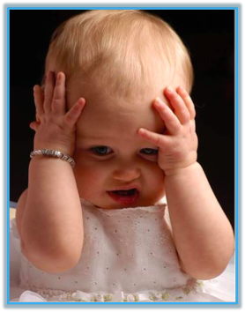
A ‘blooming buzzing confusion’?
Notes:
Can we get babies to do the experiments we just saw? Obviously, no! Infants present a problem to such methods. Infants do not talk, they cannot tell us what they know in words. Infants’ behaviours are not a reliable index of their underlying knowledge because they tend to be guided by superficial factors like perceptual salience. Furthermore, infants cannot even move in goal directed manners before a certain age. Indeed, William James, a pioneering psychologist from the 1800s said that the infants’ world was simply a ‘blooming, buzzing confusion’. According to James, infants were incapable of making sense of the world around them. From their immature perspective, the world was just a blur of colour, sounds and movements.
However, they were missing out one avenue

Slide 6
It’s in the eyes!
We can now examine and
ask some really interesting
questions by using infants’
visual attention (and other
implicit measures).

Slide 7
Infants understand heaps about the actions they witness in their daily lives …
By the end of their first year infants:
imitate simple goal-directed actions (e.g., Hamlin, Hallinan, & Woodward, 2008; Meltzoff, 1988)
attribute goals and preferences to human agents (e.g.,Luo & Johnson, 2009; Sommerville & Woodward, 2000; Woodward, 1998)
but not mechanical claws (e.g., Woodward, 1998)
anticipate an individual’s action action goals (e.g., Cannon & Woodward, 2012; Falck-Ytter, Gredebäck, von Hofsten, 2006)
Infants use various cues to identify action goals (e.g., Biro & Leslie, 2007; Csibra, 2008; for a review see Woodward, Sommerville, Gerson, Henderson & Buresh, 2009)
Notes:
So I’ll focus on two methods today and talk about corresponding studies that use these techniques.

Slide 8
Today
Visual Habituation
Cooperation
Eye Tracking
Group/Majority Influence

Slide 9
Visual Habituation
Relies on the fact that infants look at things that they find novel or interesting for some reason
Generally habituation paradigms look something like this:
Infants are shown a simple event repeatedly until their attention falls below a criterion

Slide 10
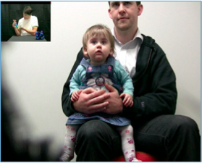
More on our visual habituation studies...
Infants sit on parent’s lap
Watch video clips
Infant controlled
Online coder coding when infant looks away
Trial ends when infant looks away > 2 sec
This part takes ~20 minutes

Slide 11
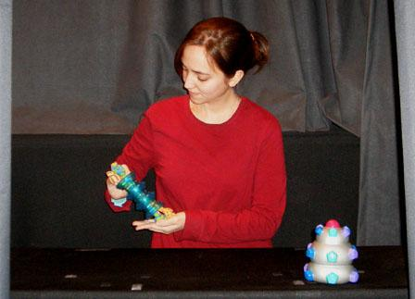
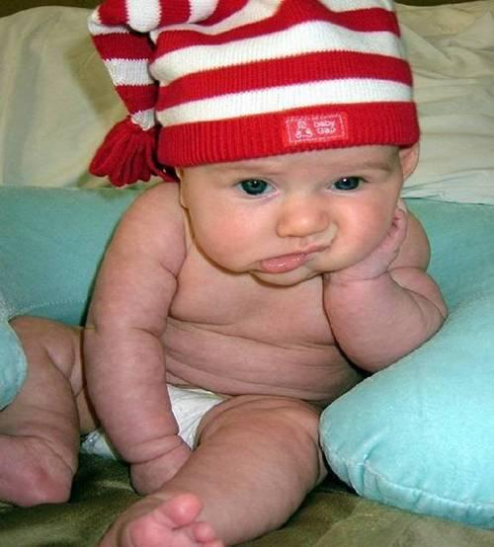
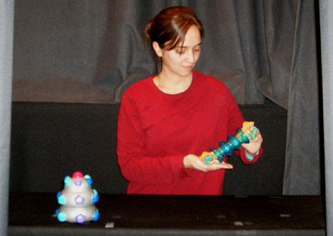
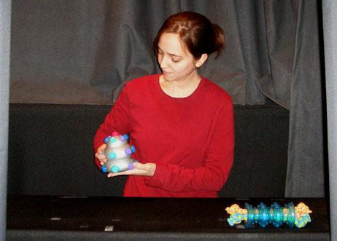
Preference using Visual Habituation
Step One:
Habituation
Step Two:
Test Events
B)
A)
Analyses: Differences in the duration of time that infants look toward either test event and/or changes in infants’ attention from last habituation trial to the first test trial of each type
Notes:
Sides are changed just to make sure that infants’ looking is not confounded by a side preference – i.e. the actor always reaches for things on the left

Slide 12
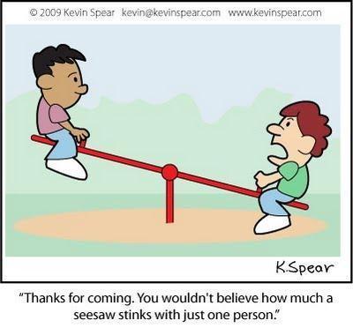
When does an understanding of cooperation emerge?
Notes:
1. Cooperation: Omnipresent and very important in functioning in our social worlds
And so, I'll focus on what we do in the lab at New Zealand - I'll be talking about 2 aspects today. One is of course how much babies understand and two, the different ways we measure their understanding. So, I'll first start with babies' third party understanding of cooperation.
Definition of Cooperation:
2 or more individuals coordinate their actions towards the attainment of a common goal
Complementary and critical to goal attainment
Driven by shared intention to attain a common goal

Slide 13
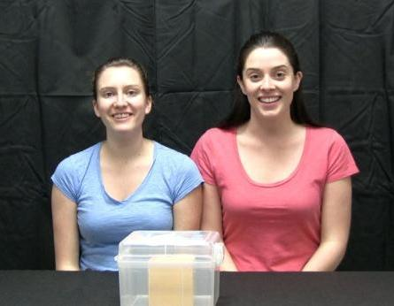
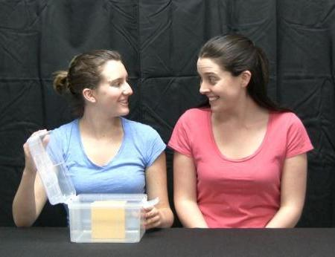
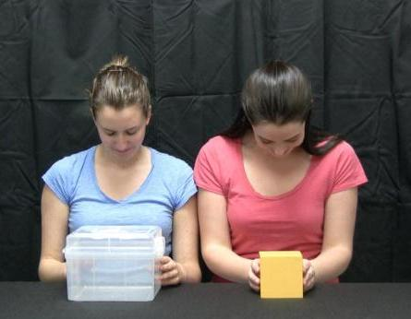
Cooperation visual habituation paradigm
Shared-goal interpretation:
“The actors were working together to get the toy”
Individual-goal interpretation:
“Blue shirt girl got the box and pink shirt girl got toy”
Do infants form a shared-goal interpretation?
Notes:
To address infants’ understanding of collaboration, Henderson & Woodward development a novel collaboration visual habituation paradigm.
This paradigm is able to explore infants’ understanding of cooperative action without them actually engaging in the task. Thus, we can tease apart infants’ understanding of the shared nature of a cooperative activity from their own engagement in such activity. And it enables us to look at younger infants possibly because this methodology does not rely on a behavioral response in the same way that previous work has.
14-month-old infants were habituated to an event involving two actors completing a cooperative action sequence, specifically one actor opened a box containing a toy block and the second actor removed the toy block from inside the box.
Again, here we have the simple cooperative problem solving event.
There are two ways in which this simple action sequence can be interpreted.
One way it can be structured is in terms of a shared goal - Alli and Jess were working together to get the duck.
On the other hand it could also be seen in terms of two individual goals - Alli got the container and Jess got the duck.
As adults we are likely to see action sequences such as this as collaborations and thus, view the actions of the individuals as being directed towards the attainment of a common goal.
What did 14 month olds think about this event?

Slide 14
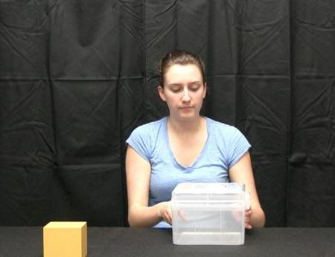
Test Trials
Box
Toy
The test trials to which infants look reliably longer towards provides us with information about how they interpreted the habituation event…
individual-goal interpretation
shared-goal interpretation
Henderson & Woodward, 2011 and Henderson, Wang, Matz, & Woodward, 2013
Notes:
After habituating to the above event, infants were shown a series of test events in which the box-opener Alli (girl in blue) grasped either the box or the toy.
14-month-old infants perceived the event like adults would and viewed Alli’s actions as being directed at the attainment of a shared goal. The test event that they found novel is the one in which she grabs the container. It’s novel that she wants the container because in the habituation event she was simply using the container as a means to get to the duck. This is a very counter intuitive prediction given Alli’s actions during habituation. Alli always interacted with the container and never the block so, there are a lot of cues that would make it hard for infants to make this interpretation.
There were other control conditions that further strengthened the finding.

Slide 15
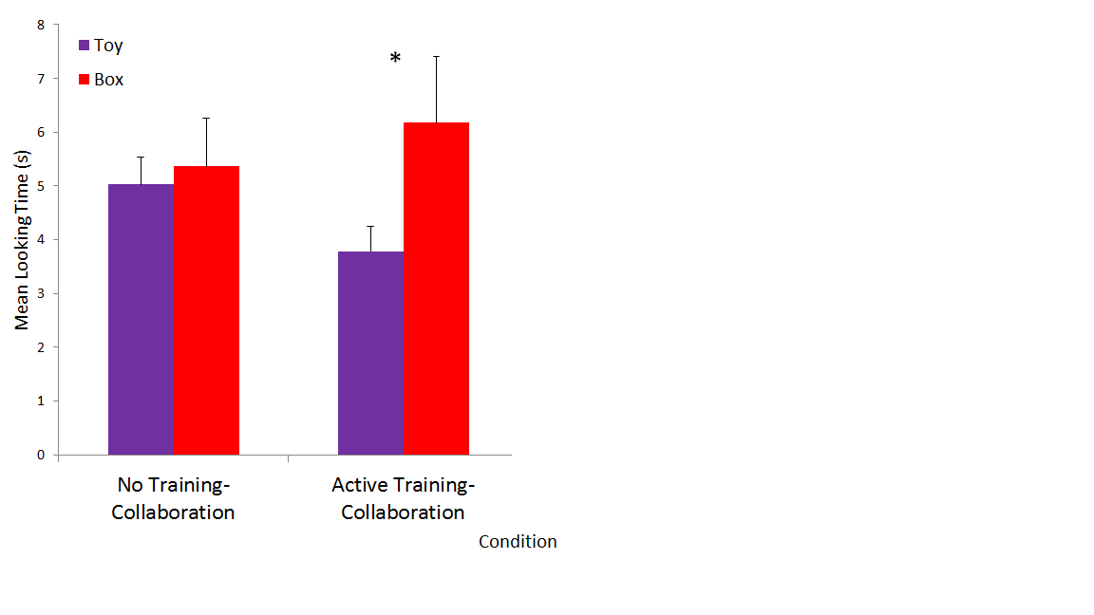
Do infants identify the cooperative goal of the habituation event?
p = .03
Infants as young as 10 months old understand the shared goal in a cooperative context
Henderson & Woodward, 2011 and Henderson, Wang, Matz, & Woodward, 2013
Notes:
These results suggest 10-month-old infants t represent the actions of two individuals who worked cooperatively to retrieve a block from inside a container in terms of a shared goal.
IT’s pretty cool to see babies as young as 10 months have some rudimentary understanding of cooperation. So when they see people interacting, it’s not like they’re seeing empty actions and gestures.

Slide 16
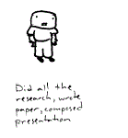
http://snapsomething.blogspot.in/2010/07/group-assignment-rage.html
Notes:
This is a fairly simple cooperative venture. However, the real world has other complexities involved – for example sharing or competing for the same resources. For example, if you were involved in a group project, one of two things may happen 1. all group members contribute equal amounts of time towards the project and all get good grades. OR 2. one person does all the work and the rest slack off and benefit from the good grades they’ll get because they know that one person will do a great job? – Unfair. And I’m sure you can think of many examples in life - it happens all the time. ☺
So, another question our lab looked into was…

Slide 18
Notes:
Now I’d like you to imagine yourselves walking through an open park and say you come across someone who’s just looking up at the sky presumably staring at something, maybe nothing…it is likely you peek a look at what he’s doing…but in general, it is more likely that we don’t and walk along. But, when you have a whole bunch of them doing the same thing, what do you think will happen now? In fact, we would be sure ‘steal’ a look and see what’s going on
This analogy is to get us thinking about how groups - majority influence us all the time, knowingly or unknowingly. Fashions, learning in ambiguous situations.
So, if we go back in time, group living has evolved as an adaptive mechanism because…

Slide 19
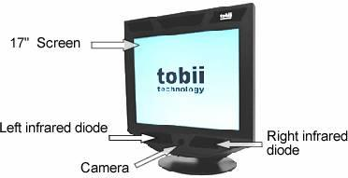
Today
Eye Tracking
Group/Majority Influence

Slide 20
Eye-Tracking Methods in Developmental Science
Allocation of attention and interest
Social interaction characteristics
Anticipation of goals/actions
Language acquisition
Visual perception related to understanding and recall

Slide 21
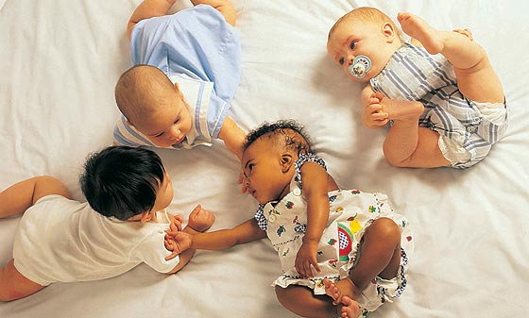
Does a majority guide attention?

Slide 22
Experiment 1 -Visual preference for toys
Eye tracking paradigm
Sample: 32 18-month-old infants (16 males)

Slide 23
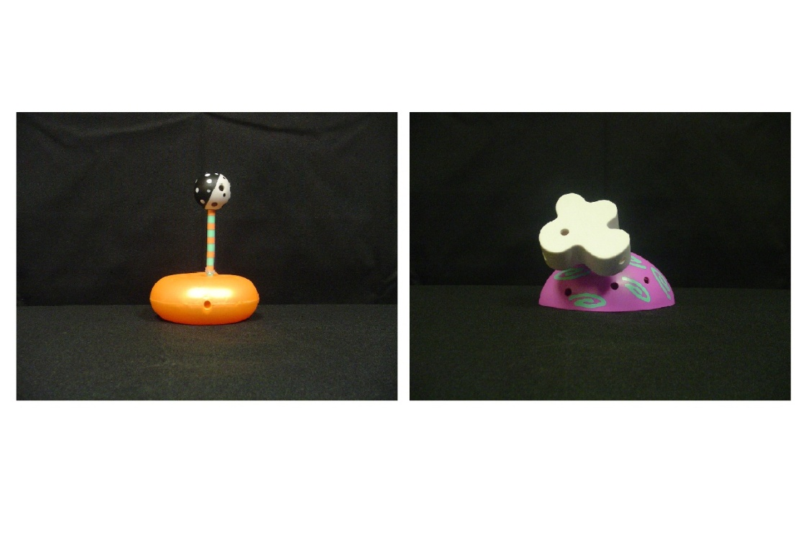
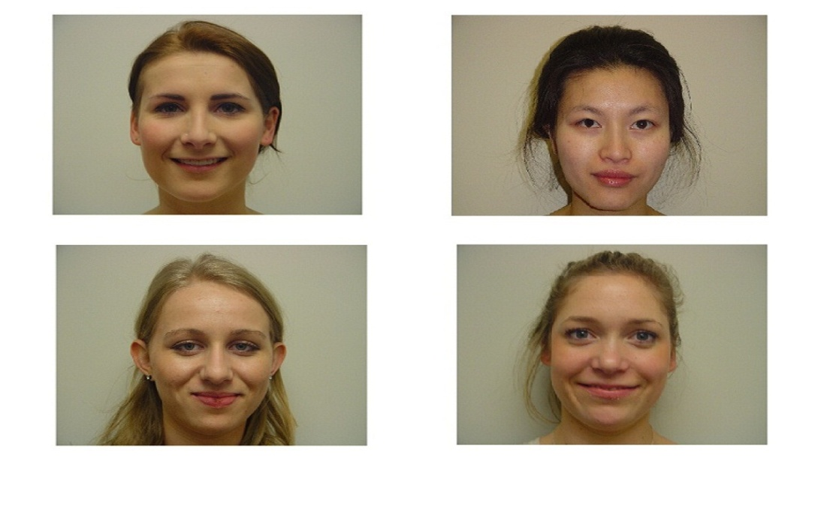
Baseline
A
B
Both stills shown for 12 seconds

Slide 24
Video - example
Notes:
Individual versus implied group- categories based on colour (individual in green and group in red)
For one of the toys, infants are shown three instances in which the same person picks up and demonstrates positive regard for one of the toys (individual-toy). For the other toy, infants are shown three different people showing a preference for the other toy (group-toy).
‘baby’ research friendly solid colours (yellow) for individual and red for group (conditions will be couter-balanced)

Slide 25
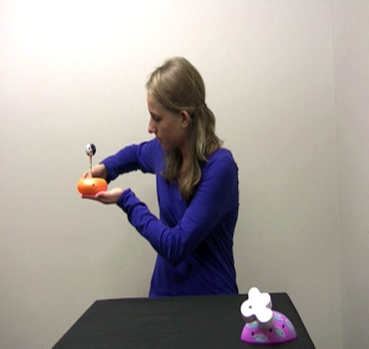
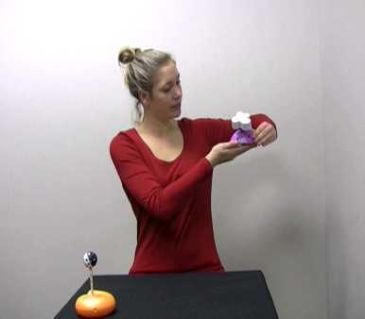
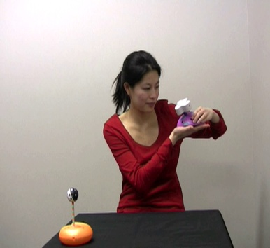
Choice events
Individual Group member 1 Individual Group member 2 Individual Group member 3
Each trial is viewed separately
Not to forget, counterbalanced!
Notes:
Individual versus implied group- categories based on colour (individual in green and group in red)
For one of the toys, infants are shown three instances in which the same person picks up and demonstrates positive regard for one of the toys (individual-toy). For the other toy, infants are shown three different people showing a preference for the other toy (group-toy).
‘baby’ research friendly solid colours (yellow) for individual and red for group (conditions will be couter-balanced)

Slide 26
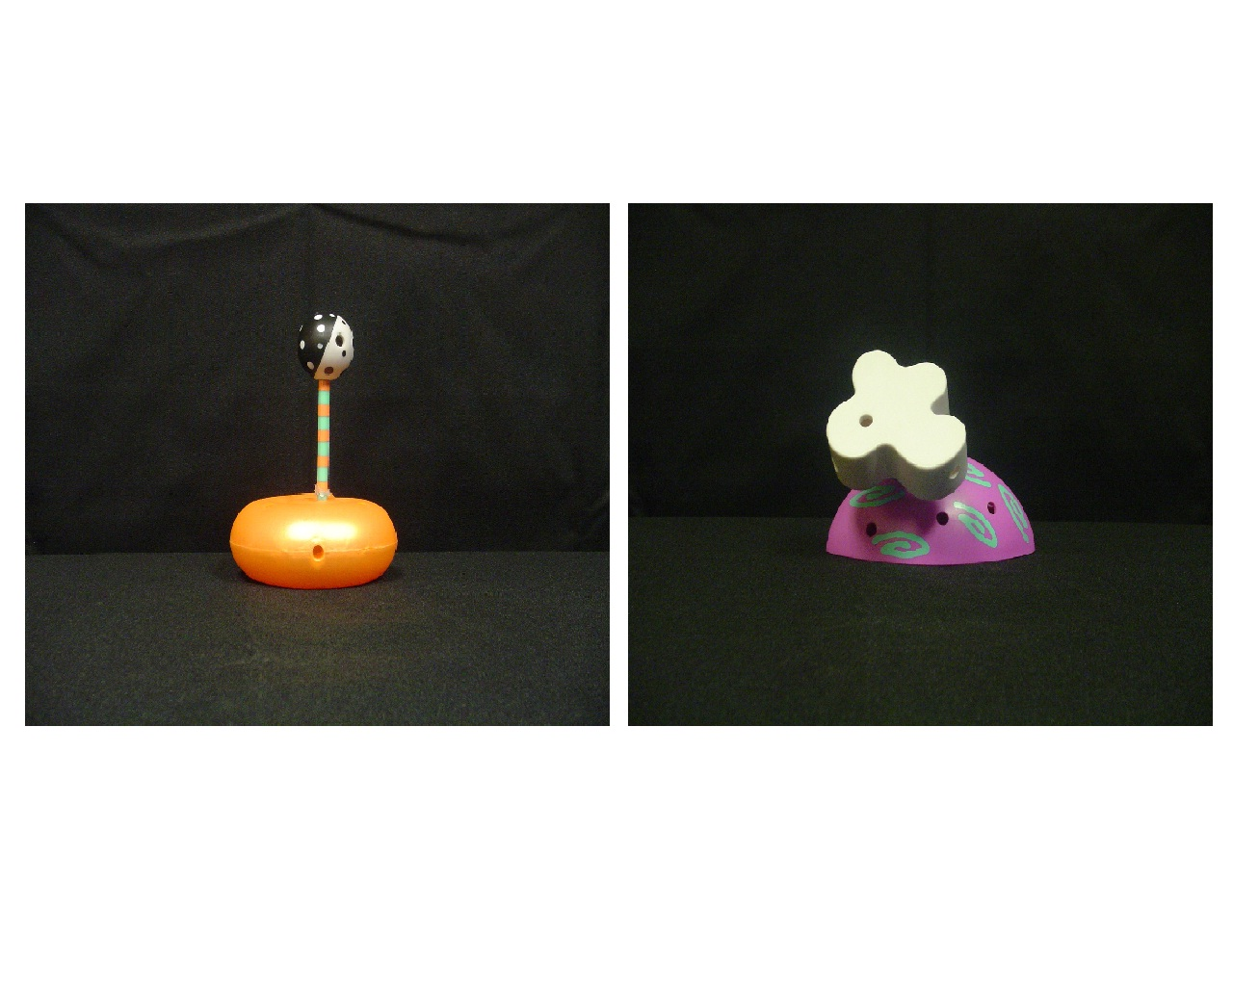
At test…
Notes:
This is different from earlier test events where babies’ expectations of what the actor would do was recorded. Here we were interested to see what the baby would do – which toy they’d look for longer
Well, if babies get infer the people in one colour belong to the same group and that they prefer a particular toy over the other one that the individual likes, they should look at the toy that the group likes longer.

Slide 27
Results – boo ☹
n.s.
Notes:
What does data so far suggest?

Slide 28
Discussion
More cues to signal a majority
Preferences are individualistic (Henderson & Woodward, 2012)
Majority salience in an ambiguous situation (Haun & Tomasello, 2012)

Slide 29
Experiment 2
Provide social cues – (Familiarization video)
Change the context (Choice events and at test)
Sample: 48 infants (Mean age = 19months 19 days , Range = 18 months 23 days to 20 months 19 days)
2 conditions: Distributed and Exemplar

Slide 30
Familiarization event
Event duration ~ 30 seconds
Notes:
The side and colours worn by actors are counterbalanced. Individual versus implied group- categories based on colour (individual in green and group in red)
Question to keep in mind (read): Memory for event (read the Miller article?)

Slide 31
Choice event - example
Notes:
Infants are shown 2 events – Individual and group. The event – people find something interesting in the 2 boxes
For one of the boxes, infants are shown three instances in which the same person picks up and finds something interesting in the purple box. For the other box, infants are shown three different people find something interesting in the green box.
This is followed by a test event.
And these sequence of events is repeated, ending up with 2 choice blocks and 2 test events.

Slide 32
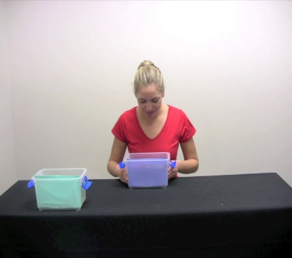
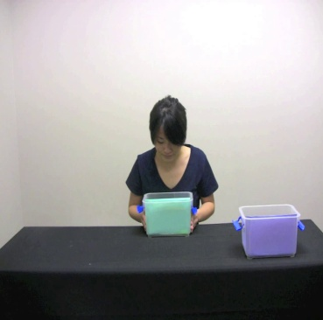
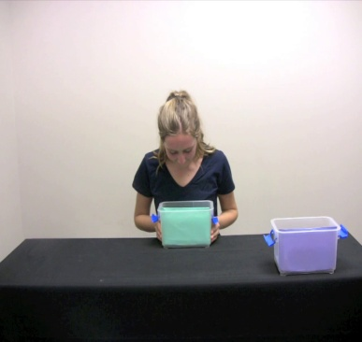
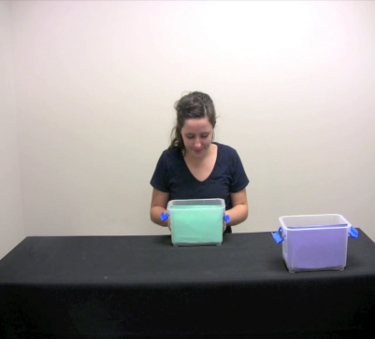
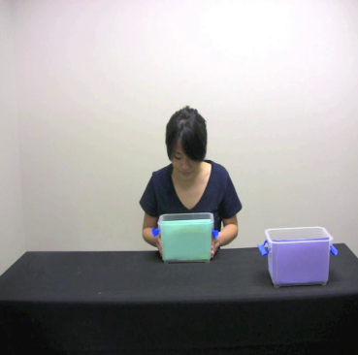
DISTRIBUTED (n = 24)
Individual Group member 1 Individual Group member 2 Individual Group member 3
Each trial is viewed separately
EXEMPLAR (n = 24)
Individual Group member Individual Group member Individual Group member
Each trial is viewed separately

Slide 33
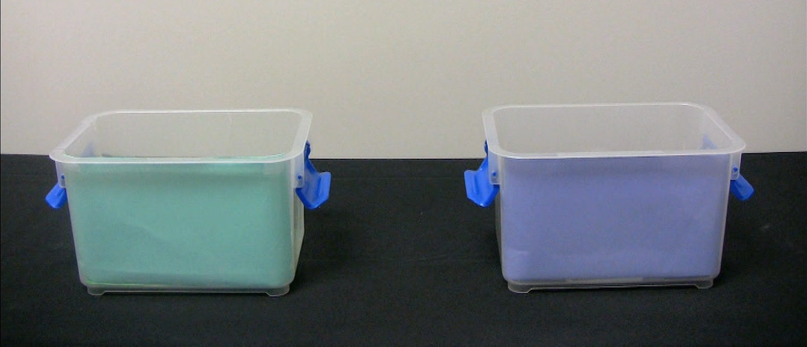
At test…
Still shown for 8 seconds
Notes:
Well, if babies infer the majority based on colour and familiarization, infants should look at the toy that the group likes longer.

Slide 34
Results
**
*
*p<.05
**p<.01

Slide 35
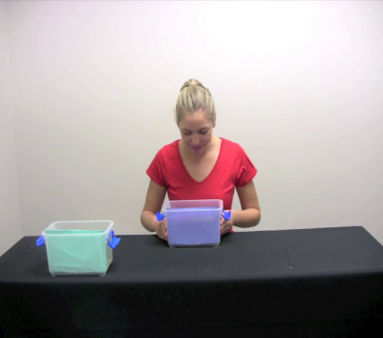
DISTRIBUTED
*BIAS
EXEMPLAR
NO BIAS

Slide 36
Discussion
The results suggest 19 month old infants pay attention to a majority
However, attention is influenced by distributional information
Open question - contribution of familiarization video in guiding infants’ attention

Slide 37
Implications
Ontogeny of majority influence as a mechanism for social learning
Different contexts in which selective biases occur or not…

Slide 38
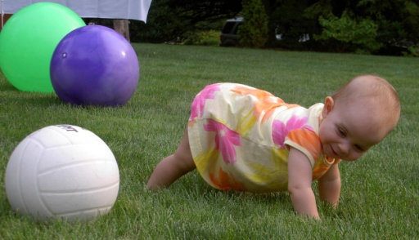
A big thanks to….
Dr. Annette Henderson (Supervisor)
Ying Wang (PhD Candidate, UoA)
Members of ELLA
Funding: Faculty Development Research Fund, Faculty of Science, UoA; University of Auckland’s Doctoral Research Fund
BIG thank you to the families who participated!

Slide 39
Thank you!
Questions &

Slide 40
Developmental origins…
2 year olds adopt choices of a majority to retrieve food
Pre-schoolers endorse information provided by adults who form a consensus in relation to strategy for monitoring accuracy in word learning
4 year old pre-schoolers conform to the normative views expressed by a majority
(Haun, 2013; Haun & Tomasello, 2011; Corriveau, Fusaro, & Harris, 2009)
Notes:
In fact, research suggests that children as young as 2 selectively adopt majority information in various contexts to guide their behaviour. But when during development do we start noticing these actions? Enter babies!
But this doesn’t still tell us if whether infants are drawn towards a consensus…so, (next slide). To my knowledge, there is a big gap in literature when it comes to majority influence between 0-2. (And, that’s a huge gap!)

