Slide 1
Digital Transformation
To
Gigabit Society
Through
Application of mmWave & 5G Technology
mmWave
C S RAO
RAN Architecture and Planning HLF Member, 5G Roadmap of DOT, Govt. of India

Slide 2
Digital Transformation of Our World
Through intelligent connected platforms
Devices & Things
People
Mobile
Devices
Last 30 Years
Next 30 Years
Interconnecting people
Interconnecting their worlds
Minutes Era
6B People
Megabytes Era
50-100B Devices

Slide 3
IT/Telecom/Internet/Media
Technologies Scaling Potential
5G/MEC/Cloud Tech Base Blending technologies in new ways to unleash next generation computational networks
Machine Intelligence (MI) Moving from cognitive MI toward augmented human intelligence
NB-IoT Industrial IoT distributed & connected IOT
AI Acceleration towards a distributed and connected IoT platform
AR/VR Immersive communication that ties user experience to the physical world
Notes:
Digitised Access to Info Emial/Web , Digitised Business Process- e-Commerce ,Digitise Interactions – Social NW and Digitised world ( IoT Connecting Peple ,Process,Data and Things)
These 5 technologies are Redeifining the old paradigm of 3Cs to go towards Commns,Commerce and Civilisation
Managed to Automated , Cnfigurable to Orchestrated , Apps Independent of NW to App Info aware NW
RAN optimization and SoN are the new areas.

Slide 4
Digital Transformation-Digital Infrastructure
BB Density : 4x
1.2M Schools, 750 Universities, 15K Colleges, 250K Panchayats,150K Post offices, etc
RKM of Fiber : 5x
2M Route Kilometre of Optical Fiber Cable
Internet BW : 10x
100 Tbps of Internet Bandwidth
IoT/MTC :10⁴x
1M devices connectivity
eMBB : 50x
20-50B Mobile Devices by 2025
Spectrum Holdings : 4x
4-5 Telcos require 100MHz to 200MHz in 3-6GHZ & 26-28GHZ bands
Power : 3x
Every 10th pole in a city to be smart pole
Tower PoP : 5x
5M Hotspots, 100+ Smart Cities
Talent Need : 3x
22M IT / Wireless and IP Network Expertise by 2025

Slide 5
Drivers & Prerequisites for 5G NR technology in India
Drivers
Aim for End user Enhanced Mobile Broadband Target Speeds from
4 Mbps to 10Mbps …100Mbps ….to 1Gbps
2020 to 2022 and 2023 to 2025 and Beyond
100 M Subs to 500 M subs to 1B subs by 2025
Aspire for massive Machine Type Communications (IoT)
300M ..to 3 B …to 5B devices to be catered during 2019 to 2025 period
Ambition to evolve large scale Sensor led Smart Cities
50 …to 100…. to …..500 Smart cities
Prerequisites of Critical NW Infrastructure for 5G NR Launch
Ubiquitous availability of OFC Tx NW with Tbps Bandwidth capability
Scalable Cloud Architectures in place for Core NW with strong Cyber Security framework
Always available &reliable Energy Infrastructure and Attractive RoW policies

Slide 6
User demands –
extremely diverse service requirements
Capacity
<10 Gb/s
peak data rates
100 Mb/s
whenever needed
1,000,000
devices per km²
Latency
10,000
x more traﬃc
Ultra-low cost for massive machine coms.
Devices
1.5 GB/day
Smart factories 1 PB/day
<1 ms
radio latency
Connectivity
Ultra reliability
<10 ⁵ E2E outage
10 years
on battery
Reliability
Billions of sensors connected
Autonomous driving 1ms latency
Zero mobility interruption

Slide 7
mm wave based 5G – Attributes
User Perspective
Performance Perspective
Management Perspective
Architecture Perspective
Operation Perspective
ms Latency & Seamless Service
Anywhere 1Gbps/User
New Contents & U/I Experience
Managed QoS
Low Battery Consumption
Ultra High Capacity(x1000)
(Peak Data Rate > 50Gbps/cell)
Massive Connectivity (IoT)
4A Connectivity (Anytime, Anywhere, Anyone, Anything)
Energy-efficient infrastructure
TCO Reduction
Flexible Configuration /Mgmt. Load /Resource Balancing)
Flat Structure/High Scalability
S/W- based Flexibility & Agility (Ease of innovation)
Analytics- based NI/BI
Network as-a-Service
High Reliability & Security
Automatic Optimization & Recovery
E2E QoE Control

Slide 8
Increase NW density. i.e S/N
Increase Channel BW
Increase # of TX/Rx Paths i.e MIMO
Increase order of Modulation

Slide 10
5G is essential for next generation mobile experiences
Mobilizing media & entertainment
Rich user-generated content
Congested environments
High-speed mobility
Connected cloud computing
Immersive experiences
Connected vehicle
Augmented reality
Fiber-like data speeds
Low latency for real-time interactivity
More consistent performance
Massive capacity for unlimited data

Slide 11
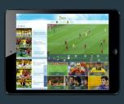
mm wave based 5G – Applications
mm wave based 5G – Applications
Mobile UHD Service
AR/VR
Remote Healthcare
UHD Streaming
Multi-angle Streaming
Augmented Reality
Virtual Reality
Remote Healthcare
Remote Surgery
N/W-Enabled Mobile Hyper Cloud
Immersive Communication
IoT Connected Car, Real-time Remote cntrl.
Telepresence
Hologram Gaming
Sensors Deployment
Connected Car

Slide 12
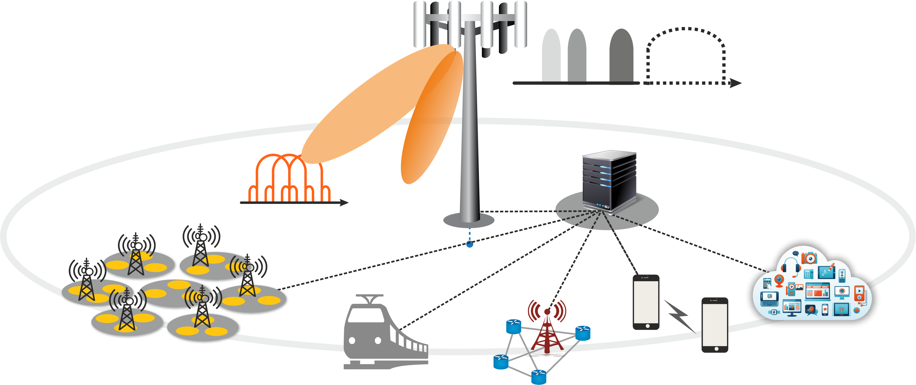
5G Deployment Considerations
Higher Special Efficiency
More Frequency Bands
Ultra Wideband
New Waveform(NOMA, FBMC)
Massive MIMO, Full Duplex
cm/mm Wave Transmission
Unlicensed Spectrum
Integration Spectrum
Ultra Wideband (cmwave, mmwave)
Cell Densification
Massive MIMO
(Beamforming)
Operational Efficiency
Ultra- dense Small Cell
Moving & Personal Cell
D2D & Multi-RAT
Advanced SON
Analytics – based Control
IOT and Public Safety
5G O&M
New waveform
IoT
Ultra-dense Small Cell
D2D & Public Safety
Moving Cell
Multi-RAT

Slide 14
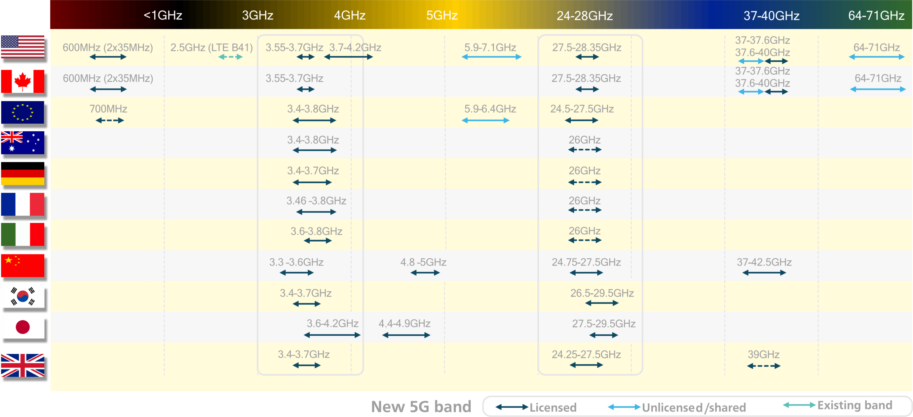
Global snapshot of 5G spectrum
Around the world, these bands have been allocated or targeted

Slide 16
FCC - key spectrum initiatives for 5G
Across low-band, mid-band, and high-band including mmWave
Low-band
Mid-band
High-band
Successfully auctioned a portion of the 600 MHz band
Includes 70 MHz (2 x 35 MHz) of licensed spectrum and 14 MHz for unlicensed use
Spectrum availability timing aligns with 5G
Opening up 150 MHz in 3.5 GHz band with 3-tier sharing with incumbents,
CBRS Alliance formally launched to drive an LTE-based ecosystem
FCC Notice of Inquiry on 3.7-4.2 GHz and 5.9-7.1 GHz
Opening up 11 GHz in multiple mm Wave bands
70% of newly opened spectrum is shared or unlicensed
Unanimously approved
FCC asked for comment on other bands identified for IMT -2020
Considering adding 24.25-24.45, 24.75-25.25 GHz, and 42-42.5 GHz

Slide 17
High-band: Spectrum Frontiers Ruling for 5G mmWave
▪ 27.5 – 28.35 GHz: 850 MHz (2x425 MHz)
▪ 37.6 – 38.6 GHz: 1 GHz (5x200 MHz)
▪ 38.6 - 40 GHz: 1.4 GHz (7x200 MHz)
Total spectrum
= ~11 GHz
Shared and unlicensed access
▪ 37 – 37.6 GHz: 600 MHz (3x200 MHz)
64 - 71 GHz: 7 GHz expansion of existing 60 GHz band
18
FCC ruling given for additional candidate bands
Including 24.25–24.45, 24.75–25.25, as well as 42–42.5

Slide 18
European Commission driving a Gigabit Society
Deploying 5G across Europe by 2020 with pre-commercial trials startied in 2018
Trials and early networks
Full commercial 5G services
Full 5G deployments
5G Action Plan
EC 5G Action Plan
Pioneer spectrum bands for 5G
CEPT harmonization of the 26 GHz band ahead of WRC-19 (June 2018 target)
5G commercial services to use both 3.4–3.8 GHz and 26 GHz in Europe by 2020
Bands for WRC-19 (e.g., 31.8 – 33.4 GHz, 40.5 – 43.5 GHz in addition to 24.25 – 27.5 GHz)
19

Slide 19
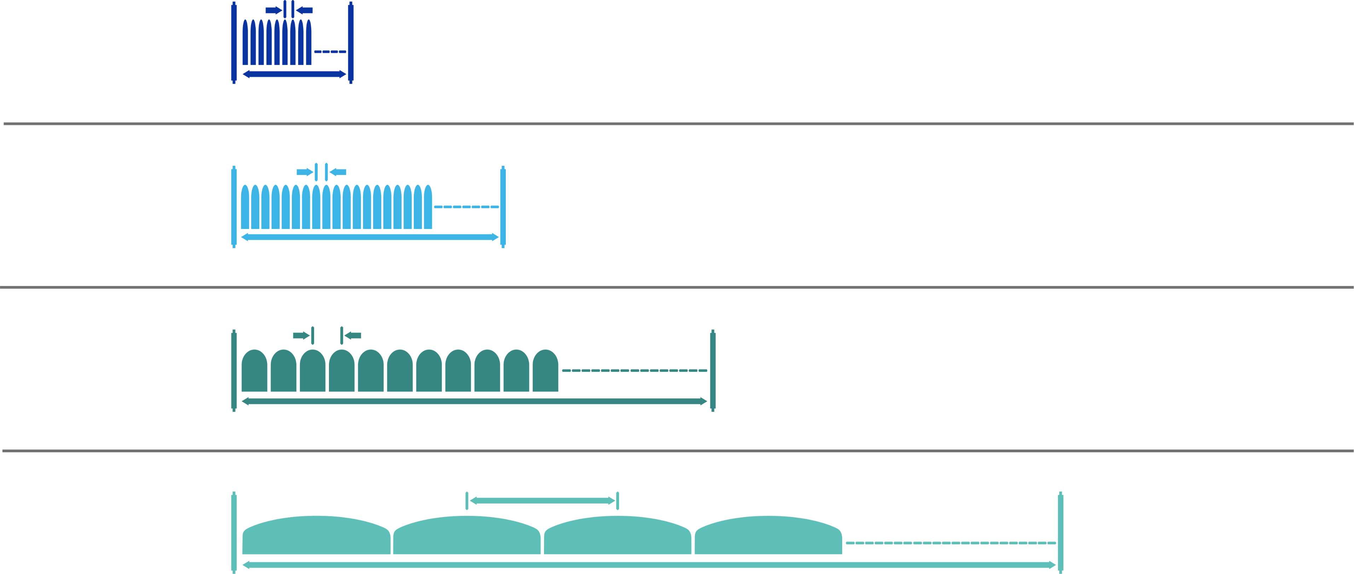
5G – mm Wave – Numerology
Scalable OFDM Numerology
To efficiently address diverse spectrum, deployments and services
RF Channel Width in OFDM Technology changes from 5MHz to 20MHz in 4G era
Outdoor and macro coverage
Subcarrier spacing
Example: 15KHz
2^{n} scaling of Subcarrier spacing
FDD/TDD <3 GHz
Example: 1,5,10 and 20MHz
Outdoor and Small cell
Subcarrier spacing
Example: 30KHz
RF Channel Width in OFDM Technology in 5G era varies from n*20 to n*100 to n*400MHz i
TDD >3 GHz
Example: 100MHz
Indoor Wideband
Subcarrier spacing
Example: 60KHz
TDD e.g. 5 GHz (Unlicensed)
Example: 160MHz
Sub carrier spcing increases from 15KHz to 120KHz and
Mbps era to Gbps era
mmWave
Subcarrier spacing
Example: 120KHz
TDD e.g. 28 GHz
Example: 400MHz

Slide 20
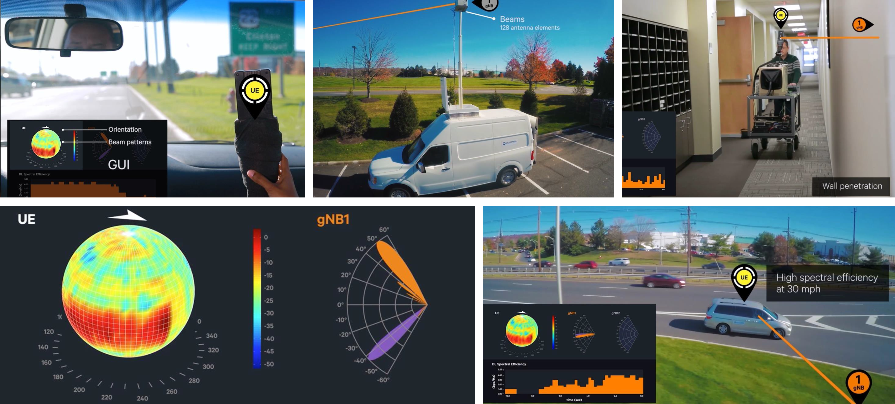
Mobilizing 5G mmWave in real-world environments
Handheld & in-vehicle UEs with four selectable sub-arrays
Multiple gNodeBs with 128 antenna elements
Indoor mobility with penetration & dynamic blockage
Utilizing adaptive beamforming and beam tracking techniques
Outdoor vehicular mobility up to 30 mph with seamless handover

Slide 21
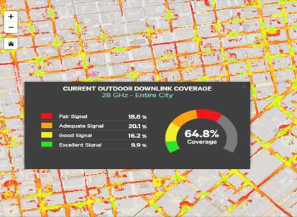
5G NR mmWave Network Coverage Simulation
Significant outdoor coverage simulated using existing LTE sites.
Outdoor coverage can be complimented with targeted indoor deployments.
Below is the summary table of captured simulation results.
Frequency | 28GHz
Site Locations | Entire City
Total Area | 9.77km2
Macro sites | 77
Small cells | 275
Site Density | 36/km2

Slide 22
Significant 5G NR mmWave coverage via co-siting Simulations based on extensive over-the-air testing and channel measurments
Outdoor
Indoor
28 GHz
downlink coverage %
Co-siting with LTE
81%
81%
85%
74%
76%
65%
66%
49%
49%
41%
US | US | US | US | EU | Korea | Korea | Hong | Japan
City 1 | City 2 | City 3 | City 4 | City 1 | City 1 | City 2 | Kong | City 1
LVCC
Venue
Site density (per km2) | Total | 48 | 36 | 32 | 31 | 28 | 41 | 31 | 39 | 37 |  | 134
 | Macro | 0 | 8 | 15 | 14 | 7 | 33 | 31 | 39 | 37
 | Small | 48 | 28 | 17 | 17 | 21 | 8 | 0 | 0 | 0
20

Slide 23
Mm Wave – Pico Radio Deployments
Exploring 3 distinct form factors for 28 -39GHz 5G NR
Additional Pico Radio Requirements
Pole Top Mounted Cylinder
12” tall x 14” OD cylindrical shape that can be mounted on pole tops
Provide 360 degree coverage
Similar in form factor to LTE canister antennas used today
Existing LTE mid-bands
4T4R CRAN 5W form factor w/ LAA
High Band
3.5GHz CBRS - FW with a potential path to 5G NR – pico form factor
LAA 5GHz and/or 3.5GHz flexibility
vRAN integration
mmWAVE Band
28-39GHz – FW & Mobility applications (pico form factor)
vRAN integration
5G Shroud / Street Furniture
Design/Architecture must fit into prescribed “footprint” to meet regulatory/zoning guidance (i.e. Maximum 6 Cu Ft on pole tops)
Pole Wrap-Around Mounting
12” H x 8” W x 4”D
Consider curved radome allowing up to three units to be mounted around a pole in a donut-like configuration
Provide 120 degree coverage per radio unit
Flat Panel
8” H x 8” W x 4”D
Traditional Flat panel design
Provide 120 degree coverage per radio unit
Consider rounding back corners to facilitate smaller diameter tri – sector for pole top cylinder mount

Slide 24
3GPP-compliant trials
and interoperability testing at sub-6 GHz & mmWave
In collaboration with…
…and more to come
29

Slide 29
India -Telecom NW Infra - mm Wave Scaling
2 M RKM urban Intracity Fiber NW
3 M RKM Intercity Fiber for 6000 Cities
Addl 1.5 Million BTS with 4G/5G capacity
Addl 0.5 Million
Poles &Towers

Slide 30
Mid-band: 3.5GHz band-A complementary spectrum for 5G NR
3550MHz
Band 42+43
3650MHz
5G coverage – macro cell & small cell deployment
Complements 4G LTE TDD /FDD if any through CA (Carrier Aggregation)
TDD
(10x10)
100MHz
3550MHz
3600MHz
3600MHz
3650MHz
(10x5)
50MHz
(10x5)
50MHz
Offers large capacity & Medium coverage
Mid-band spectrum is optimized for small cell/macro deployments
3650 Mhz
Band 43 Expansion
3700MHz
TDD
(10x5)
50MHz
5900 Mhz
3GPP yet to be Designated Band
6400 Mhz
Existing Global industry support
Operators & OEMs to enable early launches,
TDD
(20x25)
500MHz

Slide 31
Major Operators - Current LTE Spectrum holding to Deploy with
5G NR Spectrum in mm Wave Bands with massive MIMO
Massive Scaling for Gbps Wireless Needs for Beyond 2025
Current approx. holding of 4G LTE TDD/FDD Spectrum
Proposed 5G NR Spectrum TDD/FDD – Till 2020 requirement
5G NR TDD/FDD
mm Wave Spectrum – Beyond 2020
280 MHz in 28 GHz Band
10MHz FDD + 10MHZ TDD
15MHz+15MHz TDD(B42+B43/3.5GHz) 10MHz (FDD) - (B71 / 600MHz)
1000 MHz in 24 to 27 GHz Band
660 MHz in 27 to 29 GHz Band
280 MHz in 28 GHz Band
10MHz FDD + 20MHZ TDD
15MHz+15MHz TDD(B42+B43/3.5GHz) 10MHz (FDD) - (B71 / 600MHz)
1000 MHz in 24 to 27 GHz Band
660 MHz in 27 to 29 GHz Band
15MHz+15MHz TDD(B42+B43/3.5GHz) 10MHz (FDD) - (B71 / 600MHz)
280 MHz in 28 GHz Band
10MHz FDD
1000 MHz in 24 to 27 GHz Band
660 MHz in 27 to 29 GHz Band

Slide 32
T H A N K Y O U

