Slide 1
ASSISTECH Technology Solutions for the Mobility & Education of the Visually Impaired
M Balakrishnan
CSE Department, IIT Delhi

Slide 2
Key Challenges
Census 2011 Data
Disabled population: 21 Million
Visual disability: 48.6 %
Societal Inclusion
Independent Mobility
Education

Slide 3
White Cane – A Reliable Companion

Slide 4
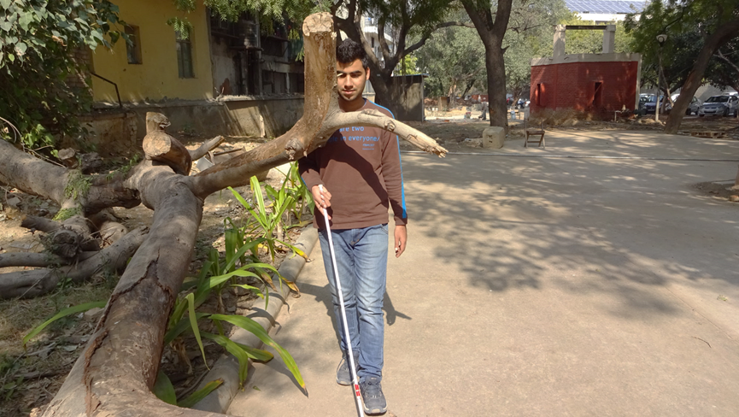
Independent Mobility

Slide 5
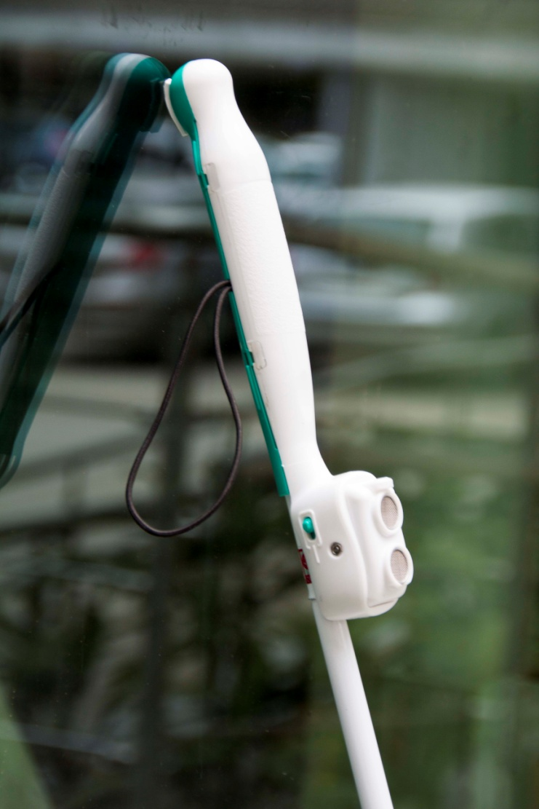
SmartCaneTM
Ultrasonic ranging – 3 meters
Warning through intuitive vibratory patterns
Complements white cane functionality
Detachable handle
Suitable for all grips
Low power & chargeable
Knee-above + non-contact
obstacle detection

Slide 6
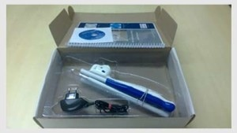
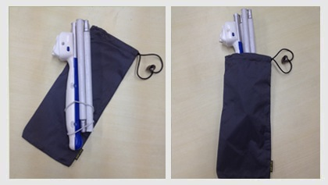
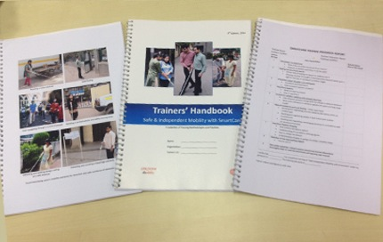
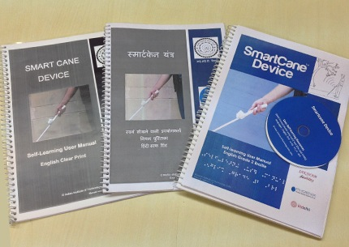
Product- Resources & Accessories

Slide 7
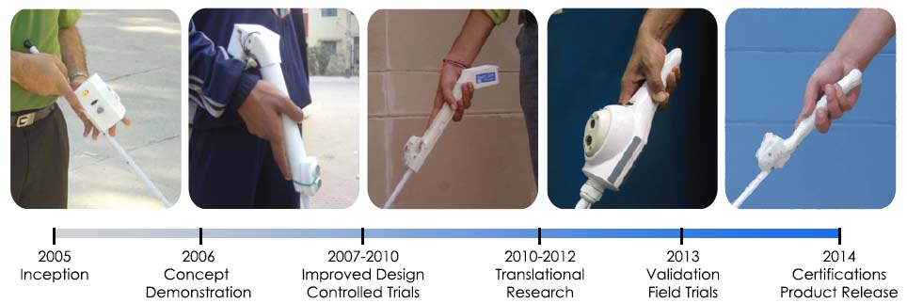
SmartCaneTM Journey

Slide 8
Mobility Continued Public Bus Access

Slide 9
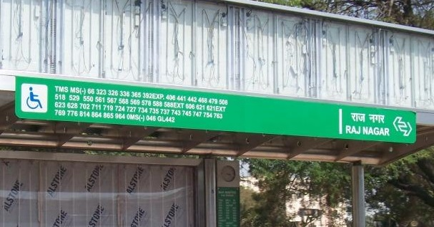
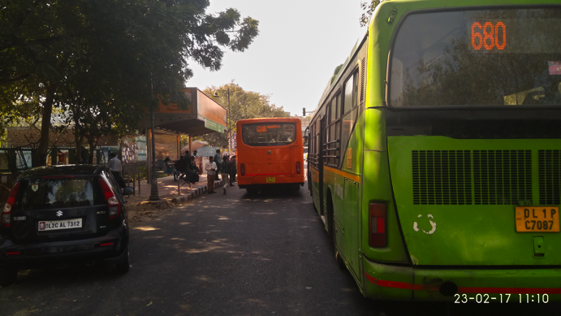
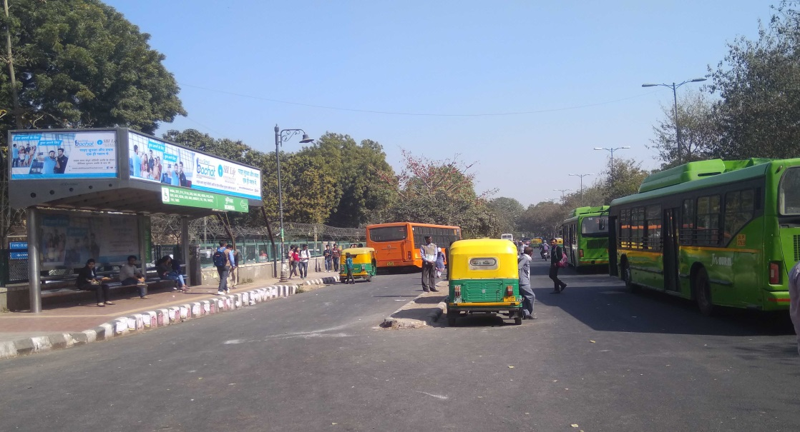
Public Bus Access Challenges
Route No ?
Where is the entry door ?

Slide 10
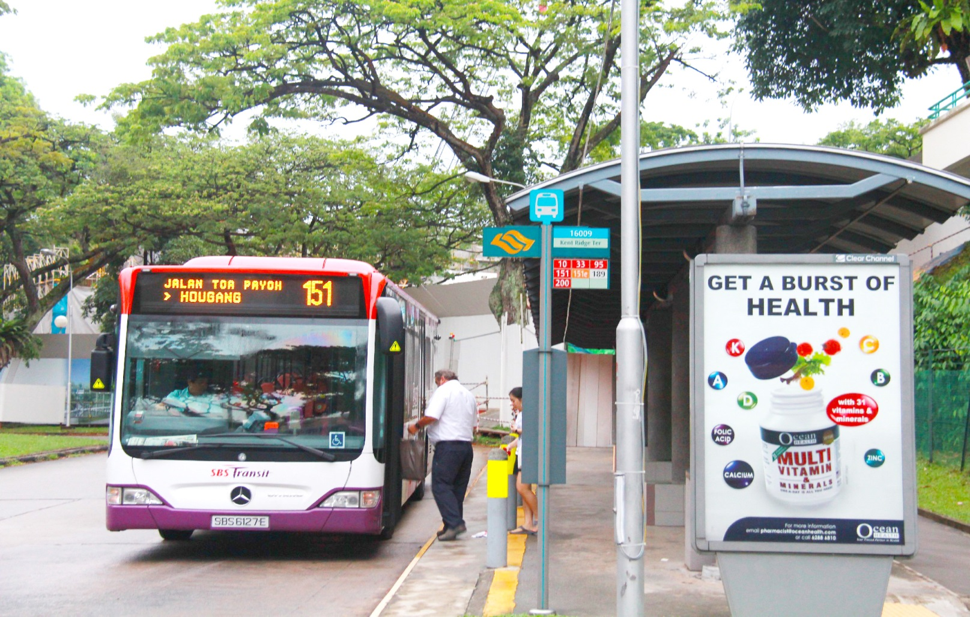
Bus Access: Challenges not the Same

Slide 11
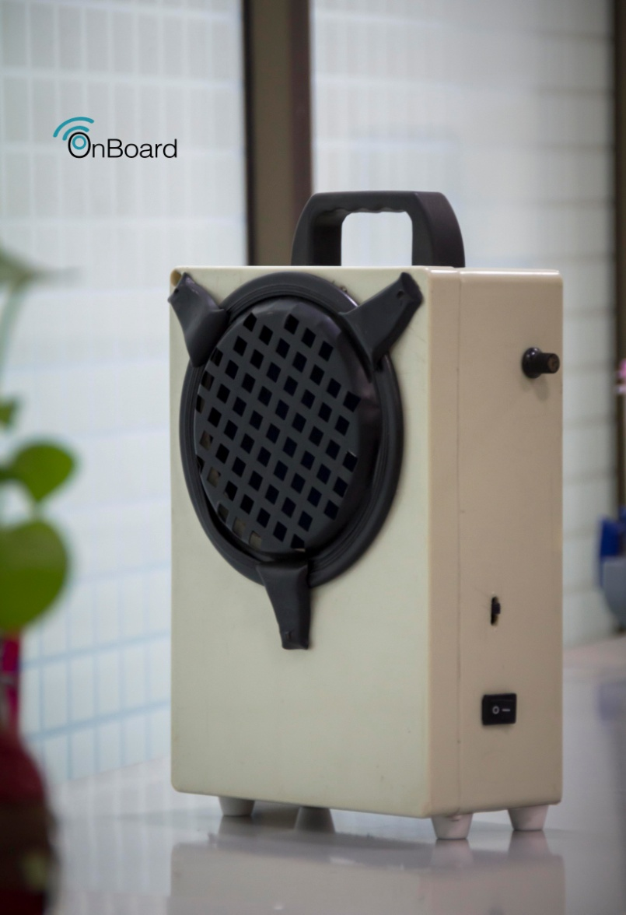
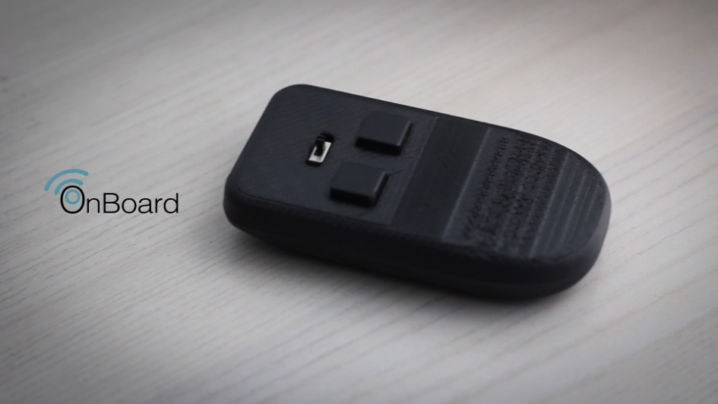
OnBoardTM

Slide 12
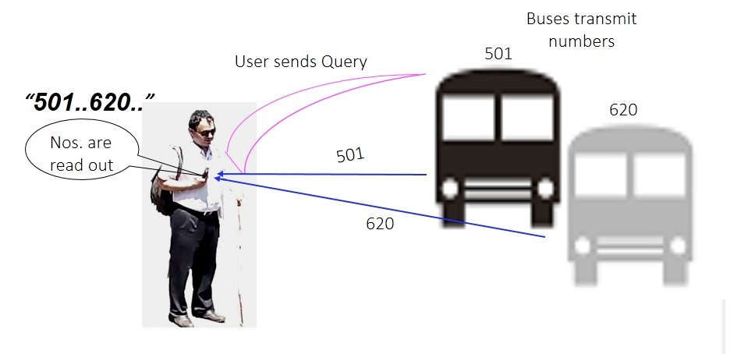
Working Principle (Query Stage)
User presses the Query button (user module)
RF query sent to all buses in the vicinity.
Buses respond with their route numbers
User module reads out all the route numbers

Slide 13
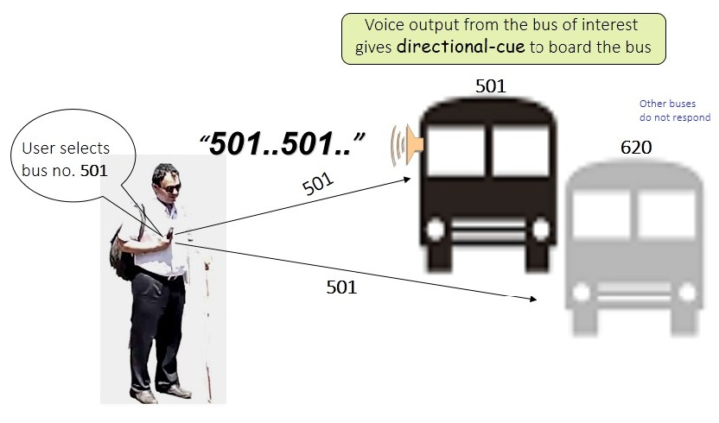
Working Principle (Selection Stage)
In case a route number is of user interest
User presses the Select button (user module)
This triggers a voice output from the speaker (bus module fixed near the door)
Acts as auditory cue for locating the door

Slide 14
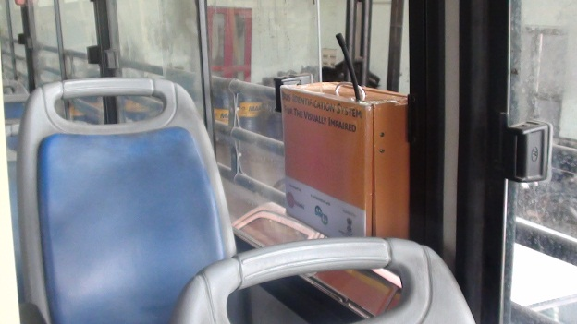
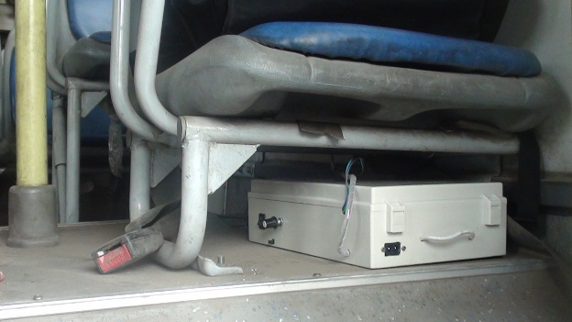
Deployment of Bus Module
Speaker and Antenna module installed on the railings next to the door
Under-the-Seat Module comprising of the battery, amplifier and control circuits.

Slide 15
OnBoard Video

Slide 16
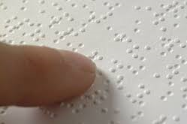
Education
How do the visually impaired read and write?
Using Braille – a script used by almost all languages of the world!
Ever thought of how do they access pictures?

Slide 17
Tactile Diagrams – Diagrams for the Visually Impaired
Diagrams created using raised lines or textures that can provide meaningful information to a visually impaired person
Examples are many
Maps
Bar graphs
Economics diagrams
Science diagrams
Yoga posture diagrams

Slide 18
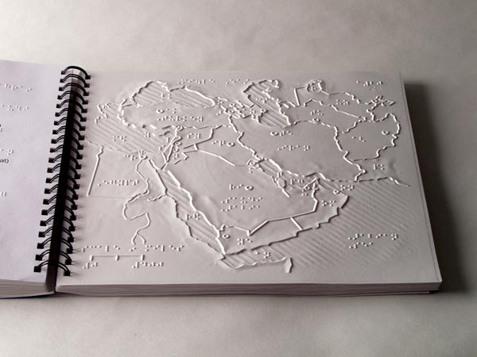
Tactile Diagrams
A Tactile Book from American Printing House

Slide 19
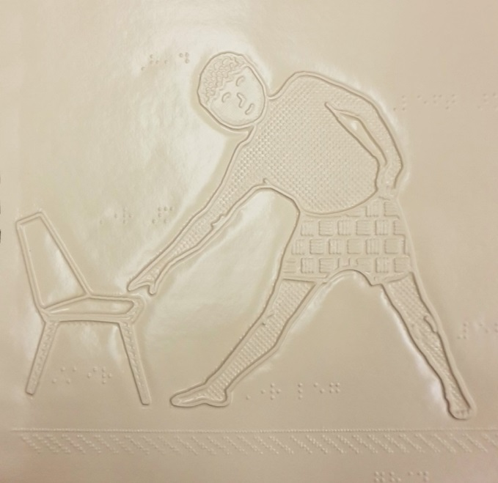
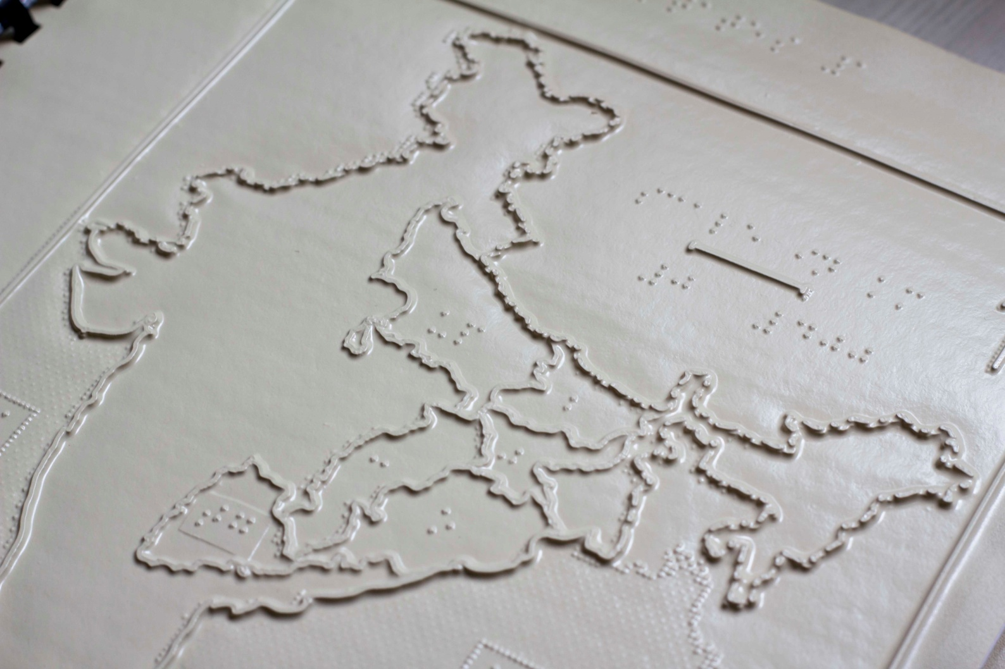
Tactile Diagrams from Centre of Excellence in Tactile Graphics IIT Delhi
Developed end to end technology to reduce the cost from nearly Rs 130 per page to Rs 15 per page
First open source software for production of tactile diagrams to be launched soon
Produced numerous books for NCERT – IX Grade NCERT Maths & Science, Maps, Economics, Introductory Mathematics …..
Pilot studies under way for testing their effectiveness

Slide 20
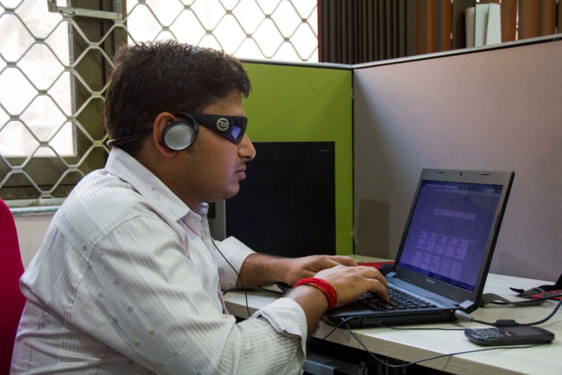
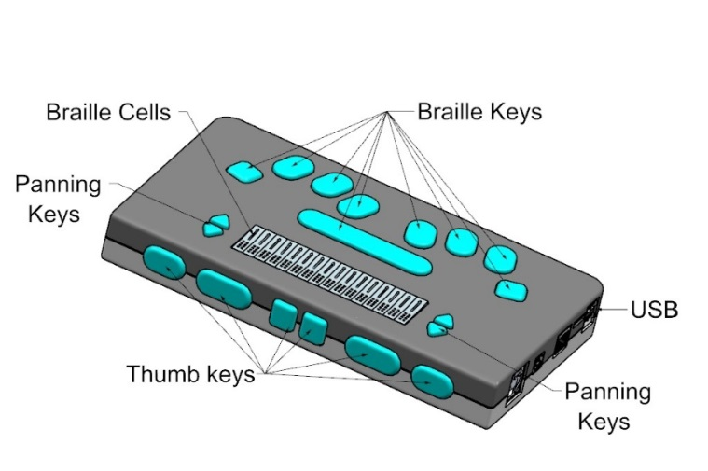
Education Continued
How do the visually impaired access e-text?
Using Audio – screen readers
JAWS and NVDA are popular screen readers
Based on TTS
Reading & Writing
Refreshable Braille Display

Slide 21
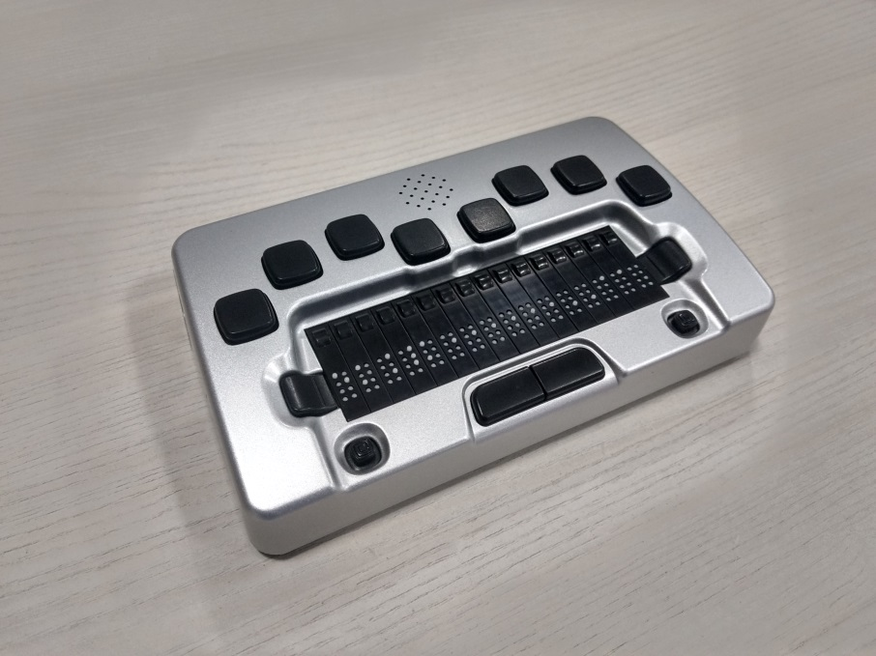
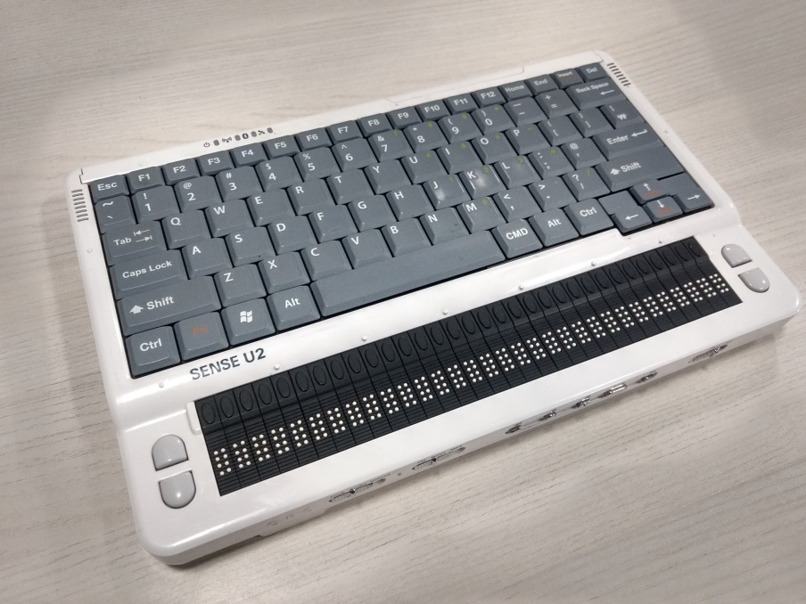
Refreshable Braille Displays
Many such devices are available
@ USD 2500 to USD 5000 hardly any penetration in India and other low income countries

Slide 22
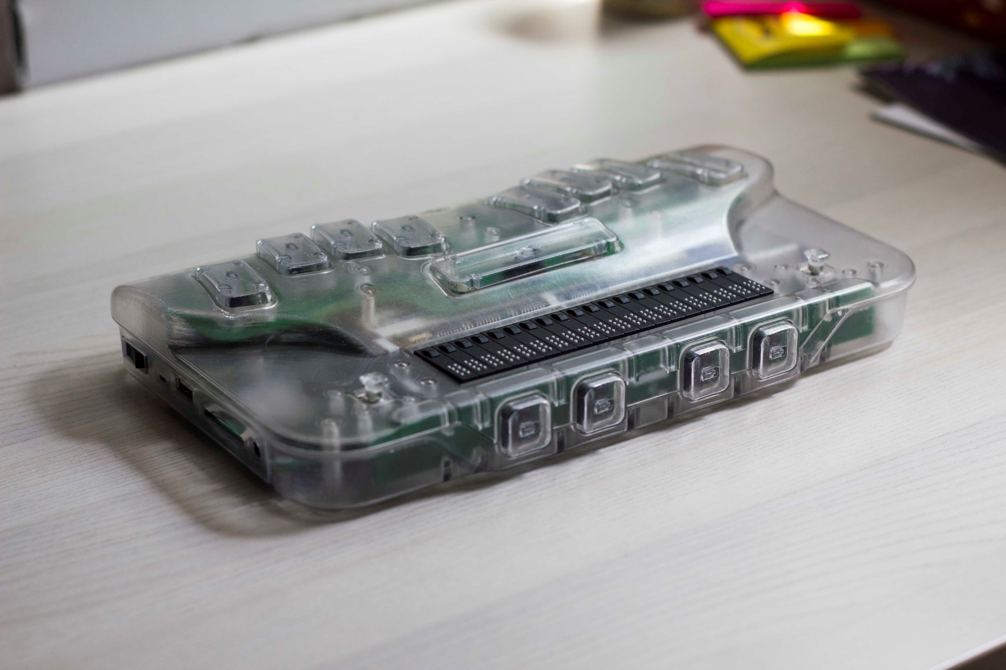
IIT Delhi RBD Prototype

Slide 23
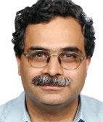
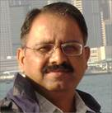
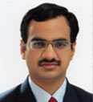
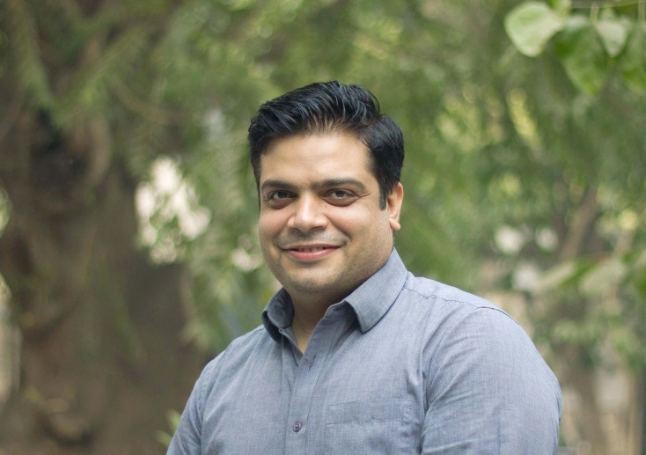
Key Collaborators
Mr. Dipendra Manocha
Prof. P V M Rao
Mr. Piyush Chanana
Dr. Rohan Paul

Slide 24
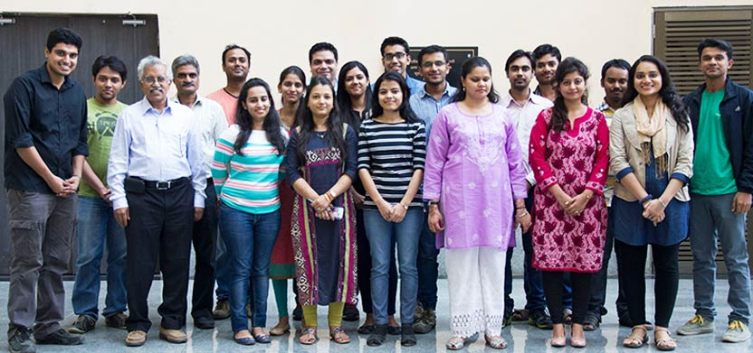
ASSISTECH Research Group
Interdisciplinary: Comp Sci, Elec Engg, Mech Engg, Design
20 Staff (incl. two visually impaired) and nearly 25 students each semester
Recently PhD and MS(R) enrolled

Slide 25
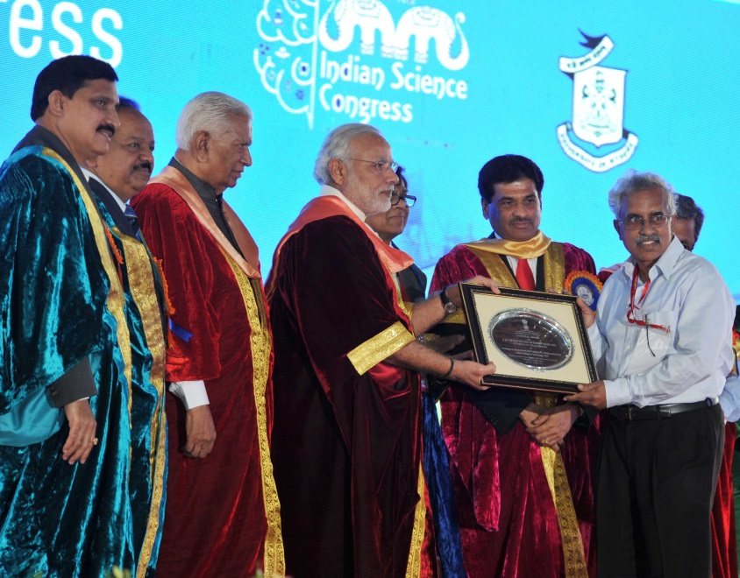
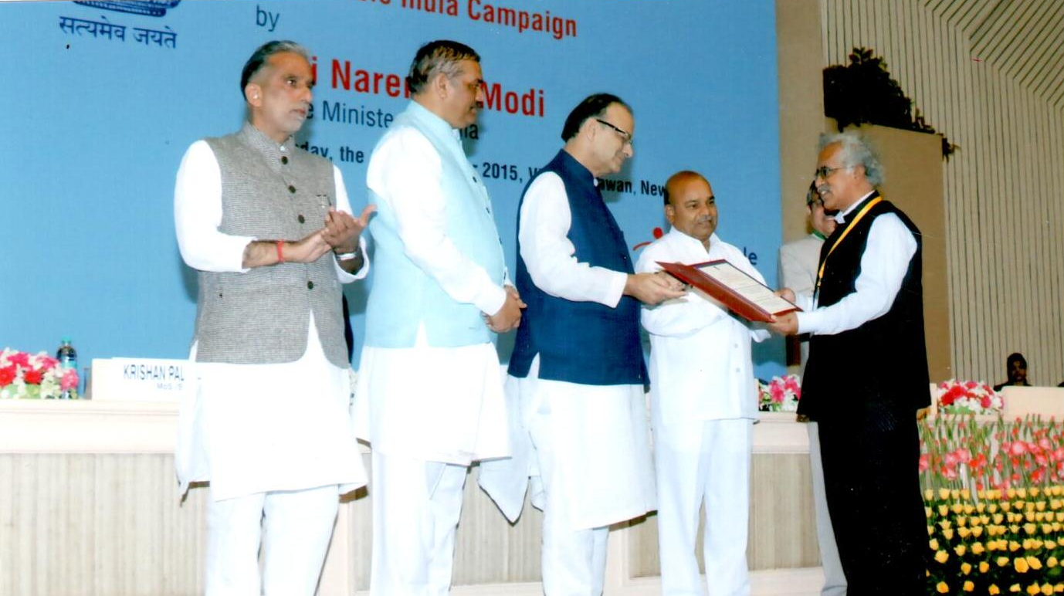
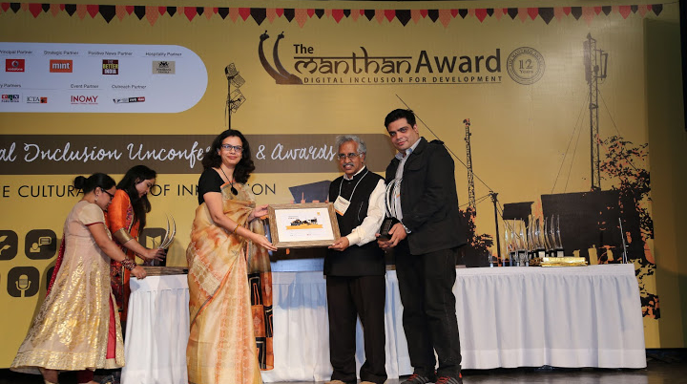
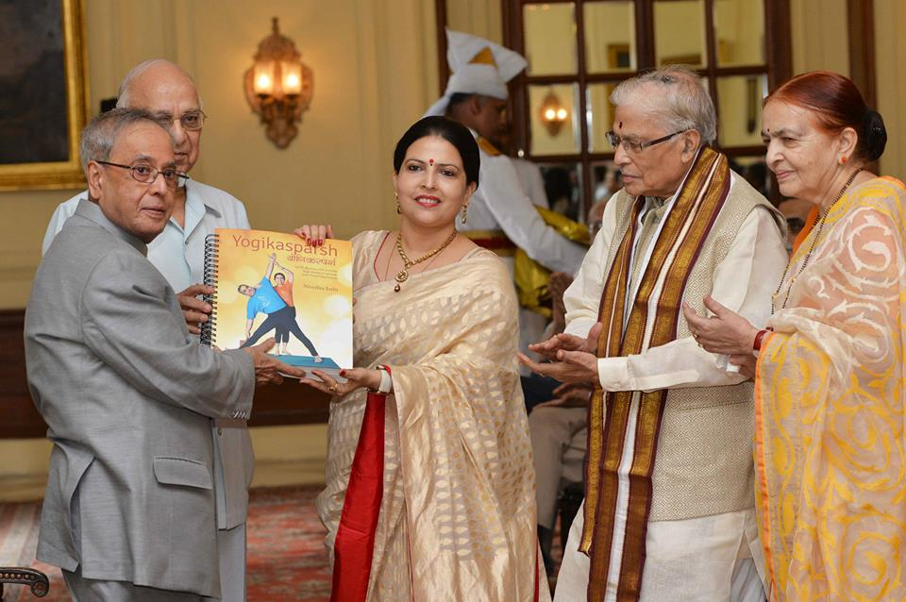
Recognitions yes – Impact ?

Slide 26
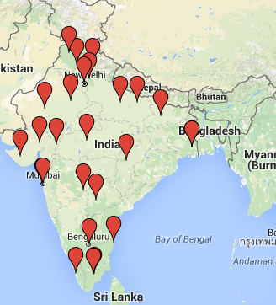
Scaling Challenges
No easy way to reach the potential users
All NGOs serve only a very small user group
40+ channel partners across the country
Incubation very hard as Govt is the main customer

Slide 27
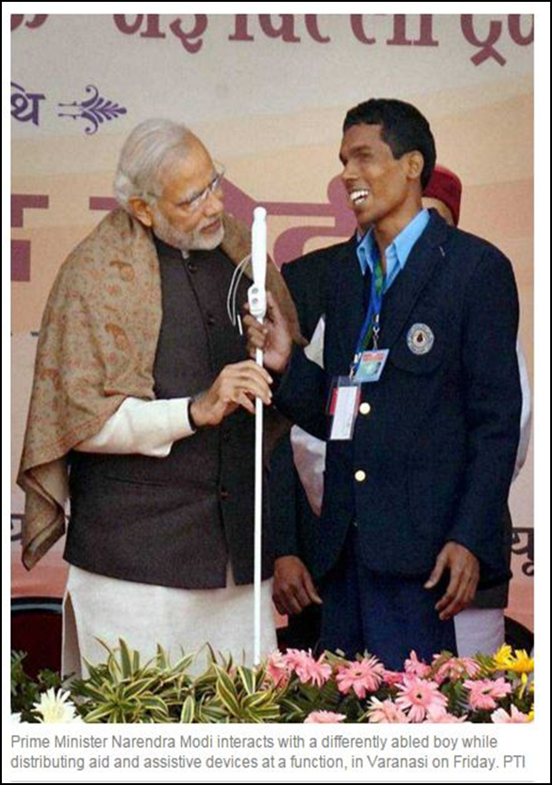
Status – 31st Dec 2016
SmartCaneTM
17997 devices sold
400 devices in 10 countries
OnBoardTM
Pilot on 25 BEST buses with 21 users, 350 unsupervised boardings
Waiting funding for BEST installation
Tactile Diagrams
Many NCERT books
IX Science & Maths books under pilot testing
Refreshable Braille Displays
Pilot trials due in May ‘17

Slide 28
To touch a million lives by 2020

Slide 29
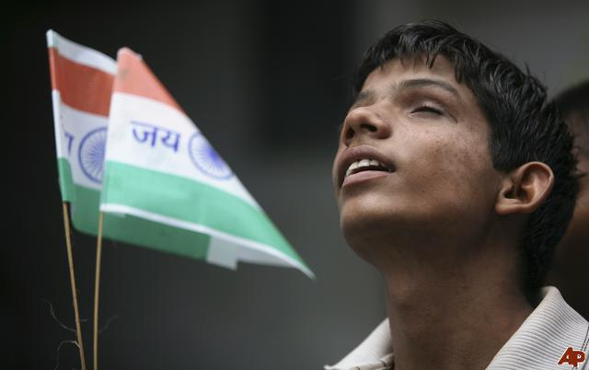
Thank you
Notes:
Secondly, the detection range of the cane is restricted to 1-2 feet from the user.
In situations like walking on the roadside, a moving obstacle like a car cannot be detected until it is dangerously close to the person.

