Slide 1
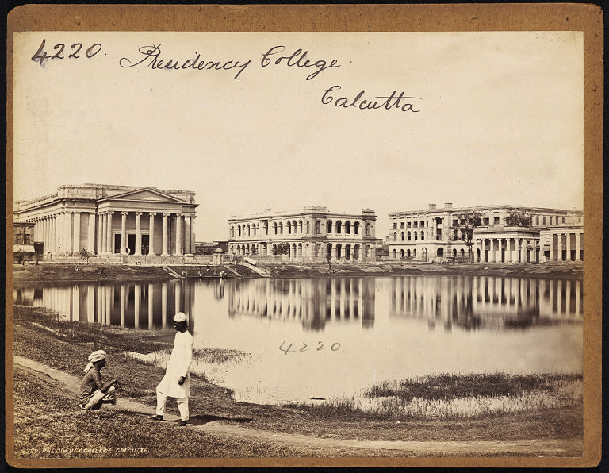
Memories of underdevelopment:
Higher Education and India’s Universities
Shobo Bhattacharya
ASET Colloquium, TIFR. April 22, 2016

Slide 2
Dedicated to the West Canteen, TIFR
pictures, quotes, anecdotes and politically incorrect stories
(both real and imagined),….a circular talk....also a GK test,….
….not passing any judgment, only bearing witness……

Slide 3
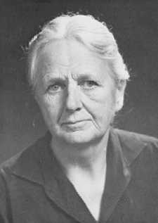
Outline
Preamble
A Brief History of Time
The Bengal Renaissance
A twist in the tale
The Brave New World of India: 1947 –
What, if anything, is to be done ?!
“Anything one can rightly say about India,
its opposite is also true.”
Joan Robinson(Cambridge)

Slide 5
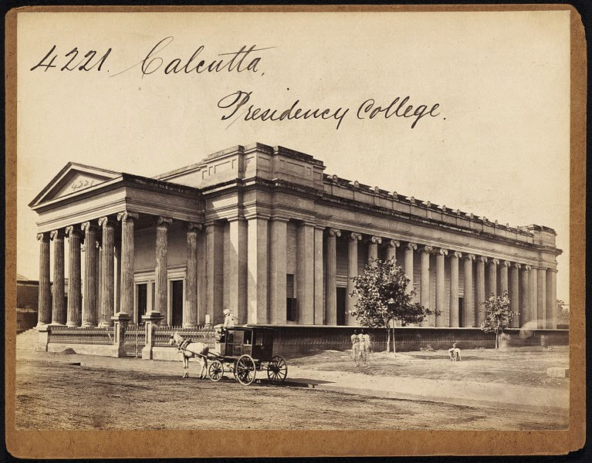
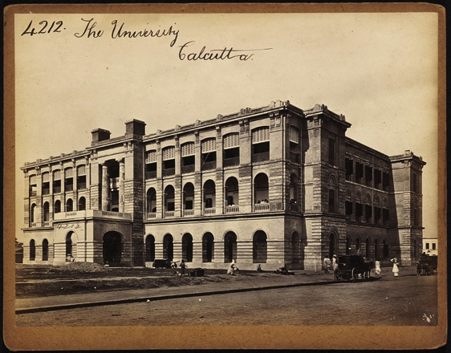
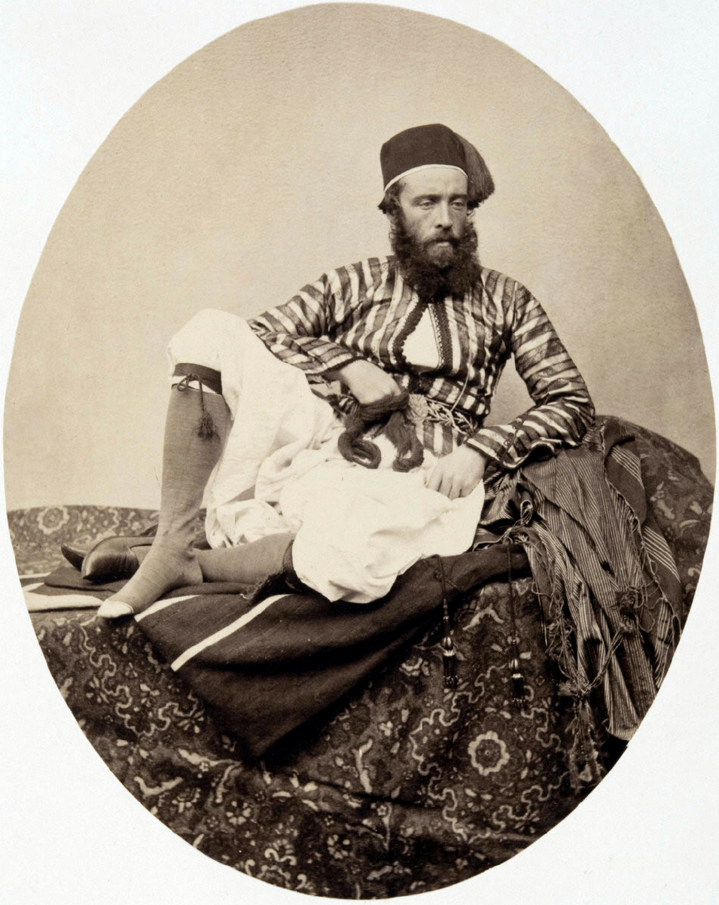
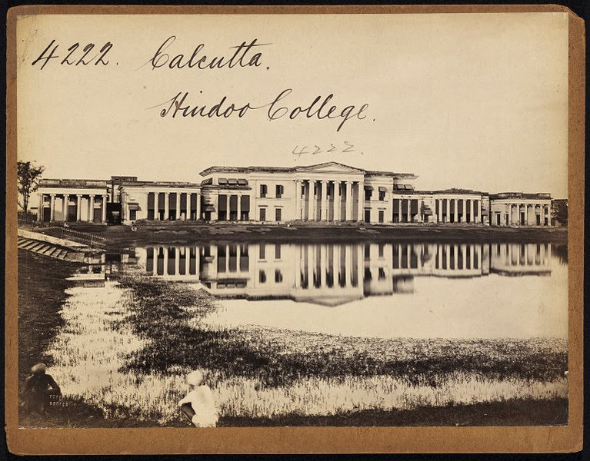
Francis Frith (1822-1898)

Slide 6
Preamble:
Midnight’s children
University as an institution for a civilization
The Leiden Story
The West’s take on modern day civilization – the top 20
A personal education at TIFR

Slide 7
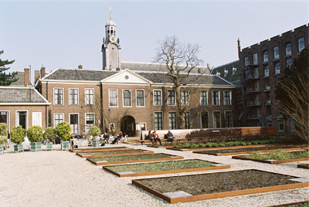
The Leiden University Story,
(1578)
John Mydosh.
Discovered
Spin-Glasses

Slide 8
A western view of history
TOP 20 IMPORTANT PEOPLE
OF THE PREVIOUS MILLENIUM
(1000-1999)
ARTS & ENTERTAINMENT TV, USA (2000)
TOP 100
http://www.wmich.edu/mus-gened/mus170/biography100

Slide 9
1 Johann Gutenberg (mass media--movable type for printing)
2 Isaac Newton (gravity)
3 Martin Luther (Protestant Reformation)
4 Charles Darwin (evolutionist writer)
5 William Shakespeare (Renaissance playwright)
6 Christopher Columbus (explorer)
7 Karl Marx (19th c. political writer)
8 Albert Einstein (physicist)
9 Nicolaus Copernicus (astromony)
10 Galileo Galilei (astromony)
11 Leonardo da Vinci (for science)
12 Sigmund Freud (psychoanalysis)
13 Louis Pasteur (bacteria)
14 Thomas Edison (inventor)
15 Thomas Jefferson (3rd US president, Declaration of Independence)
16 Adolf Hitler (Nazi leader during WWII)
17 M. Gandhi (led peaceful revolution in modern India)
18 John Locke (17th c. philosopher)
19 Michaelangelo (Renaissance artist/sculptor)
20 Adam Smith (18th c. Scottish philosopher and economist)

Slide 10
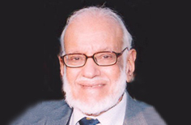
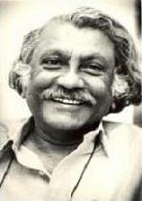
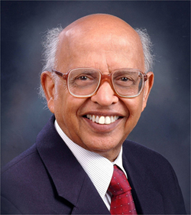
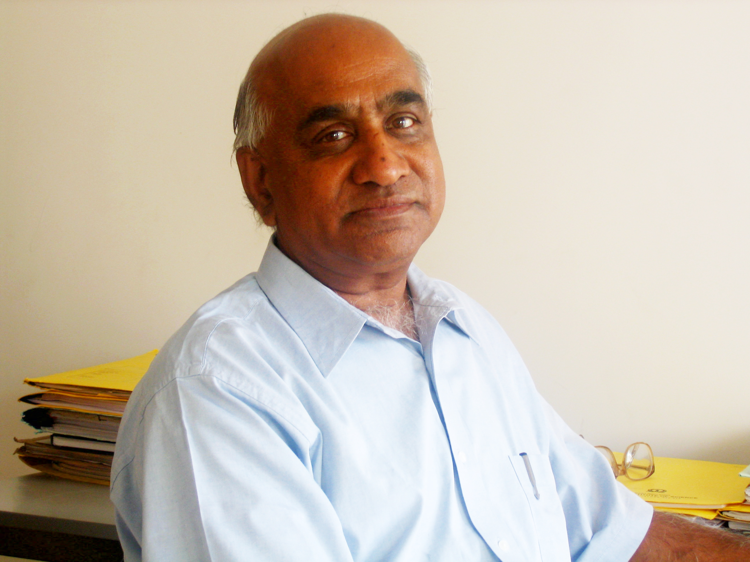
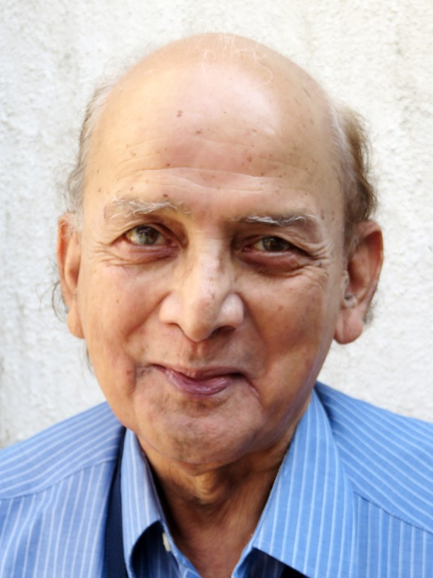
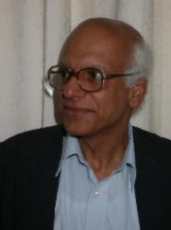
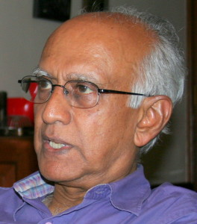
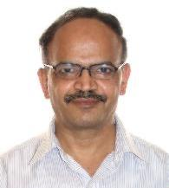
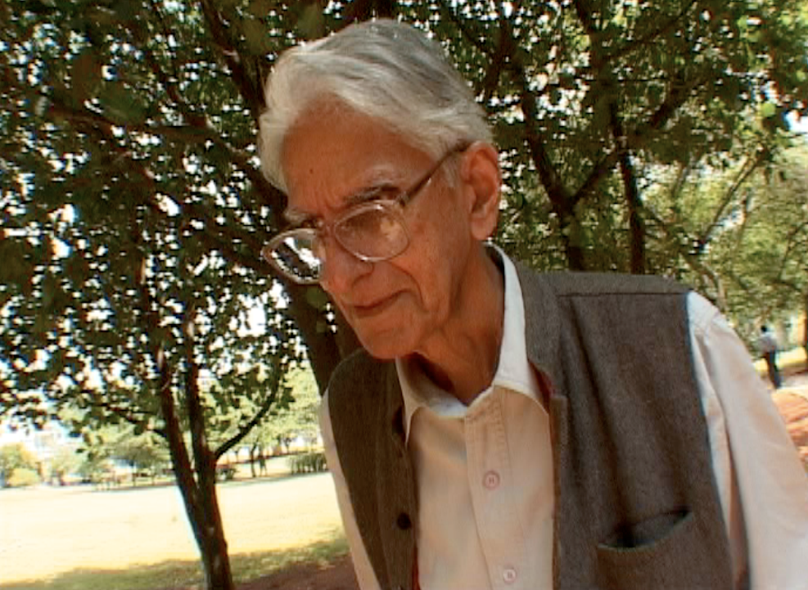
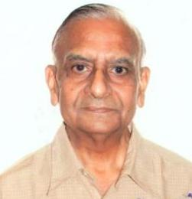
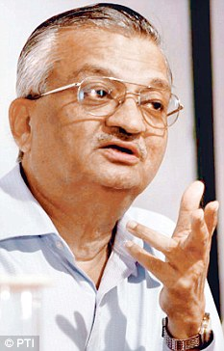
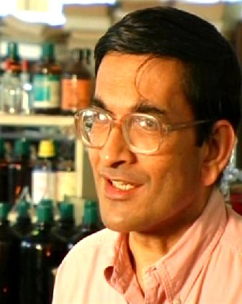
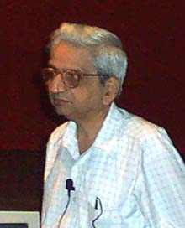
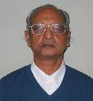

Slide 11
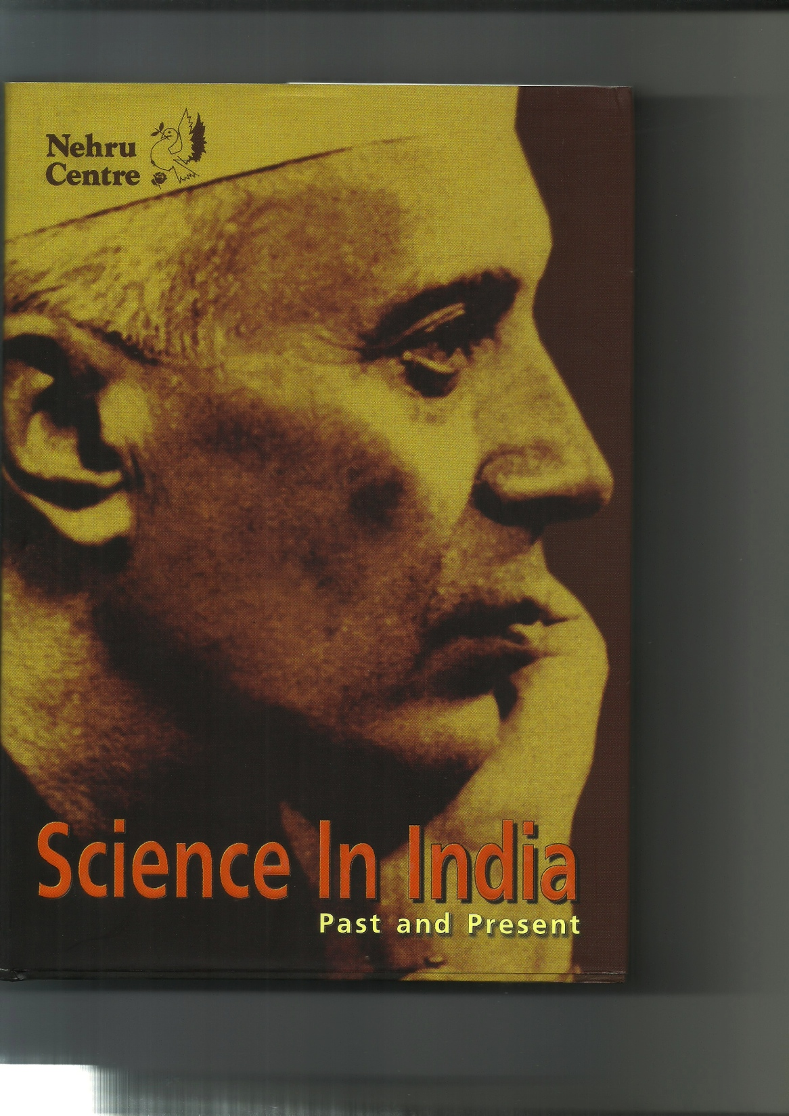
Article by M.G.K. Menon

Slide 12
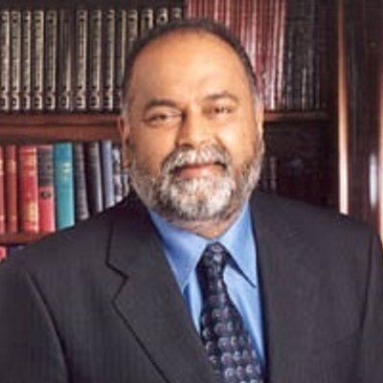
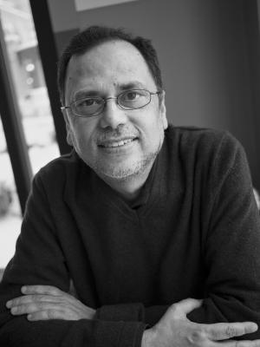
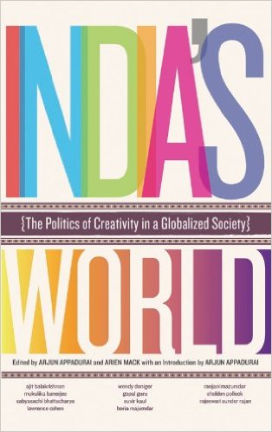
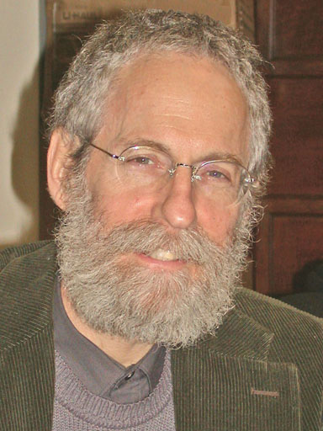
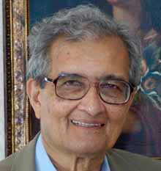
Dipesh Chakrabarty
Arjun Appadurai
Sheldon Pollock
Amartya Sen
Social Research, Vol 78, No.1: Spring 2011
(India’s World) Edited by Arjun Appadurai (out of print)
1. Crisis in the Classics, Sheldon Pollock (p. 21-48)
2. Indian Science Today: …….., SB. (p. 255-280)

Slide 13
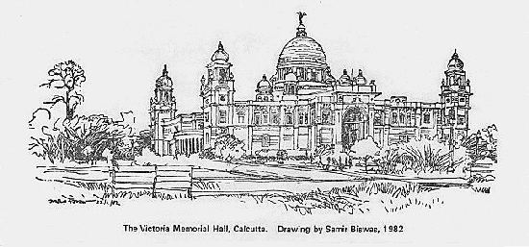
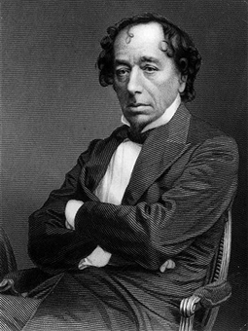
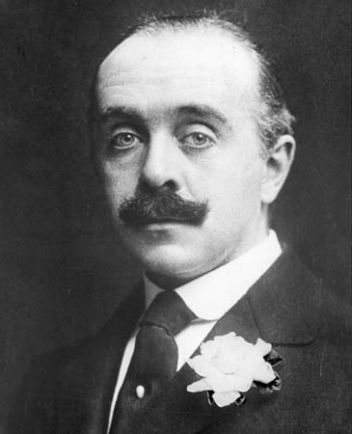
Rethinking the University:
A hundred years later
VMH, July 20, 2015
“A university should be a place of light, of liberty and of learning”
Benjamin Disraeli
“I was a modest, good-humoured boy. It is Oxford that has made me insufferable.”
Max Beerbohm
A university (Latin: universitas, "a whole") is an institution of higher (or tertiary) education and research which grants academic degrees in a variety of subjects and provides both undergraduate education and postgraduate education. The word "university" is derived from the Latin universitas magistrorum et scholarium, which roughly means "community of teachers and scholars.”
Wikipedia

Slide 14
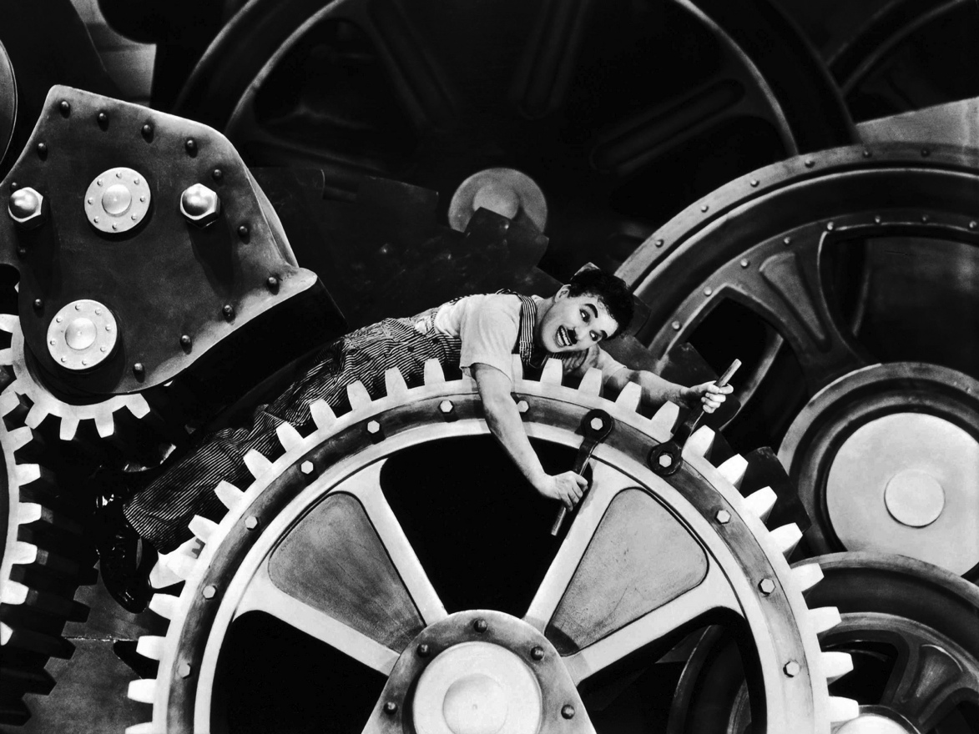
A brief history of “Modern Times”
“The past is never dead. It is not even past.”
William Faulkner

Slide 15
“A brief history of modern times”
The West
European Renaissance
Printing Press, Gutenberg (1440)
Leonardo da Vinci, Michaelangelo, Galileo, Copernicus, Shakespeare,……..
Protestant Reformation
Martin Luther 1517 Document
Newton (1642-1727) Principia 1687
John Dalton (1766-1844) Atomic Theory 1802-1807
Michael Faraday (1791-1867) – Electromagnetism 1812-1821
Charles Darwin (1808 -1882) - Origin of Species,.. 1859
Industrial Revolution (1750-1850), French, American and Bolshevik Revolutions
James Watt (1736-1819) – Steam Engine 1765
Sadi Carnot (1796-1832) - Thermodynamics
India:
Aurangzeb dies 1707 (GDP 24% of world)
Battle of Plassey 1757
Bengal Famine 1770 (1/3 of population die)
Sepoy Mutiny 1857
Independence Movement 1905 -
Partition and Independence 1947 (GDP 3% of world)

Slide 16
Not dark in Arabia,……..
Baghdad or Cordoba

Slide 17
‘A brief (and partial) history of colonial times’
1757-64: Battles of Plassey and Buxar: East India Company begins colonization.
1784 : Asiatic Society, Calcutta
1817: Hindoo /(Presidency) College, Calcutta (Hare/Rammohun Roy)
1832: Wilson College, Bombay
1840: Presidency School and College, Madras
1847 College of Civil Engineering in Roorkee
1854 Government College of Art & Craft in Calcutta
1857: “The Mutiny”. Universities in Calcutta, Bombay & Madras;
JJ School of Art in Bombay
1858: The British Crown assumes control of India
1876: IACS in Calcutta (Mahendralal Sircar/ Eugene Lafont)
1905: Independence Movement begins, Partition of Bengal
1907: Tata Steel in Bihar
1909: Hind Swaraj published; IISc founded in Bangalore (JNTata/ Swami V)
1913: First Nobel Prize to India: Literature (Tagore)
1914: University College of Science, Calcutta (Mukherjee/ P.C.Ray)
1919: Jalianwallabagh massacre
1930: Second Nobel Prize to India: Physics (Raman)
1931: Indian Statistical Institute (Mahalanobis), Calcutta (P.College)
1942: CSIR labs (Bhatnagar)
1945: TIFR (H J Bhabha); Inst. of Nuclear Physics (M.N.Saha – SINP)
1947: Partition and Independence (17 universities for 300 million)

Slide 18
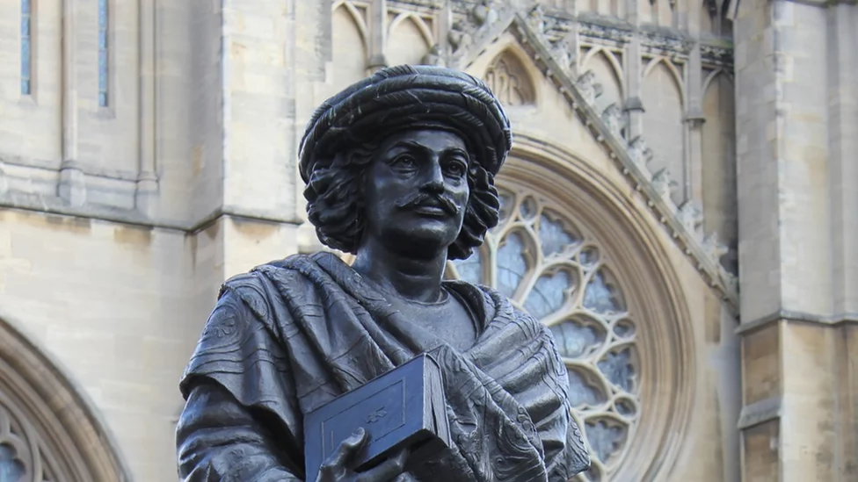
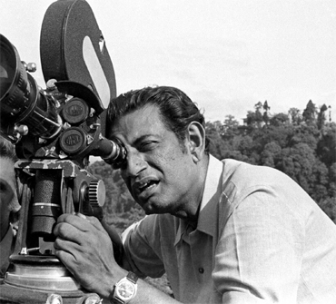
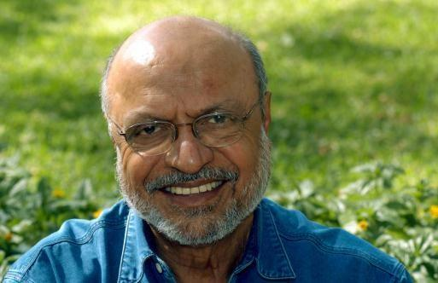
Indian Science, Past and Present,
A sociological perspective
M.G. K. Menon, pp 1-45
The Bengal Renaissance
1817/1829 - 1992
Shyam Benegal,
TOI, 1992

Slide 19
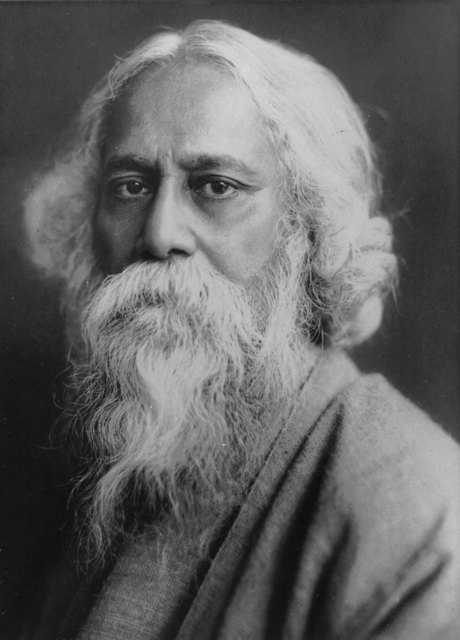
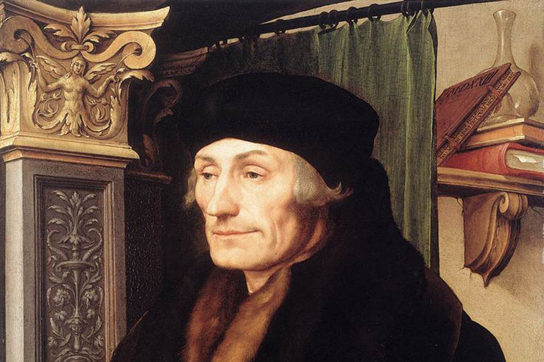
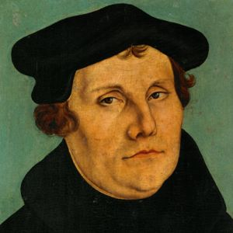
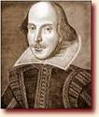
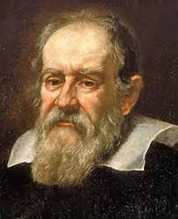
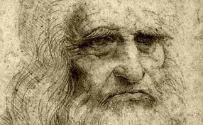
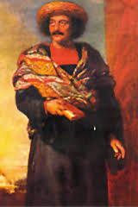
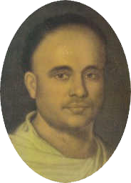
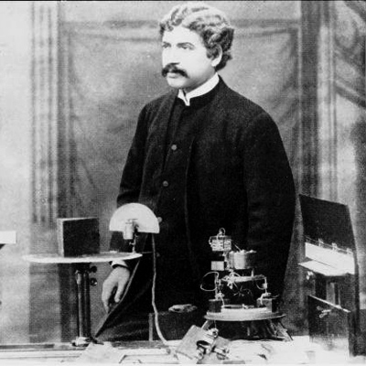
EUROPE
BENGAL
______________________________________________________________________________
______________________________________________________________________________

Slide 20
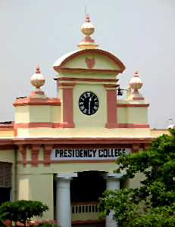
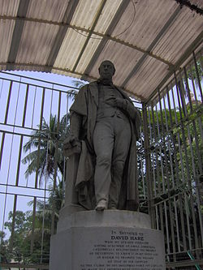
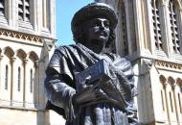
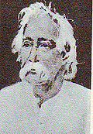
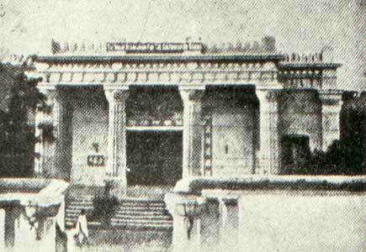
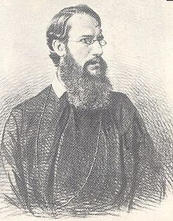
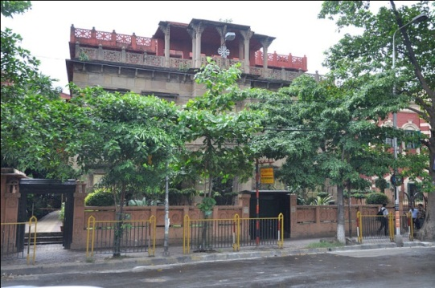
Raja Rammohan Ray
David Hare
Hindoo/Presidency College
1817
Indian Association for the Cultivation of Science
Dr. Mahendralal Sircar
1876
Fr. Eugune Lafont
Bose Institute
1917
Margaret E. Noble
“Sister Nivedita”
Jagadish Chandra Bose

Slide 21
Universal knowledge, culture and civilization
“Until men learn to respect each other’s honest convictions, and until they are free from all prejudices, in other words, until they are fearless of the consequences of discoveries in the fields of knowledge, they cannot be said to have become civilized men. The one thing that can secure this blessing, the toleration, and freedom from prejudice is knowledge”
Dr. Mahendralal
Sircar
“Science . . . was the more powerful lever for progress, for the advancement of civilization, for ennobling the mind of man. . . . Let every step of science education be explained by experiments, for science to be effectually learnt should be learnt in the laboratory: but do not attempt to make your institution a school of technical education in the industrial arts under the misnomer of practical science”.
Rajendralal Mitra
“the agents of the colonial power “wanted to transform the Hindus into a number of mechanics requiring for ever European supervision, whereas Sircar’s object was to emancipate, in the long run, his countrymen from this humiliating bondage”
Fr. Eugune
Lafont

Slide 22
29

Slide 23
Calcutta, 1930

Slide 24
Solvay Congress 1927, (29)
Calcutta 1930,
(6)
C V Raman
&
K S Krishnan
Jagadish Chandra Bose with his former pupils in 1930. Seated (L-R): MN Saha, Jagadish Chandra Bose, JC Ghosh. Standing (L-R): S Datta, SN Bose, DM Bose, NR Sen, JN Mukherjee, Sri NC Nag.

Slide 25
Geography of Modern Times in Calcutta
Recent flyover collapse at the crossing of Vivekananda Road and Rabindra Sarani
Vivekananda’s home
Thakurbari
Science College
Bose Institute
Presidency College,
Medical College,
Sanskrit College
University of Calcutta
Rammohan Roy’s Residence
IACS
Bowbazar
St. Xaviers’s College

Slide 26
Bowbazar Street
Home of IACS in 1928
`Miracle…. It [advancement in science (physics)] gave a false picture, that making discoveries is easy. It had a distorting effect. I mean it was alright in the twenties, but extended into later period, it was not. I started with a totally glamorous view of science that persisted so long as I was in India. But going to England was a shattering experience.'’
S. Chandrasekhar, Reminiscing.

Slide 27
Ashutosh Mukherjee had a vision of the kind of education he wanted young people to have, and he had the acumen and courage to extract it from his colonial masters. He set up several new academic graduate programs at the Calcutta University: comparative literature, anthropology, applied psychology, industrial chemistry, ancient Indian history and culture as well as Islamic culture. He also made arrangements for postgraduate teaching and research in Bengali, Hindi, Pali and Sanskrit. Scholars from all over India, irrespective of race, caste, and gender, came to study and teach there. He even persuaded European scholars to teach at his university. He was one of the first persons to recognise the work of Srinivasa Ramanujan.
Curzon's education mission in 1902 identified the universities including the Calcutta University, as centres of sedition where young people formed networks of resistance to colonial domination.[5] The cause of this was thought to be the unwise granting of autonomy to these universities in the nineteenth century. Thus in the period of 1905 to 1935, the colonial administration tried to reinstate government control of education. In 1923, Mukherjee refused the post of Vice-Chancellor when Lord Lytton tried to impose conditions on his reappointment.
Wikipedia
(1864- 1924)

Slide 28
Sir Ashutosh Mukherjee (1864-1924)
First General President of Indian Science Congress, Calcutta 1914
Mathematician and Jurist
Vice Chancellor, Calcutta University 1906-1923
Classmates: Acharya Prafulla Chandra Ray and
Narendranth Datta (later Swami Vivekananda)
University College of Science 1914, University College of Law, Bengal technical Institute 1909
Endowed Chairs from lawyers TN Palit , RB Ghosh and Maharaja of Khaira.
Ghosh Chair in Physics to D.M. Bose 1914, Palit Chair in Chemistry to PC Ray 1916
Palit Chair in Physics, CV Raman (+ glass blower) 1917
Lecturers in physics and applied (Mixed) math: Meghnad Saha and SN Bose 1915,
Chair in philosophy; Sarvepalli Radhakrishnan,
Mathematics : Syamadas Mukhopadhyaya
History : D.R. Bhandarkar
Created the first modern research university in India

Slide 29
A personal anecdote

Slide 30
Syamadas Mukhopadhyaya
Mathematician
4-vertex theorem
Ramananda Chattopadhyay
Editor , Modern Review
and Prabasi
Rakhal Das Bandyopadhyay
Archeologist
Discovered Mohen-jo-daro
Novelist, “Dharmapala”
Rev. C. F. Andrews, Tagore and Ramananda C.
Gandhi, Tagore, CFA
“Christ’s Faithful
Apostle”
Attenborough’s Film “Gandhi
CFA and Gandhi”

Slide 31
But all was not well : personality conflicts

Slide 32
“The early thirties in India was a disturbed period, due to non-coperation movement. Many of us hoped that the upheaval, initially with a political content, could be an occasion for the national leaders for creating a condition for the flourishing of new ideas and foundation of scientific studies and research in the country. I am sorry to say that this expectation has not been fulfilled. As I found then, the atmosphere of intrigue that reigned in the universities was paralysing in every sense. I am now retired as a professor, and in my long career, I have seen many examples of intrigues and personal rivalry in University sphere in various continents. But, believe me, what I have witnessed during two years in India exceed by far what I have seen during the rest of my life.”
Andrei Weil, Reminiscences of conversation with S.N.Bose
Also see, S.G. Dani, History of Indian Mathematics/Mathematicians
``On this side at any rate, I know the condition and with all my optimism and enthusiasm for science. I feel the present scientific atmosphere quite oppressive and it may be an advantage if you postpone your return to India by one or two years.'’
K.S. Krishnan, letter to S. Chandrasekhar in 1934

Slide 33
Born – Rutherford
Letters
Nothing can be easier in India than to rouse discord and to stir it. Once you allow and encourage people to speak, they will never end because they want an outlet. There is always latent jealousy and dissatisfaction which would be directed against almost anybody or anything. Take Professor Saha. I know the following from [him]. Saha is one of the greatest enemies of Raman. I do not know whether he also had hoped to become the successor of Raman in Calcutta, and Raman may not have helped him get this post. A very clever pupil of Raman—Krishnan—got it. Since then Saha attacks Raman when he can.
They have another object of quarrel; Saha intended to found an all- India academy, but things went too slowly for Raman’s temperament and he founded his own academy (Indian Academy of Science) in Bangalore, with his own Proceedings. Now there are two academies in India, not too many for such an enormous country, but they are bitter adversaries. All the north Indians joined Saha’s party, and the south Indians that of Raman. These parties have their delegates in the Council of the Institute, but the north-Indians, and particularly the Bengali, have the majority” .

Slide 34
J.B.S. Haldane (1892-1964)
“What ails Indian Science”, (I’ll read it a bit!)
http://www.iisc.ernet.in/currsci/jul25/articles30.htm
Philosopher Kings versus Democracy,.......insightful and controversial remarks about insitutional functioning
Much of the criticism of Born, Weil and Haldane and nearly all of John Maddox (Former Editor of Nature) would seem to be predicated on an assumption of a universal code of social engagement practiced in, say, Universities. Nearly codified in the “West”, with minor differences, say, between Europe and the US.
No such codification was visible to them in India. The swadeshi social practices also dominated places of “universal-type” activities such as academics.
Legacy of historical accident, but inertia and other problems hinder active efforts and revision, evolution, correction,…..faithful to an “original vision” (Maddox recognizes this part). Little discussion in formal fora that can intiate correction.

Slide 35
Independence and a twist in the tale
Education serving an Empire
To
Education serving a Nation

Slide 36
Two good friends with very different views on the kind of engines India needed to propel itself with after independence.
A compromise : Industrial Expansion but “Swadeshi” (Indigenous)

Slide 37
Mohandas K. Gandhi with a manually driven engine called a “charkha”

Slide 39
The spinning jenny is a multi-spindle spinning frame. It was invented in 1764 by James Hargreaves in Stanhill, Oswaldtwistle, Lancashire in England. The device reduced the amount of work needed to produce yarn, with a worker able to work eight or more spools at once. The beginning of The Industrial Revolution.
“Manchester Cotton” outperforms the Bengal Cotton, including the Muslin of Dacca with devastating consequences for Bengal and then all of India. It also made some in England very prosperous.

Slide 40
A Manchester Cotton Mill

Slide 41
The brave new world of modern India : ~ 1947 -

Slide 42
“It is science alone that can solve the problems of hunger and poverty, of insanitation and illiteracy, of superstition and deadening custom and tradition, of vast resources running to waste, or a rich country inhabited by starving people... Who indeed could afford to ignore science today? At every turn we have to seek its aid... The future belongs to science and those who make friends with science.”
Discovery of India, 1946
Scientific Policy Resolution 1958
New Delhi, the 4th March 1958 /13th Phalguna, 1879
1. No. 131/CF/57. - The key to national prosperity, apart from the spirit of the people, lies, in the modern age, in the effective combination of three factors, technology, raw materials and capital, of which the first is perhaps the most important, since the creation and adoption of new scientific techniques can, in fact, make up for a deficiency in natural resources, and reduce the demands on capital. But technology can only grow out of the study of science and its applications.

Slide 43
Nehru at TIFR

Slide 44
“The men who would be king”
L-to-R:Bhatnagar, Bhabha, Raman, Sarabhai,...(Mahalanobis)
CSIR, Atomic Energy, Space, …Indian Statistical Institute,…..

Slide 45
Homi J. Bhabha
on universities
“…..long-range research would appear, in general, best carried out in universities or in special institues attached to the universities, since while the research is in progress, its development and trend should be entirely unhampered by any thought of immediate utility” (1944) ….c.f., Rajendralal Mitra about 75 years before
Creating close ties between teaching and research is the right way to progress, “but, such a programme would need a very widespread vision of our university system in India where research facilities are very inadequate and the staff overburdened with teaching duties…” (1944)
“contact with students is a revitalizing factor for the research worker and conversely we feel that the presence of the Institute (TIFR) here will be of some advantage to the university ..”(1955)
“Above all, science teaching and research at the universities must be strengthened and expanded. The universities are, however, autonomous organizations, jealous of out side interference and the process must be slow and time-consuming..” (1965)
“ in universities people tend to stagnate. In science, stagnation should be avoided at all costs…” (1965)

Slide 46
Bhabha- Nehru vs. Saha policy battles
Substantive or Personality Feuds?
Top-down (trickle-down) versus bottom-up
Difference in social standing, style, politics,……
Bhabha builds TIFR (1945)
Saha moves Institute of Nuclear Physics (now SINP) out of University of Calcutta (1945!!)
Saha publishes “Science and Culture”
Vicious cycle of abandonment of universities and their further decline and further abandonment and further decline,…..
Building scientific institutions in India: Saha and Bhabha
Robert Anderson (in our library)

Slide 47
Science policy documents since independence:
Science Policy Resolution, Nehru 1956
Technology Policy Document , Indira Gandhi 1984
Science and Technology Policy Document, AB.Vajpayee, 2003 (ISCA) (Govil)
Science, Technology and Innovation Document, Manmohan Singh, (ISCA,) 2013
The evolution of the titles indicates the Governments’ views of the scientific enterprise’s deficiencies. Wishes to correct it by policy and associated steps.
However, the source of deficiencies remains unclearly articulated which suggests they are poorly understood and hence unlikely to be corrected.

Slide 48
In Indian science currently, a few islands of relative excellence and a small number of
talented individuals stand out amidst a vast and unremarkable background. Indian institutions which support the scientific enterprise, ranging from large universities to research institutes, government laboratories and undergraduate colleges, share no common clearly articulated purpose. There are problems of the absence of scalability of individual efforts to meaningful levels, of plain misgovernance and uninspired leadership, an overall lack of democratic functioning as well as the withering away of academic independence in many of our institutions. These are exacerbated by a failure to recognize how deep-rooted these problems are, coupled with an overall reluctance to accept correction.
(INSA 2010)

Slide 49
The Vision Group
Manindra Agarwal, Indian Institute of Technology (IIT), Kanpur
Sudarshan Ananth, Indian Institute of Science Education and Research (IISER), Pune
Arvind, IISER, Mohali
Vineetal Bal, National Institute of Immunology (NII), New Delhi
V Balaji, Chennai Mathematical Institute, Chennai
Supriya Bezbaruah, Science Journalist, New Delhi
Renee Borges, Indian Institute of Science (IISc), Bangalore
Charusita Chakravarty, IIT, New Delhi
V Chandrasekhar, IIT, Kanpur
KN Ganeshaiah, University of Agricultural Sciences, Bangalore
Rajesh Gokhale, Institute of Genomics and Integrative Biology, New Delhi
Ullas Karanth, Wildlife Conservation Society, Bangalore
Satyajit Mayor, National Centre for Biological Sciences (NCBS), Bangalore
Gautam, Menon, The Institute of Mathematical Sciences, Chennai
Sunil Mukhi, Tata Institute of Fundamental Research, Mumbai
Satyajith Rath, NII, New Delhi
Srikanth Sastry, Jawaharlal Nehru Centre for Advanced Scientific Research, Bangalore
LS Shashidhara, IISER, Pune
GV Shivashankar, NCBS, Bangalore
TS Sridhar, St. Johns’s Medical College, Bangalore
Musti J Swamy, Hyderabad Central University, Hyderabad
Usha Vijayaraghavan, IISc, Bangalore

Slide 50
Science must think in terms of a few million persons of India. (Pandit Jawaharlal Nehru, Indian Science Congress, Delhi , 1947)
I submit to this august audience that our government has invested as never before in Indian science. For many years the capacities in our higher scientific and technical infrastructure were stagnant. We built world class institutions that created islands of excellence that created new knowledge. But we did not use science and technology in our development processes as much as we should have. We did not build local capacities that could meaningfully address problems of development in a decentralised manner using this knowledge.
(Dr. Manmohan Singh , Centenary of Indian Science Congress, Kolkata, 2012)

Slide 51
What, if anything, is to be done?

Slide 52
“A brief history of modern times”
Wars : First and Second World Wars and the Cold War
Chinese Revolution
Korean and Vietnam Wars
Sino-Indian Border Clash
Several Indo-Pak Conflicts
Political aim in post-colonial times of global powers
Convert ex-colonies to client states
Underdeveloped changed to “Developing”.
A patronage structure imposed a “quota” system: lower ambition and lower bars of excellence with local reward system.

Slide 53
Another personal anecdote (demographic dividend or disaster?)
Minister says, 9% of high school graduates go to College.
In next 10 years this number needs to be 20%. So, we will build 1000 universities.
Translates into 2 per week.
Would the Minister have time to inaugurate them all ?
Declarations have no connection to reality.
Policy documents are “wish-lists” – no policy.
Efforts go more into finding why “it” cannot be done, rather than how to do something, not flawless, but useful. Not doing anything has no penalties.

Slide 54
Some things that have gone wrong badly.
Separation of (“Church and State”) research and teaching
Caste structure of institutions (chaturvarna’s)
1. Institutes / Centres
2a. IIT’s (IISER’s)
2b. Central Universities
3. State Universities
4. Undergraduate Colleges
Governance structure : Western
Governance culture : Swadeshi (Indigenous) Gurukul or Gharana : Patriotism, Protectionism, Provincialism and Patronage,….
Low emphasis on humanities,…. (not “useful” knowledge systems)
Borrowed classification of hierarchy of disciplines,…specialization at too early an age.
(scholars of Greek: “few of them know Greek, none of them anything else” – G.B.Shaw, Major Barbara)
An unresponsive and monolithic bureaucracy : the UGC !!

Slide 55
Example of special social organization
Chaturvarana’s in academic pedigree;
Trained at home, working at home
Trained abroad but working at home
Trained at home but working abroad
Trained abroad and working abroad
An assumed (but not articulated) differences make cooperation difficult among communties
Example of global political reality
In post-Independence India, bipolar world (cold war) – choosing sides and styles and governing philosophy. Obsolete.
Failed non-aligned nations movement (India not looking east or south-west)
Memories of colonial exploitation : trust-deficit with the west, yet abiding admiration. Unacknowledged paradox.
Broader political affiliation in academia: Left or left-leaning
Policies continue to be dominated by imitation of another “West”

Slide 56
Build a few Ashutosh Mukherjee models of Universities.
Excellence is not an enemy of access.
Elitism without exclusion has some virtues.
Allow diversity in institutions & programmes – it is too large a country.
Flexibility is not an enemy of rigour.
Education in the service of an Empire is not the same as one in the service of a Nation.
It is time to finally recognize it and act on it.
(J.B.S. Haldane : Philosopher Kings and democracy,…….)

Slide 57
Is it conceivable that TIFR can lead in founding one great university in Mumbai?
Thank you ( with fingers crossed) !

