Slide 1
WHO CARES?
Dr. Sandhya Raghavan
Medical section, TIFR.
05/09/2014

Slide 2
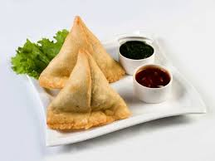
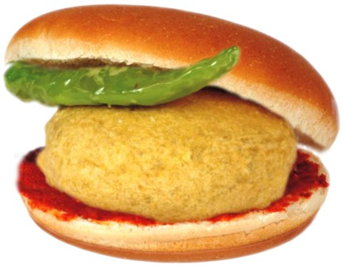

Slide 3
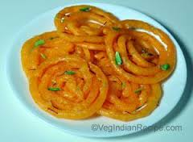

Slide 5
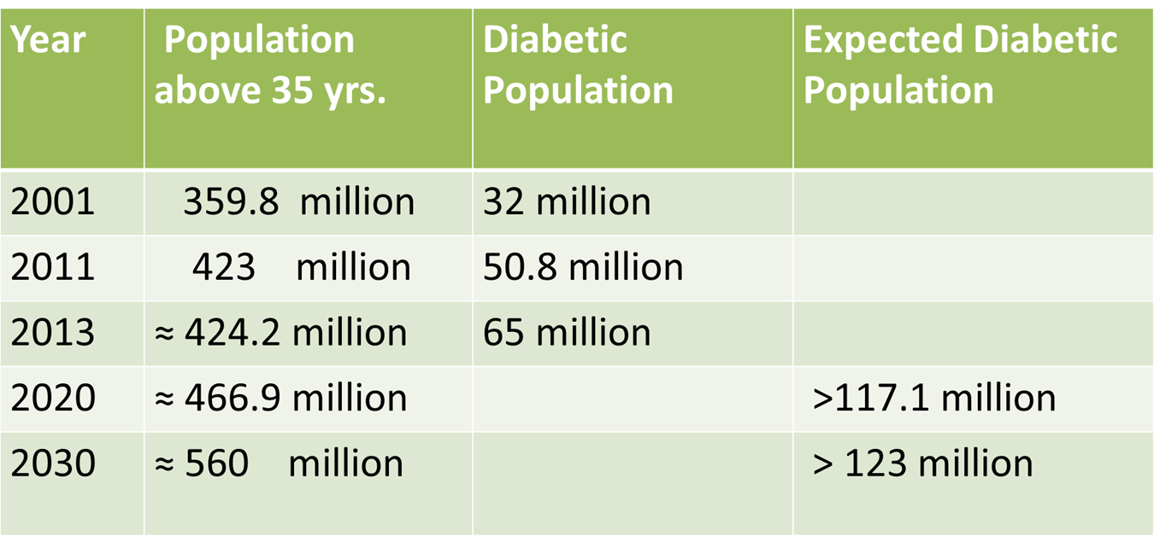
It was predicted by the scientists in 1990 that the number of diabetics will reach 100 million worldwide by 2013, but the actual number now is 382 million.
65.1 million Indians are diabetic & about 78 million are in pre-diabetes stage. There may be many more undetected.
The number predicted for 2030 is 123 million.

Slide 7
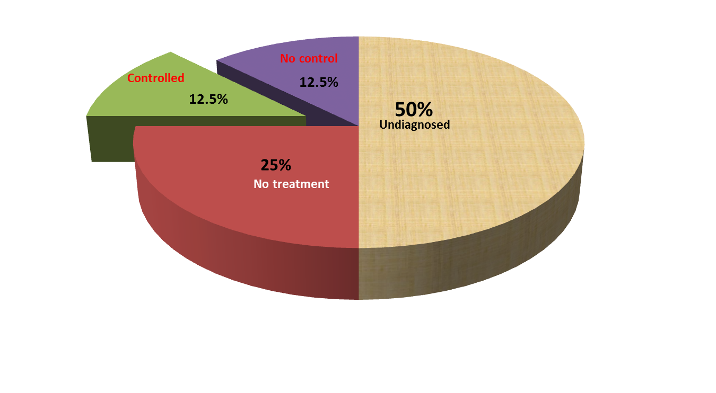
As per JNC 8 on hypertension, there are more than 1 billion hypertensive globally.
Indian number is 140 million & predicted number for 2030 is 214 million.
33% males & 32% females above the age of 25years are hypertensive. Many more are in pre-hypertensive stage.
Rule of half:

Slide 8
Youngistan India with more than
60% population below 35years.

Slide 9
Prevention of Diseases
Primary prevention: Health promotion & specific protection.
Secondary prevention: Early diagnosis & prompt treatment.
Tertiary prevention: Disability prevention & Rehabilitation.
Primordial Prevention-
Relatively new concept.
Prevention of development of risk factors themselves.
It is very important to change the environment that promotes major risk factor development.

Slide 10
Diabetes & hypertension are the biggest health problem & pandemic in human history.
Diabetes & hypertension is the deadly combination to have.
Let us see what are the common features
Both diabetes & hypertension are silent killers.
Causation for both is not definitely known. Genetic & environmental factors have a lot of influence.
Common Risk factors

Slide 12
Both have common complications:
Cardiovascular & cerebrovascular complications like myocardial infarction & stroke.
Nephropathy- leading cause of end stage renal disease globally.
Neuropathy- peripheral & autonomic.
Retinopathy- most common cause of preventable blindness worldwide.
For control of hypertension, sugar must be under control & vice versa.
Both the diseases & their complications are preventable by easy measures.

Slide 13
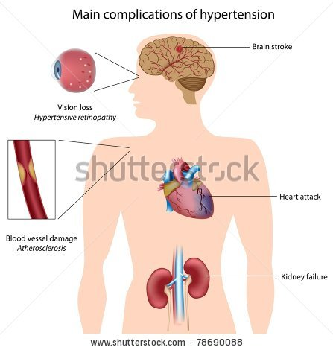
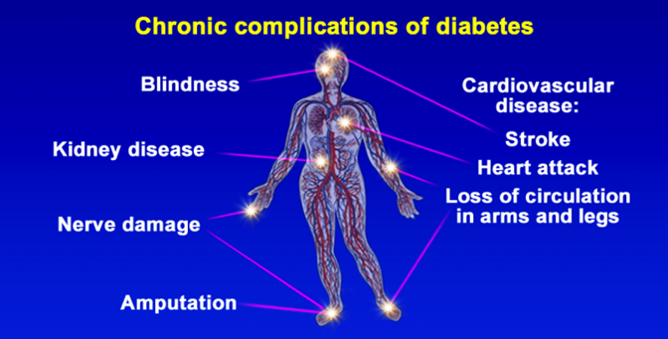

Slide 14
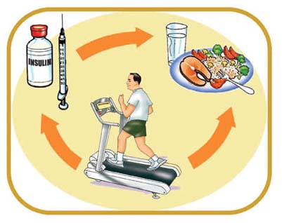
Medicines
Diet
Exercise

Slide 15
Role of life- style modification in diabetes prevention
Malmo study [Sweden]
Da Qing study [China]
Diabetes prevention study [Finland]
Diabetes prevention program [US]
Indian diabetes prevention program [India]
Conclusion:
On an average 30 to 40% reduction in diabetes development.

Slide 17
What can be done?
Parents, teachers & healthcare providers have very important role in imparting health education.
Conduct health awareness & education programs.
Canteens in the teaching institutes must serve healthy snacks & fruits in place of junk food like vada-pav, pizza, burger, samosa, aerated drinks, etc.
Compulsory physical exercise period at least three times in a week.
Psychological counseling sessions at schools to help children to tackle the stressors in their life.

Slide 19
Life style modification
Weight control
Regular physical exercise for at least 30 to 45 min. 5 days a week.
Salt restricted diet has proven advantage in controlling blood pressure.
Diet rich in proteins, complex carbohydrates, fruits & vegetables with less fats & sugars.
Abstain from smoking & alcohol consumption.
Maintain positive attitude towards life & manage stress by stress relieving activities, psychological counseling, etc.
Regular health check up.
HTN/DM groups

Slide 20
- Hypertension

Slide 21
I have to exercise early in the morning before my brain figures out what I am doing.
I exercised once, but found I was allergic to it. My skin flushed & my heart raced. I got sweaty & Short of breath. Very dangerous!!!
I joined the health club last year, spent around Rs 40,000/. Have not lost a pound. Apparently you have to show up.??????

Slide 22
& hypertension

Slide 23
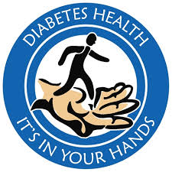
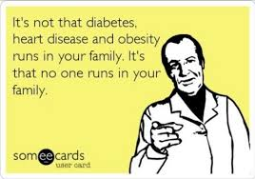
hypertension

Slide 24
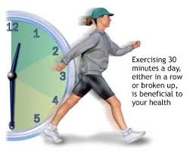

Slide 25
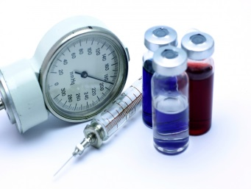

Slide 28
EBOLA- A GLANCE
Dr.Sandhya Raghavan
TIFR Medical Section
05/09/2014

Slide 29
EBOLA VIRUS
Ebola is a virus from filoviridae family.
Ebola virus has five strains.
In the present epidemic, all cases of Ebola virus have been reported in four countries: West and Central Africa, Liberia, Siberia and Nigeria.
As on today, no case has been reported in India. So please do not panic.

Slide 30
EBOLA VIRUS

Slide 31
Transmission
Initial human infection is believed to be by contact with body fluid of infected animal.
Person to person transmission requires direct contact with blood or other body fluids vomits, urine, feces and, probably, sweat.
Direct contact can lead to infection in the ritual washing or embalming of dead bodies of ebola victims.
The disease is not transmitted via air borne droplets, food or water.

Slide 32
Course of the disease
The incubation period is 8–10 days after exposure (ranging from 2–21 days). There is no evidence that asymptomatic persons still in the incubation period are infectious to others.
Non specific symptoms like fever, fatigue, headache, joint & muscle pains. Diarrhea, vomiting, abdominal pain, loss of appetite can also occur.
Less commonly patient may have sore throat, dry cough.
Bleeding from eyes or mouth may sometimes occur.
Patient may rapidly deteriorate in a week with multi organ failure & septic shock.
Mortality is 58%, death occurs between 7 to 16 days.

Slide 33
Investigation & treatment
There is no rapid diagnostic test available.
Virus culture, Real time PCR, ELISA test can be done.
Blood investigation may show decreased platelets between 50, 000 to 1 lakh; Liver enzymes may be elevated.
No specific treatment is available. Patient is treated symptomatically.
Barrier nursing is very essential to control transmission.

Slide 34
Precaution
Universal precautions- precautions to be taken considering each patient to be contagious.
Frequent hand washing is a very important preventive measure.
Covering nose/mouth while coughing or sneezing.
Avoid crowded places if you have symptoms of flu.

Slide 35
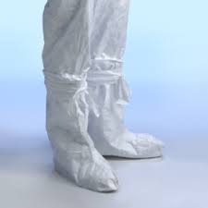
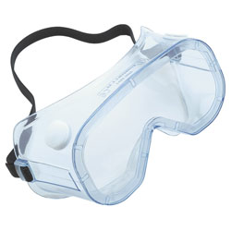
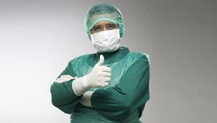
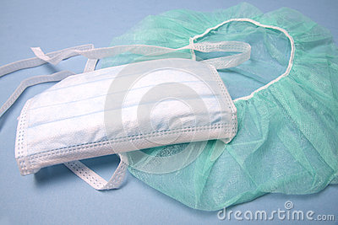
UNIVERSAL PRECAUTIONS

Slide 36
Things to be followed
Symptomatic patients should not be allowed to board a flight.
If a suspected patient enters in the country, he or she will be compulsorily isolated for 30 days.
As per the Indian government rules, all passengers who show symptoms that resemble with Ebola infection, should report to Health Officer on arrival.
In Mumbai, Kasturba hospital & Jogeshwari trauma center are designated for Ebola treatment.
Besides, anybody who has visited above mentioned countries and develops these symptoms, within 30 days of arrival in India should be vigilant & immediately visit designated hospitals.

