Slide 1
Preventing Cardiac illnesses & Sudden cardiac death: Heart surgery & what else?
Bashisth Mishra M.Ch.
Heart & Vascular Surgeon, Mumbai

Slide 2
Affiliations
Saifee Hospital Charni RoadMumbai
Reliance Hospital Kopar khairane Navi Mumbai
Bombay hospital Mumbai(Ex)
Apollo hospital Chennai(Ex)

Slide 3
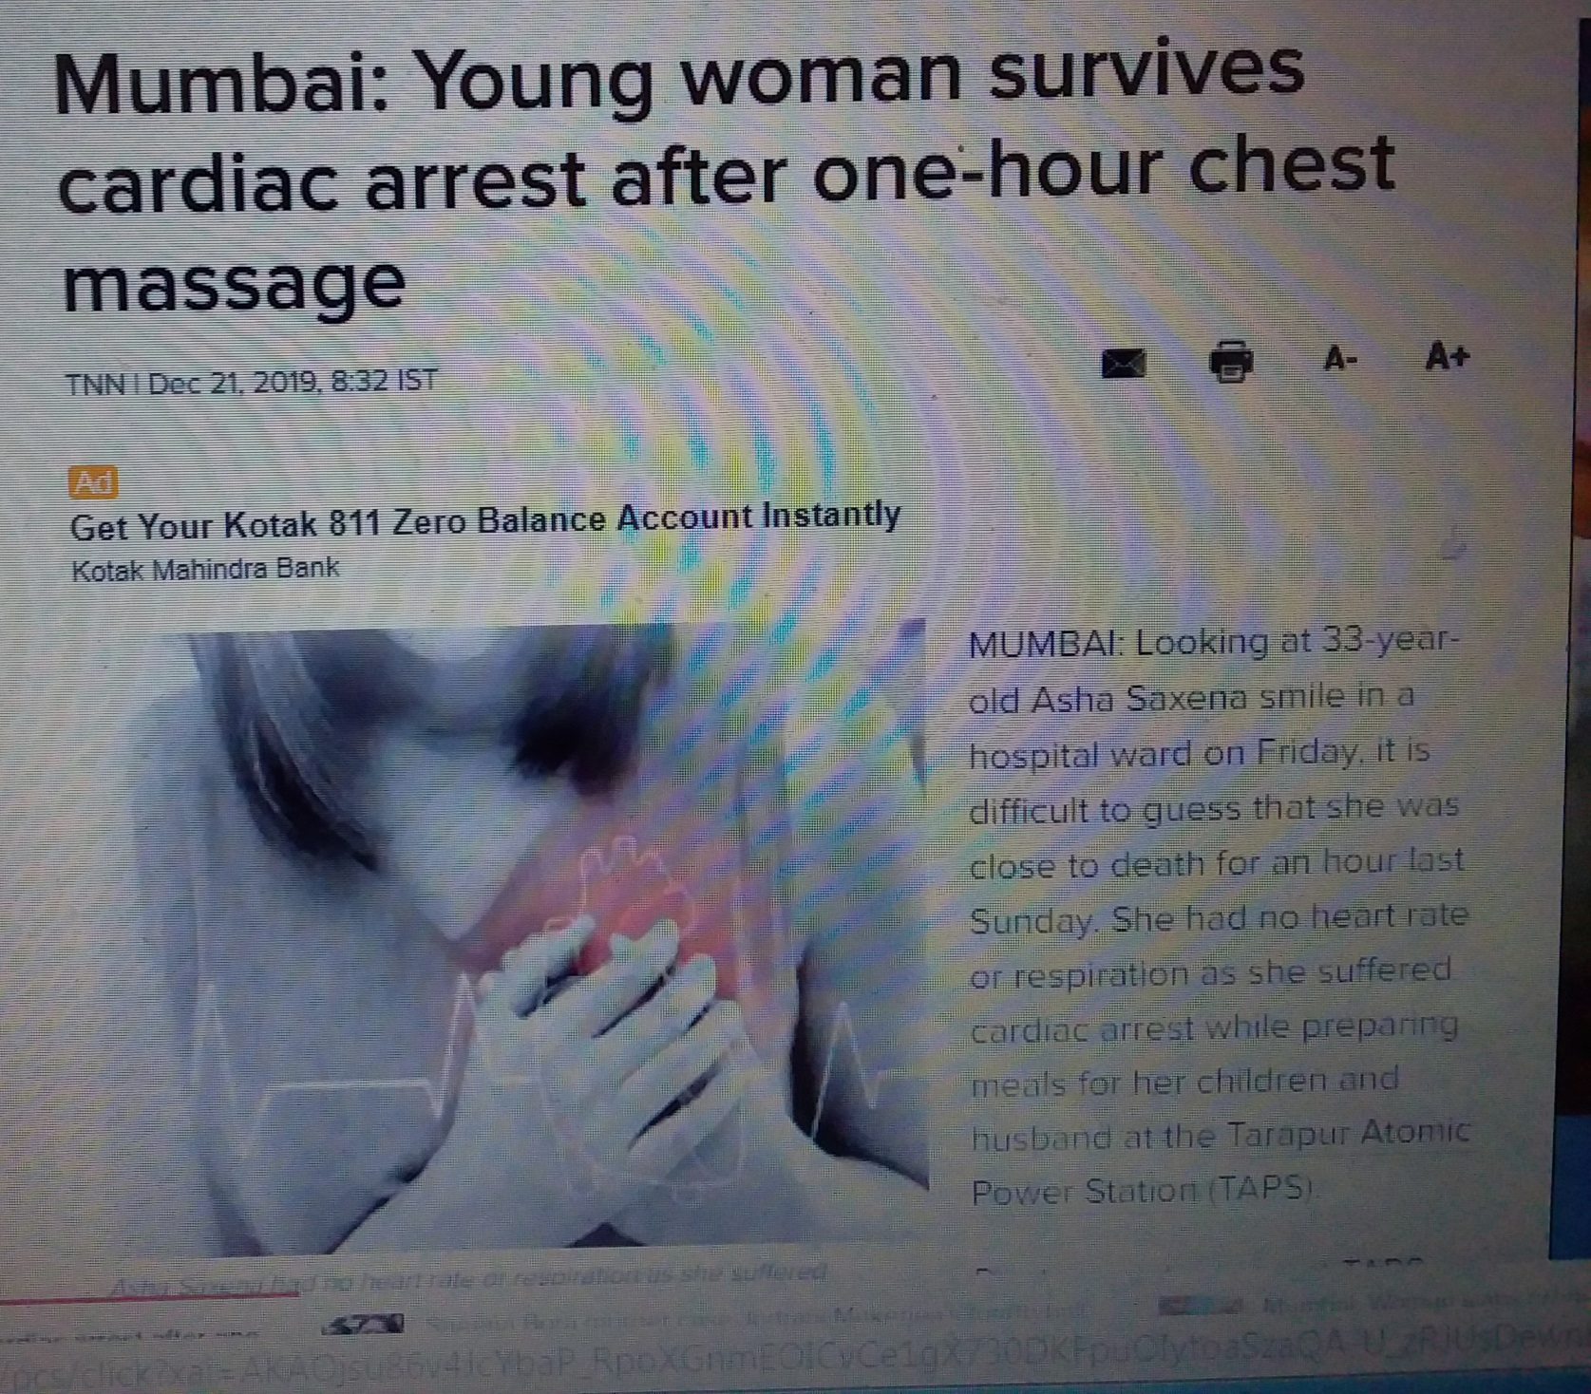

Slide 4
Visited two friends Shocked to learn!

Slide 5
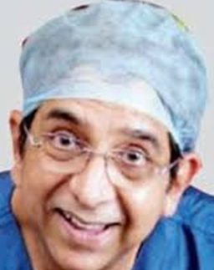

Slide 6
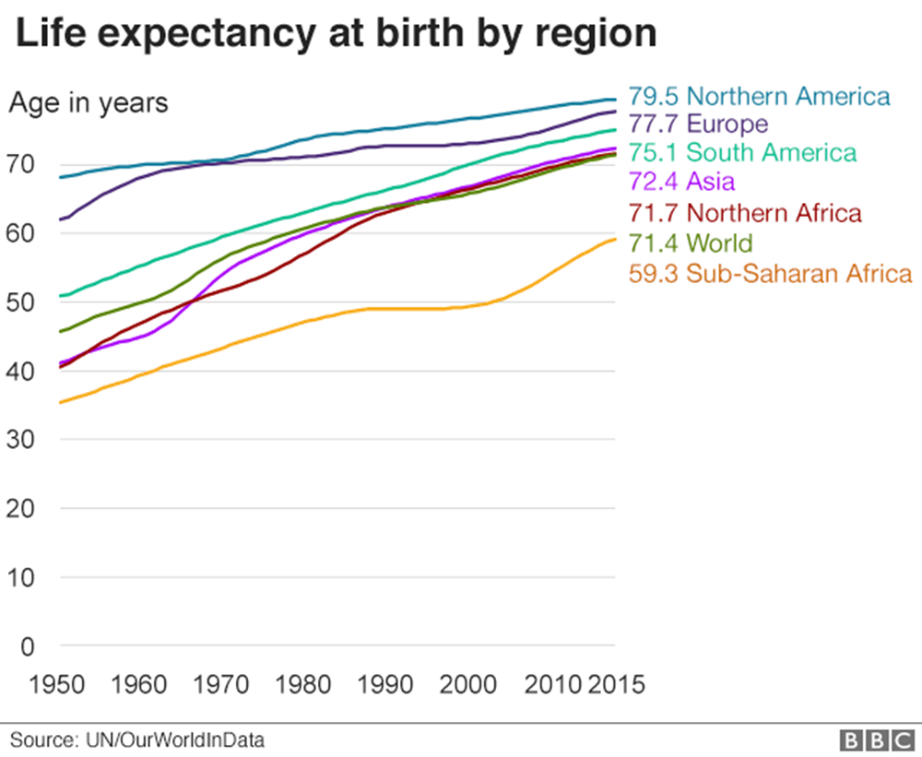
News paper stories
Devastating!

Slide 7
Magnitude of this problem
7 million people die world wide due to SCD.
320000 die due to SCD per year in USA(50% of all Heart death due to SCD)
0.1% is the overall incidence of SCD in population
Only < 8% survive after SCD in one of the most developed countries
1 in 100 000 athlete die due to SCD/year

Slide 8
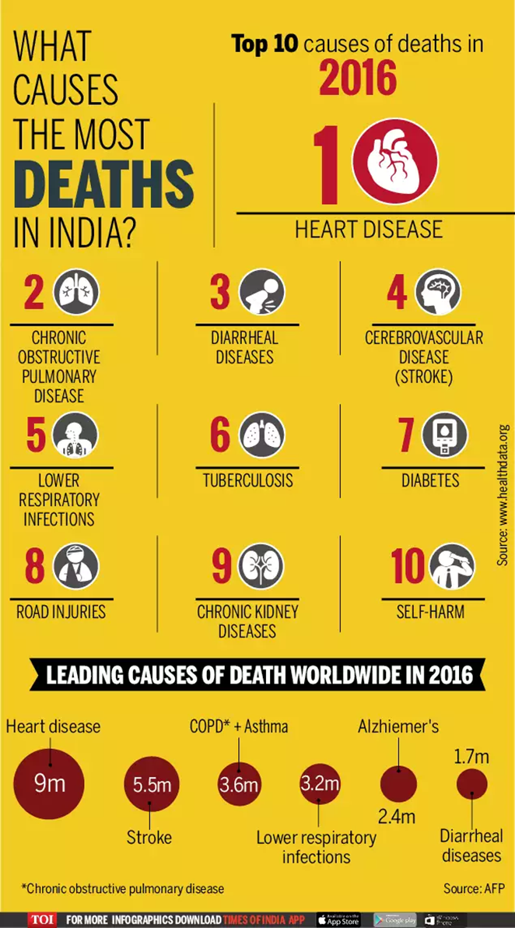
Magnitude of this problem

Slide 9
Magnitude of problem
Commonest cause of death world wide including India:
Cardiac disease (despite worldwide decrease in mortality from Heart illness)

Slide 10
Definitions
SCD: Sudden death in one Hour primarily due to heart problem in a person with or without prior presence of heart illness.
Heart Attack :Clinical condition Due to sudden severe decrease in blood supply to a part or whole of heart .

Slide 11
Journey starts

Slide 12
Purpose of this talk
Apprise you of existing problem and excite you to be proactive about your Health!
Details omitted for simplicity.
Does not intend to make you an expert & Advise you to contact the Expert if needed.

Slide 13
Common strategy
Coronary Artery Disease :CABG
Valve disease : Valve surgery
Aortic disease : Surgery
Congenital Heart Disease: Surgery

Slide 14
Advantages
Symptom Free survival
Quality of Life : Normal*
Longevity Increases
Complications of disease :Abolished
Sudden cardiac death :Abolished ☼

Slide 15
Culprits of SCD(sudden cardiac death) in young adults <35 yrs.
HOCM
Myocarditis
Coronary Anomalies(congenital)
Atheroscerotic CAD
Aortic Valve Or Aorta Disease
Arrhythmia
ARV Dysplasia
Channelopathies ( LQT /SQT Syndrome)
Burgada Syndrome
Coagulopathy
Commatio Cordis
Unknown

Slide 16
Culprits of SCD in persons of >35 year
Coronary Artery Disease(>80%)
Any Of The Previous
Unknown

Slide 17
Common causes
CAD( Coronary artery disease)
Arrhythmia
HOCM( Hypertrophic obstructive cardiomyopathy)

Slide 18
Warning signs
Repeated Attacks Of Syncope
Sudden VT /VF Needing Treatment
Unexplained Syncope/Seizure
Difficulty In Breathing

Slide 19
But Medicine has very little role to play!
Cholesterol.
Poly-pills / Statins
You cannot hire some one to do exercise for you!.

Slide 20
Causes of heart disease
Genetic : Marfan Syndrome /TOF
Environmental: COPD/Peptic Ulcer Disease
Genetic Predisposition & Environmental Causation: Smoking & Lung Cancer

Slide 21
S C D (sudden Cardiac Death)
Prevention is better than cure !
Primordial
Primary
Secondary
Screening in SCD Relatives

Slide 22
Primordial prevention
Avoiding risk factors to develop in first place!
K.Srinath Reddy1999, Primordial Prevention of Coronary Heart Disease in India: Challenges and Opportunities, Elsevier Preventive Medicine, Volume 29, Issue 6, December 1999, Pages S119-S123
Matthew W. Gillman 2015, Primordial Prevention of Cardiovascular Disease, Circulationaha.115.014849 Circulation. 2015;131:599–601

Slide 23
Primordial prevention
Primordial prevention focuses population based…. Healthy life style choices to minimize coronary risk factors

Slide 24
Primordial prevention
Andrea et al 2015, Healthy Lifestyle in the Primordial Prevention of Cardiovascular Disease Among Young Women, Journal of the American College of Cardiology,Jan 6 Vol 65, Issue 1, 43-51.

Slide 25
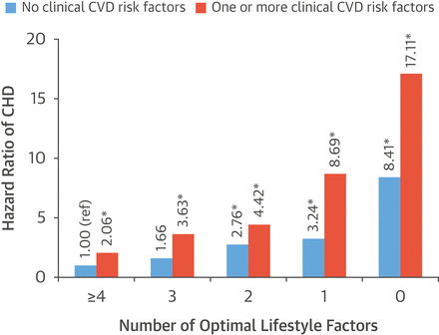
Primordial prevention
Enormous potential!

Slide 26
Primary prevention
Treating/Modifying risk factors to prevent
OR
Delay development of Cardiac disease!

Slide 27
Risk factors
Stress
Smoking
Blood pressure
Cholesterol
Diabetic
Lack of exercise/Obesity
Unhealthy food
Family history/Genetics
overall unhealthy life style

Slide 28
Stress &Smoking: Avoid it!
Joel E 2008, Psychological Stress and Cardiovascular Disease, J Am Coll Cardiol. Apr 1; 51(13): 1237–1246.
Jaskanwal et al. "Association Between Work‐Related Stress And Coronary Heart Disease: A Review Of Prospective Studies Through The Job Strain, Effort‐Reward Balance, And Organizational Justice Models". Journal Of The American Heart Association, vol 7, no. 9, 2018.
Stress causes or increases Heart disease vulnaribility?

Slide 29
Stress
Psychological stress contributes to cardiovascular disease at several stages, including the long-term development of coronary heart disease and acute triggering of cardiac events.
Steptoe & Kivimäki 2012, Stress and cardiovascular disease, Nature Reviews Cardiology volume 9, pg 360–370.

Slide 30
Stress
Short-term psychological stress triggers acute myocardial infarction
Stress at work and in private life is associated with a 40–50% increase in the occurrence of coronary heart disease
Long-term stress is associated with poor prognosis among patients with established coronary heart disease.
Stress-management interventions improve the quality of life in these patients

Slide 31
Blood Pressure: control it!
Damages every organ
Causes Heart failure
Can cause heart illness/coronary artery disease
Can cause Stroke /Hemiplegia/Paraplegia
Can cause Ac Dissection/Sudden death

Slide 32
Cholesterol: control it!
Coronary Plaque
Acute Heart attack
Sudden Death due to Heart attack

Slide 33
Diabetics: control it!
Diabetic damages every organ like Heart ,Vascular system, Kidney /Brain
Double the risk of heart failure in men and increases it by 5 times in female
Metabolic derangements are responsible for many of its effects

Slide 34
Exercise : Do it!
Improves blood circulation in heart brain and
almost every other organ of body.
Helps skeletal system to function better.
Development of Collaterals* in heart vessels.
Decreases the risk of Mental illness.

Slide 35
Food & Fat (Obesity):Healthy food habits & avoid excess fat!
Healthy food .
Fat is a risk factor for obesity as well.(30% OBESE)
Obesity is a part of Cardio metabolic syndrome

Slide 36
Secondary Prevention
Definition : Treating to avoid further complications once it has
Manifested.
AED(Automated External Defibrillator)
&
AICD( Auto Implantable Cardioverter & Defibrillator)

Slide 37
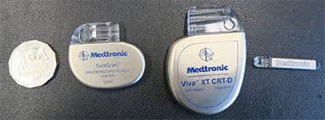
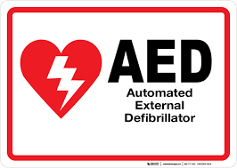
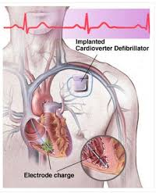

Slide 38
Who should have it?
Any one with H/O sudden heart attack and high chance of
SCD with expected life expectancy more than 1 yr.

Slide 39
Genetics of SCD
Priori 2014, Genetic testing to predict sudden cardiac death: current perspectives and future goals, Indian Heart J. 66(Suppl 1): S58–S60.
Robert & Roberts 2017, Discovery of a Gene Responsible for Sudden Cardiac Death, Clinical Electrophysiology. Volume 3, Issue 3, March 2017
Bezzina et al. 2015, Genetics of Sudden Cardiac Death Originally published 5 Jun 2015, Circulation Research. 2015;116:1919–1936

Slide 40
Genetics of SCD
JACC: Clinical Electrophysiology
Volume 3, Issue 3, March 2017
Editorial comment by Robert Roberts
Discovery of a Gene Responsible for Sudden Cardiac Death.
Very positive & can hold a great preventive significance

Slide 41
Ways to prevent SCD
1.Awareness/Knowledge
2.Therapeutic/Preventive strategy
3.Genetic screening for victims of SCD relation…. concerns of anxiety if incorrect ,cost of procedure….,Unavailability at major centres
4.Post mortem examination of SCD victims & its use for prevention!

Slide 42
Role of Government & Medical community
Spread awareness by various initiatives& social education Enforce preventive measures as enumerated above
Train manpower & community to handle such cases in CPR & use of AED.
Invest in AED & AICD/Research for effective medicines.

Slide 43
Genetics in prevention of SCD
Routine Endomyocardial Bioplsy & Genetic Testing …
For All Cases Of SCD Holds A Great Promise For Future
And Can be Applied For Preventing SCD In Community
In General & Relatives Of SCD Victims In Particular !

Slide 44
Sudden cardiac death
A: Avoid stress & smoking
B: Blood pressure control it
C: Cholesterol Control it
D: Diabetics control it
E: Exercise Do it.
F: Food habits Maintain healthy ,Avoid fat.

Slide 45
Take home message
Be proactive & Follow ABCDEF
Thank you

