Slide 1
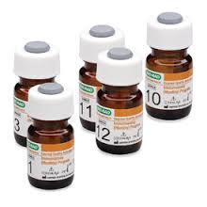
Quality Control – Part II
Mrs. Neelam M. Surve
Medical Section
Pathology Laboratory

Slide 2
What is External Quality Control (EQC) ?
How it is done ?
Importance of EQC
In our Laboratory, what we do for Quality Control ?
External
Quality
Control

Slide 3
External Quality Control (EQC)
System
Evaluation
For checking Laboratory’s performance
by an 3rd party
Of the performance by numerous laboratories
Using external agency
With specially supplied samples

Slide 4
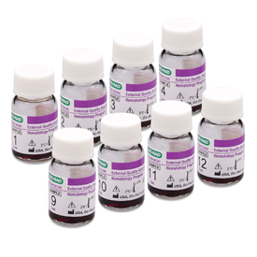
Process of External Quality control (EQC)
Laboratory
Report
Test
External Quality Control
Method
Send results to
organizer
Registration
Machine
Reagents
Pack of
12 lyophilized Samples
Processing one Sample every month

Slide 5
Why EQC is needed:
Complementary
Activities
IQC
EQC
Outside Agency - 3rd party
certification and can not be manupulated
Within the Lab
Maintaining the long term accuracy of the analytical
Methods
Daily monitoring of the precision and accuracy of analytical method
Ensure the laboratory is performing to an external standard.

Slide 6
TIFR Lab. Quality Control

Slide 7
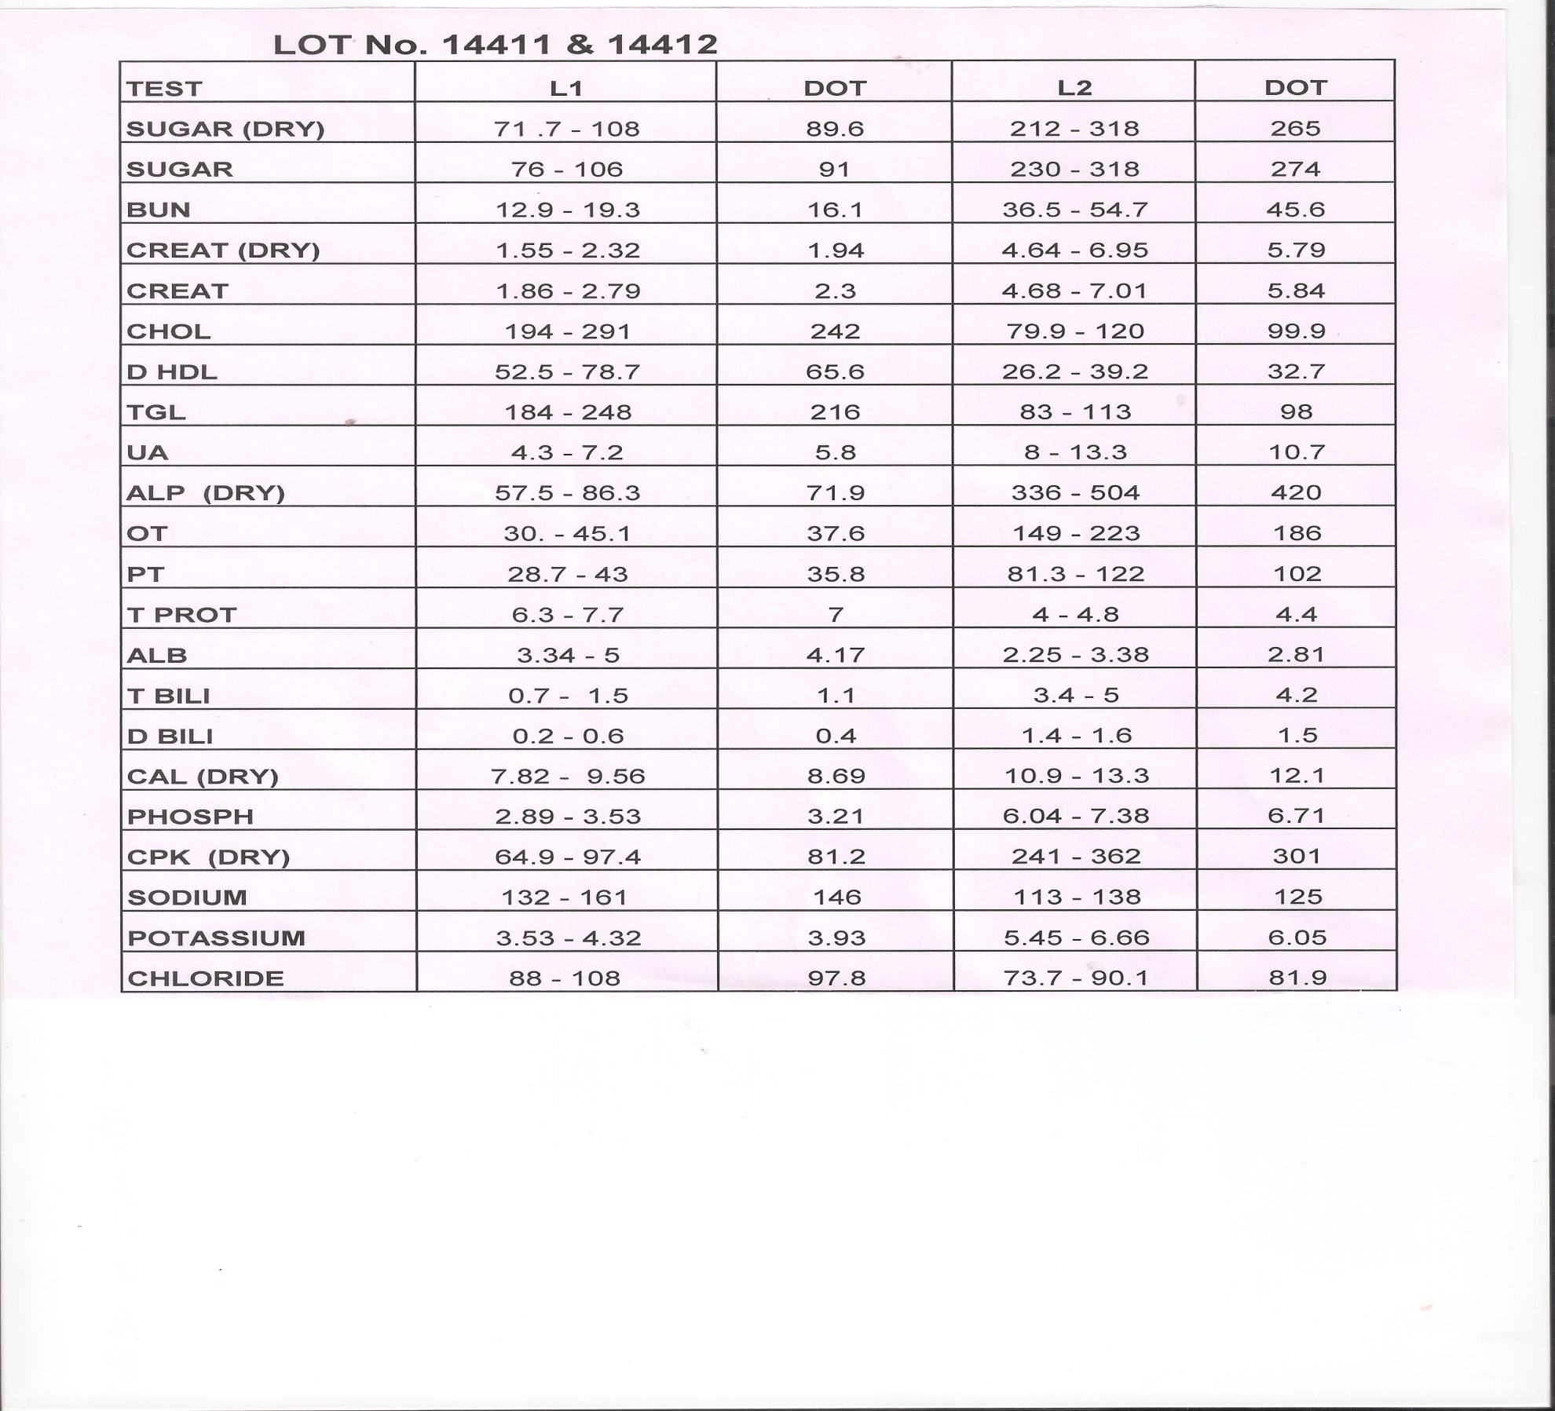
Internal Quality Control (IQC):
Everyday - Control level 1 and level 2

Slide 8
Other Internal Quality Control procedures :
Calibration is done as per specifications and whenever required.
Checking reagent stock and expiry date regularly.
Checking previous reports
Re checking Results –
i) abnormal values i.e. low or high values
ii) values deviating from previous values
Every year Annual Maintainance Contract (AMC) is done for all the machines.

Slide 9
External Quality Control (EQC) :
From June 2004 ,we started doing EQC.
Before this we used interlaboratory testing by sending samples to BARC lab and Dr. Shekhar Sheth lab.
In 2004 : External Quality control Programme of Erba Mannheim (Germany) Quality Assurance System (EM – QAS)
Our laboratory has consistently received grade ‘A’ certificate for our excellent performance

Slide 10
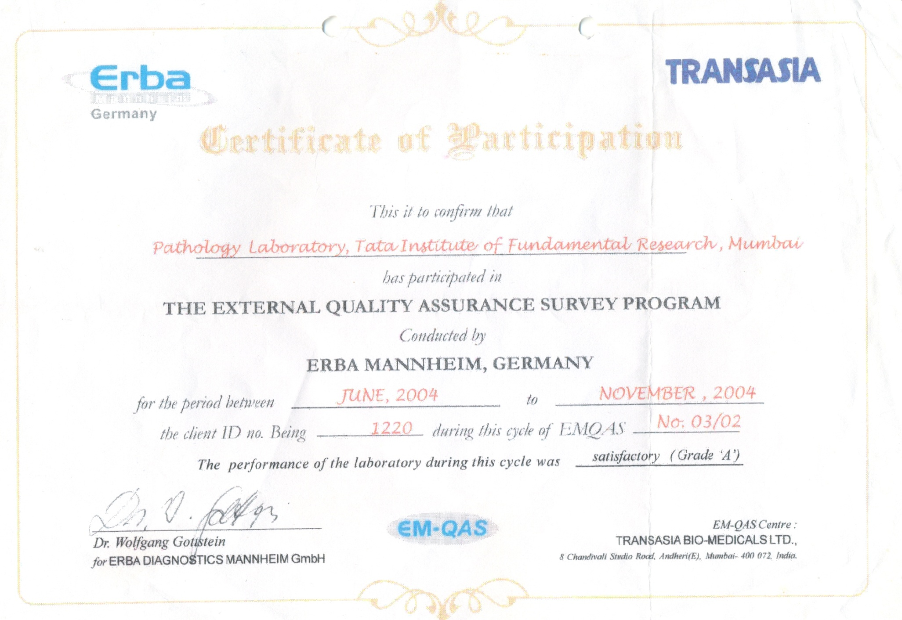

Slide 11
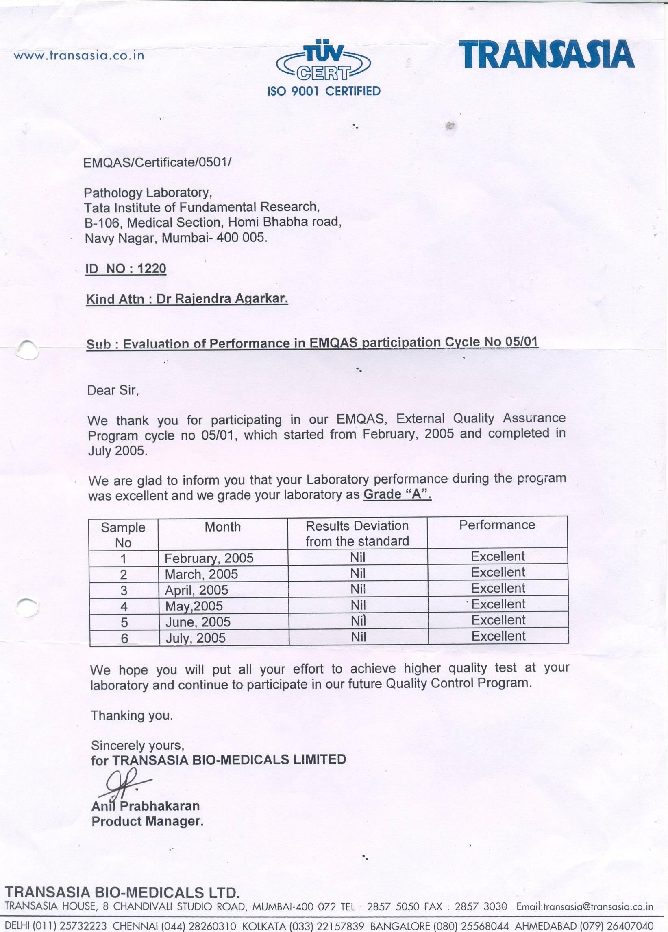

Slide 12
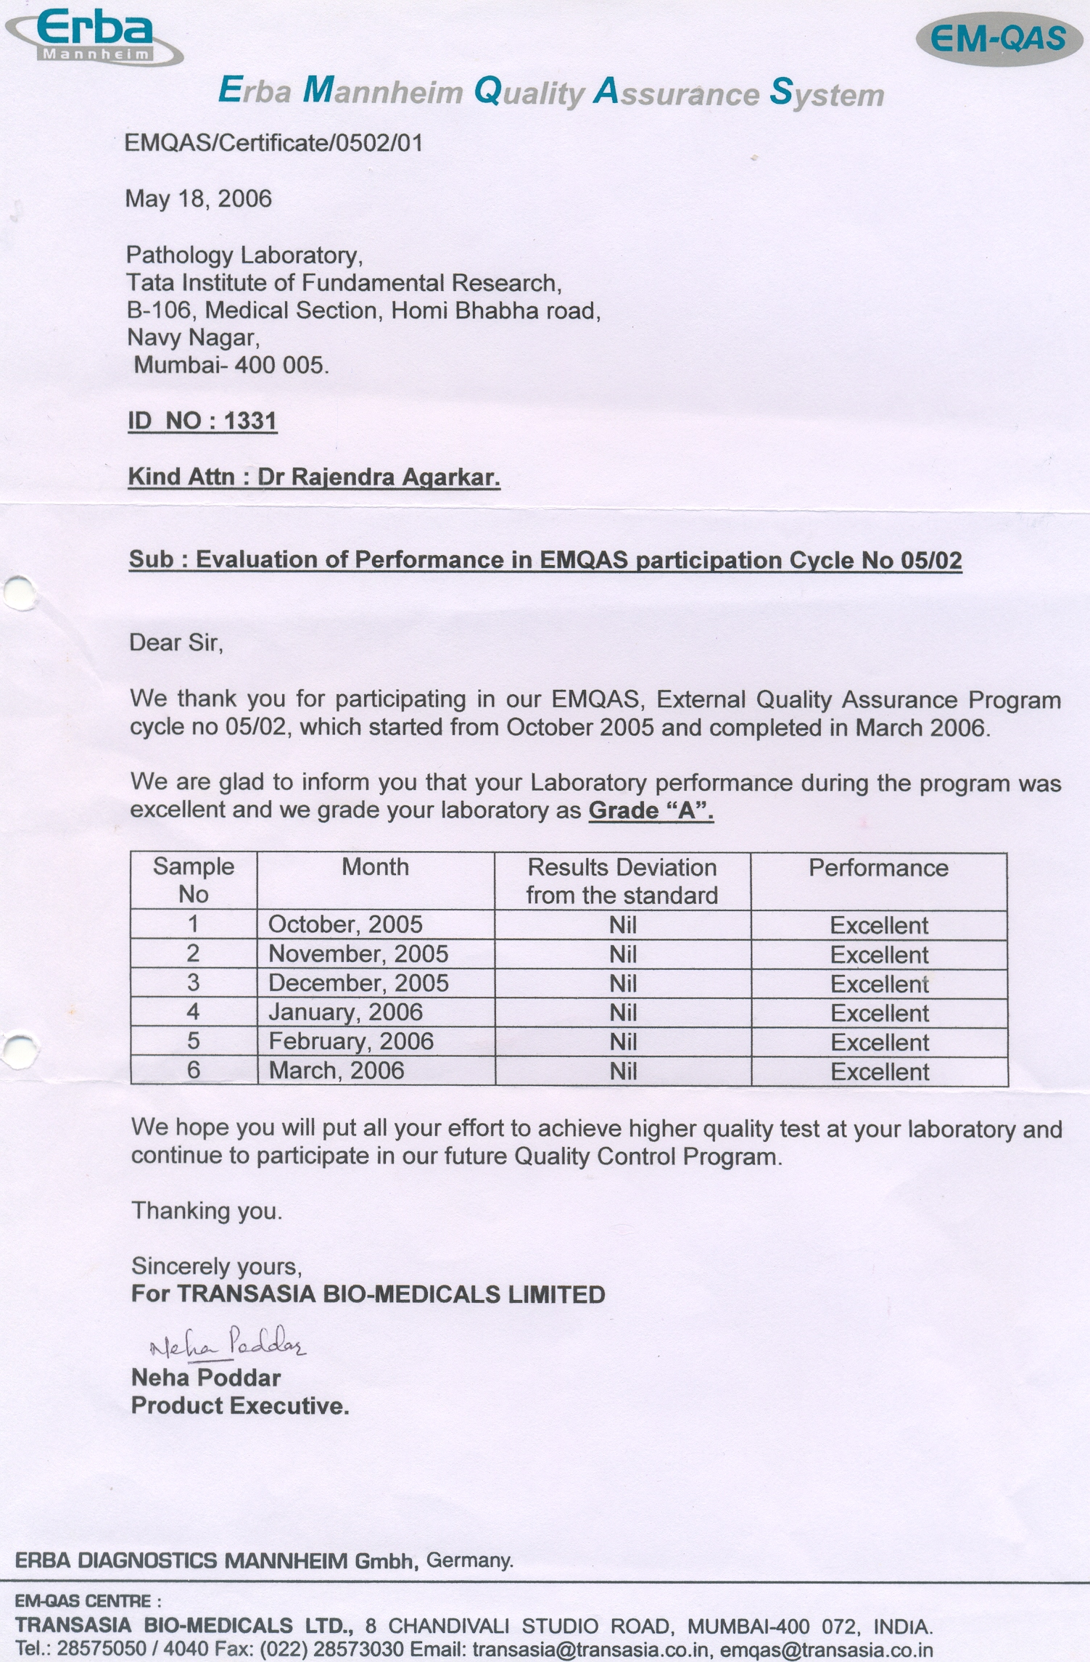

Slide 13
EQAS ( External Quality Assurance System) program
Since 2007
EQAS ( External Quality Assurance System) program
International Prog. conducted by Bio-rad
participants from over 109 countries & 5000-6000 labs
One year prog. from July to June
23 Parameters

Slide 14
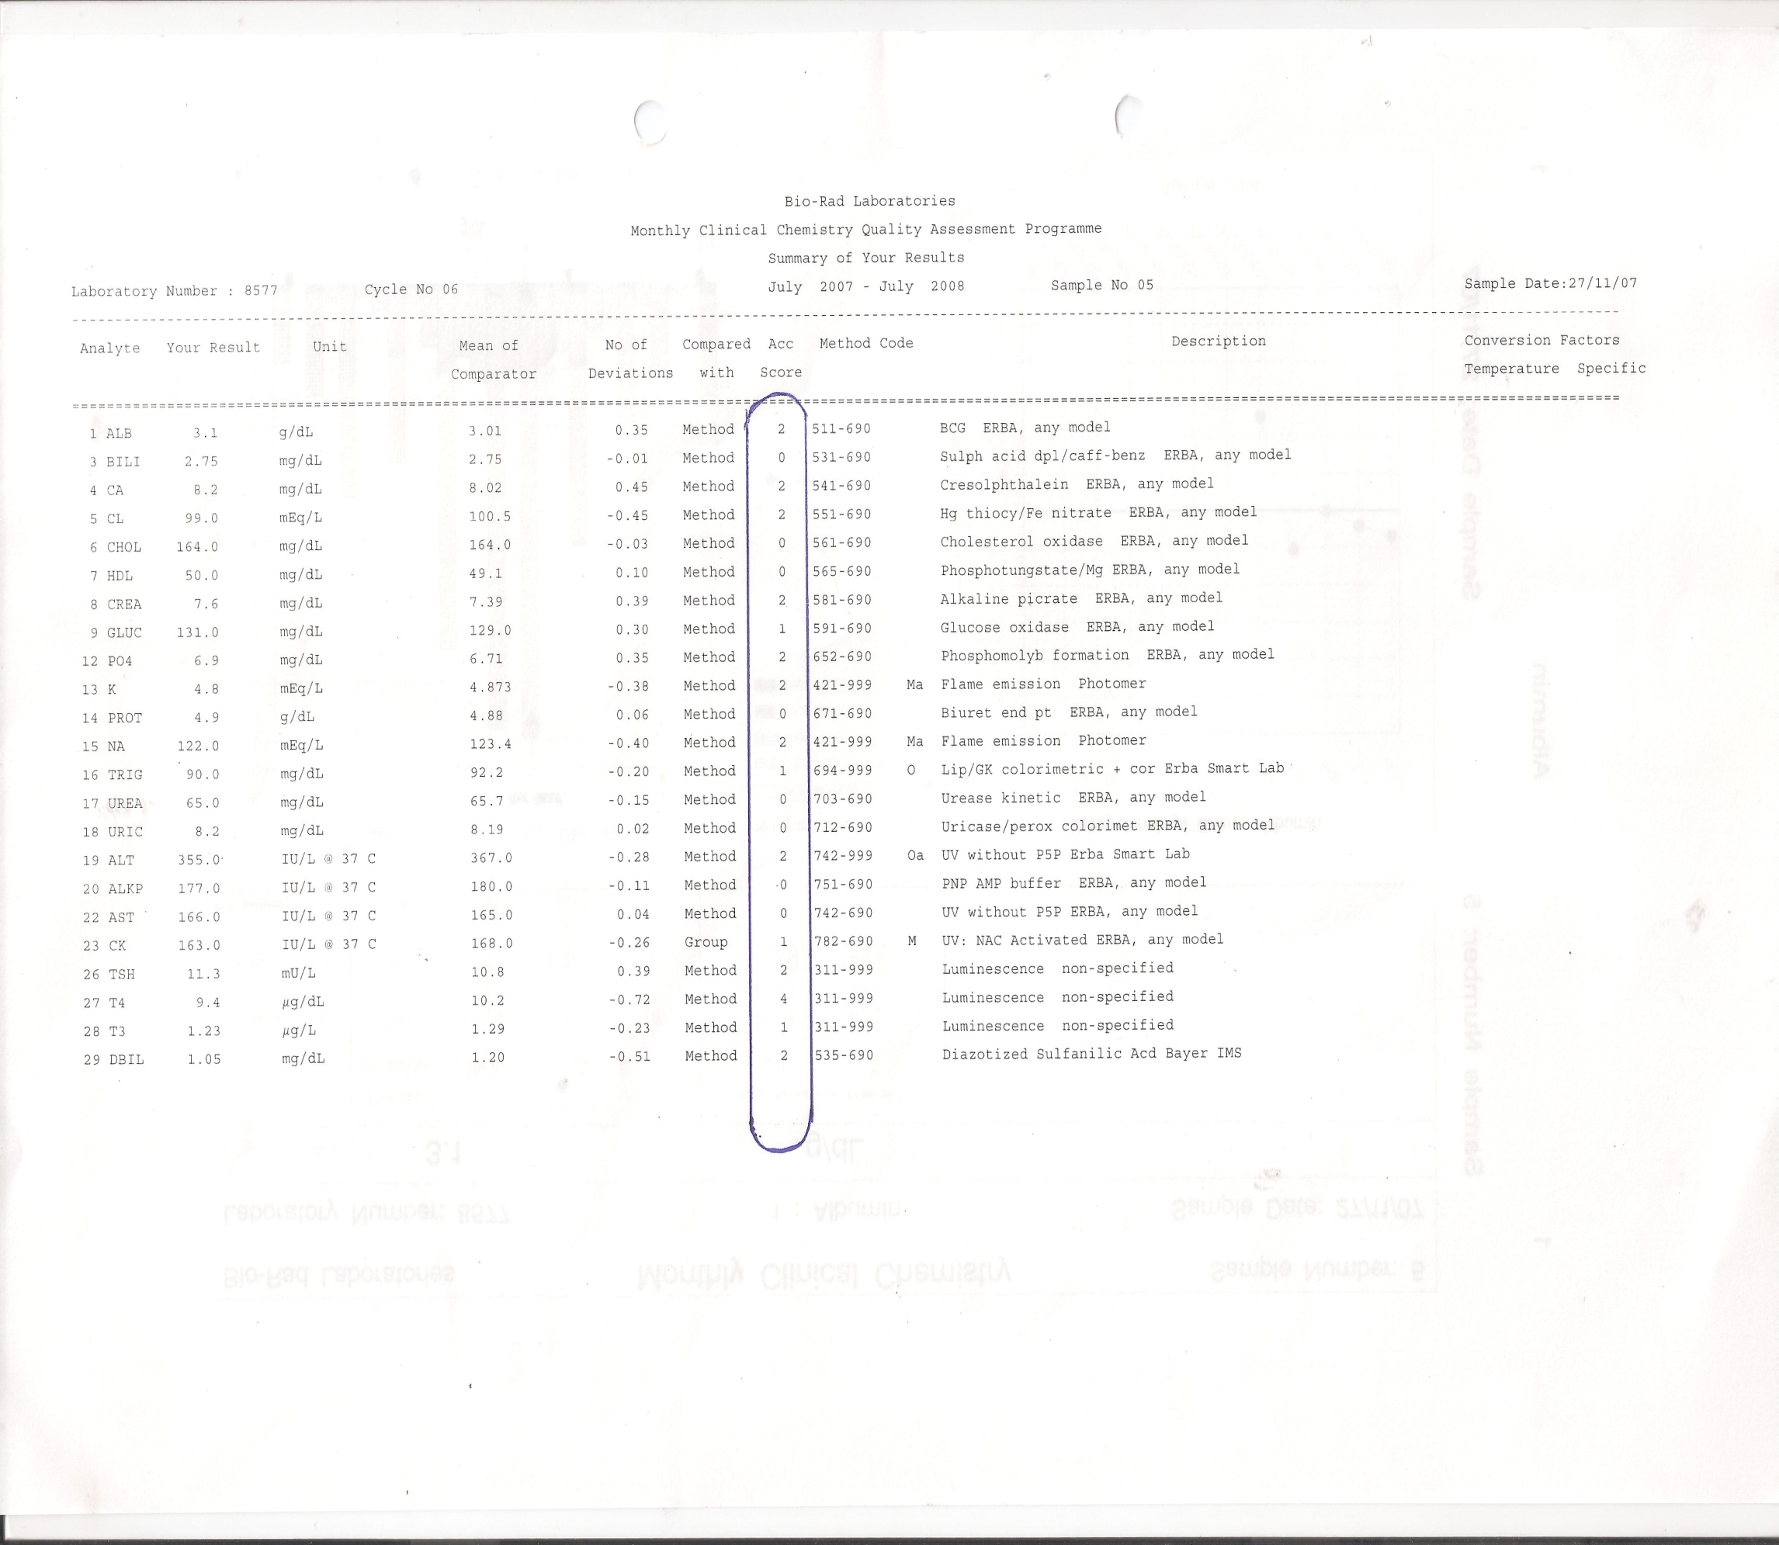

Slide 15
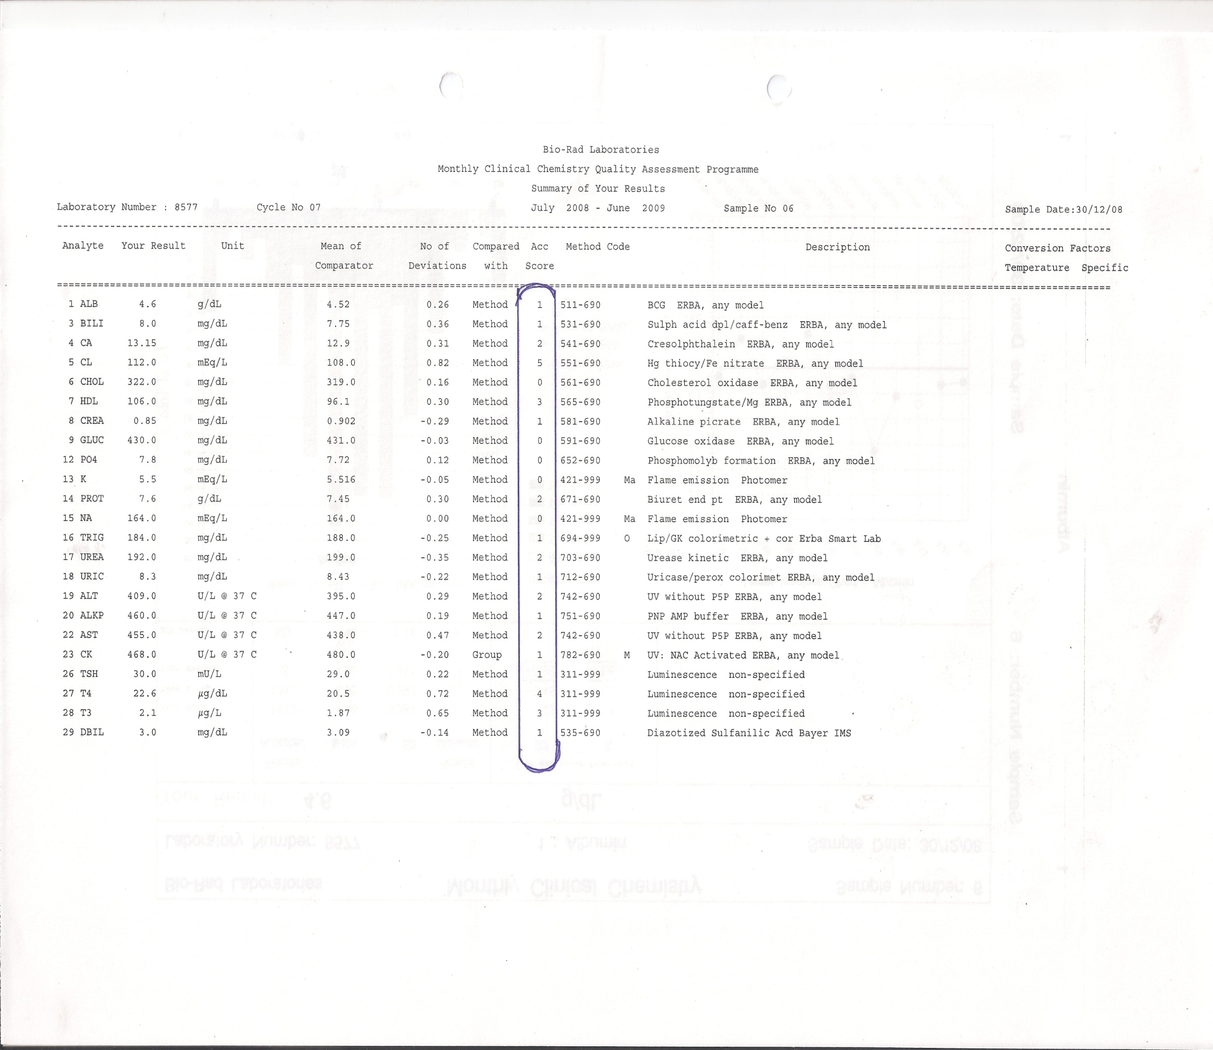

Slide 17
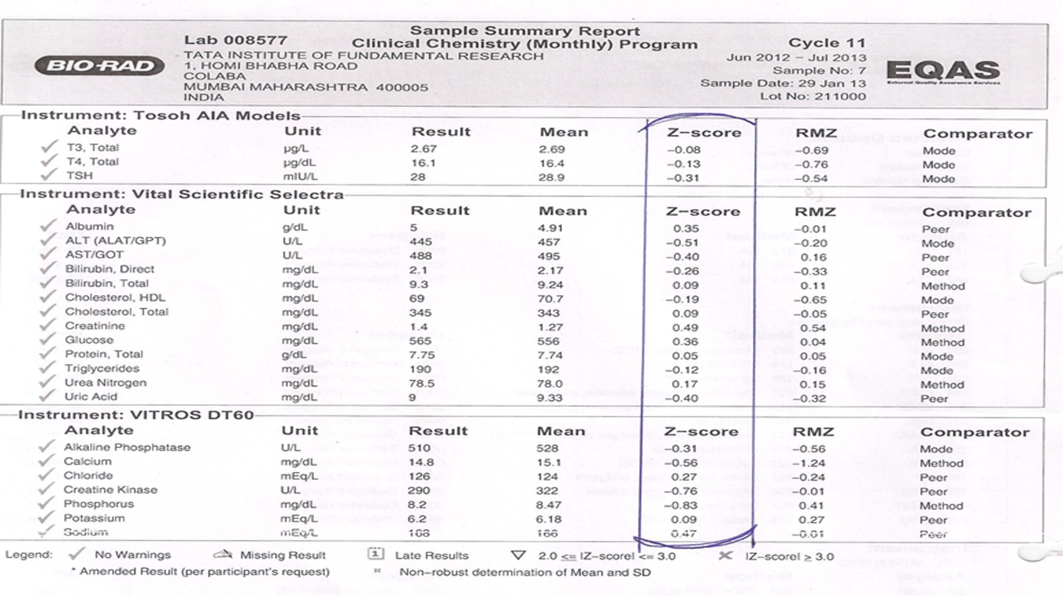

Slide 21
Other External Quality Control procedures :
Whenever new test is started , sample is sent to SRL Lab, Shahabazkar’s Lab for rechecking the results.
All the precautions are taken to avoid all types of errors.
To upgrade our knowledge, we attend seminars and CMEs arranged by Tata Hospital and Bio-rad every year.

Slide 22
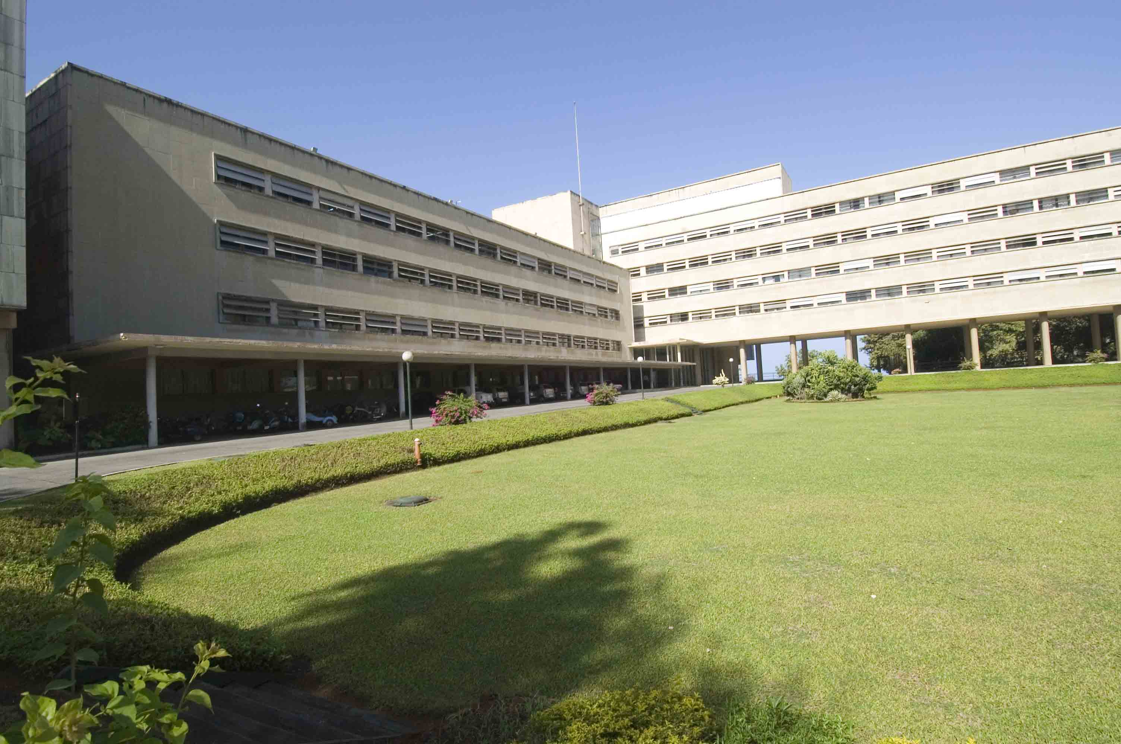
Thank You

