Slide 1
Verification of pairwise non-locality trade-off
in pure symmetric 3-qubit states
using the IBM open access quantum computer
Humera Talat, A R Usha Devi
Department of Physics, Bangalore University, Jnanabharathi, Bengaluru-560056, India
Sudha, B P Govindaraja
Department of Physics, Kuvempu University, Shankaraghatta-577129, India.

Slide 2
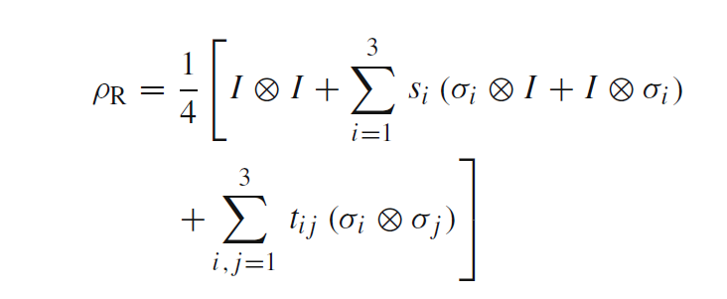
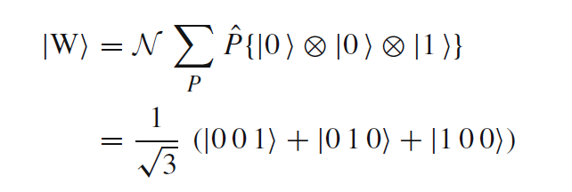
Majorana construction of 3-qubit pure
symmetric state with 2 distinct spinors
2-qubit reduced state of

Slide 3
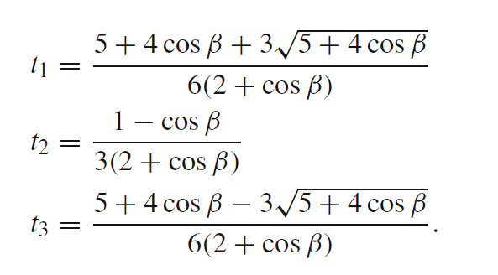
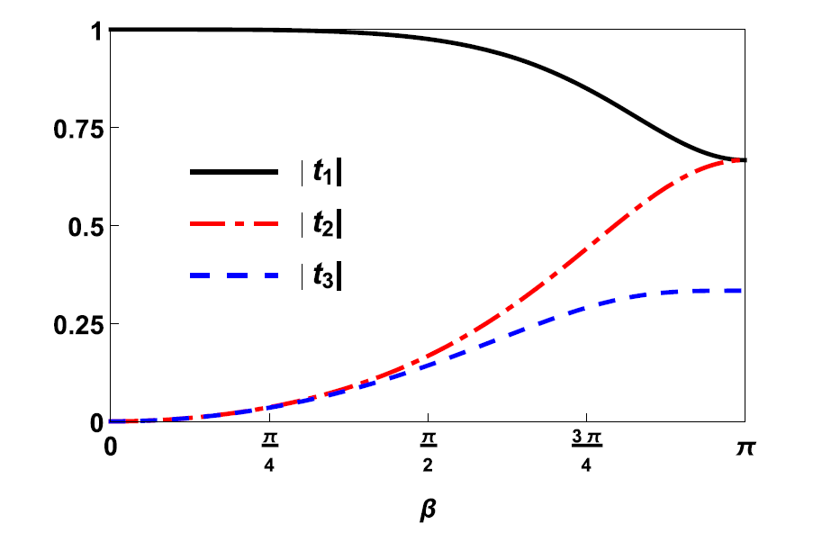
Bell-CHSH Inequality
Correlation matrix of $ρ_{R}$
${〈CHSH〉}_{AB}=〈A_{1}⊗ B_{1}〉+ 〈A_{1}⊗ B_{2}〉+〈A_{2}⊗ B_{1}〉−〈A_{2}⊗ B_{2}〉$
$〈A_{i}⊗ B_{j}〉=Tr\left[ρ_{AB}A_{i}⊗ B_{j}\right]$, ${ A}_{i}=\vec{σ}. {\vec{a}}_{i}, B_{j}= \vec{σ}. {\vec{b}}_{j}, i,j=1,2$
Pauli observables with orientation directions ${\vec{a}}_{i}, {\vec{b}}_{j}$of qubits $A, B.$
Correlation probabilities
evaluated based on the
measurement outcomes
of the observables
of Alice and Bob
Maximum value
Absolute values
two largest eigenvalues of

Slide 4
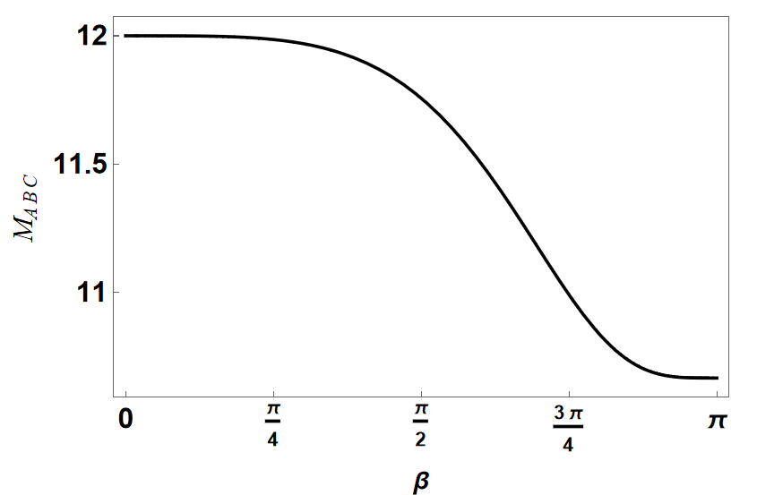
Monogamy trade-off relation in the case of 3-qubit states
Monogamy constraint imposes the trade-off relation
$𝕸_{ABC}≡{〈CHSH〉}_{AB}^{2}+{〈CHSH〉}_{BC}^{2}+{〈CHSH〉}_{AC}^{2}≤12$
3-qubit permutation symmetric states
${〈CHSH〉}_{AB}={〈CHSH〉}_{BC}={〈CHSH〉}_{AC}$
CHSH Monogamy relation
Any arbitrary 2-qubit state extracted from 3-qubit permutation symmetric system cannot violate CHSH inequality, even though the constituent qubits are entangled.

Slide 5
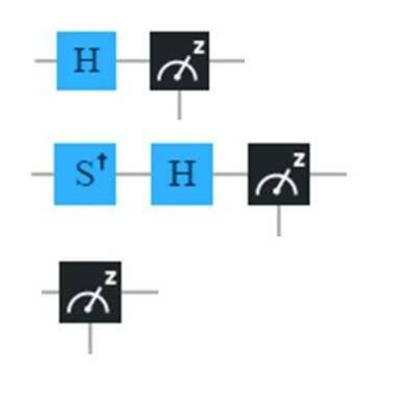
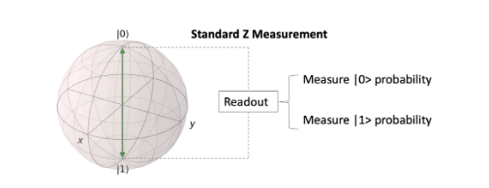
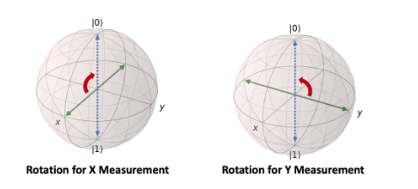
Verification of monogamy relations using open access IBM quantum computer ibmq_lima
Using IBM open-source software kit Qiskit we initialize the 3-qubit state $|\left.Ψ_{3,2}\right\rangle$ for $β=π/6,π/4, {3π}/8, {9π}/{16} , π$.
Recording measurement data on the 2-qubit reduced density matrices and construction of correlation matrix T
Experimental verification of monogamy relation $𝕸_{ABC}≤12$
X measurement
Measurements of Pauli gates X, Y and Z
Y measurement
Z measurement
Measurement of the X or Y Pauli matrices requires application of unitary rotation operation so as to rotate the X - or Y –axis to be the Z-axis.

Slide 6
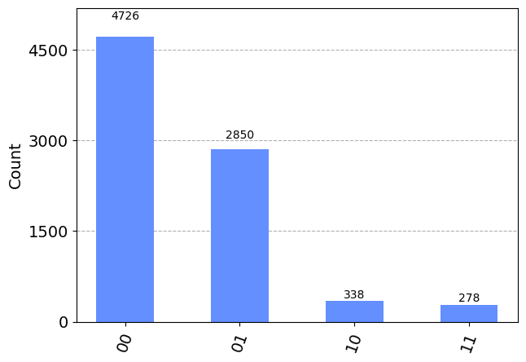
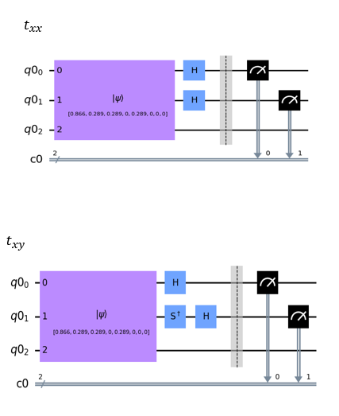
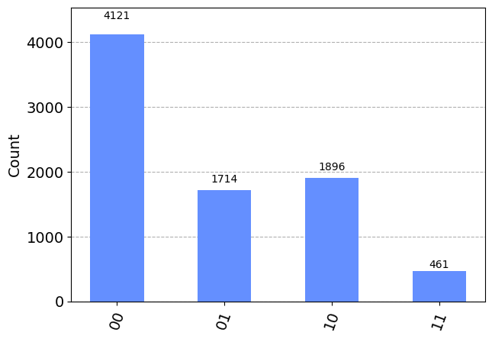
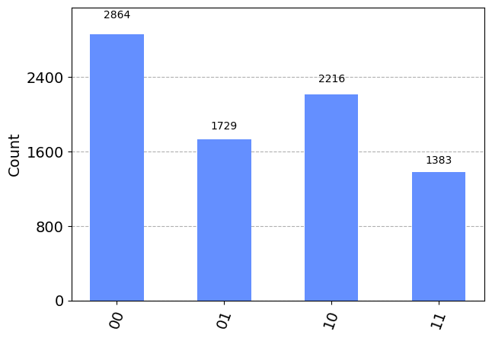
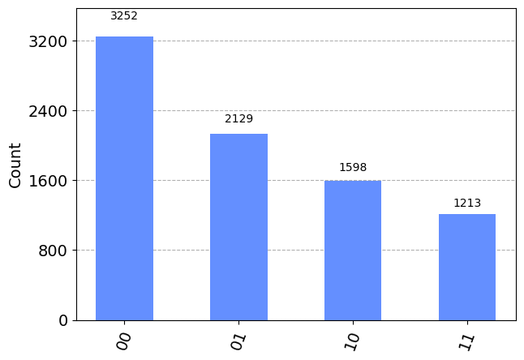
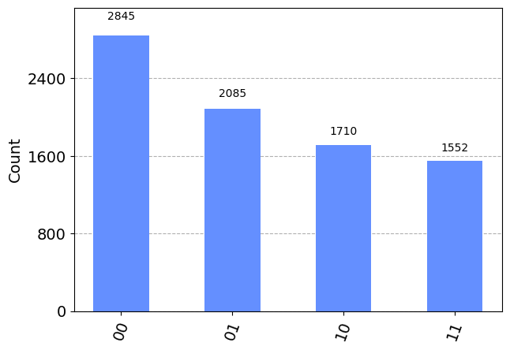
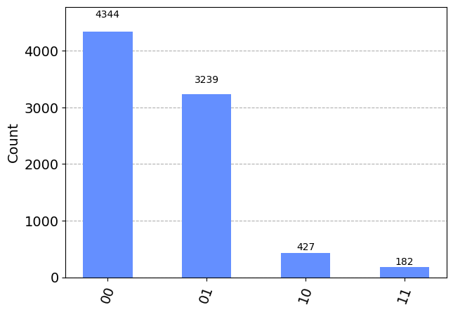
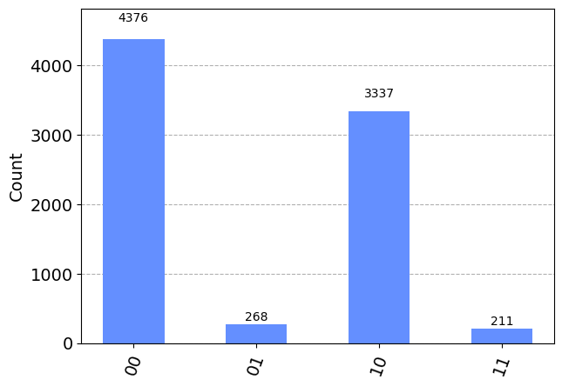
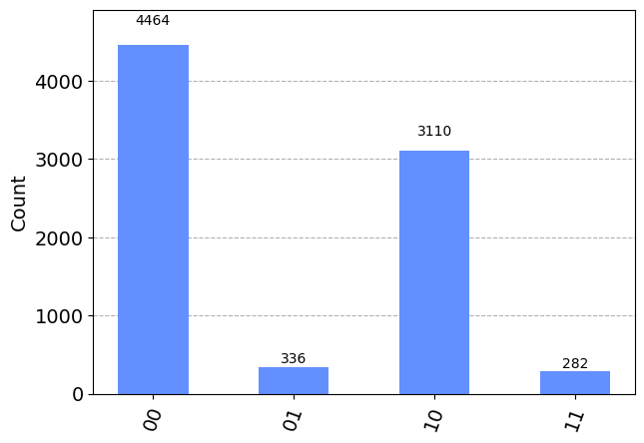
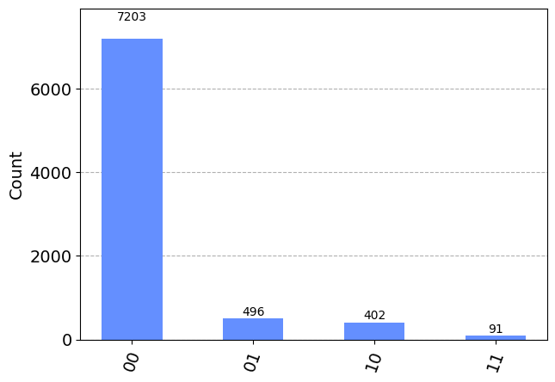
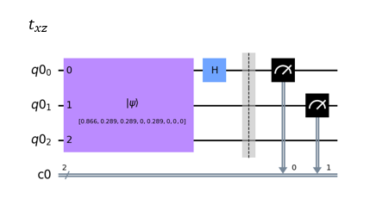
𝑀𝑒𝑎𝑠𝑢𝑟𝑒𝑚𝑒𝑛𝑡 on qubits 1 & 2: C𝑜𝑢𝑛𝑡𝑠 for $β=π/4$(ibmq_lima)
Total number of trials: 8192
Total number of measurements for each $β:27$
XX
XY
XZ
YX
YY
YZ
$T_{12}^{Exptl}$=$\left(\begin{matrix}0.0315 & 0.03686 & 0.2216 \\ 0.0288 & 0.07348 & 0.105 \\ 0.11987 & 0.1586 & 0.7807\end{matrix}\right);t_{1}^{Exptl}=0.7149,{ t}_{2}^{Exptl}=0.0027$
${ t}_{1}^{Th}=0.9987,{ t}_{2}^{Th}=0.0360$
${〈CHSH〉}_{AB}^{Exptl}$=1.6943, $𝕸_{ABC}^{Exptl}$=9.2728 $; { 〈CHSH〉}_{AB}^{Th}$=1.9987, $𝕸_{ABC}^{Th}$=11.9855

Slide 7
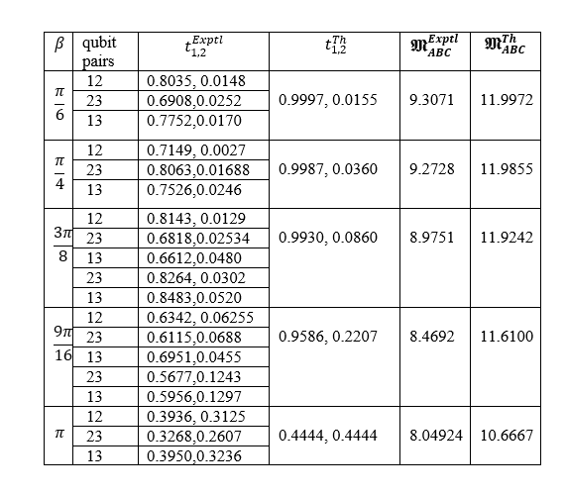
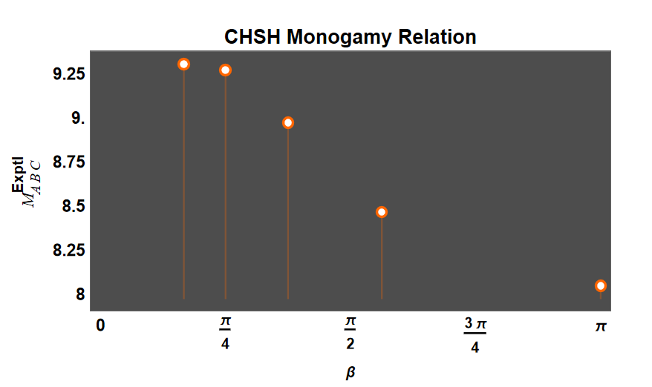
Conclusion: Shareability places restrictions on CHSH non-locality.

Slide 8
References
J. S. Bell, On the Einstein–Podolsky–Rosen paradox, Physics 1, 195 (1964)
J. F. Clauser, M. A. Horne, A. Shimony, R. A. Holt, Proposed experiment to test local hidden-variable theories, Phys. Rev. Lett. 23, 880 (1969)
H. -H. Qin, S. -M. Fei, X. Li-Jost, Trade-off relations of Bell violations among pairwise qubit systems, Phys. Rev. A 92, 062339 (2015)
K. Anjali, S. H. Akshata, H. S. Karthik, S. Sahu, Sudha, A. R. Usha Devi, Characterizing nonlocality of pure symmetric three-qubit states, Quantum Information Processing, 20, 18 (2021)
IBM quantum computing platform (2019). https://quantum-computing.ibm.com/
Acknowledgements
ARU & Sudha are supported by the Department of Science and Technology (DST), India, through Project No. DST/ICPS/QuST/Theme-2/2019 (Proposal Ref. No. 107)

