Slide 1
Particle identification at LHCb
Yanxi ZHANG/张艳席
Peking University
27/10/2022
India+ lectures on Heavy Ion Collision experiments
yanxi.zhang@pku.edu.cn

Slide 2
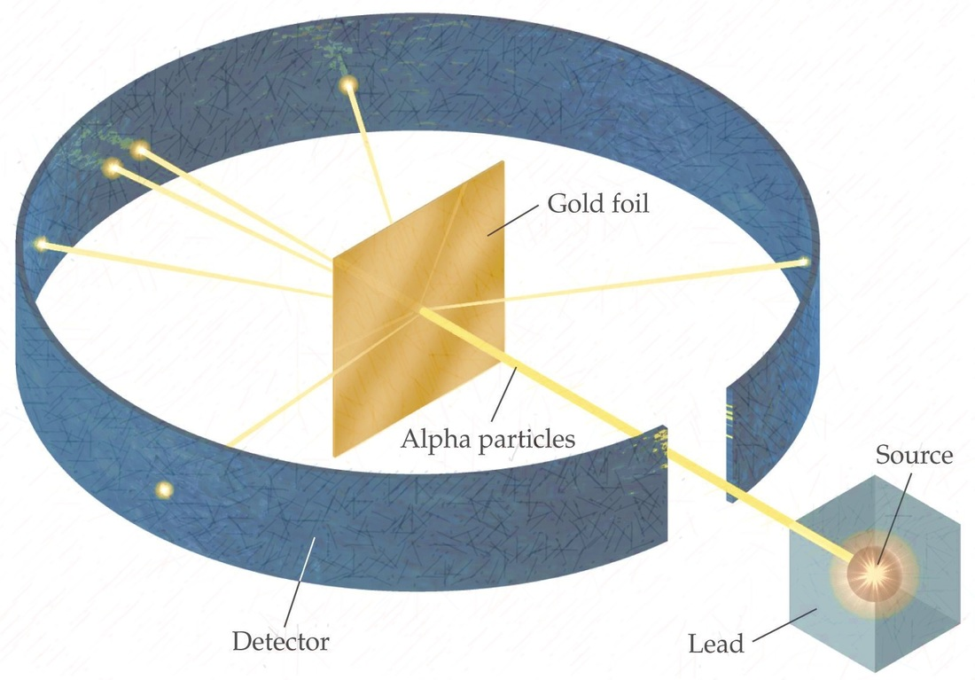
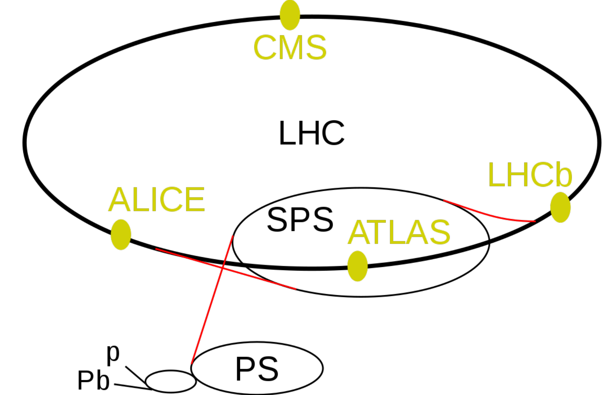
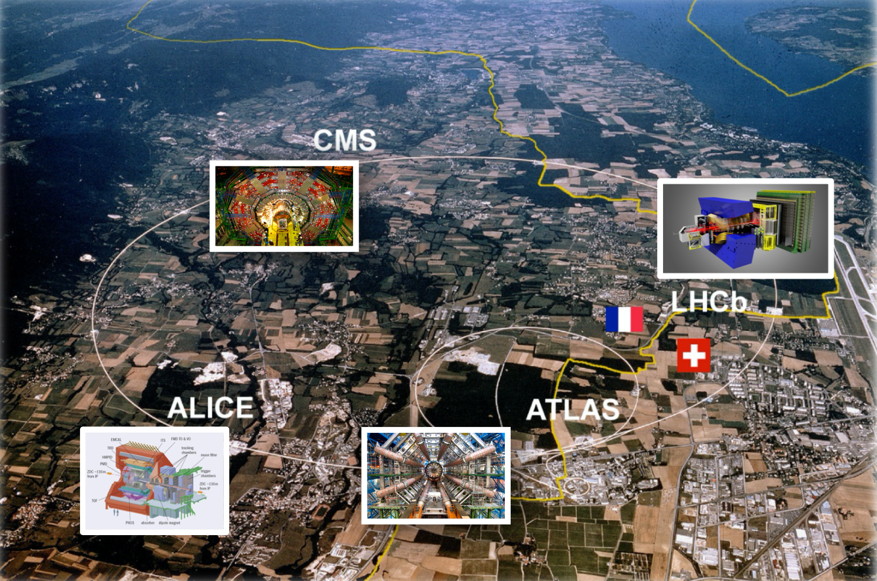
The LHCb experiment
One of the four large experiments on the Large Hadron Collider (LHC) at CERN
Co-use LHC beams: proton-proton, proton-lead, lead-lead collisions
Detect final state particles and study ”what happened”, a modern version of Rutherford experiment
LHC accelerator complex
Aerial photo of CERN area

Slide 3
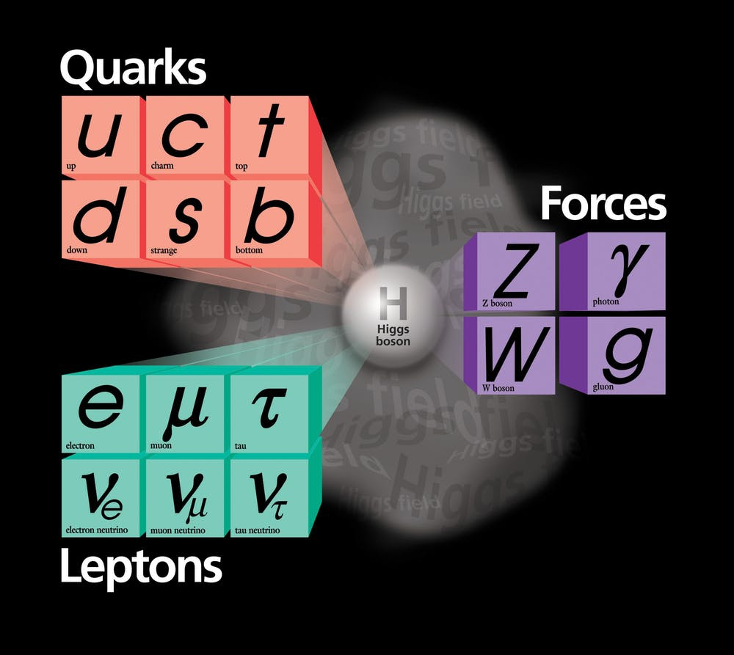
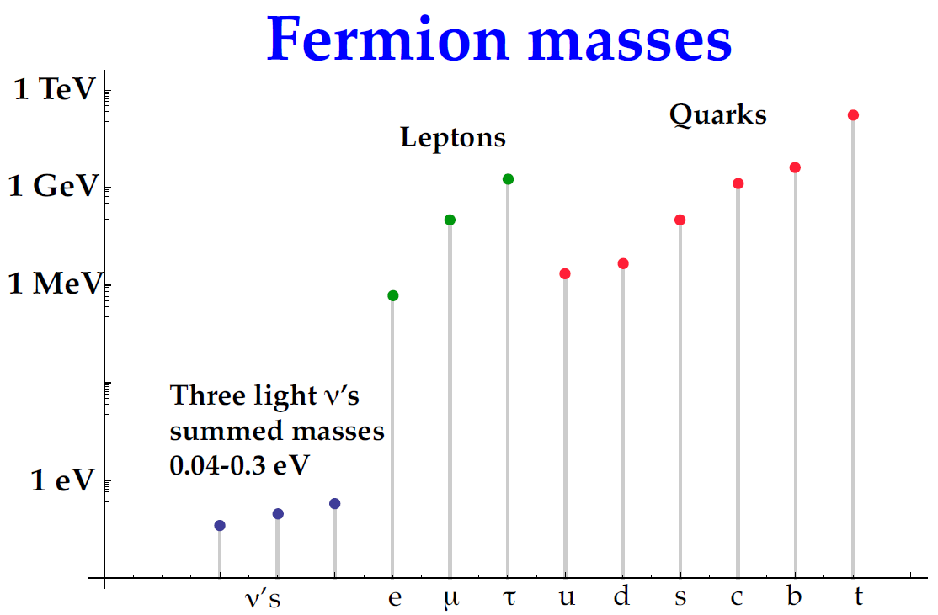
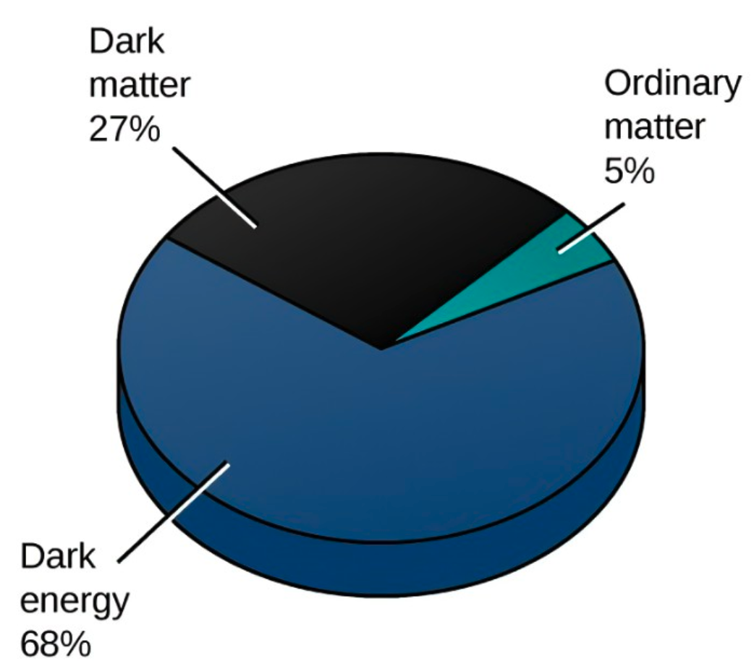
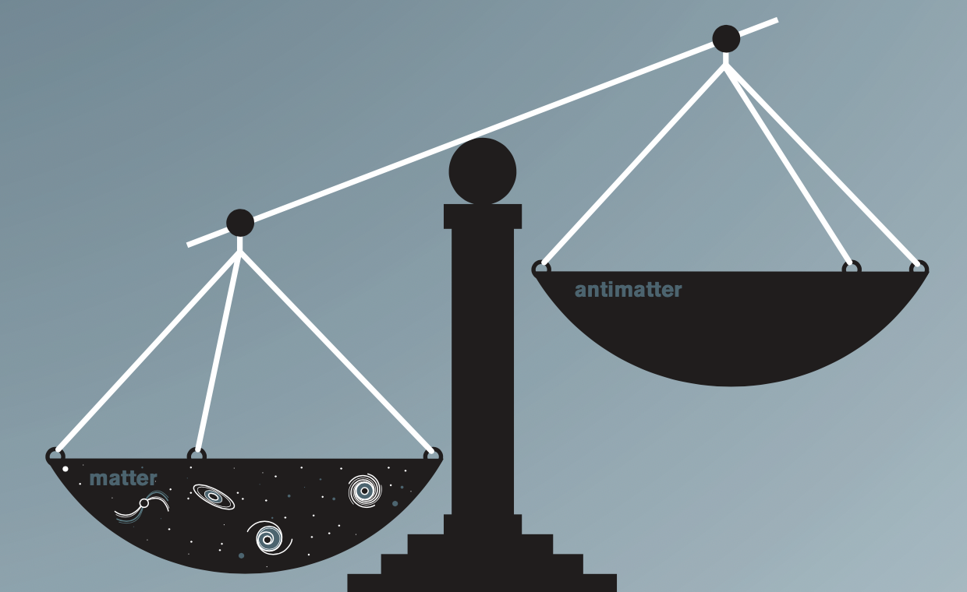
A bit of flavor physics
The Standard Model (SM): remarkably successful at describing particles of Nature and interactions between them
But answered questions/observations
Dark matter, dark energy
Baryon Asymmetry in the Universe (BAU): $n_{B}/n_{\overline{B}}≫1$
Family structure and fermion masses
…
Anti-Baryon
Baryon matter

Slide 4
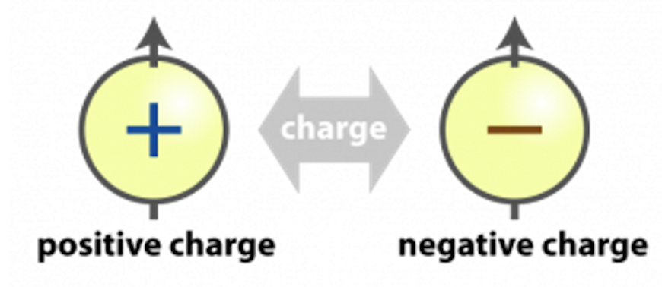
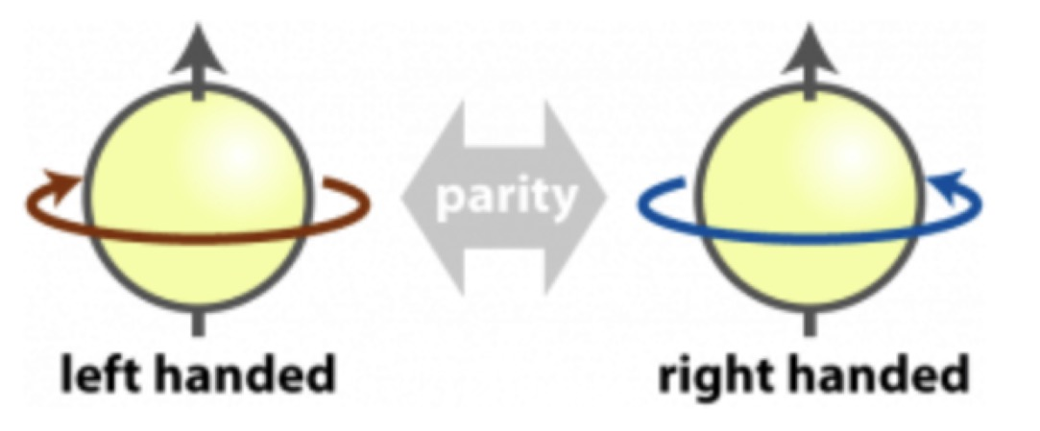
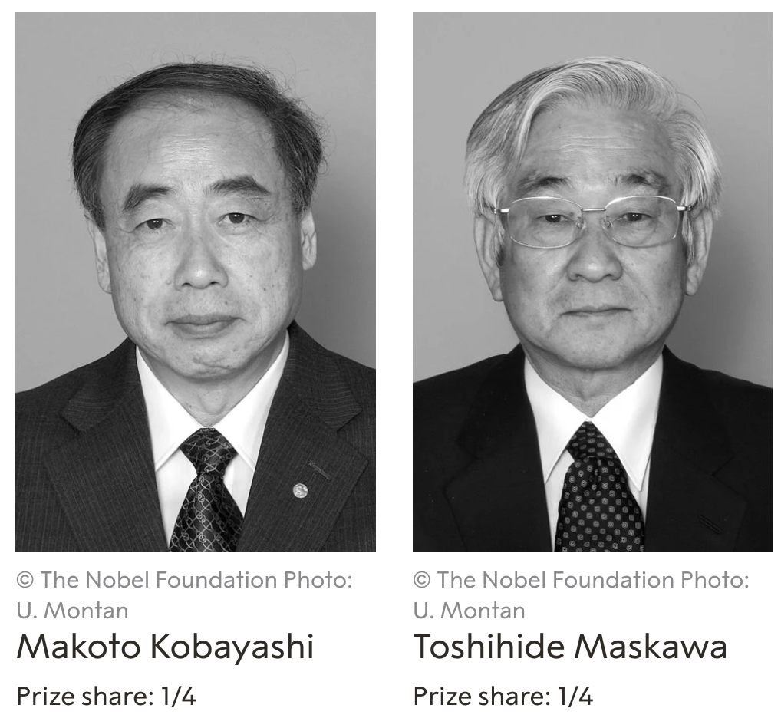
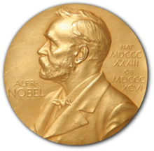
CP violation and CKM
Violation of CP symmetry is required generate BAU
Sakharov (1967)
C: change conjugation
P: space inversion
CKM mechanism in the Standard Model (1973)
Mixing between quarks of three generations
CPV is allowed by CKM
2008
But far insufficient to account for BAU

Slide 5
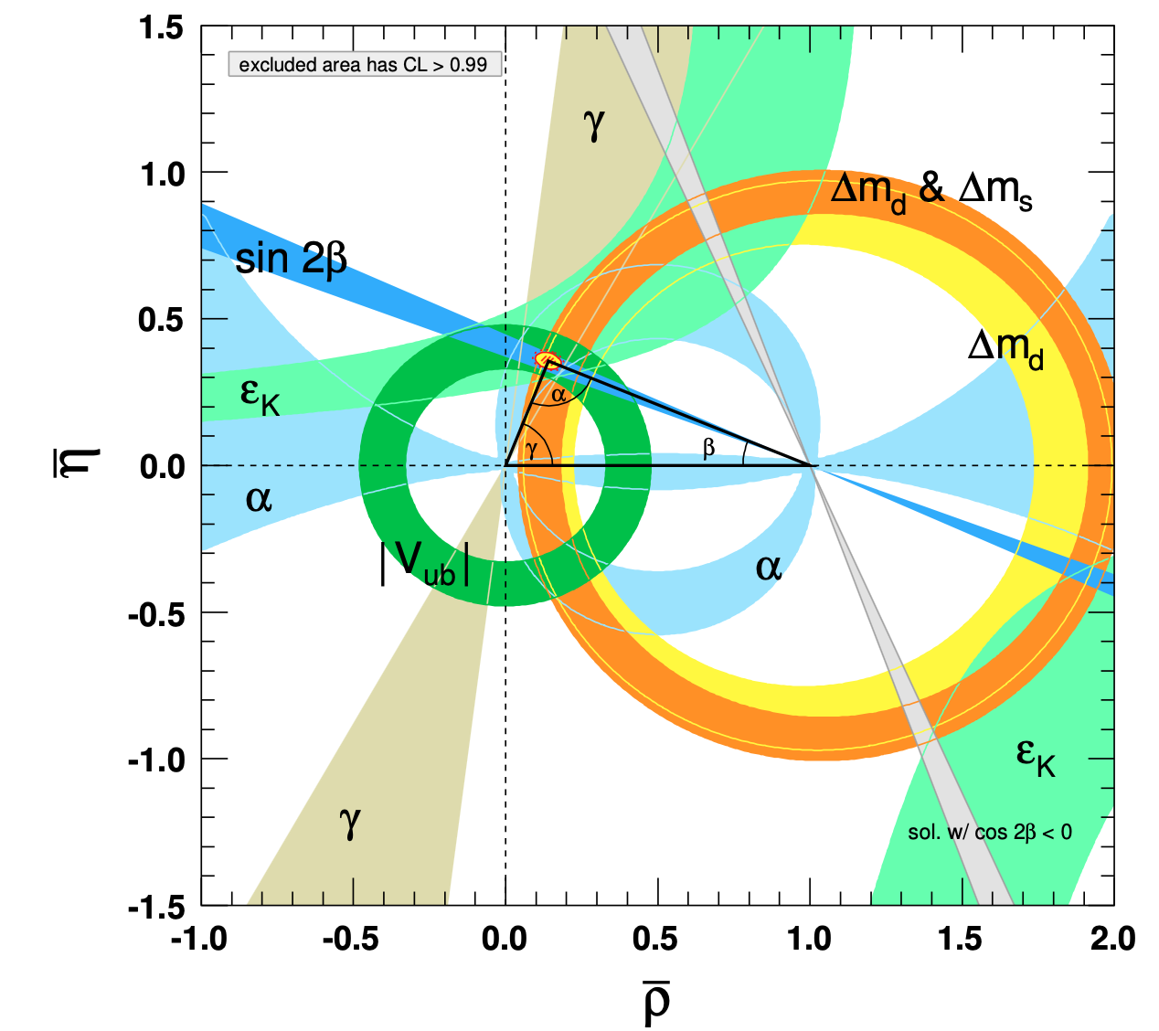
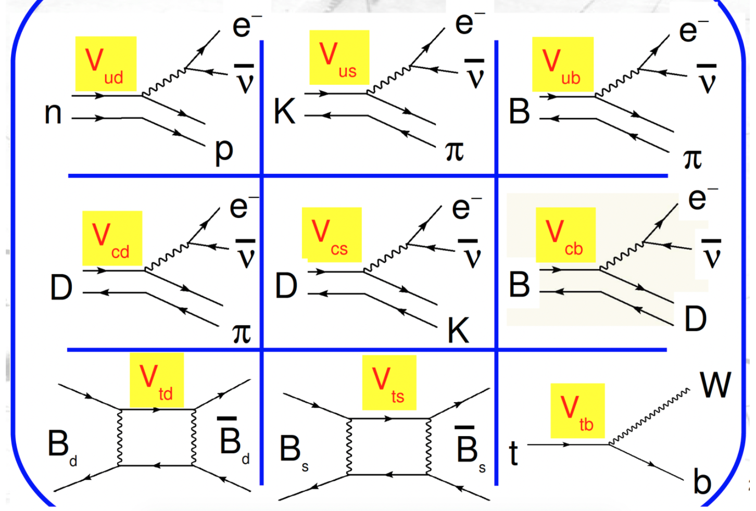
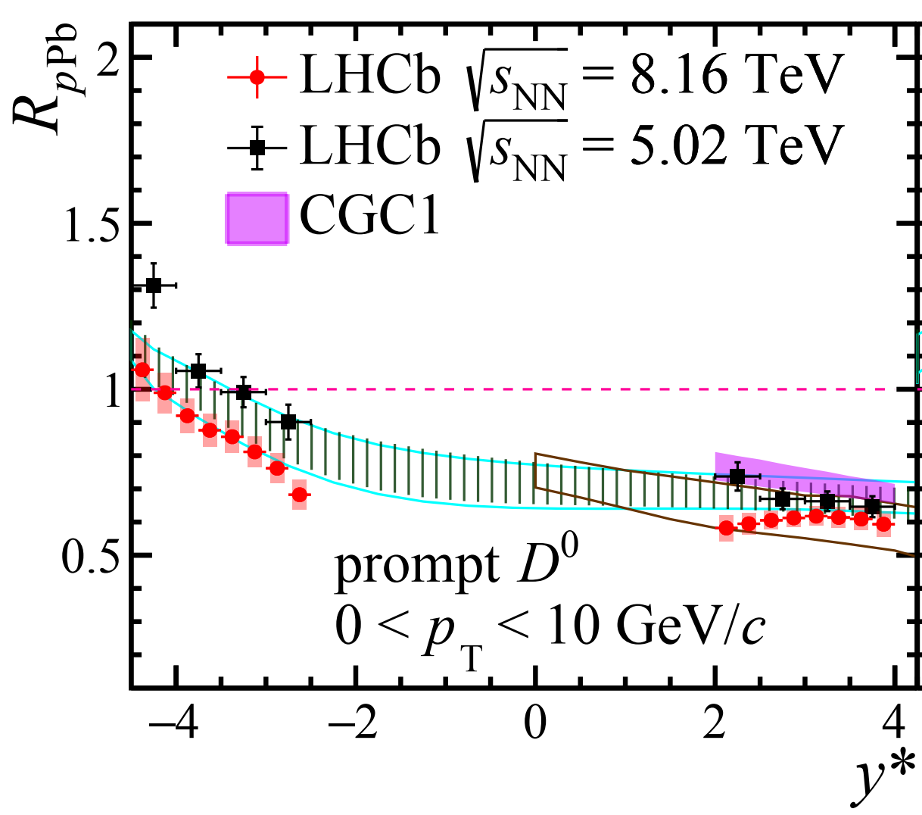
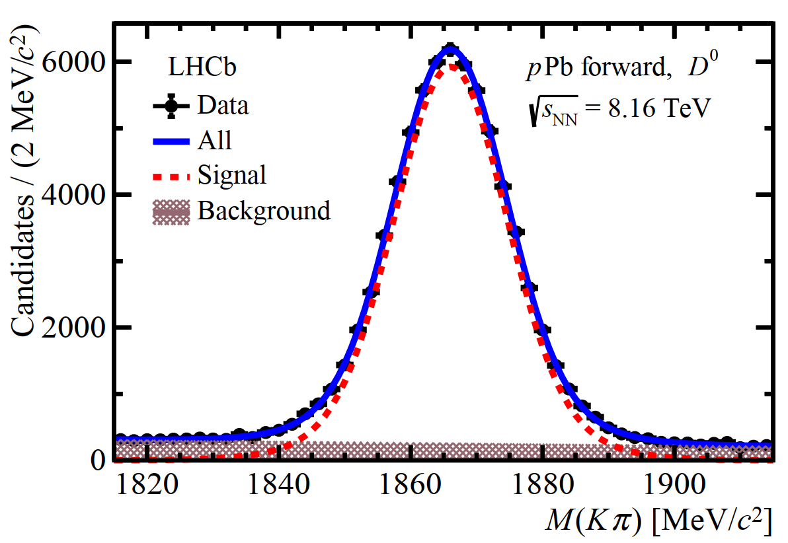
Physics at LHCb
Is CKM a correct description of Nature?
Global/over constraints of CKM matrix elements
$b$-quark
Is CKM a complete description of Nature?
Heavy ions
Precisely probe initial/final state with heavy flavor production
CPV from new physics must exist, searched in heavy flavor: CPV/rare decays not predicted by CKM
LHCb-PAPER-2022-007
* Heavy flavor: $b$ and $c$ quarks/hadrons

Slide 6
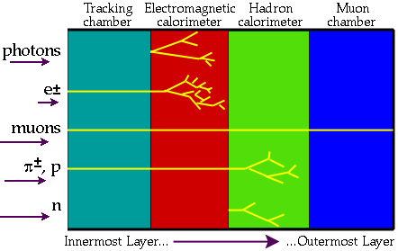
How to detect particles
Most particles unstable, decay shortly ($<{10}^{−9}$s) after production, including all heavy flavor hadrons
Can only detect those live “longer” than detector dimension ($∼m$ for modern large spectrometers)
Charged: $p, K^{+}, π^{+}, μ^{+}, e^{+}$ + anti-particles
Neutral: $n, \overline{n}, γ$
Neutrinos not discussed here
Different interactions with material (atomic matter)
Sub-detectors with various technologies to detect and discriminate them
Modern large spectrometers: layers of sub systems: Tracker, Ecal, Hcal, Muon
Notes:
Instrumented for heavy flavor measurement

Slide 7
How to detect particles
Most particles unstable, decay shortly ($<{10}^{−9}$s) after production, including all heavy flavor hadrons
Can only detect those live “longer” than detector dimension ($∼m$ for modern large spectrometers)
Charged: $p, K^{+}, π^{+}, μ^{+}, e^{+}$ + anti-particles
Neutral: $n, \overline{n}, γ$
Particle identification (PID)
Determine a particle type among this list
Equivalent to measurement of mass
Notes:
Instrumented for heavy flavor measurement

Slide 8
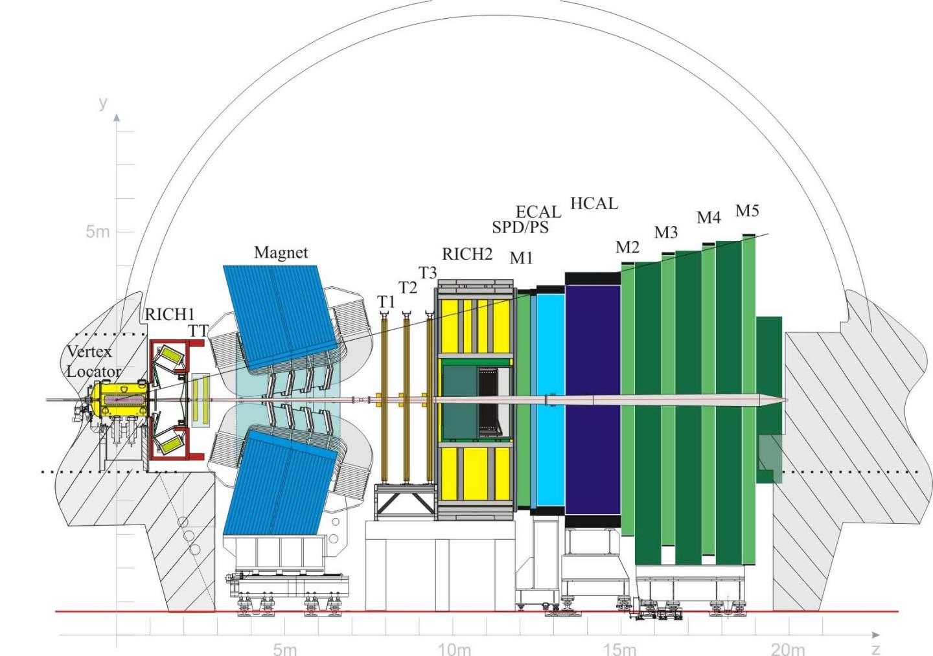
LHCb detector
JINST 3 (2008) S08005
IJMPA 30 (2015) 1530022
Notes:
Here is the layout of the LHCb detector

Slide 9
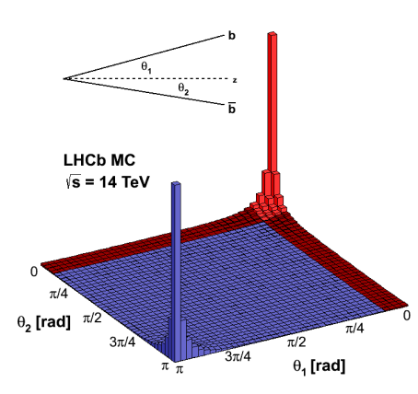
LHCb detector
JINST 3 (2008) S08005
IJMPA 30 (2015) 1530022
Single arm: small solid angle covering the interaction region
Pseudo-rapidity w.r.t. beam: $2<η<5$
Beam1
Beam2
LHCb
$±0.3$ radian
$25\%$ of total $b\overline{b}$
Two beams cross/collide here
Notes:
Instrumented for heavy flavor measurement

Slide 10
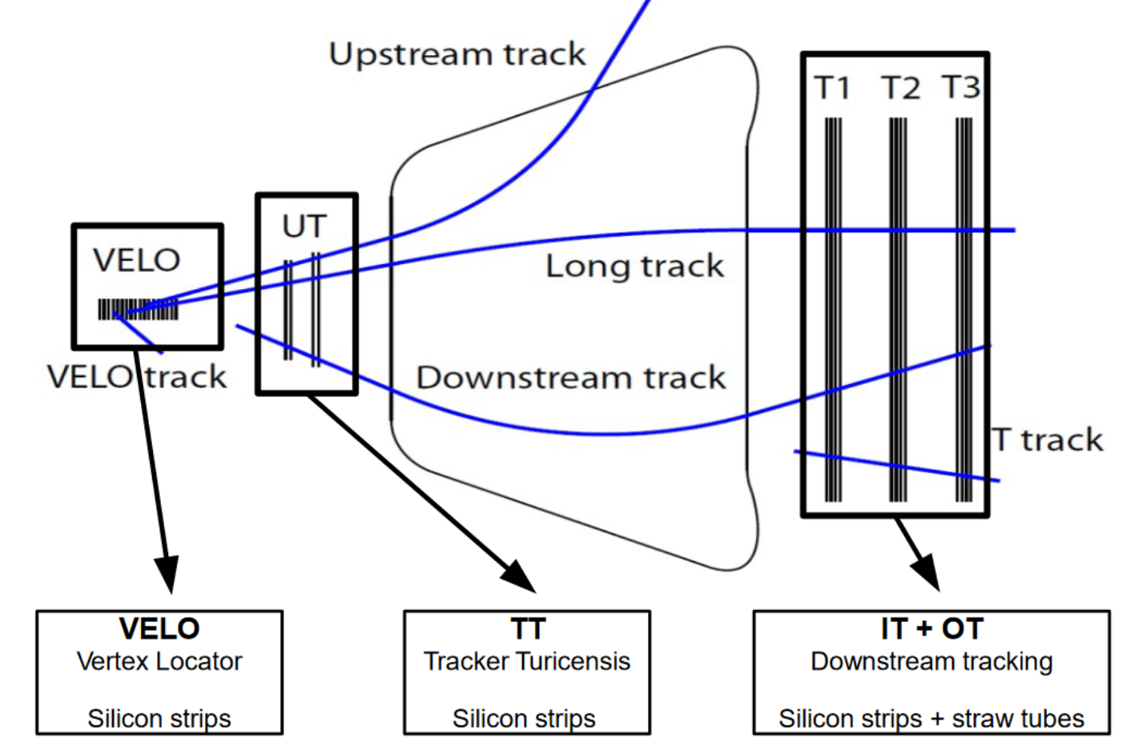
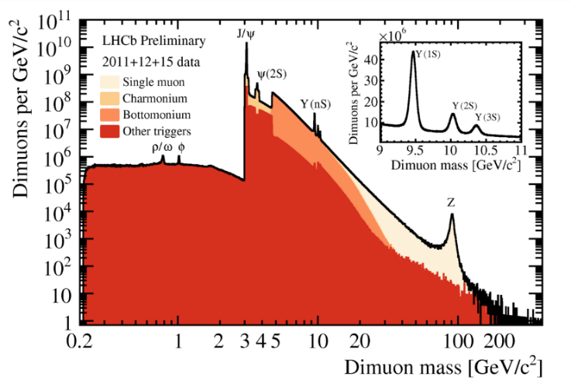
LHCb tracking detectors
JINST 3 (2008) S08005
IJMPA 30 (2015) 1530022
Detect charged particles and measure momentum $(p)$
Magnet
Tracking parameters
$ε\left(Tracking\right)\sim 96\%$
${δp}/p\sim$0.5%-1%
$ε\left(m_{J/ψ}\right)≈15$ MeV
T-stations
VELO
UT
Good resolution helps to separate neighboring states, and signal from background
Notes:
Instrumented for heavy flavor measurement

Slide 11
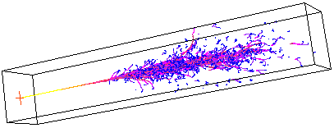
LHCb calorimeters
JINST 3 (2008) S08005
IJMPA 30 (2015) 1530022
Detect neutrals, also destination of charged hadrons and $e^{±}$
Particle deposit all energies in calorimeters and form showers: spatial distribution of secondary particles
Magnet
T-stations
ECAL
HCAL
Electron
VELO
UT
$E=\sum{shower }$
Neutron
?
Charged hadron
Photon
Notes:
Instrumented for heavy flavor measurement

Slide 12
LHCb muon detector
JINST 3 (2008) S08005
IJMPA 30 (2015) 1530022
Detect/identify muons: ﻿$μ^{+}$ is most penetrating charged particle
M1-M5
Magnet
T-stations
ECAL
HCAL
The “only” particle reaching/passing through muon detectors
VELO
UT
Muon
Calorimeter + iron shielding
Notes:
Instrumented for heavy flavor measurement

Slide 13
Common setup
Charged: $p, K^{+}, π^{+}, μ^{+}, e^{+}$ + anti-particles
Neutral: $n, \overline{n}, γ$
Able to classify*
$\left\{μ^{±}\right\}$, $\left\{e^{±}\right\}$ , $\left\{n,\overline{n}\right\}$, $\left\{γ\right\}$, $\left\{p^{±},K^{±},π^{±}\right\}$
But not within
$$\left\{p^{±},K^{±},π^{±}\right\}$$
With calorimeter
$m^{2}=E_{calo}^{2}−p^{2}$?
*Magnetic field separates $+$ from $−$ charges
Notes:
Instrumented for heavy flavor measurement

Slide 14
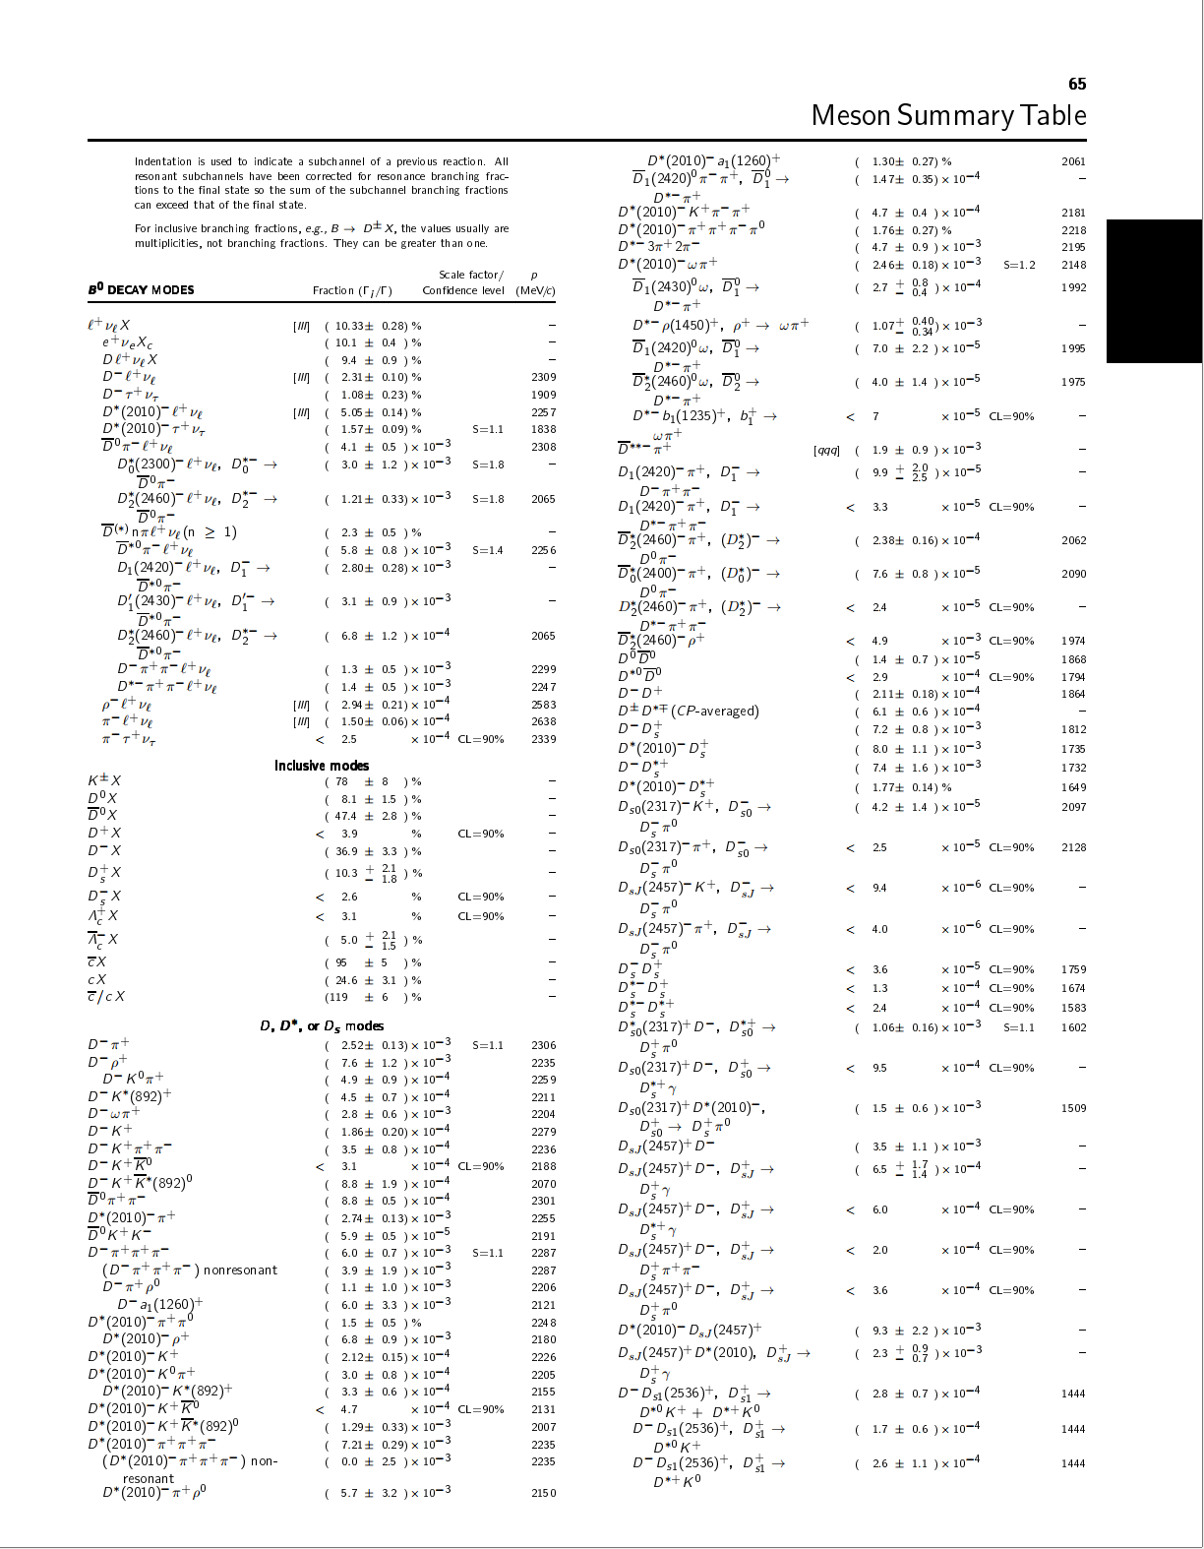
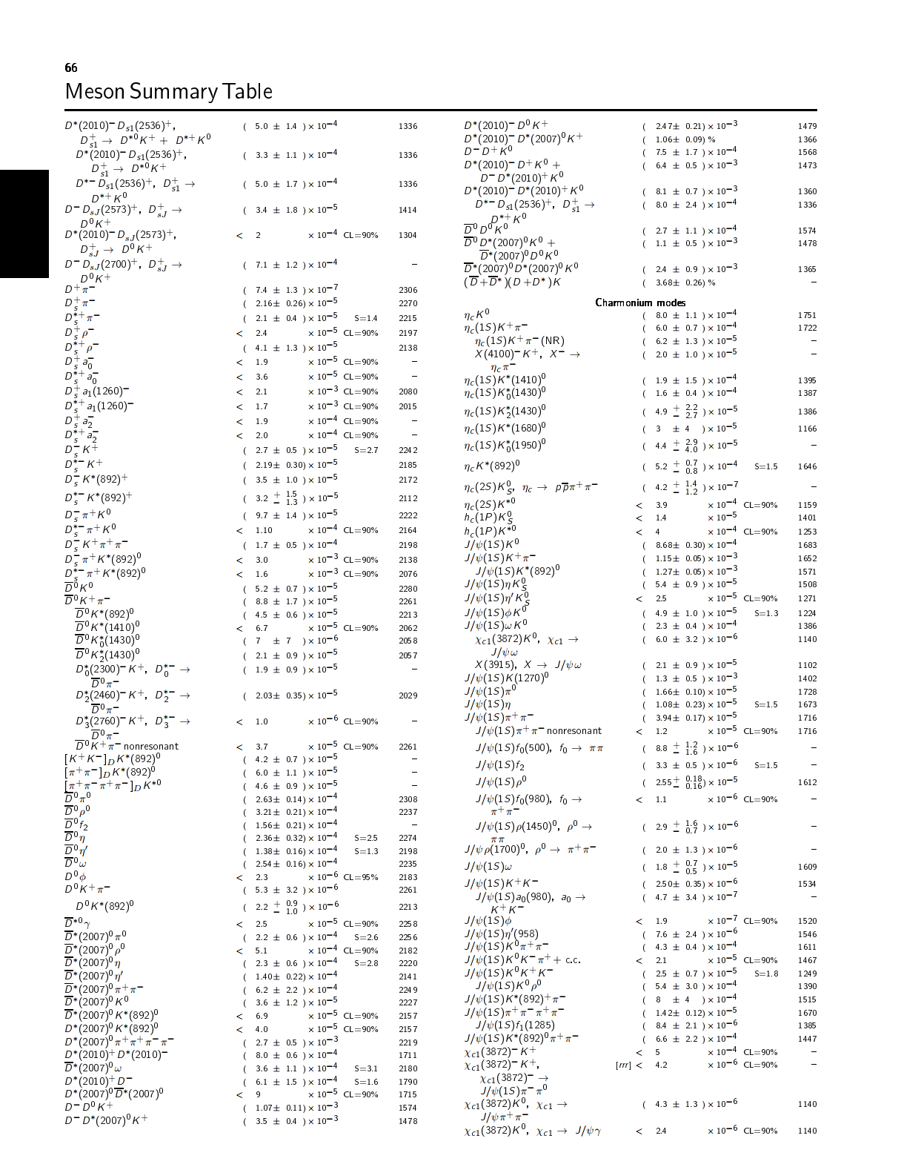
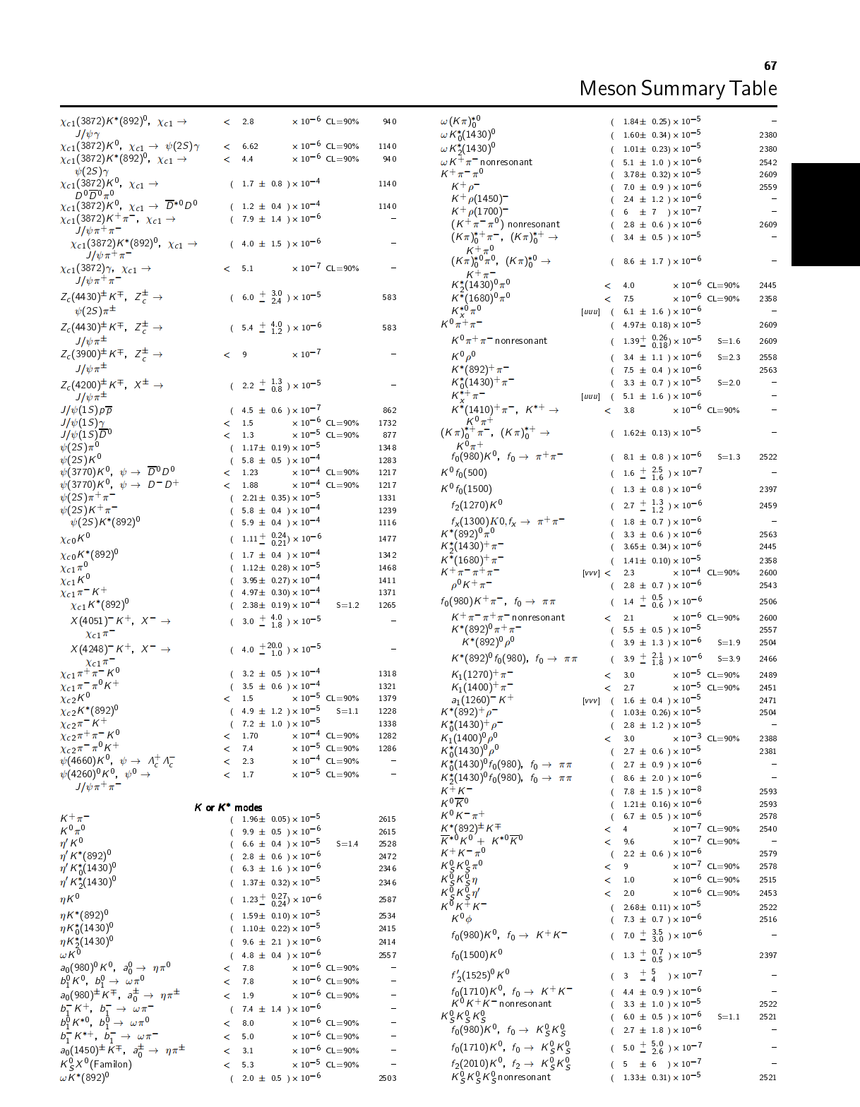
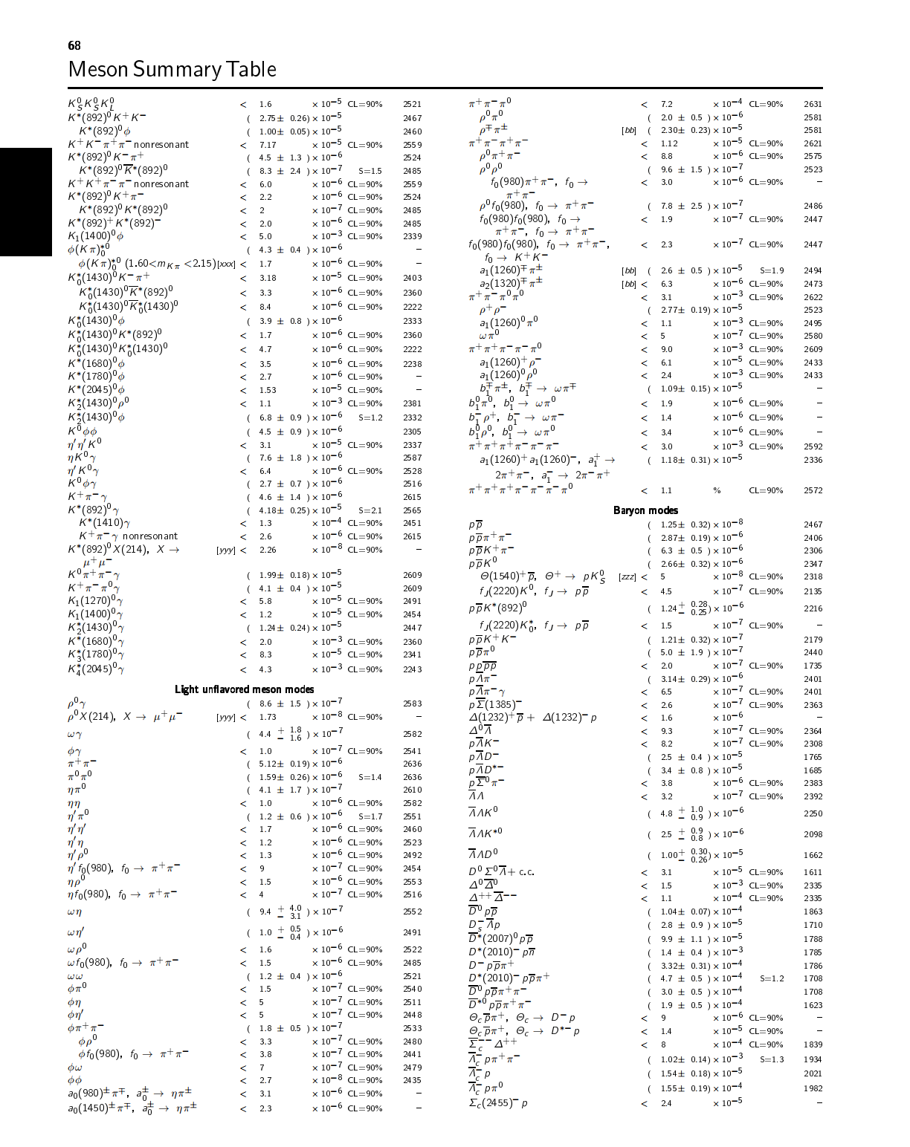
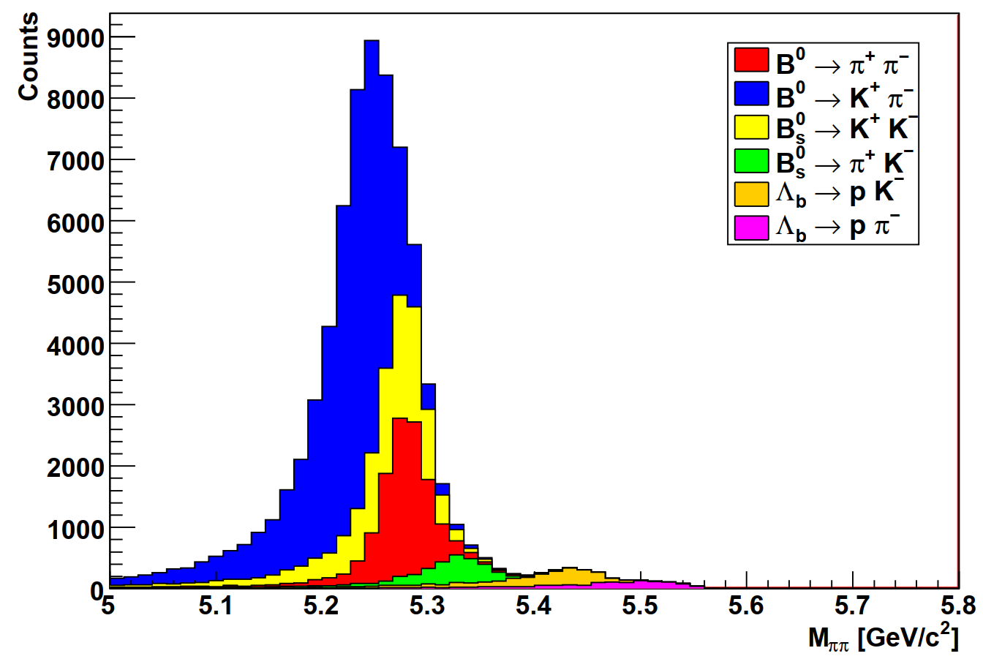
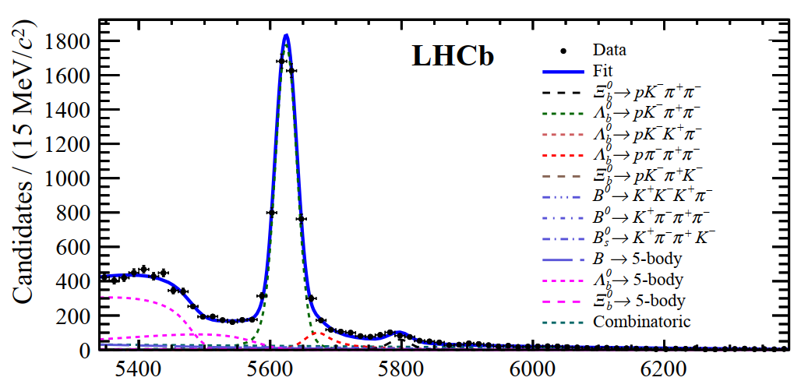
LHCb cares about charged hadron species
$b$-hadrons have many decay modes (500+ known)
Each may be unique and contributes to relevant measurements
Measured exclusively!
But one decay could pollute the other, due to mis-identification (misID) of decay products, in particularly among decays with $p^{±},K^{±},π^{±}$
$B^{+}$ decays (Particle Data Group2020)
Core flavor physics at LHCb
$$H_{b}→h_{1}^{+}h_{2}^{−}$$
$$H_{b}→ph_{1}^{+}h_{2}^{−}h_{3}^{−}$$
Data
LHCb simulation
Notes:
One decay mode can be a source of background for the other decay

Slide 15
Identification of $p^{±}, K^{±}, π^{±}$at LHCb
JINST 3 (2008) S08005
IJMPA 30 (2015) 1530022
Two RICH detectors﻿, also useful to identify $μ^{±}, e^{±}$
RICH: Ring Imaging CHerenkov detectors, installed on trajectories of charged particles
RICH2
RICH1
Notes:
Instrumented for heavy flavor measurement

Slide 16
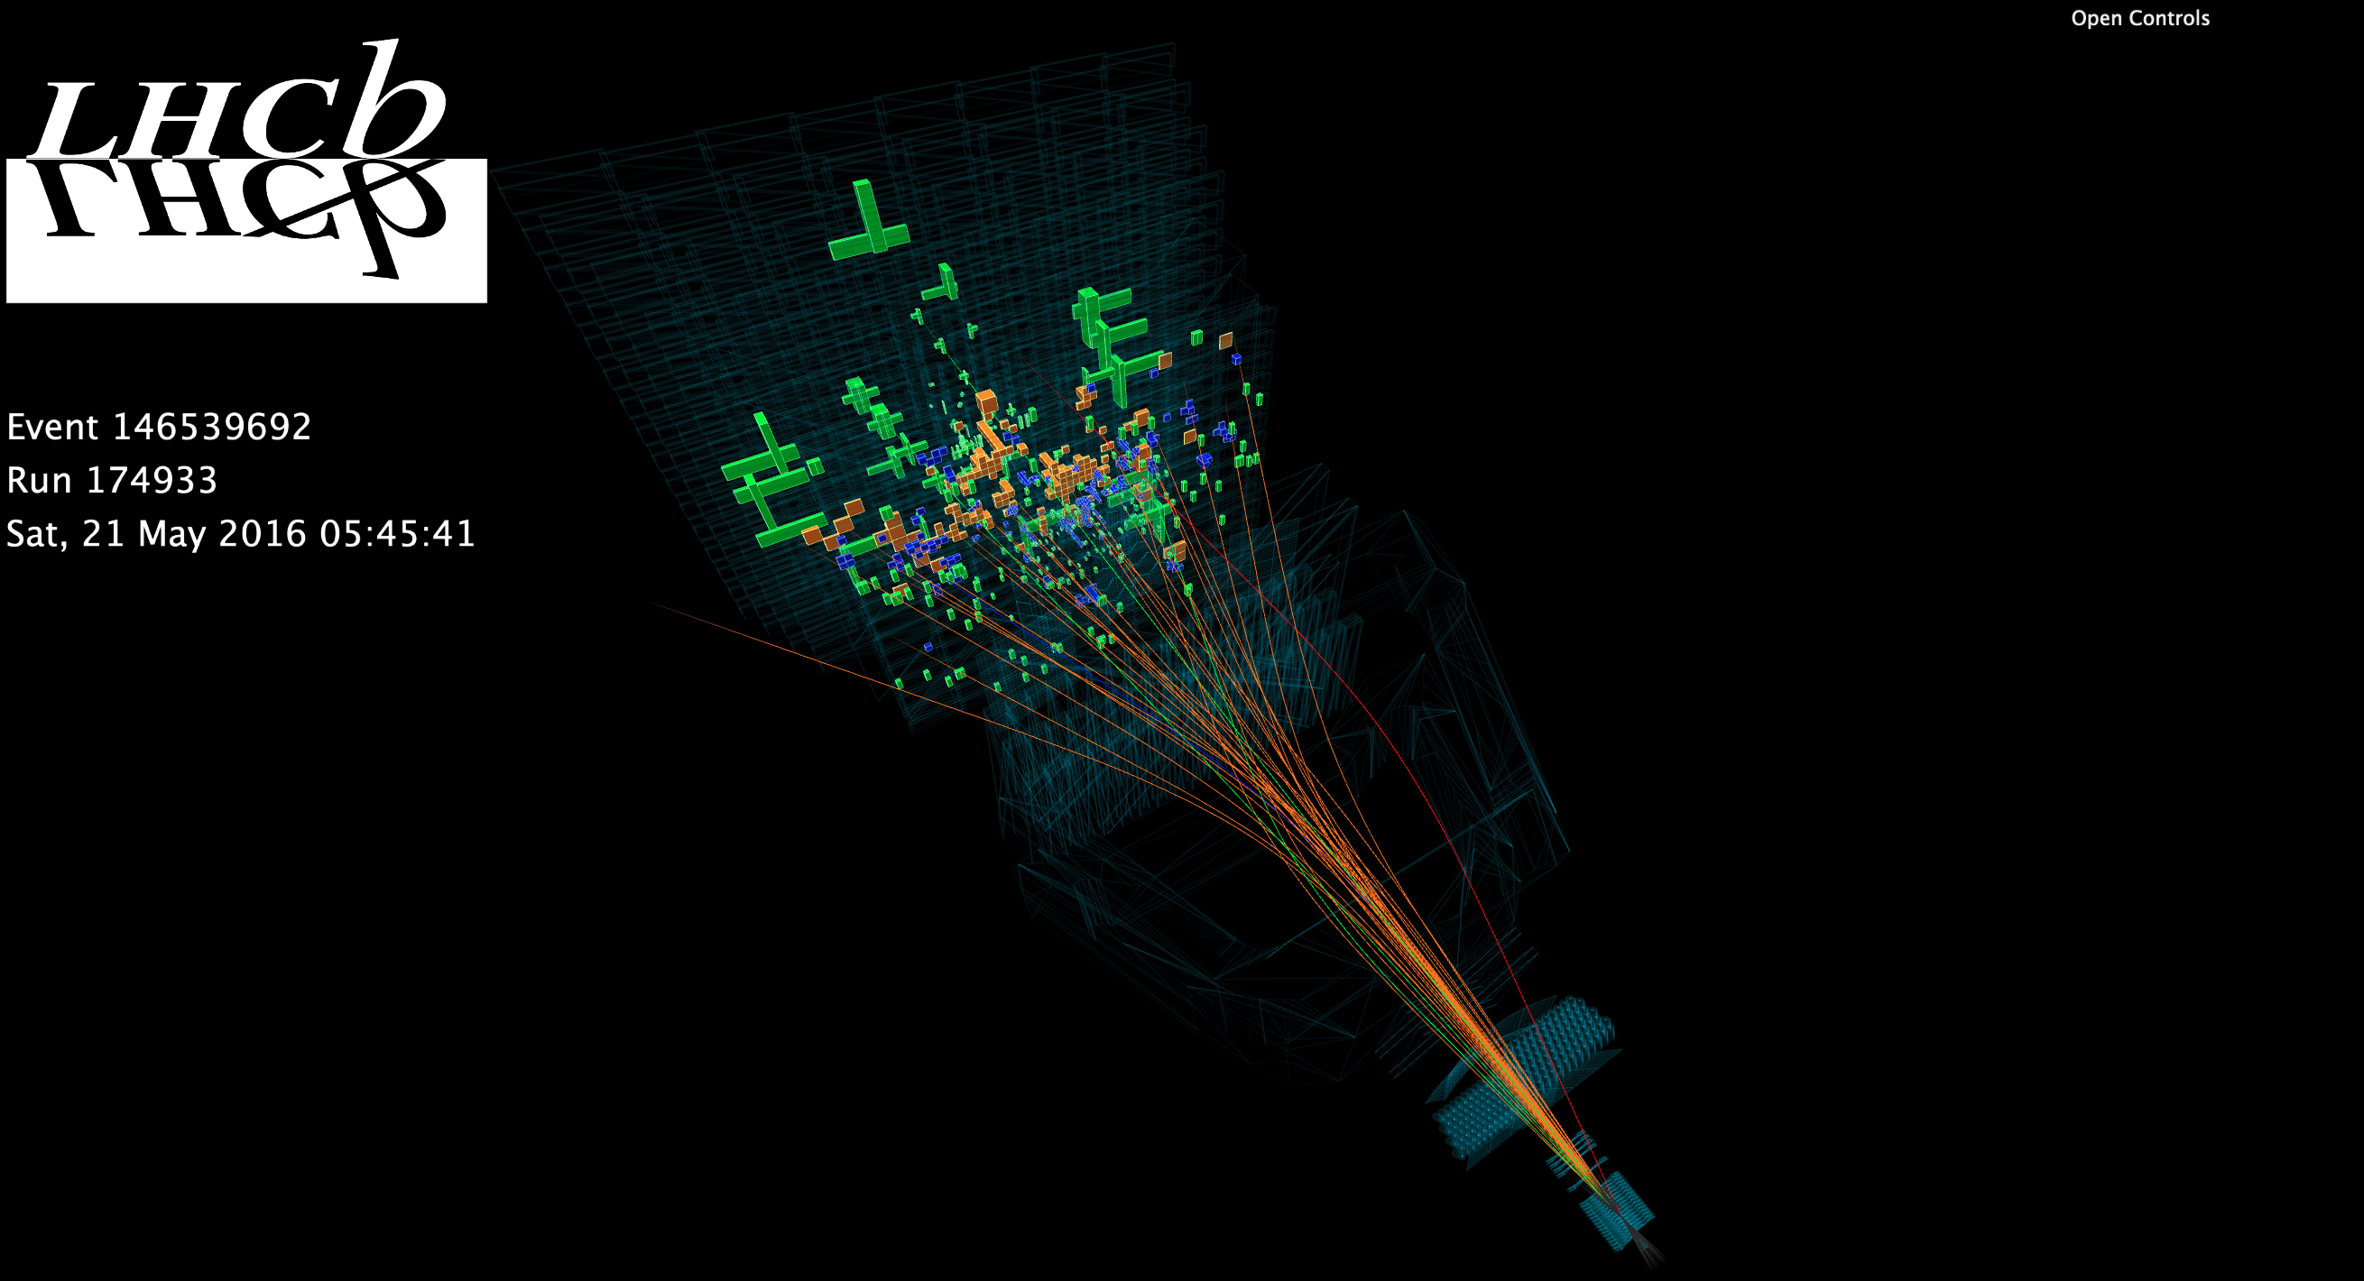
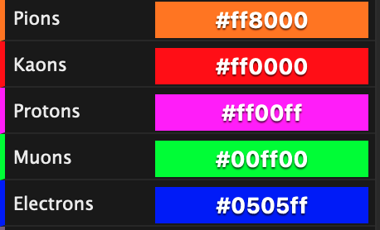
A typical event reconstructed by LHCb (event display)

Slide 17
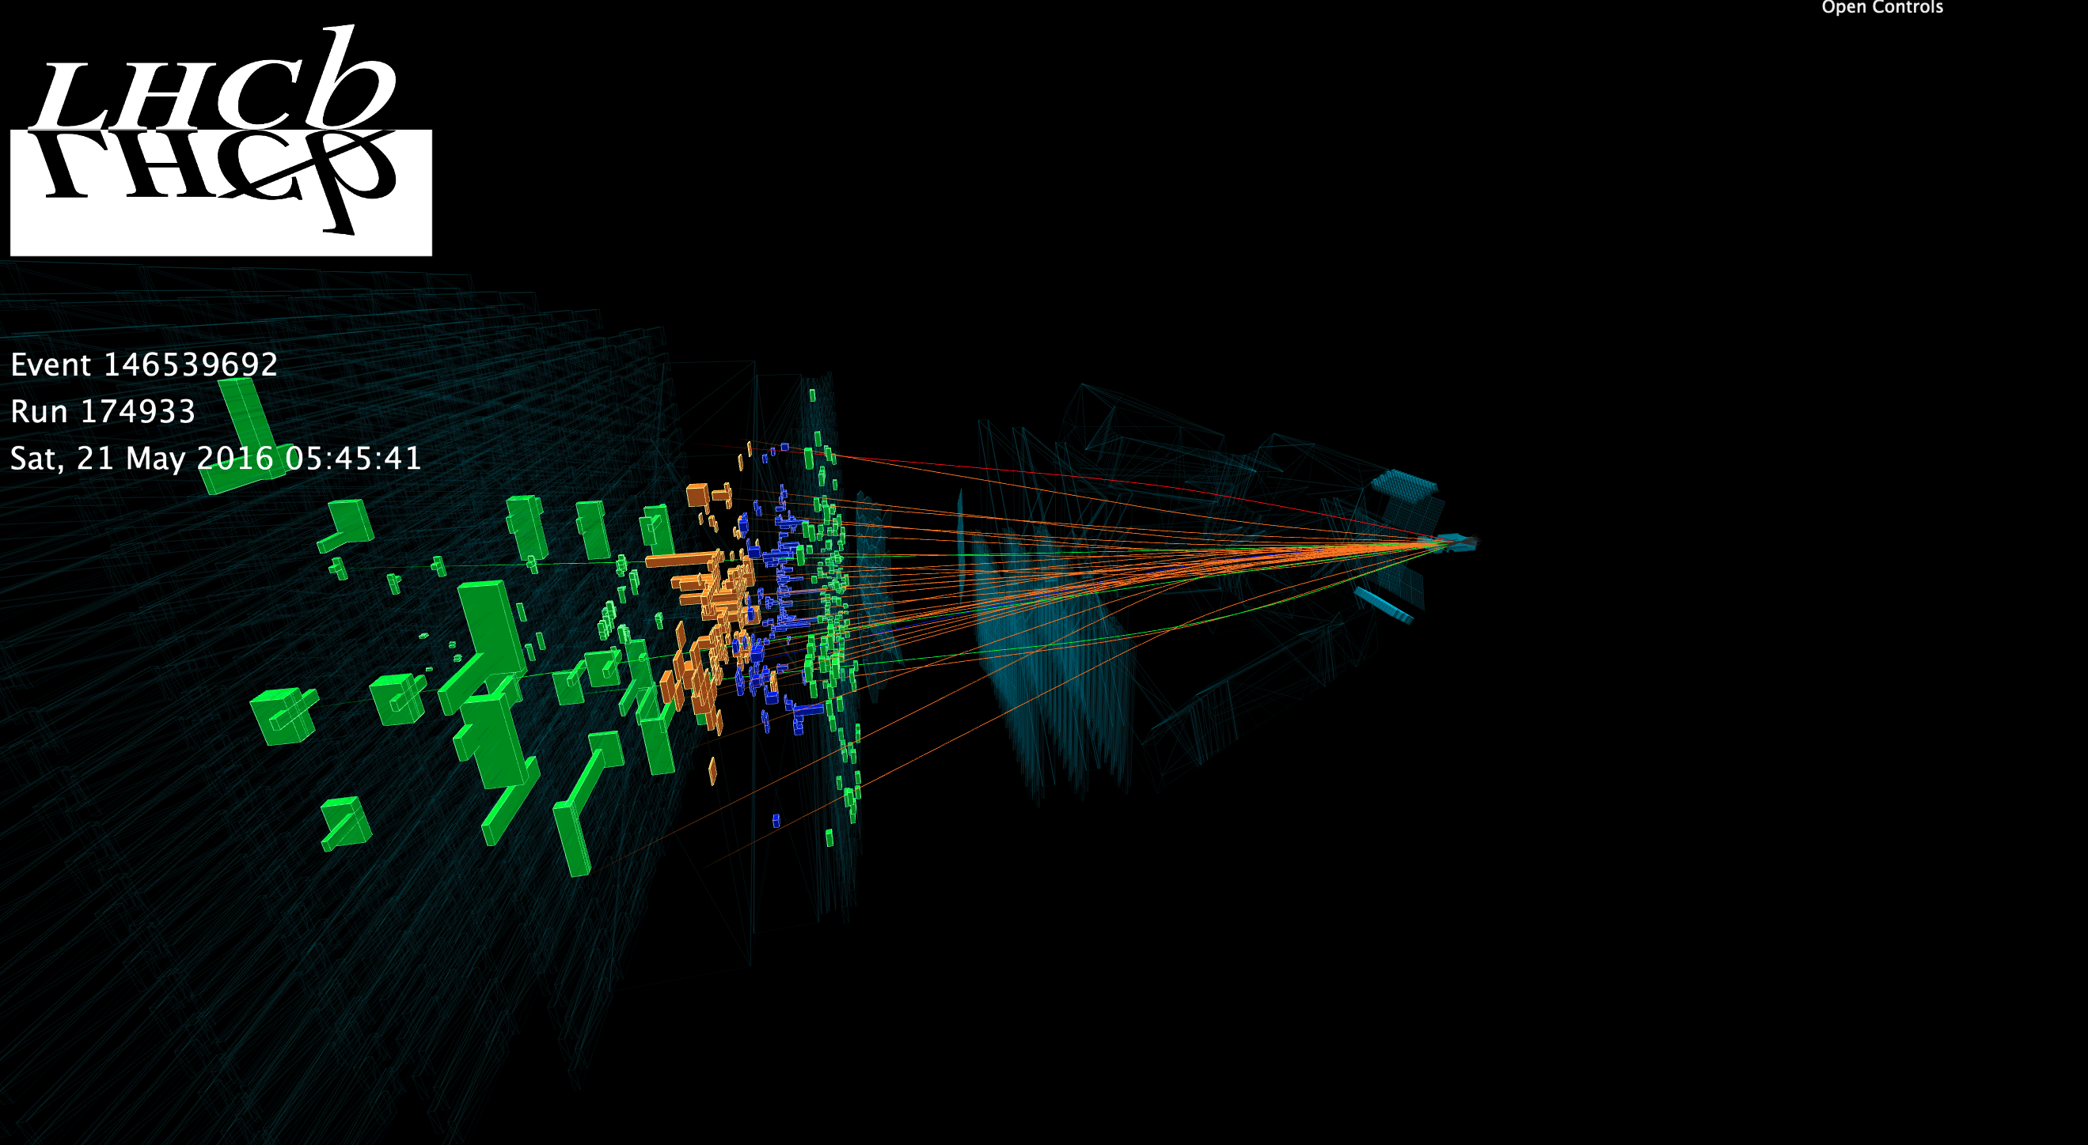
A typical event reconstructed by LHCb (event display)

Slide 18
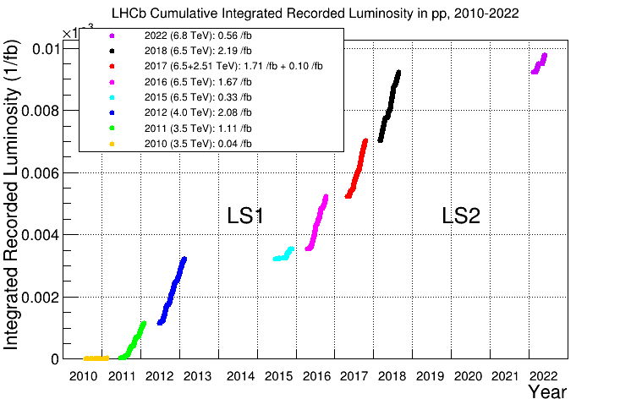
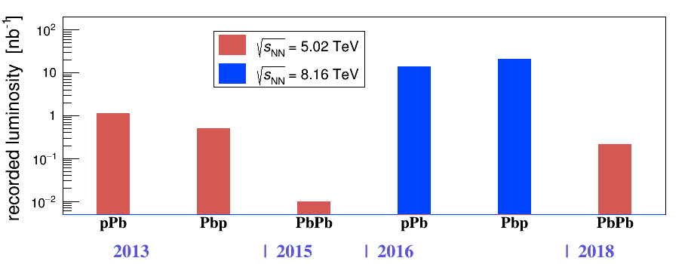
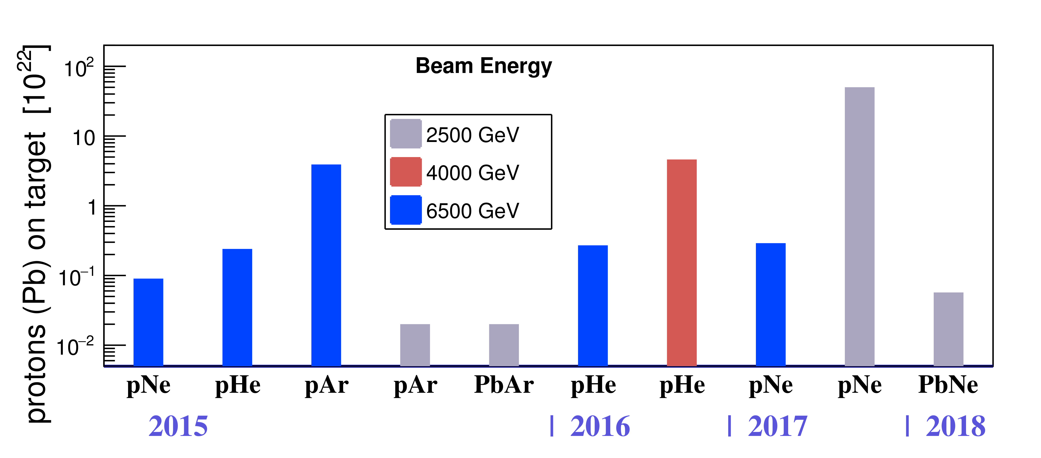
LHCb data
Proton-Proton collisions
Heavy ion collisions
Colliding modes
Run3 TBD
at 13.6 TeV
Run1 $3 fb^{−1}$ at 7/8 TeV
LS1
LS2
Fixed-target
Run2 $6 fb^{−1}$ at 13 TeV
Run3 (2022-25) just started

Slide 19
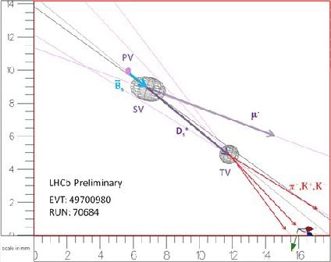
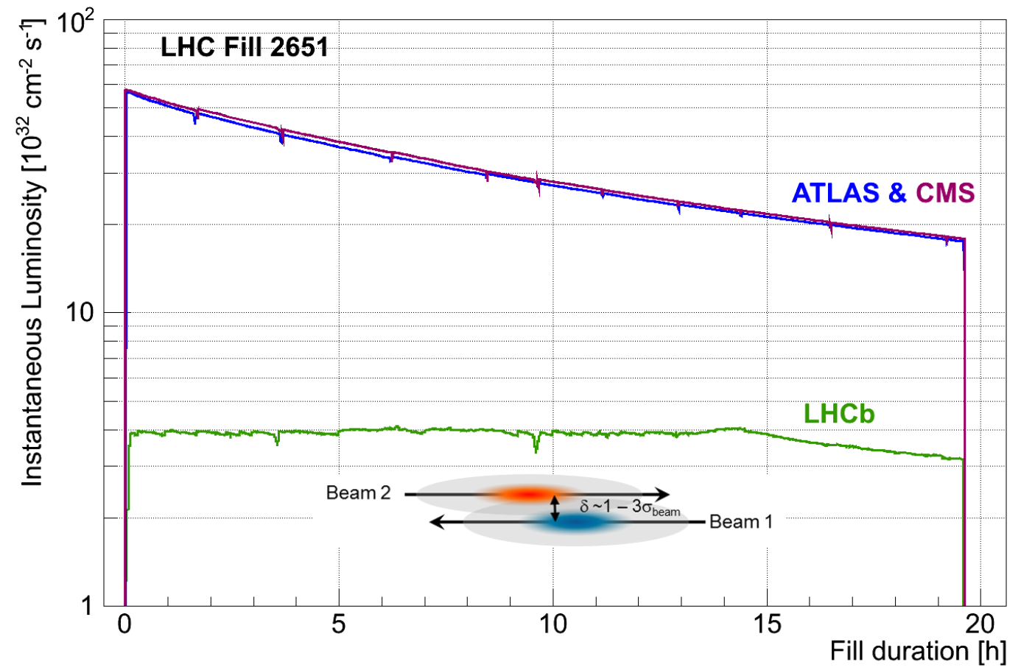
LHCb operated at lower luminosity
Required to associate $b$ decay vertex to production vertex, i.e. $p−p$ collision point
Detector performance degrades at higher occupancy
Tune $\left\langle μ\right\rangle ∼1$ for Run1-2
Keep $\left\langle μ\right\rangle$ constant during a fill and over the year
Stable conditions: benefit event reconstruction and detector calibration
Primary interaction
Secondary vertex
Tertiary vertex
$\left\langle μ\right\rangle$: average $pp$ interaction/event

Slide 20
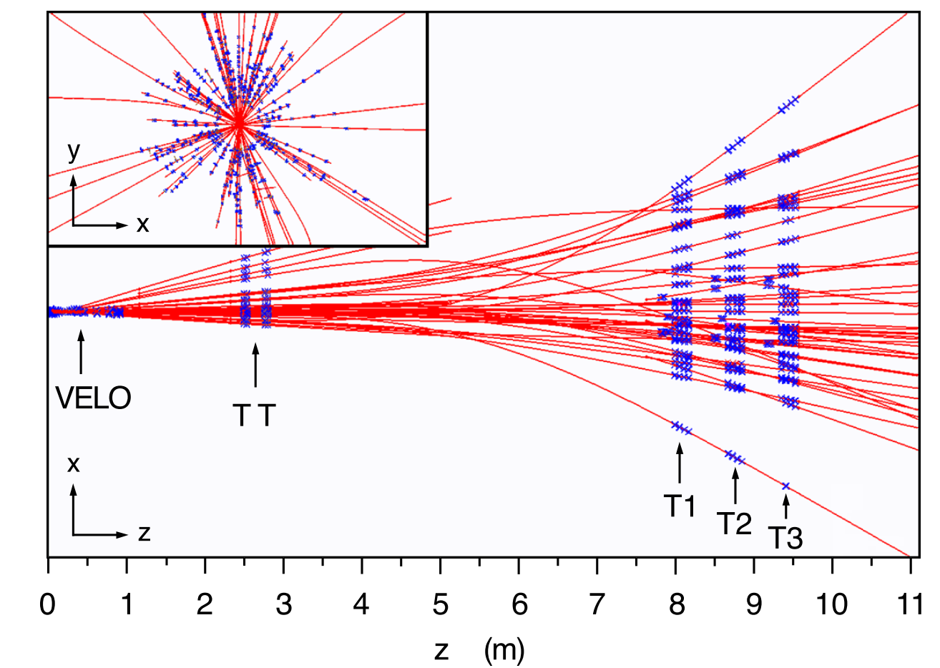
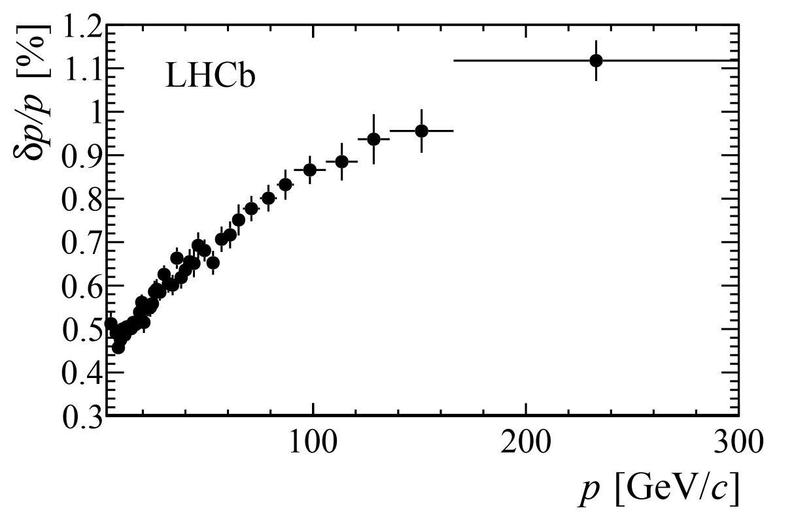
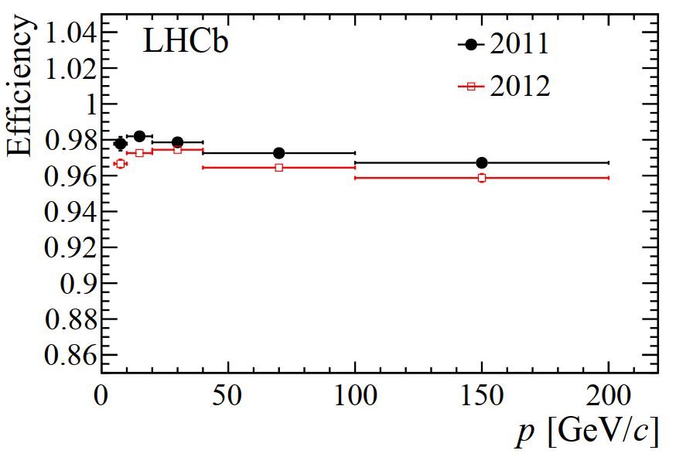
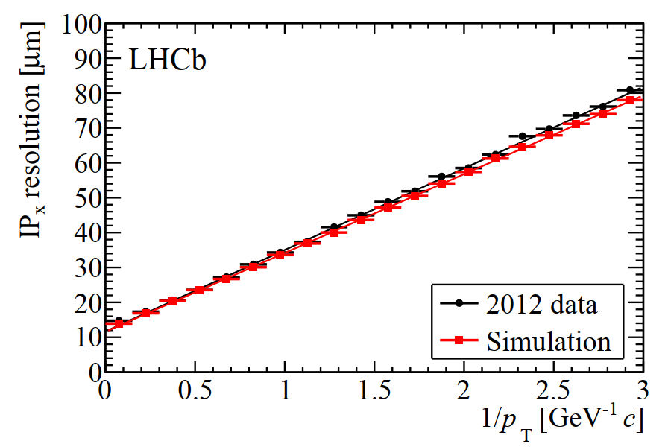
LHCb tracking for charged particles
~100 tracks/event of all kinds
High momentum
resolution
High spatial resolution
PV
IP
High efficiency
particle

Slide 21
Particle identification systems

Slide 22
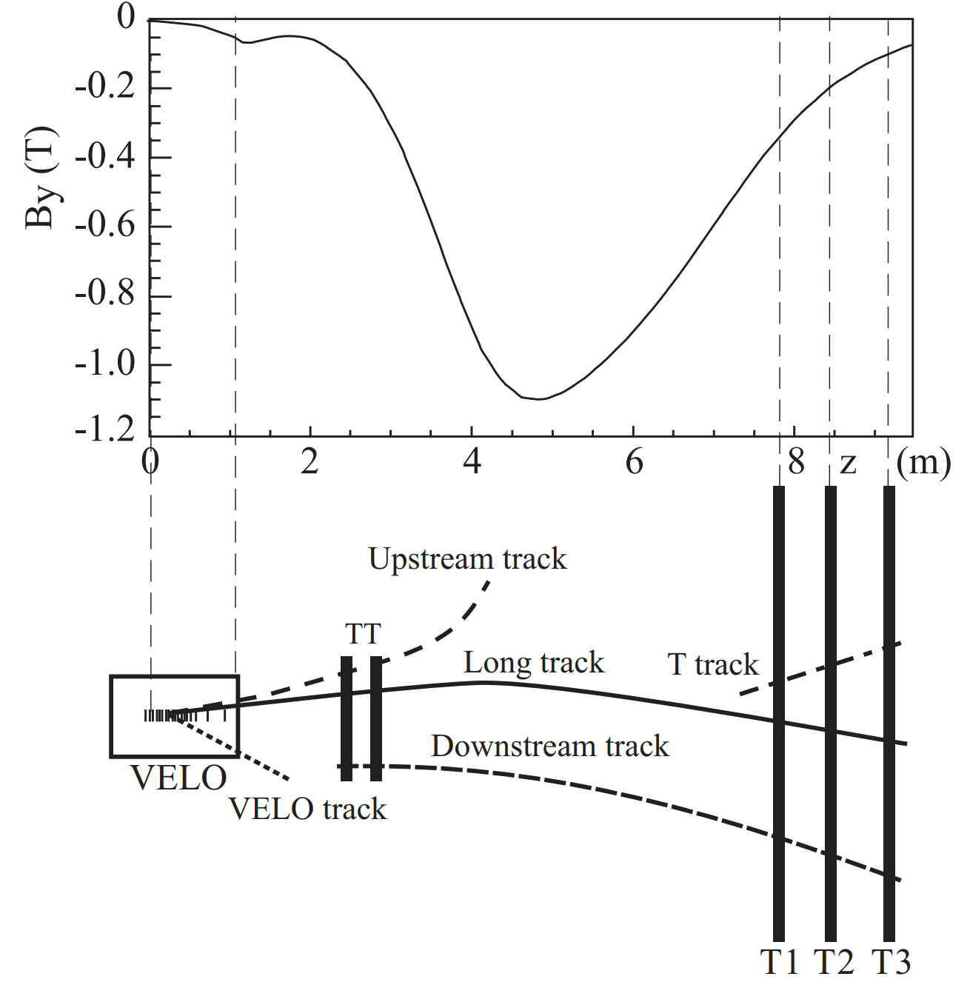
General ideas for charged hadron identification
Momentum $p$ measured by tracking system
Then using $v=\frac{pc}{E}=\frac{c}{\sqrt{1+m^{2}/p^{2}}}$, mass $m=p\sqrt{{\left(1/β\right)}^{2}−1}$
Determine particle species equivalent to measuring velocity
Four main processes depending on velocity
Bethe-Bloch formula
Roger Forty (CERN)
Exploited by LHCb
$c$: speed of light in vacuum, $β≡v/c$

Slide 23
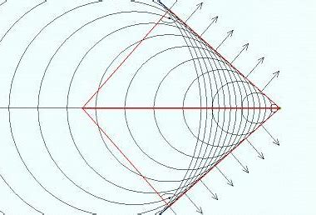
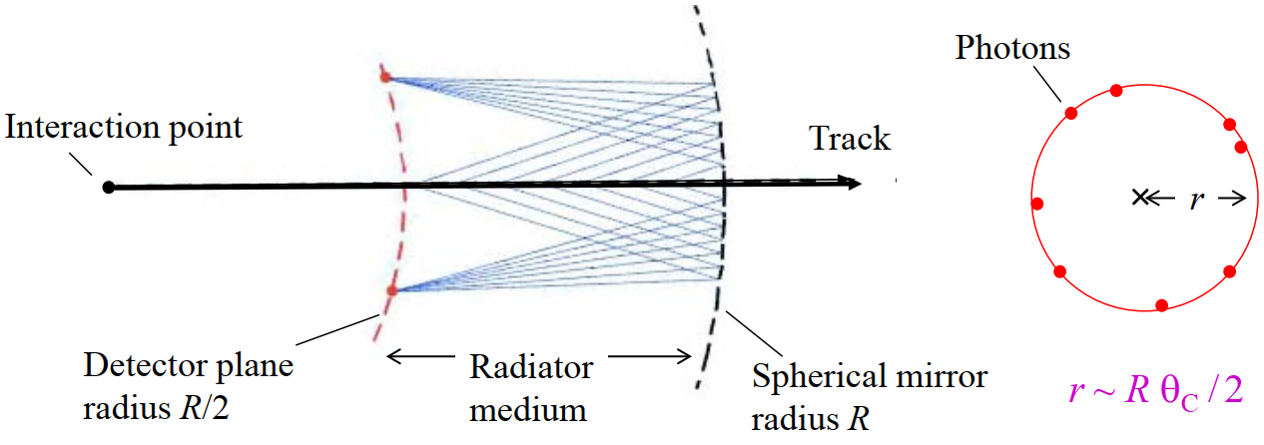
Cherenkov radiation
$v>c/n$
Particle travels faster in material of refractive index $n$ radiates photons
The “particle”
$$θ_{c}$$
$$θ$$
Charged particle
Light
The “photon wave”
Cherenkov light produced in 3-dimension, forming a cone around particle direction
A spherical mirror can image the cone to a ring, its radius $r$ measures $θ_{c}$
Cone (Cherenkov) angle $θ_{c}$:
$$\cos{θ_{c}}=\frac{c}{n}/v=\frac{1}{nβ}$$
$$r=f\left(θ_{c}\right)$$

Slide 24
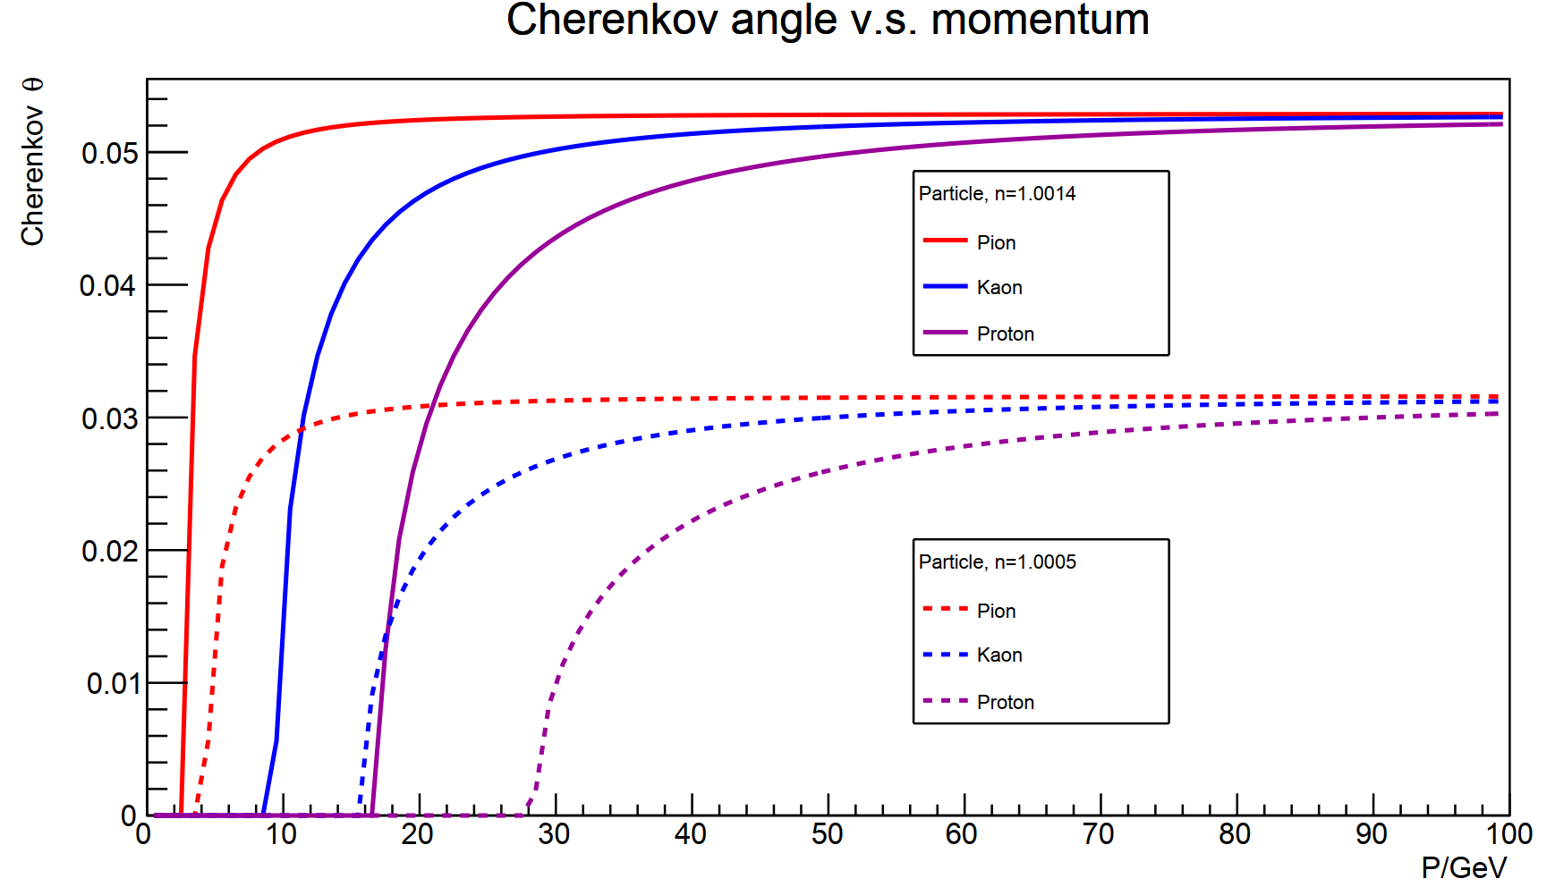
Application of Cherenkov detector
$m=p\sqrt{{1/β}^{2}−1}$, $\cos{θ_{c}}=1/(nβ)$
Lower limit for $p$: $βn>1$ ➔ $p>m/\sqrt{n^{2}−1}$
Upper limit for $p$ defined by experiment resolution for Cherenkov measurement
$m_{1}^{2}−m_{2}^{2}=p^{2}n^{2}\left(−2\sin{θ}Δθ\right)≈−2p^{2}n^{2}\sqrt{1−1/n^{2}}Δθ=−2p^{2}\sqrt{n^{2}−1}$ $Δθ$
$$(β→1)$$
$p<\sqrt{\frac{\left|m_{1}^{2}−m_{2}^{2}\right|}{2\sqrt{n^{2}−1}σ_{θ}}}$
$Δθ>σ_{θ}$➔
$$n=1.0014$$
$\frac{m}{\sqrt{n^{2}−1}}<p<\sqrt{\frac{\left|m_{1}^{2}−m_{2}^{2}\right|}{2\sqrt{n^{2}−1}σ_{θ}}}$
$$n=1.0005$$
Vary refractive index to have larger $p$ coverage

Slide 25
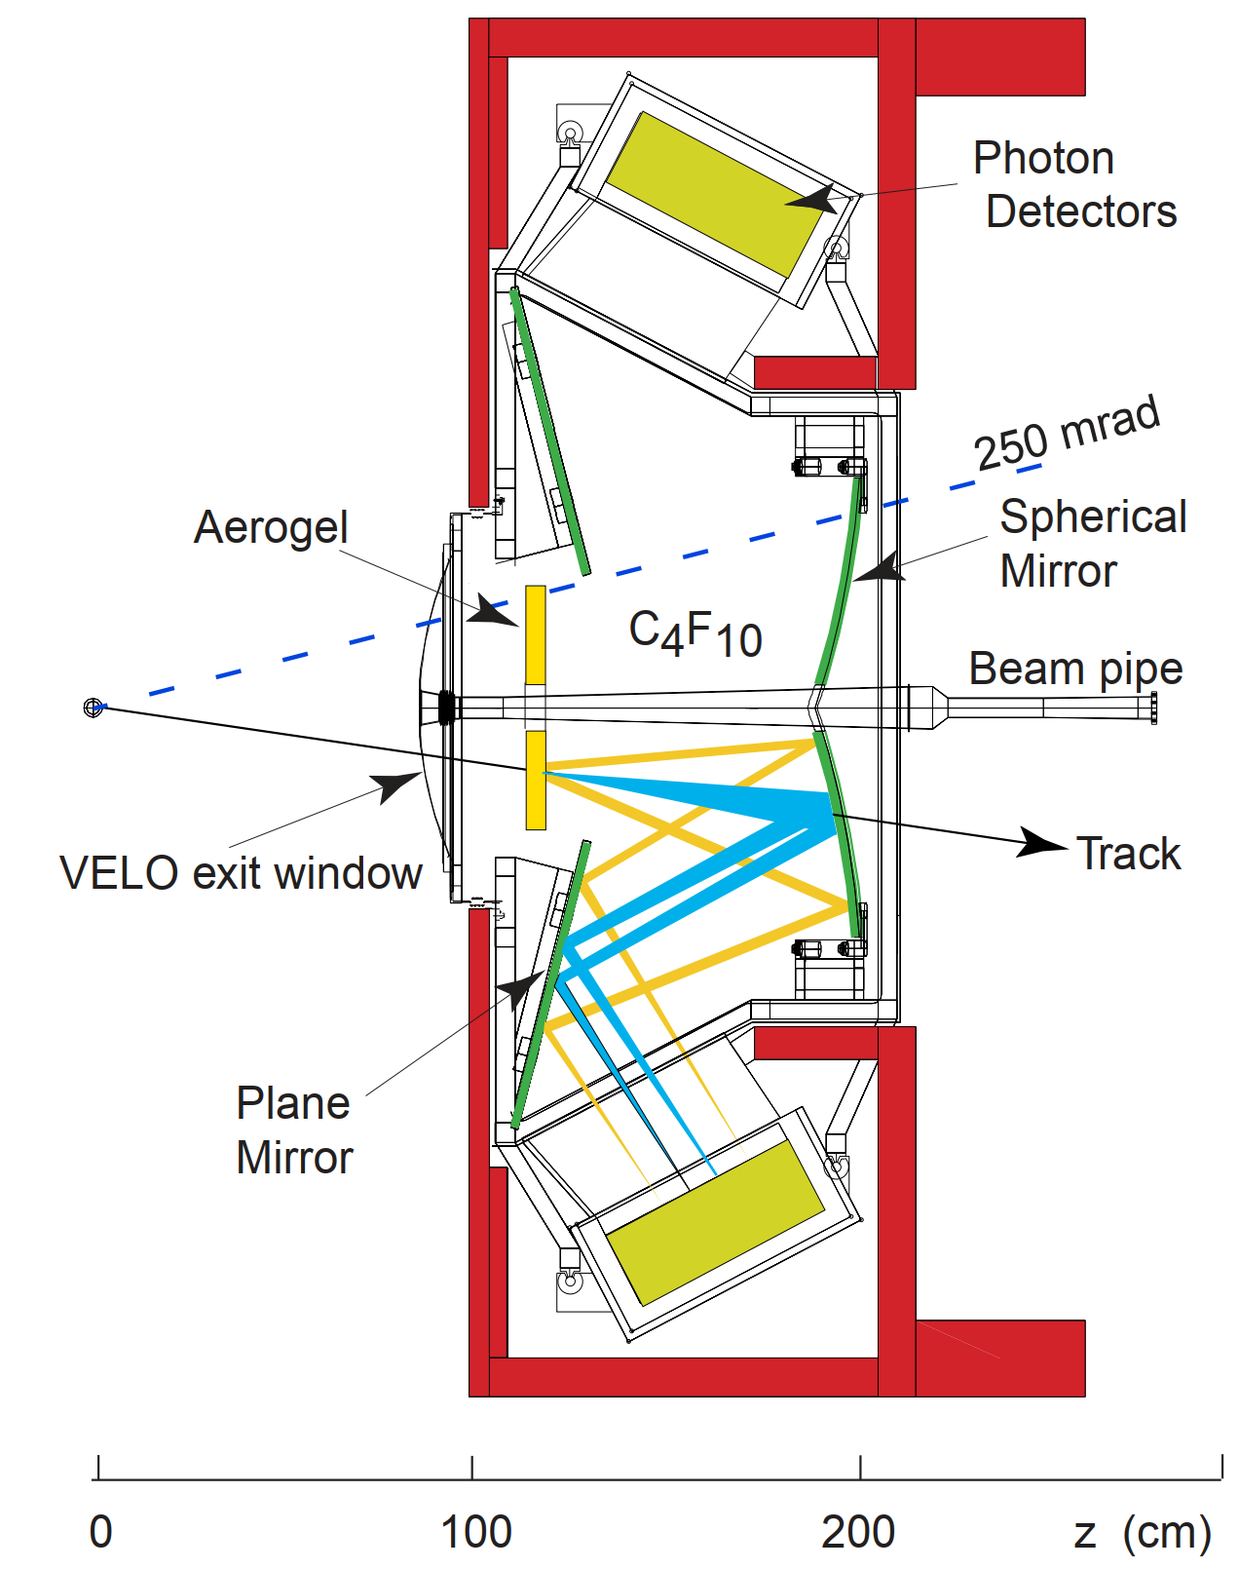
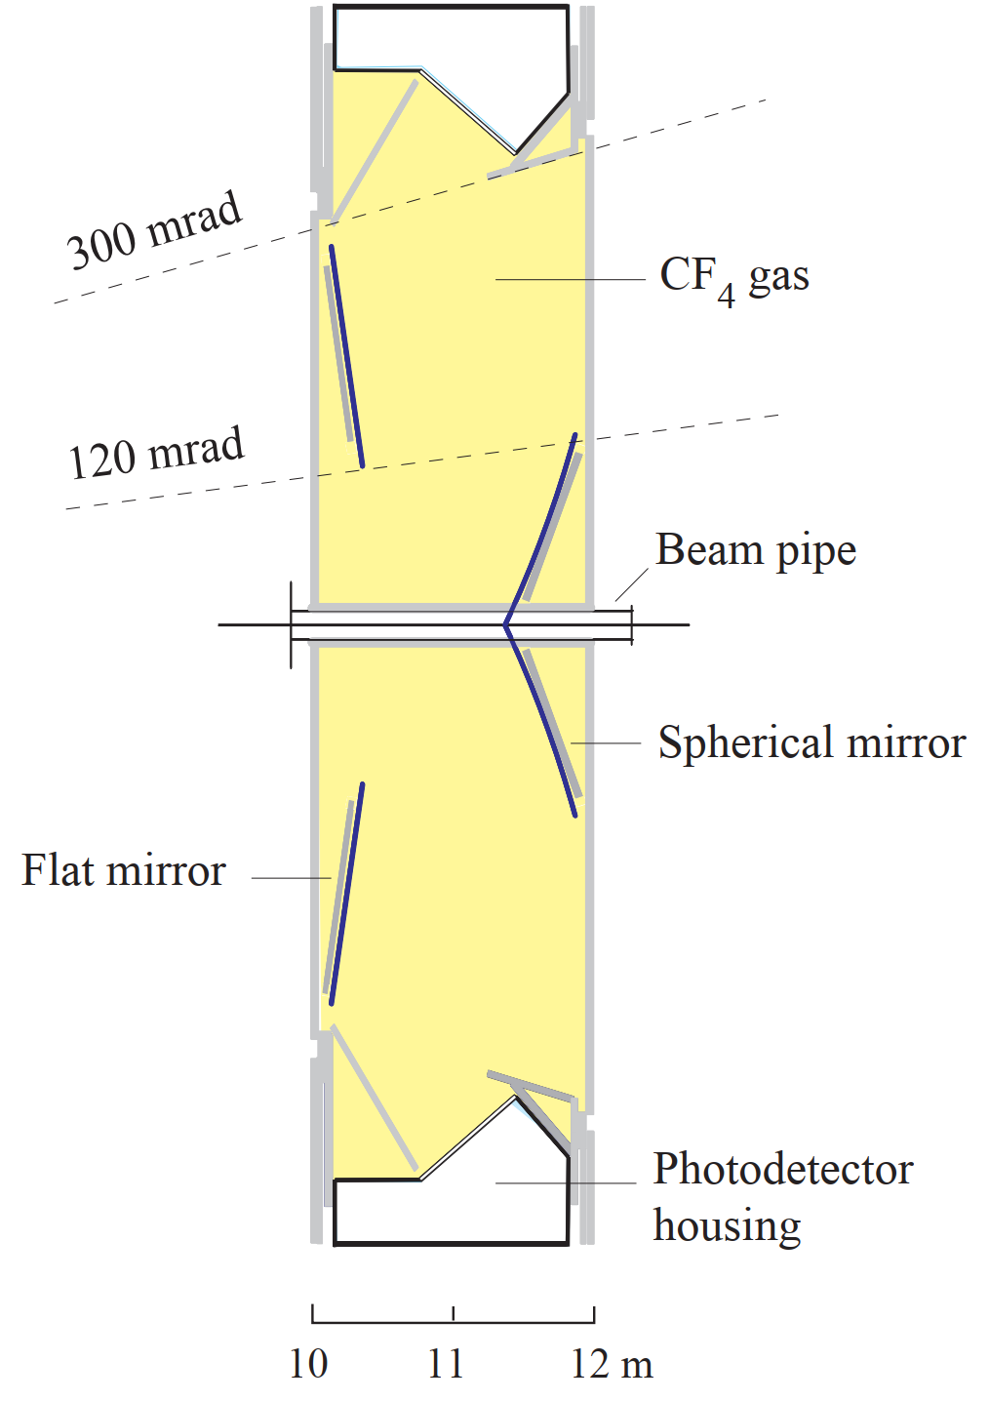
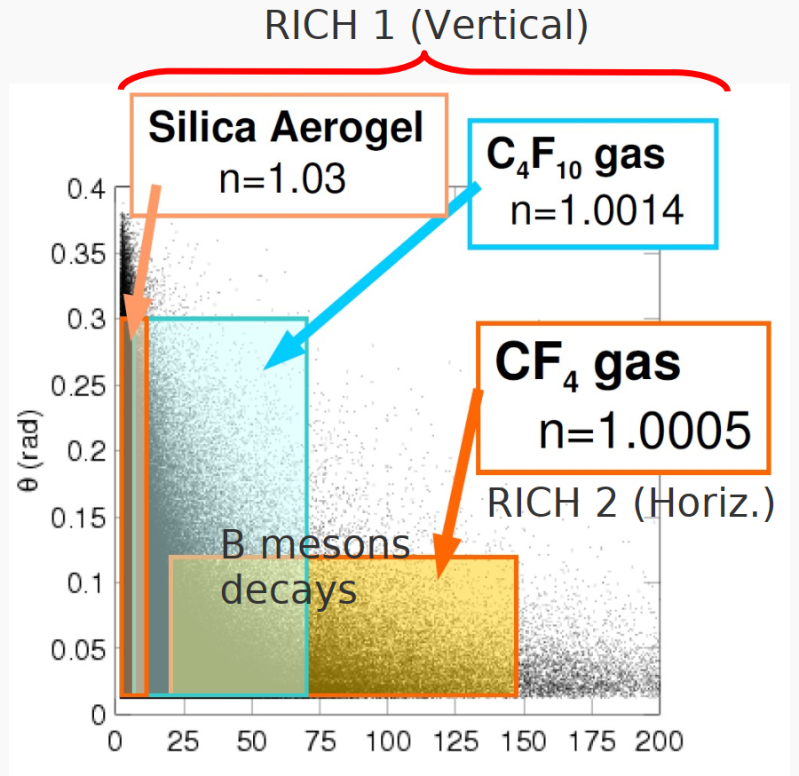
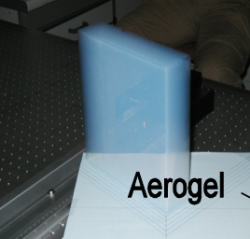
Two RICH detector at LHCb
$2<p<60$ GeV
$20<p<100$ GeV
RICH1
RICH2
Track momenta of $B→π^{+}π^{−}$
CF₄
Polar angle $θ$ (rad)
GeV

Slide 26
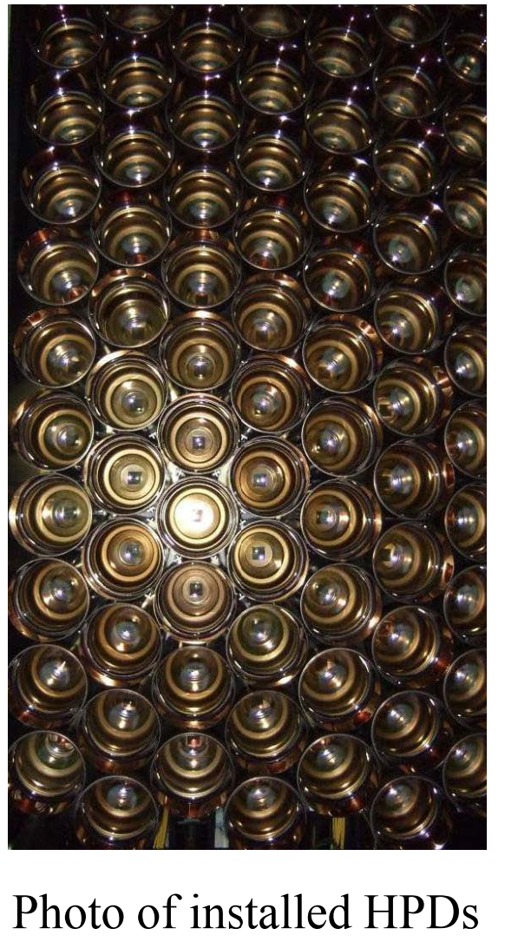
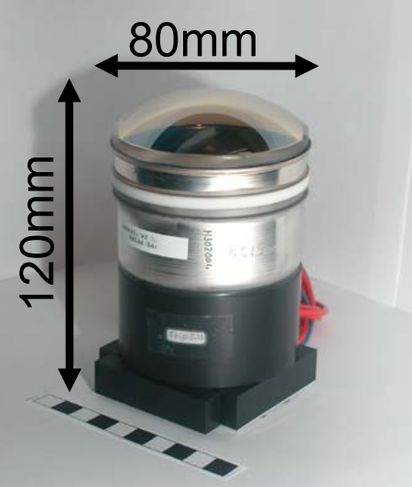
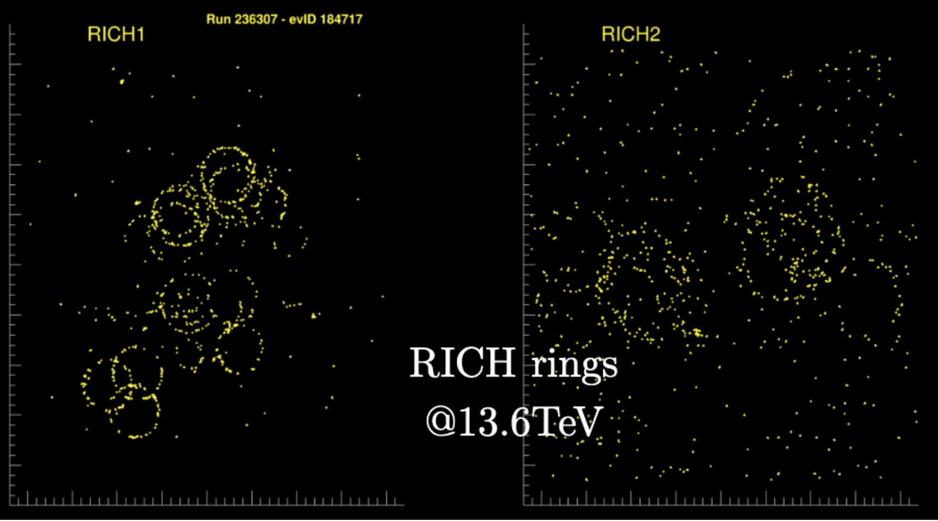
RICH operation
CERN-LHCC-2000-037
CERN-LHCC-2003-030
Cherenkov light readout by arraies of Hybrid Photon Detector
RICH rings
$32×32$ pixels
of ${\left(0.5 mm\right)}^{2}$

Slide 27
But usually more dirty
Hits in a typical event
RICH2
RICH1

Slide 28
RICH PID reconstruction
RICH PID: Delta log-Likelihood of different hypotheses of each track
Assume all reconstructed tracks are $π$, calculate global likelihood $ℒ_{π}$: matching between predicted hits distribution and observed hits. Testing $θ_{c}$ compatibility.
Change to other hypotheses ($K,p$ etc) for track $i$, determine change of likelihood $Δlnℒ_{Xπ}^{i}=lnℒ_{X}^{i}−lnℒ_{π}^{i}$. Assign X PID with the largest $Δlnℒ_{Xπ}^{i}$.
Repeat 2. for each track
Iterations needed to reach a global maximum

Slide 29
Reconstructed Cherenkov angle
RICH1
Events with isolated tracks

Slide 30
Cherenkov angle resolution
IJMPA 30 (2015) 1530022
RICH2
CF₄
Data
RICH1
C₄F₁₀
Data
$1.6$ mrad
$0.7$ mrad
Table of simulated resolution
RICH1
Aerogel
Data
$5.6$ mrad
Removed for Run2

Slide 31
Performances
Separation of $p, K, π$

Slide 32
Performances
JHEP 03 (2021) 075, PLB784 (2018) 124, PRL 119 (2017) 232001
$$H_{b}→h_{1}^{+}h_{2}^{−}$$
Simulation

Slide 33
LHCb calorimeter
arXiv:2008.11556
Sampling calorimeter
ECAL cell (Pb+plastic)
HCAL cell (iron+plastic)
ECAL
HCAL

Slide 34
$e^{±}$ ID with calorimeter
$χ^{2}$-matching between track and ECAL cluster
Energy in ECAL cluster over momentum by tracking
Energy in HCAL
Building $Δ\ln{ℒ_{e−h}^{CALO}}$

Slide 35
$e^{±}$ ID performance
JHEP 12 (2020) 081
Efficiency v.s. misID rate
$B^{0}→K^{∗0 }e^{+}e^{−}$ signal

Slide 36
$γ$ ID with calorimeter
$χ^{2}$-matching between any track and ECAL cluster
Energy deposit in PS detector
Shower shape
$B^{0}→K^{∗0 }γ$ signal
$σ≈90$ MeV/c²
$$π^{0}→γγ$$

Slide 37
LHCb Muon system
2D array of MultiWire Proportional Chambers (MWPC)
Detects ionizing signals of charged particles in gaseous medium

Slide 38
LHCb Muon PID
Extrapolate tracks to Muon detectors
Hits searched for in rectangular Field of Interest around track (Boolean IsMuon PID)
Calculate average distance between hits and extrapolated track (Likelihood PID)
With $μ$ likelihood
With $μ$ likelihood
$$μ→μ$$
$$π→μ$$

Slide 39
Muon PID performance
$B_{s}^{0}→J/ψ\left(→μ^{+}μ^{−}\right)φ$ for $φ_{s}$ measurement
All kinds of $H_{b}→h_{1}^{+}h_{2}^{−}$ decays almost all killed

Slide 40
PID with full detector information
arXiv:1803.00824
Combining all PID detectors
Multivariate techniques (Multi Layer Perceptron etc.) combining all detector information: PID and tracking systems
Best performance achieved

Slide 41
Data driven PID calibration
arXiv:1803.00824

Slide 42
Beauty production in pPb
$$∫ℒdt≈30 {nb}^{−1}$$
PRD99(2019)052011
$$B^{+}→{\overline{D}}^{0}π^{+}$$
$$B^{+}→J/ψK^{+}$$
Nuclear modificatiaon factors
$$Λ_{b}^{0}→Λ_{c}^{+}π^{−}$$
$$B^{0}→D^{−}π^{+}$$

Slide 43
Charm in PbPb
$$∫ℒdt≈200 μb^{−1}$$
arXiv:2210.06939
Centrality interval 65-90%
$$\left\langle N_{part}\right\rangle ≈16$$
$$D^{0}→K^{−}π^{+}$$
Productioin ratio
$$Λ_{c}^{+}→pK^{−}π^{+}$$

Slide 44
Saturation at high occupancy
LHCb-INT-2020-004
Run1-2 (2010-18)
Run3 (2022-25)
Up to 60% centrality

Slide 45
Future prospects

Slide 46
LHCb timeline

Slide 47
Run 3 detector: $5×$ lumi than Run1-2
Calorimeter
No L0, new Readout throughput
New tracking system
UT: Silicon strips
SciFi: Scintillating Fibers
Pixel detector
Full software trigger
5$×$ more speed to disk
Cherenkov PID detector
New optical system in RICH1
New photon detectors
Muon system
new Readout throughput

Slide 48
Challenges at high luminosity
Higher pileup, higher multiplicity, higher radiation damage, computing
Higher granularity, timing information, GPUs/FPGAs …
Simulation
$$π^{0}→γγ$$
5D Calorimeter
4D tracking
No timing
dt=30 ps

Slide 49
Conclusions
Flavor physics
LHCb $b$-physics
LHCb detector and data
RICH PID
Calorimeter PID
Muon PID
Upgrade
Thank you very much

Slide 50
Backup slides

Slide 51
Run3+4 (2030, 50 fb-1) projections

Slide 52
LHCb detector
Vertex reconstruction
Large boost
$σ_{IP}\sim 20 μm$
$σ_{τ}\sim 45 fs$ w.r.t. $τ_{B}≈1.5$ps
Muon identification
$ε\left(μ→μ\right)\sim 97\%$
MisID rate $\left(π→μ\right)\sim 1−3\%$
$pp$ collision
Track reconstruction
$ε\left(Tracking\right)\sim 96\%$
${δp}/p\sim$0.5%-1% (5-200 GeV)
$ε\left(m_{J/ψ}\right)≈15$ MeV
Hadron identification
$ε\left(K→K\right),ε\left(p→p\right)>90\%$
MisID rate $\left(π→K/p\right)<5\%$
Notes:
Instrumented for heavy flavor measurement

Slide 53
LHCb RICH detectors
JINST 3 (2008) S08005
IJMPA 30 (2015) 1530022
Identify charged particles: ﻿ $p^{±}, K^{±}, π^{±}$ and also $μ^{±}, e^{±}$
M1-M5
Magnet
T-stations
ECAL
HCAL
RICH2
RICH1
VELO
UT
Calorimeter + iron shielding
Notes:
Instrumented for heavy flavor measurement

Slide 54
Detector top view

Slide 55
Mass resolutions

Slide 56
Calorimeter modules

Slide 57
Calorimeter regions

Slide 58
Muon regions

Slide 59
IsMuon efficiency and PDF for likelihood

