Slide 1
Positioning in the Pasteur’s Quadrant:
Developing Science and Technology Together
B.N. Jagatap
Chemistry Group
Bhabha Atomic Research Centre
bnj@barc.gov.in
ASET Colloquium
Tata Institute of Fundamental Research
January 01, 2015

Slide 2
How do we understand this Data?
India’s World Rank in 2015
Publications (scientific/technical)
06
Human development index
135
Most innovative country
81
(Bloomberg ranking)
Patents per capita
20
GDP per capita
164

Slide 3
How long will it take India to overtake other large economies in per capita GDP?
Assumptions: (1) Indian economy grows at 8% (2) Other economies remain stagnant

Slide 4
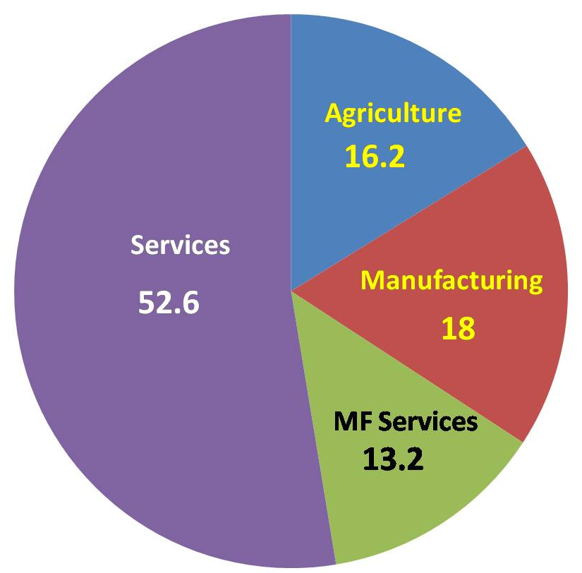
Indian Economy: 2014-15
“Make in India”
“Lab to Land”
‘GDP Sectorial Growth Rates: What is Driving Economy’, by J.G. Rajakumar and Anita Shetty
Economic & Political Weekly, Feb.28, 2015

Slide 5
What Economist Say…………
The literature on economic development and growth have long argued that technology is a major component of long-run economic growth of increased productivity.
Scholars have called for a concerted effort in promoting technological research and the background science to consolidate and develop research findings.
J. Schumpter, ‘The Theory of Economic Development’, Cambridge (1934).
C. Futardo, ‘Economic Development of Latin America, Historical Background and Contemporary Problems’, Cambridge University Press (1970).
C. Freeman, ‘The Economics of Hope’, Essays on Technical Change, Economic Growth and the Environment’, Pinter, London (1992).

Slide 6
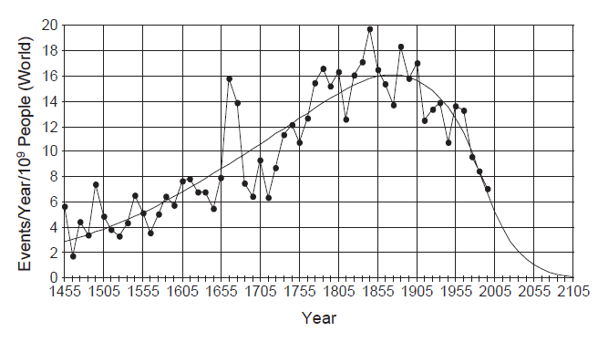
Global Rate of Innovation
Events per year per billion people
Electricity & Magnetism
Quantum Mechanics
Mechanics
Nuclear Technology, Lasers
Compass
J. Huebner, Technological Forecasting and Social Change, 72, 980 (2005).
‘The Great Stagnation’ by Tyler Cowen, George Mason University, USA (2013)

Slide 7
“Is there one invention, one technology, one idea produced by you that has helped make the society and the world a better place?”
N.R. Narayana Murthy
‘How can you, the graduates of IISc, contribute towards a better India and a better world’
July 15, 2015

Slide 8
How do we understand/establish connection between
basic research and technology development?

Slide 9
We discuss:
Basic Sciences and applied sciences
Their inter relationships
World Historical Perspectives
Indian Perspective
Our experience in Chemistry Group, BARC
Invention: Accumulation and creation of knowledge that results in a new tool, device or process that accomplishes a specific purpose.
Discovery: Creation of new knowledge and facts about the world.

Slide 10
Science ⎯ the Endless Frontier: A report to the President
By Dr. Vennevar Bush (July 15, 1945)
The separation of research into ‘Basic’ and ‘Applied’ domains and their interrelationship was discussed for the first time in this famous report.
Dr. Vannevar Bush was Director, Office of Scientific Research and Development, USA, during the World War II.

Slide 11
Science ⎯ the Endless Frontier: A report to the President
By Dr. Vennevar Bush (July 15, 1945)
The report was in response to President Roosevelt’s letter (November 17, 1944) which contained 4 questions:
What can be done, consistent with military security, and with the prior approval of the military authorities, to make known to the world as soon as possible the contributions which have been made during our war effort to scientific knowledge?
With particular reference to the war of science against disease, what can be done now to organize a program for continuing in the future the work which has been done in medicine and related sciences?
What can government do now and in the future to aid research activity by public and private organizations?
Can an effective programme be proposed for discovering and developing scientific talent in American youth so that the continuing future of scientific research in the country may be assured on a level comparable to what has been done during the war?

Slide 12
Summary of Bush Report
“Progress in war against disease depend upon the flow of scientific knowledge. New products, new industry and more jobs require continuous additions to knowledge of the laws of nature and the application of that knowledge to practical purposes. Similarly our defense against aggression demands new knowledge so that we can develop new weapons. This essential new knowledge can be obtained only through basic scientific research.
The publicly and privately supported colleges, universities and research institutes are the centres of basic research. They are the wellsprings of knowledge and understanding. As long as they are vigorous and healthy and their scientists are free to pursue truth wherever it may lead, there will be a flow of scientific knowledge to those who can apply it to practical problems in the government, in industry or elsewhere.”

Slide 13
Summary of Bush Report
“Scientific progress on a broad front results from free play of free intellectuals, working on subjects of their own choice in the manner dictated by their curiosity for exploration of unknown. Freedom of inquiry be preserved under any plan for Governmental support of science…….”
“A nation which depends upon others for its new scientific knowledge will be slow in its industrial progress and weak in its competitive position in the world trade, regardless of its mechanical skills.”

Slide 14
Scientific Policy Resolution 1958
Key to the national prosperity lies in effective combination of three factors: Technology, Material and Capital. The first is far important since it can make up for the deficiency in other two.
Technology can only grow out of study of science and its applications.
Science has not only radically altered man’s material environment, but also has provided new tools of thought and extended man’s mental horizon.
Scientific approach and methods, and use of scientific knowledge is essential to the idea of a welfare state.
Scientifically trained human resource can become an asset.
We need to bridge the gap between us and the advanced nations with most vigorous measures and putting forward our utmost efforts.
It is inherent obligation of a great country like India with its traditions of scholarship, original thinking and great cultural heritage to participate fully in the march of science.

Slide 15
Abstract of Bush Report
Basic research = Curiosity driven research
Applied research = Application oriented research arising from
advances in basic research
Basic Research
Technology Development
This linear model became the backbone of science & Technology planning

Slide 16
Why this premise in Bush’s Report: Science, the Endless frontier
Experience of World War II
Ideological Baggage from History

Slide 17
Experience of World War II
1932 Discovery of neutron
1933 Discovery of nuclear force
1934 Discovery of artificial radioactivity
1935 Mass/binding energy formula
1936 Compound nucleus model
Basic Research
1937 Liquid drop model
1938 Theory of energy production in stars (fusion)
1939 Fission of uranium
1939 Idea of uranium bomb
1941 Discovery of new element, Pu
1941 Manhattan Project
1942 Construction of isotope separation facility
Technology
1942 Fermi’s nuclear pile
1945 Nuclear Bomb

Slide 18
Ideological baggage
Foundation of the Royal Society (17th Century)
Science was to be fostered and nurtured as leading to the improvement of man’s lot on earth by facilitating technological invention.
The Royal Society does not intend to stop at some particular benefit but goes to the root of all novel investigations.
Further, those experiments which do not bring with them immediate gain are not to be condemned for as the noble Bacon had declared, experiments on light ultimately conduce to a whole troop of inventions useful to the life and state of man.
Robert K. Merton
“Science, Technology and Society in Seventeenth Century England”

Slide 19
Ideological baggage
“The republic of science is a society of explorers in which scientists freely making their own choices of problems and pursuing them in the light of their own personal judgment, are working under self-coordination of independent initiatives guided by an invisible hand towards the joint discovery of a hidden scheme of things.
Any attempt by external authority to interfere with the coordination of science poses a threat to scientific progress.
The aspiration of guiding progress of science into socially beneficial channel was an impossible and nonsensical aim.”
Michael Polanyi
“The Republic of Science. The Political and Economic Theory”, Vol.1

Slide 20
There were other voices too……..
“Preference should be given to the applied sciences over the basic, curiosity driven research and that there is no moral boundary between the production of knowledge and its applications.
Science is an instrument of social transformation and emancipation and should be rooted in practical life.”
J.D. Bernal, The Social Foundation of Science (1939)
“Science should be judged by its utility broadly. Construed scientific freedom is legitimately limited by governmental research policies and disinterestedness should be replaced by a comprehensive ethical obligation towards the production and applications beneficial to society.”
Jon Dewey, ‘The Supreme Intellectual Obligation’, Science 79 (1934) 240-243

Slide 21
Analyzing the Bush Model
Basic research as pre-requisite for technology innovation
View-1:
Specific idea emerging from basic research is the inspiration and source of technological innovation
View-2:
Cumulative output of basic research is essentially a source that can be mined by applied scientists and engineers for the purpose of innovation

Slide 22
Current Information and Communication Technology & Nobel Prizes in Physics
1956 Nobel Prize
2000 Nobel Prize
Discovery of transistor and invention of bipolar junction transistor
Invention of semiconductor heterostructure and invention of integrated circuit
Shockley, Bardeen and Brattain
Alferov, Kroemer, Kilby
1964 Nobel Prize
2009 Nobel Prize
Discovery of quantum electronics and invention of lasers and masers
Invention of fiber optic waveguides and the invention of CCD
Townes, Basov and Prokhorov
Kao, Boyle, Smith
1985 Nobel Prize
Discovery of the quantum hall effect
Klitzing
Communication Technology

Slide 23
Basic science is performed without thought of practical ends
This has been taken as a definition.
This also came to mean that
• there is an inherent tension between basic and applied sciences
• an attempt to mix pure and applied research is sure to result in applied driving out the pure
Bush made it clear that the defining characteristics of basic research is its attempt to find more general physical and natural laws to push back the frontiers of fundamental understanding.

Slide 24
Converting knowledge to practical use is not scientists’ responsibility
“ As long as the scientists are free to pursue truth wherever it may lead, there will be new scientific knowledge to those who can apply it to practical problems in the government, in industry or elsewhere…..”
Basic research
New Scientific knowledge
Technology Generation
Interested and capable agency
In the absence of ‘those who can apply’ the basic research can not be converted to technology.

Slide 25
Example: Invention of MASER & LASER
Schawlow & Townes @ Bell Laboratories
“Neither man was planning on inventing a device that would revolutionized a number of industries, from communications to medicine. They had something more straightforward in mind, developing a device to help them study molecular structure.”

Slide 26
‘Those who can apply’ made the uses of lasers possible
1960
Invention of Ruby laser by Maiman
1962
First medical application by Goldman
Laser breakdown spectroscopy for chemical analysis
1964
Laser range finder
1968
Refractive eye surgery
1969
Apollo 11 : Distance between earth and moon
Measured to an accuracy of 3 cm
1974
Super market bar code
1978
Laser disc player
Today laser is a multi-billion dollar industry

Slide 27
R&D Spending in US is under three categories
Basic Research
Advancing knowledge and understanding.
Applied Research
Deciding which discoveries can become products.
Developmental Research
Developing these discovered technologies into actual products.

Slide 28
Basic research
New Scientific knowledge
Technology Generation
Interested and capable agency
And suppose the ‘interested and capable agency’ happens to be from the country other than the one which has funded the basic research?
Or ‘the interested and capable agency’ in the country funding the basic research is late in the race to convert basic research to technology?
Advantage of the basic research cannot be harnessed by that country
“Knowledge is global, technology is local”

Slide 29
Nation will capture the technological benefits of its investment in science
Can we tell the society that a heavy investment in basic sciences would produce the technology to handle a full spectrum of society’s needs?
This can not be done since the basic research is curiosity based and has no practical thought embedded in it.

Slide 30
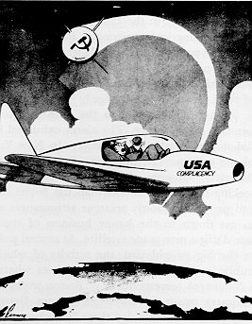
Following Bush’s assumption - ‘Nation will capture the technological benefits of its investment in science’, USA invested heavily in basic research .
Landing of Sputnik in 1957 heavily damaged this assumption.
Cartoon reaction to Sputnik I. (By Thomas Flannery, Baltimore Sun.)
'What was that?‘

Slide 31
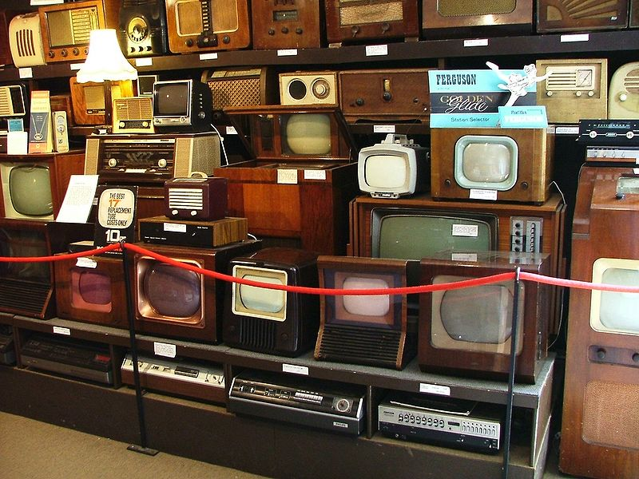
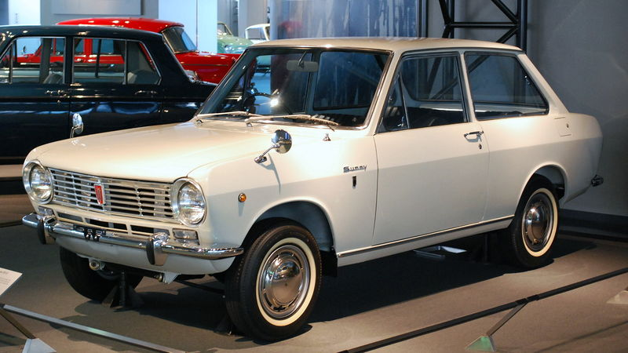
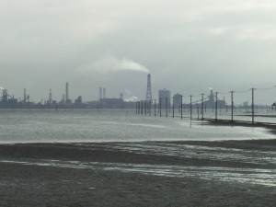
Sixty years ago, Japan made greatest industrial strides while they continued to be behind US and Europe in basic sciences
1960s
Japanese made TV sets
Nissan Sunny
Nippon steel plant
Bush assumption- ‘A nation which depends upon others for its new scientific knowledge will be slow in its industrial progress and weak in its competitive position is the world trade regardless of its mechanical skill’ became untenable.

Slide 32
Long and short of the whole thing:
Basic research
New Scientific knowledge
Technology Generation
Bush report is a linear and unidirectional model of knowledge creation and application
It was formulated following the international experience of world war II and its technological culmination in the detonation of two atomic bombs on Japan.
It’s validity has been often questioned.
What is the new thinking?

Slide 33
Two Pertinent Questions
Is Basic Research always curiosity driven ?
Is priority to work of the head over the work of hand and thus to the creation of scientific knowledge over technical expertise is justified?
Does Technology Generation Follow Linear Model?
Whether understanding always precedes invention?
What does the history of science tell us?

Slide 34
James Watt invented his steam engine before the laws of thermodynamics were postulated.
In fact, the science of thermodynamics owes a great deal to the steam engine.
Rise of microbiology in late 19th century is an example of development of a whole new branch of science because of consideration of use and not only the quest of fundamental understanding.
Louis Pasteur wanted to understand the process of disease at the most fundamental level as well as the other microbiological processes that he discovered, but he wanted to deal with silk worms, cholera in chicken, spoilage of milk, vine and vinegar, and rabies in people.
Pasteur never did a study that was not applied while he laid out a whole fresh branch of science.

Slide 35
Thomas Edison was a pure applied scientist driven to solve practical problem.
Lord Kelvin believed that physics was profoundly industrial and inspired in substantial part by the need of empire.
The work of synthetic organic chemists (Germans and Americans) over the turn of the 19th century as they laid down the basics of chemical dye industry and later pharmaceutical.
Study of Earth Science is always influenced by natural disasters and economic gains.
Irvin Langmuir was fascinated by the surfaces of the electronic components that were manufactured by General Electric. His work led to the whole discipline of ‘Surface Physics’.

Slide 36
Summary of these observations:
The trajectories of basic research and technology development profoundly influence each other.
Every science discipline has its modern form, in part, as a user inspired research.
21st Century trend: More and more science is technology based, and more and more technology is science based.
Therefore, the linear model of relationship between basic research and technology development (as proposed by Bush) is no longer valid.

Slide 37
A new Model of Scientific Research
Pasteur’s Quadrant
Quest for fundamental Understanding
YES
Pure Basic Research
User inspired Basic Research
(Bohr)
(Pasteur)
Consideration of use
NO
YES
?
Pure applied Research
(Edison)
NO
Donald E. Stokes, Pasteur’s Quadrant: Basic Science and Technological Innovation (1997).

Slide 38
Pasteur’s Quadrant
Quest for fundamental Understanding
YES
Pure Basic Research
User inspired Basic Research
(Bohr)
(Pasteur)
Curiosity driven, pure voyage to discovery
Work that locates the centre of research is an area of basic scientific ignorance that lies at the heart of a social problem
NO
Consideration of use
YES
?
Pure applied Research
(Edison)
Science to what end?
End goals other than curiosity or application
Inventor driven to solve a practical problem
NO

Slide 39
Pasteur’s Quadrant
Expands the linear one-dimensional model by a two-dimensional plane that seeks to replace the idea of the unsullied quest for knowledge with a desire to solve a practical problem.
The model excited many in the science policy and academic communities, who believed it would free them form the binders of the linear model.
“Stokes’s analysis will, one hopes, finally lay to rest the unhelpful separation between basic and applied research that has misinformed science policy for decades”
George E. Brown Jr. US Congressman

Slide 40
Basic Premise of Pasteur Quadrant
The motivation of the researcher at the time of the work decides the outcome of research.
By an large, this motivation is dependent on the factors:
How the system of innovation is organized?
What causes them to be organized as they have been?
What values, norms and structural factors that have been related to the success and failure of these social systems of innovations?
How the systems inter-relate and respond to environmental changes?

Slide 41
Environment and positioning of a researcher
Quest for fundamental Understanding
YES
User inspired Basic Research
Pure Basic Research
(Pasteur)
(Bohr)
Work that locates the centre of research is an area of basic scientific ignorance that lies at the heart of a social problem
Curiosity driven, pure voyage to discovery
NO
Consideration of use
YES
?
Pure applied Research
Science to what end?
(Edison)
End goals other than curiosity or application
Inventor driven to solve a practical problem
NO

Slide 42
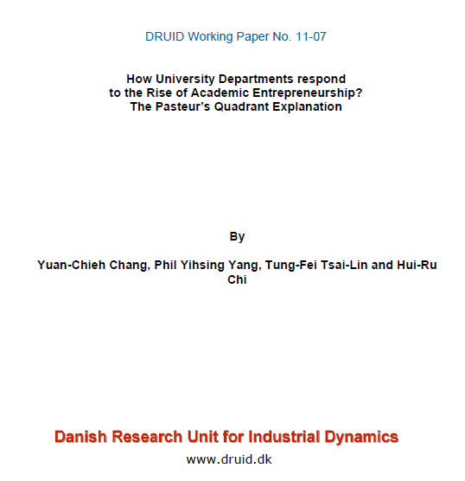

Slide 43
Pasteur’s Quadrant
Coupling Knowledge with Action
John R. Feussner M.D. MPH
Medical University of South Carolina

Slide 44
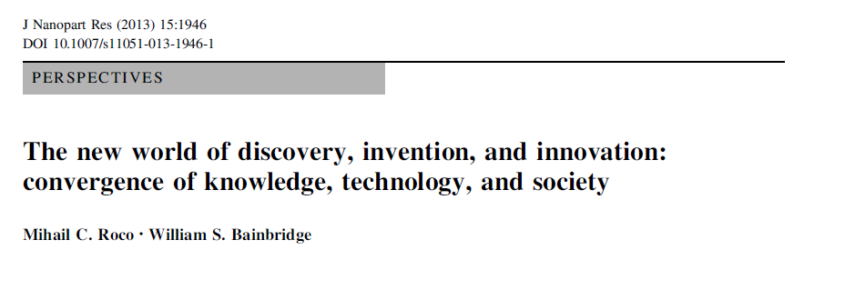

Slide 45
Experience at Hand
Chemistry Group, Bhabha Atomic Research Centre
Quest for fundamental Understanding
YES
Pure Basic Research
User inspired Basic Research
(Bohr)
(Pasteur)
Consideration of use
NO
YES
?
Pure applied Research
(Edison)
NO
Defining characteristics of basic research is its attempt to find more general physical and natural laws to push back the frontiers of fundamental understanding

Slide 46
Technology Development and Diffusion
Technology development is for satisfying a need.
Technology diffusion is spreading of technological knowledge related to specific innovation of interest to the population.

Slide 47
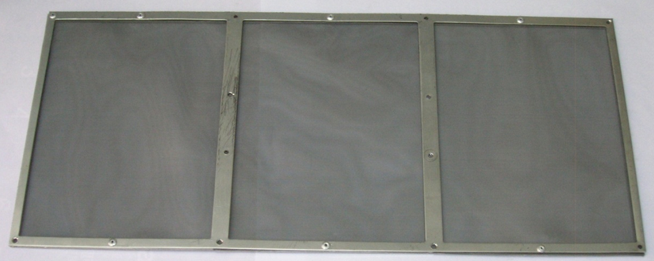
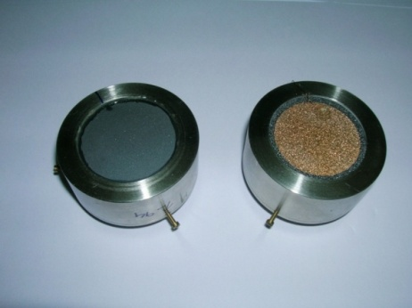
Passive Catalytic Recombiner Device for Hydrogen Mitigation
Technology transferred to M/s Electronic Corporation of India Ltd.
Safety device under severe nuclear accident conditions
Diamond film based alpha detector
Diamond film based alpha radiation detector is developed for measuring plutonium and uranium-233 in the concentration range 1-1000 ppm in corrosive liquids.
Important technology input for the back end fuel cycle

Slide 48
Reduction Catalyst
Pt/ZrO₂ catalyst is developed which gives 99% conversion of U(VI) to U(IV) in 7 hours. Performamnce is comparable to the currently used commercial Pt/SiO₂ catalyst.
Production at kg level achieved in collaboration with M/s Monarch Catalyst
Ultra-pure Germanium
Germanium of purity 99.999999% (8N) is developed.
2 kg of ultrapure material has been delivered for detector development.
Germanium ingot (8N)

Slide 49
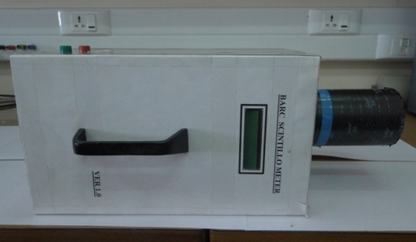
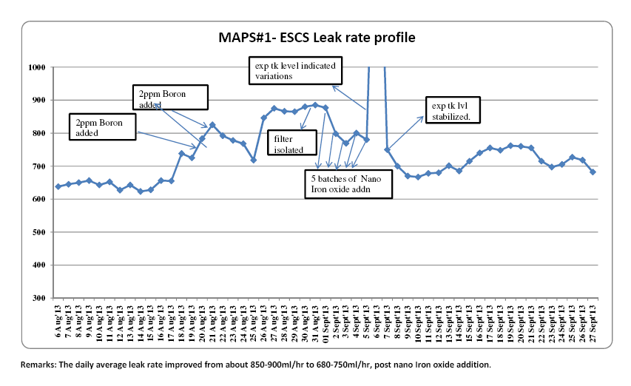
Plastic Scintillation Radiation Detectors
The technology of these detectors is developed based on polymers like polystyrene/polyvinyl toluene along with organic fluorescence additives.
The performance of the monitor is comparable to that of the imported ones.
Sealing of leak in MAPP end shield
Use of magnetite nano particles

Slide 50
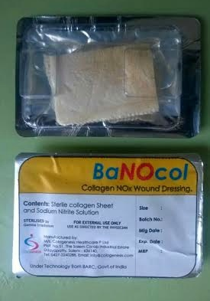
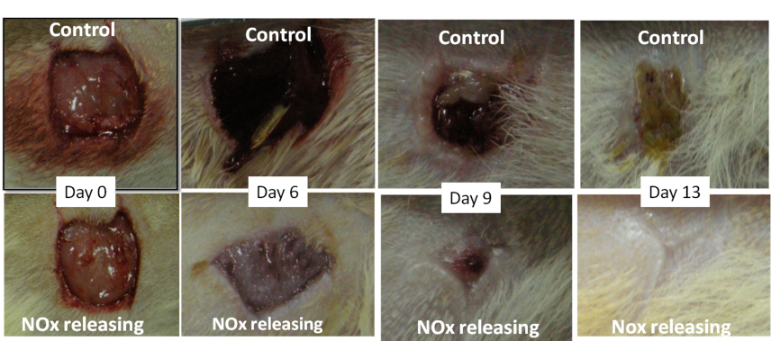
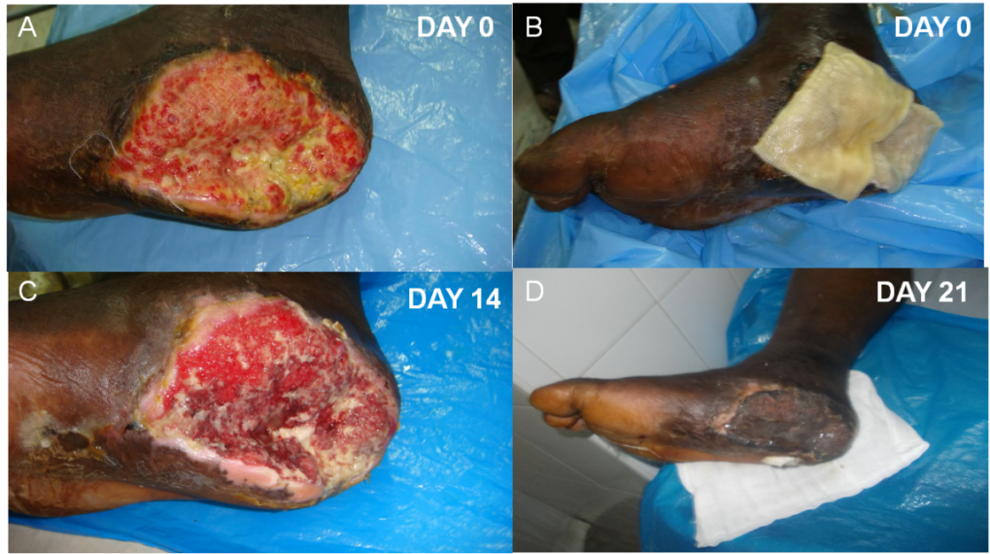
Nitric oxide releasing wound dressing
The dressing is very effective against a broad spectrum of infection-causing microbes. The dressing is found effective against chronic and non-healing wounds including diabatic wounds
Technology transferred to M/s Cologen Healthcare, Tamilnadu

Slide 51
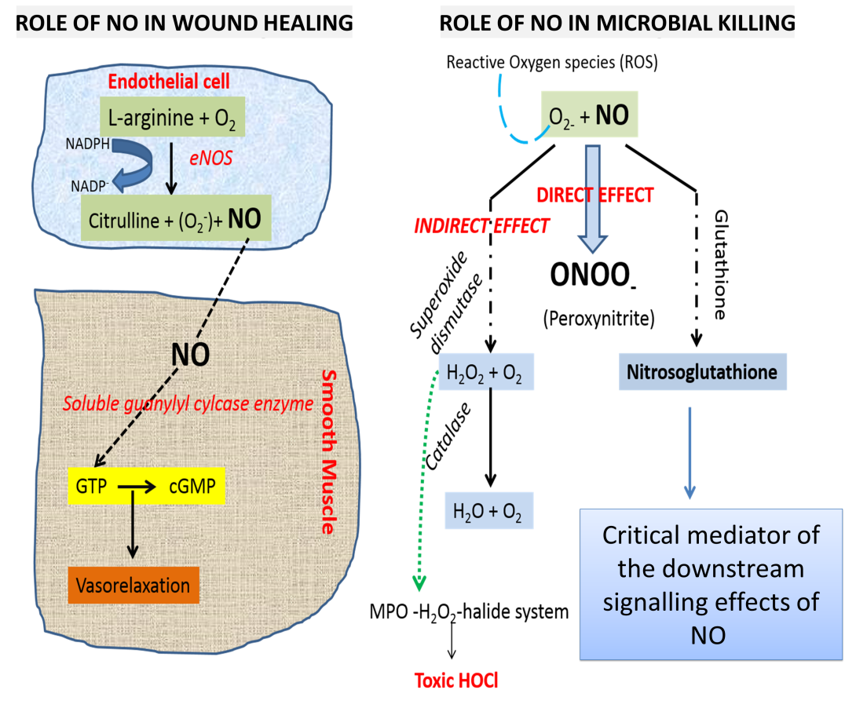
Nitric Oxide (NO) Releasing Wound Dressing
Essential Features of NO in bacterial killing and wound healing
Powerful microbiocide
Can penetrate wound biofilm and kill the microbes
Does not promote resistance buildup in microbes
Has broad-spectrum activity
Helps in vasodilation and angiogenesis
NO delivering creams (popular method to deliver NOx) setbacks
Instantaneous release of NO
Debridement required daily, adds agony to the patients
Care-giver cannot see the progress in wound healing

Slide 52
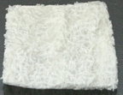
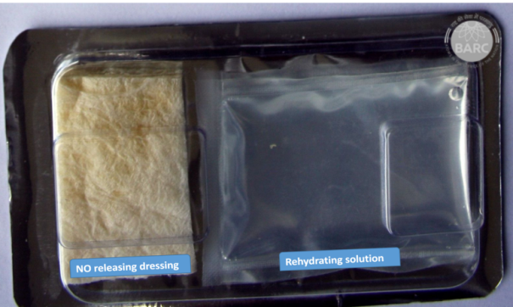
Phase: 1
NO releasing dressing developed that overcomes the setbacks
ANIMAL TRIALS of the nox releasing dressing
Indian patent applied for;
application no: 3026/MUM/2013.
Phase: 2
Technology incubated with M/s Cologenesis HealthCare Pvt Ltd
Under incubation:
Base material changed to collagen for better homeostasis
NO release time decreased from 10 to 2 min.
Aesthetic appeal of the finished product enhanced.
Human case studies conducted to test the efficacy of this product.
Phase: 3
Incubation successfully completed and closed
Know-how transferred to M/s Cologenesis Health Care Pvt ltd, for 2 y on exclusive basis

Slide 53
Market Size
“The demand for advanced wound care products is expected to rise over the next 10 years, driven by increase in chronic wounds. This can be attributed to an aging population and lifestyle related disorders such as diabetes and obesity. Visiongain predicts the total advanced wound care market to be worth $16.3bn in 2023.”
Ref:http://finance.yahoo.com/news/advanced-wound-care-world-market-120200209.html

Slide 54
TURBOVITA
High Protein Nutritional Supplement Designed to Provide Health Benefits of Curcumin
A single serving of Turbovita provides about 100 mg of available curcumin. The regular consumption of Turbovita, a source of bioavailable curcumin is beneficial for human health.
Product developed for Veena Industries, Nagpur

Slide 55
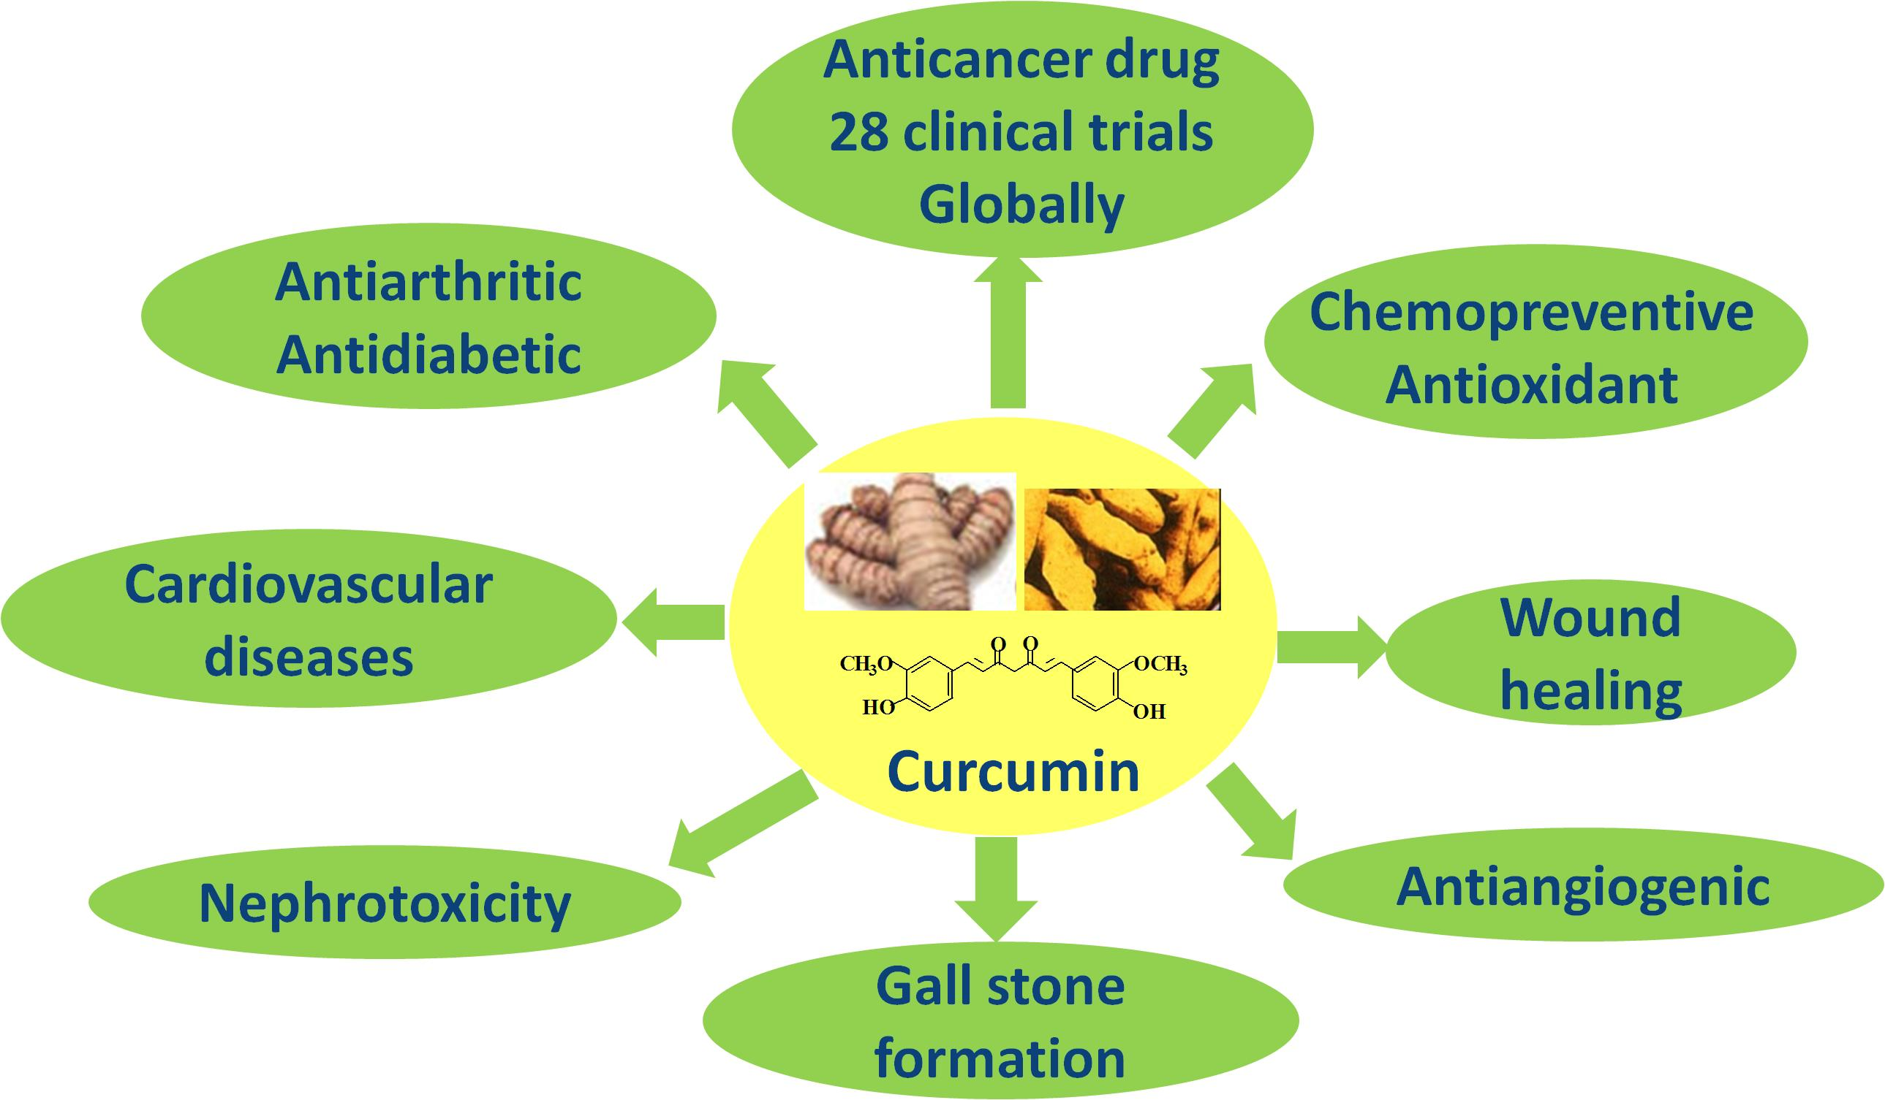
Development of Neutraceutical: TURBOVITA
(An age old medicine with modern solution)
Turbovita is developed in collaboration with M/s Veena Industries, Nagpur, under BARC incubation of technologies.

Slide 56
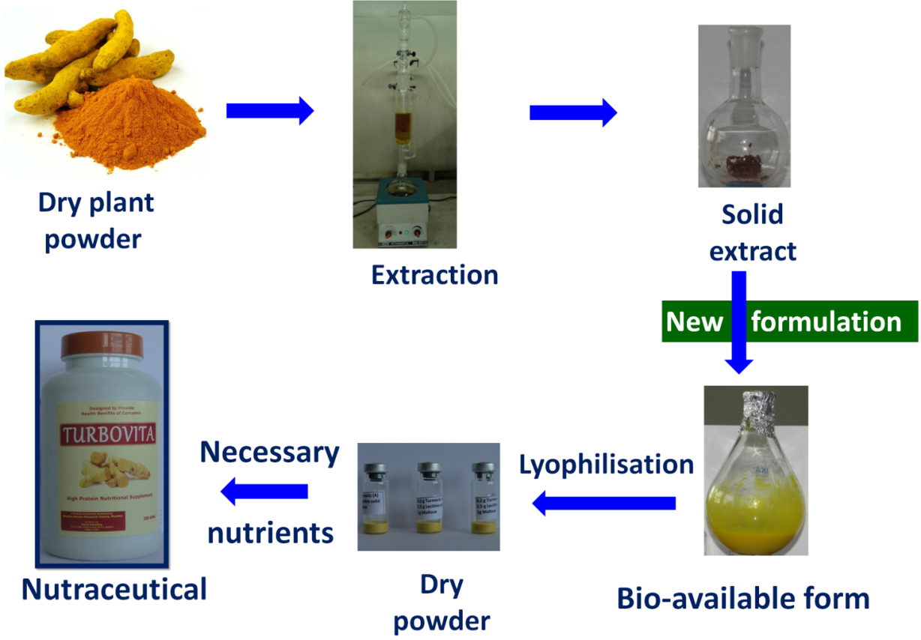
Turbovita
Turmeric extract
Curcuminoids
Soya Protein Isolate
Whey Protein Isolate
Calcium Cassinate
Dextrose
Inulin
Maltodextrin
Cocoa Powder
Soluble fibre
Soya Lecithin
Vitamin-A-D-E-K
B-Group Vitamin
Vitamin-C
Tri-calcium Phosphate
Silicon dioxide
Pectin
A single serving of Turbovita provides about 100 mg of available curcumin.

Slide 57
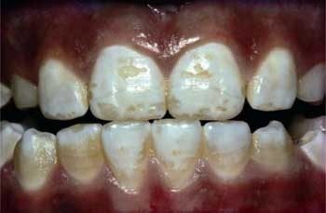
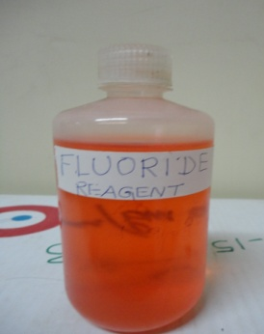
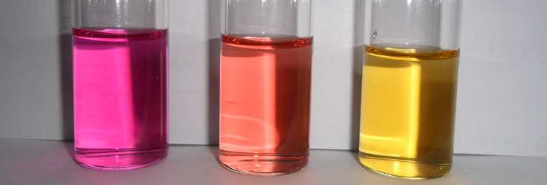
Visual Detection kit for fluoride in ground water
Fluoride contamination in ground water is creating health problems to 90 million people in India.
200 districts in 15 states are affected with fluoride contamination.
WHO has recommended safe level of fluoride in drinking water to be in the range 1-1.5 mg/L
Dental and skeleton fluorosis
Mix 4 parts of water and 1 part of the reagent
Visual fluoride detection kit, which gives different colours depending on deficient (<1 mg/L), safe or normal (1-1.5 mg/L) and toxic (>2 mg/L) levels of fluoride in ground water.
Fluoride detection reagent
Deficient
Normal
Toxic
The kit has been adjudged as the best kit among 18 kits by a UNICEF survey.

Slide 58
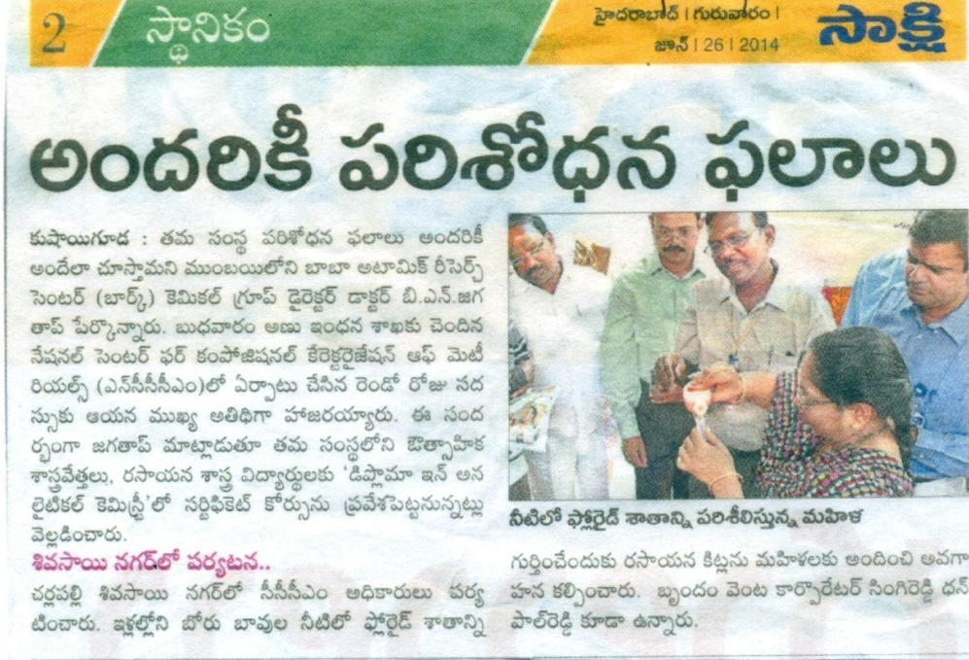
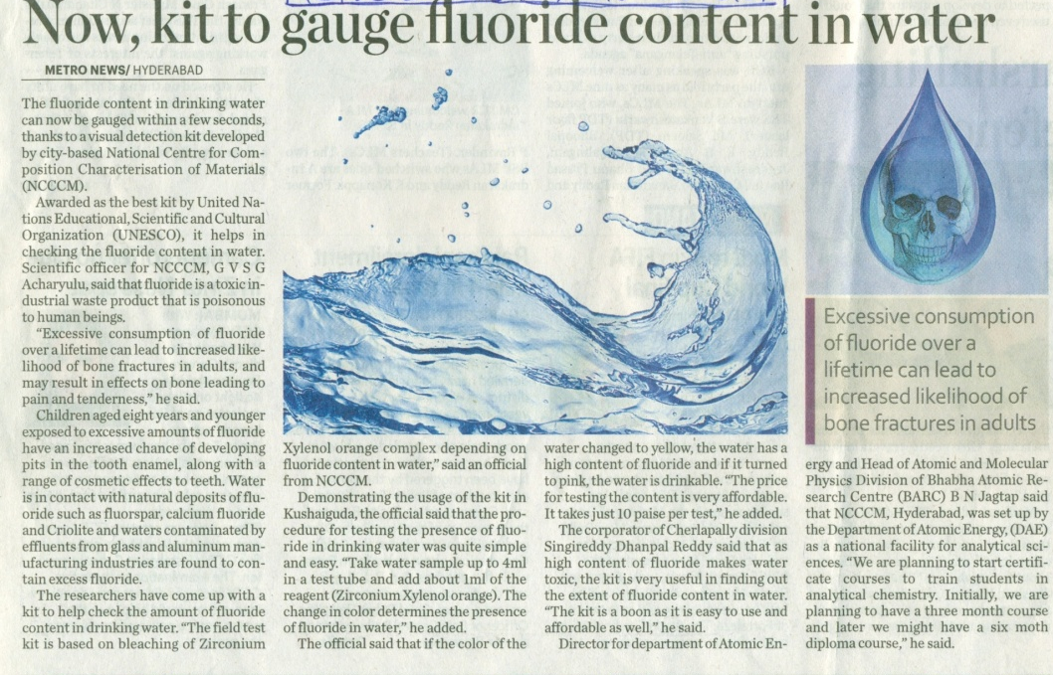
SAKSHI , Hyderabad, 26.06.2014
METRO INDIA, Hyderabad, 26.06.2014
The corporator of Cherlapally Division, Singireddy Dhanpal Reddy said that as high content of fluoride makes water toxic, the kit is very useful in finding out the extent of fluoride in water. “The kit is a boon to us as it is easy to use and affordable as well.”
Technology Transferred to
M/s S. K. Kayakalp Remedies Pvt Ltd, Bhopal
M/s H.S. Industries Pvt Ltd, Hyderabad
M/s P.S. Industies Pvt Ltd, Amravati
M/s ORLAB Instruments Pvt Ltd Hyderabad
M/s LTEK Systems, Nagpur
M/s Agrotech, Baroda

Slide 59
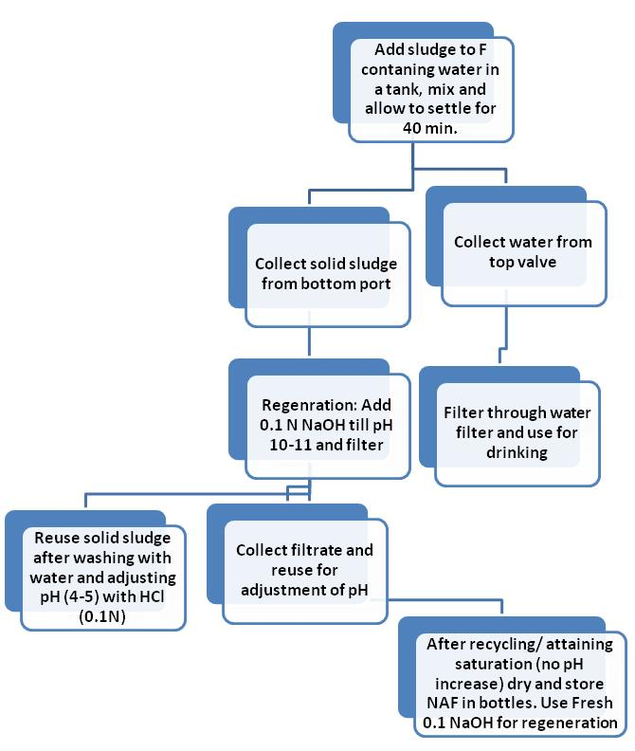
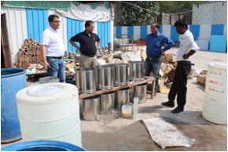
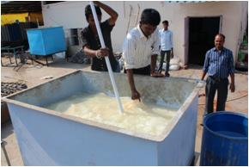
Reagent for removal of fluoride from ground water
Incubation MoU with M/s Kayakalp Remedies, Bhopal

Slide 60
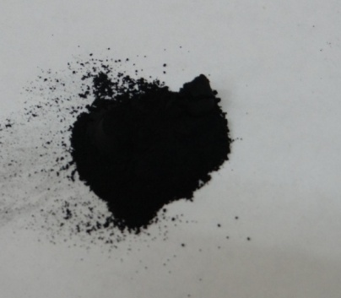
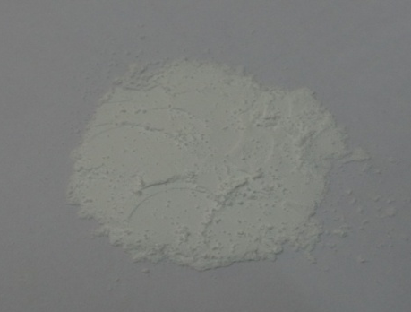
Materials for Li ion battery
Light weight energy storage and conversion device (3.5-4.0V), better than Pb-acid battery (~2V)
Battery with nano LiFePO₄/C as cathode and nano Li₄Ti₅O₁₂ as anode has several advantages
Developed and optimized protocols for synthesis of nano LiFePO₄/C and nano Li₄Ti₅O₁₂ and demonstrated successfully lithium ion battery
LiFePO₄/C
Li₄Ti₅O₁₂
The material technology has been transferred to M/s Utopia Automation & Control Pvt. Ltd., Satara, MS.
M/s Utopia Automation & Control Pvt. Ltd. will upscale the technology to produce lithium ion batteries for use in public transport buses that conform to zero emission.

Slide 61
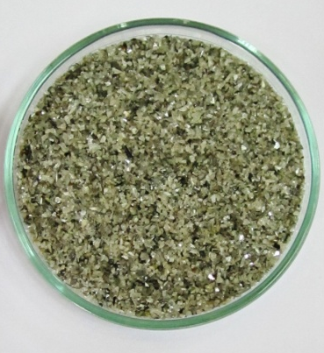
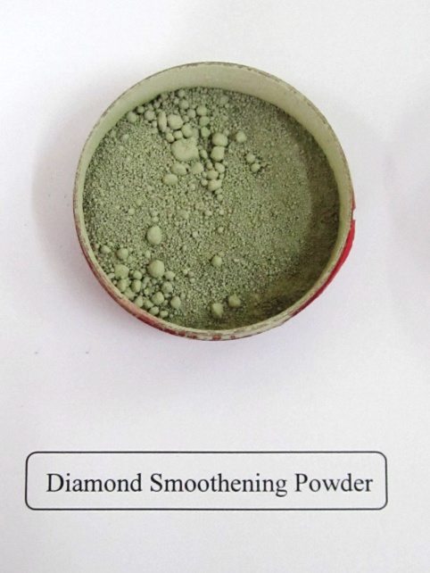
Utilization of Diamond Waste of Diamond Industries
Diamond industry produces large amount of diamond waste during the process of cutting and polishing of diamonds.
Diamond waste (Chura as it is called by the industry)
Development of technology of utilization of this waste by converting it into diamond polishing/smoothening powders is undertaken. Currently these polishing/smoothening powders (made from synthetic diamonds) are imported by the industry.
Polishing Powder (Imported)
Chemical and mechanical methodologies have been finalized and technology will be transferred .
Smoothening Powder (Imported)
Chemically purified diamond waste
This technology is being developed for M/s Hari Krishna Diamond Exports, Surat

Slide 62
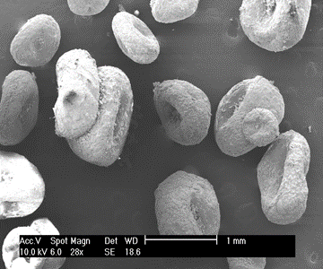
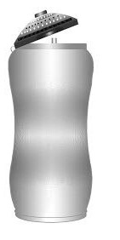
Drinking Water Disinfection System
Biodegradable polymer degrades releasing acid, which reacts with nitrite to produce ClO₂
An “on the go” chlorine dioxide based water purification device
Portable personal water purifier
A bottle (500- 1000 ml) with the disinfection chamber fitted with the ClO₂ releasing polymer. Disinfection achieved within a contact time of 10 minutes.
Portable personal water purifier is a low cost solution and can be used by anyone.
Currently there are no ClO₂ based disinfection systems in the country; the product therefore shall have good market.
MoU with M/s KENT

Slide 63
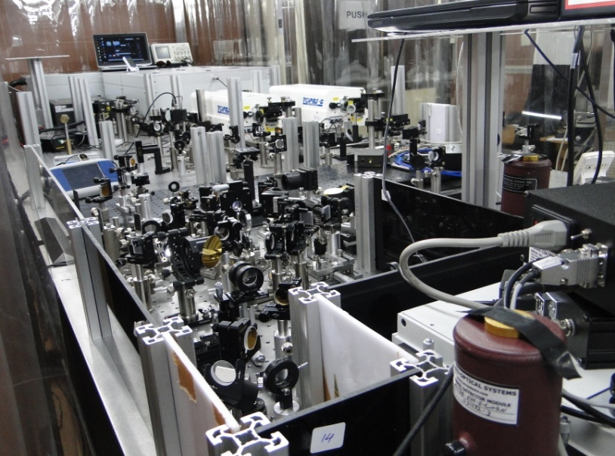
Two-Dimensional Infrared Spectrometer
High end R&D equipment for investigating chemical reactions in biology
Vibrational dynamics reveal the coupling between different chemical bonds. (Results from indigenously developed equipment).
Two dimensional infrared spectrometer developed in BARC. First of its kind in India.
Development cost is only 25% of the imported equipment
Transfer of technology to M/s Advanced Photonics, Mumbai, under progress

Slide 64
Indian Reference Material
BND 4101.01

Slide 65
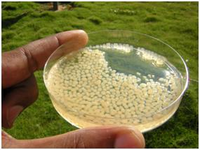
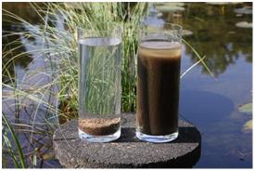
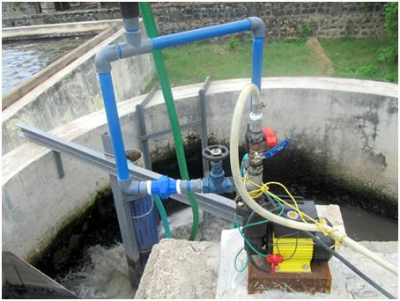
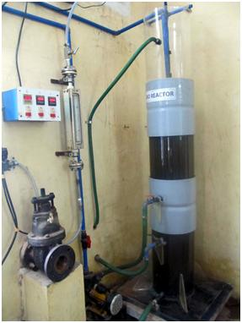
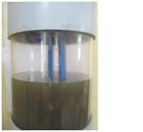
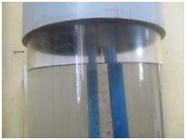
Wastewater treatment
Granular biomass technology
•Activated sludge into granular biomass
•All processes take place in one single reactor
•Small foot-print
•Quick settling (no bulking)
•Less energy requirement
•More efficient
6500 L demonstration plant
100 L plant

Slide 66
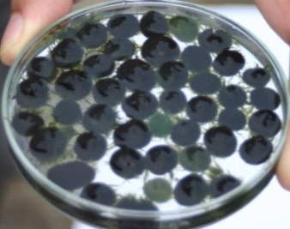
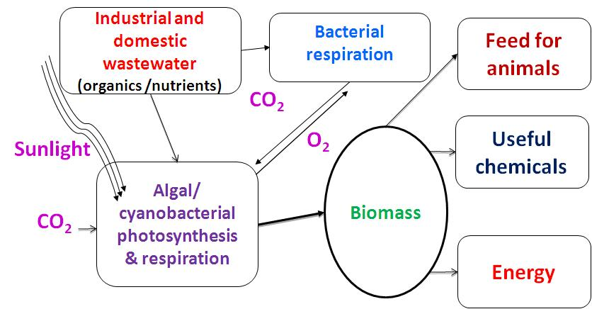
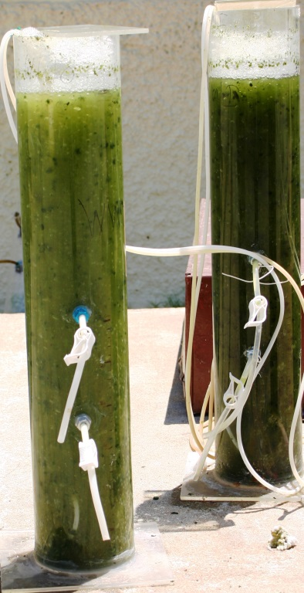
Wastewater treatment
Phototrophic granular biomass technology
Consortium: bacteria + microalgae
•Waste Water Treatment
•Biofuel generation
•Carbon dioxide sequestration

Slide 67
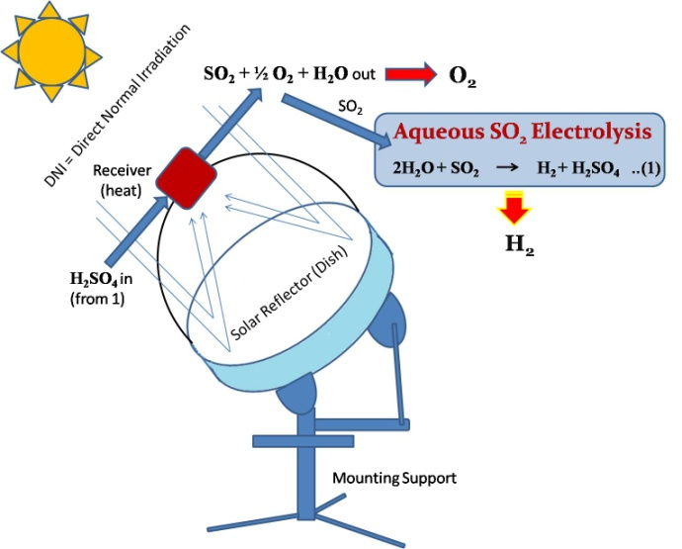
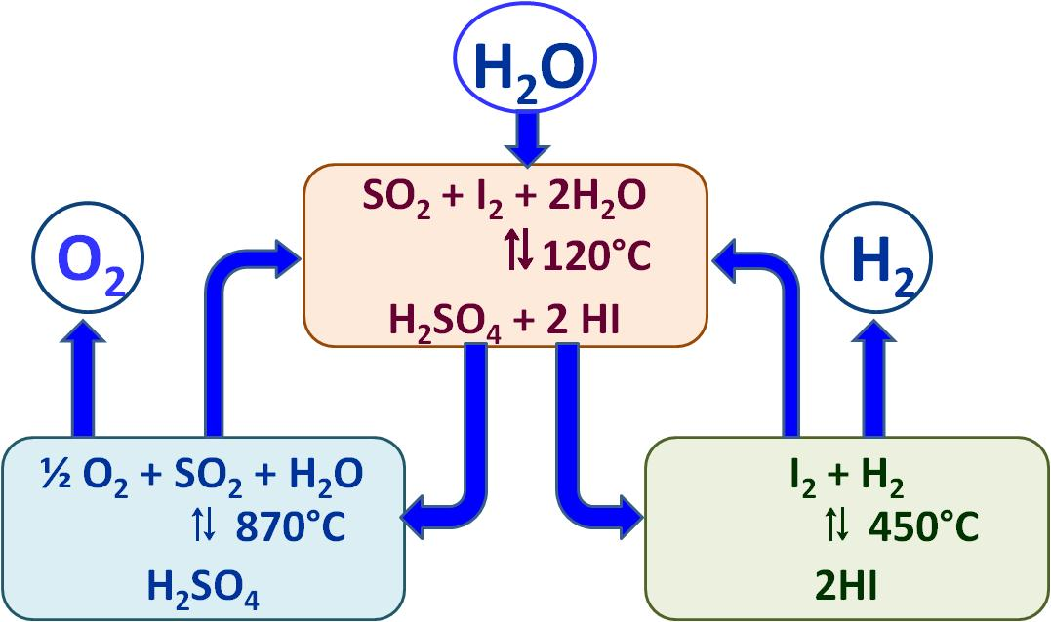
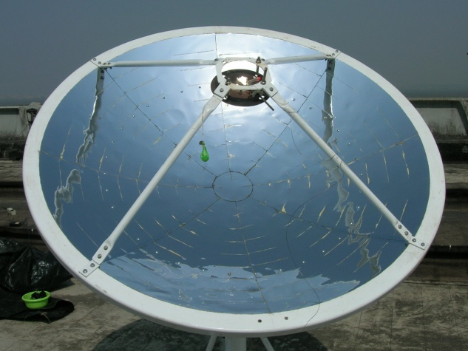
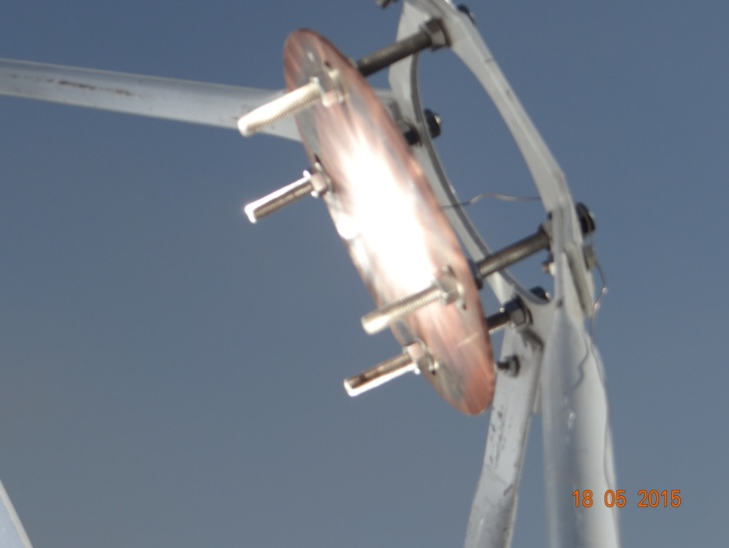
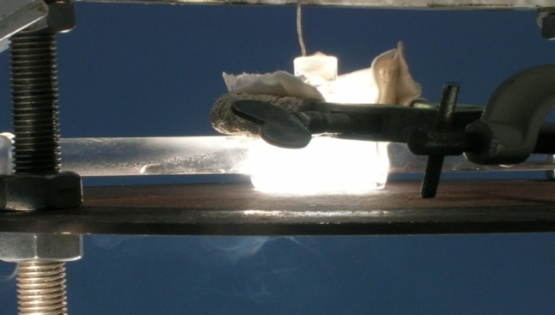
Technology developments on hand
Solar Hydrogen Technology
Hybrid sulfur cycle
Sulfur-Iodine thermo-chemical cycle

Slide 68
Closing the Gallium Supply Chain
Device Applications
Aluminum Industry
MOCVD
Recovery of Gallium in Beyer’s Process
Organometallic Precursors
Commercial Ga
Electronic grade Ga (7N)
Ultra-purification

Slide 69
Recovery of Gallium in Beyer’s Process
Red Mud
(30% Ga)
140-300 ⁰C, 50-100 psi
70% Ga
Aluminate Liquor
Bauxite
Digester
Filter
NaAl(OH)₄
NaOH
Al(OH)₃ seed
110⁰C, Atm.
Green Liquor
Spent Liquor
Crystallization
Al(OH)₃
Ga
200-400 ppm
Al₂O₃

Slide 70
For highest number of publications in interdisciplinary Chemistry in India for the period 2013-2015

Slide 71
Knowledge Economy
Quest for fundamental Understanding
YES
Pure Basic Research
User inspired Basic Research
(Bohr)
Knowledge
(Pasteur)
Economy
NO
YES
Consideration of use
?
Research to what end?
Pure applied Research
(Edison)
NO
Can we locate ourselves in the (YES, YES) Quadrant?
Excellent must be relevant, and relevant must be excellent!
YES, IT IS POSSIBLE!

Slide 72
It is not enough to say that science can benefit the society, but it must actually benefit. The beneficiaries of science will then become the promoters of science, and science will not die in that country
Acknowledgements
All my colleagues of Chemistry Group

Slide 73
Research is Good, Results are Better
⎯ Lyndon B. Johnson
Thank You
Thank You

Slide 74
Hundred Years of Indian Science
1888 - 1945
Nationalistic Phase
Science and Education as a Part of Freedom Movement
Jagadish Chandra Bose, Sayendra Nath Bose, C.V. Raman……
1945 - 1992
Nation Building Phase
Science and Technology as an Integral Part of Nation Building
Homi Jahangir Bhabha, Vikram Sarabhai, Kurien, ……….
1992 -
Globalized Phase
To make India an International hub for innovation and convert it into a knowledge-based economy
Rajesh Kocher in ‘Rise and Fall of Indian Science’, Academy Science Letters (2006)

Slide 75
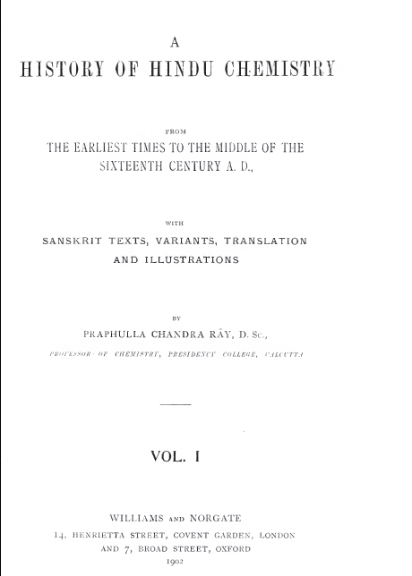

Slide 76
Why Could We not Continue This Great Tradition?
Decline of Scientific Spirit
“ The cast system was established de nuvo in a more rigid form……The art being relegated to the low casts and professions made hereditary, a certain degree of fineness, delicacy and deftness in manipulation was no doubt secured, but this was done at a terrible cost.
The intellectual portion of the community being then withdrawn from the active participation in the art, the how and why of phenomena ⎯ the combination of cause and effect ⎯ were lost sight of ⎯ the spirit of inquiry gradually died out among a nation naturally prone to speculations and metaphysical subtleties, and India for once bade adieu to experimental and inductive science. Her soil was rendered morally unfit for the birth of a Boyle or a Newton and her name was all but expunged from the map of scientific world.”

Slide 77
Structure and Value system of Indian science, Technology and Innovation ecosystem
Our problems:
Lack of proper perspective of basic research
Research has little connection with social and economic realities
Follow the West attitude, thereby working on ‘their’ problems and not ‘ours’
More stress on abstract research that does not connect with realities
In a 10,000 m race, we run 9000 m fast but give up in the last 100 m
Skewed ‘peer review’ system and reward system
Basic research in such an ecosystem will hardly generate technology even if funded handsomely.

Slide 78
R&D Employment : Industry vs Govt. Sector
Country | Researchers per million | % Researchers by section of employment
 |  | Business | Govt. | Higher Education
Finland | 7,707 | 65 | 11 | 24
Singapore | 6,173 | 62 | 11 | 27
Denmark | 5,670 | 60 | 9 | 31
Korea | 5,481 | 74 | 13 | 13
Sweden | 5,239 | 60 | 6 | 34
Japan | 5,180 | 76 | 9 | 13
USA | 4,673 | 74 | 12 | 14
Germany | 3,980 | 67 | 15 | 18
China | 863 | 62 | 19 | 19
India | 136 | 23 | 62 | 15

Slide 79
R&D Expenditure around the World
Government vs Private
Country | R&D Investment US $ billion (ppp) | R&D Invesment as % GDP | Expenditure on R&D
 |  |  | Govt. | Industry
USA | 402 | 2.9 | 31 | 69
China | 154 | 1.7 | 28 | 72
Japan | 138 | 3.4 | 18 | 82
Germany | 86 | 2.8 | 30 | 70
Korea | 53 | 3.7 | 23 | 77
India | 24 | 0.8 | 75 | 25
Singapore | 6 | 2.5 | 38 | 62
In India, the industrial R&D investment has grown by ~250% between 2005 and 2010.

