Slide 1
“Live On”: A Life Style Management
Dr. Shilpa Desai
Health Psychologist

Slide 2
Psycho-physiological Aspects and its effect on Respiratory System through Naturopathy on children (5-12 yrs)

Slide 3
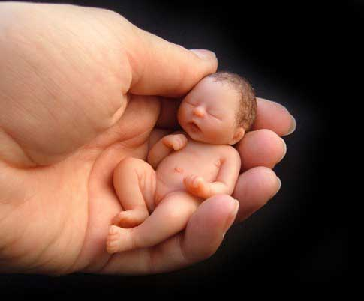
My ultimate aim…….
PROTECT OUR future GENERATION

Slide 5
De-code Nature

Slide 6
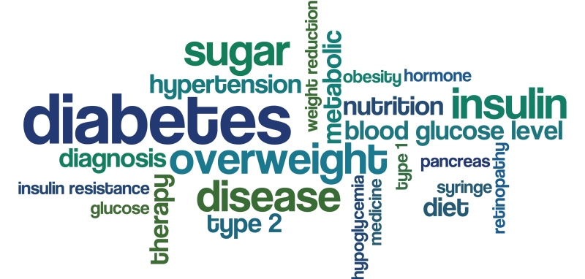
Recent updates of life style diseases amongst population
OBESITY
PAIN DISORDER
MALNUTRITION
RESPIRATORY DISEASES
DIABETIES
HORMONAL DISORDER
CARDIOVASCULAR DISEASES
MENTAL STRESS
ANXIETY

Slide 7
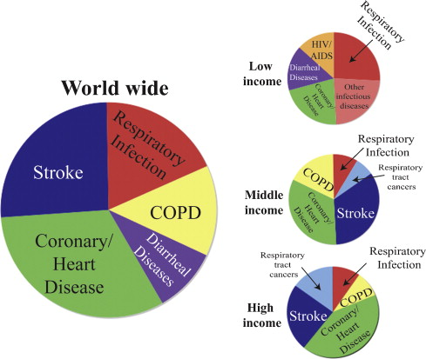

Slide 8
Major health concerns of modern world
PUBLISHED IN BMJ-project involving 50 countries found that ,who ate junk food three times a week were 39% more likely to get severe ASTHMA AND RESPIRATORY DISEASES.
Those with low level of vitamin C have increased risk of breathing problem.
CANCER
SECOND BIGGEST KILLER
Number of case doubled from 5.5 lakh in 1990 to 10.6 lakh in 2016
Adjusted for change in population and age profile, no increase in cancer incidence
Stomach cancer, the most common type is falling; liver cancer us rising fastest
HEART DISEASE
BIGGEST KILLER
Caused 28 million death in 2016
Diet the biggest cause, followed by high blood pressure
DIABETES
Cases went up from 26 million in 1990 to 65 million in 2016
Tamil Nadu, Kerala, Delhi Worst three

Slide 9
RECENT DATA
MUMBAI has a green Ratio of only 0.03 Acre of open space for every 10,000 kids as against the ideal of 4 Acres per 1000 kids.
Psychological Effect:
17% →children suffer from stress
28% → student sleep less than 8 hours everyday
30% → Children in Private School are overweight /obese in Mumbai
44% kids have complaints like abdominal pain, body pain, headache, nausea vomiting.

Slide 10
Technological Exposure & Shocking statistical numbers
TV-Video Game & Mobile
82% → Children age group 6-17 watch 35 hour of TV a week & playing Video Game.
63% → Student spend at least an hour online everyday.
Sex
40% → Children exposed to online adult contact.
79% → are mobile phone users.
78% → Parents have never discussed sex openly with their children.

Slide 11
INTERVENTION
Physiological Parameters
Exercise Form - Surya Namashkar
Pranayam - lom-vilom, shodh- bandhak
Therapy - Diet and counseling
Psychological Parameters
Mental health inventory (M.H.I) of
Dr. Jagdish and A. K. Shrivastava

Slide 13
THE DIMENSIONS OF MENTAL HEALTH by Dr.Jagdish & A.K Shrivastava
Positive self-Evaluation (PSE)
Perception of Reality (PR)
Integration of Personality (IP)
Autonomy (AUTNY)
Group Oriented Attitudes (GOA)
Environmental Mastery (EM)

Slide 14
1. Positive Self-Evaluation (PSE): It includes self-confidence, self-acceptance, self-identity, feeling of worth­-wholeness, realization of one's potentialities, etc.
2. Perception of Reality (PR): It is related to perception free from need distortion, absence of excessive fantasy and a broad outlook on the world.
3. Integration of Personality (IP): It indicates balance of psychic forces in the individual and includes the ability to understand and to share other people's emotions, the ability to concentrate at work and interest in several activities.
4. Autonomy (AUTNY): It includes stable set of internal standards for one's action, dependence for own development upon own potentialities rather than dependence on other people.
5. Group Oriented Attitudes (GOA): It is associated with the ability to get along with others, work with others and ability to find recreation.
6. Environmental Mastery (EM): It is includes effici­ency in meeting situational requirements, the ability to work and play, the ability to take responsibilities and capacity for adjustment,

Slide 15
RESEARCH DESIGNING
Pre-post
PAIR- ‘t ’ test – with description for gain score treatment.
group | TEST | TREATMENT | TEST
EXPERIMENT | PRE | YES | POST

Slide 16
OBJECTIVE
To study pre and post effects of natural remedies and counselling on children aged between 5-12years.
To study the mental health and body quotient of children between age group 5-12 years and enhances vital capacity.
To compare the present environmental effects with prescribed lifestyle among children between ages 5-12 years.

Slide 17
Hypothesis
Individuals would be improving their haemoglobin levels which will positively affect immunity of an individual.
Every individual would be having own pattern related to environment.
Right pattern of diet would be positively affect Total health of children.
Positive stimulation of mind would show elevated effect on total health of the body.
Recommended lifestyle would be working as a future remedial measure.
Exercise and appropriate diet would positively be improving children total health.

Slide 18
Variables
Independent variable
Hemoglobin study
Body parameter: height, weight, age, BMR, BMI
Mind parameter: psychometric test counseling
PFT: peak flow, spirometry
Oxymeter
Diet Plan
Dependent variable
Genetic factor
Adjustment Level
Personality
Environment
Climate

Slide 19
Age group
5-12 years
Overall
Performance
Food Intake and Physical
Activity
Genetic
Factors and Environmental Behaviour
Total Health Effect
Health
Indicators
(CBC count)
Vital Parameters
O₂ – CO₂ Mechanism (Respiration)

Slide 20
PARENTS AND TEACHER feed back
Cough And Cold
Fever
Pain in body specially legs
Headache
Stomach upset
Anger
Mood swings

Slide 21
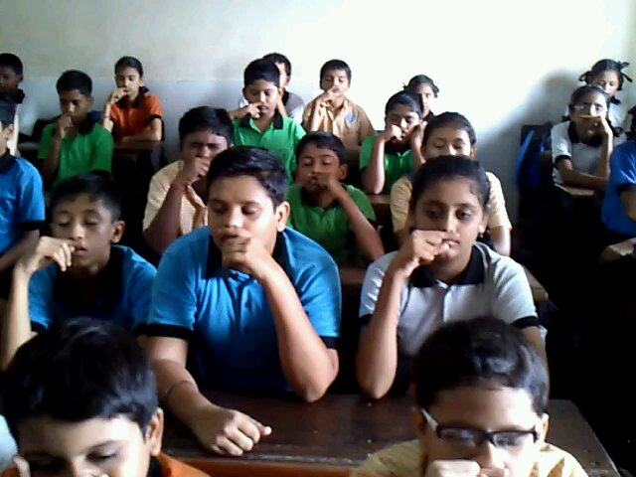
MASTER CHART AGE GROUP 9-12 Years (PRE-PUBERSCENT AGE)

Slide 22
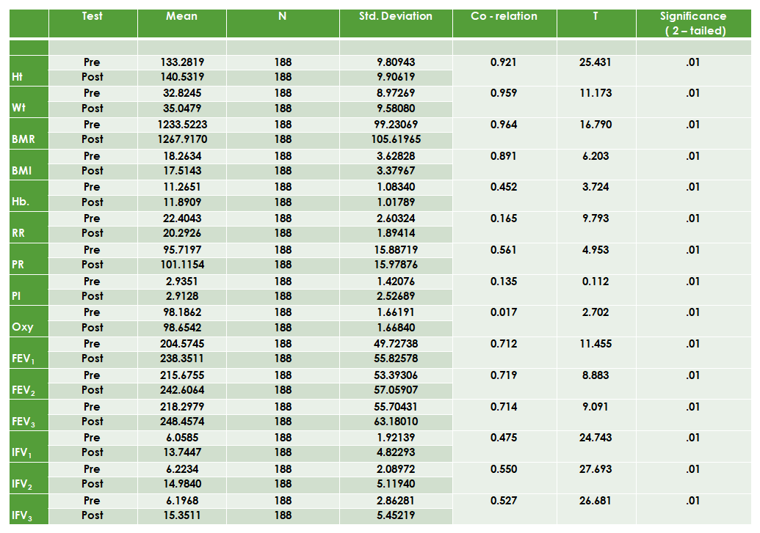

Slide 23
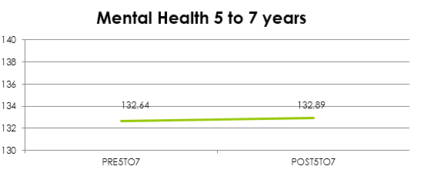
CHART OF M.H.I Test

Slide 24
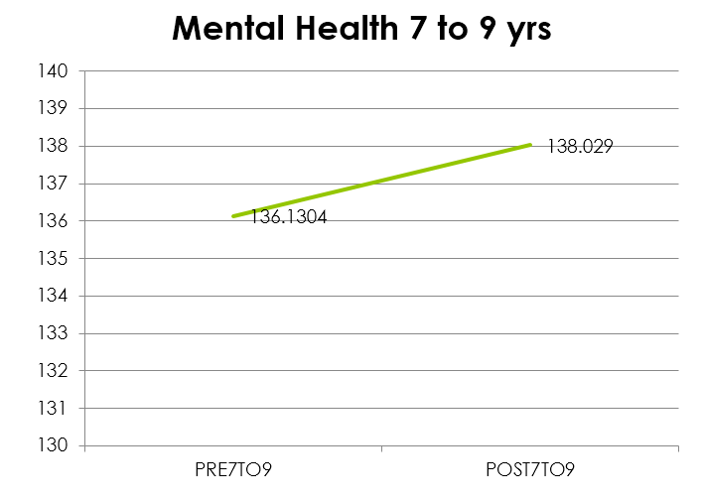

Slide 25
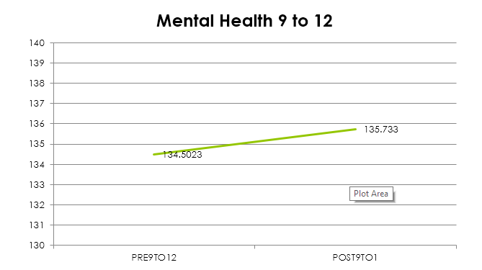

Slide 27
FINDINGS
Lack of awareness is affecting physical fitness of children age group 5-12 years.
Lack of parental awareness related to children fitness is widening the gap between current generation and the family.
Preventive measure could benefit children to grow happily and healthily in a not so predictable environment.
BQ is an primary factor to stimulate healthy mind.
Precaution is working as a future remedial measure

Slide 29
EARLY PREVENTION RESULT
 |  |  |  | Short Term |  | Long Term
 |  | 5 – 7 yrs |  | Brain Development |  | Cognitive education performance
Early nutrition |  | 7 – 9 yrs |  | Growth muscle mass – body composition |  | Immunity , work capacity, respiratory function
 |  | 9 – 12 yrs |  | Metabolic Programming of Glucose – lipid, protein, hormones, and receptor genes. |  | Diabetes, obesity, aging, cancer, stroke

Slide 30
RESULT
It has observed that STUDENTS/CHILDERN has shown consistent improvement in weight &and their Haemoglobin value were elevated. The behavior pattern and concentration of the children were also improved. Their apatite increase & children were quiet playful & in happy state of mind. Parent has to say that children were happily responded to natural diet.

Slide 31
Intresting statestic – DIFFICULT BUT NOT IMPOSSIBLE
One student – given piggy bank – saving daily 5 rupees
60 student –one class probablity saving in 20 days - 6000 rs
in 200 days – 60,000 rs / per year
In school if 40 Class join in saving scheme in 200 days – 24,00,000 rs / per year
Parents – also included by saving 10-15 rs by not consuming tobacco or smoking or drinking
IMAGINE IF PARENTS AS WELL START AT HOME !!!!!

Slide 32
SCOPE
1 .This research can become a guideline for future researcher by changing variable
and parameter.
2. This study has shown an effective way of getting healthy by introducing complete
concept of health in school children in mass number get motivation and understand importance of health in today’s unpredictable modernization.
3. Researchers study shows that lower vital capacity of children are at a higher risk
of psychological disturbance which may influence the development of respiratory diseases.
4. Researcher could open up promising evidence that in infancy to late middle
childhood with asthma stressful events, can exacerbate and can worsen airway inflammation.
5. Researcher’s depth of study will improvise lifestyle, which otherwise asthma stressful events can exacerbate and can enhance airway inflammation in infants to children in late middle childhood.

Slide 33
SCOPE
A climate scientist Roger Pielke Sr. (University of Colorado) has mentioned that the role of added carbon dioxide as a major contributor in climate change has been firmly established. As per this prediction, research would be playing a great role of awareness about their life style pattern.

Slide 34
IMPORTANCE OF DAILY ROUTINE
DRI shows your
Actual Living Quotient

Slide 35
What about energy ? Why is it so important ?

Slide 37
THEORY OF O₂ – CO₂
BREATH RIGHT

Slide 38
WHY?
WHAT?
HOW?
AWARENESS TOWARDS COMPLETE FITNESS

Slide 39
WHY?
DEMANDS OF ENVIRONMENT
STRESS & DEPRESSION & ANXIETY
CHANGING SCENARIO OF EDUCATION

Slide 40
COMPLETE EFFORTS
BODY
DISCIPLINE
HABIT
MIND
SKILLS- PATIENCE
PRACTICE
SECURED MIND

Slide 42
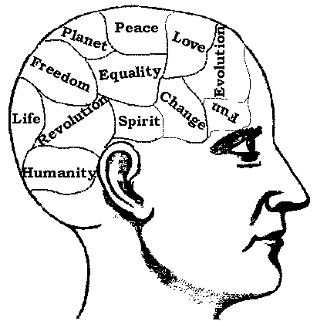
Satisfaction
Greed
Work progress
Escapism
Achievement
Argument
Self growth
Careless
Excuses
Let go attitude
Anxiety
Anger

Slide 43
Nutrition & Illness
Deficiency
haemoglobin
B12
Results in
Conscious
‘Look’
Mind set
Anxiety
B complex
Vitamin D
Vitamin C
BUT ?
Anger
Concentration
Memory
Back pain
Low vitality
Skin diseases

Slide 44
MAGIC OF NATURE

Slide 45
MAGIC OF NATURE

Slide 46
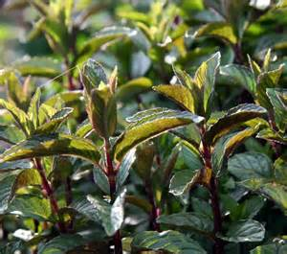
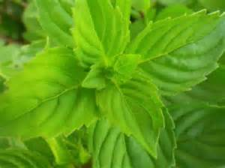
Herbs & Remedies
BASIL
MINT
FEVER
RESPIRATORY DISEASES
KIDNEY STONE
HEADACHE
SKIN DISORDER
UPSET STOMACHE
FLATULENCE
GASTRITIS
BODY ACHE

Slide 47
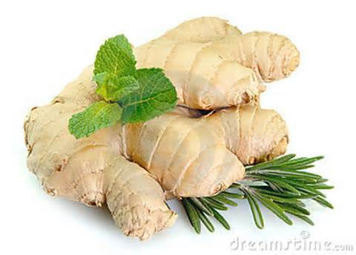
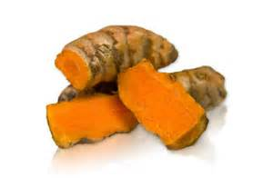
Herbs & Remedies
GINGER
FRESH TURMERIC
DIGESTIVE DISORDER
MENSTRUAL DISORDER
HEADACHE
PAIN KILLER
ACT AS DEWORM
ANEMIA
SPRAIN
INTESTINAL DISORDER
COUGH AND COLD

Slide 48
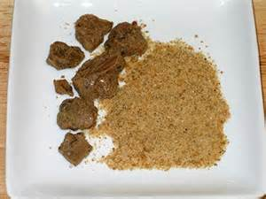
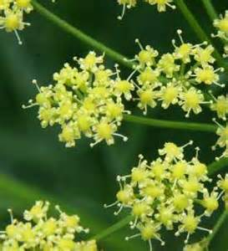
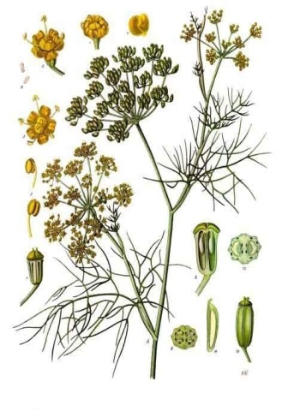
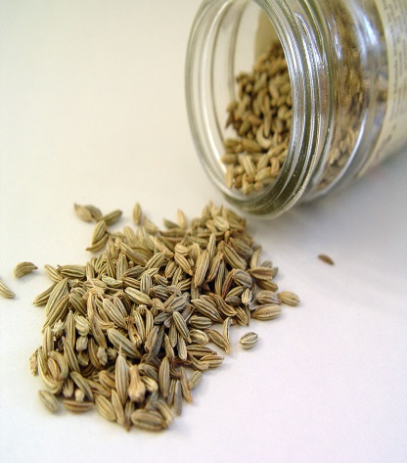
Herbs & Remedies
HING (ASAFOETIDA)
SAUNF (FENNEL)
DIGESTIVE DISORDER
CONSTIPATION
ANTIFLATULENCE
RESPIRATORY DISORDER
DIGESTIVE DISORDER
CONSTIPATION
PH BALANCE
ANTAACID

Slide 49
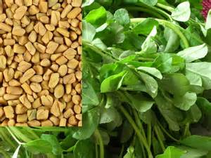
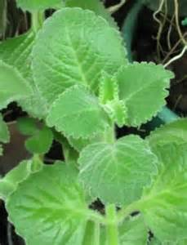
Herbs & Remedies
METHI (FENUGREEK)
AJWAIN (CELERY)
ANAEMIA
MOUTH ULCER
DIABETES
SORE THROAT
DANDRUFF
TOXEMIA
ARTHRITIES—LEAVES
INSOMNIA
ANAEMIA

Slide 50
Daily physical quotient
Maintain daily exercise schedule as per individual work and job profile.
Form of exercise
Yoga
Walking
Cycling
Running
Adventure sport
Sports activity
Important to breath right way by learning correct breathing exercise.

Slide 51
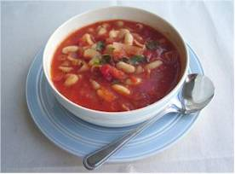
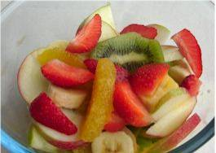
Healthy eating doesn’t have to be boring or avoiding all your favourite foods.
In fact, the first of rule of healthy eating is to ENJOY your food!
Eating healthily is all about getting the balance right.

Slide 52
Going Green
merge
immunity
inbuilt
environment
habit
attitude
efforts
discipline
Vision for future

Slide 53
THANK YOU
Email: greenremedes@gmail.com
Positively Journey is ON

