Slide 1
Radiation Technology for Cleaner India Lalit Varshney Bhabha Atomic Research Centre 06/07/2018

Slide 2
India
330 millions in 1947
1340 millions in Feb.2018
1/6 of the world’s population
About half of the population lives in cities
More than 50% less than 25 years, average age by 2020 – 29 years
Young India

Slide 3
Our requirements are huge and so are the problems. Technology solutions are the most import means to make India an advanced country.

Slide 4
However you will agree with me that we are very poor in managing our Environment

Slide 5
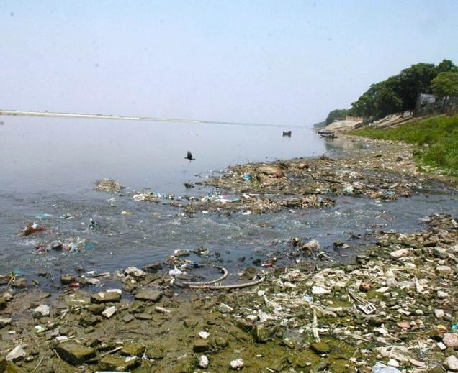
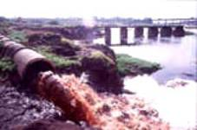
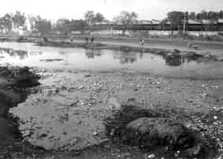
Water Pollution

Slide 6
Isotopes and Radiation Technology is being used world over for societal benefits and also generating billions of Dollar Business

Slide 7
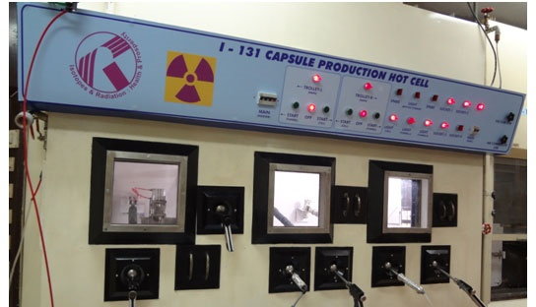
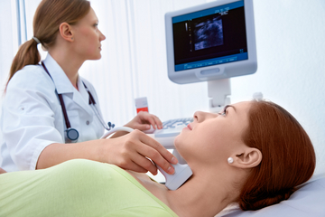
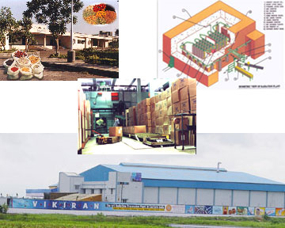
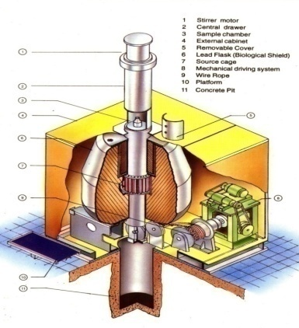
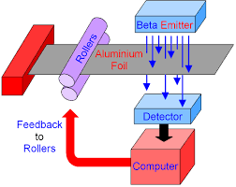
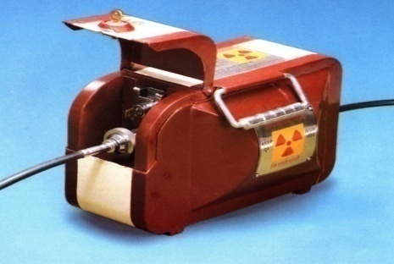
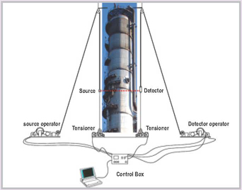
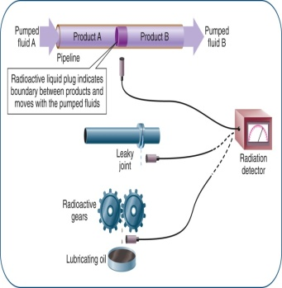
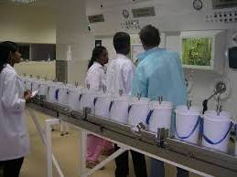
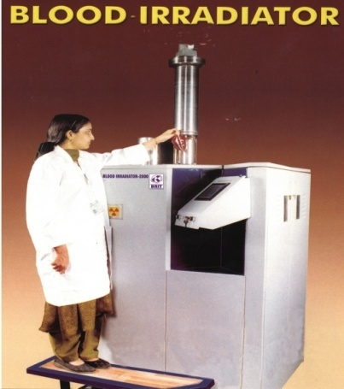
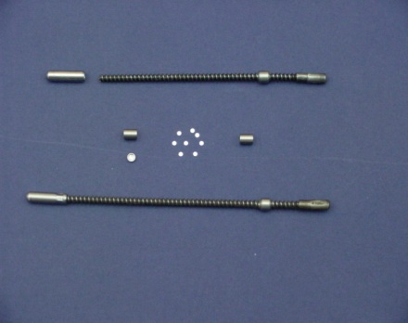
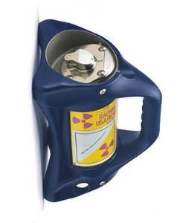
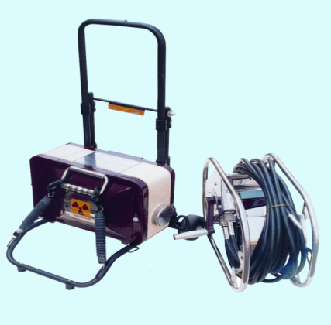
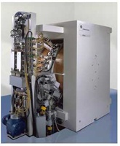
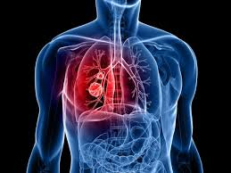
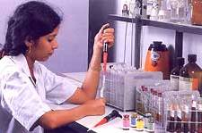
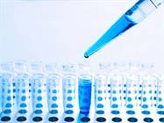
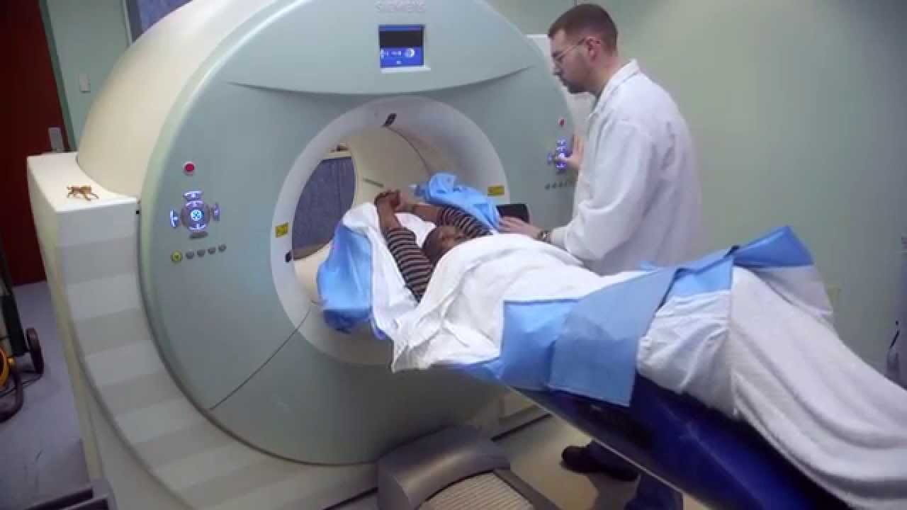
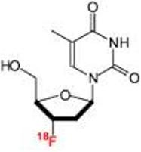
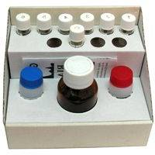

Slide 8
Considering the 2nd Largest populated country in the world, our requirements are huge but what we have achieved so far is far from expectations in employing Radiation Technology Applications be it food preservation, medical sterilization, industrial products etc[ we have about 21 Gamma Facilities(China:190) and 15-20 Accelerators(China:>300).

Slide 9
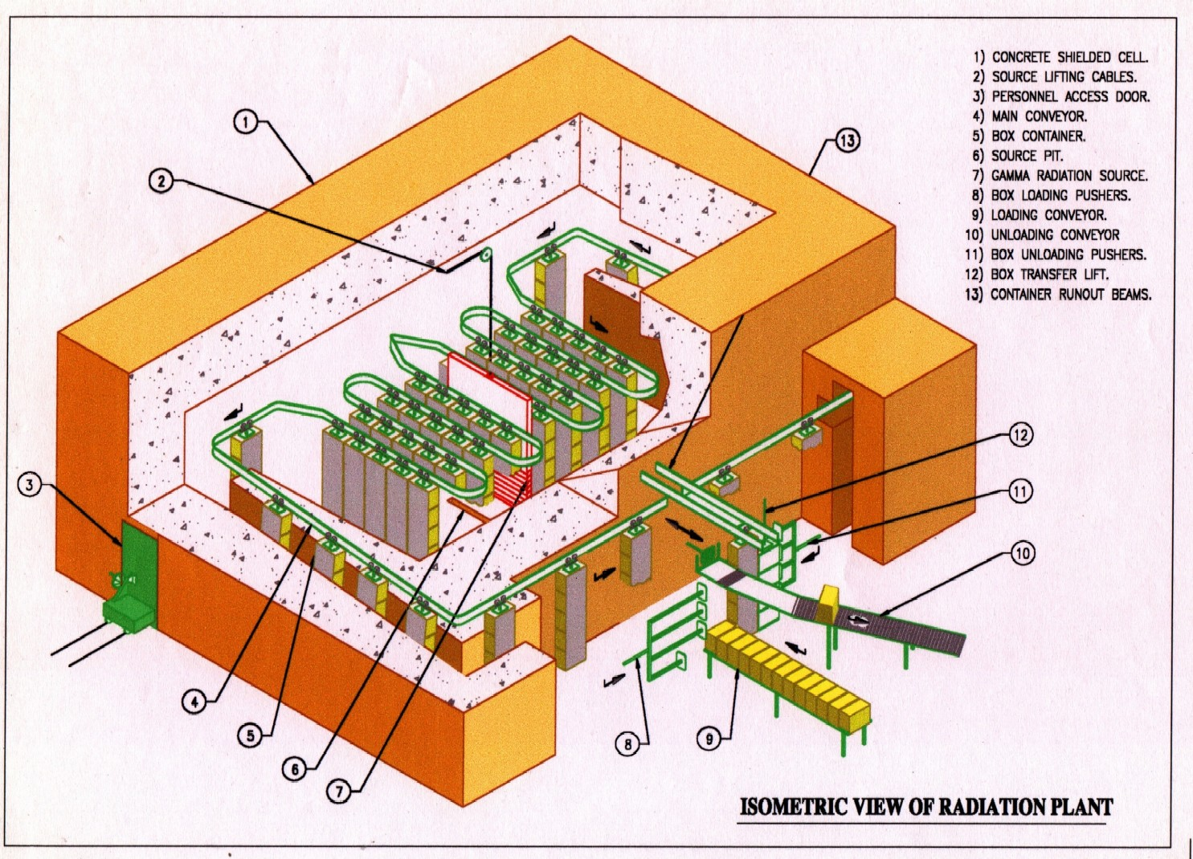
ISOMED, Trombay Panoramic, Dry Source Storage (Cat.II)

Slide 10
Electron Beam accelerator ….ILU-6

Slide 11
Radiation Effects on DNA
Direct Effect
Indirect Effect
H
e⁻
e⁻
O
γ-ray
H
Hº
P⁺
OHº

Slide 12
Radiation processing of Polymer
Grafting, crosslinking, and degradation are major reactions in radiation processing of polymer.
Monomer
γ-ray or E-beam
Grafting
Crosslinking
Polymer
Radical creation
Decomposition
Grafting：Any shapes (membrane, cloth, and fiber)
Crosslinking：Any states (solid and sticky liquid)
Degradation ：w/o Chemicals

Slide 13
One of the biggest challenge of the high density population is the generation of huge amount of waste water directly by self consumption and indirectly by industries meeting their needs.

Slide 14
Treatment of Sewage
Sewage coming to STP
Aeration Tank

Slide 15
Generation of Sewage Sludge
Drying Bed
Filter Press

Slide 16
Presently about 40 Billion litres of sewage is produced in cities and towns of India which is expected to grow to 133,000 MLD by 2050. The solid infectious sludge generated from the waste water at STP’S is 7 million tons per year today and will be more than 24 million tons in 2050.

Slide 17
What to do with it………..?

Slide 18
What is being done today?
Disposed in unregulated manner(Health Hazard).
Forms heaps (NMC)
Sold to farmers in unregulated , unhygienic manner at throw away price for agriculture applications

Slide 19
COMPOSITION OF DRY SEWAGE SLUDGE
Rich Source of organic carbon(20-40%) higher than Farm Yard Manure and city compost organic fertilizers (12 %, FCO,1985),.
Rich Source of Macro nutrients (N,P,K) and
Micro nutrients (Zn, Fe,Cu)
Presence of Pathogens. e.g. Bacteria, Viruses, Parasites responsible for diseases such as typhoid, Cholera, Hepatitis and other water borne diseases.
Heavy toxic Metals : Arsenic, Cadmium, Chromium, Lead etc.

Slide 20
Advantages of Radiation Hygienized Sewage Sludge
Most of the live forms in the sewage are inactivated. Pathogens are inactivated with high degree of reliability.
Foul smell in the sludge is significantly reduced.
Toxic chemicals are partially degraded .
Overall quality of sludge is significantly improved for land application.
Can be converted into bio-fertilizer by adding PGPB to hygienized sludge.

Slide 21
IMPORTANT SPECIFICATIONS OF ORGANIC FERTILIZERS:- A COMPERATIVE ANALYSIS
No. | Specifications | City Compost FCO – 1985 | Treated Sludge | FYM
1 | Organic Carbon% by weight (minimum) | 12 | 20-40 (200-400 kg/ton) | 20-30
2 | Nitrogen (N)% by weight (minimum) | 0.8 | 1.8 (18 kg/ton) | 1.4
3 | Phosphorous (P₂O₅) % by weight (Minimum) | 0.4 | 0.2 (2 kg/ton) | 0.4
4 | Potash (K₂o) % by Weight (Minimum) | 0.4 | 0.3 (3 kg/ton0 | 0.2
5 | Pathogens | ABSENT | ABSENT | PRESENT

Slide 22
Major concerns in Indian Agriculture
Excessive use of Urea. N:P:K is getting distorted.
Ideal N:P:K Ratio 4:2:1
All India N:P:K Ratio 8.3:2.7:1
Gujarat N:P:K Ratio 13.2:3.4:1
Punjab N:P:K Ratio 61.7:19.2:1
NEED TO PROMOTE ORGANIC FRERTILIZERS

Slide 23
CEILING LIMITS(mg/kg) AND DRY SLUDGE (AHMEDABAD ) ANALYSIS
No. | Particulars | FCO- City Compost Specifications | USEPA,40CFR 503 Sludge Specifications | EU Directive 86/278 Sludge Specifications | AMC Sludge. Minimum-Maximum Range
1. | Zinc | 1000 | 7500 | 2500-4000 | 212-721
2. | Copper | 300 | 4300 | 1000-1750 | 218-644
3. | Arsenic | 10 | 75 | - | BLD-0.5
4. | Cadmium | 5 | 85 | 20-40 | 0.9-15.54
5. | Chromium | 50 | 3000 | - | 52.6-76.4
6. | Nickel | 50 | 420 | 300-400 | 25-46.2
7. | Lead | 100 | 840 | 750-1200 | 4.1-99.9
8. | Mercury | 0.15 | 57 | 16-25 | BLD-1.2

Slide 24
Some Data, calculations and inferences
Gujarat State
About 2.3 million tons of UREA Consumption per year
15 million hectare land under cultivation
4 major cities produce about 1.5 lakh tons of sludge per year[500 tons/day].
Upcoming facility can treat maximum30,000 tons/year.
If all sludge is used in agriculture it will save Rs. 225 crores of subsidy given by Government of India every year[15x1.5x 10⁸].
At 1 ton per hectare application just sufficient for 1% of cultivated land and is about 6.5% of UREA consumption.

Slide 25
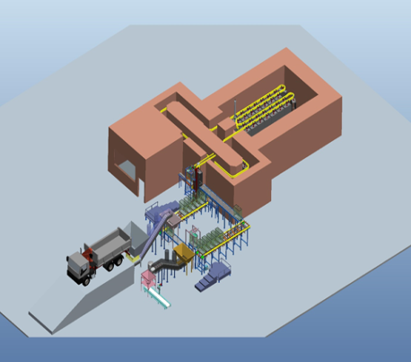
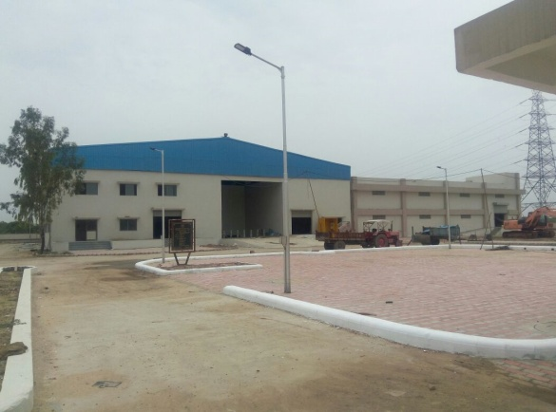
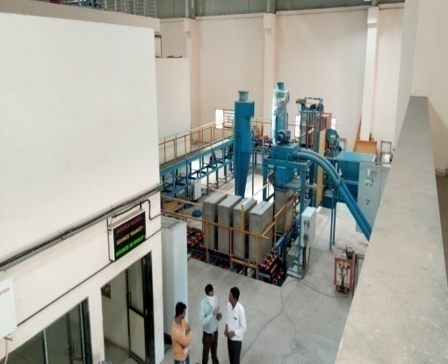
Radiation Technology For Municipal Sewage Sludge Hygienisation
1st facility of 100 tons/day is now operational at Ahmedabad and second at Indore to commence soon.
Total cost of the project
Rs. 30 Crores.
Converts waste sludge
to Manure
Protects health
and environment
Provides organic
Carbon to soil
Saves subsidy on Urea
Dried sludge crushed and packed in tote boxes
Treated sludge to farmers (manure)
⁶⁰Co radiation dose of 10 kGY
Bio NPK
Ahmedabad City Sludge Hygienisation Facility October 2017

Slide 26
BIO-NPK Technology
Patented Technology of Anand Agriculture University, Gujarat.
Available on transfer of technology basis
Cost about 50 Lakhs including Transfer Fees of 15 Lakhs .
Production cost Rs. 35/litre
Requirement is 1litre/ton sludge

Slide 27
Hygienized sludge with PGPB consortium (5 x 10⁷ cfu/g of sludge) remained at par with chemical NPK supplement showed possible reduction of about 20%of chemical fertilizers in a field study of three test crops of Wheat, Potato and Tomato.

Slide 28
BIOGOLD

Slide 29
Field trials at AAU, Anand

Slide 30
Foundation Laying Function: 30 Jan. 2016

Slide 31
Director Visit August, 2016

Slide 32
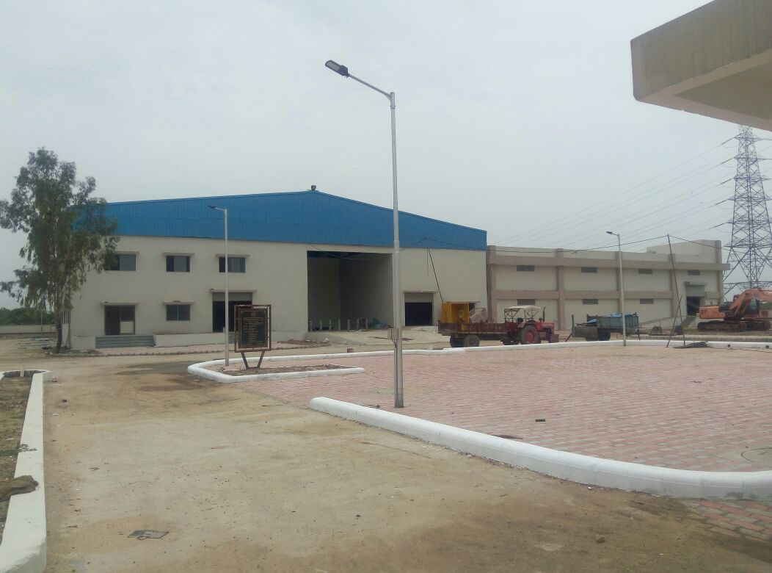
Dec. 2017

Slide 33
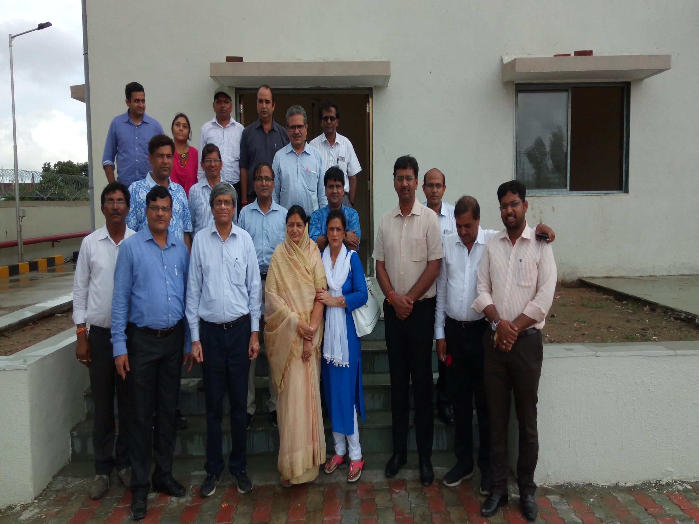
Indore Mayor Visit to AMC Facility in Oct. 2017

Slide 34
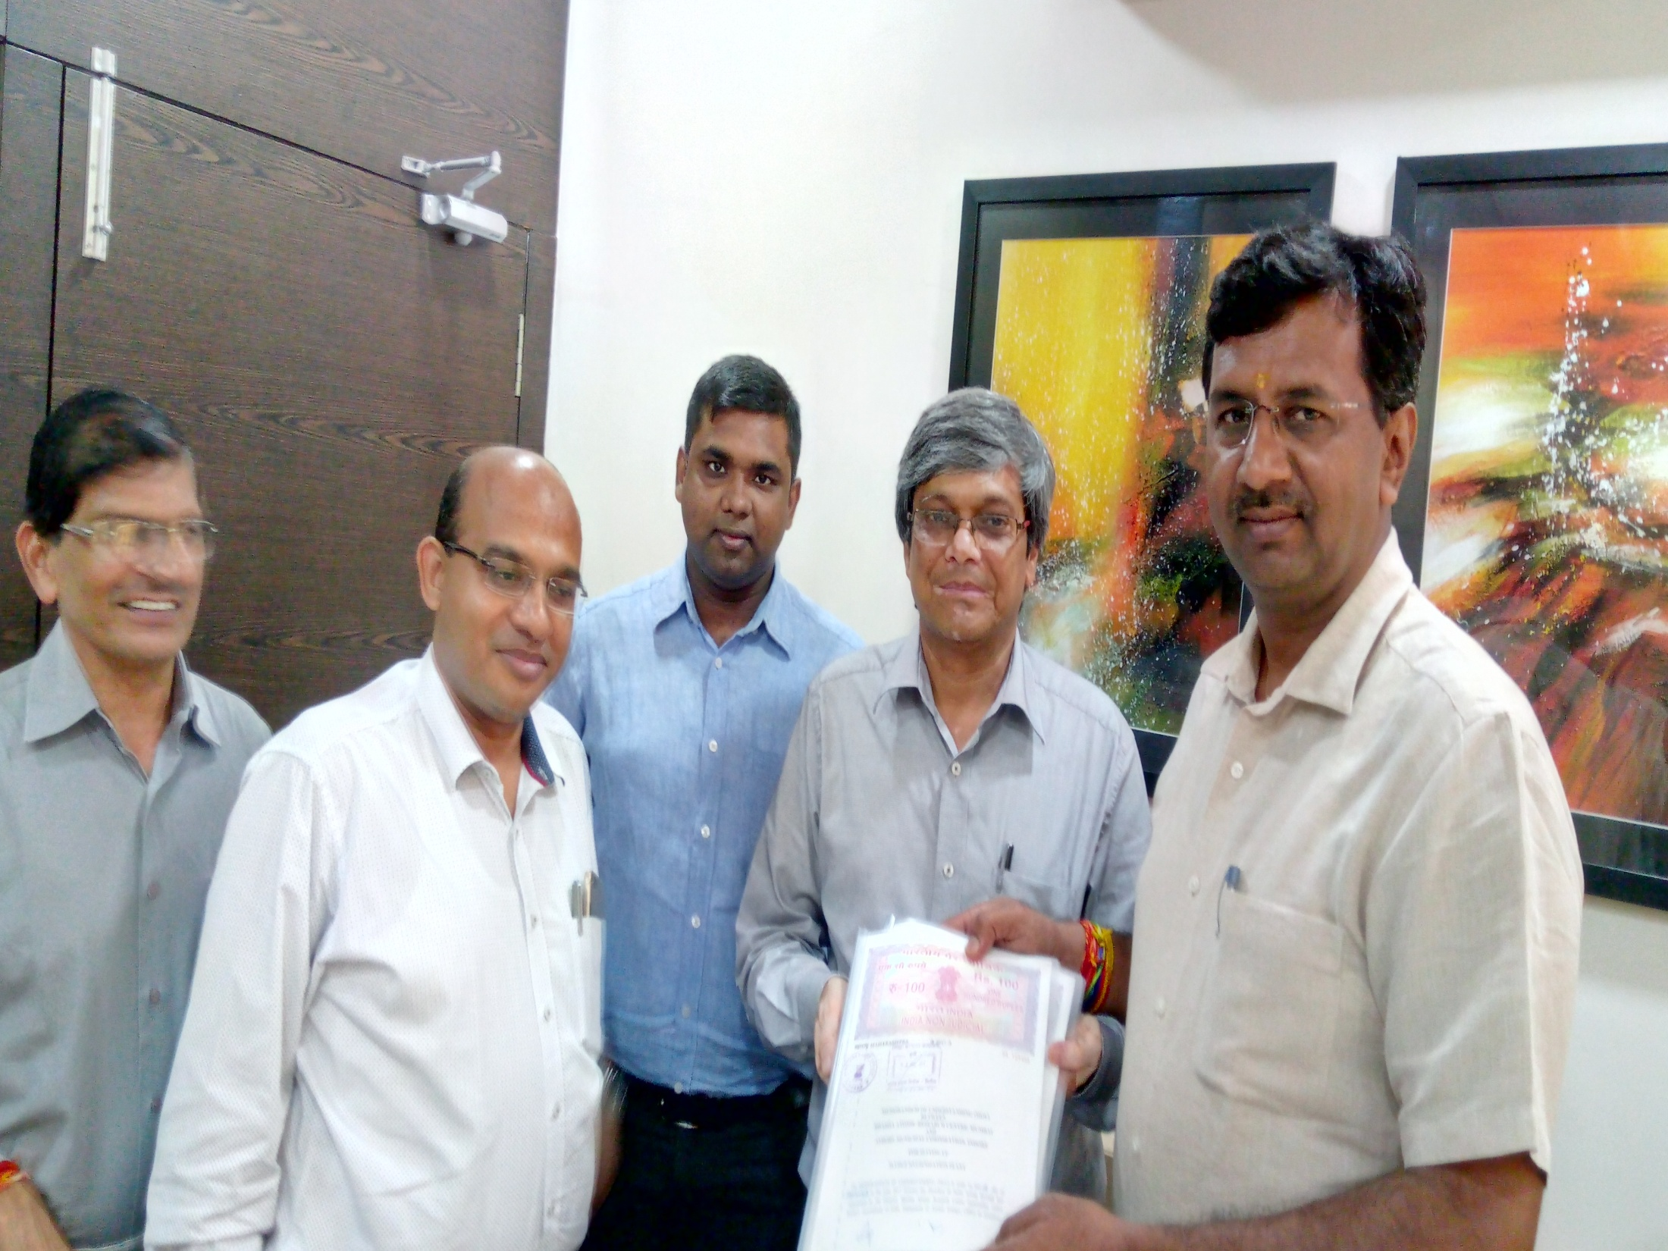
Signing of MoU with IMC in October 2017

Slide 35
Effluent/Water Treatment

Slide 36
Trunk Polymers for Graft Polymerization
Variously shaped Polymers
Introduction of function by grafting
Nonwoven
fabric
Fibrous
adsorbent
Adsorbent
film
Film
EB
Irradaiation
CH₂=CH
Adsorbent
particle
Hollow fiber
Particle
Hollow fiber
adsorbent
Polyethylene
Polypropylene
Cellulose
etc.
Monomer
Fiber
Fibrous adsorbent
etc
Capable of introducing the function of metal adsorption into polymers
having various shapes

Slide 37
Chelates and metal selectivity
Chemical structure
Selectivity
Iminodiacetic
acid
CH
2
COOH
Hg
3+
>Cu
2+
>UO
2
2+
>Pb
2+
>Fe
3+
>Al
3+
>
N
Cr
+
>Ni
2+
>Zn
2+
>Ag
+
>Co
2+
>Cd
2+
>Fe
2+
>
3
2+
2+
2+
3+
2+
+
CH
2
COOH
Mn
>Ba
>Ca
>Sr
>Mg
>Na
O
Th
4+
>U
4+
>UO
2+
>Fe
3+
>Be
2+
Phosphoric acid
>H
+
>Ag
+
>Cd
2
>Zn
>Cu
>Ni
P
OH
2+
2+
2+
2+
OH
>Co
2+
>Mn
2+
>Ca
2+
>Na
2+
Cu
2+
,Ru
6+
,Au
3+
,Rh
3+
,V
4+
,Pd
2+
,U
6+
,
C
NOH
Pt
2+
,Fe
3+
,Mo
6+
(High selectivity)
Amidoxime
NH
2
Cu
2+
>Ni
2+
>Co
2+
>Zn
2+
>Mn
2+
Ag
+
>Cu
+
>>Pb
2+
>Cd
2+
>>Zn
2+
>Ni
2+
Tiol
SH
>Fe
3+
>Ca
2+
Glucamine
NCH
(CHOH)
H
BO
2-
2
5
3

Slide 38
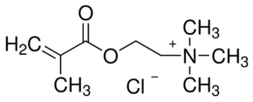
+
+
+
+
+
+
+
+
+
+
+
+
+
+
+
+
+
+
+tive charged Grafted Polymer
Hydrophobic and Hydrophilic interactions
Radiation Grafting by Gamma Radiation
_
_
_
_
_
_
_
_
_
_
_
_
_
_
_
_
-tive charged Grafted Polymer

Slide 39
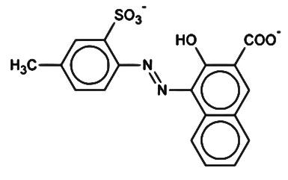
Textile Dye Effluent Treatment
10,000 dyes and pigments in use
7 x 10 ⁵ tons produced globally (India 6%)
200,000 tons lost to environment
About 200 litres of water consumed for colouring one kg of textile
Unorganized small scale industries are the most polluting and find it difficult to afford technological solutions
These industries cater to low income population
W. Europe
China
South America
India
Rest of Asia
U.S.A.

Slide 40
Textile Dye Effluent Treatment………
Many textile units are getting closed in Tamil Nadu, Gujarat, Rajasthan and Punjab states of India for not able to meet PCB norms.
Unorganized small scale industries find it difficult to afford technological solutions. These industries
Cater to low income masses
~50% of population

Slide 41
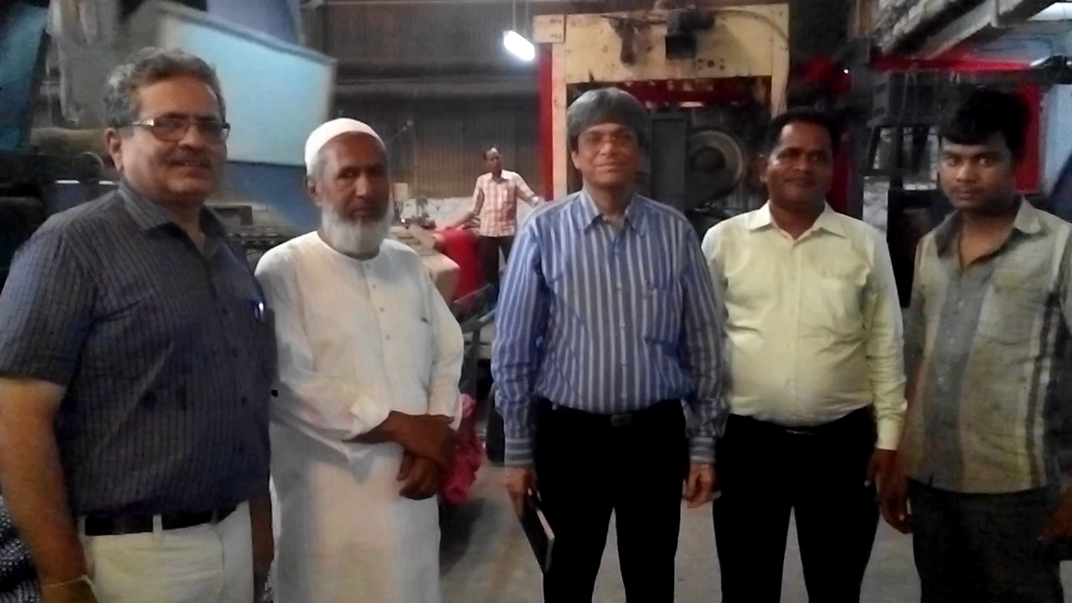

Slide 42
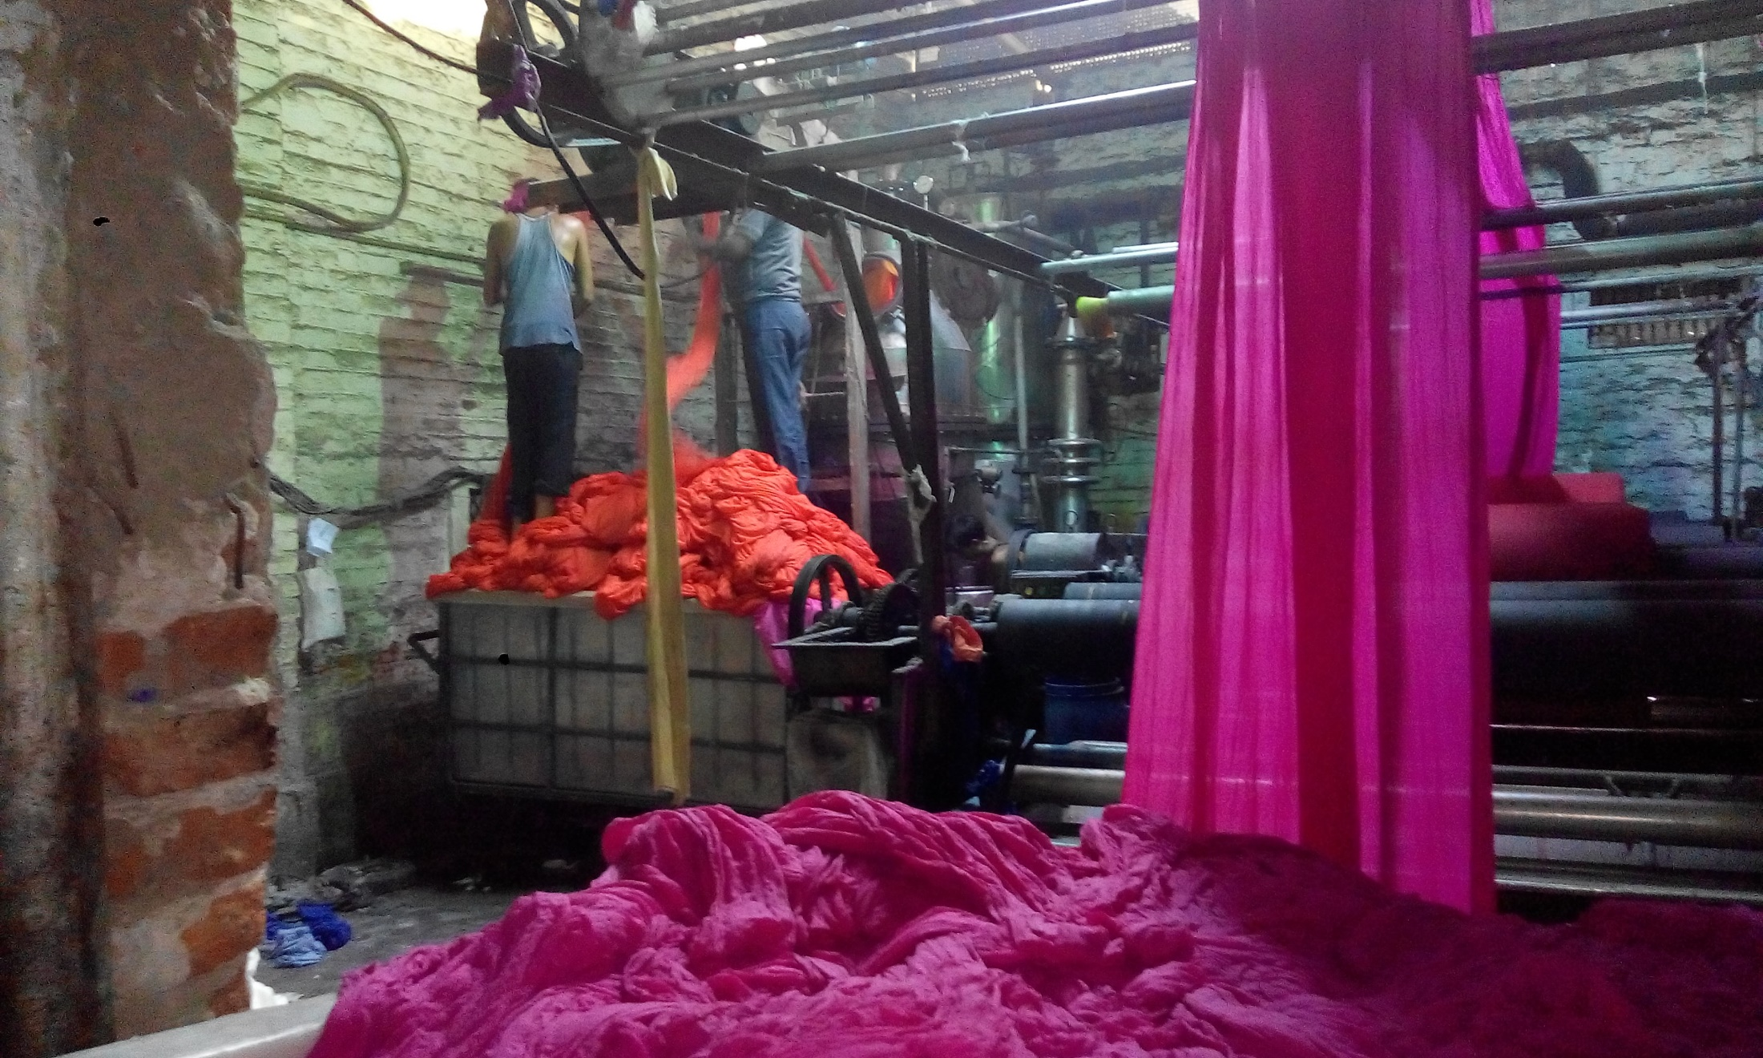

Slide 43
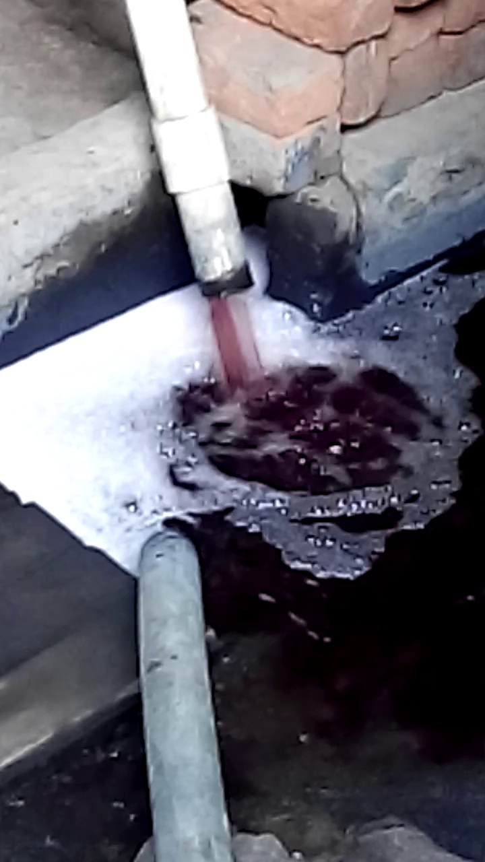

Slide 45
Adsorbent Cartridges using Radiation Grafted Cloth material

Slide 46
Salient features of dye adsorbent
Low cost (Approx. USD 8/kg)
20,000 litres of effluent containing 200 mg/litre dyes can be treated using one kg adsorbent in ten cycles.
High capacity (400-500 mg/g)
Reusable
Cationic/anionic adsorbents
Dye recyclable
Useful for small scale industries

Slide 47
Pilot scale facility( 100,000 litres/day)

Slide 48
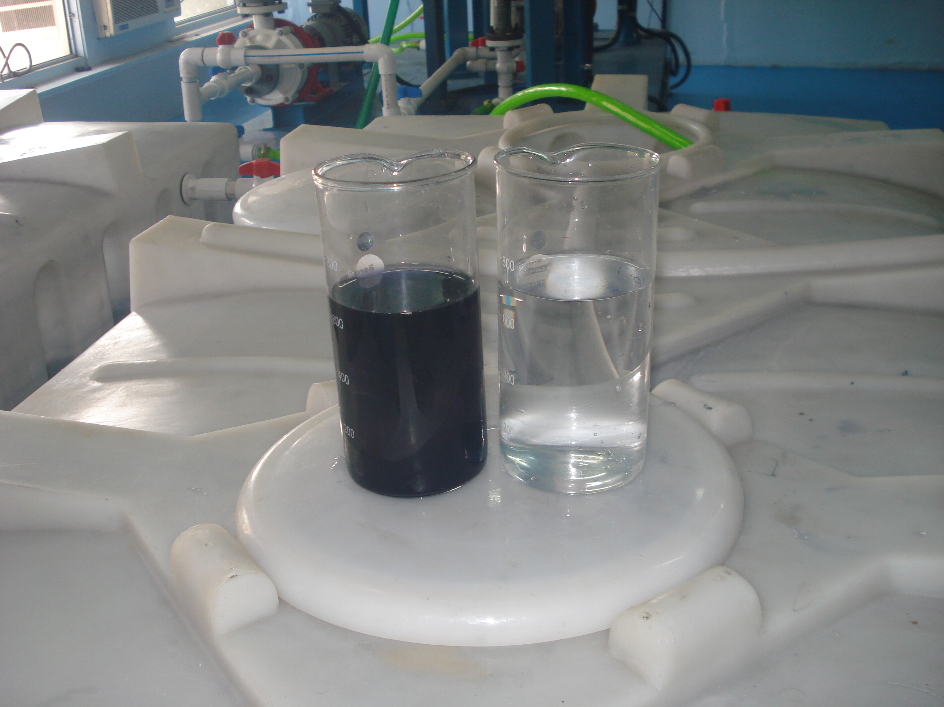

Slide 49
Dye Adsorbent Cartridges after removal of dyes.

Slide 51
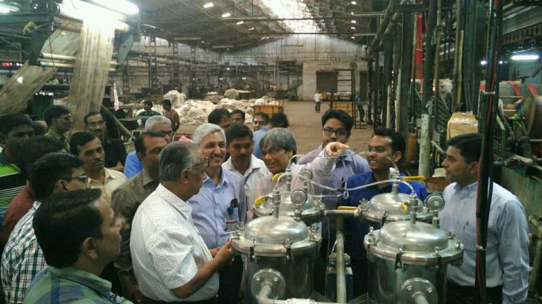

Slide 52
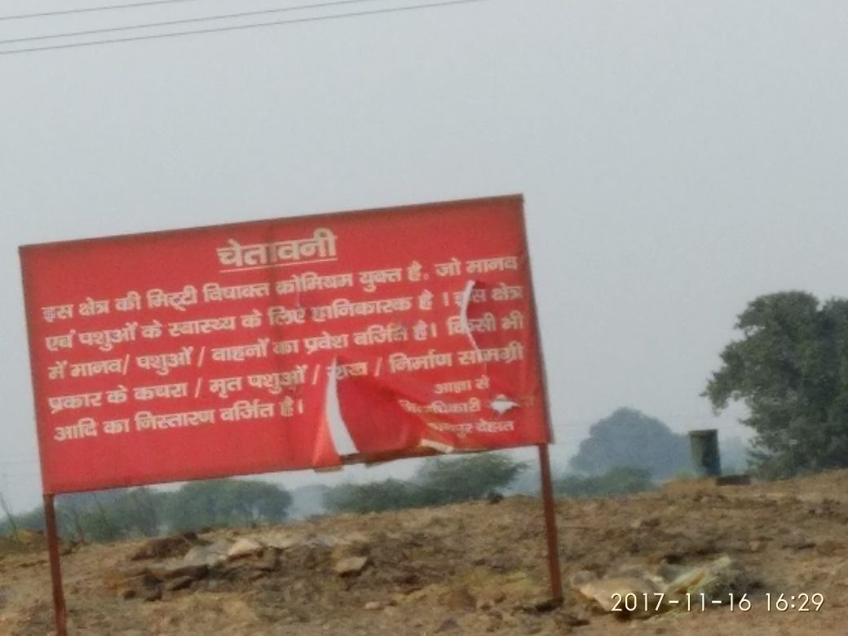

Slide 53
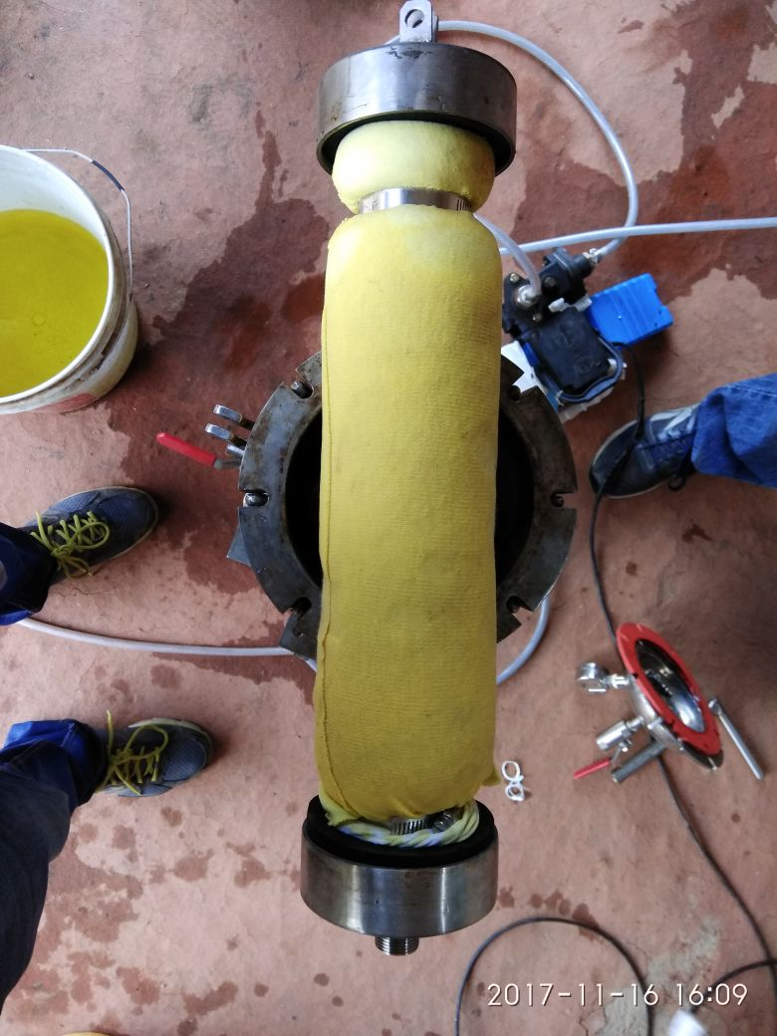
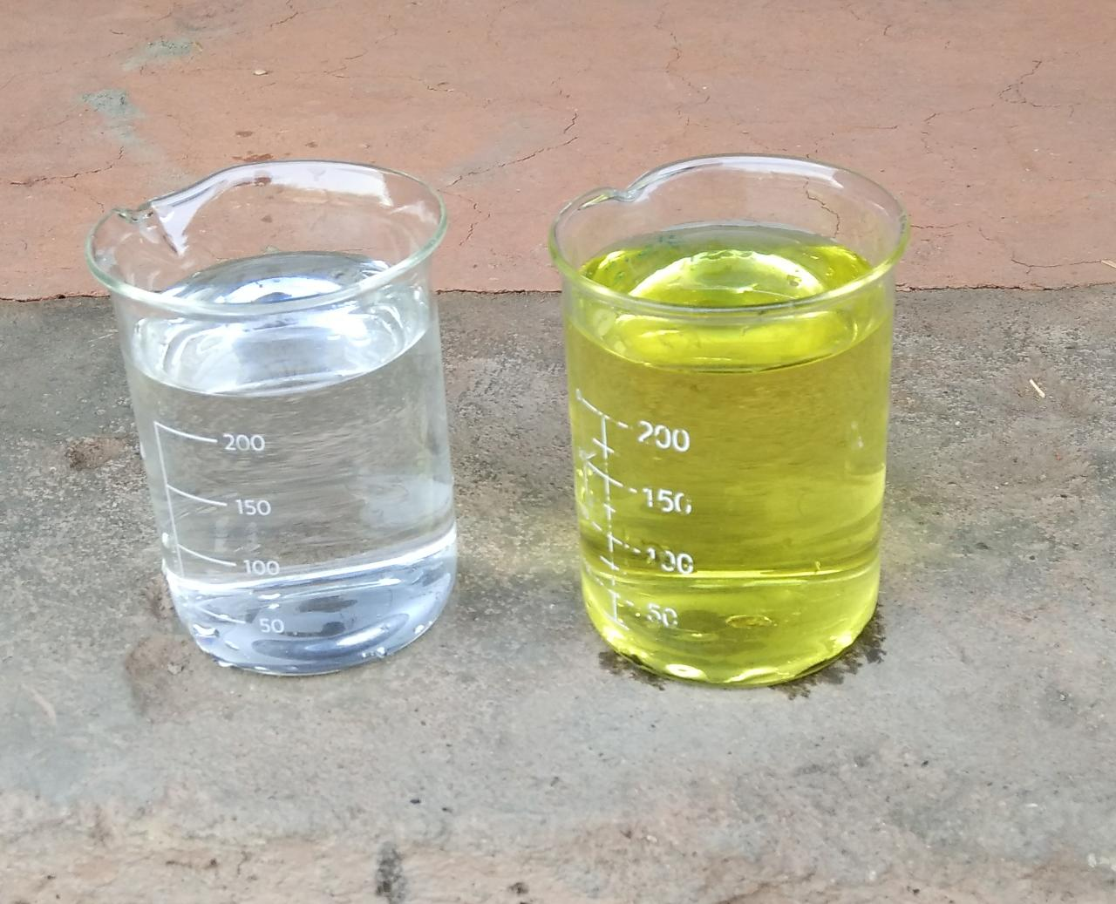
Column after filteration
Water after treatment (colourless)and before treatment(yellow)

Slide 54
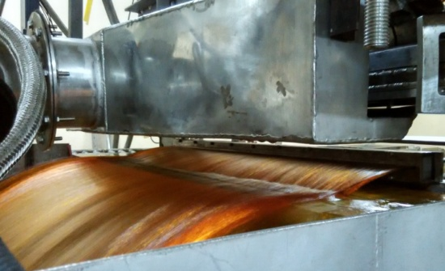
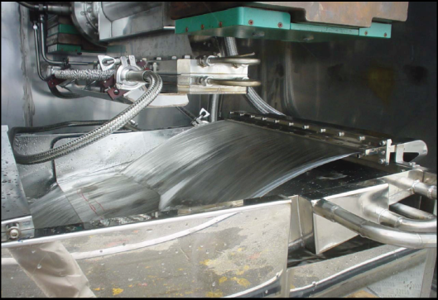
Electron Beam Processing Technology
Direct Interaction with waste water bringing decoloration, disinfection and chemical contaminant degradation:
Pre-irradiation and then Biological treatment increases about 25% throughput.

Slide 55
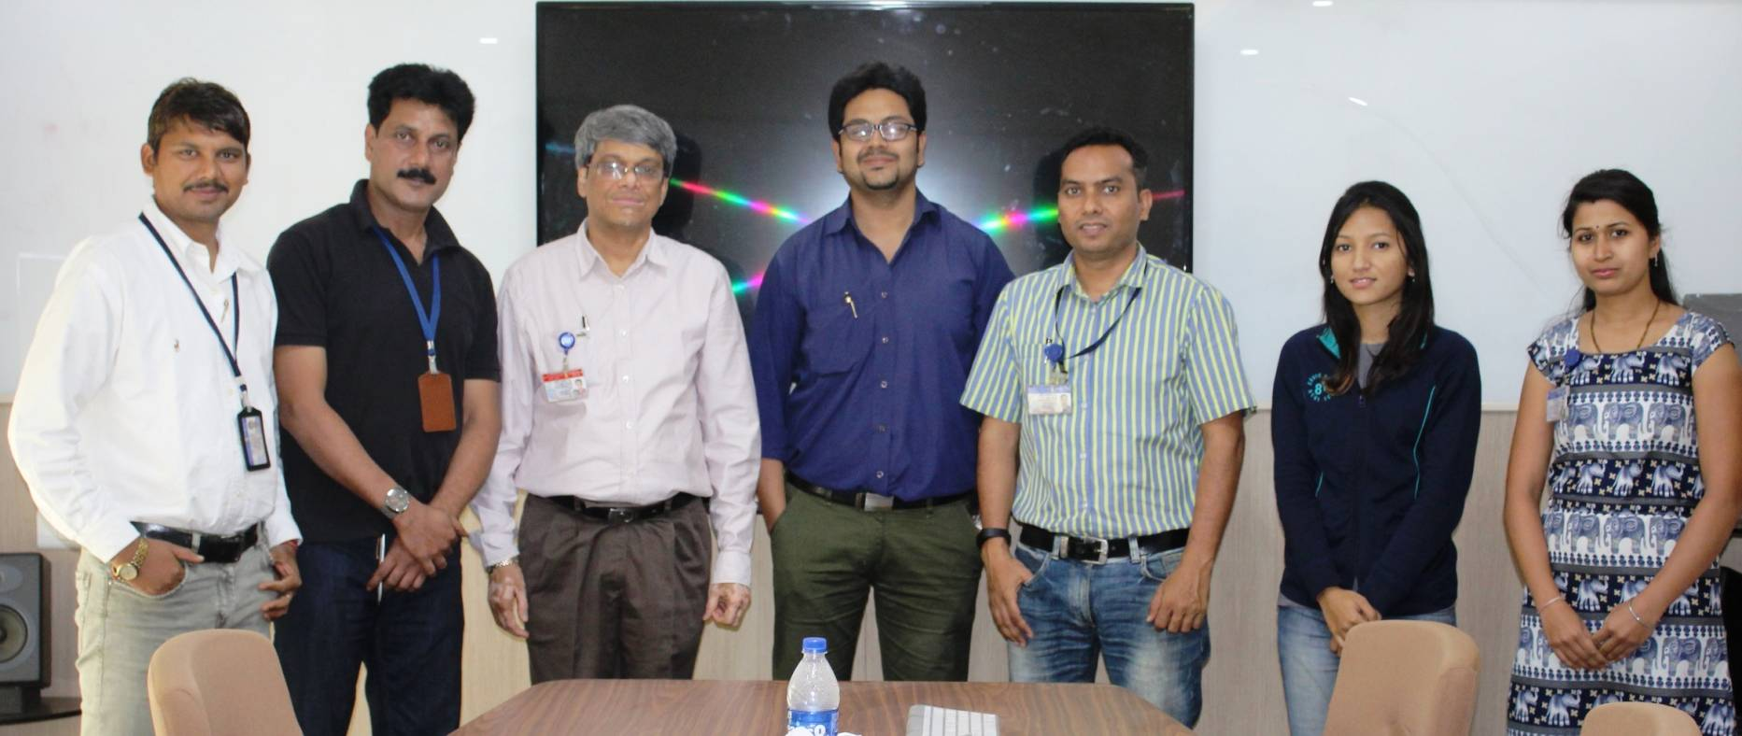
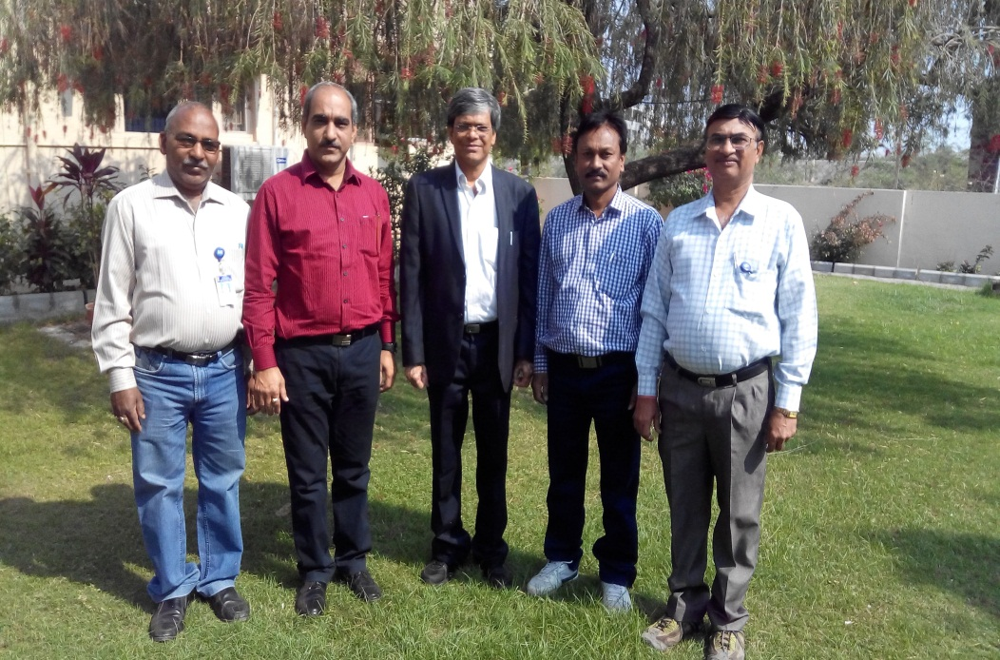
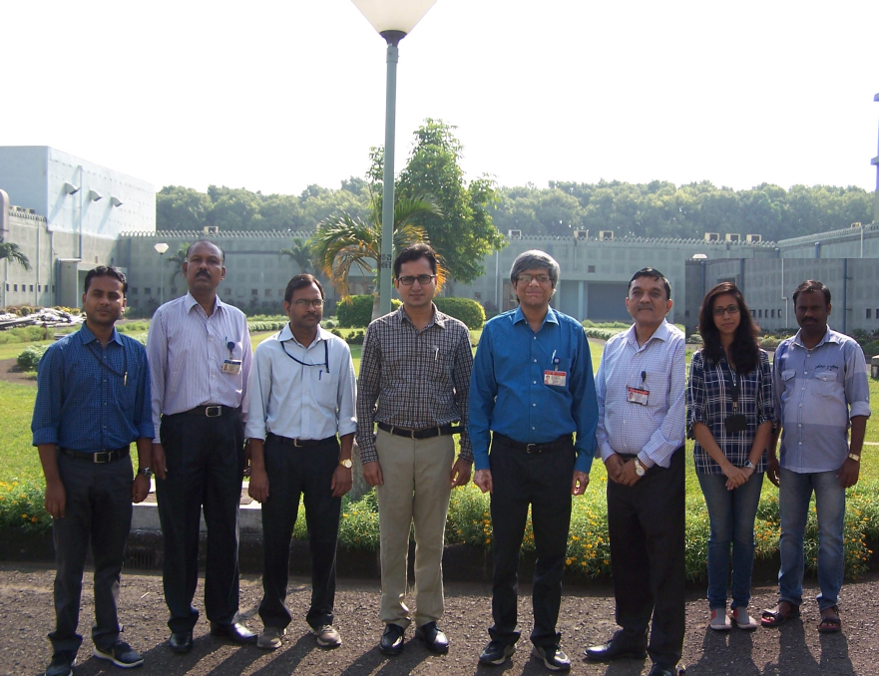
TEAM RTDD

Slide 56
“Nothing in life is to be feared, it is only to be understood. Now is the time to understand more, so that we may fear less.
-Marie Curie

Slide 57
When Radiation Technology Helps Common Man ATOMS SMILE
Notes:
*

Slide 58
TEAM RTDD

Slide 59
धन्यवाद

