Slide 1
Electronics, trigger and data acquisition systems for the INO ICAL experiment
B.Satyanarayana
For and on behalf of the INO/ICAL Electronics team
S.Aniruddhan¹, A.Behere², N.Chandrachoodan¹, V.B.Chandratre², Chitra¹, D.Das², V.M.Datar³, S.R.Joshi³, S.D.Kalmani³, T.Kasbekar², P.Kaur³, H.Kolla², N.Krishnapura¹, A.Lokapure³, G.Majumder³, A.Manna², S.Mohanan², S.Moitra², N.K.Mondal³, P.Nagaraj³, P.Nair², S.Padmini², Pathaleswar³, A.Prabhakar¹, M.Punna², K.C.Ravindran³, M.N.Saraf³, B.Satyanarayana³, R.R.Shinde³, S.Sikder², D.Sil³, M.Sukhwani², M.Thomas⁴, S.S.Upadhya³, P.Verma³, E.Yuvaraj³
¹Indian Institute of Technology Madras, IIT P.O., Chennai, 600036
²Bhabha Atomic Research Centre, Trombay, Mumbai, 400085
³Tata Institute of Fundamental Research, Homi Bhabha Road, Mumbai, 400005
⁴Electronics Corporation of India Limited, Veer Savarkar Marg, Mumbai, 400028

Slide 2
Please visit posters for details
Analog Front End Solutions for ICAL RPCs
Front End Data Acquisition and Control Module for ICAL RPCs
Global Services and Calibration for the INO ICAL Electronics
Multilevel and Configurable Trigger System for INO-ICAL Experiment
INO-ICAL: Network Scheme for Distributed Data Processing

Slide 3
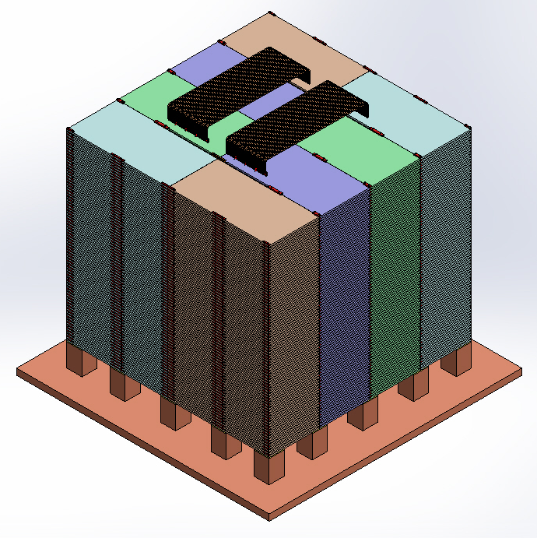
ICAL and its Engineering Module
Magnet coils
RPC handling trolleys

Slide 4
Some facts and figures

Slide 5
Challenges of ICAL electronics
Large number of electronic data readout channels. This necessitates large scale integration and/or multiplexing of electronics.
Large dimensions of one unit of RPC. This has bearing on the way the signals from the detector are routed to the front-end electronic units.
Large dimensions of the ICAL detector. Disparate distances (i.e. delays of signals in cables) of RPCs from the backend requires elaborate calibration procedures for global signals.
Road structure for the mounting of RPCs. This necessarily imposes constraint that signals from both X & Y planes of the RPC unit, along with other service and power supply lines are brought out only from the transverse direction of the detector.
About 25cm gap is available between the face of the detector and the service trolleys. Any installations on the face of the detector have to be designed with this consideration.
About 40mm gap between iron layers is available for the RPC detector. Thickness of the RPC holding tray, thickness of tray sliding track, tolerances of the iron plate thickness, height of the on detector high voltage module, analog and digital front-end modules, routing of cables and all other service lines must fit in this gap.
Effect of fringe magnetic field on the performance.
Low power consumption per channel (25mW/channel → 100KW/detector)
Long service life of electronics, component spares availability/replaceability is major a concern.

Slide 6
Design inputs to electronics
RPC strip’s characteristic impedance: 50±3Ω. Strip capacitance (1m): ~60pF. Signal coupling: DC
RPC signal’s rise time is of the order of 500-800ps. Therefore, we will need a resolution of about 200ps for the timing devices used for recording RPC signal arrival times w.r.t to ICAL trigger.
The opening width of the amplified signals is of the order of 25nSecs. The minimum width of the RPC pulse over the threshold in the avalanche mode is as low as a few ns. This is an important input for the front-end electronics design.
Mean strip pulse amplitude: ~0.6pC. The amplifier in the avalanche mode preferably should have a fixed gain in the range 100-200 depending on the noise levels obtainable and hence the minimum discriminator levels settable.
Discriminator overhead (ratio of average peak pulse height to discriminator level) of 3-4 is preferable for reliable performance. Variable (but common) threshold in the range of ±10 to ±50mV for the discriminators should be supported.
Timing measurement: 200ps (LC), multi-hit, both edges

Slide 7
RPC strip rate considerations
RPC strip signal rates mainly contributed by the surrounding low energy activities such as stray radioactivity, local electrical discharges, dark currents of the detector and other electrical/electronic disturbances.
For a given RPC, installed at particular location, operating at a particular high voltage, and a gas mixture, the average counting rate or noise rate is fairly constant and is in fact commonly used to monitor the stability of the above mentioned RPC operating parameters.
One of the main background tasks (while not collecting event data) of the ICAL DAQ system is to sequentially monitor individual strip rates of all the RPCs in the detector, with a reasonable (of the order of 1 hour cycle time for a strip) frequency.
Average RPC strip rate is ~200Hz (on surface).
The noise rate has consequences on the design of trigger system. The threshold of the trigger system is such that it shouldn’t generate triggers due to chance coincidence of noise rates.
Event rate is ~10Hz (nominal)

Slide 8
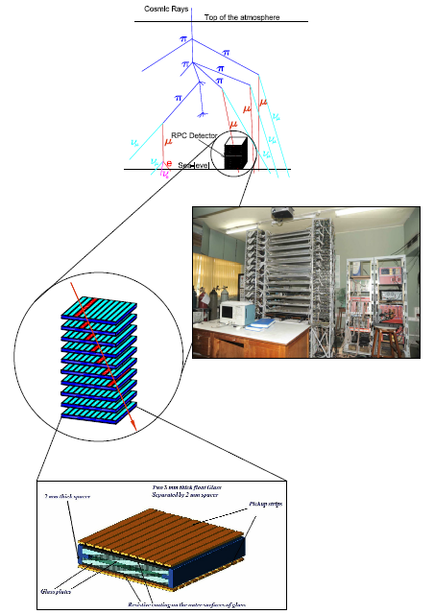
Functions of ICAL electronics
Signal pickup and analog front-end
Strip hit latch
Pulse shapers, timing units
Background noise rate monitor
Digital front-end and controller
Data network interface and architecture
Multilevel trigger system
Backend data concentrators
Event building, data storage systems
On-line data quality monitors
Slow control and monitoring
Gas, magnet, power supplies
Ambient parameters
Safety and interlocks
Voice and video communications
Remote access to detector sub-systems and data

Slide 9
First sketch of ICAL electronics

Slide 10
Components of ICAL electronics
Analog Front-end based on Anusparsh ASIC
Digital Front-end (RPCDAQ) using a TDC ASIC
Trigger System
Global services, calibration and synchronisation
Network and backend hardware
Backend software
Power supplies
Electronics integration

Slide 11
RPC and its readout components
High voltage supply
Y-Side analog front-end
Digital front-end
X-Side analog front-end

Slide 12
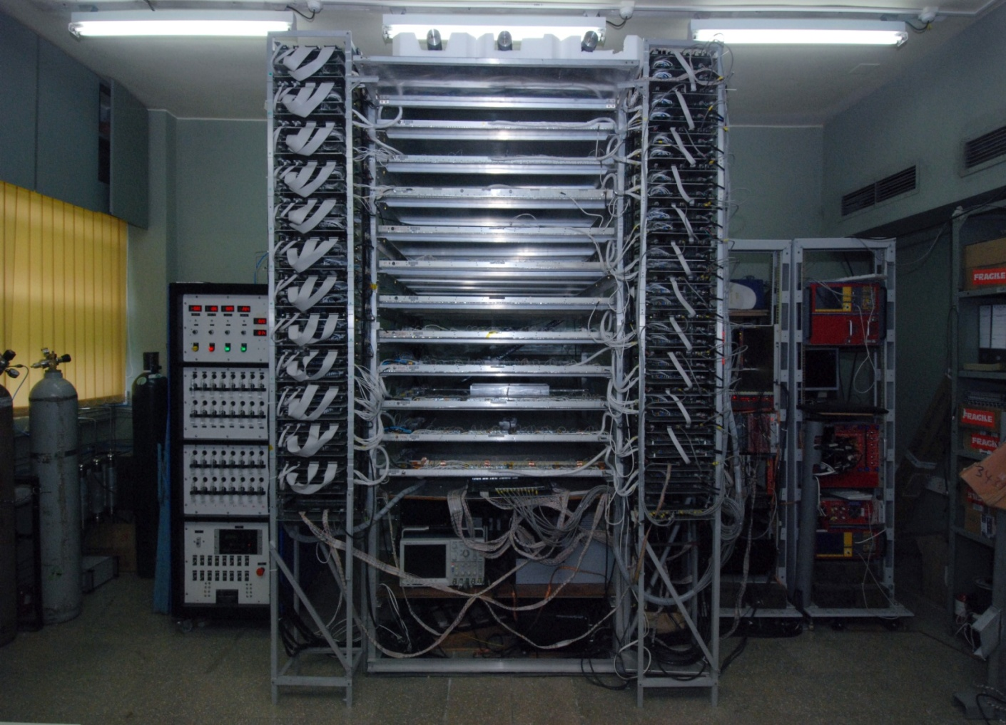
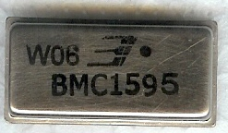
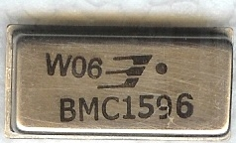
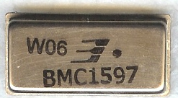
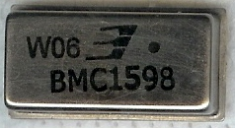
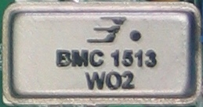
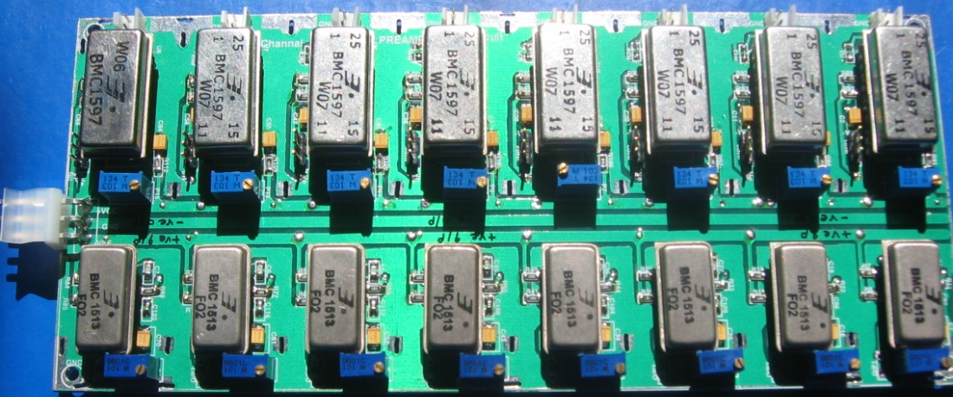
HMC preamps for ICAL test stands
BMC1595
(Negative In – Negative Out)
BMC1596
(Positive In – Positive Out)
BMC1597
(Positive In – Dual Out)
BMC1598
(Negative In – Dual Out)
BMC1513
(Negative In – Negative Out)
Input & Output impedance: 50Ω
Nominal gain: 10
Rise time: ~1.2 ns
Bandwidth: 350MHz
Package: 22-pin DIP
Power Supply : ± 6V
Power Consumption:110mW

Slide 13
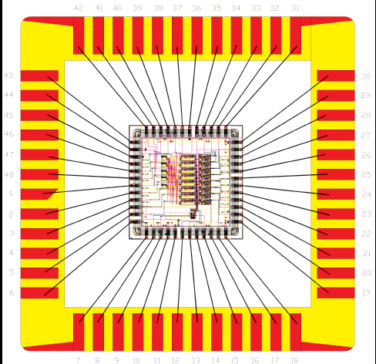
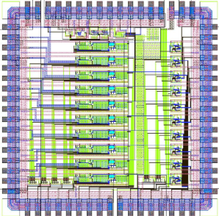
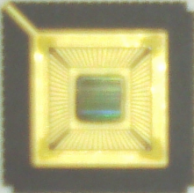
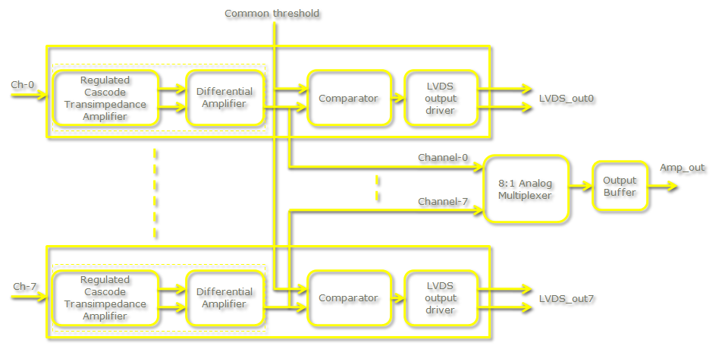
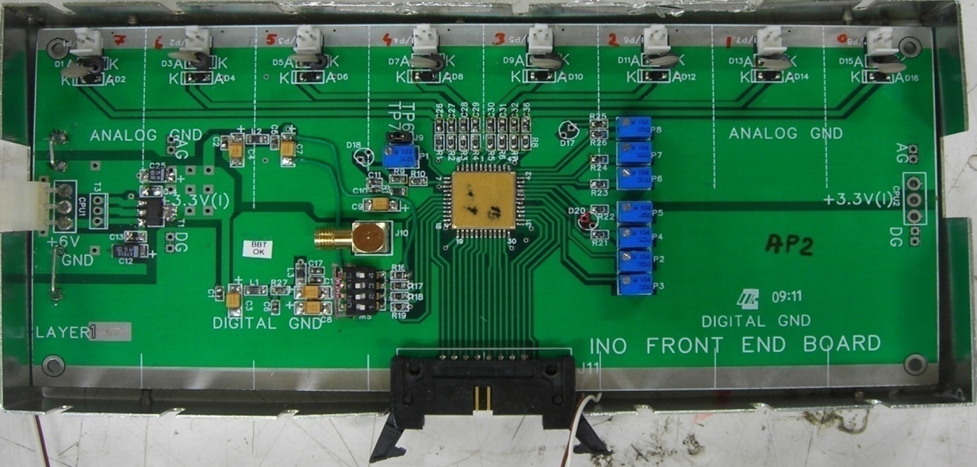
Transimpedance AFE ASICs
Process: AMSc35b4c3 (0.35μm CMOS) by IMEC, Belgium
Input dynamic range: 18fC(1μA)–1.36pC(80μA)
Input impedance: 45Ω @350MHz
Amplifier gain: 8mV/μA
3-dB Bandwidth: 274MHz
Rise time: 1.2ns
Comparator’s sensitivity: 2mV
LVDS drive: 4mA
Power per channel: ~20mW
Package: CLCC(48/68-pin)
Chip area: 13mm²

Slide 14
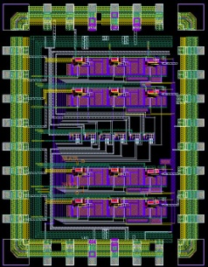
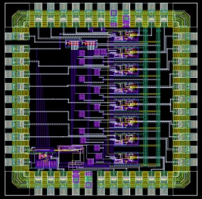
Voltage amplifier ASICs
An 8-channel AFE board using two, 4-channel preamplifier and one, 8-channel discriminator ASICs designed, fabricated and extensively tested on RPC test stands at BARC and TIFR.
Horizontal mounting in the RPC tray agreed upon for the Engineering Module as the board dimension couldn’t reduced below 200mm × 45mm.
Small volume order for the ASIC chipset in QFN package and boards produced.
Chip packing options, board manufacturer development, automatic assembly lines and test equipment are being planned.
SOIC-28
package
(11mmx18mm)
CLCC-44
package
(16mmx16mm)
QFN-48
package
QFN-48
package
0.35μm SiGe BiCMOS process

Slide 15
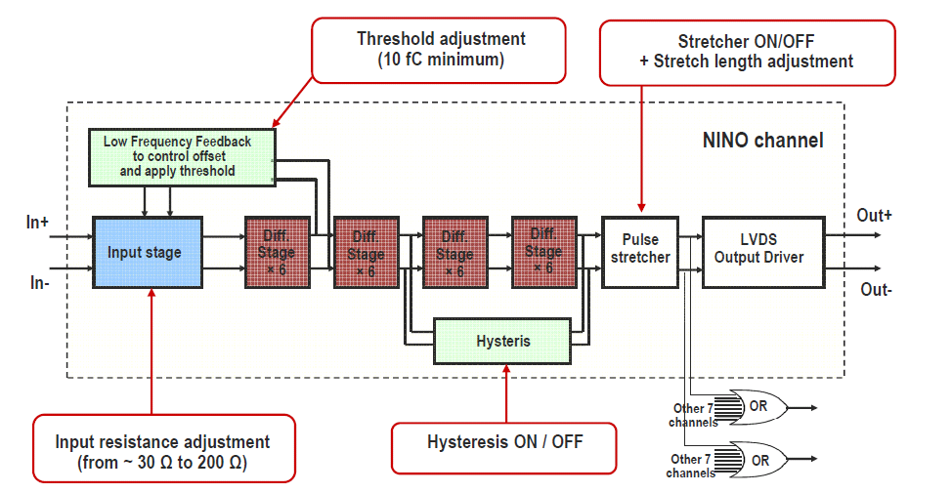
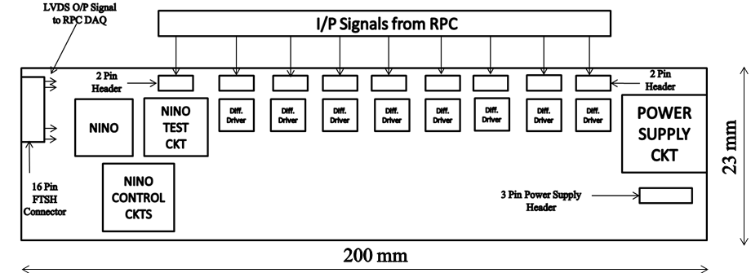
NINO based AFE board

Slide 16
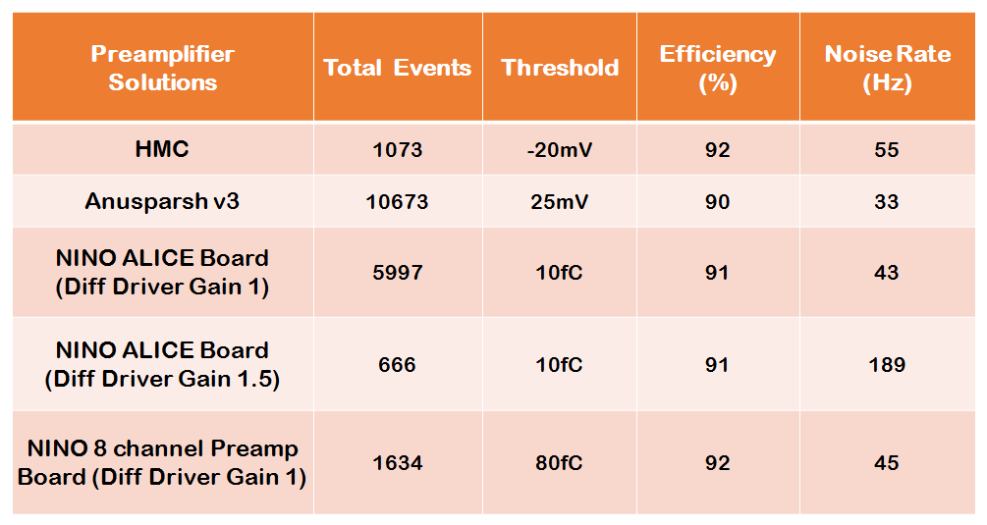
Performance comparison

Slide 17
DFE module – the workhorse
Unshaped, digitized, LVDS RPC signals from 128 strips (64x + 64y)
16 analog RPC signals, each signal is a summed or multiplexed output of 8 RPC amplified signals.
Global trigger
TDC calibration signals
TCP/IP connection to backend for command and data transfer

Slide 18
Soft-core processor
(EP4CE115F780)
Event data acquisition
Monitoring data acquisition
Command interface
Remote system upgradation
HV control and Monitoring
Read/Write Hardware register
access
Flash memory Access
TDC JTAG Access
Wiznet Network Interface

Slide 19
ICAL TDC specifications
Parameter | Specification
Number of channels | 8 or 16
Least count | 200ps
Dynamic range | 2μs (essential), 32μs (desirable)
Number of bits | 14 (essential), 18 (desirable)
Type | Common stop
Hits | Single hit (essential), multi hit (desirable)
Double hit resolution | 5-10ns
Readout buffer size | 128 words (maximum)
Signal and control inputs | LVDS and LVTTL respectively
DNL/INL | 100ps (typical)
Power rail | 3.0 to 3.6V (suggested)
Control and readout interface | SPI (essential), SPI + parallel (desirable)

Slide 20
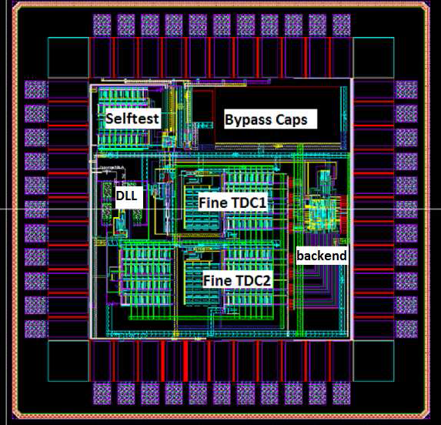
ASIC based TDC device
Principle
Two fine TDCs to measure start/stop distance to clock edge (T₁, T₂)
Coarse TDC to count the number of clocks between start and stop (T₃)
TDC output = T₃+T₁-T₂
Specifications
19 bit parallel output
Clock period, T_{c} = 4ns
Fine TDC interval, T_{c}/32 = 125ps
Coarse TDC output: 14 bits
Fine TDC output: 5 bits
Coarse TDC interval: 2¹⁴ * T_{c} = 65.536ms

Slide 21
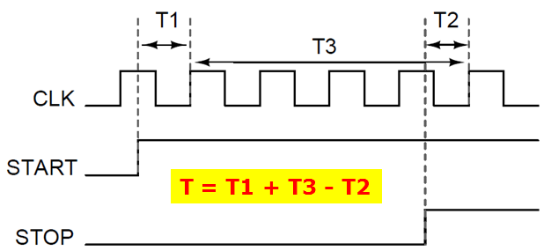
Overall block diagram
Principle of timing measurement

Slide 22
Implementation of fine TDC

Slide 23
First module of ICAL’s DFE
Altera Cyclone 4
HPTDC
Wiznet 5300
Three boards

Slide 24
ICAL DFEs in the RPC test stand

Slide 25
An RPC with NINO AFEs and a DFE
Integrating in a 2m x 2m RPC at IICHEP next week

Slide 26
DFE test jig

Slide 27
ICAL trigger scheme
Insitu trigger generation. Autonomous; shares data bus with readout system
For ICAL, trigger system is based only on topology of the event; no other measurement data is used
Huge bank of combinatorial circuits; Programmability is the game, FPGAs, ASICs are the players
Distributed
architecture

Slide 28
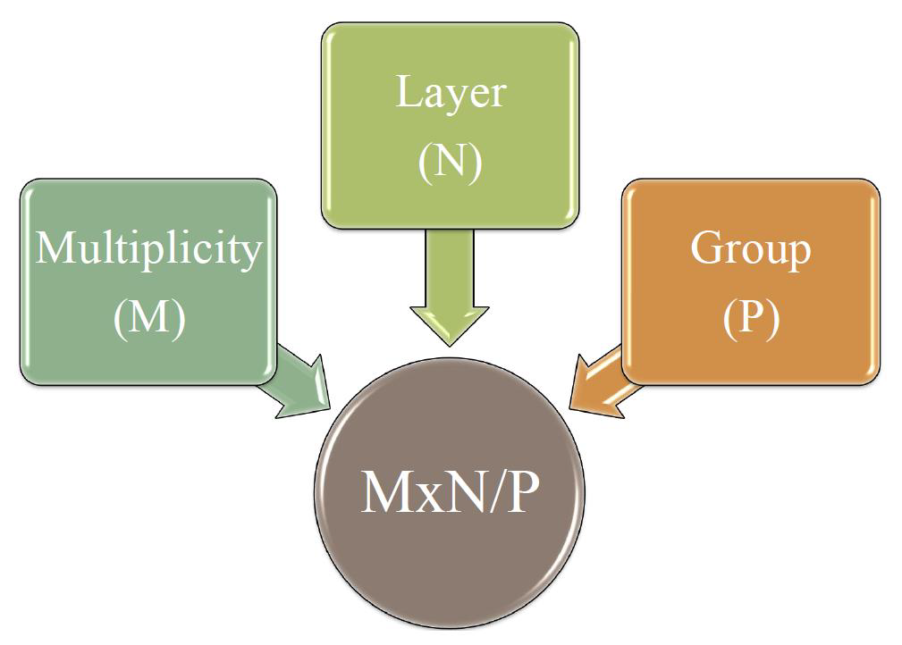
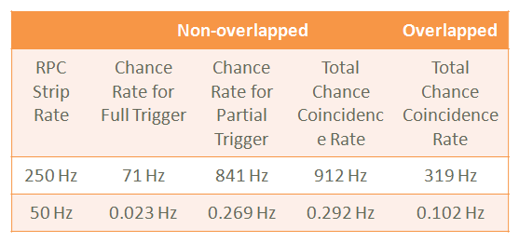
Trigger criteria

Slide 29
Trigger system for ICAL-EM

Slide 30
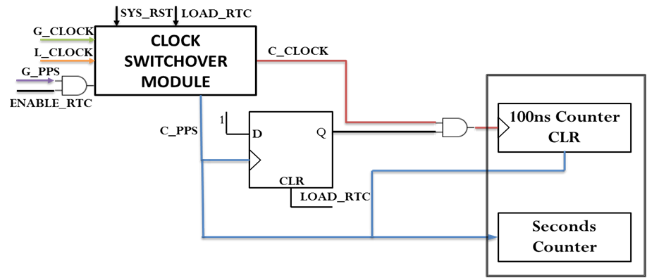
Calibration and synchronisation

Slide 31
Functional blocks of calibration unit

Slide 32
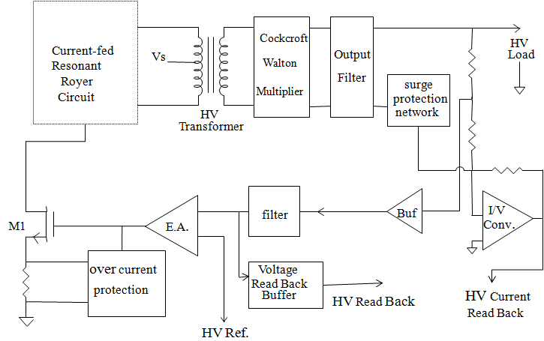
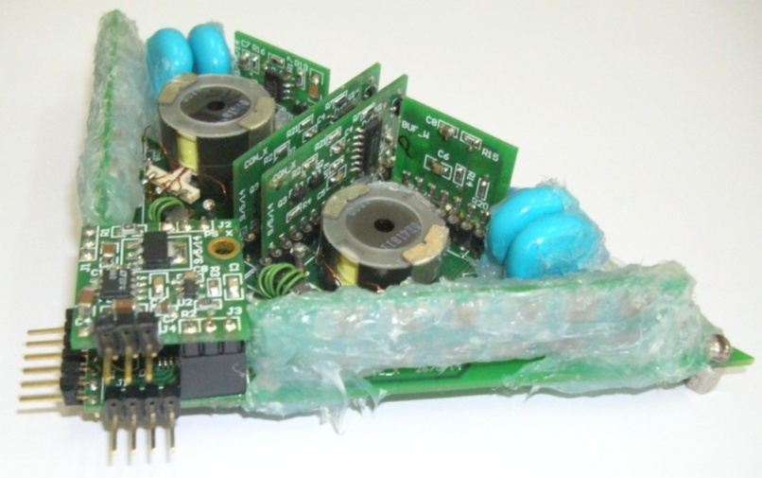
High voltage power supply
Output voltage adjustable in the range ± 0-6KV (to generate 0-12KV) with output current up to 2µA.
HV load regulation: better than 0.1% F.S
Output ripple/noise voltage: within 200 mV (p-p).
Adjustable HV Ramp rate 10-1000 Volts/ sec, HV on/off control, HV output read back facility.
HV load current read back facility with a resolution of 5 nA.
Required LV Input supply: 12V @200mA
Ambient fringe magnetic field: 500 gauss

Slide 33
Overview of ICAL data LAN
ICAL RPCs constitute a massive LAN with 30K nodes!

Slide 34
Backend hardware

Slide 35
Backend data handling

Slide 36
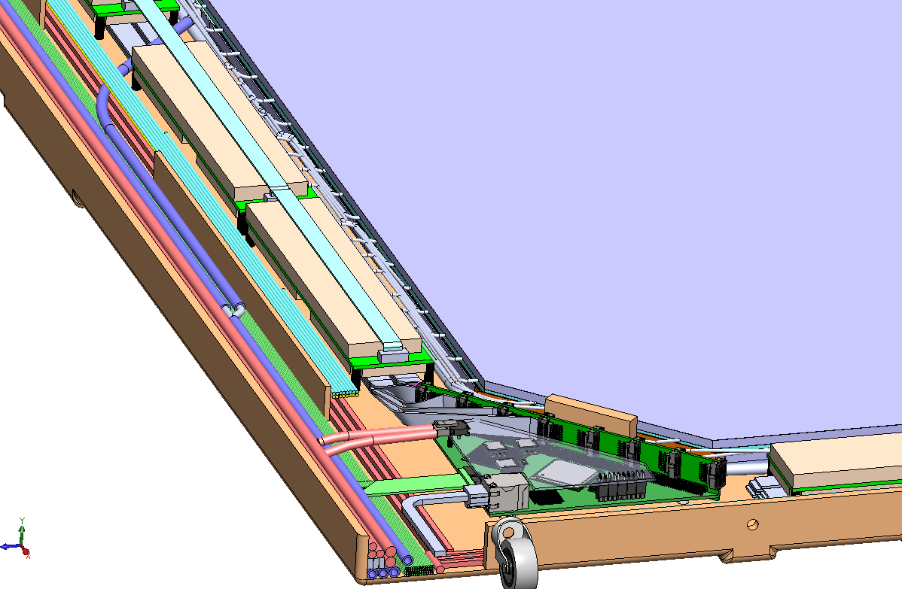
Integration of electronics in RPC

Slide 37
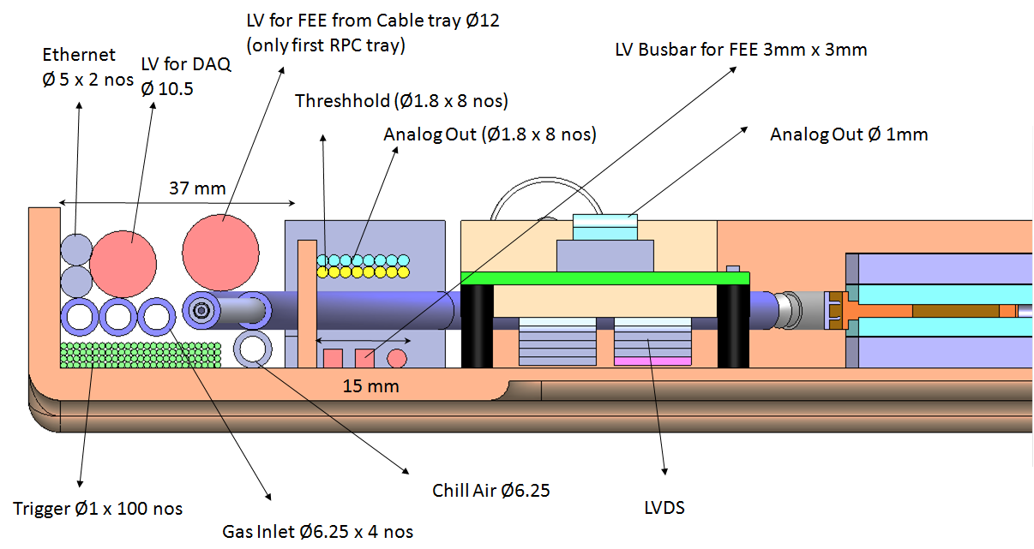
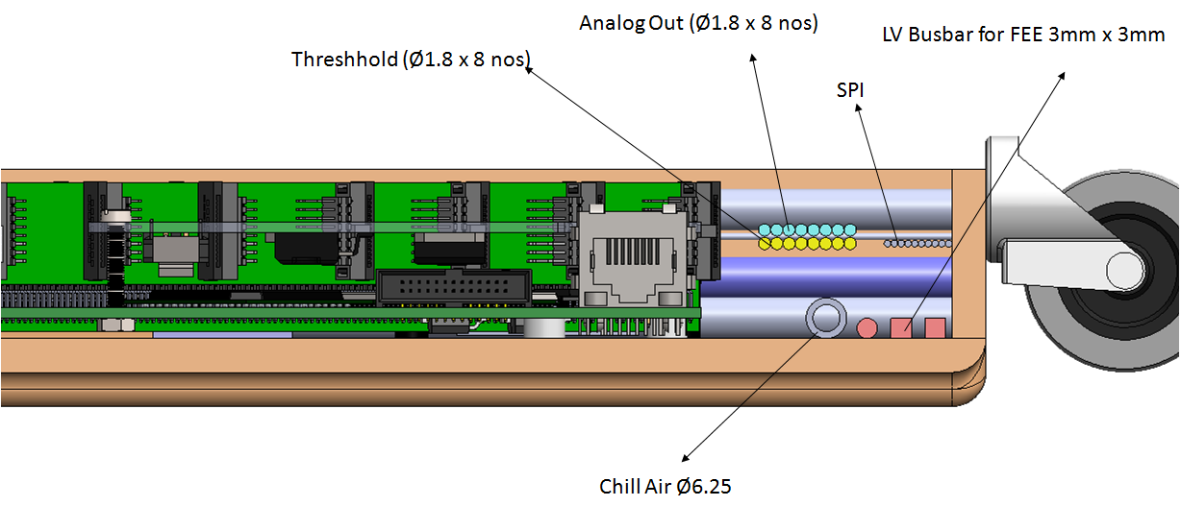
Side views of the RPC tray

Slide 38
Status of ICAL electronics
Analog Front End ASICs developed, boards fabricated and tested on RPC test stands. Ready for production.
Digital Front End board designed, fabricated and tested on RPC test stand stands. Ready for production. Firmware, processor software, network protocols, data structures are all designed. Design validated on two target FPGAs.
ICAL TDC ASIC. Design of the third and final version ready for submission.
Global services and calibration module designed, currently under production.
Trigger scheme validated, most of the boards already produced. To be integrated and tested in the detector stacks.
High voltage module designed, produced, tested on RPC, will go for production soon.
Backend DAQ hardware configured, to be purchased.
Data concentrator and event builder software developed, under testing and bench marking.
Data quality monitors, data storage solutions under development, will be frozen soon.
Integration of front-end electronics on the detector tray is being tackled and modelled.
….. so essentially waiting ☹

Slide 39
Thank you for your attention

Slide 40
Backup slides

Slide 41
Dead time of FE software

Slide 42
Hardware based Wiznet

Slide 43
Passive Star Optical Networks

Slide 44
Data network schematic

Slide 45
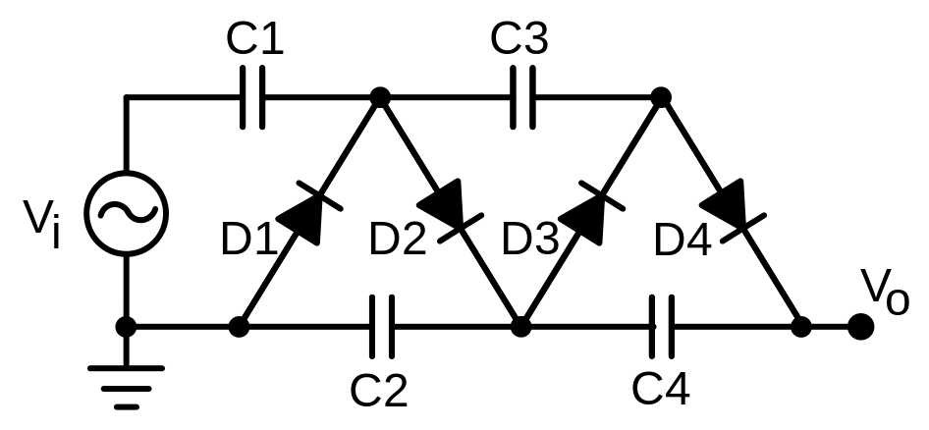
High Voltage power supply
Cockcroft–Walton generator

