Slide 1
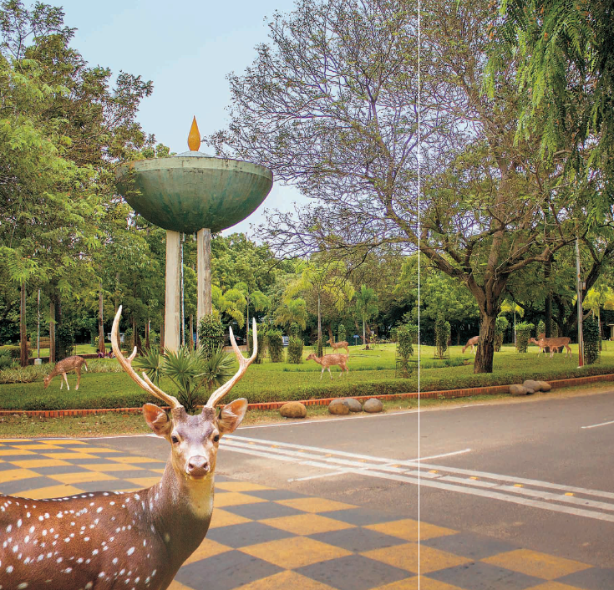
Latest CMS Results on ϕ_{s}
Prafulla Kumar Behera
IIT Madras, India,
On Behalf of CMS Collaboration
9th International Workshop on the CKM Unitarity Triangle (CKM2016)
TIFR, Mumbai
29th November, 2016

Slide 2
Outline
Motivation
Analysis procedure
Results
Conclusions
Prafulla Kumar Behera, IIT Madras
CKM2016 workshop@TIFR

Slide 3
Motivation
No direct evidence of physics beyond the SM has been found at LHC
More Important to test the SM in various ways
Study of the weak B_{s} decay phase (ϕ_{s})
the decay width difference (_{ΔΓs} ) between the light and heavy B_{s} mass eigenstates
The weak phase (ϕ_{s}) stems from the interference between direct B_{s} meson decays into a CP eigenstate and decays through mixing to the same J/ψφ final state
Phys.Lett. B757 (2016) 97-120
Prafulla Kumar Behera, IIT Madras
CKM2016 workshop@TIFR

Slide 4
Motivation
The weak phase ϕ_{s} is related to the elements of the CKM matrix ϕ_{s} ≅ -2β_{s} ( ) (Neglecting penguin contribution)
(SM prediction global fit)
Any deviation of measured value as a hint for physics beyond SM
The theoretical prediction for ΔΓ_{s} =0.087 ±0.021 ps⁻¹ (Assuming no new physics B_{s} mixing)
Prafulla Kumar Behera, IIT Madras
CKM2016 workshop@TIFR

Slide 5
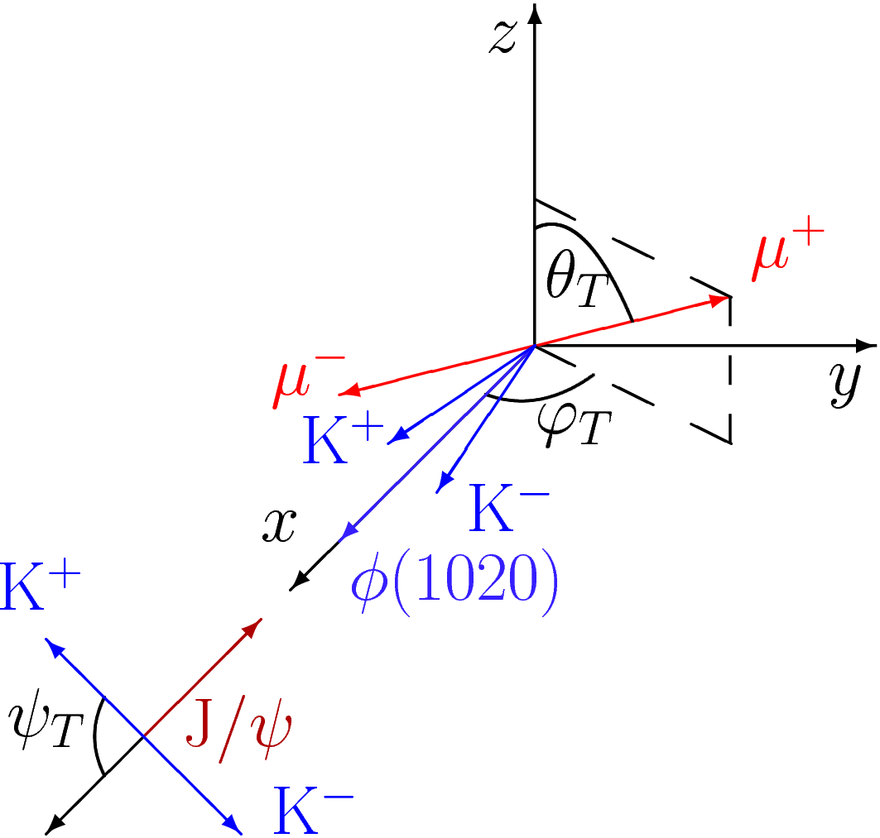
Analysis strategy
B_{s} ➔ J/ψ (μ⁺μ⁻) φ(K⁺K⁻)
Decay topology (θ_{T},ψ_{T},ϕ_{T})
The azimuthal angle of the μ⁺ in
the rest frame of J/ψ
helicity angle ψ_{T} is the angle of the K⁺ in
the φ(1020) rest frame with respect to
the negative J/ψmomentum direction
The polar angle of the μ⁺ in the rest frame of J/ψ
Prafulla Kumar Behera, IIT Madras
CKM2016 workshop@TIFR

Slide 6
Signal Reconstruction
19.7 fb⁻¹ , 8 TeV Data
μ_{PT} > 4.0 GeV, P_{T} (μμ) > 6.9 GeV, |η| < 2.1
Distance of closet approach of μ+μ- (3D) < 0.5 cm and have common vertex.
The transverse decay length significance (L_{xy}/σ_{Lxy}) > 3.0
L_{xy} is the distance between the primary and secondary vertices in the transverse plane and σ_{xy} is the uncertainty.
The vertex fit probability > 10%
|M(μ⁺μ⁻ ) – M_{J/ψ} (PDG)| < 150 MeV.
Cosine of angle between transverse momentum and L_{xy} >0.9
Prafulla Kumar Behera, IIT Madras
CKM2016 workshop@TIFR

Slide 7
Signal Reconstruction
19.7 fb⁻¹ , 8 TeV Data
P_{T} (Kaon) > 0.7 GeV
|M(K⁺K⁻ ) – M_{φ} (PDG)| < 10 MeV.
5.20 GeV < Mass (B_{s}) > 5.65 GeV
Vertex probability greater than 2%.
At least one primary vertex. In case of multiple vertices, the one which minimizes the angle between the flight direction and the momentum of the B_{s} is select.
Non prompt J/ψ (B_{c}, Λ_{b} B⁰,B±) contribution is negligible.
PYTHIA (V6.424)/EVTGEN for MC
Prafulla Kumar Behera, IIT Madras
CKM2016 workshop@TIFR

Slide 8
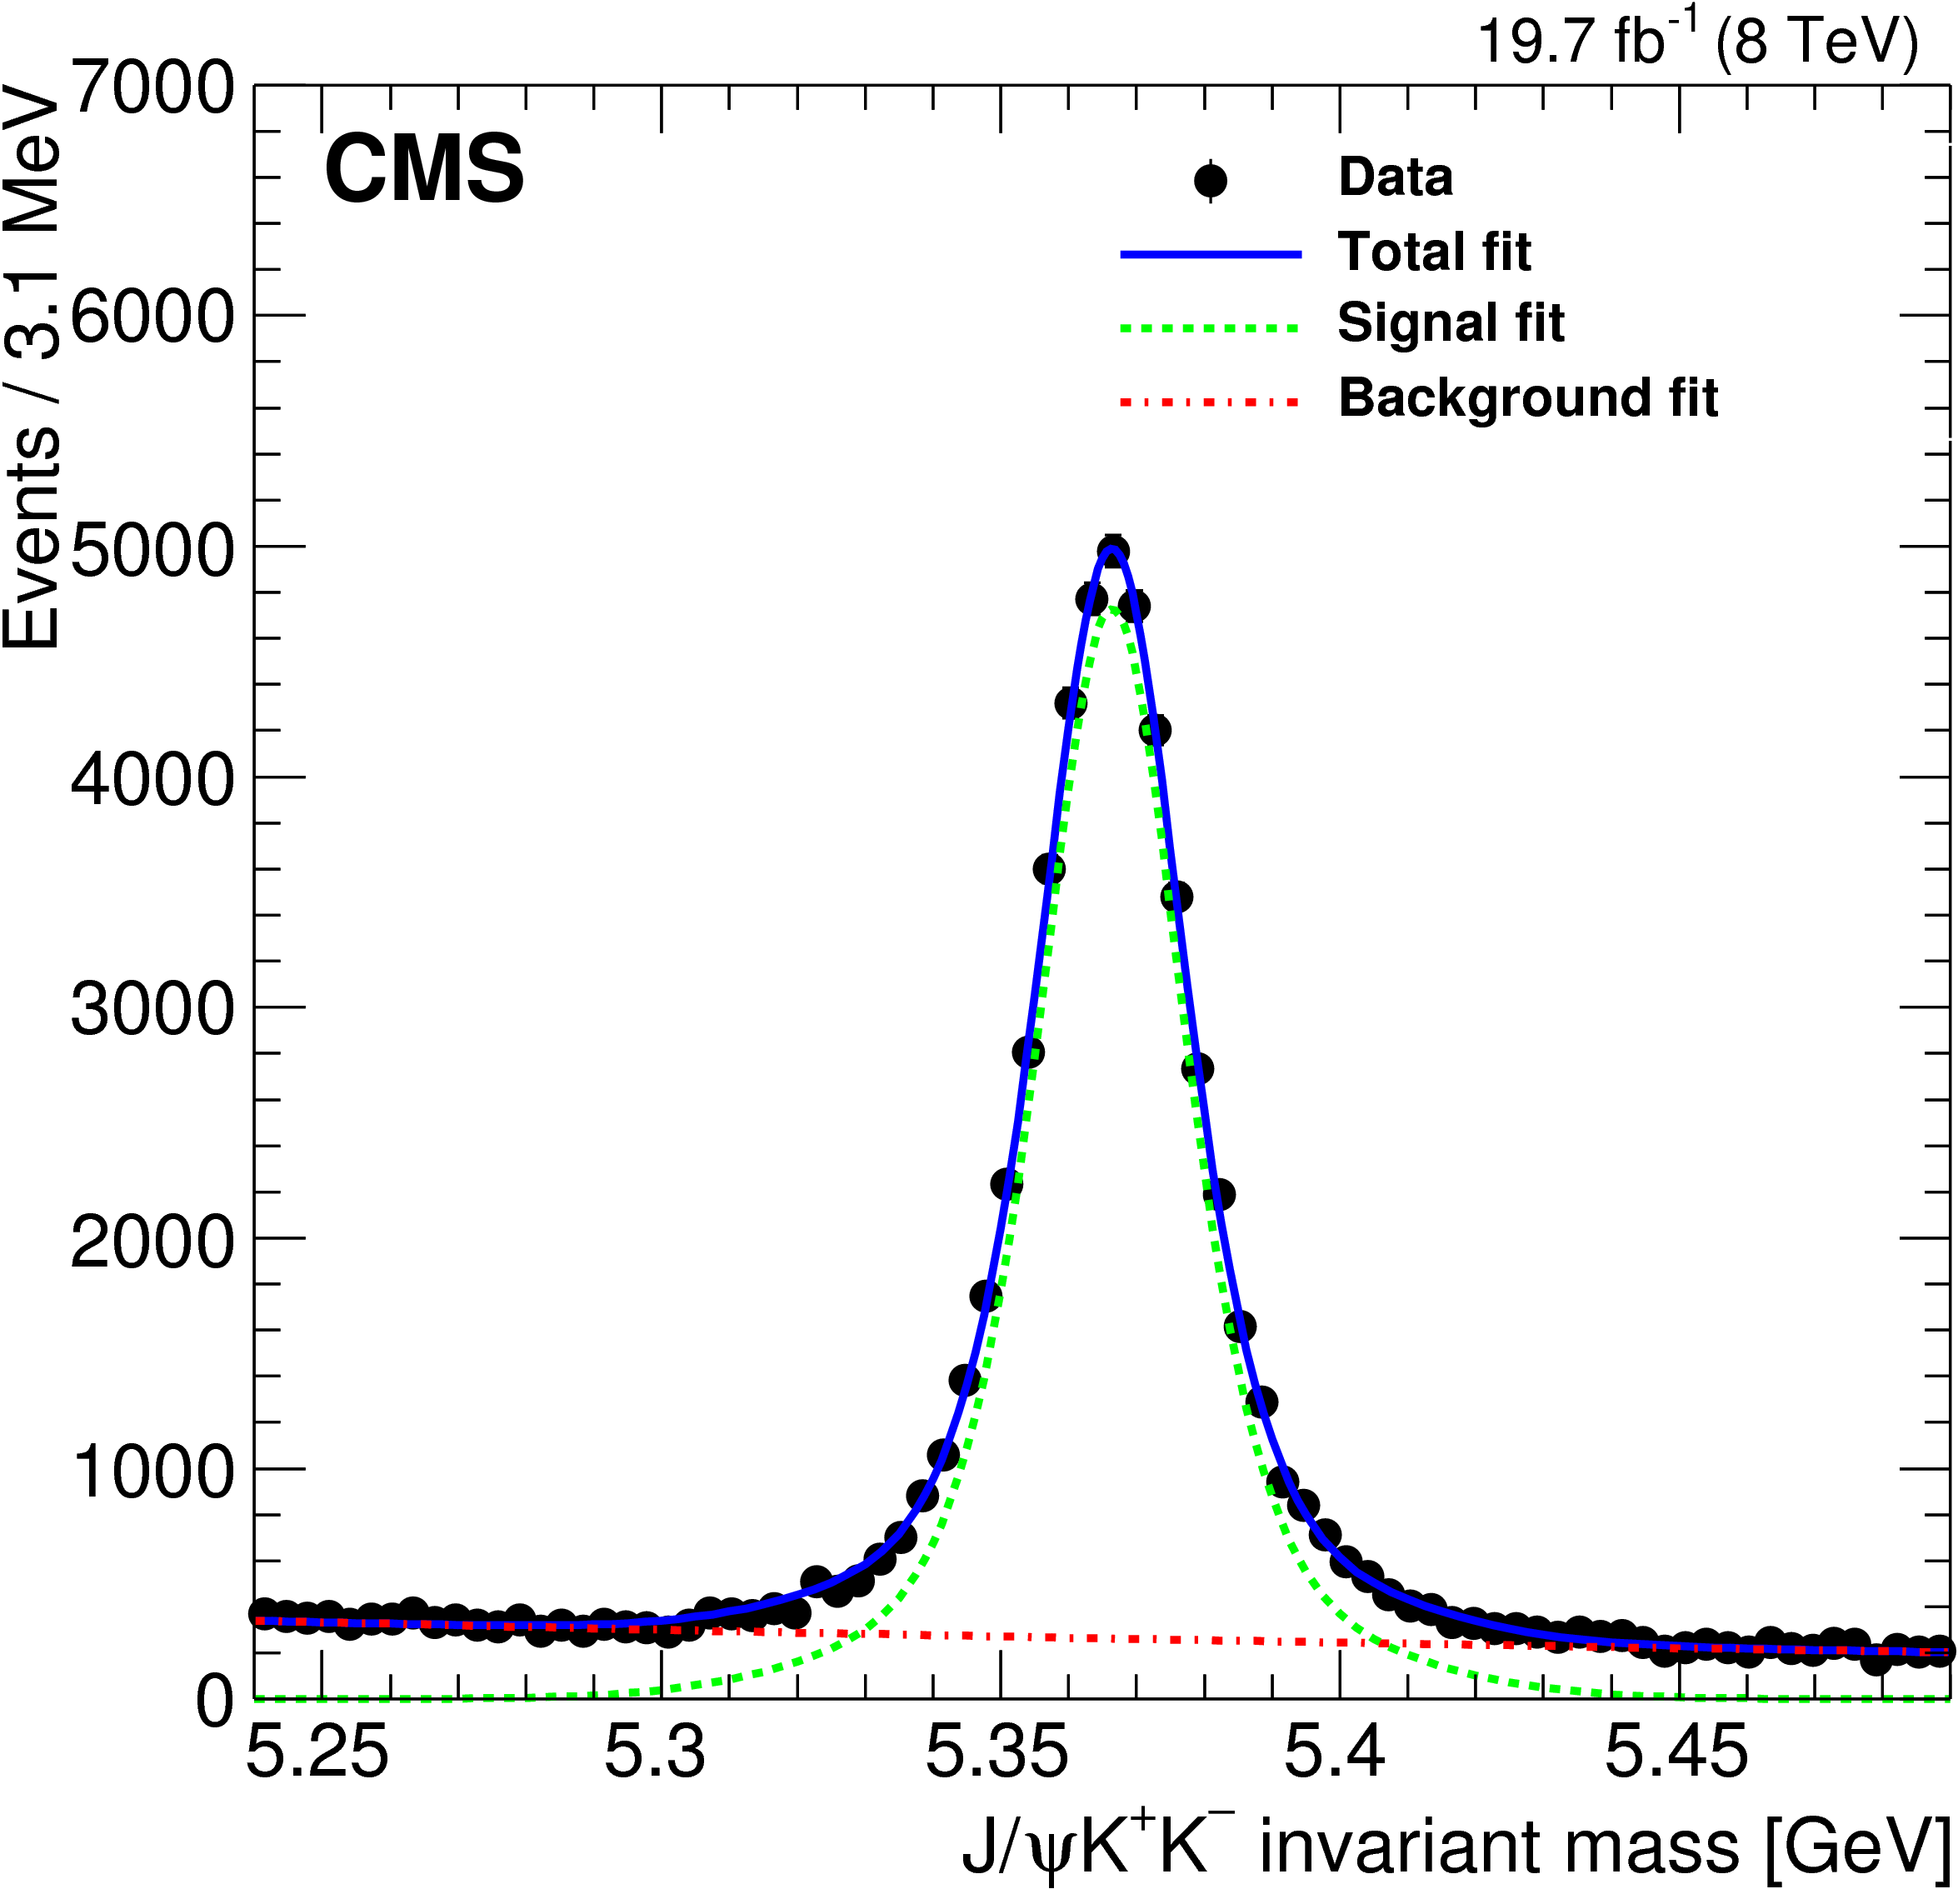
Reconstructed B_{s}
Prafulla Kumar Behera, IIT Madras
CKM2016 workshop@TIFR

Slide 9
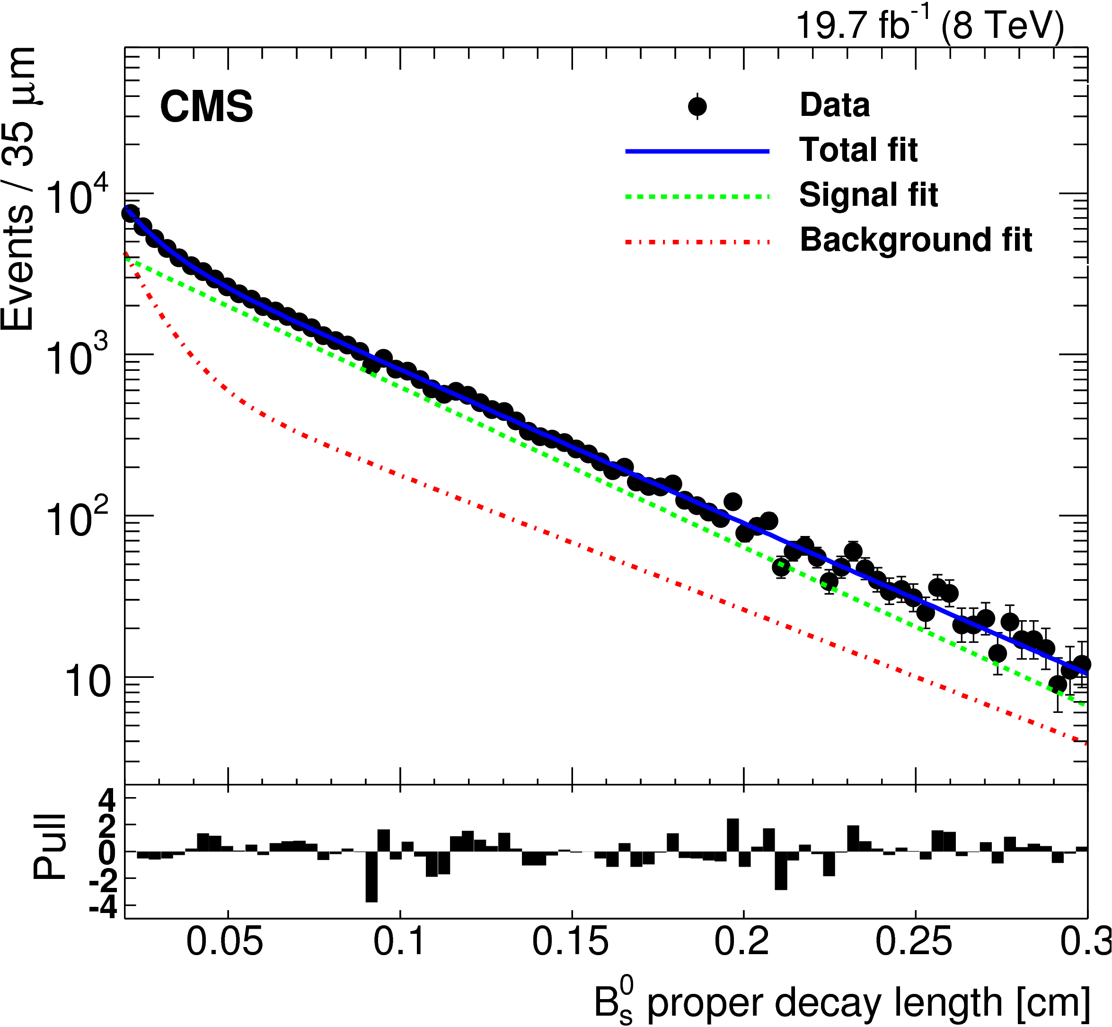
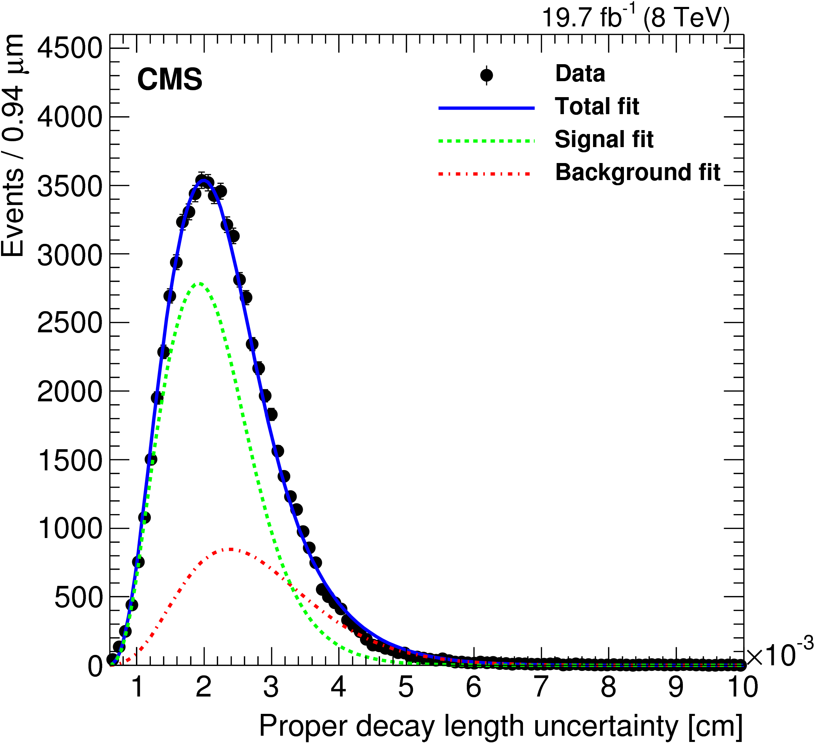
Signal selection
Prafulla Kumar Behera, IIT Madras
CKM2016 workshop@TIFR

Slide 10
Flavor tagging
The charge of lepton from other Bs decay gives the flavor of signal Bs at production time.
The power of tagging P_{tag} = ε_{tag} ( 1 − 2 ω)² , where ε_{tag} is the efficiency of tagging, ω is the mistag fraction.
P_{T} ( tag lepton)> 2.2 GeV.
The distance (3D) from primary vertex of Bs < 0.1cm
Prafulla Kumar Behera, IIT Madras
CKM2016 workshop@TIFR

Slide 11
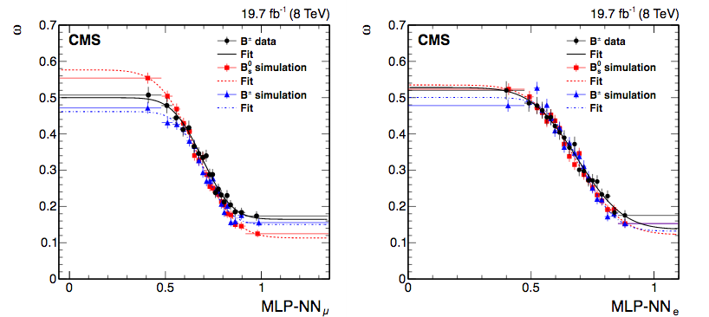
Mis – Tag Probability (ω)
Tagging Efficiency: 8.3% (data)
Combined mistag probability
Prafulla Kumar Behera, IIT Madras
CKM2016 workshop@TIFR

Slide 12
Maximum likelihood fit
Fit is performed using, invariant mass Bs, proper decay time (ct), three decay angles, proper decay length uncertainty (σ _{ct})
Total events in the fit 70,500 ( 5650 tagged event)
Prafulla Kumar Behera, IIT Madras
CKM2016 workshop@TIFR

Slide 13
Angular Distribution from Data
Dr. Prafulla Kumar Behera, IIT Madras
CKM2016 workshop@TIFR

Slide 14
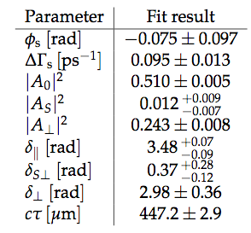
Results
Prafulla Kumar Behera, IIT Madras
CKM2016 workshop@TIFR

Slide 15
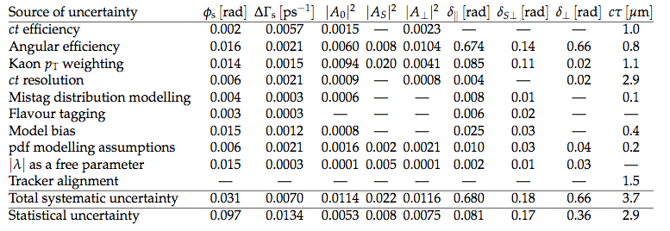
Systematic Uncertainties
Ralatively large statistical uncertainties
Prafulla Kumar Behera, IIT Madras
CKM2016 workshop@TIFR

Slide 16
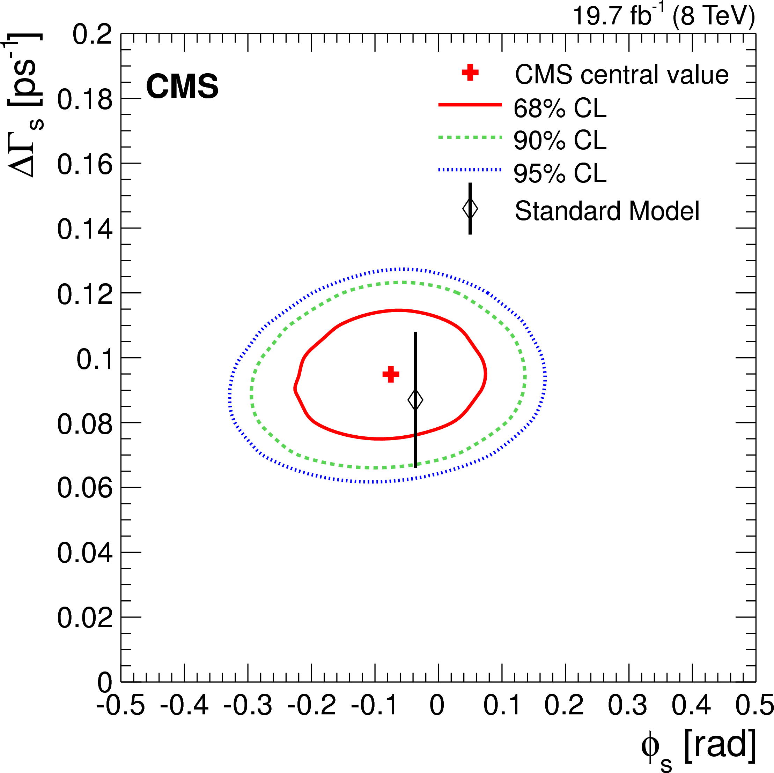
Results
Prafulla Kumar Behera, IIT Madras
CKM2016 workshop@TIFR
Notes:
Insert a photo

Slide 17
Conclusions
ϕ_{s} measurement is consistent with SM fit prediction
ΔΓ_{s} is measured to be non zero
Uncertainties on ϕ_{s} and ΔΓ_{s} measurement are dominated by statistical uncertainties.
Look forward to use 13 TeV data for improved measurement!
Prafulla Kumar Behera, IIT Madras
CKM2016 workshop@TIFR

Slide 18
Thank You
Dr. Prafulla Kumar Behera, IIT Madras
CKM2016 workshop@TIFR

