Slide 1
8th IUPAP International Conference on Women in Physics(ICWIP 2023) 10-14 July 2023
Assessing Radon and Radon Exhalation Rates in Traditional Main Halls of University of Ghana Campus: A Sealed-Can Technique Approach
Irene Opoku-Ntim, Darkwa Charles Aboagye, Aba Bentil Andam

Slide 2
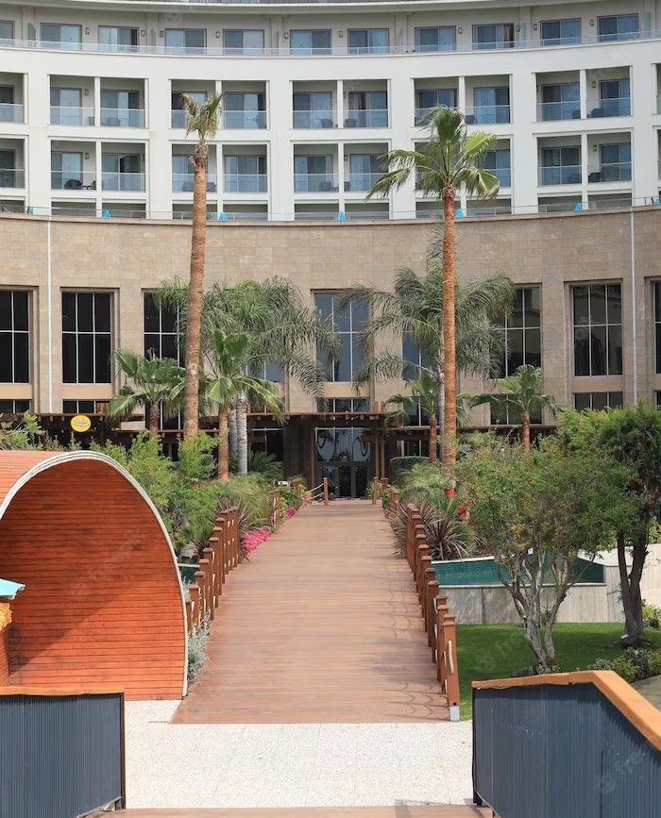
Introduction
The quantity of radon generated in the soil is determined by the concentrations of uranium and thorium in the bedrock and soil components.
Radon generated in the soil migrates through pore spaces in soil, cracks in rocks, and weak zones such as shear, faults, and thrust via the mechanisms of emanation, diffusion, and convection [Chiad et al., 2012].

Slide 3
Objective
To assess the radon, it health risk and radon exhalation rates in traditional main halls of the University of Ghana campus using a sealed-can technique.
Fig 1: A modifiable lung cancer risk factor
Source: https://www.ilcn.org/radon-a-modifiable-lung-cancer-risk-factor/

Slide 4
Radon and Health Risks
Radon is a radioactive gas that can accumulate indoors. Prolonged exposure to high levels of radon can increase the risk of lung cancer.
It is important to measure radon levels in buildings, especially in areas where people spend a signiﬁcant amount of
time.
Fig 1: Health Risk of Radon (EPA, Ireland, 2023)

Slide 5
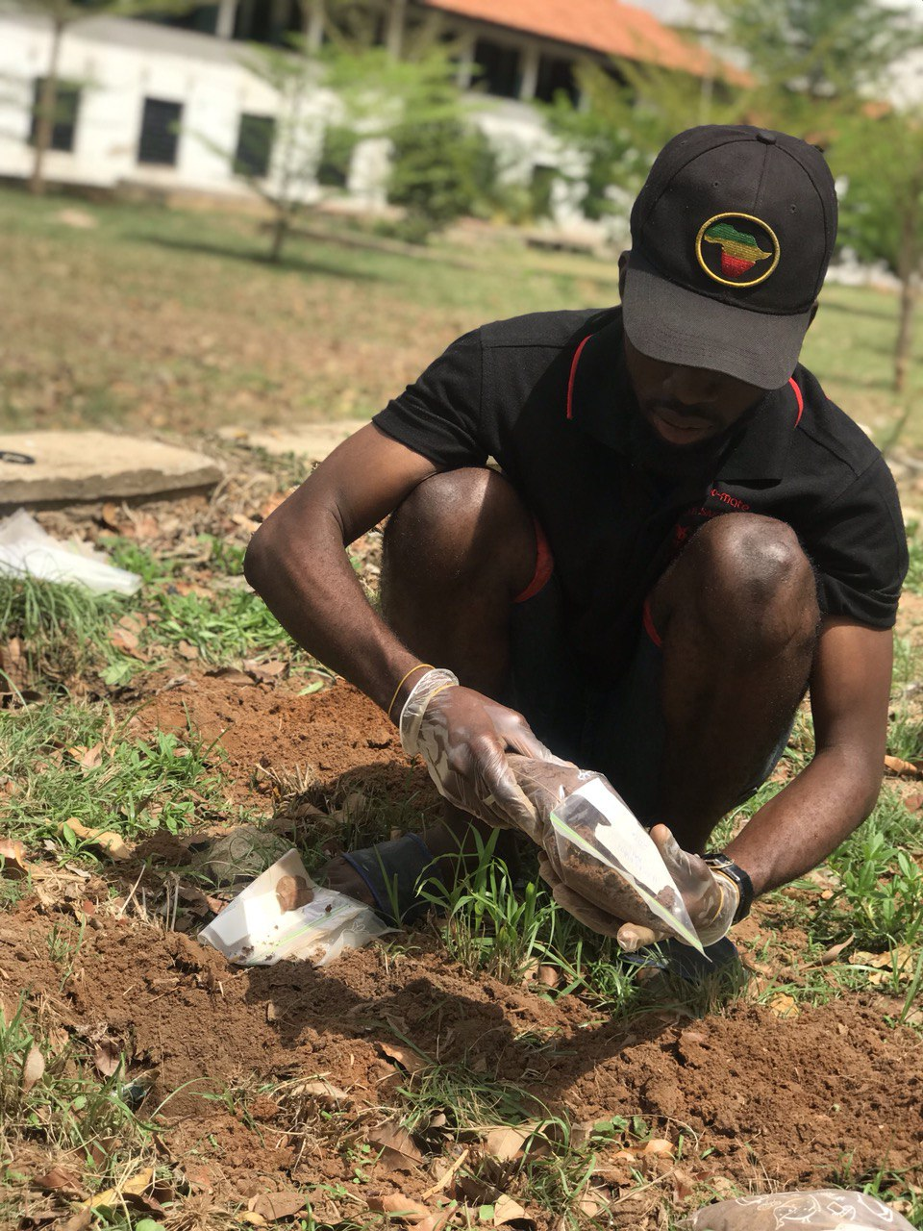
Methodology
Soil samples were collected from the traditional halls namely Akuafo, Mensah Sarbah, Legon, Common Wealth and Volta at the University of Ghana Campus. The 0.5 kg samples were ground, homogenized and sieved to about 150mm. The samples were dried at 100◦C for 48 h to ensure that moisture is completely removed. Weighed samples were placed in sealed plastic bottles, 1 month to allow radioactive equilibrium to be reached as shown in Fig 2
Fig 4: Analysis of radon in Soil
Fig 3: Sampling of soil Samples

Slide 6
Results and Findings
Figure 6 : A graph showing the minimum, maximum and average surface exhalation rates of the traditional halls
Figure 5: A graph showing the minimum, maximum and average radon concentrations of the traditional halls.
Preliminary results indicate varying levels of radon in different traditional main halls of the University of Ghana campus.
Akuafo hall was found to have the lowest average radon concentration being (166.26 ± 32.67) Bqm⁻³ whereas Commonwealth hall recorded the highest average radon concentration of (222.20 ± 66.82) Bqm⁻³ in the University of Ghana (traditional halls).
.

Slide 7
Conclusion
The sealed-can technique provides valuable insights into the radon levels and exhalation rates in traditional main halls of the University of Ghana campus. concentrations.
The mean surface exhalation rate for the Traditional halls in the University of Ghana was found to be (12.50 ± 1.52) μBqm-2h-1, which is below the world average exhalation rate of 57,600 mBqm-2h-1.
The average radon concentration for the Traditional halls was (189.96 ± 23.12) Bqm-3, which is below the globally accepted average radon concentration 300 Bqm-3 (WHO, 2009).
Further research and mitigation measures may be necessary to ensure the safety and well-being of individuals exposed to high radon

Slide 8
Thanks!
Do you have any questions? addyouremail@freepik.com
+91 620 421 838
yourcompany.com

