Slide 1
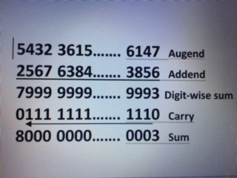

Slide 2
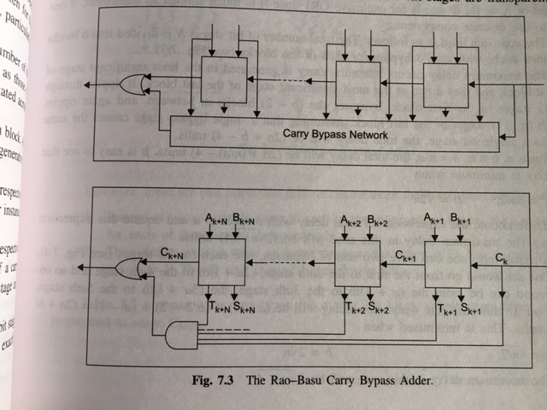

Slide 3
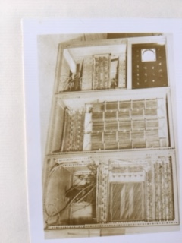

Slide 4
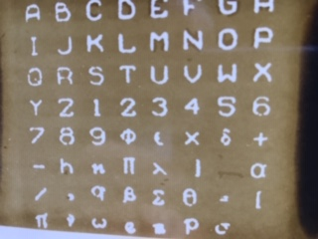

Slide 5
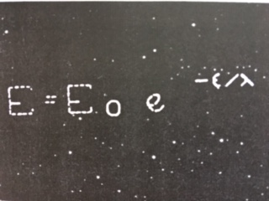

Slide 6
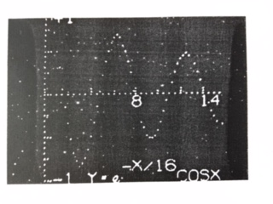

Slide 7
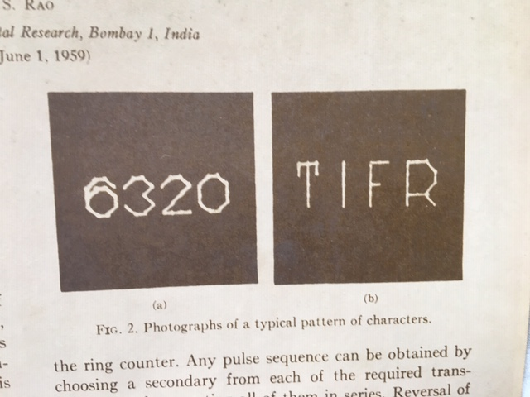

Slide 9
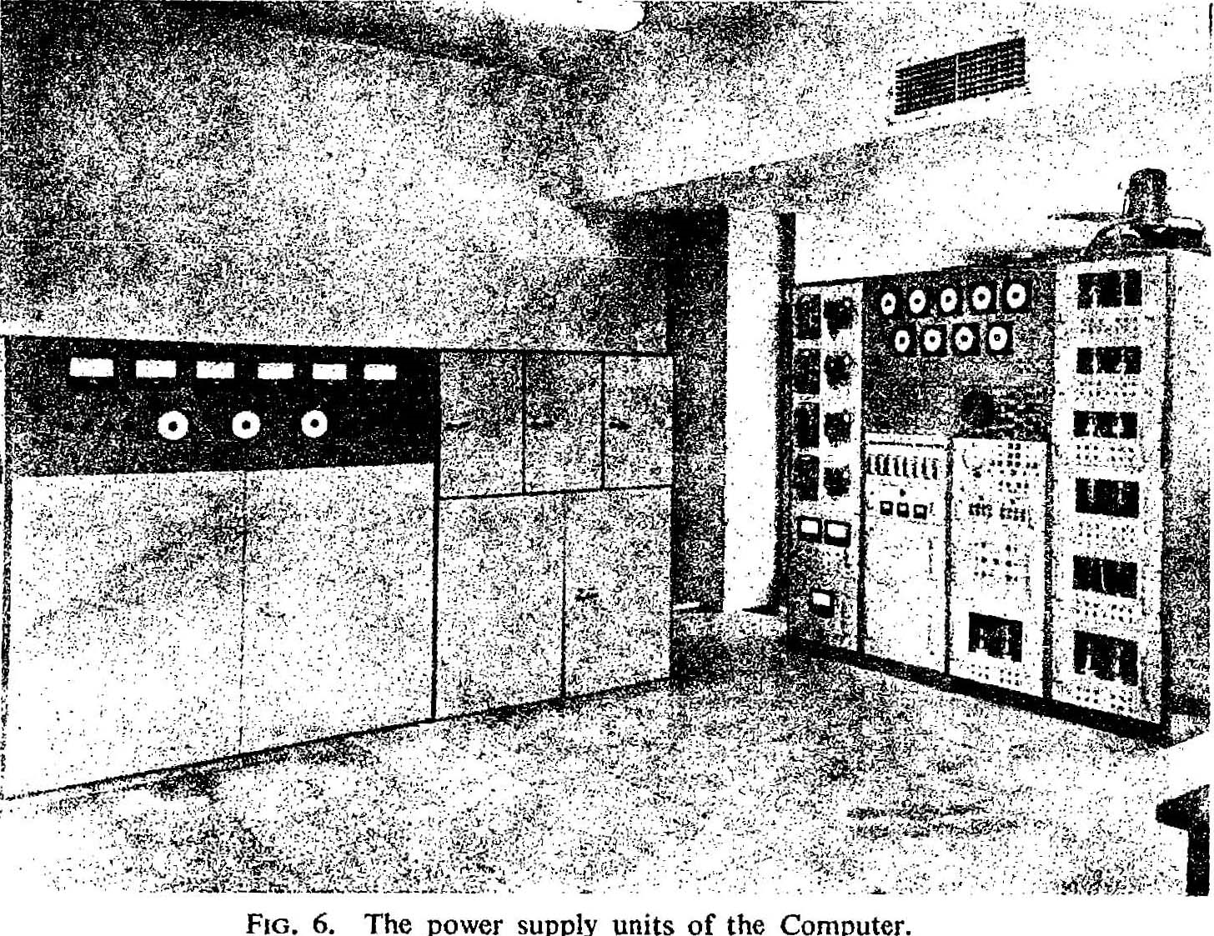

Slide 10
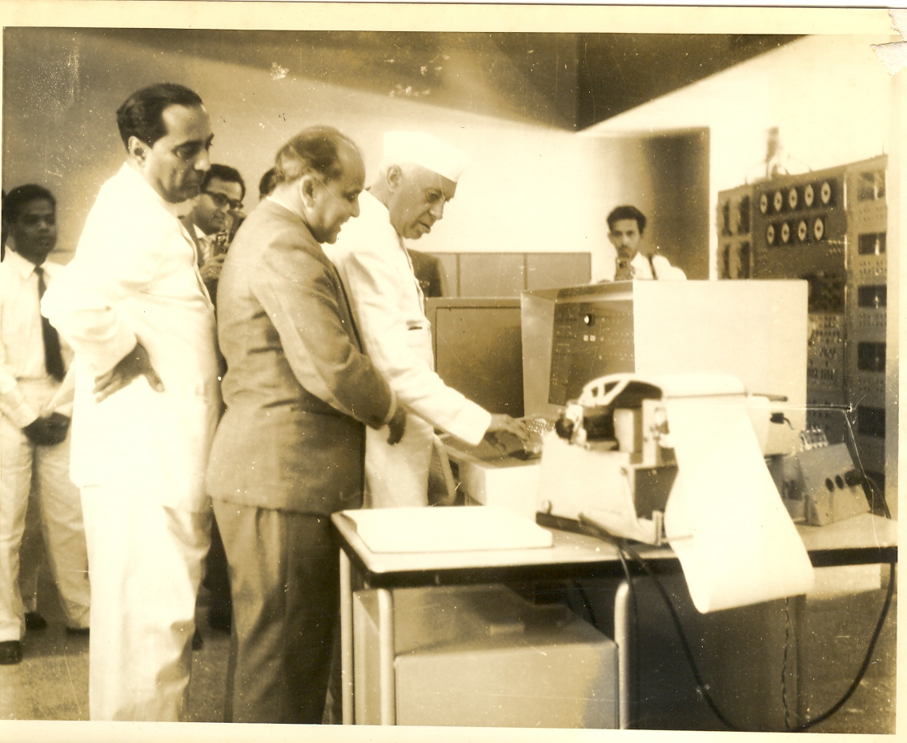

Slide 11
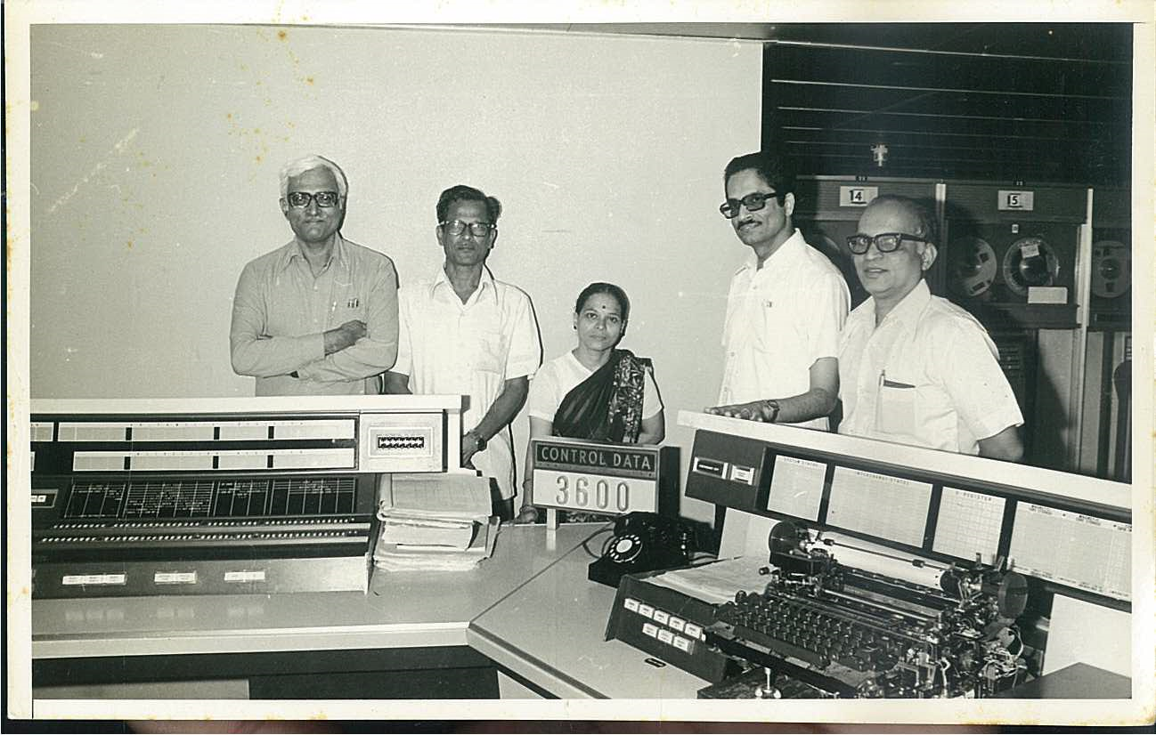

Slide 12
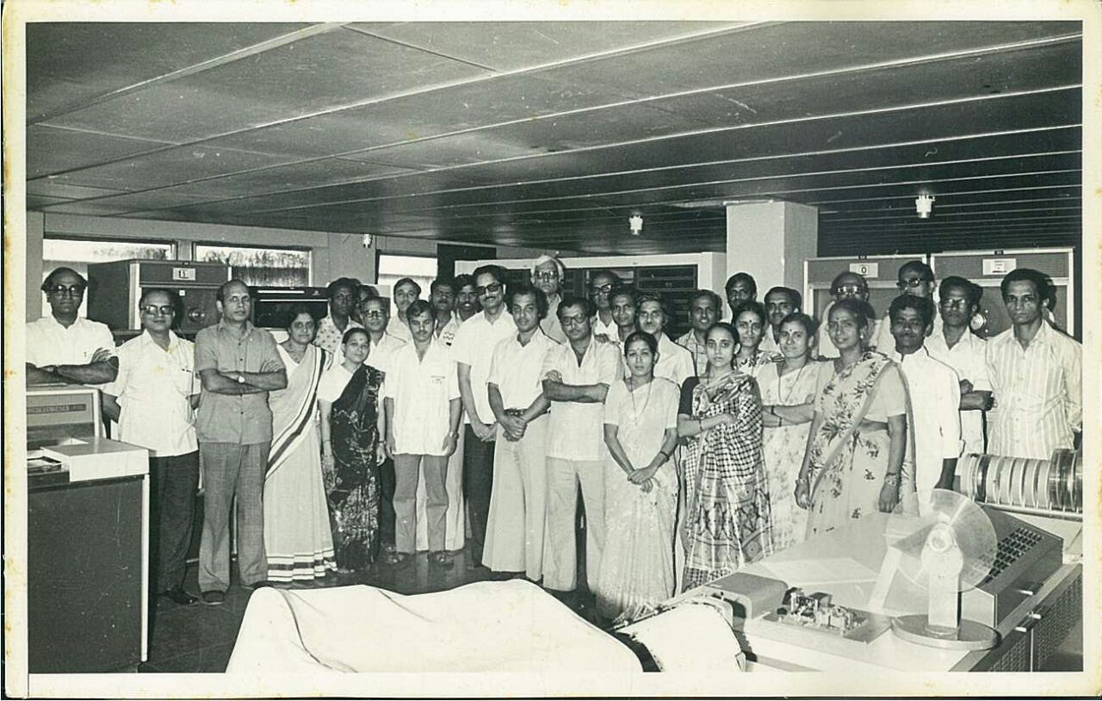

Slide 13
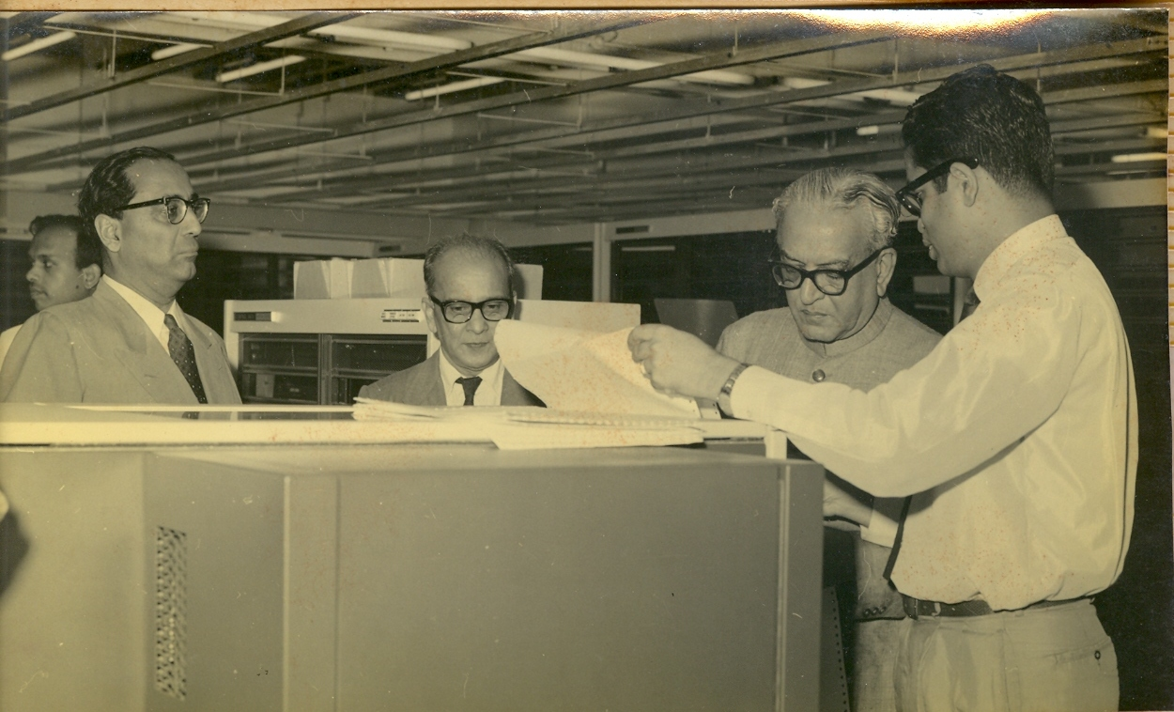

Slide 14
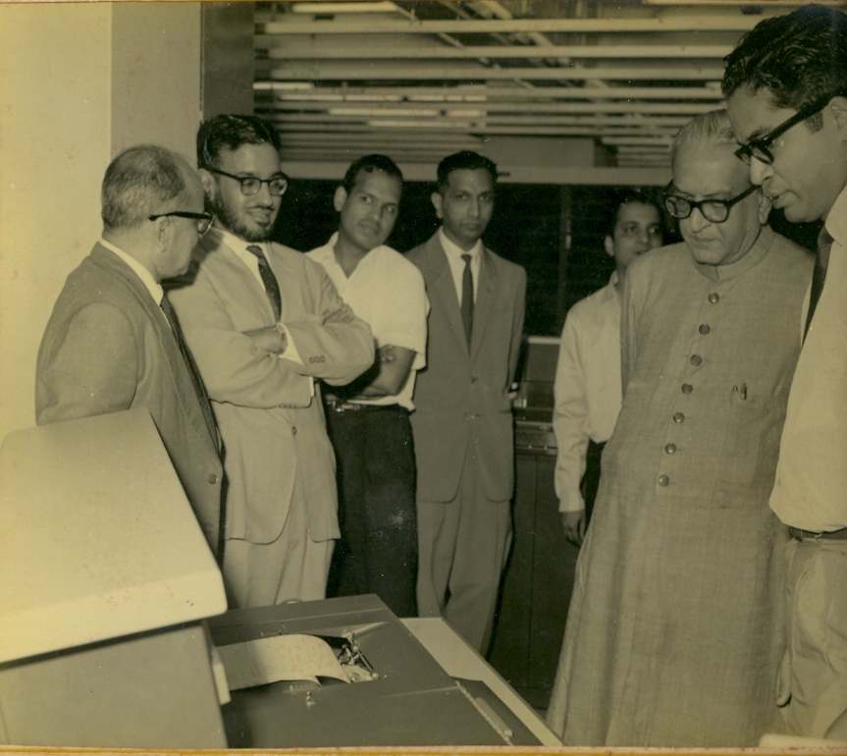

Slide 15
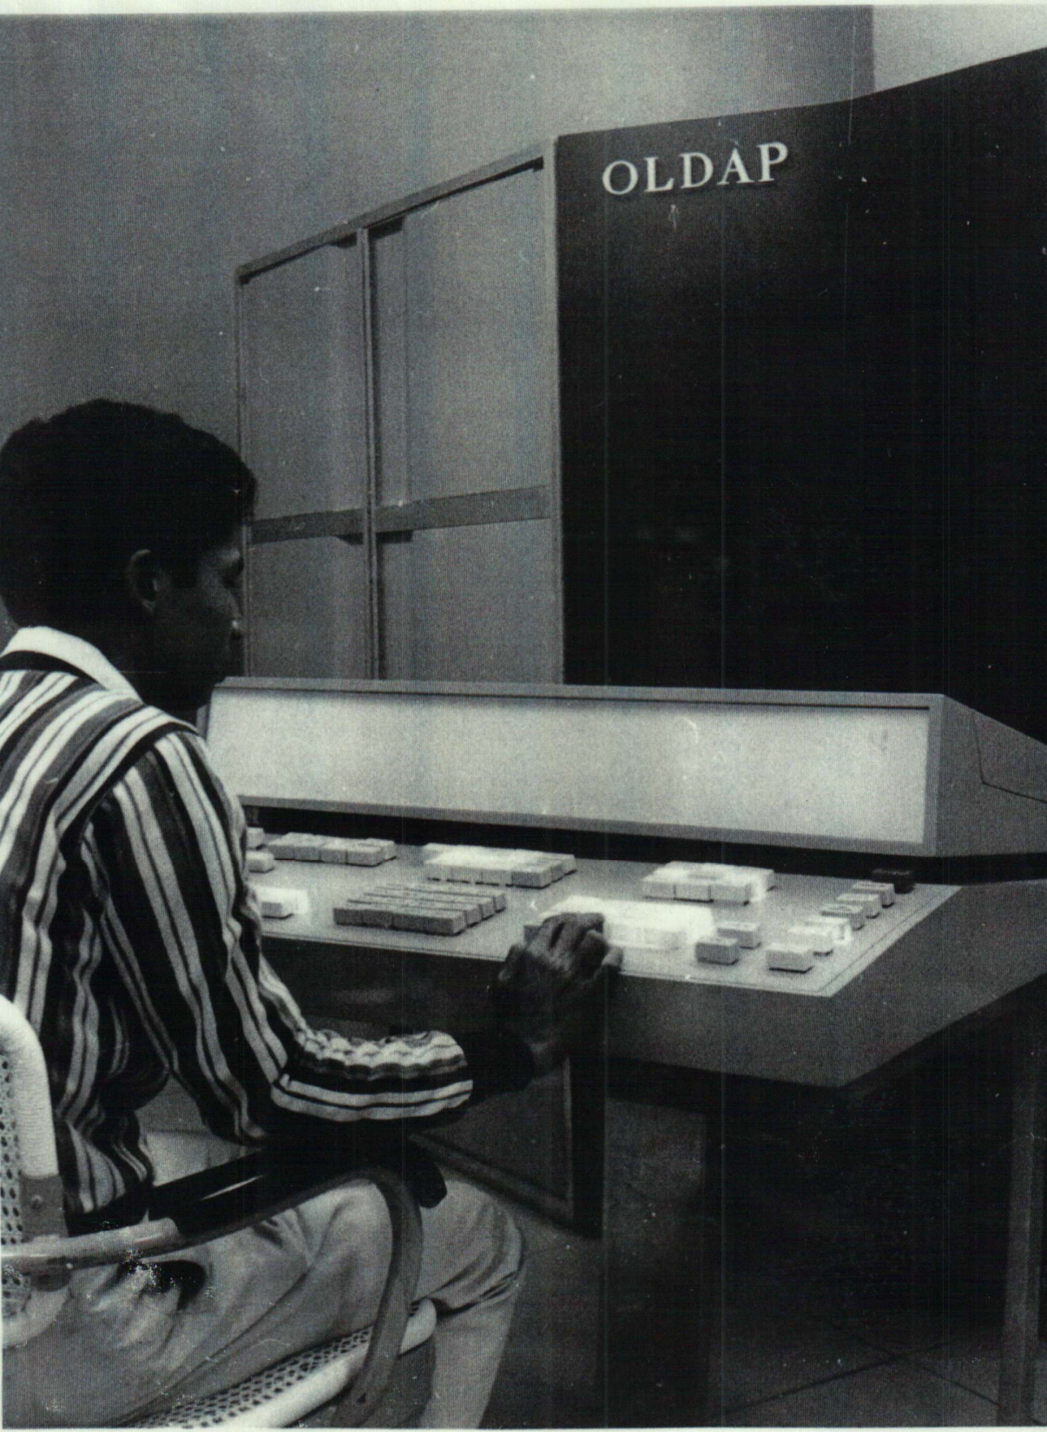

Slide 16
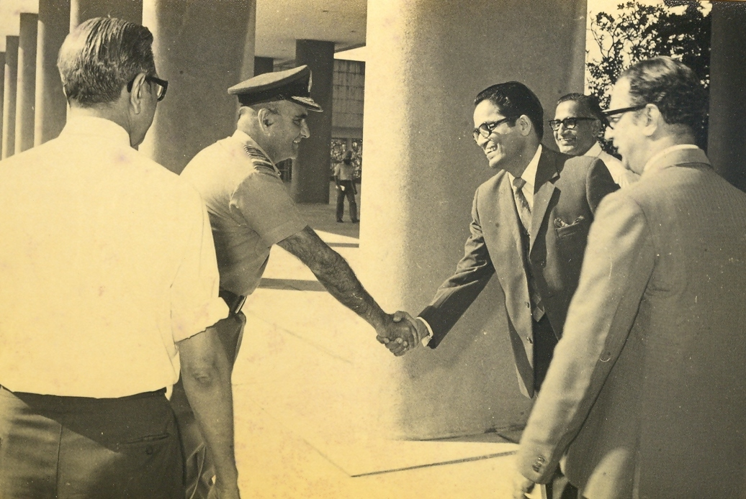

Slide 17
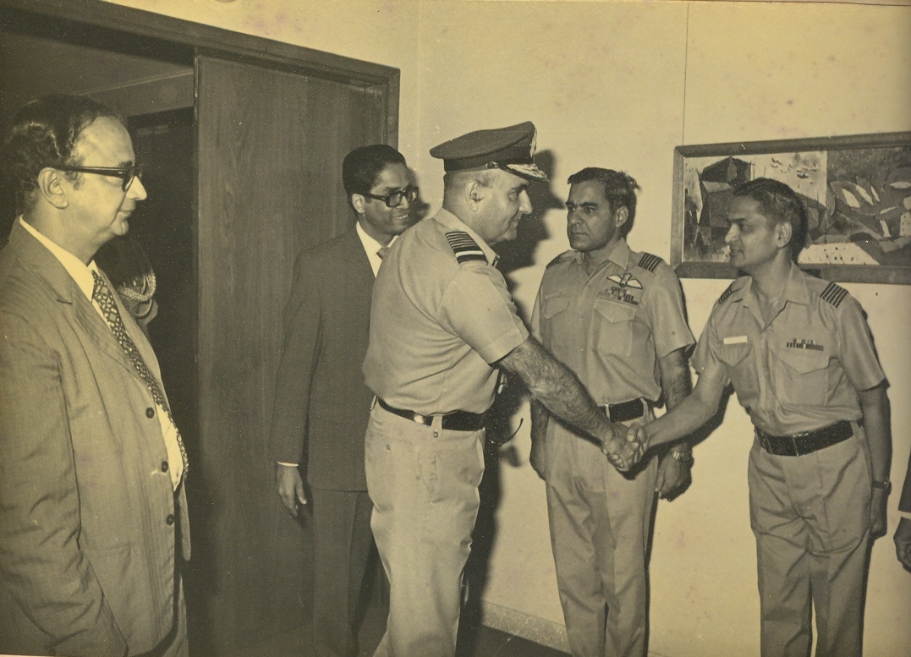

Slide 18
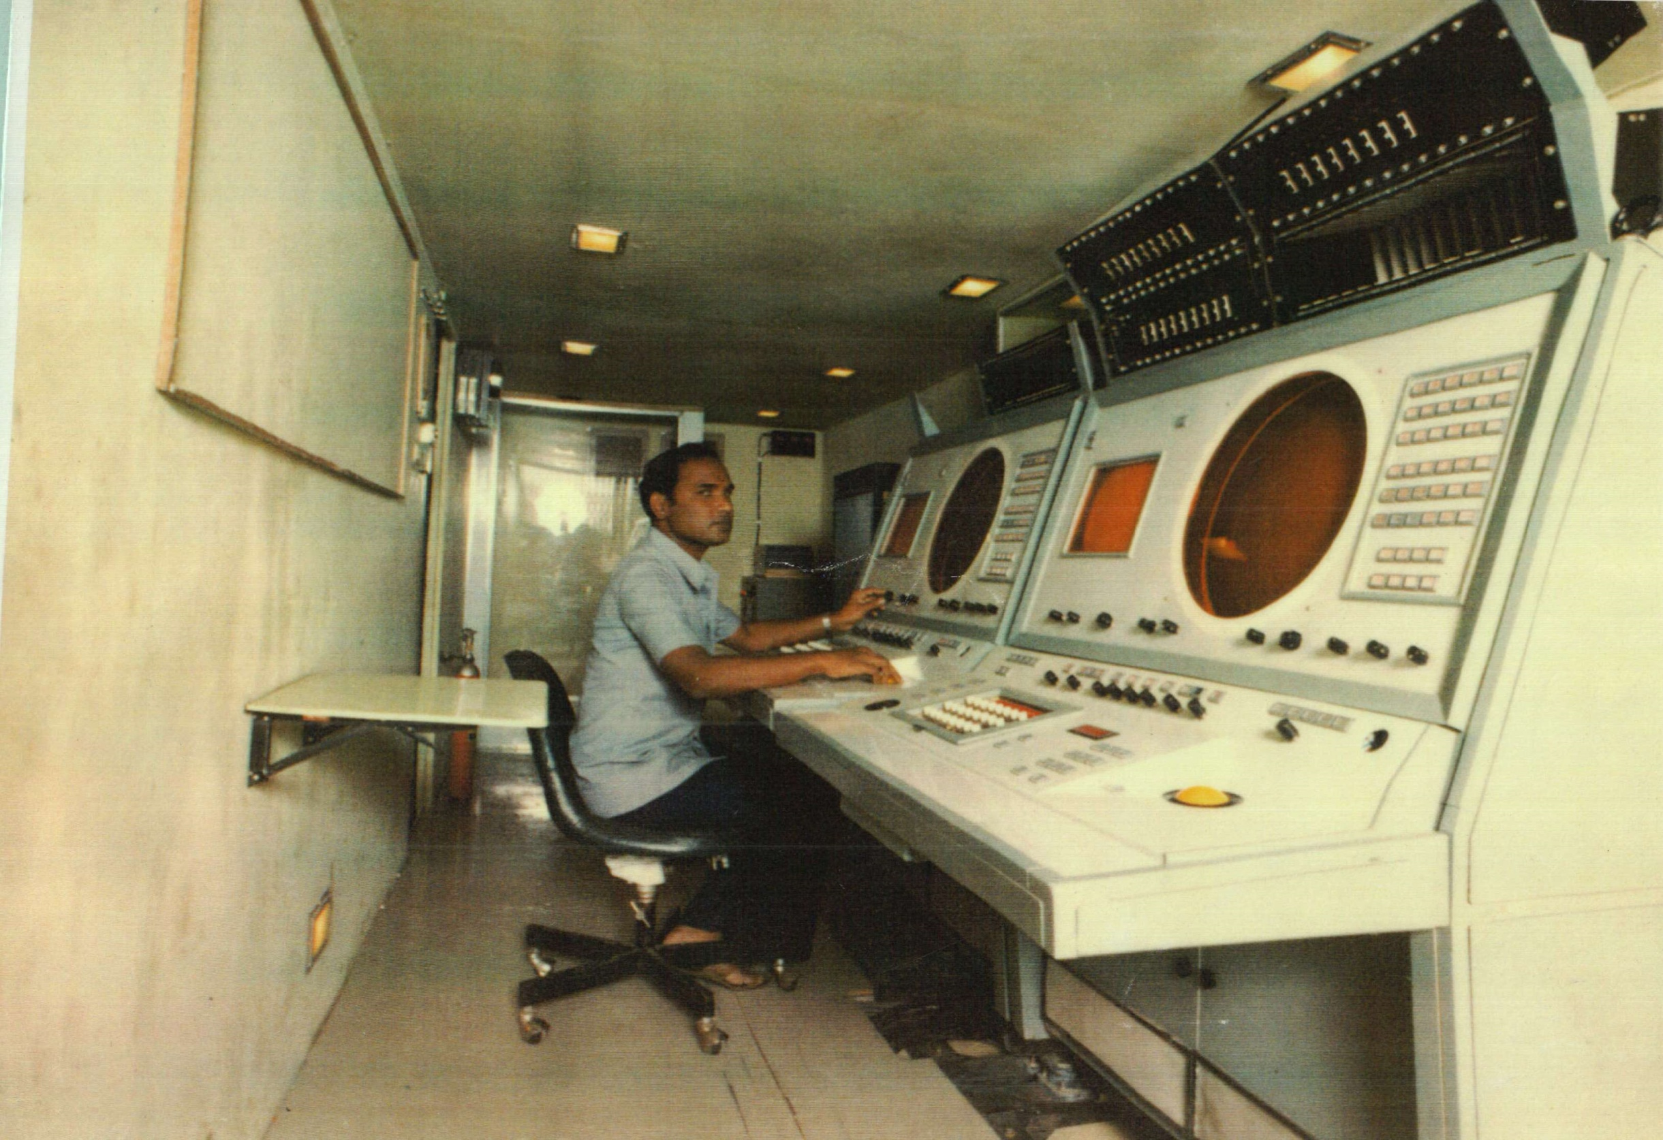

Slide 19
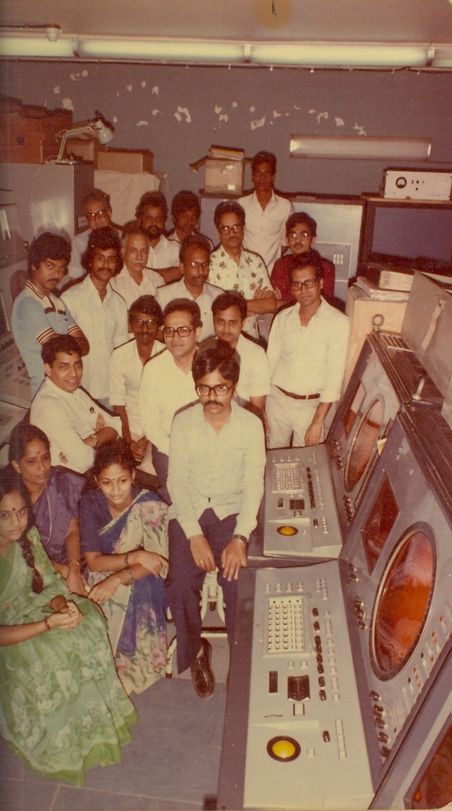

Slide 20
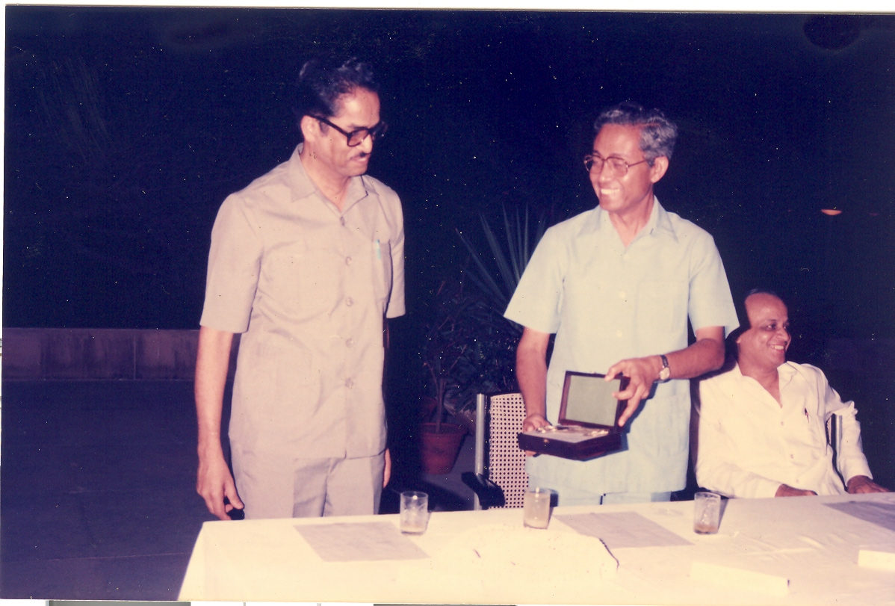

Slide 21
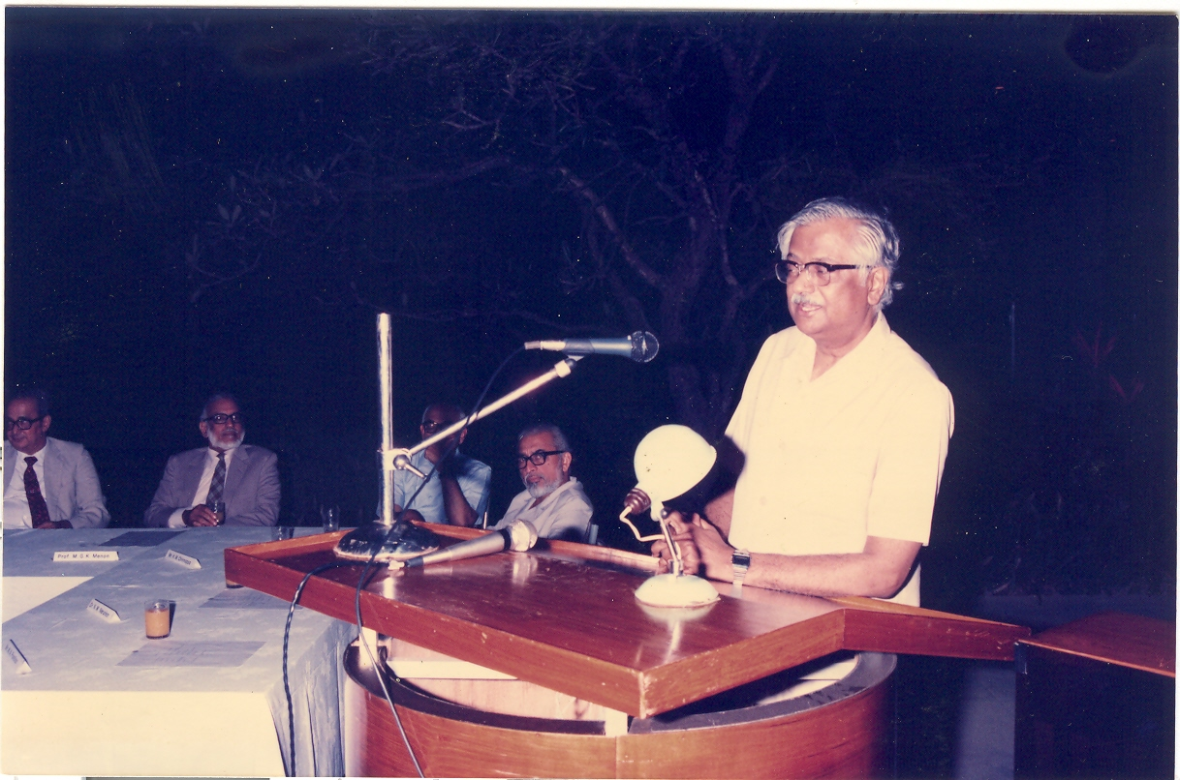

Slide 22
TIFRAC . First-Generation Computer men
with Self confidence, daring innovation
. National Computation Center (50 organisations)
. Computer Consciousness in Indian Academia,
Administration and Industry
UNDP Programs
CDC3600 - NCSDCT- NCST - CDAC
Speech technology - 5th Gen Computers
OLDAP TDC 12 (AEET, ECIL) TDC series of computers.
ADGES ECIL (Indian Air Force, Defence Readiness)
Entry of Private Sector (Tata’s) into Defence
AES CDOT, Rural automatic exchanges

Slide 23
FIRST GENERATION (Self-taught) COMPUTER BUILDERS
TIFRAC
R. Narasimhan (Overall),
B.K. Basu, P.V.S. Rao, T.R.N.Rao, M.M. Dosabbhai, and V.K Joglekar, (Arithmetic and Control),
S.P. Srivastava, R.N. Neogi and B.B. Kalia, (Memory),
K.L. Bhakhru (Input Output), D.S. Kamat (Magnetic Drum),
P.V.S. Rao and R.R. Nargundkar (text and graphics display)
M.M. Farooqui and D.F. Cooper (Power supply) and
K.S. Kane (Software),
OLDAP
P.V.S. Rao (Overall),
M.N. Cooper, R.N. Kaura (Hardware),
V.K. Jogkekar (Hard Ware and Software involving diagnostic routines, BASIC assembler, loaders),
S G Wagle (Simulator for OLDAP on CDC 3600),
J.G. Nemivant (Magnetic Drum, peripherals)
High Reliability Self-diagnosing Computer
P.V.S. Rao (Overall).
S. Sanyal (all aspects)
M. N. Cooper, S. S. Ukhalkar, R. Krishnamurti,
M. M. Paranjape, P. S. Khandge,
Xavier Furtado, S. Srikumar.

