Slide 1
Extreme events in optics: what can we learn to predict ocean rogue waves?
Günter Steinmeyer Max Born Institute, Berlin, Germany steinmey@mbi-berlin.de
ASET colloquium Tata Institute of Fundamental Research
March 8, 2019
Max-Born-Institute

Slide 2
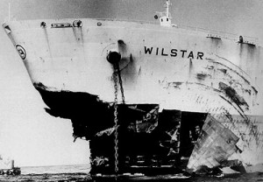
Outline
What actually is a rogue wave?
Can we measure the unexpectedness of rogue waves?
Can we predict RWs? Is it practical?
Can we measure the „freakyness“ of the ocean?
Maybe it‘s all very simple? Linear interference can explain it all!
S. Birkholz et al., PRL 114, 213901 (2015); Sci. Rep. 6, 35207 (2016).

Slide 3
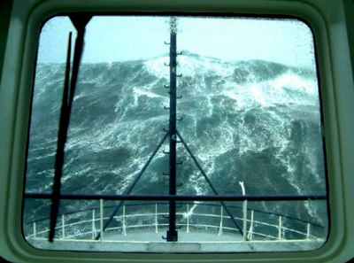
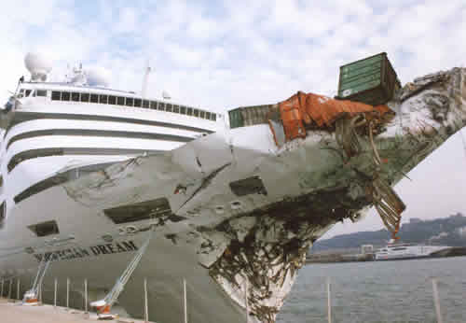
What Exactly is a Rogue Wave?
Criteria generally agreed upon:
Sparsity: rogue events are extremely rare
Extremeness: rogue events surpass any prediction derived from observation of previous events
Statistical unlikelihood: rogue waves defy regular Gaussian statistics
Unpredictability: rogue waves appear w/o warning and disappear w/o a trace
Difficult to quantify
Only criterion so far
New criterion
Rogue Waves – Towards a Unifying Concept? Eur. Phys. J. Special Topics 185 (2010).
Max-Born-Institute

Slide 4
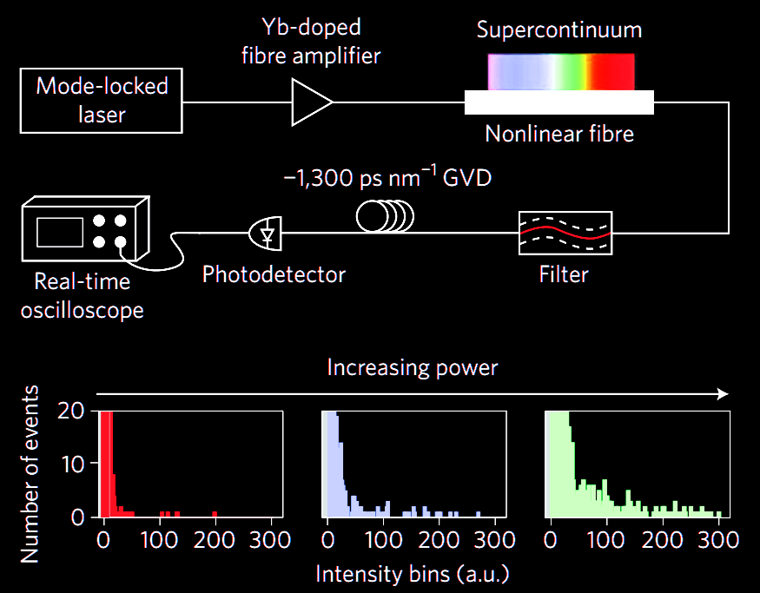
Optical Fiber Rogue Waves
Solli et al., Nature 450, 1054 (2007).

Slide 5
Is this a Rogue Wave?
J.H.E. Cartwright & H. Nakamura, What kind of a wave is Hokusai's Great wave off Kanagawa ? Notes Rec. R. Soc. 63, 119-135 (2009).

Slide 6
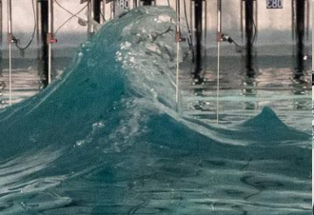
Rogue wave in wave tank experiment ?
J. Fluid Mech. 860, 767–786 (2019)

Slide 7
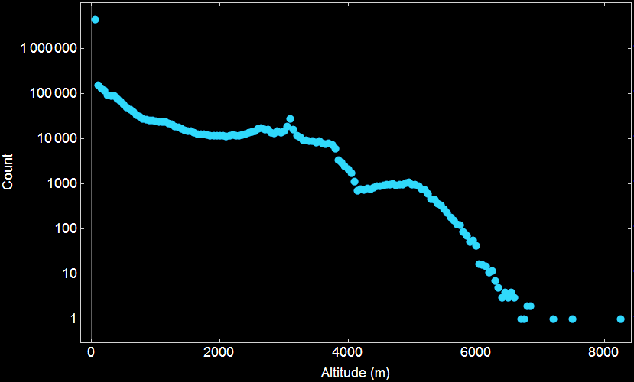
Are Mountains Actually Rogue Waves?
This is where rogue starts
This is where we are below the rogue threshold
Source: Geo Elevation Data Mathematica, Wolfram Research
Earth surface sampled at 0.1^{O} steps 6,400,000 data points

Slide 8
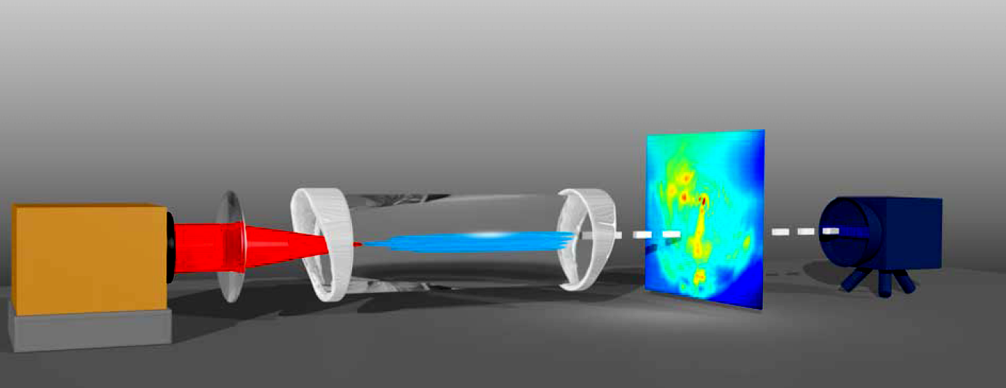
Multifilament Rogue Scenario
dynamic beam profile
f =0.75m
Ti:sapphire laser 1 kHz, 5 mJ, 40 fs
1 kHz linescan or 100 Hz 2D camera
xenon cell (2 bar)
Ref.: S. Birkholz et al., Phys. Rev. Lett. 111, 243903 (2013)

Slide 9
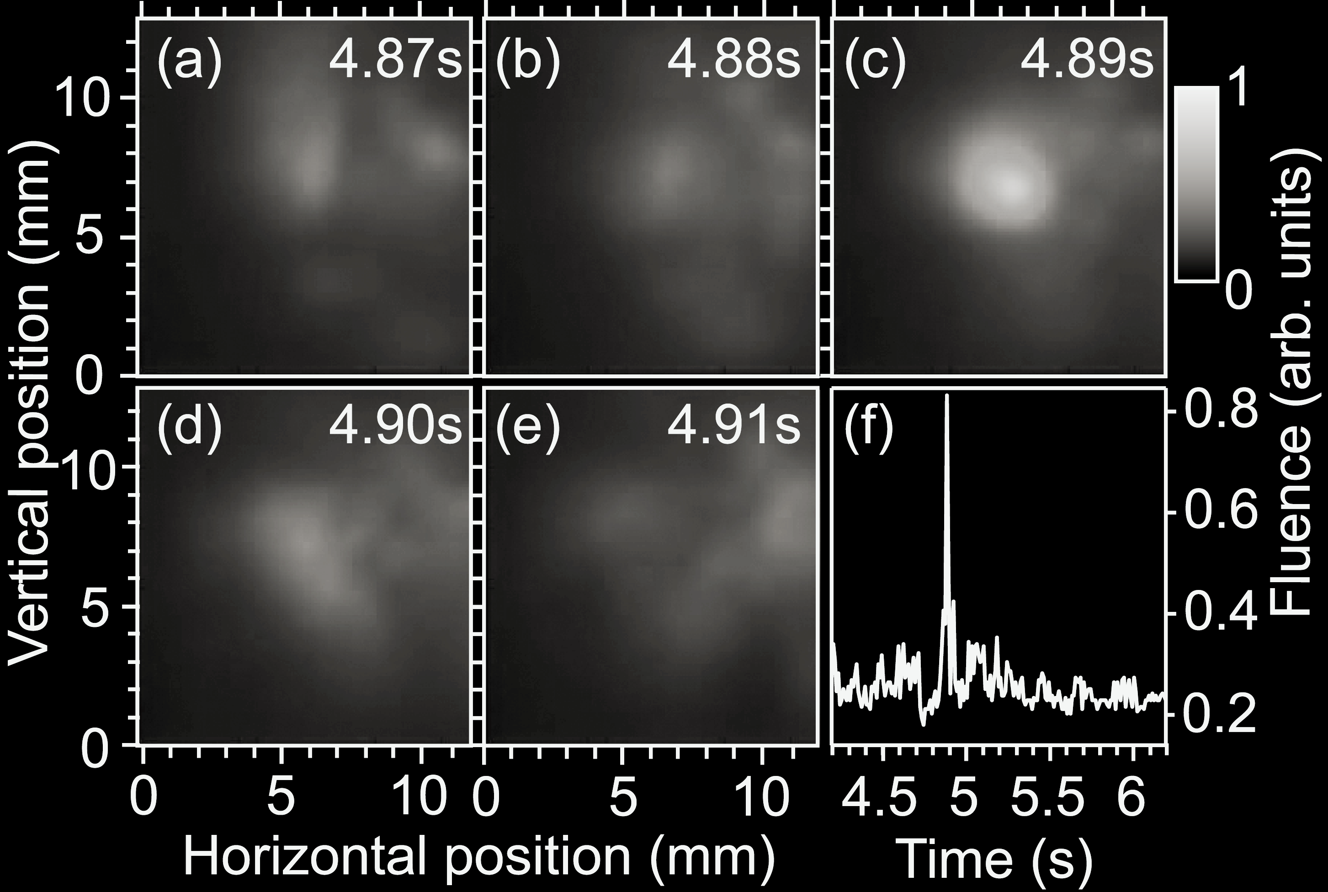
Spatio-temporal isolation
Ref.: S. Birkholz et al., Phys. Rev. Lett. 111, 243903 (2013)

Slide 10
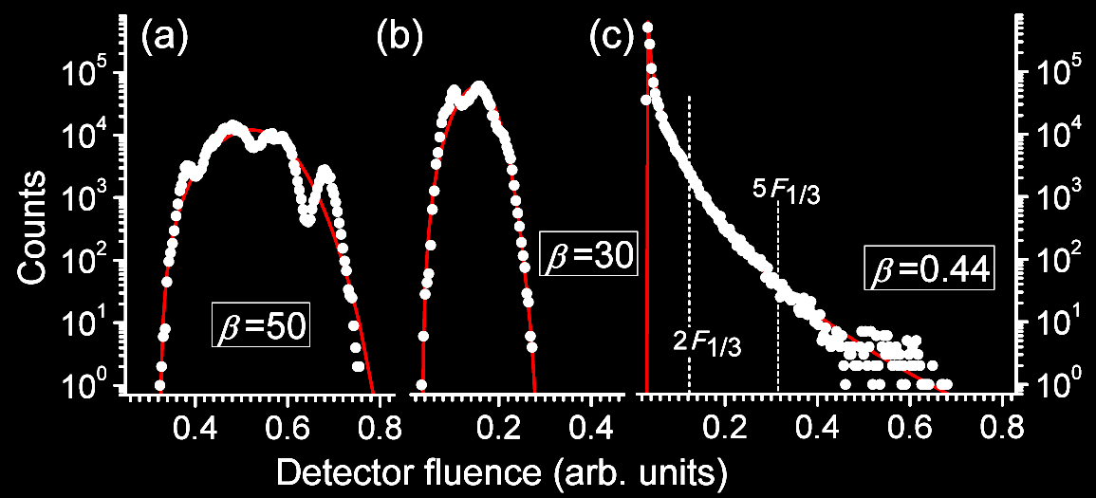
Statistical Analysis
Single Filament
Multi Filament
Laser
Events at 10x significant wave height F1/3
Ref.: S. Birkholz et al., Phys. Rev. Lett. 111, 243903 (2013)
W. Weibull, J. Appl. Mech.-Trans. 18, (1951)

Slide 11
Nonlinear time series analysis
Linear statistical description:
Average, Variance, Histogram, Spectrum etc.
Nonlinear statistical description:
Phase space dimension D (number of interfering oscillators)
Kolmogorov entropy K (information loss per time)
P. Grassberger and I. Procaccia, Phys. Rev. Lett. 50, 346 (1983).

Slide 12
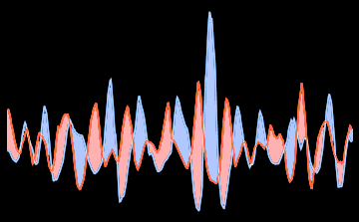
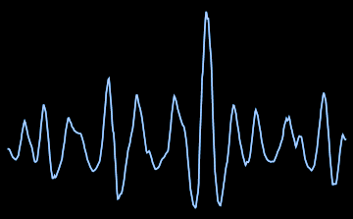
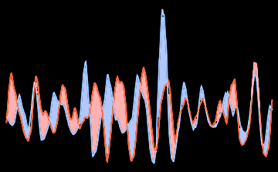
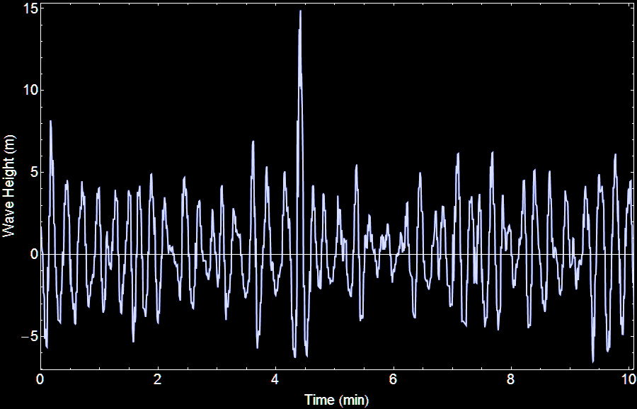
Predictability of rogue events
P. Grassberger and I. Procaccia, Phys. Rev. Lett. 50, 346 (1983).
1. Select segment S_{i,i+L}
2. Compute ||S_{i,i+L}-S_{j,j+L}||² for all i,j

Slide 13
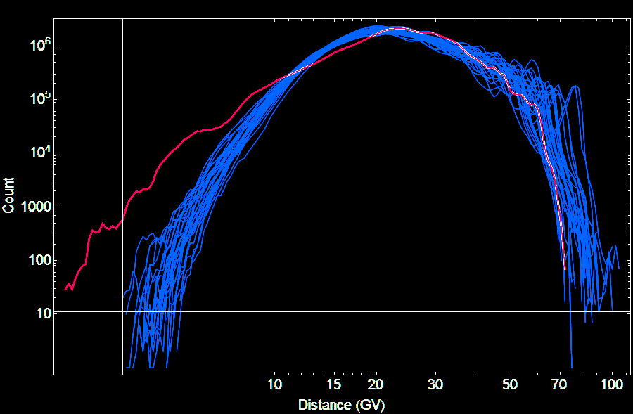
Histogram representation
most segments are fairly dissimilar
But then there are some “déjà vus“
Counts
||S_{i,i+L}-S_{j,j+L}||²
S. Birkholz et al., PRL 114, 213901 (2015).

Slide 14
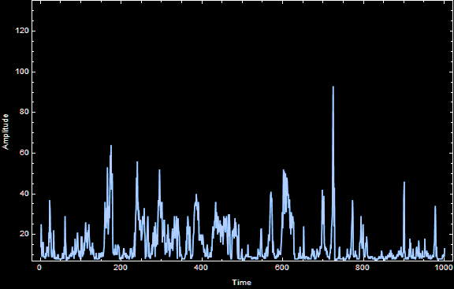
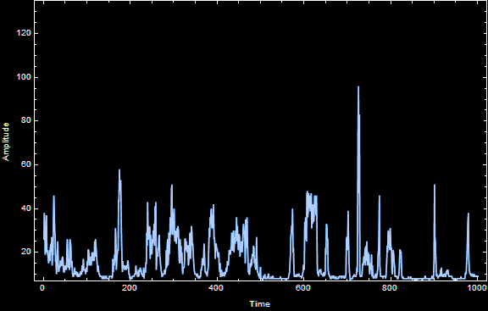
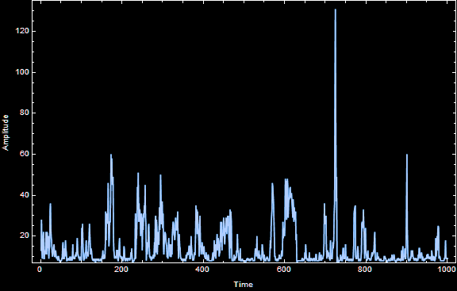
Surrogates
Maintain histogram
Maintain spectrum
Conserve linear correlation function
Use „true“ random numbers
Amplitude
Time
Refs.: D. Prichard & J. Theiler PRL 73, 951 (1994). T. Schreiber & A. Schmitz PRL 77, 635 (1996) True random numbers from www.random.org

Slide 15
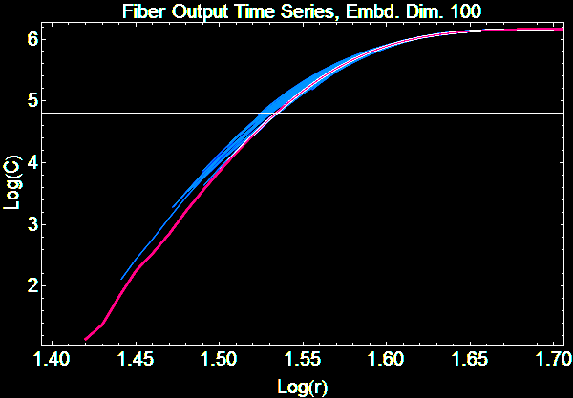
Analysis for fiber Rogue waves
1 µs segment length
Fiber rogue waves really come out of nowhere and they leave without a trace
Original data more random than surrogates Positively no determinism !!!
Original data courtesy D. Solli, UCLA D. Solli et al., Nature 450, 1054 (2007)

Slide 16
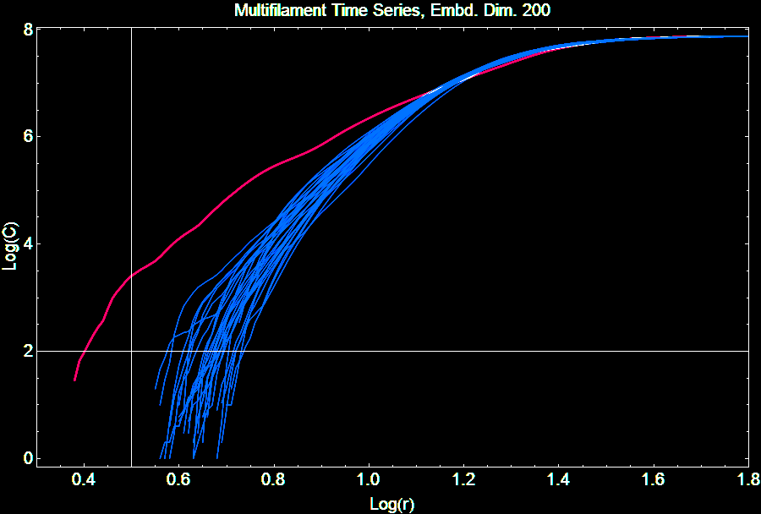
Determinism of multifilament data
original
surrogates
several thousand “déjà vus“ in the original
200 ms segment length = 15x lin. correlation time

Slide 17
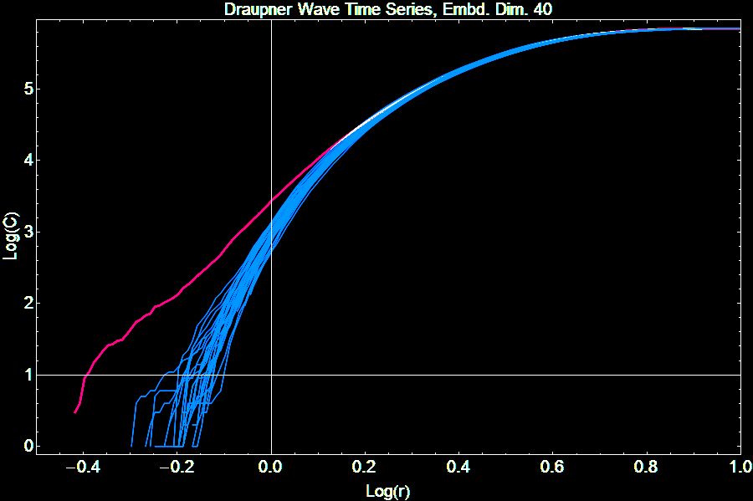
Analysis for original Draupner event
Data is clearly deterministic !
20s segment length
Original data of Draupner event courtesy M. Olagnon IFREMER, Brest, France and Statoil ASA, Norway

Slide 18
Predictability and Determinism
Expectedness and rogue character of a large wave are completely independent from each other
NLSE rules all three systems
NLSE only conveys input conditions in a deterministic fashion
If input is ruled by QM fluctuations output is stochastic, no prediction possible
There are at least two different types of rogue waves in nature
One cannot draw safe conclusions from one type to the other

Slide 19
Unravelling ocean phase space dynamics
Textbook Equation: Linear superposition of random periodic waves is a natural representation of sea waves:
N amplitudes h_{j} and N phases ϕ_{j}
For constant ampl. Resulting phase space dimension D=N
How many N ?
Kharif, Pelinovsky, Slunyaev, Rogue Waves in the Ocean, Eq. (2.79)

Slide 20
Can you guess phase space dimension?
D=1
D=2
D=5
D=10
D=100

Slide 21
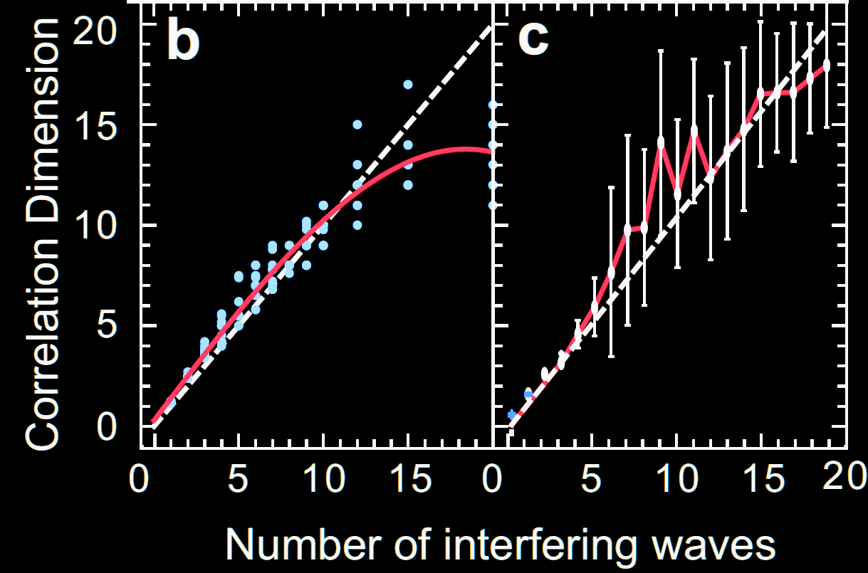
Phase space dimension estimation w/ GPA
D
„classic“
simulated 20 minute Draupner-like records
statistical evaluation
N
P. Grassberger and I. Procaccia, Phys. Rev. Lett. 50, 346 (1983).

Slide 22
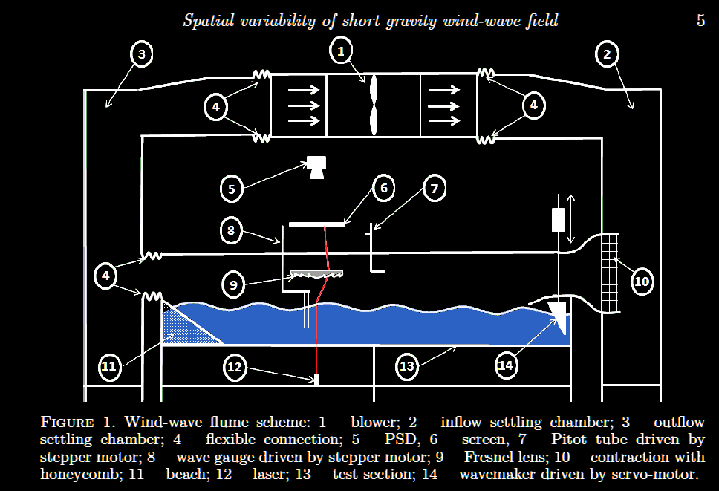
Application to wind wave tank data
Ref.: Andrey Zavadsky, Alvise Benetazzo, and Lev Shemer, „Spatial variability of short gravity wind-wave field,” Phys. Fluids 29, 016601 (2017)

Slide 23
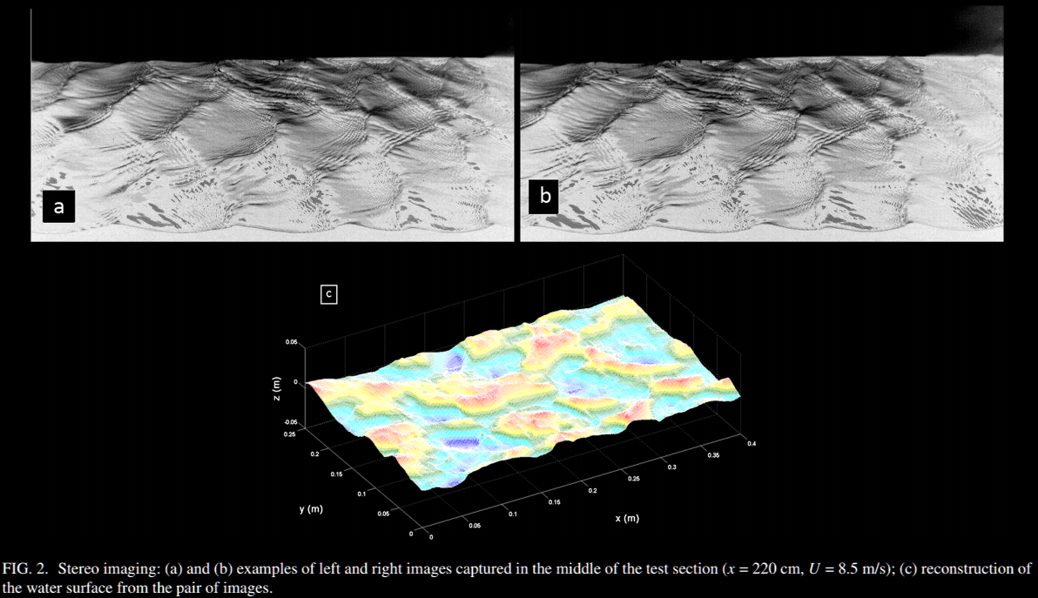
Stereoscopic measurements
25 cm channel width
Ref.: Andrey Zavadsky, Alvise Benetazzo, and Lev Shemer, „Spatial variability of short gravity wind-wave field,” Phys. Fluids 29, 016601 (2017)

Slide 24
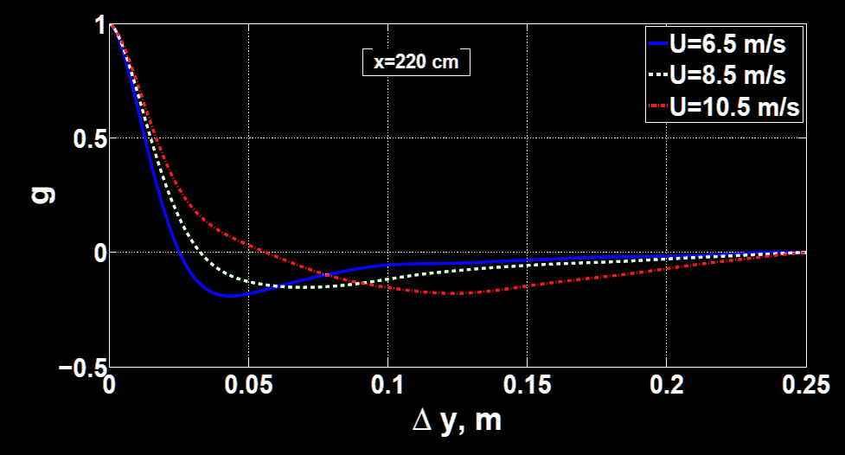
How many independent parallel waves?
autocovariance
maybe 5 – 8 „independent“ waves ?
25 cm channel width
Ref.: Andrey Zavadsky, Alvise Benetazzo, and Lev Shemer, „Spatial variability of short gravity wind-wave field,” Phys. Fluids 29, 016601 (2017)

Slide 25
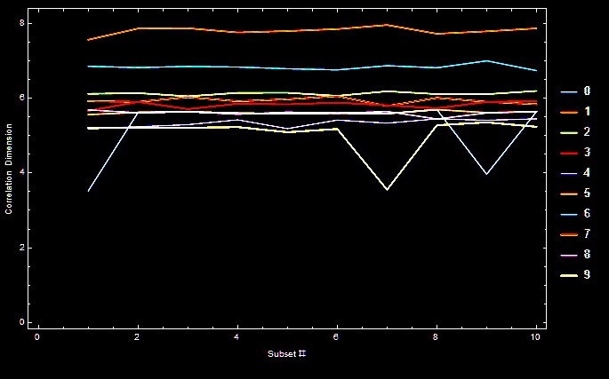
GPA analysis for wave gauge data
D=5-8
Data courtesy Lev Shemer, Tel Aviv University Analysis by GS

Slide 26
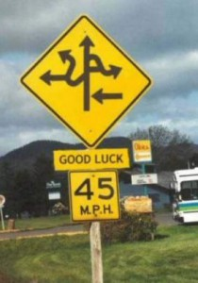
Is the dynamics getting more or less complex with increasing wind strength?

Slide 27
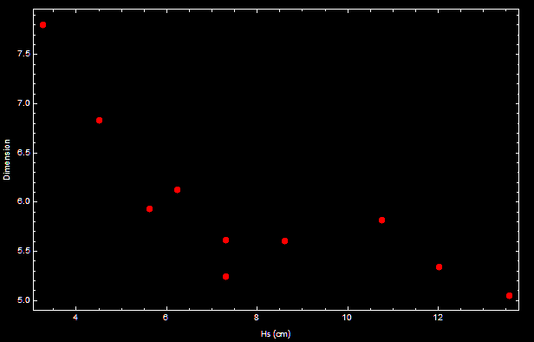
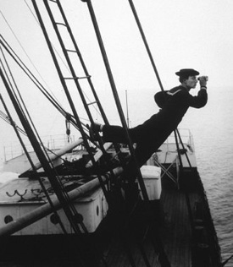
Dimension vs. significant wave height
gentle breeze heavy storm
Dynamics get less complex with stronger winds??

Slide 28
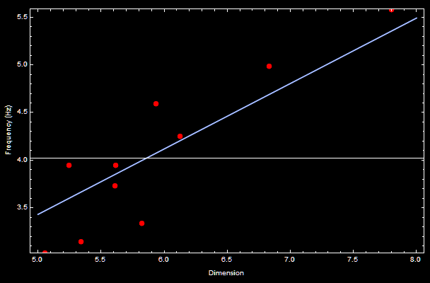
Frequency vs. dimension
Wavelength increases with wave height! More „independent“ waves fit into the tank for small H_{s}

Slide 29
Back to the real world…
The wave channel is clearly a finite system.
If phase space dimension can already be 8 in the tank, what will it be like on the ocean?
10 100 1000 ∞
√

Slide 30
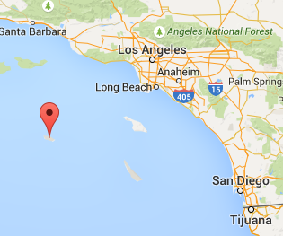
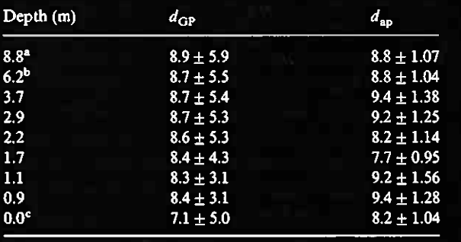
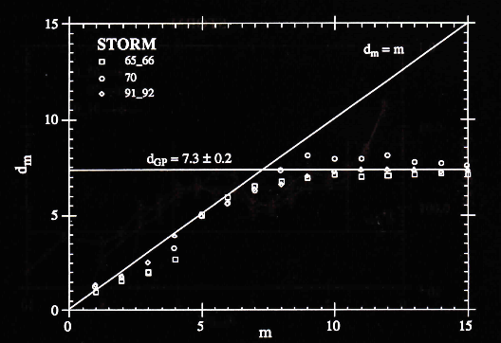
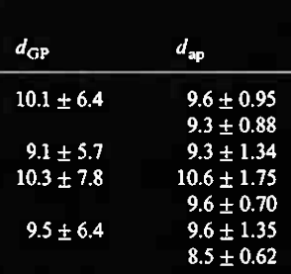
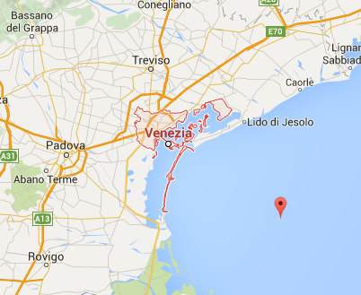
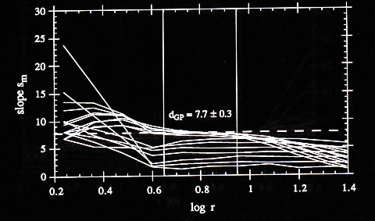
Previous application of GPA to ocean waves
S. Elgar and G. Mayer-Kress, Physica D 37, 104 (1989)
L. Bergamasco, M. Serio, A.R. Osborne, and L. Cavaleri, Fractals 3, 55-78 (1995).
St. Nicholas Island 110m water depth
20 km off Venice 16m water depth

Slide 31
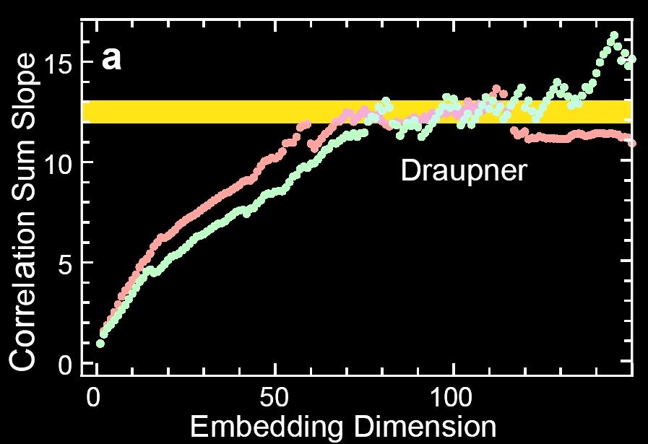
Evaluation of the Draupner event
(two data sets from same storm only one containing rogue event)
The Draupner event appeared due to at least 12 interfering elementary waves!

Slide 32
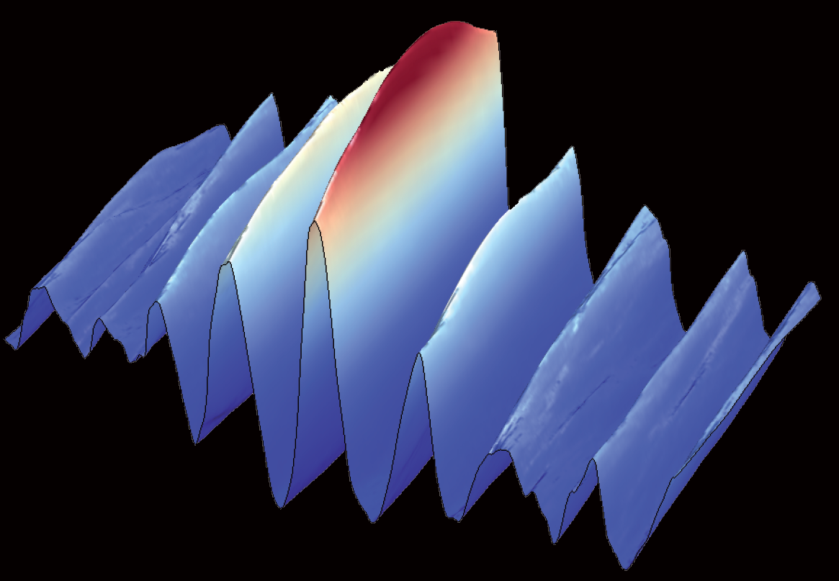
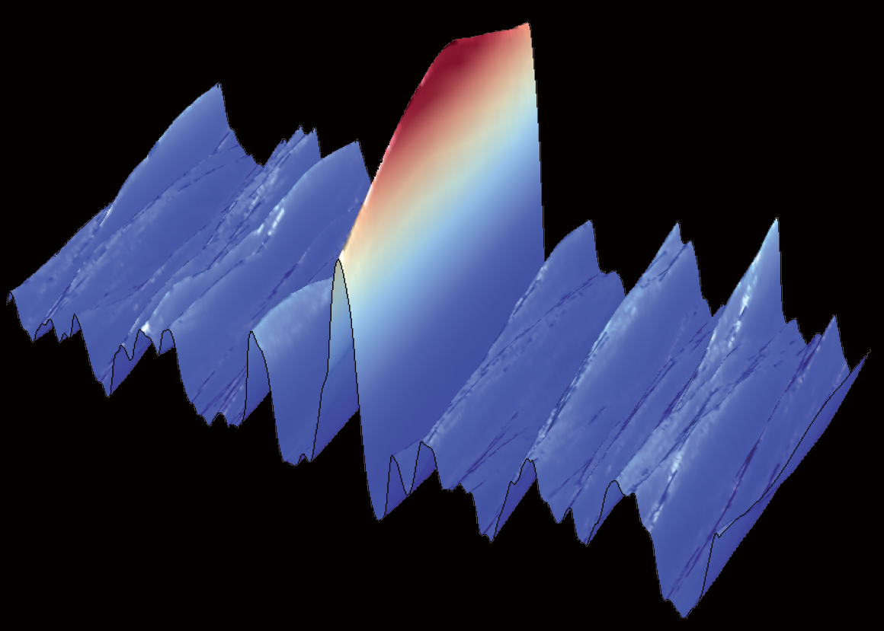
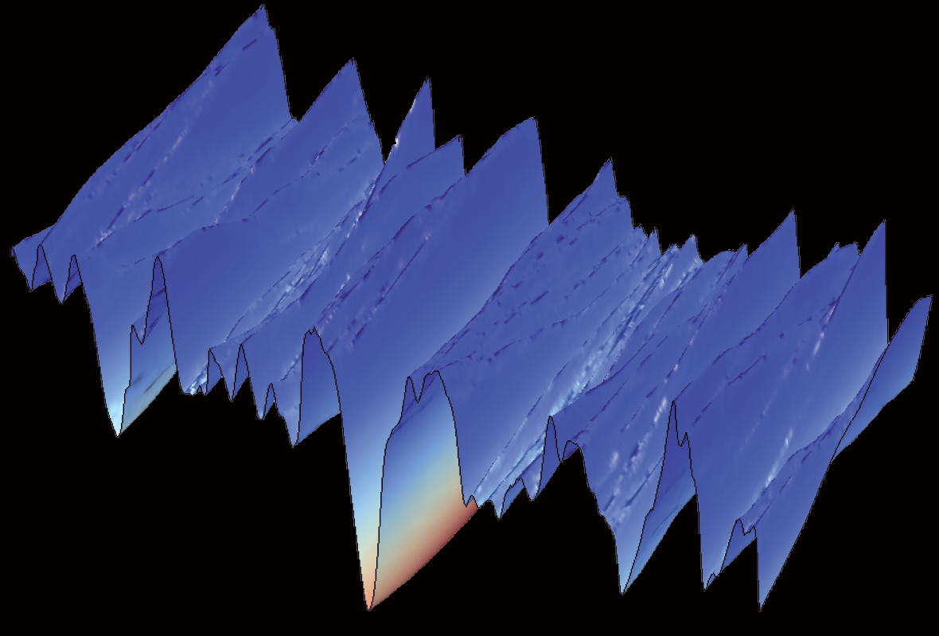
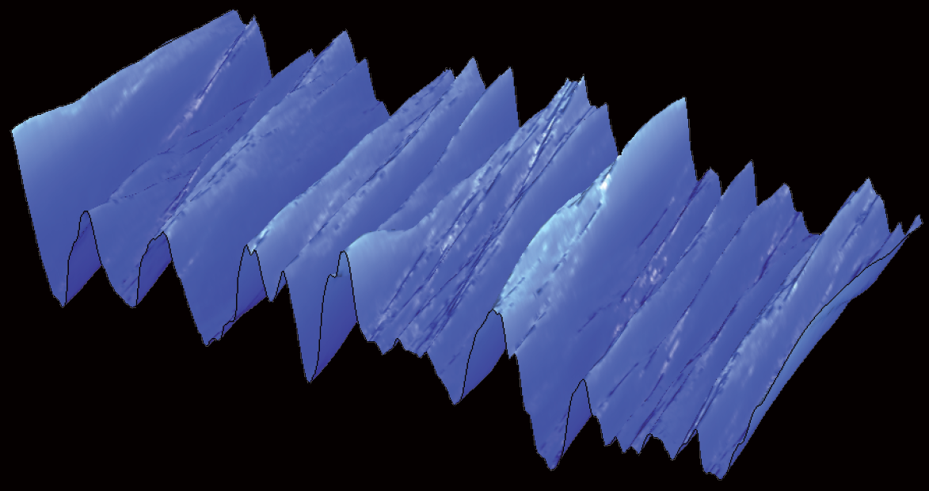
Prototypical rogue situations
The „Three sisters“ S.S. Rozhkov. Euro. Phys. Lett. 85, 24001 (2009).
Simulation of the Draupner event
Normal ocean state, random phases
The “rogue hole” P. Stansell. Ocean Engin. 32, 1015-1036 (2005).

Slide 33
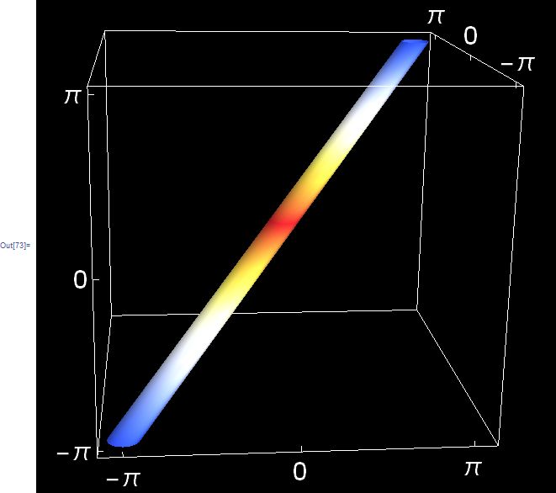
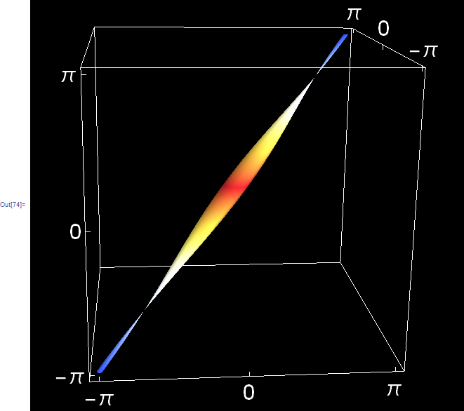
Rogue island
Rogue island: cylindrical region around the diagonal of a 12-dimensional hypercube

Slide 34
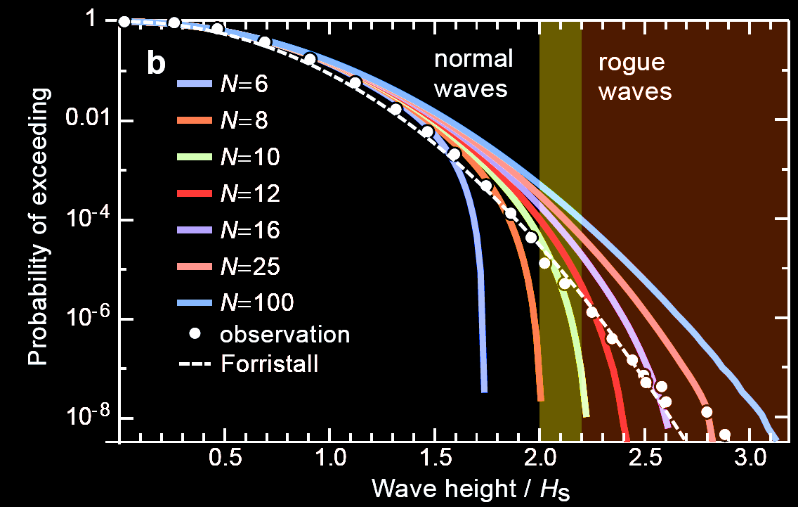
Mapping out rogue island
Ref. data from: M. Christou and K. Ewans. Proc. ASME 2011 30th Int. Conf. Ocean Oshore Arctic Engin. (OMAE2011) Credits: http://www.datathief.org/

Slide 35
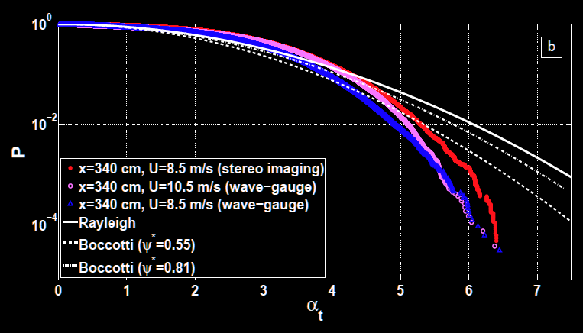
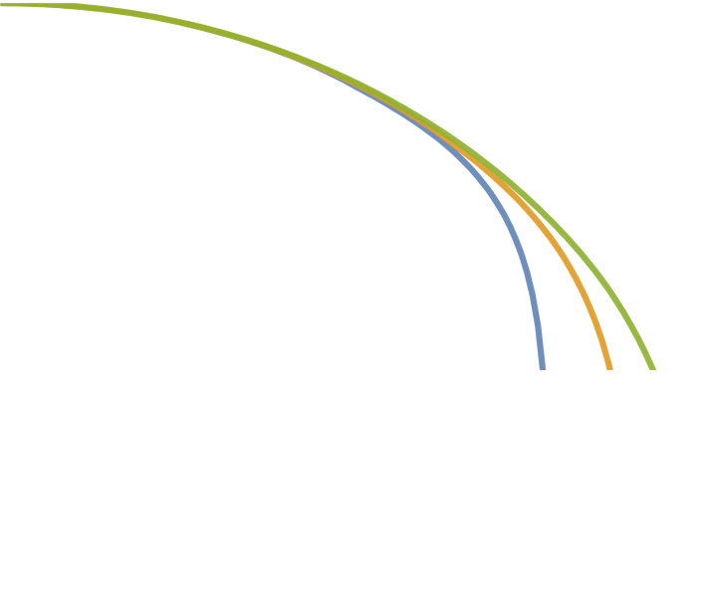
Wave tank experiments
N=8
N=6
N=10
Ref.: Andrey Zavadsky, Alvise Benetazzo, and Lev Shemer, „Spatial variability of short gravity wind-wave field,” Phys. Fluids 29, 016601 (2017)

Slide 36
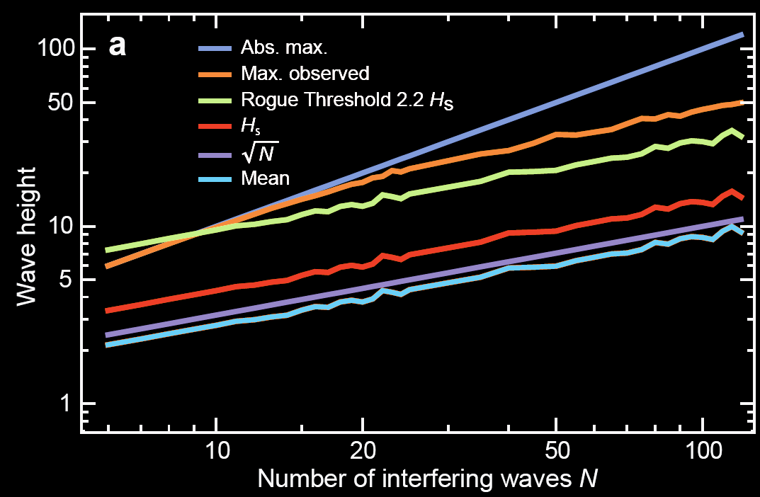
Rogue waves can only appear for N>10
only linear interference considered

Slide 37
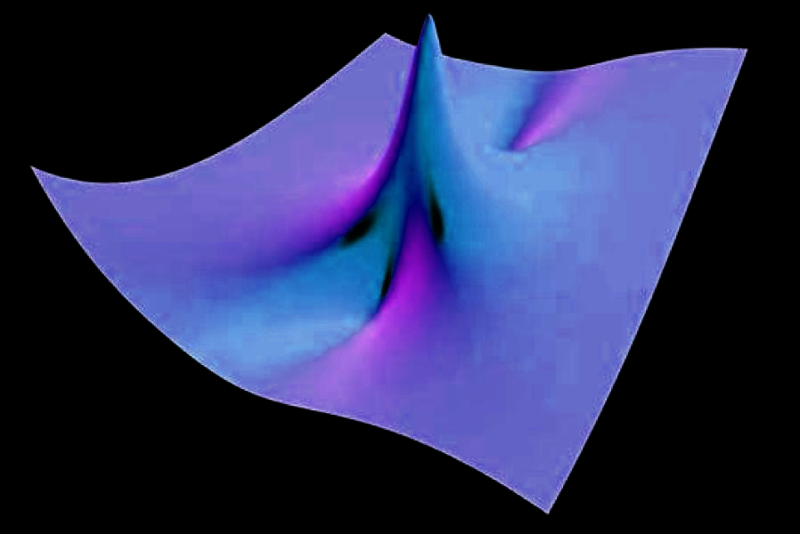
Myth busting…

Slide 38
What speaks against a nonlinear origin?
NLSE is an envelope equation, the SVEA must hold!
Measured examples from Kharif, Pelinovsky, Slunyaev, Rogue Waves in the Ocean

Slide 39
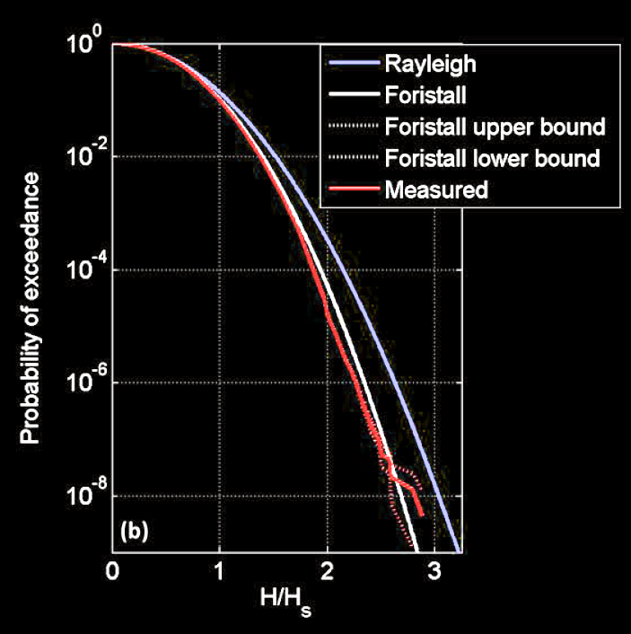
What speaks against a nonlinear origin?
Dimensionality of the problem:
The ocean is two-dimensional.
2D solitons are unstable.
Nonlinearities will further lift the heavy tail.
We need the opposite to explain observations…

Slide 40
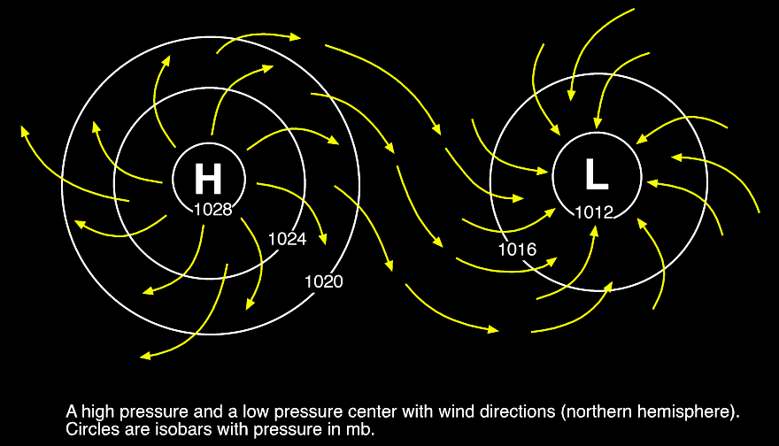
The answer is blowing in the wind…
defocusing conditions reduced N
focusing conditions increased N

Slide 41
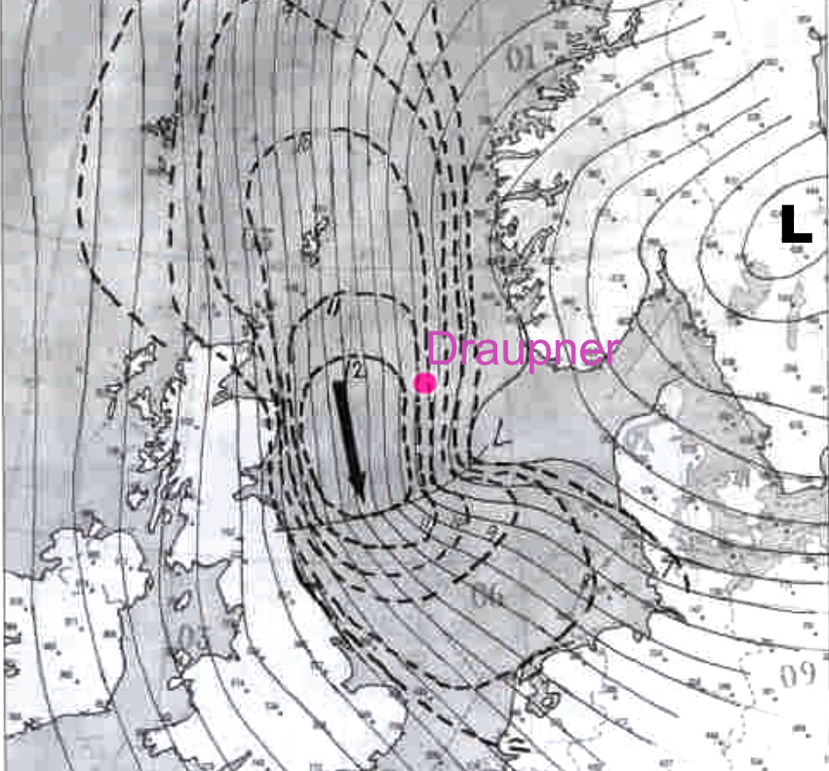
Weather situation on Jan. 1, 1995, 12 UTC
(Draupner wave occurred at 14:20 UTC, i.e., 2 hours later)
extremely convex isobars together with strong winds
Sverre Haver, A Possible Freak Wave Event Measured at the Draupner Jacket January 1 1995, Proc. Rogue Waves, IFREMER, Brest, 2004

Slide 42
Conclusions
Ocean rogue waves are perfectly explainable by linear interference
Weak role of ocean nonlinearities, but necessary to explain rogue hole anomaly
We are having a stochastic problem here; we are not trying to solve a PDE!
GPA for measuring dimension of phase space
Meteorological warning seems absolutely feasible; rogue waves don‘t come out of nowhere!

Slide 43
http://www.dottysdoodles.com/rogue-wave/

