Slide 1
Belle II SVD L4 Ladder Assembly
Kameswara Rao
Dept of High Energy Physics
28th March 2016

Slide 2
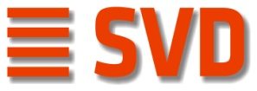
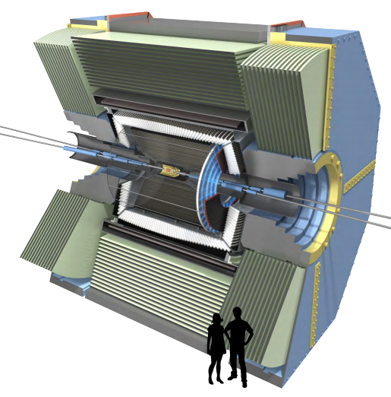
Belle II Vertex Detector (VXD)
Determine the vertex position of the weakly
decaying particles
Measure the two-dimensional track position
and momentum for charged particles
PiXel Detector (PXD)
Silicon Vertex Detector (SVD)
Double-sided silicon strip detectors (DSSDs)
SVD
VXD requirements
Fast – to operate in high rate environment
Excellent spatial resolution
Radiation hard (up to 100 kGray)
Good tracking capability – to track particles
down to 50 MeV in p_{T}
PXD

Slide 3
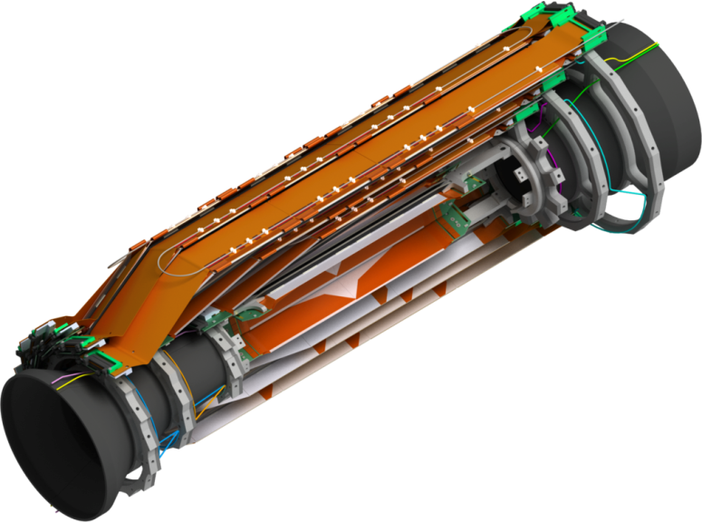
SVD Structure Overview
SVD cut model
Layer | Institute
3 | University of Melbourne
4 | TIFR Mumbai
5 | HEPHY Vienna
6 | IPMU University of Tokyo
FW & BW | INFN Pisa
~650mm
Backward
Angular acceptance 17⁰<θ<150⁰
Forward
4 SVD layers (L3 to L6) composed of ladders arranged in a windmill structure
Improved resolution at IP w.r.t Belle I
Very lightweight – only 0.58%X₀ per layer
3

Slide 4
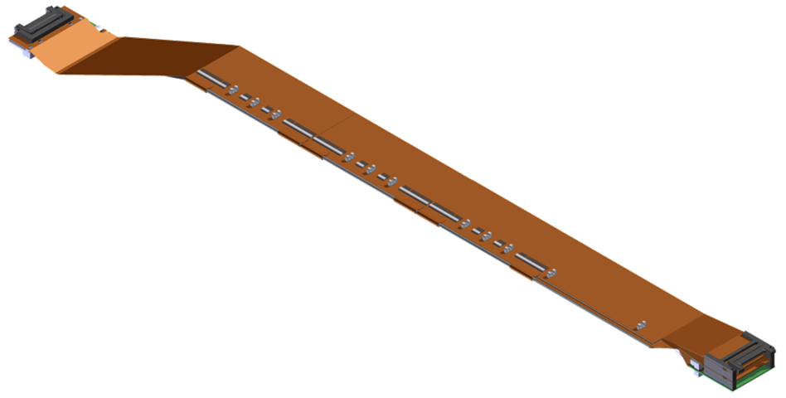
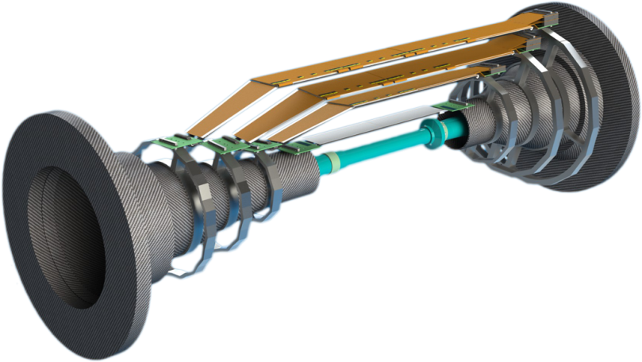
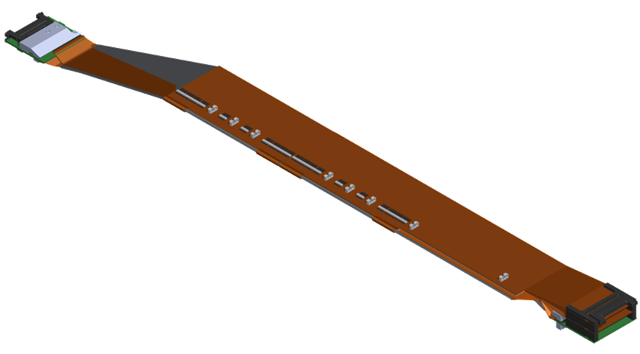
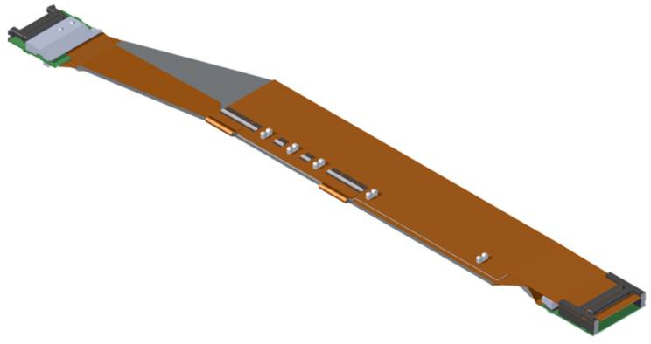
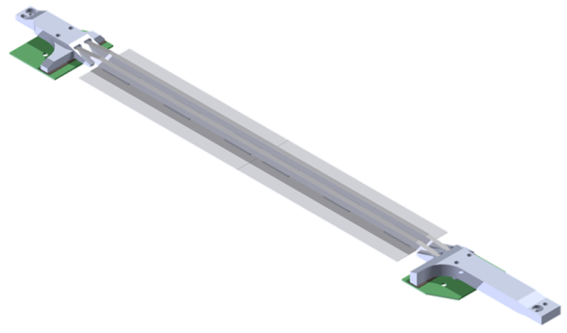
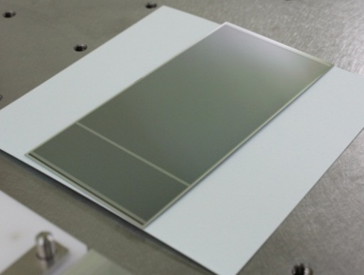
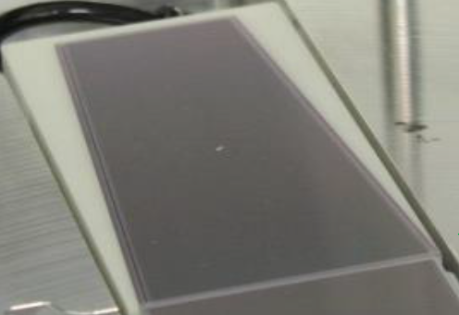
SVD Ladder Layout
Four layers
Sensor
L6
Sensor
L5
Sensor
Sensor
Sensor
Sensor
R_{L3} = 38mm
R_{L4} = 80mm
R_{L5} = 115mm
R_{L6} = 140mm
L4
Sensor
Sensor
Sensor
L3
Sensor
Sensor
Sensor
Layer | Ladders | Sensors / Ladder | APVs
6 | 16 | 5 | 800
5 | 12 | 4 | 480
4 | 10 | 3 | 300
3 | 7 | 2 | 168
Rectangular sensor
Trapezoidal sensor

Slide 5
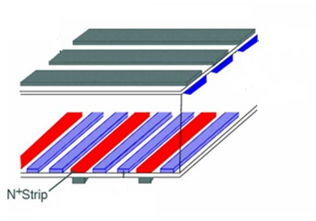
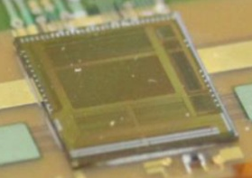
SVD Sensors and Readout ASIC
Double-sided Si strip detector
Readout ASIC (APV25)
As high hit rate is anticipated at Belle II, the readout chip should have a short signal shaping time for low noise and a good radiation hardness.
P⁺ strip
Sensor thickness = 300-320μm
Si
“DSSD”
We adopted the APV25
N⁺ strip
The APV25 was originally developed for the CMS.
Shaping time = 50ns.
Radiation hardness > 1MGray.
Other characteristics
# of input channels = 128 / chip.
192-deep analog pipeline for the dead-time reduction.
Thinned down to 100μm for the material budget reduction.
 | Rectangular | Trapezoidal
# of p-strips | 768 | 768
p-strip pitch | 75μm | 50…75μm
# of n-strips | 512 | 512
n-strip pitch | 240μm | 240μm
Active area | 57.72x122.9mm² | 5890mm²

Slide 6
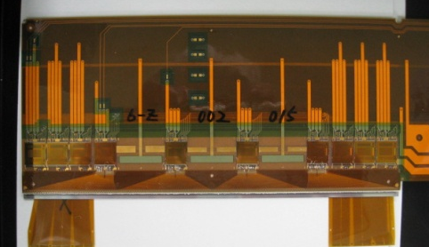
Chip-on-Sensor and “Origami” Concepts
APV25 on sensor
The APVs for the inner sensors are placed directly on the DSSDs to minimize the analog path length (capacitive noise)
P-side readout
Signals on the sensor backside are brought to the upper side by other flex circuits and readout by APV25 chips mounted on the top
Signal readout by the APV25s on the sensor
Backside signal readout by the other APV25s
… …
DSSD n-side (512 strips)
Fan-out flex circuit
Wire bonding between the sensor and flex
The other flex
Readout ASICs on the same side & line → easier chilling by a single cooling pipe.

Slide 7
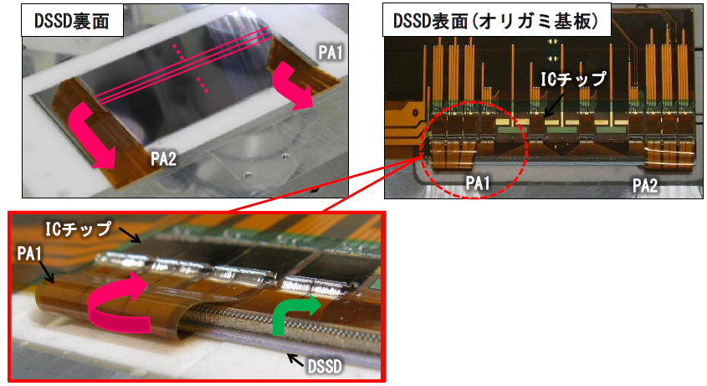
Snapshot – the “Origami” Concept
DSSD backside
DSSD front side with APV25s
Flex
APV25
Flex
Flex
Flex
APV25
Flex
The backside signals are transmitted to the APV25 via bent (and glued) flex circuits.
DSSD

Slide 8
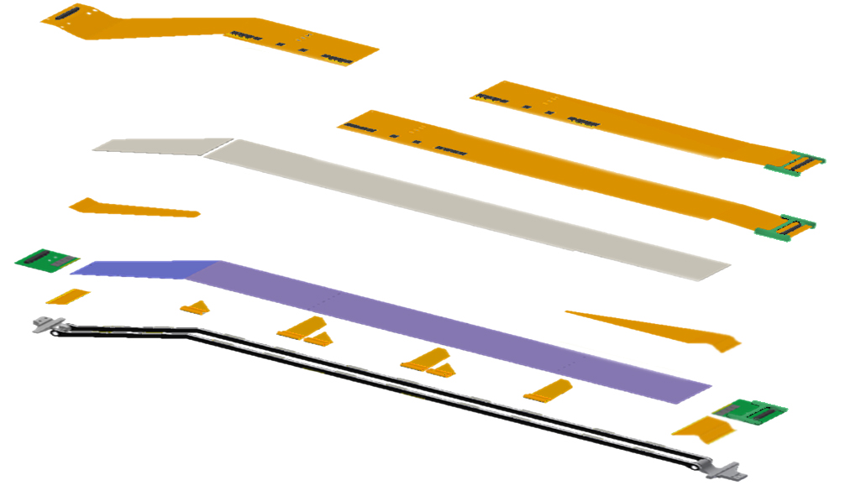
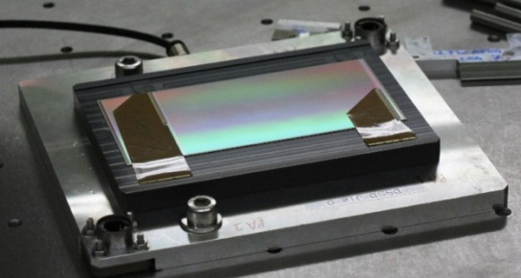
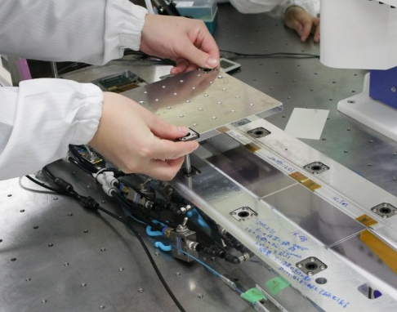
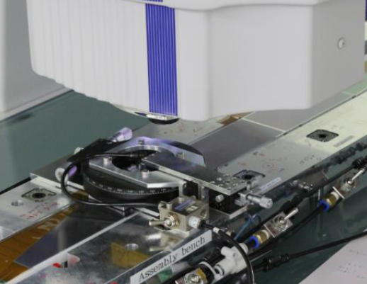
SVD Ladder Assembly
Precision DSSD alignment
Flex circuit hybrid
DSSDs are handled with precision assembly jigs (O(50μm)), on which the sensors are fixed by vacuum chucking.
Thermal insulator
APV25
Thermal insulator
APV25
Sensor fixed on a jig
Sensor placement
DSSD array
Sensors are aligned with a
Precision of 10μm by a position tuning jig with monitoring through a CMM.
Flex circuits
APV25
Support ribs

Slide 9
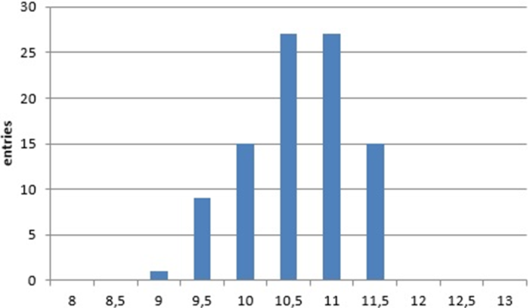
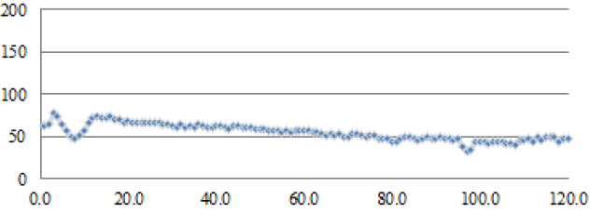
SVD Ladder Assembly
Ladder fabrication: gluing
Electrical connection: wire bonding
Ladders are fabricated by gluing the components by Araldite®2011
The flex↔DSSD strips and flex↔APV25s are electrically connected by the wire bonding
Glue spread below bonding pads can affect the bonding yield and pull strength → glue amount and glue lining are controlled by a gluing robot.
with Aℓ(99%) wire(φ=25μm).
Number of total bonds = 450k.
Appropriate spread of glue to the flex edge
Bonding machine parameters are fine tuned to realize yield>99% and pull strength f:μ_{f}>5g, σ_{f}/f<20%.
Wire bonding pads
μ_{f} = 10.7g
σ_{f} = 0.6g
(97 samples)
t = 55+10μm
Entries / 0.5w
Glue thickness [μm]
Position on the gluing line [mm]
Pull strength [g]
9

Slide 10
Assembled ladders
L3
L4
L5
L6

Slide 11
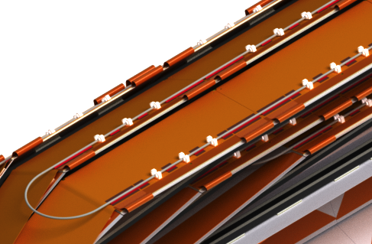
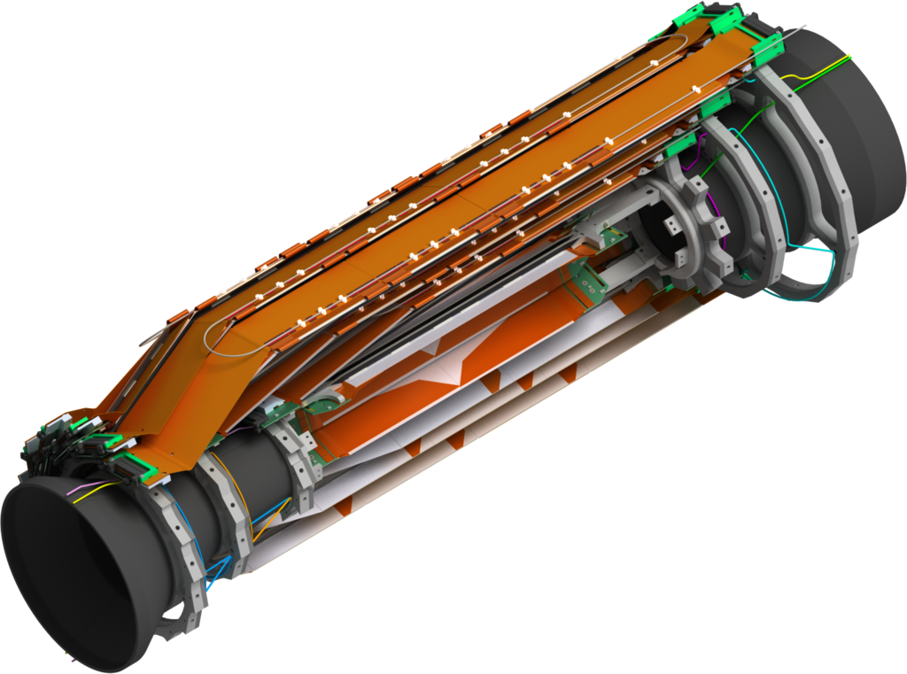
CO₂ Cooling
The total SVD (Origami) power dissipation 688(328) W
Edge hybrids: APV25 chips cooled by end rings
A pre-bent cooling pipe (OD=1.6mm) will be clipped onto the ladders on top of the Origami APVs

Slide 12
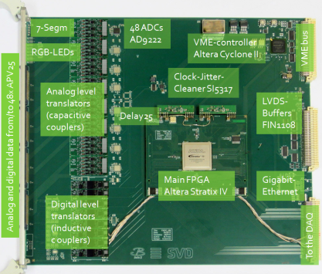
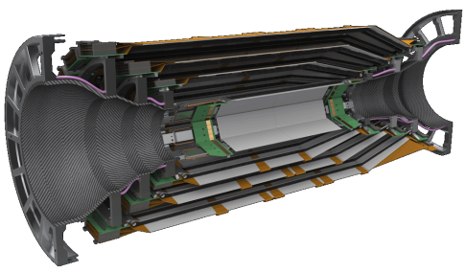
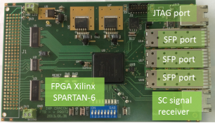
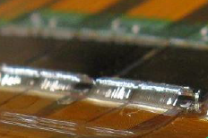
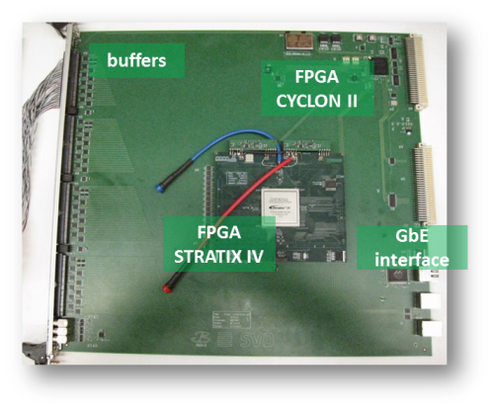
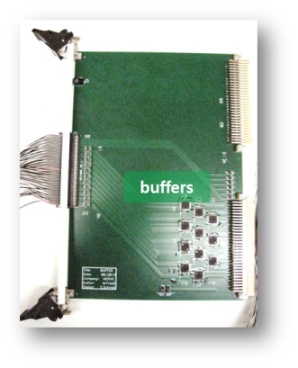
FADC Readout System
“COPPER” board
x48 FADC
RX
Data stream
CPU
SVD
FADC
Zero supp.
Formatter
Repeater
to HLT
~2m
~10m
belle2link
TX
x1748
APV25s
Aurora link
TRG/CLK signals
VME
PXD region of interest gen
x4 buffer
to PXD
Data size reduction
Cu cable
FADC Ctrl
APV trig gen
Decoder
Trigger/
timing
distributor
Central TRG
FADC-Ctrl
SVD readout system
Central DAQ
Prototypes of all components have been developed.

Slide 13
Outline
3D model of an Layer-4 ladder
Components of each ladder
Software used to develop the 3D model for Jigs
Jigs designed and produced
Instruments needed for the assembly
Assembly procedure
Summary

Slide 14
L4 Ladder: 3D Model

Slide 15
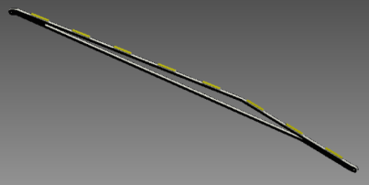
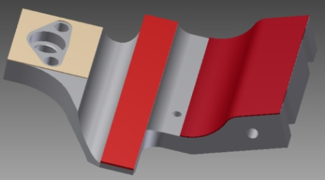
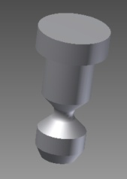
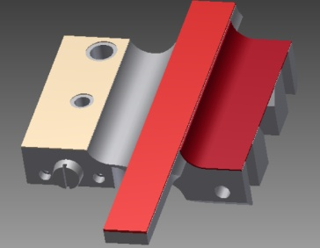
Components of each ladder
Ribs = 2 numbers -- made from carbon fiber
Light in weight, stiff
low material budget
Backward (BW) end mount with silpad and keratherm
silpad - placed between the endmount and hybrid
Keratherm – thermal conduction and electrical
isolation
-- to hold BW side of ribs
BW kokeshi pin - placed in the BW endmount
Forward( FW) endmount with silpad and keratherm
-- to hold FW side of ribs

Slide 16
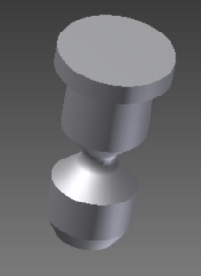
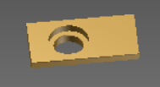
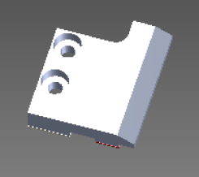
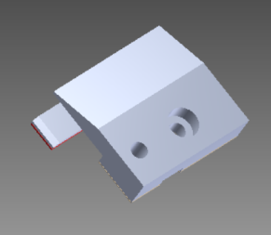
Components of each ladder
FW kokeshi pin -- will be inserted in to prism rail
Prism rail -- will be inserted in to FW endmount
BW APV guard -- placed above APV chips on BW hybrid
( APV - Analog Pipeline chip, Voltage-mode )
FW APV guard – placed above APV chips on FW hybrid

Slide 17
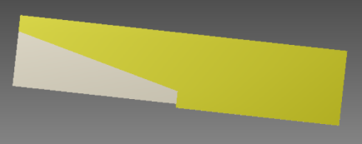
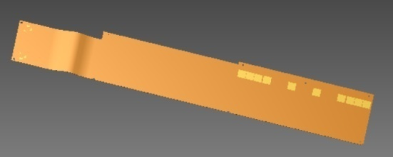
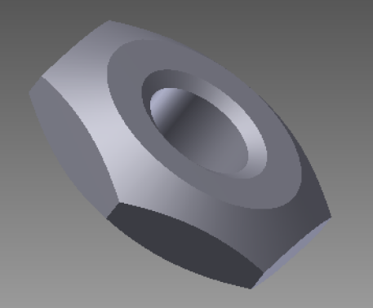
Components of each ladder
Rectangular double-sided silicon sensor
size : 124.88mm x 59.6 mm , Th : 300µm
Airex - placed between sensor
and origami module
Origami –Z module - Meant for reading one
silicon sensor
DIN 439 ( M2 x 0.4 ) = 2 numbers

Slide 18
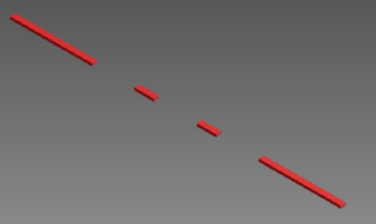
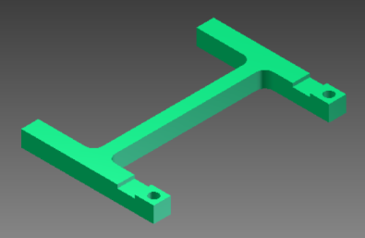
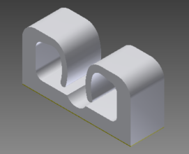
Components of each ladder
Keratherm for origami -- above APV chips
H shape for hybrid board – support for the
connector on the hybrid board
CO2 clamps - 6 no.s - to hold the C02 pipe

Slide 19
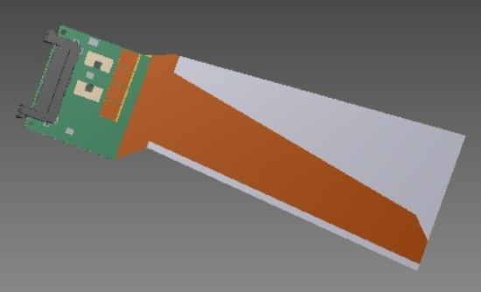
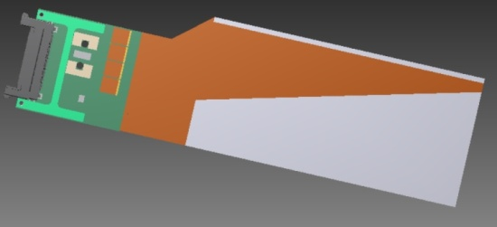
Components of each ladder
FW sensor sub-assembly:
Size of the sensor : 125.580 x 60.63/41.02 mm
Trapezoidal sensor with pitch adapter and hybrid
board for reading the sensor
BW sensor sub-assembly:
one of double sided silicon sensor with pitch
adapters and hybrid board for reading the sensor

Slide 20
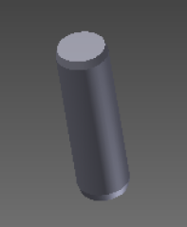
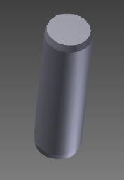
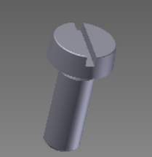
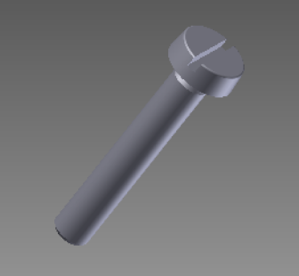
Components of each ladder
ISO 8734 Pins (ɸ 1 x 10mm ) = 4 numbers
ISO 8734 ɸ3 x 10mm = 1 number
DIN 84 ( M2 x 8 ) = 2 numbers
( BW APV guard )
DIN 84 ( M2 x 12 ) = 2 numbers

Slide 21
How to assemble the components?
Need a clean room
Precise placing of each component is very important
Jigs needed to place components
Development of 3D modeling of Jigs
2D conversion along with tolerance
Jigs produced
Verification of Jigs using a CMM
Fine tuning of the produced Jigs
Gluing of components with a gluing robot
Wirebonding of sensors, PAs and readout chips
Verification of the ladder using the CMM
Electrical Testing of the ladder

Slide 22
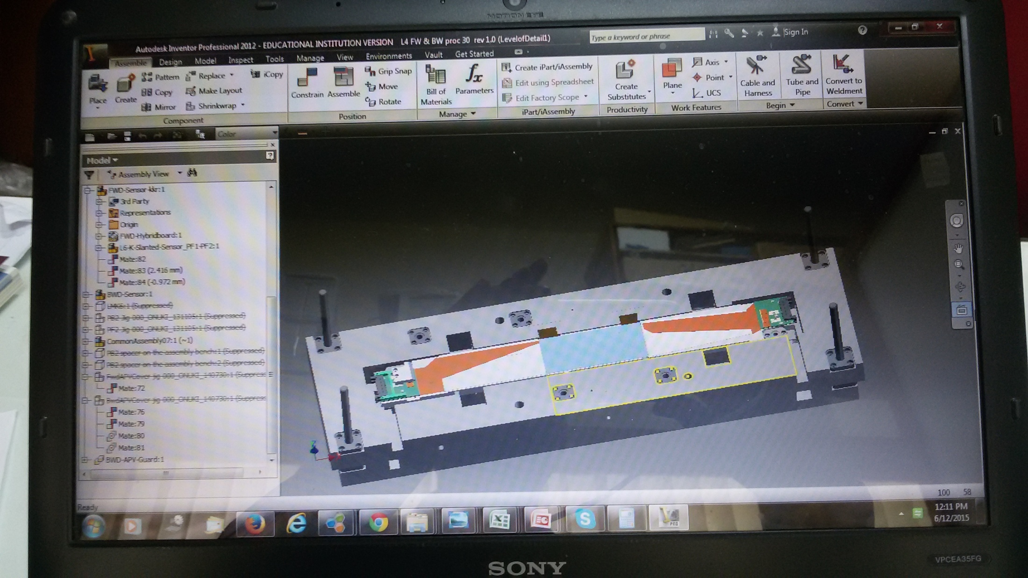
Software
Autodesk Inventor Professional 2012

Slide 23
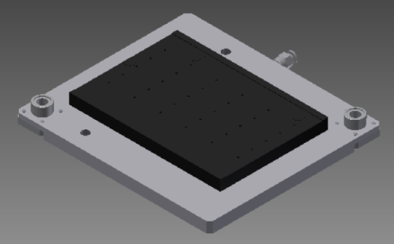
3D models of jigs designed
Jig name 3D Model
DSSD jig - to hold sensor
PA1 and PA2 jig - to hold pitch adaptors
Airex jig - to hold Airex
Assembly bench - to hold all sensor

Slide 24
Jigs and its Pictures
Jigs name 3D Model
Assembly base - to hold assembly bench
BW mount block - to keep BW endmount
FW mount block - to keep FW endmount
BW jig - for picking up the BW sensor
and placing it on the ribs

Slide 25
Jigs and its Pictures
Jigs name 3D Model
FW ( slanted )jig - Picking up FW sensor
and placing on the ribs with 11.9° angle
BW supporting rods
FW supporting rods
Slant support - to stop the tilt angle
BW Inlet 2 jig -- needed on the assembly bench
to hold the BW sensor

Slide 26
Jigs and its Pictures
Jigs name 3D Model
FW inlet 2 jig -- needed on assembly bench
to hold the FW sensor
Rib gluing jig - setup to make ribs glued to
FW and BW endmounts
PB2 jig -- for picking up the BW sensor from the
multipurpose chuck
PF2 jig -- for picking up the FW sensor from the
multipurpose chuck

Slide 27
Jigs and its Pictures
Jigs name 3D Model
Origami alignment jig -- aligning the origami module
Origami – Z jig -- pick the origami from
origami alignment jig
CO2 clamp jig -- to place CO2 clips on the ladder

Slide 28
Jigs and its Pictures
Jigs name 3D Model
PA bend jig ( Photo ) -- used for wrapping the
pitch adaptors
FW APV guard jig
BW APV guard jig

Slide 29
Shared Jigs and its Pictures
Jigs name 3D Model
XYZ Theta stage from Japan – for aligning the sensors on the assembly bench
We uses 3 such stages for aligning the sensors
(BW , Central and FW )
BW Multipurpose chuck from Pisa – pickup the
Sensor with hybrid with PB2 jig
FW Multipurpose chuck from Pisa – pickup the
Sensor with hybrid with PF2 jig

Slide 30
Photo’s of Jigs
Material used for jigs: Aluminum alloy 6061 and Polyacetal
Assembly base
Assembly bench
Backward jig
Slant jig ( 11.9 ° )

Slide 31
Photo’s of Jigs
DSSD jig
PA1 and PA2 jig
Airex jig
Origami –Z jig

Slide 32
Photo’s of Jigs
FW and BW supp. rods
FW & BW mount blocks
Lift assembly parts

Slide 33
Photo’s of the Jigs
PF2 jig
PB2 jig
CO2 Clamp jig
Template for the Airex sheet

Slide 34
Photo’s of the Jigs
Rib gluing jig
Origami Alignment jig
Origami –Z jig

Slide 35
Photo’s of the Jigs
Base plate for wirebonder
Length of rods tolerance : +/- 20 µm
Flatness of small jigs : ~40 µm
Flatness of large jigs : ~150 µm
Jig for gluing robot
Production of the jigs and their CMM were performed in our workshop

Slide 36
Instruments needed for assembly
in the clean room
Wire Bonder
Pull Tester
Microscope
Gluing robot
CMM

Slide 37
Gluing procedure
Compressed
air unit is
connected
to this controller
cable
Musashi ShotMaster 3 Gluing robot
Glue Dispenser
Gluing robot jig support the following jigs using its
alignment pins
PA1 and PA2 jig
Airex jig
Origami jig
Assembly bench jig
Developed programs for each application
Teaching Pendant

Slide 38
Gluing procedure (cont.)
2575 rounds / min.
Glue Dispensing in to the syringe
Awatron 3 – Musashi co. - Centrifuge
Alignment in Z direction
Alignment in X-Y direction
Placing of syringe
PA2 Glue Dispensing
video
Now the Gluing robot is ready for glue dispensing
PA1 Glue Dispensing
video

Slide 39
Glue dispersion on the sensor
Microscopic
pictures
More Glue - it will overflow on the pads
Less Glue - we can not wirebond on the corresponding pads
Bubbles formation in the glue while dispensing - we can not bond at that location
We have to optimize the speed , distance and height of the syringe to get good results

Slide 40
WireBonding
Delvotec 6400
Wedge Tool :
2145 - 15 - 20 - 1.0
Hole size = 38µm
Bond length = 51µm
Wire : Al Si (1%), 25µm diameter

Slide 41
Ultrasonic wedge bonding
Descent to 1st bond pad
Apply US power
Lift bond head
Move head to 2nd bond pad (clamp open)
Apply US power
Close clamp, lift head and cut wire

Slide 42
Bonding Parameters
Ultrasonic power
time
Bond force
Wire loop height and form
Wire diameter (typically 25µm)
Wedge size and form
Deformation of wire
Speed and traverse path of bond head
Working height
etc.,

Slide 43
PA1 and PA2 wirebonding with DSSD
Developed an Automatic wirebonding Program on the wirebonder
Bonding Results :
PA2 to sensor - 100%
PA2 to sensor (bias pad) - OK
PA1 to sensor - 100%
PA1 to sensor (bias pad ) - OK
PA1 to DSSD : Number of wires to be bonded = 384
PA2 to DSSD : Number of wires to be bonded = 384
Video of wirebonding of PA1 to DSSD : MVI_6954
Keep Monitoring the bonding under
microscope during Autobonding

Slide 44
Bonded wires pictures
Sensor side
loops
Pitch adapter side

Slide 45
Pull Testing
Pull Force
Dage 4000 Plus -- Pull Tester
Pull testing of a bonded wire

Slide 46
Pull Testing between PA1 and DSSD
Pull Strength Wire broke at
( gm )
9.78 Pitch adaptor
11.72 Sensor
11.19 Sensor
9.34 Pitch adaptor
11.26 Pitch adaptor
10.57 Pitch adaptor
10.68 Pitch adaptor
11.68 Sensor
11.34 Pitch adaptor
10.86 Pitch adaptor
11.16 Pitch adaptor
11.63 Sensor
Pull Tester
Loop distance = 1510 µm
Loop Height = 533 µm
 | PA | sensor
US time | 25 ms | 25 ms
US power | 90 | 75
Bond force | 125 | 120
Average pull strength = 11.0 gm
Average pull tests per sample = 100

Slide 47
CMM talk by Babu
APVDAQ talk by Deepanwita

Slide 48
Past Reviews
Class C1 - Onsite review on 5th February 2015
Class C2 - Onsite review on 27th June 2015
Class B- (L4.905) - Electrically working but mechanically not
Class C3 (L4.906) - Mechanically good but one corner of the FW
sensor lifted up to 400microns
L4.905 and L4.906 ( remote ) - 6th January 2016
L4.001 ( Class B ) - 25th February 2016

Slide 49
Before starting of the L4.001 ( Class B )
Shimming study performed to reduce the lift off due to the tension generated from PF1 and PF2
Modification of BW APV guard due to the 100nf capacitor
Modification of FW endmounts due to L3 cables
Ladder container - used for source scan and transportation
L4.001 - Included the shimming study

Slide 50
Assembly Manual
Updated the assembly manual
- APVDAQ test for SBW,SFW , O-Z etc.,
- hybrid board and origami module testing with the test board PCB
- when to update the checklist
- loading of the measurement files at proper location in the database
Followed the assembly manual during the ladder assembly ( Hard copies are kept next to the assembly table )

Slide 51
Summary
For the first time we are involved in such a high-precisions detector project
Starting from the scratch, we’ve come a long way – at par with colleagues in Japan and EU
All the assembly jigs are designed, produced and fine-tuned
Built up expertise on wirebonding, gluing, pull testing, CMM analysis and electrical Q&A
Well established the assembly procedure and produced a number of prototypes
Ready for the full-scale production

Slide 52
Thank you

Slide 55
Double-sided silicon detector
Purpose: Provide precise two-dimensional position information for charged particles passing through it
Rectangular sensors
Al
SiO₂
p⁺
bulk n
p⁺ stopper
n⁺
Trapezoidal sensors
SiO₂
Al

