Slide 1
HGCAL R&D and Prototyping Activities at TIFR
Kameswara Rao, S. Mayekar,
R. Thomas, I. Mirza, M. Shelake,
M. Kumar, S.R. Dugad, G.B. Mohanty
DHEP Annual Meeting
May 5, 2022

Slide 2
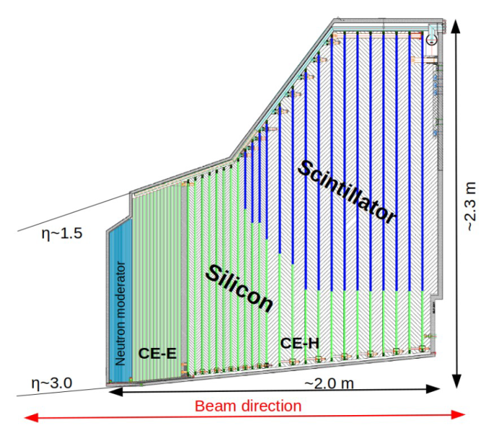
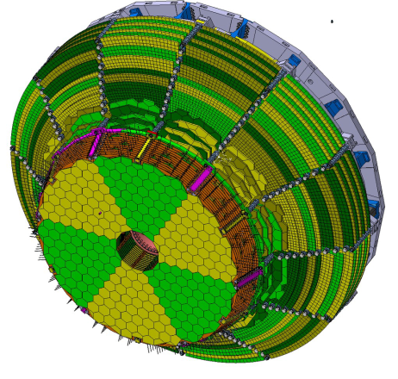
LHC Upgrade to High Luminosity LHC
Calorimetry
● Replacement of the endcap calorimeter with high-granularity calorimeter (HGCAL)
Radiation tolerant
High granularity
Precise hit/cluster timing
Enhanced capability for particle flow
reconstruction
Operation at -30°C
CE-E (Electromagnetic)
Active: Silicon
Passive: Cu, CuW, Pb absorbers
13 double-sided layers (full silicon)
CE-H (Hadronic)
Active: Silicon + Scintillator /
Silicon-photomultiplier
Passive: Steel absorbers
7 all-Si layers

Slide 3
Why HGCAL?
Need to improve the jet resolution for the next generation of calorimeters
At high jet energy, correct association between the tracks and calorimeter cluster is very important, so going for calorimeter with very high granularity
To realize a high-granularity calorimeter (HGCAL), we need: low cost/area active material(s), radiation-tolerant on-detector electronics, high-bandwidth data transmission, powerful FPGAs for off-detector electronics
A largely silicon-sensor-based calorimeter

Slide 4
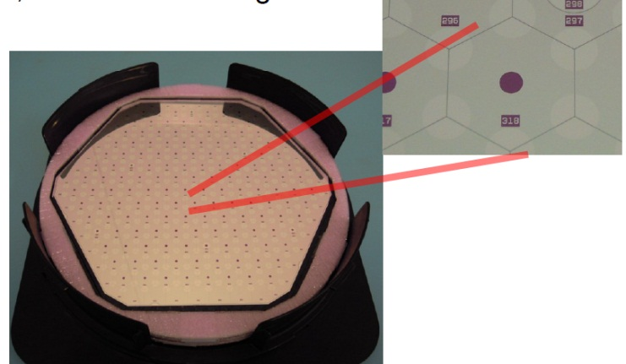
Technical Requirements of HGCAL
Planar p-type DC-coupled sensor pads
simplifies production technology
p-type more radiation tolerant than n-type
Hexagonal sensor geometry preferred to square
makes most efficient use of circular sensor wafer
reduces no. of sensors produced & assembled into modules
8” wafers preferred to 6”
reduces no. of sensors produced & assembled into modules
cost per area is cheaper and simplifies the module mechanics
300μm, 200μm and 120μm active sensor thicknesses
match sensor thickness to radiation field for optimal performance
Simple, rugged module design & automated module assembly
provide high volume, high rate, reproducible module production & handling
About 5K siIicon detector modules need to be assembled in India for a total requirement of ~27K modules (~15 modules per day)
8” low-density sensor
192 cells with ~1.1 Sq. cm size
300µm & 200µm active thickness
8” high-sensity sensor
432 cells with ~0.5 Sq.cm size
120µm active thickness

Slide 5
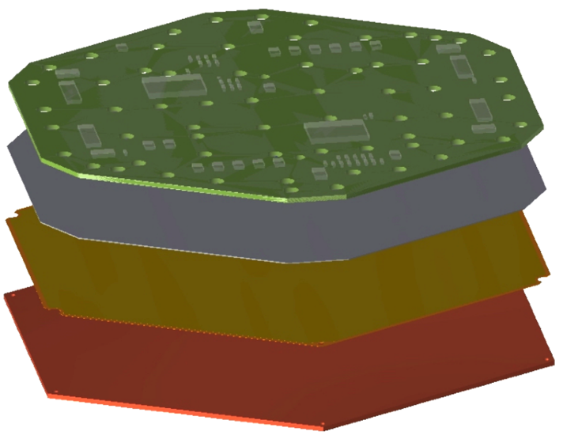
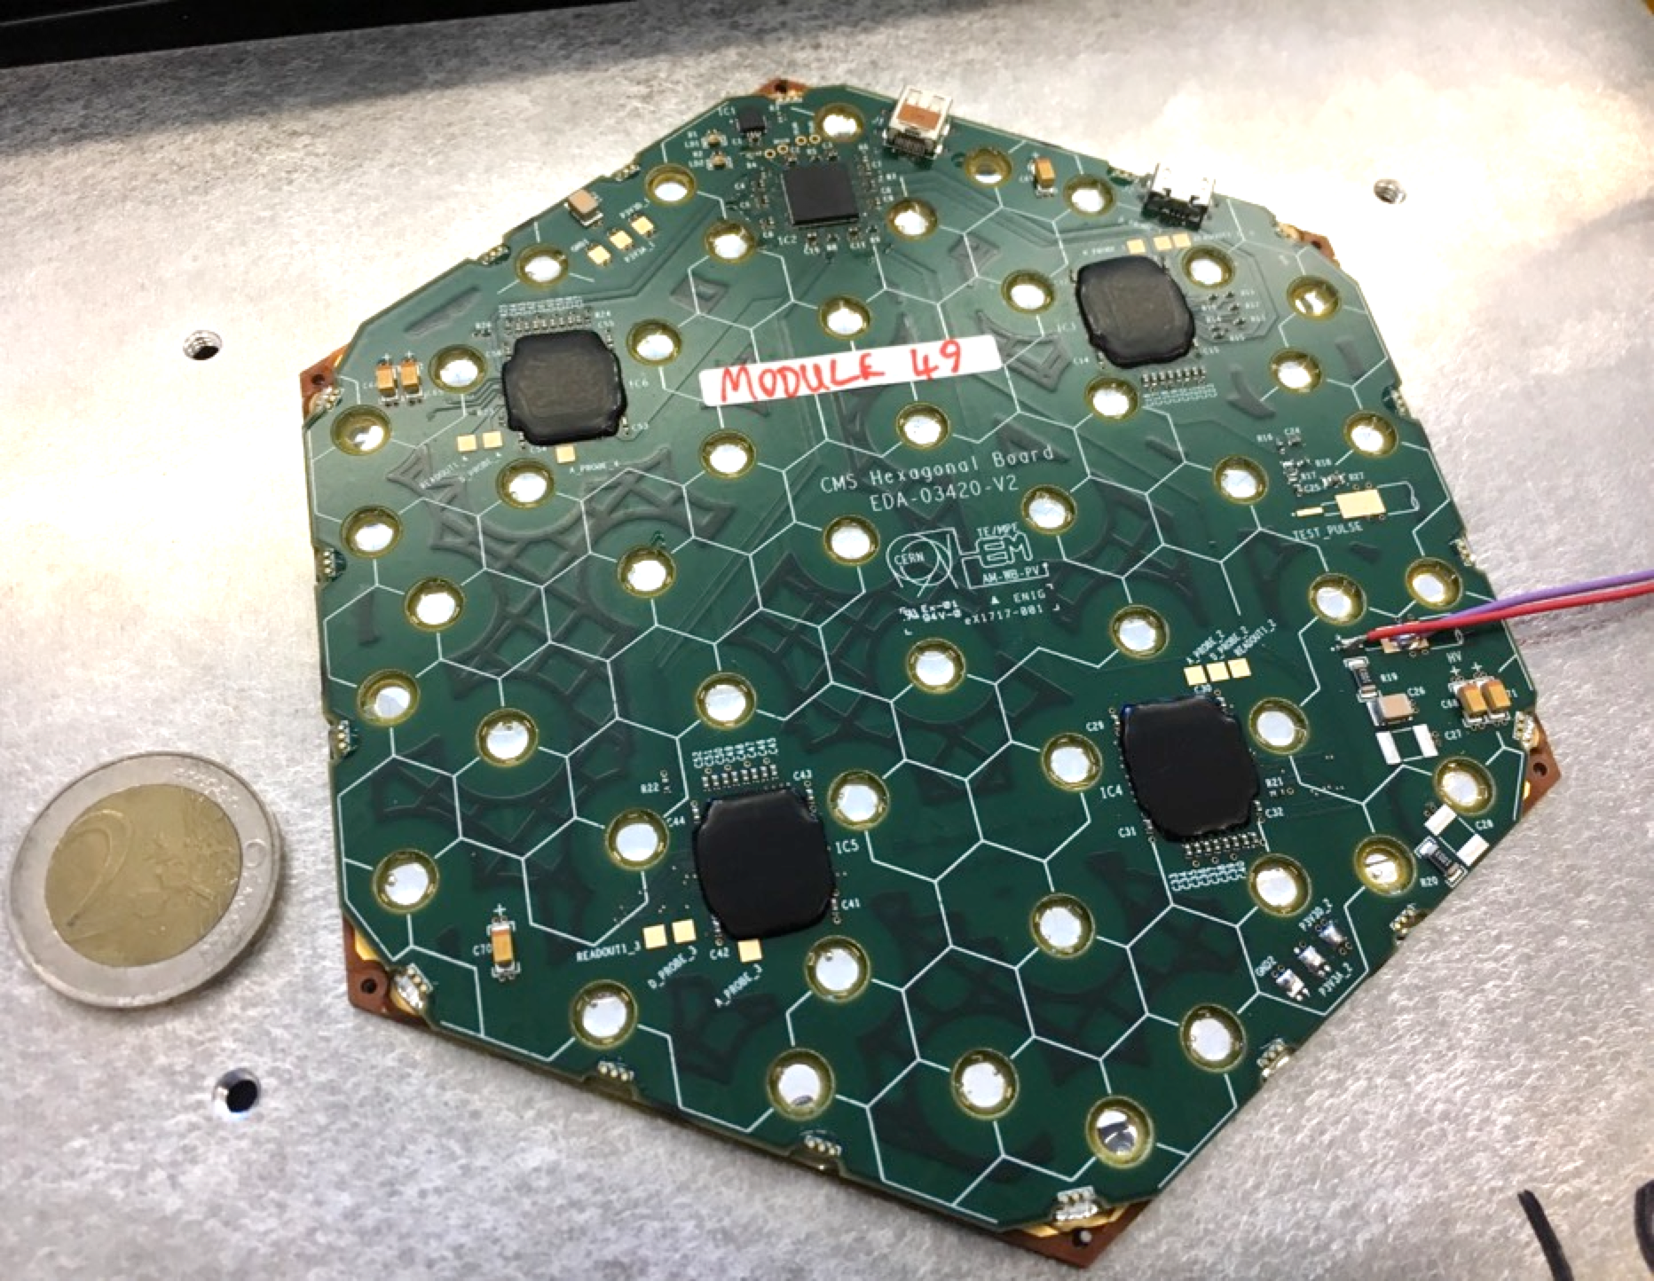
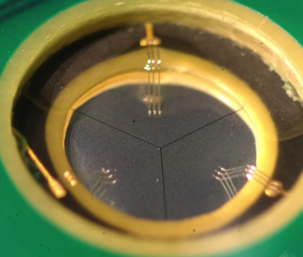
Components for an HGCAL Module
Key steps involved:
Gluing
Wire-bonding
Visual inspection
Electrical testing
Encapsulation
PCB
Module
parts
Silicon
Kapton
Silicon sensor glued to baseplate and
PCB containing front-end electronics
Baseplate
Wire-bonding from PCB to silicon via holes
5

Slide 6
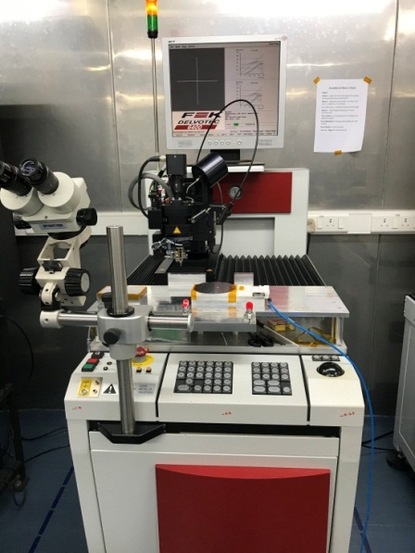
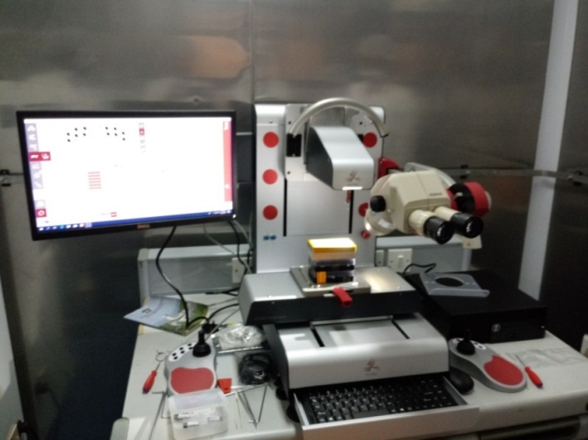
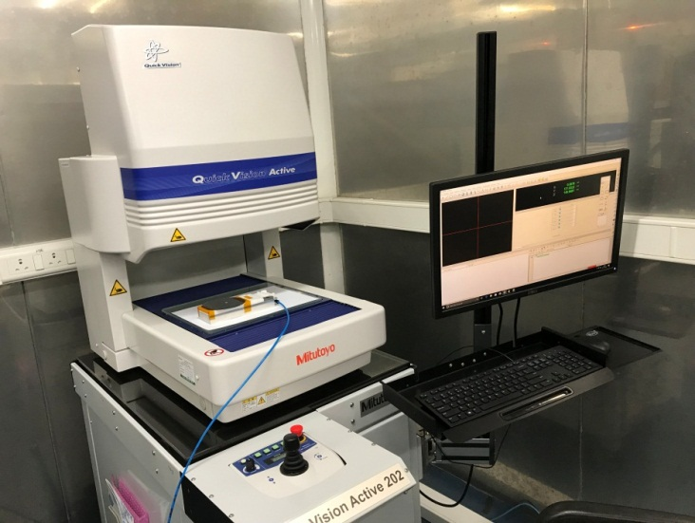
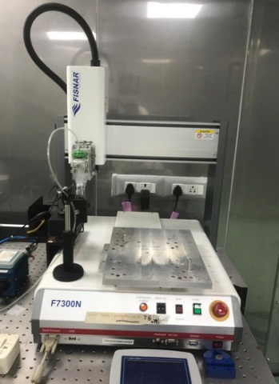
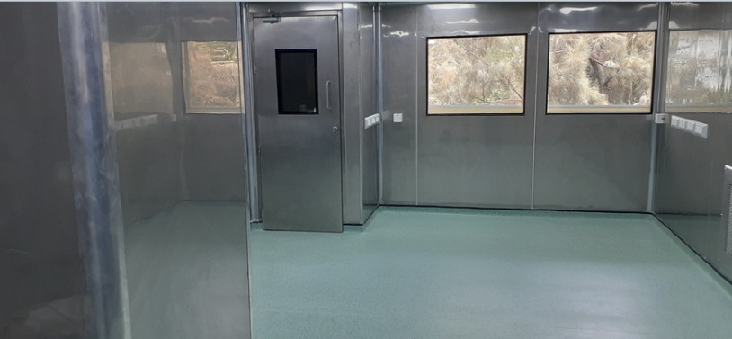
Existing Instruments and Infrastructure
Wire Pull Tester
XYZTEC condor sigma lite
Coordinate Measuring Machine
Mitutoyo Vision Active 202
Working area: 250x200x150mm
Wire-bonder
Delvotec 6400 (used for Belle II SVD)
Working area: 150 x 200, 25mm in Z
Suitable for up to 6” wafers
Leica M80 microscope
Motic microscope
Mushashi SM-300SX-3A mini gantry
Optical table
Additional 300 Sq ft of clean-room area
On the way:
Aerotech gantry
Mini Gantry
Fisnar F7300N

Slide 7
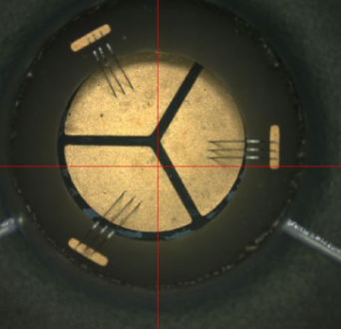
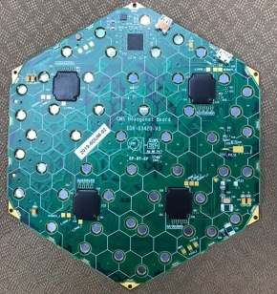
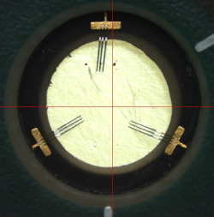
Wire-bonding Studies
Small hole size : 4 mm
Big hole size : 6 mm
Step size of 0.6 mm
Bonds at 120° locations
Automatic program has
been developed for this
application
Part
A
Part
B
Dummy 8” HGCAL PCB
One of the stepped holes
6” HGCAL module
One of the stepped holes

Slide 8
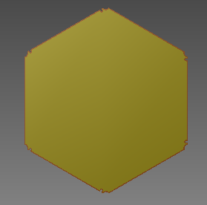
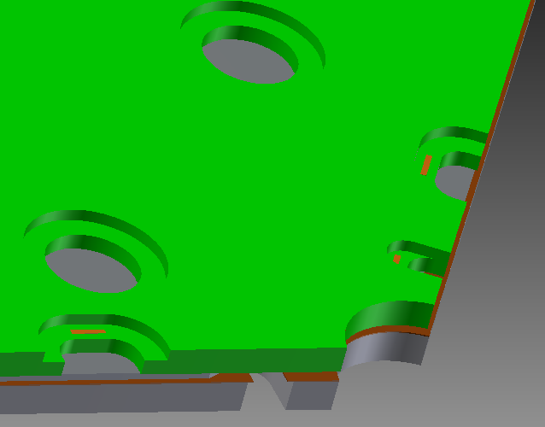
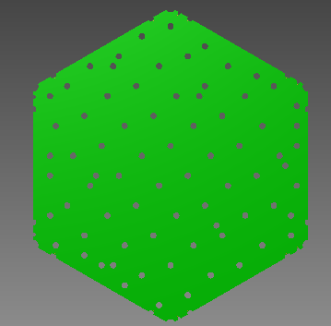
HGCAL Dummy Module Assembly: Components
Baseplate
Measured :
Flatness: 0.173 mm
Thickness : 0.87 mm
Design values :
Length : 166.940mm
Thickness : 1.4mm
166.508mm
Sensor
Measured :
Flatness: 0.05 mm
Thickness : 0.330 mm
Design values :
Length : 166.570mm
Thickness : 0.300mm
166.441mm
Edge to Edge distance details
Baseplate and sensor : 0.185 mm
Base plate and PCB : 0.150 mm
Sensor and PCB : 0.035 mm
PCB
Measured :
Flatness : 0.078 mm
Thickness : 1.262 mm
Design values :
Length : 166.640mm Thickness : 1.194mm
166.733mm

Slide 9
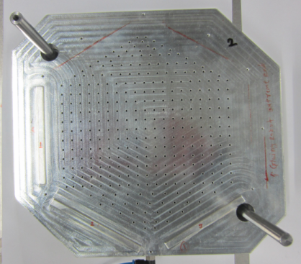
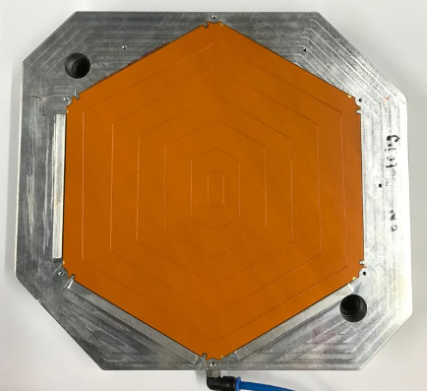
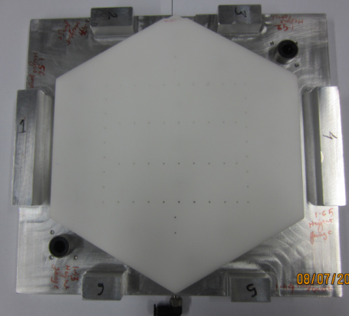
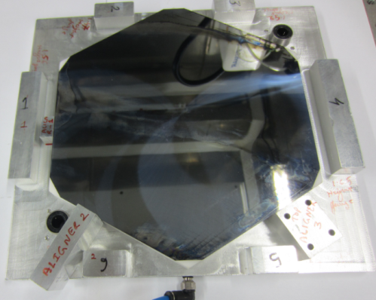
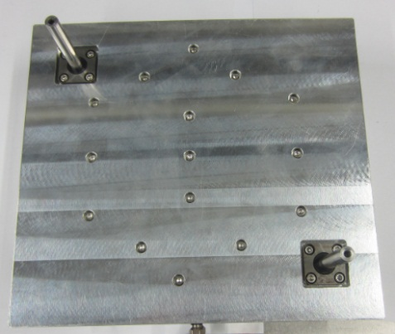
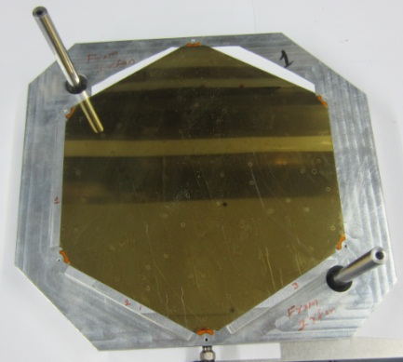
Dummy HGCAL Module Assembly
Designed and produced:
1) Multipurpose jig
2) Sensor jig
3) PCB pickup jig
Sensor alignment and placing setup
Multipurpose jig
Baseplate aligned on multipurpose jig
glue pattern on base plate
Glue: Araldite 2011 slow setting glue
Aligners for sensor
Sensor jig
Sensor aligned on jig
After gluing the sensor:
Flatness of baseplate + sensor: 0.265 mm
Thickness of baseplate + sensor: 1.261 mm
Glue thickness: 0.06 mm
Sensor jig placed on
multipurpose jig
Sensor on baseplate

Slide 10
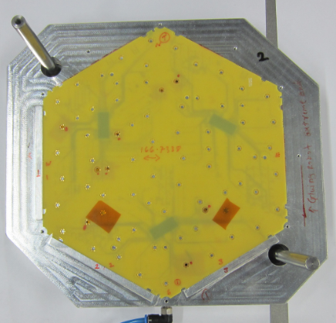
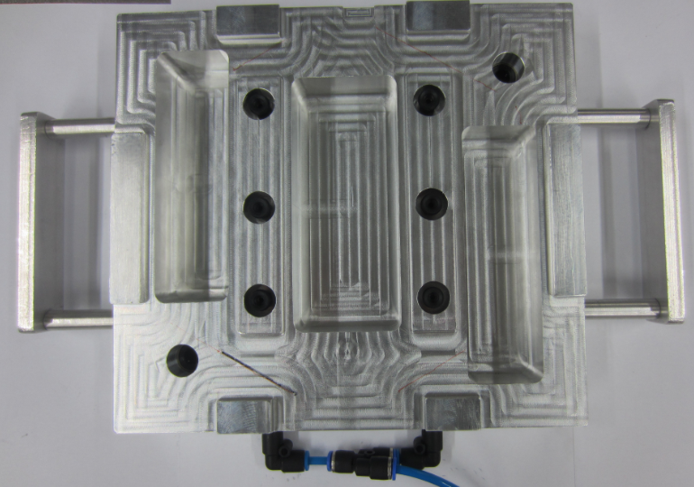
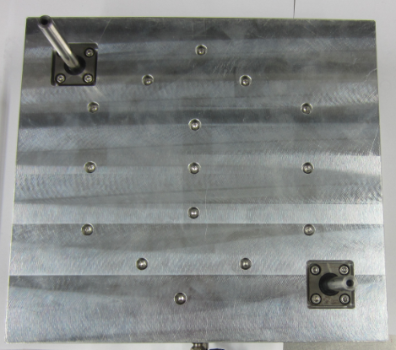
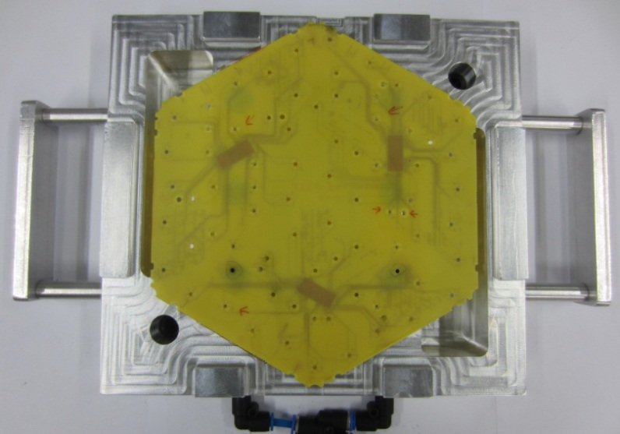
PCB Pickup Setup
PCB aligned on multipurpose jig
PCB pickup jig
Placed tape to avoid interference with vacuum cups
Placed PCB pickup jig on
Multipurpose jig
PCB picked up

Slide 11
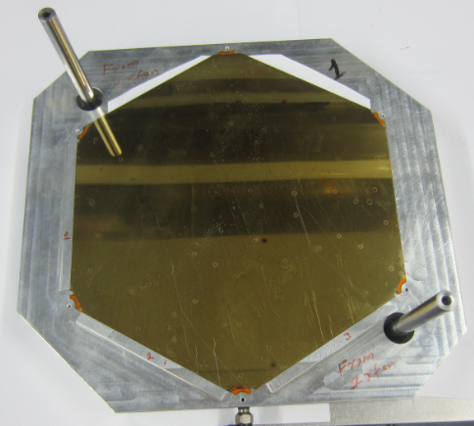
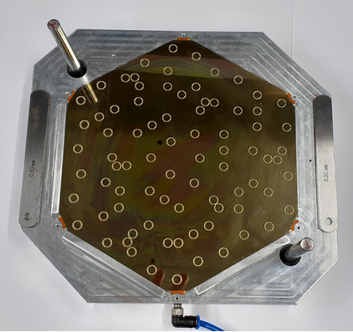
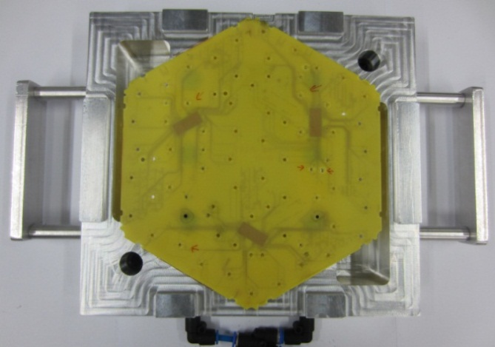
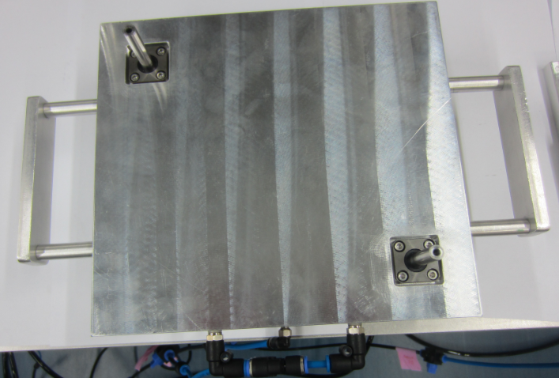
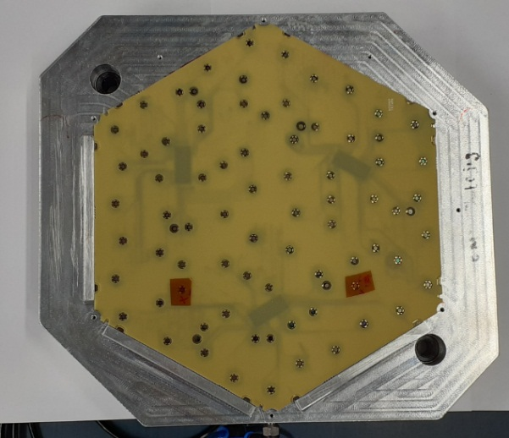
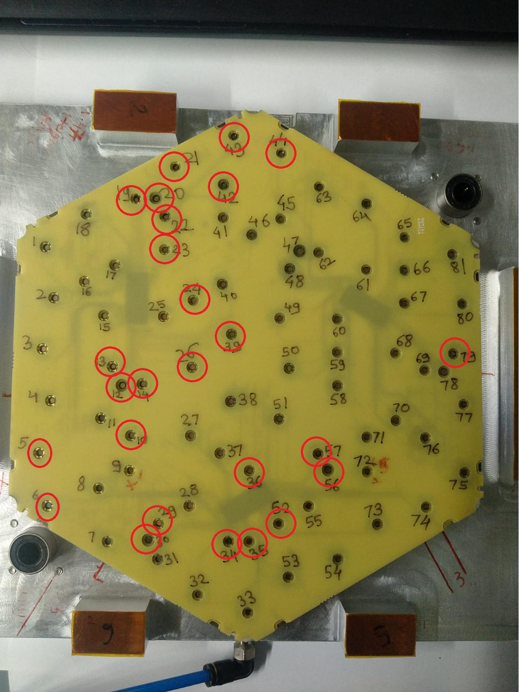
Placing PCB on Sensor
Baseplate and sensor on
multipurpose jig
PCB pickup jig
Glue – Araldite 2011
More details on gluing in the poster of Sukant
Placed the PCB on multipurpose jig
All together
Glue spread observed on
above red circles
Glue thickness achieved is around 53 microns between sensor and PCB

Slide 12
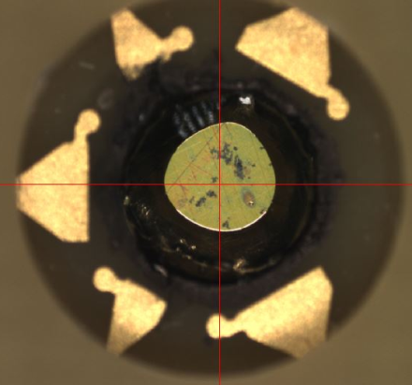
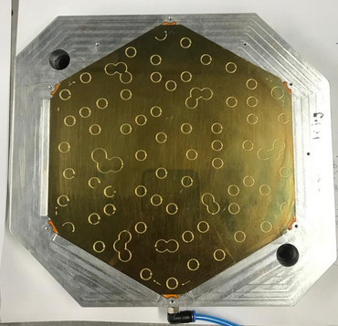
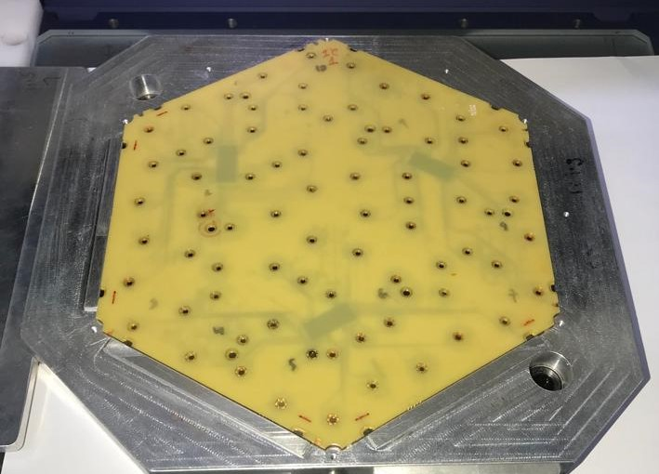
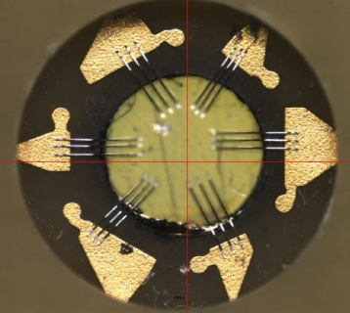
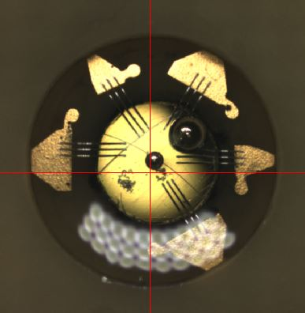
HGCAL Assembled module
Glue spread seen on
the sensor at some holes
Optimized the parameters to avoid the glue spread
Improved version of glue pattern
(Modules 2 and 3)
Assembled module
Wire-bonding
Flatness of complete assembly = 0.076 mm
Thickness of complete assembly = 2.529 mm
Need to perform wire-bonding
Followed by encapsulation
Encapsulation

Slide 13
Summary
Developed HGCAL mechanical prototypes
Completed gluing, wire-bonding and encapsulation studies
Need to develop jigs suitable for main gantry – work in progress
Waiting for the main gantry to be delivered at TIFR $⇒$ needed for the large-scale production of modules
Need to work on the module testing and thermal cycling set-ups

Slide 14
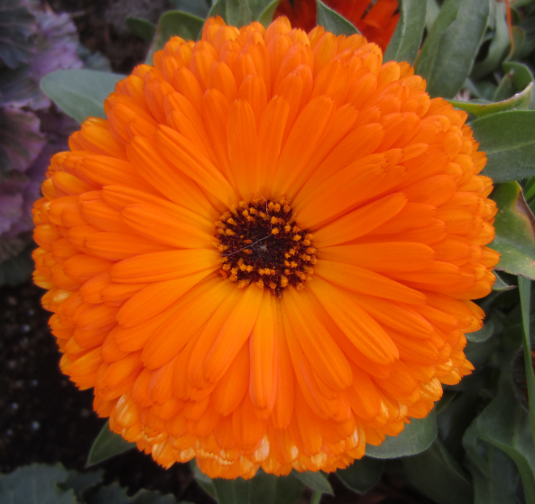
Thank you

Slide 15
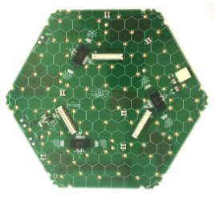
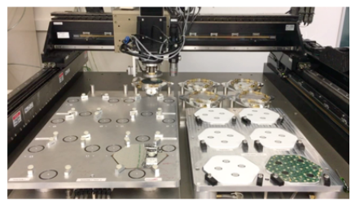
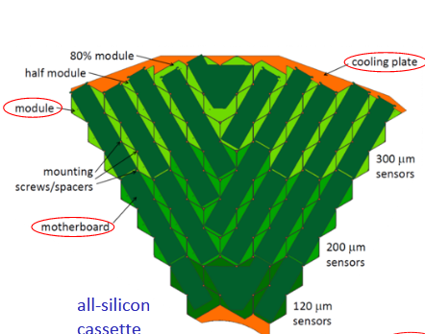
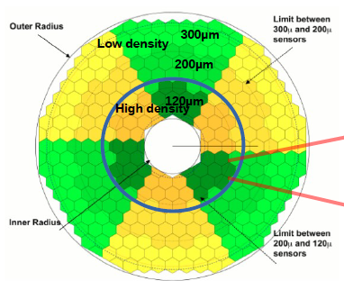
Main Gantry and HGCAL modules in Cassette
Procuring this Main Gantry
for mass production
HGCAL module
Values for both endcaps
Silicon
600 m² of silicon
6M channels
HGCAL module in Cassette

