Slide 1
Women in Physics in the United Kingdom: A review of recent policy and initiatives
Sally Jordan¹, Sarah Bakewell², Tracey Berry³, Holly Campbell⁴, Josie Coltman⁵, Wendy Sadler⁶ and Chethana Setty¹
¹School of Physical Sciences, The Open University, Milton Keynes, UK; ²Institute of Physics, London, UK; ³School of Engineering, Mathematical and Physical Sciences, Royal Holloway, London, UK; ⁴UK Atomic Energy Authority, Culham Science Centre, Abingdon, Oxfordshire, UK; ⁵AWE, Aldermaston, Berkshire, UK; ⁶School of Physics and Astronomy, Cardiff University, Cardiff, UK.

Slide 2
Overview: Recognising that progress has been made, whilst identifying gaps for improvement
A strengthening of policy, and opportunities for governmental influence have brought a potential for significant improvement at a systemic level.
The UK Government's Gender Equality Roadmap¹ recognises that women take on more unpaid work than men, make up the majority of informal carers and on average do around 60% more cooking, cleaning and childcare than men. This hugely impacts on their participation in the workforce and their career choices and journeys.
Gender inclusive policies in the workplace such as menstruation and menopause are being introduced more widely and the introduction of Shared Parental Leave supports the career development and retention of physicists.
We have categorised our presentation into three areas to show where progression is being made. These categories cover the spread of education and careers for physicists; schools, higher education and the workplace.
Definition of Women
In the UK, we recognise that gender is no longer a binary concept. When we use the term 'women' and 'girls' this also includes Trans and Non-Binary women and girls
Colour Guide
School Level – up to age 19
Higher Education – age 19+
Careers

Slide 3
Policy and Influencing
The Institute of Physics (IOP) Strategy, Unlocking the Future², states as one of its core ambitions: “We want to build a thriving, diverse physics community and play our part in solving the science, technology, engineering and maths (STEM) skills shortage by ensuring that people, no matter their background or where they live, have access to world class physics education and training” with a goal of girls making up at least 30% of those studying physics aged 16-19.
The IOP has also input to the House of Commons Science and Technology Committee inquiry into Diversity in STEM.
UK Research and Innovation (government sponsored groups for research) has an Equality Diversity and Inclusion Strategy³, with four objectives designed to create a more inclusive research and innovation system, where people, creativity, and ideas can flourish.
Each of the seven Research Councils under UKRI has its own EDI strategy action plan to achieve equity across all disciplines, recognising that different approaches will be required to meet the strategic goals.
Women in Work:
The introduction of the Gender Pay Gap⁴ reporting in 2017 has highlighted pay inequities that must be reported by all organisations with over 250 employees. This is encouraging a focus on reducing this gap.
The IOP has input to the All Party Parliamentary Group consultation on Equity in the STEM Workforce to highlight inequities in physics.
Women in Work (WiW) Summit UK⁵– Prioritising women's health policy, retaining women in work and driving competitive, economic advantage across the UK.

Slide 4
Current status (data)
Schools (Age 16-19 yrs)
(Joint Council for Qualifications 2019-2020) - IOP Limit Less report 2020⁶
Note that data is not collected consistently across the UK Nations and is an ask of Government in the recent Science and Technology Committee inquiry into diversity in STEM.
Higher Education (Age 19+)
49% increase in female Physics UG
40% increase in female Physics Doctoral
students
Overall, increase in female students at various levels but still large discrepancy with numbers of male students in physics
Source: Physics-Students-in-UK-Universities-HESA-Data-Brief.pdf (iop.org)⁷
UK country | Physics qualification | % of girls taking
England | A Level | 2.6%
Northern Ireland | A Level | 1.0%
Ireland | Leaving Certificate | 3.59%
Scotland | Highers | 27.5%
Wales | A Level | 2.0%
Careers / staff in HE Institutions
Between academic years 2012/13
until 2020/21 there has been an increase
in female professors from 8-14%
Source: Physics staff in UK universities (iop.org)⁸

Slide 5
Environment
Area | Issue | Progress made | Barriers to overcome
Schools | Fewer girls take up Physics / STEM subjects post 16 | Systemic change sought through policy change; increased outreach activities and active role models | Persistent lack of specialist physics teachers in schools
Higher Education | Encouraging more women into HE and research physics | Improving the culture through Project Juno and Athena SWAN; scholarships for PhD students and Undergraduate conferences | Retention and progression of women; culture still needs improving to include intersectionality
Careers and workplaces | Retention and progression of women in physics | New Inclusion Model for physics⁹ to replace Project Juno. Returner programmes available and shared parental leave introduced. | Lack of resources to support systemic change; policies not consistently applied; progression routes not transparent
 | Workplace bullying and harassment is still reported frequently, often after the fact | Institutes have Codes of Conduct, policies and employment laws. Training such as awareness and bystander training is deployed more | Culture change requires consistent effort and application of policies and processes by organisations and institutions.
 | Women playing multiple roles in society | Flexible working / work from home being used more widely | Lack of awareness of support available and presenteeism still expected

Slide 6
Initiatives
Schools
The IOP's Limit Less campaign seeks to encourage more students to study physics post 16 by influencing those they may seek advice from - parents, carers, media and teachers - on what you can do with a physics based degree or apprenticeship. It also calls for changes through government.⁶
Support young people to change the world | Institute of Physics (iop.org)
Higher Education
An annual conference to bring Undergraduate women and non-binary physicists together in order to encourage and support them with their personal and professional development.¹⁰
Bell Burnell Graduate Scholarship Fund
A fund to encourage greater diversity in physics by assisting PhD physics students from under-represented groups.^{11,12}
Hear from the beneficiaries
Careers and workplaces
Returner programmes support those wishing to return to their career after a break, through structured and supported programmes such as STEM returners¹³ and the Daphne Jackson Trust¹⁴.
Workplace culture change is supported through programmes such as WISE Ten Steps¹⁵ (Industry) Athena Swan (HE)¹⁶ and Project Juno (Physics HE Depts)¹⁷. Juno is being replaced with a new inclusion model⁹ in 2024.

Slide 7
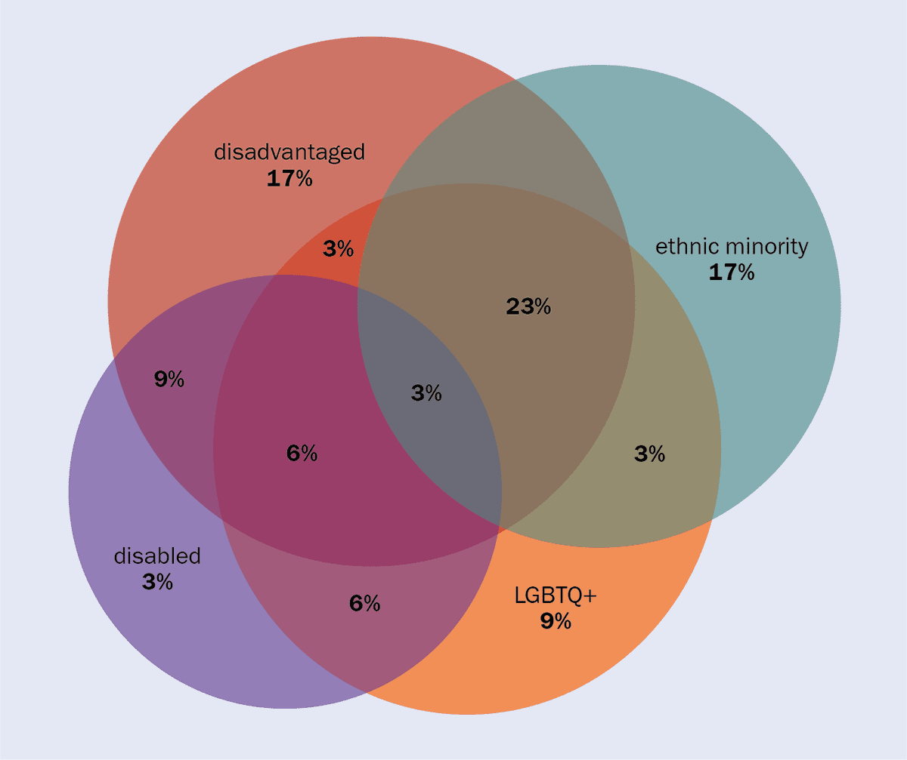
Summary
We have made good progress in the UK, but we have a long way to go before we have greater representation of women, trans women and non-binary physicists.
We recognise that intersectionality plays an increasing role in making systemic and positive change, and the future will focus more in this area to ensure that we continue to ensure women, Trans women and non-binary physicists are encouraged in their careers and the environment they work in is equitable and free from bullying and harassment.
Intersectionality Analysis of all this year’s applicants to the Bell Burnell Graduate Scholarship Fund (BBGSF) shows that the majority meet multiple criteria. For reference, 80% of this year’s applications came from women. Figure Courtesy of IOP Publishing, from data supplied by Helen Gleeson¹².
The full article in Physics World can be found here
"As a white woman who began my degree in 1980, I find it hard to imagine how much harder my career progression would have been if I’d suffered the double (or triple) whammy of multiple bias, discrimination or marginalization. However, this is the reality for many of our very capable undergraduates today."
- Helen Gleeson, Cavendish Professor and Chair of the BBGSF

Slide 8
References
UK Government, Gender equality at every stage: A roadmap for change (2019) https://www.gov.uk/government/publications/gender-equality-at-every-stage-a-roadmap-for-change
Institute of Physics, Unlocking the future: The Institute of Physics Strategy 2020-2024, https://www.iop.org/strategy
UK Research and Innovation, UKRI’s equality, diversity and inclusion strategy (2023) https://www.ukri.org/publications/ukris-equality-diversity-and-inclusion-strategy/
UK Government, Gender pay gap reporting (2023) https://www.gov.uk/government/publications/gender-pay-gap-reporting-guidance-for-employers
WiW: Women in Work Summit 2023, https://www.wiwsummit.com/
Institute of Physics, Limit Less: Support young people to change the world (2020). https://www.iop.org/sites/default/files/2020-11/IOP-Limit-Less-report-2020-Nov.pdf
Institute of Physics, Physics students in UK universities (2021) https://www.iop.org/sites/default/files/2021-12/Physics-Students-in-UK-Universities-HESA-Data-Brief.pdf
Institute of Physics, Physics staff in UK universities, 2023 https://downloads.iop.org/Physics-staff-in-UK-universities.pdf

Slide 9
References cont.
Institute of Physics, A new inclusion model for the physics community, https://www.iop.org/about/IOP-diversity-inclusion/new-inclusion-model
Conference for Undergraduate Women and Non-binary Physicists, UK and Ireland, https://www.iop.org/conference-undergraduate-women-physics-uk-and-ireland
Bell Burnell Graduate Scholarship Fund, https://www.iop.org/about/support-grants/bell-burnell-fund
H. Gleeson, Breaking barriers and opening up physics – the growing impact of the Bell Burnell Graduate Scholarship fund, Physics World, 18th April 2023.
STEM Returners, https://www.stemreturners.com/
Daphne Jackson Trust, https://daphnejackson.org/
WISE, 10 steps, https://www.wisecampaign.org.uk/ten-steps-framework/
Advance HE, The transformed UK Athena Swan Charter, https://www.advance-he.ac.uk/equality-charters/transformed-uk-athena-swan-charter
Institute of Physics. Project Juno, https://www.iop.org/about/IOP-diversity-inclusion/project-juno

Slide 10
Thank You

