Slide 1
Torsion Balance Motion Control System & Autocollimator Calibration System
DHEP Annual Meeting
7th & 8th April, 2016
Simon Pereira
Gravitation Group.

Slide 2
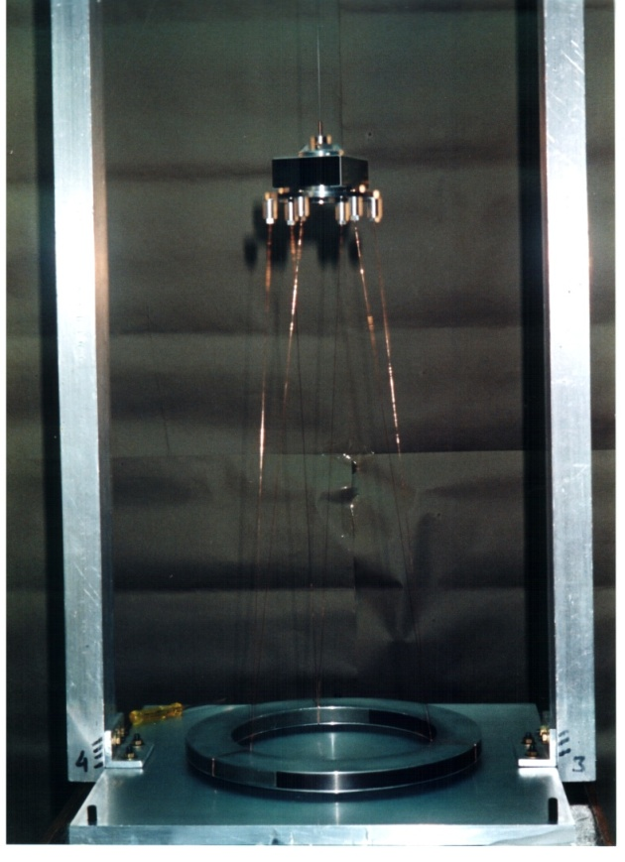
Motion Control System for Torsion Balance
THE NEED FOR ADJUSTMENTS
i) The initial amplitude of torsional oscillation is often quite large (tens of degrees to several full rotations).
BUT, the full measurement range of our Optical
Lever (OL) is about 5 micro-radian, and the p-p
amplitude of the torsional oscillation should be less
than this! (Note that the OL resolution is about 3 x
10⁻¹⁰ radians, for a total dynamic range of > 10⁴!)
ii) The angular orientation of the axis of the optical
lever (OL) may be offset from the direction of the normal
to the mirror. (by an angle going anywhere upto 10⁰)
Clearly, we need to be able to reorient the angular
setting of the torsion balance
Torsion Balance

Slide 3
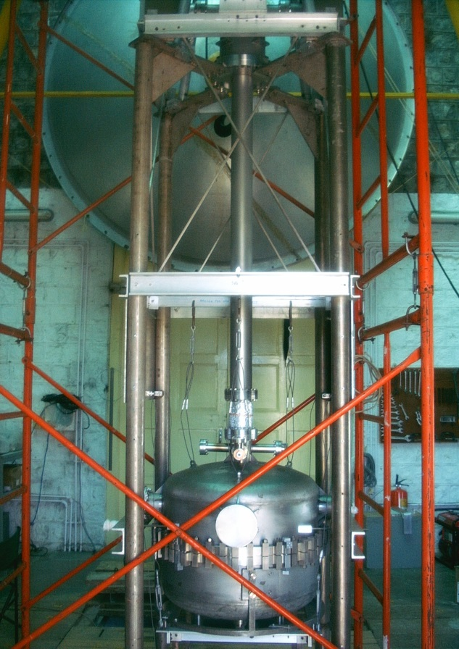
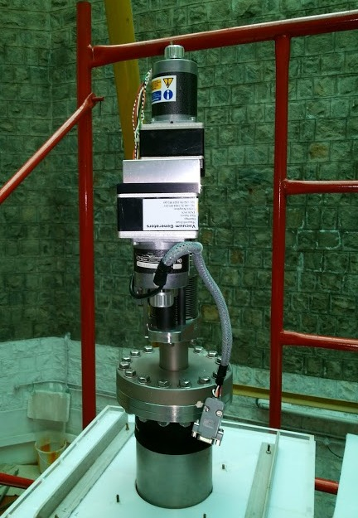
Motion Control Technique (Mechanical, for Large Angle Osc.)
Oscillations of Very Large Amplitude are damped down to a few milli-radians by our “patented” mechanical technique. (“Sudden Shifting of Potential Wells”)
The Rotary Motion Drive at the top of the UHV system is used to damp the initial large oscillation amplitude (several radians) of torsion balance.
A set of precisely-timed rotary motions of the top feed-through using the stepper motor, with appropriate drive parameters allows the rapid damping of very large amplitude of oscillations.
The drive parameters for stepper motor are determined through careful and accurately timed measurements of the optical signal of torsion balance motion.

Slide 4
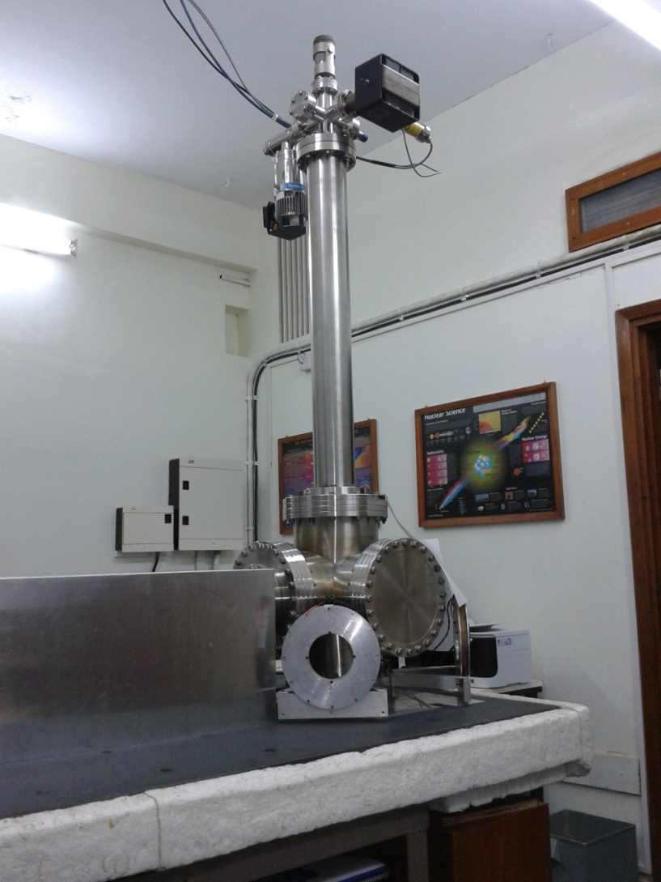
Motion Control Technique (Electrical, for small Amplitude Osc.)
Damping below ~ 10 m-rad amplitude of oscillations to micro-radians is done by our home-built Magnetic Induction Drive (MID) System
Two sets of orthogonally oriented current–carrying coils, external to the UHV chamber are driven with AC signals in quadrature, to generate a rotating magnetic field at the location of the mass-bob of the torsion balance.
In effect, the coil then functions like the stator, and the mass-bob as the rotor of an induction motor. The resulting torque on the rotor is proportional to (Drive Voltage)² and to Drive Frequency. We can change the direction of the torque by changing the direction of rotation of the magnetic field.
This gives us a very powerful tool for the control of the Torsion Balance, and we can generate drive torques that can be:
Proportional to the angular displacement of the Balance.
OR
Proportional to the angular velocity of the Balance.

Slide 5
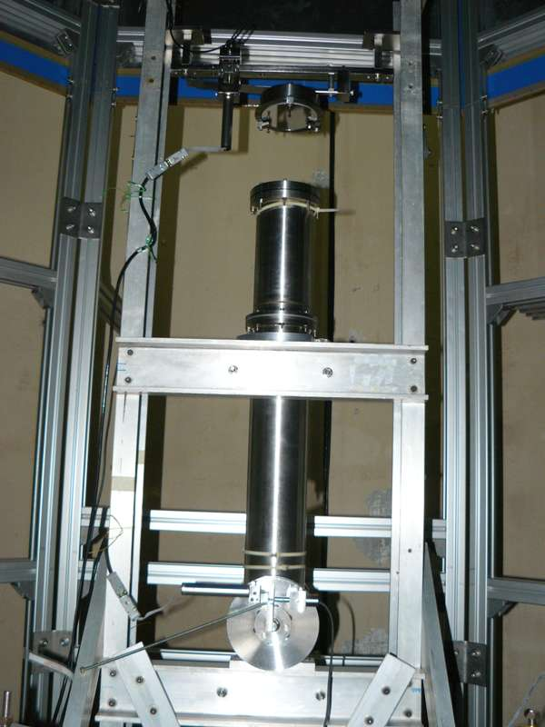
Automated Calibration System for Optical Lever
Optical Lever is used to monitor the motion of Torsion Balance.
The sensitivity of the optical lever is 3x10⁻¹⁰ rad./(Hz^{1/2}) and has linear range of +/- 2.5x10⁻⁶ rad.
The system has a very precise in-built mechanical simulator of angular movement for calibration. (This is what we call the “Compensating Plate”.)
Any system has “drifts”.
While we may spend a great deal of effort in reducing these drifts at source, it is necessary to calibrate the system periodically and the calibration has to be obtained even while the torsion balance is executing oscillation.
Optical Lever

Slide 6
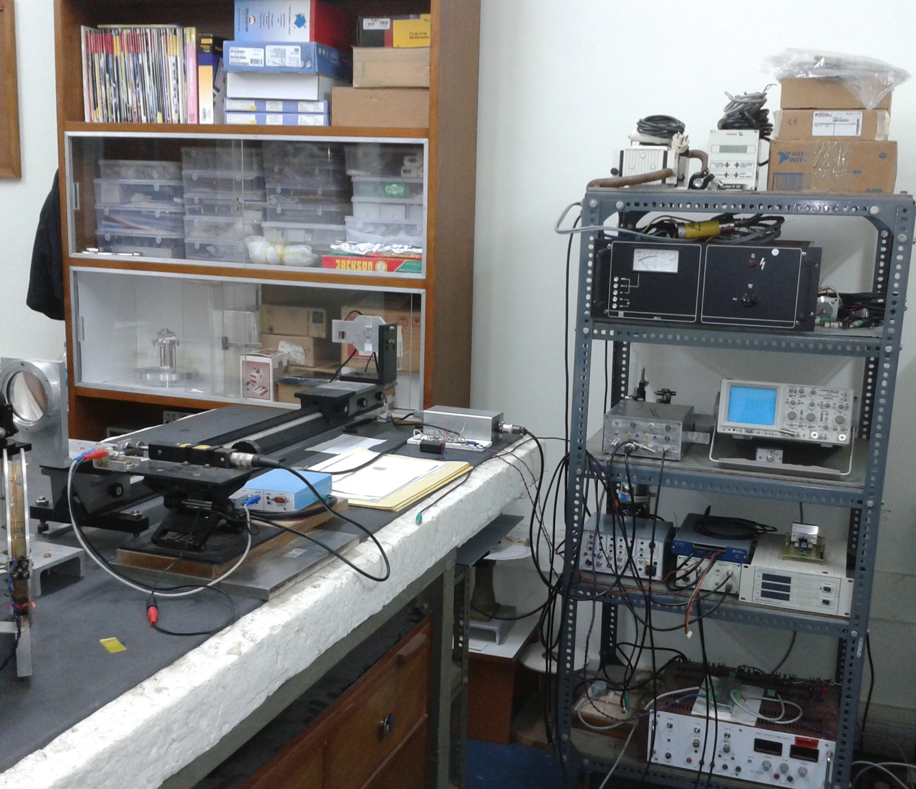
Prototype setup at Mumbai Lab

Slide 7
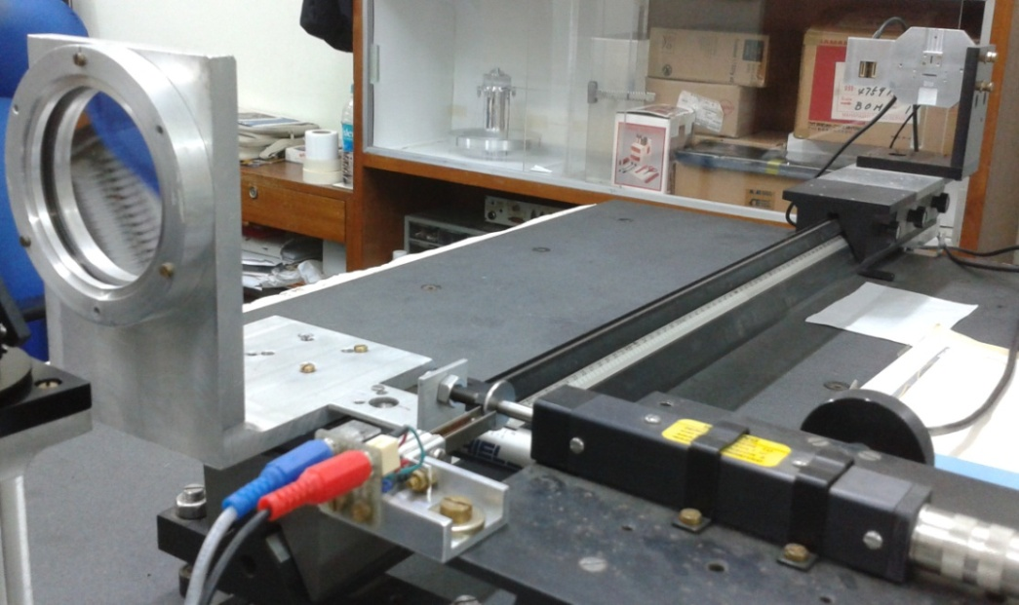
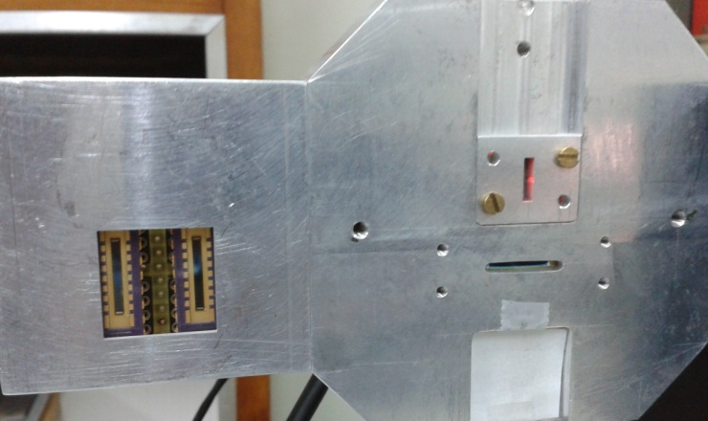
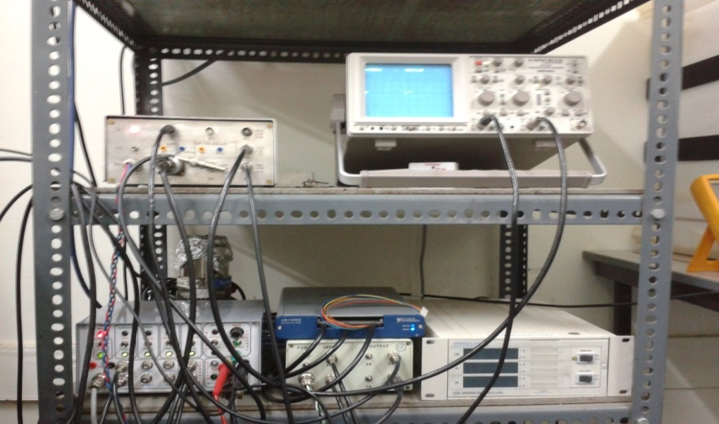
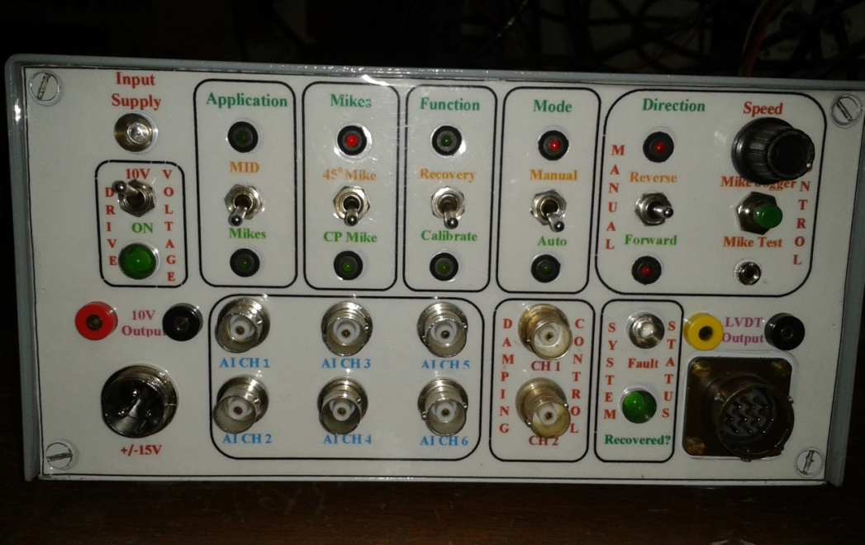
Prototype setup at Mumbai Lab cont..

Slide 8
Block Diagram of State Machine Lab VIEW Program (only a small part of the full system!)

Slide 9
Front Panel of Lab-VIEW State Machine Program

Slide 10
Performance of the system at a Glance

Slide 11
Precise Amplitude measurement

Slide 12
Precise Amplitude measurement

Slide 13
Motion Monitoring, Driving & Damping Application
A
B
B
A
C
C

Slide 14
Reset Signal , Calibrate OL & Recover Signal Application

Slide 15
Optical Lever Calibration Data

Slide 16
Torsion Balance Data recorded at Mumbai Lab

Slide 17
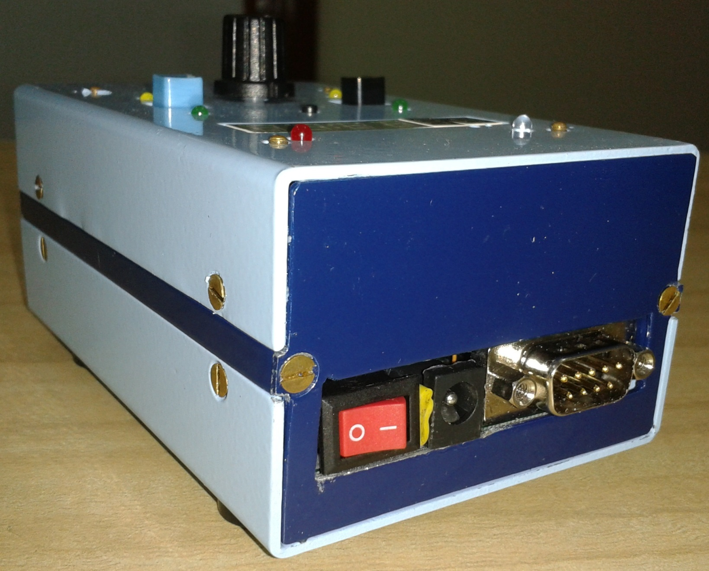
Home Made Encoder Mike Controller

Slide 18
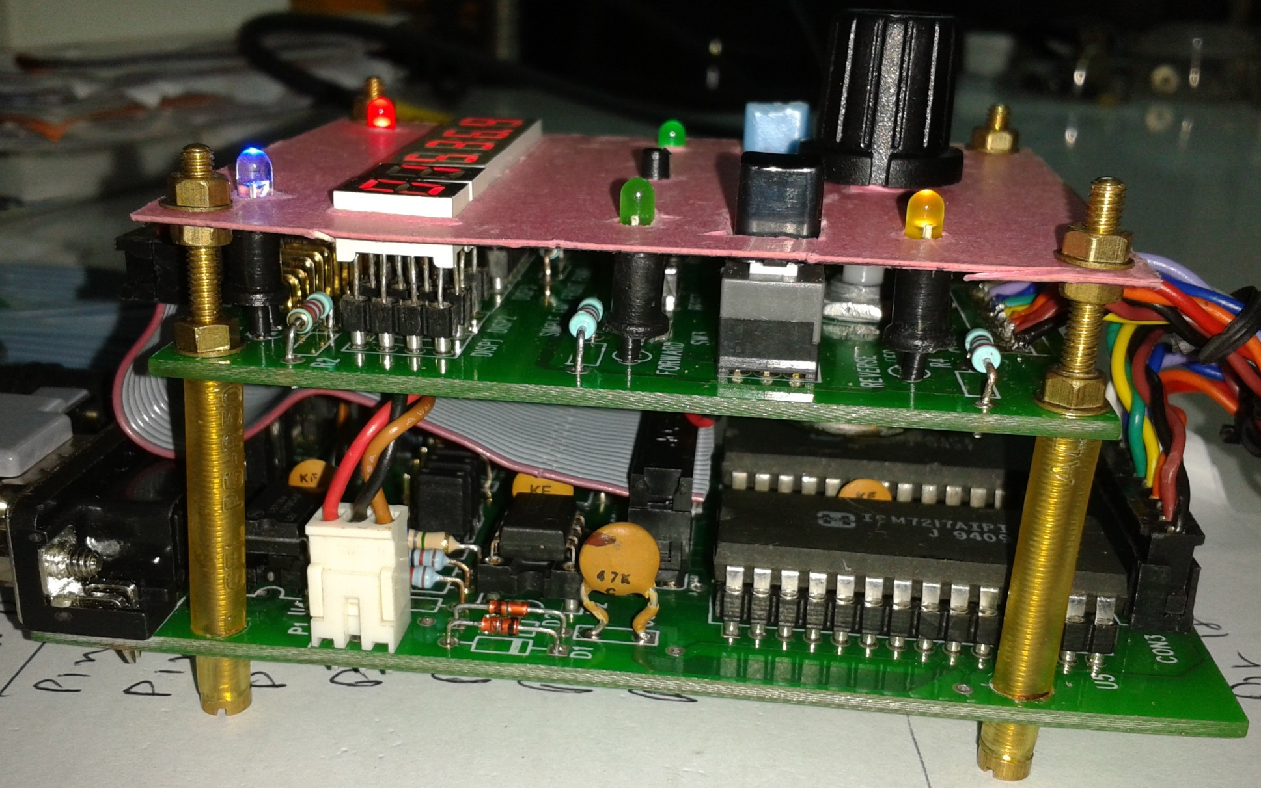
Encoder Mike Controller Circuit Boards

Slide 19
Advanced version of EMC
EM1
EM2
PWR
Basic version of EMC
AUTO RUN
RESET
LOAD
EM
PWR
SW10
SW2
SW9
AUTO
MIRROR EM
OP MODE
SELECT EM
SW4
SW3
MANUAL
CP EM
FORWARD
RESET
RUN
DIRECTION
MOTOR
FORWARD
RUN
SPEED
DIRECTION
MOTOR
REVERSE
HALT
SW5
SW6
SPEED
REVERSE
HALT
MEMORY
COUNTER
SW7
1
1
1
1
1
1
SW8
TWS
REGISTER
DATA IN
THUMBWHEEL SWITCH
DATA OUT

Slide 20
Thank you for your attention!

