Slide 1
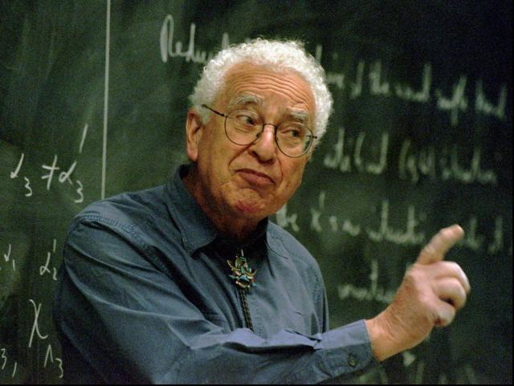
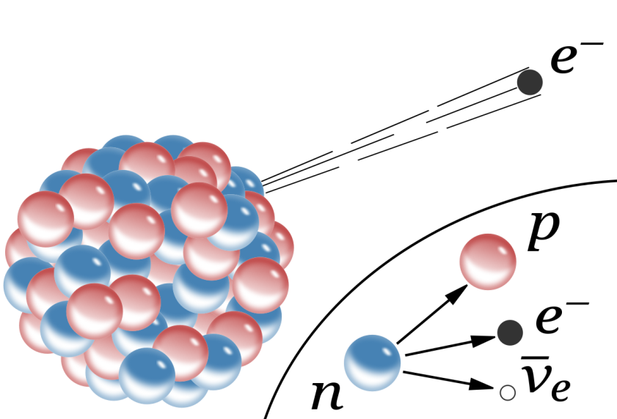
Murray Gell-Mann and weak interactions
Amol Dighe
Gell-Mann commemorative special ASET Colloquium
July 26th, 2019

Slide 2
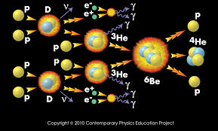
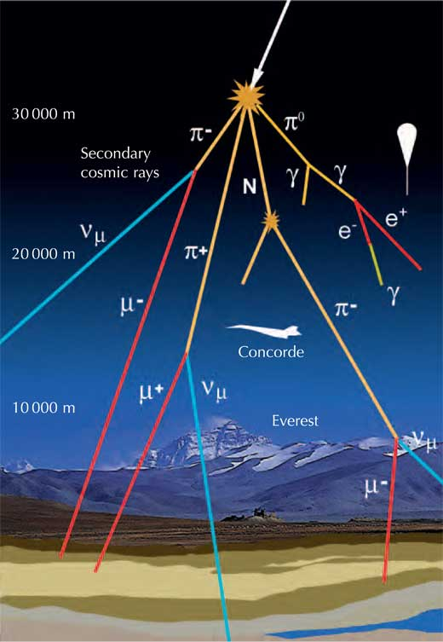
Weak interactions around us
Nuclear fusion inside the Sun
Nuclear beta decays
Decays of muons, pions, and kaons
in cosmic rays

Slide 3
Understanding strange particles
Early 1950’s
Protons – neutrons related by ``isospin’’ symmetry
Charged and neutral pions related by isospin symmetry
Isospin conserved in ``strong’’ interactions but violated in EM
Strange particles found in cosmic rays:
$$\left(V_{1}^{+}, V_{1}^{−}, V_{1}^{0}, V_{4}, τ^{+},τ^{−}\right) ≡(Σ^{+}, Σ^{−}, Σ^{0}, Λ, K^{+}, K^{−})$$
Associated production, long lifetimes
Are these just isospin partners of nucleons and pions ?
Proposals:
Peaslee: $V_{1}$ may have isospin $\frac{5}{2}.$
$⇒$ strong interactions forbid decay to protons/neutrons, but EM do not !
Pais: New particles have extra “orbital isospin” and negative isotopic parity
$⇒$ Associated production OK, strong and EM forbidden

Slide 4
Decoupling spin and isospin
1953
Gell-Mann proposal:
Fermions $\left(V_{1},V_{4}\right)$with integral isospin and
bosons $\left(τ\right)$with half-integral isospin
$⇒$Both strong and EM forbidden
$⇒$ Associated production also restricted
i.e. $N+N→V+V$not possible !
Confirmed by observations
Isotopic spin and new unstable particles,
Gell-Mann, PR 1953

Slide 5
Neutral meson mixing $(K−\overline{K)}$
1955
Neutral spin-0 particles $θ^{0}$ also discovered,
$θ^{0}→π^{+} π^{−}$ observed
Argument:
There should exist an antiparticle ${\overline{θ}}^{0}→π^{+}π^{−}$
Then there should be $θ^{0}↔{\overline{θ}}^{0}$ mixing, since both go to $π^{+}π^{−}$
The true particles observed should be $θ_{1}^{0} and$ $θ_{2}^{0}$
These particles should have different lifetimes
Behavior of neutral particles under charge conjugation,
Gell-Mann and Pais, PR 1955

Slide 6
Nature of weak interactions
Mid- 1950’s
1956: Lee-Yang propose parity violation in weak interactions
1957: Wu, Garwin-Lederman-Weinrich et al. confirm experimentally
$→$Search for Lorentz structure of weak interactions that will explain data, including parity violation
Lee-Yang: combination of S and T operators
Sudarshan-Marshak proposal (1957-58): ``$V−A$’’ interaction
Could explain:
Beta decay: neutron, $O^{14}$, allowed, forbidden, parity conserving, non-conserving …. except $e−ν$ correlation in $He^{6}$ decay and electron asymmetry from polarized neutron decay
All muon decays except one experiment (Columbia) with $e^{+}$polarization from $μ^{+}$ decay
Pion decays, except for apparent absence of electron mode
All strange decays except decays of $Ξ$

Slide 7
$V−A$theory works !
1958
Some experiments like $He^{6}$ “must be wrong”, pion to electron decay may have a subtle resolution.
Parity violation even in processes that do not involve neutrinos
Both, parity violation and neutrino polarization have their origin in weak interactions
Test: any experiment indicating that electron is not 100% left-polarized as $v→c$
Distinguishing between $V+A$ and $V−A$:
polarized neutron decay angular asymmetry
zero for $V−A$, maximal for $V+A$
Footnote 5: ``A universal V,A interaction has also been proposed by E.C.G. Sudarshan and R.E. Marshak (to be published)’’
Theory of Fermi interaction,
Feynman and Gell-Mann, 1958

Slide 8
Universality of weak coupling
1960
Observation that Fermi constant for muon decay and neutron decay are very similar, but not exactly the same
If the difference is real, it may be explained by
$$G V_{α}^{ΔS=0}+G V_{α}^{ΔS=1}=G_{μ}\overline{p} γ_{α}\frac{\left(n+ε Λ\right)}{\sqrt{1+ε^{2}}}$$
(Footnote added in proofs)
The axial vector current in beta decay,
Gell-Mann and Levy, NC 1960
Seeds of Cabibbo angle, acknowledged by Cabibbo in his paper

Slide 9
8-fold way, quarks, octet gluons…
1960’s
EM current for the quarks written down (charges 2/3 and -1/3)
“It is fun to speculate about the way quarks would behave if they were physical particles of finite mass, (instead of purely mathematical entities that they would be in the limit of infinite mass)
One of the quarks (u or d) absolutely stable, beta decay for the other
Ordinary matter near the Earth’s surface may be contaminated by stable quarks from cosmic rays
Covered by Sourendu
A schematic model of baryons and mesons,
Gell-Mann, PL 1964

Slide 10
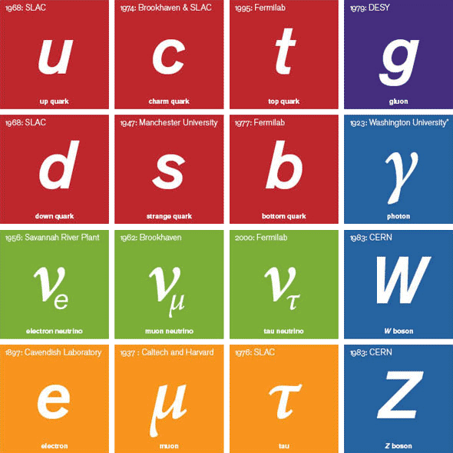
Standard Model of weak interactions
1960’s
Glashow 1961, Weinberg 1967, Salam 1968:
Identification of gauge group as $SU\left(2\right)×U\left(1\right)$, but only left-handed quarks/leptons charged under the SU(2) symmetry $⇒SU{\left(2\right)}_{L}×U\left(1\right)$
Right-handed quarks singlets, parity violation even with massless quarks
Masses of quarks, leptons and gauge bosons through the Higgs Mechanism
Only two generations of quarks / leptons
Discovered so far…
Now

Slide 11
Weak interactions with 3 generations
1975
Kobayashi-Maskawa had predicted three quark generations for CP violation (1972)
Indications from electron-positron annihilation experiments ($E_{CM}=$3-5 GeV) that more elementary particles may exist
Minimal theory based on 6 quark flavors, 6 lepton flavors, and SU(2) x U(1) gauge symmetry
Vector-like weak currents, parity violation from fermion masses
Vectorlike weak currents and new elementary fermions
Fritzcsh, Gell-Mann, and Minkowski, PL 1975

Slide 12
Beyond weak interactions
1979
Looking for gauge unification, a larger gauge symmetry which will break eventually to SU(3) x SU(2) x U(1)
Within SM, there are no right-handed neutrinos. So neutrinos cannot have a mass.
Larger gauge groups may allow for right-handed neutrinos, and can give observed neutrinos a mass.
With SO(10) unification, neutrinos can get Dirac and Majorana masses, and hence the mass of the observed neutrino would be
$$m_{ν}=\frac{m_{Dirac}^{2}}{M_{Majorana}}$$
One of the first ideas of Seesaw mechanism (others by Minkowski 77, Yanagida 80, Mohapatra-Senjanovic 80, Schechter-Valle 80)
Complex spinors and unified theories
Gell-Mann, Ramond, and Slansky, Supergravity Proceedings, 1979

Slide 13
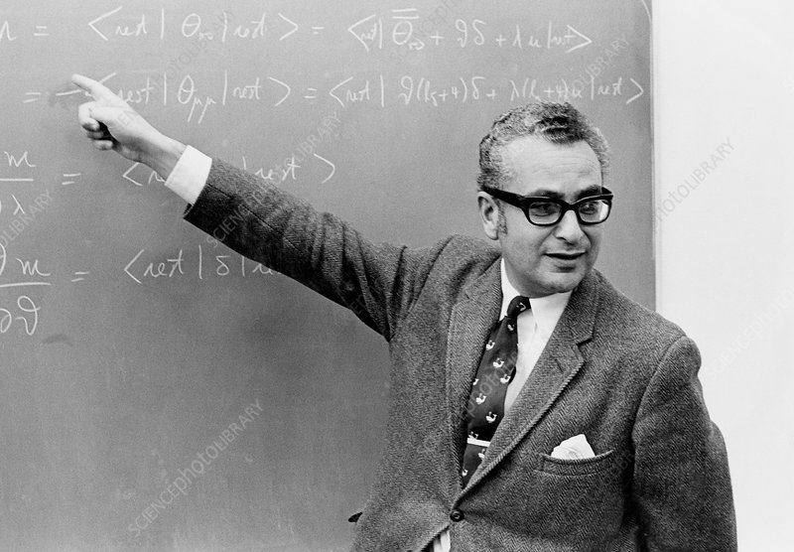
1929-2019

