Slide 1
Scientific Heritage of North-West of India : A Comprehension
Arun Kumar Grover*
Honorary Professor,
Punjab Engineering College (Deemed to be University), Chandigarh
ASET Colloquium
Friday, July 28, 2023
Host : Tata Institute of Fundamental Research, Mumbai
*Sr. Prof. (Retd.), Department of Condensed Matter Physics and Materials Science, TIFR
& ex-Vice Chancellor (2012-18), Panjab University, Chandigarh
arunkgrover@gmail.com

Slide 2
THREE ASET COLLOQUIA SINCE July 2012
I. Ruchi Ram Sahni to Homi Bhabha via Birbal Sahni and Shanti Swarup Bhatnagar:
A perspective
Arun Grover (Vice Chancellor, Panjab University, Chandigarh )
ASET Colloquium, Friday, July 12, 2013
II. Evolution of Education and Research agenda in pre and post independent India : A personal comprehension
Arun K Grover*
Panjab University, Chandigarh 160014
ASET Colloquium, Friday, December 29, 2016
*On leave of absence from TIFR , Mumba
III. A V Hill Report to Kasturirangan’s NEP : 75 years of S & T in India
Arun Kumar Grover
Emeritus Professor and DAE Raja Ramanna Fellow,
Punjab Engineering College (Deemed to be University), Chandigarh 160012
ASET Colloquium, Friday, November 27, 2020

Slide 3
Premise of Today’s Colloquium (IV)
“...Punjab has produced so many top scientists and that's a well-kept secret probably known primarily to Dr. Grover and very few others, that needs to be publicized a lot. ”,
Surmised by Prof. K Vijayaraghavan, FRS during an Online Event organised by Punjab State Council for Science & Technology on Feb. 25, 2022.
Today’s Presentation
Prologue : The annexation of Punjab by East India Company (EIC), the enunciation of first Education Policy, the establishment of three affiliating Universities and the take over of control of India from EIC by the British Government happened in quick succession from 1849-1858.
I shall provide a glimpse into contributions of selection of scientists from North West, which include : A science poularizer, Botanists, Zoologists, Geologists, an Archeologist, Mathematicians, Chemists, Pharma-scientists, Drug developers, Medical Scientists, Physicists, Technologists, Agriculture Scientists, Food providers, Innovators and Enrepreneurs, Atomic Energy and Space Scientists.
I shall include only examples of those born well before the independence of India.

Slide 4
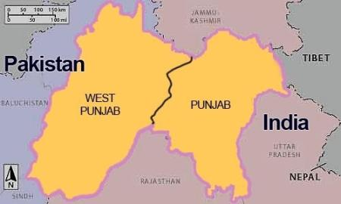
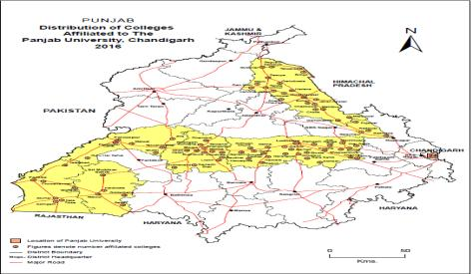
Pre Partition Punjab (1849)
University of Panjab at Lahore was created in 1882 for the North-West : Punjab, Rajputana & Kashmir
Kashmir
EAST
Rajputana
1947: Punjab partitioned
Reorganised again in 1966 : 170 colleges left in PU
Reduction in geographic footprint of Panjab University, Chandigarh on partitioning of Punjab
in 1947 and 1966.
There are three affiliating Universities in truncated Punjab at present (PU,Chandigarh, Punjabi Univ., Patiala and GNDU, Amritsar), sharing the same heritage.
Chd
Truncated domain of P.U. as in 1975 (194 colleges now)

Slide 5
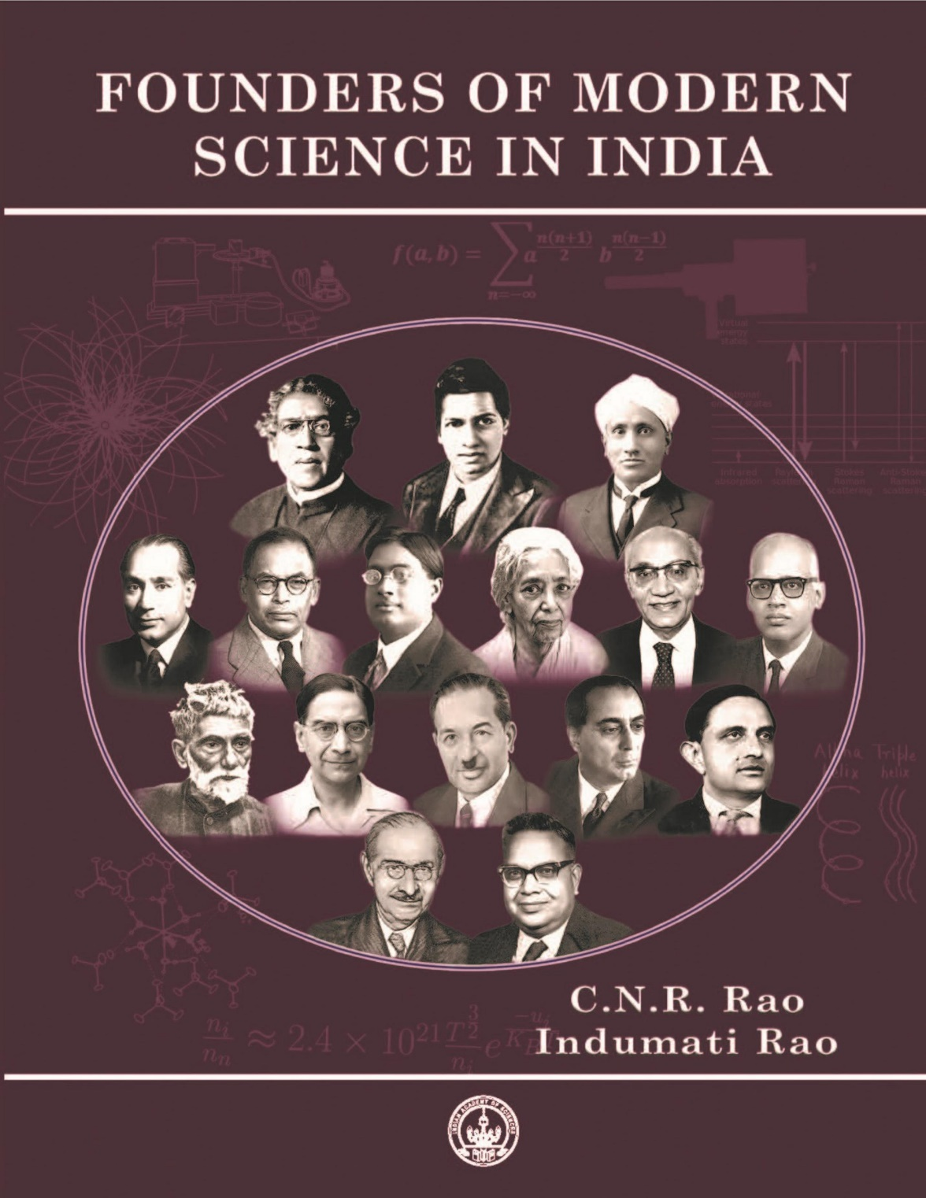
A Book released Online on
March 31, 2021 on the
platform of Indian Academy of Sciences,
Bengaluru to commence the ‘Aazadi ka Amrut Mahotsava’ by the Academy.

Slide 6
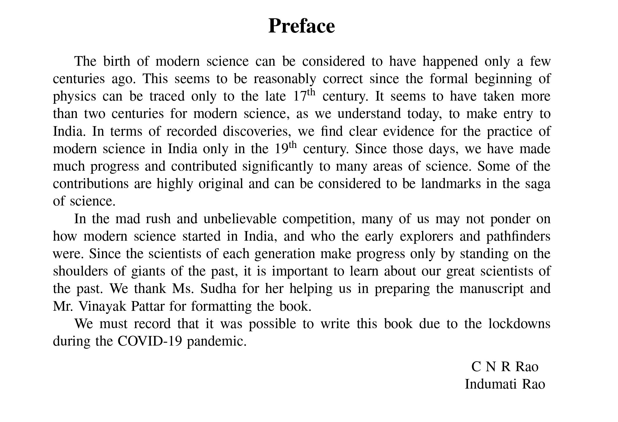
------------------------------------------------------
-----------------------------------------------------------------
Practise of Modern Science in India
commenced in the 19th Century : C N R Rao

Slide 7
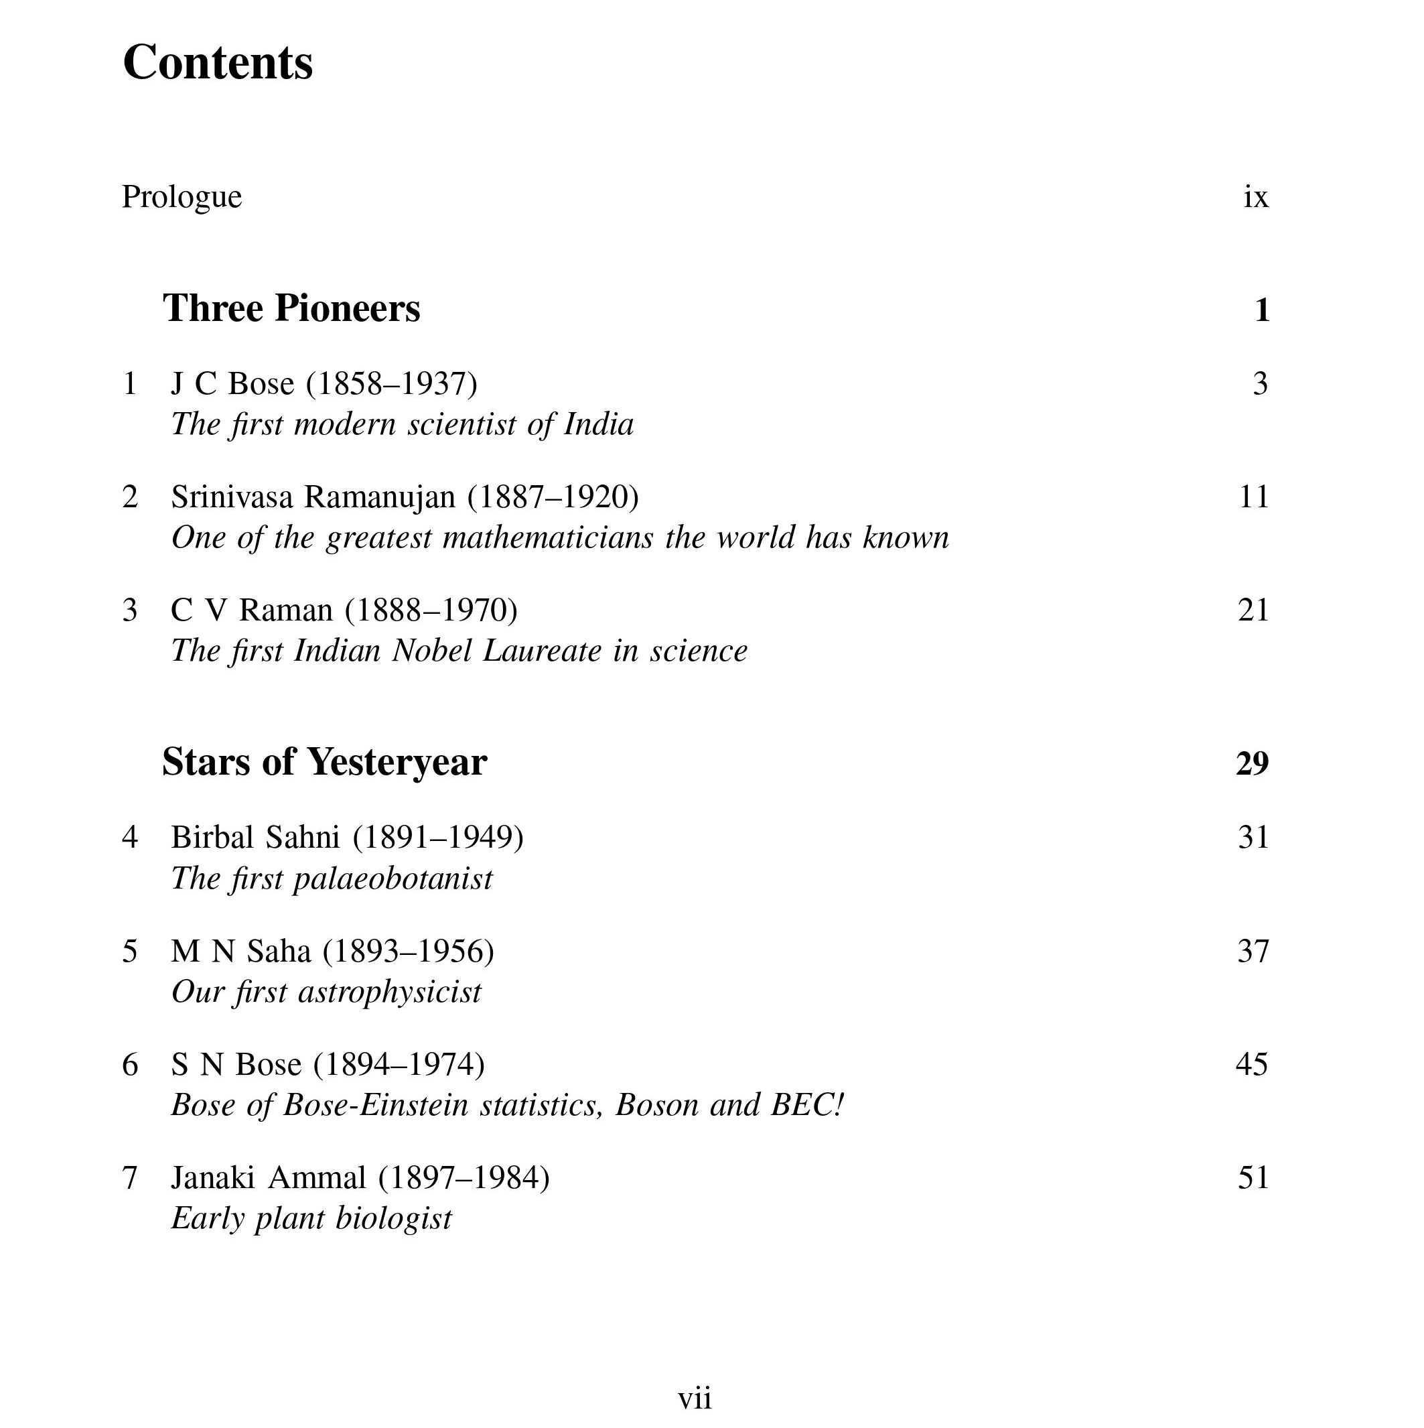
Sixteen scientists selected , sub-divided in four categories,
three of them are from North West of India
[FRS 1920]
[FRS 1917]
[FRS 1924]
[FRS 1943]
[PU@Lahore}
[FRS 1927]
[FRS 1958]

Slide 8
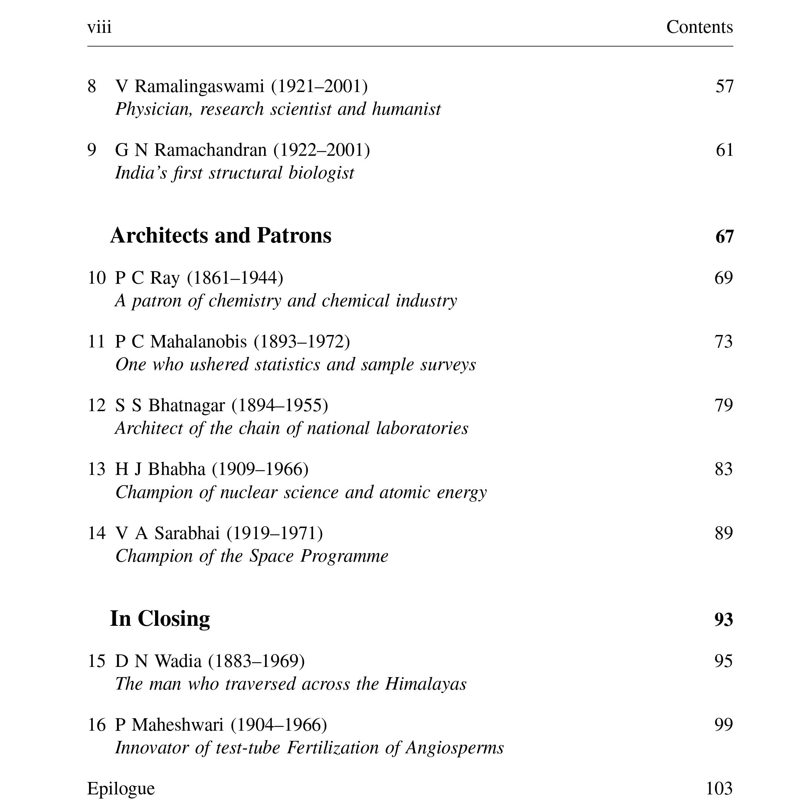
[FRS 1986]
[FRS 1977]
[FRS 1945]
[FRS 1943]
[PU @Lahore]
[FRS 1941]
[FRS 1957]
{Prince of Wales College, Jammu}
[FRS 1965]

Slide 9
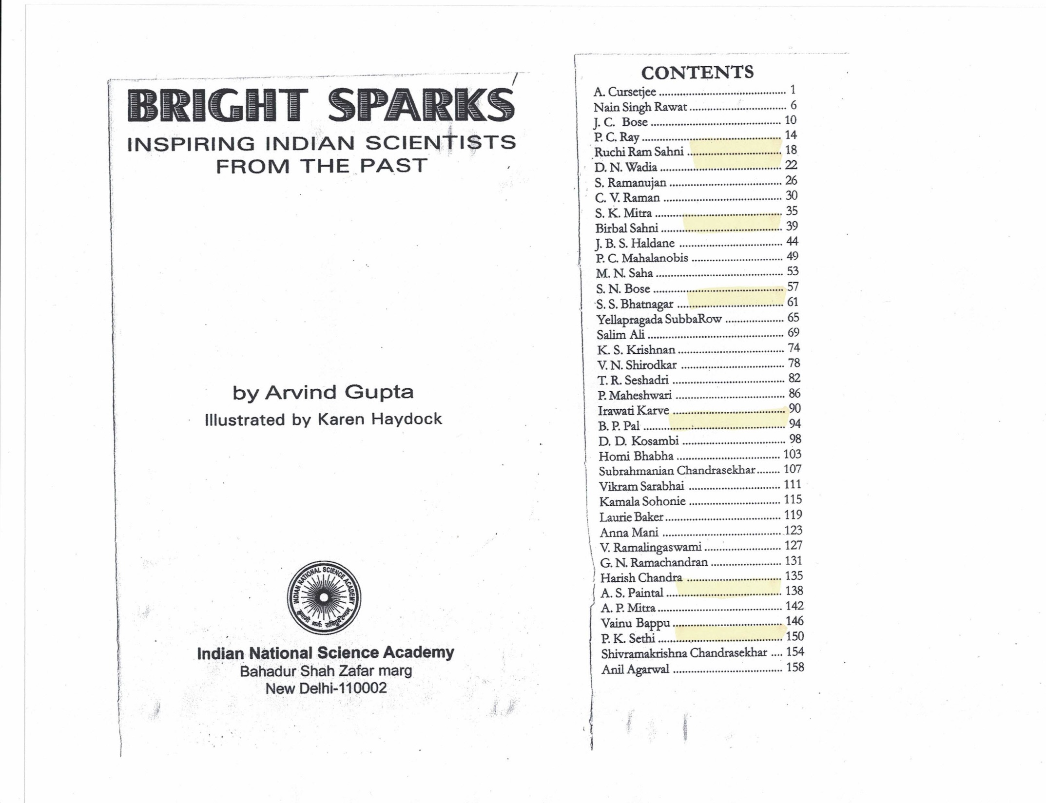
Published in 2009, the 75th year of INSA
1. Ruchi Ram Sahni*
(1863-1948)
2. D N Wadia, FRS
(1883-1969)
3. Birbal Sahni, FRS*
(1891-1949)
4. S S Bhatnagar, FRS*
(1894-1955)
5. B P Pal, FRS
(1906-1989)
6. A S Paintal , FRS*
(1925-2004)
7. P K Sethi
(1927-2008)
Scientific Research Heritage of India as projected
via biographies of 40 scientists from all across India.
Shortlisting of names done by Prof. J V Narlikar,
Prof. Madhav Gadgil and Prof. T Padmanabhan
Seven of them were from North West.
Four out of Seven had studied at Lahore.
Indian Academy of Sciences also published in 2009 one page sketch of all its Fellows since its establishment by C V Raman in 1934. Seventy Five (~8%) of them had Punjab background.

Slide 10
Inspring Indian scientists included in the BRIGHT SPARKS Book
ZONEWISE DSTRIBUTION : India had 5 Universities headquartered at Calcutta, Madras,
Bombay, Lahore and Allahabad in 1904
Bengal Presidency (9)
1. J C Bose, FRS (1858-1937)
2. P C Ray (1861-1944)
3. C V Raman, Nobel Laureate, FRS (1888-1970)
4. S K Mitra , FRS (1893-1960)
5. P C Mahalanobis , FRS (1893-1972)
6. M N Saha, FRS (1894-1955)
7. S N Bose, FRS (1894-1974)
8. K S Krishnan, FRS (1898-1961)
9. A P Mitra , FRS (1927-2007)
Madras Presidency (11)
1. S Ramanujan, FRS (1887-1920)
2. C V Raman, NL, FRS (1888-1970)
3. Y Subbarao (1895-1948)
4. K S Krishnan, FRS (1898-1961)
5. T R Seshadri, FRS (1900-1975)
6. S Chandrasekhar, Nobel Laureate, FRS (1910-1995)
7. Ms. Anna Mani (1918-2001)
8. V. Ramalingaswami , FRS (1921-2001)
9. G N Ramachandran, FRS (1922-2001)
10. Shivaramakrishna Chandrasekhar, FRS (1930-2004)
11. Vainu Bappu (1927-1982)
Bombay Presidency (9)
1. A Cursetjee, FRS (1808-1877)
2. D N Wadia FRS (1883-1969)
3. Salim Ali (1896-1987)
4. V N Shirodkar (1899-1971)
5. Ms. Iravati Karve (1905-1970)
6. D D Kosambi, (1907-1966)
7. Homi Bhabha, FRS (1909-1966)
8. Vikram Sarabhai (1919-1971)
9. Ms. Kamala Sohonie (1912-98)
United Provinces and Central Provinces (8)
1. Nain Singh Rawat, Victoria Cross (1830-1895)
2. P Maheshwari, FRS (1904-1966)
3. B P Pal, FRS (1906 - 1989)
4. Harish Chandra, FRS (1923-1983)
5. V Ramalingswami, FRS (1921-2001)
6. A S Paintal, FRS (1923-83)
7. Anil Agrawal (1947-2002)

Slide 11
Nine out of the 40 Presidents of
National Institute of Sciences (NIS)/
Indian National Science Academy (INSA)
have been scientists of Punjab origin
(either born or studied or taught in Punjab) since 1935 :
(NIS in India was renamed as INSA in 1970)
1. Sir Dr. R N Chopra (1939-40)
2. Dr. D N Wadia FRS (1945-46),
3. Sir Dr. S S Bhatnagar, FRS (1947-48)
4. Dr. S L Hora (1951-52)
5. Dr. A N Khosla ( 1961-62)
6. Dr. B P Pal , FRS (1975-76)
7. Dr. A S Paintal, FRS (1987-88)
8. Dr. Krishan Lal (2011-13)
9. Dr. A K Sood, FRS (2017-19)
NIS
INS
A

Slide 12
Symposium on ‘Post War Organisation of Scientific Research in India’
Sept. 27-28, 1943 convened by J C Ghosh, President, NIS, Calcutta
22 Papers were published in the Proceedings
4 papers were contributed by Punjabi scientists
Post War Organisation of Scientific research
in India by S S Sokhey.
2. Organisation of Scientific and Industrial research in India by S S Bhatnagar.
3. Zoological Research by S L Hora.
4. A plea for the Establishment of a Fishery Research Institute by S L Hora.
List of other contributors
M N Saha, K G Naik, J B Grant, H J Bhabha, B C Guha,
J N Mukherjee, J De Graff Hunter, J Taylor, CWB Normand, B Vishwanath, J A Dunn, C S Fox, P C Mahalanobis, S P Agharkar, V Subrahmanyan, H K Sen, D M Bose, S K Mitra
The recommendations of this Symposium were validated by the Nobel Laureate A V Hill in his Report ‘Scientific Research in India’, which became the
agenda for development of India post independence.
Proc. NIS, Vol X, No. 1, pp.1-96, 1944
----------------------------------------------

Slide 13
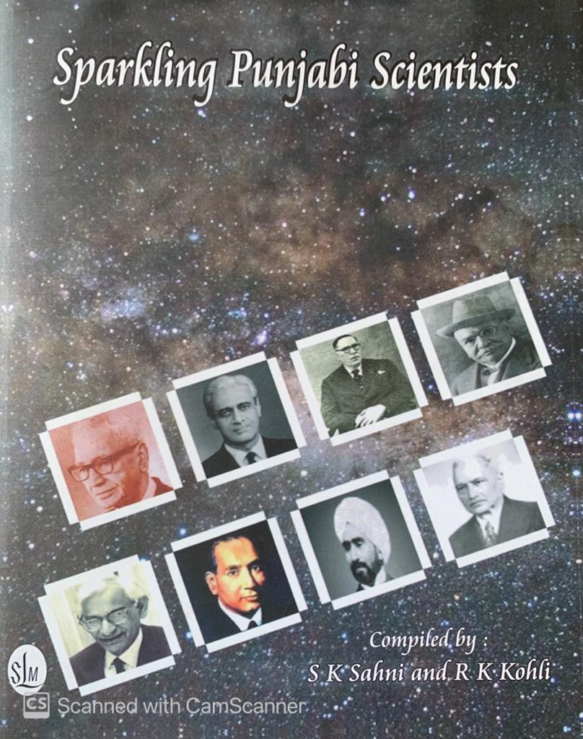
Published in 2018
Compiled by S K Sahni
Executive Secretary, INSA & Prof. R K Kohli, ex-VC, Central University of Punjab, Bathinda. Currently, VC, Amity University Punjab, Mohali
Lists (one page each) contributions of 200 Punjabi Scientists sourced out from Academies of Science, Engineering, Medicine and Agriculture.
150 of them were born prior to 1940.

Slide 14
Chronology after the annexation of Punjab by EIC in 1849
1854 : President of Board of Control of Education in EIC in UK sent a despatch to Governor General Lord Dalhousie . The famous Sir Charles Wood Despatch articulated that education from Schools to Universities be looked together as a continuum. [First Education Policy of India]
1857 : Three affiliating Universities were created in the then three Presidencies of India at Calcutta, Madras and Bombay .
Two more Universities were created in 1882 and 1887 at Lahore and Allahabad, respectively by progessive reduction in the domain of CU.
College of Civil Engineering had been started at Roorkee in 1847 by Lt. Governor of North West prior to the annexation of Punjab. Such a position got discontinued later.
The five Universities neither constructed campuses, nor created University Departments until the promulgation of Indian Universities Act (1904).
The new Act had enjoined the Universities to appoint teachers who had potential for research. However, no additional financial support was promised to do so.

Slide 15
College Education in Punjab: 1864-1902
January 1864: Two Government Colleges started at Lahore (GCL) and Delhi (GCD) simultaneously, the latter folded up in 1877 & merged with GCL. Both were affiliated to Calcutta University.
1875 : Mayo College of Industrial Art initiated, appended to Lahore Museum and College of Oriental Studies, Lahore. Mr. John Lockwood Kipling was the first Curator of the Lahore Museum. His son Rudyard Kipling grew up in Lahore and received the Nobel Prize in Literature in 1907.
Sir Ganga Ram (1851-1927) was deputed (1871) to study Civil Engineering at Roorkee. He returned to teach engineering courses at Oriental College and emerged as an entrepreneur, innovator and builder of modern Lahore. His contributions are comprable to that of Sir M Visvesarayya (1861-1962).
S. Dyal Singh Majithia (1849-98), a contemporary of Ganga Ram, founded The Tribune in 1881, and there after had played a crucial role in establishing a University at Lahore on the lines of Universities in Europe.

Slide 16
Summary of Science initiatives at Panjab University, Lahore
(1885-1904)
Punjab Science Institute was set up in 1885 by Prof. J C Oman and Ruchi Ram Sahni on the lines of Indian Association for Cultivation of Science (IACS), Calcutta. However, it wound up in 1898.
Ruchi Ram Sahni (1864-1948) was a contemporary of Asutosh Mukherjee at Presidency College for one year in 1885-86 at Calcutta, but there were no equivalents of J C Bose and P C Ray at Government College Lahore. There were no research facilities created of any measure at Lahore till the end 19th century.
By 1901-02, there were 15 Colleges affiliated to P.U. at Lahore.
After the introduction of new 1904 Act, teachers in Government Colleges were allowed to seek ‘Study Leave’ for Higher Studies and Research abroad.

Slide 17
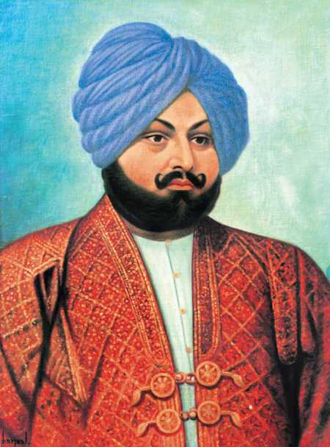
Sardar Dyal Singh Majithia (1848-98)
Son of Gen. Lehna Singh, an Innovator & Head of Ordinance, Maharaja Ranjit Singh
Administrator of Harmandir Sahib, Amritsar
Founder, Lahore Brahmo Samaj
Founder, The Tribune (1881)
First Chairman, Punjab National Bank (1894)
Promoter of PU as a Western University
Mentor of Ruchi Ram Sahni, a Brahmo
Provider of financial support to start Schools for Brahmos in Lahore and Bhera.
S S Bhatnagar received Financial support at the initiative of Ruchi Ram Sahni from Dyal Singh Majithia Trust
Dyal Singh College established in
Lahore in 1910 after his death.

Slide 18
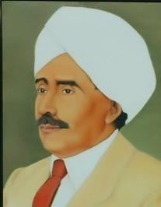
Ruchi Ram Sahni (1863-1948), a Science Populariser
Mentor of Birbal Sahni (his son) and Shanti Swarup Bhatnagar at Lahore
Motivated by Dyal Singh Majithia, he came under the influence of Brahmo Samaj as a student.
A stamp was released to honour Ruchi Ram Sahni in his 150th Birth year on October 24, 2013 at PU campus.
Contemporary of Asutosh Mukherjee at Presidency College, Calcutta (1885).
First native officer in Meteorology Department of Colonial Government .
First native science teacher in Govt. College Lahore (1887).
Founder Secretary of Punjab Science Institute (1885), Lahore.
First Indian to work in Lord Rutherford’s Laboratory at Manchester (1914-15).
Also, worked with C V Raman at Calcutta on return from Manchester in 1916.

Slide 19
Initiatives at Panjab University, Lahore (1904 -1914)
Small grants were made available to the Universities after 1904 to invite eminent teachers from abroad for extended stay in Indian institutions during ‘Cold Months’ in Europe and America.
(a la GIAN Scheme of MHRD initiated in 2014)
From 1912 onwards, Panjab University started to invite researchers from abroad using the government grant.
The first visitor was Mr Daniel Jones, followed by Mr Ramsey Muir, who commenced Inter-Collegiate classes for talented students of different colleges.
Another visitor Prof. A Smithells, FRS in 1913-14 motivated a very young faculty member Mr. B H Willesden of Govt College Lahore to prepare a scheme for Honours School of Chemistry under the central control of the University, teaching being provided on an collective basis by all the affiliated colleges in Lahore.
Panjab University invited Prof. A H Compton to visit Lahore in 1926.
{Homi Bhabha had listened to his lecture in Royal Inst. of Science at Bombay in 1926}

Slide 20
1 1919 : Honours School System introduced at Colleges of Lahore
1919 : Panjab University Syndicate approved the initiation of a new Integrated Honours School System (3+1), instead of the usual two years of Bachelor’s followed by two years of Master’s degree in different subjects for bright students of different colleges of Lahore.
A similar scheme had been introduced in few selected colleges by University of Madras in 1911, where a 2-years of Bachelor course and a 2-years of Master course was compressed into a three years of Honours Course for very bright students. The Honours scheme in University of Madras was discontinued after Indian independence in 1957. The last Honours examination at Madras was conducted in 1960.
However, the Honours school System (3+1) started to bloom in Panjab University’s new Chandigarh campus from 1960 onwards.
Interestingly, the (3+1) System was the equivalent of four years Bachelor’s scheme in NEP 2020 !

Slide 21
Higher Education Initiatives at Panjab Univ., Lahore (>1919 )
Several college teachers who had been given study leave to go abroad returned with exposure to research, some of them were appointed as University Professors, Readers and Lecturers in their respective subjects in 1919.
Shiv Ram Kashyap (Botany), Gopal Singh Chowla (Mathematics), Bawa Kartar Singh (Chemistry), Birbal Sahni (Botany), et al were teachers at Lahore by 1919.
The Panjab University had made only a dozen new appointments for its Honours School System from 1919 onwards.
In 1919 itself, it was proposed to erect University Chemical Laboratory (UCL) at a cost of 4.5 lakhs and look for a Professor of Physical Chemistry. A global search for Professor’s position was commissioned in 1924.

Slide 22
Happenings at Panjab Univ., Lahore (1920 onwards)
Dr. S S Bhatnagar had assumed charge as Director of University Chemical Laboratories in 1925. He was Research Professor at BHU from 1921-24, like, C V Raman at Calcutta University. He built the world class School for Chemical Sciences at Lahore.
C V Raman had visited Lahore in 1920 and delivered 15 lectures at Govt. College Lahore. However, the Physics Honours School was the last to get started in 1934.
Dr P K Kichlu, a student of Prof. Meghnad Saha at Allahabad University, joined Govt. College Lahore in 1929. He was an integral part of Physics Honours School at Lahore from 1934 to 1947. B M Anand got inducted as a Lecturer in Physics in 1934.
Dr. Sarvadaman Chowla returned to Lahore in 1936 as the Head, Department of Mathematics at Govt. College Lahore and PU.
Hari Ram Gupta, F C Auluck, R P Bambah, the would be Nobel Laureate Abdus Salam and the would be founder of Tata Consultancy Services (TCS) F C Kohli were amongst the students of Dr. Sarvadaman Chowla at Lahore.

Slide 23
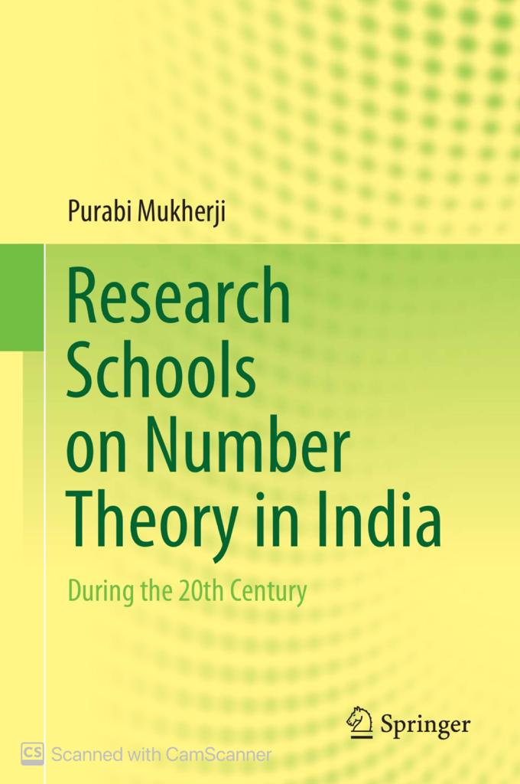
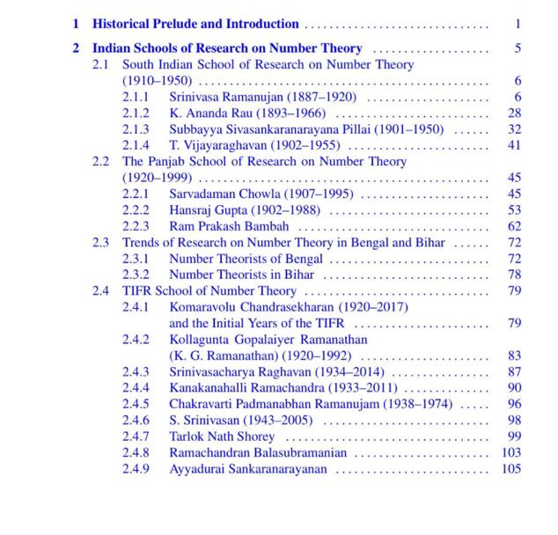

Slide 24
Consequence of Introduction of Honours Schools System
in the Colleges of Panjab University at Lahore
PU Calendar (1945) :
The teaching in Honours School shall consist, so far as is possible, of discussion between teacher and student, guidance in reading and criticism of written and practical work, with attention to the particular development of individual student.
It shall EXCLUDE the use of text books and delivery of lectures to be recorded and memorized like text books.
One can therefore enumerate today numerous inspiring examples of outstanding contributions in different areas of science by the teachers and students who hailed from erstwhile Punjab, before and after the Indian independence.

Slide 25
Some of the early Science Teachers at Govt. College and PU at Lahore
Physics and Chemistry
J C Oman (1877-98) : Physics , Chemistry and General Science
Ruchi Ram Sahni (1887-1917) : Chemistry and Physics
A S Hemmy (1898-1906) : Physics
B M Jones (1906-12) : Chemistry
Chetan Anand ( 1906-1928) : Physics
B S Willesden (1912- ) : Chemistry
H B Dunnicliff (1917-47) : Chemistry
Kartar Singh Bawa (1918-1921) : Chemistry
N A Yajnik (1919- ?) : Chemistry
S S Bhatnagar (1925-40) : Chemistry
J B Seth (1925-45) : Physics
Dr. P K Kichlu (1929-46) : Physics
B M Anand (> 1934) : Physics
H R Sarna (> 1934) : Physics
Mahan Singh (>1934) : Chemistry
Biology
H M Chhibber (1902-1906) : Biology
Shiv Ram Kashyap (1906-34) : Botany
J Stephensen (1906-1912) : Zoology
R H Whitehouse (1913-1918) : Zoology
Behari Lal Bhatia (1909-26) : Zoology
George Mathhai (1918-1942) : Zoology
S L Ghose (1935-45) : Botany
H Chaudhuri (1935-45) : Botany
Vishwa Nath (1945-1947) : Zoology
P N Mehra ( 1935-47) : Botany
Dewan Anand Kumar (1920 - 47) : Zoology (VC, PU, Cdg)
Mathematics
W H Crank (1865-1869)
T W Lindsay (1869-1877)
J Sime (1877-1881)
S B Mukherjee (1881-1898)
Golak Nath Chatterjee (1898-1909)
Maulavi Abdul Aziz (1898- ?)
Gopal Singh Chowla (1902-28)
Kishen Kapur (1918 - ?)
A M Mian (1934- ?)
Sarvadaman S Chowla (1936-47)
F C Auluck (1938-?)
R P Bambah (1945-46)
The researchers in each area
were indeed small in number
at Lahore, however, the
quality of their work was World Class.

Slide 26
Physics Researchers at Lahore (1925 onwards)
Prof. D J Fleming, Forman Christian (F C) College Lahore ( >1907)
Dr. J M Benade, F C College (1912-57) [had worked with K H Compton]
J B Seth, M. A. (Canteb.), Professor and Head of Physics (1926-45), GCL
Dr. P K Kichlu, Lecturer in Physics (1929-46), GCL [had worked with M N Saha]
B M Anand , Lecturer in Experimental Physics, Panjab University (>1934)
Dr. A M Mian, Lecturer in Physics/Mathematics, Panjab University (>1934)
Dr. H R Sarna, Lecturer in Physics, GCL (>1934)
Dr. R M Chaudhury, Islamia College (1933-38) [had worked with Mark Oliphant]
Dr. Piara Singh Gill, F C College (1940-47) [had worked with A H Compton]
Dr. G L Datta, DAV College Lahore (~1930-47) [had worked with C V Raman]
)

Slide 27
Inter-collegiate Faculty of Honours School in Physics, PU, Lahore
(1938)
1. J B Seth, MA (Cantab.), Prof. and Head, Physics Dept., GCL and PU
2. Abdul Hamid Beg, MSc., Lecturer, GCL
3. B D Chabra, MSc., Lecturer, GCL
4. P K Kichlu, MSc. (PU), DSc. (Allahabad Univ), Lecturer, GCL
5. Mela Ram, MSc., Ph.D., Lecturer, Forman Christian College, Lahore
6. B M Anand, MSc., Lecturer in Physics, PU
7. A M Mian, MA, PhD, Lecturer, PU
8. P N Kalia, MSc. PhD, Lecturer, Dyal Singh College, Lahore
9. H R Sarna, MSc. PhD., Lecturer, GCL
10. Jatindra Nath, Demonstrator, PU

Slide 28
Board of Control of Honours School in Physics, PU, Lahore
(1938)
1. J B Seth, MA (Cantab.), Prof. and Head, Physics Dept., GCL and PU
2. G L Datta, MSc., PhD ( Calcutta), Lecturer, D A V College, Lahore
3. B D Chabra, MSc., Lecturer, GCL
4. P K Kichlu, MSc. (PU), DSc. (Allahabad Univ), Lecturer, GCL
5. Rafi Muhammed Chaudhuri, MSc., PhD , Professor, AMU
6. Mela Ram, MSc., Ph.D., Lecturer, Forman Christian College, Lahore
7. B M Anand, MSc., Lecturer in Physics, PU
8. J M Benade, MSc., PhD (Princeton), Professor, F C College, Lahore
9. Faqir Chand Auluck, M.A., Lecturer, PU (Temporary)
The underlined were teaching the Honours School students.

Slide 29
First Research Scientist of PU at Government College, Lahore
Shiv Ram Kashyap (1882-1934)
Botany Department of PU Chandigarh is called Kashyap Hall
--------------------------------------------------------------
J C Bose and Shiv Ram Kashyap were awarded DSc. (Honoris Causa)
by Panjab University at its Golden Jubilee Convocation in 1933
(The above Plaque was put up in 2014)

Slide 30
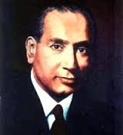
Extracted from ‘Sparkling Punjabi Scientists’
Compiled by S K Sahni and R K Kohli,
SLM Publishers, Patiala, 2018
First Botanist from India to be FRS
Professor Birbal Sahni, FRS
(1891-1949)
Prof. Sahni was born on 14 November, 1891,at Bhera, Shahpur, Punjab (Pakistan); received early education at Government College University, Lahore (where his father Ruchi Ram Sahni worked) and Punjab University, Lahore (Punjab) (1911). He learnt Botany under great botanist Prof. S.R. Kashyap. He graduated from Emmanuel College, Cambridge in 1914 and did his doctorate work (D.Sc.) from University of London (1919) and another D.Sc. (1929) from University of Cambridge, UK. Briefly, he worked in Munich, Germany and returned to India in 1919 and was Professor of Botany, Banaras Hindu University, Varanasi and Punjab University, Lahore for about a year. In 1921 he was appointed as First Professor and Head, Department of Botany, University of Lucknow and served till 1949.
He founded the Paleobotanical Society and established the Institute of Paleobotany on 10 September, 1946 which initially functioned from the Botany Department of Lucknow University. On 3 April, 1949, Pt. Jawaharlal Nehru, Prime Minister of India laid the foundation stone of the new building of the Institute. A week later, on 10 April, 1949 Prof. Sahni succumbed to a heart attack. Now the Institute is named as Birbal Sahni Institute of Palaeobotany. He was member of Editorial Board of Chron Bot.
Prof. Sahni was deeply interested in botany, palaeobotany and geology. He made extensive contributions to the structure and affinities of certain zygopterid ferns. His studies on Indian Gondwana plants, describe a number of entirely new fossil plants and involve revising several old species and their geological ranges. He also investigated the structure and affinities of various Indian fossil plants from Palaeozoic to the Quaternary beds.
He was a Fellow, of the Royal Society, London and Asiatic Society; Foundation Fellow, Indian National Science Academy (Vice President,1935-36) ,Indian Academy of Sciences, and National Academy of Sciences (India)(President ,1943-44); Honorary Foreign Member, American Academy of Arts and Sciences. He was President, Botany Section (1921, 1938), Geology section (1926) of Indian Science Congress and Vice-President, Palaeobotany Section(1935) International Botanical Congress and General President (1940), Indian Science Congress.
Prof. Sahni received numerous awards, notableare: Barclay Medal by Asiatic Society (1936); Sir Cattamanchi Ramlinga Reddy National Prize; and Nelson-Write Medal of Numismatic Society (1944).
Prof. Sahni died on 10 April, 1949.

Slide 31
Birbal Sahni (1891-1948)
First Botanist from India to be FRS
Birbal Sahni was mentored by Ruchi Ram Sahni and Shiv Ram Kashyap at Lahore.
He collated evidence in fossil samples from Himalayas for the proposition of Continental Drift. Himalaya range is a consequence of it.
He set up Birbal Sahni Institute of Palaeosciences (BSIP) in 1946 at Lucknow, an autonomous institute under DST today.
National Council for Science and Technology Council (NCSTC) had commissioned a 5-part serial titled “Fossil Memoirs” by filmmaker Nandan Kudhiyadi to commemorate Birth Centenary of Birbal Sahni in 1991.

Slide 32
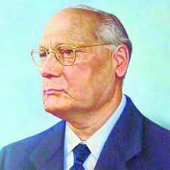
A contemprary of Dr. Homi Bhabha (1909-1966)
Dr. Mohinder Singh Randhawa (1909-1986)
Dr. Randhawa was born on 2 February, 1909 at Zira, Punjab; received B.Sc. (Hons.) and M.Sc. (Hons.) in 1930; D.Sc. (1955) from Punjab University, Lahore. He joined Indian Civil Services in 1934 and served in various capacities in Uttar Pradesh till 1945. He was Secretary, Imperial Council of Agricultural Research, New Delhi (1945-46); Additional Director-General, Rehabilitation and Director-General, Rehabilitation, Punjab (1949-51); Commissioner, Ambala Division (1951-53); Development Commissioner, Rehabilitation and Custodian, Evacuee Property (1953-55), Punjab; Vice President, Indian Council of Agricultural Reserch (ICAR) and Secretary to the Government of India, Ministry of Food and Agriculture (1955-60); Natural Resources, Planning Commission (1961-64); Special Secretary, Ministry of Food and Agriculture (1964-66); Chief Commissioner, Union Territory, Chandigarh (1966-68); and Vice-Chancellor, Punjab Agricultural University, Ludhiana (1968-76).
Dr. Randhawa was specialist in phycology, floriculture and agriculture. He did extensive work on morphology, taxonomy, distribution and ecology of algae. He co-authored books Evolution of Life (CSIR, 1968), Zygnemaceae (ICAR, 1959) and Flowering Trees in India (ICAR, 1961). He served on numerous governing bodies/committees of ICAR, CSIR, ISI (now BIS), and other bodies. As an all-round personality, he contributed to the India’s development in general, and rural uplift in particular. He made huge contributions for growth and development of ICAR which was responsible for the Green Revolution in India. He was Chief Editor of ICAR publications and of CSIR’s (Publication and Information Directorate) monographs on Botany series.
Dr. Randhawa received many honours and awards, notable are: Punjab University Robe of Honour for Services to Punjabi Literature (1968); Grant Gold Medal by Royal Agro-Horticultural Society of India (1971); Padma Bhushan (1972); D. Sc. (h.C.) by the University of Udaipur (1974). Innovator in Agriculture Honour by the President of India (1976); and Silver Jubilee Commemoration Medal by INSA (1979). He was a Fellow ofthe Indian Academy of Sciences, Bangalore;, National Academy of Sciences (India), Allahabad, Indian National Science Academy (Vice President 1979-80); Vice President, Indian Society of Agricultural Statistics; President,Phycological Society of India and Patron, Northern Indian Science Association.
Dr.Randhawa died on 3 March, 1983.

Slide 33
Dr. Mohinder Singh Randhawa (1909-1986)
M S Randhawa, was a student of Prof. Shiv Ram Kashyap at Lahore.
He qualified for ICS in 1934.
He served as First Chief Commisioner of UT Chandigarh (1966-68).
Vice Chancellor, Punjab Agriculture University, Ludhiana (1968-76)
Dr. M S Randhawa was honoured with Innovator in Agriculture Award by the President of India in 1974.
He was also chosen for ‘Robe de Honour’ of Panjab University for Punjabi Literature in 1968.

Slide 34
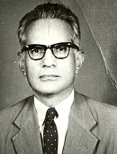
Classmate of M S Randhawa
Professor Amar Chand Joshi (1908-1971)
Prof. Joshi was born on 18 September, 1908; at Bahadurpur, Hoshiarpur (Punjab); obtained D.Sc. degree (1937) from Panjab University, Lahore. He was Professor of Botany, Government College, Lahore; Director, Botany Laboratory, Punjab University (Lahore); Professor of Botany, Government College, Hoshiarpur (1947); Principal, Government Training College for Teachers, Julandhar (1951); Director, Public Instruction and Secretary, Government Punjab (1953-57); Honorary Vice-Chancellor, Kurukshetra University (1956-59); Vice Chancellor, Panjab University, Chandigarh (1957-65); Educational Adviser, Planning Commission, New Delhi (1965); and Vice Chancellor, Banaras Hindu University, Varanasi.
Prof. Joshi did significant work on the anatomy and embryology of flowering plants, morphology of flower, cytology and systematics. His work on the classical carpel and anomalous secondary growth is notable.
He was a Member,University Grants Commission (1960-1965); Central Advisory Board of Education; Advisory Board of ICAR; National Council of Science Education; National Planning Council, etc. Prof Joshi’s contributions to the improvement of school science education deserve special mention. He was largely responsible for organizing All India Council of Secondary Education; Indian delegate to UNESCO Conference (Bangkok, 1956) to consider problems of science teaching in South-East Asian countries; Chairman, Science Committee, World Confederation of Organizations of Teaching Professors (1963-64). A prolific writer on educational and cultural subjects and was Editor of a number of scientific and educational periodicals.
Prof. Joshi was a Fellow, of the National Academy of Sciences (India),Indian National Science Academy (Vice President 1963-64); President, Indian Botanical Society (1948, 1956). He was President, Indian Science Congress (1969).
Prof.Joshi died on 14 February, 1971.

Slide 35
Botanist Amar Chand Joshi (1908-1971), classmate of M S Randhawa
A C Joshi co-authored his first book ‘Flora of Lahore’ while serving as a Teaching Assistant at PU, Lahore in 1930-31, when Shiv Ram Kashyap was the Director of Botany Laboratory.
He moved to BHU as an Assistant Professor in 1931.
A C Joshi obtained his PhD from BHU.
Dr. A C Joshi received his DSc. from PU in 1937.
Prof. Joshi served as the Director of Botany Laboratories at Lahore from 1945-47.
Dr. A C Joshi (VC, PU from 1957-65) had got built the present PU campus and sourced out the talented faculty from all across India and abroad.
PU Library is named as A C Joshi Library.
He also served as Vice Chancellor of BHU from 1967-69.

Slide 36
Professor Shiv Ram Kashyap Oration Lectures
(2014-22)
Prof. Deepak Pental*, FNA (former VC, DU):
Transgenic Crops: Opportunities and Fears (28.4.2014)
2. Prof. M.S. Swaminathan , FRS :
Next Generation Genomics and Zero Hunger Challenge (13.3.2015)
3. Prof. K.S. Bawa*, FRS:
Reconnecting with Nature to Secure our Future (06.2.2016)
4. Prof. Gurdev S. Khush*, FRS :
Biotechnology for Food Safety (24.3.2017)
5. Prof. Imran Siddiqi, FNA ( Infosys Prize Winner) :
GM Crops in the Indian Context: Will the Past Inform the Future (24.4.2019)
6. Prof. Sudhir K. Sopory, FNA ( ex- VC, JNU, New Delhi) :
Strategies towards developing plant tolerance under abiotic stress (24.4.19)
Prof. Satish Chandra Verma*, Emeritus Prof., Dept of Botany, PU :
Breeding System in Fern [ 2020]
Prof. A N Purohit, Ex-VC, HNB Garhwal University, Srinagar (Uttrakhand) :
Climate Change and importance of research on plant Biology. [2021]
9. Dr. P K Khosla*, Chancellor, Shoolni University, Solan, HP :
Himalayan Biodiversity : An Overview [2022]
* PU ALUMNUS (5 lectures delivered by them)

Slide 37
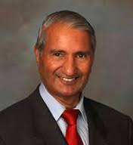
Dr. Gurdev Singh Khush, FRS (b: 1935)
Winner of World Food Prize (1996)
PU Vigyan Ratna (2008) and DSc (Honoris Causa) of PU (2016)
Seven other India Educated Winners of World Food Prize since 1987 :
Prof. M S Swaminathan (1987) 2. Dr. V Kurien (1989) 3. Dr. B R Barwale (1998)
Dr. Surinder K Vasal * (1998) 5. Dr. M Vijay Gupta (2005) 6. Dr. Surya Rajaram (2014)
7. Dr. Rattan Lal * (2020)
Born in Amritsar * Born in Karyal, Gujranwala (now in Pakistan)
Three Punjab born (and educated in PAU Ludhiana) Agricultural Scientists have won World Food Prize in 1996, 1998 and 2020.

Slide 38
Vigyan Ratna Awards at Panjab University, Chandigarh
1. Dr. G S Khush, FRS (2008): Agricultural Scientist
2. Dr. Yash Pal, ex-Chairperson, UGC, (2010) : Physicist
3. Dr. Ajay Sood, FRS, President, INSA, (2011) : Physicist
4. Dr V P Kamboj, ex-President, NASI, (2012) : Drug discovery
5. Dr. Amod Gupta, Founder, Advanced Eye Centre, PGIMER (2013)
6. Dr. Nitya Anand, ex-Director, CDRL, (2014) : Drug Chemistry
7. Dr. Girish Sahni, ex-DG, CSIR (2015) : Biotechnologist
8. Dr. P D Gupta, ex-VC, HBNI, (2017) : Laser Technologist
9. Dr. Veena Tandon, ex-Professor, NEHU,(2023), Zoologist
Udyog Ratna Award of PU for Entrepreneurship
Dr. Sukh Dev (2014)
Dr. F C Kohli (2015)
Mr. S K Munjal (2017)
Mr. Ashok Bharti Mittal (2023)

Slide 39
Photograph taken at the PU Guest House in March 2014
Dr. R. P. Bambah (b: 1925), Dr. Nitya Anand (b:1925),
Dr. Sukh Dev (b: 1923) and Dr. F. C. Kohli (1924 - 2020).
All students at Lahore together with the would be
Nobel Laureates Har Gobind Khorana and Abdus Salam .

Slide 40
Citation of Dr. Nityanand (b: 1925), PU Vigyan Ratna Awardee (1914)
Dr. Nityanand graduated from the University of Punjab at Lahore and obtained his Doctorate degrees, the first from the University Department of Chemical Technology, Bombay and the second from the Cambridge University in U.K. Dr. Nitya Anand was a Rockfeller Foundation Fellow (1959) at the Department of Bacteriology & Immunology, Harvard Medical School, Boston (USA). He joined the Central Drug Research Institute (CDRI), Lucknow in 1951. He superannuated from the CDRI in 1984, after having served as its Director from 1974. Dr. Nitya Anand was INSA Senior Scientist during 1985-87. He built an active School of Research in Medicinal Chemistry at CDRI, which contributed significantly to the design, discovery and development of new drugs. He published over four hundred research papers and guided numerous students for Ph.d. degree. He has to his credit nearly one hundred and thirty national and international patents. He remained associated with formulation of drug policy by different bodies of Government of India for over four decades. Dr. Nitya Anand was a Council Member of Indian National Science Academy (INSA) from 1974 – 76 and was named a recipient of its Vishwakarma Medal in 1982. He is also a Fellow of the National Academy of Sciences of India, Allahabad and the Indian Academy of Sciences, Bangalore.
Har Gobind Khorana, Sukh Dev, Nityanand, R P Bambah, F C Kohli and Abdus Salam were contemporaries at Lahore

Slide 41
Citation of Padma Bhushan Prof. Sukh Dev (b: 1924), Udyog Ratna Awardee (2014)
An iconic alumnus of the University of Punjab at Lahore and the Indian Institute of Science, Bangalore, Prof. Sukh Dev is acknowledged amongst the rare category of scientists who themselves proceed towards technology development and production that brings economic benefits to the society. He has had plethora of distinctions to his credit, which merit the conferment of Udyog Rattan Award to him.
After serving as the Head of Organic Chemistry (Natural Products) at NCL from Pune (1960-74), he moved to the newly created Malti-Chem Research Centre, near Vadodara, to serve as its Research Director till 1998 and to develop technologies, based on his original research. As he moved from institution to institution, the thrust of his contributions underwent shifts, in consonance with the mandate of the institutions, ranging from curiosity-driven to market- driven technology oriented processes. He worked on the Indian economic raw materials, such as lac, Indian turpentine oil, devadaaru, and Indian medicinal plants. Longifolene, a typical component of Indian turpentine was converted into useful aroma compounds, which are being manufactured not only in India, but also abroad. Carene, another characteristic constituent of this oil, was fashioned into several commercially important molecules. Himachalenes, hydrocarbons from devadaaru, were recognised as effective against ectoparasites and have been commercialised as a veterinary drug. He has been a recipient of numerous honours, which include Distinguished Alumnus Award by IISc (1980), VASVIK Award (1980), FICCI Award (1980), Fellowships of all the Science Academies in India and the World Academy of Sciences (ICTP, Italy), Padma Bhushan (2008), etc.
His expertise in matching the progress in science to manufacturing and economic gains has few parallels in India.

Slide 42
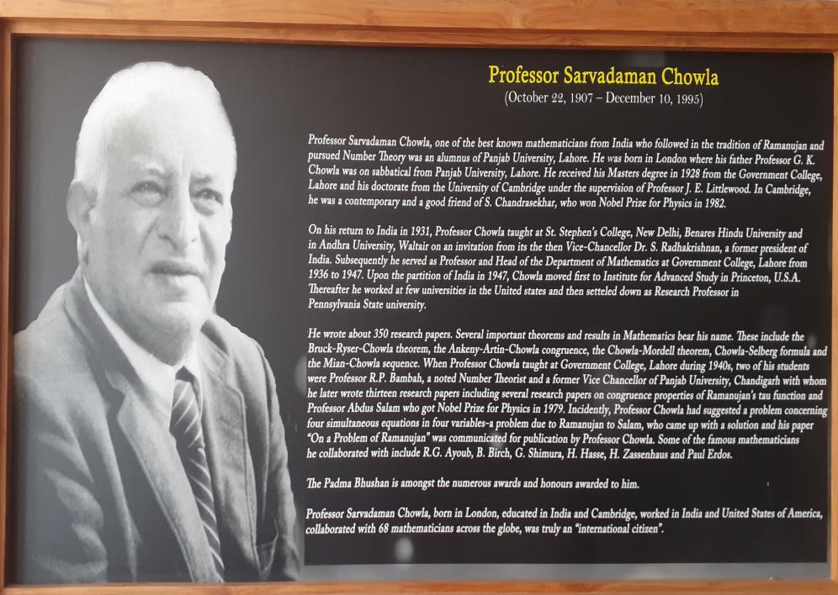
International Guest House at PU campus is named after him
London born s/o Professor G S Chowla, described as the British born American
Mathematician of Indian origin, established the School of Number Theory at Lahore

Slide 43
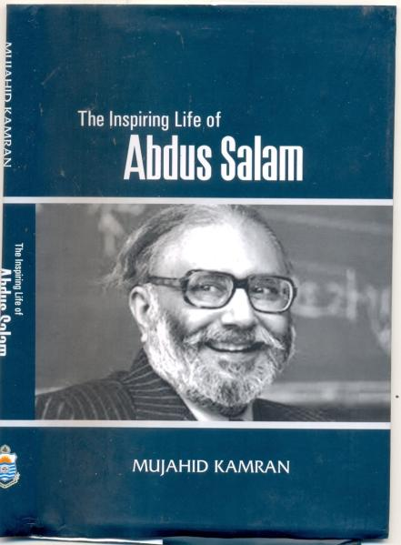
Nobel Laureate in Physics (1979) Prof. Abdus Salam, FRS
Student at Dept. of Mathematics of Government College at Lahore (1940-46)
One of the problems posed by Dr. Chowla concerned four simultaneous equations in four variables – this was a problem due to Ramanujan.
Salam’s solution was sent by Dr. Chowla to a magazine. Thus, in the year 1943, Salam’s first mathematical research paper titled “On a Problem of Ramanujan” was published in the March – July 1943 issue of Maths. Student (volumes XI, Nos 1-2).
R P Bambah, his contemporary at Lahore, had motivated Abdus Salam to move over to Physics as he went to Cambridge for higher studies..
VC of Univ. of Punjab at Lahore

Slide 44
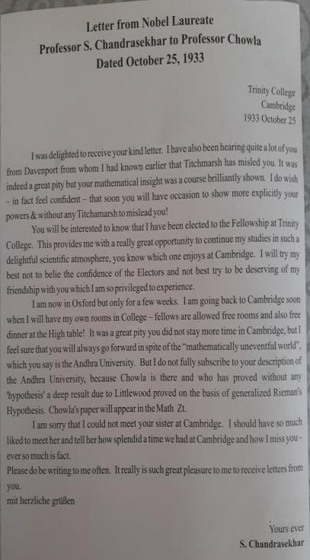
Extract from S Chandrasekhar’s Letter to Sarvadaman Chowla in 1933 :
...I feel sure that you will always go forward in spite of ‘mathematically uneventful world” which you say is Andhra University (whose VC at that time was the legendary Dr. S Radhakrishnan).
I do not subscribe to your description of Andhra University, because Chowla is there and who has proved without any hypothesis a deep result due to Littlewood ...
Ramanujan had worked with Littlewood and Hardy in Cambridge
S Chandrasekhar received Nobel Prize in Physics in 1982

Slide 45
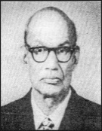
Professor Hans Raj Gupta
(1902-1988)
Prof. Hans Raj was born on 9 October, 1902, at Rawalpindi (Pakistan); obtained M.A. in Mathematics, in first position (1925) from Punjab University, Lahore, became Lecturer at the Sadiq Egerton College, Bahawalpur (1926-28), Lecturer, Government College, Hoshiarpur, did his Ph.D. in Mathematics from Punjab University, Lahore in 1936. After the partition in 1947, Government College, Hoshiarpur was taken over by the Panjab University and in 1954 he was appointed as Professor and Head of the Department of Mathematics, Panjab University, Hoshiarpur. For a short duration he was Principal, Government College, Chandigarh but returned back as Professor of Mathematics, Department of Mathematics which in 1962 shifted to Chandigarh. He retired as Director of Centre of Advanced Studies in Mathematics, Panjab University, Chandigarh in 1966. He was Honorary Professor of Mathematics, Panjab University, visiting Professor, University of Colorado and Arizona , USA , University of Alberta, Canada (1969).
Prof. Gupta’s main contributions were in the area of theory of numbers and combinatorics. He was well-known for his work on perpetual calendar.
He published many monographs in the field of number theory and combinatorics, Table of Partitions (Royal Society of London) and Representations of Primes by Quadratic Forms. He was a member of the Editorial Board of Indian Journal of Pure and Applied Mathematics.
He was a Fellow, of the Indian National Science Academy (1950) and National Academy of Sciences (India), Member of Indian Mathematical Society (President, 1963), Edinburgh Mathematical Society and American Mathematical Society.
Prof. Gupta received Medal and Certificate of Merit of British Empire Exhibition (1924). He was President, Mathematics Section of Indian Science Congress (1964) and recipient of Mathematical Association of India Award (1979).
Prof.Gupta died on 23rd November, 1988.

Slide 46
Prof. Hans Raj Gupta
(1902-88)
Mathematics Block in PU Campus is named after him
He was also taught by G S Chowla, father of Sarvadaman Chowla, during MA in Math (1925) at Lahore. He received first PhD in Maths of PU in 1936.
He had to be content teaching at Govt Intermediate College Hoshiarpur from 1928-47. Later the same college became nucleus of Dept. of Mathematics of PU in independent india.
R P Bambah had returned from Cambridge to join him at Hoshiarpur. School of Maths of PU continued to flourish thereafter in Independent India.

Slide 47
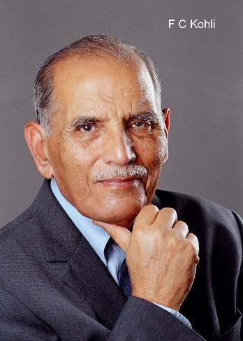
Citation of Dr. Faqir Chand Kohli (1924-2020)
Udyog Ratna Awardee of PU (2015)
Dr. F.C. Kohli is the Emeritus Chairperson of Tata Consultancy Services (TCS). A visionary and pioneer by nature, he is acknowledged as the ‘Father of the Indian Software Industry’. Dr. F.C. Kohli is an alumnus of the University of Punjab at Lahore and the Massachusetts Institute of Technology (MIT), USA. Dr. Kohli had joined the Tata Electric Companies and helped to set up the Load Despatching System to manage the system operations. He then became the General Superintendent in 1963, and Deputy General Manager in 1967. Simultaneously, he worked as a consultant to Tata Consulting Engineers. In September 1969, he moved to Tata Consultancy Services as its first General Manager. In 1974, he was made the Director-in-Charge and in 1994 its Deputy Chairman under the overall Chairmanship of the legendary Mr. J.R.D Tata, a recipient of honour of Bharat Ratna. Dr. Kohli has received innumerable awards, which also include the very prestigious Dadabhai Naoroji Memorial Award in 2001. He was honoured with Padma Bhushan in the year 2002. Numerous Universities in India and abroad have honoured him with Honoris Causa doctorate degrees.

Slide 48
Professor M. Afzal Hussain (1889 - 1970) Entomologist and Agriculture Scientist First Full time VC, PU@Lahore (1938 - 44)
Prof. Hussain was born in 1889; at Batala, Punjab ; obtained B.Sc. (1911) and M.Sc. (Zoology) from University of Punjab (1913); Foundation Scholar and Bachelor Scholar, Christ’s College, Cambridge, London (1914); Natural Science Tripos, Cambridge University (1916); Carried out Research Work in Cambridge, London and Manchester (1916-19).
He made significant contributions to the biology, ecology and food preferences of the desert Locust. His contribution to agricultural education and research both in pre-partition India and later in Pakistan were note worthy.
He was Chairman, Pakistan Agricultural Council (1965-69); Pakistan Public Service Commission (1948-53); Member and Chairman, Punjab and NWFP Public Service Commission, India/Pakistan (1945-48); Vice Chancellor, University of the Punjab, Lahore, (1938-44); Principal, Punjab Agricultural College, Lyallpur (1933-38); Imperial Entomologist, Imperial Agricultural Research Institute (1930-33); Entomologist, Punjab Government and Professor of Entomology, Punjab Agricultural College, Lyallpur (1919-30); Entomologist, Imperial Agricultural Research Institute, Pusa, Bihar (1919); Demonstrator in Zoology, Cambridge University, England.
Prof. Hussain was a Fellow, of the National Academy of Sciences ( India); Foundation Fellow, Entomological Society, India; Foundation Fellow, Indian National Science Academy; President, Philosophical Society, Lahore (1943-44); General President, Pakistan Association for the Advancement of Science (1949); President, Pakistan Academy of Sciences (1953). Member, Pakistan Government Economy Appraisal and Development Committee (1952-53); General President, Indian Science Congress (1946); Member, Indian National War Memorial Committee (1945); Member, Famine Enquiry Commission, Government of Bengal, India (1944-45); Member, Advisory Board, Imperial Council of Agricultural Research; Member, Central Advisory Board of Education, Government of India.
He received many honours and awards, notably are : Charles Darwin Prize of Christ’s College, Cambridge; Frank Smart Prize for Zoology of Cambridge University.
Prof. Hussain died on 1 November, 1970.

Slide 49
Prof. Hem Singh Pruthi (1897-1969) Another Entomologist and Agriculture Scientist Contemporary of Dr. S S Bhatnagar (1894-1955) Second Indian as Director IARI, New Delhi (1944-45)
Prof. Pruthi was born on 23 February, 1897,at Deska, Sialkot (Pakistan); obtained Ph.D. (1925) and D.Sc. (h.c.) from University of Cambridge, UK. He was Assistant Professor, Agriculture College, Lyallpur; Officer-in-Charge, Entomology Division, Indian Museum, Calcutta (1925-34); Imperial Entomolgist, Indian Agricultural Research Institute (IARI), Bihar and New Delhi (1934 and 1936-43) and Director, IARI, New Delhi (1944-45); Plant Protection Adviser, Government of India (1945), Ex-officio Director, Plant Protection and Quarantine Organization (now the Directorate of Plant Protection), Director, Locust Control (1946-53); and Professor of Entomology, Punjab University, Hoshiarpur (1954-69).
Prof. Pruthi’s researches encompassed : (i) economic entomology, (ii) biological control of insect pests, (iii) termite research and control, (iv) pests of wheat, (v) damage potential of insects in sugarcane, (vi) pests of fruits and fruit trees, (vii) pests of oilseeds (cotton), (viii)taxonomic studies on homopterous group of insects, (ix) storage pests, (x) desert locust control. He pointed out the thrust areas of entomological problems of India and abroad. Prof. Pruthi’s major contribution for Indian Agriculture and farmer’s was his sincere fight against desert locust. In 1950, he published The Desert Locust Cycle of 1940-46 in India, its Progress and Control(A monumental work which included several new information on locust ecology and swarm migration to India in relation to meteorology). He also authored ‘Textbook of Agricultural Entomology’ published by ICAR. He was Chief Editor of the Indian Journal of Entomology.
Prof. Pruthi was awarded, Order of the British Empire.
He was a Fellow, of Entomological Society of India (President, 1940, 1948-50); President, Zoology Section, Indian Science Congress (1940) and a Foundation Fellow, of the Indian National Science Academy ( Secretary ,1947-52).
Prof.Pruthi died on 23 December, 1969.

Slide 50
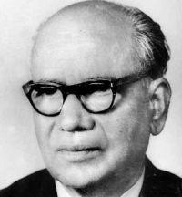
Extracts from write up on B P Pal, FRS by MS Swaminathan, FRS
Dr. Benjamin Peary PAL (1906-1989), Director IARI/ICAR (1950-65)
‘It was during Dr. B P Pal’s leadership that the agronomic research equaled the best in the world. He was truly the architect of India’s Green Revolution’ – Dr. Norman Borlaug, Nobel Laureate
First Director General Indian Councuil of Agricultural Research (ICAR)
( Born in Jullundur Distt., Punjab, named Brahm Das at birth by his father Dr. Ralla Ram Pal )
Dr. B P Pal shaped the course of Indian Agricultural Research for over three decades and designed instruments for achieving interdisciplinary and inter-institutional cooperation in basic and applied sciences.
He ranks amongst the most eminent Biological Scientists India has produced.
Often referred to as ‘Homi Bhabha of Agricultural Research’
He used to emphasise that what India needs is not just Agricultural Education, but, Education for Agriculture.

Slide 51
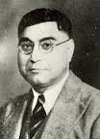
Extracted from ‘Sparkling Punjabi Scientists’
Compiled by S K Sahni and R K Kohli,
SLM Publishers, Patiala, 2018
Professor Karam Narayan Bahl (1891-1954)
A Zoology pioneer from PU
Prof. Bahl was born on 14 February, 1891; D.Sc., Punjab (1920), D.Phil. Oxon (1921);
Reader and Head, Department of Zoology, Lucknow University (1921-22); Professor and Head (1923-51) and Vice-Chancellor, Patna University (1951-52).
Prof. Bahl entire career was spent in unraveling the complicated nature, both anatomical and physiological, of the Nephridia of Earthworms from various parts of the world. Besides his successful research career he was pioneer in editing a series of monograph called the Indian Zoological Memoirs on Indian Animals.
He was a Foundation Fellow, of the Indian National Science Academy (Vice President 1951-53); National Academy of Sciences( India) (President 1933-35); Fellow, Asiatic Society of Bengal; Honorary Fellow, Zoological Society of India (Editor 1948-52),Vice President (1950-52), President (1953-54);President, Vigyan Parishad, Allahabad (1936-38); Member, University Education Commission, Government of India (1948-49).
Prof.Bahl was a recipient of Joy Gobind Law Memorial Gold Medal (1942); President, Zoology Section, Indian Science Congress Association (1924).
Prof.Bahl died on 21 April, 1954.

Slide 52
Prof. Karam Narayan Bahl (1891-1954), Zoologist
DSc. (1920, PU), D. Phil (1921, Oxford)
Vice Chancellor, Patna University (1951-52)
Senior to Shanti Swarup Bhatnagar at Govt. College , Lahore.
Edited Series on ‘Indian Zoological Memoirs on Indian Animals’.
Head, Dept of Zoology, Lucknow University (1921-51).
Member, Univ. Education Commission, Chaired by Dr. S Radhakrishnan, 1948.
Foundation Fellow, INSA.
President, NASI(1933-35).
Prof. G S Thapar, Dept of Zoology, Lucknow Univ.,
Prof. H R Mehra, Head, Dept. of Zoology, Allahabad Univ., Dr. Baini Prasad, Director, Zoological Survey of India et al. had also studied at Lahore.

Slide 53
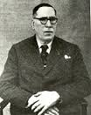
Dr. Sunder Lal Hora (1896-1955), another Zoologist
(A contemporary of Dr. S S Bhatnagar (1894-55) at Lahore)
Dr. Hora was born on 2 May, 1896 at Hafizabad, Punjab (Pakistan); obtained M.Sc. (Zoology) from University of Punjab, Lahore (standing first in all science subjects and was awarded Maclagan Medal). He joined Zoological Survey of India in 1919 as research scholar and became Assistant Superintendent in 1921. He was awarded Ph.D. by Punjab University, in 1921 and second Ph.D. by Edinburgh University in 1928.
Dr. Hora’s research spanned a wide range of zoological topics-physiology, systematics, bionomics, ecology, evolution, zoogeography and palaeogeography besides history of zoology, always with fish as the motif. His main contribution was to taxonomy of fish. He studied the systematics of fish of India, Afghanistan, Burma, Malaya, Thailand, China, Indonesia and Iraq. He discovered a large number of new species, several new genera and revised numerous families. He put forth ‘Satpura Hypothesis’ (in 1937) where he explained that the similarity between the Malayan fauna and the fauna of Paninsualr India without an apparent connecting link (a well-known fact of zoography known since the last century) was due to migration from eastern regions to the western via the Satpura Range of mountains in central India. This hypothesis was mainly based on evidence from freshwater fish. Later on, he elaborated it to include diverse group of animals. He published about 400 original papers in Indian and Foreign journals.
He was a Fellow, of the Royal Society of Edinburgh, Senior Fellow, of the Asiatic Society, Foundation Fellow, of the Indian National Science Academy (President 1951-52); Fellow, of the National Geographical Society of India, Zoological Society of India, Natural History Society, President of Indian Science Congress (1954), Honorary Secretary General of the Indian Board of Wild Life, Member, International Association of Oceanography and Central Board of Geophysics, Member of Editorial Board of Evolution (USA), Current Science and Science & Culture. He was Honorary Director, Central Inland Fisheries Station, Calcutta (1936-39) and Director of Fisheries of Bengal (1942-47).
Dr Hora was awarded Maclagan Medal (1919); Joy Gobind Lal Medal of Asiatic Society, Jawahar Lal Nehru Medal of National Geographical Society, Sir Dorab Tata Memorial Medal of Zoological Society of India and many honorary titles and medals from Scientific bodies in India and abroad. The Indian National Science Academy has instituted a ‘Sunder Lal Hora Medal’ in his honour.
Dr. Hora died on 8 December, 1955.

Slide 54
Dr. S L Hora (1896 -1955)
MSc. (Zoology) in 1919, awarded Maclagan Medal for standing First in all science subjects at Lahore.
PhD from PU Lahore (1921)
Taxonomy of Fish was his expertise.
Published 400 research papers.
Director of Fisheries of Bengal (1942-47).
Fellow Royal Soc. Edinburgh (FRSE)
INSA President (1951-52)
INSA instituted a medal in his honour.

Slide 55
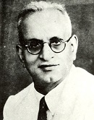
A contemporary of S L Hora (1896-1955)
and S S Bhatnagar (1894-1955)
Dr. Bashambher Nath Chopra (1898-1966), a Zoologist
DSc. in Zoology and Fisheries from PU
Dr. Chopra was born on 24 September, 1898 at Akalgarh (Pakistan); obtained his D.Sc. from Punjab University, Lahore in zoology and fisheries. He was Assistant Superintendent (1923-44) and Director (1944-47), Zoological Survey of India, Indian Museum, Calcutta; Deputy Fisheries Development Adviser and Fisheries Development Adviser, Government of India (1947-till retirement).
He had varied interests in systematics. At Zoological Survey of India, he was responsible for extensive field surveys in different parts of the British Empire including Burma and Ceylon besides undivided India, and one of his earliest surveys of a fairly long duration covered the Shan States and the Indawggyi Lake in Upper Burma.
Dr. Chopra contributed greatly to the development of Inland and Marine Fisheries of India.
Dr. Chopra was President, Zoology and Entomology Section of Indian Science Congress (1943). He was a Founder Fellow, of the Zoological Society of India and Indian National Science Academy.
The Indian National Science Academy has instituted ‘Bashambhar Nath Chopra Memorial Lecture’ in his honour.

Slide 56
Professor Vishwa Nath (1897-1976) Yet, annother contemporary of S S Bhatnagar A Zoologist and a Cricketer (Maharaja of Patiala gave him his first job due to his talent in Cricket)
Prof. Vishwa Nath was born on 9 July, 1897, at Amritsar); Ph.D.( 1925), D.Sc. Cambridge (1957). Professor of Zoology, Mahindra College, Patiala (1920, 23, 25 and 27); Professor of Zoology, Government College, Lahore (1942-47); Principal, Government College, Dharamsala (1947); Principal, Government College, Hoshiarpur (1948-52); Professor of Zoology, Punjab University (1952-59) and University of Jodhpur (1963-65).
Prof. Vishwa Nath was a renowned Cytologist who worked on the reproductive organs of scorpions and mosquitoes. He studied in great detail cell biology and protozoology. He was well known, particularly for his work on the spermatid and the sperm of the crab-Paratelphusa spinigera. He authored books on Zoology for Intermediate Students, The Decapod Sperm, A Text book of Zoology, Animal Gametes (Male), Animal Gametes (Females) and Cell Biology.
He received Joy Gobinda Law Memorial Gold Medal (1968) of Asiatic Society. He was President, Zoology Section, Indian Science Congress Association (1944). He was a Fellow ofthe Indian National Science Academy and Royal Microscopical Society, London.
Indian National Science Academy has instituted ‘Vishwa Nath Memorial Lecture’ in his honour and Panjab University, Chandigarh has named a Hall in his memory.
Prof. Vishwa Nath died on 19 December, 1976.
Zoology Department of PU is
named as Vishwa Nath Hall

Slide 57
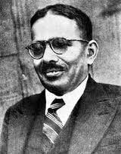
Shri Daya Ram Sahni (1879-1939)
Another scholar born in Bhera, and , also,
a contemporary of Shiv Ram Kashyap (1882-1934)
Archeologist
Shri Daya Ram Sahni was born on 16 December, 1879 at Bhera, Shahpur, (Pakistan); obtained B.A. in Sanskrit as major (Gold Medal); M.A. (1903) from Oriental College, Punjab University, Lahore. His Sanskrit studies were sponsored by the Archeological Survey as such he was recruited by the Survey. He joined Archeological Survey in 1903 and was posted at the Punjab and United Provinces Circles. He was involved in the excavation of Kasia in (1905) Rajgir (Bihar) (1906) Stupa at Rampurya in Champaran District. He was Curator of Lucknow Museum (1911-12). He was Assistant Superintendent incharge of United Provinces and Punjab posted at Lahore during 1917.
He was the first person to initiate excavation of Indus Valley site at Harappa.
Shri Sahni was transferred to Delhi in 1925 as Deputy Director General and in July 1931 became Director General ASI - a first indian to be appointed to the post. He retired in 1935. After retirement, Shri Sahni continued his interest and unearthed almost untapped and rich archeological field in the State of Jairpur and excavation at Birat, unearthed one of the earliest Budhist Stupa in Rajputana. He did some work on ancient site of Naliasar – Sambhar and Rain. He published numerous articles particularly on Epigraphical subject in Scientific Journal and two volumes on Sarnath. He was a Fellow of Indian Academy of Sciences. Shri Sahni died on 7 March, 1939 at Jaipur.

Slide 58
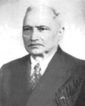
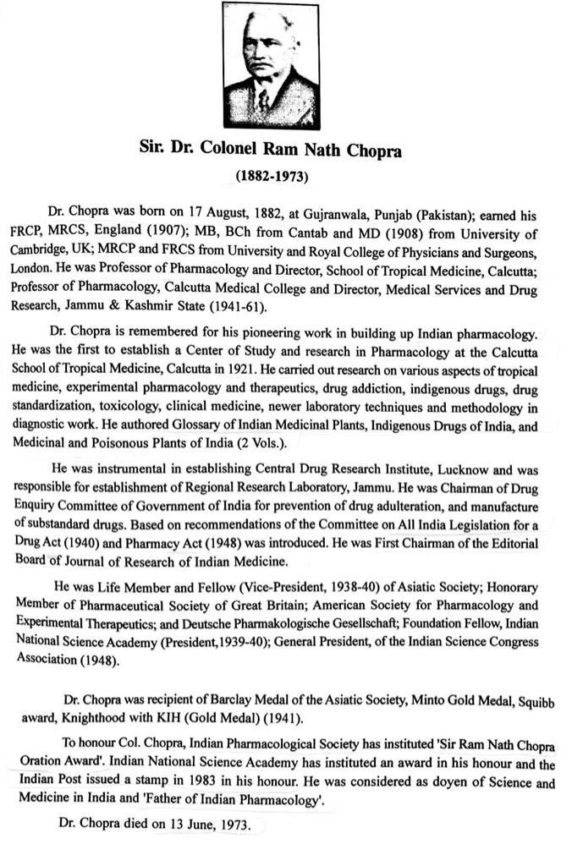
Sir Dr. Ram Nath Chopra,
MD, FRCP, FRCS (1882-1973)
Also, a contemporary of Shiv Ram Kashyap (1882-1934).
Father of Indian Pharmacology
Director of School of Tropical Medicine Calcutta
Knighted in 1941
First Chairman of the Editorial Board of Jour. of Research In Indian Medicine.
Chairman Drug Inquiry Committee
Helped establish CDRI, Lucknow and
RRL, Jammu
President, INSA (1939-40)
A Postal Stamp was released on his Birth Centenary in 1983.

Slide 59
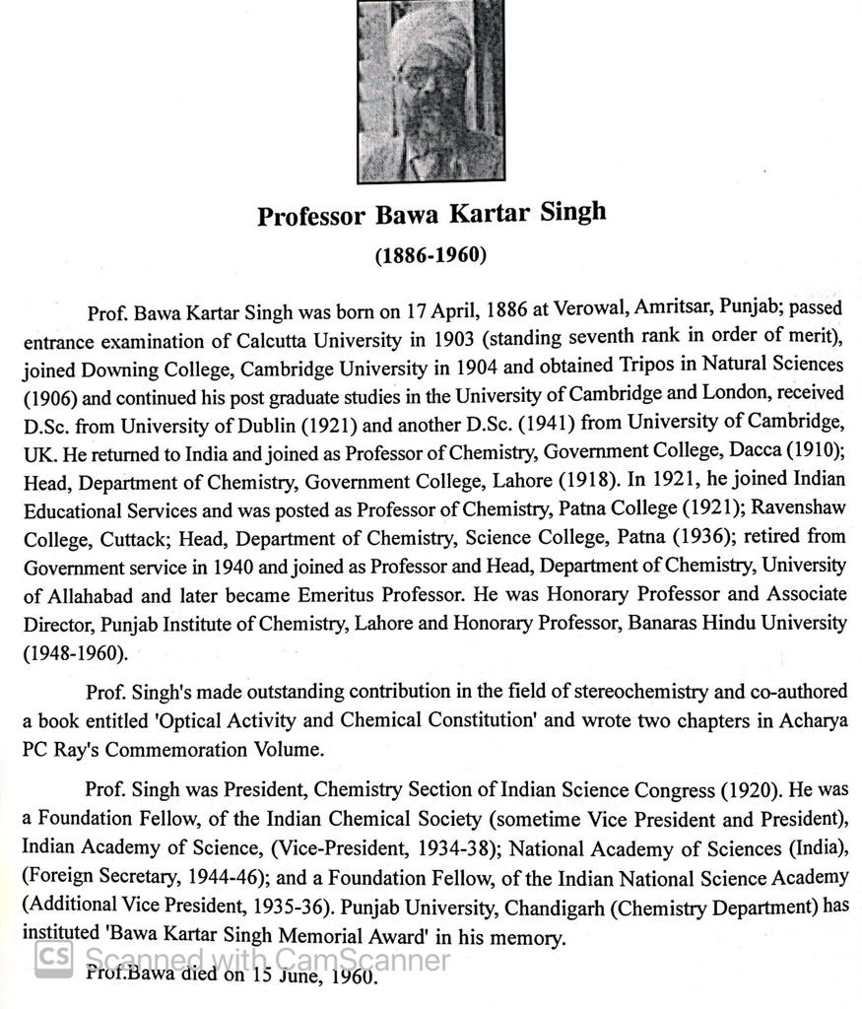
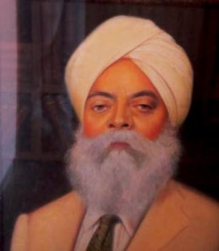
Prof. Kartar Singh Bawa (1886-1960)
Another contemporary of
Shiv Ram Kashyap (1882-1934)
Head, Dept. of Chemistry, Govt. College Lahore (1918-21).
Taught at Patna, Cuttack, Allahabad and BHU later.
CV Raman had invited him to be his first
Vice-President of IASc, Bangalore in 1934.
He was also the Vice President of
National Institute of Sciences as it
was established in 1934 at Calcutta.
Dr. Homi Bhabha, FRS gave
the first Bawa Kartar Singh
Oration at PU in 1963.
38 such Orations have been
delivered at PU so far.

Slide 60
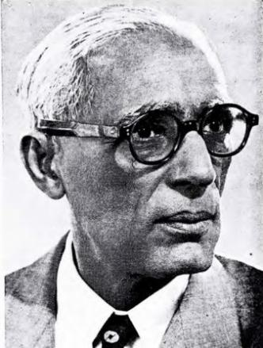
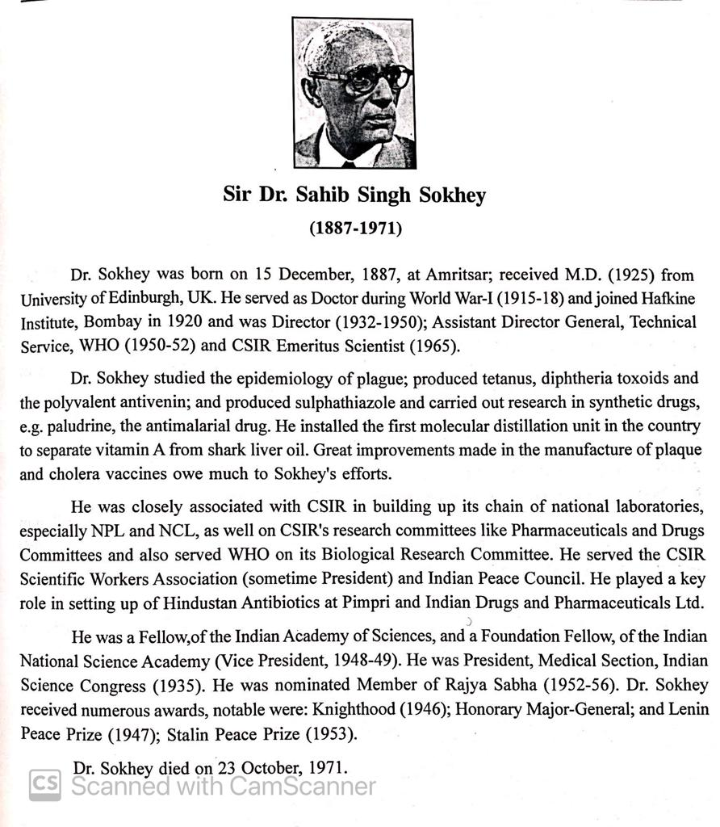
Sir Dr. Sahib Singh Sokhey (1887-1971)
Yet, another contemporary of Dr. Shiv Ram Kashyap (1882-1934).
He made outstanding contributions to prolong and save human lives by pioneering essential antibiotics and other drug manufacturing in India.
Vice Pres., INSA (1948-49)
Nominated Member of first Rajya Sabha (1952-56), when M N Saha was an elected member of first Lok Sabha.

Slide 61
Assessment of Dr. S S Bhatnagar (1894-1955) as a Scientist
Nobel Laureate Lord Rutherford in 1937:
We have here (at PU) a flourishing Honours School of Technical Chemistry :
…the genius of Professor Bhatnagar has provided a bridge of communication between scientists and industrialists.
H.E. Sir Henry Craik, Governor of Punjab, 1939:
There has also been a much greater output of written works, notably in Physics and Chemistry, whole Chemistry department under the distinguished direction of Prof. Bhatnagar has attracted students from all parts of India, and its achievements have won recognition in Europe also.

Slide 62
Dr. Shanti Swarup Bhatnagar as Director, CSIR
As the World War-II began, SSB was persuaded by Sir Arcot Ramaswamy Mudaliar to move from Lahore to Calcutta to head war time Science effort of British India.
An advisory body named as Board of Scientific and Industrial Research (BSIR) with Sir Mudaliar as Chairman was created on April 1, 1940.
Rs. 10 Lakhs for five years were given to BSIR in November, 1941. The CSIR was registered as a Society in March, 1942.
On September 26, 1942, the control of the fund was transferred to CSIR and Dr. S S Bhatnagar was designated as first Director, CSIR.
On Feb.29, 1944, a sum of one Crore was sanctioned to create 5 National Laboratories under CSIR.

Slide 63
Dr. Bhatnagar as Secretary, HE and Chairman, UGC
SSB was a member of Sarkar Committee (1945) which gave a framework for setting up MIT (USA) like institutions in post second world war India. Four IITs were proposed.
SSB also served as member of the Sargent Committee (1944) which gave a report on the restructuring of education in post war India.
He became Secretary, Higher Education in independent India in 1947, succeeding Sir John Sargent.
He was appointed first Chairman of UGC w.e.f. 16.11.1953.
The first act of Dr. Bhatnagar as Chairman, UGC was to announce increase in salary of all College and University teachers in India by twenty percent, to bring their salaries at par with the Salary grades of Teachers of Panjab University at Lahore.

Slide 64
Dr. Birbal Sahni, FRS (1936) & Dr. S S Bhatnagar, FRS (1943)

Slide 65
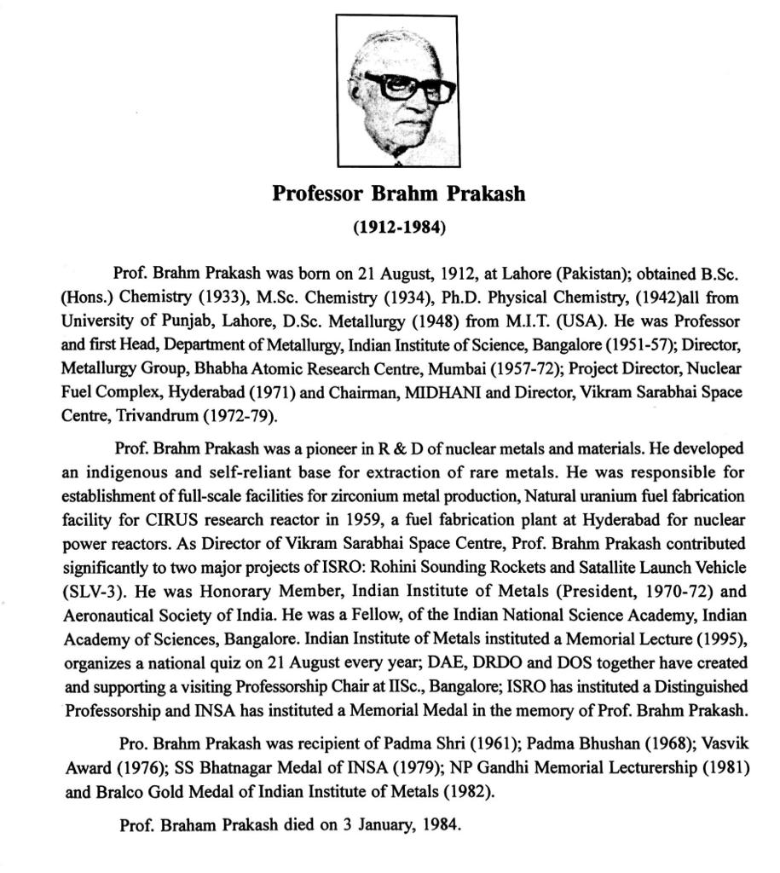
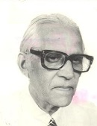
He did PhD under SSB at PU, Lahore,
went abroad to MIT in USA on an Overseas Fellowship scheme.
Was inducted by Homi Bhabha as a Metallurgist for DAE and stationed as Faculty at IISc. Bangalore (1951-57).
He is credited with the indegenious Atomic Fuel development Programme.
After the sudden passing away of Dr. Vikram Sarabhai in 1971, he was sent to TERLS to look after Space programme.
As per MGK Menon : It was Dr. Brahm Prakash who brought success to VSSC (ex-TERLS) , weilding all the amorphous entitities, of which it was composed and nutured it to a dynamic structure.
Dr. Satish Dhawan was inducted as first Chairperson of Space Commission (1972).
Brahm Prakash and Satish Dawan had travelled together to study in USA in 1945.
The two together set an example of team work for the Space Programme
He mentored APJ Kalam at ISRO.
Dr. Brahm Prakash
(1912-84)
(Student of SSB @Lahore)

Slide 66
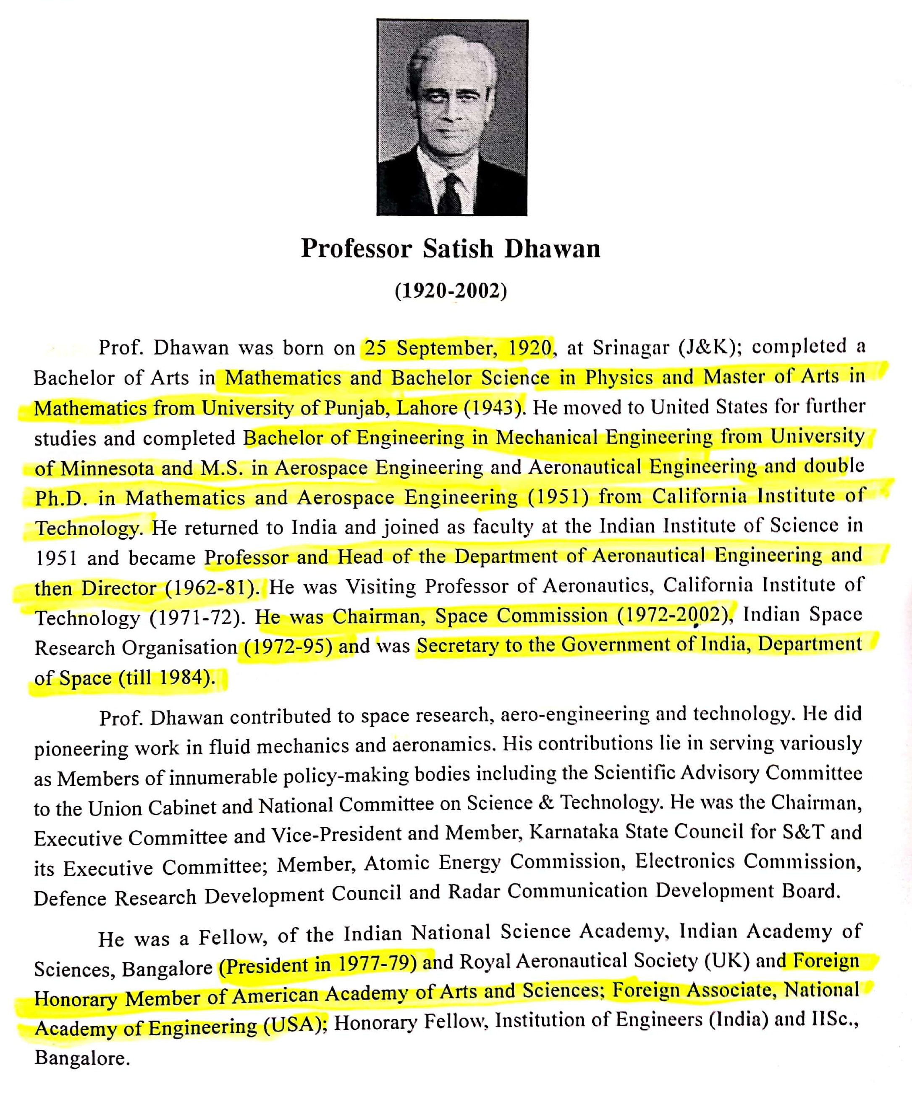
Dr. Satish Dhawan (1920-2002)
Dr. Satish Dhawan, Physics, Mathematics and Mechanical Engineering Degrees holder from PU at Lahore, was the first Chairman of Space Commission (1972-84).
He had succeeded Dr Vikram Sarabhai.
He was the Director, IISc , Bangalore (1962-81).
He also served as President, Indian
Academy of Sciences.
He was honoured with Padma Vibhushan.
Dr. A P J Kalam acknowledged him as one his two Mentors in his book ‘Wings of Fire’. The other mentor is named as Dr. Brahm Prakash, another PU alumnus.
Extracted from “Sparkling Punjabi Scientists” by
S. K. Sahni and R. K. Kohli

Slide 67
U R Rao, Satish Dhawan, A P J Kalam and Brahm Prakash at Vikram Sarabhai Space Centre (VSSC ), Thiruvanathapram .

Slide 68
Professor Har Gobind Khorana (1922-2011) An extract from ‘A Life in Science’ ( Science 280, 810,2000)
At age 18, when I sought admission to the Punjab University in Lahore, I applied to two departments, English Literature and the Honours Course in Chemistry. Admission into the latter was restricted and required an interview. My shyness kept me from the interview, but, they saved a place for me anyway, and thus I became a Chemist.
Har Gobind Khorana and Gurbaksh Singh (first VC, University of Hyderabad) co-authored research papers on synthesis of Organic compounds with their teacher Mahan Singh at GCL, Lahore in 1945-46.
Khorana travelled to UK and Gurbaksh Singh to USA after the second World War on Overseas Fellowship scheme proposed by A V Hill.
He was a contemporary of R P Bambah , Nityanand and Abdus Salam at both Lahore and UK.

Slide 69
Dr. Mulk Raj Sahni (1899-1983), a Geologist Brother of Dr. Birbal Sahni & father of Dr. Ashok Sahni Founder Head of Dept. of Geology, PU Chandigarh in 1958
Geology Dept Building is named as M R Sahni Hall
Dr. Sahni was born on 1 March, 1899,at Behra (Pakistan); obtained M.A. (Cantab), DIC, Ph.D., DSc from University of London, UK. He was Superintending Geologist and Palaeontologist, Deputy Director and Acting Director, Geological Survey of India.
Dr. Sahni made extensive contributions to palaeontology and stratingraphy, carried out field work in the Shan State of Burma and discovered highly fossiliferous Lower Triassic beds. This discovery brought him recognition as one of the foremost palaecontologists of India. In 1964, he discovered graptolites from Kashmir. His other researches related to : morophology and zonal distribution of British Chalk Terebratulids, and brachial apparatus of British Chalk Terebratulids, evolutionary studies on Jurassic and Cretaceous Terebratulids, Mesozoic brachiopods sof Baluchistan, discovery of Eurydesma and Conularia from Eastern Himalayas; Argentine and Australian affinities of Lower Permian faunas from Central India, discovery of Cretaceous nautiloid mandible from South India and first record of Orbitolina from the Indian subcontinent. He authored the monograph Terebratulidae of The British Chalk (Palaeontological Society of London, 1929).
He was President, International Palaeontological Union, International Geological Congress (1968) and Vice-President, Geological, Mining and Metallurgical Institute of India; Member, Board of Research in Nuclear Science, Atomic Energy Commission, Government of India and UNESCO Committee on Arid zone, Founder President, Paleontological Society of India, President, Geology Section of the Indian Science Congress (1941). Honorary Member, Palaeontological Society of USSR and Deutsche Geologiche Gessellochaft, Germany and Foreign Representative, Palaeontologists Association, London. He was a Fellow, of the Indian National Science Academy and Indian Academy of Sciences.
Dr. Sahni received Tata Memorial Gold Medal of Palaeontological Society of India.
Dr. Sahni died on 13 January, 1983.

Slide 70
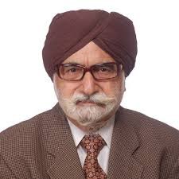
DSc. (Honoris Causa) citation of Padma Shri Prof. Harkrishan Singh (1928-2020)
First Professor of Pharmacy to be honoured with Padma Shri
An iconic alumnus and an Emeritus Professor of Panjab University, Professor Harkishan Singh was born on 25th November 1928 in Lyallpur district. He obtained his B. Pharmacy from Panjab University in 1950, ranked first; and M. Pharm. and Ph.D. degrees, from Banaras Hindu University, in 1952 and 1956, respectively. After a brief stint in pharmaceutical industry, he started as faculty at BHU, and then moved to University of Saugar, before arriving back at Panjab University in 1964. He also served as Head, Department of Pharmaceutical Sciences (1976-81), Founder Dean, Faculty of Pharmaceutical Sciences (1981-85).
His scientific research has been focused on Organic Chemistry, Medicinal Chemistry and Natural Products. Over 350 publications, 18 books and 14 patents are testimony to his outstanding research credentials. One of the rarest accomplishments to the credit of Professor Singh and of PU, per se, is the discovery of a clinically useful drug, Chandonium Iodide (named after Chandigarh) or HS-310, later named as Candocuronium Iodide. This is the only drug discovered from any Indian University till date. He has also been instrumental in envisioning and establishing NIPER.
He has been General President of Indian Pharmaceutical Congress. He has been decorated with rare achievements and honours, including Amrut Mody Award (1975), APTI Srivastava Memorial Award (1983), Ranbaxy Research Award (1987), Schroff Memorial Award (1988), and IPA Eminent Pharmacist Award (1999). Lifetime achievement awards have been conferred on him by several bodies. He has been a member of American Institute of History of Pharmacy, IUPAC, and British Society for History of Pharmacy. Professor Singh's standing as a historian has been recognized through his election to Academie Internationale d'Histoire de la Pharmacie. University of Sciences in Philadelphia recently conferred upon him the degree of Doctor of Science (Honoris Causa) in recognition of his stellar contributions to scientific and historical research.
In recognition of his outstanding scientific and professional accomplishments, and life-long commitment to human welfare, the Senate and Syndicate of PU recommend that Professor Singh be admitted to the Degree of Doctor of Science (Honoris Causa).

Slide 71
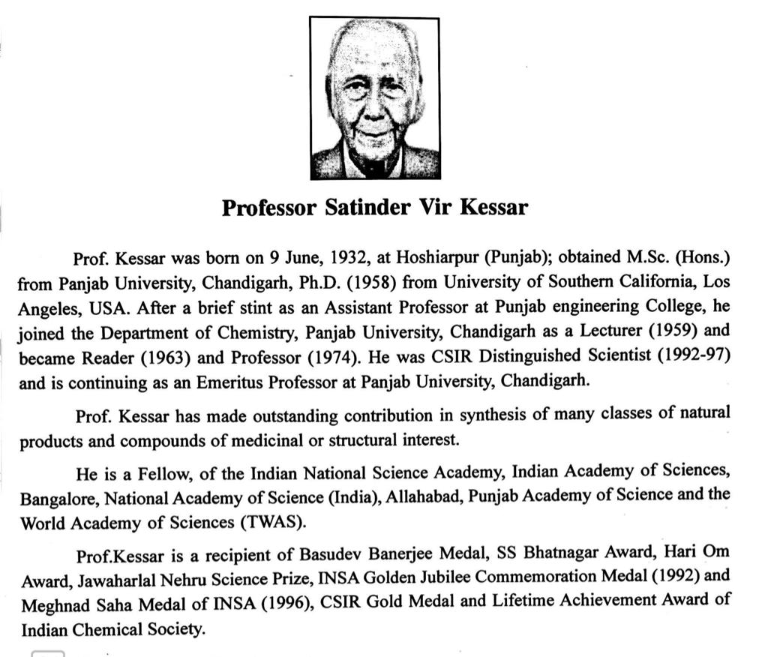
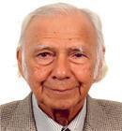
Prof. S V Kessar (b: 1933)
Awarded S S Bhatnagar Prize in Chemistry (1972)

Slide 72
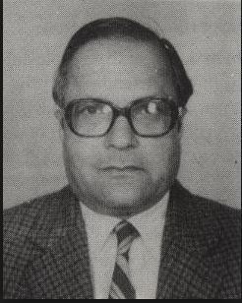
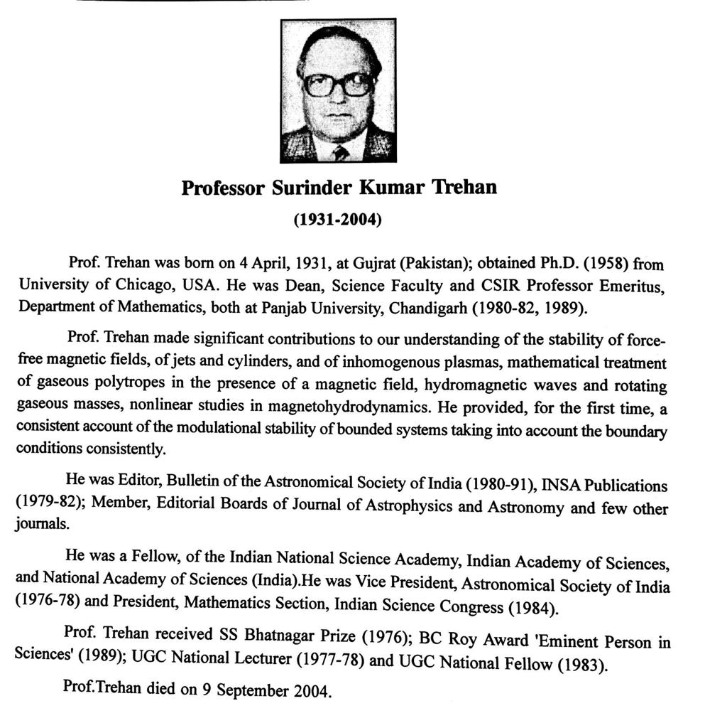
Prof. S K Trehan (1931-2004)
Ph.D student of Nobel Laureate S Chandrasekhar at University of Chicago.
Joined PU as Faculty in 1960.
Awarded S S Bhatnagar
Prize in Mathematics in 1976.

Slide 73
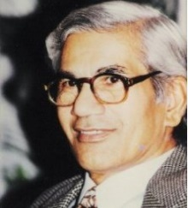
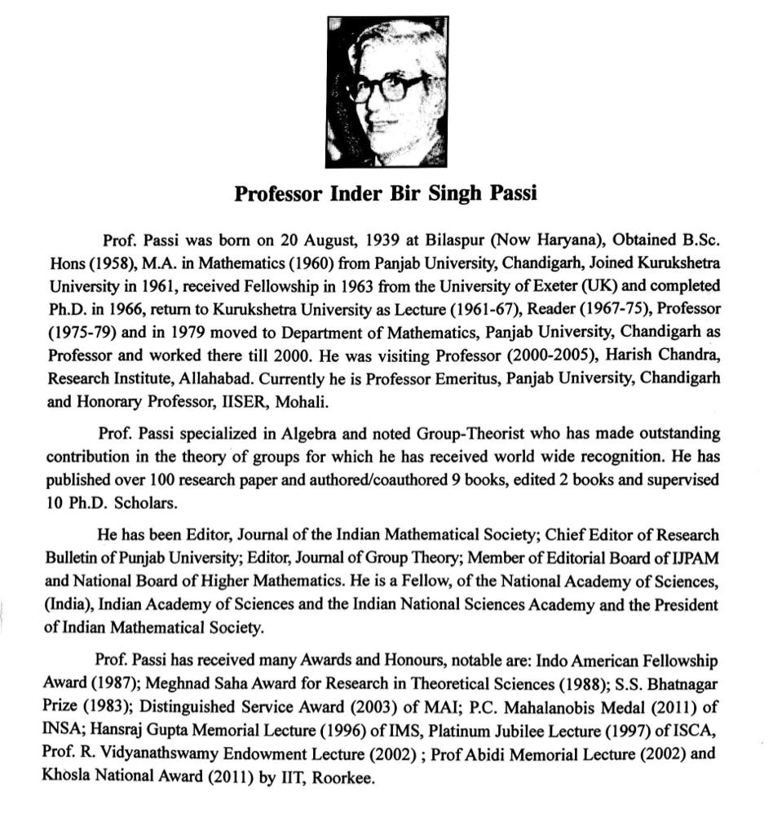
Prof. I B S Passi (1939-2021)
Emeritus Professor
Dept. of Mathematics,
Panjab University, Chandigarh
SS Bhatnagar Prize in
Mathematics (1983)

Slide 74
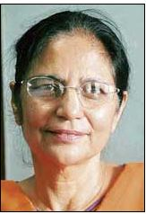
Prof. Ms. R J Hans-Gill
(b: 1943)
An eminent woman
Mathematician of India,
Fellow : TWAS, INSA,
NASI.
Emeritus Prof.,
Dept. of Mathematics,
& ex-Dean University
Instructions,
Panjab Univ., Chandigarh

Slide 75
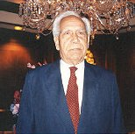
Dr. Piara Singh Gill (1911-2002)
Prof. Gill was born on 28 October, 1911,at Chela, Punjab; obtained his Ph.D. from the University of Chicago , USA (1940). He was Lecturer in Physics, FC College, Lahore (1940-47); Professor of Physics, Tata Institute of Fundamental Research, Bombay (1947-48); Officer on Special Duty, Atomic Energy Commission (1948-49); Professor and Head, Department of Physics (1949-63), Dean, Faculty of Science (1950-53, 1956-58); Aligarh Muslim University, Aligarh; Director, Gulmarg Research Observatory (1951-71); Director, Central Scientific Instruments Organization, Chandigarh (1963-71); Visiting Professor, Washington State University, USA; Visiting Scientist, National Centre for Atmospheric Research (USA); Adjunct Professor of Physics, Georgia Institute of Technology, USA and Visiting Scientist, National Bureau of Standards (USA). Prof. Gill established the Gulmarg Research Observatory jointly by the Aligarh Muslim University and Kashmir University. He was also responsible to build CSIR-Central Scientific Instruments Organization, Chandigarh. He made outstanding contribution in the field of Cosmic Rays Physics such as (i) burst frequency of cosmic rays vs. size, which helped determine spin of
A contemporary of Dr. Homi Bhabha, he obtained his PhD at University of Chicago, working in the group of Nobel Laureate A H Compton in 1940.
Faculty, F C College Lahore (1940-47).
Appointed by Homi Bhabha as the Professor of Experimental Physics at TIFR (1947-49).
First Head of Physics Dept. at AMU
Nurtured H S Hans, S P Puri et al at AMU.
First Director of CSIO, Chandigarh.
mesons; and (ii) azimuthal variations on cosmic ray intensity in Lahore, Gulmarg and Srinagar. He studied the latitude effect on cosmic ray at sea level and at 33,000 ft. Prof.Gill was a member of Editorial Board of International Journal of Comprehensive Med; Member, Panel of Consultants in Technological Sciences and Applied Research to Director-General of UNESCO (1967) and Chairman, Development Council for Instruments Industry, Government of India. He was a Fellow, of the Indian National Science Academy (Foreign Secretary,1961-64); National Academy of Sciences, India and American Physical Society. He was a President, Physics Section of Indian Science Congress (1954), President, Optical Society of India (1970). Prof.Gill died on 23 March, 2002.

Slide 76
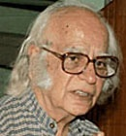
Prof. Yash Pal (1926-2017)
A Legendary scientist , he had been taught
by P K Kichlu, J B Seth and B M Anand at Lahore
Prof. Yash Pal was born on 26 November, 1926, at Jhang (Pakistan); obtained B.Sc. Hons.(1948),M.Sc.(1949) from Punjab University, Ph.D. (1958) from Massachusetts Institute of TechnologyU.S.A. specializing in high-energy physics. He was Professor, Tata Institute of Fundamental Research, Mumbai; Director, Space Applications Centre, Ahmedabad (1973-81); Chief Consultant, Planning Commission (1983-84); Secretary, Department of Science and Technology (1984-86) and Chairman, University Grants Commission (1986-91), New Delhi.
Prof. Yash Pal has made significant contributions to the study of cosmic rays, high-energy physics, astrophysics, science education, communication and development.
He was a Member,of UN Advisory Committee on Science and Technology for Development; Scientific Council, International Centre for Theoretical Physics, Trieste and Executive Committee, United Nations University; Vice President, IUPAP. He has done extensive work in theory and practice of communication for development. He proposed ways of using modern technology, space technology in particular, in ways appropriate for developing countries. Prof. Yash Pal was known for his regular appearances on the science programme ‘Turning Point’ telecasted on Doordarshan, and for his knack of explaining scientific concepts in layman’s language. He has been on the advisory boards for several TV Science programmes like Bharat ki chaap. He was President, Indian Physics Association and a Fellow,of the Indian National Science Academy, Indian Academy of Sciences, National Academy of Sciences (India), Gujarat Science Academy, and Indian Astronomical Society. He was a National Fellow, National Institute of Education.
He has received, Marconi International Fellowship Award (1980), GP Chatterjee Memorial Award of Indian Science Congress Association (1987), Association of Space Explorer Award (1989), Padma Bhushan (1976); Indira Gandhi Prize for Popularization of Science (2000), Meghnad Saha Medal (2006) and Daulat Singh Kothari Memorial Lecture (2008) all of INSA.
Dr. K G Vohra (1925-85) and Dr. M S Chadha (b:1928) at BARC were other contemporaries of Yash Pal from Lahore

Slide 77
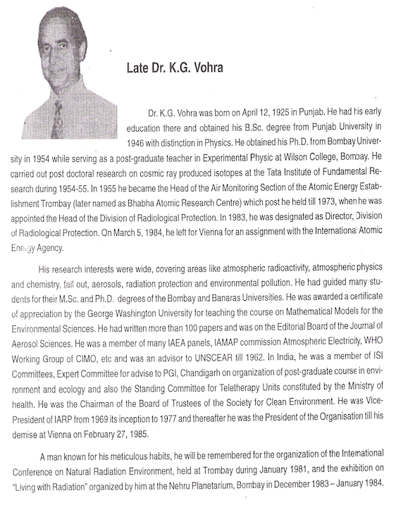
Dr. K.G. VOHRA
(1925-1985)
A contemporary of Prof. Yash Pal
Dr. Krishan Gopal Vohra, Ex Head, Division of Radiological Protection (DRP), BhabhaAtomic Research Centre is recognized of his outstanding contributions in the field of atmospheric radioactivity, fallout, environmental sciences, aerosols, radiation protection and risk evaluation. He passed away on February 27, 1985 while on an IAEA assignment at Vienna.
Dr. Vohra was President of Indian Association for Radiation Protection (IARP).
IARP has instituted an oration award in the year 1987 in his memory. The award is bestowed onpersons of eminence for excellence in any of the above fields.
BSc. (Physics) from PU (1946)
The idea of introducing Thermo Luminescence Dosimeters (TLD) to replace the then prevalent film dosimeter for personnel monitoring in India was mooted and successfully implemented by Dr. K G Vohra in 1960s.
Courtesy Dr. Dinesh K Aswal,
Head, Health, Safety & Environment Group
BARC, Mumbai

Slide 78
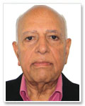
Dr. G P Talwar (b: 1926) Founder Director, National Institute of Immunuology (NII), New Delhi Another contemporary of Dr. Yash Pal at Lahore who made the transition across 1947
Prof. Talwar was born on 2 October, 1926,at Hissar, (Now in Haryana); obtained B.Sc. (Hons.) and M.Sc. (Tech.) from the University of Punjab, D.Sc from Institut Pasteur, Paris and DSc (hc) from Bundhelkhand University (2004), Alexander von Humboldt Postdoctoral Fellow at Tubingen, Stuttgart and Munchen. He joined as Associate Professor of Biochemistry (1956), All India Institute of Medical Sciences (AIIMS), New Delhi and became Professor and Head till 1983. He was Head, ICMR-WHO Research and Training Centre in Immunology for India and South East Asia (1972-91). He founded and was the first Director of the National Institute of Immunology (NII) (1983-91) and continued as Professor of Eminence till 1994.He was Professor of Eminence and Senior Consultant, International Centre for Genetic Engineering and Biotechnology (ICGEB), New Delhi (1994-99) and Director Research, Talwar Research Foundation, New Delhi and Visiting Professor, Institute of Bioinformatics and Biotechnology, University of Pune (2005-10).
Dr. Talwar’s notable contributions include the development of an immunotherapeutic vaccine for leprosy. He also pioneered research on immunological approaches to contraception and invented the first birth control vaccine in the world whose safety and efficacy has been tested. He has published over 500 publications in reputed journals and authored/edited ten books and monographs.
He was Project Leader and Member Executive, International Committee on Contraception Research and Population Council, New York (1975-94), and Member, WHO Task Force on Birth Control Vaccines (1984-90), Executive Committee Member of International Network for Molecular and Cell Biology, UNESCO, and Lifetime Managing trustee of the Immunology Foundation.
He is a Fellow, of the Indian National Science Academy, National Academy of Medical Sciences , National Academy of Sciences (India), Allahabad, Indian Academy of Sciences, Bangalore, Royal College of Obstetricians and Gynaecologists, London, World Academy of Art and Science and many other such bodies. He was President, International Society for Immunology of Reproduction (1995-98), Federation of Immunological Societies of Asia-Oceania (1992-95), Indian Academy of Vaccinology and Immunology (1994-98), Indian Immunology Society (1973-77), Endocrine Society of India (1978), Indian College of Allergy and Applied Immunology (1979), Association of Clinical Biochemists of India (1982), 10th International Congress of Immunology (1998), and Vice President of the World Institute of Sciences, Paris (1991).
Prof. Talwar has received numerous awards, notable are: National Award in Bio-Medicine of Ministry of Health and Family Planning (1969), Basanti Devi Amir Chand Senior Prize of ICMR (1972), National Lecturership of UGC (1975), FICCI Cash Award (1977), Sunder Lal Hora Medal of INSA (1978), JC Bose Award in Life Sciences of Hari Om Ashram Trust and UGC, Jalma Trust Prize in Leprosy of ICMR (1979), Jawaharlal Nehru Fellowship (1979-81), Rameshwardas Birla Smarak Kosh National Award for Outstanding Research in Medical and Related Fields (1982), Ranbaxy Research Award for Biomedical Sciences (1990), Officer de la Legion d’Honneur, France (1991), Padma Bhushan (1992), Nils Lagelof Memorial Award (1992), Indira Gandhi Priyadarshini Award (1994), Life Time Achievement Award of Indian Immunology Society (1998), Mastroianni-Segal Award of World Academy of Art and Science (1999), Silver Jubilee Award of International Academy of Human Reproduction (1999), Acharya JC Ghosh Memorial Award (2003), DP Burma Memorial Award of Society of Biological Chemists of India (2007), Golden Jubilee Commemoration Medal in Biological Sciences of INSA (2007), and many oration awards.

Slide 79
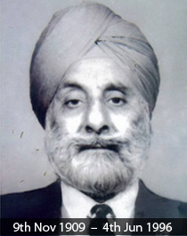
Prof. Dr. Santokh Singh Anand (1902-96)
Director, Post Graduate Institute of Medical Education
and Research (PGIMER), Chandigarh (1963-69)
Dr Santokh Singh Anand was born on 9th November 1909 at Sibi in Baluchistan, in the present Pakistan. He graduated in Medicine in 1932, took Fellowship of the Royal College of Surgeons of England in 1939. He was honoured with FACS(1951), FCCP(1951) and FAMS(1960).
From 1943-1947, he worked as Assistant Professor of Surgery at the King Edward Medical College, Lahore. With India becoming independent, he moved into Amritsar, Punjab and held the position of Professor and Head of the Department of Medical College, Amritsar, Punjab from 1947 to 1962. He also had the administrative responsibility as the Principal of the College from 1958-1962.
Dr Santokh Singh Anand was invited to the Postgraduate Institute of Medical Sciences at Chandigarh in 1962 on its inception, where he worked as the Director and Professor of Surgery till 1969.
“The fragrance of his teaching, the moral guidelines laid down by the great man of the yesteryears and his personality still pervades the atmosphere and shall continue to do so as long as the students are around. Great teachers leave this world and ascend to those immortal mansions above, whence all goodness emanates. They live always in the hearts, nay in the minds of those they taught.” Wrote a student of Dr Anand.

Slide 80
Founder Director, PEC at Chandigarh as well as that of IIT Delhi
Mr. Rajinder Nath Dogra (1908-99)
( Another contemporary of Homi Bhabha )
A visionary Civil Engineer in the service of Government of Punjab.
Associated with Bhakra Nangal Project and Capital Project Chandigarh.
He was asked to look after East Punjab Engineering College at Roorkee from 1947, and thereafter, establish PEC at Chandigarh from 1953 onwards.
He persuaded Mr. M S Thacker, Member, Planning Commission to recommend establishment of an IIT in Delhi .
The foundation stone of IIT Delhi was laid in 1960 and the first batch of students joined on August 16, 1961 on the campus of Delhi College of Engineering. IITD was initially registered as a Society in 1960.
Mr R N Dogra served as founder Principal/Director of IIT Delhi.
The main auditorium of IIT Delhi is named after Mr R N Dogra.

Slide 81
Attempted to validate the Premise
“Scientific Heritage of North West is indeed rich, and needs to be made known and recorded for posterity”,
Summary of Presentation
Provided you a glimpse into contributions of selection of scientists from North West.
Could include only examples of those born well before the independence of India.
Highlighted contemporaries of Shiv Ram Kashyap (1882-1935), S S Bhatnagar (1894-1955), Homi Bhabha (1909-1966), Har Gobind Khorana (1922-2011)
Have not been able cover all the outstanding scientists, many other inspiring examples have got left out. You can find them in the book edited by Dr. S K Sahni and Prof. R K Kohli.

Slide 82
Prof. Yash Pal delivered the First B M Anand (1905-1998) Memorial Lecture and unveiled the Potrait of BMA in the Physics Auditorium named after him at the PU campus, Chandigarh
Extracted from “ Bal Mokand Anand : His Life and Science Across the Partition of India”
by Rajinder Singh, a book released on the occasion of 7th BMA Lecture on July 21, 2023.

Slide 83
Thanks for your patience!
Acknowledgements :
Prof. R K Kohli, VC, Amity University Punjab, Mohali for soft copy of his book.
Dr. Aseem Vasisht, PSCST, for his help in compiling the presentation.

