Slide 1
Sense & Sensorability
ASET Colloquium, 13th Dec, 2019
Hemant Adarkar
Meetasha Rathi

Slide 2
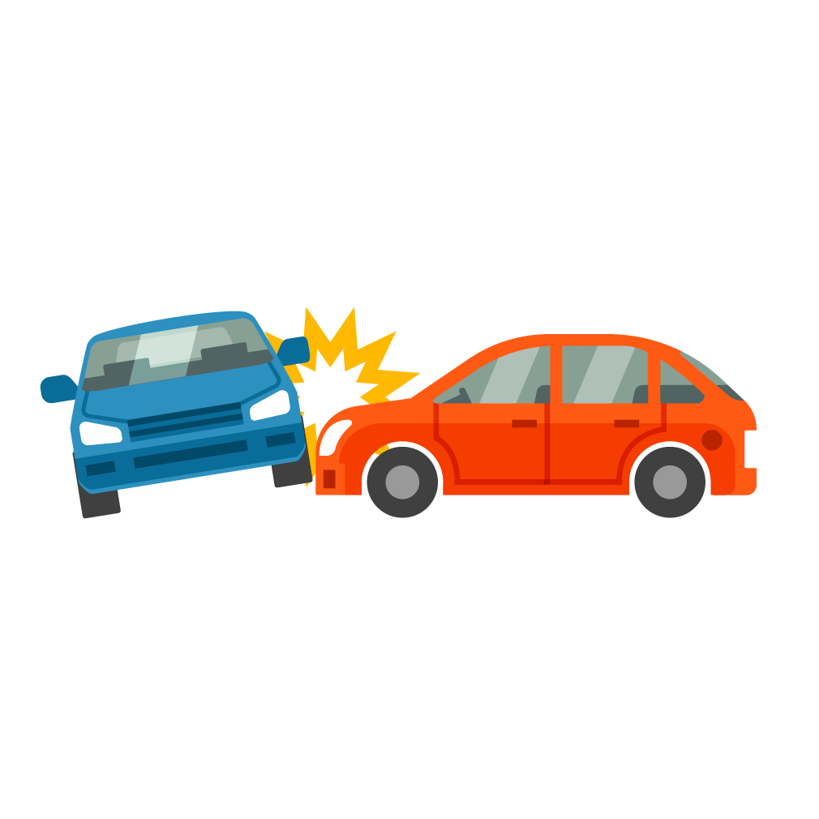
1.35 million
3,287
3% of GDP
Road traffic deaths occur every year
Deaths everyday on average
Cost of road traffic crashes
Source: https://www.who.int/news-room/fact-sheets/detail/road-traffic-injuries

Slide 3
ZENSUNGTM
Vision : to create better driving experience, improve road safety and reduce pollution.

Slide 4
Sensor
The present

Slide 5
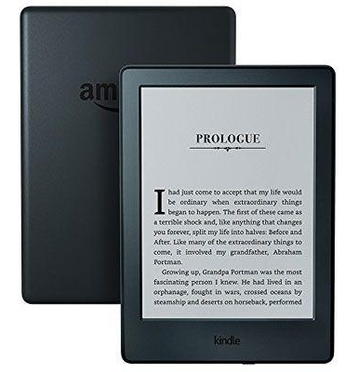
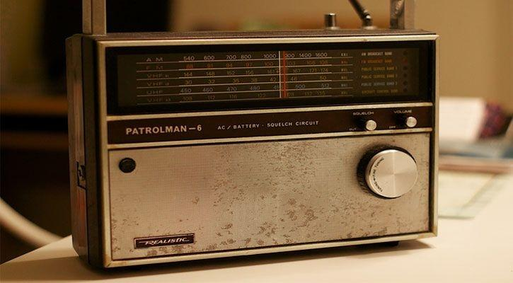
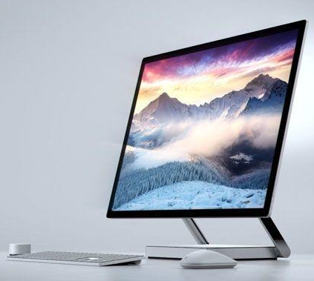
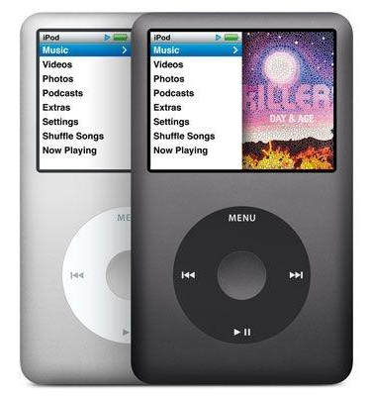
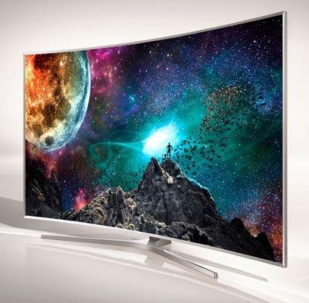
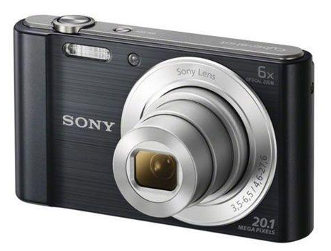
Smartphones have replaced…

Slide 6
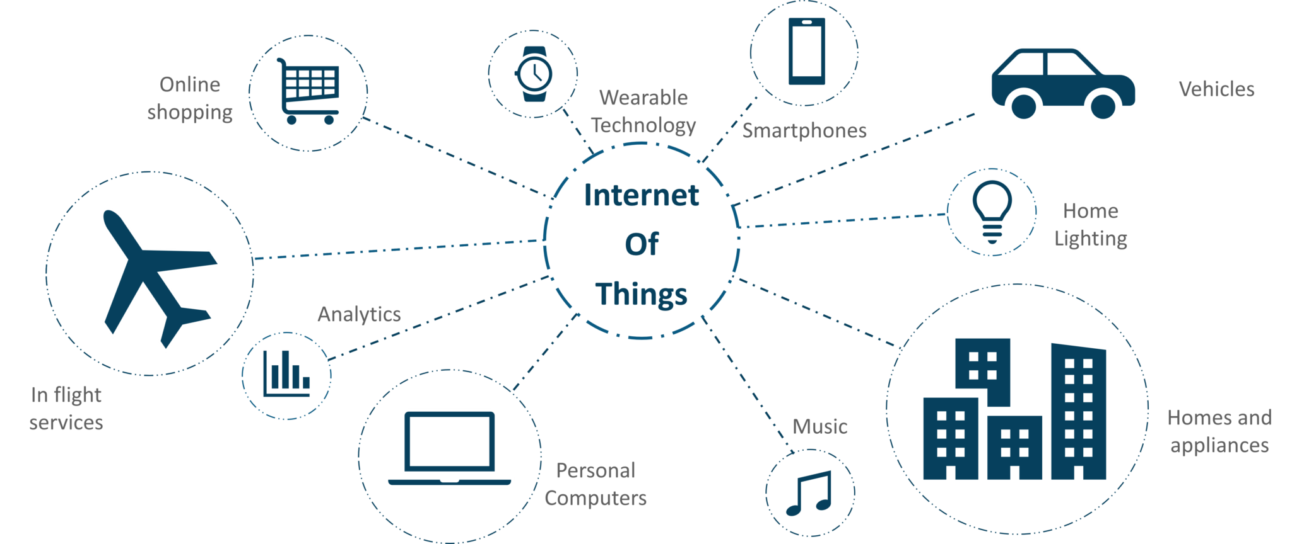
What is IoT?
Source: https://medium.com/edureka/iot-applications-c62cd48b7363

Slide 7
“What the Internet of Things is really about is information technology that can gather its own information. Often what it does with that information is not tell a human being something, it [just] does something.”
— Kevin Ashton
Technology Pioneer, MIT

Slide 8
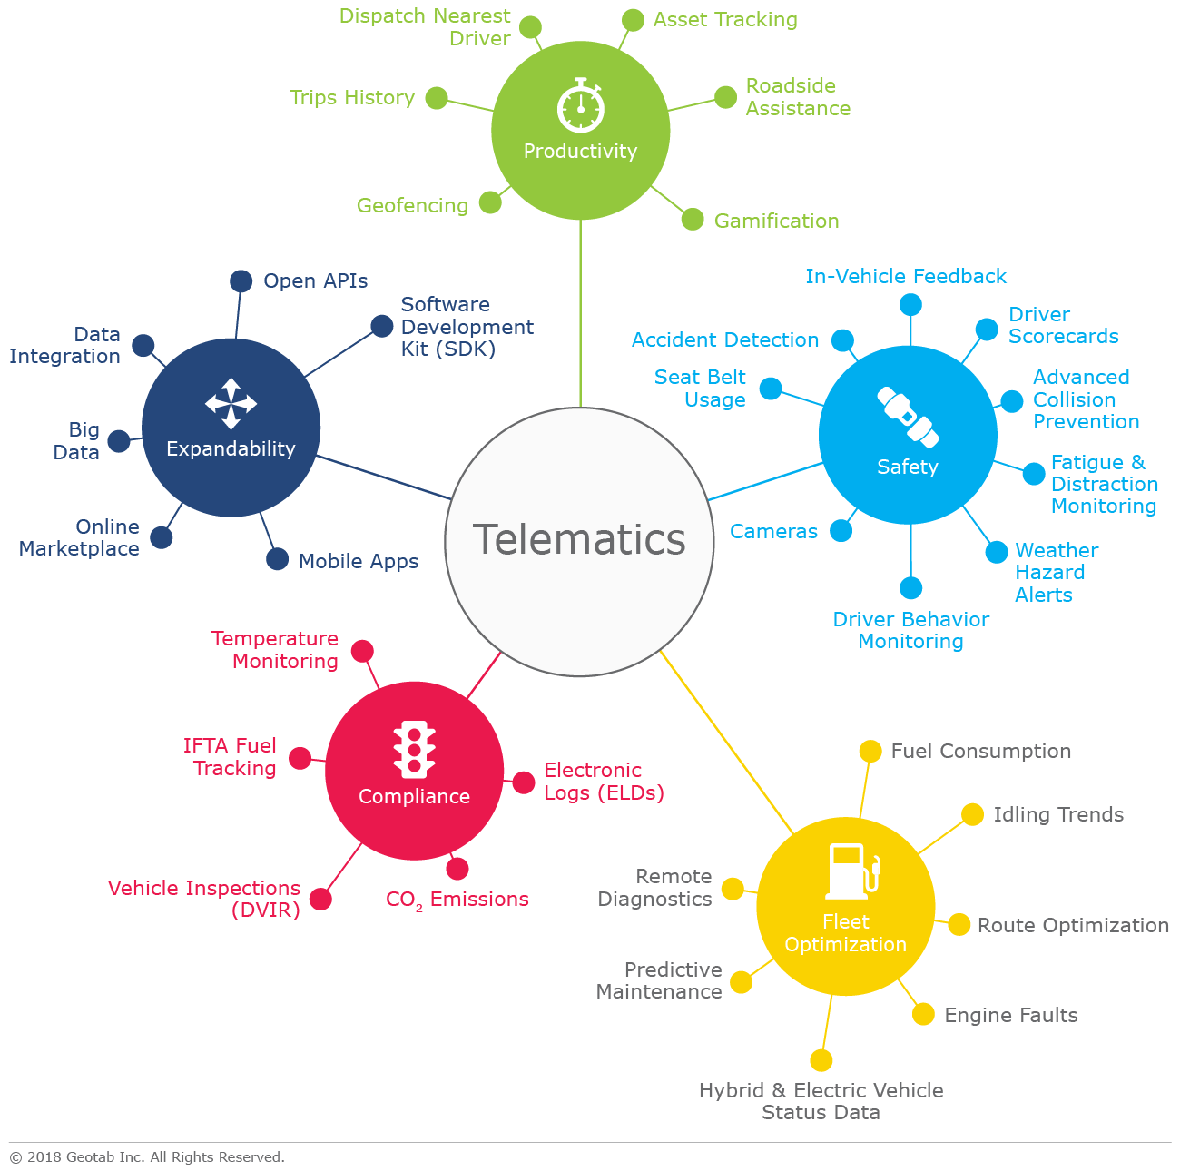
Telematics
Source: https://www.geotab.com/blog/what-is-telematics/

Slide 9
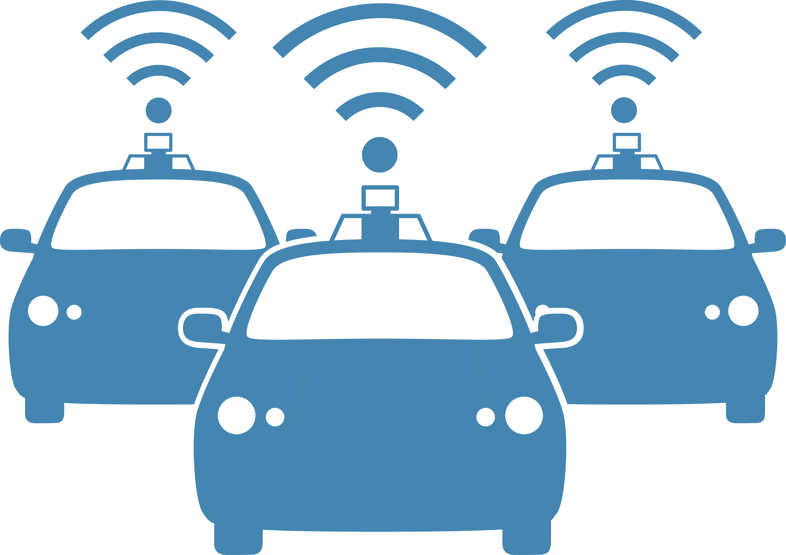
Our Use Cases
Auto insurance
Fleet management
Competitions

Slide 10
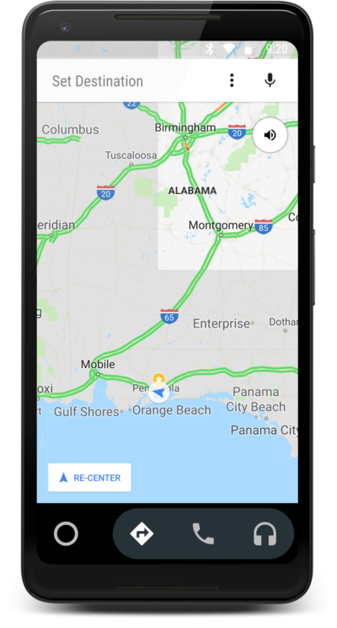
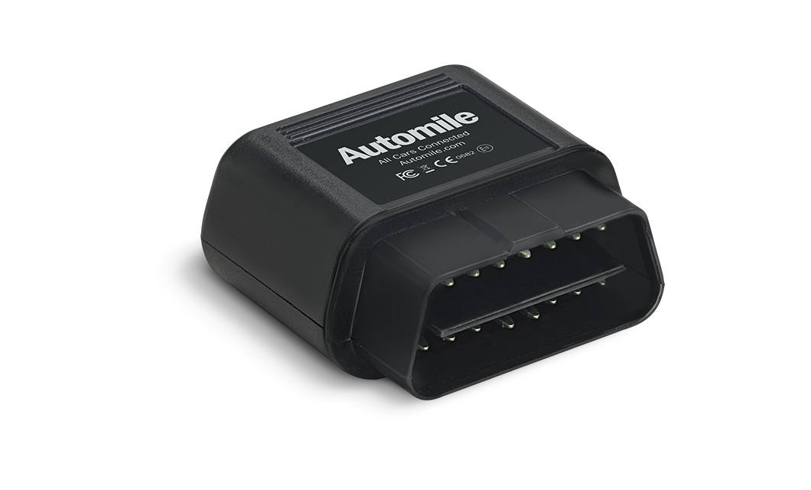
OBD Vs Smartphones
Installation
Cost
Availability
Phone usage detection
Data Sanity
Source: https://blog.automile.com/myth-obd-ii-devices-void-warranty/
https://www.androidcentral.com/android-auto

Slide 11
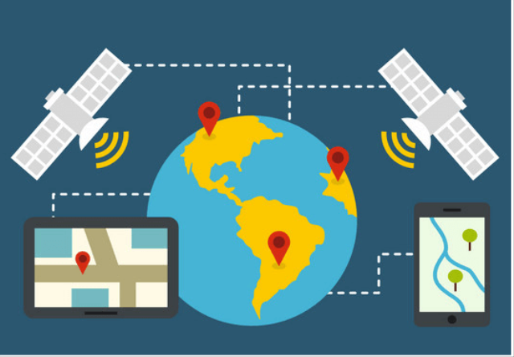
GPS Sensor
Fitted in devices
Provides parameters:
Latitude
Longitude
Speed
Heading
Source: https://electricalfundablog.com/global-positioning-system-gps/

Slide 12
Sensors
Accelerometer
Gyroscope
Magnetometer

Slide 13
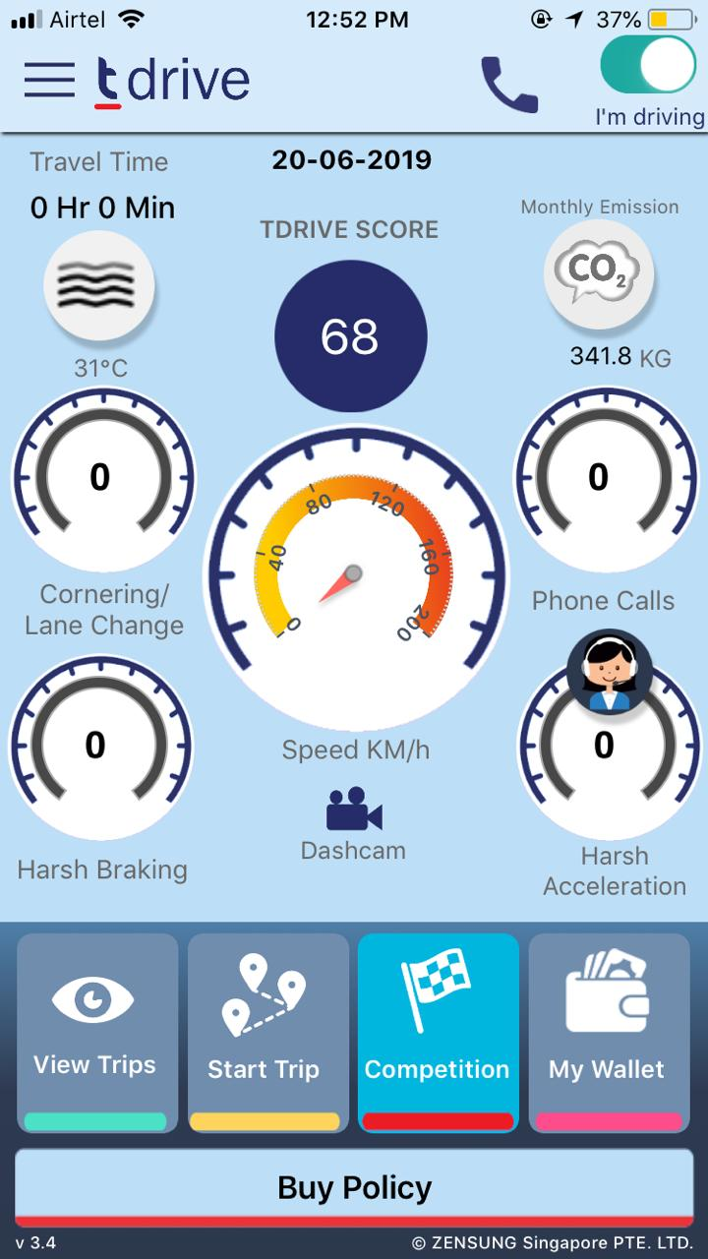
tDrive App
App collects sensor data which it uses to analyse driving patterns of the user

Slide 14
tDrive App features

Slide 15
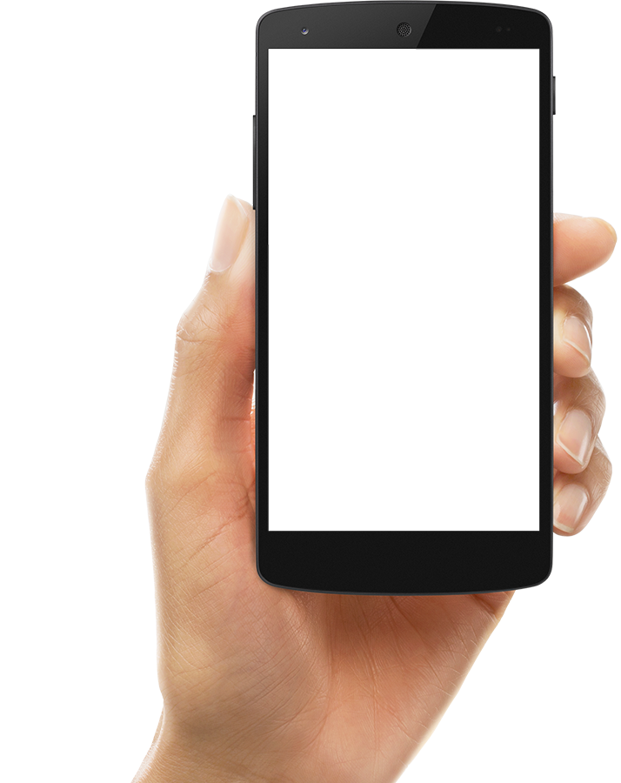
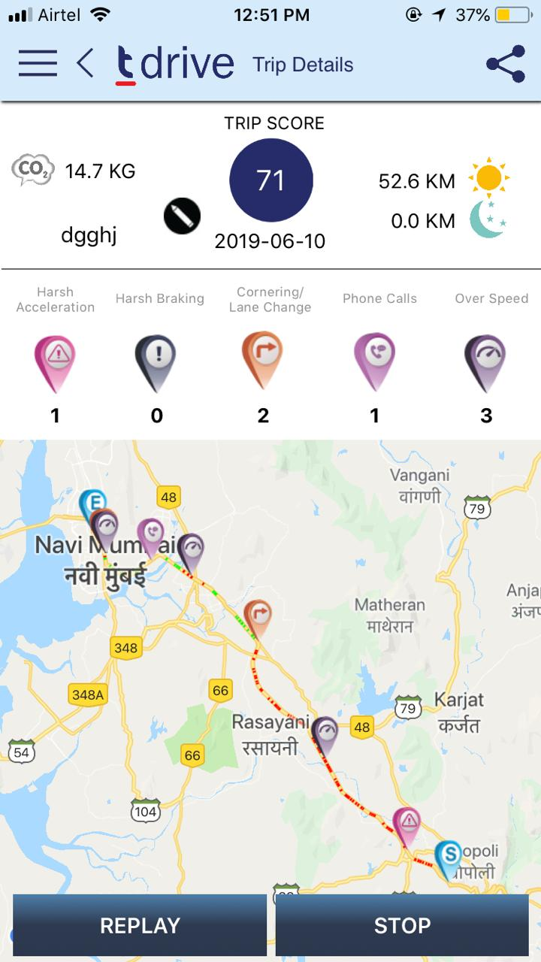
Driving Skills Analysis
Harsh Acceleration
Harsh Braking
Harsh Cornering
Over-Speeding
Phone Calls

Slide 16
Sensorability
The road ahead

Slide 17
Telematics Policies & IoT
Pay How You Drive

Slide 18
Sensor & IoT
High and continuous volume
Raw dirty data
Managing time-series data
Bi-directional communication

Slide 19
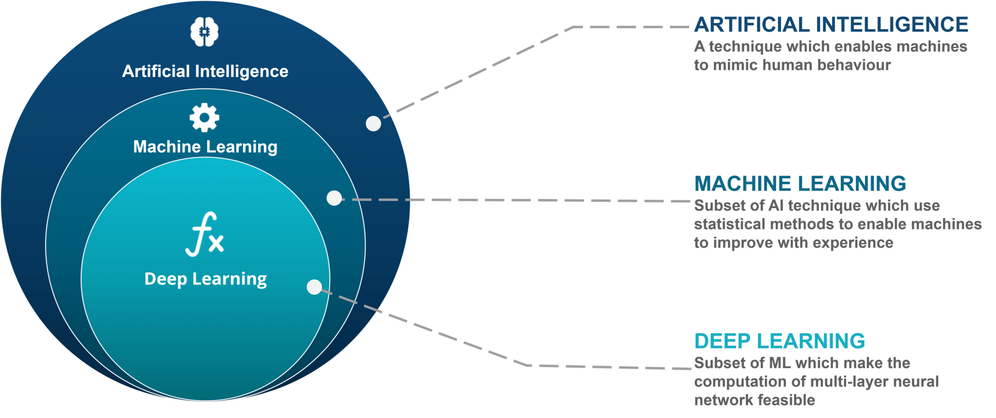
Source: https://towardsdatascience.com/deepfakes-an-unknown-and-uncharted-legal-landscape-faec3b092eaf

Slide 20
Machine Learning
Supervised
Unsupervised
Reinforcement
Classification
Regression
Clustering
Dimensionality Reduction

Slide 21
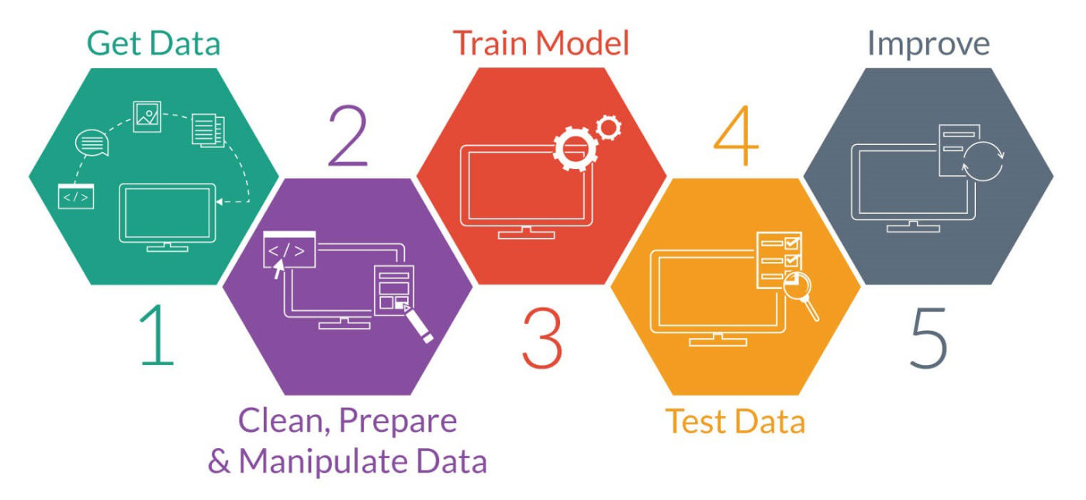
Analytics Workflow

Slide 22
Identification of Mode of Transport
Objective To identify the mode of transport and thereby consider only those trips which are in car
Data: Sensor data

Slide 23
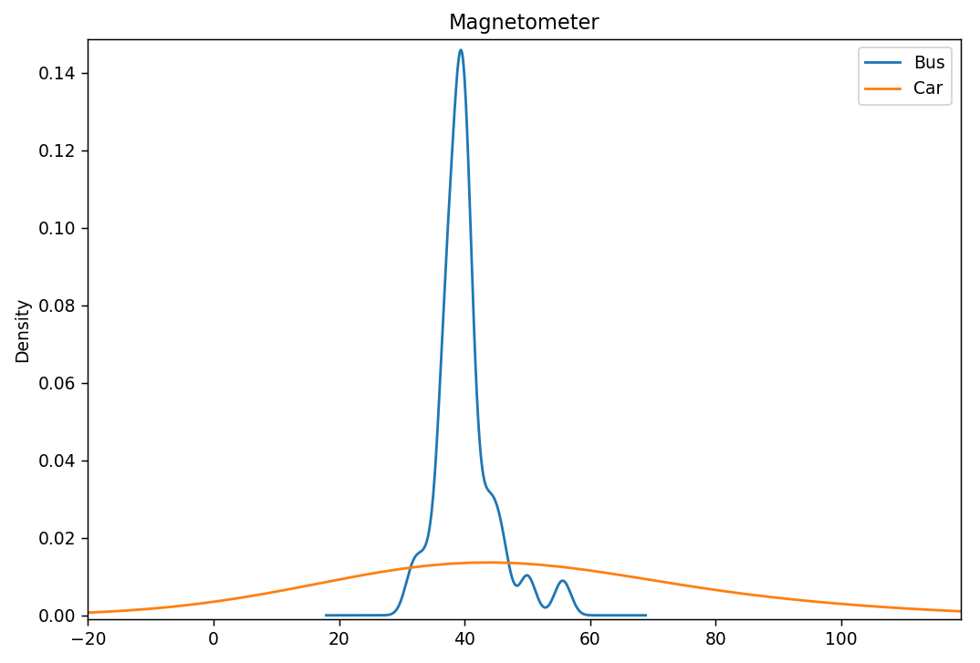
Magnetometer Density Plot
Magnetometer reading (μT)

Slide 24
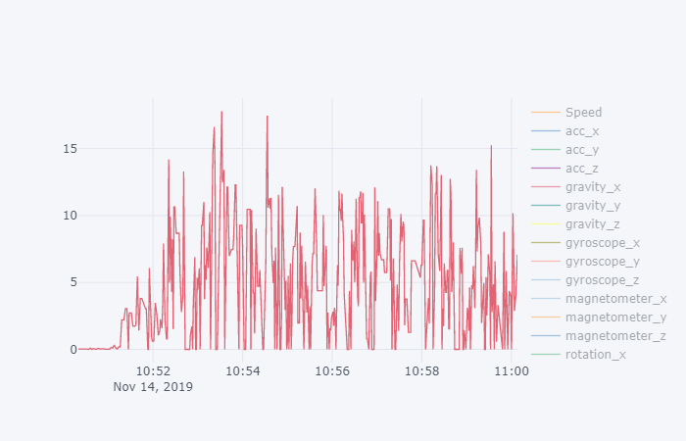
Linear Acceleration - Walking
Linear Acceleration - Car
Linear Acceleration - Train
Linear Acceleration - Bike

Slide 25
Methodology
Collection
Packets from smartphone
Cleaning
Formats, frequency, exceptions
Feature Engineering
Statistical features
Model Building & Validation
E.g.: Random Forest
Windowing
EDA
Distributions
Correlations

Slide 26
Driver vs Passenger Identification
Objective: : Identify and consider only those car trips where the user has been the driver
Data: Sensor
Methodology: Supervised ML (Classification Algorithm)

Slide 28
Driving pattern Analysis
Objective: To analyse driving patterns of individuals and alert in case of deviation from norm
Data: Sensor and GPS data
Methodology: Anomaly detection algorithms

Slide 29
Insurance Product Recommendation
Objective: Adequate coverage
Data: User profile and claims data
Methodology : Recommendation Engine

Slide 30
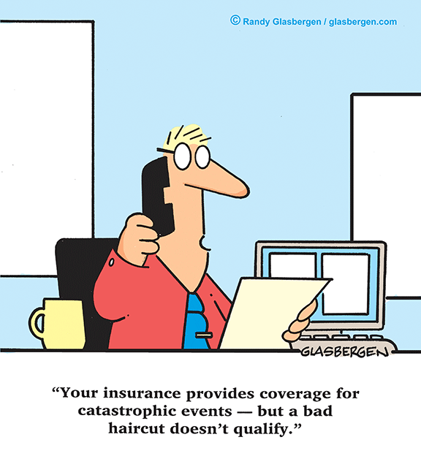
THANKS!
Any questions?
You can also reach us at:
hemant@zensung.com
meetasha@zensung.com

