Slide 1
MATLAB for research
Debanand Singdeo, PhD Spandhana Gonuguntla, PhD
MathWorks India Pvt. Ltd. MathWorks India Pvt. Ltd.
Pune Bangalore
dsingdeo@mathworks.com sgonugun@mathworks.com
13th March 2020

Slide 2
Outline
Introduction
Example of problem solving on MATLAB
Research user stories
Resources for researchers

Slide 3
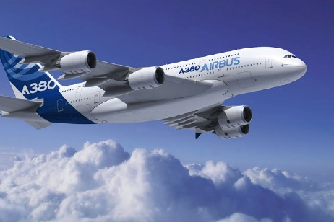
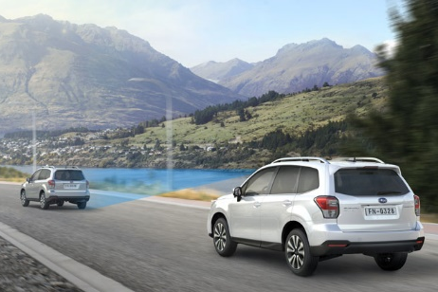
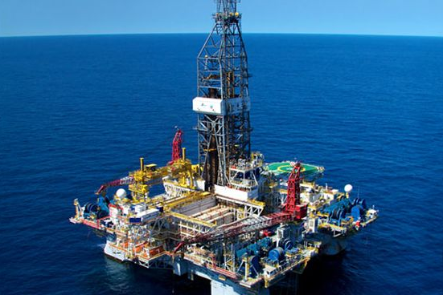
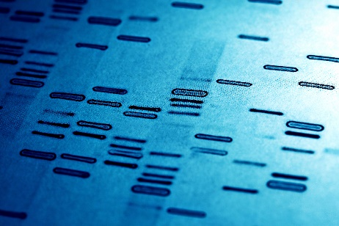
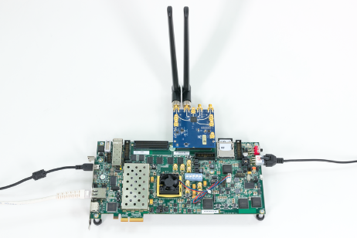
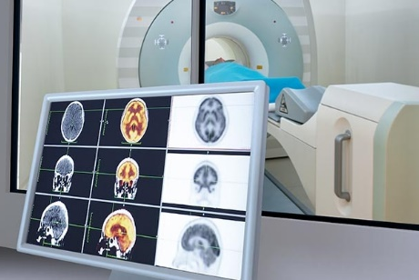
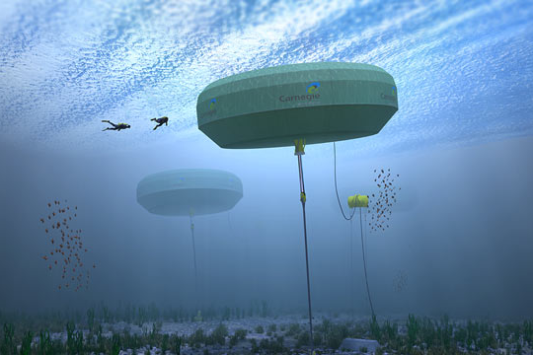
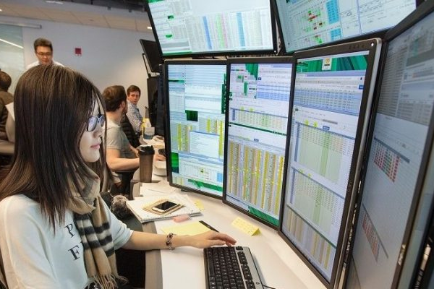
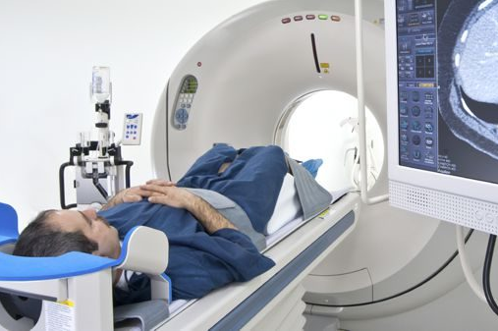
Who we are ?
Education Team at MathWorks:
- We collaborate with students, educators, researchers and their institutions achieve success
Aerospace | Automotive | Oil and gas | Biotech and Pharmaceutical | Communications
Medical device | Energy Production | Financial Services | Semiconductor | Medical Devices
Metals, Materials, Mining | Neuroscience |  | Semiconductors

Slide 4
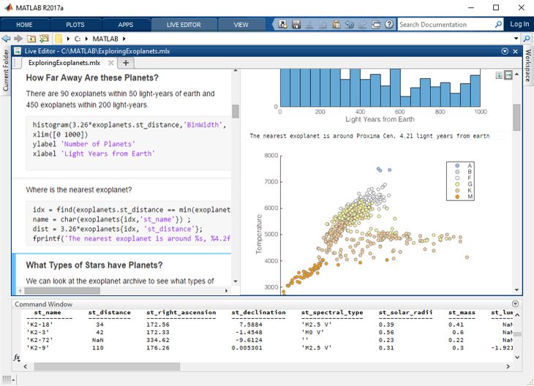
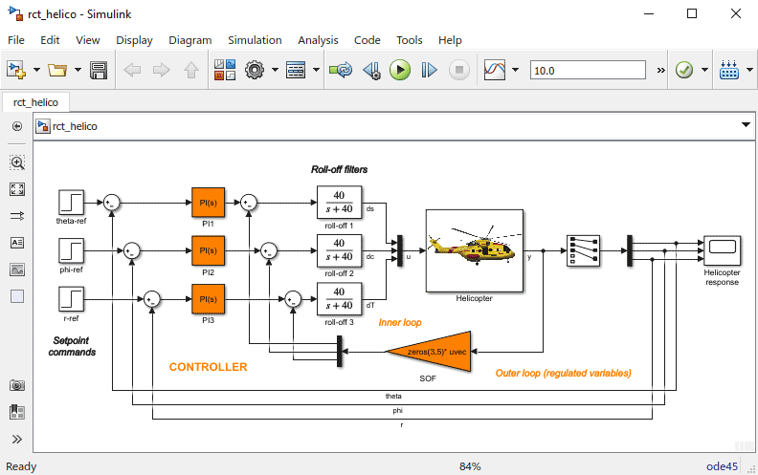
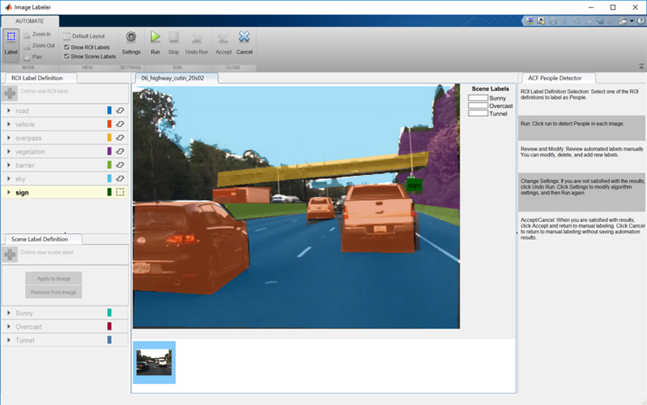
Accelerating the pace of Engineering & Science
Simulink
Computer Vision System Toolbox
MATLAB
MATLAB is a programming environment for algorithm development, data analysis, visualization, and numeric computation.
Simulink is a graphical environment for designing, simulating, and testing systems.
Nearly 100 add-on products for specialized tasks are available.
Notes:
MATLAB is a programming environment for algorithm development, data analysis, visualization, and numeric computation <CLICK>
Simulink is a graphical environment that allows engineers to design, simulate, and test systems before moving to hardware <CLICK>
And we produce nearly 100 additional products for specialized tasks such as data analysis, image processing, and computer vision
MATLAB description source: MathWorks.com Technical Computing landing page
Simulink description source: MathWorks.com Simulink landing page

Slide 5
Example of problem solving on MATLAB

Slide 6
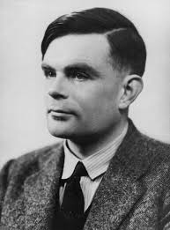
Reaction diffusion model for morphogenesis
Alan Turing
Variety of patterns are observed in nature
Notes:
Turing was interested in how a spatially homogeneous system, such as a uniform ball of cells, can generate a spatially inhomogeneous but static pattern, such as the stripes of a zebra.

Slide 7
A simplified approach using model
B
A
$$\dot{A}=f(1−A)\text{ +}D_{A}∇^{2}A −{AB}^{2}$$
Equations
$$\dot{B}=−\left(k+f\right)B\text{ +}D_{B}∇^{2}B+{AB}^{2}$$

Slide 8
Research User Stories
Developing Radio Astronomy Instruments with Simulink Libraries
Using machine learning to build a better battery

Slide 9
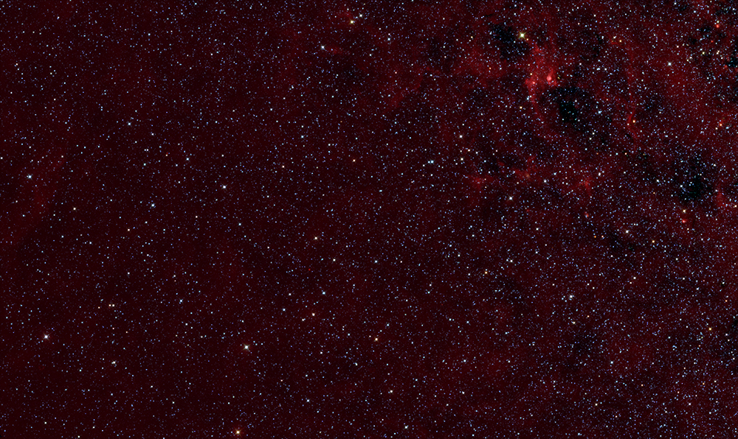
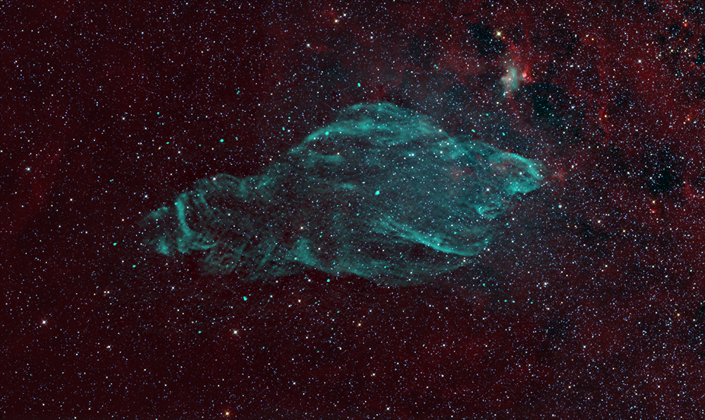
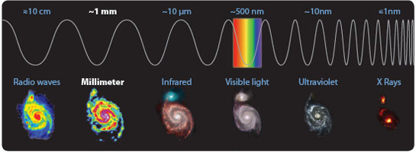
About Radio astronomy
Notes:
Objects in the universe, such as galaxies and stars, produce light that spans the entire electromagnetic spectrum. Each segment of the spectrum reveals something different about the physics of the objects. Radio astronomy is the study of celestial objects through analysis of radio waves. This field allows scientists to observe astronomical phenomena that are often undetectable in other portions of the electromagnetic spectrum. In its brief 70-year history, radio astronomy has revealed new types of celestial objects, including pulsars and quasars, and notably, cosmic microwave background radiation, which is the cooled remnant of the Big Bang event that formed our universe. Radio astronomers are most interested in objects that emit in the frequency range between 3 kilohertz and about 900 gigahertz

Slide 10
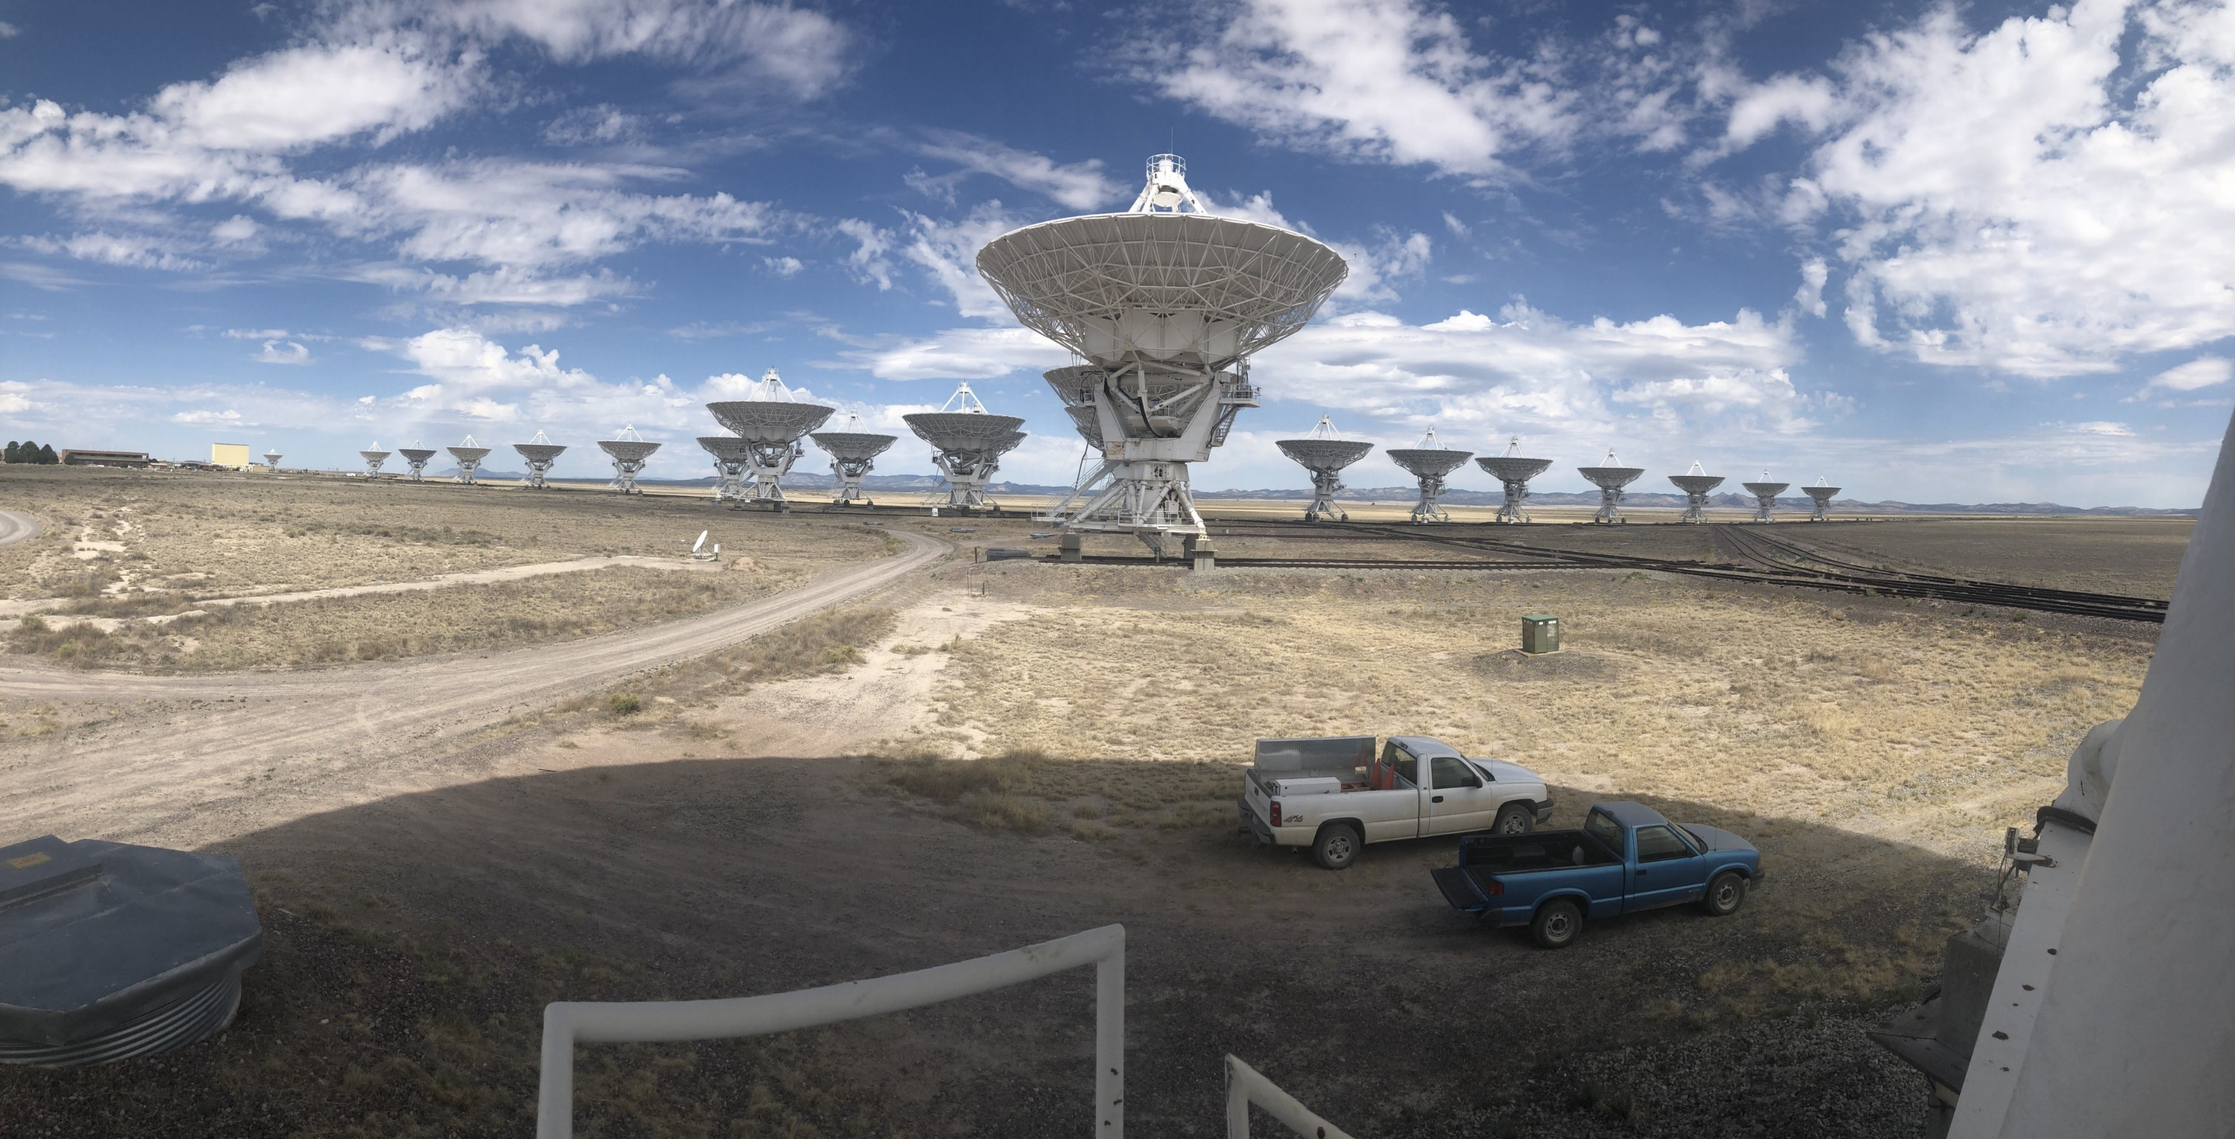

Slide 11
Signal processing workflow
Domain-specific expertise
Deployment
Notes:
Signal acquisition->RF Conversion->Digitization->Digital Signal Processing->Data transfer
This is the deep learning workflow you have seen in previous talks. We identify three main challenges when dealing with signals:
1. Training a network requires a large high quality labeled data set
2. Feature extraction and signal transformations require domain knowledge – both of the nature of the data and of signal processing
3. Deploying the trained model across multiple platforms requires C or GPU code which can be challenging to obtain
In the next slides I will give an overview of solutions we offer for these challenges.

Slide 12
Challenges in radio astronomy
Processing digitized signals from antennas in real time is a key challenge in radio astronomy.
A single antenna element can produce data on the order of 200 gigabits per second
Multiple antennas are common
Burst from a pulsar typically lasts only a few milliseconds
Traditionally, the development of real-time instrumentation for processing radio data involves design and implement the system using custom electronics.

Slide 13
Solution
(CASPER) → the Center for Astronomy Signal Processing and Electronics Research (https://casper.berkeley.edu/)
“Our aim is to produce tools which allow astronomers to rapidly design and deploy new instruments using FPGA, GPU, and CPU processors.”
Needed a reusable, modular hardware platform for signal processing and FPGA development.
Most radio astronomy instruments comprise commonly used components.
Ex: A spectrometer includes polyphase filter banks (PFBs), fast Fourier transform (FFT) blocks, integrators, transposers, and buffers.
Notes:
has developed a set of hardware and software tools for building radio astronomy digital instrumentation. CASPER was created as a result of the realization that digital signal processing
hardware technology, and especially FPGAs, have reached a point where it is possible to build almost all the digital instrumentation required in a radio telescope from a common hardware platform The CASPER philosophy is that minimizing time-to-science, the time between conception of an instrument and its deployment, is a priority when designing instrumentation. The second generation of this reconfigurable, scalable FPGA-based computing platform is the BEE2.

Slide 14
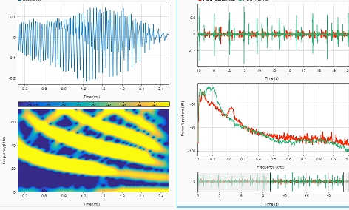
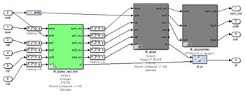
CASPER library
Simulink® used to develop a library of parameterized functional elements of common components for implementing on reconfigurable, modular hardware
Can be shared, reused and scaled as hardware capabilities expand
Astronomers can directly target FPGAs (Field-Programmable Gate Array) for deployment, once design is verified
Build design from library
Simulate
Deploy
A 4-input wideband FFT Simulink library block.
Notes:
The CASPER library is a set of Simulink implementations of these common components that enables astronomers to quickly assemble and simulate instrument designs. Because the library is open source, it contains components created by the CASPER group and the broader user community.
Once the design has been verified through simulation, the team generates hardware description language (HDL) code using Xilinx System Generator for DSP. The code is then synthesized and deployed to the BEE2, IBOB, or ROACH boards that form the hardware platform for the system (see sidebar). Astronomers can directly target Xilinx FPGAs because each CASPER library component has been developed using the bit-true and cycle-true Xilinx System Generator for DSP blockset.
Before connecting the completed hardware implementation to a radio telescope, the astronomer typically connects it to real signal inputs and noise sources to verify that it operates as intended.
, and for interfacing with abstracted hardware specific components such as ADCs, DRAM, and other FPGAs

Slide 15
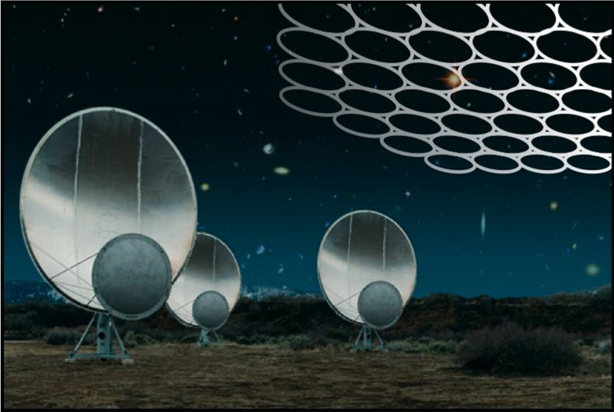
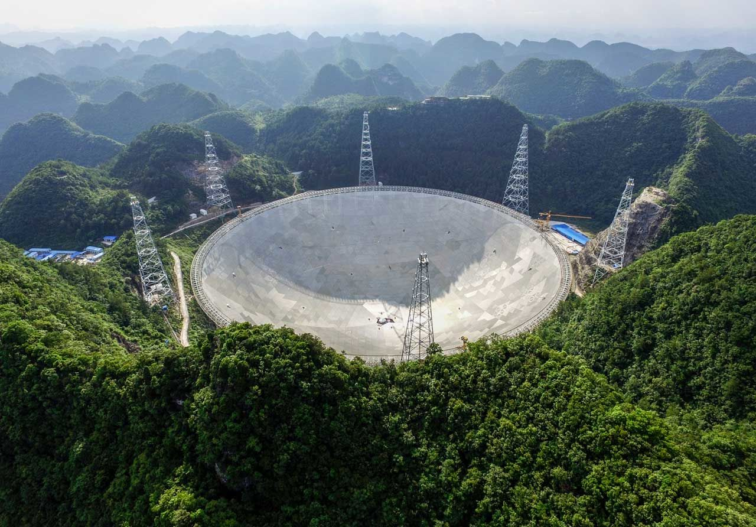
Applications
Fly’s eye
FAST
Plus
Significant cost savings
Accelerated workflow for scientists
Ease of collaboration
Design verification before deployment
It can detect extremely faint radio-wave whispers from an array of sources across the Universe

Slide 16
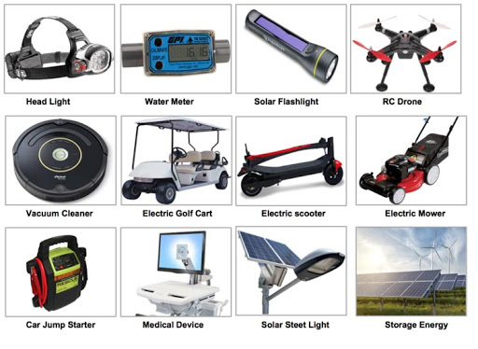
Identifying safer battery material using AI
Battery technology has become an integral part of the applications we commonly use

Slide 17
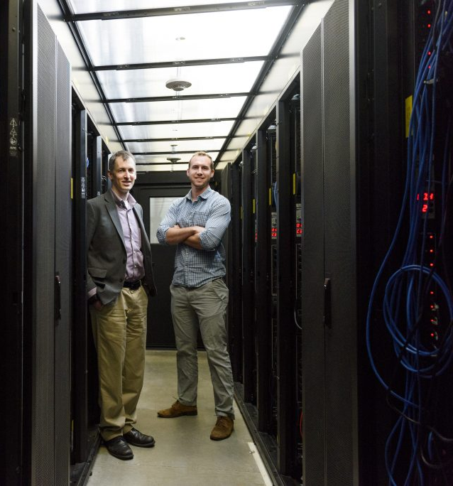
Major concern with batteries
Incidences of fire, smoke, extreme heat, explosion etc. involving Lithium batteries
Federal Aviation Administration (FAA) reported about 46 related incidents in 2019
Importance of battery safety
Challenges
Identification of ideal material combination for battery is time consuming (trial-and-error computational and experimental).
Austin Sendek and Professor Evan Reed (Stanford University) used AI to identify promising electrolyte candidates
Notes:
This highlights the critical importance of battery safety

Slide 18
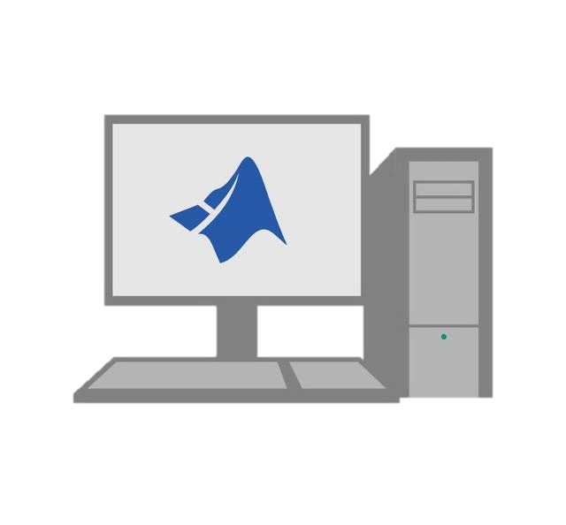
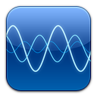
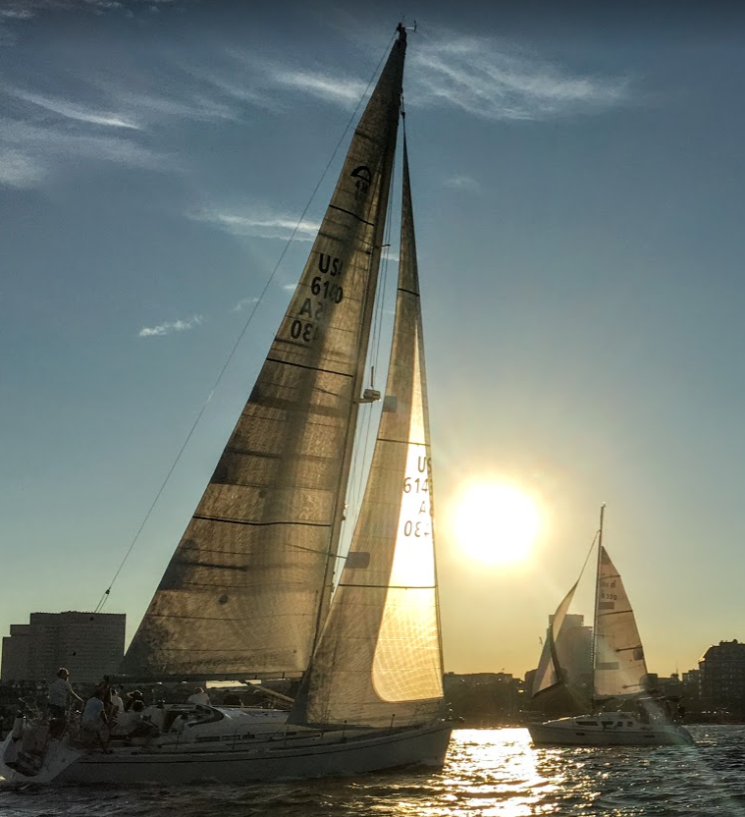
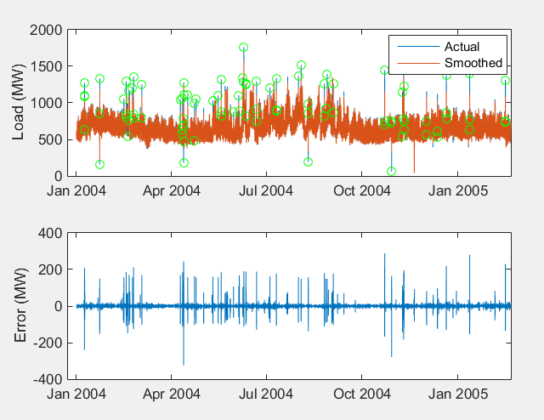
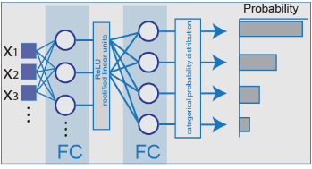
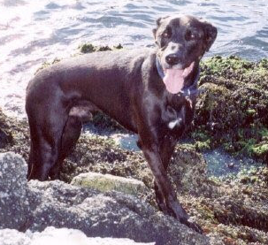
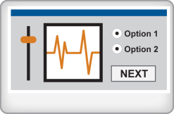
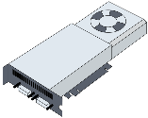
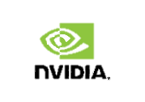
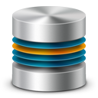
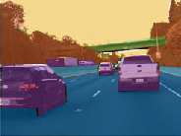
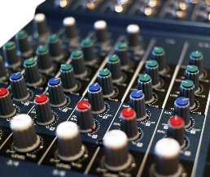
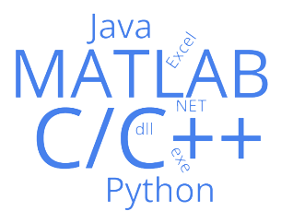
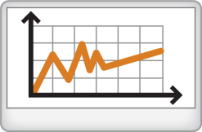
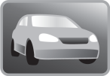
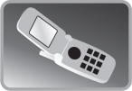
Typical AI Workflow
Access and Explore Data
Label and Preprocess Data
Develop Predictive Models
Integrate Models with Systems
Files
Working with Messy Data
Hardware-Accelerated Training
Desktop Apps
20 features
Selected characterizing
the local
atomic arrangements
and chemistry of the crystals
Access data from datastore with 12,000+ Li containing materials
Databases
Labeling Automation
Hyperparameter Tuning
Enterprise Scale Systems
Logistic regression Binary classification model
Sharing models and publish results
Sensors
Data Augmentation/ Reduction/ Transformation
Model Validation
Embedded Devices and Hardware
Notes:
The screening considered multiple additional criteria including cost and availability. The goal is to identify lithium-containing crystalline solids that demonstrate high ionic conductivity, low electronic conductivity, and both structural and chemical stability.
If there is an R&D center/industry project how this can be used by other people

Slide 19
Outcome from the work
Ref: Chem. Mater. 2019, 31, 2, 342-352
“We used MATLAB for all the data analysis in this work: for reading in atomic structure files, extracting the features, learning the best model from the features, and then applying the optimal model to the structures in the Materials Project database,” – Austin D Sendek .
Notes:
are predicted
to exhibit low electronic conduction, high stability against oxidation, and high thermodynamic
stability

Slide 20
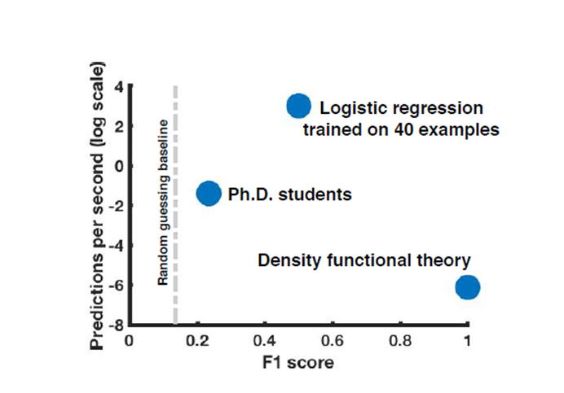
Comparison with different approaches

Slide 21
Resources for researchers

Slide 22
https://www.mathworks.com/academia/tah-portal/tata-institute-of-fundamental-research-31122786.html

Slide 23
Wireless Design
Computational Biology
Mathematics & Physics
Campus-Wide License
Most complete, up-to-date suite of products available for Academic Use
Facilitates research collaboration within and across institutions
Immediate access to newly released MATLAB & Simulink tools
Systems Engineering
Robotics
Economics & Finance
Earth & Ocean Science
Health & Environment
Neuroscience & Psychology
Collaboration in Academic Research is the Norm
~ 60%
Science & Engineering research articles were produced by authors at multiple institutions
~ 20%
Science & Engineering research articles include authors from more than one country
~ 33%
Science & Engineering research articles are the product of multi-disciplinary collaboration
Notes:
Collaboration is now the norm for academic research. Research crosses both discipline and industry boundaries, making it all the more important that researchers be able to share data, methods and tools with their research partners.
The Campus-Wide License has the most complete and up-to-date set of MATLAB & Simulink tools available for academic use. By selecting a Campus-Wide License for your institution, your research faculty will join their peers at hundreds of universities who already have open access to the all MATLAB. As an additional benefit, every MathWorks release a new product for Academic use, that propuct will be added to your Campus-Wide License at no additional charge.
Sources:
Science & Engineering Indicators 2018, National Science Board. National Science Foundation. www.nsf.gov/statistics/2018/nsb20181/downloads. Pulled December 7, 2018.
“Types and Levels of Collaboration in Interdisciplinary Research in the Sciences,” Qin, Jian, F.W. Lancaster, Bryce Allen. Journal of The American Society for Information Science, October 1997. Page 898.

Slide 24
Third-Party Access for Collaborative Research in Academia
Third-Party Access to MATLAB
Licensed institutions may provide credentials to professors, students, and academic researchers at outside institutions
Fosters research collaboration and joint research initiatives across institutions

Slide 25
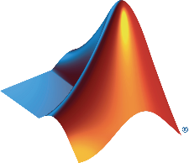
A Campus-Wide License Supports the Innovation Cycle
Campus-Wide License Academic Research Discovery Graduate Education
Accelerator & Startup Program
Commercialization of IP
Product Development
Academic Research
Knowledge Curricula
Innovation Expertise
Undergraduate Education
Industry Collaboration
Standard Licenses Commercial Research
Tools and Technology Product Development
Campus-Wide License
Workforce Training Future Researchers
Skilled Workforce
Notes:
In many of the fastest growing areas of basic and applied research today, e.g.,. AI, deep learning, IoT, robotics, and autonomous systems, it is important to understand the ecosystem between industry and education as well.
[click]
Much of the basic research on these technologies begins in research centers on university campuses.
[click]
University Accelerators play a key role in commercializing IP,
Industry moves the technologies further through applied research, until they make their way into production through goods and services.
[click]
As the new products and services grow, there’s an increasing demand from industry for skilled labor capable of working with the new technology. Undergraduate education fills this need through knowledge transfer and skill development.
[click]
MathWorks supports this ecosystem both through our Campus-Wide Licenses covering students and faculty in universities and undergraduate institutions, through our Startup and Accelerator license programs, which bridge the gap between basic research and industry, and through our commercial licenses for industry. We believe that by partnering with this entire ecosystem, it provides MathWorks with a unique opportunity to address emerging areas of research and job opportunities such as robotics, AI, deep learning, and IoT.

Slide 26
Share MATLAB Code Professionally as Toolboxes and Apps
MATLAB files
Data
Documentation
MATLAB Authors
MATLAB End Users
.mltbx
Check-in / check-out
Revision control
Collaborate
Peer
GitHub
Source control
(Git, Subversion)

Slide 27
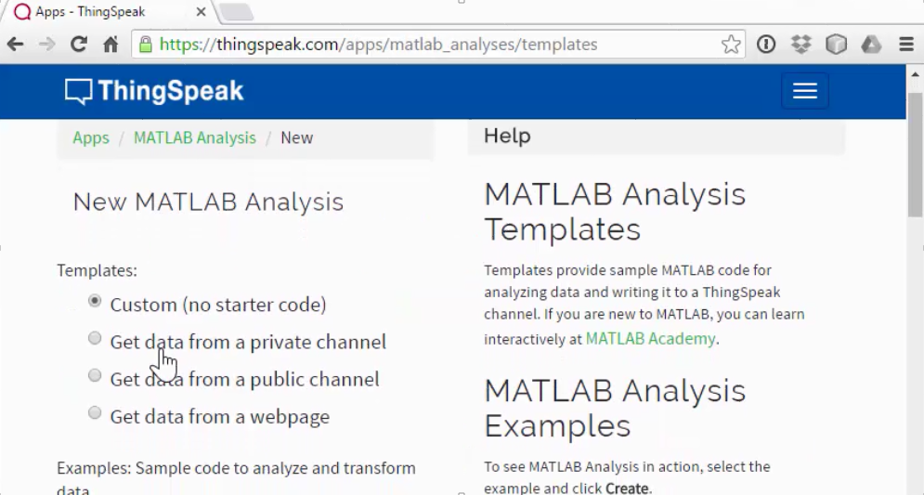
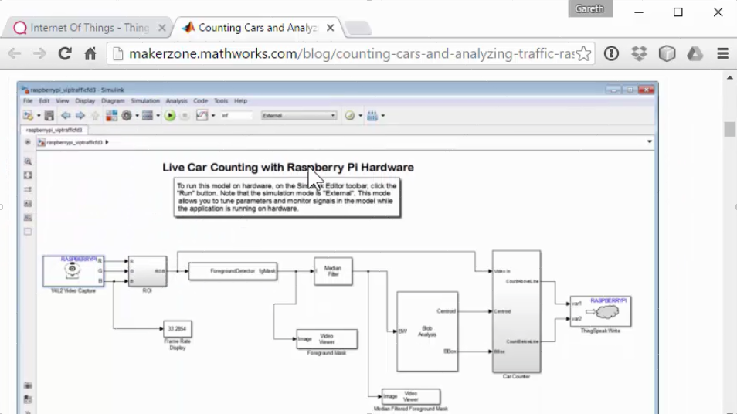
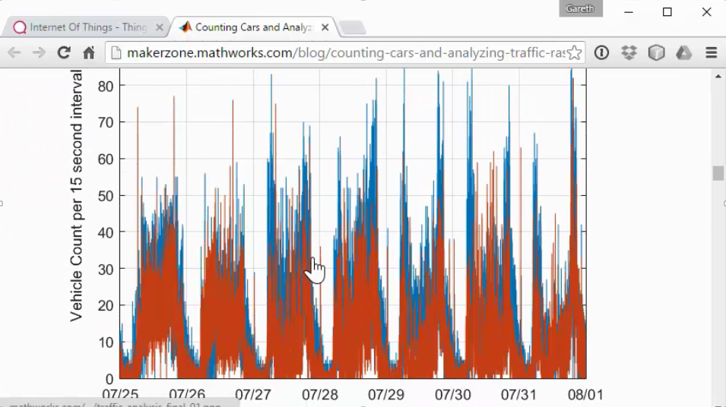
ThingSpeak IoT analytics platform for students and makers
Make “things”
using Simulink and Raspberry Pi
Built-in MATLAB analysis
Create visualizations of live data
Notes:
ThingSpeak™ is an IoT analytics platform service that allows you to aggregate, visualize, and analyze live data streams in the cloud.
[Click]
You design and build a “thing” that can send data to ThingSpeak from your devices, such as your Raspberry P.
[Click]
With MATLAB® analytics inside ThingSpeak, you can write and execute MATLAB code to perform preprocessing, visualizations, and analyses.
[Click]
With ThingSpeak you can create instant visualizations of live data, and send alerts using web services like Twitter® and Twilio®.
ThingSpeak enables engineers and scientists to prototype and build IoT systems without setting up servers or developing web software.

Slide 28
MATLAB Code ← → Other Languages
Call other-language libraries from MATLAB
Java
Python
C/C++
Fortran
COM components and ActiveX® controls
RESTful, HTTP, and WSDL web services
Call MATLAB from another language
Java
Python
C/C++
Fortran
COM Automation server

Slide 29
What will you do with MATLAB?
Notes:
Computational Thinking - approach to framing and solving problems
This is why you are learning MATLAB/Simulink
Motivate for future use and accomplishment

