Slide 1
Indigenous Cancer-Care Equipments for Societal Benefits Manjit Singh Director, Design, Manufacturing & Automation Group BARC, Trombay

Slide 2
Cancer & Treatment
A class of diseases, in which a group of cells
Grow in uncontrolled way,
spread to other locations of the body.
In many cases, it forms tumor (benign/ malignant )
Treatment Modalities:
Surgery, Chemotherapy, Radiation Therapy
Radiotherapy deposits energy to destroy cells
Distributed into many fractions
Good cells can recover faster
Notes:
There are more than 100 types of cancers. There is only one thing common among them: the cells grow out of control.
There are two types of tumors: benign and malignant
Benign tumors do not spread to other parts of the body.
Cells of a malignant tumor can also break away and spread to other parts of the body through blood stream or lymphatic system.
There is one major difference between cancer and other chronic diseases. One can live with diabetes, or cough, BP, but not with cancer; either you have to kill cancer or cancer will kill you.

Slide 3
Radiation Therapy
Destroys cells in the target location
Normal cells are also affected, but recover from the effects of radiation faster
Total dose is distributed into many fractions
Most suitable for localized cancers
It can be curative or palliative
Aim: to deliver prescribed dose to the tumor while minimizing the dose to the adjacent healthy tissues
Established mode for cancer management for more than 100 years
Notes:
Radiation can also be used to treat lukemia.
Certain types of radiation can penetrate more than deeply into the body than can others.
Some types of radiation can be very finely controlled to treat a small area.
Total dose is divided into smaller fractions, that are given daily over a specified time period (5-7 weeks).
This maximizes destruction to cancer cells, while minimizing the damage to healthy tissues.

Slide 4
Cancer Scenario in India
Prevalent cases: 20-25 lakh
No. of deaths due to cancer: >500,000 per year
No. of new cases: >800,000 per year
Approx. 2/3rd (~500,000) requires radiation therapy
Majority can not afford; social and ethical dilemma
Only 30-40% actually receive radiotherapy treatment
By year 2020, more than 70% of global cancer burden will be in the developing countries

Slide 5
Inadequate Resources
For any healthcare setup, major funding goes to radiotherapy department due to expensive equipments
RT Equipment | Units per million (developed nations) | India (~1240 million)
 |  | Scaled down requirement | No. of units available | Shortfall
Teletherapy (cobalt & linac) | 4 | 1 | ~ 500 | >700
RT Simulator | 1 | 0.5 | 200 | >400
Brachytherapy | 1 | 0.5 | 150 | >450
Most of the facilities are located in big cities
Many of the existing units are quite old

Slide 6
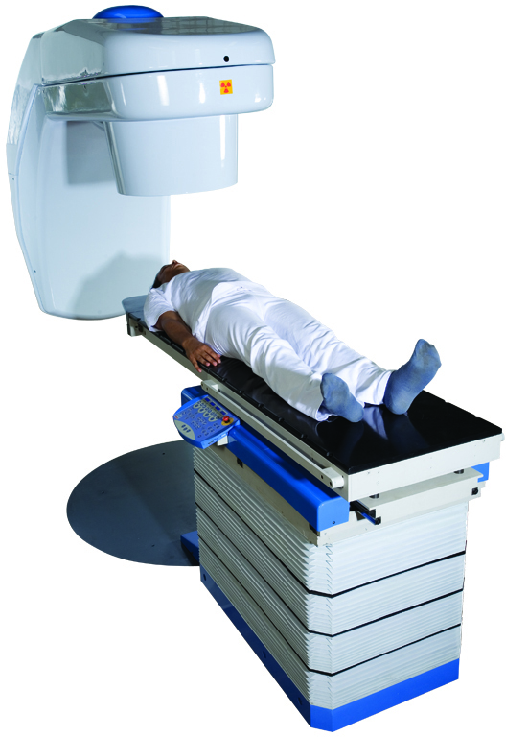
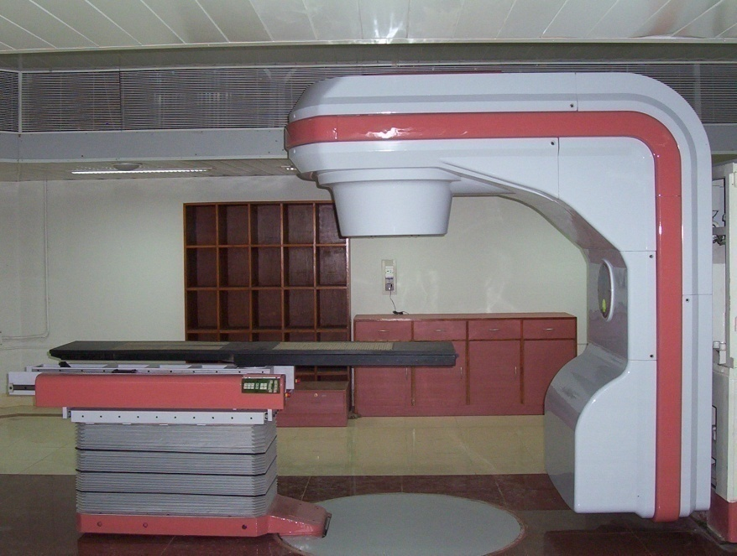
BHABHATRON-II (since 2006)
BHABHATRON-I
(decommissioned in 2007)

Slide 7
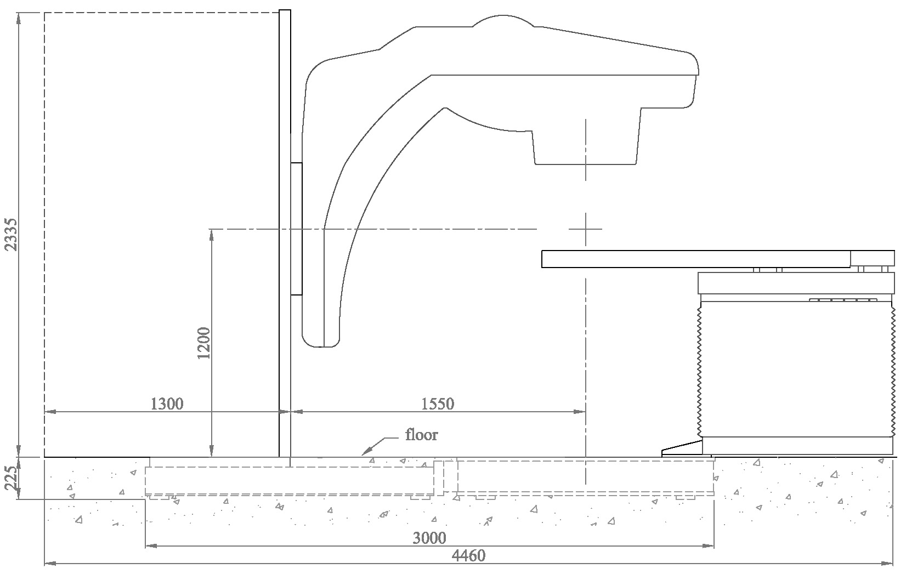
Important Dimensions
Installation Pit Size: 3500mm X 1520mm X 230mm (Weight: 6500 Kg)

Slide 8
Specifications
Source-Axis distance(SAD) | : | 800mm
Max. source capacity | : | 250RMM
Max. field size at SAD | : | 0 x 0 (completely closed)
Collimator | : | Motorized- four motions
Asymmetric Collimation | : | Yes
Collimator Auto Set-up | : | Yes
Patient positioning table | : | Motorized- four motions
Wedge Filter | : | Manual; 15°, 30°, 45°, & 60°
 | : | Motorized (upto 60°)
Power requirement | : | 1.5KW
Compliance | : | IEC 60601-2-11
Regulatory Approval | : | AERB

Slide 9
Co-60 Source for Teletherapy
High specific activity: >250 Ci/gm
High source strength: >12 kCi
Weight of source: ~ 50 gm
Pellet size: 1 mm diameter x 1 mm long
Pellets are placed in a double container and TIG welded

Slide 10
Technology for Indigenous Source
Irradiate Co-59 pellets in nuclear power reactors
Co-60= Co-59+ n
Processing and fabrication of sources
RAPPCOF, Kota (RAPP Cobalt Handling Facility)
RLG, Trombay
HIRUP, Trombay (High Intensity Radiation Utilization Project)
Strength of indigenous source: ~180 RMM
(RMM: Roentgen per minute at one metre distance)

Slide 11
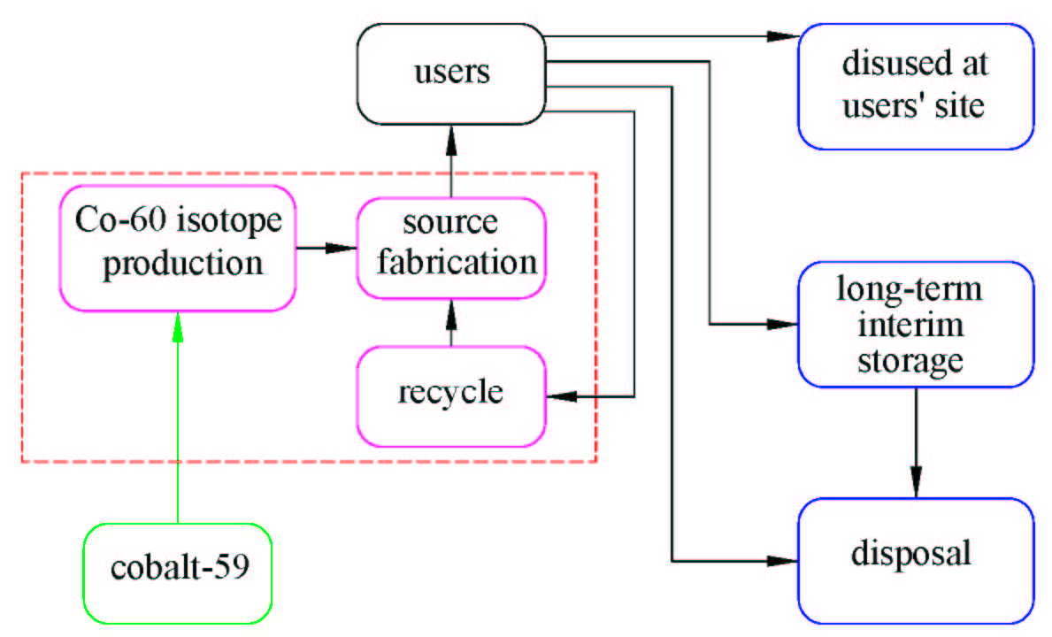
Cobalt life-cycle

Slide 12
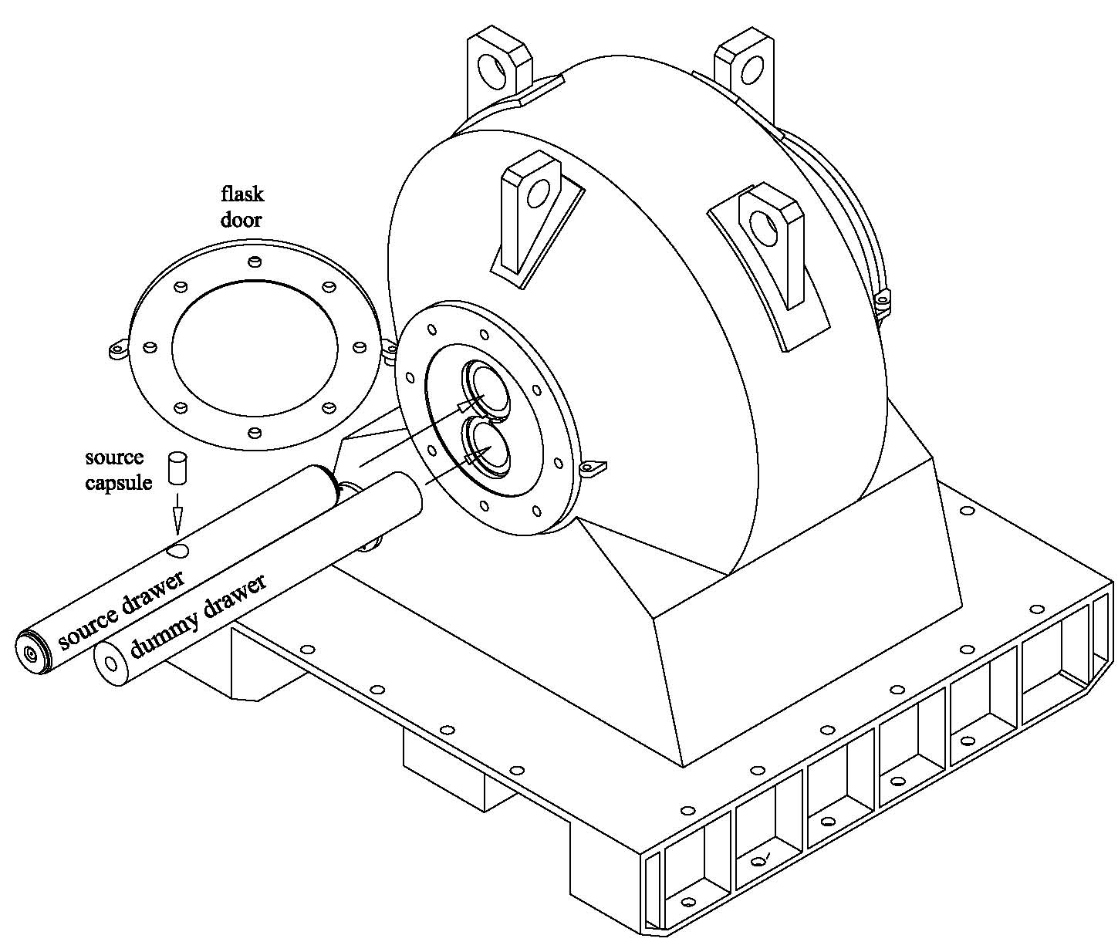
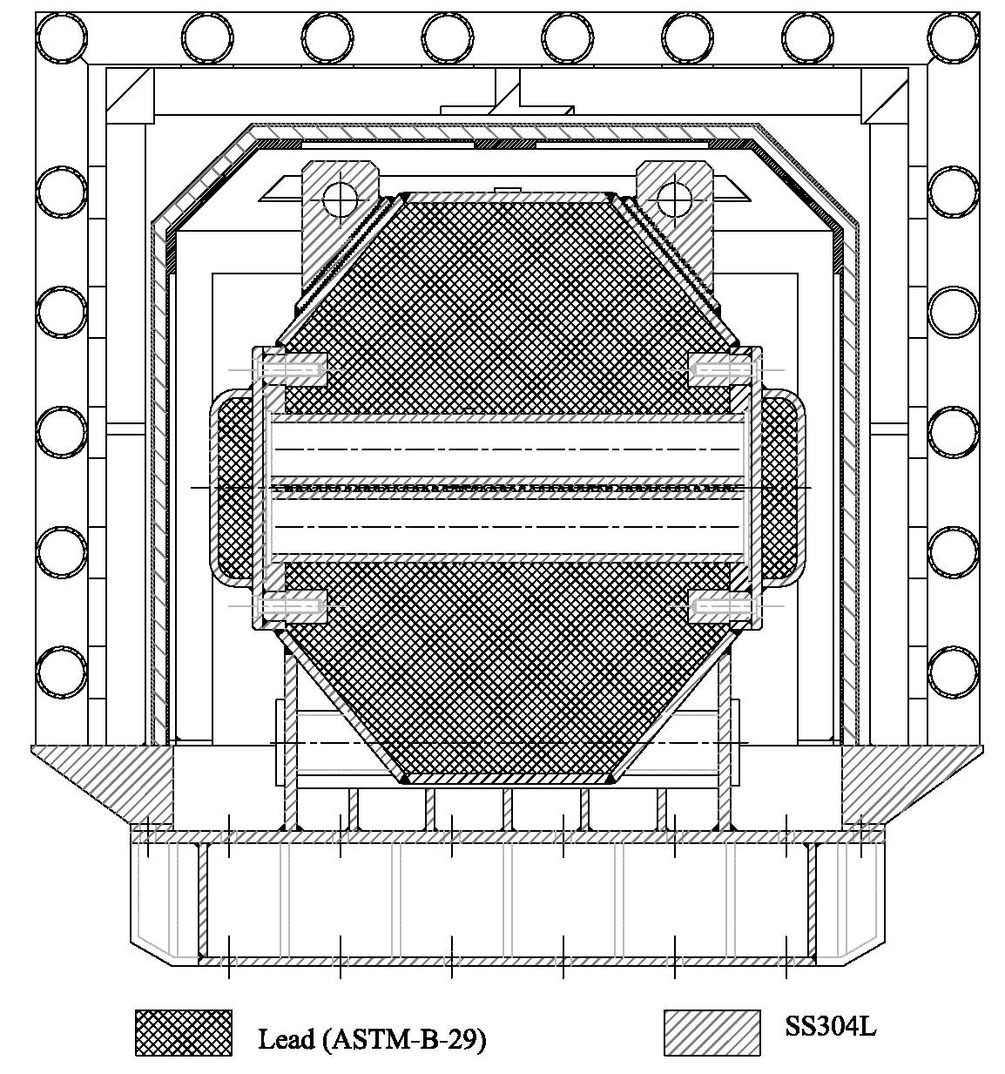
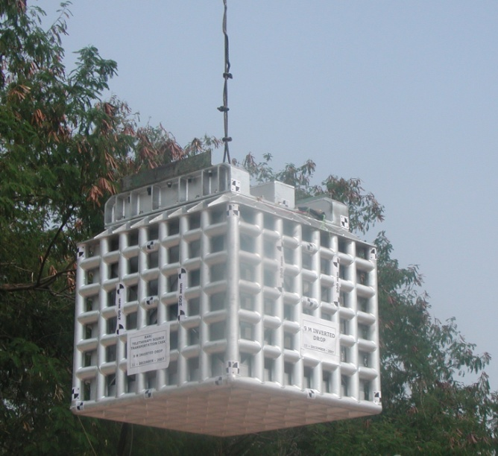
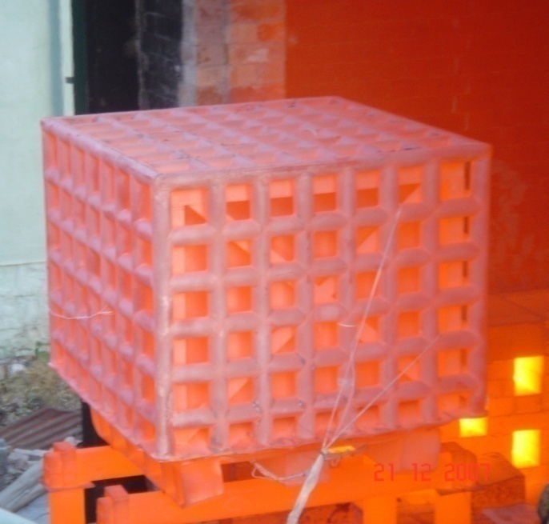
Source Transportation
Capacity | : | 15 KCi (Cobalt-60 )
Gross Weight | : | 2900 Kg
Package Size | : | 1.1m x 1.1m x 1.1m
Shipment | : | Rail/ Road/ Ship/ Air
Regulatory approval | : | Type B(U)

Slide 13
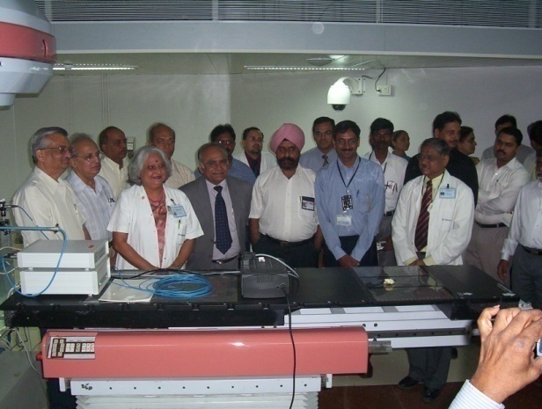
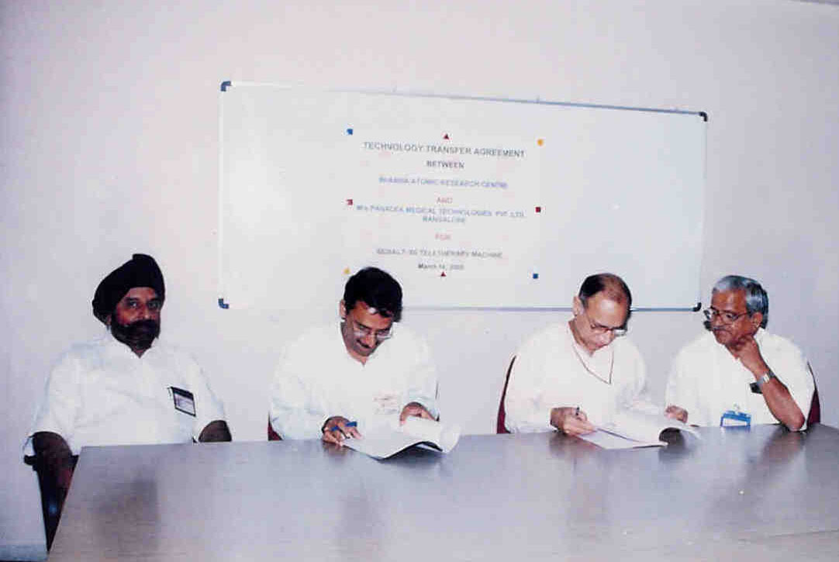
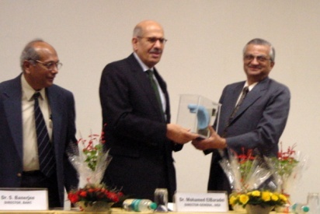
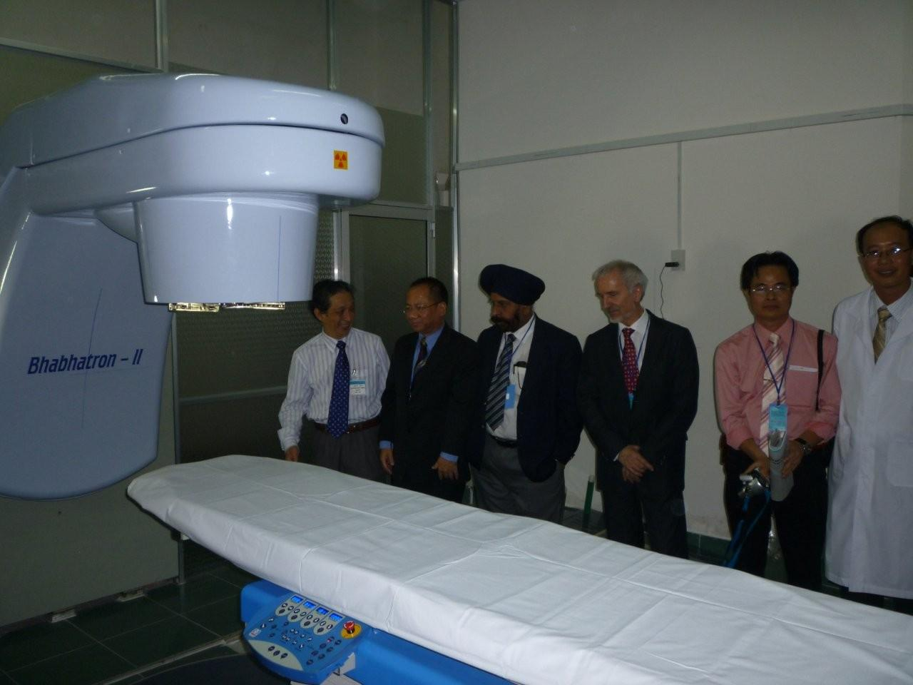
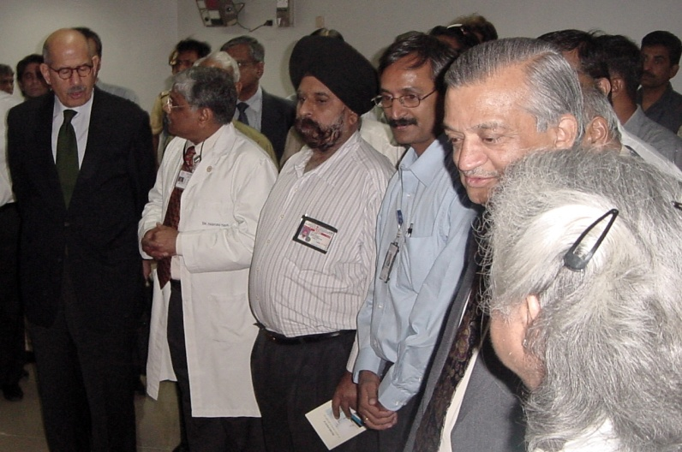
Milestones
2005
2005
2007
2007
2009

Slide 14
QA and Certifications
Extensive Clinical Trials by Tata Memorial Centre (Advanced Centre for Training, Research & Education in Cancer, Navi Mumbai)
Compliance to International Electrotechnical Commission (IEC) Requirements (Certified by Underwriters Laboratories Inc.)
Approval by Atomic Energy Regulatory Board, India

Slide 15
The Impact
Low-cost indigenous unit has reduced the cost for establishing radiotherapy facility
Irregular power supply is major problem particularly in rural areas. With low power requirement (1.2 KVA only), and battery backup treatment can be continued without interruption
Since most of the components/spares are available/made in India, the cost of spares and maintenance will also be less
Imported units no longer enjoy the monopoly

Slide 16
Work in Progress- Conformal Radiotherapy
Conformity to irregular tumour geometry permits high radiation doses to the tumour while sparing the surrounding healthy tissues.
Multi-leaf Collimator (MLC) System is useful for superior conformity essential for conformal treatments
So far, MLC system for any telecobalt unit is not developed anywhere due to severe technical challenges
At BARC, MLC system is developed for Bhabhatron, and currently being tested at ACTREC for performance evaluation

Slide 17
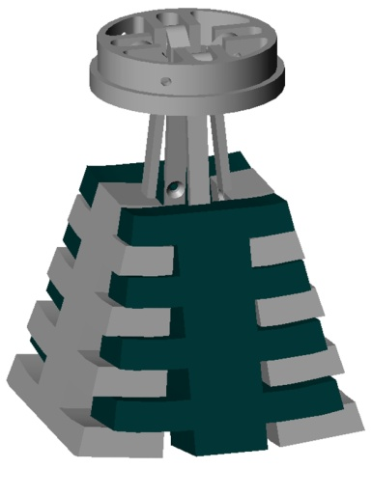
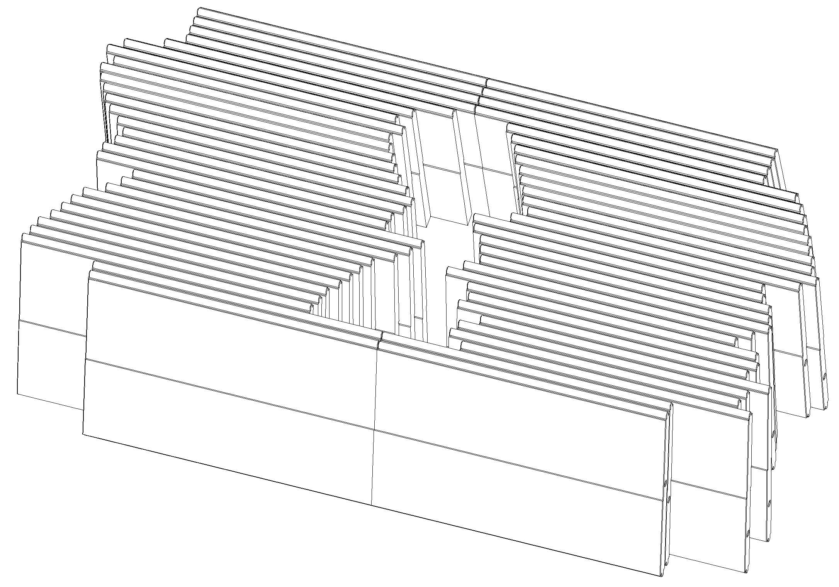
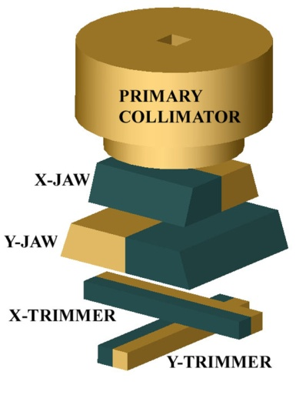
Multi-Leaf Collimator (MLC) System
Other Telecobalt
Bhabhatron MLC
Bhabhatron

Slide 18
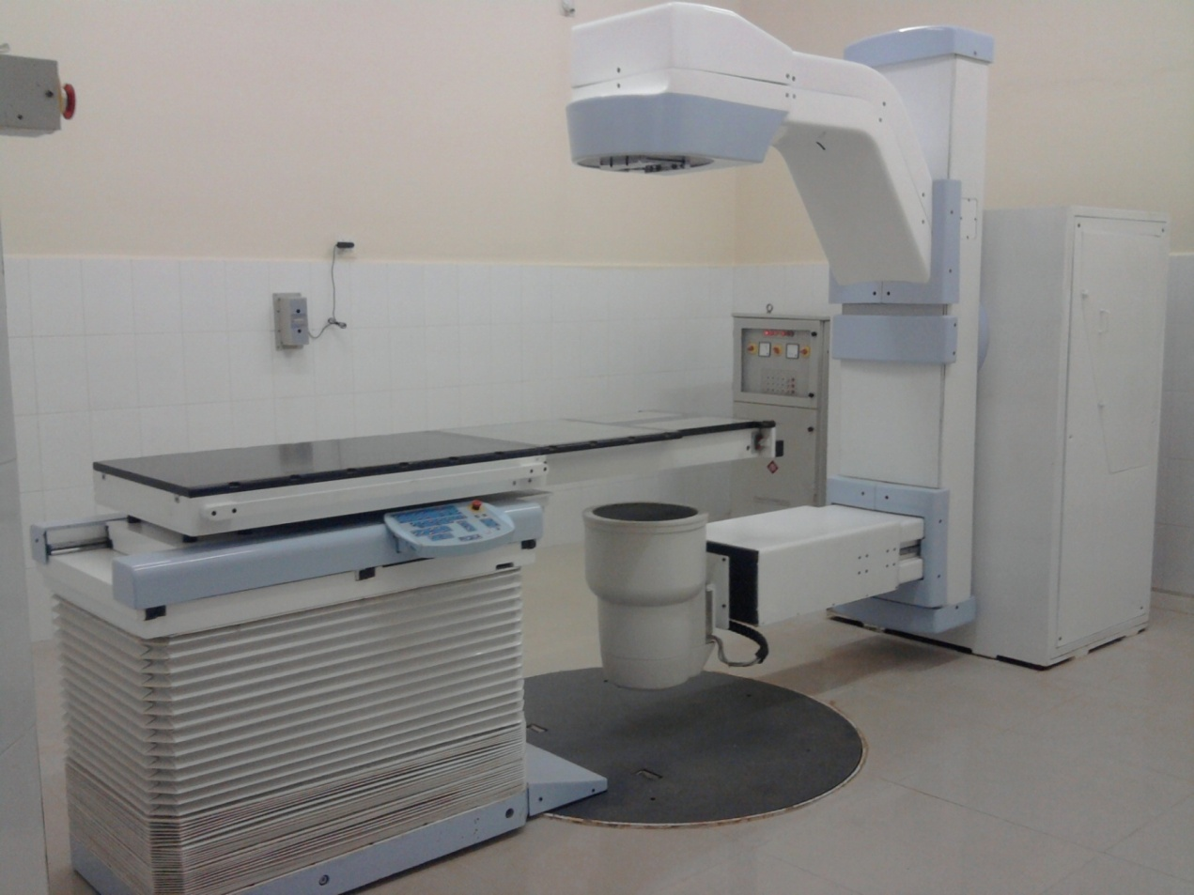
Radiotherapy Simulator
for tumour localization, radiotherapy planning plan verification etc.

Slide 19
Radiotherapy Simulator
Hospital may have multiple treatment machines with different SADs. Simulator offers the flexibility to adjust own parameters to suit such variations.
Parameters determined through simulations are used in radiotherapy units for treatment setup.
Many cancer hospitals in India have radiotherapy machines but don’t have any Simulator
BARC has successfully developed the technology indigenously

Slide 20
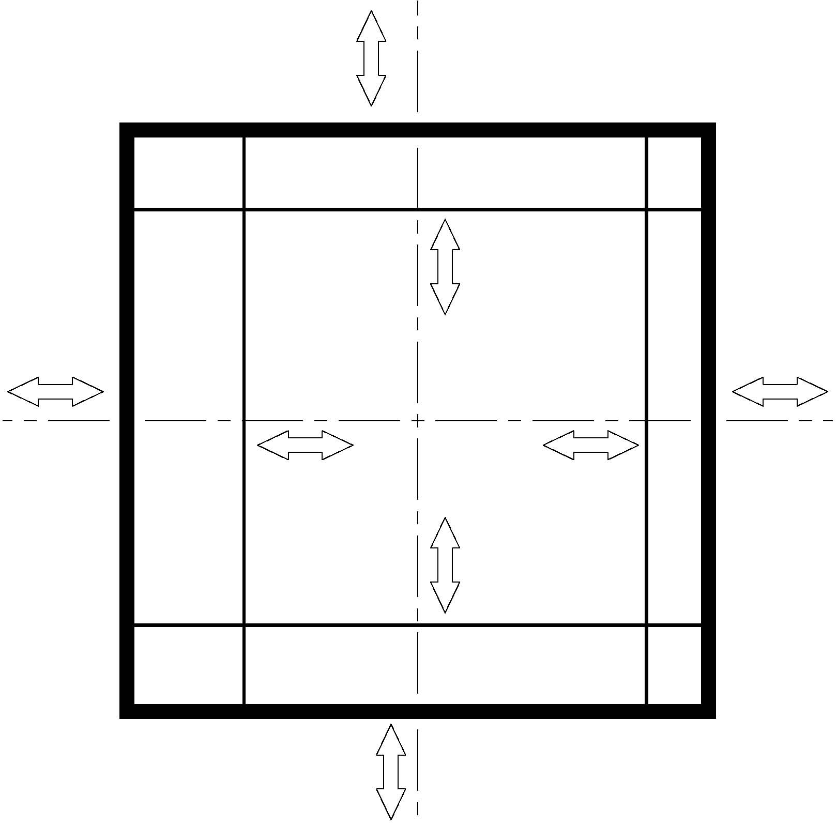
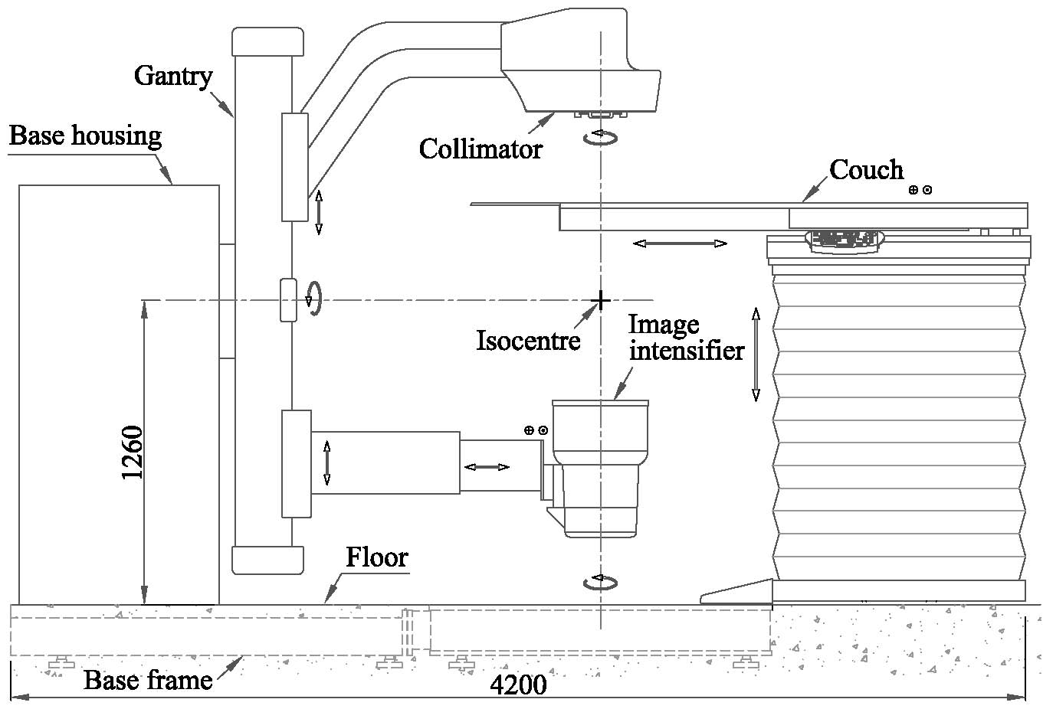
Radiotherapy Simulator (Schematic)
Total 18 motions

Slide 21
Salient Features
Focus to axis distance (FAD) | : | 800-1200 mm
Isocenter height | : | 1260 mm
Gantry (C-Arm) rotation | : | Motorized, isocentric design, ± 180°
Collimator rotation | : | Motorized, ± 100 deg.
Field Size (shielding jaws) | : | 500 mm x 500 mm (at FAD 1000mm)
Field Size (delineating wires) | : | 400 mm x 400 mm (at FAD 1000mm)
Patient positioning table | : | Motorized- four motions
Image Intensifier Arm | : | Motorized- three motions
Collision detection | : | Yes
X-Ray Generator | : | Power: 65KW
 | : | KVp: 40-125(fluoro); 40-150(rad.)
 | : | mA: 0.2-12.5(fluoro), 10-1000 (rad.)
X-Ray Tube | : | Focal spot: 0.4 & 0.8; Target angle: 15°
Image Intensifier | : | 300mm dia.(max.)
Supply voltage | : | Three phase, 400V AC
Filmless operation | : | Yes
DICOM Compatible | : | Yes
Compliance to Intl. Standards | : | IEC601-1, IEC60601-2-29
Regulatory approval | : | Atomic Energy Regulatory Board

Slide 22
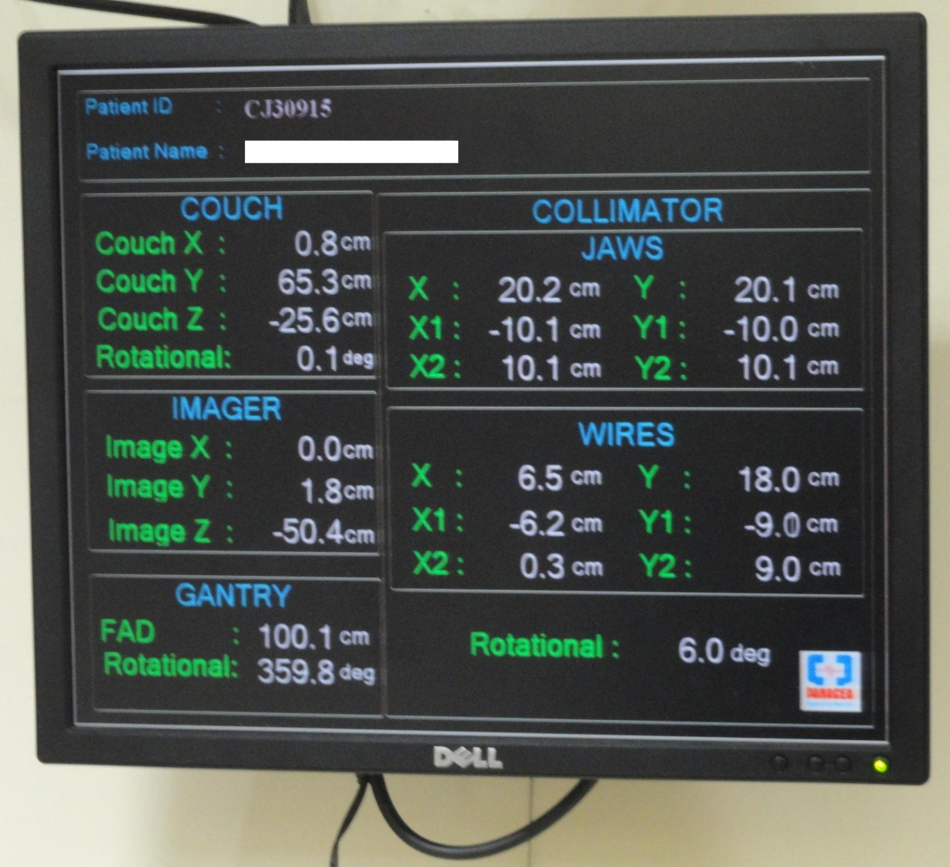
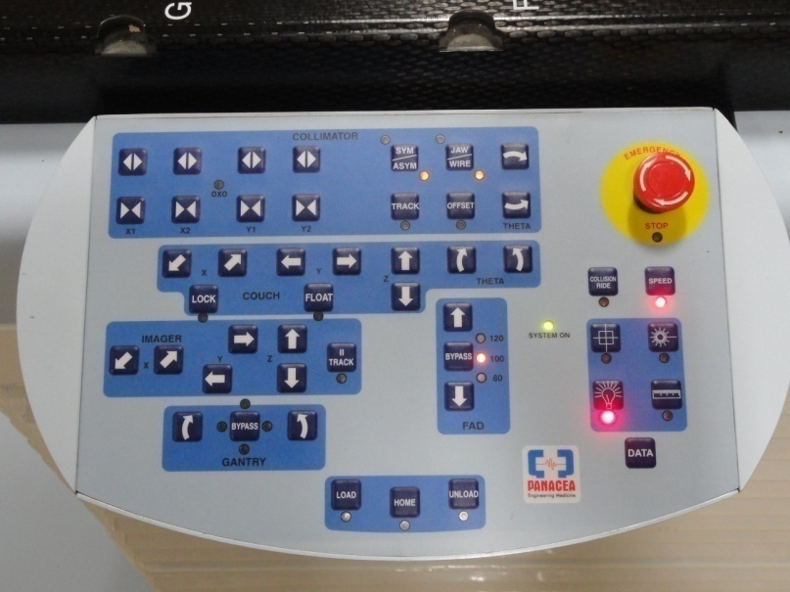
User Interface (Local)

Slide 23
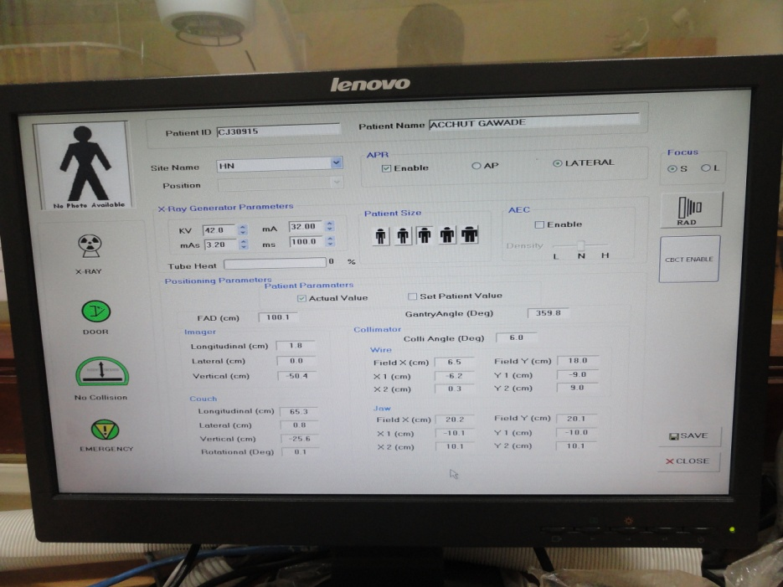
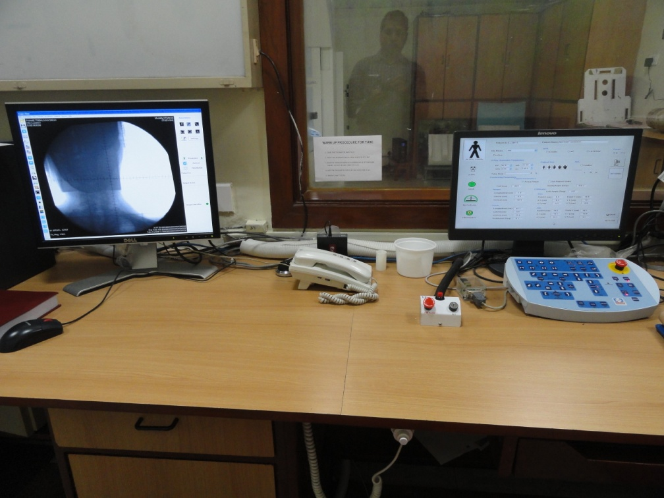
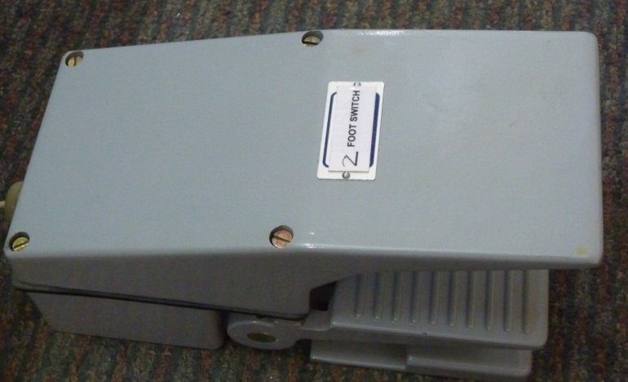
User Interface (Remote Console)

Slide 24
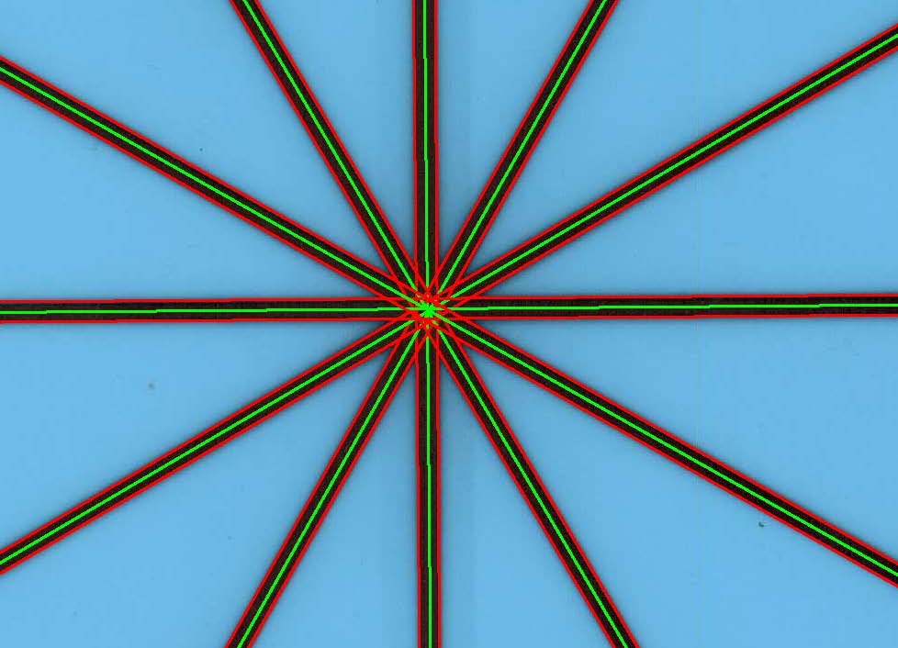
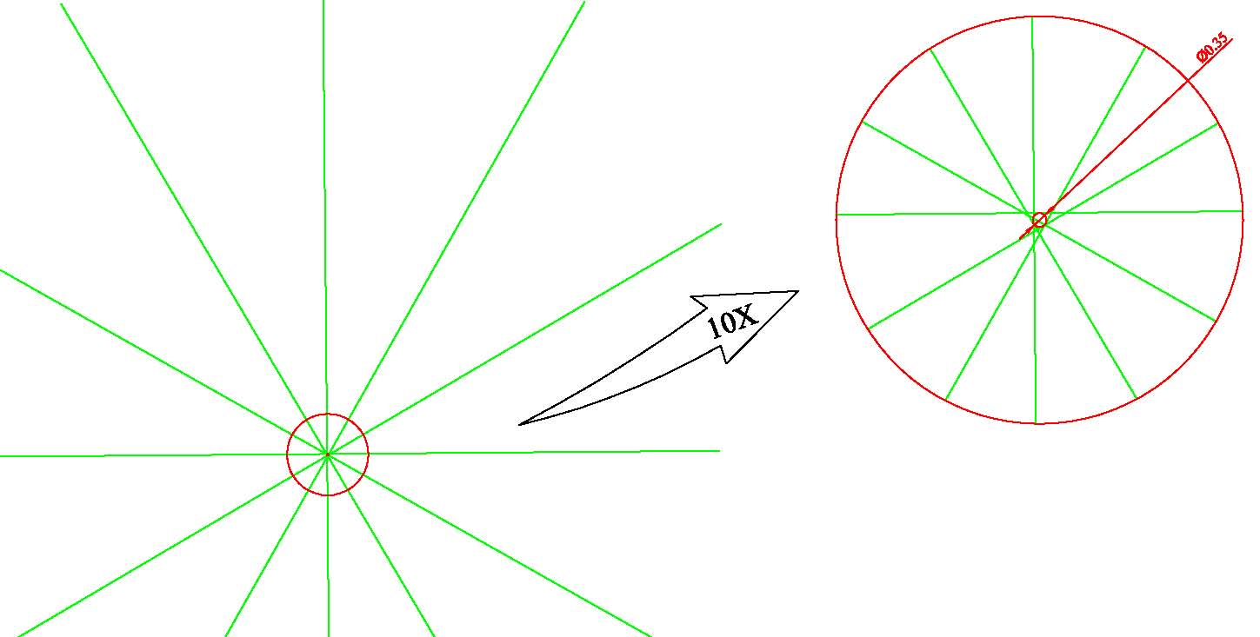
Stringent Performance Criteria
Radiation Isocentre

Slide 25
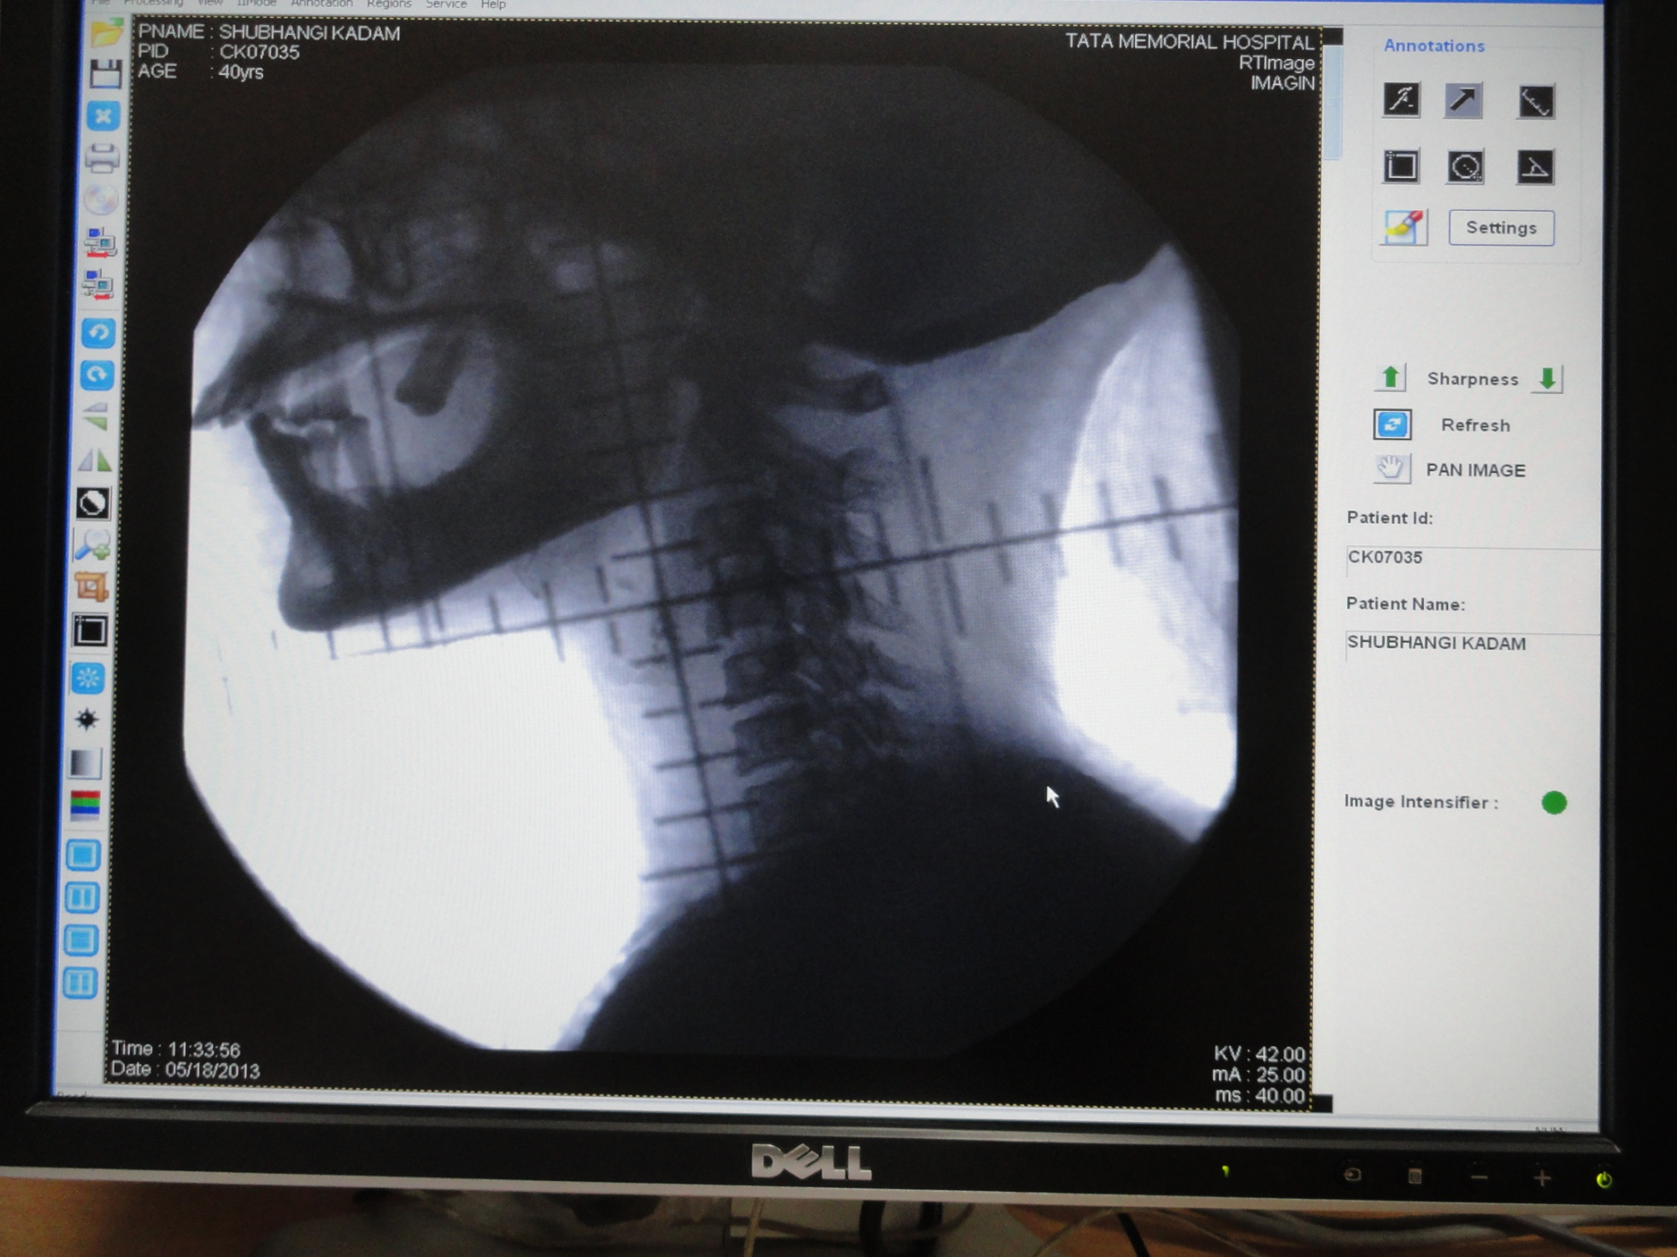
The image

Slide 26
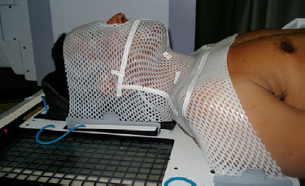
Target Localization & Immobilization

Slide 27
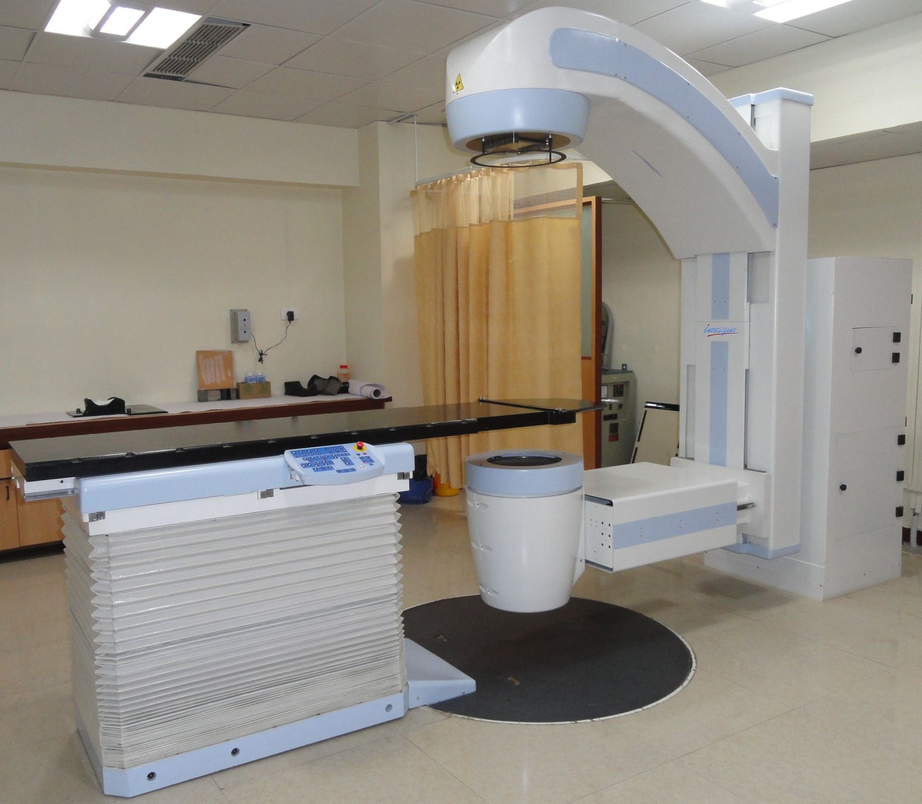
Commissioned at TMC, Parel
Inaugurated by DG-IAEA
in March,2013

Slide 28
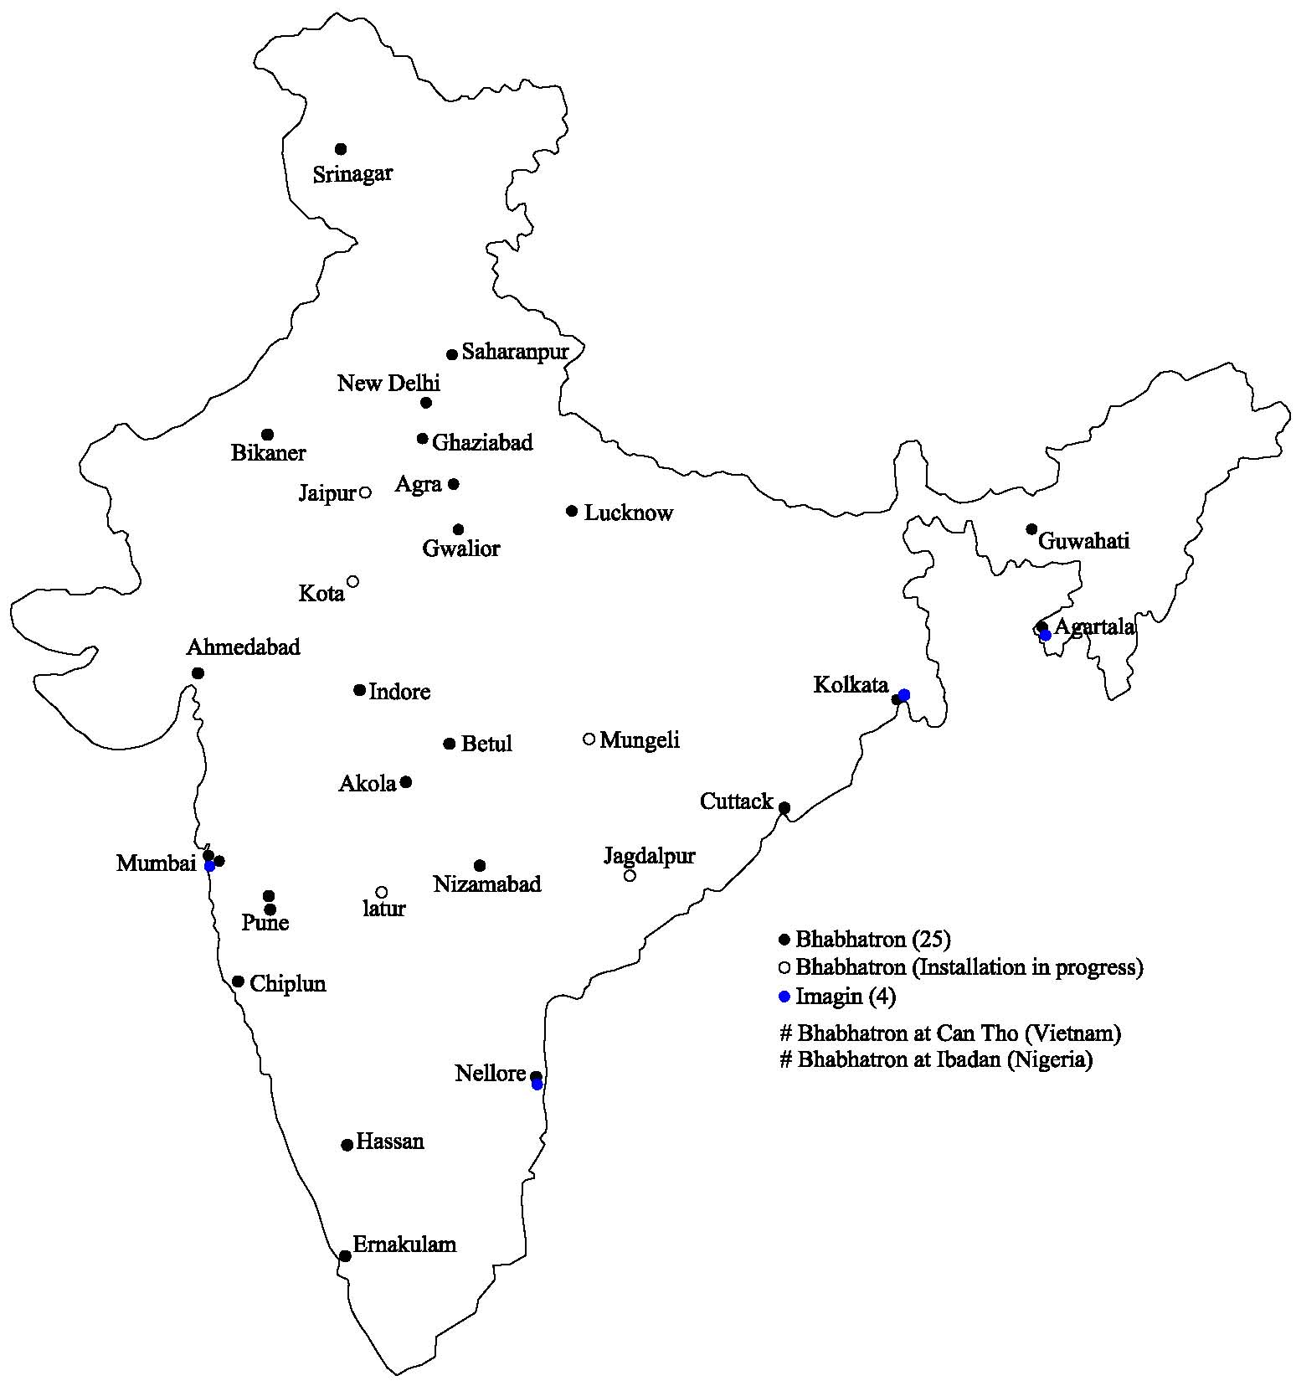
Installations in India

Slide 29
Sincerely acknowledge the contributions of
ACTREC, Kharghar
AERB
ARAI, Pune
BRIT
DCSEM
IRCS, Nellore
ERTL, Trivandrum
PMT Pvt. Ltd.
SAMEER, Kharghar
TMC, Parel
BARC(Trombay)
AFD
CDM
CD
FRD
IAD
SIRD
MPD
QAD
RP&AD
RSD
RSSD
RTD
TT&CD
UED

Slide 30
Other Indigenous Developments in this Area
Digital Mammography System – BARC
High Dose Rate (HDR) Brachytherapy- BRIT
LINAC based Teletherapy Machine- SAMEER

Slide 31
thanks

