Slide 1
Overview of the activities of the IUPAP group for women in physics in Serbia in the last three years
Stojanović, Maja¹, Mirjana Popović-Božić², Tatjana Marković-Topalović³, Dragica Knežević⁴, Sanja Janićević⁴
¹Department of Physics, Faculty of Sciences University of Novi Sad, Trg D. Obradovića 3, Serbia
²Institute of Physics, University of Belgrade, Pregrevica 118, Serbia
³High Medical School, Cara Dušana 9, Šabac, Serbia
⁴Department of Physics, Faculty of Science, University of Kragujevac, R. Domanovića 12, Serbia

Slide 2
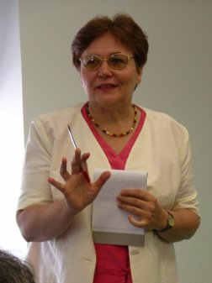
Conferences
Belgrade hosted the 11th International Conference of the Balkan Physical Union, 28 August – 1 September 2022.
The members of our team took active part as members of International Scientific Committee (Violeta Petrović, Maja Stojanović, Andrijana Žekić) in section Physics Education, History and Philosophy of Physics.
Professor Mirjana Božić gave a notable lecture ‘Fairy tale of electricity for Tesla clubs and STEAM education’ at the 10th Conference ‘Tesla Spirit Award and Tesla’s People 2023’, Hotel New Yorker, New York City, January 14, 2023.
Figure: Mirjana Popović Božić
8th International Conference on Women in Physics (ICWIP 2023), online mode, 10–14 July 2023

Slide 3
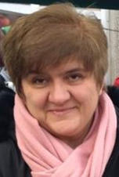
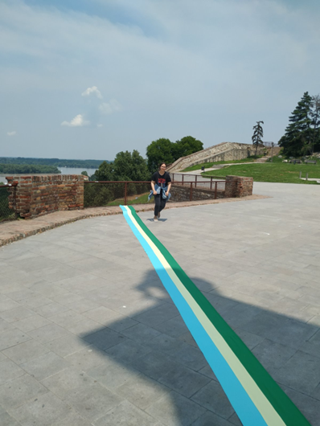
Figure: Biljana Stojičić
On April 18-23, 2023 professor Mirjana Božić and Biljana Stojičić participated in the Astronomical Conference ‘The development of astronomy among Serbs XII’ in Belgrade, with the presentation:
‘The initiative for marking the meridian line and placing a
Parallel globe on Kalemegdan – how to impIemented the
initiative after the positive answers?’
Figure: The photo made by Biljana Stojičić on June 20, 2023 at 12:40 p.m. local time. A strip in three colors, placed along the shadow cast by the Victor monument, mark the local meridian.

Slide 4
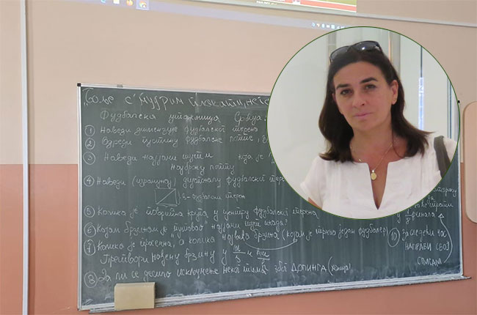
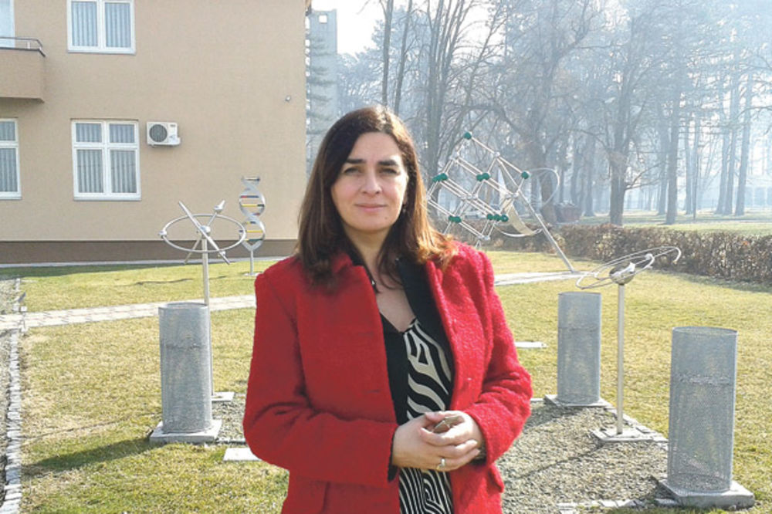
Activities
Makers Lab - Room
Makers Lab was established in June the 14th at Medical High School, Šabac, Serbia. Team leader for school is Tatjana Marković - Topalović, Physics Teacher (PhD – Physics Education). Maker space is the meeting place for creativity. This lab brings together young students and teachers with common interest in creating in science. It is kind of workshop equipped with both traditional tools and modern digital technology. It would be a new place for collaboration of 4 teachers (Physics, Biology, Chemistry and Mathematics) in science.
Figure: Tatjana Marković-Topalović
(Foto: Facebook/Tatjana Marković Topalović)
Tatjana M. Marković - Topalović
‘Educational visualization of physical phenomena in the science parks and school yards’
Doctoral dissertation
(defended 2022)
8th International Conference on Women in Physics (ICWIP 2023), online mode, 10–14 July 2023

Slide 5
Physics education
We also take active part in working groups for changing standards, plans and programs in Physics education. From 17 members in total, 12 are women.
According to recent studies, Serbia is facing a shortage of physics students and teachers. Statistics for the previous three years is shown in Table presented in the next slide.
In the previous period we participated in introducing the State Matura. This project was supported by the Ministry of Education of Serbia. The aim of the project was to introduce and prepare the final exams at the end of secondary education.
We had representatives:
in the focus groups at all universities and
in the working group formed to prepare exam materials.
State Matura supposed to start this school year, but was postponed due to a number of problems.
We are greatly concerned about the small number of students applying for teaching physics. In Belgrade, the Faculty of Physics offers a program called General Physics, specifically designed for aspiring physics teachers right from the first year. In Novi Sad, we have Integrated Master studies in Physics Education, which span over a period of 5 years. Students in Niš and Kragujevac also have the opportunity to become a Physics teacher, but only at the master's level.

Slide 6
Table. Number of students who enrolled in the first year of Physics
 | 2020/2021 |  | 2021/2022 |  | 2022/2023
 | female | male | female | male | female | male
Faculty of Physics, University of Belgrade | 39 3 | 42 3 | 34 4 | 35 3 | 27 6 | 38 2
Faculty of Sciences, University of Novi Sad | 11 1 | 9 / | 8 / | 16 1 | 6 1 | 11 1
Faculty of Science, University of Kragujevac | 10 | 7 | 6 | 7 | 7 | 6
Faculty of Sciences and Mathematics, University of Niš | 2 | 9 | 4 | 1 | 4 | 5
The shortage of physics students can be attributed to several factors:
- Physics is often perceived as a challenging subject that requires a strong aptitude for mathematics
- There is a lack of awareness among students about the numerous career opportunities available to physics graduates
- The number of physics teachers in schools has declined in recent years, resulting in limited access to high-quality
physics education for students, which can have an impact
8th International Conference on Women in Physics (ICWIP 2023), online mode, 10–14 July 2023

Slide 7
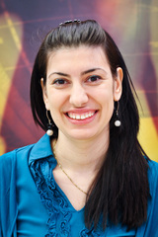
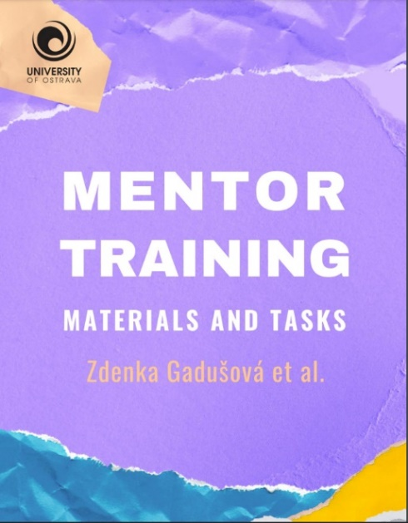
In an effort to address this issue, the Board of Association of School Directors of Serbia has submitted short-term solutions to the Ministry of Education.
One such solution is to permit the hiring of retired professors or students from teaching faculties to teach subjects where there is a shortage of staff.
Branka Radulović is a project manager of ERASMUS+ project ‘Mentor training’, and coordinator for bilateral project with Slovakia: Mentor`s Vademecum (MeVa).
Figure: Branka Radulović
The deans of the eight faculties at the University of Belgrade, where future teachers are trained, have also responded by proposing several measures. These include increasing scholarships for students pursuing deficit professions, raising teachers' salaries by 30 to 50 percent, revising lesson plans, and restoring dignity to the education system.
Our mission:
ATTRACTING, DEVELOPING AND RETAINING EFFECTIVE TEACHERS!
Figure: Coverpage of the publication (Source: https://www.mentra.ukf.sk/en/index.html)
8th International Conference on Women in Physics (ICWIP 2023), online mode, 10–14 July 2023

Slide 8
References
https://www.mentra.ukf.sk/docs/MENTRA%20Eng_e-book%20after%20review.pdf Planck Collaboration et al. In: A&A 594 (2016), A13.
Acknowledgements
The authors gratefully acknowledge the financial support of the Ministry of Science, Technological Development and Innovation of the Republic of Serbia (Grant No. ‪451-03-47/2023-01/200125)‬
8th International Conference on Women in Physics (ICWIP 2023), online mode, 10–14 July 2023

Slide 9
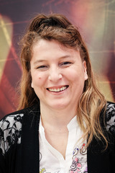
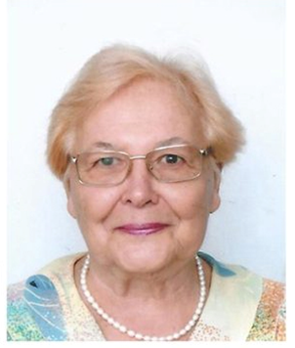
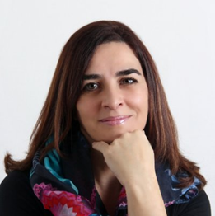
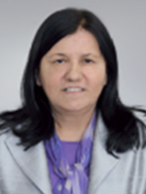
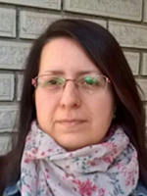
Thank you
Maja Stojanović
Mirjana Popović-Božić
Tatjana Marković-Topalović
Dragica Knežević
Sanja Janićević
8th International Conference on Women in Physics (ICWIP 2023), online mode, 10–14 July 2023

