Slide 1
Evidence for an extremely energetic jet-base during the June 2015 outburst of V404 Cygni
Dipankar Maitra (Wheaton College)
+ John Scarpaci (Wheaton)
+ Victoria Grinberg (MIT ESTEC)
+ Rob Hynes (Louisiana State Univ.)
+ Tom Maccarone (Texas Tech. Univ.)
+ Sera Markoff (Univ. of Amsterdam)
+ Mark Reynolds (Univ. of Michigan)
Wide Band Spectral and Timing Studies of Cosmic X-ray Sources TIFR 2017 January

Slide 2
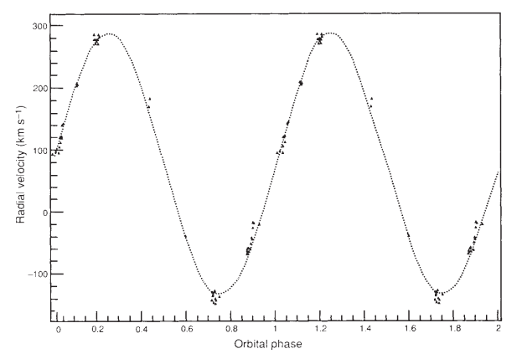
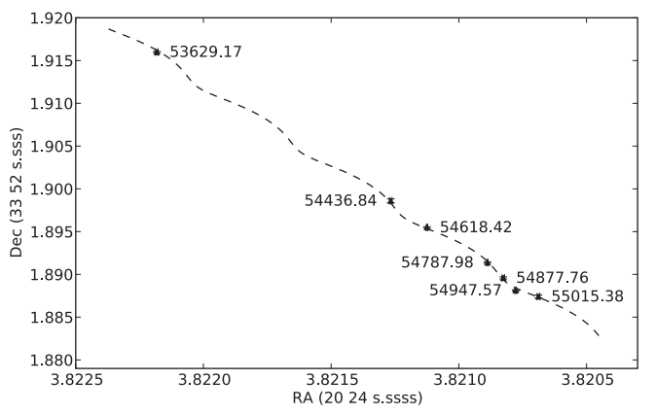
V404 Cygni: System properties
Casares+1992, Shahbaz+1994, Miller-Jones+2009
Casares+1992
Mass of black hole: 10 – 15 M_{Sun}
Donor star: K3 type, 0.5 – 1 M_{Sun}
Orbital period: 6.5 days
Distance: 2.39 ± 0.14 kpc
Last outburst (prior to 2015) in 1989
Miller-Jones+2009

Slide 3
TITLE: GCN CIRCULAR #17929
SUBJECT: Swift trigger 643949 is V404 Cyg
DATE: 15/06/15 18:55:32 GMT
FROM: Scott Barthelmy at NASA/GSFC <scott@milkyway.gsfc.nasa.gov>
At 18:31:38 UT, the Swift Burst Alert Telescope (BAT) triggered and located V404 Cyg. Swift slewed immediately to the source.
And thus it started …

Slide 4
But nothing about the 2015 outburst was “usual “…
… in soft X-rays …
Rodriguez+2015
1 day
MJD 57194 is 2015 June 21

Slide 5
But nothing about the 2015 outburst was “usual “…
… or in medium-energy X-rays …
Rodriguez+2015
1 day
MJD 57194 is 2015 June 21

Slide 6
But nothing about the 2015 outburst was “usual “…
… or in medium-high-energy X-rays …
Rodriguez+2015
1 day
MJD 57194 is 2015 June 21

Slide 7
But nothing about the 2015 outburst was “usual “…
… or in reasonably-high-energy X-rays …
Rodriguez+2015
1 day
MJD 57194 is 2015 June 21

Slide 8
But nothing about the 2015 outburst was “usual “…
… or in quite-high-energy X-rays …
Rodriguez+2015
1 day
MJD 57194 is 2015 June 21

Slide 9
But nothing about the 2015 outburst was “usual “…
… or in darned-high-energy X-rays …
Rodriguez+2015
1 day
MJD 57194 is 2015 June 21

Slide 10
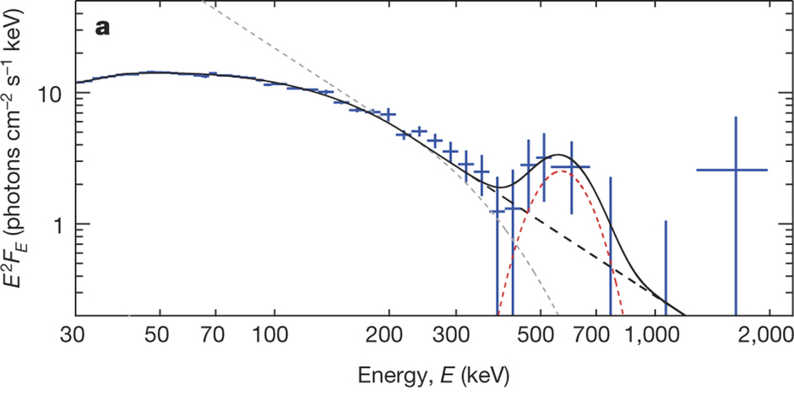
But nothing about the 2015 outburst was “usual “…
… or even in γ-rays, where an excess at ~500 keV was detected,
interpreted as e⁻e⁺ annihilation line. Cool!!!
Siegert+2016

Slide 11
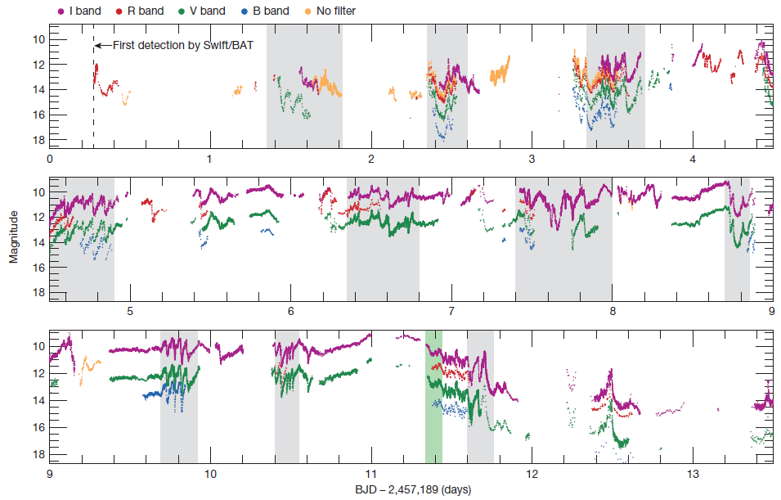
But nothing about the 2015 outburst was “usual “…
Similarly weird light curves seen in optical
Kimura+2016
MJD 57189 is 2015 June 16.

Slide 12
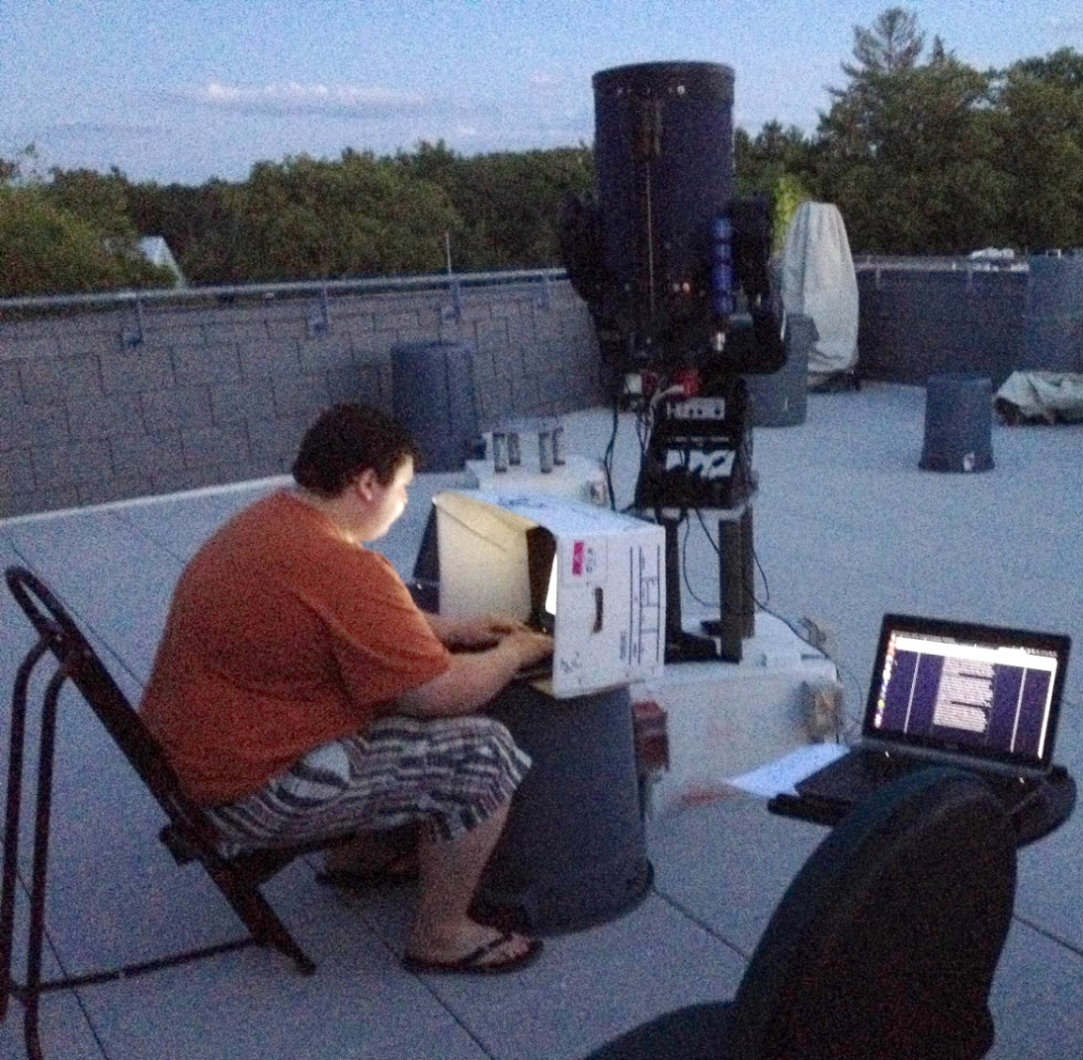
But nothing about the 2015 outburst was “usual “…
Similarly weird light curves seen in optical
… made us get our powerful scopes out!!!
Equipment: 12” SCT + SBIG STT-8300M @ -20C, with Johnson-Cousins filters
Observers:
John Scarpaci (class of 2017)
DM
Nightlong imaging + often using a hair-dryer to get rid of condensation on the scope from time to time.

Slide 13
Observations using Wheaton College Observatory’s 12” scope: June 24-25
V-band flux-density (mJy)
~9x variation
in ~15 minutes!
Scarpaci & DM, ATel 7721 (2015)
MJD 57198 is 2015 June 25

Slide 14
Observations using Wheaton College Observatory’s 12” scope: June 24-25
Repeats every ~4000s?
V-band flux-density (mJy)
Scarpaci & DM, ATel 7721 (2015)
MJD 57198 is 2015 June 25

Slide 15
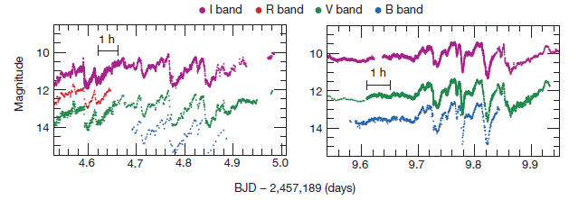
Observations using Wheaton College Observatory’s 12” scope: June 24-25
Repeats every ~4000s?
V-band flux-density (mJy)
Kimura+2016
Scarpaci & DM, ATel 7721 (2015)
MJD 57198 is 2015 June 25.

Slide 16
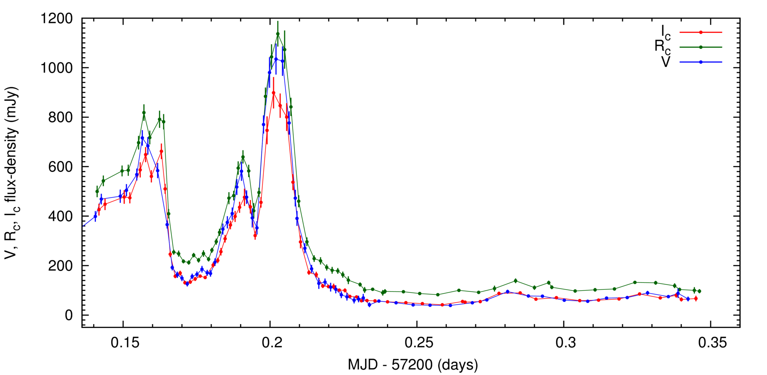
Observations using Wheaton College Observatory’s 12” scope: June 26-27
DM+2015, ATel 7737
MJD 57200 is 2015 June 27

Slide 17
Observations using Wheaton College Observatory’s 12” scope: June 26-27
DM+2015, ATel 7737
MJD 57200 is 2015 June 27

Slide 18
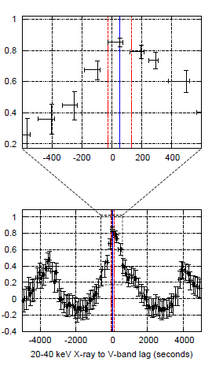
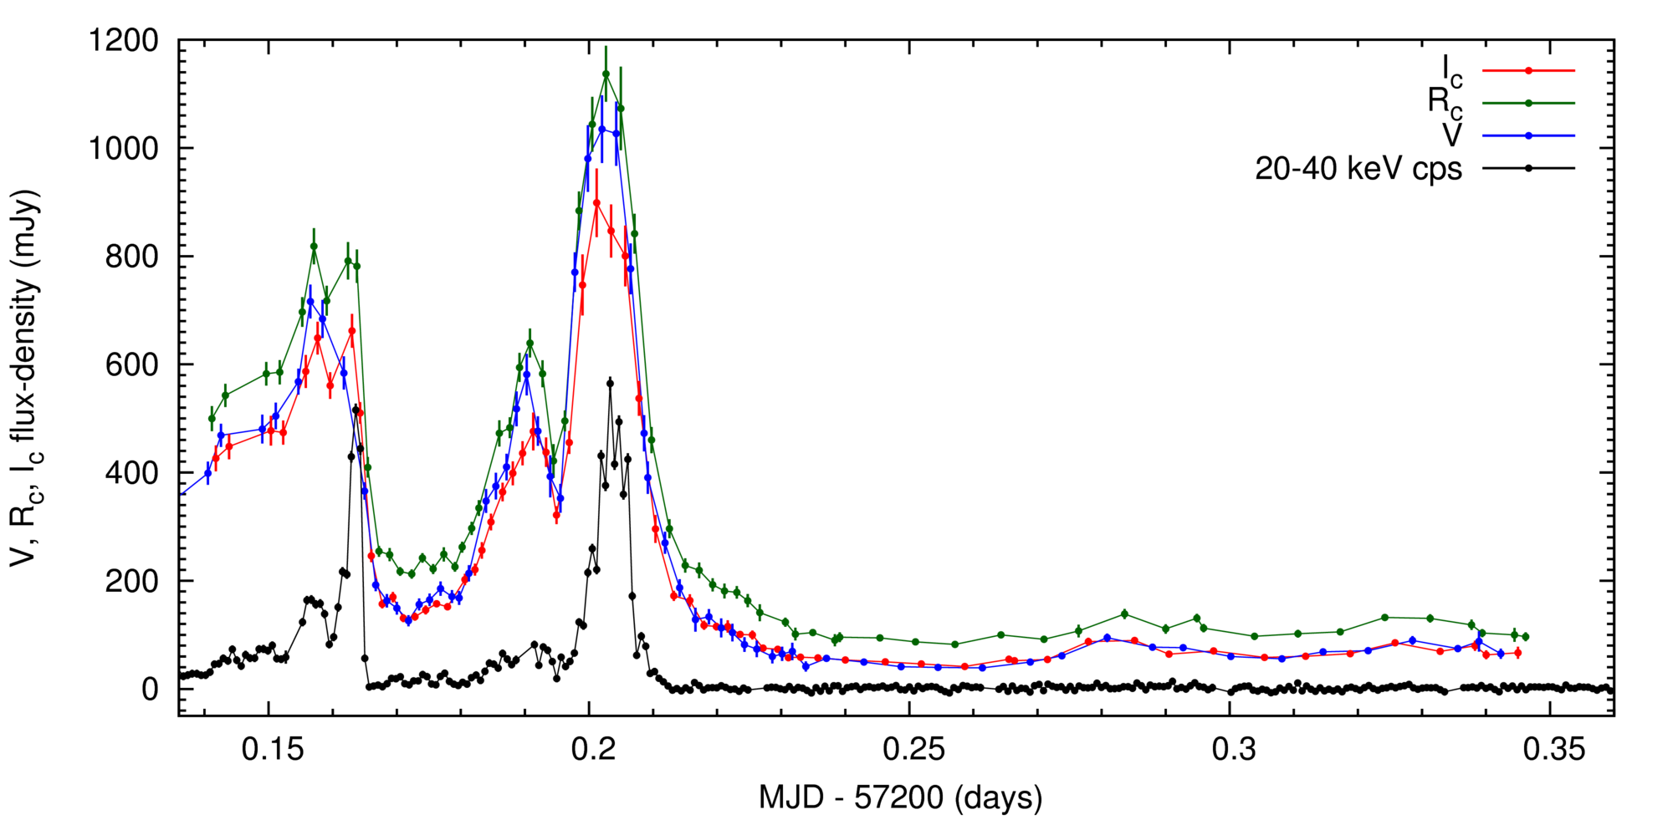
Observations using Wheaton College Observatory’s 12” scope: June 26-27
And simultaneous INTEGRAL 20-40 keV light curve
MJD 57200 is 2015 June 27

Slide 19
What do the SEDs look like?
log ( f_{ν} )
log (ν )
MJD 57200 is 2015 June 27

Slide 20
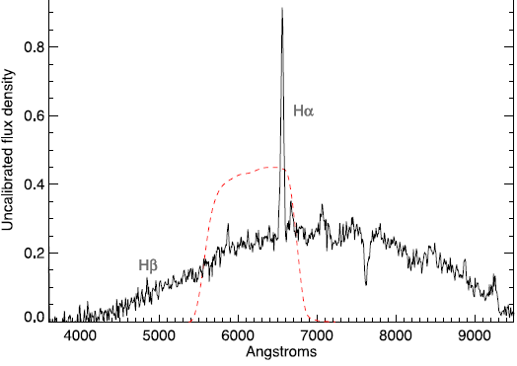
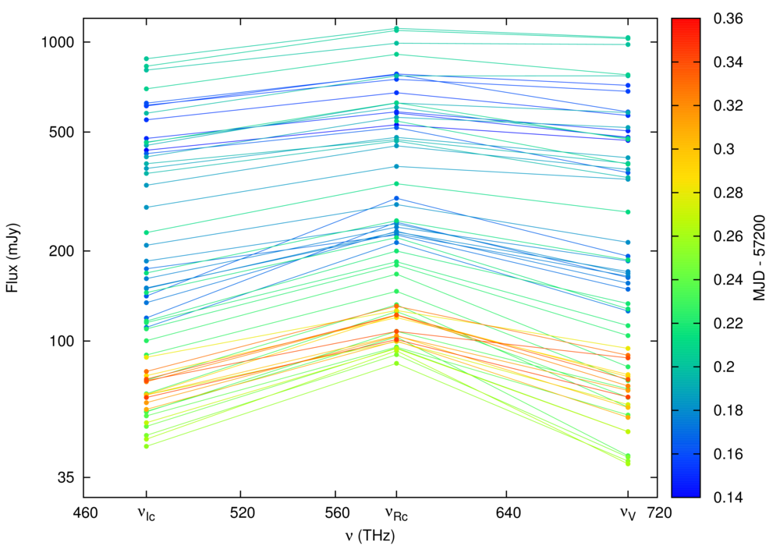
What do the SEDs look like?
Gandhi+2016
I-band
R-band
V-band

Slide 21
What do the SEDs power law slopes look like?
Power law slope between V and I
Mean α_{VI} : 0.2 ± 0.1
Q. What process(es) in an XRB can produce (and maintain) this slope despite 25x optical flux change in <1 hour?

Slide 22
Let there be light (Optical spectral shapes due to different radiative processes in XRBs)
(a) Canonical “Shakura-Sunyaev” accretion disk with T(r) ~ r^{-3/4}
Leads to f_{ν} ~ ν^{1/3} in the optical, but viscous timescales are much larger
(b) Irradiation of the outer disk by the inner X-rays
Inconsistent with the value and constancy of the V-I slope (0.2 ± 0.1)

Slide 23
Let there be light (Optical spectral shapes due to different radiative processes in XRBs)
(a) Canonical “Shakura-Sunyaev” accretion disk with T(r) ~ r^{-3/4}
Leads to f_{ν} ~ ν^{1/3} in the optical, but viscous timescales are much larger
(b) Irradiation of the outer disk by the inner X-rays
Inconsistent with the value and constancy of the V-I slope (0.2 ± 0.1)
(c) A relativistic jet outflow
log ( f_{ν} )
Synchrotron
log (ν )

Slide 24
Let there be light (Optical spectral shapes due to different radiative processes in XRBs)
(a) Canonical “Shakura-Sunyaev” accretion disk with T(r) ~ r^{-3/4}
Leads to f_{ν} ~ ν^{1/3} in the optical, but viscous timescales are much larger
(b) Irradiation of the outer disk by the inner X-rays
Inconsistent with the value and constancy of the V-I slope (0.2 ± 0.1)
(c) A relativistic jet outflow
A flat/slightly inverted slope is expected
in the optically thick regime.
Optically thick
Optically thin
log ( f_{ν} )
Observed α_{VI} is 0.2 ± 0.1 => jet is such that V and I bands are in optically thick regime.
I
V
log (ν )

Slide 25
To conclude: A simplistic picture of what might have been going on
The Hα line, originating in a much larger outer accretion disk, does not change as rapidly.
As long as the optically thick-to-thin break is somewhere bluer than V, changes in most jet model parameters will change the V/R/I fluxes, but without affecting the flux ratios.
If the break is indeed at a frequency higher than that of V-band, this would
Imply an extremely energetic jet-base.
If so, this may tie in with
the putative e⁻e⁺ annihilation line which would require the a highly compact and energetic base (Siegert+2016)
observed low optical polarization (Shahbaz+2016, Lipunov+2016)
Optically thick
Optically thin
log ( f_{ν} )
I
R
V
log (ν )

Slide 26
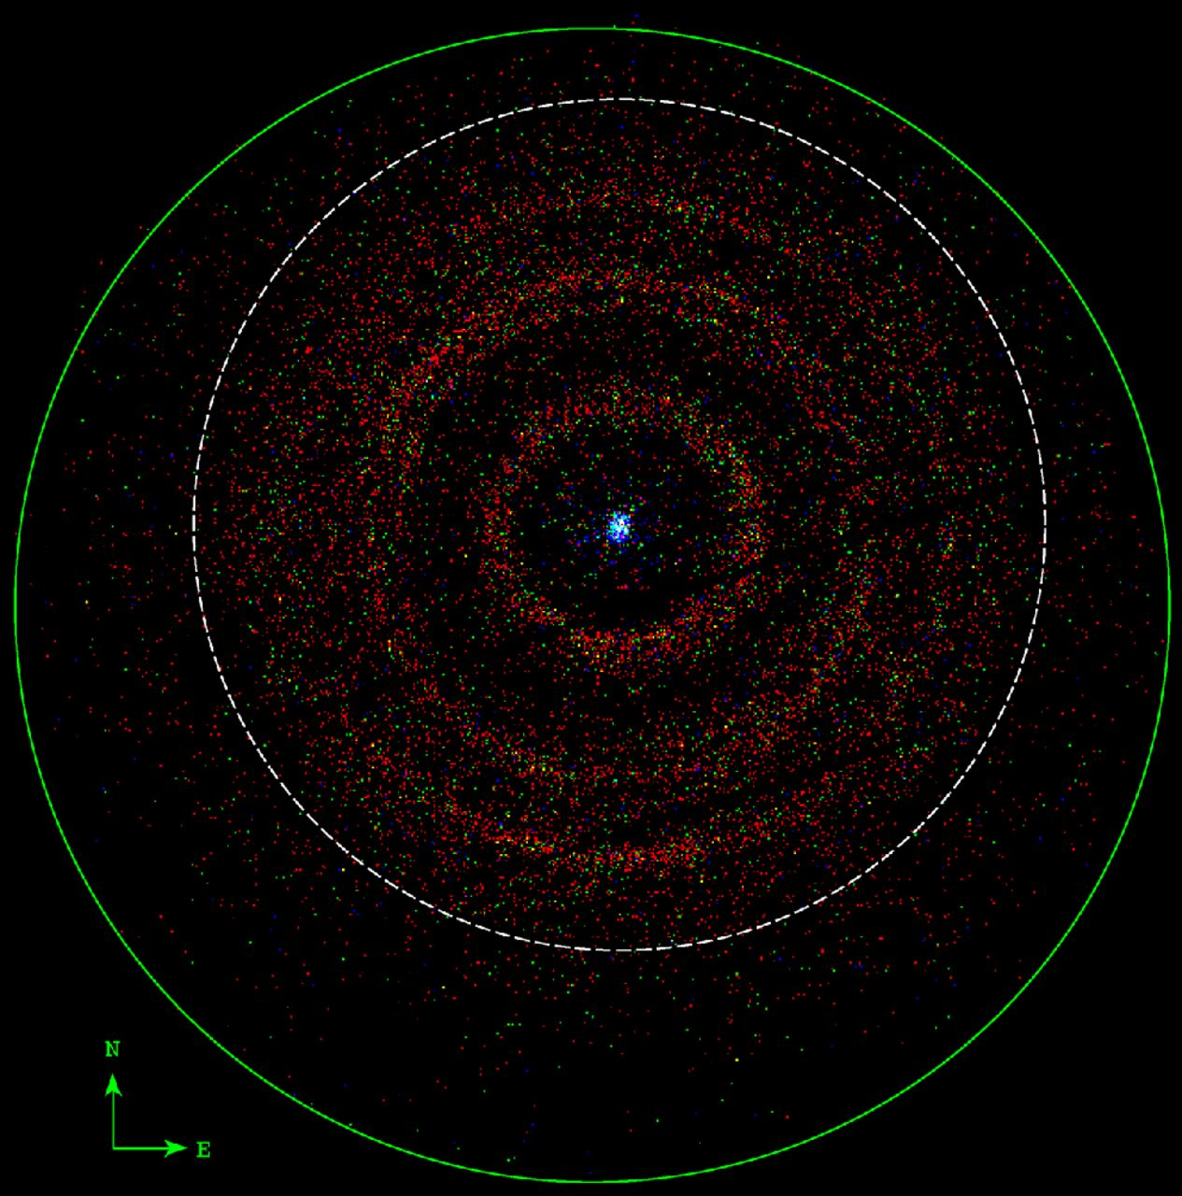
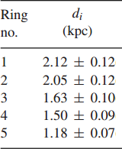
Btw., a cool spinoff science project
X-ray dust-scattered rings observed by Swift/XRT
Vasilopoulos & Petropoulou (2016)

Slide 27
Observations using Wheaton College Observatory’s 12” scope: June 24-25
Strictly simultaneous with 3 Swift visits
V-band flux-density (mJy)
Scarpaci & DM, ATel 7721 (2015)
MJD 57198 is 2015 June 25.

Slide 28
Observations using Wheaton College Observatory’s 12” scope: June 24-25
Strictly simultaneous with 3 Swift visits
V-band flux-density (mJy)
Scarpaci & DM, ATel 7721 (2015)
MJD 57198 is 2015 June 25.

Slide 29
Observations using Wheaton College Observatory’s 12” scope: June 24-25
Strictly simultaneous with 3 Swift visits
V-band flux-density (mJy)
Scarpaci & DM, ATel 7721 (2015)
MJD 57198 is 2015 June 25.

Slide 30
CCF-N1-Visit1
MJD 57193 is 2015 June 20.

Slide 31
CCF-N1-Visit2
MJD 57193 is 2015 June 20.

Slide 32
CCF-N1-Visit3
MJD 57193 is 2015 June 20.

Slide 33
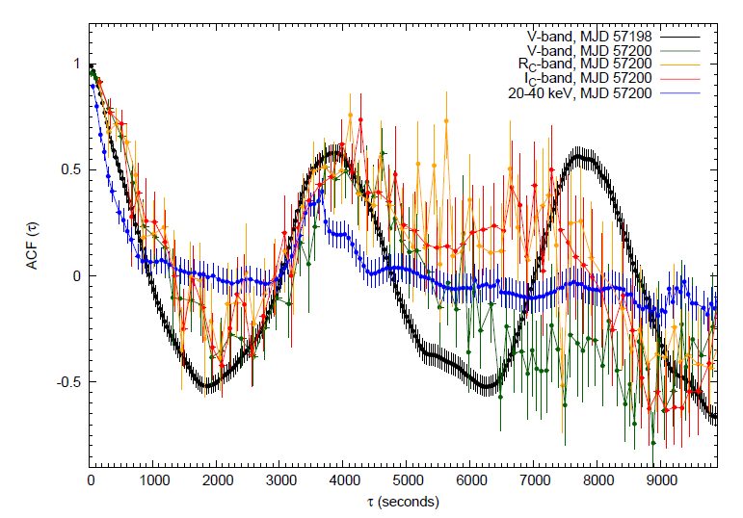
Autocorrelation functions

Slide 34
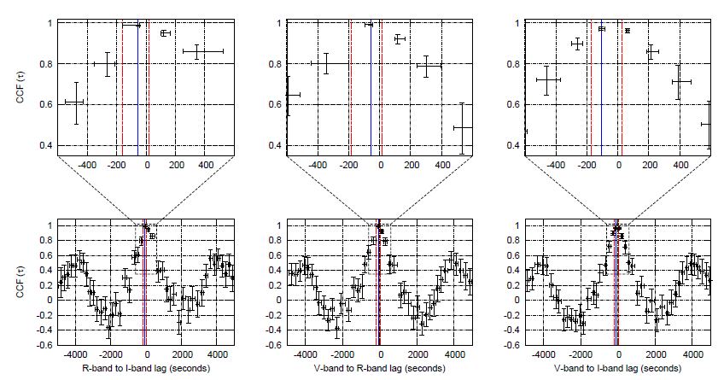
Optical CCFs

Slide 35
What do the colors SEDs power law slopes look like?
Slope between V and R
MJD 57200 is 2015 June 27

Slide 36
Roche lobe overflowing X-ray binaries
X-ray heated (irradiated) surface of companion
Jet
Irradiated outer disk
Accretion stream
Accretion
disk
Companion/Donor
www.phys.lsu.edu/~rih/
Disk wind

Slide 37
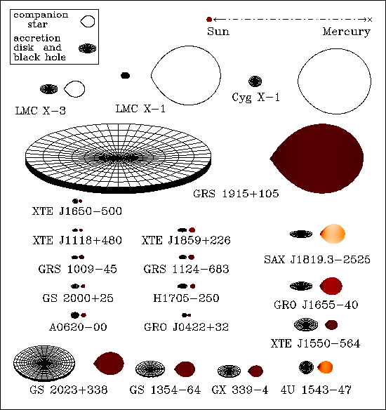
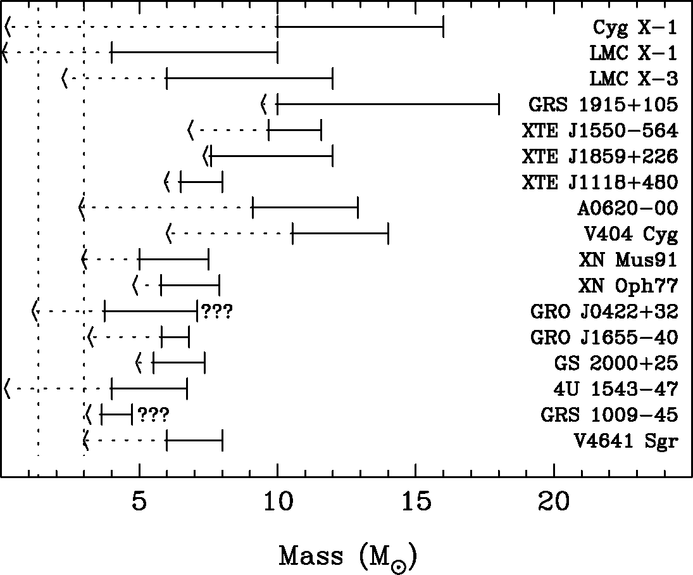
X-ray binaries with a black hole Size scales, and an incomplete census
V404 Cyg
mintaka.sdsu.edu/faculty/orosz/web/

Slide 38
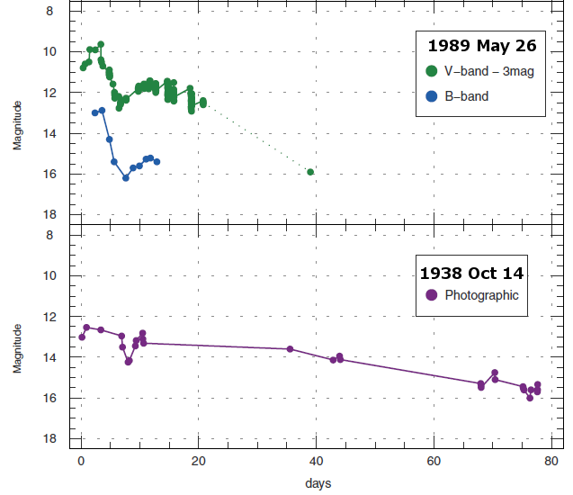
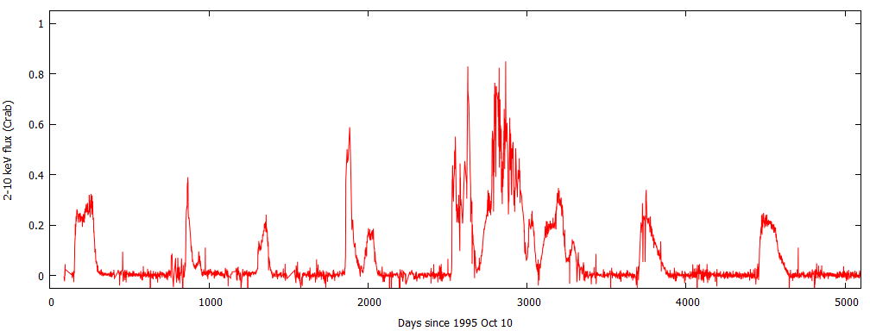
Transient X-ray binaries (like V404 Cyg)
Spend most of the time in an inactive ‘quiescent’ state
Occasional ‘outbursts’, when L_{outburst} ~ 10⁴⁻⁶ L_{quiescence}
Outburst recurrence timescales – months to tens of years or more
Kimura+2016
4U 1630-47
2-10 keV flux (Crab)
Days since 1995 Oct 10

Slide 39
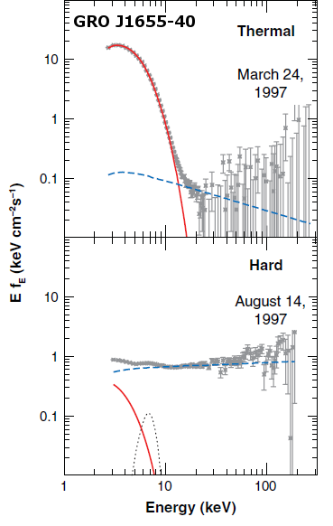
Different accretion states
Luminosity ∝ Mass accretion rate,
wide range of accretion states observed
Soft state: High , thermal spectra
Origin: Accretion disk
Hard state: Low , power law spectra
Origin: Comptonization in Corona and/or synchrotron from Jets
Remillard & McClintock (2006)

