Slide 1
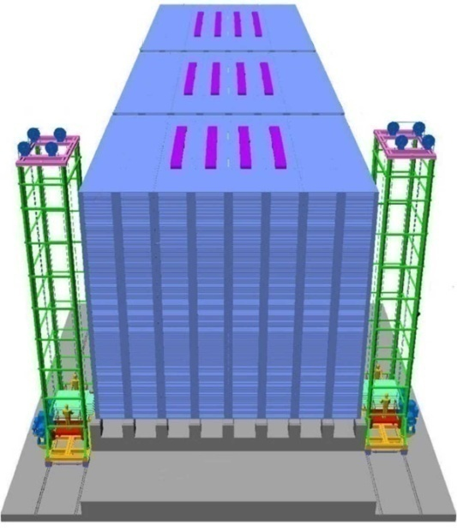
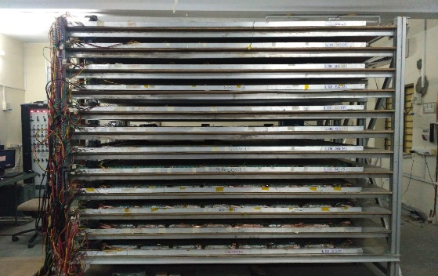
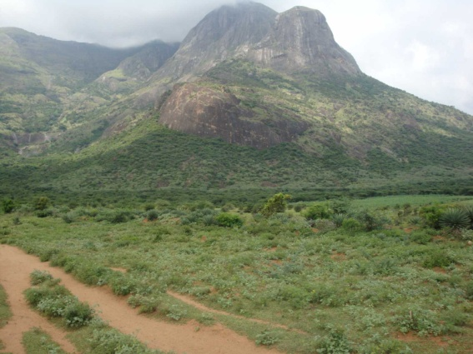
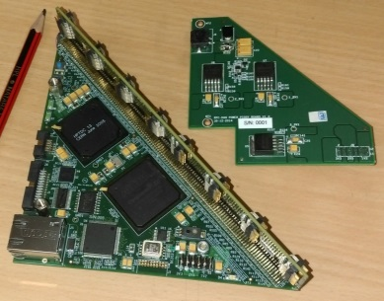
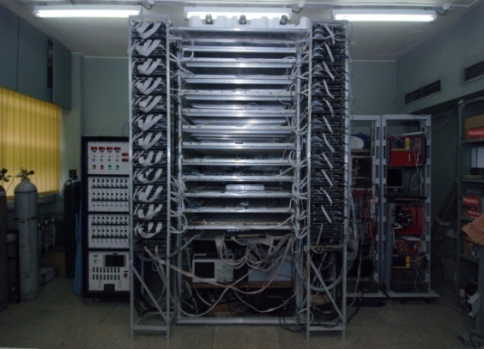
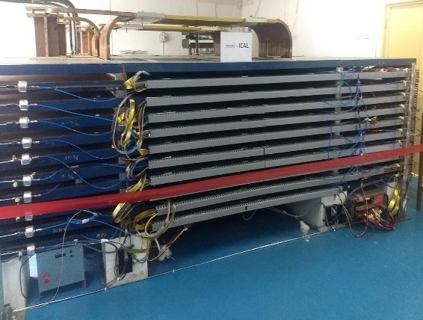
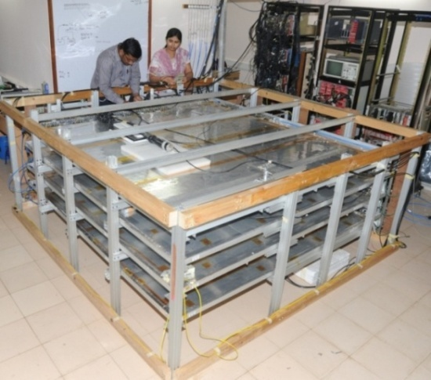
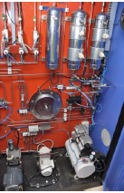
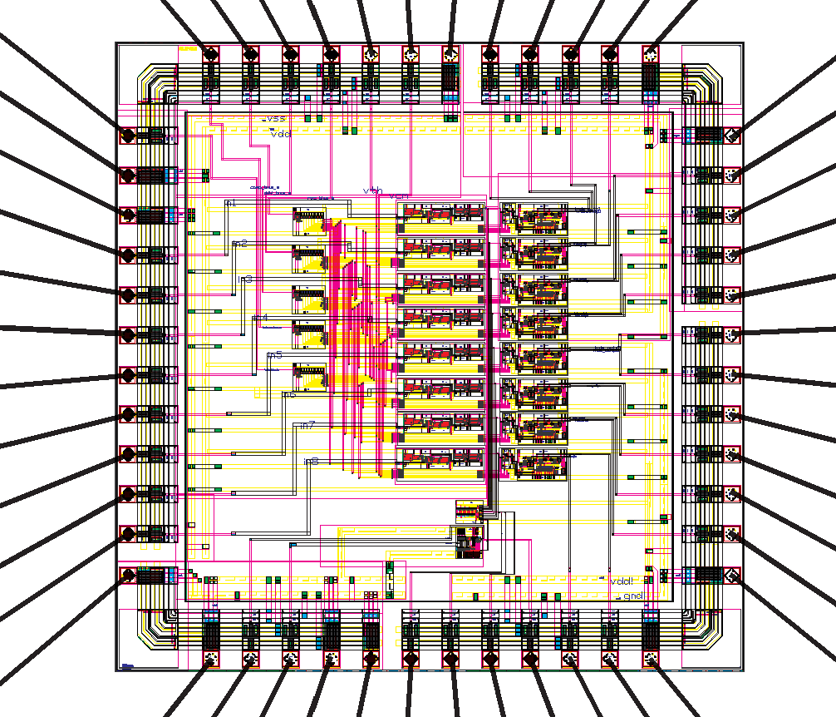
India-Based Neutrino Observatory (INO)
2m X 2m RPC stand at Madurai
HV module
INO Peak at
Bodi West Hills
ICAL
( conceptual)
Naba K Mondal,
Raja Ramanna Fellow
SINP, Kolkata
1m X 1m RPC Test stand
Front end DAQ module
2mX2m RPC Test Stand at TIFR
Prototype mini-ICAL
Closed loop Gas system
ASIC for RPC

Slide 2
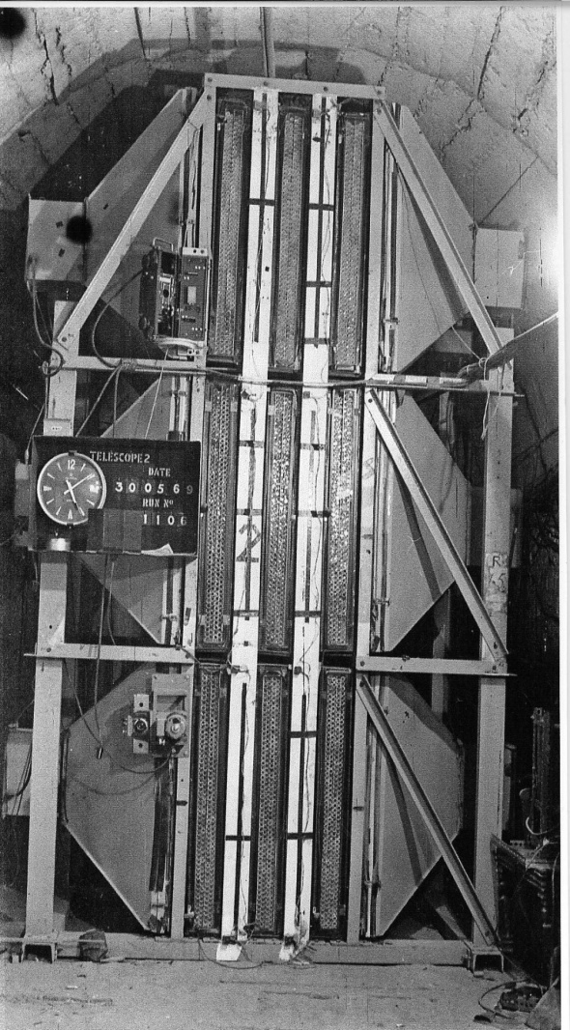
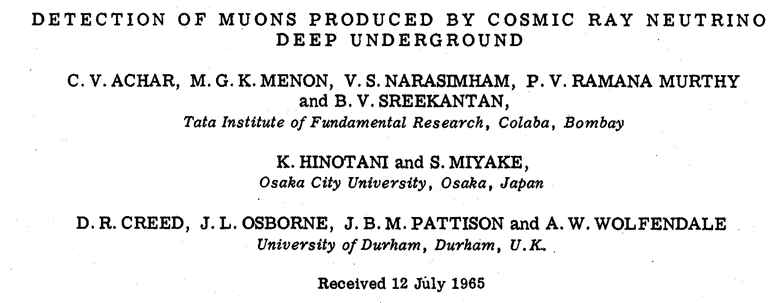
Atmospheric neutrinos – India connection
Physics Letters 18, (1965) 196, dated 15th Aug 1965
Atmospheric neutrino detector
at Kolar Gold Field –1965
PRL 15, (1965), 429, dated 30th Aug. 1965
Notes:
2

Slide 3
INO Project components
Construction of an underground laboratory and surface facilities near Pottipuram village in Theni district of Tamil Nadu.
Construction of the massive 50 kton magnetised Iron calorimeter (ICAL) detector to study properties of neutrinos.
Construction of the INO centre- The Inter-Institutional Centre for High Energy Physics (IICHEP).
Human Resource Development ( INO Graduate Training Program).
R & D for NDBD, Dark Matter Search, Low Energy Accelerator for Astrophysics.

Slide 4
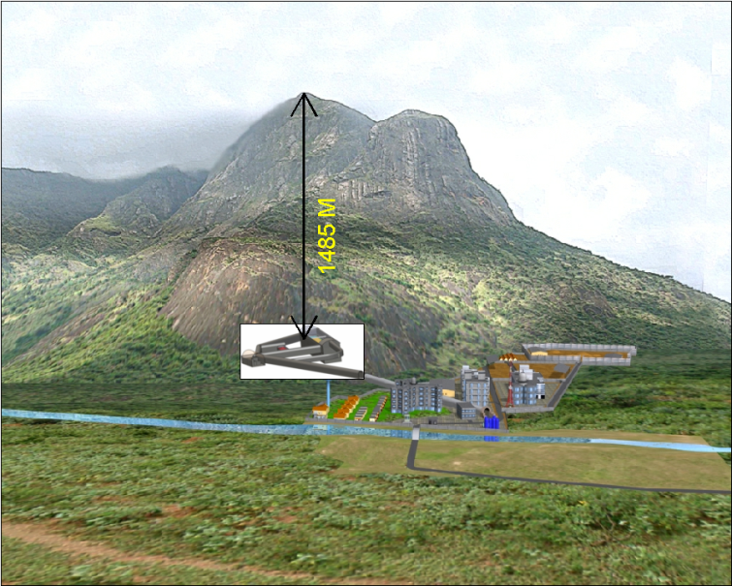
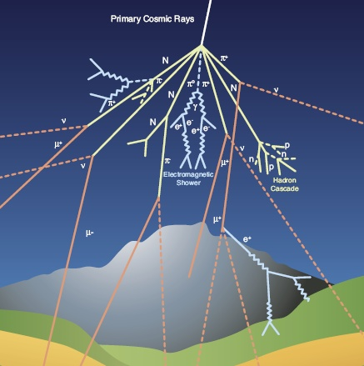
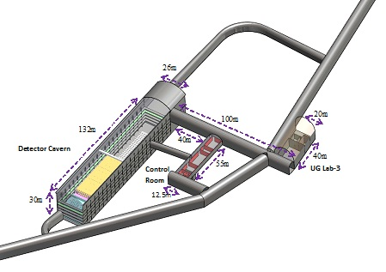
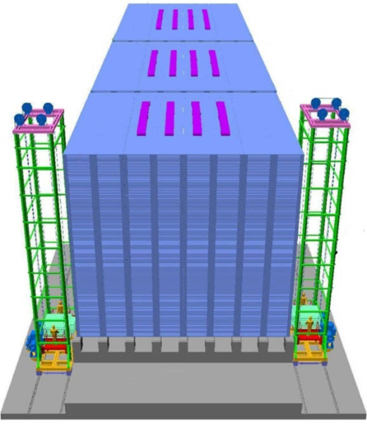
INO-ICAL Experiment
Atmospheric neutrinos
Underground complex
50 Kton ICAL neutrino Detector

Slide 5
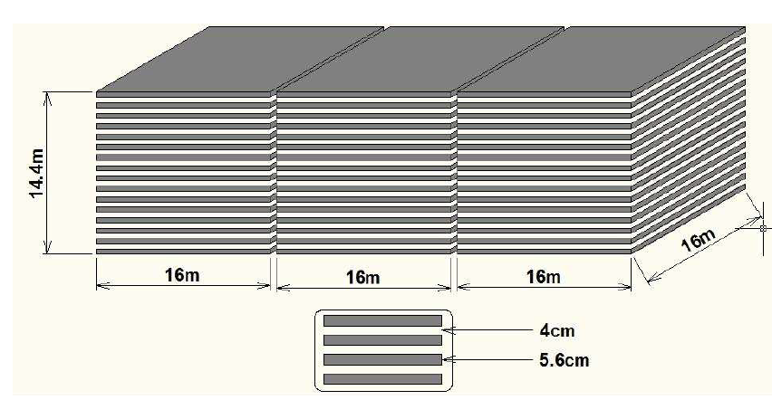
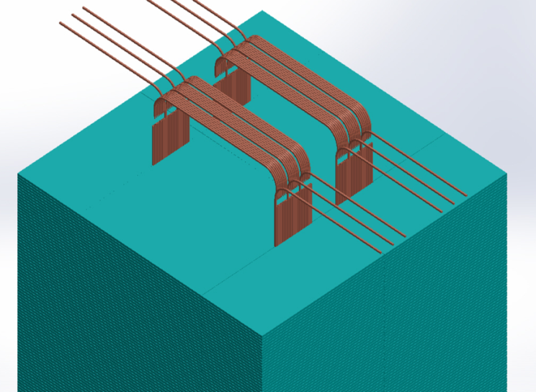
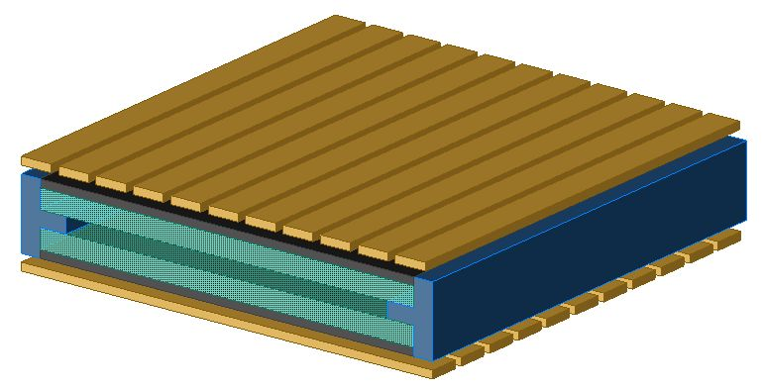
INO-ICAL Detector
Rectangular detector
Modular structure
Active Detector Element :
Resistive Plate Chambers (RPC)
151 layers of iron plates interleaved
with RPCs
Resistive Plate Chambers (RPC)
Glass plates
Pickup strips

Slide 6
ICAL factsheet
No of modules | 3
Module dimension | 16 m X 16 m X 14.4m
Detector dimension | 48.4 m X 16 m X 14.4m
No of layers | 150
Iron plate thickness | 5.6cm
Gap for RPC trays | 4 cm
Magnetic field | 1.4 Tesla
RPC unit dimension | 195 cm x 184 cm x 2.4 cm
Readout strip width | 3 cm
No. of RPCs/Road/Layer | 8
No. of Roads/Layer/Module | 8
No. of RPC units/Layer | 192
Total no of RPC units | 28800
No of Electronic channels | 3.7 X 10⁶

Slide 7
ICAL@INO- Salient Features
Sensitive to muons:
Good Energy determination from
Track length.
Track curvature in the magnetic field.
Directionality from tracking and ns timing resolution.
Charge identification from track curvature in the magnetic field.
Hadron shower construction enables to determine the neutrino energy with greater accuracy

Slide 8
ICAL@INO – Physics Goals
Reconfirmation of atmospheric neutrino oscillations using neutrinos and antineutrinos separately.
Improved precision of atmospheric oscillation parameters.
Neutrino mass hierarchy using matter effect via charge discrimination.
Measure the deviation of 2-3 mixing angle from maximal value and determine its octant.
Testing new physics scenarios like sterile neutrinos, CPT violation, NSI, long range forces ……
Indirect searches of Dark matter, Magnetic Monopoles …

Slide 9
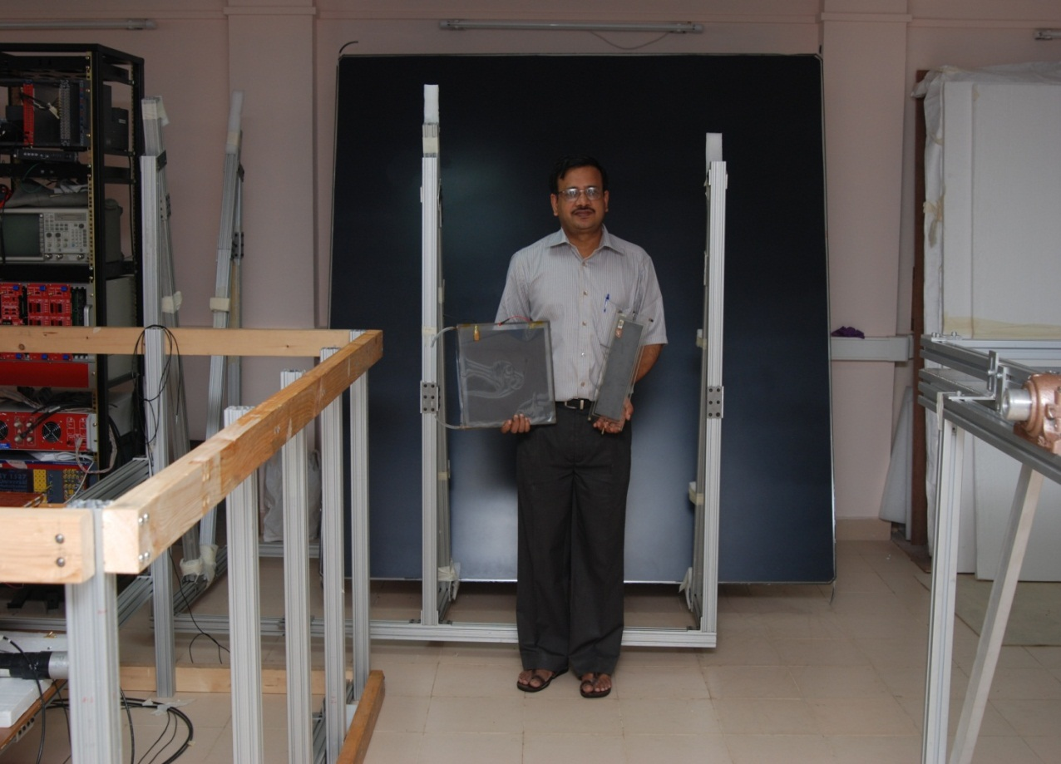
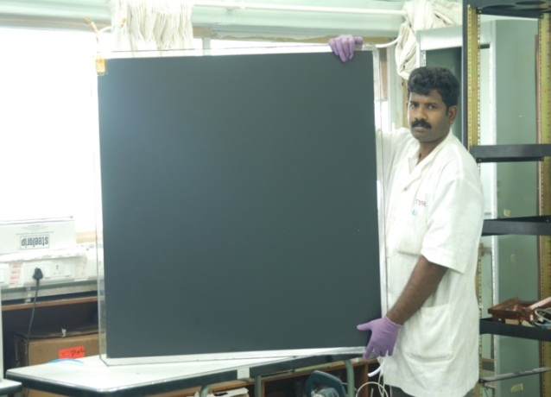
RPC R & D
200 cm x 200 cm
10 cm x 30 cm
100 cm x 100 cm
30 cm x 30 cm

Slide 10
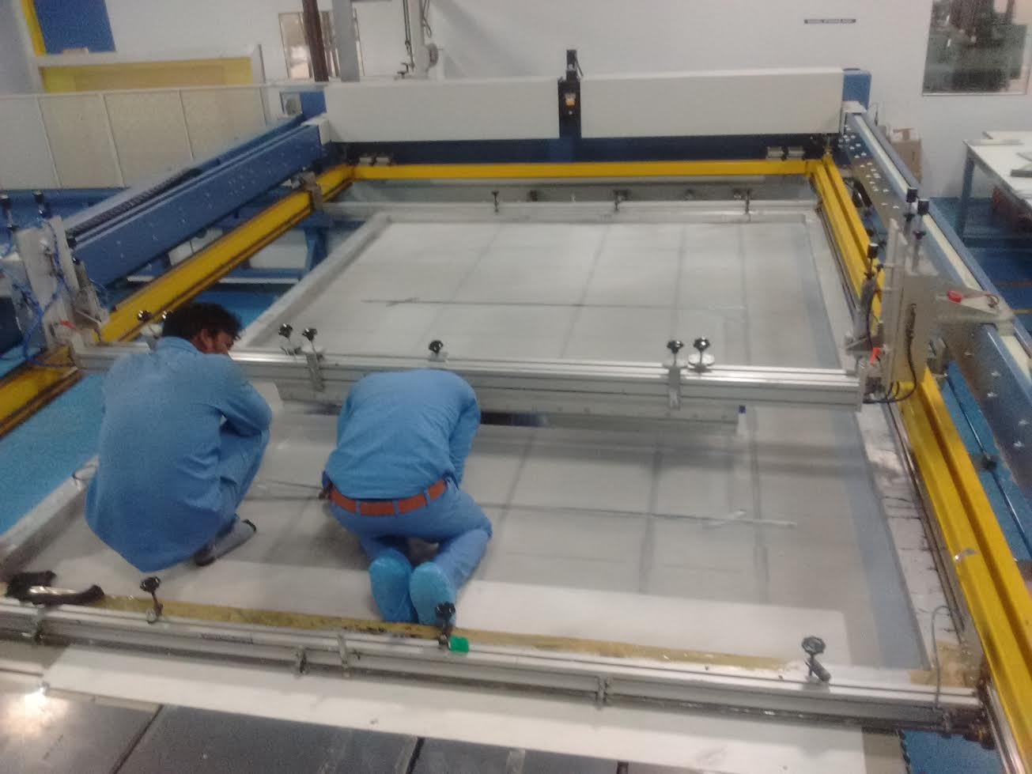
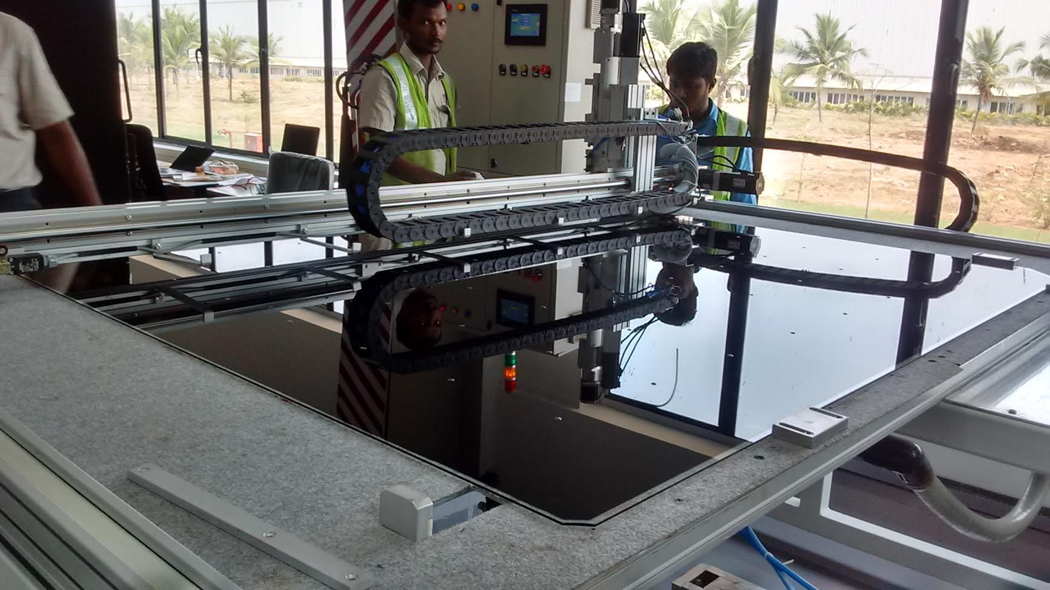
RPC making at the Factory

Slide 11
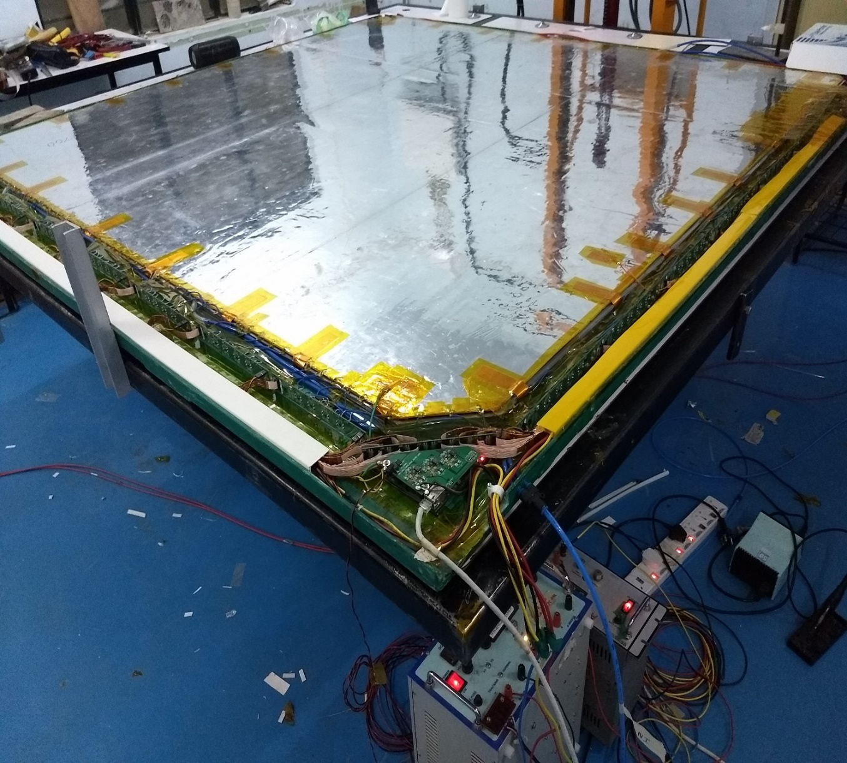
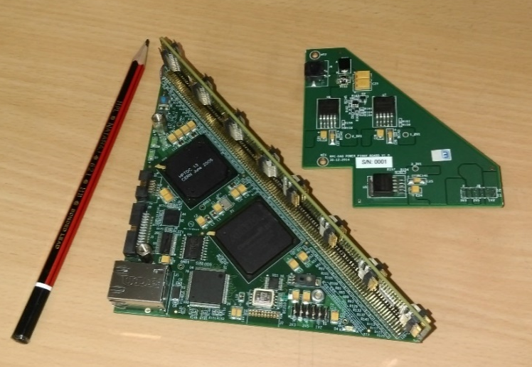
Front End DAQ Electronics
HV Module
2m X 2m RPC with tray
RPC DAQ
ANUSPARSH
NINO

Slide 12
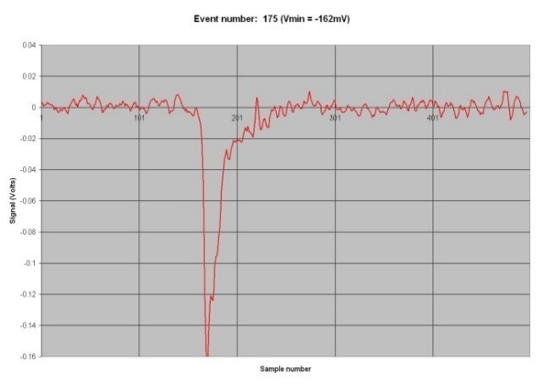
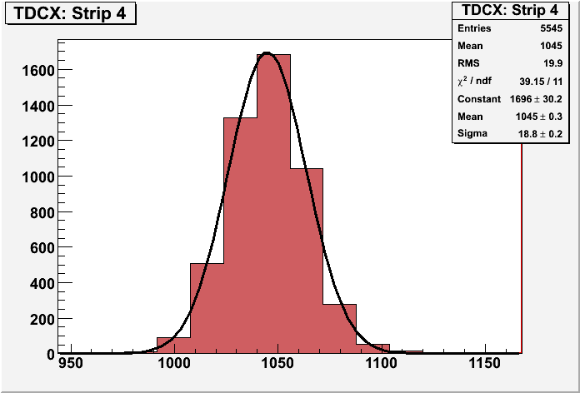
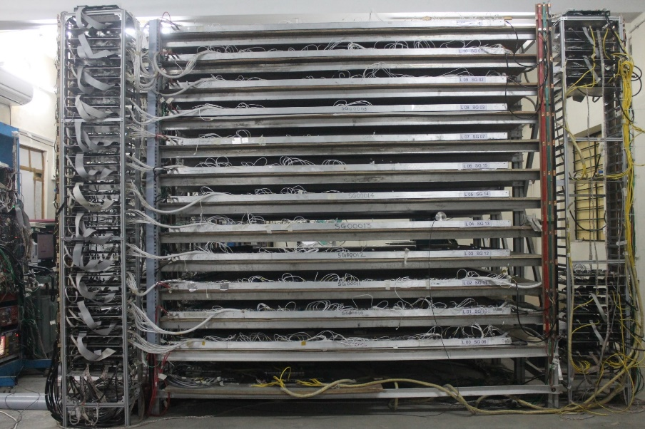
RPC Stacks at TIFR & Madurai
Using new DAQ system
Old front end electronics
Notes:
12

Slide 13
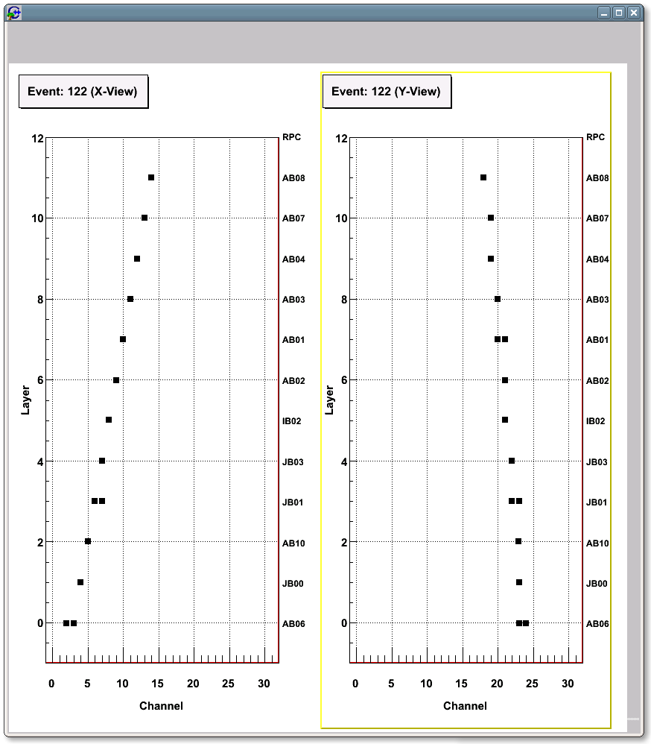
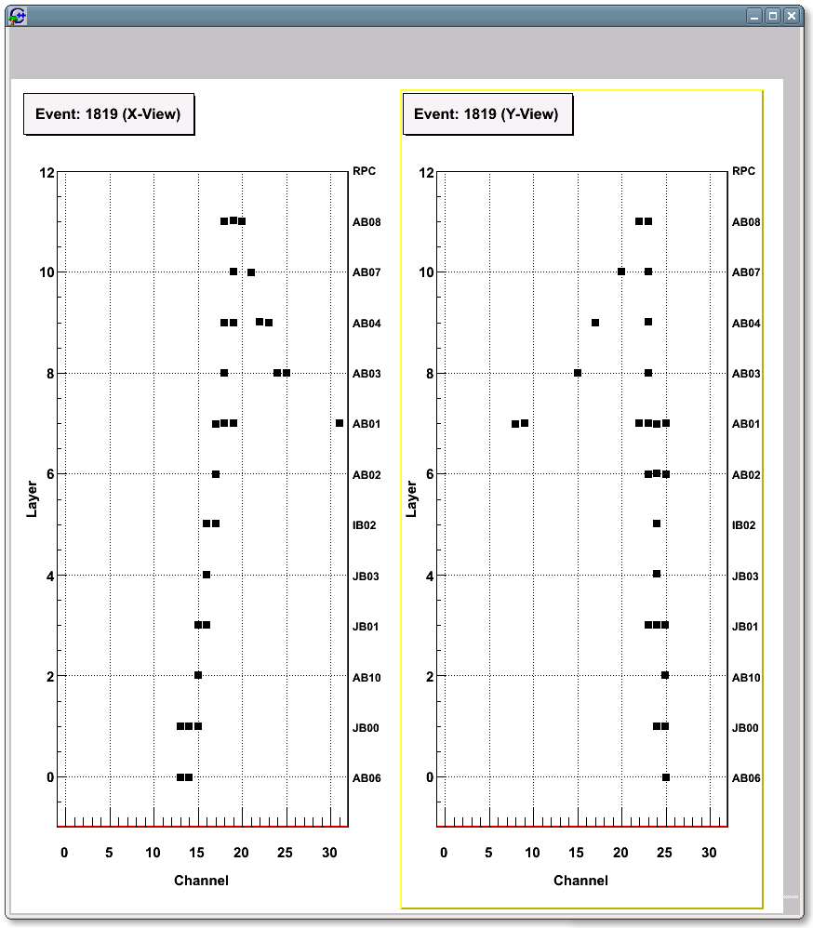
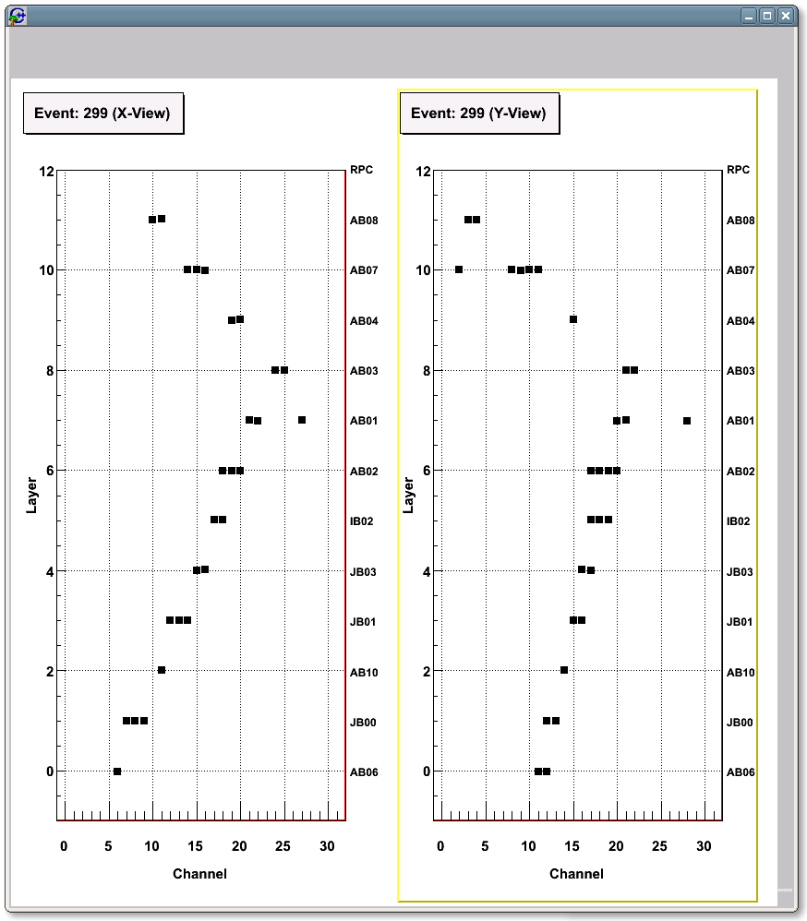
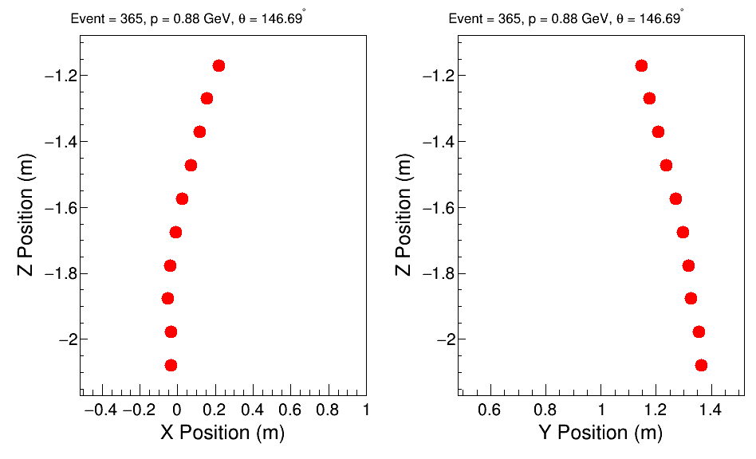
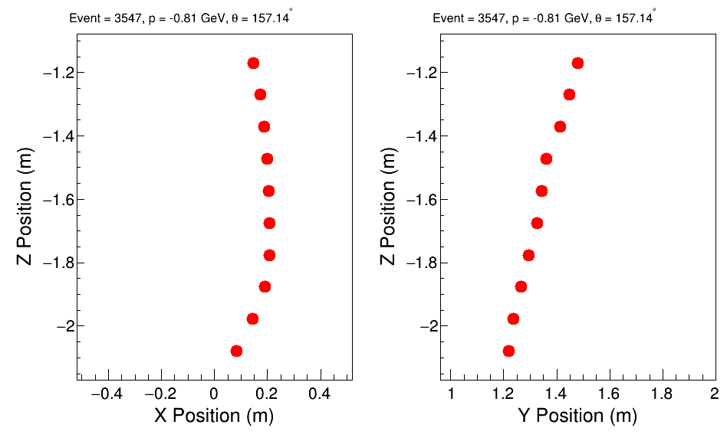
Muon tracks in the RPC stack & M-ICAL
Demonstrate the Tracking Capability of the RPC system

Slide 14
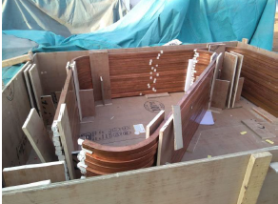
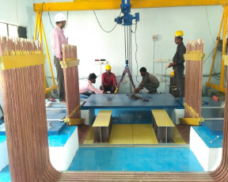
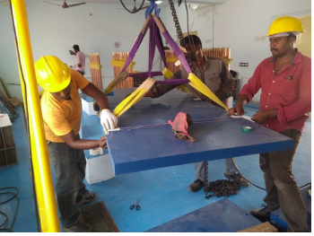
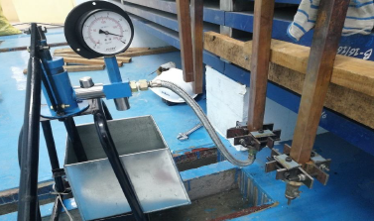
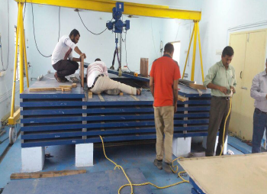
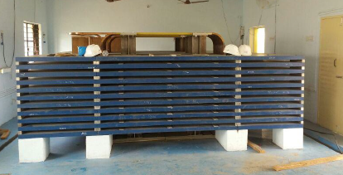
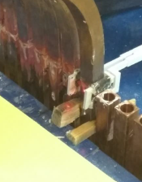
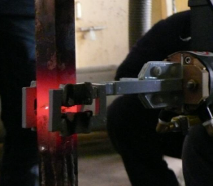
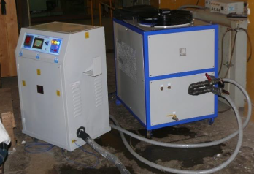
2 coils, 18 turns each
X-sec 30 X 30 mm² and 17 mm bore
Gap of 12 mm
‘C’ and ‘U’ section Coils
Placement of ‘U’ coils
Iron plate lifting using gantry
mICAL magnet assembly
Coil Hydrostatic Pressure test
Description | Size
Size of magnet | 4m x 4m x 1.1m
Weight of the magnet | ~ 85 tons
No of Iron detector layers | 11
No of RPC detector layers | 10
No coils | 2
Holding pressure = 12 bars (1Hr)
Iron plate placing on Pedestal
In-situ brazing of upper “C” and lower “U”
Induction brazing in progress
Water cooled Induction brazing machine
Resistance test < 5uohm

Slide 15
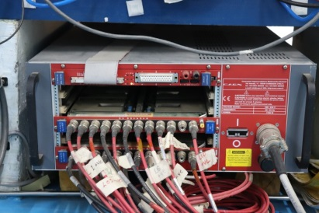
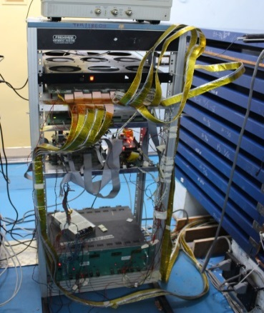
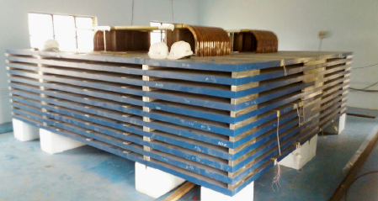
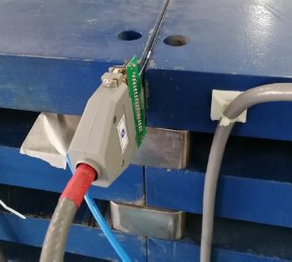
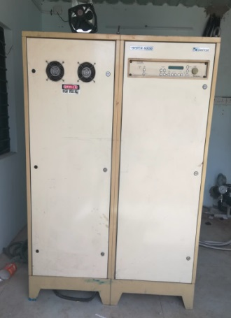
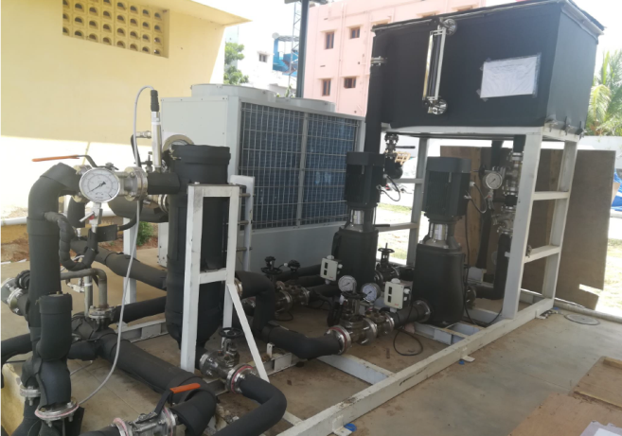
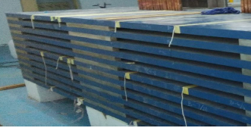
Mini ICAL sub-Systems
Power board
DFE and AFE power Supply
100ps TDC
12 Channel HV distribution
Purifier
FPGA
Ethernet
Side board
1.5kW power unit & mainframe
LV Power Supply
HV Power Supply
Pump
Compressor
Front End DAQ Module
Closed loop Gas system
Run Control Backend and Data Storage
SRB
CAU
Trigger logic board
Power Supply
Trigger System
DM water tank
Hall Probes
Chiller
30V , 1500A
Danfysik
Manual & auto
mode
CAM Software
Pump
8 to 10 µS/cm
Search Coils
Magnet Power Supply
Low Conductivity Water Cooling system
Magnet Field Measurement

Slide 16
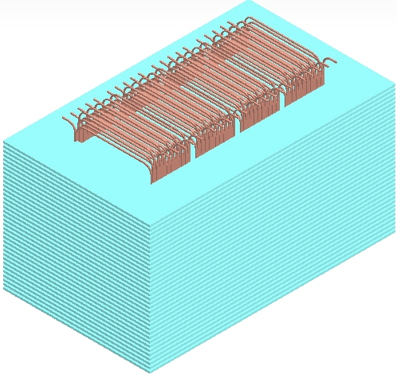
Magnet design
ICAL MAGNET QTY - 3
Size :- 16(L) × 16(W) × 15(H) meter
COIL SIZE :- 15m x 8m
Ampere-Turn :- 80,000 AT
Max. Design Value:- 100,000 AT
Max. Power requirements in each magnet:- <150KW (Coils & Power Supply)
Each coil gap = 1300mm x 80 mm
Soft Iron Plates
Copper Coils
Power Supply
Coil Cooling System
60 kA-turn

Slide 17
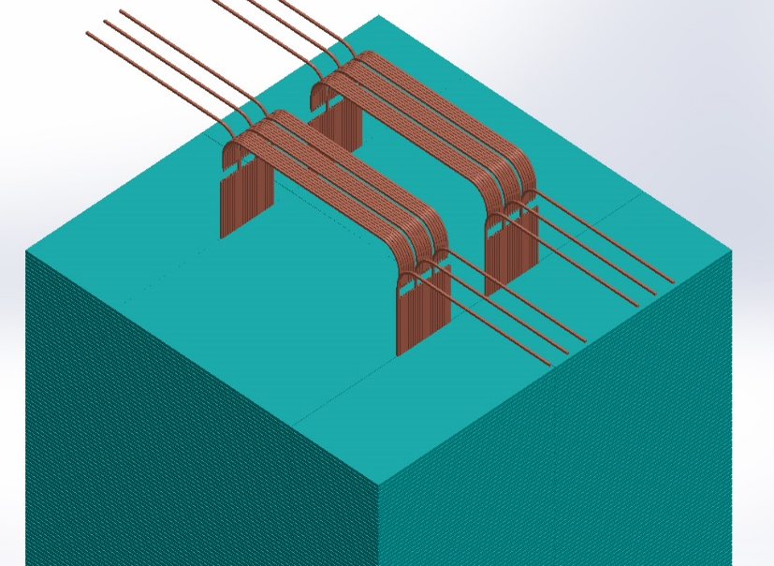
20 × 8 × 8 Prototype at Madurai under construction

Slide 18
Current Status
Financial approval by Govt. in 12/14 for Rs. 1583 Cr INR ( approx. 240 M$).
Awaiting wildlife clearance & building clearance
TN Pollution control board clearance will follow.
Detector design finalized.
Full size RPCs (2m X2m ) have been fabricated and characterization done.
400 glass RPCs have been ordered .
Mini-ICAL with magnet is operational at Madurai since June 2018.
600 tons of low carbon steel, OFHC copper conductor spools ( approx. 9.6 tons) ready to start construction of Engineering module.
8m high RPC handling trolley delivered.
Electronics, DAQ, Trigger for 20 layer engineering module are in the final stage of production.
Simulation software developed ; Further improvement ongoing.
Physics white paper published ( Pramana, J-Phys (2017) 88: 79).
Running 12th batch of INO graduate school.

Slide 19
Why India should be interested in neutrino detection ?
Excitement of carrying out front ranking research in the exciting area of neutrino physics.
Will address a key question in neutrino physics- Neutrino mass ordering.
Help us to pick up the correct theory beyond Standard Model of particle Physics.
Will learn how matter behaved at extremely high energies existed in the early stage of our universe.
Will develop various cutting edge technologies for developing state of the art particle detectors.
Massive 50 kton magnet
Sophisticated state of the art electronics
Online monitoring and Data Acquisition System
Science students across the country will have the opportunity to participate in building each of these components from scratch . Many are already doing it.
It will create an ambiance of doing things with our own hands. A culture that is lacking in India

Slide 20
Thank You for your attention

