Slide 1
Indian industries in FAIR
Subhasis Chattopadhyay
Variable Energy Cyclotron Centre
&
Bose Institute
Kolkata
(FACILITY FOR ANTIPROTON AND ION RESEARCH)

Slide 2
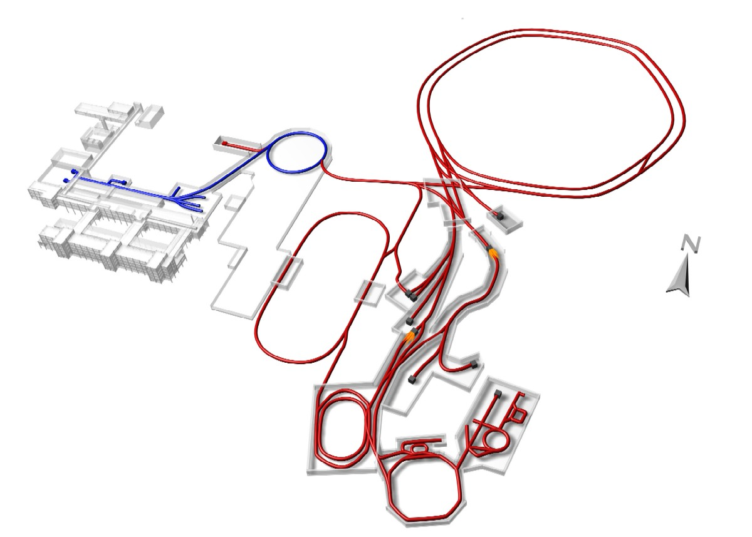
Prominent features of FAIR accelerator
High Intensity beams:
1000 x
For primary HI beam
10 000 x
For radioactive ion beams
10 0 x
For antiproton beams
Primar y beams:
10¹² /s ²³⁸U²⁸⁺ 1-2 AGeV
4·10¹³/s Protons 90 GeV
10¹⁰/s U 35 AGeV (Ni 45 AGeV)
Secondary beams:
rare isotopes 1-2 AGeV
antiprotons up to 30 GeV
Highest Beam Intensities
Brilliant Beam Quality
Higher Beam Energies
Highest Beam Power
4 parallel operations
Synchrotrons
SIS100 SIS300
Existing GSI
p - LINAC
Member
Countries:
Germany
Russia
India
France
Poland
Romania
Finland
Slovenia
Spain
Sweden
UK
Compressed Baryonic Matter (CBM)
High-Energy Storage Ring
HESR
Superconducting
large-acceptance Fragment Separator
Super-FRS
Collector Ring
CR
Recycled Exp. Storage Ring RESR
New Experimental Storage Ring
NESR
Cost of first phase : 1.2 billion Euro (2005 price),
Indian contribution (3%) = 36 MEuro (2005 price)

Slide 3
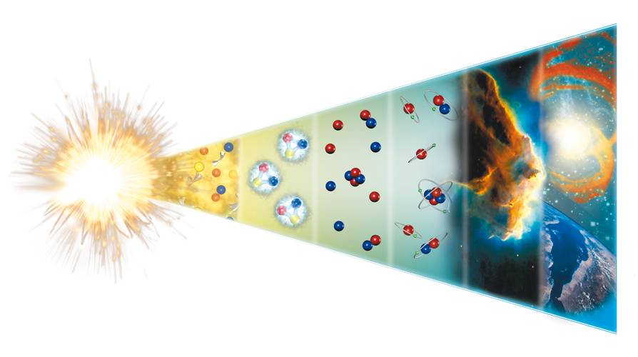
Physics at FAIR
FAIR – NUSTAR research programs (Nuclear Structure, Astrophysics and Reactions
The evolution of the universe
Indian connection
Nustar: nuclear
physics research
QCD: community
active in high energy
nuclear physics
APPA:
Atomic, plasma and
laser community is large
T[K]
1 TeV 10¹⁶
1 GeV 10¹³
1 MeV 10¹⁰
1 KeV 10⁷
1 eV 10⁴
1 meV 10
Nuclei
Parlicles
Atoms
10⁻¹² 10⁻⁶ 1 10⁶ 10¹² 10¹⁸ t[s]
FAIR – QCD research programs (Quantum Chromodynamics
Today
13.7 bln y. later
FAIR – APPA research programs (Atomic ,Plasma Physics and Applications)

Slide 4
Indian participation in FAIR Experiments
India-NUSTAR collaboration
Bhabha Atomic Research Centre, Mumbai
Saha Institute of Nuclear Physics, Kolkata
Tata Institute of Fundamental Research, Mumbai
Variable Energy Cyclotron Center, Kolkata
Inter University Accelerator Center, New Delhi
Indian Institute of Technology, Bombay
Indian Institute of Technology, Kharagpur
Indian Institute of Technology, Roorkee
University of Delhi, New Delhi
University of Calcutta, Kolkata
Punjab University, Chandigarh
Aligrah Muslim University, Aligrah
Karnatak University, Dharwa
Guwahati University
Continuation of activities at VECC, IUAC and TIFR accelerator centres
India-CBM
collaboration
Aligarh Muslim Univ.
Panjab Univ.
Rajasthan Univ.
Univ. of Jammu
Univ. of Kashmir
Univ. of Calcutta
B.H. Univ. Varanasi
VECC Kolkata
SINP Kolkata
IOP Bhubaneswar
IIT Kharagpur
Gowhati Univ.
Bose-Institute, Kolkata
North Bengal Univ, WB
India-PANDA collaboration
(EOIs)
BARC-Mumbai (NPD)
IIT Mumbai
SINP- Kolkata
VECC- Kolkata
IIT Indore
IIT- Gowhati
Pune university
AMU Aligarh
South Gujarat Univ.
NIT Jalandhar
MSU Vadodara
Magadh University
TIFR- Mumbai
+ APPA collaboration
Motivation of our participation is to take part in advanced scientific and
technological activities

Slide 5
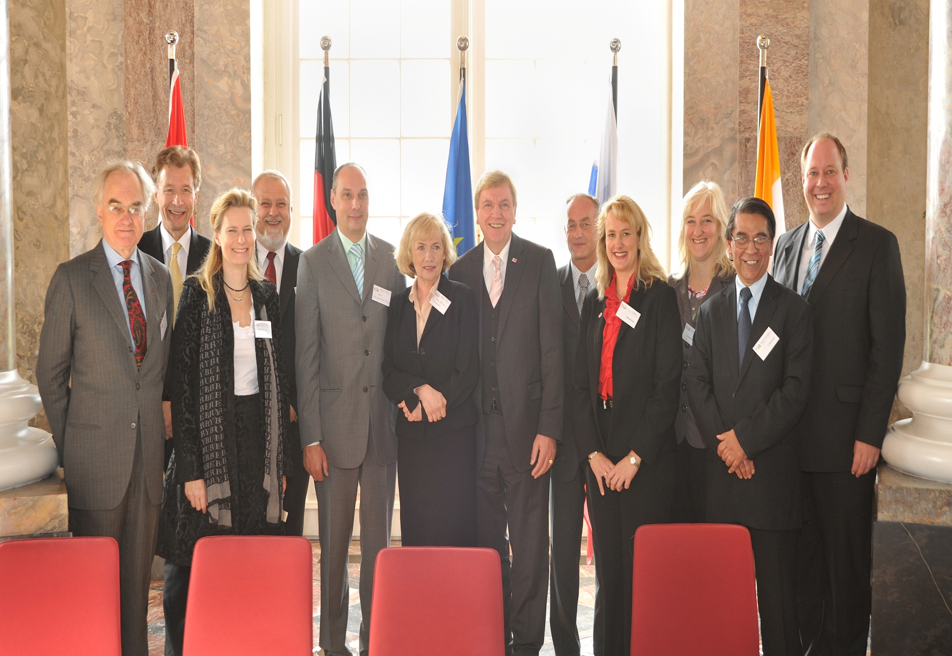
FAIR GmBH formed on 4th October 2010
Founder
countries:
Germany
Russia
India
France
Poland
Romania
Finland
Slovania
Sweden

Slide 6
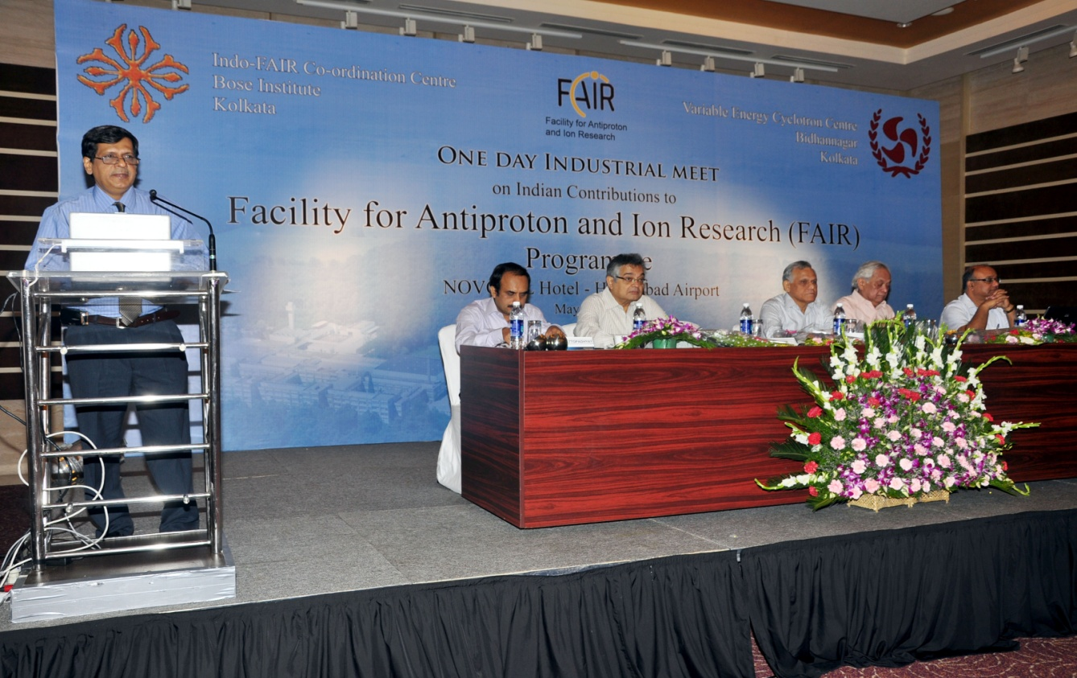
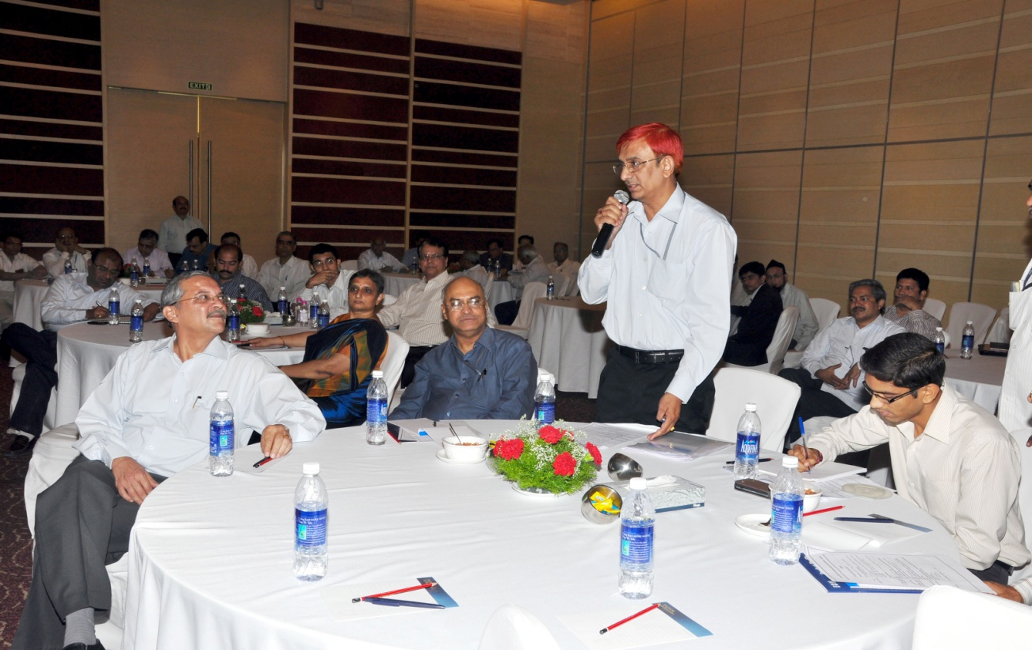
First Industry meet, Hyderabad
24 members, 14 houses
1. ECIL (Hyderabad) 2. BHEL (New Delhi) 3. L&T (Mumbai) 4. National Instruments
(Bangalore) 5. Indo-German tool room
(Indore) 6. Hind-Hi vac (Hyderabad) 7. VT-vacuum (Bangalore)
8. Vacuum Techniques
(Bangalore) 9. Avsarala (Bangalore) 10. Stesalit (Kolkata) 11. Pfeiffer-Vacuum
(Secunderabad) 12. Rittal (Secunderabad)
13. Seto Teknolog Pvt Ltd
(mumbai)
14. Growcontrols(Hyderabad)

Slide 7
A team visited GSI:
Y. S.Mayya
R. K. Bhandari
S. Sudhakar
Major decision: ECIL will take up the power converters for
HEBT, SIS100, Super-FRS

Slide 8
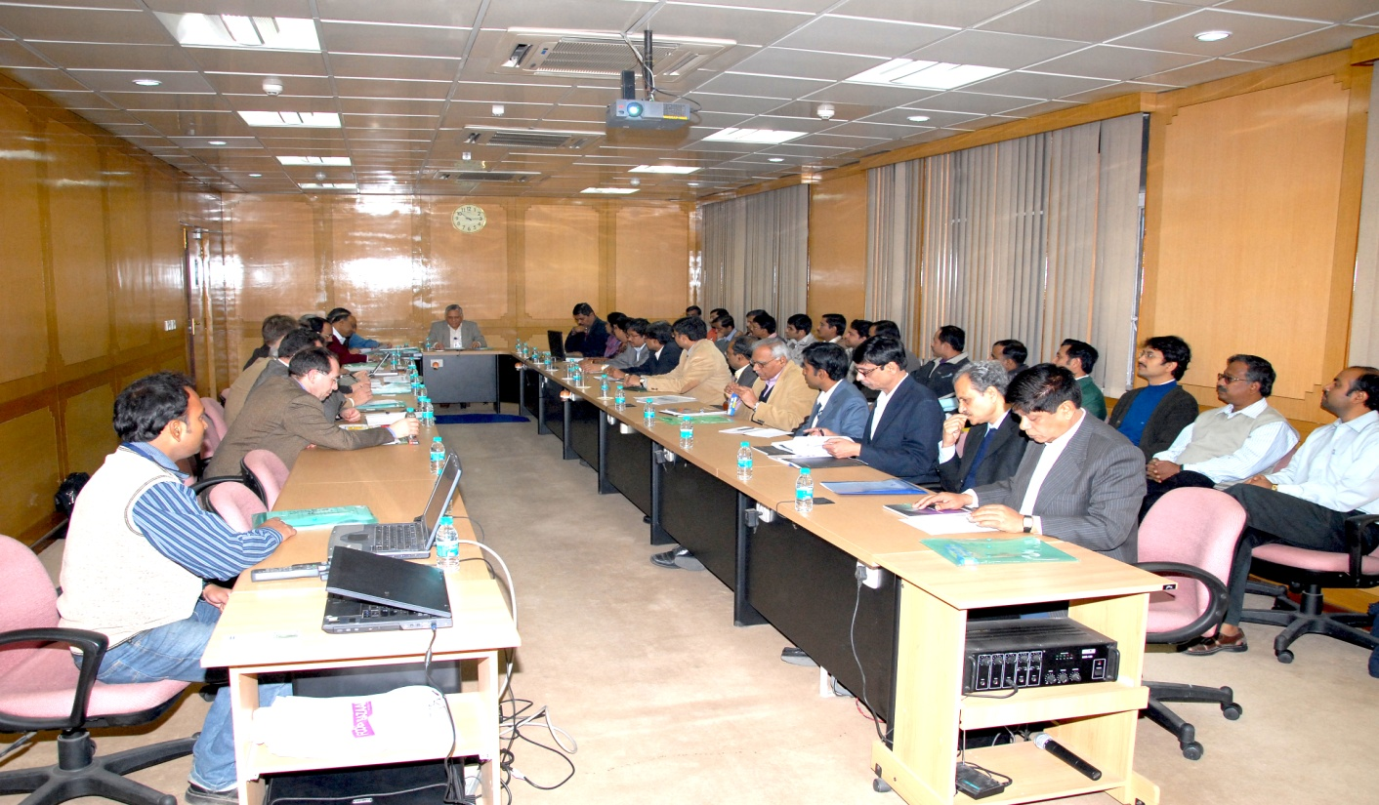
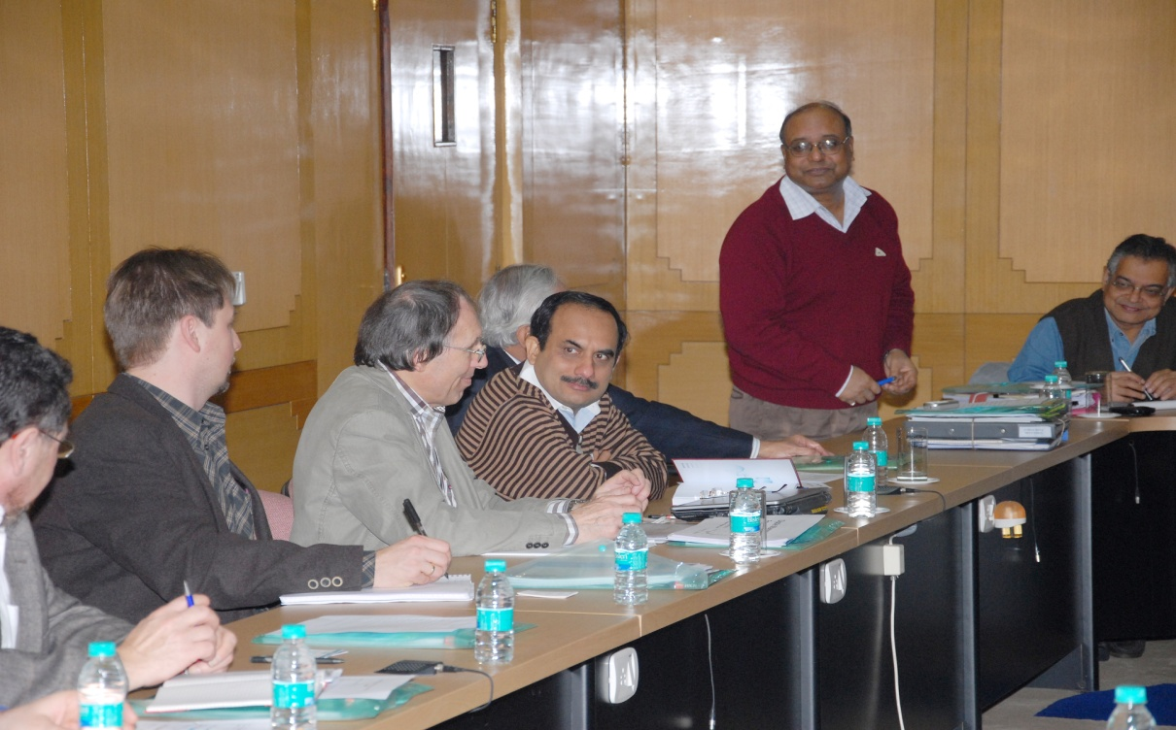
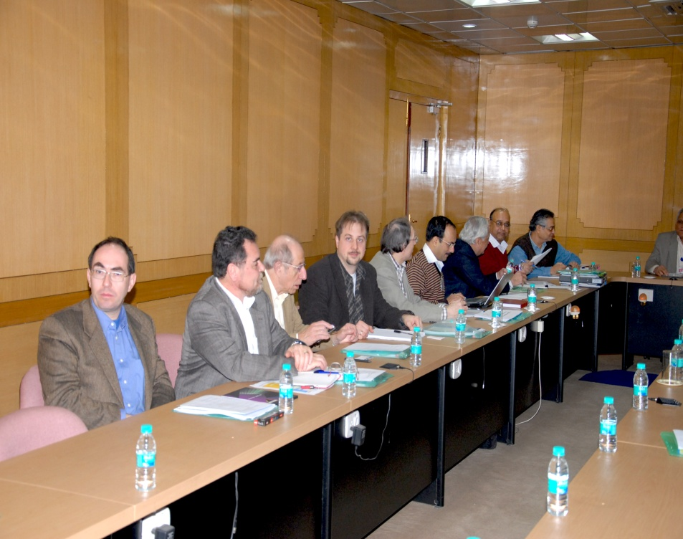
FAIR technical team visited India (ECIL, Avsarala, Kolkata)
Ramakers (GSI)
Marcus (UHC chambers)

Slide 9
Major outcome:
100 UHV chambers for beam diagnostic chambers
Superconducting magnets for LEB
Followed by another Industry meeting in Hyderabad

Slide 10
Indian in-kind items identified so far
Accelerator components
Detectors and Electronics
Power converters (750 nos)
Ultra-high Vacuum chambers (~100)
Beam stoppers (3 nos)
SC magnets for LEB
Power cables (180Km)
Spectrometer for nuclear physics
Neutron detector for nuclear physics
Ion-trap for nuclear physics
Muon chambers for high energy expts
Covers ~25 M Euro)

Slide 11
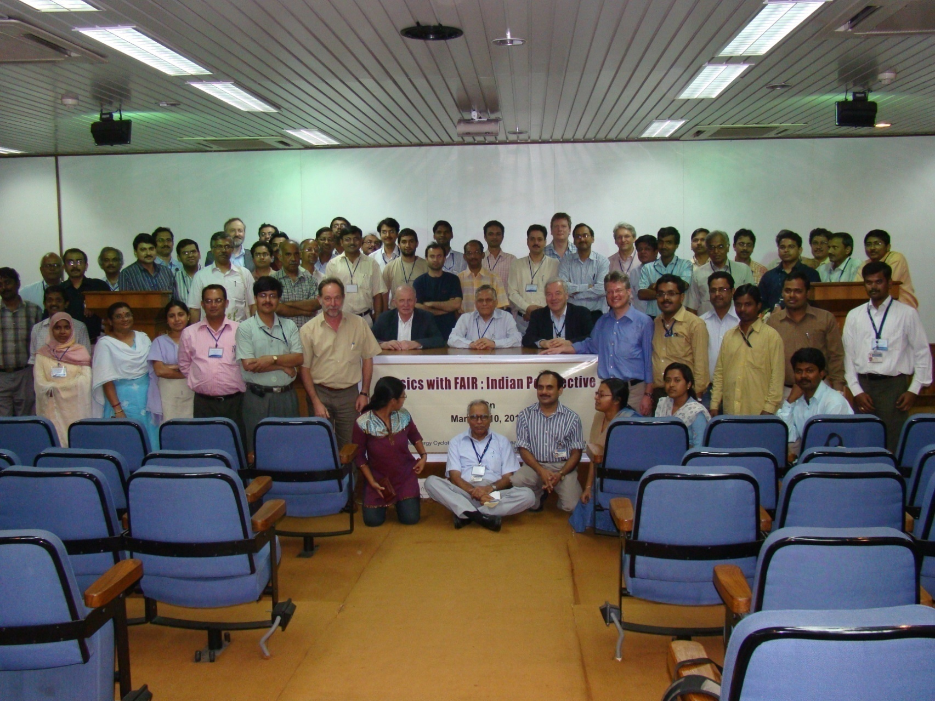
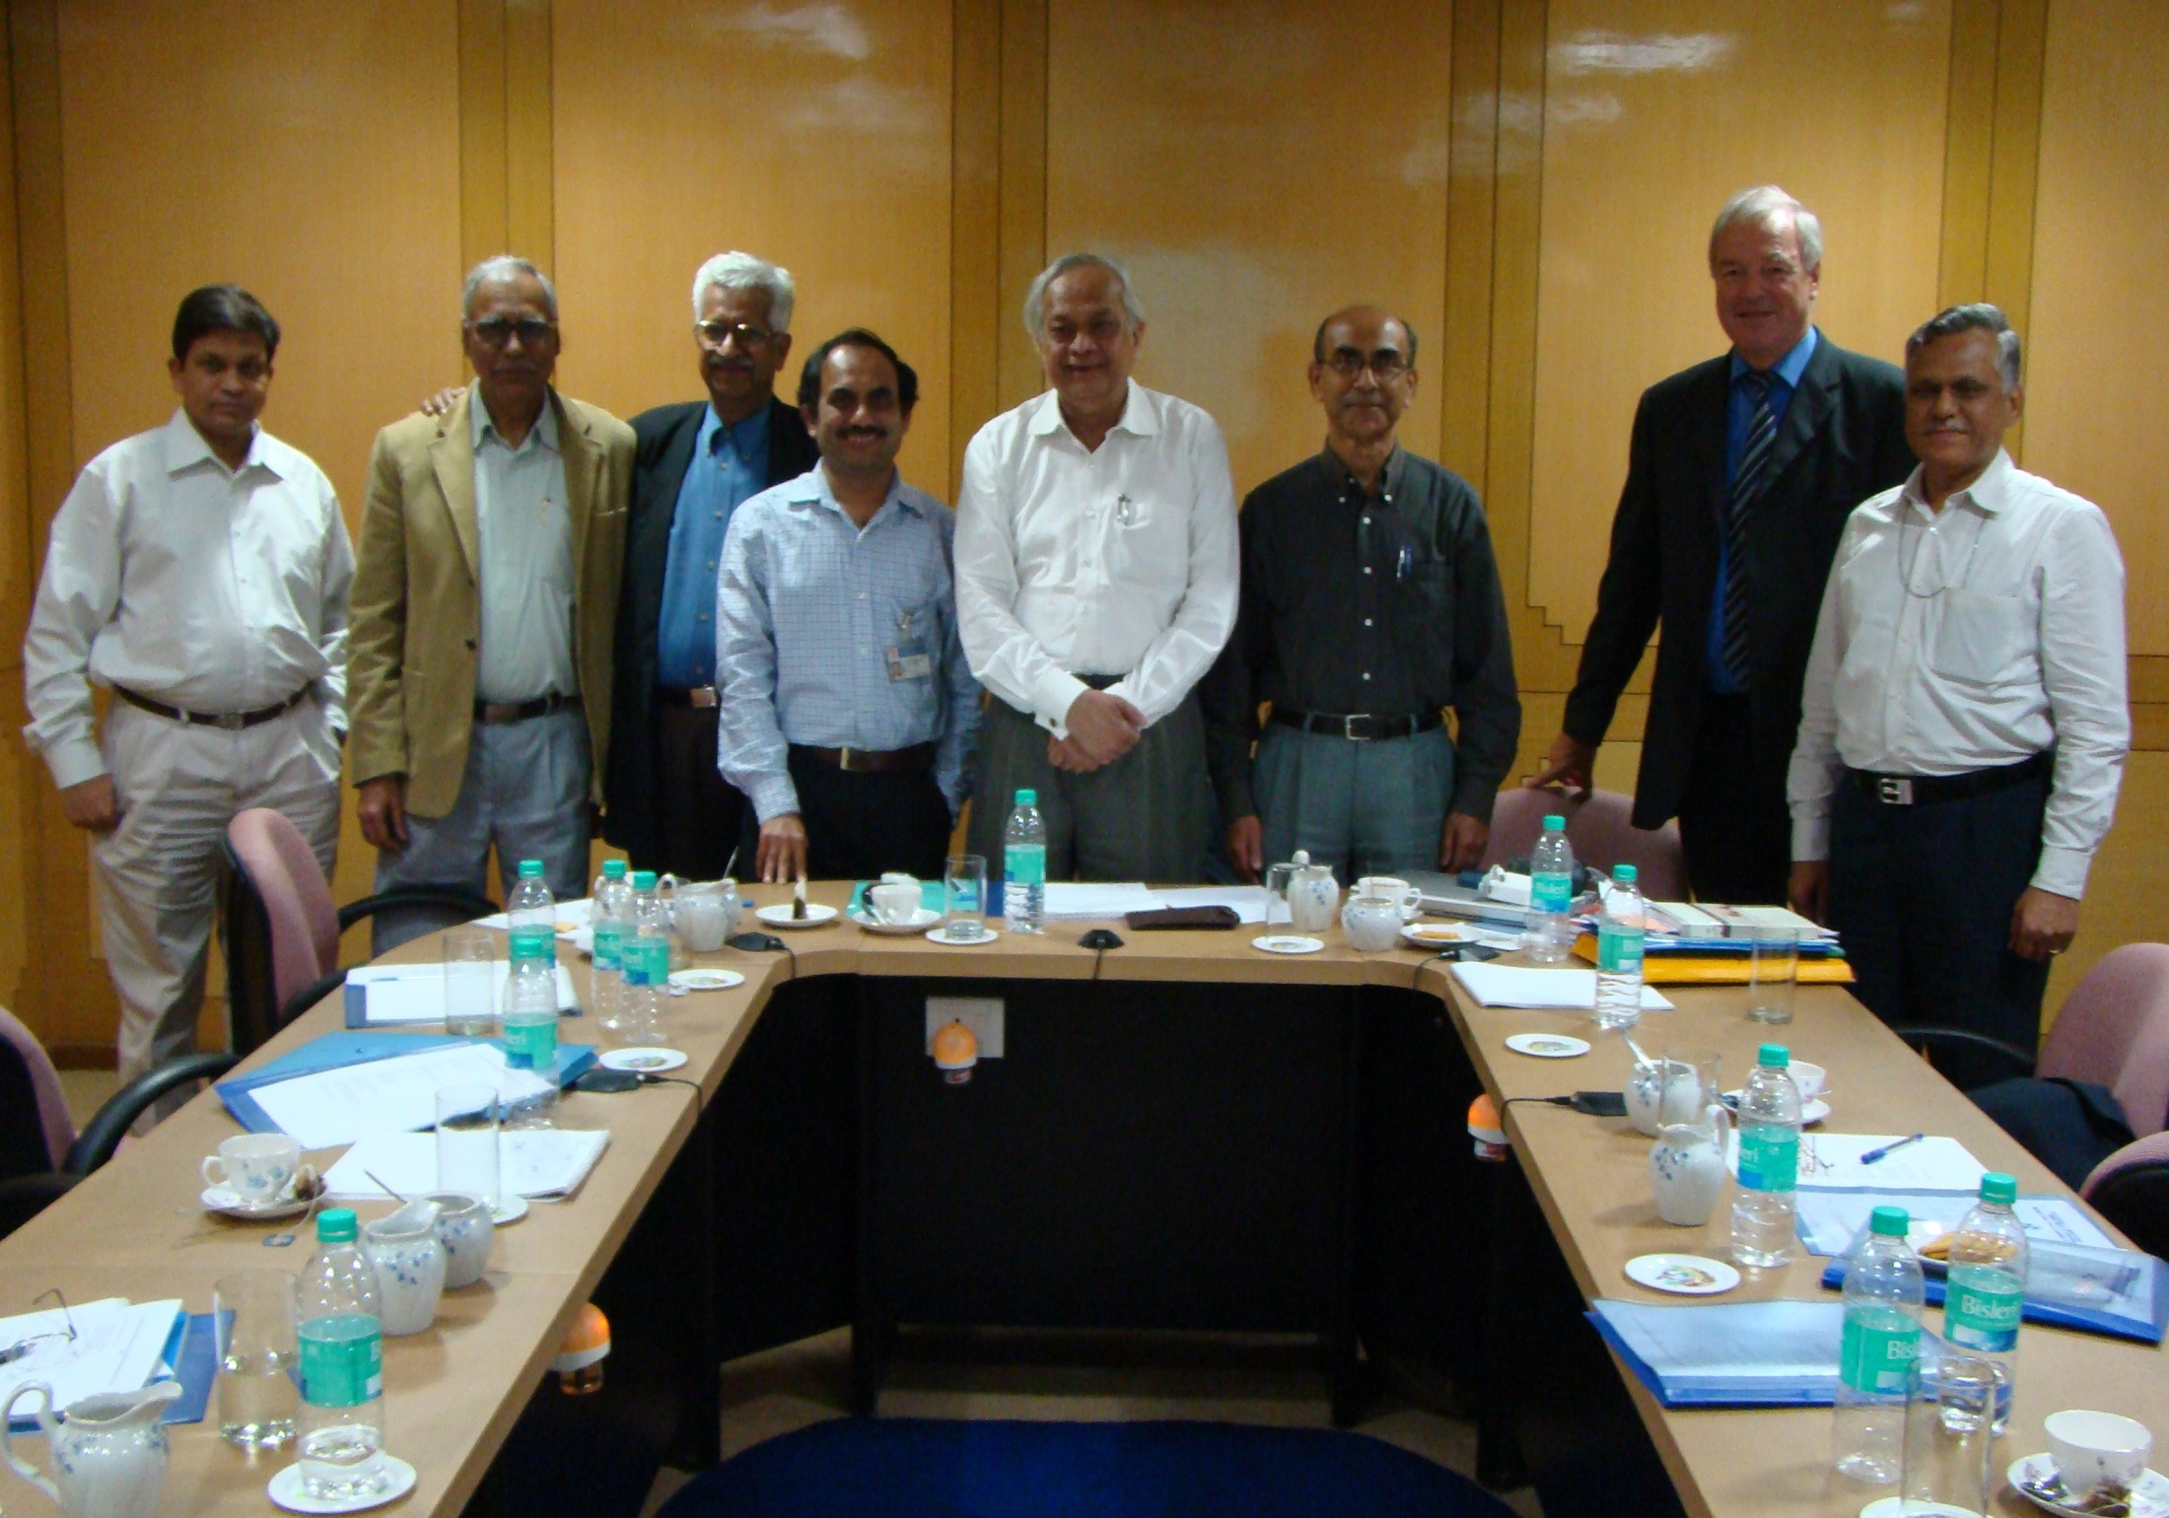
Indian contributions:
Several technical meetings took place at ECIL, VECC, BARC-Mumbai, TIFR, IUAC

Slide 12
Chronology of events so far (Power converter)
Sept. 2011: Countrywide call for tender for all power converters (Indian in-kind contribution) by BI
Sept. 2012: A bi-party contract signed between BI and ECIL for ALL assigned power converters, BI is bound for this contract (533 power converters, 28 types, HEBT, Super-FRS, SIS100, CR), seed money transferred, R&D started
So far tripartite contracts signed for 196 units
May 2014: IKC-1 (78 power converters, 4 types, HEBT)
March 2016: IKC-2 (118 power converters, 5 types, HEBT)
Four labs (VECC, BARC, RRCAT, ECIL) designed and built internal prototypes of 4 types
October 2016: Two “first-of-series” prototypes (HB.Q2 and HB.Q10) converters dispatched to FAIR/GSI after clearing FAT; A few observations received from FAIR
February 2017: It was decided to build 6 more power converters (HB.Q2) at various stages of manufacturing for inspection
January 2018: FAIR team visited ECIL for inspection
March 2018: FAT of one converter witnessed; May 2018: FAT reports of all 6 converters accepted; June 2018: Shipped
67 power converters are now ready to be shipped to FAIR
Procurement started for 200 power converters for SIS100

Slide 13
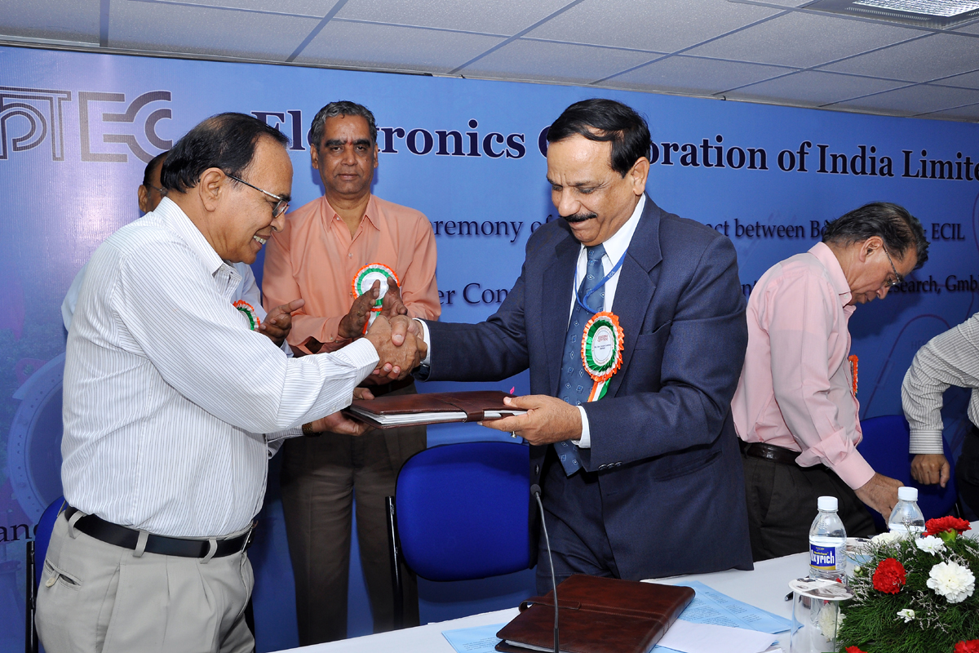
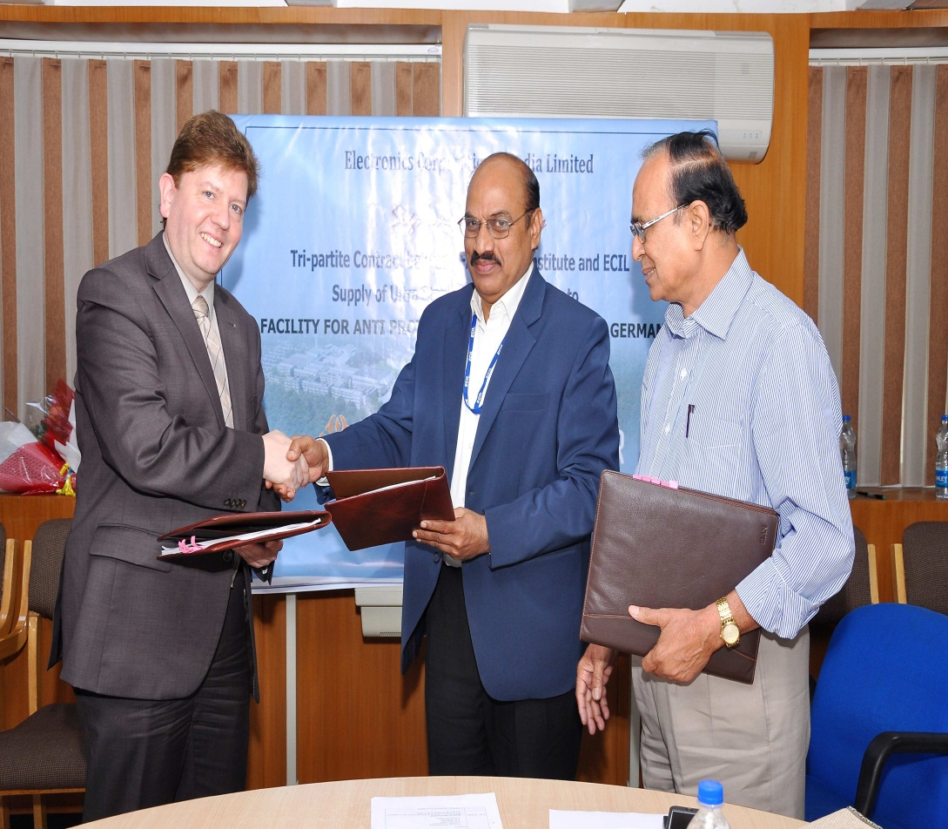
Signing of contract
Sept. 2012: A bi-party contract
May 2014: IKC-1

Slide 14
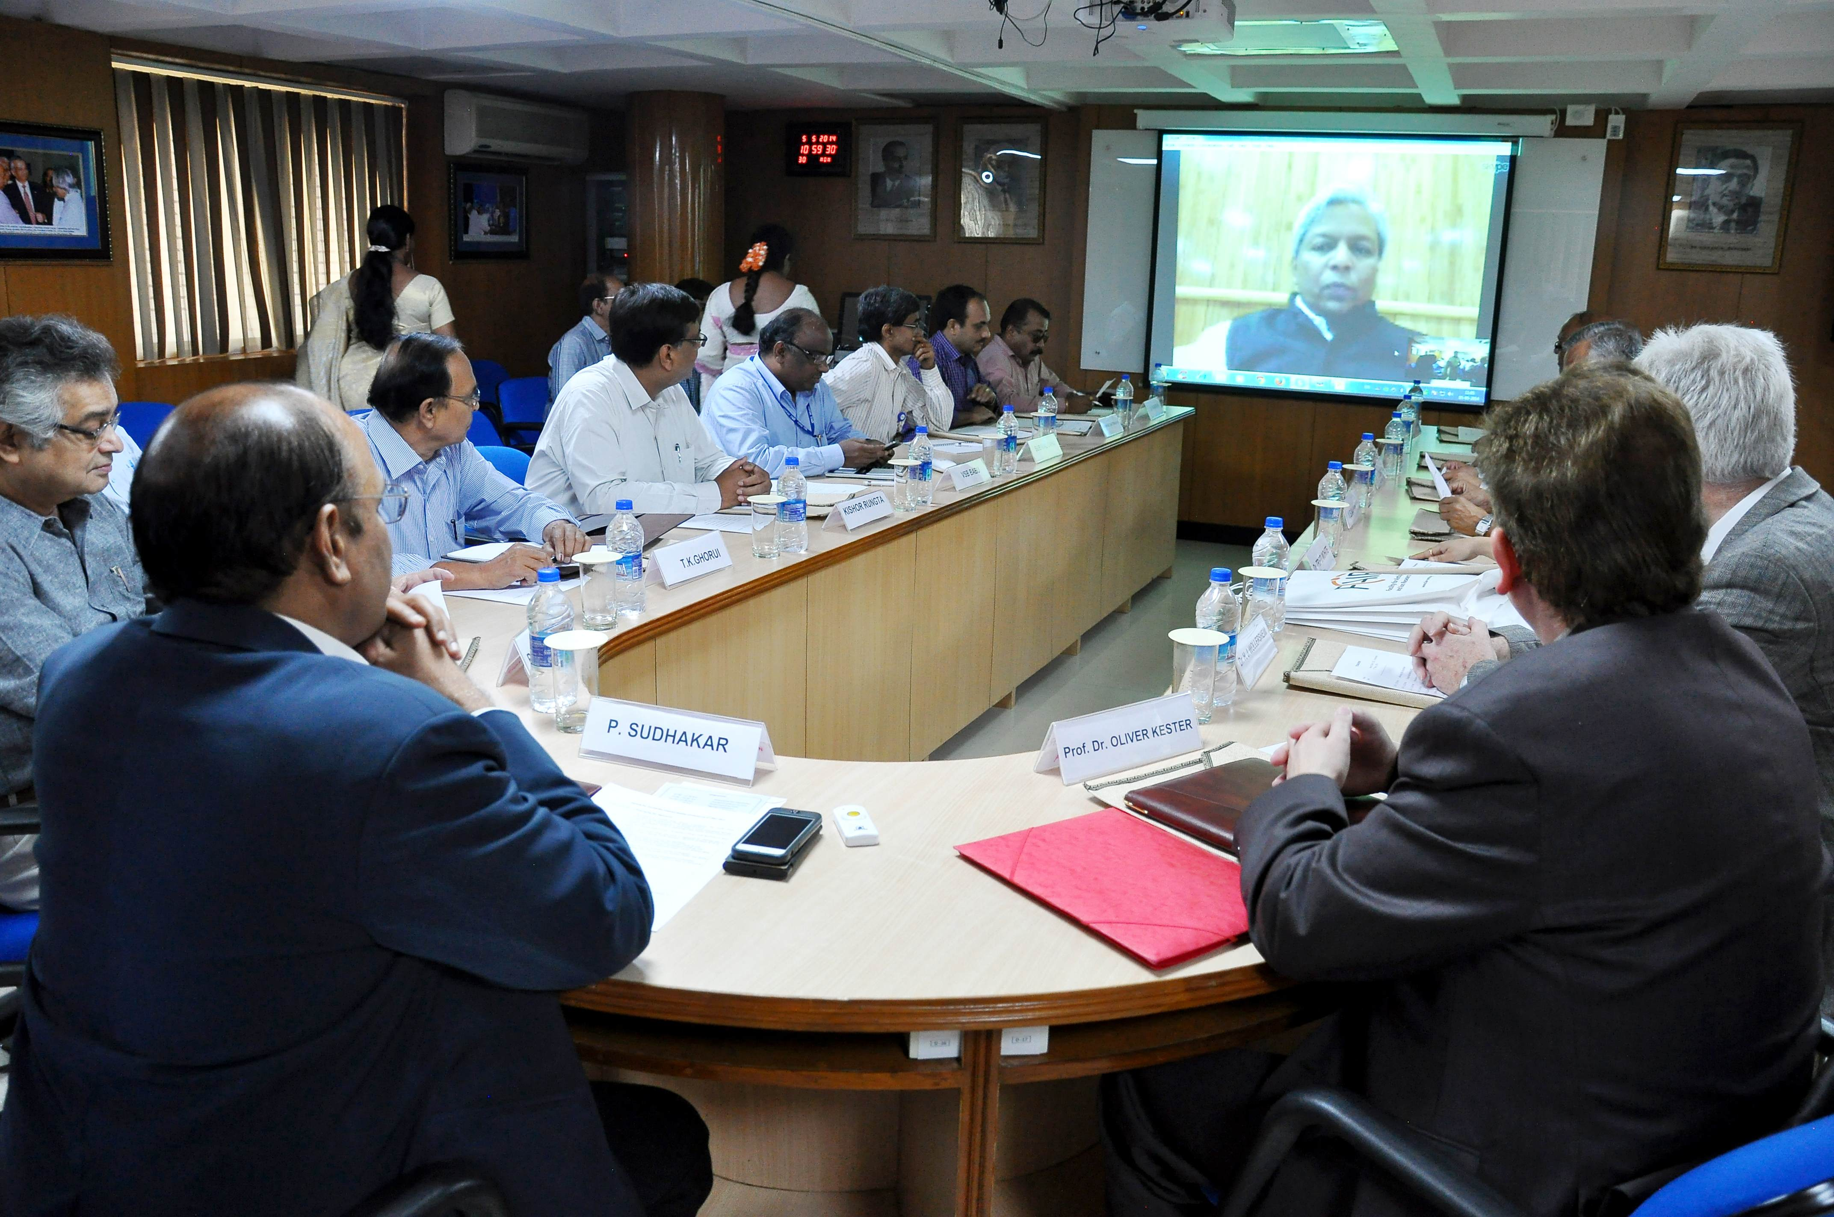
1st tripartite agreement with ECIL for power converter

Slide 15
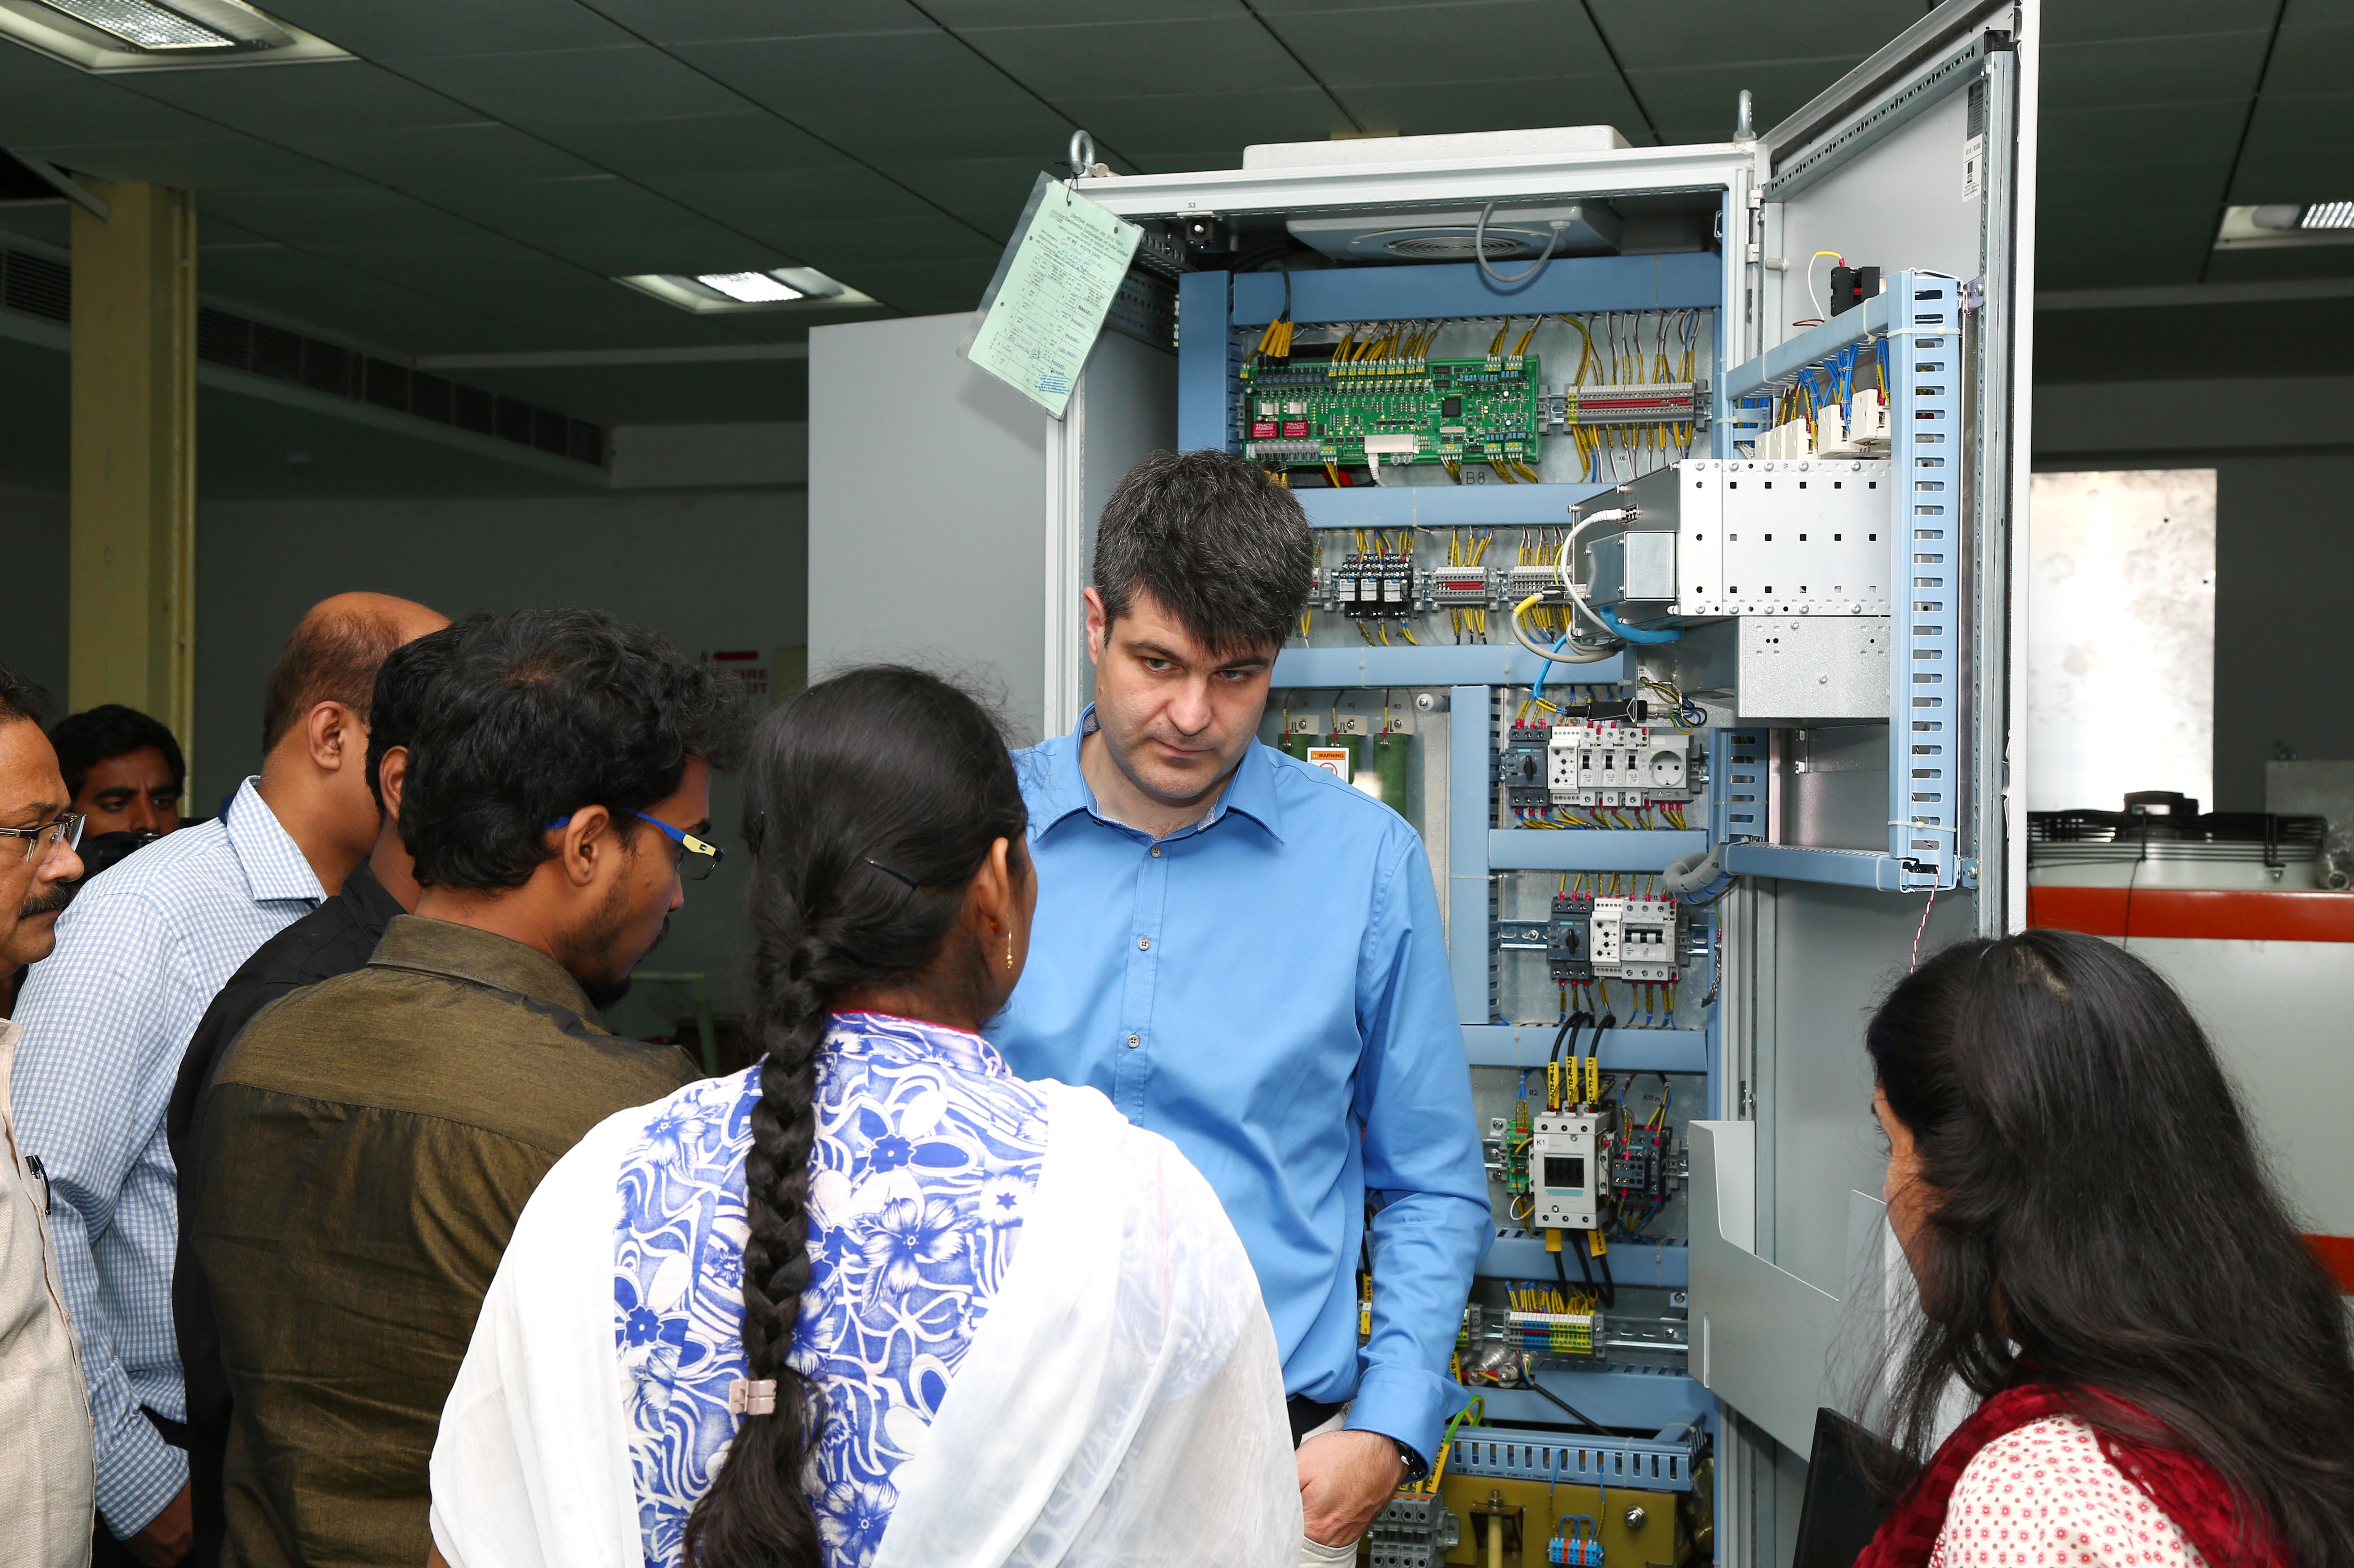
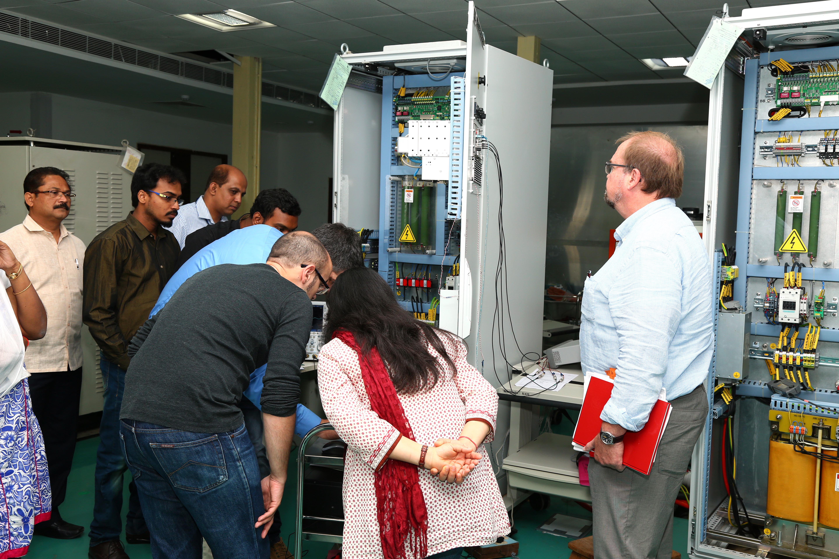
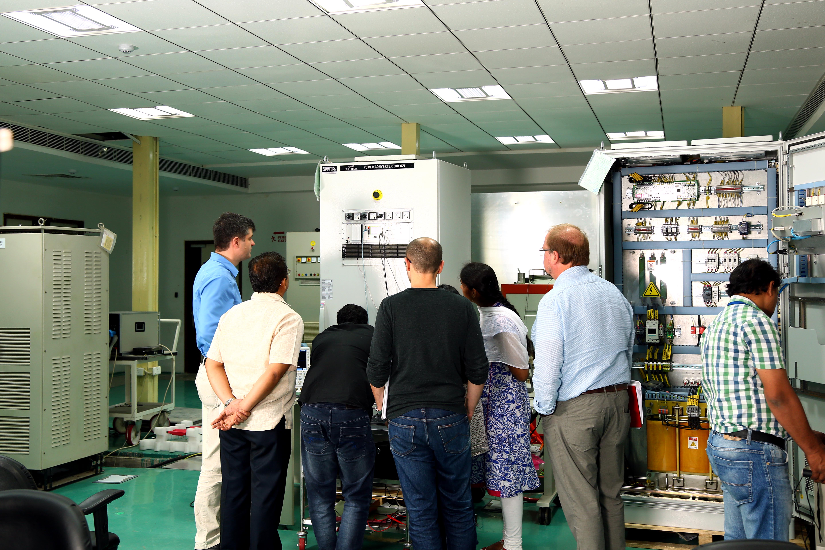
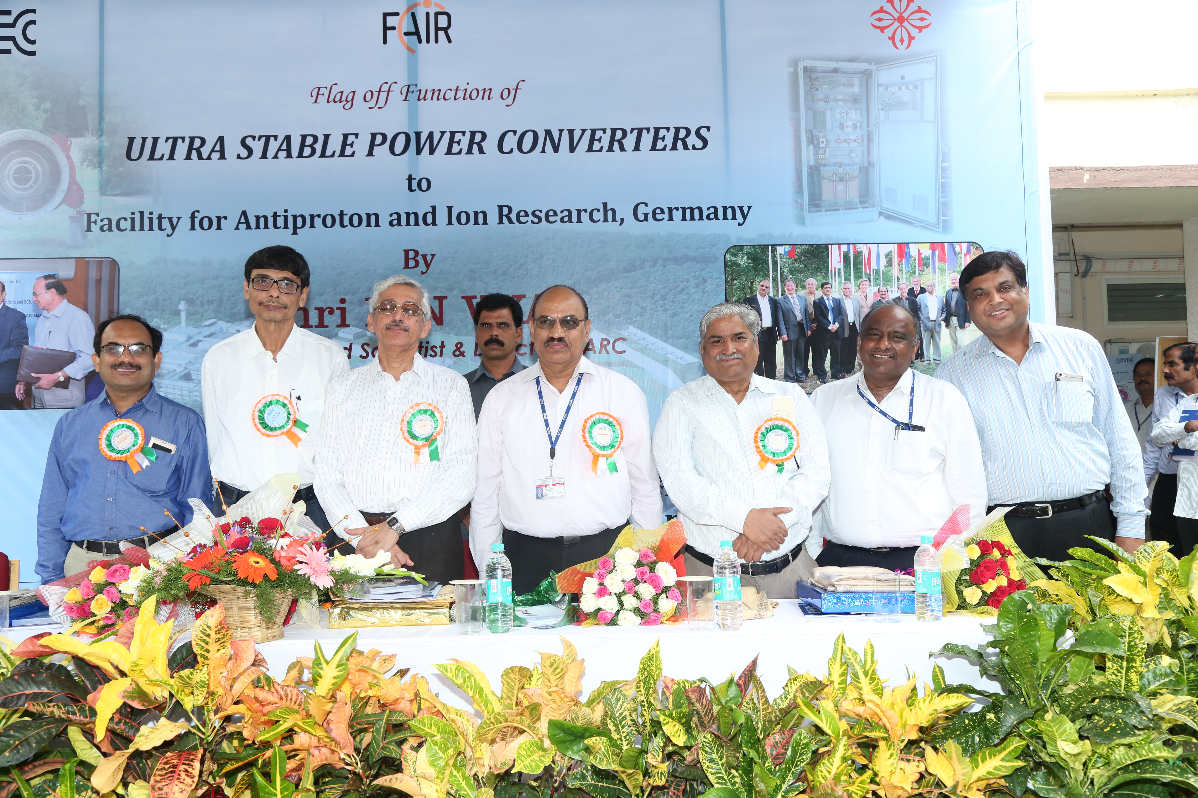
Factory Acceptance test (FAT) at ECIL in 2016

Slide 16
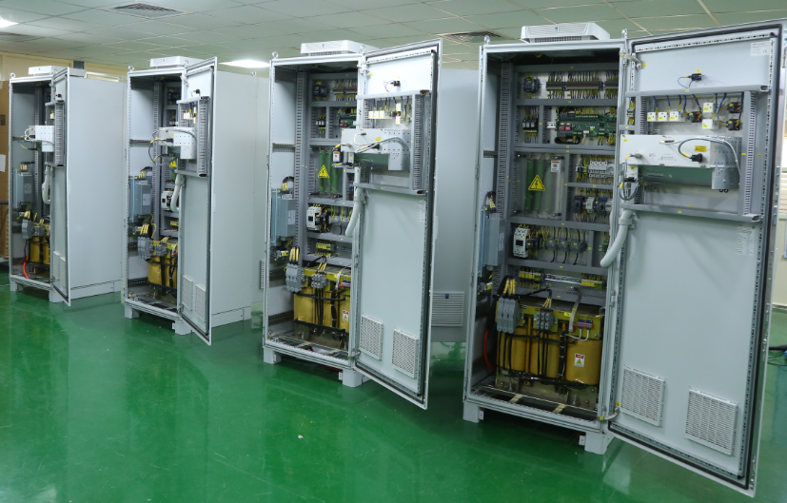
The six HB.Q2 Power Converters (continued…)
Part of 67 ready to be shipped

Slide 17
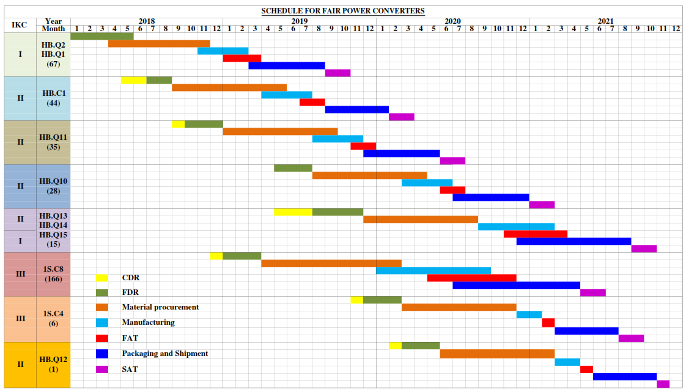
Draft Production Planning (IKC – I, II and III)

Slide 18
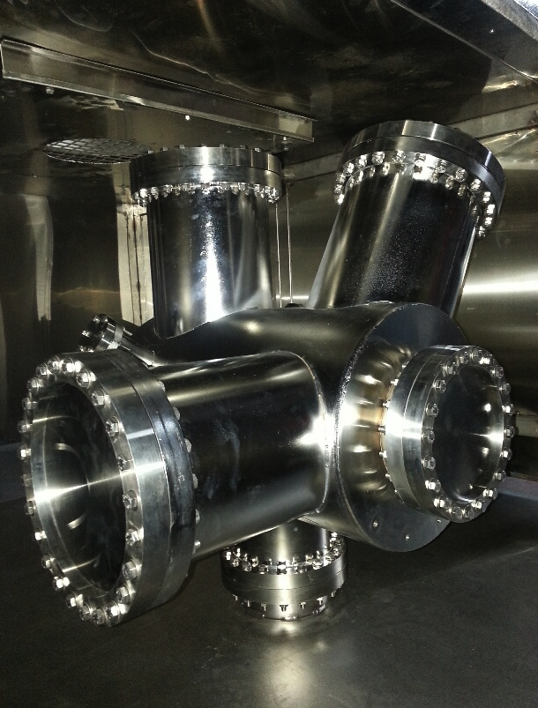
Ultra-high vacuum chambers
PO issued to a company with a condition to build a prototype
After 1.5 years,
the prototype passed vacuum test, issues with mechanical tolerances
A global tender issued (2 Indian, 4 German companies):
PO issued to vacuum technique
First review meeting next week
Tremendous pressure on production at the earliest

Slide 19
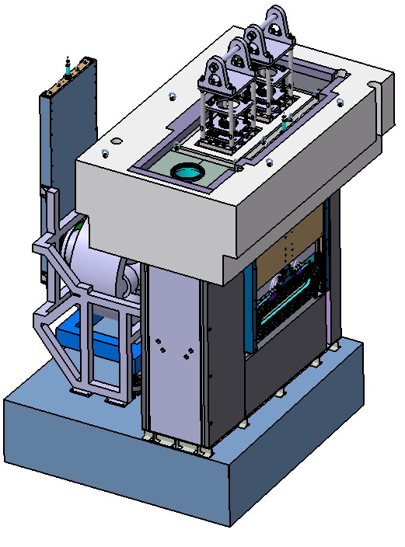
Beam stopper:
Huge power dumped in a very short time interval
Requires detailed design on
effective cooling
Material properties
Shape of the absorber
Contract with CMERI
CDR approved by FAIR, FDR in final stage
3 industries shortlisted
Tender papers will be issued very soon
Fabrication to start soon

Slide 20
Co-axial power cables (180 Km: total)
Sample produced by RPG industries : Tested OK by FAIR
Specifications obtained very recently: tender to be issued soon

Slide 21
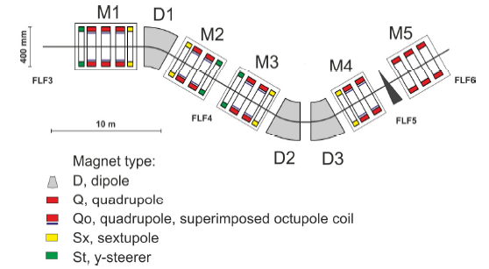
Low Energy Branch (LEB) magnets
Design completed by VECC engineers : 2 times
Cost is 3-7 times higher compared to cost book + inflation (major Indian Cos)
Withdrawn from production
Cost Review committee has recommended to credit
6 Cr for design to Indian shareholder

Slide 22
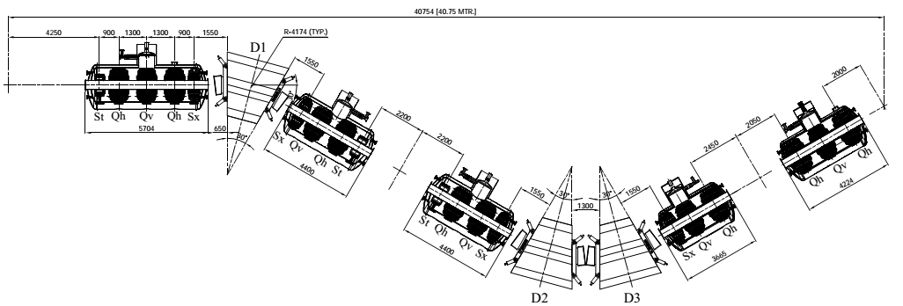
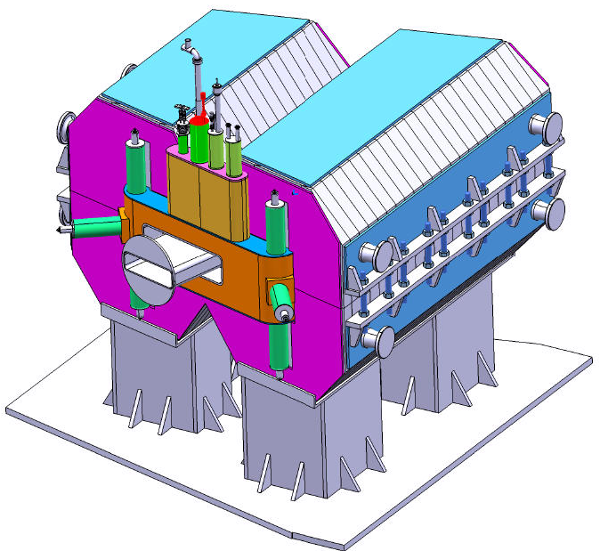
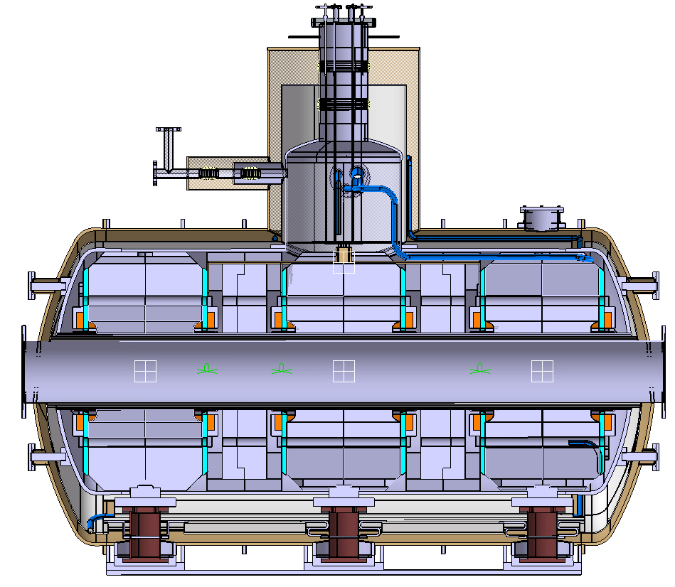
3 dipoles
Multipoles
6 Quadruples + 3 Sextupole + 2 Steerer
Multipole cryostat
Dipole

Slide 23
Industry involvement in FAIR experiments:
PCB industry : Large 8-layer PCBs for GEM chambers
Large size low resistivity Bakelite plates for RPC
Precision mechanical engineering for DESPEC experiment
ASIC design and fabrication (SCL-Chandigarh)
Recent ongoing discussion:
Iron shielding: Casting required
Contacting Foundries

Slide 24
Outside Indian in-kind:
Regular call for tenders from FAIR:
RF system
Power supply
Room temperature magnets
Superconducting magnets
…
Sent the msg around:
Industries mostly interested in in-kind items

Slide 25
Summary:
A new technological avenue has opened up at
FAIR for Indian industries
All Indian in-kind items are being developed and built in India
Would request Indian industry to explore the possibility of
non-inkind avenues
We are ready to work together

