Slide 1
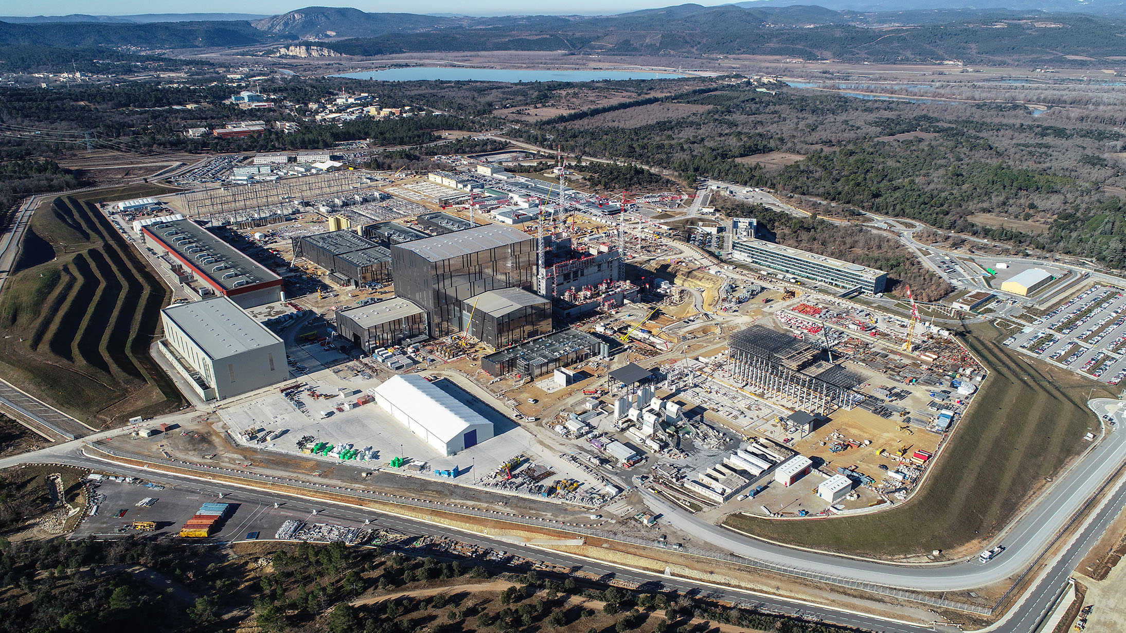
ITER
The way to a new, clean, safe and nearly unlimited energy
Laban Coblentz,
Head of Communication, ITER Organization
Vigyan Samagam Mega-Science Exhibition Opening
Mumbai, 8-9 May 2019

Slide 2
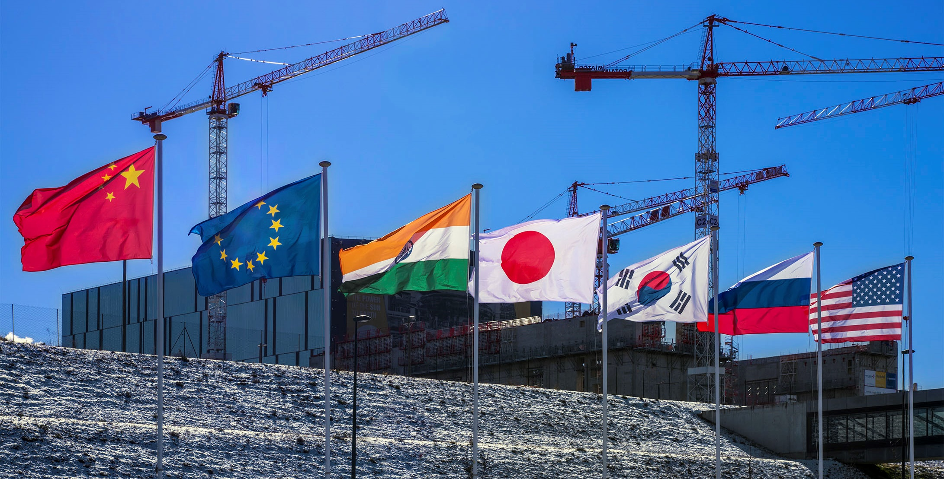
ITER
A multinational scientific collaboration without equivalent in history
A large-scale experiment to demonstrate the feasibility
of fusion energy

Slide 3
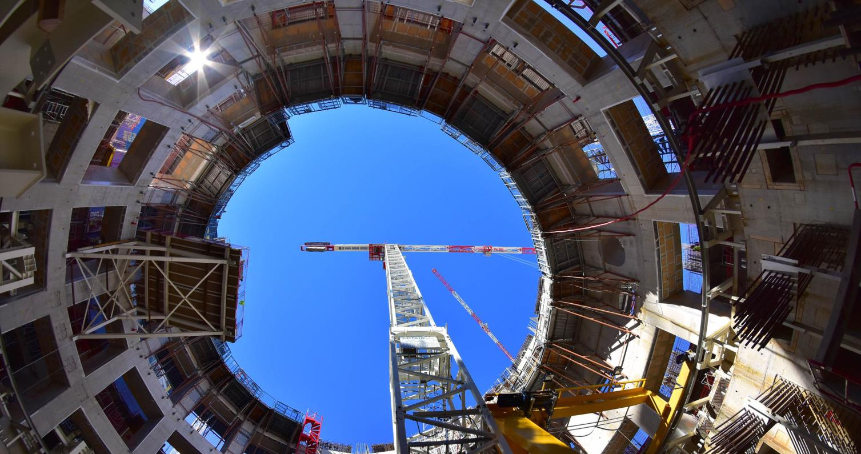
One of the biggest challenges
for our civilization

Slide 4
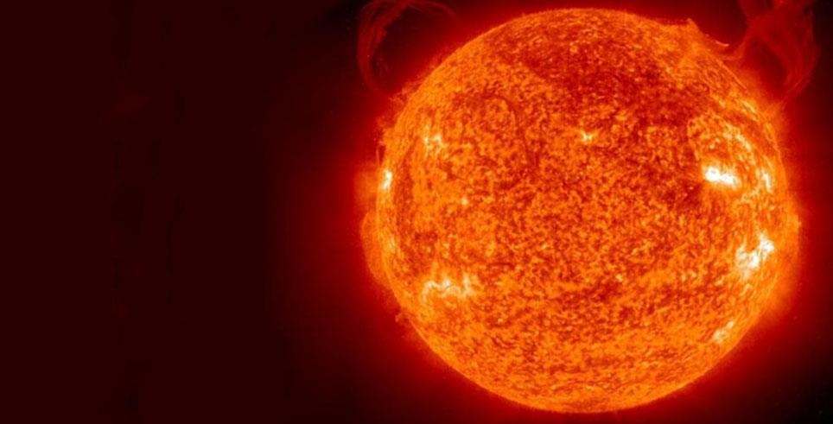
Fusion in the Universe
Fusion powers the Sun and stars.
In a fusion reaction, two light atomic nuclei combine, form a heavier nucleus and release energy.
The Big Challenge: to reproduce in a fusion machine (Tokamak*) a similar reaction on Earth.
ΔE=Δmc²
A tiny loss of mass
A huge liberation of energy
* Tokamak: a Russian acronym for « Toroidal
Chamber, Magnetic Coils ».

Slide 5
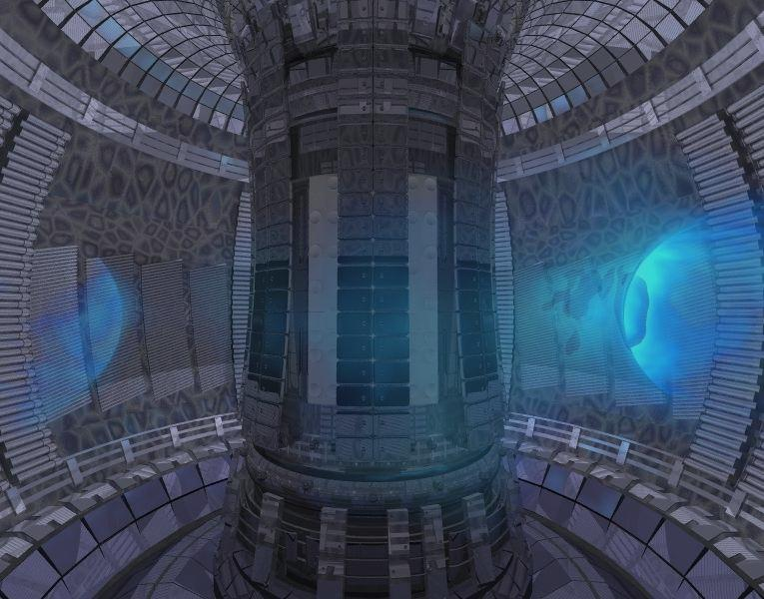
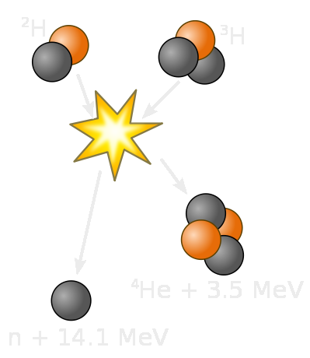
Fusion on Earth
1 gram of fusion fuels = 8 tons of oil
A plasma of Deuterium + Tritium (hydrogen isotopes) is heated to more than 150 million °C.
The hot plasma is shaped and confined by strong magnetic fields.
Helium nuclei sustain burning plasma.
Neutrons transfer their energy to the Blanket.
In a fusion power plant, conventional steam generator, turbine and alternator will transform the heat into electricity.
0.7 MeV
Notes:
Keep hot plasma KD: “will” transform
Hot to High energy,
alpha particles

Slide 6
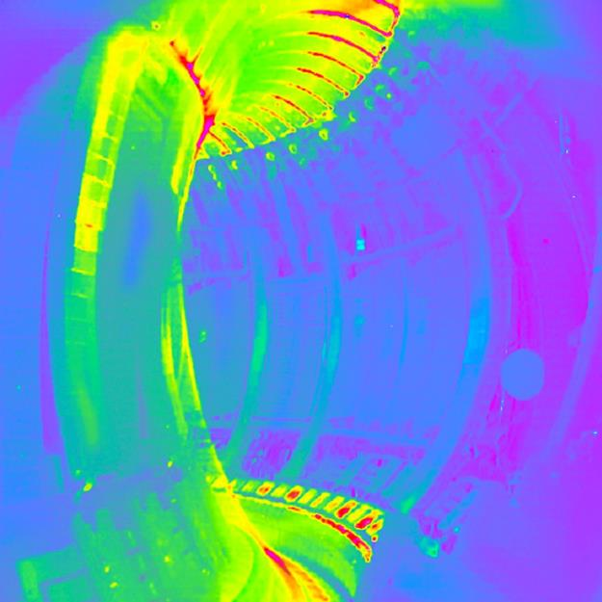
Fusion’s advantages
Massive, continuous baseload energy
Safe, environmentally responsible
No CO² or other greenhouse gases emission
No production of long-lasting high-activity radioactive waste
Almost limitless supply of fuel for millions of years, widely distributed around the globe
A plasma in the European tokamak JET

Slide 7
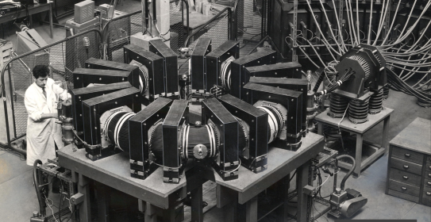
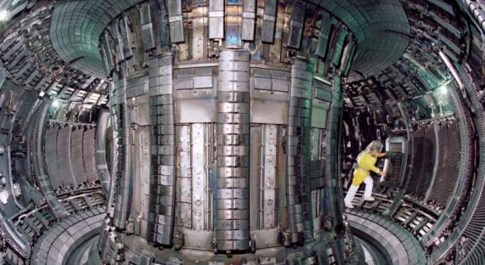
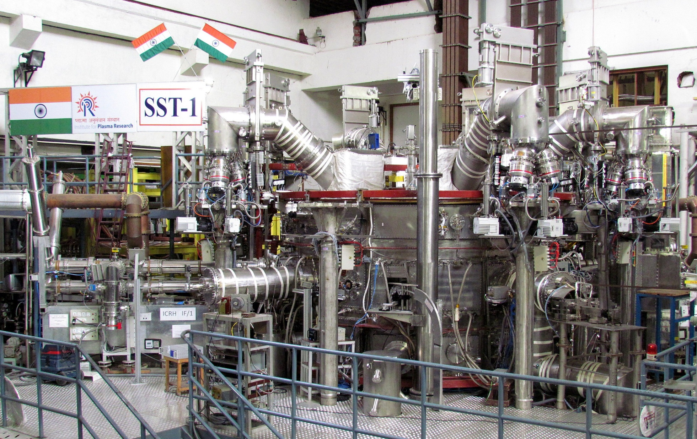
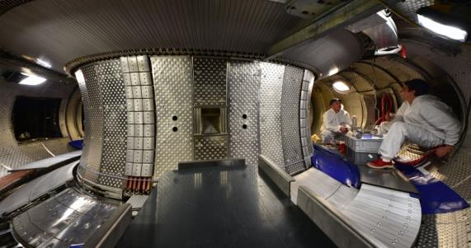
60 years of constant progress
TA-2000,
France, 1957
JET, Euratom, 1992
SST-1-India, 2005, in reboot phase
WEST, CEA-Euratom, 1988, now testbed for ITER

Slide 8
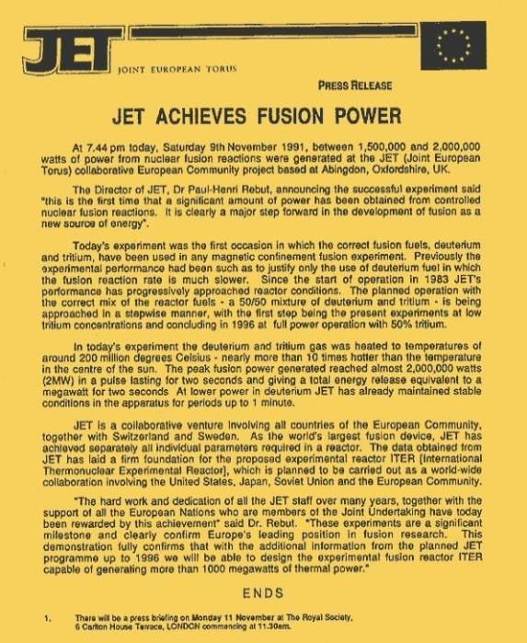
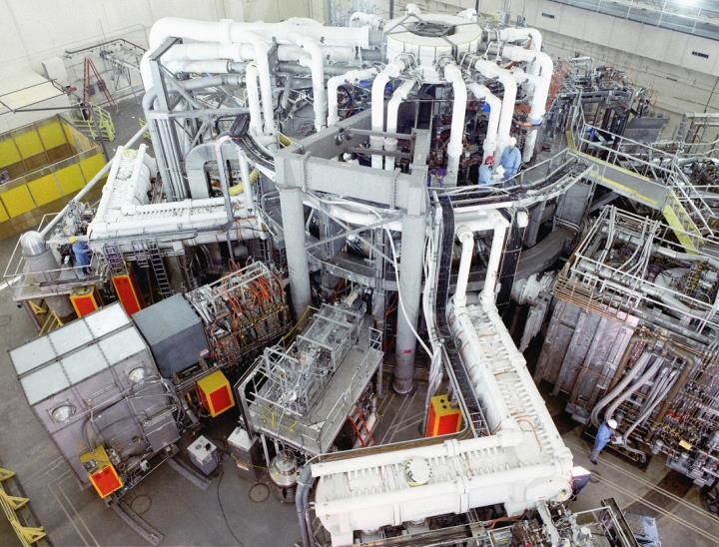
DT Fusion demonstrated!
Among the large tokamaks that went into operation in early 1980s, two were designed to perform Deuterium-Tritium operations: the European JET and the American TFTR. Both achieved DT fusion : JET in 1991 (2 MW of fusion power) and 1997 (16 MW); TFTR in 1993 (6.2 MW) and 1994 (10 MW). However, both machines had required more energy to « light the fire » than the fire had given in return (ratio of Q ~ .65). ITER aims for a ratio of Q > 10.

Slide 9
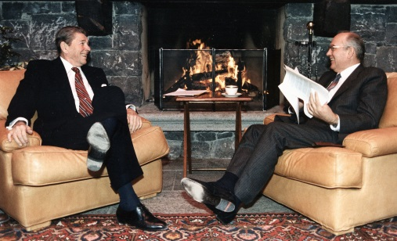
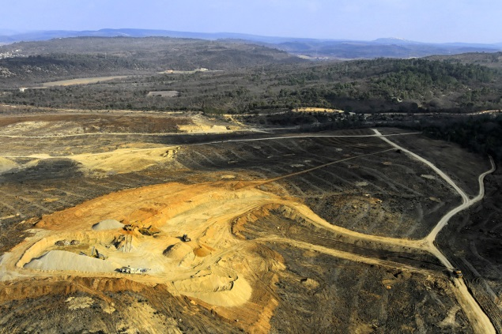
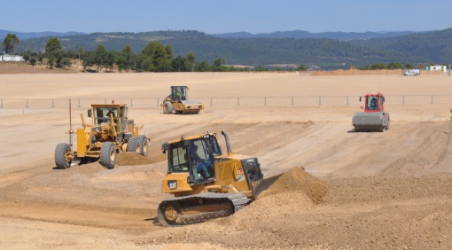
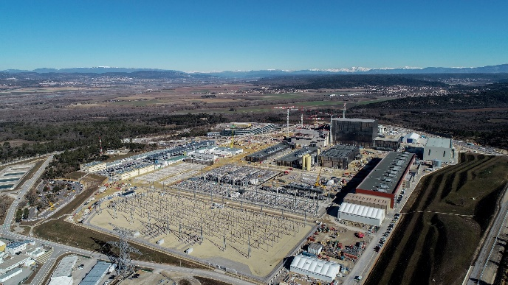
ITER: from paper project
to steel-and-concrete reality
November 1985
At the Geneva Summit President Reagan and General Secretary Gorbachev give a decisive political push to an international collaboration on fusion “for the benefit of all mankind”…
January 2007
Preparation works by France (clearing, levelling, etc.) begins on the 42-hectare ITER Platform.
Today
Construction on the ITER site and components manufacturing by the ITER Members are progressing in accordance with the 2016 baseline.
August 2010
Construction works begin in earnest.

Slide 10
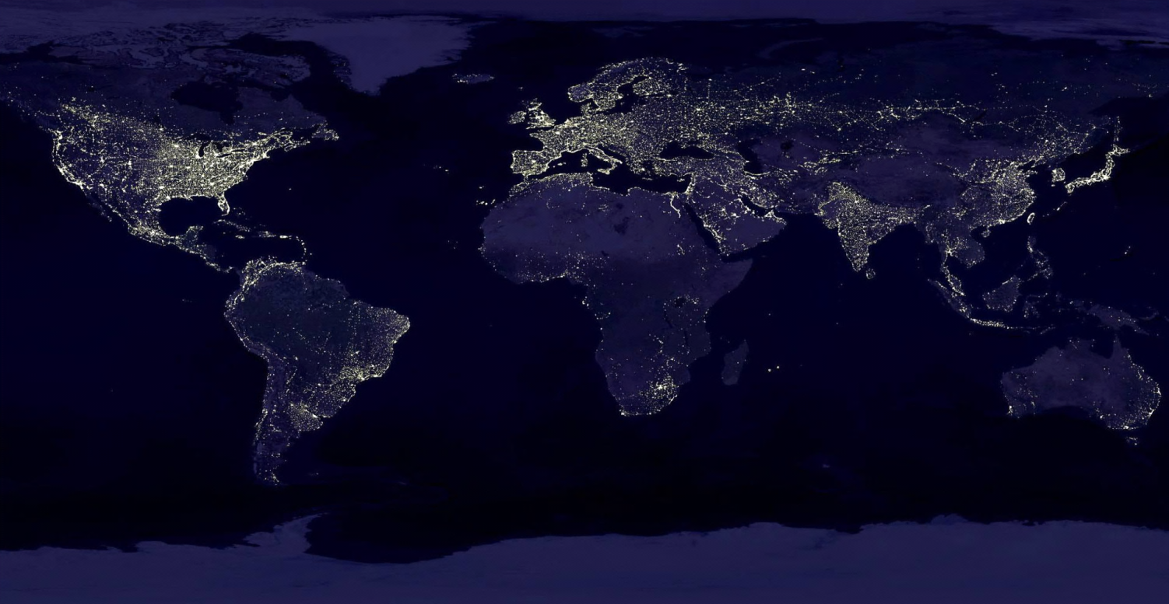
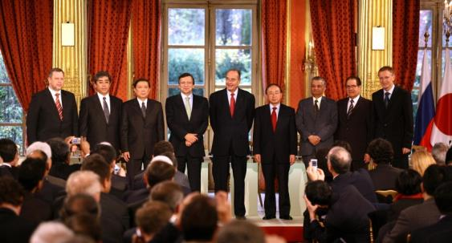
Global challenge,
global response
28 June 2005: The ITER Members unanimously agreed to build ITER on the site proposed by Europe
21 November 2006: The ITER Agreement was signed at the Élysée Palace, in Paris.
The seven ITER Members represent more than 50% of the world’s population and about 85% of the global GDP
China EU India Japan Korea Russia USA
Notes:
KD: “represent” KD: Remove “on” from dates

Slide 11
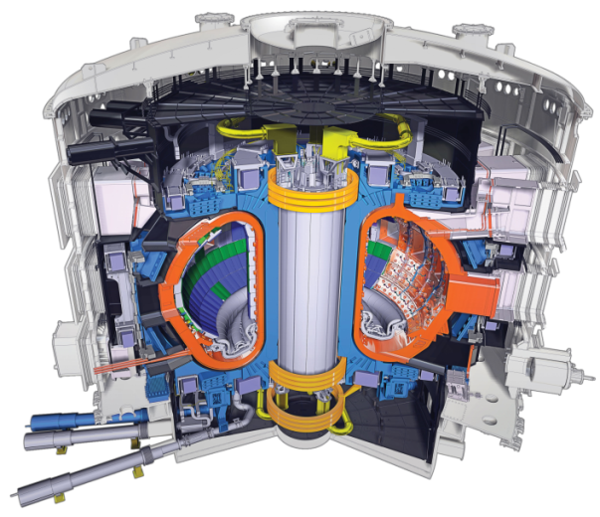
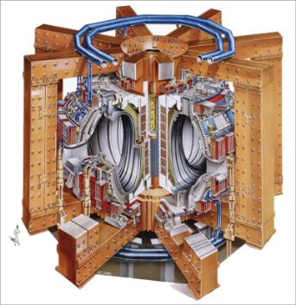
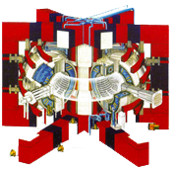
Size matters
Tore Supra-WEST (France-CEA)
V_{plasma} 25 m³
P_{fusion} ~0
P_{chauffage} ~15 MW
T_{plasma} ~400 s
I_{plasma} ~ 1.7 MA
JET (Europe)
V_{plasma} 80 m³
P_{fusion} ~16 MW
P_{chauffage}~23 MW
T_{plasma} ~30 s
I_{plasma} ~ 5-7 MA
ITER (35 countries)
V_{plasma} 830 m³
P_{fusion} ~500 MW
P_{chauffage} ~ 50 MW
T_{plasma} > 400 s

Slide 12
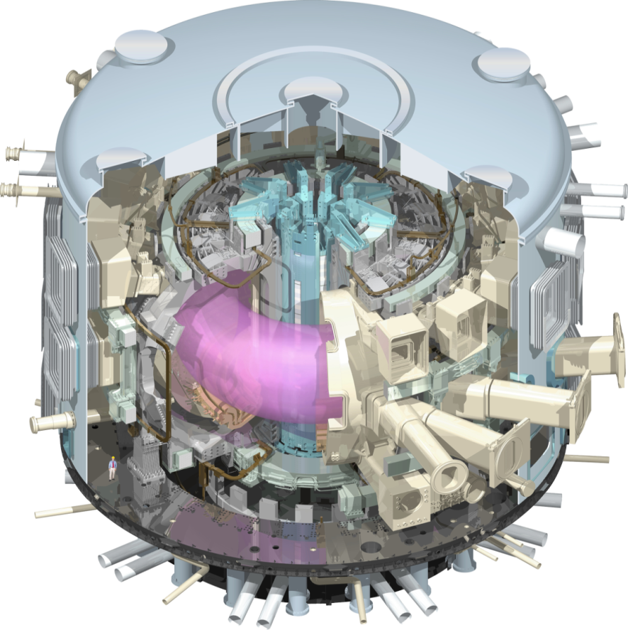
ITER mission
To demonstrate the scientific and technological feasibility of fusion power for peaceful purposes
To produce a burning plasma.
Q>10
Output (fusion power): 500 MW
Input (heating power): 50 MW

Slide 13
How does it work?
Run a strong electrical current in the DT gas. You have created a plasma.
Continue heating by way of electromagnetic waves.
Inject high-energy neutral particles.
By combining these different heating techniques, you reach the requested temperature for fusion reactions to occur.
But what can contain something that is 10 times hotter
than the core of the Sun?

Slide 14
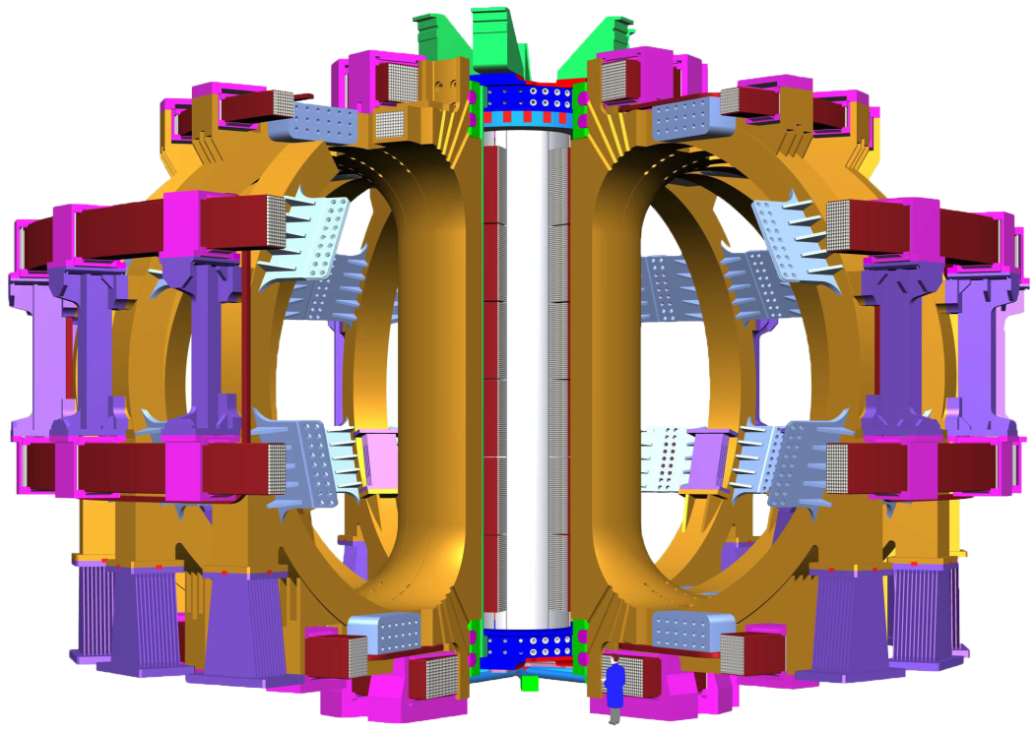
A large magnetic cage
An intense magnetic field, generated by powerful superconducting magnets shape and confine the hot plasma, and keep it away from the vacuum vessel wall.
1 central solenoid, 13 m high, 1,000 tons, powerful enough to lift an aircraft-carrier out of the water
18 Toroidal Field Coils, 17-metre high, 360 tons each.
6 Poloidal Field Coils, 8 to 24 m. in diametre, 200 to 400 tons.

Slide 15
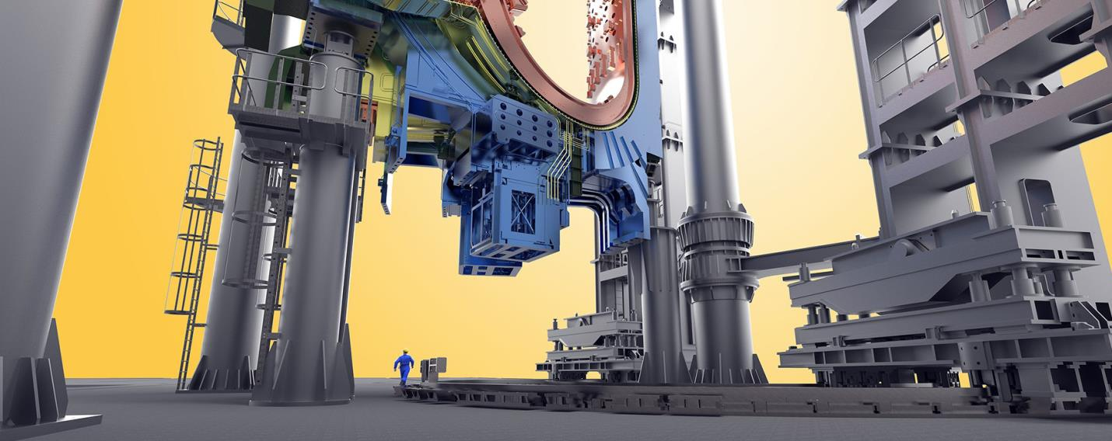
Naval construction-size components…
Inside the Assembly Hall, giant tools (procured by Korea) will handle loads up to 1,500 tons

Slide 16
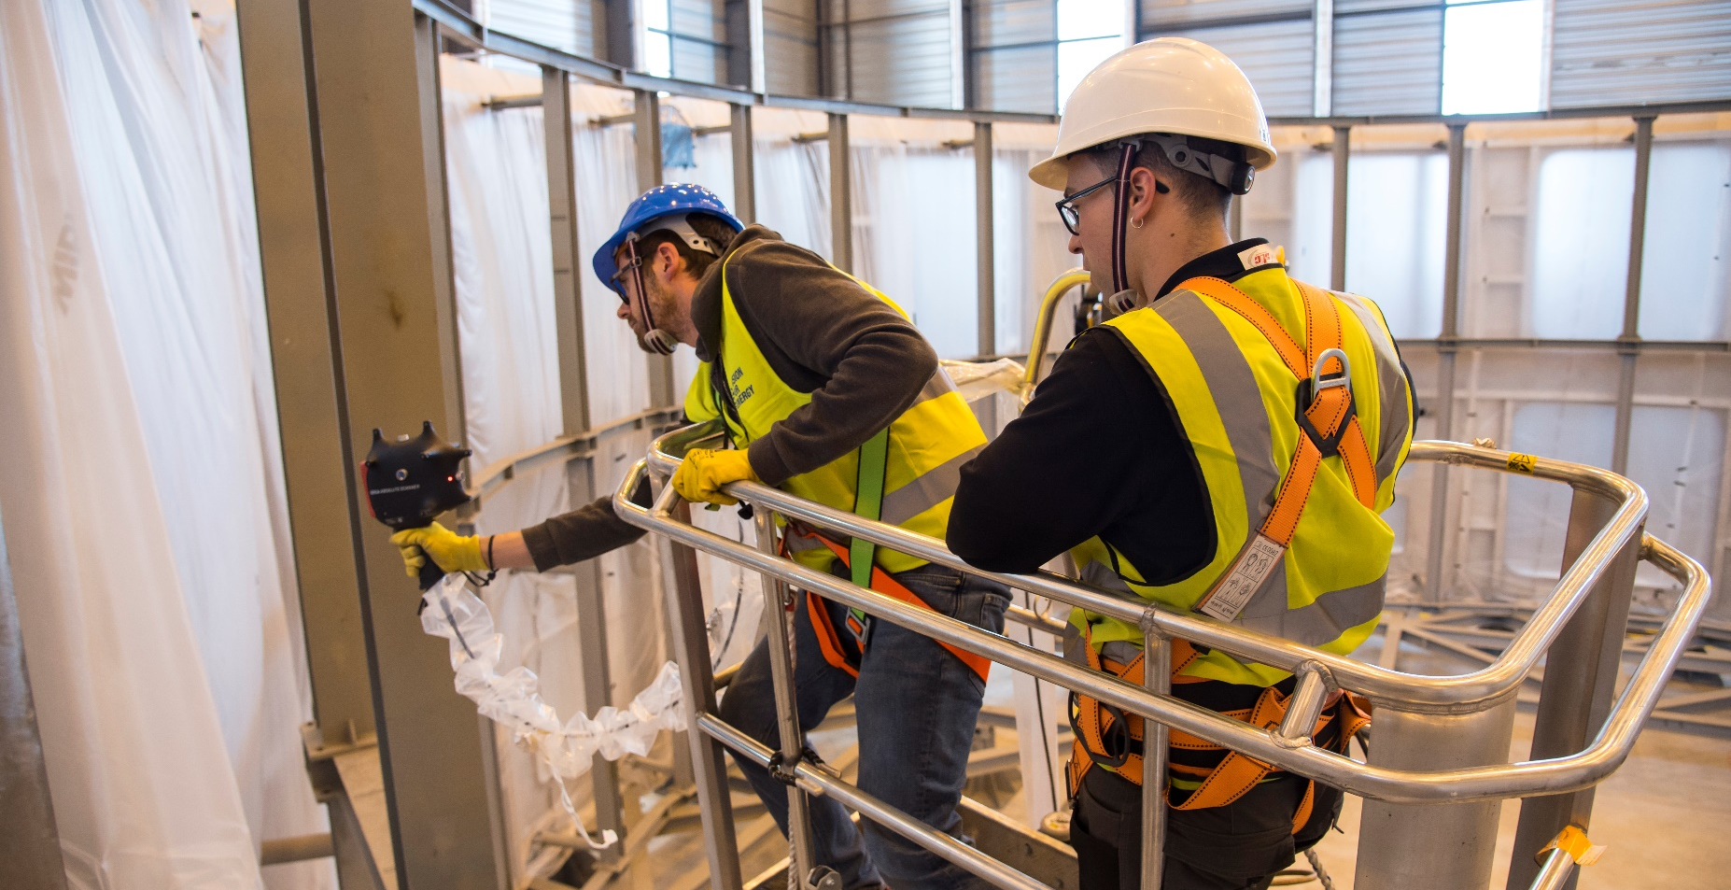
…watch-like precision
Using 3D laser-scanning techniques, metrology specialists create an ultra-precise topography of the Cryostat Lower Cylinder’ interfaces with other systems.

Slide 17
An integrated project:
Central Team & Seven Domestic Agencies
IO
The 7 ITER Members make cash and in-kind contributions (90%) to the ITER Project. They have established Domestic Agencies to handle the contracts to industry.
The ITER Organization Central Team manages the ITER Project in close collaboration with the 7 Domestic Agencies.
The ITER Members share all intellectual Property generated by the Project.
CN
US
ITER Project
RF
EU
KO
IN
JA

Slide 18
A unique formula
ITER is being built through the in-kind contributions
of the seven Members of the ITER Organization.
400
China, India, Japan, Korea, Russia and the United States each have responsibility for ~ 9% of procurement packages.
Europe’s share, as Host Member, is ~ 45% (construction and manufacturing).
300
200
100
Machine Core
0
Internal Auxiliary
External Auxiliary
EU
CN
Heating, Diagnostics, Control
CN
IN
IN
JA
KO
RF
Buildings
US
IO

Slide 19
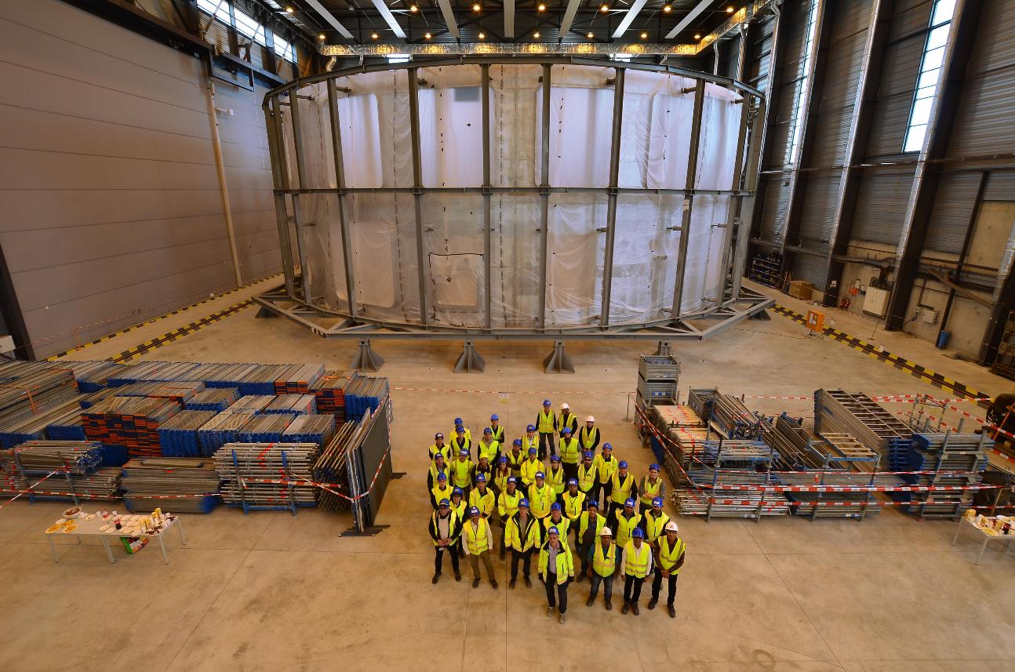
A strategic partnership
India became an ITER Member in December 2005.
Its share in the project’s value is 9.1%. Presently Indian nationals account for ~ 4% of ITER personnel (35 staff, 16 IPA, 2 interns).
India is fully responsible for the ITER cryostat, cryolines and cryodistribution, in-wall shielding, secondary cooling circuit, diagnostic neutral beam, and ion cyclotron power sources.
India is also contributing to the electron cyclotron heating system and the PRIMA neutral beam test facility.
Celebrating the completion of the Cryostat Lower Cylinder on 14 March 2019.

Slide 20
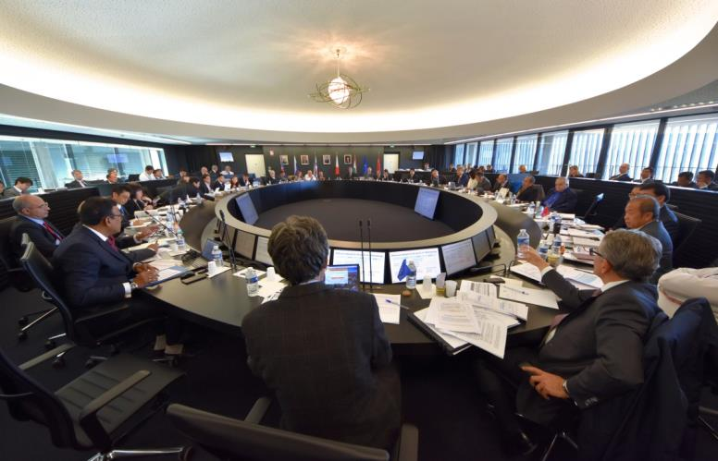
18th & 19th ITER Council endorse updated Schedule
First Plasma in December 2025; first physics experiments 2028; nuclear plasma (DT) in 2035
The updated Schedule is challenging but technically achievable.
It represents the best technically achievable path forward to First Plasma.
Members now have all the elements needed to go through their domestic processes of obtaining approval for the Resource-Loaded Integrated Schedule
ITER Council convenes in June and November each year at ITER HQ

Slide 21
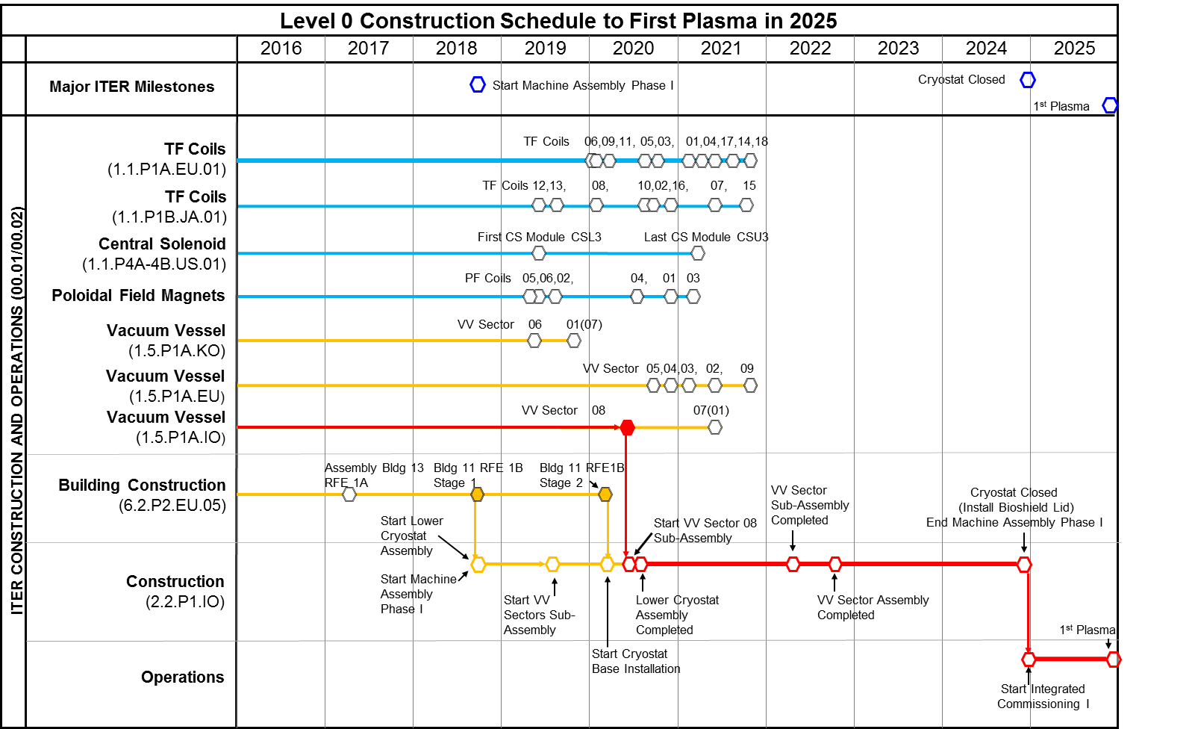
Major assembly milestones

Slide 22
A staged approach to DT plasma
Extensive interactions among IO and DAs to finalize revised baseline schedule proposal
Schedule and resource estimates through First Plasma (2025) consistent with Members’ budget constraints
Proposed use of 4-stage approach through Deuterium-Tritium (2035) consistent with Members’ financial and technical constraints

Slide 23
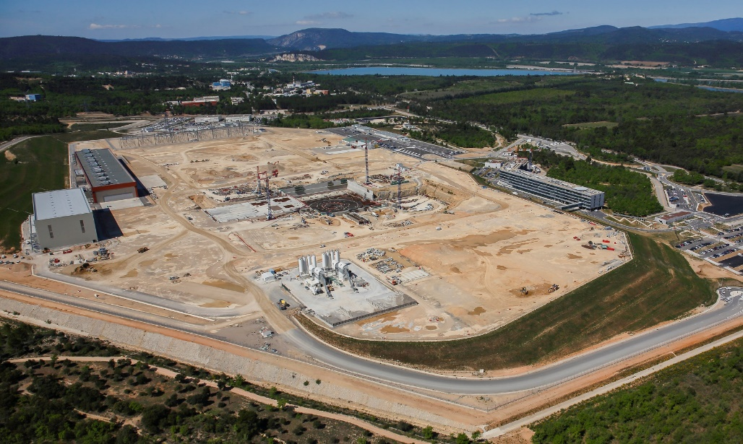
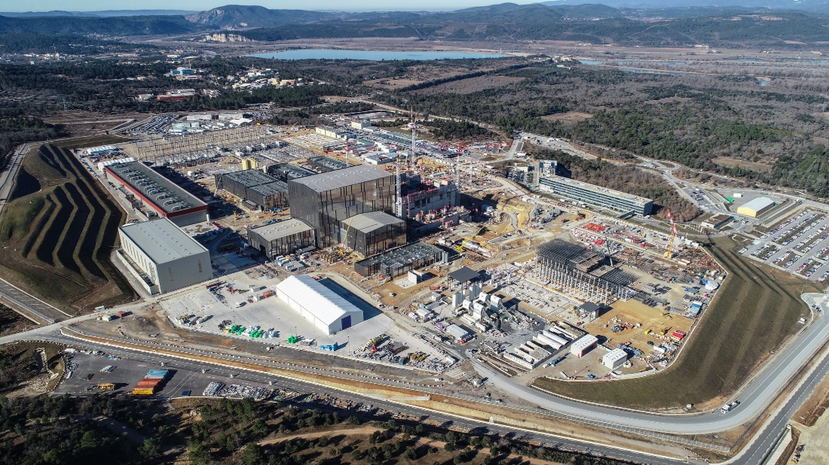
Five-year progress
Apr. 2014 – Feb. 2019
More than 72 % of the installation’s civil works are completed

Slide 24
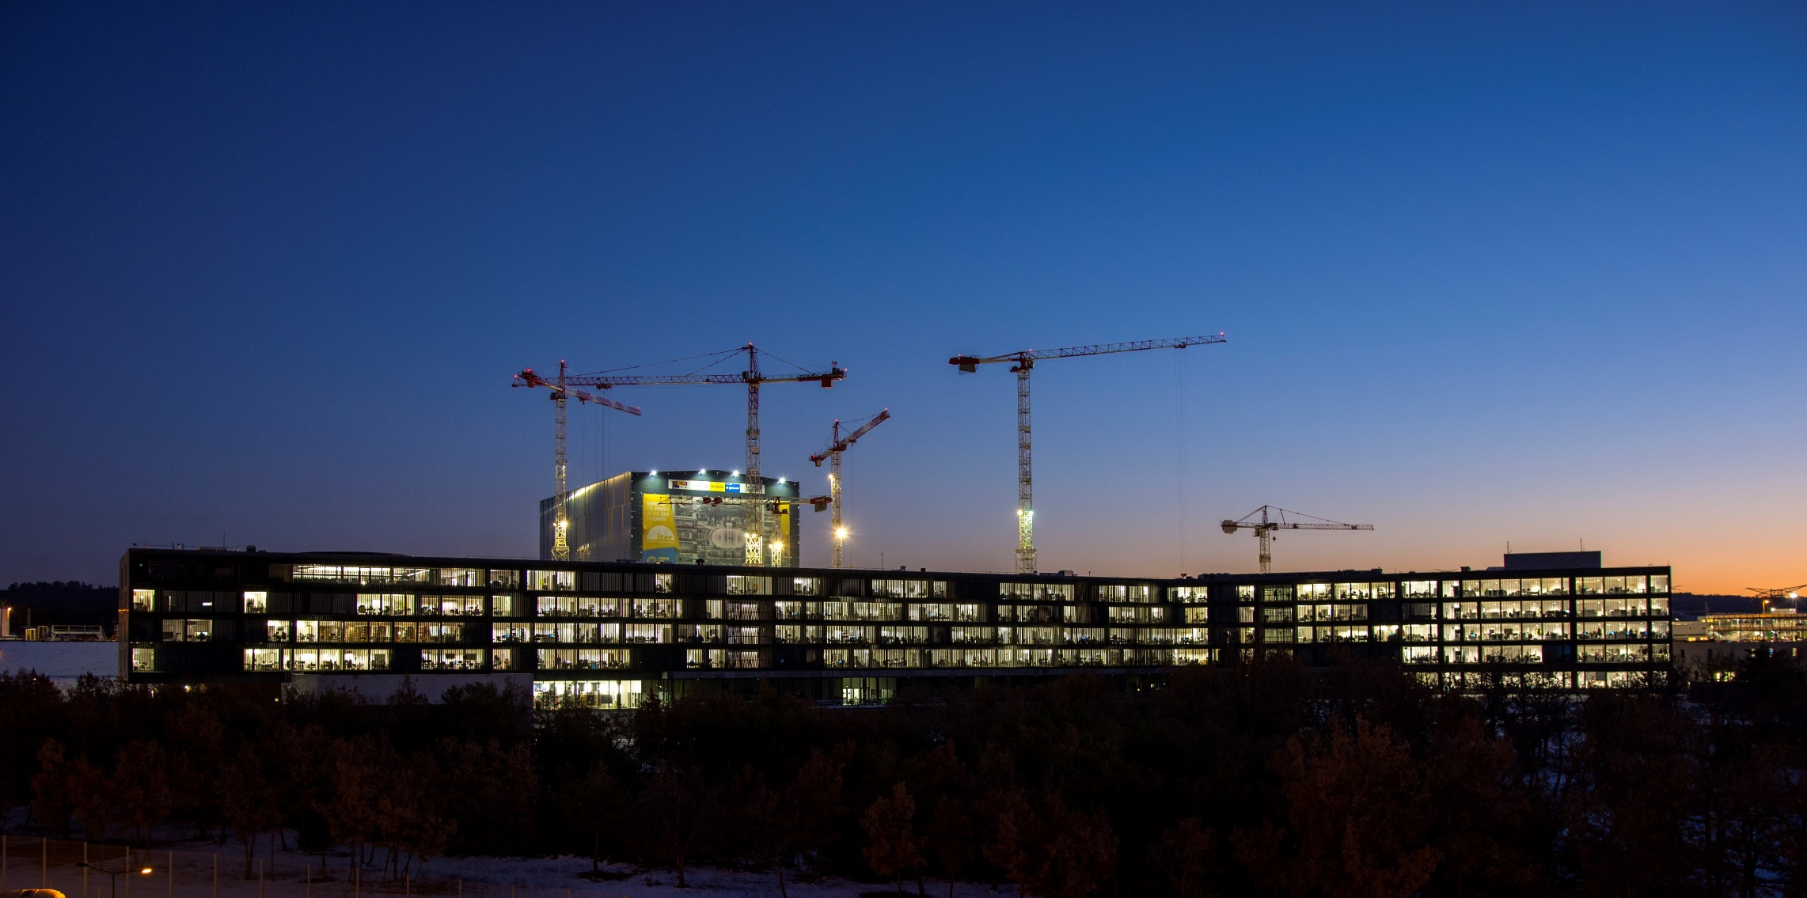
More than halfway to First Plasma
According to the stringent metrics that measure project performance, over 62 percent of the "total construction work scope through First Plasma" is now complete.
The current progression rate is in the order of 0.7 % per month.
Etc.

Slide 25
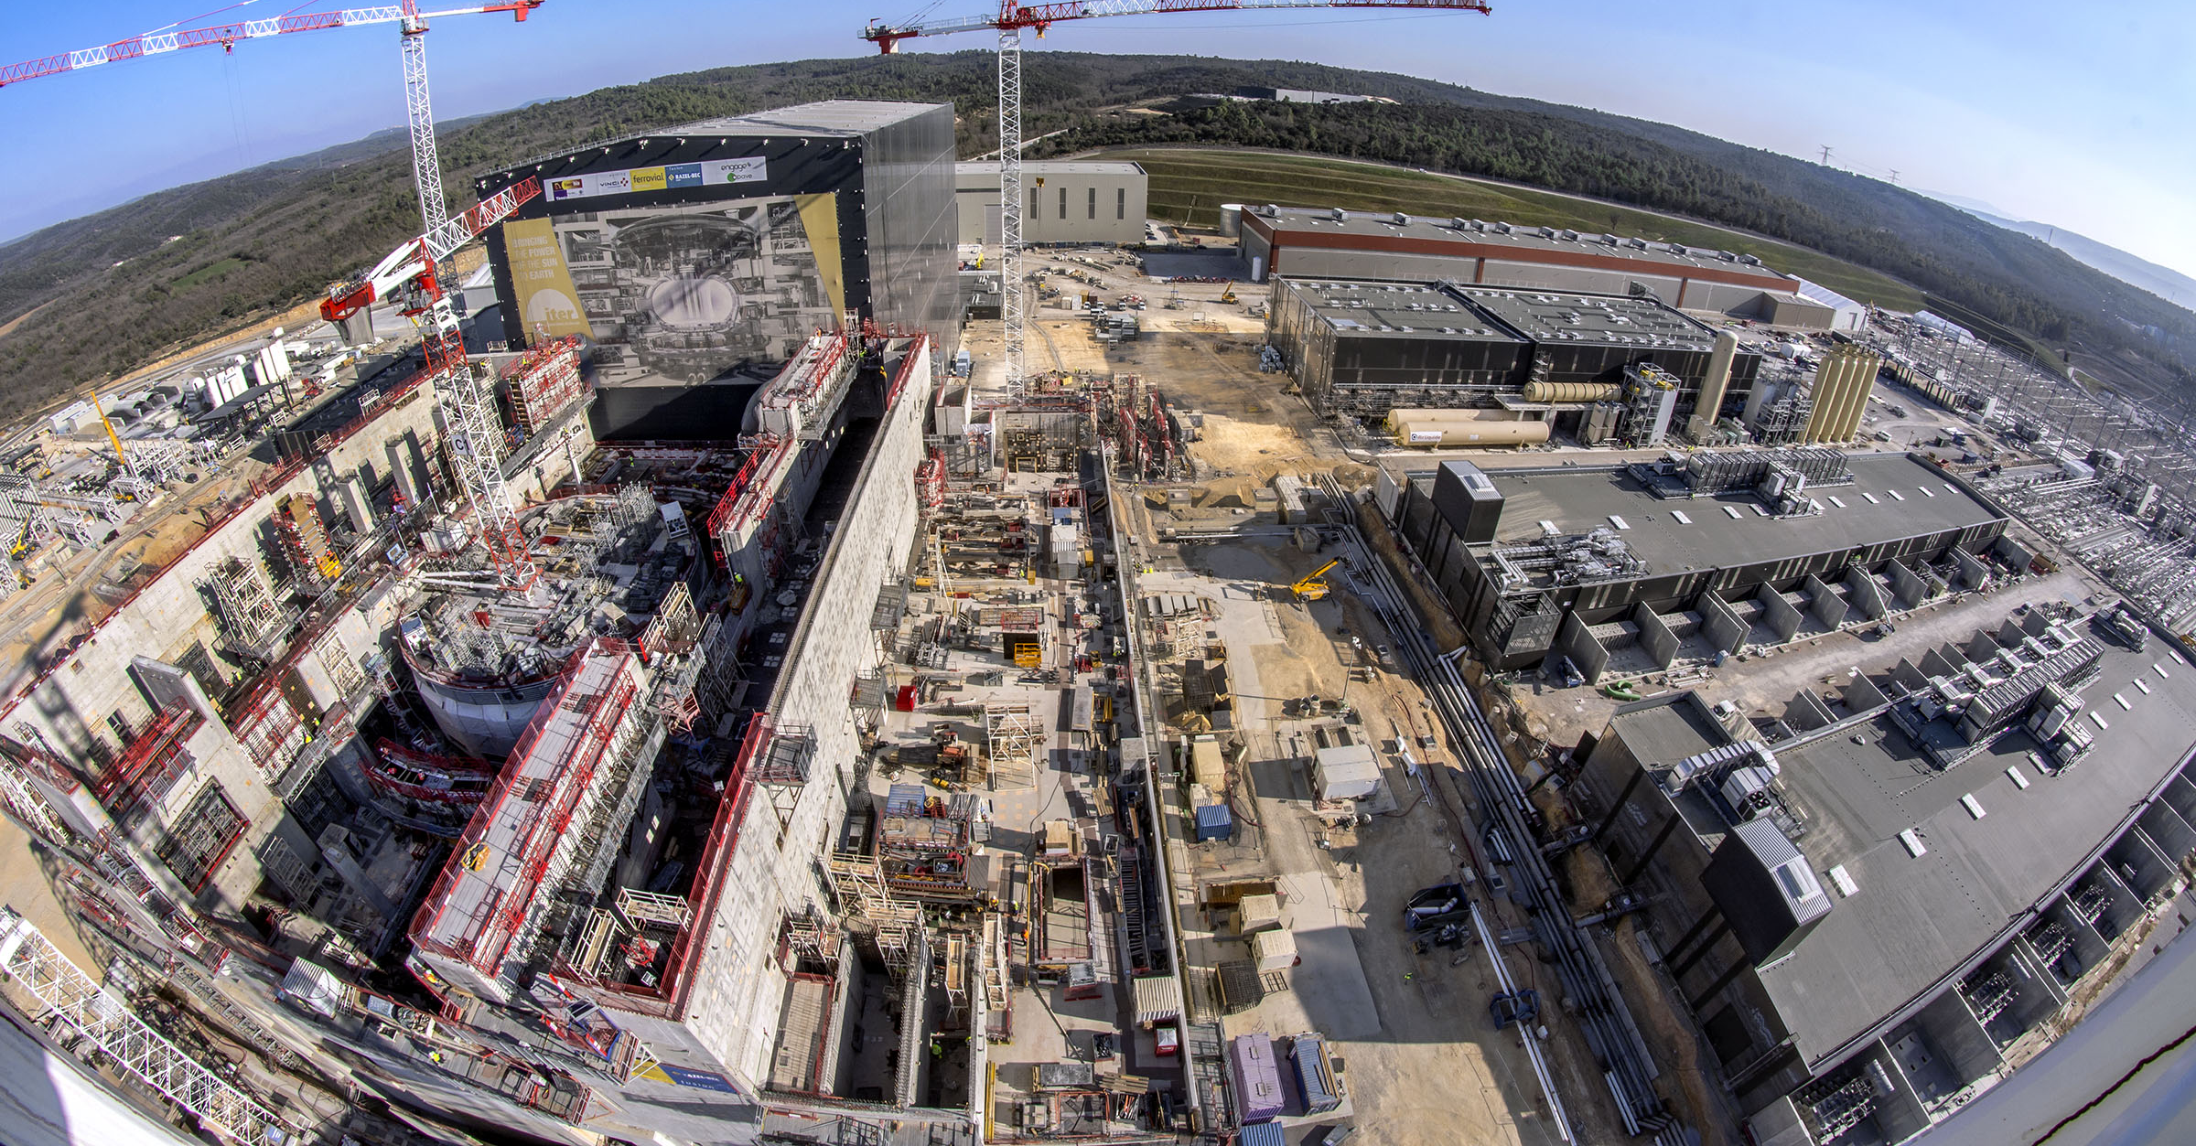
Worksite progress
Assembly Hall
Cryostat Workshop
PF Coil Winding Facility
Radiofrequency Heating
Cryoplant
Cooling System
~ Machine axis
400 kV Switchyard
Tritium Bdg.
Preparation for Crane Hall
Bioshield
Tokamak Bdg.
Diagnostics Bdg.
Magnet Power Conversions Bdgs.
25 March 2019

Slide 26
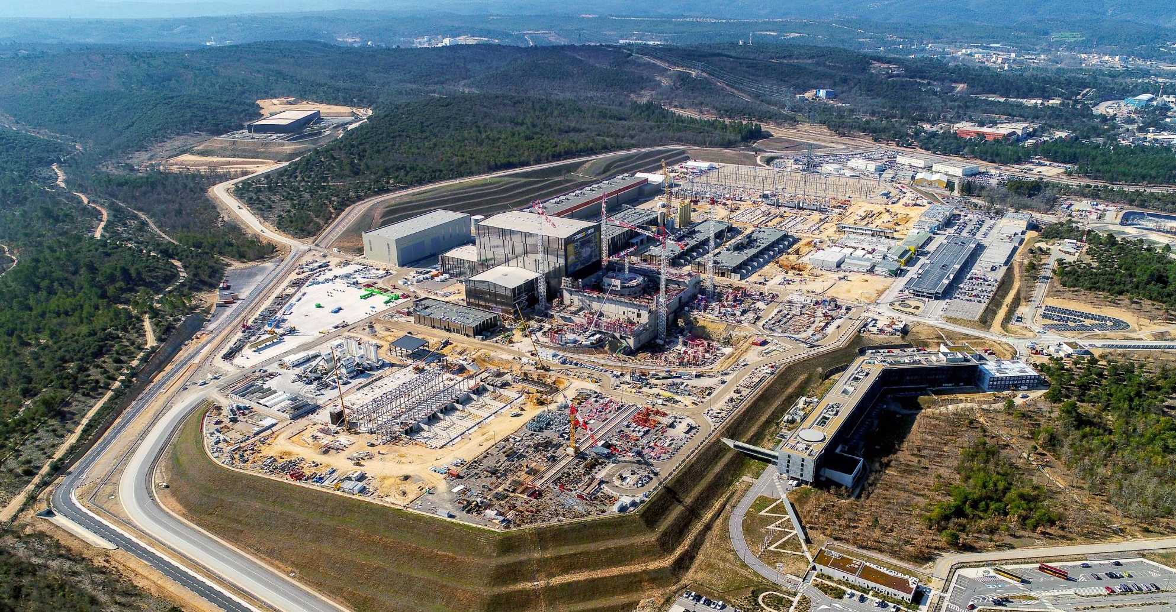
India’s activity on site
Cryogenic lines
Cryostat Workshop
Electrical components installation
Diagnostic Neutral Beam
Heating and Current Drive
In-Wall Shielding
Heat Rejection system

Slide 27
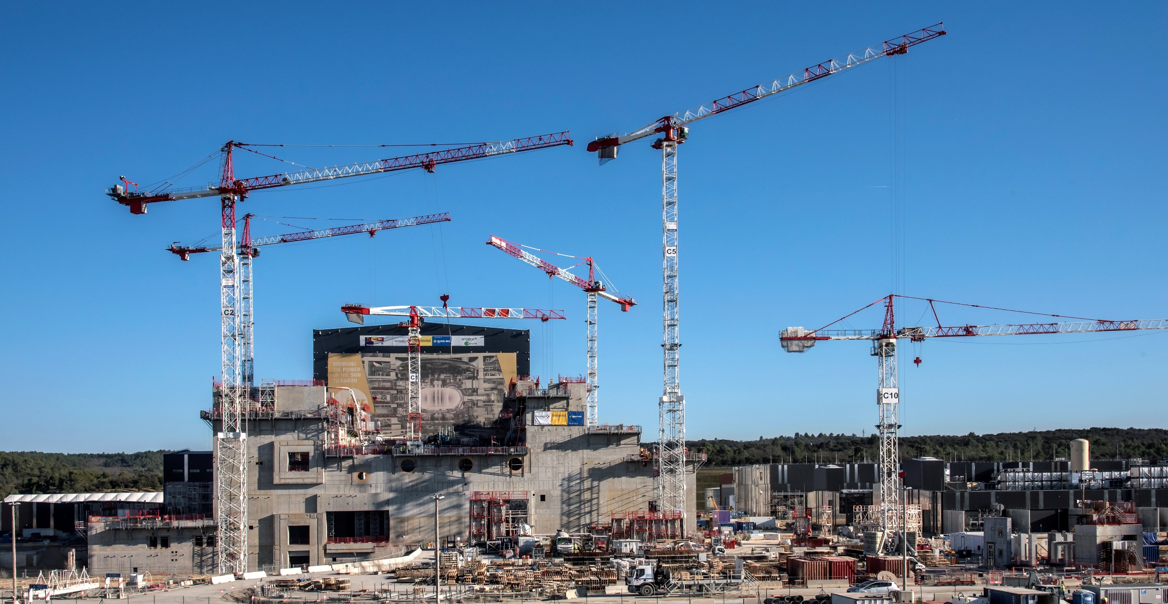
Tokamak Complex
Tokamak Building
Tritium Building
Diagnostics Building

Slide 28
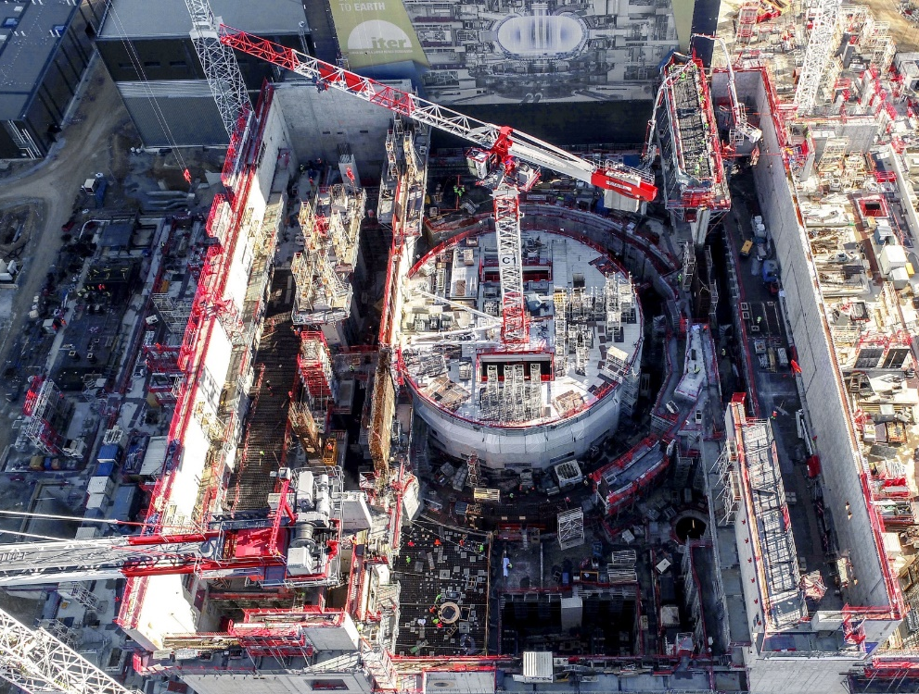
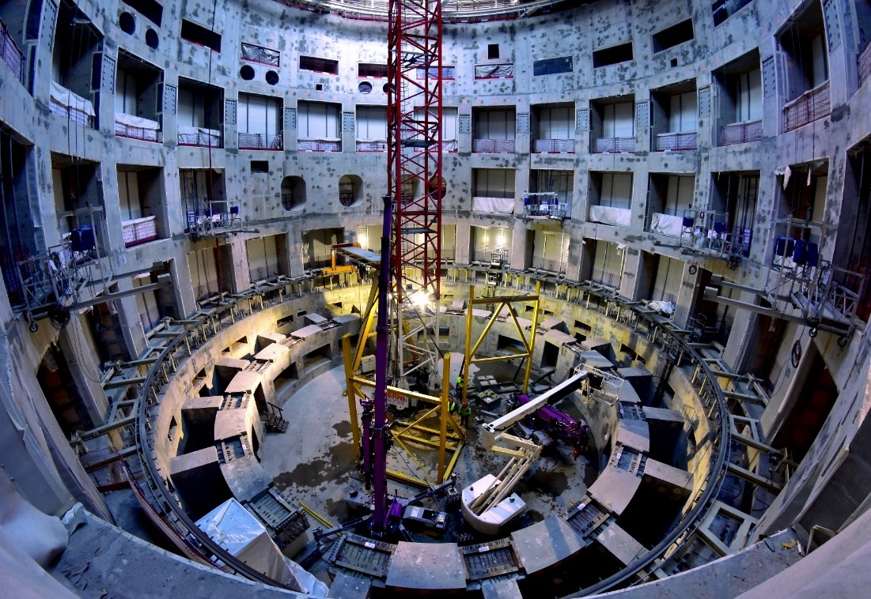
Tokamak Building
The bioshield is now finalized. Openings in the wall are for the cryostat bellows that will connect the machine to the port cells designed to give access to systems such as remote handling, heating and diagnostics. The crown (right) that will support the machine (23,000 tonnes) was finalized in August 2018. The inside of the pit is being prepared for painting.

Slide 29
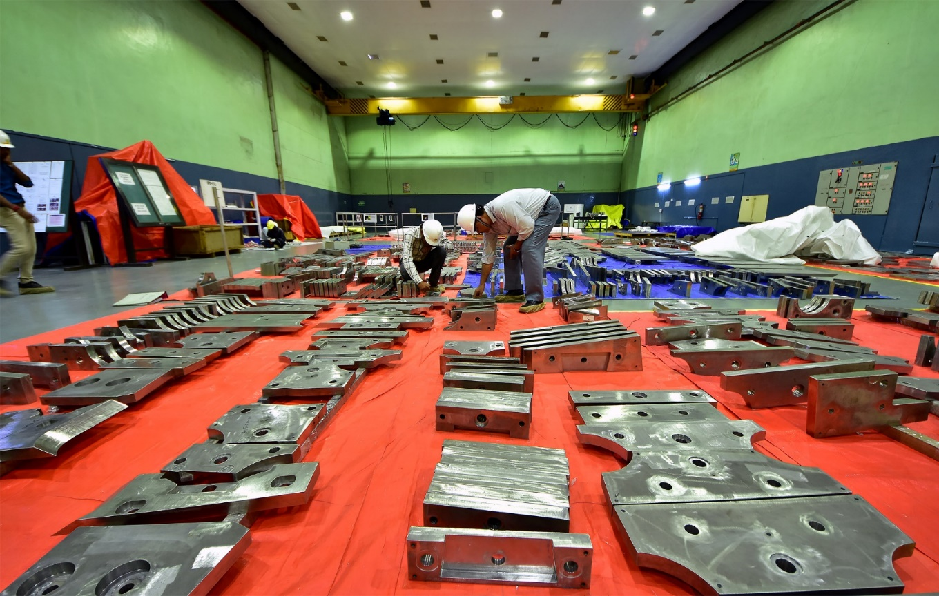
In-wall shielding blocks
India is responsible for the procurement of 100% of the stainless steel blocks that will be inserted between the double walls of the vacuum vessel for neutron shielding (some 9,000 blocks in all made of more than 50,000 plates).
Manufactured by Avasarala Technologies Limited (ATL) and Larsen & Toubro Ltd, the plates are assembled into blocks before being shipped to Korea and Europe to be inserted into the vacuum vessel sectors being manufactured there.

Slide 30
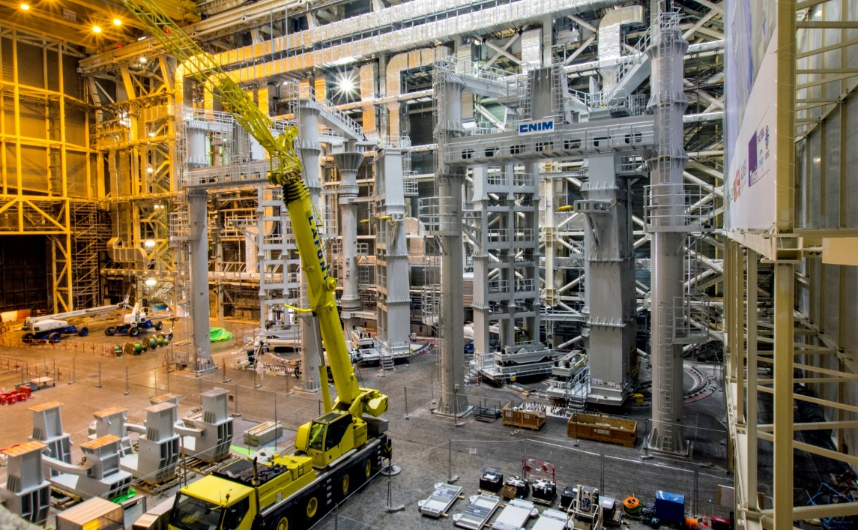
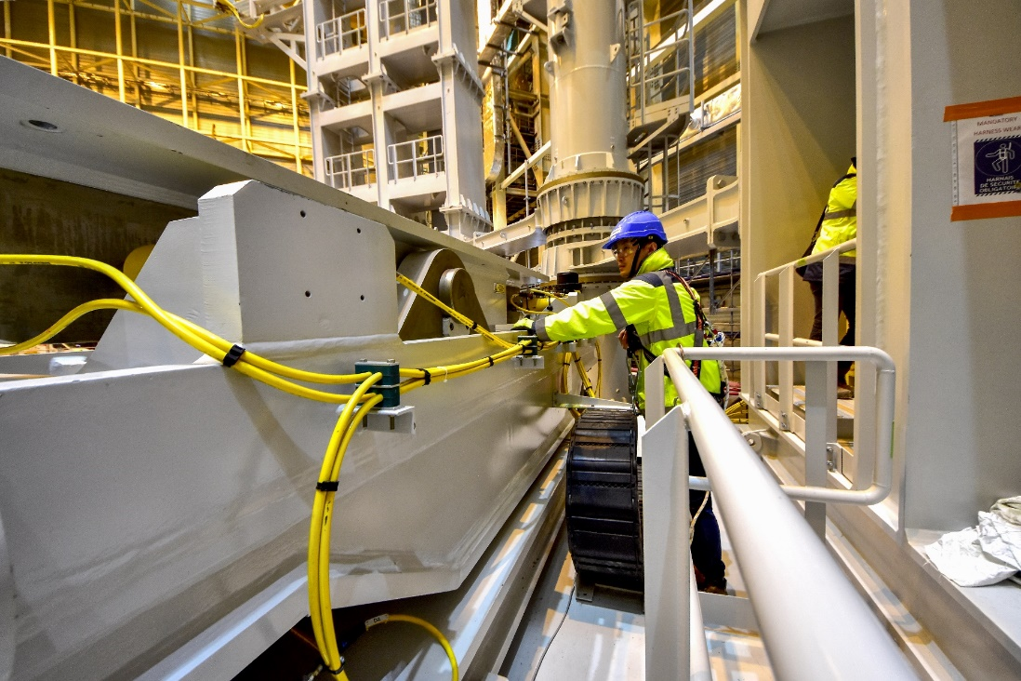
Assembly Hall
SSAT-1
SSAT-2
Before being integrated in the machine, the components will be prepared and pre-assembled in this 6,000 m2, 60-metre high building. The Assembly Hall is equipped with a double overhead travelling crane with a total lifting capacity of 1,500 tons.
Mechanical tests are ongoing on sub-assembly tool # 1 (SSAT-1) and assembly work is being finalized on SSAT-2.

Slide 31
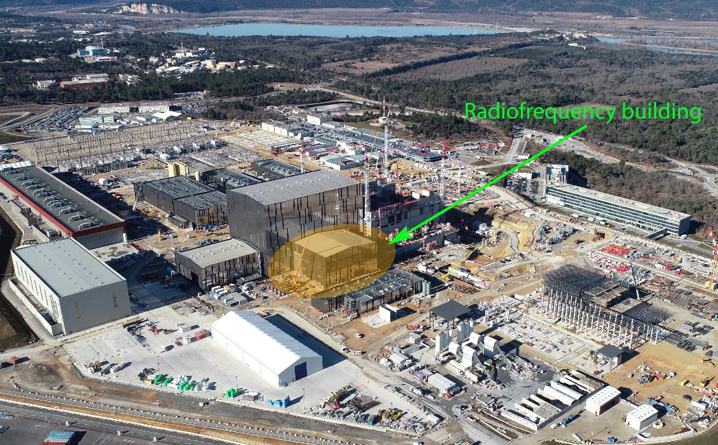
Heating and current drive
Ion cyclotron radio frequency power sources ( 2.5 MW, 35-65 MHz ): 100%
Ion cyclotron radio frequency power supply: 44%
Electron cyclotron high voltage power supply: 30%
Electron cyclotron radio frequency gyrotron (1 MW/127 GHz): 8% - 2 gyrotrons)
Plus: the diagnostic neutral beam (100 keV (H) /70A ) and contributions to the ITER neutral beam test facility

Slide 32
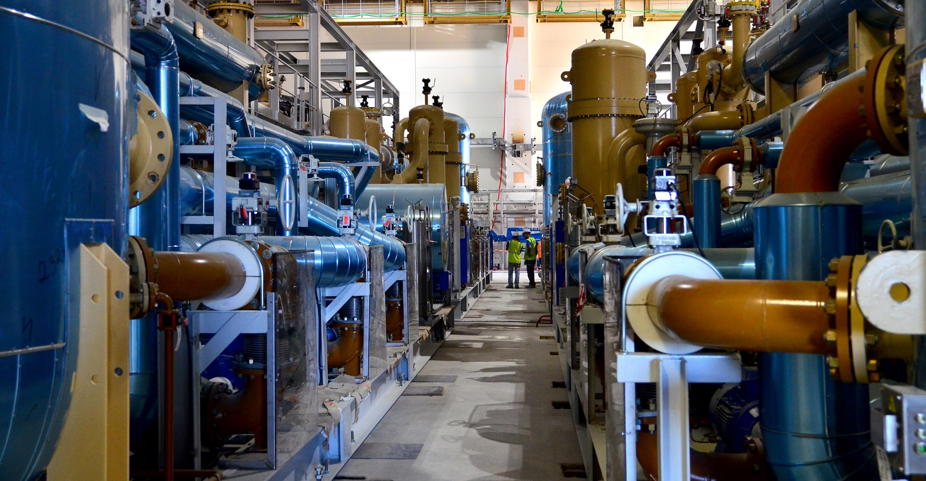
Cryoplant
4,500 tonnes of equipement (out of a total 4,800) are now installed in what will be the largest cryogenic unit in the world.

Slide 33
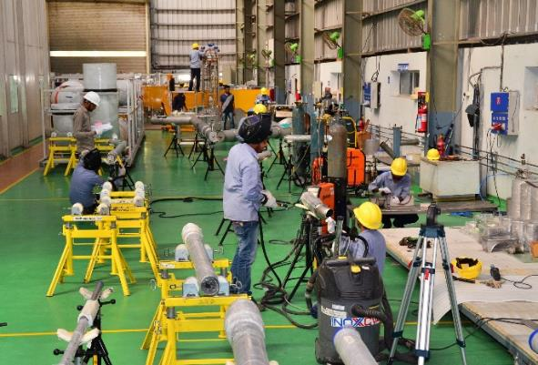
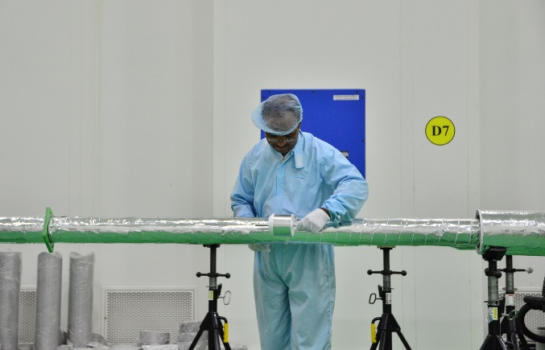
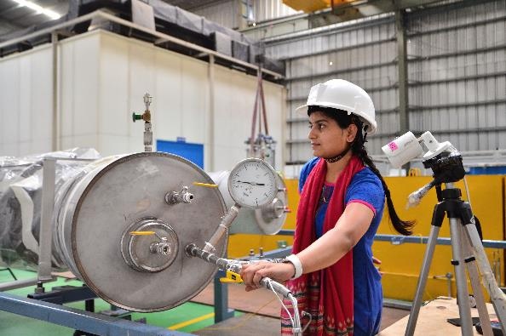
Cryolines & cryodistribution
Nearly 25 tonnes of supercritical helium—at 4 K (minus 269 °C)—will circulate through a five-kilometre network of pipes, pumps and valves, partly procured by India, in order to cool the superconducting magnets, the thermal shield, vacuum cryopumps, and certain diagnostics.
At the INOXCVA facility in Vadodara, Gujarat

Slide 34
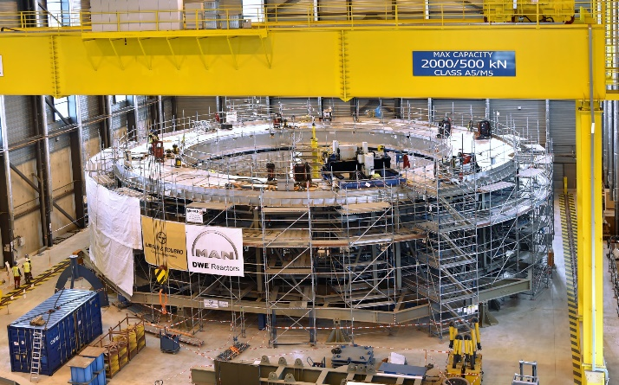
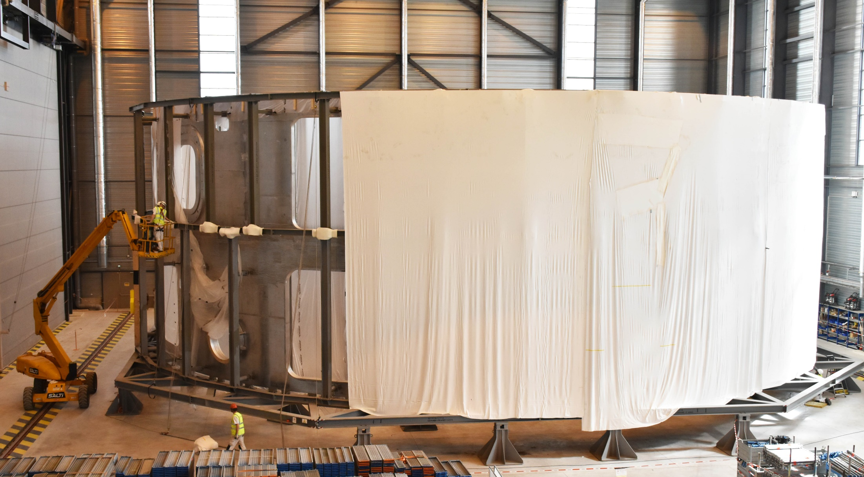
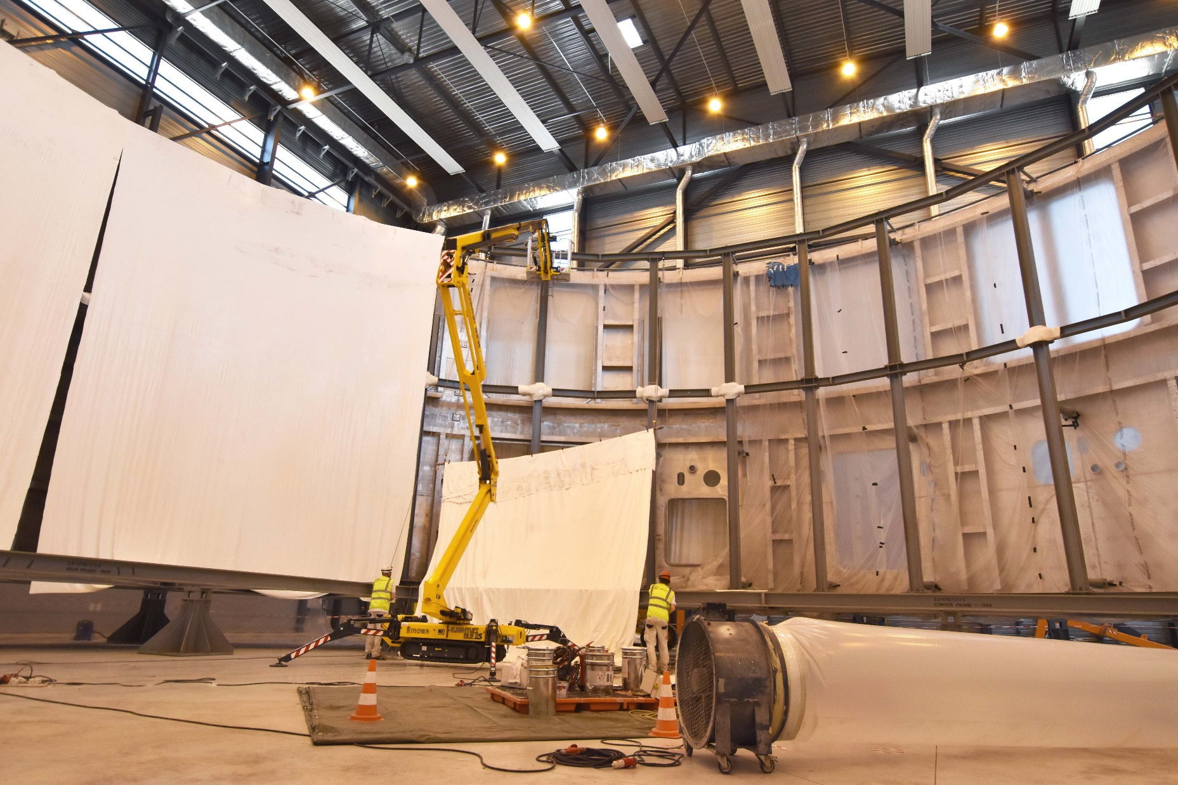
Cryostat workshop
Following the completion of the Cryostat Lower Cylinder in March, « cocooning » operations are now ongoing in the Cryostat Workshop. The massive component is being wrapped into protective insulation material that creates an air-tight, controlled environment that insulates the machine during the storage phase.
Lower cylinder finalized
Base section to be finalized in July
Ongoing « cocooning » operations
Ongoing « cocooning » operations

Slide 35
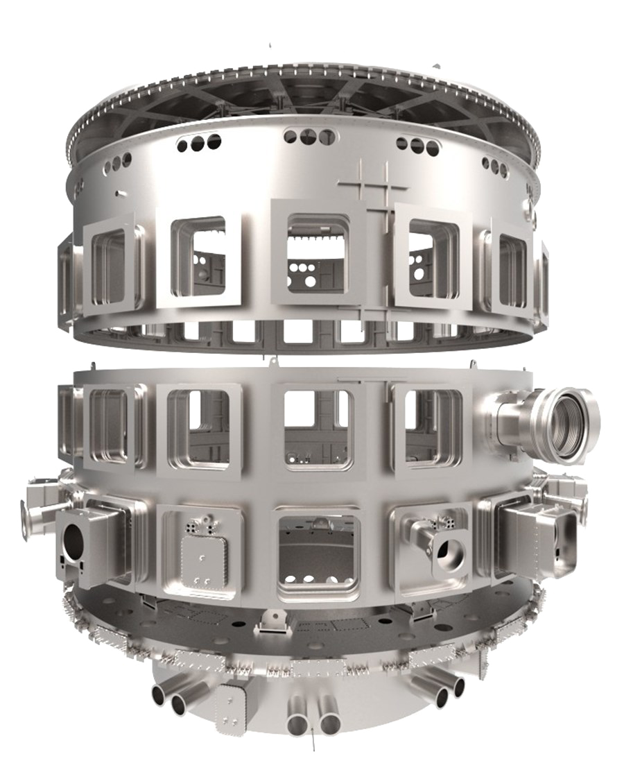
The ITER cryostat
India is responsible for the procurement of the massive 3,850 tons “thermos” (30 metres high, 30 metres in diameter, 280 penetrations) that will completely enclose the ITER Tokamak.
Top lid
Procurement Arrangement signed In Sept. 2011
Manufacturing contract signed with Larsen & Toubro in 2012
On-site workshop completed in November 2014
First steel segments arrived at ITER in December 2015
Lower cylinder finalized in March 2019
The Base section will be finalized in July 2019
First Upper cylinder segments expected on site in May 2019
Upper cylinder
Lower cylinder
Base section

Slide 36
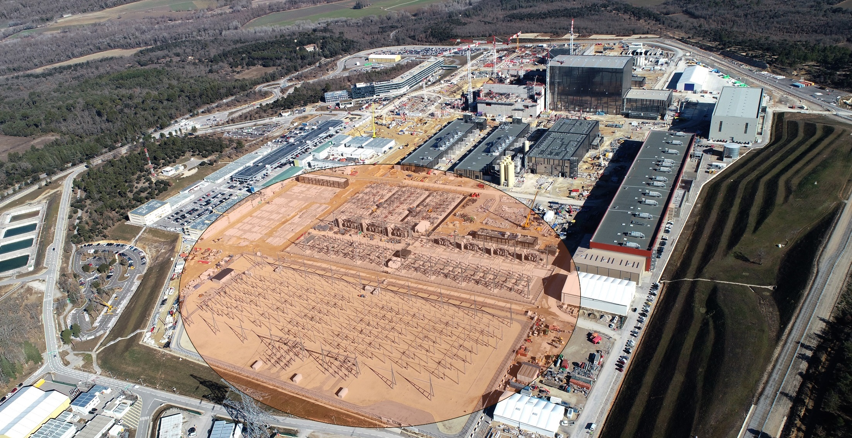
Electrical network
The connection to the French grid (400 kV network) is effective as of 26 January 2019

Slide 37
Electrical conversion
Two large Magnet Power Conversion buildings will host the transformers and converters ( AC ► DC) feeding power to the ITER magnets.
The twin buildings are now ready for equipment. Electrical components from India, China, Korea and Russia are being progressively installed inside of the building as well as in the exterior bays.

Slide 38
From fabrication…
Manufacturing of ITER components is taking place at the cutting edge of technology:
Geometrical tolerances measured in millimetres for steel pieces up to 17 m tall weighing several hundred tons
Superconducting power lines cooled to minus 270 degrees Celsius
Plasma facing components to withstand heat flux as large as 20 MW per m²
Cryoplant cooling capacity up to 110 kW at 4.5 K; maximum cumulated liquefaction rate of 12,300 l/hr
Etc.

Slide 39
…to Assembly preparation
In Spain, welding procedures and techniques are being tested on a real-size vacuum vessel mockup.
On the night of 26 November 2018, the first machine component (cryostat feedtrhrough) was lowered into the Tokamak Pit.

Slide 40
Who manufactures what? The ITER Members share all intellectual property
Cryostat
Feeders (31)
Thermal shield
Toroidal Field coils (18)
Vacuum vessel
In-wall shielding
Poloidal field coils (6)
Blanket modules
Correction coils (18)
Central solenoid (6)
Divertor

Slide 41
Manufacturing Progress
Vacuum Vessel, Magnets, Cryostat, Thermal Shields, Cryopumps, etc.

Slide 42
Manufacturing Progress
Total average component manufacturing through First Plasma is >65% complete.
Cryolines
Correction Coils
Thermal Shield
Central Solenoid
SPIDER Neutral Beam
TF Coil Winding Pack
PF Coil #1

Slide 43
Economic benefits
More than 9 billion euros in contracts for construction and fabrication
ITER

Slide 44
Who works for ITER?
Distribution by Member
4.6%
5.8%
4.1%
53 India nationals work for the ITER Organization (35 staff, 16 ITER Project Associates, 2 interns).
3.3%
4.0%
62.2%
9.2%
March 2019
The international staff of the ITER Organization (Central Team) comprises ~ 850 persons (35 countries).
Close to 500 contractors and experts are directly working for ITER in Saint-Paul-lez-Durance, France.
More than 3,000 specialists are involved in ITER throughout the world.

Slide 45
ITER is moving forward!
http://www.iter.org

Slide 46
Thank you for your attention!
http://www.iter.org

