Slide 1
Living with Arthritis: a saga of change
Pradeep Bambery
Bundaberg, Queensland,
Australia

Slide 2
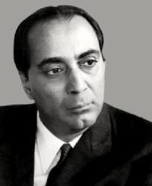
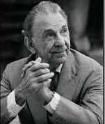
"Scientist, engineer, master-builder and administrator, steeped in humanities, in art and music, Homi was a truly complete man".
JRD Tata

Slide 3
Since, therefore,
I cannot increase the content of life by increasing its duration,
I will increase it by increasing its intensity.
Art, music, poetry and everything else that I do, have this one purpose - increasing the intensity of my consciousness and life".
Letter to Jessie Maver, December 8th, 1934

Slide 4
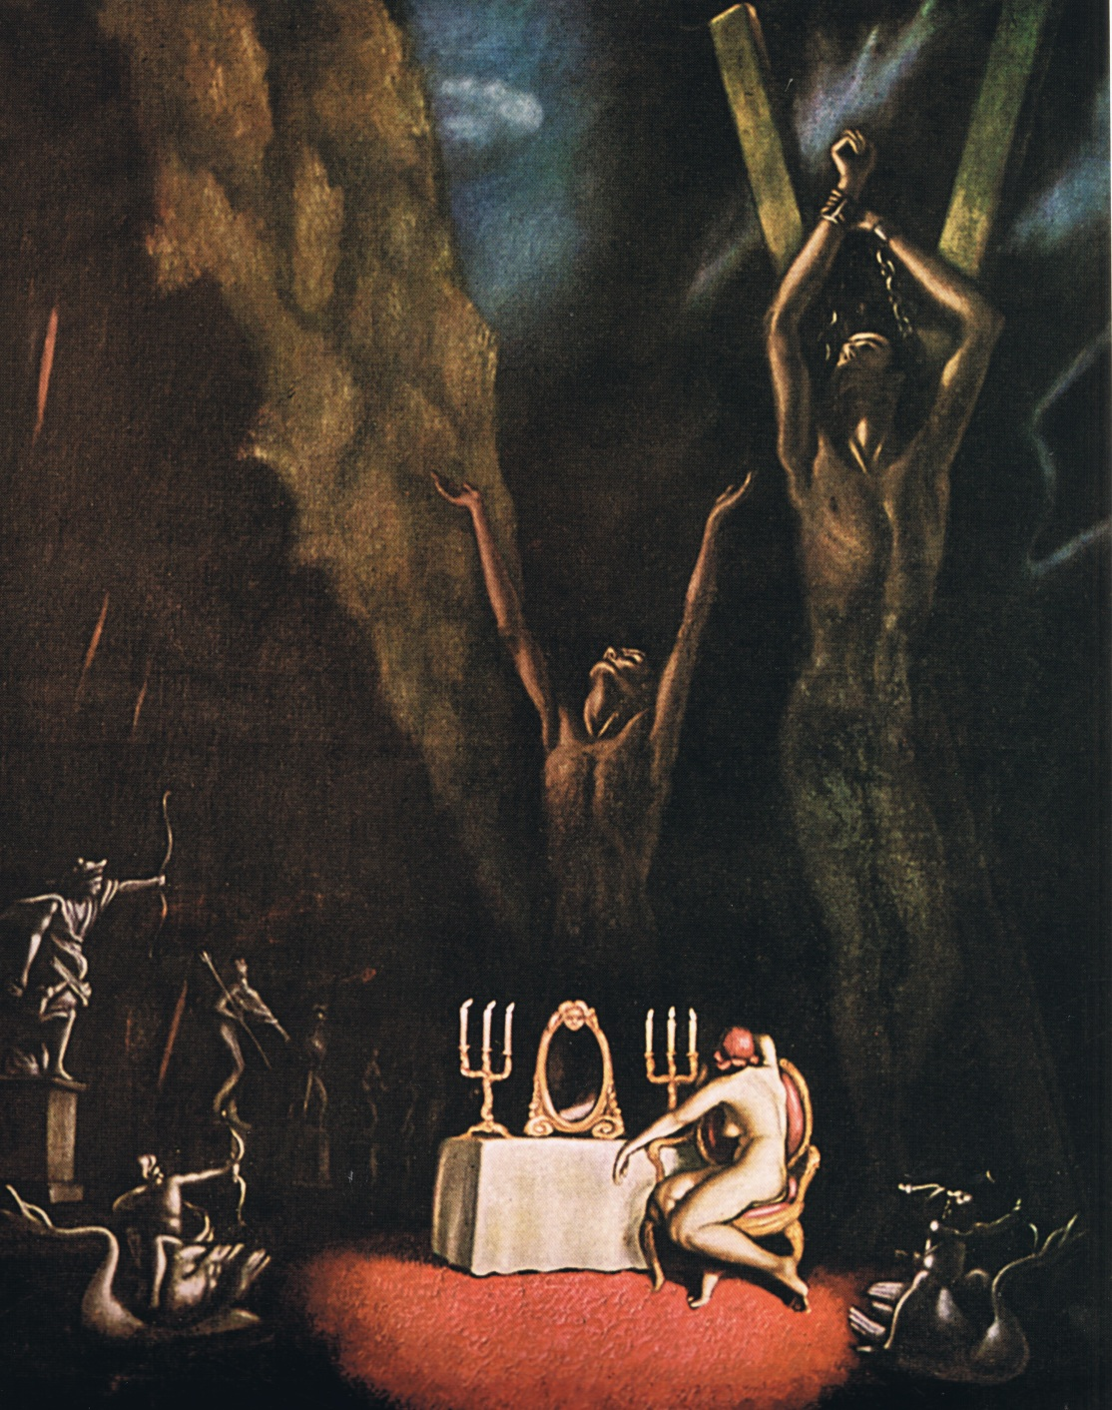

Slide 5
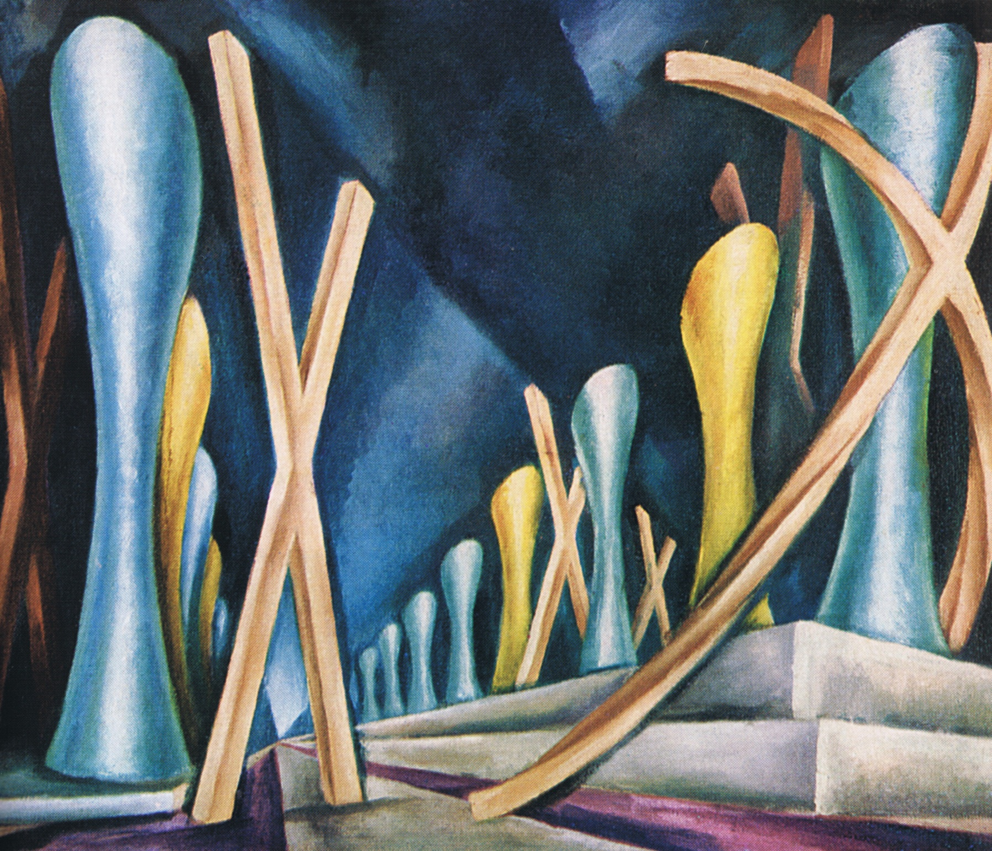

Slide 6
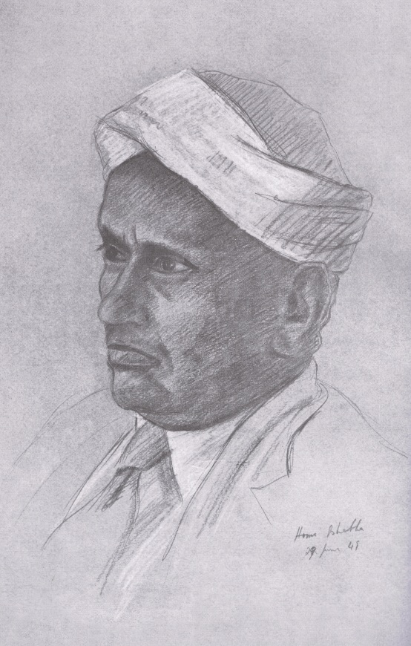
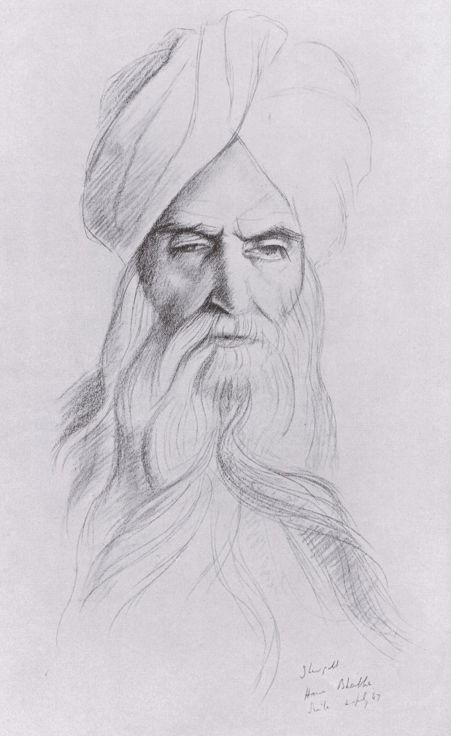
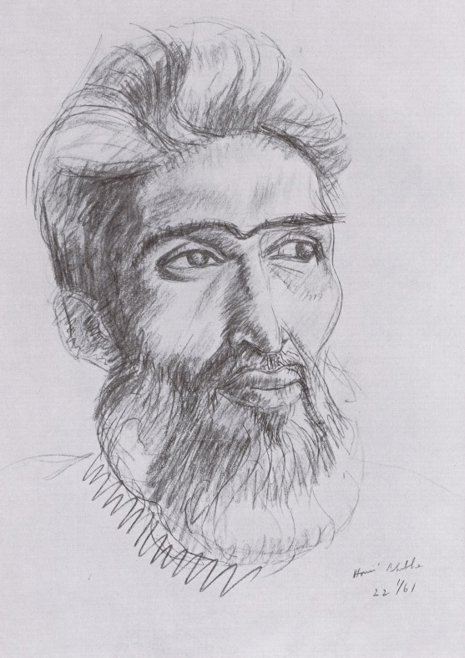

Slide 7
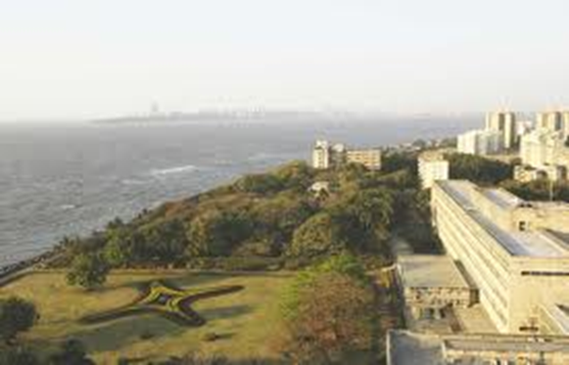
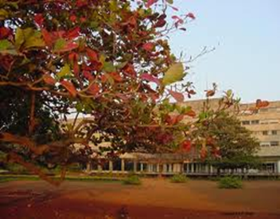

Slide 8
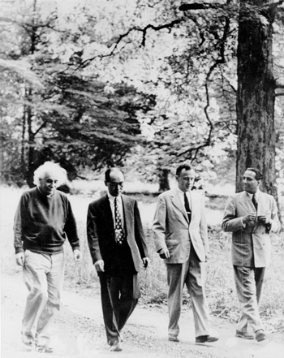

Slide 9
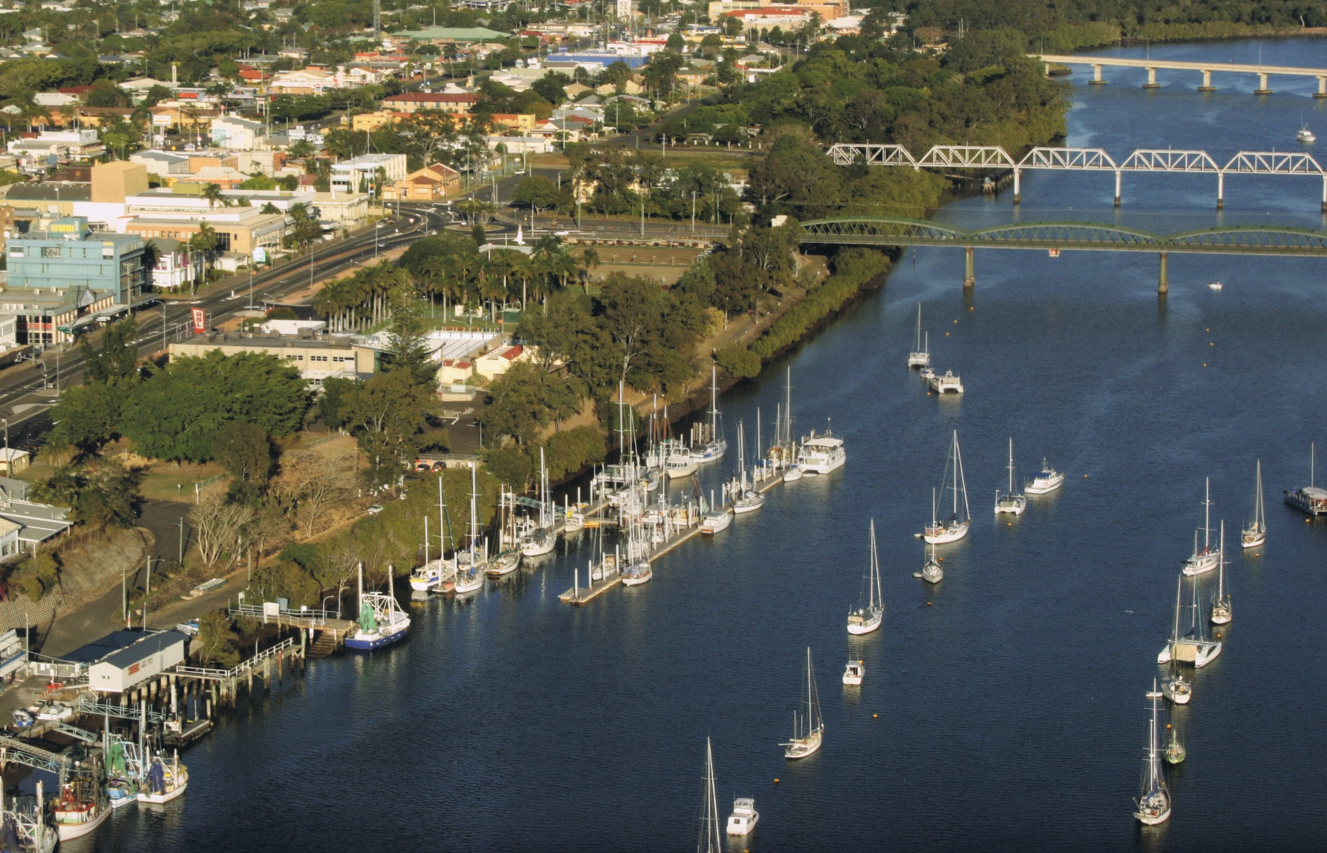
Bundaberg

Slide 10
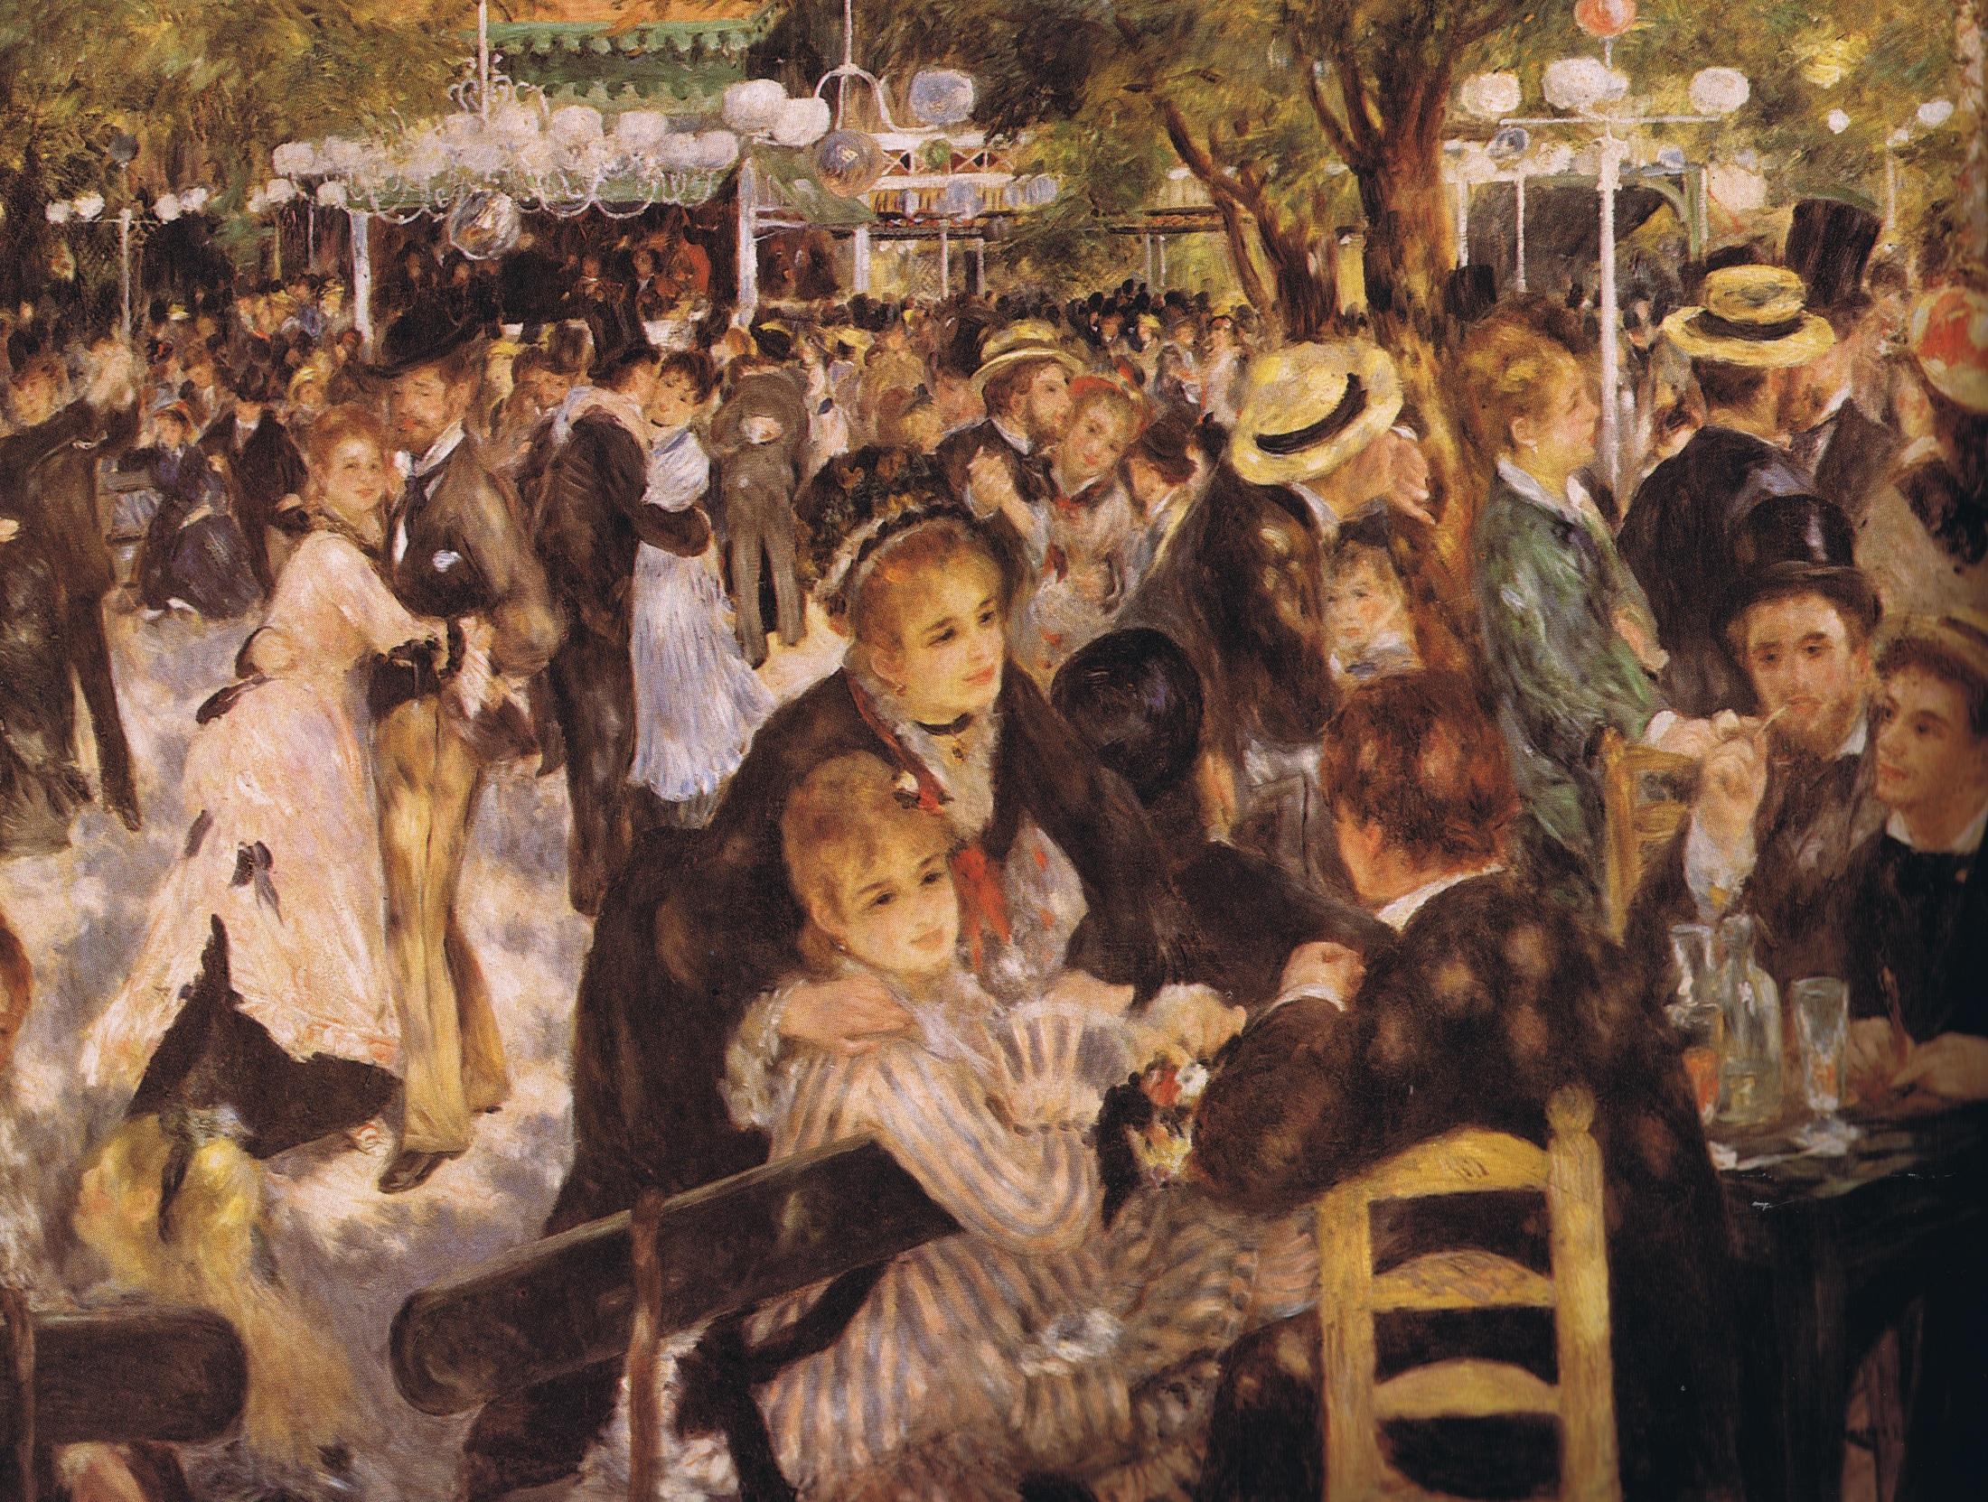

Slide 11
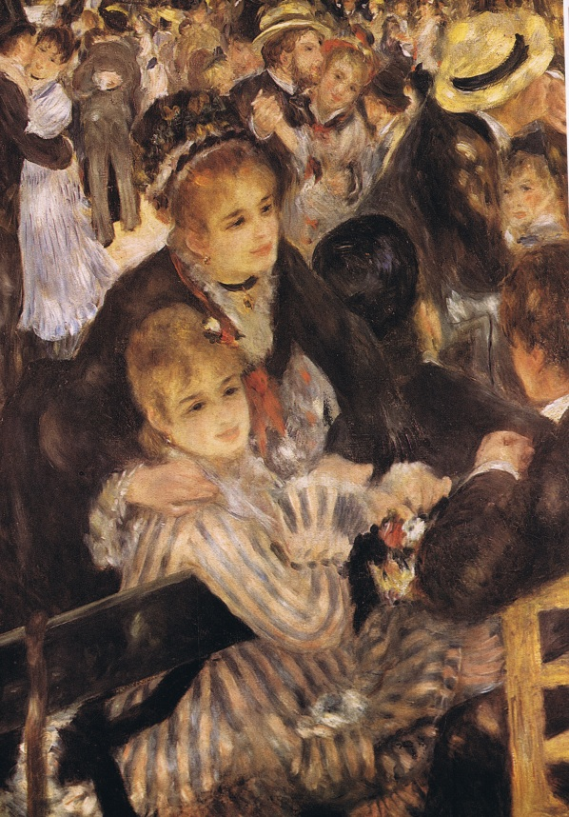
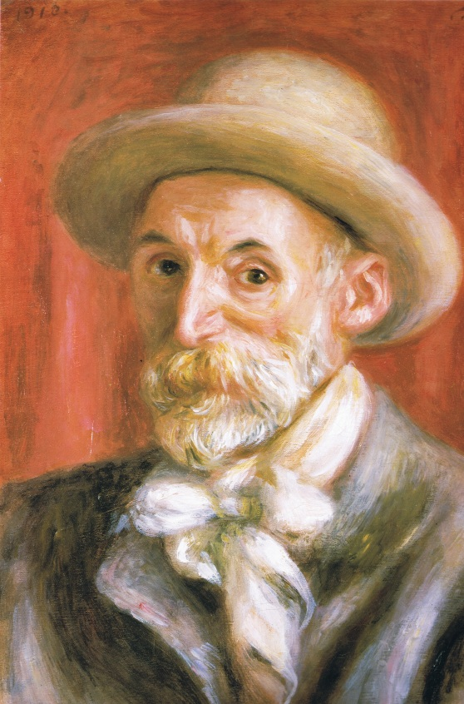
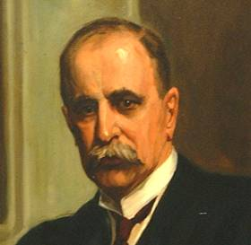
Living with Arthritis: a saga of change

Slide 12
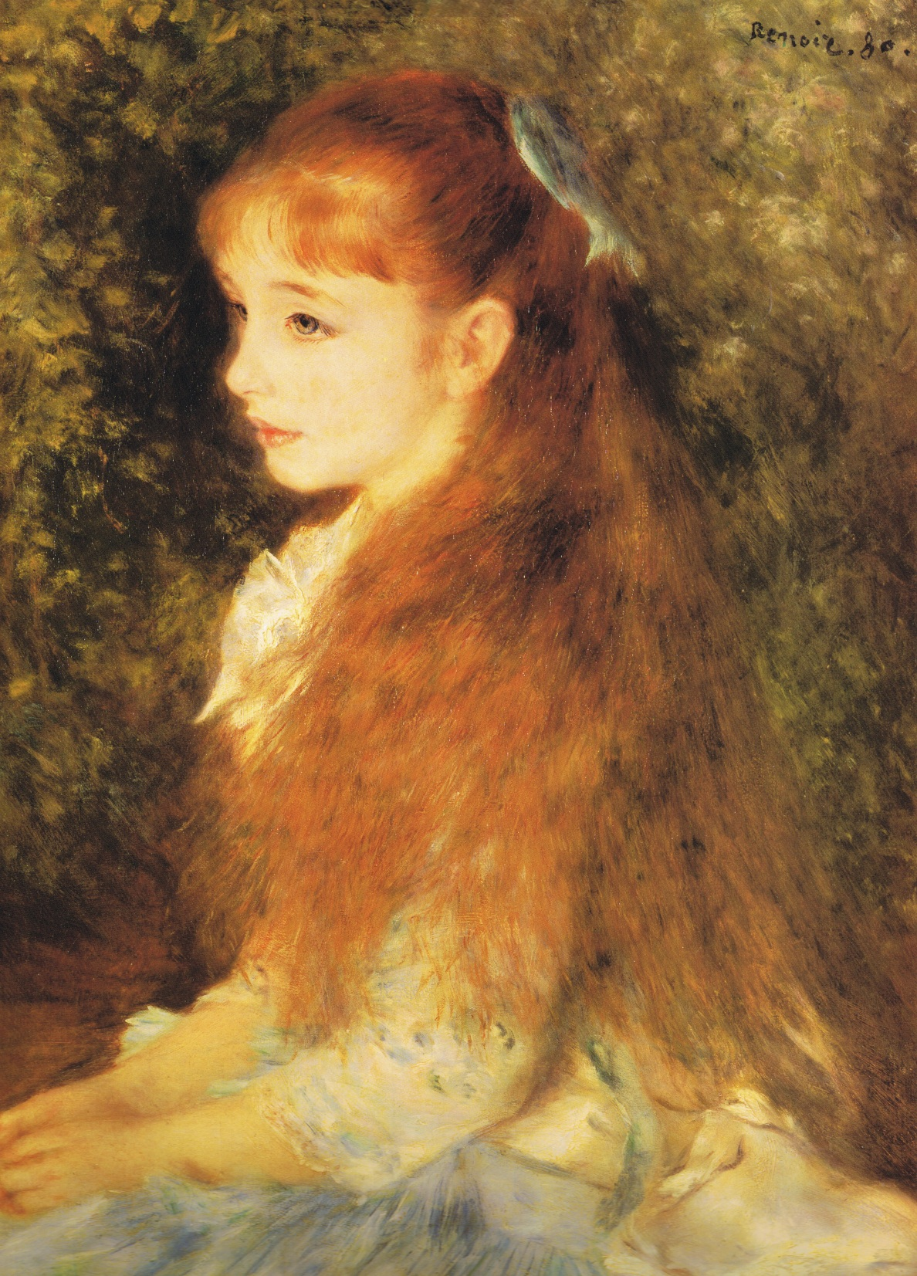
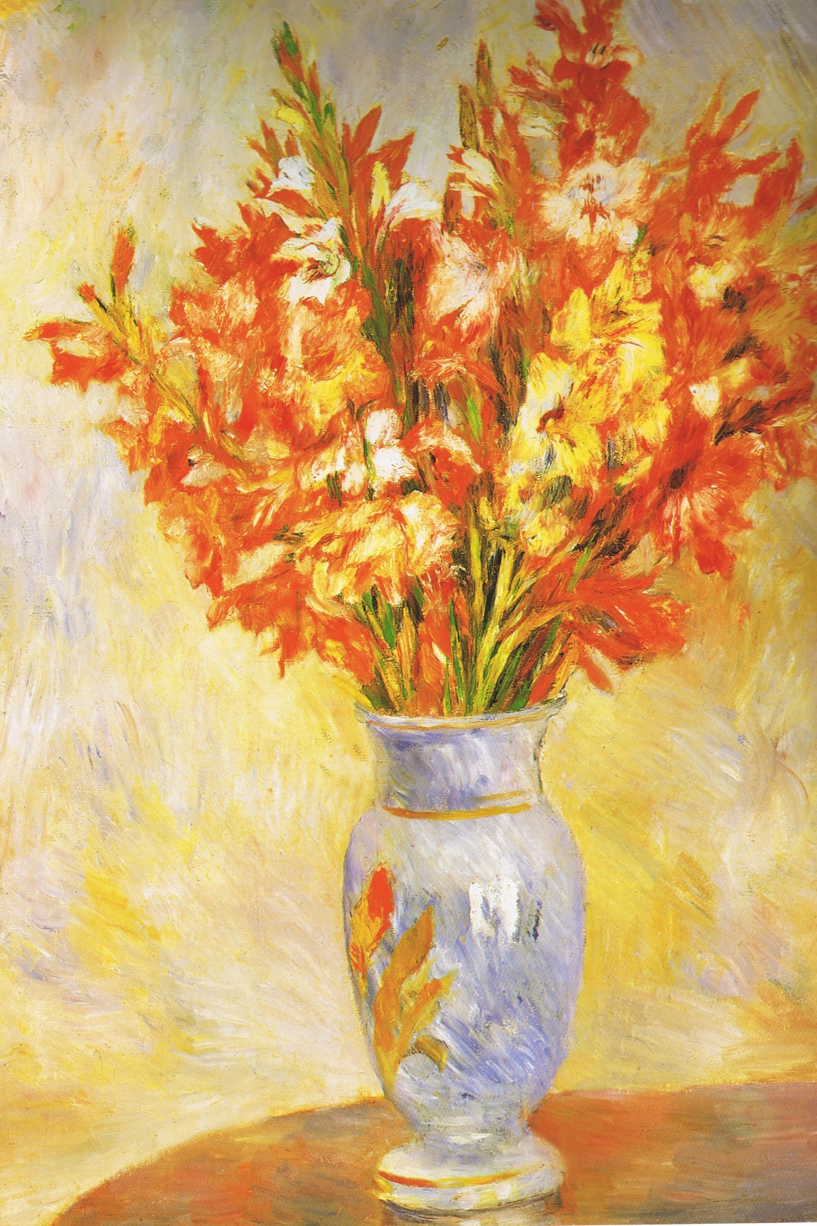
1880
Notes:
Irene Cahen d’Anvers 1880, Gladioli 1884.

Slide 13
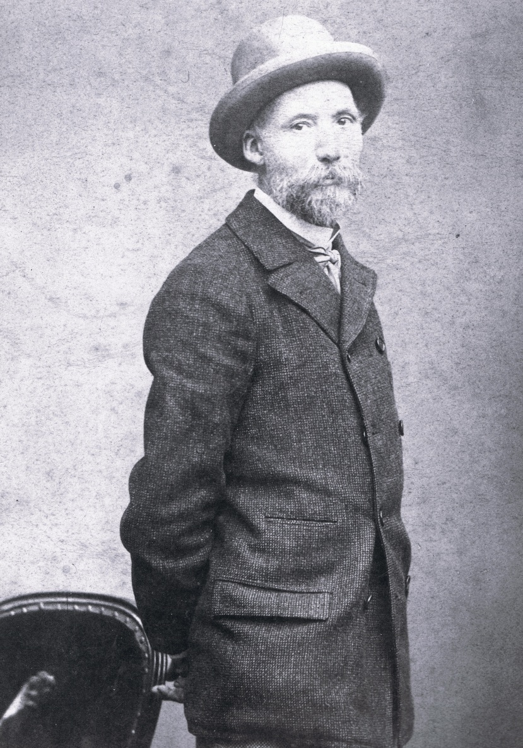
Pierre Auguste Renoir (25.02.1841-03.12.1919)

Slide 14
Pierre Auguste Renoir (25.02.1841-03.12.1919)
In the late 1880’s
he developed
Arthritis Deformans
(Rheumatoid Arthritis)

Slide 15
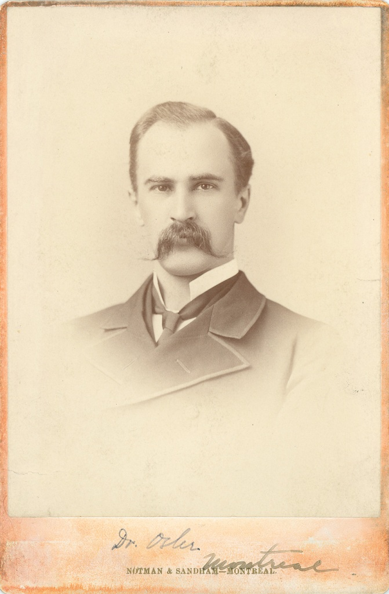
Sir William Osler (12.07.1849 - 29.12.1919)
“…head out the back door
whenever an arthritis patient
came through the front door”

Slide 16
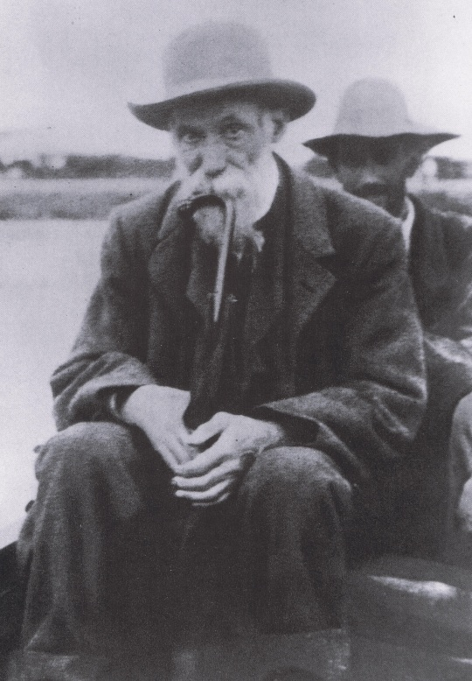
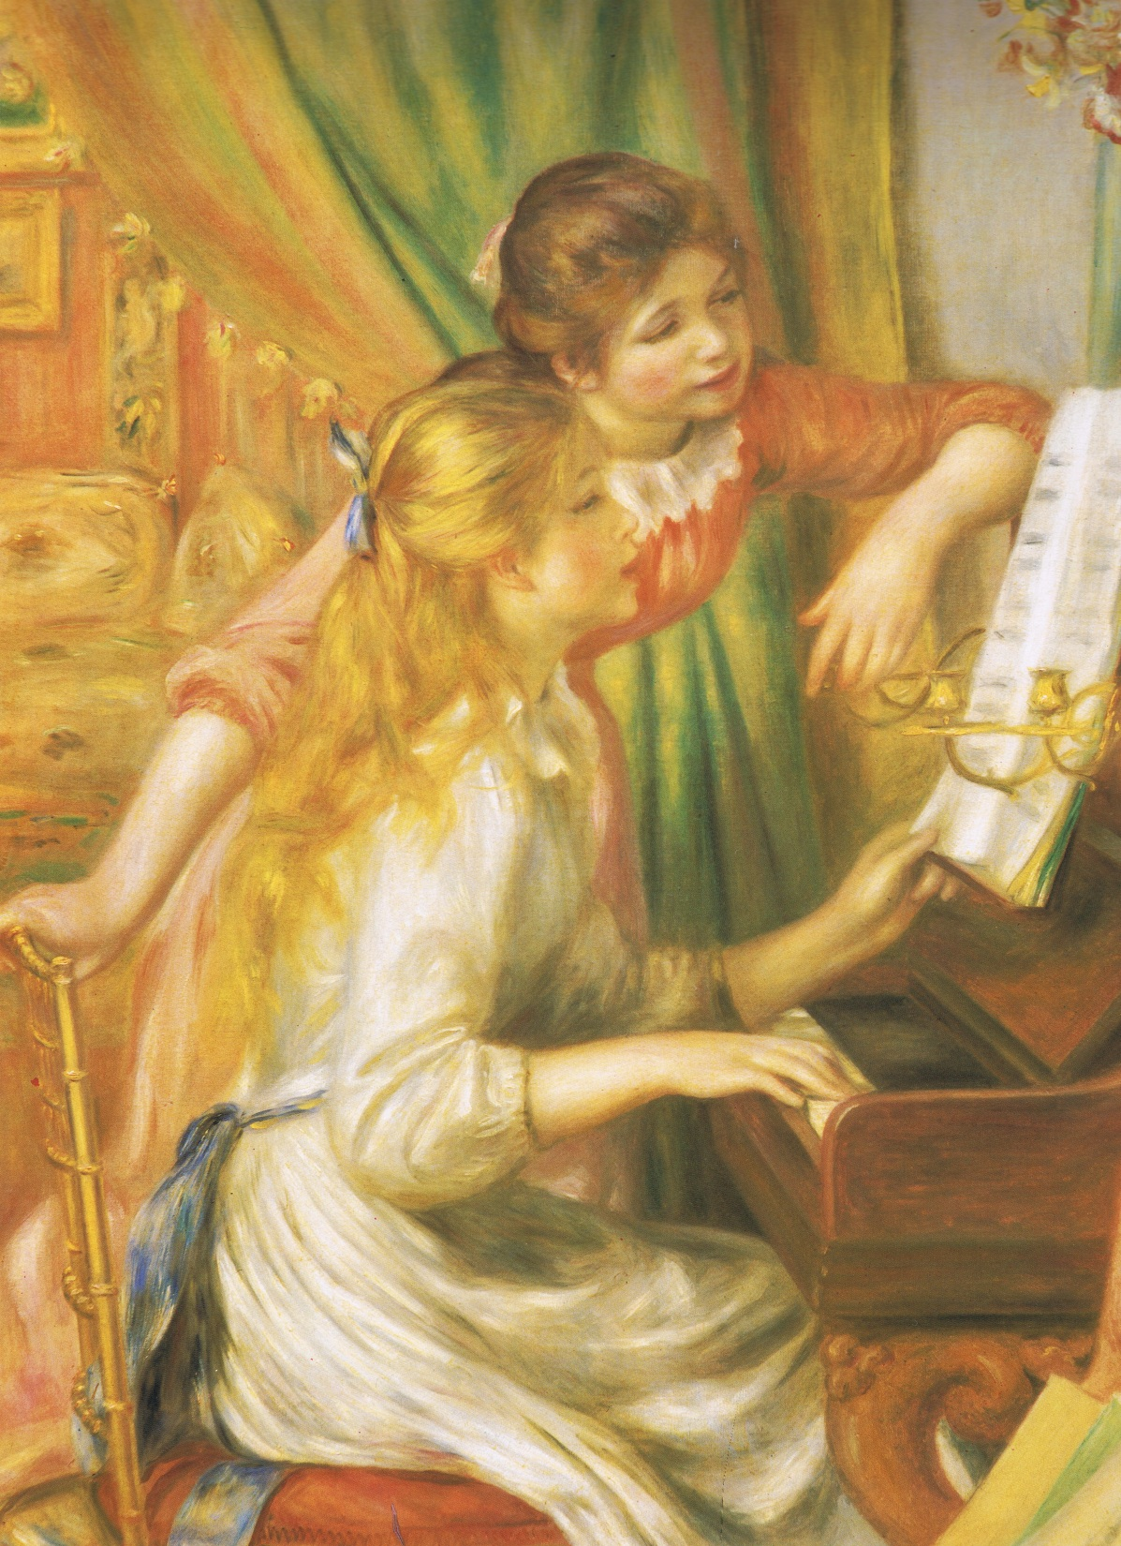
1892
1892
Notes:
Girls at the piano.

Slide 17
1892
William Osler
Married
Grace Revere
(grand daughter of the Paul Revere)

Slide 18
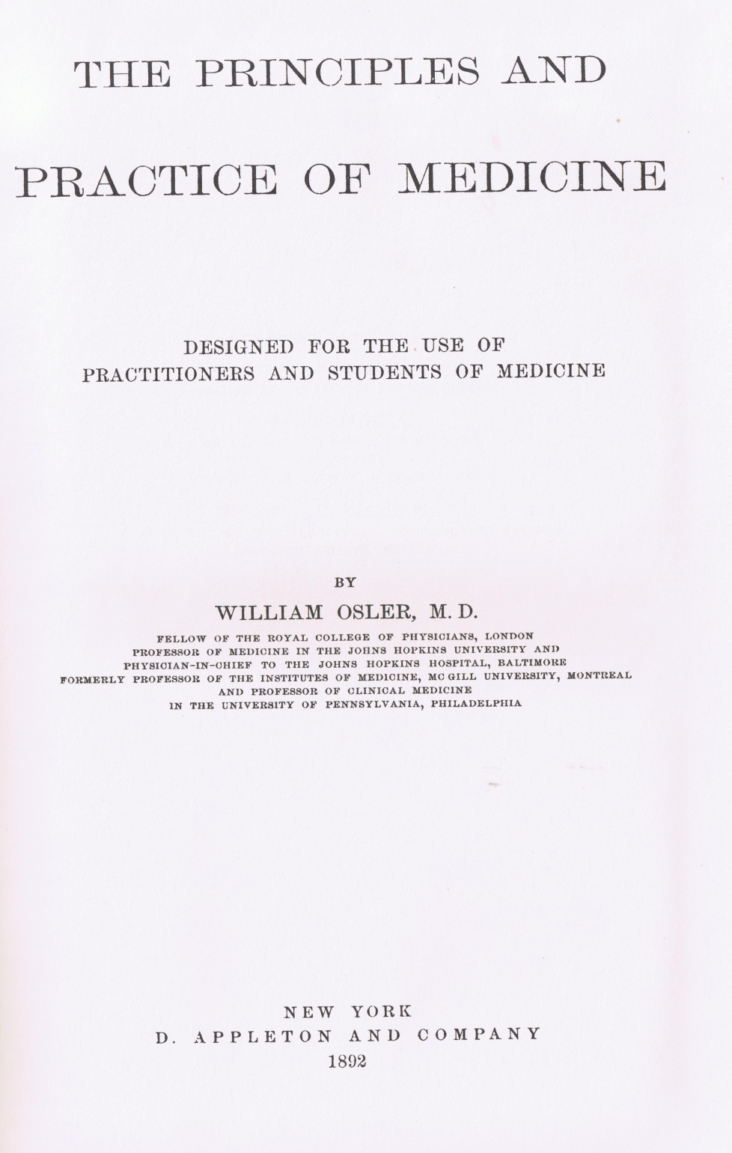
The problem
 | “Arthritis deformans is an incurable disease. …… Too often it invades successively all the articulations and in ten, fifteen or twenty years the crippling becomes general and permanent.”

Slide 19
The solution
 | “It is useless to saturate the patient with iodide of potassium, salicylates or quinine. Arsenic seems to do good as a general tonic…. Hydrotherapy, with carefully performed massage, is best for the alleviation of the pain… When good results, it is largely from change of scene and climate and careful regulation of diet…”

Slide 20
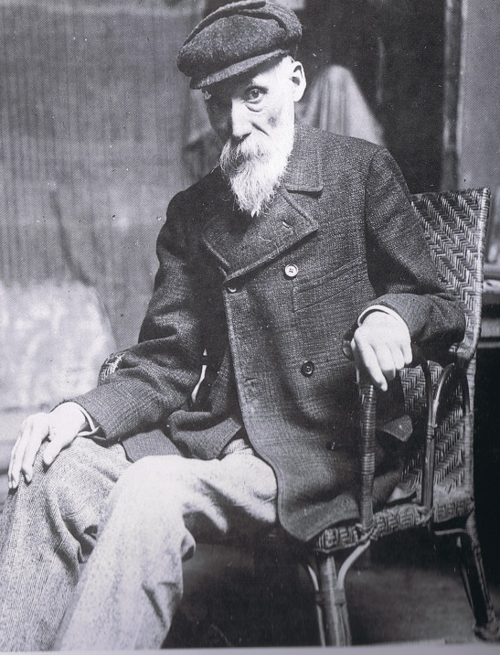
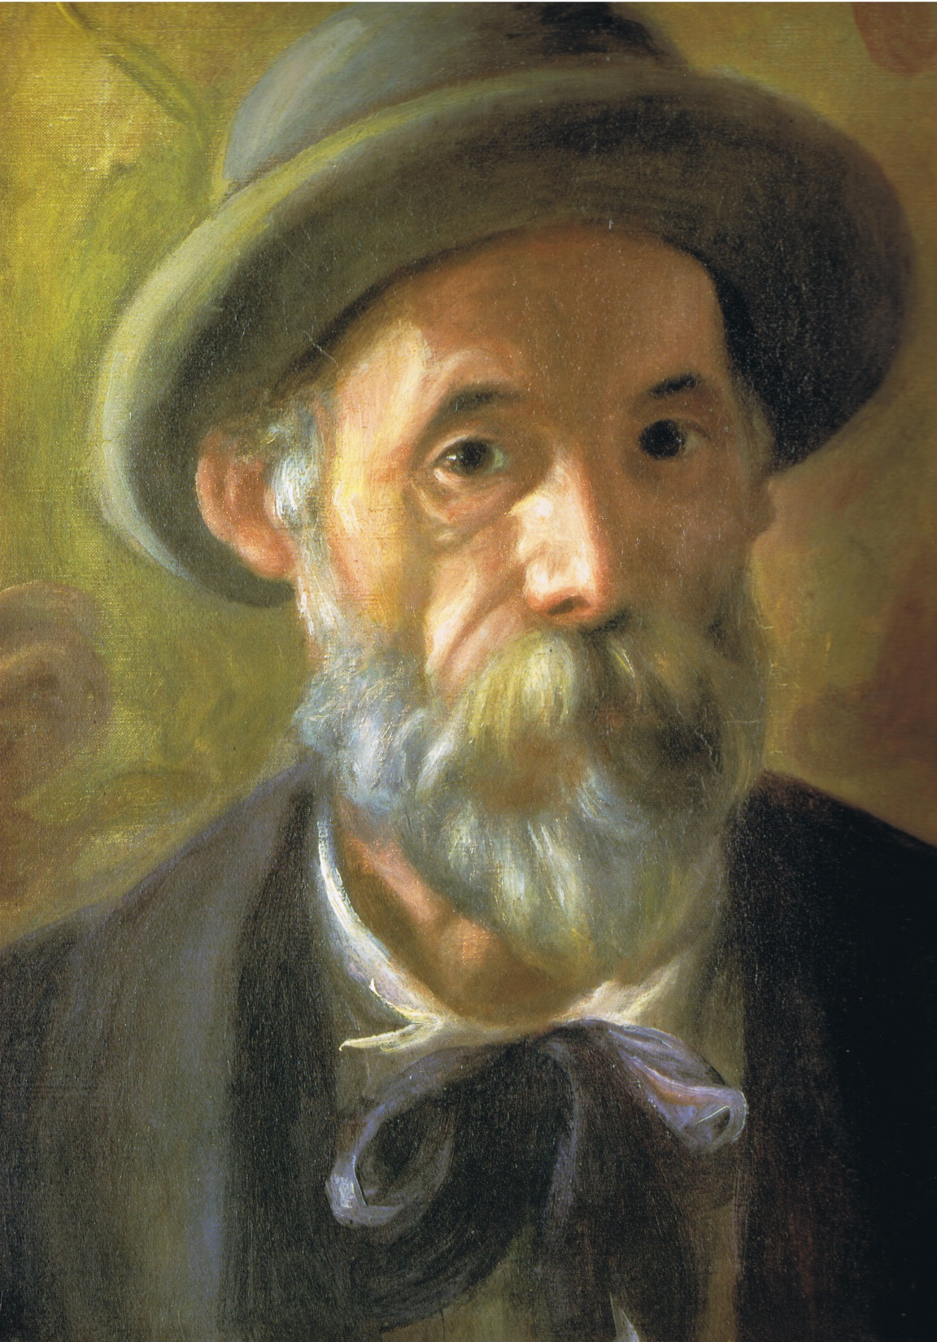
1900
Notes:
Self portrait

Slide 21
7th Edition 1909
“No single remedy is of special value. Arsenic in full doses is helpful in some.. Syrup of iodide of iron… Fresh air and personal hygiene Eat all the good food they can digest.. Hydrotherapy Massage, hot air, systematic exercises..” | “It is useless to saturate the patient with iodide of potassium, salicylates or quinine. Arsenic seems to do good as a general tonic…. Hydrotherapy, with carefully performed massage, is best for the alleviation of the pain… When good results, it is largely from change of scene and climate and careful regulation of diet…”

Slide 22
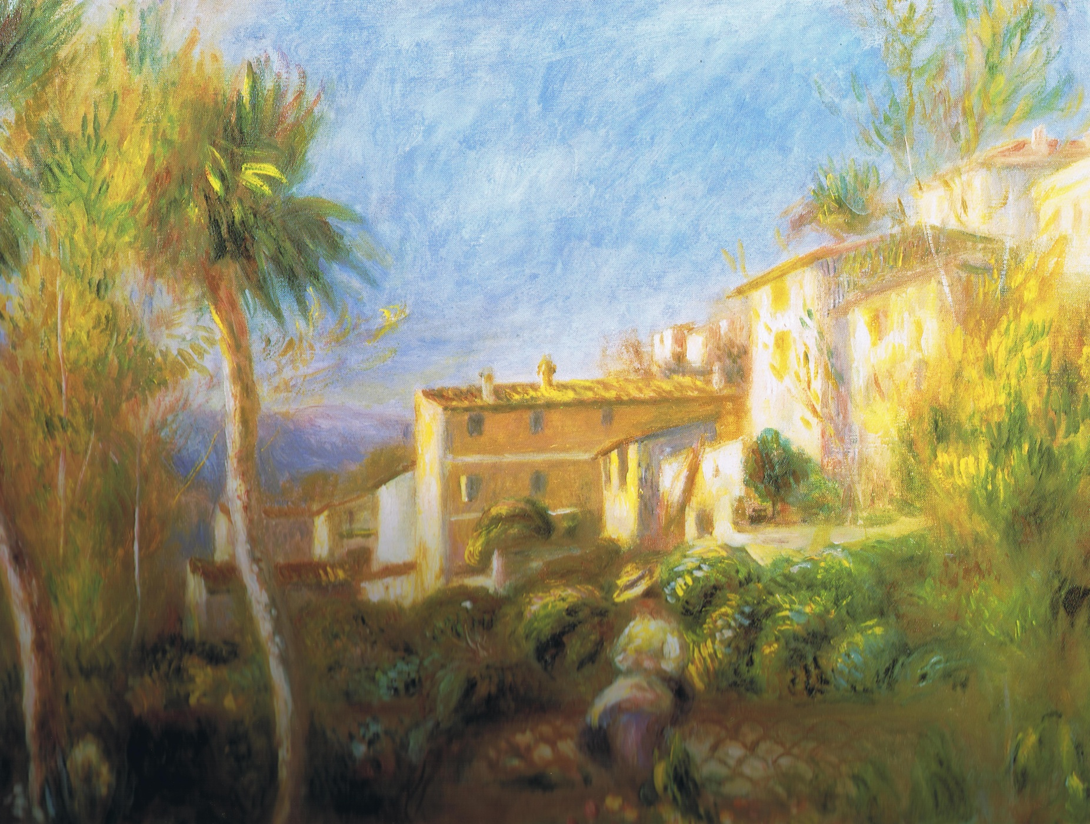
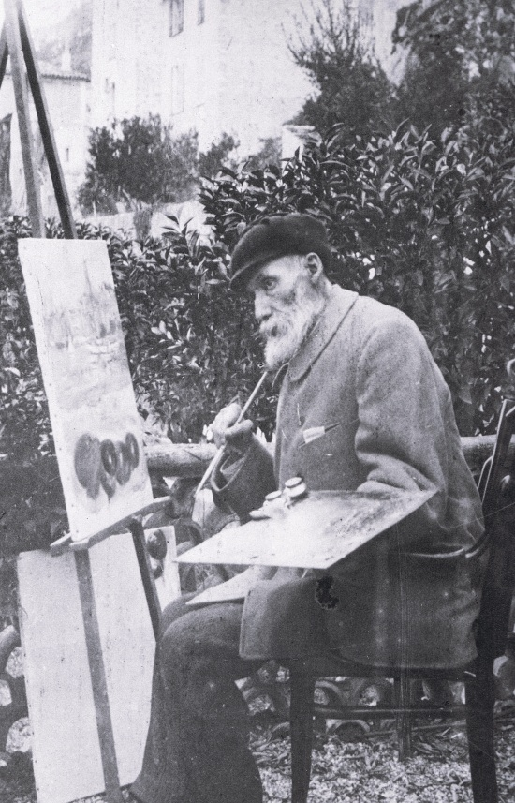
1903
Notes:
Villa de la Poste at Cagnes.

Slide 23
1903-1905
Controversy
“The fixed period” speech
Regius Professor of Medicine
Oxford.

Slide 24
Treatment of Arthritis 1910-1950
Salicylates
Injectable Gold
Anti malarials

Slide 25
Diagnosis of Rheumatoid Arthritis
ARA Criteria 1958
Morning stiffness
Pain and tenderness of at least one joint
Swelling of at least one joint
Swelling of at least one other joint in 3 months
Symmetrical joint swelling
(All for at least 6 weeks)
Subcutaneous nodules
Typical radiologic features
Positive Rheumatoid factor
Synovial fluid
Synovial histology
Nodule histology
+
20 exclusions!

Slide 26
Diagnosis RA
1958
Morning stiffness Pain/tenderness 1 joint Swelling 1 joint
Swelling one other joint Symmetrical swelling
All for 6 weeks Rheumatoid factor + ve
Nodules Typical radiology
Synovial fluid Synovial histology
Nodule histology
20 exclusions

Slide 27
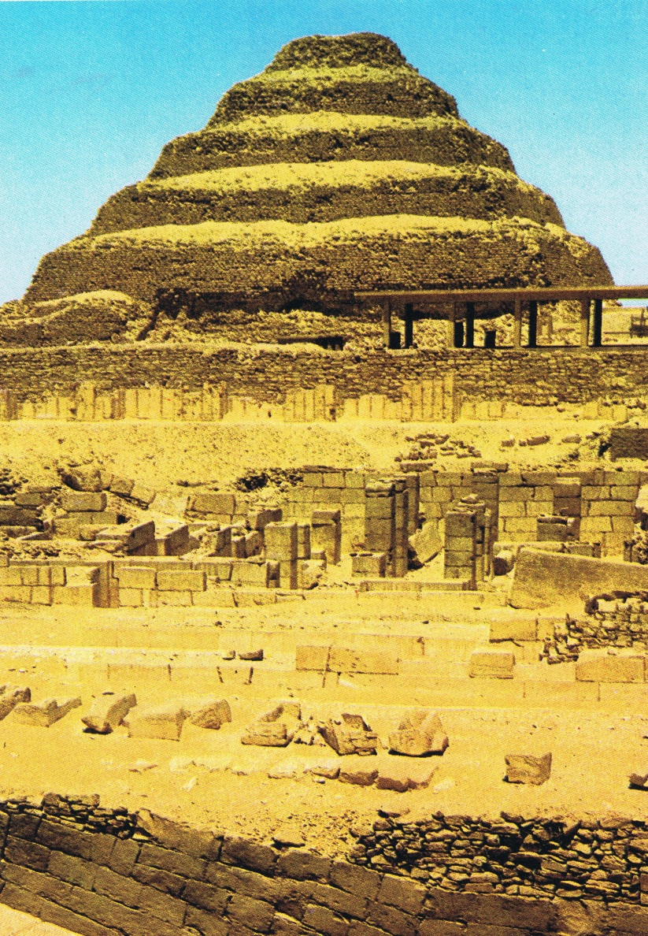
Treatment of Rheumatoid Arthritis
 | 1960’s - 1980s
Steroids
Cytotoxic agents
Immunosuppressants
Penicillamine
Anti malarials and Gold
Salicylates
Non steroidal
Anti inflammatory drugs

Slide 28
DMARD Treatment of Rheumatoid Arthritis 1950’s
1950’s Gold,…Corticosteroids.
1960’s Gold,…Sulphasalazine, Anti malarials.

Slide 29
DMARD Treatment of Rheumatoid Arthritis
1950’s Gold,…Corticosteroids!!
1960’s Gold,…Sulphasalazine, Anti malarials.
1970’s Gold, Penicillamine, Methotrexate,
Antimalarials, Sulphasalazine.
1980’s All above + Corticosteroids.

Slide 30
Treatment of Rheumatoid Arthritis
 | 1960’s - 1980s

Slide 31
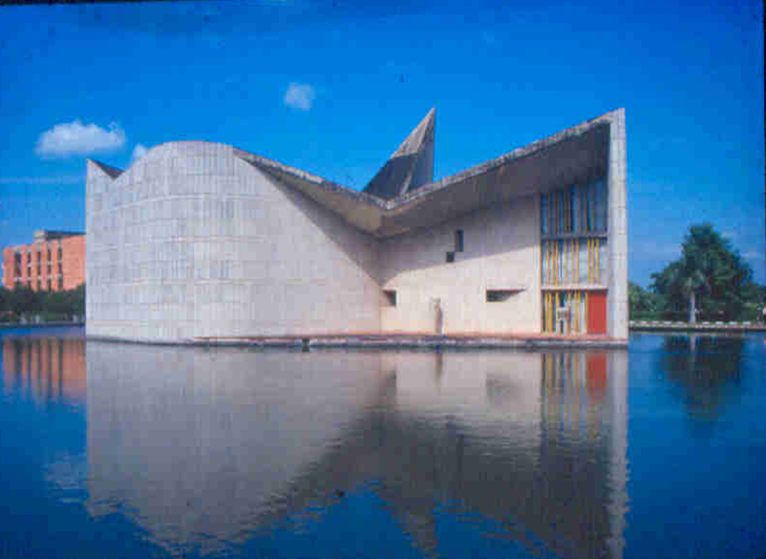
Treatment of Rheumatoid Arthritis
 | 1980’s and beyond

Slide 32
Diagnosis of Rheumatoid Arthritis
ARA Criteria 1987
Morning stiffness (> 60 min)
Arthritis of 3 or more joint areas
Arthritis of hand joints
Symmetrical arthritis
(For at least 6 weeks)
Rheumatoid factor
Rheumatoid nodules
Typical radiologic changes

Slide 33
Treatment of Rheumatoid Arthritis
Early DMARD’s Singly Methotrexate Sulphasalazine Hydroxychloroquin Leflunomide Or 2/3 drugs Depending on the severity Bridge Steroids Taper if reponsive

Slide 34
Treatment of Rheumatoid Arthritis
Early DMARD’s Escalate Singly if inadequate Methotrexate response Sulphasalazine Hydroxychloroquin Consider Leflunomide bDMARD’s Or 2/3 drugs Depending on the severity Bridge Steroids Taper if reponsive

Slide 35
Treatment of Rheumatoid Arthritis
Early DMARD’s Escalate Singly if inadequate Methotrexate response Sulphasalazine Hydroxychloroquin Consider Leflunomide bDMARD’s Or 2/3 drugs Depending on the severity Bridge Steroids Taper if reponsive | Steroid “pulse” For flare

Slide 36
Treatment of Rheumatoid Arthritis
Early DMARD’s Escalate Singly if inadequate Methotrexate response Sulphasalazine Hydroxychloroquin Consider Leflunomide bDMARD’s Or 2/3 drugs Depending on the severity Bridge Steroids Taper if reponsive | Biologic DMARD’s Steroid “pulse” For flare Escalate DMARD’s revisit previously effective agents

Slide 37
DMARD Treatment of Rheumatoid Arthritis 1950
1950’s Gold,…Corticosteroids!!
1960’s Gold,…Sulphasalazine, Anti malarials.
1970’s Gold, Penicillamine, Methotrexate,
Antimalarials, Sulphasalazine.
1980’s All above + Corticosteroids.
1990’s All above, Leflunomide + bDMARD’s

Slide 38
Diagnosis RA
1958 | 1987
Morning stiffness Pain/tenderness 1 joint Swelling 1 joint | Morning stiffness > 1hr
Swelling one other joint Symmetrical swelling | Arthritis of 3+ joint areas
All for 6 weeks Rheumatoid factor + ve | Arthritis of hand joints
Nodules Typical radiology | Symmetrical arthritis For at least 6 weeks
Synovial fluid Synovial histology | Rheumatoid factor
Nodule histology | Nodules
20 exclusions | Typical radiology

Slide 39
Paradigm shift
Diagnostic delays Lack of therapeutic urgency Gradual increments Single drugs Procrastination | Quick and positive diagnosis Need to induce remission Flexible patient driven approach Combination of drugs Urgency

Slide 40
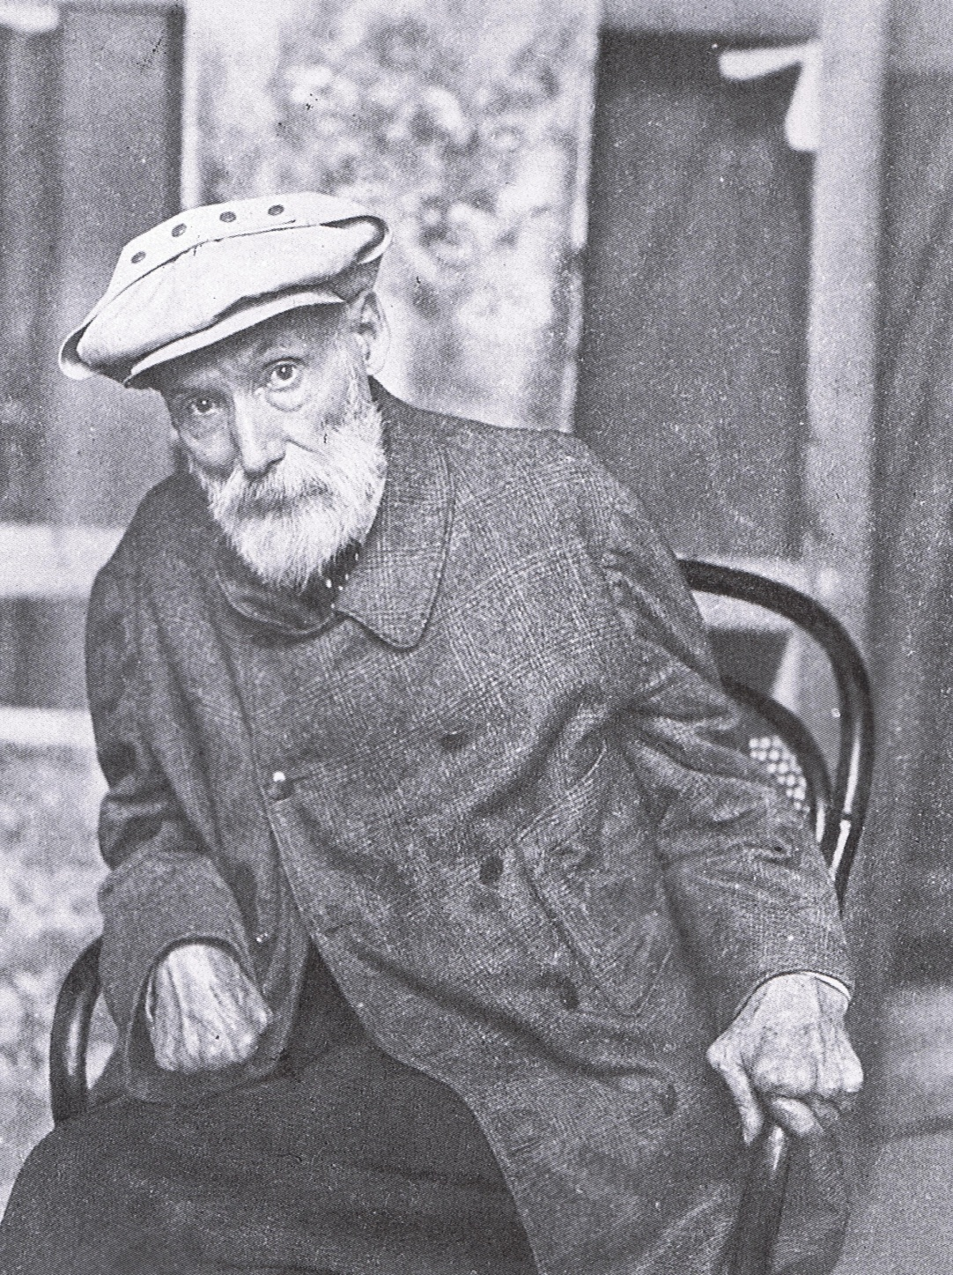
1910
Notes:
Self portrait.

Slide 41
1910
Osler founded
Postgraduate Medical Association

Slide 42
Diagnosis of RA
Rheumatoid arthritis classification criteria 2010
Aletaha D et al Arthritis Rheum,2010;62:2569-2581
A | Joint involvement | Score | B | Serology | Score
 | 1 large joint | 0 |  | Negative RF and ACPA | 0
 | 2-10 large joints | 1 |  | Low positive RF or ACPA | 2
 | 1-3 small joints | 2 |  | High positive RF or ACPA | 3
 | 4-10 small joints | 3
 | >10 small joints | 5
C | Acute phase reactants | Score | D | Duration of Symptoms | Score
 | Normal CRP and ESR | 0 |  | < 6 weeks | 0
 | Abnormal CRP or ESR | 1 |  | > 6 weeks | 1
 | 6 = definite RA |  |  | 4 major domains

Slide 43
Diagnosis RA
1958 | 1987 | 2010
Morning stiffness Pain/tenderness 1 joint Swelling 1 joint | Morning stiffness > 1hr | Joint involvement 1 to > 10 Scored 1-5 Small and large
Swelling one other joint Symmetrical swelling | Arthritis of 3+ joint areas | More than 6 weeks Scored 0-1
All for 6 weeks Rheumatoid factor + ve | Arthritis of hand joints | Acute phase reactants ESR. CRP Scored 0-1
Nodules Typical radiology | Symmetrical arthritis For at least 6 weeks | Serology RF, ACPA Scored 0-3
Synovial fluid Synovial histology | Rheumatoid factor
Nodule histology | Nodules
20 exclusions | Typical radiology

Slide 44
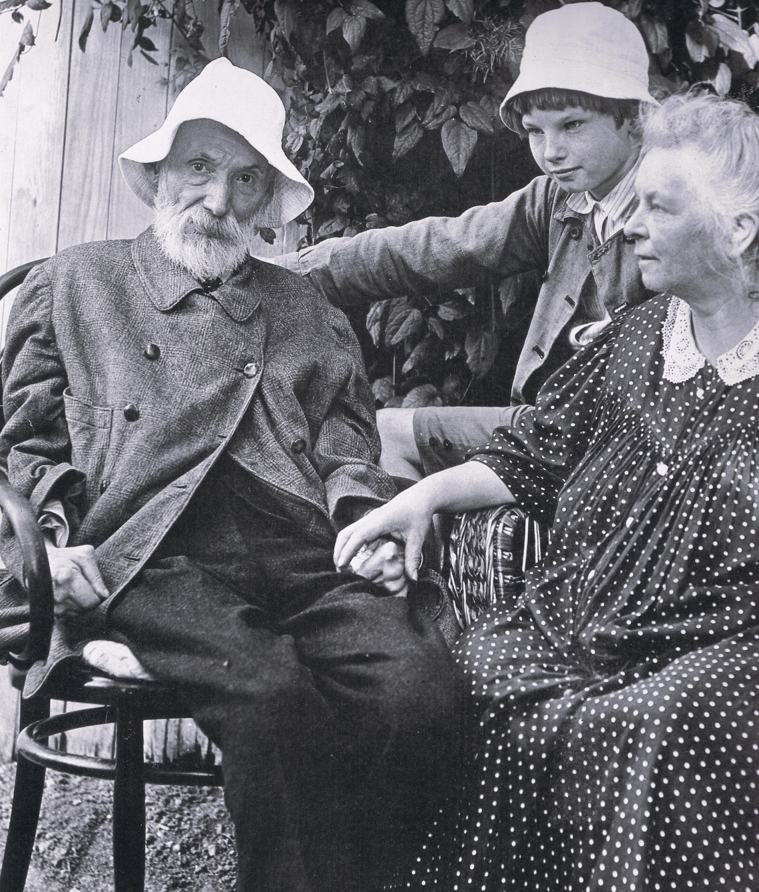
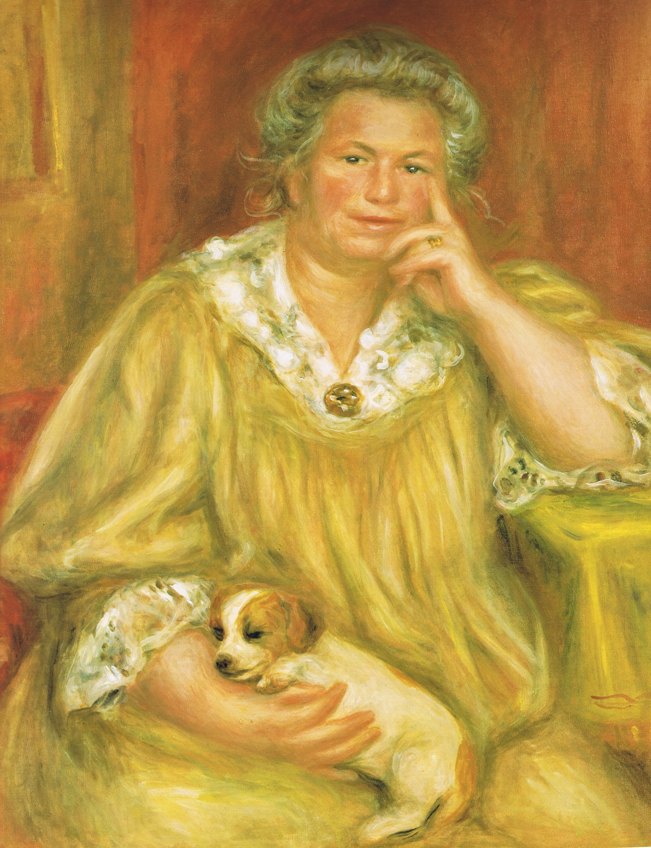
1912
Notes:
Mme Renoir

Slide 45
1912
Baronet William Osler

Slide 46
Corticosteroids
Boon or Bane ?

Slide 47
Nobel Prize Medicine and Physiology 1950

Slide 48
Clinical use of Corticosteroids
Dramatic
Widespread

Slide 49
Clinical use of Corticosteroids
Dramatic
Widespread
Deadly

Slide 50
Clinical toxicity of Corticosteroids
Obesity Diabetes mellitus Electrolyte problems
HPA axis suppression Growth retardation
Withdrawal syndrome Addison’s like syndrome
Opportunistic infections Hypertension
Myopathy Osteoporosis Osteonecrosis
Peptic ulceration Pancreatitis
Psychosis Depression Intracranial hypertension
Cataract Glaucoma Acne Striae Bruising

Slide 51
Clinical use of Corticosteroids
Dramatic
Widespread
Deadly
Retribution

Slide 52
Clinical use of Corticosteroids
Dramatic
Swift
Widespread
Long lasting
Equally Deadly
Retribution

Slide 53
Clinical use of Corticosteroids
Dramatic
Swift
Widespread
Long lasting
Popular folk lore
Equally Deadly
Retribution

Slide 54
Steroid folk lore
Ultimate embodiment of evil
“I’d rather die than take steroids.”
“I’d rather my patient go blind, compromise his
kidneys, brain, lungs, heart and liver, than give
him the steroids that can help him.”

Slide 55
Clinical Reuse of Corticosteroids
Slow, reluctant
Isolated
“Steroid sparing agents”
Gradually gained ground.

Slide 56
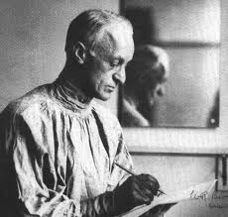
Steroid induced Osteoporosis
Harvey Cushing (1869-1939)

Slide 57
Steroid induced Osteoporosis
“ Spontaneous fractures occurred from time to time, involving sternum clavicle and ribs. The autopsy showed skeletal osteoporosis with spinal curvature, the bones being easily cut with a knife…the spongy part of bone having largely disappeared”
Harvey Cushing Bull Johns Hopkins Hosp 1932;50:137-195.

Slide 58
Steroid induced Osteoporosis
Commonest cause of secondary osteoporosis.
Fracture in 30-50% long term users
2.5-7.5 mg Prednisolone/day
Cancellous bone areas Vertebrae, Neck of femur

Slide 59
Steroid induced bone loss
Reduced formation Increased resorption
PTH
Proliferation Androgens Parathyroid gland
Protein Viability
Synthesis Calcium Calcium
Apoptosis Adrenal/ Testis Absorption Resorption
Osteocyte
Osteoblast Osteoclast GIT Renal Tubule
survival

Slide 60
Steroid induced bone loss
Reduced formation Increased resorption
PTH
Proliferation Androgens Parathyroid gland
Protein Viability
Synthesis Calcium Calcium
Apoptosis Adrenal/ Testis Absorption Resorption
Osteocyte
Osteoblast Osteoclast GIT Renal Tubule
survival

Slide 61
Steroid induced bone loss
Reduced formation Increased resorption
PTH
Proliferation Androgens Parathyroid gland
Protein Viability
Synthesis Calcium Calcium
Apoptosis Adrenal/ Testis Absorption Resorption
Osteocyte
Osteoblast Osteoclast GIT Renal Tubule
survival

Slide 62
Steroid induced bone loss
Bisphosphonates Tereparatide
Reduced formation Increased resorption
PTH
Proliferation Androgens Parathyroid gland
Protein Viability
Synthesis Calcium Calcium
Apoptosis Adrenal/ Testis Absorption Resorption
Osteocyte
Osteoblast Osteoclast GIT Renal Tubule
survival

Slide 63
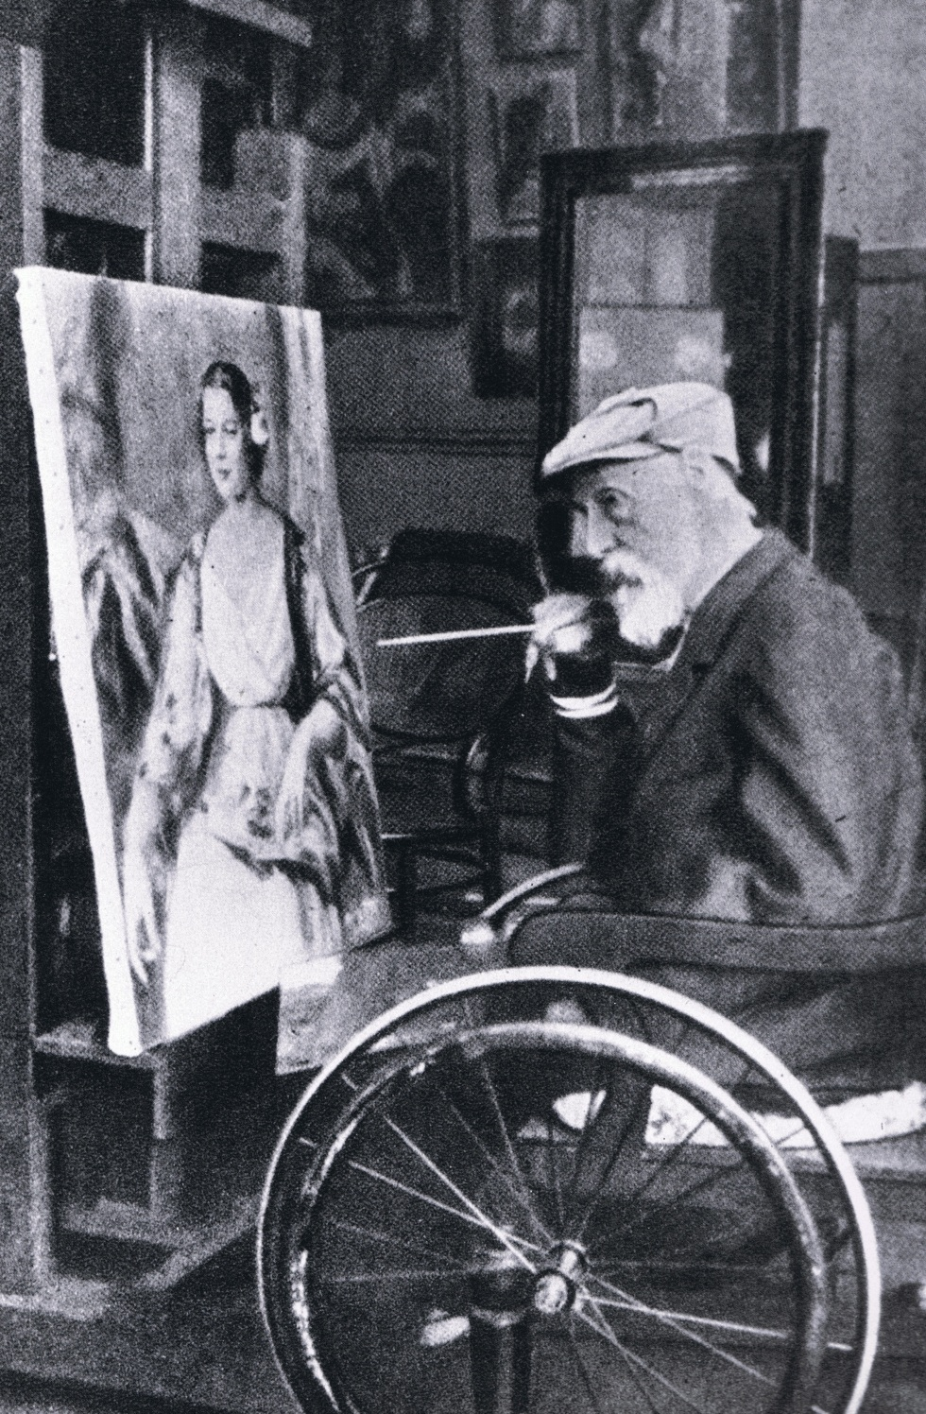
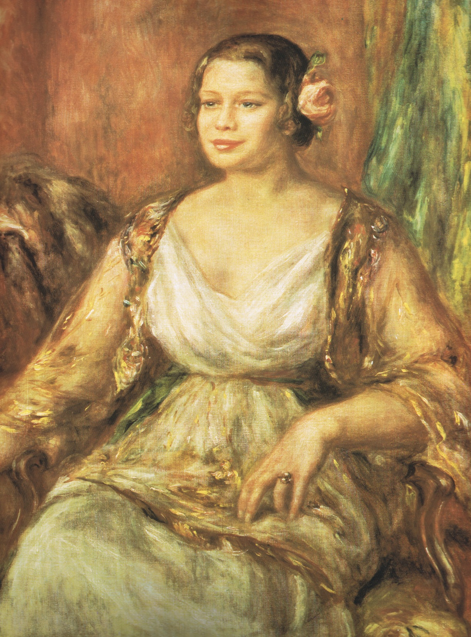
1915
Notes:
Tilla Durieux

Slide 64
Problems
Pain
Stiffness
Fatigue
Sleep problems
Emotional problems

Slide 65
Pain
Impossible to quantify Impossible to feel others Acute: Protective Chronic: Self perpetuating Neural Chemical Inflammatory Non inflammatory | Gate control theory. The pain matrix. Medial: Emotional aspects Lateral: Somatic aspects

Slide 66
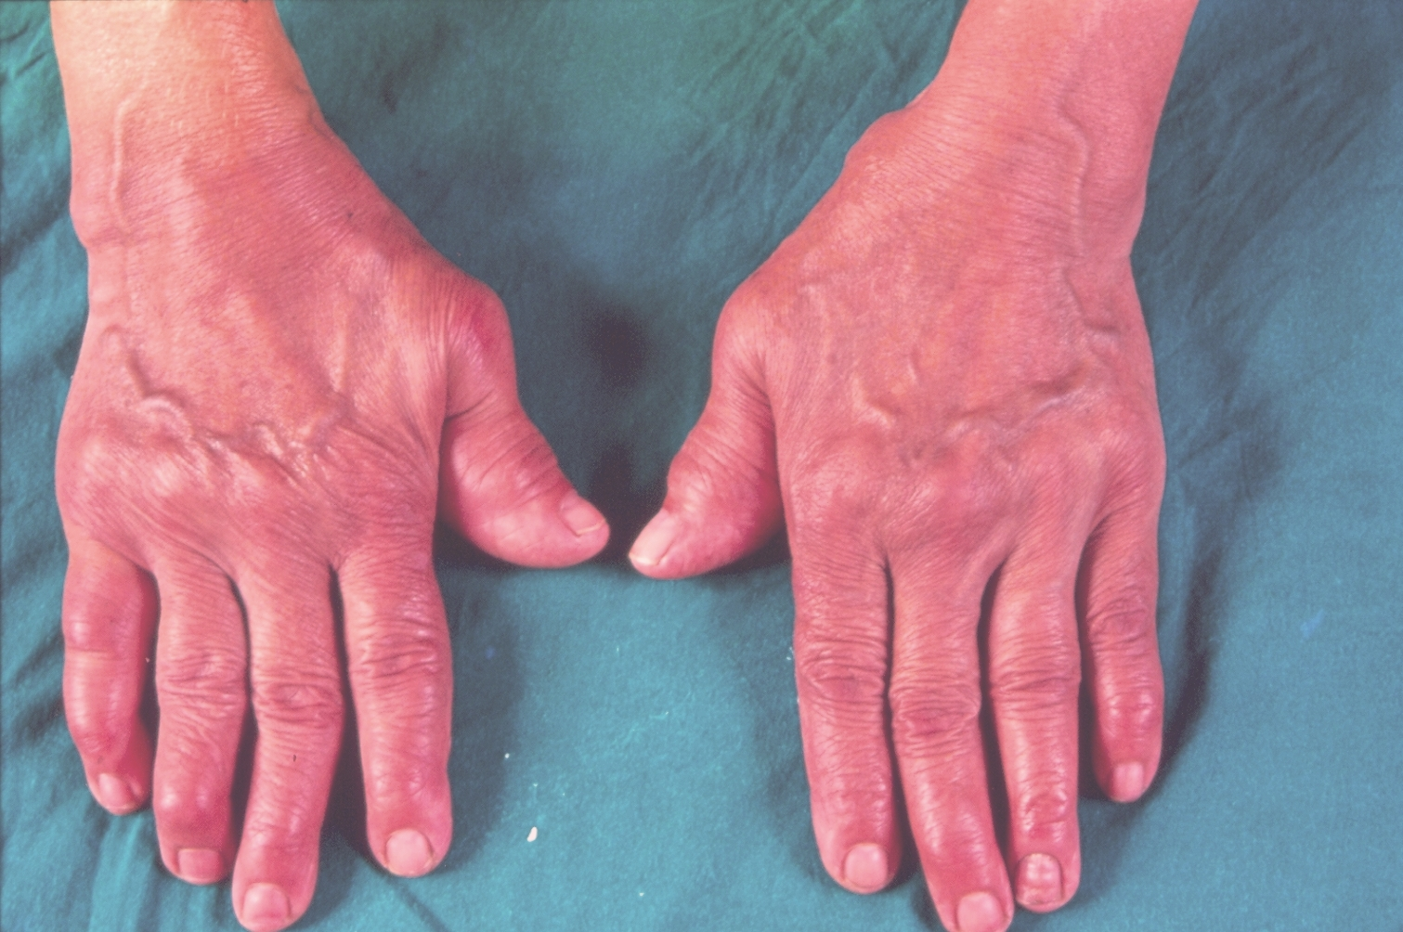
Pain

Slide 67
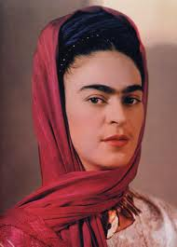
Pain

Slide 68
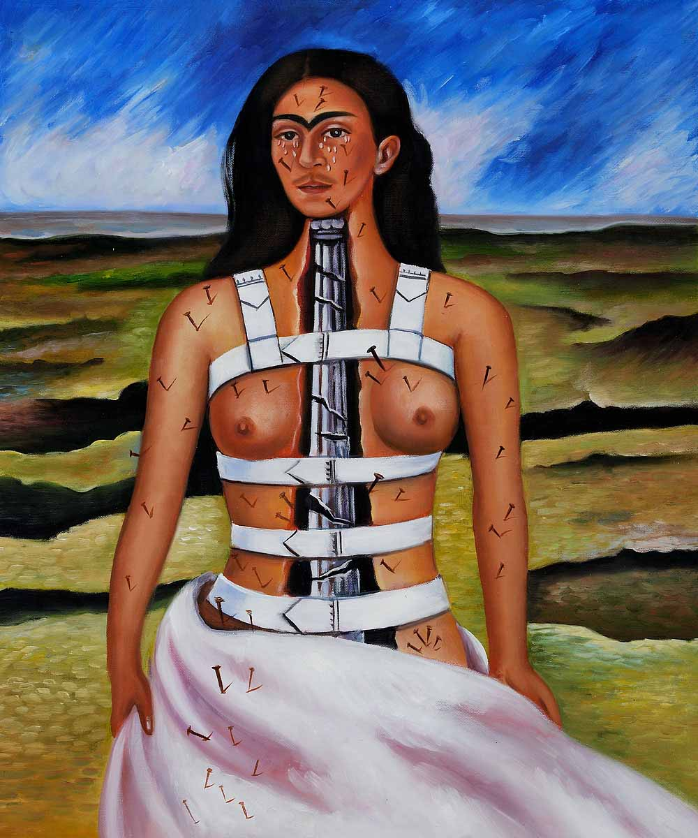
Pain
Frida Kalho (1907-1954) “The Broken Column” (1944) | Frida Kalho

Slide 69
Pain
Anxiety
Depression
Negative thoughts
Inactive Isolated Recluse
Pain Matrix Activation

Slide 70
Stiffness
Inflammatory
Worsens with rest
Can last hours
Afternoon is usually
“Best time of the day.”
Heat
Massage

Slide 71
Fatigue
Causes
Inflammation

Slide 72
Fatigue
Causes
Inflammation
Anaemia and Iron deficiency
Under performing thyroid
Diabetes mellitus

Slide 73
Fatigue
Causes
Inflammation
Anaemia and Iron deficiency
Under performing thyroid
Diabetes mellitus
Other inflammatory diseases

Slide 74
Fatigue
Causes
Increased effort required to do things.

Slide 75
Fatigue
Causes
Increased effort required to do things.
Combination of pain and stiffness
Immobility

Slide 76
Fatigue
Causes
Increased effort required to do things.
Combination of pain and stiffness
Immobility
Overdoing it on a “good” day.

Slide 77
Fatigue
Causes
Increased effort required to do things.
Combination of pain and stiffness
Immobility
Overdoing it on a “good” day.
Sleep related issues

Slide 78
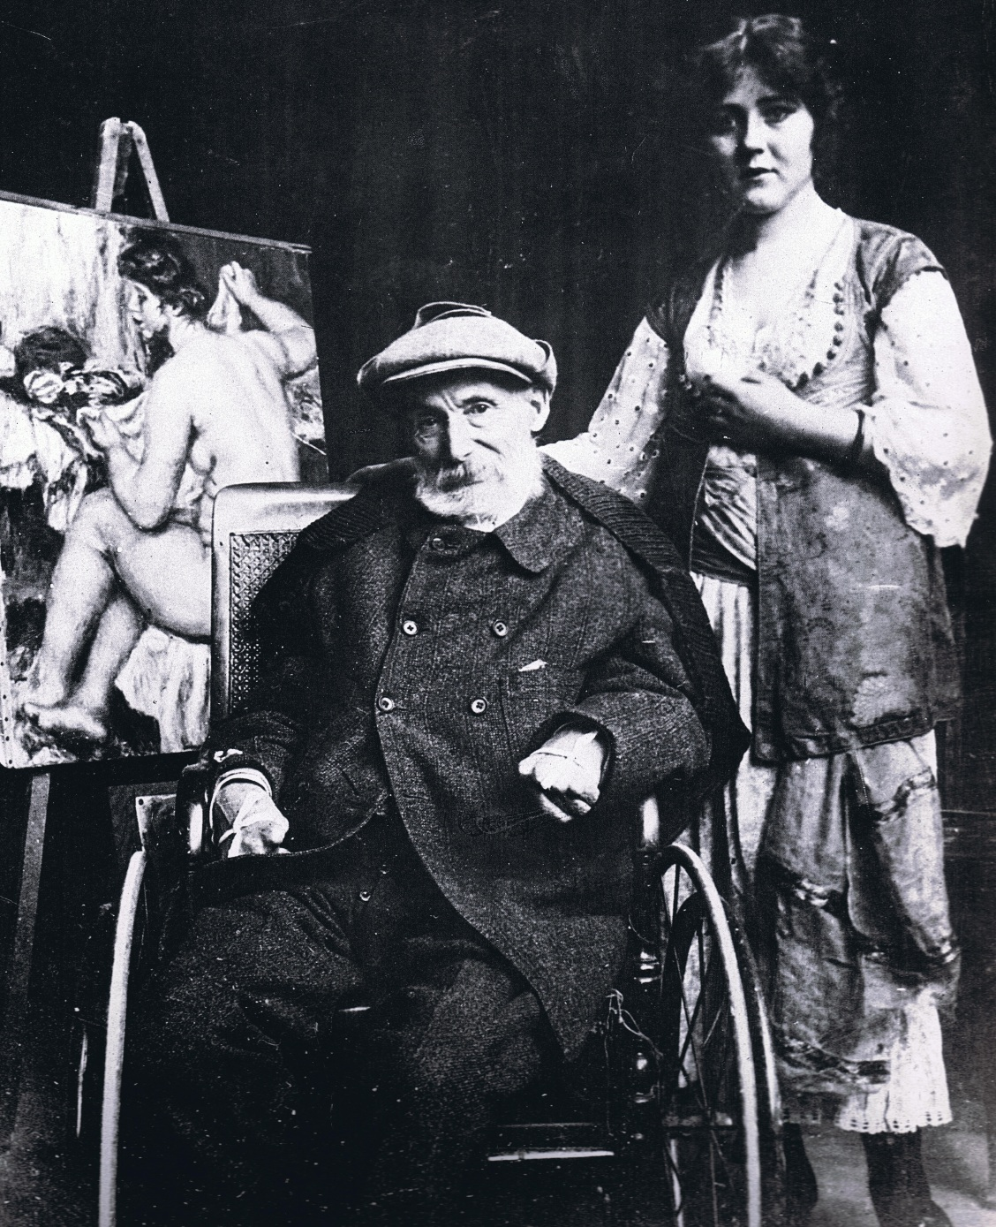
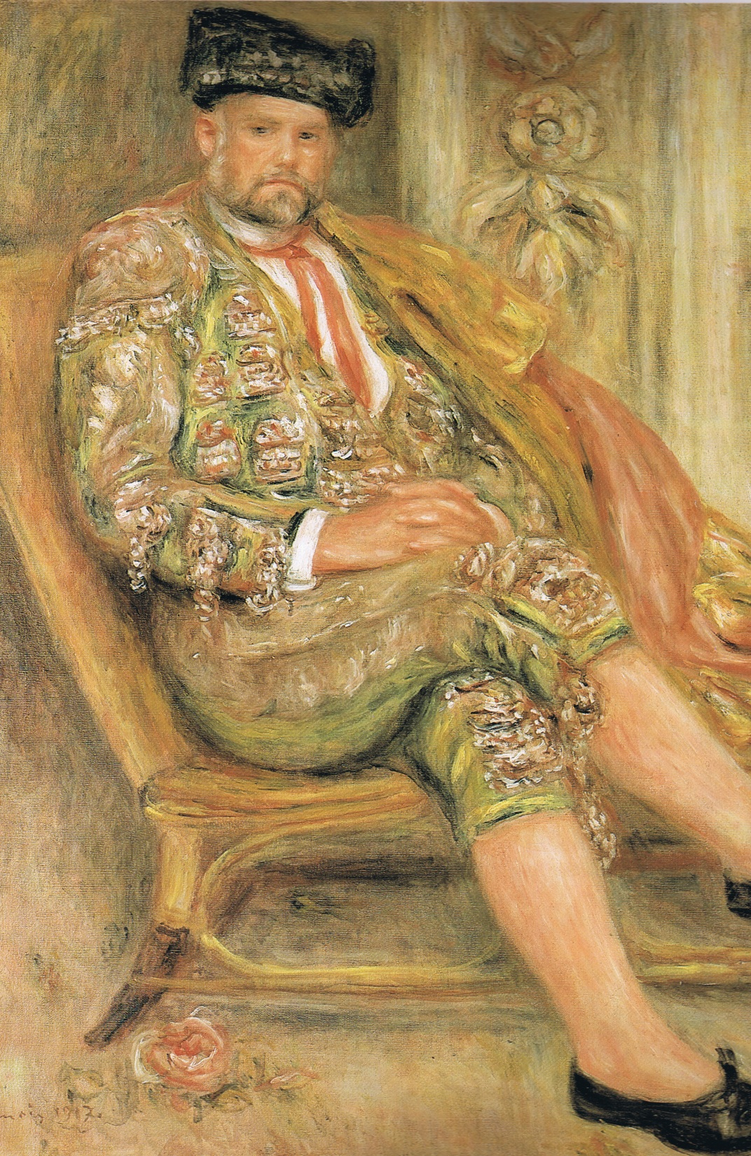
1917
Notes:
Ambroise Vollard

Slide 79
1917
Edward Revere Osler
Died of war injuries.

Slide 80
Unhelpful
Smoking
Excessive alcohol
Inactivity
Weight gain

Slide 81
Helpful
Exercise within limits
Choose the correct exercise
Protect joints
Good nutrition
Being sociable
Understand your problem

Slide 82
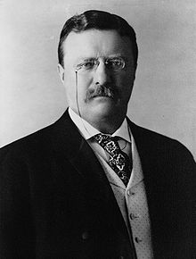
Helpful
Work as much as is possible
“ Far and away the best prize that life has to offer,
is the chance to work hard at work worth doing.”
Theodore Roosevelt
(1858-1919)
26th President of the United States

Slide 83
Ravaged but still very useful !

Slide 84
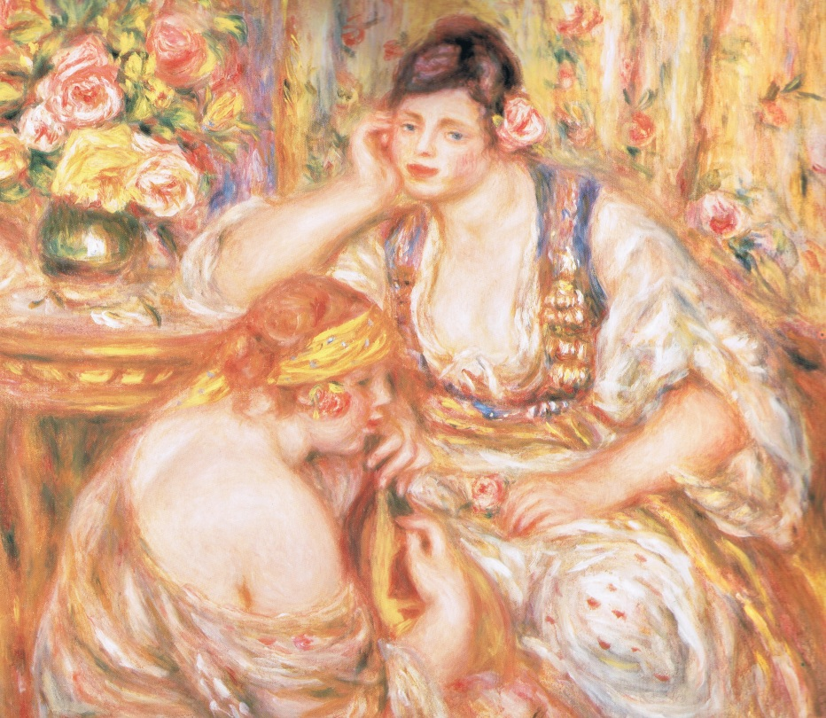
December 1919
Both
Pierre Renoir and Sir William Osler
Died of Pneumonia
Notes:
The concert.

Slide 85
Message
Hope
Cautious optimism

Slide 86
Acknowledgements
My patients with arthritis
For the lessons they selflessly taught
that I, very often, reluctantly, learnt.

Slide 87
Bibliography
.Osler, William
The Principles and Practice of Medicine.
D Appleton and Co, New York. 1892.
Wilkins, Robert H.
Neurosurgical Classics
Johnson Reprint Corporation, New York, 1965
Harvey, A McGehee; McKusick, Victor A (eds)
Osler’s Textbook Revisited
Appleton-Century-Crofts, New York, 1967.
White, Barbara Ehrlich.
Renoir: His life, art and letters.
Abrams, New York. 1984

Slide 88
Acknowledgements
Professor Arun Grover
Drs Suresh Murthy and Kees Nydam
My parents and family .

Slide 89
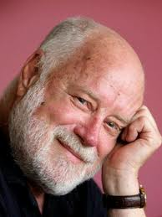
“…for books are the sleepers on the railway of life, the pickets in the fence of your history, the bricks with which you’ve built your brain.
Phillip Adams
The Weekend Australian Magazine, February 4-5, 2012.

Slide 90
Clinical toxicity of Corticosteroids
Obesity Diabetes mellitus Electrolyte problems
HPA axis suppression Growth retardation
Withdrawal syndrome Addison’s like syndrome
Opportunistic infections Hypertension
Myopathy Osteoporosis Osteonecrosis
Peptic ulceration Pancreatitis
Psychosis Depression Intracranial hypertension
Cataract Glaucoma Acne Striae Bruising

Slide 91
Pain
Impossible to quantify Impossible to feel others Acute: Protective Chronic: Self perpetuating Neural Chemical Inflammatory Non inflammatory | Gate control theory. The pain matrix. Medial: Emotional aspects Lateral: Somatic aspects

Slide 92
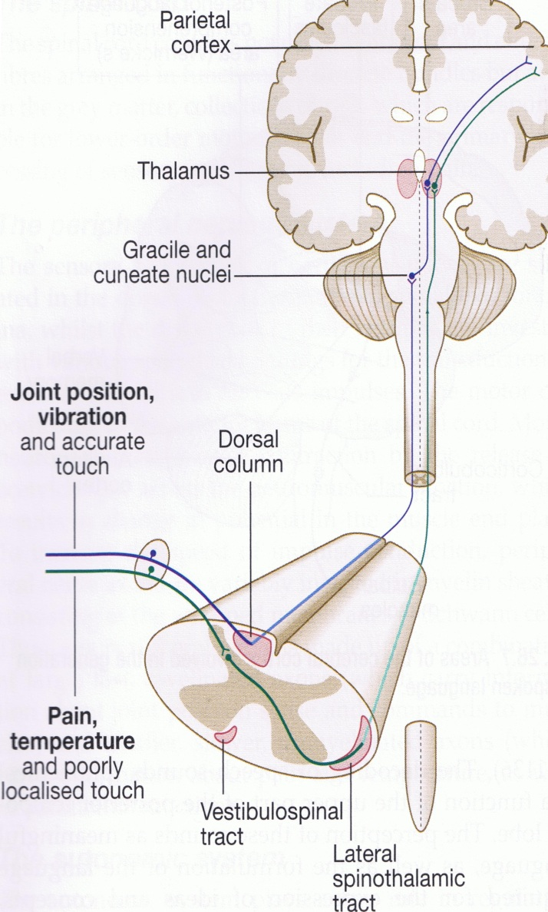
Pain
 | Impossible to quantify Impossible to feel others Acute: Protective Chronic: Self perpetuating Neural Chemical Inflammatory Non inflammatory

Slide 93
Pain
 | Gate control theory. The pain matrix. Medial: Emotional aspects Lateral: Somatic aspects

Slide 94
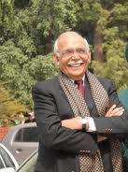
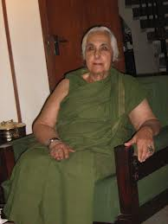
Erudition and Scholarship

Slide 95
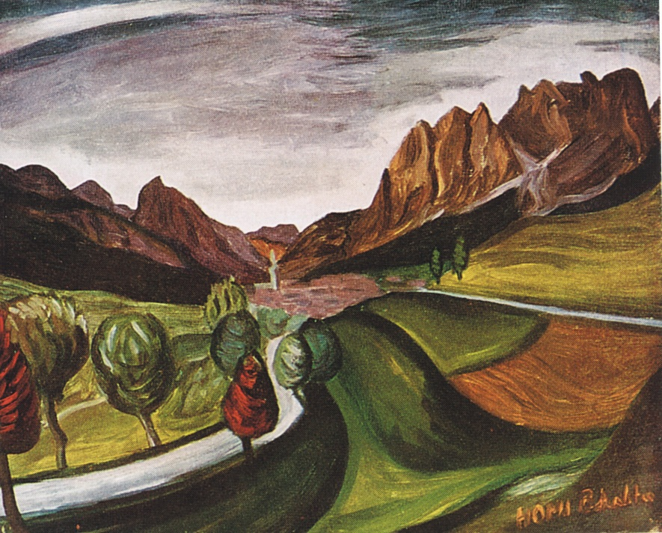
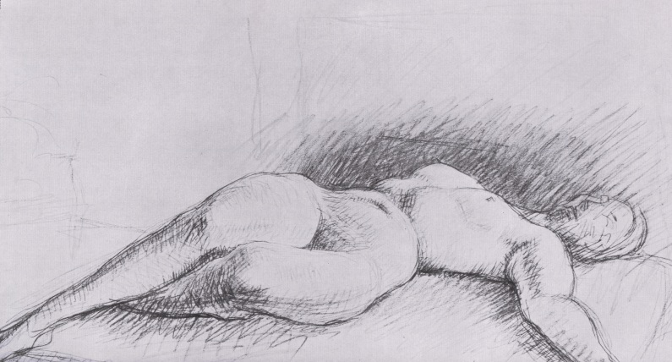
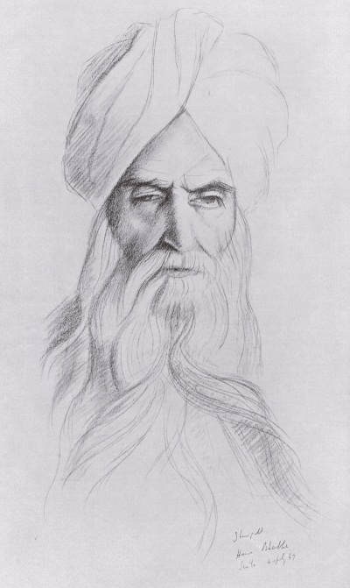

Slide 98
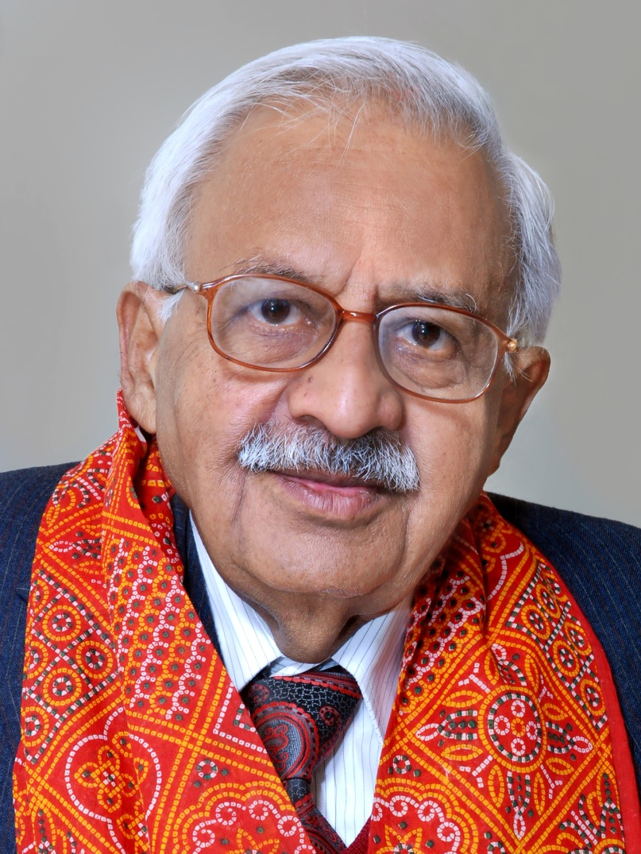
Sridhar Devdatt Deodhar (1938-2011)
“..his life was gentle, and the elements so mix’d,
that nature could stand up and say to all the world;
this was a man.”
William Shakespeare. The Tragedy of Julius Caesar (Act V, Scene V)

Slide 99
Treatment of Rheumatoid Arthritis
19 | 1980’s and beyond

