Slide 1
Challenging Technology Horizons for Expanding Discovery Space
A. N. Ramaprakash
Associate Programme Director, India TMT
(On behalf of ARIES, IIA, IUCAA & others)

Slide 2
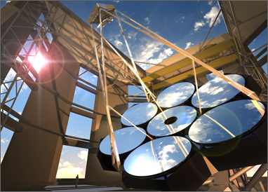
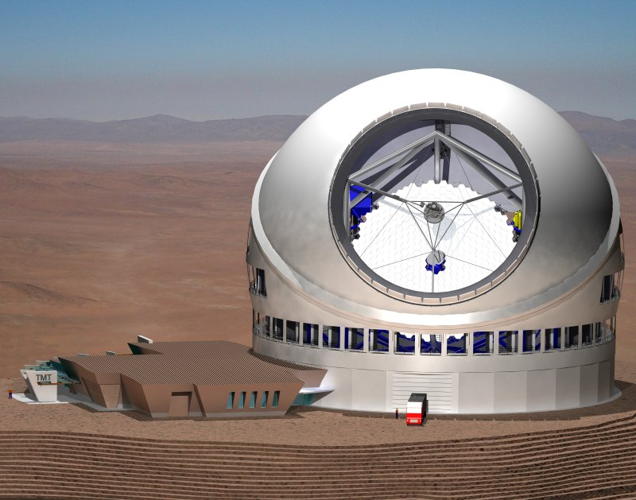
Mega-Optical and IR Facilities
30-m TMT
39-m E-ELT
24.5-m GMT
Three international projects approached Indian communities in 2006-2007
Evaluation process lasted over a year
Need for participation
Selection of the most suitable project
Level of participation and human resources
Community chose TMT for 10% level participation
Guaranteed in-kind contribution
Based on segmented technology with Keck heritage
Smaller group – larger say
Synergy with existing facilities in the Northern hemisphere

Slide 3
India’s Participation
Led by India-TMT consortium
Aryabhatta Research Institute for Observational Sciences (ARIES), Nainital
Indian Institute of Astrophysics (IIA), Bengaluru
Inter-University Center for Astronomy and Astrophysics (IUCAA), Pune
India-TMT Coordination Centre (ITCC) at IIA campus
Funded by DST and DAE
Mega-Facilities for Basic Science Programme
Other institutes and centres
CDAC, TIFR, IIST, IISERs, Universities

Slide 4
India’s Participation Status and Future
2007-2014
Development of consensus among the scientific community
Proposal development
Technology demonstration and Prototype development
Fund approval by the Union Cabinet – 24th Sept. 2014
Agreements signed by Union Cabinet Minister for S&T on 2nd Dec. 2014
2015-2019
Execution of partner work packages
Civil construction stalled
2019 – 2029/30
Resume On-site Construction of TMT International Observatory
Execution of our share of work packages
Development of human resources and readiness to use the facility
2030 – 2080
Science Operations

Slide 5
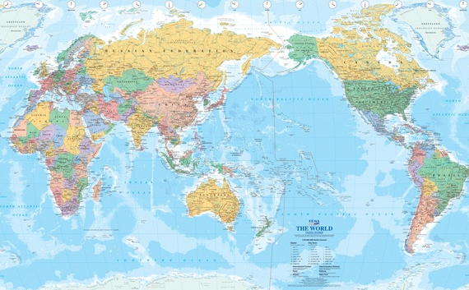
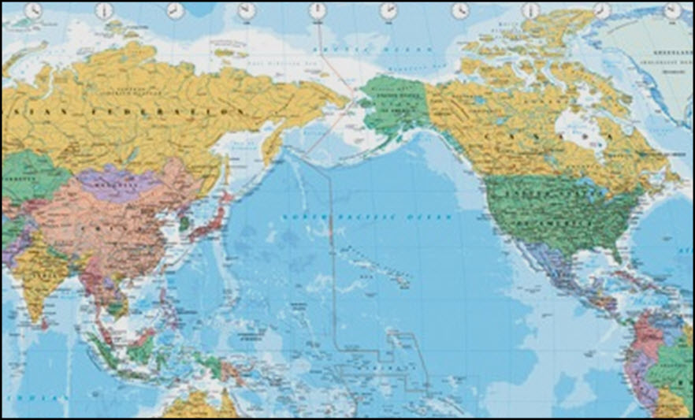
TMT Collaboration
Ottawa 7650 km
Beijing 8470 km
Tokyo 6470 km
Washington, DC 7670 km
Delhi 12250 km
Calif. 4030 km
Mauna Kea

Slide 6
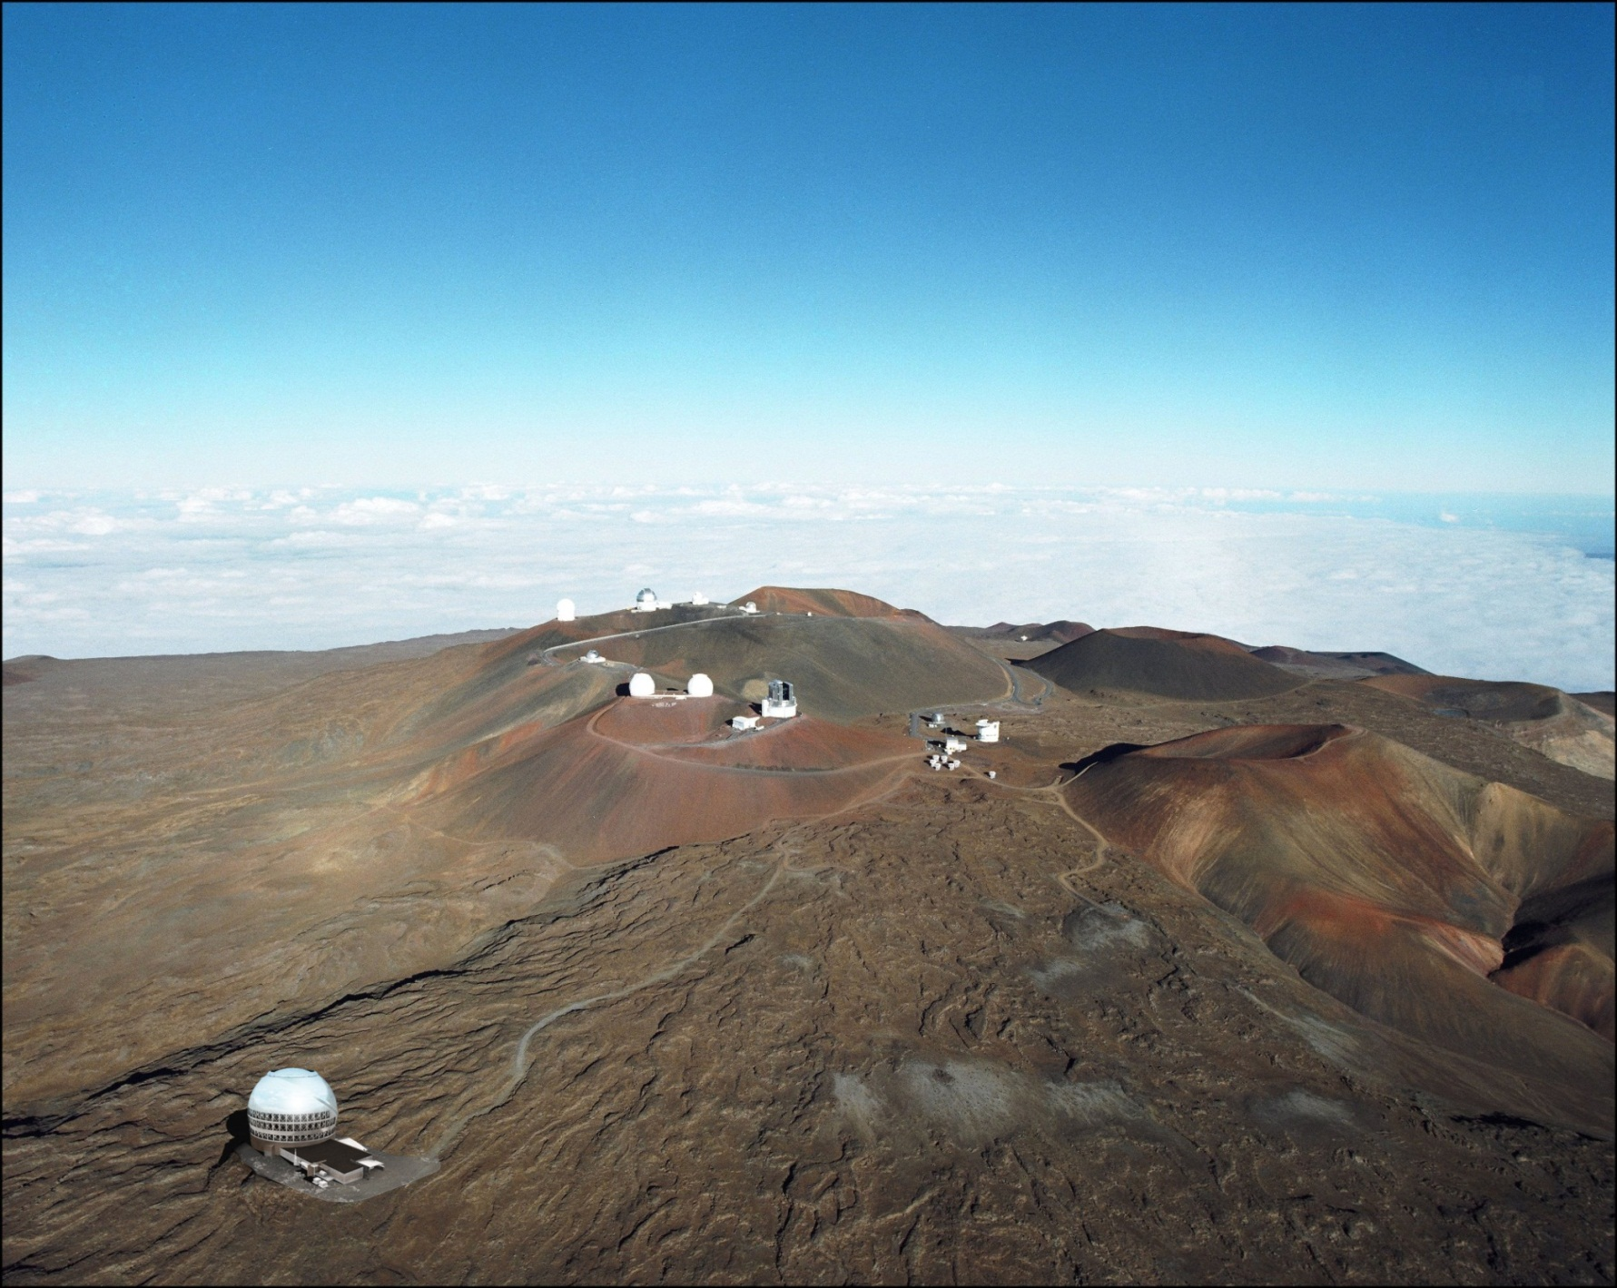
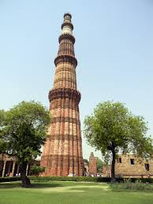
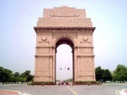
Summit of Mauna Kea ~ 4200m above MSL

Slide 7
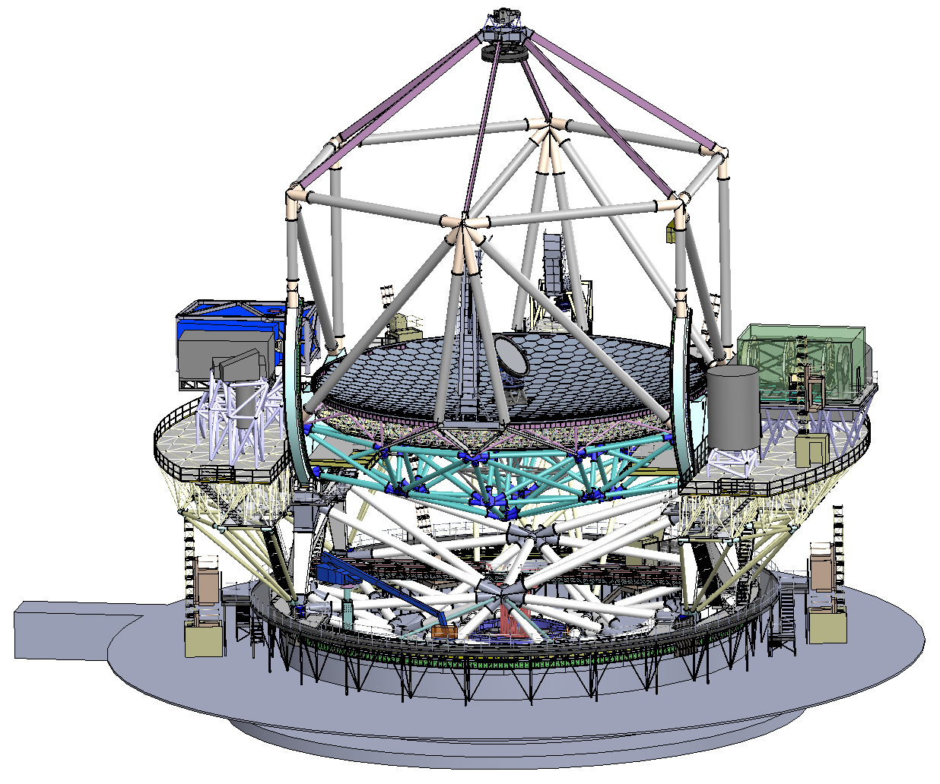
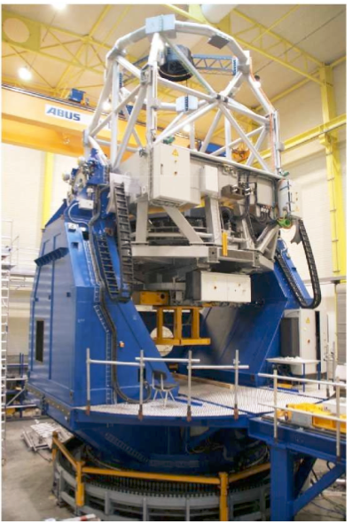
Thirty Metre Telescope Project
Highly segmented (492) primary mirror
Three mirror approach
Flat tertiary mirror allows quick steering of light into a suit of instruments mounted on two Nasmyth focii
Built-in post focal adaptive optics system on one of the Nasmyth platforms
Exploit diffraction limited resolution
Enhance sensitivity to 50-60 times of current largest telescopes

Slide 8
Indian Role
Cash contribution to the project capped at 30%
To a common pool for common fund, infrastructure etc.
Up to 70% of all partner contributions will be made in in-kind
Subsystems (h/w and s/w)
Human resources (b/w)
Services

Slide 9
TMT Observatory: Partners Work Share
Canada: Calotte type dome, AO systems, instruments
USA: Segments, Polishing, Civil Works,
Integration,instruments
Japan:Telescope Structure,
Segment Blanks, segments
instruments
China: tertiary mirror(M3)
Na GS laser launching
Segments, instruments
India : M1 Control system, Software, segments
Instruments

Slide 10
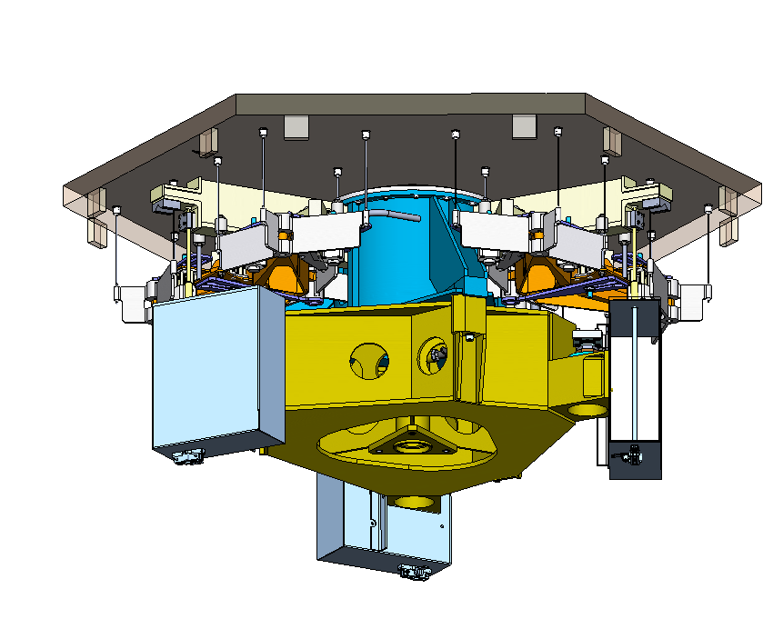
Indian Role

Slide 11
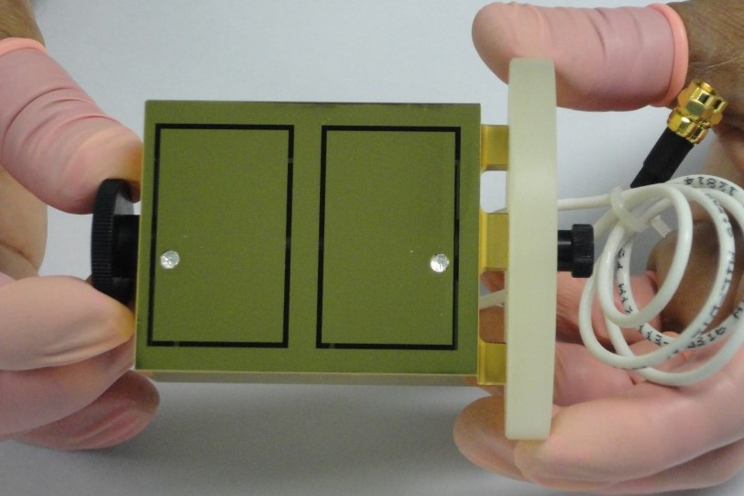
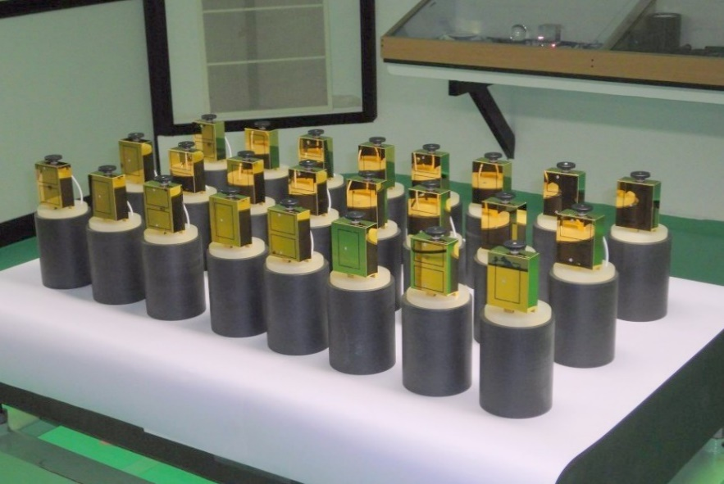
Edge Sensors
Prototype developed at GOAL, Puducherry
Precision machined glass blocks, lithography, etching

Slide 12
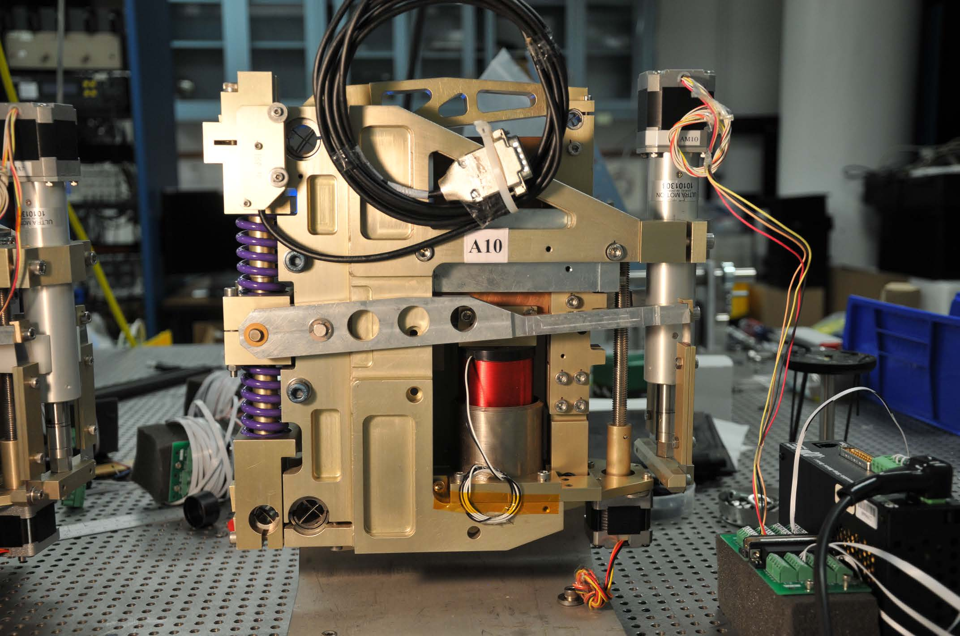
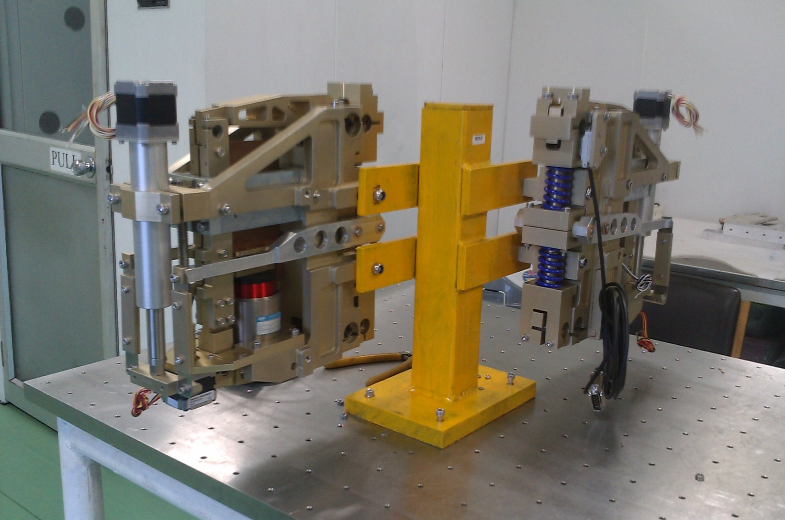
Actuators
Prototypes made at Avasarala Technologies Ltd., Bengaluru

Slide 13
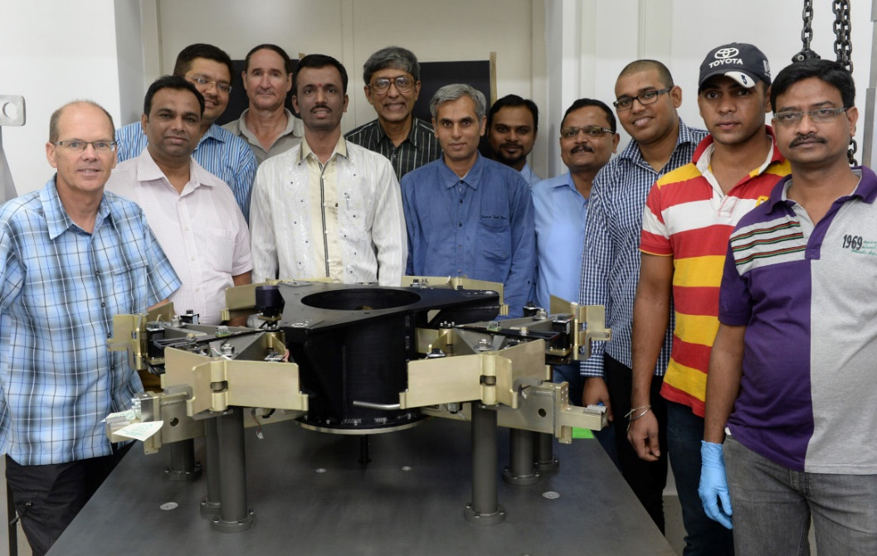
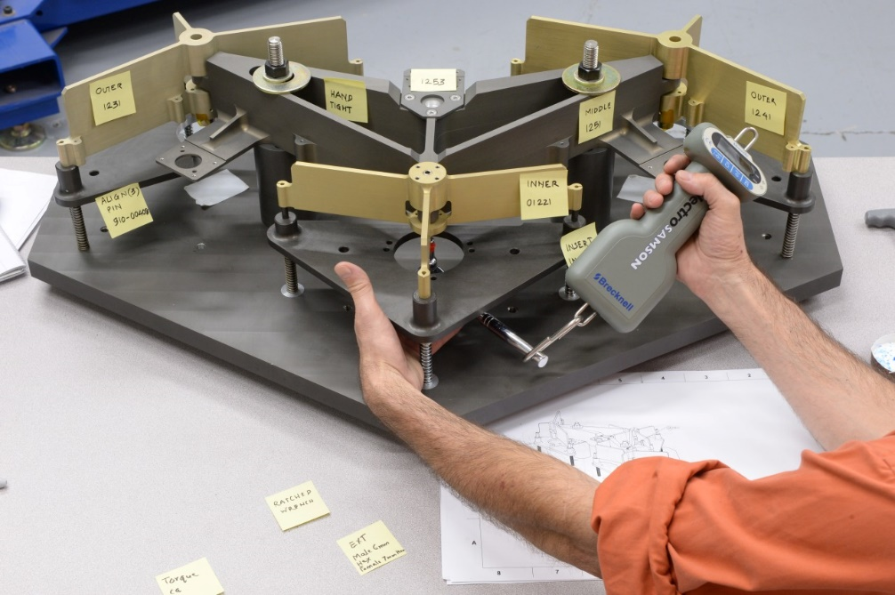
Segment Support Assembly
Prototypes made at Avasarala Technologies, Bengaluru and Godrej & Boyce, Mumbai

Slide 14
Other work in progress
Hardware
Primary Mirror Control System
Industry exploration in progress
M1, M2 and M3 Coating plant
Design work to be initiated
Software
Honeywell, Persistent Systems, Thoughtworks
Observatory Control System
Common Software development started – Thoughtworks, Pune
Initial work with CDAC
Telescope Control System
Preliminary design work initiated – Honeywell, Pune

Slide 15
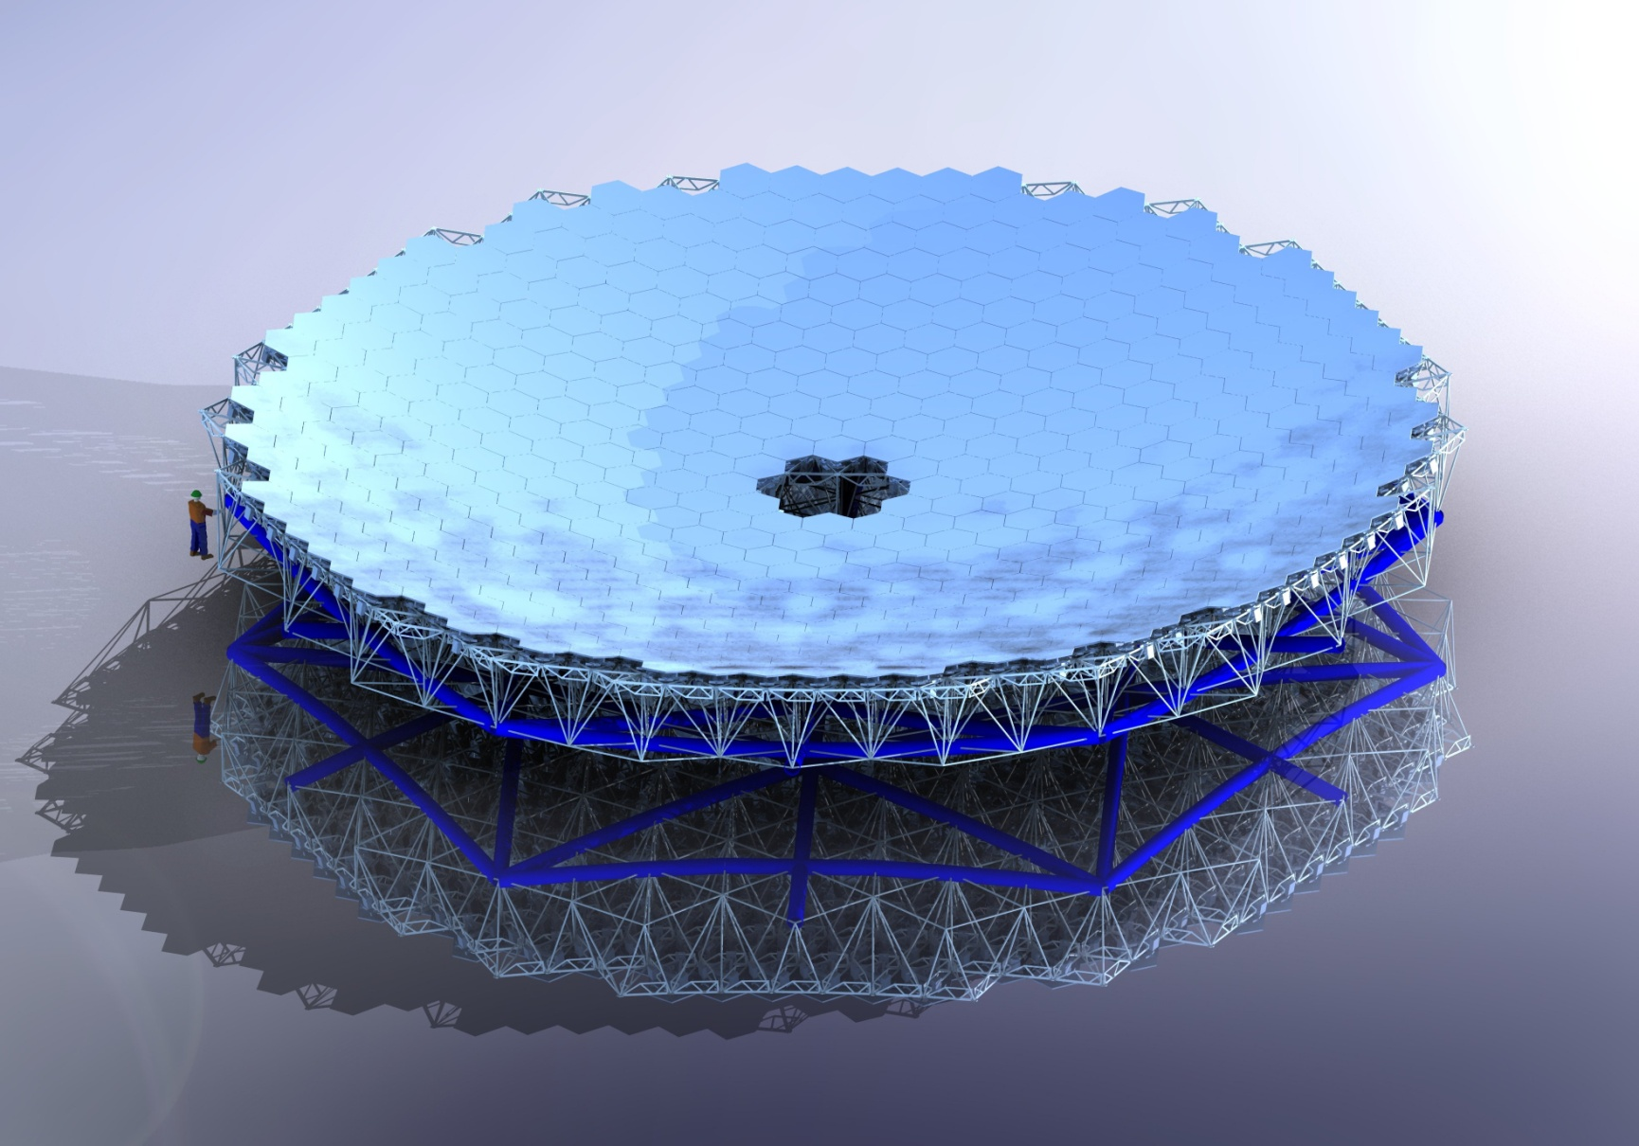
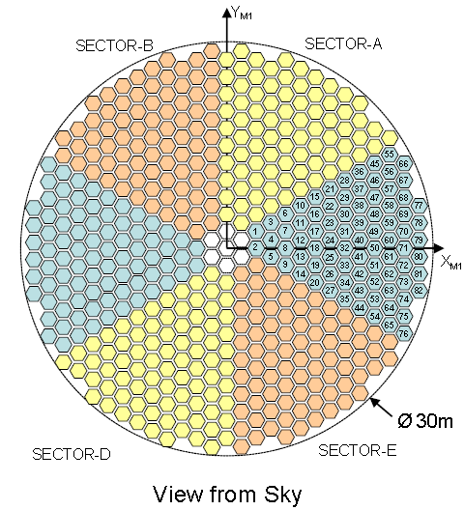
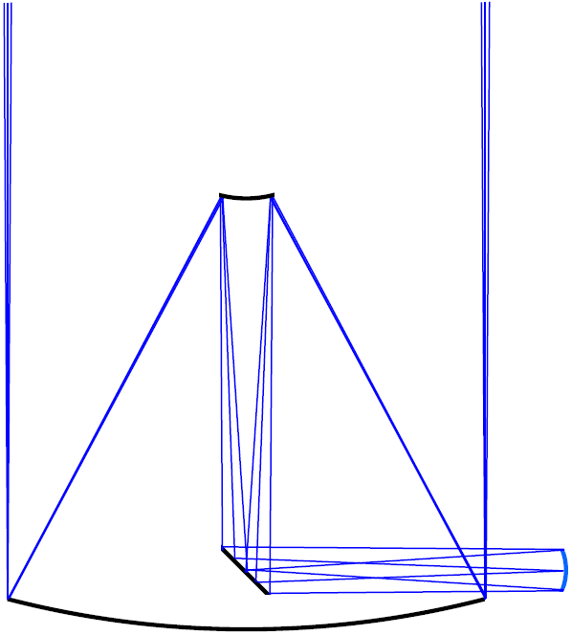
Primary Mirror Segment Polishing
574 segments of 82 different types
492 + 82 spares
1.44 m across corners, 45mm thick
Aspheric, Off-axis
Curvature changes from centre to edge
f/1 near paraboloid primary
Radius of curvature should match to very high precision and good accuracy
Surface roughness <2nm rms with no sub-surface damage
Tight specification on surface figure
India TMT is setting up an optics facility at IIA’s Hosekote campus near Bengaluru

Slide 16
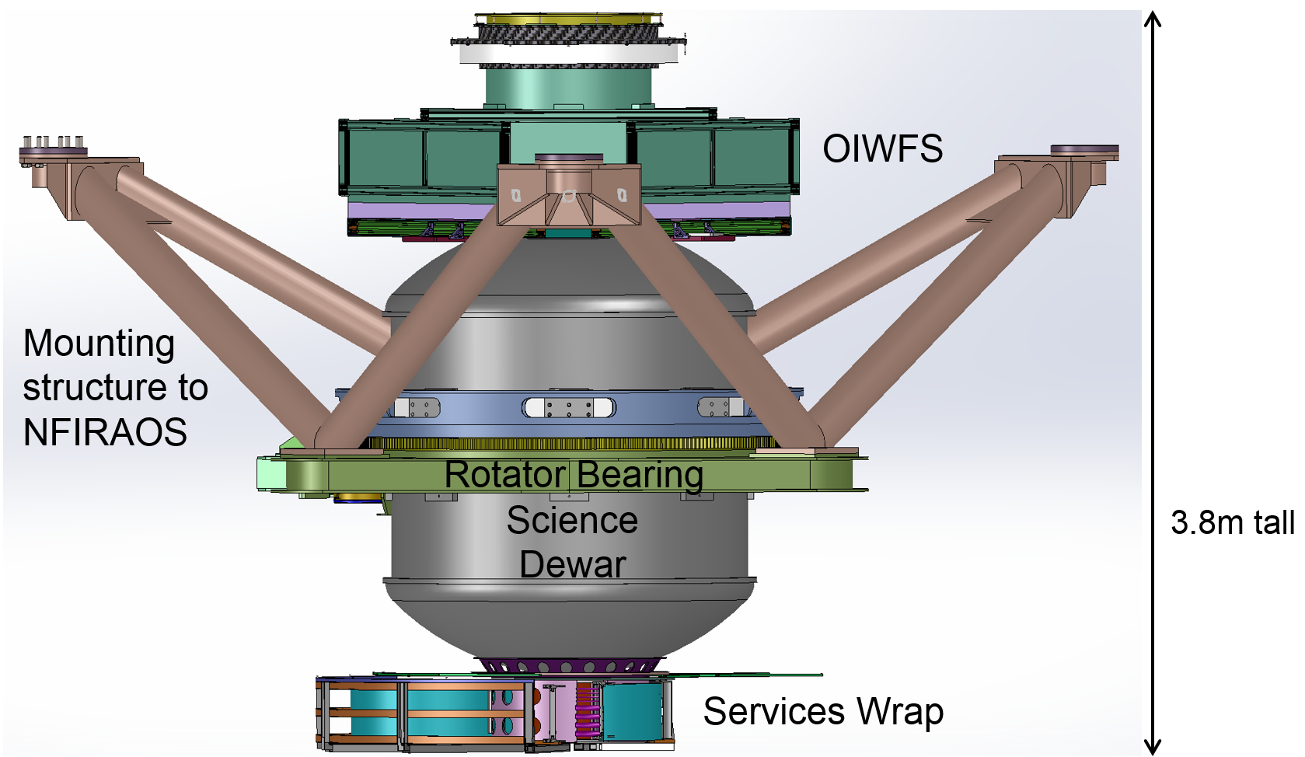
First Light Instruments

Slide 17
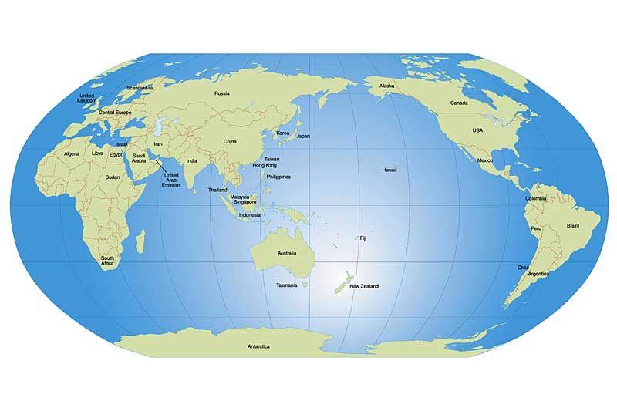
TMT Global Participants
USTC, Beijing
(MOBIE AGWFS)
NAOJ/Canon, Tokyo
(IRIS imager, MOBIE cameras)
HIA, Victoria
(IRIS OIWFS)
DI, Toronto
(IRIS Science, NSCU)
TIPC, Beijing
(Cooling)
CSEM, Neuchatel (IRMS CSU)
UCSC, Santa Cruz
(MOBIE)
IUCAA, Pune (IR readout electronics)
UCLA/CIT
(IRIS, IRMS)
IIA, Bangalore (IR-GSC)
NIAOT, Nanjing (MOBIE AGWFS)
UH IfA, Hawaii
(MOBIE detector readout electronics)

Slide 18
Challenges
Globally distributed construction of such a complex and precision equipment
Heterogenous work force
levels of expertise and exposure
work cultures
industry standards
language (spoken and written)
time zones
Laws and Regulations
taxes, duties
labour
environment
health and safety
intellectual property
dispute resolution
ownership
liabilities

Slide 19
Challenges
Logistics
Import, Export Processes
Packaging
Shipping
Insurance
Long duration
Retention of knowhow and key personnel
Motivation of workforce
Changes in technology
Changes in scientific aspirations and landscape
Changes in funding support

Slide 20
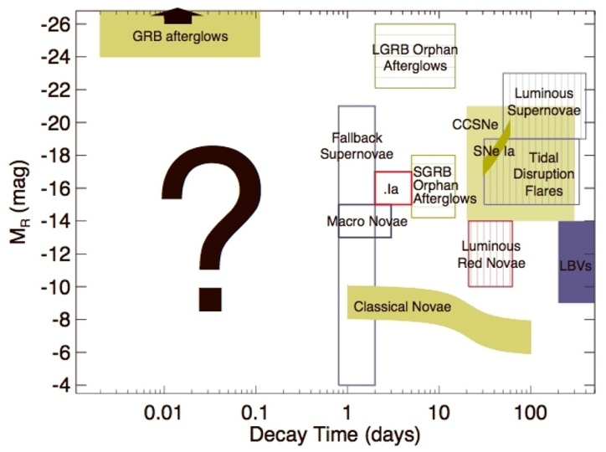
TMT Discovery Space – the known unknowns

Slide 21
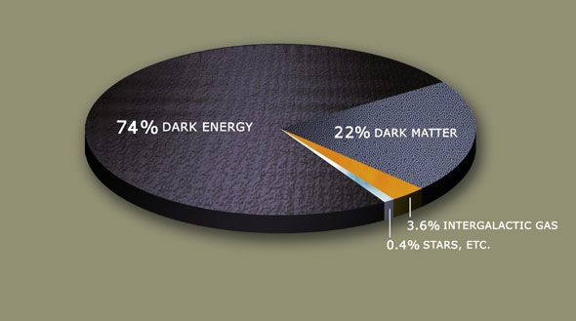
Our Universe

Slide 22
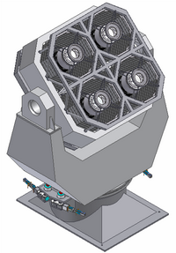
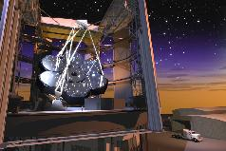
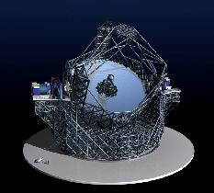
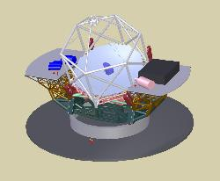
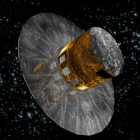
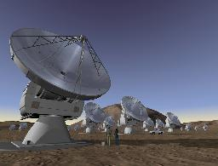
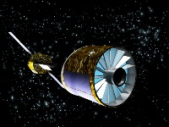
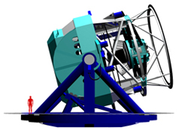
Astonishing future, Fundamental questions
How and when did the universe come into being?
How did galaxies take birth and evolve into what we see today?
What is the large scale structure of this universe?
Is there stuff we can’t see? If so how much?
Is there life anywhere else in this universe?
How do massive blackholes form and evolve?

Slide 23
Beyond Imagination

Slide 24
Imagining the knowns
Imagining the knowns and discovering the unknowns
Thank You

