Slide 1
Technology spin-offs and societal benefits of INO project
Dr. B.Satyanarayana ▪ Department of High Energy Physics
Tata Institute of Fundamental Research
Homi Bhabha Road ▪ Colaba ▪ Mumbai ▪ 400005 ▪ INDIA
T: 09987537702 ▪ E: bsn@tifr.res.in ▪ W: http://www.tifr.res.in/~bsn ▪ F: bheesette

Slide 2
ICAL detector and construction
Our own ‘Made In India’ mega science project

Slide 3
Facts and figures of ICAL

Slide 4
Deployment scenario of RPCs

Slide 5
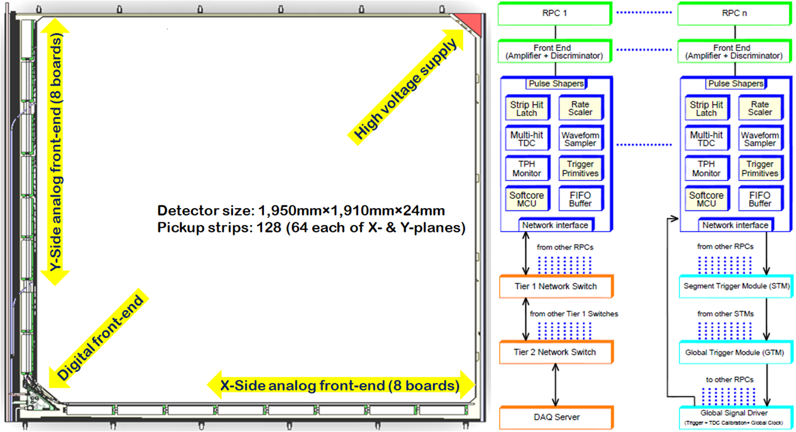
Detector and instrumentation
Design, development and characterisation of RPCs to their industrial production.
Materials design, production and process optimisation.
Overall scheme of electronics, DAQ and trigger systems.

Slide 6
Indigenous industrial solutions
Polycarbonate components for RPC gap making
Pickup panels for signal extraction from RPC detectors

Slide 7
Industrial production of RPCs

Slide 8
Generations of gas systems
ICAL detector holds about 200,000 litres of gas all the time. Gas recycling system ensures that almost no gas is wasted.

Slide 9
Integrated circuits development

Slide 10
DAQ and trigger systems

Slide 11
ICAL prototype detector stack

Slide 12
Selfie tomography of an RPC!

Slide 13
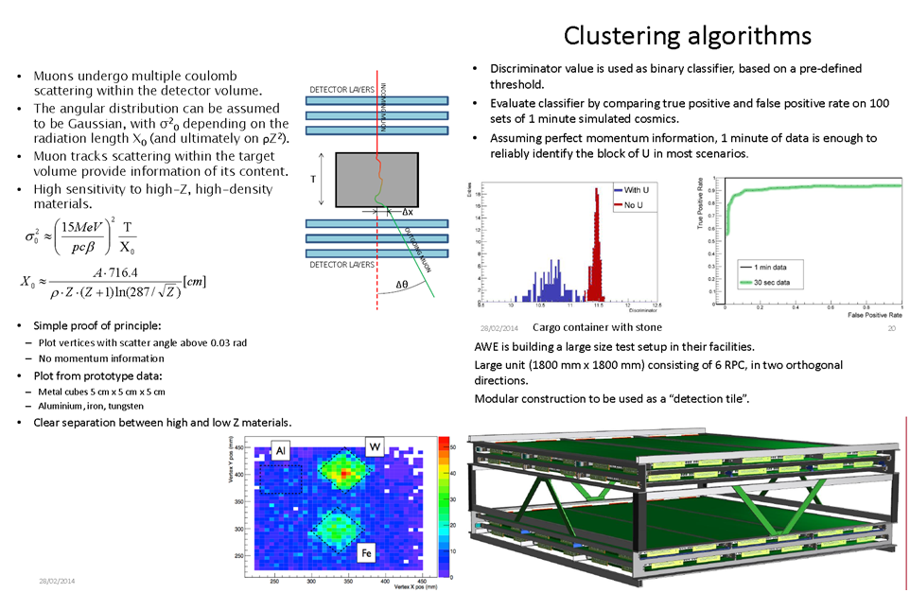
RPC muon tomography
Drift tubes and Scintillators are presently used.
BAESSO, Paolo

Slide 14
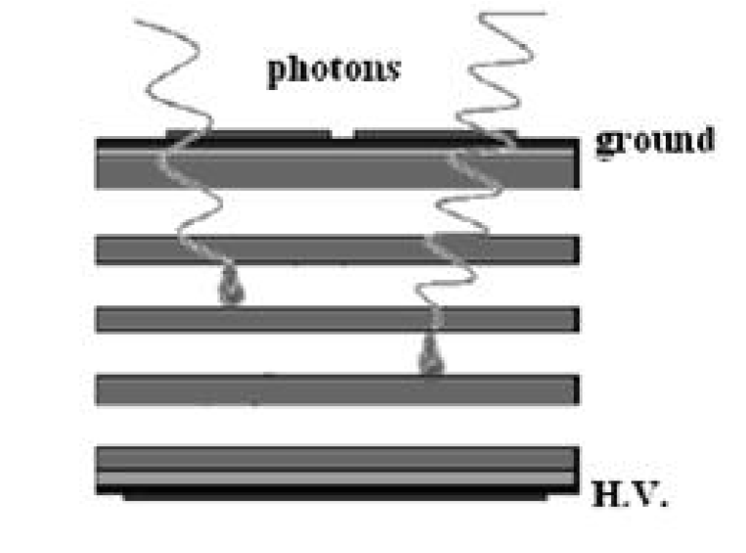
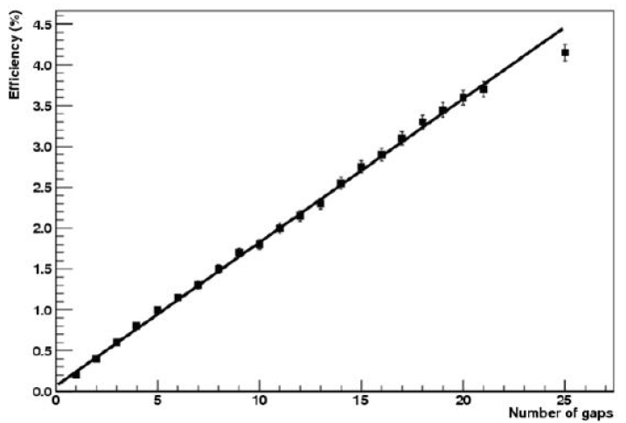
MRPCs for PET imaging
Detector with good efficiency, spatial, timing and energy resolutions.
Low system dead time (lower dose)
Rejection of scattered, random or multiple events.
Scintillation crystals (Bismuth Germanium Oxide (BGO), Gadolinium Oxyorthosilicate (GSO), Lutetium Oxyorthosilicate (LSO), etc.) current choices.
MRPC is a cheaper, works on direct detection, with higher FOV
Gamma sensitivity saturates at a thickness of 400µm for bakelite, 200µm common glass and 150µm for lead glass.
Standard electrodes are coated with with high Z material acting as γ-e converter.
Maria Necchi

Slide 15
RPC-PET for small animals
FONTE, Paulo

Slide 16
INO’s Multi-gap RPC setup

Slide 17
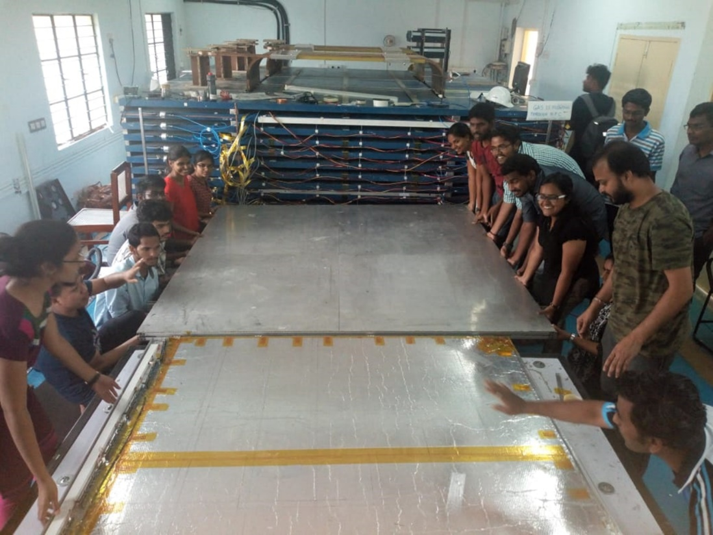
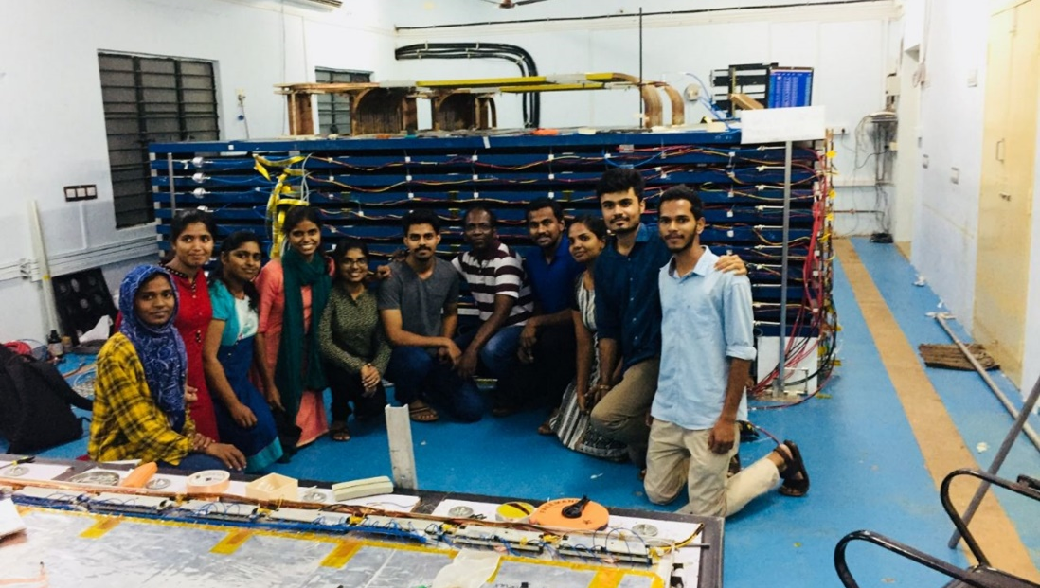
Student training and INO School

Slide 18
Nuclear weapons inspection
Spent nuclear fuel has long been a major source of concern for regulatory agencies as plutonium produced in reactors could be diverted for building weapons.
Detectors can monitor anti-neutrinos produced during the fission reactions in the reactors in real time.
A network of neutrino detectors are also useful to estimate radioactive material reserves.

Slide 19
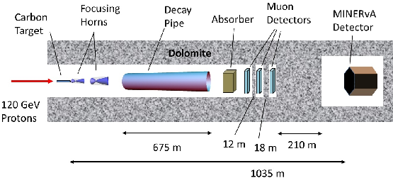
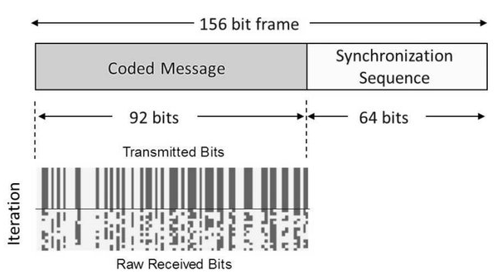
Neutrino based communication?
Electromagnetic radiation is today's carrier of choice for moving information.
Can’t work in some situations. Neutrinos as the carrier!
First demonstration by MINERvA experiment at Fermilab in 2012 (arXiv.org > hep-ex > arXiv:1203.2847).
Word ‘neutrino’ transmitted at 0.1bits/s!!!
Futuristic, but looong way to go …

Slide 20
Deliverables of INO project
Design of state-of-the-art engineering infrastructure
Thorough understanding of basic detector physics and engineering
Cutting edge signal processing, trigger, data acquisition, network and software technologies
Able support of local industry at all stages is crucial
Successful model of collaborative scientific research
Corporate class financial, personnel and project management practices
Scientific human resource development
Public outreach and societal responsibilities

