Slide 1
ASET COLLOQUIUM
TATA INSTITUTE OF FUNDAMENTAL RESEARCH
MUMBAI
October 23, 2015

Slide 2
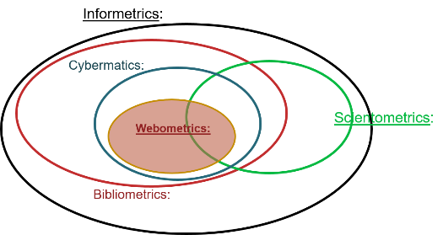
Websites of Astronomy And Astrophysics Libraries: A Webometric Study
Dr. R. Prabakaran
Scientific Information Resource Centre
Tata Institute of Fundamental Research
Mumbai 400 005

Slide 3
Webometrics
Quantitative study of the websites on World Wide Web is called Webometrics. It analyses the World Wide Web to get knowledge about the number and types of hyperlinks, structure of the World Wide Web and usage patterns.
Webometrics is a science based on informetrics methods which studies the nature and characteristics of websites.
Webometrics has the origin from bibliometrics in line with other metric studies, viz., Infometrics, Scientometrics and Cybermetrics.

Slide 4
5 Metrics of Information
Informetrics: Relating to information
Bibliometrics:
Relating to publications and their citations
Cybermetrics: Relating to information in the virtual space
Scientometrics:
Relating to scientific literature
Webometrics:
Relating to web contents and interrelation

Slide 5
Over view of Webometrics
The web has a greater impact on communications and society than perhaps any other technology.
Webometrics is important because the number of web pages and contents are increasing everyday.
On the web, the data can be shifting, web pages can disappear or alter, URL’s may change and documents can become inaccessible.
Webometric techniques are expected to continue to evolve in response to new web developments.

Slide 6
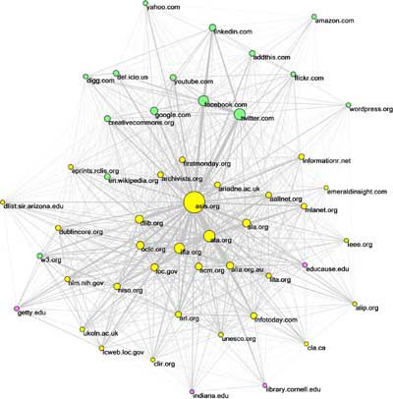
Purpose of Webometric Study
The purpose of webometric study is to audit websites in order to measure the web structures, content, visibility and presence. The focus areas of study includes the number of web pages, in-links, out-links and the most popular link(s), etc.
Methods of Journal Impact Factor (JIF) have been adopted for web link studies and is called Web Impact Factor (WIF).
There are various types of WIFs, such as Simple WIF, Self-Link WIF, External-Link WIF and Revised Link WIF. Ranking of websites are calculated on the basis of these WIFs.
Other criteria followed to rank the websites are Google PageRank, Alexa Traffic Rank and Web Indicators for Science, TEchnology and Innovation Research (WISER).

Slide 7
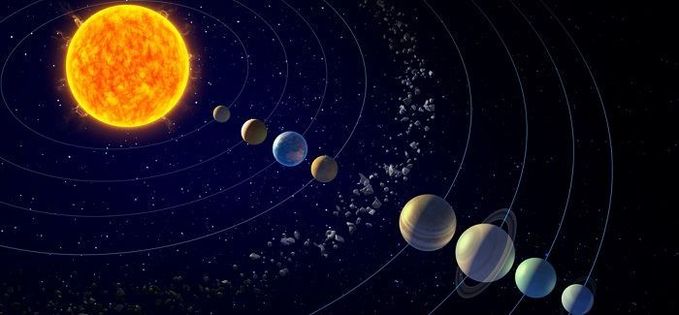
Astronomy related Institutions and Libraries’ Websites
National and International Level
S. N. | Subject Category | No. of Institutions / Universities | Countries | No. of Library Websites | Excluded from the study (no or poor website) | Included for the study
1 | Astronomy and Astrophysics | 405 | 69 | 55 | 350 | 55
2 | Observatory | 445 | 78 | 41 | 404 | 41
3 | Space Science | 93 | 104 | 17 | 76 | 17
 | Total | 943 | 251 | 113 | 830 | 113

Slide 9
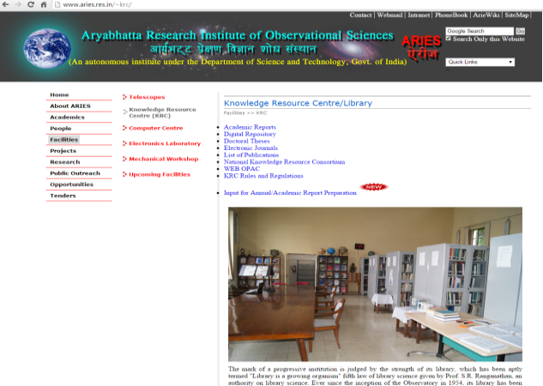
Website of Astronomy and Astrophysics Libraries (sample)
S.N. | Astronomy and Astrophysics Library | Country | Website
1 | Aryabhatta Research Institute of Observational Sciences Library | India | http://www.aries.res.in/facilities/library/
2 | Indian Institute of Astrophysics Library | ‘’ | http://www.iiap.res.in/facilities/library
3 | Inter-University Centre for Astronomy and Astrophysics Library | ‘’ | http://www.iucaa.ernet.in/~library/
4 | National Centre for Radio Astrophysics Library | ‘’ | http://ncralib1.ncra.tifr.res.in/library/
5 | Argentine Institute for Radio Astronomy Library | Argentina | http://www.iar-conicet.gov.ar/biblio/
6 | Institute for Research in Astronomy and Astrophysics Library | ‘’ | http://www.iafe.uba.ar/docs/biblioteca.html
7 | Astronomical Society of South Australia Library | Australia | http://www.assa.org.au/facilities/library/
8 | Astronomy Library, University of Vienna | Austria | http://bibliothek.univie.ac.at/fb-astronomie/astronomy_library.html

Slide 10
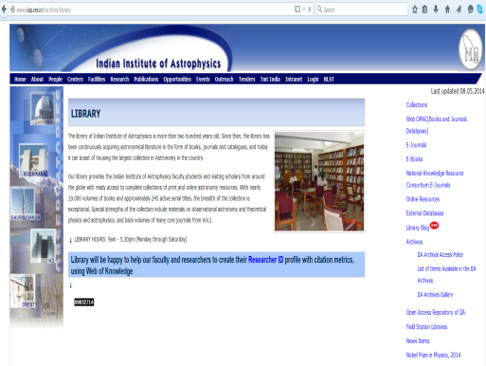
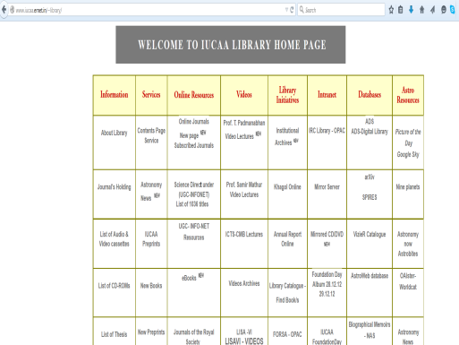
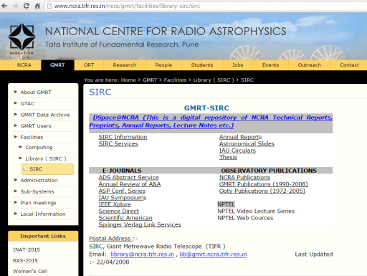
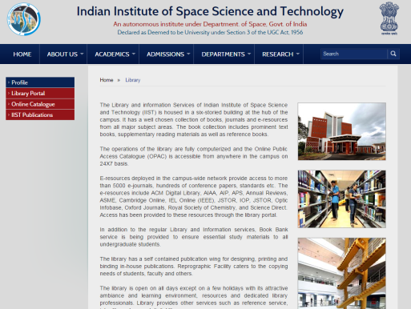
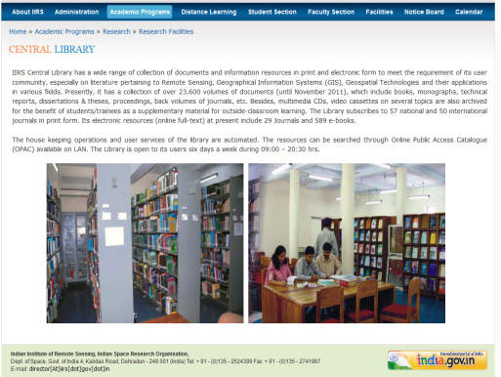
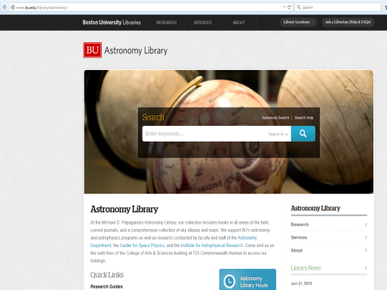
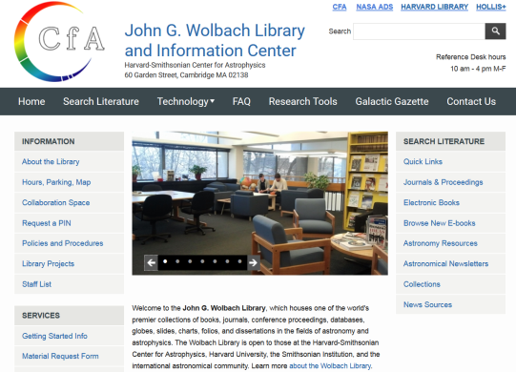
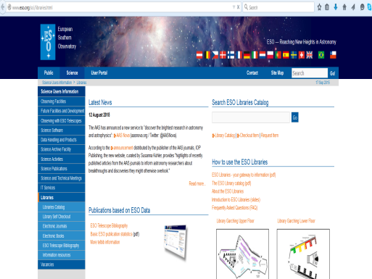
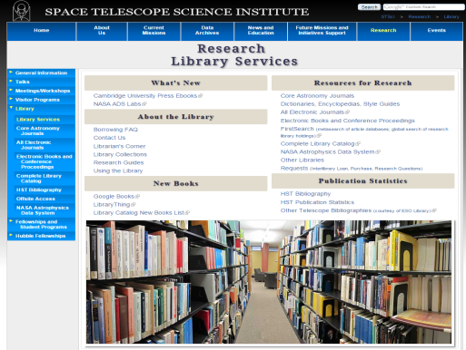
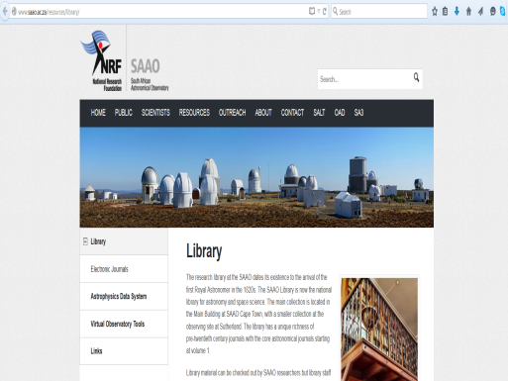
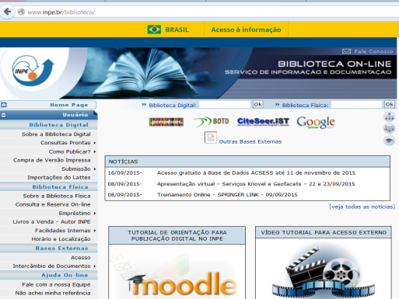
Sample Websites of
Astronomy related Libraries in India
and select sample from the rest of the World

Slide 11
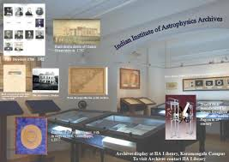
Profiles of Astronomy and Astrophysics Libraries
Astronomy Libraries have been a support for the study and research activities of the parent institution with its collection of books, journals, print / electronic resources in astronomy and related disciplines. Services are also provided through the library website.
For the research study, it has been classified in to 3 categories, viz. Astronomy and Astrophysics, Observatory and Space Science Libraries.
The brief details such as its establishment, location, country, collection, services through the website have been collected for 55 Astronomy and Astrophysics, 41 Observatory and 17 Space Science Libraries in India and International.

Slide 12
Objectives of the study - I
To trace and classify websites of Astronomy and Astrophysics Libraries;
To investigate and analyse the number of web pages, web link structure and rich files of Astronomy and Astrophysics Libraries’ Websites;
To measure/calculate the Web Impact Factor of Astronomy and Astrophysics Libraries’ Websites;

Slide 13
Objectives of the study - II
To assess the web performance based on total size of the contents and download speed; and evaluate web accessibility errors of Astronomy and Astrophysics Libraries’ Websites;
To rank and compare the Astronomy and Astrophysics Libraries’ Websites by applying various tools, i.e. WIF, WISER, Google PageRank and Alexa Traffic Rank.
To present the Link Network Analysis of Astronomy and Astrophysics Libraries’ Websites by using SocSciBot and Pajek Software.

Slide 14
Research Methodology
Investigative and descriptive methods of research were followed for this study.
The study focused on the six areas of Webometrics.
Web Page Content Analysis;
Web Link Structure Analysis;
Web Impact Factor (WIF);
Ranking of Websites;
Performance and Accessibility;
Link Network Analysis.

Slide 15
Research Methodology
Astronomy and Astrophysics Institutions, Observatories and Space Science Research Institutions/Agencies have been identified by referring to Encyclopaedia of Astronomy and Astrophysics, Physics and Astronomy Directory and also Wikipedia.
Each institution’s websites were browsed to find out these specific subject areas and filtered other subjects.
Only the libraries that have proper website/web pages were selected for the research study.

Slide 16
Research Methodology
The reasons for the libraries website that have been excluded are as follows:
The departmental library and its website deals apart from Astronomy viz., Mathematics, Physics, Optics, Electronics and Meteorology.
Website provided only catalogues.
Website is forbidden.
Website has provided only the list of books.
Website has provided only information in few lines.
Website has provided only the contact information.
Website has provided the catalogue search only.

Slide 17
Tools Used for Data Collection
Webometric tools comprise of web crawler software: SocSciBot4 full version (for link analysis), Search Engine Optimization (SEO) tools (for link extractor); Google Search Engine; Google Scholar (for academic items);
Alexa Web Analyst (for web traffic); Web Page Analyzer (for website performance tool and web page speed analysis);
WAVE: web content evaluator (for accessibility and error); and Pajek 2.03 Software for large network analysis.

Slide 18
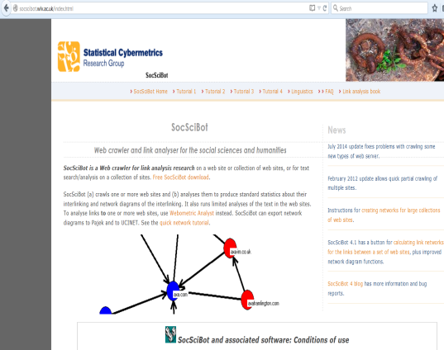
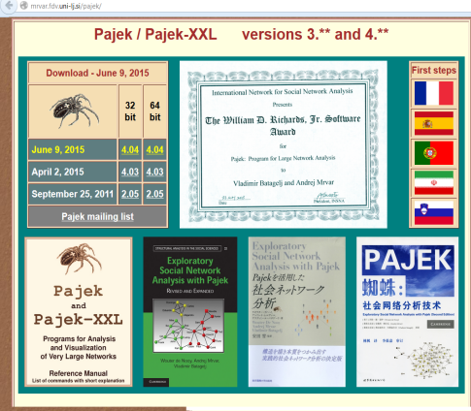
Software Tools
SocSciBot4 full version (http://socscibot.wlv.ac.uk/) has been downloaded after the permission of Prof. Mike Thelwall, Statistical Cybermetrics Research Group, University of Wolverhampton, U.K.
SocSciBot software has been used to extract various links from the Library website and for link network analysis.
Pajek 2.03 software (developed by Vladimir Batagelj and Andrej Mrvar, University of Ljubljana, Slovenia) has been downloaded for large network analysis [http://vlado.fmf.uni-lj.si/pub/networks/pajek/].

Slide 19
Data Collection
Each Library Website has been navigated to analyse the content of the web pages and gathered information on Authority, Collection Details, Contact Details, Digital Repository, Frequently Asked Questions (FAQ), Feedback, Links to E-resources, News, OPAC, Online Forms, Sites Language, Site Map and Update Status.
The required data on Total Number of Web Pages and Out Links or External Links were extracted using SocSciBot software.
The data on In-Links or Back Links, Self Links and Total Links were extracted by using SEO tools viz., backlinkwatch.com, www.check-domains.com/seo/tools/link-analyzer/ and www.webmaste-toolkit.com/link -extractor.shtml respectively.

Slide 20
Data Collection
Rich files consist of PDF, PS, DOC and PPT and the data on these were collected through Google Search Engine by using the search syntax example, site:abc filetype:pdf, site:abc filetype:ps, site:abc filetype:doc and site:abc filetype:ppt respectively.
From Google Scholar data was collected on domain name of the library websites. For each website, Google PageRank was collected by using www.checkpagerank.net.
For each website, Traffic ranking was collected by using Alexa Traffic Rank (www.alexa.com).

Slide 21
Data Collection
The data on total size of the website, images and download speed were collected from ‘Web Page Analyzer’ (www.websiteoptimization.com/services/analyze).
The data on Website Accessibility Error for each website was collected from the website WAVE (wave.webaim.org).

Slide 22
Web Page Content Analysis
Astronomy / Astrophysics courses or research are carried out in 405 institutions / universities from 45 countries. A total of 55 libraries’ websites from 24 countries are analysed.
Around 445 observatory facilities are available in 59 countries. A total of 41 libraries’ websites from 19 countries are analysed.
Space science research are carried out in 93 institutions from 46 countries. A total of 17 libraries’ websites from 11 countries are analysed.

Slide 23
Web Page Content Analysis
The analysis covers types of contents, designs, features, contacts, links, functionality, usability and accessibility.
The aim of the analysis is to find out the qualities of the website and services.
The qualities are measured on the basis of its authority, usefulness, relevance, clarity, accuracy, completeness, influence, intended audience, maintenance and consistency.

Slide 24
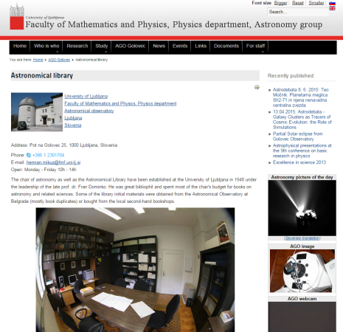
Content Analysis
Comparison of Content Analysis of the Websites of AA, OBS and SS Libraries
S.N. | Subject Categories | Parameters
 |  | Authority | Collection Details | Contact Details | Digital Repository | FAQ | Feedback | Links to E-resources | News | OPAC | Online Forms | Site in English | Site Map | Site Update Status
1 | Astronomy and Astrophysics Libraries’ Websites | 55 | 41 | 55 | 9 | 3 | 15 | 42 | 13 | 42 | 14 | 40 | 13 | 20
2 | Observatory Libraries’ Websites | 41 | 33 | 40 | 9 | 7 | 10 | 34 | 8 | 35 | 8 | 32 | 8 | 14
3 | Space Science Libraries’ Websites | 17 | 15 | 14 | 5 | 2 | 5 | 11 | 4 | 12 | 4 | 15 | 6 | 7

Slide 25
Web Link Structure Analysis
Number of Web Pages (NWP) is the number of web pages in a particular website
External Links (EL) is the number of external links provided in a particular website
In-Links (IL) is the number of links that particular site received from another site
Self Links (SL) is the number of links (internal links) within a particular website
Total Links (TL) is the total number of links in a particular website

Slide 26
Web Link Structure Analysis (AA)
55 AA Libraries’ Website have:
Number of Web Pages between 1 page to 6,653 pages
External Links between 0 to 5,96,025
In Links between 11 to 1,03,048
Self Links between 4 to 200
Total Links between 7 to 368
Percentage-wise emphasis of web pages and various links illustrate that
Number of Web Pages: 1.77%
External Links: 75.33%
In Links: 22.51%
Self Links: 0.15%
Total Links: 0.24%

Slide 27
Web Link Analysis AA Libraries in India and USA (Sample)

Slide 28
Web Link Structure Analysis (OBS)
41 OBS Libraries’ Website have:
Number of Web Pages with a range from 1 page to 6,481 pages,
External Links varies from 0 to 2,42,099,
In Links from 31 to 99,399,
Self Links from 0 to 132
Total Links from 1 to 396
Percentage-wise emphasis of web pages and various links of illustrate that
Number of Web Pages: 3.20%
External Links: 61.15%
In Links: 35.10%
Self Links: 0.22%
Total Links: 0.33%

Slide 29
Web Link Structure Analysis (SS)
17 SS Libraries’ Website have:
Number of Web Pages with a range from 1 page to 2,373 pages
External Links varies from 0 to 2,05,334
In Links from 11 to 65,568
Self Links from 0 to 137
Total Links from 0 to 145
Percentage-wise emphasis of web pages and various links illustrate that
Number Web Pages: 1.29%
External Links: 56.81%
In Links: 41.49%
Self Links: 0.19%
Total Links: 0.22%

Slide 30
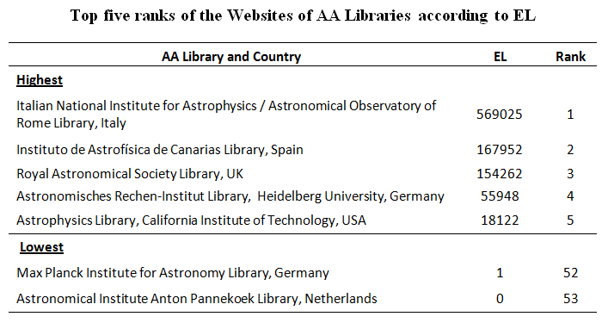
Link Analysis of AA, OBS and SS Libraries’ Websites
The data analysed and computed for Libraries’ Websites of AA, OBS and SS are summarized and the top 5 ranks according to highest and lowest of NWP, EL, IL, SL and TL have been ranked.
When compared Link Analysis of AA, OBS, SS Libraries websites, it has been indicated that the number of External Links (EL) or Out Links are higher than other links described above for all 3 categories.

Slide 31
Web Impact Factors (WIFs)
The impact of website measured with various types of links is considered Web Impact Factors (WIFs).
There are 4 types of WIFs, such as Simple WIF (SWIF); Self-Link WIF (SLWIF); External-Link WIF (ELWIF); and Revised WIF (RWIF).
WIFs are calculated with the following formulas:
SWIF = B/A, where B = Total Links and A = Number of Web Pages
SLWIF = C/A, where C = Self Links and A = Number of Web Pages
ELWIF = D/A, where D = External Links and A = Number of Web Pages
RWIF = E/A, where E = In Links and A = Number of Web Pages

Slide 32
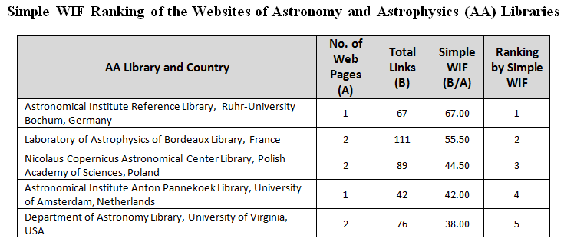
Highest Web Impact Factors (WIFs) Ranking - SWIF
Astronomical Institute Reference Library, Ruhr-University Bochum, Germany stands first position with 67 total links and 1 web page with 67 SWIF.
South African Astronomical Observatory Library stands first position with 210 total links and 2 web pages with 105.00 SWIF.
Institute of Space Technology Library, Pakistan stands first position with 102 total links and 1 web page with 102.00 SWIF.
Ranking of AA, OBS, SS Libraries’ Websites according to Simple Web Impact Factor indicated that more number of Total Links and less Number of Web Pages ranks top.

Slide 33
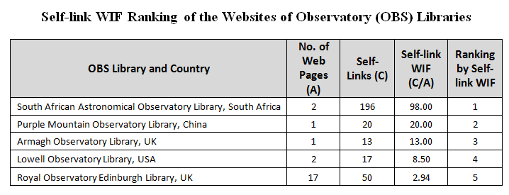
Highest Web Impact Factors (WIFs) Ranking - SLWIF
Astronomical Institute Reference Library, Ruhr-University Bochum, Germany stands first position with 43 self links and 1 web page with 43.00 SLWIF.
South African Astronomical Observatory Library stands first position with 196 self links and 2 web pages with 98.00 SLWIF.
Institute of Space Technology Library, Pakistan stands first position with 92 self links and 1 web page with 92.00 SLWIF.
Ranking of AA, OBS, SS Libraries’ Websites according to Self-link Web Impact Factor indicated that more number of Self-Links and less Number of Web Pages proportionately ranks top.

Slide 34
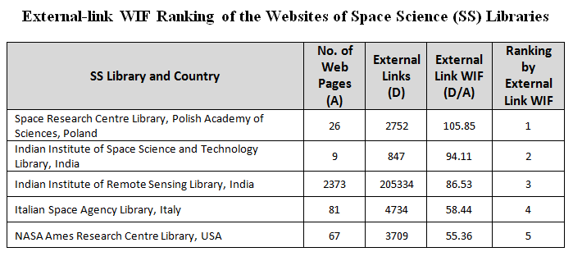
Highest Web Impact Factors (WIFs) Ranking - ELWIF
Italian National Institute for Astrophysics Library holds first position with 5,96,025 external links and 3,622 web pages with 164.56 ELWIF.
South African Astronomical Observatory Library holds first position with 447 external links and 2 web pages with 223.50 ELWIF.
Space Research Centre Library, Polish Academy of Sciences, Poland holds first position with 2,752 external links and 26 web pages with 105.85 ELWIF.
Ranking of AA, OBS, SS Libraries’ Websites according to External-link Web Impact Factor indicated that more number of External-Links and less Number of Web Pages proportionately ranks top.

Slide 35
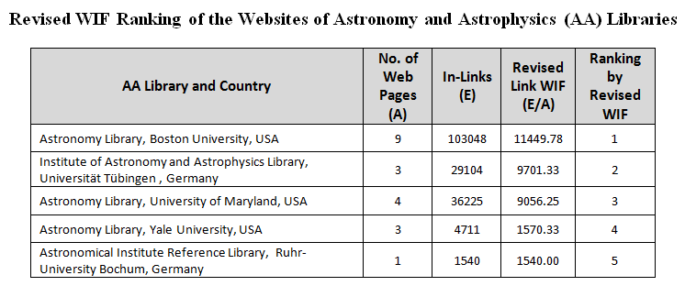
Highest Web Impact Factors (WIFs) Ranking - RWIF
Astronomy Library, Boston University, USA occupies first position with 1,03,048 in-links and 9 web pages with 11449.78 RWIF.
South African Astronomical Observatory Library occupies first position with 17, 572 in-links and 2 web pages with 8786.00 RWIF.
INPE - National Institute for Space Research Library, Brazil occupies first position with 43,464 in-links and 1 web page with 43464.00 RWIF.
From the above analysis and interpretations, it has been observed that the library website with high number of links and less number of web pages proportionately are remained at top level for all the three categories of libraries’ websites.

Slide 36
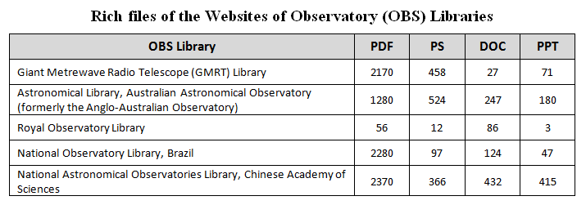
WISER
The Web Indicators for Science, TEchnology and Innovation Research (WISER) are survey tool to measure the structure and nature of the web.
These indicators are measured based on link analysis that combines the number of external in-links and the number of pages of the website.
A ratio of 1:1 between visibility and size; and number of documents, measured from the number of rich files in a web domain, and number of publications being collected by Google Scholar database.
The rich files comprise of Portable Document Format (PDF), Post Script (PS), Microsoft Word (DOC) and Microsoft Power Point (PPT).

Slide 37
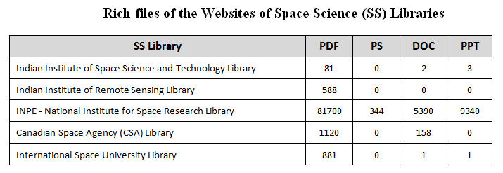
Best Websites with Rich Files
Harvard Smithsonian Center for Astrophysics, USA has the highest number of 9,11,000 PDFs and 29,200 PPTs and Institute for Astronomy, University of Hawaii, USA has highest number of 2,18,000 PS files and 1,02,000 DOC files.
McDonald Observatory, University of Texas, USA has the highest number of 5,95,000 PDFs, 43,400 DOC files, and 25,500 PPTs and European Southern Observatory (ESO), Germany has highest number of 90,100 PS files.
NASA Ames Research Centre, USA has the highest number of 4,63,000 PDFs and INPE - National Institute for Space Research, Brazil has 5,390 DOC files and 9,340 PPTs and Institute of Space and Astronautical Science, Japan has highest number of 53,200 PS files.

Slide 38
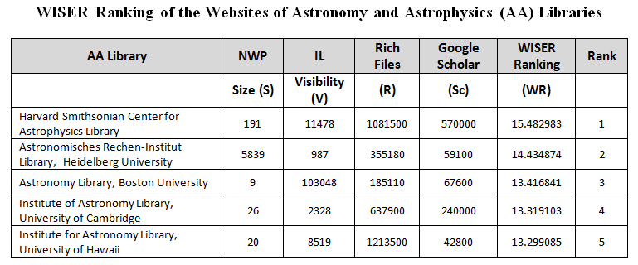
WISER Ranking
WISER Ranking (WR) is based on four indicators viz., Size, Visibility, Rich Files and Scholar. They are combined according to the following formula for the WISER Ranking.
WR = Log (Visibility 50%) + Log (Size 20%) + Log (Rich files 15%) + Log (Scholar15%).
The visibility is the external links received (in-links) by the web site, size is the total number of web pages, rich files available in the web site and Scholar is the number of papers, citations, reports and other academic items retrieved from Google Scholar. For each website, these data were collected, computed, log normalized.
Ranking has been assigned on basis of highest value to lowest value for AA, OBS and SS Libraries’ Websites.

Slide 39
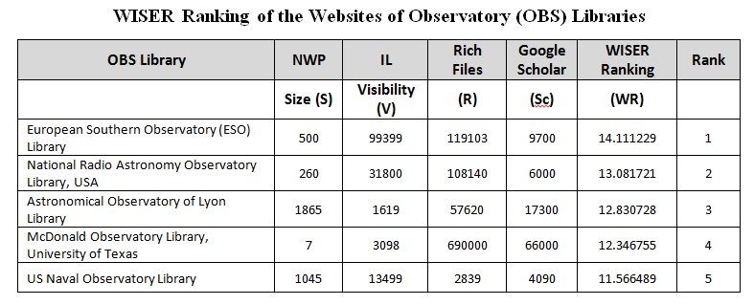
Highest WISER Ranking
According to WISER ranking, Harvard Smithsonian Center for Astrophysics Library, USA ranks 1st and Astronomical Society of South Australia Library has stands in last position.
European Southern Observatory (ESO) Library, Germany ranks 1st and Purple Mountain Observatory Library, China ranked at the last position in WISER ranking.
Space Telescope Science Institute Library, USA ranks 1st and Institute of Space Technology Library, Pakistan positioned at the last.

Slide 40
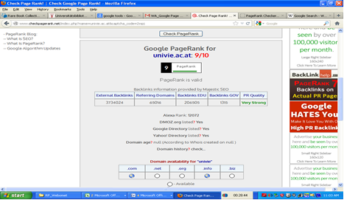
Google PageRank
Google PageRank is one of the methods used to determine a page's relevance or importance. Important pages receive a higher PageRank and are more likely to appear at the top of the search results.
Google PageRank is a measure from 0 - 10. Google PageRank is based on backlinks / in-links.
The more quality in-links means the higher Google PageRank. The data collected on Google PageRank and ranking of AA, OBS, SS Libraries’ Websites are done.

Slide 41
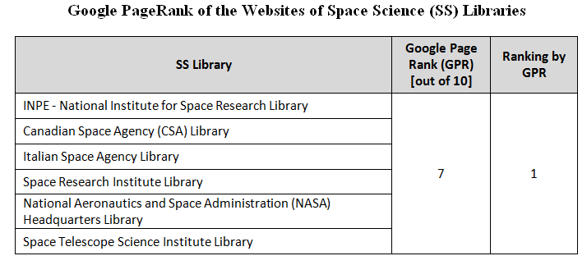
Highest Google PageRank
The analysis indicated that Google PageRank for AA libraries website ranges from 4 to 9; OBS libraries website ranges from 3 to 8; SS libraries website ranges from 3 to 7.
Astronomy Library, Vienna University, Austria has Google PageRank 9 and positioned at 1st among AA Libraries Website.
European Southern Observatory (ESO) Library, Germany and Smithsonian Astrophysical Observatory (SAO) / NASA Astrophysics Data System (ADS) Digital Library, USA both have scored Google PageRank 8 and positioned at 1st among OBS Library Websites.
6 SS libraries website secured 1st rank with Google PageRank 7.

Slide 42
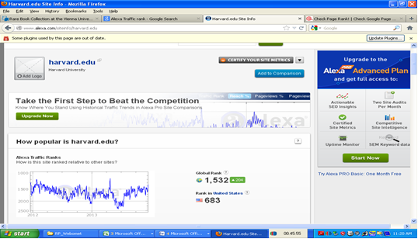
Alexa Traffic Rank
The ranking process is calculating the reach and number of page views for all the sites on the Web on a daily basis.
The Alexa ranking is obtained by performing the geometric mean of reach and page views, averaged over a predefined period of three months.
Alexa Traffic Rank (ATR) collected for AA, OBS, SS Libraries’ Websites using its domain names.

Slide 43
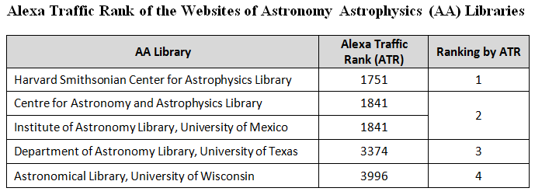
Highest Alexa Traffic Rank
Harvard Smithsonian Center for Astrophysics Library, USA, has been ranked 1st with 1751 ATR. Argentine Institute for Radio Astronomy Library, Argentina did not have enough data for this ranking.
Smithsonian Astrophysical Observatory (SAO)/ NASA Astrophysics Data System (ADS) Digital Library, USA, has been ranked 1st with 1751 ATR.
Canadian Space Agency (CSA) Library, Canada, has been ranked 1st with 570 ATR.

Slide 44
Comparative Analysis of Ranking
The comparative analysis of ranking has been conducted with various ranking such as Ranking of Simple WIF, Self-Link WIF, External Link WIF, Revised Link WIF; WISER Rank and Alexa Traffic Rank.
It was explored whether any similarity or difference in ranking occurs.
The comparative analysis of various ranking of AA, OBS and SS Libraries indicated that the ranking varies and are not similar, while applying various Webometric ranking.

Slide 45
Comparative Analysis of Ranking of the Websites of SS Libraries (sample)
S. N. | SS Library | Simple WIF | Ranking by Simple WIF | Self-Link WIF | Ranking by Self-Link WIF | External Link WIF | Ranking by External Link WIF | Revised Link WIF | Ranking by Revised WIF | WISER Ranking (WR) | Ranking by WR | Google Page Rank (GPR) | Ranking by GPR | Alexa Traffic Rank (ATR) | Ranking by ATR
1 | Indian Institute of Space Science and Technology Library | 16.11 | 3 | 15.22 | 3 | 94.11 | 2 | 285.44 | 6 | 5.443079 | 14 | 6 | 2 | 135491 | 7
2 | Indian Institute of Remote Sensing Library | 0.06 | 14 | 0.05 | 13 | 86.53 | 3 | 1.16 | 12 | 9.209923 | 7 | 6 | 2 | 685467 | 13
3 | INPE - National Institute for Space Research Library | 0.00 | 16 | 0.00 | 15 | 1.00 | 15 | 43464.00 | 1 | 10.143388 | 4 | 7 | 1 | 25432 | 5
4 | Canadian Space Agency (CSA) Library | 14.75 | 4 | 13.75 | 4 | 37.75 | 6 | 5760.00 | 2 | 7.683327 | 12 | 7 | 1 | 570 | 1
5 | International Space University Library | 0.14 | 10 | 0.12 | 10 | 31.48 | 8 | 0.48 | 13 | 7.263815 | 13 | 5 | 3 | 606734 | 12
6 | Italian Space Agency Library | 0.98 | 7 | 0.91 | 7 | 58.44 | 4 | 458.93 | 5 | 9.523794 | 6 | 7 | 1 | 571591 | 11
7 | Institute of Space and Astronautical Science Library | 0.12 | 12 | 0.11 | 11 | 5.86 | 13 | 10.36 | 9 | 9.056025 | 8 | 6 | 2 | 46515 | 6
8 | Institute of Space Technology Library | 102.00 | 1 | 92.00 | 1 | 0.00 | 16 | 861.00 | 4 | 3.967884 | 17 | 5 | 3 | 468037 | 10
9 | Space Research Centre Library, Polish Academy of Sciences | 1.23 | 6 | 1.12 | 6 | 105.85 | 1 | 0.42 | 14 | 5.020928 | 16 | 3 | 5 | 2510633 | 15
10 | National Institute of Aerospace Research Library | 0.08 | 13 | 0.06 | 12 | 13.59 | 11 | 0.39 | 15 | 8.764914 | 10 | 6 | 2 | 12163800 | 16
11 | Space Research Institute Library | 26.50 | 2 | 21.50 | 2 | 0.00 | 16 | 4896.00 | 3 | 8.814778 | 9 | 7 | 1 | 227614 | 9
12 | Center for Astrophysics & Space Sciences Library, University of California | 1.30 | 5 | 1.17 | 5 | 19.17 | 10 | 9.87 | 10 | 5.231035 | 15 | 6 | 2 | 7105 | 4
13 | University of Tennessee Space Institute Library | 0.96 | 8 | 0.70 | 8 | 34.95 | 7 | 122.98 | 7 | 8.517266 | 11 | 5 | 3 | 1310993 | 14
14 | National Aeronautics and Space Administration (NASA) Headquarters Library | 0.03 | 15 | 0.02 | 14 | 7.33 | 12 | 5.31 | 11 | 10.536532 | 2 | 7 | 1 | 1292 | 2

Slide 46
Comparative ranking of the Websites of Space Science Libraries (Sample)

Slide 47
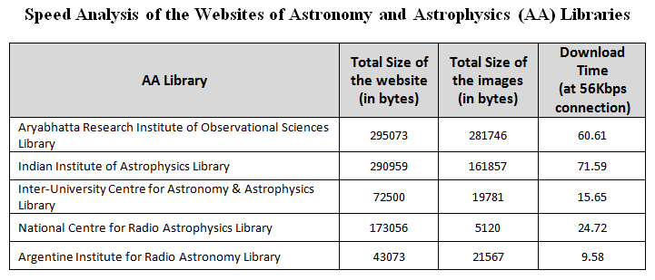
Web speed Analysis
Web speed analysis has been performed for AA, OBS and SS Libraries’ Websites using free website analytics tool, Web Page Analyzer.
It calculates page size, composition and downloads time and it helps to improve website performance.
Department of Astronomy Library, University of Virginia, USA page may download quickly with 0.22 seconds at 56 kbps internet connection.
Lowell Observatory Library, USA page may download quickly with 1.05 seconds at 56 kbps internet connection.
Space Research Library, Brazil page may download quickly with 0.55 seconds at 56 kbps internet connection.

Slide 48
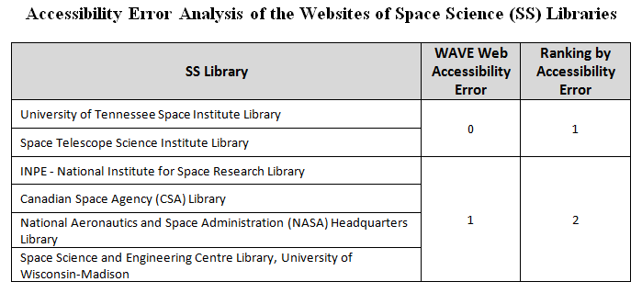
Accessibility Error Analysis
Web site error analysis has been measured for AA, OBS, SS Libraries’ Websites using WAVE, web accessibility evaluation tool.
The number of errors (0 to 140) for each website has been assessed and its ranking has been assigned.
The web accessibility error analysis shows that 7 AA Libraries’ Websites have ‘0’ error and ranks equally first.
For Turin Astronomical Observatory Library, Italy, the error analysis could not be performed by the website of WAVE.
Center for Astrophysics and Space Sciences Library, University of California, USA has highest number of errors (52) and ranked at last.

Slide 49
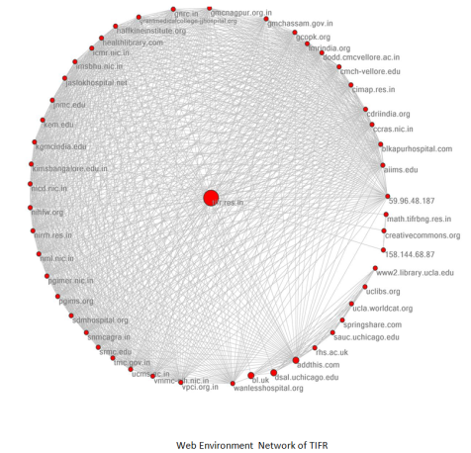
Link Network Analysis
Network analysis provides the linking and connectivity pattern among the websites analysed.
The network analysis can bring interconnection between institutions, organizations and universities.
The network diagram brings out to see visually the connectivity between the web nodes.
SocSciBot has been used to extract data and draw visual network diagram.
Also, Pajek software has been used for large network diagram.

Slide 50
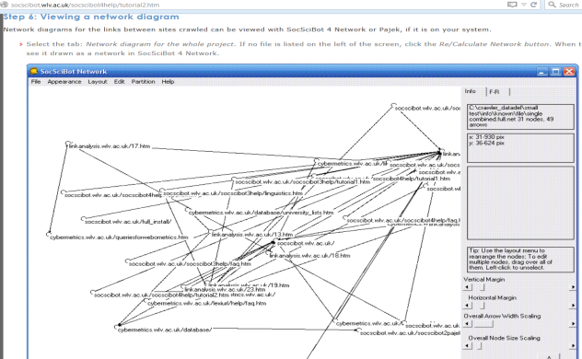
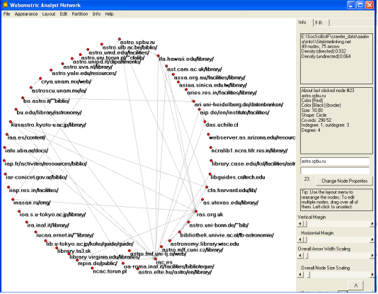
Link Network Analysis (AALW)
Link Network Diagram of AA Libraries drawn from SocSciBot

Slide 51
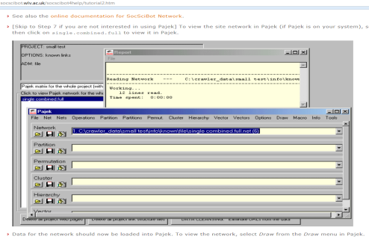
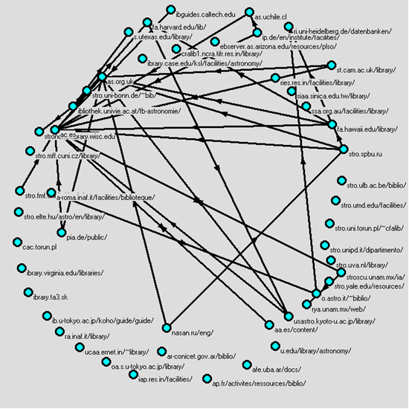
Link Network Analysis (AALW)
Link Network Diagram of AA Libraries drawn from Pajek
The link network analysis between AA Libraries indicated that the interlinking of 49 web nodes between 55 AA Libraries. There are 75 arrows indicating the link from to other websites.

Slide 52
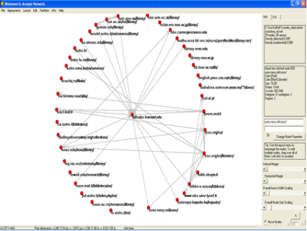
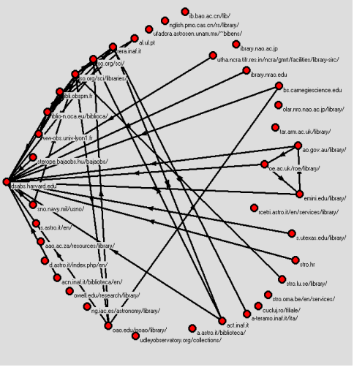
Link Network Analysis (OBSLW)
Link Network Diagram of OBS Libraries drawn from Pajek
The link network analysis between OBS Libraries indicated that the interlinking of 39 web nodes between 41 OBS Libraries. There are 66 arrows indicating the link from to other websites.

Slide 53
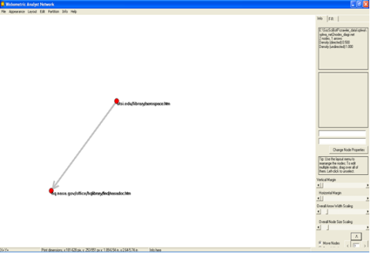
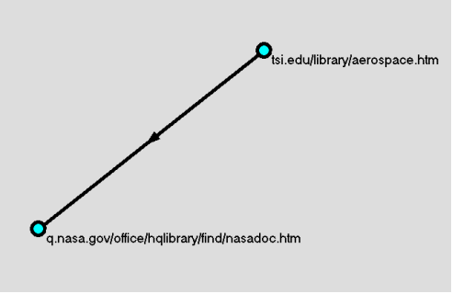
Link Network Analysis (SSLW)
Link Network Diagram of SS Libraries drawn from Pajek
The link network analysis between SS Libraries indicated that only 2 web nodes between 17 SS Libraries. There is only 1 arrow indicating the link from ‘University of Tennessee Space Institute Library’ to ‘National Aeronautics and Space Administration (NASA) Headquarters Library’.

Slide 54
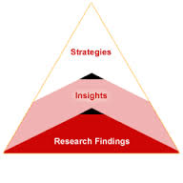
Findings
Web presence of Astronomy and Astrophysics related Libraries:
405 institutions / universities exist in this subject related area and out of which 350 did not have a separate library website exclusively for Astronomy and Astrophysics. Only 14% Astronomy and Astrophysics Libraries having Website which are accessible.
445 observatories exist in India and other countries. 404 observatories did not have library website and only 41 libraries’ websites were available. Only 9% observatory libraries’ websites were available and accessible.
93 Space Science Institute exist in India and other countries. 76 Space Science Institute did not have library website and only 17 libraries’ websites were available. Only 18% space science libraries’ websites were available and accessible.

Slide 55
Findings
Web Content Analysis:
Majority of AA, OBS and SS Libraries have provided details on collection, contact details, links to e-resources, catalogue search or OPAC in their website.
However, the details such as digital repository, FAQ, feedback forms, news items, online forms, site maps and site updates are provided by only few AA, OBS and SS Libraries websites.
Much more attention need to be given by Libraries to compare other libraries website facilities and include the same in their own website for the benefit of the users.

Slide 56
Findings
Web Link Structure Analysis:
AA, OBS and SS Libraries’ Websites have an average of 468 , 631 and 360 web pages per site respectively.
AA, OBS and SS Libraries’ Websites have an average of 19,942; 12,072; and 15,863 external hyper links per site respectively.
AA, OBS and SS Libraries’ Websites have an average of 5,959; 6,929; and 11,584 in-links received per site respectively.

Slide 57
Findings
Web Link Structure Analysis:
AA, OBS and SS Libraries’ Websites have an average of 40; 42; and 53 self-links per site respectively.
AA, OBS and SS Libraries’ Websites have an average of 63; 65; and 61 total links per site respectively.

Slide 58
Findings
Revised Web Impact Factor Ranking:
Astronomy Library website, Boston University ranked 1st with 9 web pages and 1,03,048 in-links and Italian National Institute for Astrophysics Library website ranked last (55th) with 3,622 web pages and 85 in-links.
South African Astronomical Observatory Library website ranked 1st with 2 web pages and 17,572 in-links and National Astronomical Observatory Library website, Japan ranked last (41st) with 1,351 web pages and 255 in-links.
Space Research Library website, Brazil ranked 1st with 1 web page and 43,464 in-links and Space Science and Engineering Centre Library, University of Wisconsin-Madison ranked last (17th) with 344 web pages and 103 in-links.
Website with less number of web pages and high number of in-links ranks first.

Slide 59
Findings
WISER Ranking:
As per Web Indicators for Science, Technology & Innovation Research (WISER) method, Harvard Smithsonian Center for Astrophysics Library website ranked 1st with 10,81,500 rich files and 5,70,000 results from Google Scholar.
European Southern Observatory (ESO) Library website ranked 1st with 1,19,103 rich files and 9,700 results from Google Scholar.
Space Telescope Science Institute Library website, USA ranked 1st with 94,880 rich files and 9,920 results from Google Scholar.
Website with high number of rich files and high number of results from Google Scholar ranks first.

Slide 60
Findings
Google PageRank:
According to Google Page Rank, Astronomy Library website, Vienna University ranked 1st with score 9 out of 10.
2 OBS Library websites ranked 1st with score 8 out of 10.
6 SS Library websites ranked 1st with score 7 out of 10.
Google PageRank is based on backlinks / in-links. The more quality in-links means the higher Google PageRank.

Slide 61
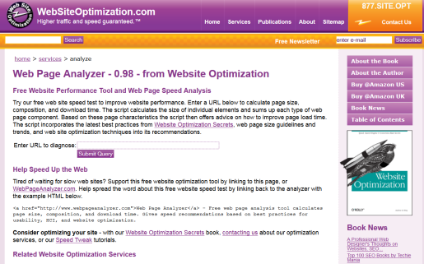
Findings
Alexa Traffic Rank: The highest users reach and page views ranks first in Alexa Traffic Rank.
Performance and Accessibility: Website with small images size in less bytes will download quickly than the bigger images with large bytes; Website having ‘0’ error accessibility ranks top.

Slide 62
Observations
Some search engines were not able to do the analysis / web crawling due to the invalid character in the website address of the Libraries.
Some library website address has characters such as ‘tilde ~’, hyphen (-), space between the address, etc. [example: Research Institute for Astronomy and Astrophysics of Maragha (RIAAM) Library, Iran http://www.riaam.ac.ir/en/index.php?option=com_content&view=article&id=53&Itemid=59]
Some of the library website URL are lengthy. [example: Institute of Astronomy and Astrophysics Library, Universität Tübingen, Germany ;
http://www.uni-tuebingen.de/en/faculties/ faculty-of-science/departments/physics/institutes/astronomy-astrophysics/institute/astronomie/section-astronomy/bibliothek.html]
Some of the Libraries’ website is in non-English language such as Chinese, German, Italian, etc.

Slide 63
Suggestions
Library website address should have standard URLs (non-lengthy and invalid characters).
Cybermetrics experts should consider developing software programs to do Webometric analysis of sub web pages and sub-domain analysis.
Library website should be designed properly in order to make user-friendly and easy to locate the desired information.
When a Library has been considered as a heart of an Institution, similarly a Library Web Site also should be treated in the same way by giving importance.

Slide 64
Areas of Further Research
Webometric research can be explored in the areas of other subject specific Libraries.
In India, so far the Webometric research were carried for important institutions/university websites and attempts can be made to analysis the Library websites too.
Webometric analysis can be done for the institutional repositories in India and ranking them.
Webometric techniques can be sharpened as it has been considered one of the methods in ranking of Universities and Institutions.

Slide 65
Conclusion
Webometric technique helps to analysis the website, web pages and links between the set of similar subject related libraries and their web network.
Various impact factors and ranking of library website helps to identify the importance of website design, its content, size, usability and accessibility.
Webometric Ranking of websites may bring a competitive nature among the libraries to provide better services through their websites.
Library website requires periodic update for changes, additions and redesign as per new technology to serve the users.

Slide 66
Publications
Hyperlink Analysis and Web Impact Factor of Websites of Observatory Libraries by R. Prabakaran. International Journal of Library and Information Studies, Vol. 4 (4) (2014) 38-51.
Astronomy and Astrophysics Libraries’ Websites in India: A Webometric Analysis by R. Prabakarn and Shalini Lihitkar In Dynamics of Librarianship in the Knowledge Society: Festchrift in honour of Prof. B. Ramesh Babu. New Delhi: B. R. Publishing Corporation, 2012, pp 1184-1192.

Slide 67
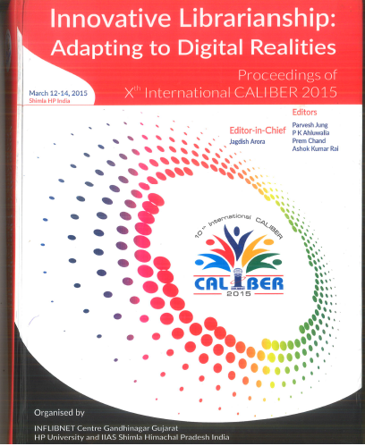
Publications
Web Link Analysis and Web Impact Factors of Space Science Libraries’ Websites by R. Prabakarn and Shalini Lihitkar In Proceedings of 10th International CALIBER 2015: Innovative Librarianship: Adapting to Digital Realities. Gandhinagar: INFLIBNET Centre, 2015, pp 325-333.
WISER Ranking of Astronomy and Astrophysics Libraries’ Websites by R. Prabakarn and Shalini Lihitkar. Accepted for publication in forthcoming 11th International Conference on Webometrics, Informetrics, Management and Scientometrics (WIS) and the 16th COLLNET Meeting 2015, 26 - 28th November 2015, Delhi.

Slide 68
THANK YOU

