Slide 1
Scaling behavior of lateral distribution of electrons in EAS
A. Bhadra
High Energy & Cosmic Ray Research Centre
University of North Bengal

Slide 2
My collaborators for this work are
R. K. Dey, Dept. of Physics, University of North Bengal
J. N. Capdevielle, APC, University Paris-Diderot

Slide 3
Introduction:
EAS experiments chiefly measure densities and arrival times of EAS particles
electrons (positrons and negatrons)
photons
Muons
Hadrons
The main parameters associated with the EAS electron component at the given observation level are the shower size,
and the lateral (or transverse) shower age

Slide 4
A major challenge is the reliable and unambiguous estimate of the shower parameters from the experimentally measured electron densities.
From a number of studies it has been revealed that shape of several (average) distributions of electrons in EAS such as the energy distribution exhibits the so called universality: it depends only on the stage of longitudinal shower development in the atmosphere or equivalently on longitudinal shower age parameter.
The longitudinal age can be estimated observationally only if EAS experiment is equipped with Cherenkov or fluorescence detectors.

Slide 5
A conventional EAS array consisting of particle detectors offer to study electron component and its lateral distribution.
Usually lateral density distribution of electrons in EAS is approximated by the well known Nishimura-Kamata-Greisen (NKG) structure function
where

Slide 6
The NKG structure function is the same for any EAS event irrespective to the energy of the shower initiating particle, which implies a scaling behavior of the structure function.
The normalization of f(r) implies that the electron density
The shower parameters viz. shower size (N_{e}) and lateral shower age (s) are evaluated by fitting the structure function with the measured densities.
Experimentally it is observed that the NKG function with a single lateral age parameter is insufficient to describe the lateral distribution of EAS electrons properly at all distances implying that the lateral age changes with radial distance.

Slide 7
An improvement of NKG function was proposed by inserting a modulation of Moliere radius by the longitudinal age parameter such as
where m = 0.78-0.21s_{L}
The KASCADE group found that the experimentally observed lateral density fitted best when m is around 0.4 suggesting clear departure from the results of cascade theory.
In this work we have examined the situation critically by means of detailed Monte Carlo simulation study of EAS in the quest for better understanding of the lateral structure function of electrons in EAS.

Slide 8
Simulation procedure adopted:
QGSJET 01 version 1c has been used in combination with the low energy (below 80GeV/n) hadronic interaction model GHEISHA (version 2002d) in the framework of the CORSIKA Monte Carlo program version 6.600 to generate EAS events.
The US-standard atmospheric model with planar approximation has been considered.
The simulated shower library consists of more than 10,000 EAS events with EGS4 option and more than 1, 50, 000 events with NKG option in the primary energy interval of 10¹⁴ eV to 3 × 10¹⁶ eV and about 1000 events at 10¹⁸ eV with EGS4 option.

Slide 9
Results:
For small arrays (limited radial distance) the NKG function with a single constant age serves the purpose to a certain accuracy
For large arrays a single constant age is incompatible for the whole radial distance.

Slide 10
NKG fitting (with a constant single age) of the EGS4 output of electron density at NBU site restricting radial distance up to 100 m.

Slide 11
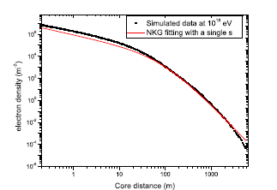
NKG fitting of the EGS4 output of electron density for p primary covering radial distance more than 5000 m

Slide 12
Local age parameter:
Capdevielle introduced the notion of local age parameter which is quite helpful to judge the radial variation of shape of the structure function.
For two neighboring points, i and j, one can give a lateral age parameter for any distribution f(x) which characterizes the best fit by a NKG -type function (x=r/r_{m} ):
Where

Slide 13
A typical behavior was predicted with a characterized minimum value of s(r) near 50 m from the axis, followed by a general increase at large distance
The dependence of s(r) on r rules out a consistent integration of the structure function and then an accurate relation between density and size.

Slide 14
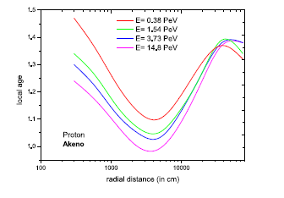
Local age parameter (obtained from simulated data) as a function of radial distance for different primary energies

Slide 15
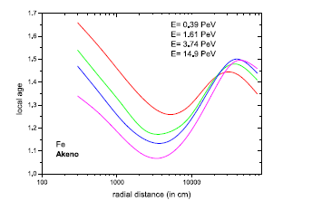

Slide 16
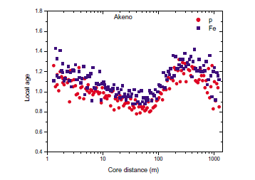

Slide 17
Modified NKG function and local age parameter

Slide 20
Conclusions:
It is known from the previous studies that the local age parameter initially decreases with radial distance, reaches a minimum between 30 to 50 m and then increases with radial distance.
Here we have noticed two other interesting features:
the local age again starts to decrease around 300 m
the nature of the variation of local age with radial distance appears nearly the same for all primary energies.
This means that the local age (or the lateral distribution of electrons in EAS) exhibits some sort of scaling behavior in respect to radial dependence from the shower core.

Slide 21
Even for the modified structure functions the lateral shower age parameter still found to vary with the core distance.
Are different part of EAS develop differently in the atmosphere?
Work is under progress -

Slide 22
Thank you

