Slide 1
Class B ( L4.001 ) Data Base Tutorial
Kamesh

Slide 2
DataBase
Ladder
components
components
L4.xxx -- RS4.xxx ( check list )
OS4.xxx ( check list ) -- SPA4.xxx ( check list )
SBWxxx
SFWxxx
Check list items to be followed during assembly :
First : RS4.xxx
Second : SPA4.xxx
Third : OS4.xxx and L4.xxx
APVDAQ Testing :
SBWxxx after arrival , results of csv,ped,cal measurement section + eDefectfinder csv
SFWxxx after arrival, results of csv,ped,cal measurement section + eDefectfinder csv
IV data, eDefectfinder pdf, captured images for the above in the item file section
3) Origami –Z test before assembly and load the results in the meas. Section
SBWxxx and SFWxxx after gluing on to the ribs – load the results in the mea. Section
Origami subassembly ( after wirebonding and before placing on the ribs ) – load the results
in the mea. Section
6) L4.xxx - after ladder assembly – SFWxxx, SBWxxx, origami –Z with source and load the results
in the measurement section ( csv, ped , cal, eDefectfinder csv ), pdf files & other
images in the Item files section

Slide 3
Data Base usage for class B
Database used for L4.001 and for all the ladders during ladder production
Components, sub-assemblies and ladders are registered in the DB
ID’s used during the ladder assembly
L4.001 - class B ladder
SFW001 and SBW003 for subassemblies from Pisa
SPA4.001 – sensor + pitch adapters
OS4.001 - origami subassembly ( O-Z065 – origami –Z )
A4.024 – Airex sheet
RS4.003 – Rib subassembly
Updated the checklist during the ladder assembly

Slide 4
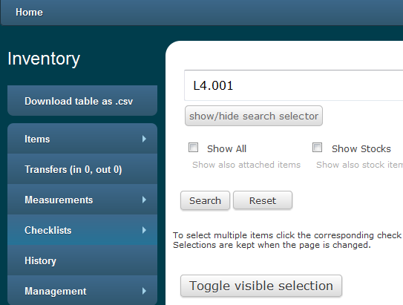
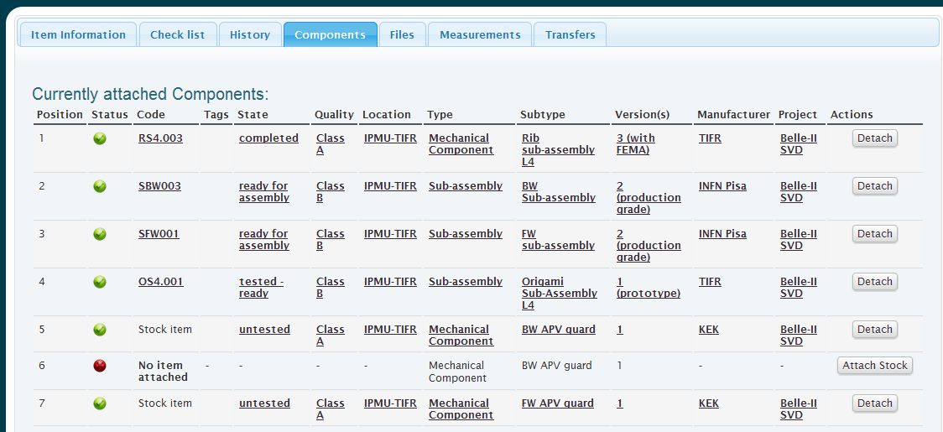
Components attached to the Ladder

Slide 5
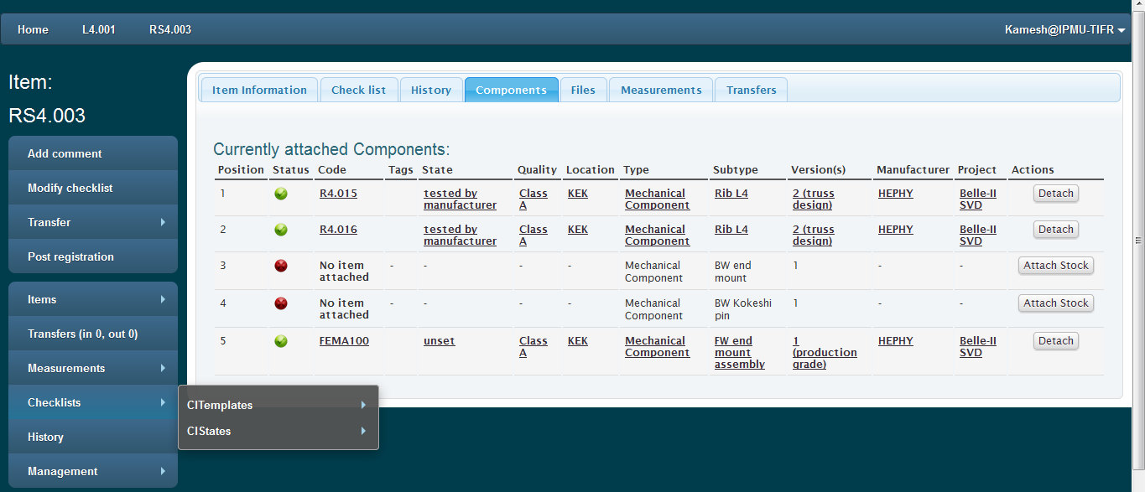
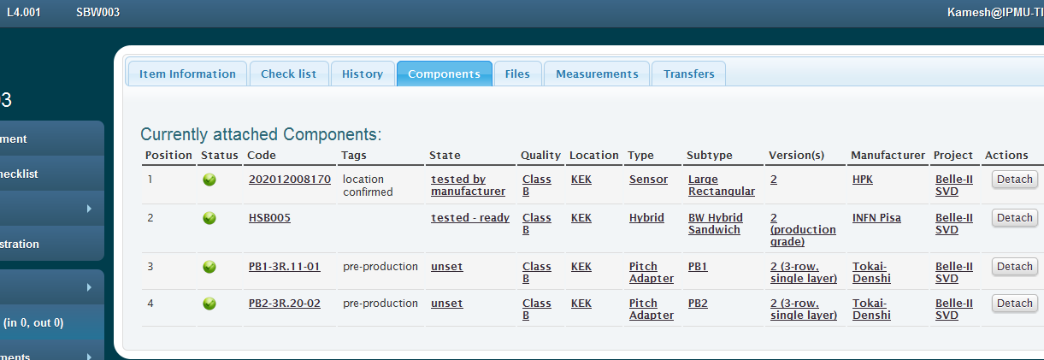

Slide 8
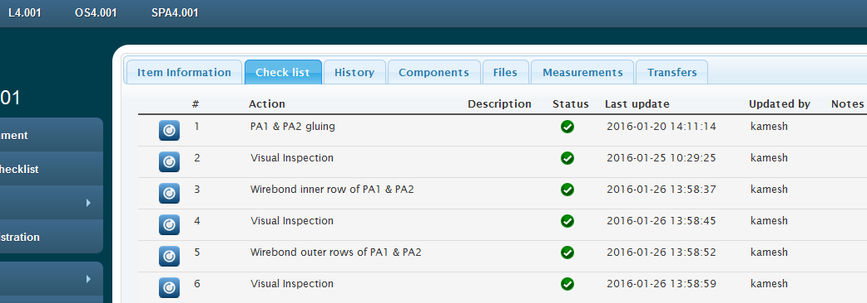
Check list for each components
Checklist templates
A4_Cl - Airex sheet
SPA4_Cl - Sensor + PA sub-assembly
RS4_Cl - Rib sub-assembly
OS4_Cl - Origami sub-assembly
L4_Cl - L4 ladder

Slide 10
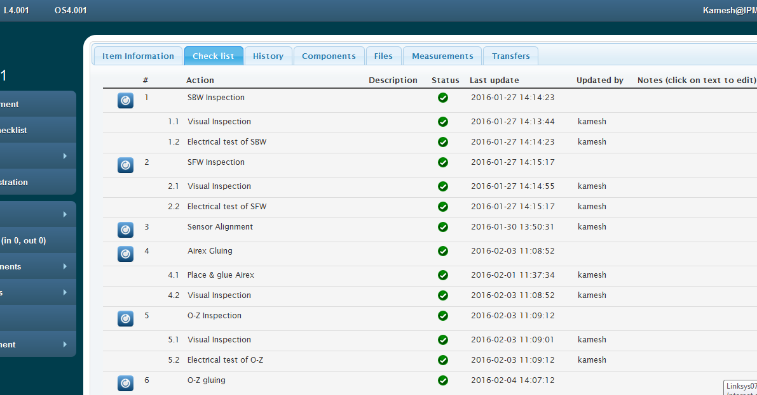

Slide 11
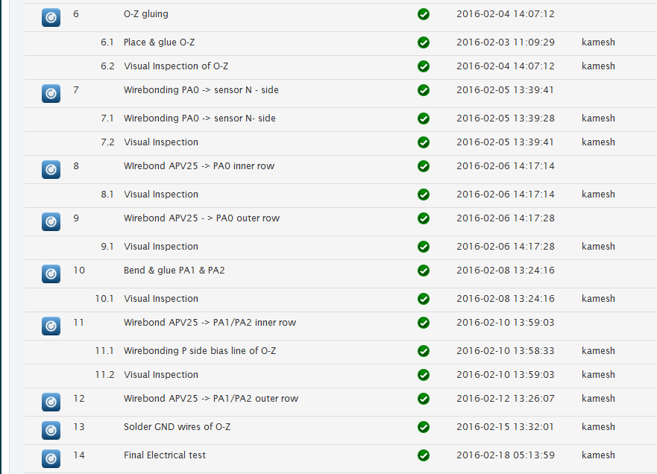
Check list continued

Slide 12
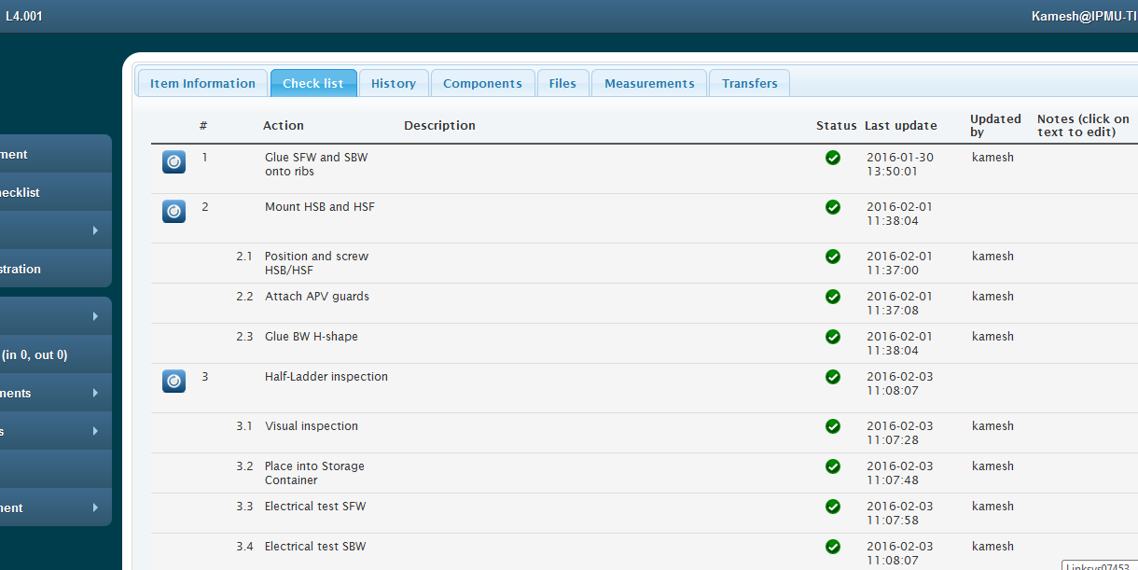

Slide 13
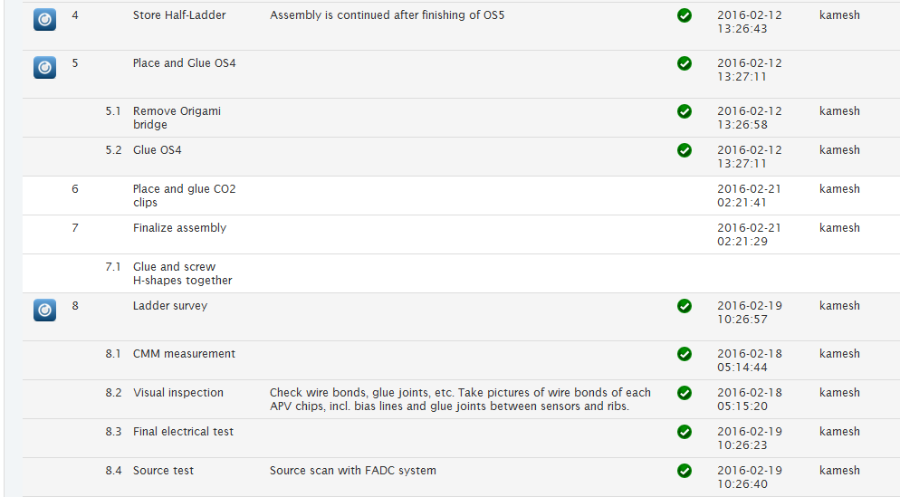
Check list continued

Slide 14
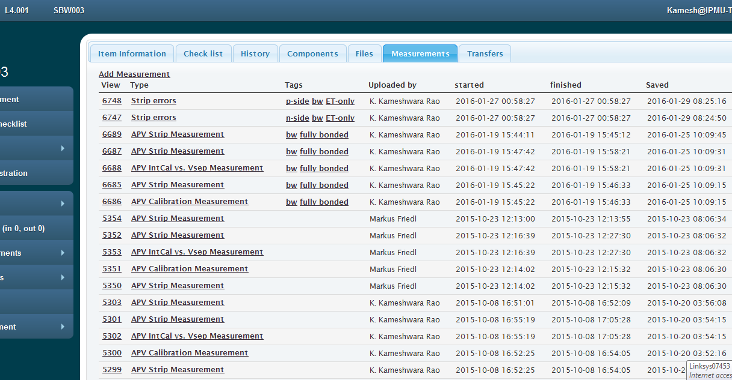
Attaching the measurement files
*.ped,*.cal, *.csv files to be uploaded in the measurement section

Slide 15
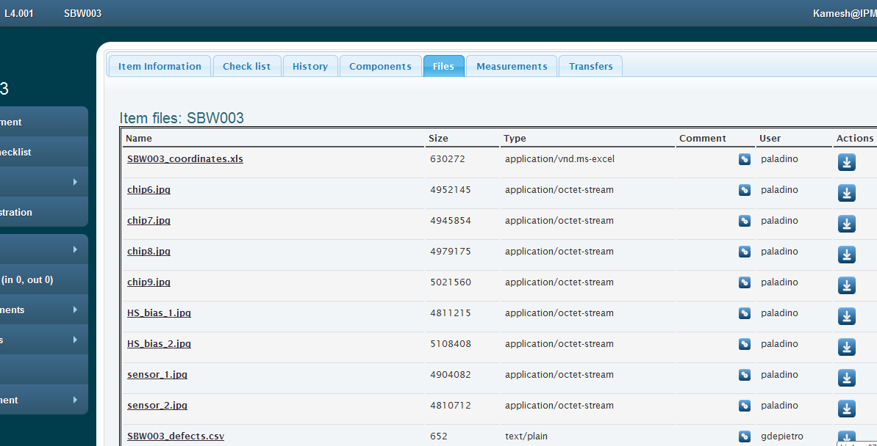

Slide 16
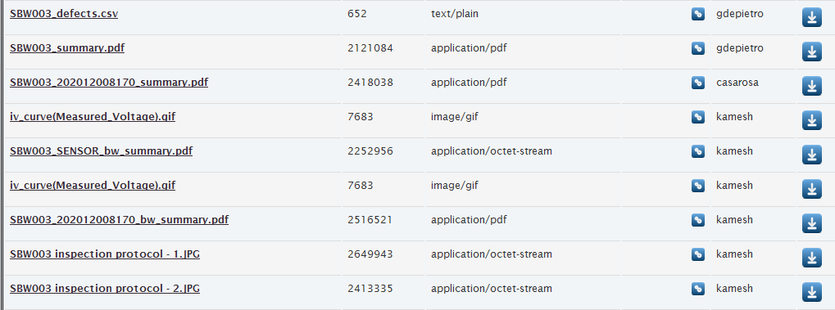
Continued

Slide 17
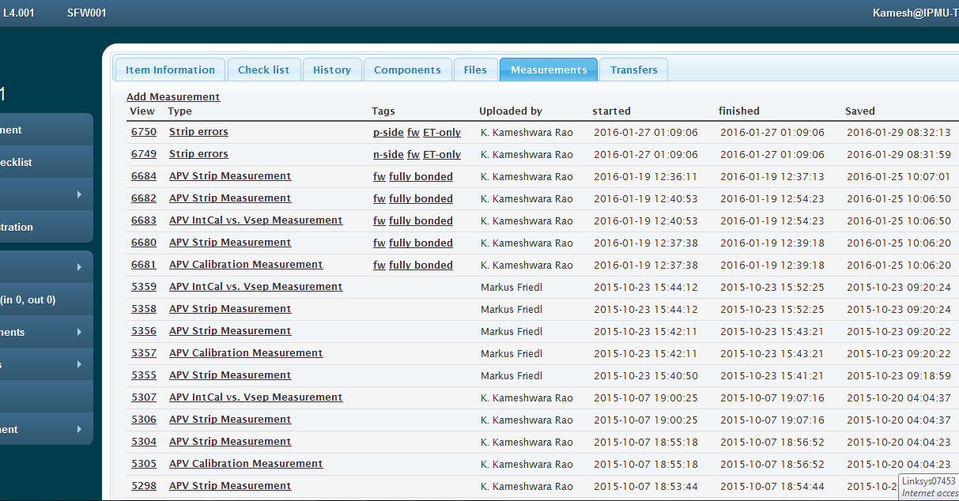

Slide 18
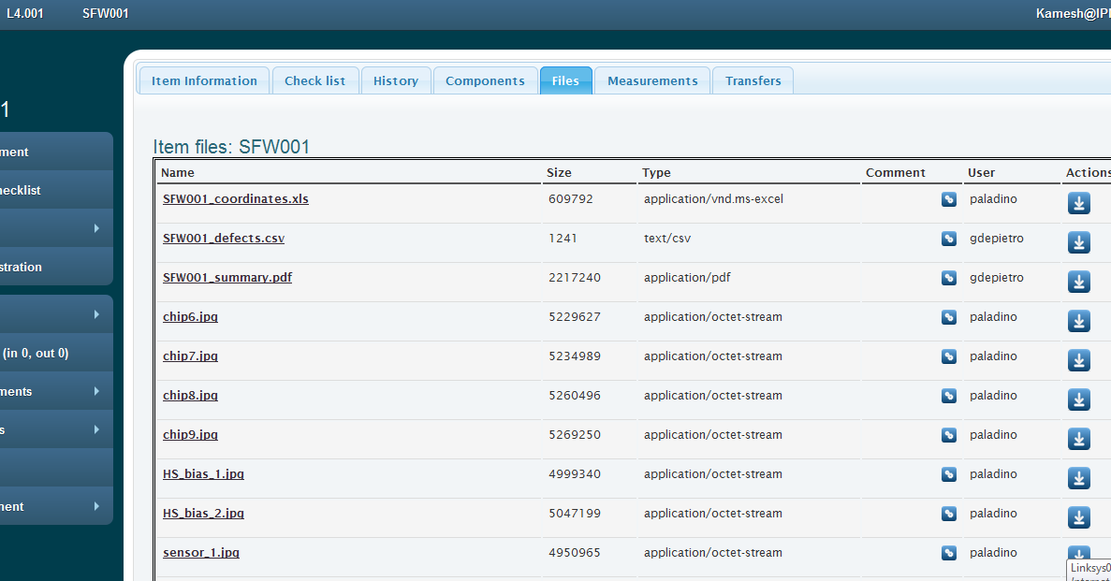

Slide 19
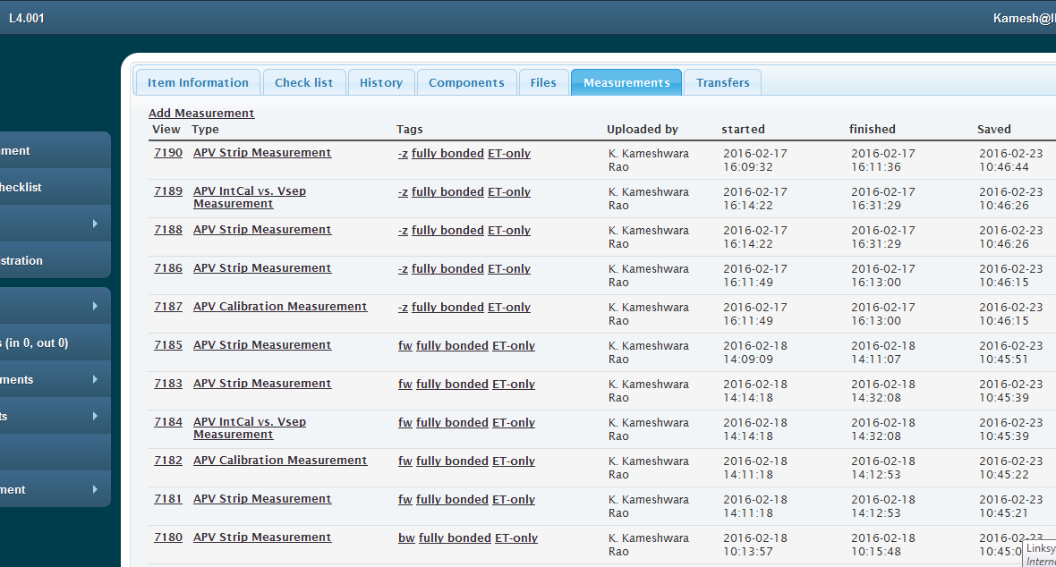

Slide 20
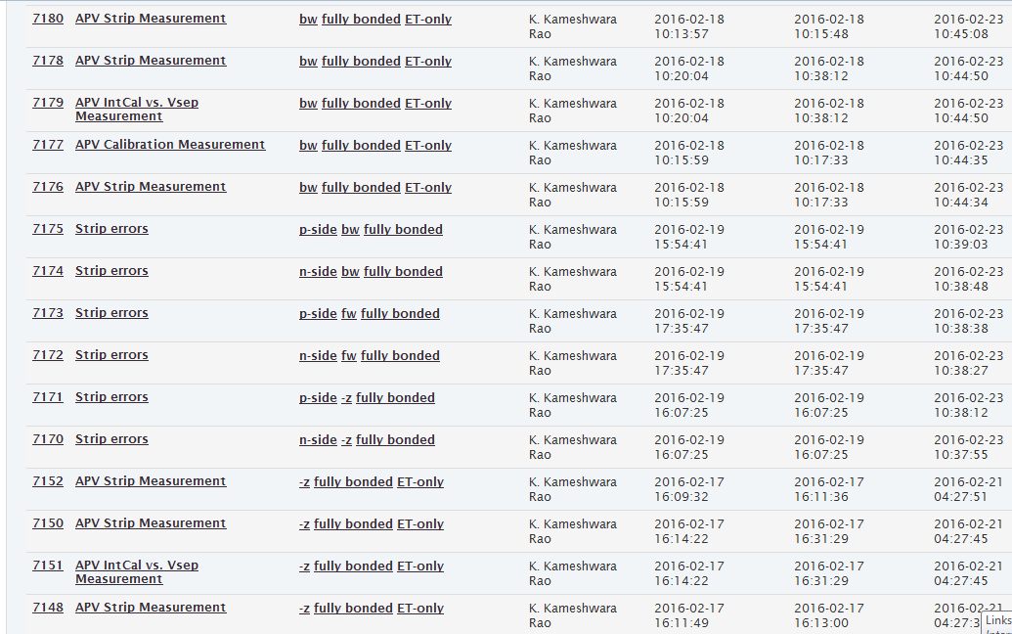

Slide 21
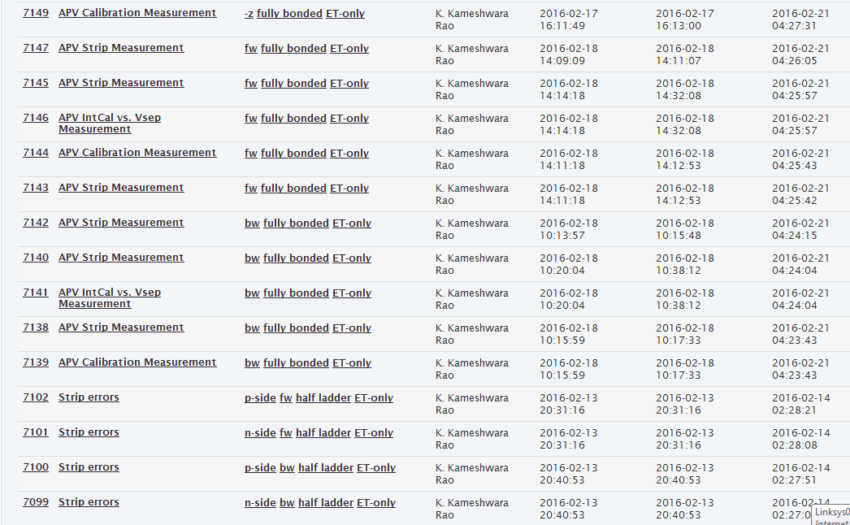

Slide 22
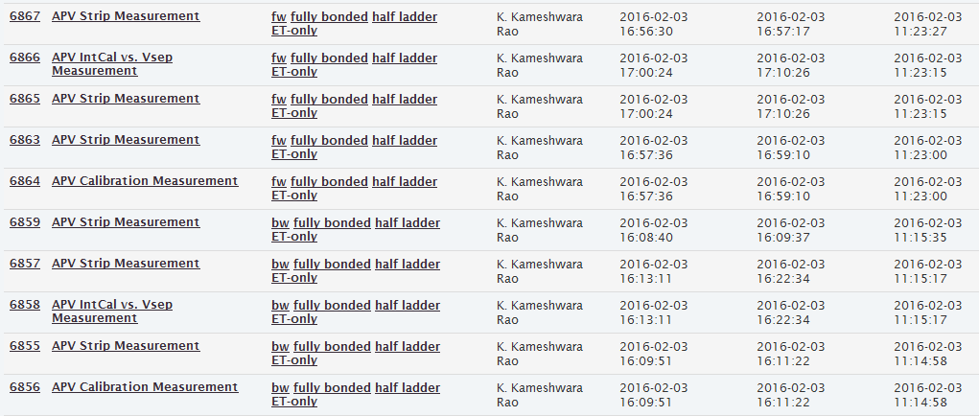

Slide 23
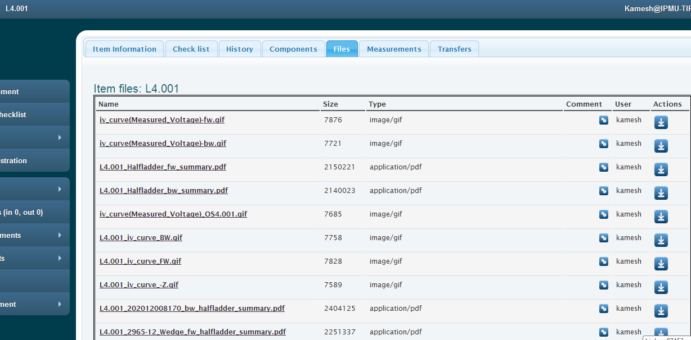

Slide 24
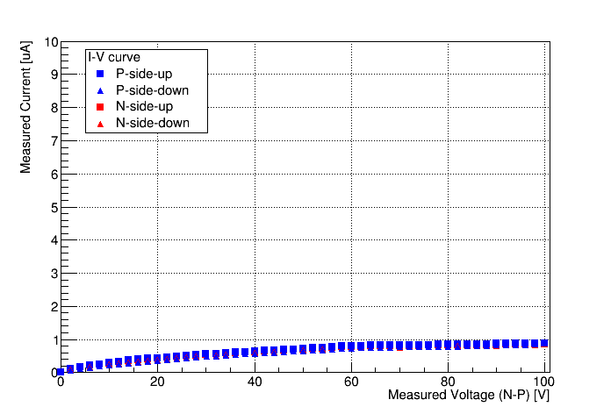
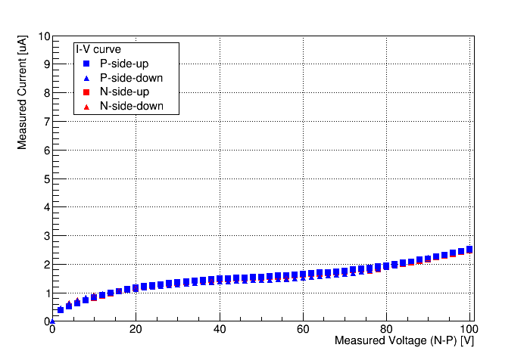
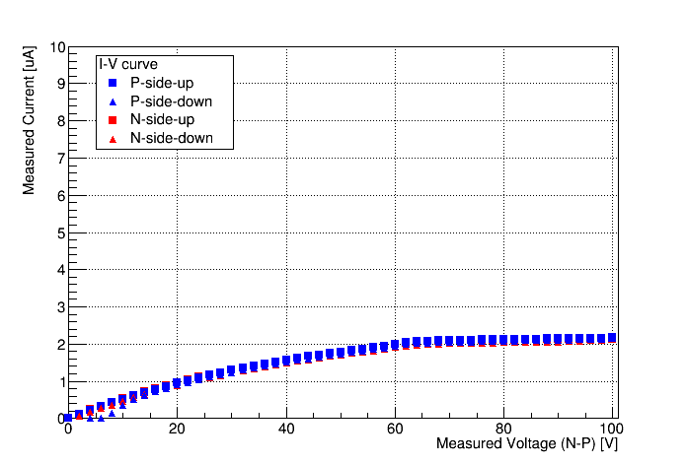
Before assembly IV
BW
FW
-Z

Slide 25
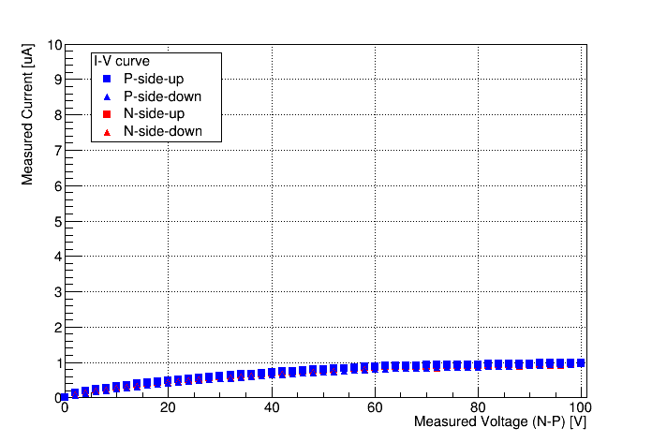
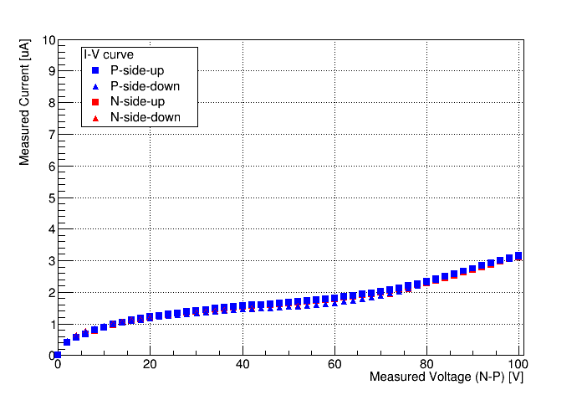
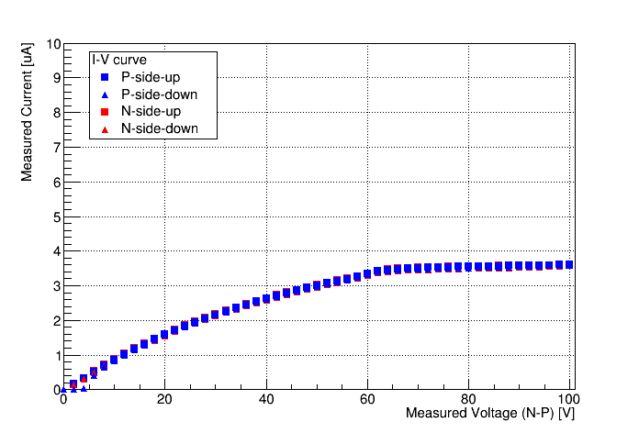
BW
After assembly IV
FW
-Z

Slide 26
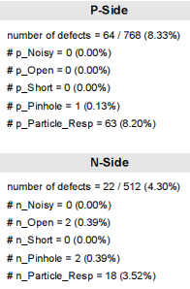
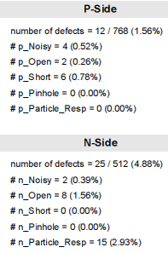
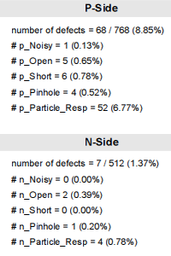
Assembled Ladder results

Slide 27
Thank you

