Slide 1
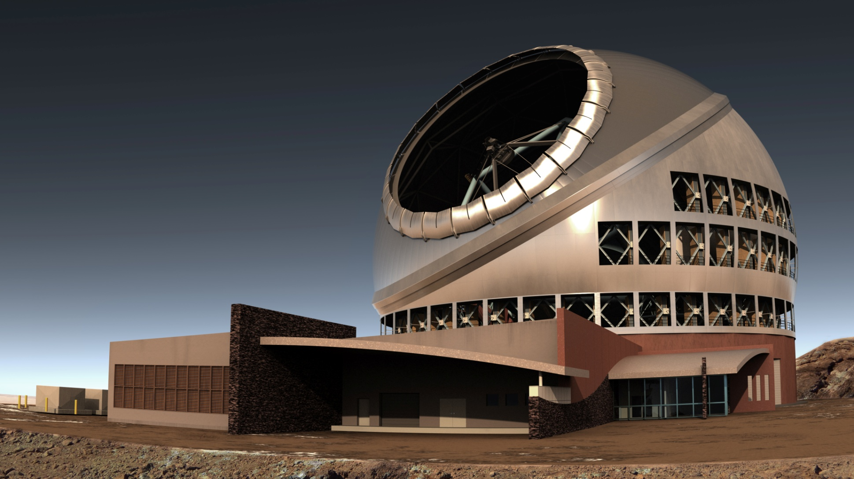
India's Contribution to TMT and the Challenges
Viswanatha N
viswanatha.itcc@iiap.res.in
India TMT Coordination Centre
Indian Institute of Astrophysics. Bangalore

Slide 2
Thirty Meter Telescope (TMT)
Notes:
near-ultraviolet to mid-infrared (0.31 to 28 μm wavelengths) observation

Slide 3
Shutter
Calotte
Cap
Rotating base
Ø66m
Fixed base
Notes:
comparable in height to an eighteen-storey building
Specifications
Aperture of primary mirror30 meters (492 segments)
OpticsRitchey-ChrétienFocusNasmyth focus
Combined focal length450 meters
Field of view15 arcminutes
Primary mirror F-number1Diffraction limit8 arc milliseconds (1 micrometer in wavelength)
Observing wavelength0.31 to 28 micrometers
Main observing instrumentsInfrared Imaging Spectrograph (IRIS) Wide-field Optical Spectrometer (WFOS) Infra-Red Multi-object Spectrograph (IRMS)

Slide 4
Ray Diagram of TMT
Light
M2
Instruments
M3
Instruments
M1 Primary Mirror
Notes:
Ray diagram of telescope.
Mounted on hexa pad Secondary 3.1m dia concave hyper 100 mm thick
Tertiary a flat mirror2.5x3.5 100 thick
The atmosphere limits the angular resolution (‘seeing-limited image quality’) to about 0.5 arcsec. However, using adaptive optics (AO) a diffraction-limited angular resolution of 7 milliarc-sec can be achieved at a wavelength of 1 μm. TMT’s Adaptive Optics Instrument will produce images ten times sharper than those of the Hubble Space Telescope

Slide 5
TMT Systems
Ø3.1 m on Hexapod
2.5x3.5 m
Notes:
M2 is made by China
The Secondary Mirror (M2) is a 3.1m convex hyperboloid. It reflects the light from the f/1 primary mirror and converts it to an f/15 beam for the science instruments. It will have a passive whiffletree support and a hexapod for active alignment.
M3 is made by

Slide 6
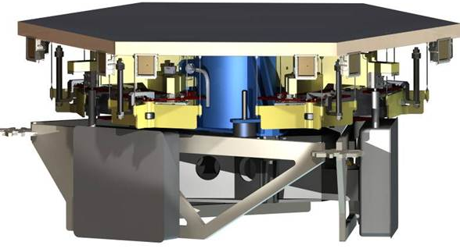
M1 Primary Mirror
Mirror Segment
M1
~1440
45
M1 with 492 Segmented Mirrors
PSA On Mirror Cell
Notes:
total of 1,476 actuators and 2,772 sensors will control the overall shape of the primary mirror to just a few nanometers
-The focal ratio of the TMT M1 is faster than Keck (f/1 vs. f/1.75). This leads to segments that are more aspheric for a given size. It was the main reason to make the TMT segments 20% smaller than the Keck segments. The smaller segments can also be thinner.

Slide 7
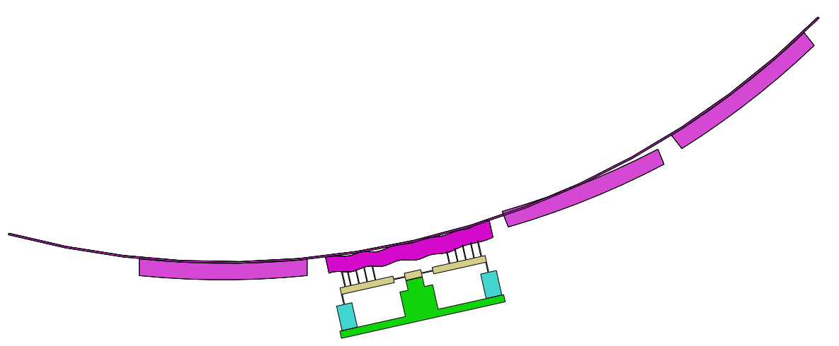
Mirror Errors Correction
Tip-tilt and piston error
Surface Figure error
Ideal Mirror Surface
Segment Support Assembly
Whiffletree Support
Notes:
low-order aberrations, which are primarily induced by manufacturing error, gravity deformation, and temperature change
RMS value improves from 64.9 to 25.4 nm

Slide 8
Segment Support Assembly (SSA)
Moving Frame
Central diaphragm
MRF axial support
Triangle
Tower
Fixed Frame
27-point whiffletree axial support mounted on 9 Triangles
Central diaphragm lateral support
21 Warping Harness Actuators
9 L type and 3 straight type leaf springs for load adjustment &measurement

Slide 9
Polished Segment Assembly (PSA)
Edge Sensors -6 Nos
Mirror Segment
SSA
Mirror cell
Position Actuators ( 3 per segment)

Slide 10
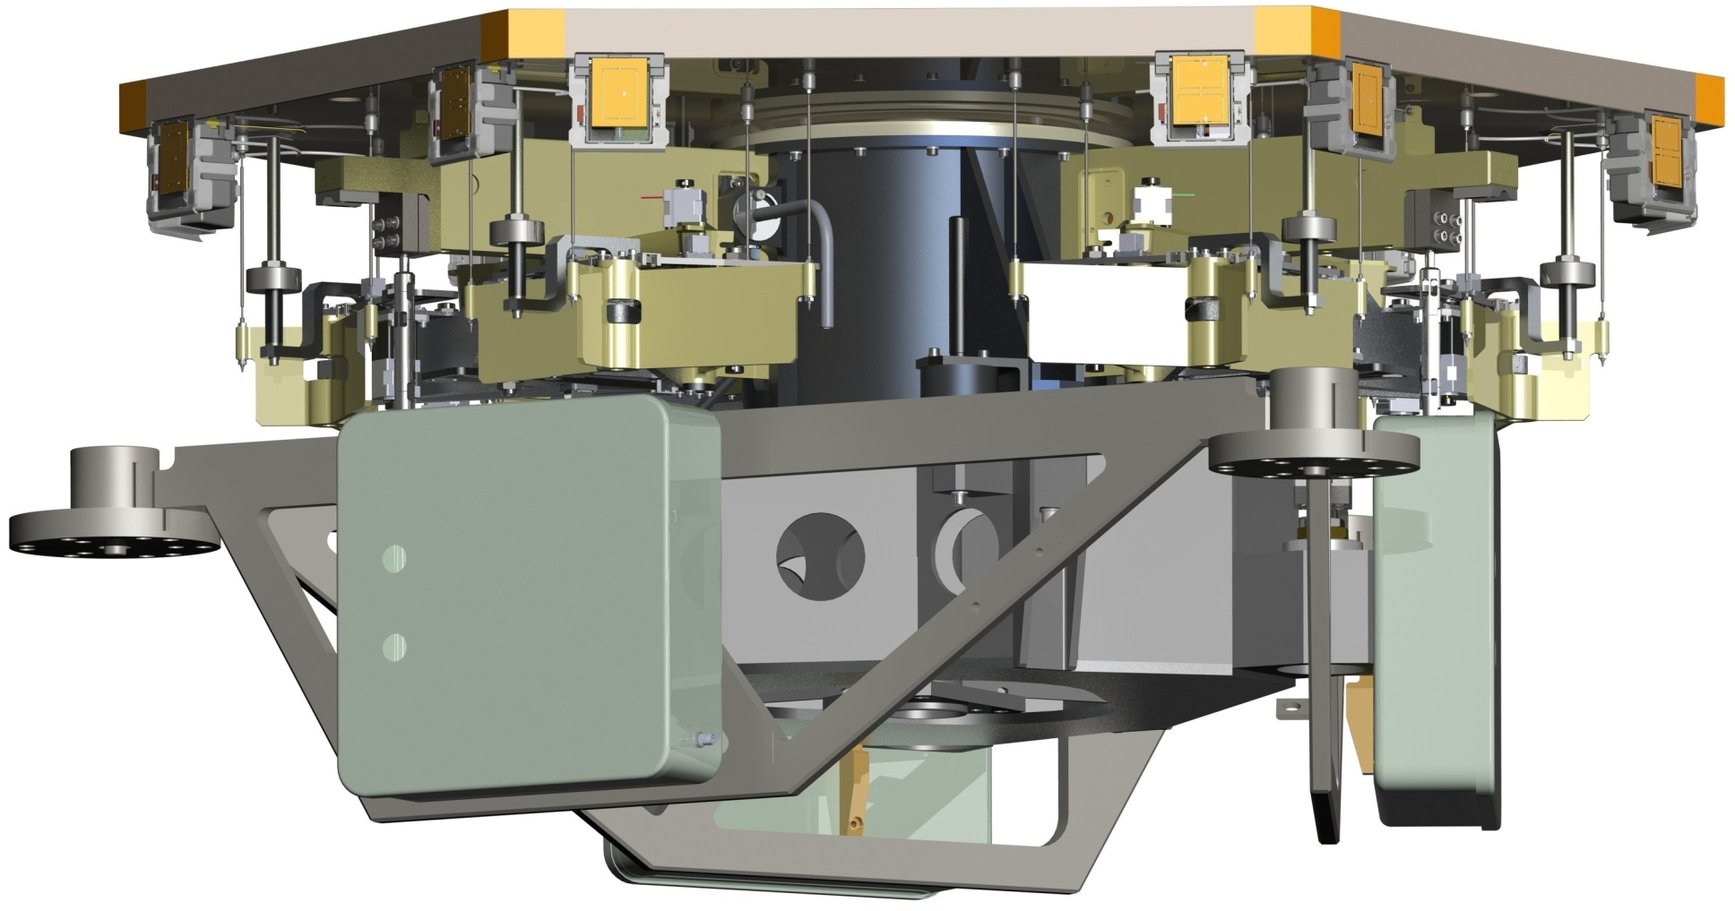
List of India’s Contribution to TMT Hardware
Mechanical hardware
Primary mirror Segment Support Assemblies-SSAs ( 492 Nos +82 spares)
Actuators - LH&RH Type (1476+ 60 Spares)
Optics Hardware
Primary Mirror Segments ( 84 nos out of total 584 nos)
Edge sensors
Sense and Drive Pair ( 3334 pairs)
SSA Electrical harness
Science Instruments
WFOS - Wide Field Optical Spectrograph
Camera Tilt Mechanism
Grating & Filter Exchange Mechanism
HROS - High Resolution Optical Spectrograph
Leading PI
Software
Observatory Software, Telescope Control System (TCS), Ect.
Others Facility
Aluminium coating chamber and handling fixtures at Telescope facility
Notes:
The Department of Science and Technology (DST) and the Department of Atomic Energy (DAE) are jointly giving Rs 1,300 crore to the project, of which 70% is to be spent on developing hardware and software systems for the project. The total project cost is $1.4 billion, or just over Rs 10,000 crore.

Slide 11
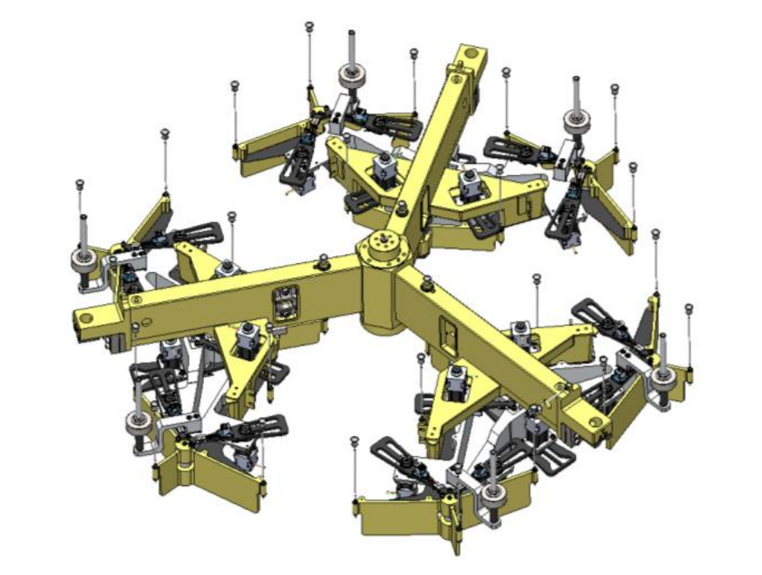
SSA Components
Triangles, whiffletrees system and Leaf springs
Rod Flexures
Motor
Moving Frame
Middle Triangle
Leaf spring
Notes:
Actuator stroke operational ± 4.5
Working range of motion L type± 4.5 S type 4.7 mm
Leaf spring actuator 7x3=21

Slide 12
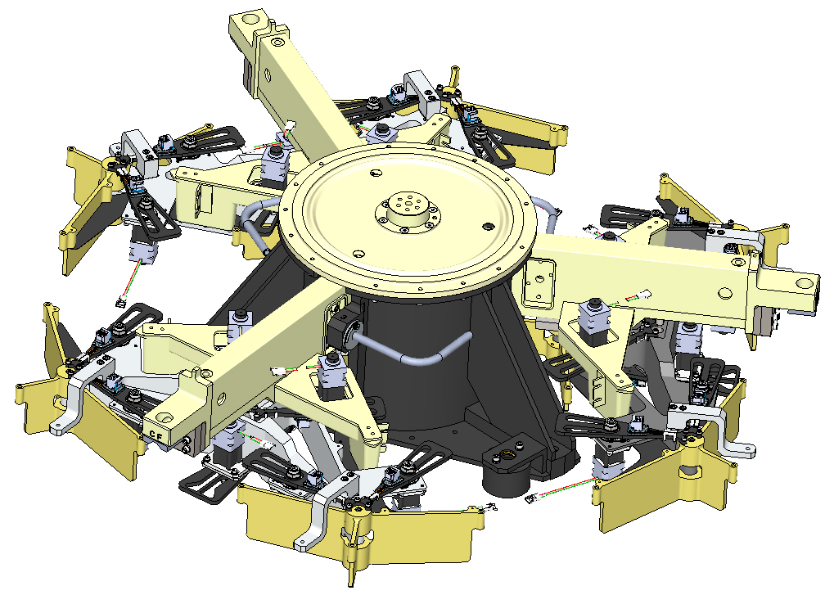
SSA Components
SSA Assembly

Slide 13
Proto SSA Assembly

Slide 14
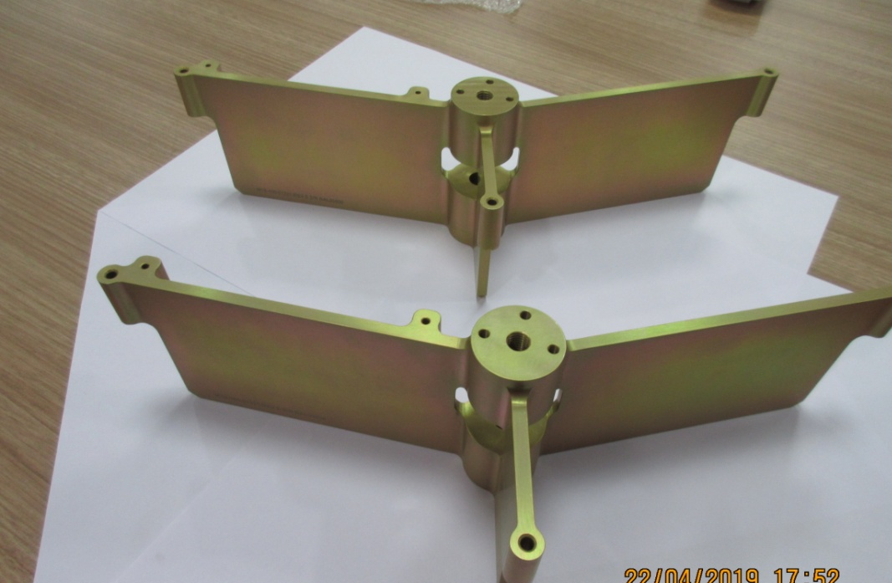
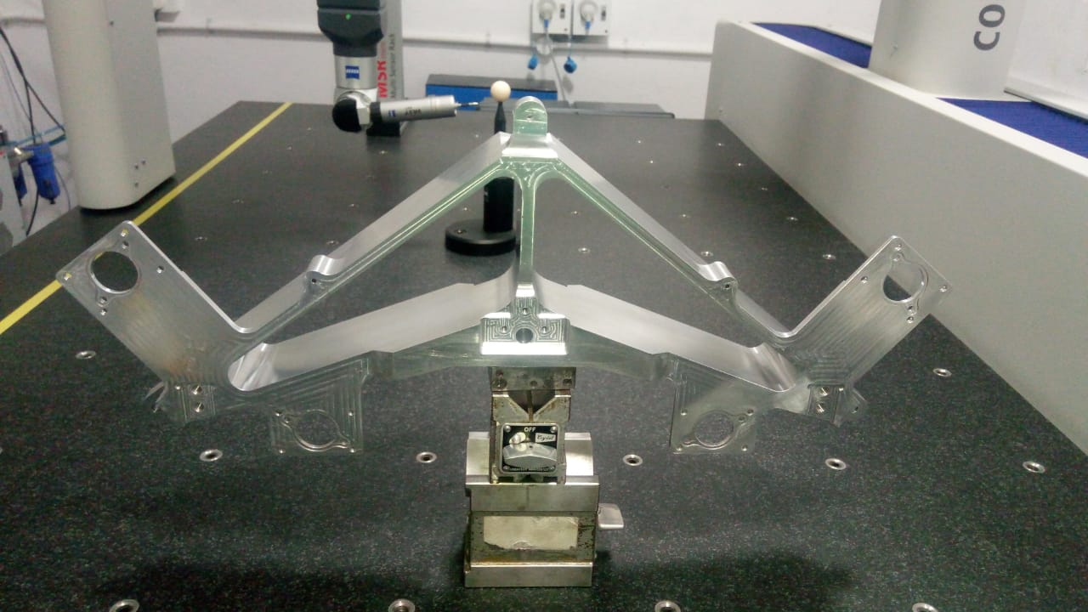
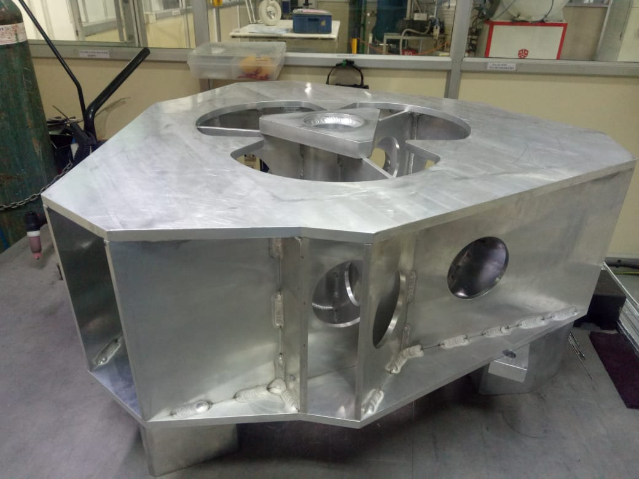
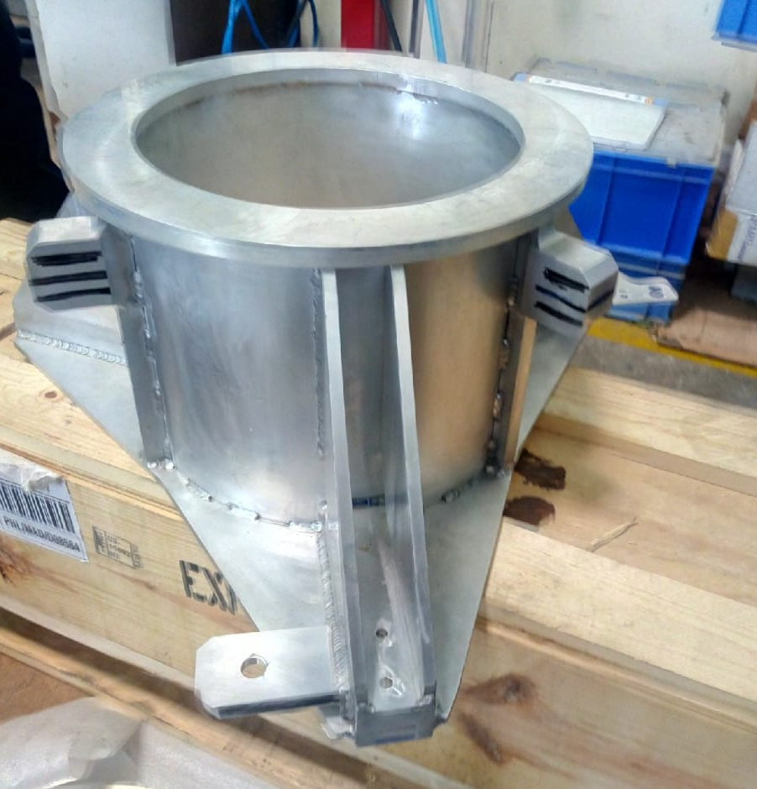
SSA Components
Outer triangle
Middle triangle
Fixed frame weldment
Tower weldment

Slide 15
Mirror Rod Flexure Axially stiff and lateral flexible 15768 nos
SSA Components
2X Flexible Region:
1.6mm Dia x 10mm Long
Stiffer Region:
3.0mm Dia x 126mm Long
Total 208 long
Rod Material: 304 CD
Rod Material: 17-4 PH H1150

Slide 16
Central Diaphragm Design Evolution
SSA Components
Central Diaphragm (PDR)
Central Diaphragm (FDR)
6X M6 Through
V-Slots index with Tooling
Central Hole for Centering Boss
Continuous Outer Flange, Bond Surface,
M5 Helicoil and C’Bore for Custom Flanged Stud
Slotted Outer Flange, 24 Bond Surfaces with tooling interface M2 tapped holes
Notes:
Glass transition temperature

Slide 17
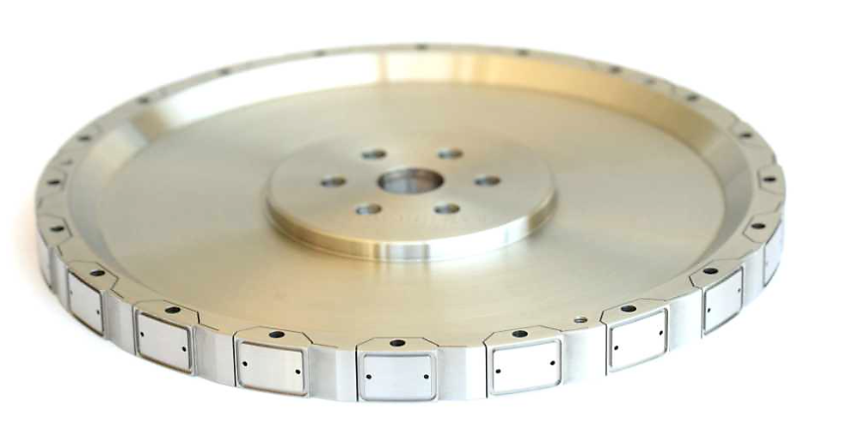
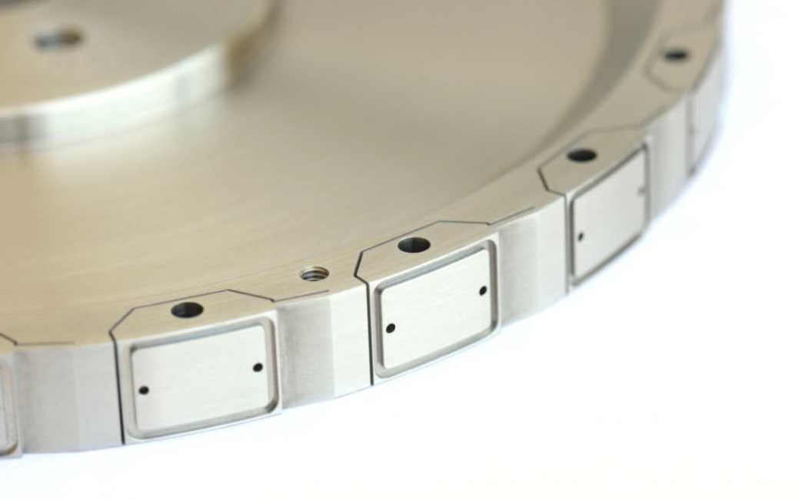
New Central Diaphragm
SSA Components
Ø155.5mm
11mm
Middle thin section is 0.4 ± 0.025
Notes:
Parallelism requirement =0.150 mm

Slide 18
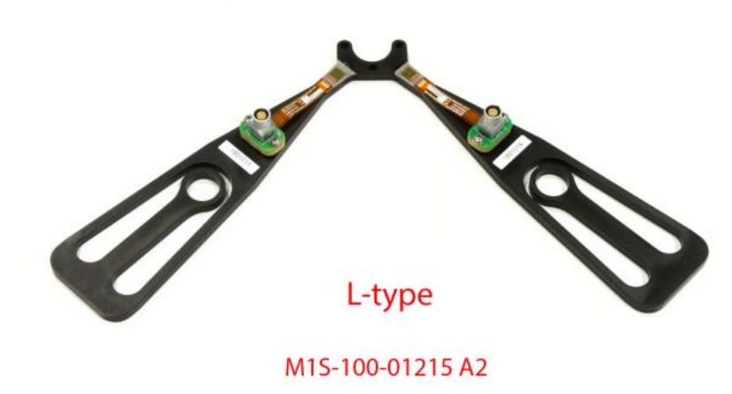
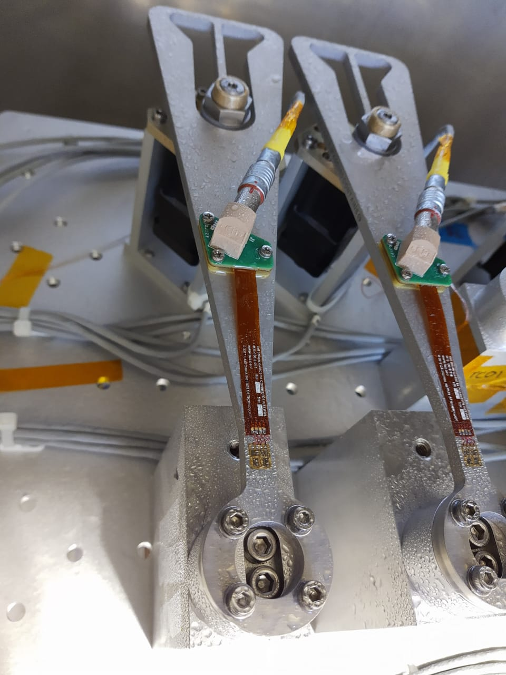
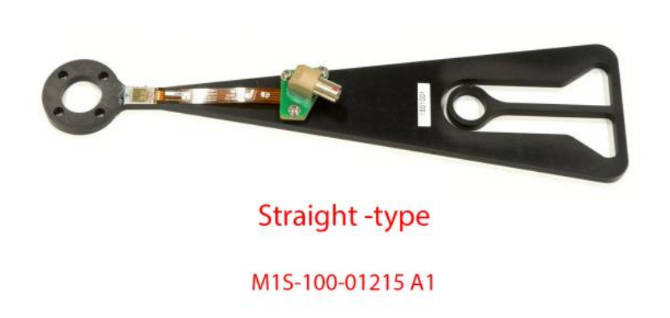
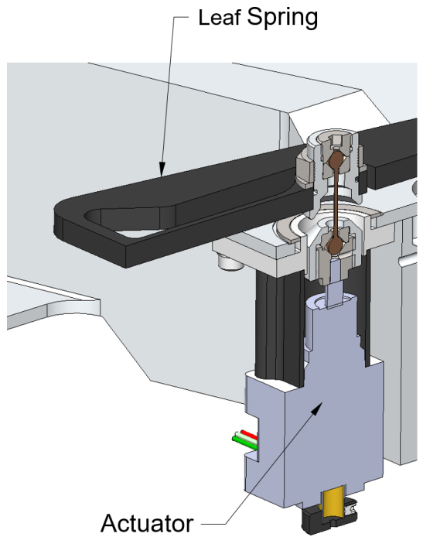
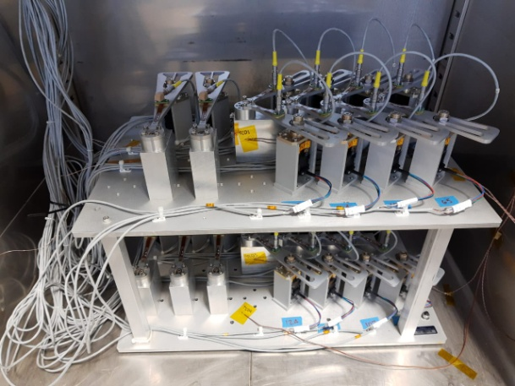
SSA Components
Warping Harness (Leaf springs)
Condensation test

Slide 19
Assembled Actuator –P2E
To be supplied
1476+ spares 60
Total =1536
20 Actuators manufactured by 4 vendors supplied and are qualified

Slide 20
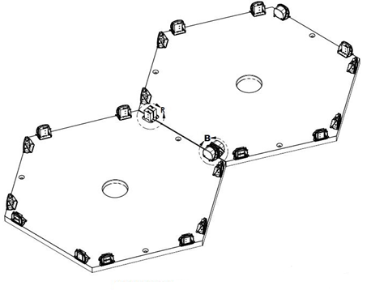
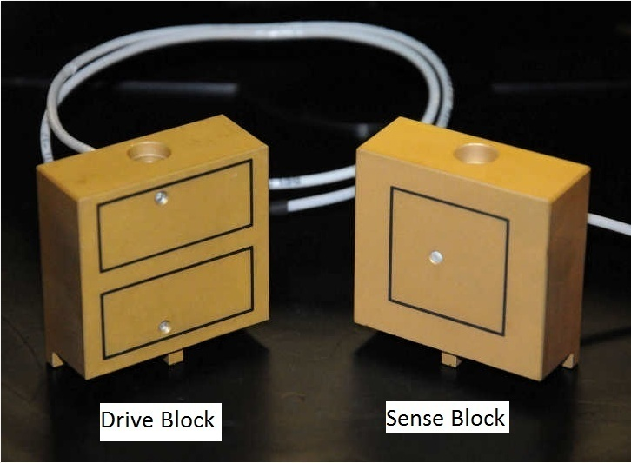
Edge sensors
Capacitive Parallel Plate technology
Air as Dielectric medium.
High precision contact-less measurement
50
Edge Sensors
A Drive Half (or transmitter) mounted on one Segment edge and a
Mating Sense Half (or receiver) mounted on a neighbouring Segment edge.
Ohara Clearceram Z HS Material
75
Size: 50x75x25.54 mm each ~1700nos
Gold coating: 0.45 to0.55 µ thick

Slide 21
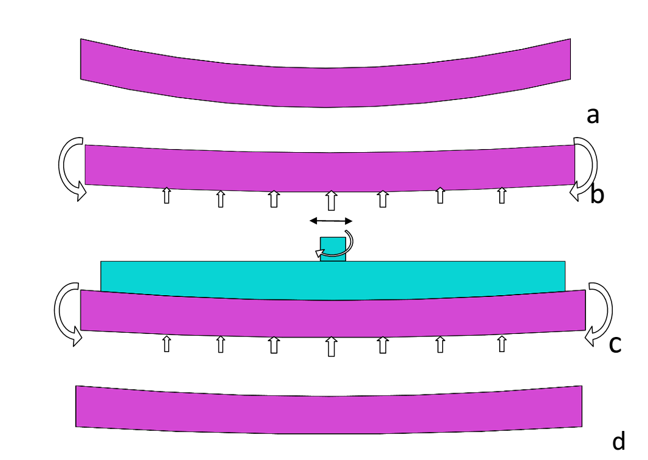
Primary Mirror Segments Polishing
Stress Mirror Polishing SMP
Bond Pads
Lever Arm
Mirror Blank
80 Nos
Spherical polish
Hyperbolic surface
Edge moments and shear force are used to bent the glass to attain aspheric shape over which sphere is grind and polished.
Roundel
TOOL
F_{out} F_{in}
F_{in} F_{out}
F_{out} F_{in}
Back Support
F_{in} F_{out}
Back Support
Notes:
Notably, a first-of-its-kind large optics facility called the IndiaTMT Optics Fabricating Facility (ITOFF) is being constructed at the Indian Institute of Astrophysics campus in Hosakote, near Bengaluru.
Polishing of the aspheric segments is done with a technique called stress mirror polishing (derived from Keck). In this technique, forces and moments are selectively applied to the edges of a mirror blank in order to warp the blank to the desired degree of distortion. The segment is polished as a sphere. After removal of the forces and moments, the spherical surface will elastically deform into the desired aspherical shape.
After segment assembly, Polished Mirror Assemblies (PMAs) are finished with ion beam figuring (IBF). Residual errors from IBF and mounting in the Mirror Cell (a small clocking error of a few micrometers creates strong astigmatism) are removed with an active Warping Harness. 21 Actuators apply small moments to the whiffletrees and can correct low-order segment aberrations such as focus and astigmatism.

Slide 22
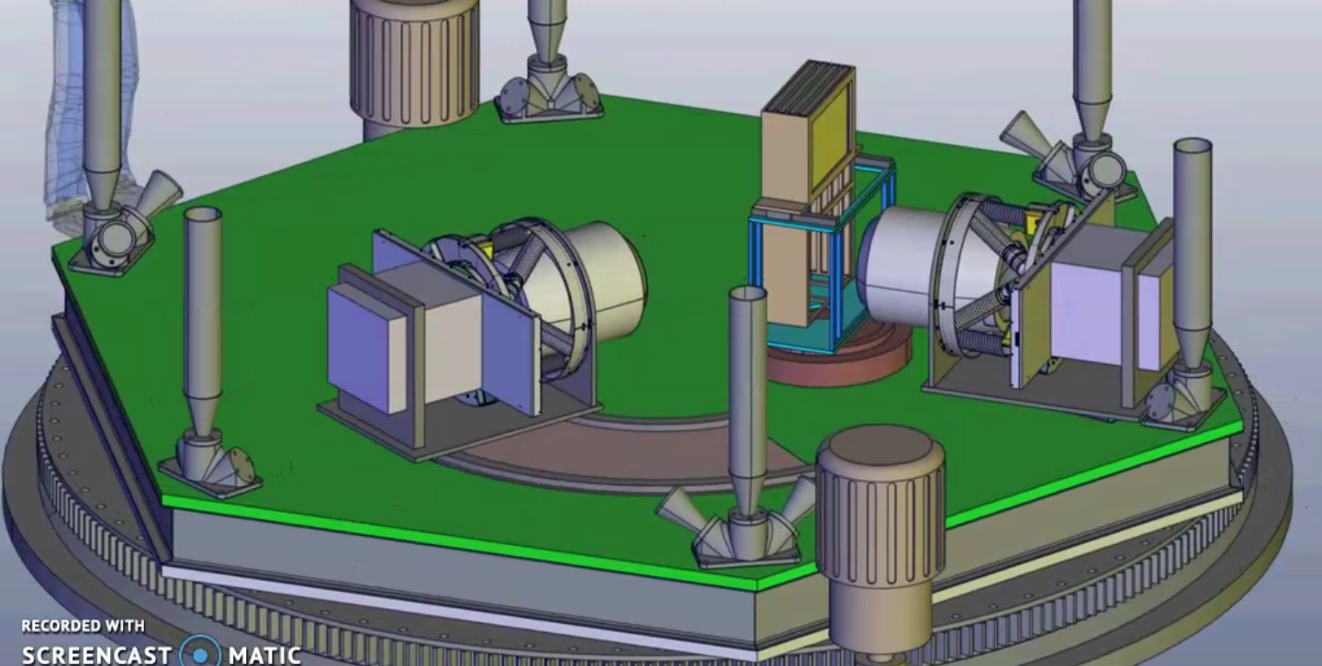
WFOS Camera Rotation and Grating Exchange Design Concept
WFOS - Wide Field Optical Spectrograph
Camera Rotation and Grating Exchange System
The size of the grating is 330mm x 460 mm x 20 mm.
The space in-between primary and secondary optical bench is 1.5m vertically.
The axis of the camera is approx. at 415 mm from primary optical bench.
The position of the grating for each camera angle is given as below (obtained from CAD Model):
330 mm
380 mm
460 mm
510 mm
Fig: Grating
 | Red (Angle) |  | Blue (Angle)
 | Camera | Grating | Camera | Grating
Imaging | 0 | 0 | 0 | 0
Low | 31.04 | 15.44 | 30.88 | 15.52
Medium | 65.82 | 32.88 | 65.76 | 32.91
High | 86.16 | 43.95 | 87.90 | 43.08
1.5 m
Fig: WFOS Structure
Notes:
Wide Field Optical Spectrometer (WFOS)
The Wide Field Optical Spectrometer (WFOS) will provide near-ultraviolet and optical (0.3-1.0 μm wavelength) imaging and spectroscopy over a more than 40 arcmin field of view. Using precision-cut focal plane masks, WFOS will enable long-slit observations of single objects as well as short-slit observations of hundreds of objects simultaneously. WFOS will use natural (uncorrected) seeing images

Slide 23
Acknowledgements
I and India TMT Project gratefully acknowledges the support of the TMT Project, TMT collaborating institutions. They are the California Institute of Technology, the University of California, the National Astronomical Observatory of Japan, the National Astronomical Observatories of China and their consortium partners, the Department of Science and Technology of India and their supported institutes, and the National Research Council of Canada. This work was supported as well by the Gordon and Betty Moore Foundation, the Canada Foundation for Innovation, the Ontario Ministry of Research and Innovation, the Natural Sciences and Engineering Research Council of Canada, the British Columbia Knowledge Development Fund, the Association of Canadian Universities for Research in Astronomy (ACURA), the Association of Universities for Research in Astronomy (AURA), the U.S. National Science Foundation, the National Institutes of Natural Sciences of Japan, and the Department of Science and technology & Department of Atomic Energy of India.

