Slide 1
An Automated calibration method from shower data
Prabhakar Tiwari , Pankaj Jain,
Indian Institute of Technology Kanpur
P K Mohanty , GRAPES-3 Team ,
Tata Institute of Fundamental Research
5th Winter Program on AstroParticle Physics
14-29 December 2010 , CRL , Ooty

Slide 2
Outline
Aim of Calibration and Current method
Limitation with Current Calibration
Solution : SHOWER DATA !!!
A Robust Method
Diagnostic Uses :
1) Corrections for HT change
2) Rejection of abnormal data
3)Temperature dependent corrections
Summary

Slide 3
Current Calibration
GRAPES-3 experiment currently has 372 plastic scintillation detectors in operation.
These detectors are used to detect shower particles.
Single particle gain is needed to get number of particle passing through detector .
Single particle calibration is done using muon paddle .

Slide 4
Paddle Calibration
Detector data
Trigger
muon

Slide 5
Paddle Calibration
Paddles are made of two plastic scintillator of dimension 20 cm x 20 cm x 3 cm.
For single particle calibration we put the paddle just below the detector and coincidence of the two paddles is used to select almost vertical muons.
One detector calibration takes around 1 hour (~12000 calibration events) and per day we calibrate ~8 detectors.
It takes around one and half month to complete one round for all detectors.

Slide 6
Paddle Calibration …
A detector is calibrated once in one and half month.
Some intermediate calibration is also done, when we change cable , PMT or may be due to some other reasons.
The gain is adjusted approximately by adjusting HT and by calibrating.
One calibration gain is used for analysis up to the time of next available calibration .

Slide 7
Paddle Calibration Plots Detector No: 599 Date : 2010824

Slide 8
Limitations with Current Method
It take one and half month to have next calibration for a detector.
After changing the HT , sometime the calibration is not done immediately , may be after few hours or even next day. In principle we should use this calibration gain from the time of HT change. However we can correct this by checking the Log Book manually.
No correction for all types of intermediate problems specially short time !.

Slide 9
Solution
In case of HT change we can reject the shower data from the time of HT change to the calibration as PMT also takes sometime to stabilize .
For all type of intermediate gain changes :
Reject the data for that period
(how to know where is problem ?)
OR
correct the gain
(???)

Slide 10
Solution: SHOWER DATA!!!
To monitor all type gain changes we need something which is available all the time.
SHOWER DATA !!!
If we can use shower data then this is available all the time.

Slide 11
A Robust Method
The method is based on some universality.
If the detector is functioning normally then ratio between average ADC mean of the shower to single particle gain is constant , In other words the average number of particles in shower data is constant.
If the gain of the detector is changing due to any reason then the average shower ADC mean will change and it will be proportional to change in gain . And if we are using wrong calibration gain then the ratio will also change proportional to change in one particle gain.

Slide 12
A Robust Method
The mean value of the shower data for every one hour is calculated taking the showers with ADC value grater than 0.5 particles in the detector.
The ratio of the shower ADC mean to paddle gain is calculated using the previous calibration or current calibration (if detector is calibrated in same hour !).

Slide 13
Diagnostic Uses
Identification and Rejection of data
during the transit period
(from HT change to next calibration )

Slide 14
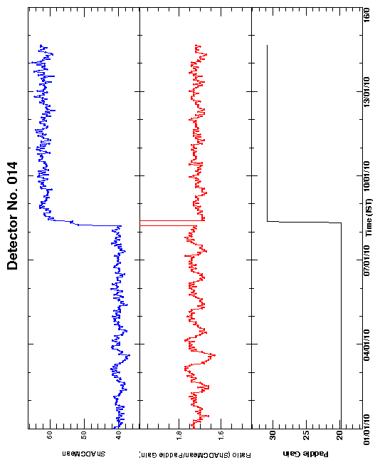
Gain Increased by increasing HT

Slide 15
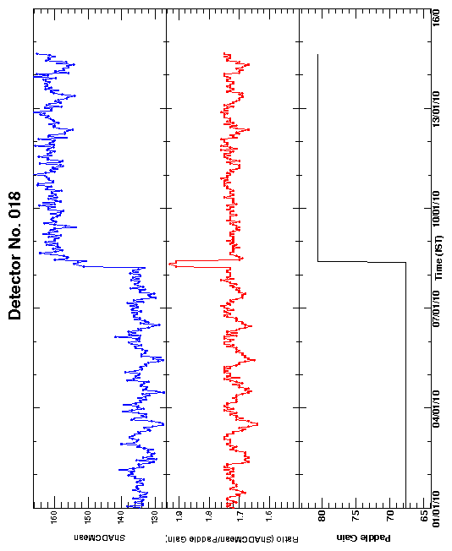

Slide 16
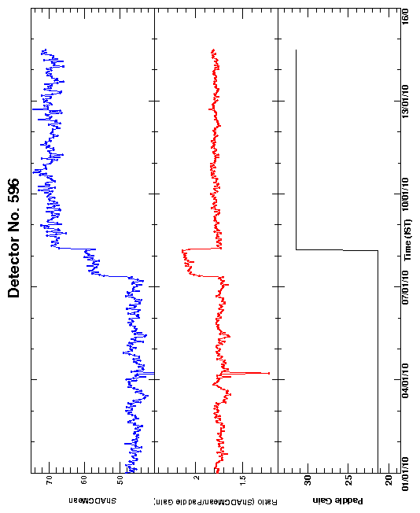

Slide 17
Conclusion from above plots
Once the base line for the ratio is known , then it ‘s easy to identify the transit period and reject the data by putting some cuts.
Determination of base line will be discussed later in this talk .

Slide 18
Identification And Rejection
Of
Abnormal Shower Data

Slide 19
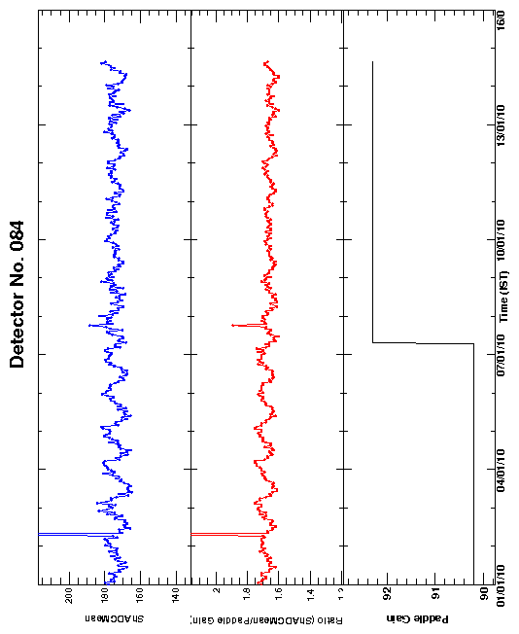

Slide 20
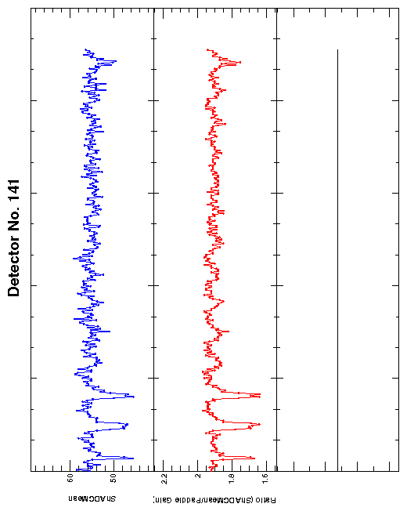

Slide 21
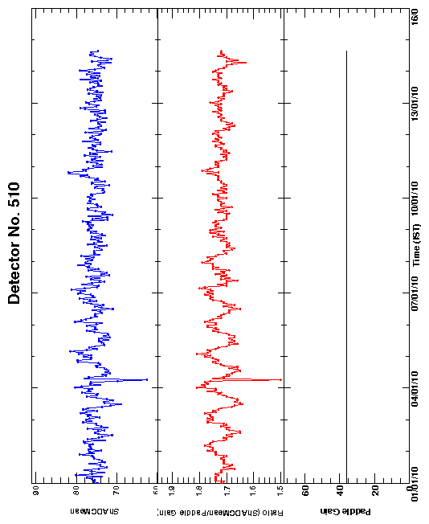

Slide 22
The Ratio Base Line

Slide 23
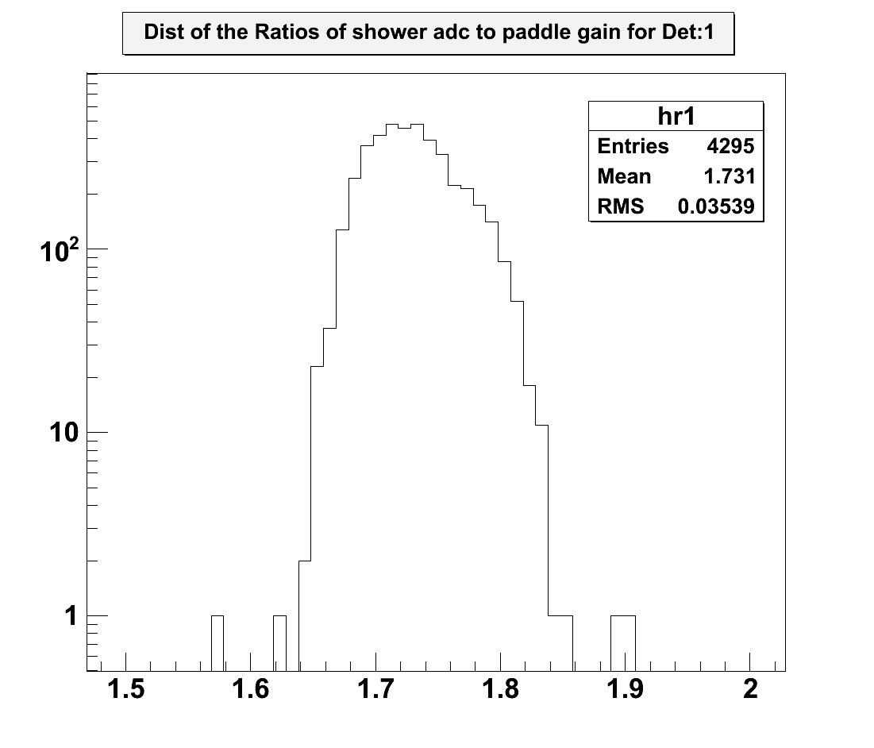
Ratio distribution for six month

Slide 24
Rejection Of Data
If the ratio is beyond +/-5 sigma from mean value , the detector data can be rejected for the period.
OR
If it happens for a long time, then gain can be corrected with the help of ratio.

Slide 25
Temperature Dependent Correction
Detector calibration is done during day time when temperature is high so the single particle gain determined correspond to day temperature.
About 10% gain variation is expected (as seen in average shower mean! ) due to day night temperature variation .
…… we can correct temperature dependent hourly

Slide 26
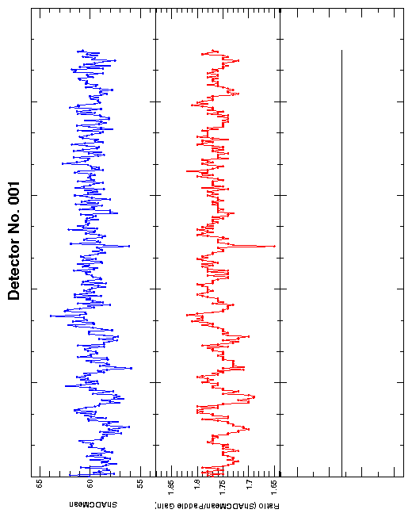

Slide 27
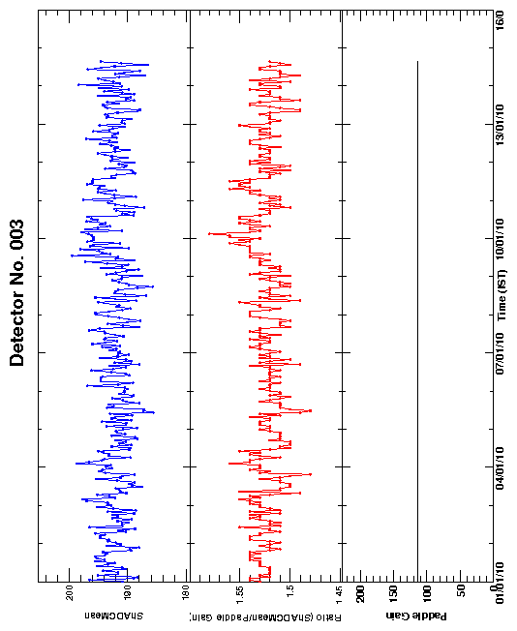

Slide 28
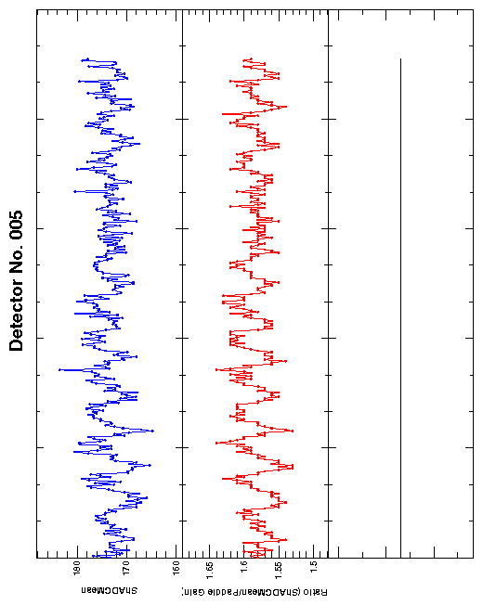

Slide 29
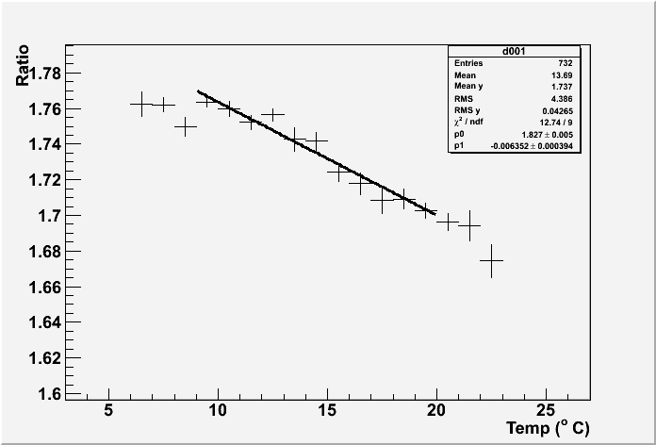
Ratio Vs Temperature

Slide 30
Summary
Shower data itself can be used as a excellent monitoring tool (with paddle calibration).
The method can be used to correct the gain hourly.
Other short time gain variation studies like temperature dependence can be done.
The parameter (ratio) can also be used for long time detector performance studies .

Slide 31
Summary…
As all the detector (at least in a ring) should have same ratio (same shower particle average), so the method also provide a check on our particle cut for SHOWER DATA.
THANKS

